Slide 1




Cosmic RAY INDUCED HIGH ENERGY EXTENSIVE AIR SHOWERS:
Exploring EXOTICS in No𝝼A
Mehreen Sultana, UNIVERSITY OF GEORGIA
Martin Frank, UNIVERSITY OF VIRGINIA
[SIST Final Presentation, August 4th, 2014]

Slide 2
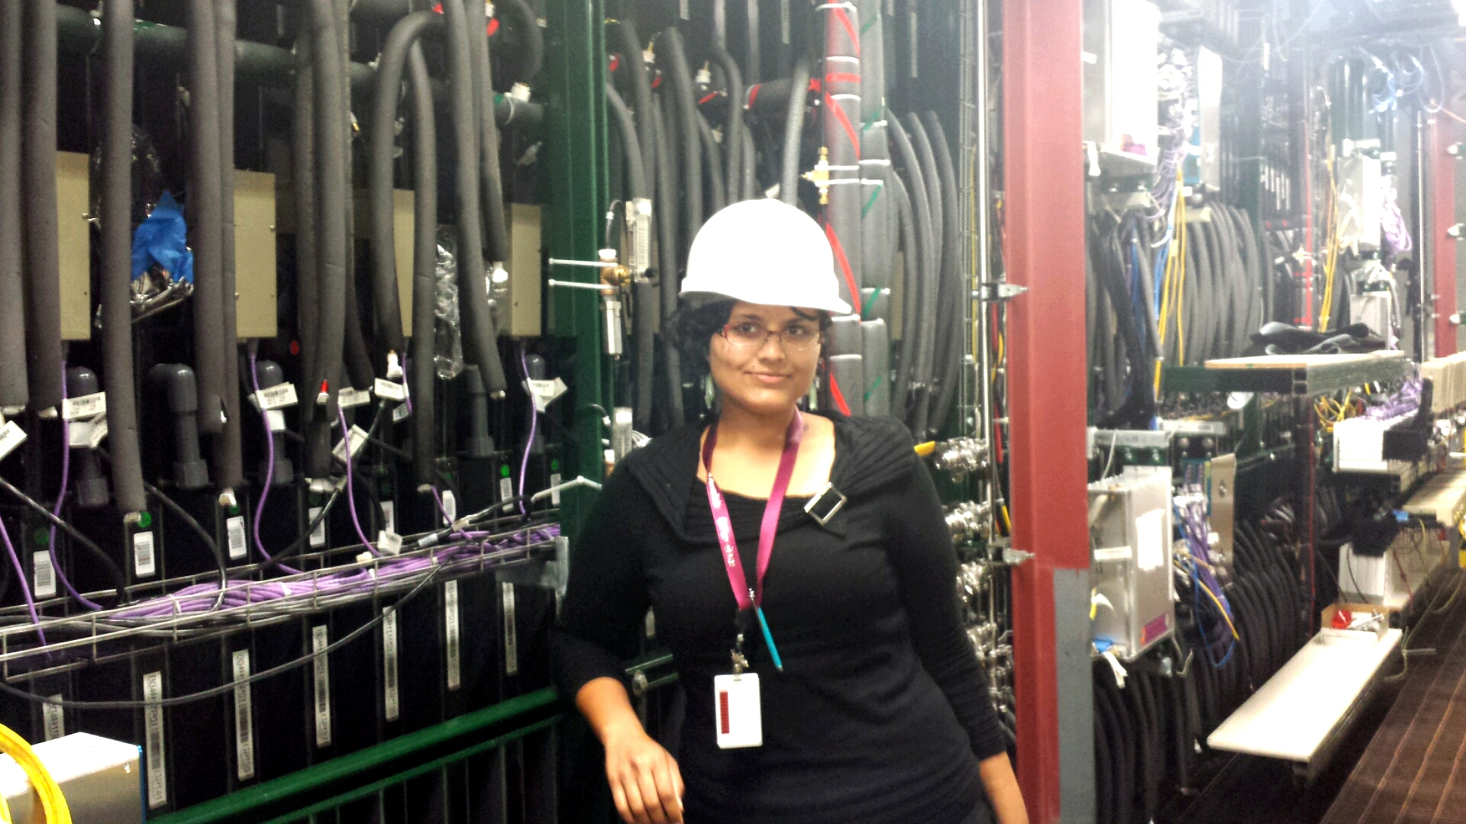
Outline
Introduction: NOvA Detector Setup, Motivation
Method: Identification and Analysis
Reconstruction/Tracking:
  HoughTransform
  KalmanTrackMerge
Future Prospects and
Conclusions
Aug. 4th, 2014
Mehreen Sultana
SIST Final Presentation

Slide 3
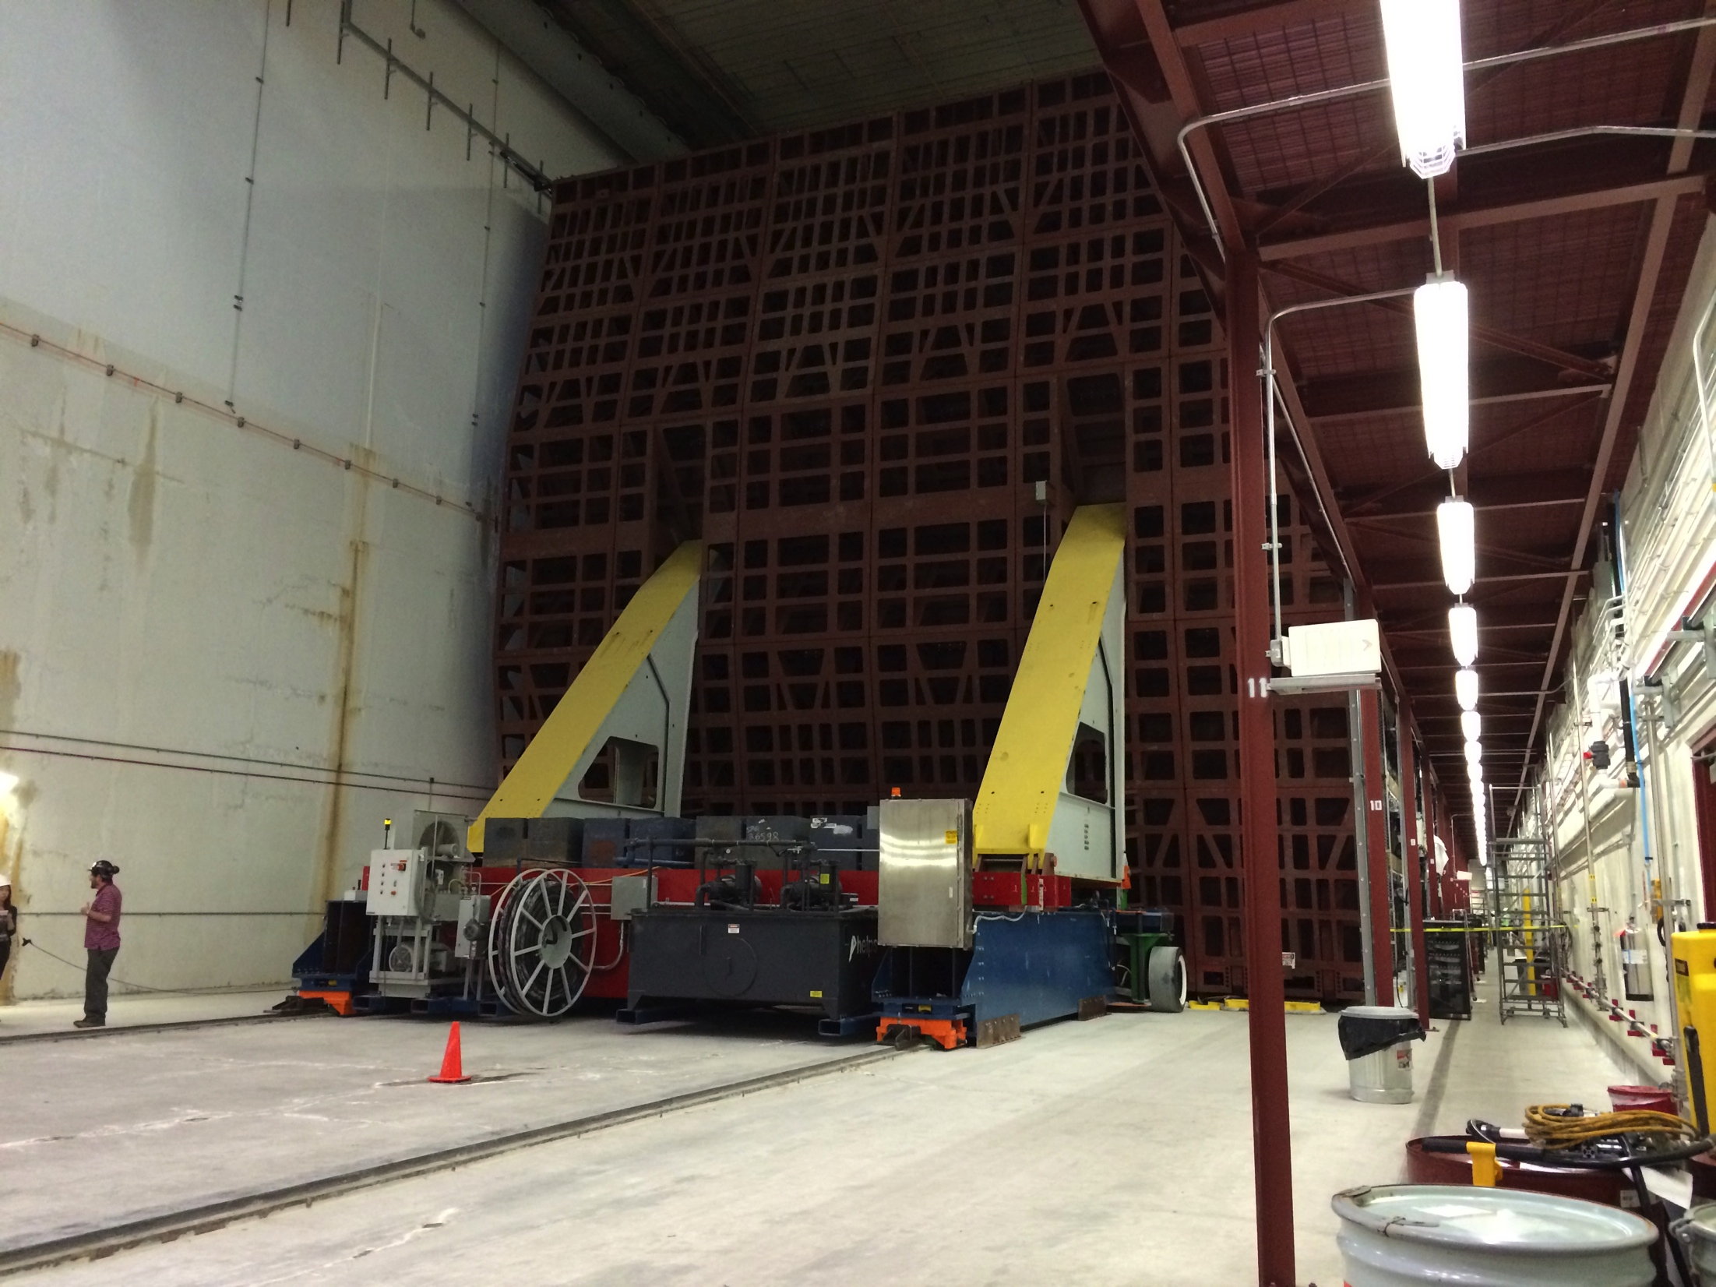
Introduction – DETECTOR SETUP
Aug. 4th, 2014
Mehreen Sultana
SIST Final Presentation

Slide 4
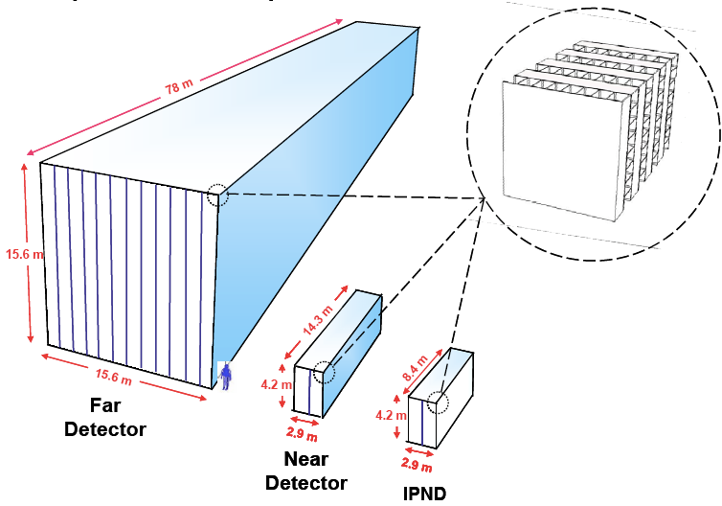
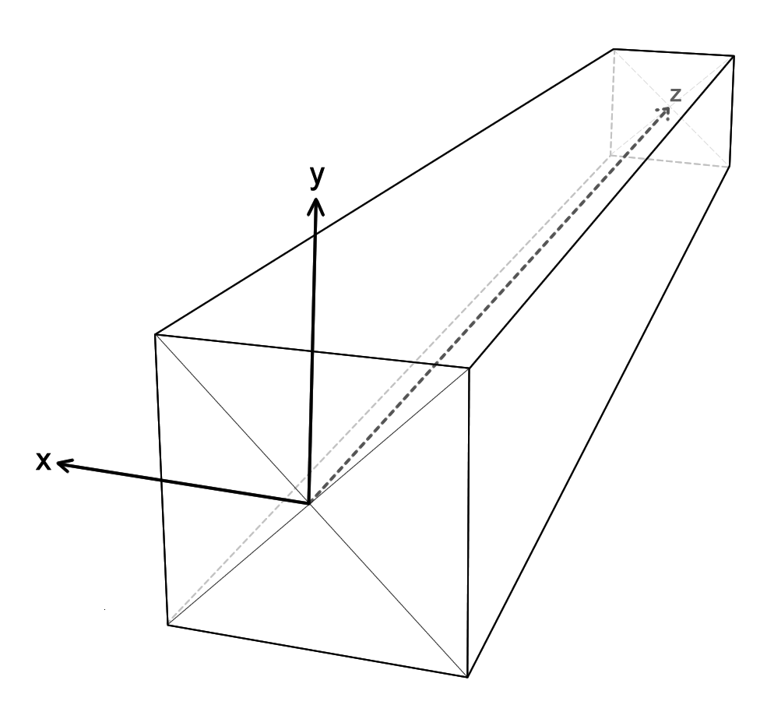
Introduction – Detector setup
Human
NDOS

Slide 5
CosMIC RAY INDUCED HIGH ENERGY AirSHower
Cosmic Ray –
Highly energetic proton or nucleus from space
~ 20 km
Surface Detectors
Ground/Surface
Aug. 4th, 2014
Mehreen Sultana
SIST Final Presentation

Slide 6
Introduction - Motivation
Want to study highly energetic cosmic ray induced air showers
Majority of particles produced in first interactions are pions and kaons which produce large number of muons
Easily detectable at sea level
Most of the electrons are absorbed/scattered/canceled out in the overburden above the detector
Best chance to study air showers in NOvA detectors is through muons
NOvA detectors potentially provide a unique opportunity to study their multiplicity and directionality
How?
Aug. 4th, 2014
Mehreen Sultana
SIST Final Presentation

Slide 7
Step 1: IDENTIFICATION
Events recorded from detector based on high energy triggers.
NDOS: > 40,000 ADC (Analog-Digital (Converter) Counts)
Far Detector: > 275,000 ADC
Cuts on the data allow further filtering and easier identification
Major distinguishing parameters in raw data (that I know of):
Total ADC per slice – sum of ADC counts from each cell in a slice
Average ADC per Cell per Slice (Total ADC/NCells/Slice)
Z extent of the slices/tracks
Noisy and uninteresting events (and slices) can be filtered out by applying cuts to above parameters
Aug. 4th, 2014
Mehreen Sultana
SIST Final Presentation

Slide 8
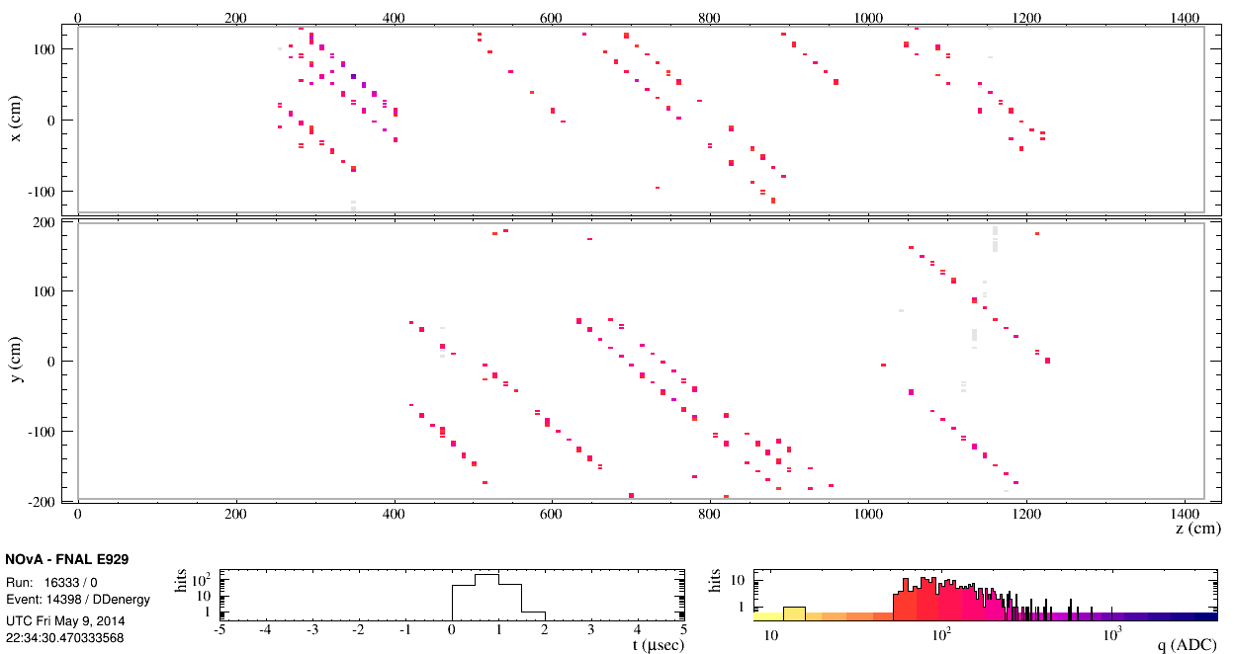
Ideal Muon Shower Event
Noise Event
(probably an electronics issue)

Slide 9
Identification: NDOS
Applied cuts to Total ADC, Average ADC, and Z Extent of the slices to filter out noisy and uninteresting slices
Ideal event candidates (Golden Events) seem to have
  (at least) one slice > 40,000 ADC [dependent on multiplicity of tracks]
  Average ADC in range 140-170 (in NDOS)
  Span most of the detector (large Z extent in both NDOS and Far Detector)
Aug. 4th, 2014
Mehreen Sultana
SIST Final Presentation

Slide 10
All Events
Golden Events

Slide 11
All Events – Average ADC
Golden Events – Average ADC

Slide 12
All Events
Golden Events

Slide 13
Step 2:
STUDY what they look like
Want to study multiplicity (number of particles) and directionality (angle of track)
Need to reconstruct tracks to find out where they come from in the atmosphere
What is the best approach to extract this information from the data?
Tracking:
  HoughTransforms – parameterized space, not dependant on start and end points, peaks represent tracks in an event
  KalmanTrack(Merge) – simply draws lines, based on start and end points of a track
Aug. 4th, 2014
Mehreen Sultana
SIST Final Presentation

Slide 14
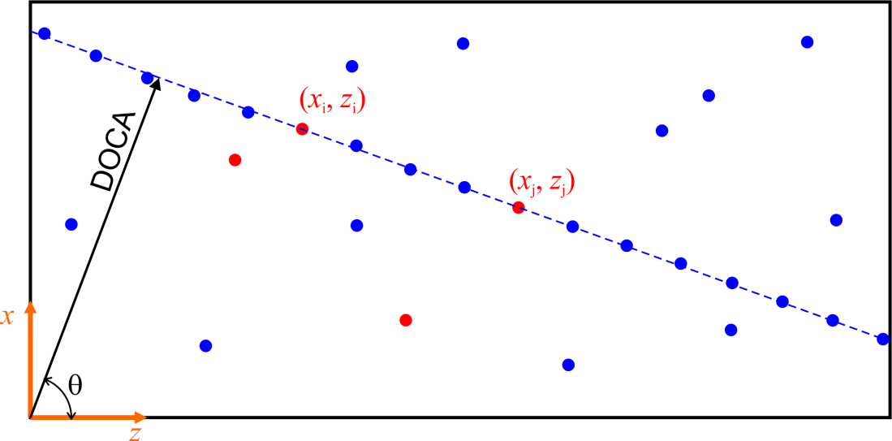
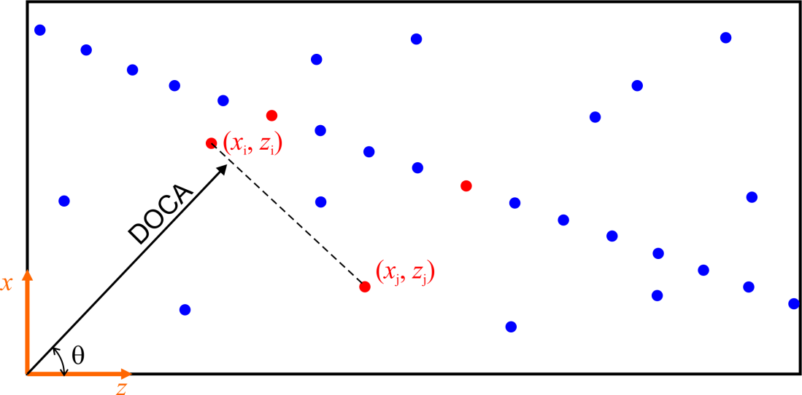
HoughTransform
Noise Pair
DOCA : Distance of Closest Approach
DOCA = zcosθ + xsinθ

Slide 15
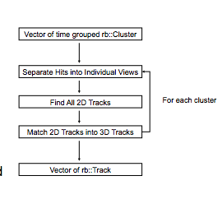
Kalman TRACK
Basically only draws lines based
start and end points
Easy to configure parameters
Does a good job of matching
Takes a very long time for slices
with large number of hits
  Far Detector:
    MaxHitCut = 20000!
    > 30 minutes
  NDOS:
    MaxHitCut = 1000
    < 10 minutes
Aug. 4th, 2014
Mehreen Sultana
SIST Final Presentation

Slide 16
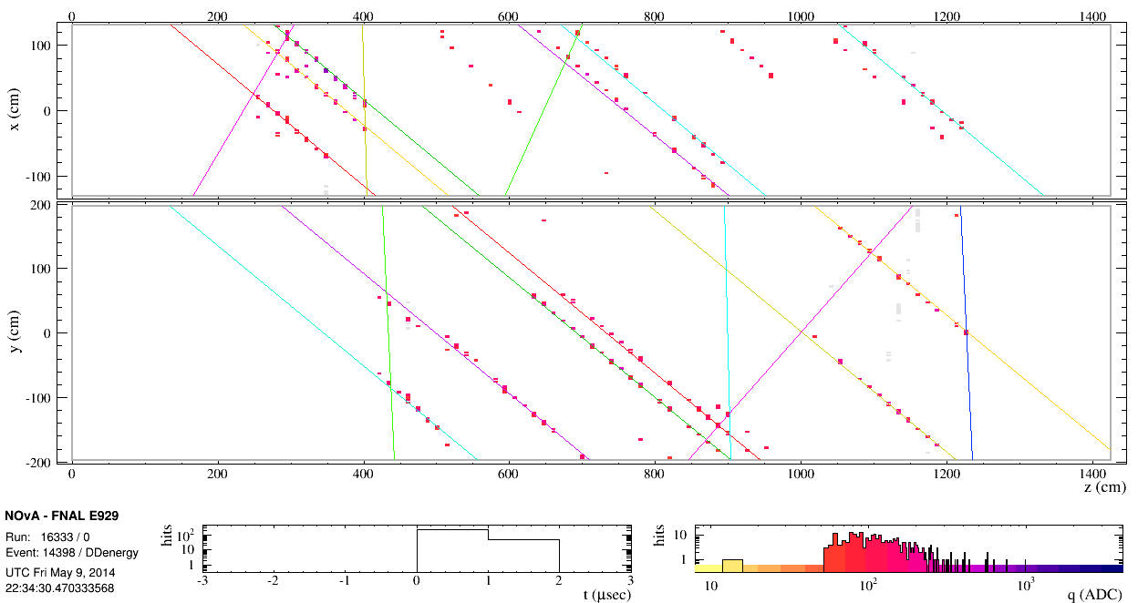
Without Reconstruction
Hough Transform
Kalman Track Merge
NDOS Golden Event
Aug. 4th, 2014
Mehreen Sultana
SIST Final Presentation

Slide 17
Far Detector:
Reconstruction Problems
Module related:
  Large number of muon tracks recorded in a single slice
  Makes tracking difficult and time consuming because of multiplicity of cell activity
Vertical/Steep Tracks:
  Few hits in one view make it difficult to reconstruct/match tracks
  Horizontal tracks appear “broken” because of steepness of the track
Low Multiplicity events were used for actual analysis due to time constraints and unreasonable computational time with the available algorithms
Aug. 4th, 2014
Mehreen Sultana
SIST Final Presentation

Slide 18
High multiplicity event
Each track is a muon
moving through the
detector
Note: This was before
the Far Detector was
completed.
Low multiplicity event

Slide 19
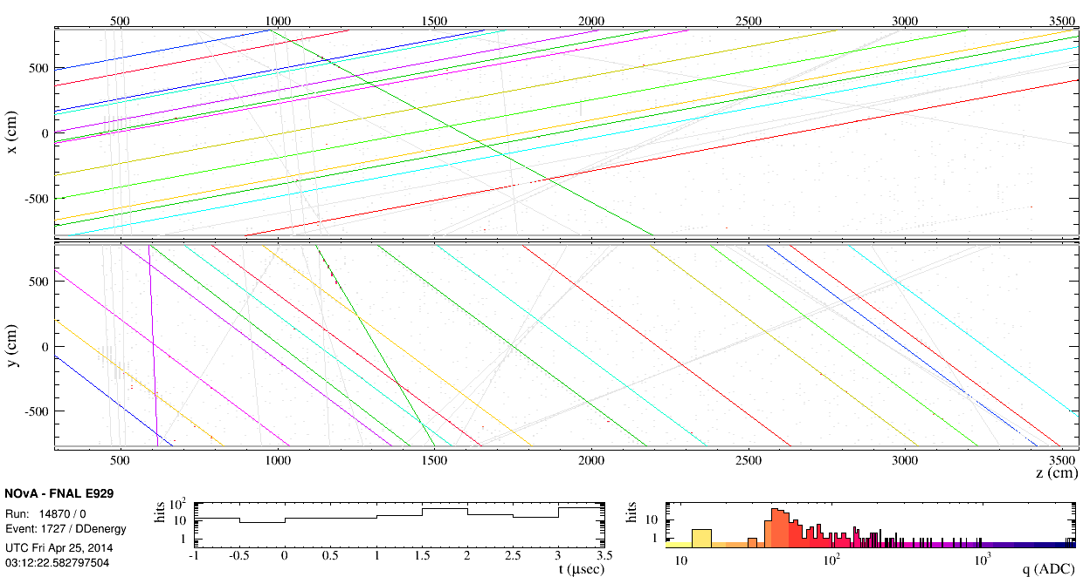
No Reconstruction
HoughTransform
Far Detector Golden Event
KalmanTrackMerge
Aug. 4th, 2014

Slide 20
Directionality
Single incoming muon track
θ_{Y}
+ Y
θ_{Y}
Single incoming muon track
Aug. 4th, 2014
Mehreen Sultana
SIST Final Presentation

Slide 21
Angle of Tracks in Event 1727
= 0.535 rad or 30.6º
^{(center of the bin)}
Aug. 4th, 2014
Mehreen Sultana
SIST Final Presentation

Slide 22
Notice there are 18 tracks within the same θ binwidth, as the plot showed
Angle peaks show multiplicity
of muon tracks

Slide 23
Angle of Tracks in Event 1727 (Rebinned)
Δθ_{Y} ~ 1.0º
Aug. 4th, 2014
Mehreen Sultana
SIST Final Presentation

Slide 24
Event Display verification:
We can see that the angle from the vertical is about
(-)30º
θ
Tracks like these can be
filtered out by applying a cut to
the difference in
angular distribution for each set of
tracks

Slide 25
Next Steps & End Notes
Hough Transforms works well in a reasonable time for large number of tracks in a slice in an event .
Kalman Tracking took 50 minutes(!) to plot out only a portion of the tracks in an event with a large number of hits. (shown later)
Need to see if these two options could be merged
Need to run simulations and reconstruct the particle composition and angular momentum of the showers.
Future experimental prospects for this study could be to place smaller surface detectors around the Far Detector to get a sense of the timing, spread, and the multiplicity of the showers as a function of θ.
Aug. 4th, 2014
Mehreen Sultana
SIST Final Presentation

Slide 26
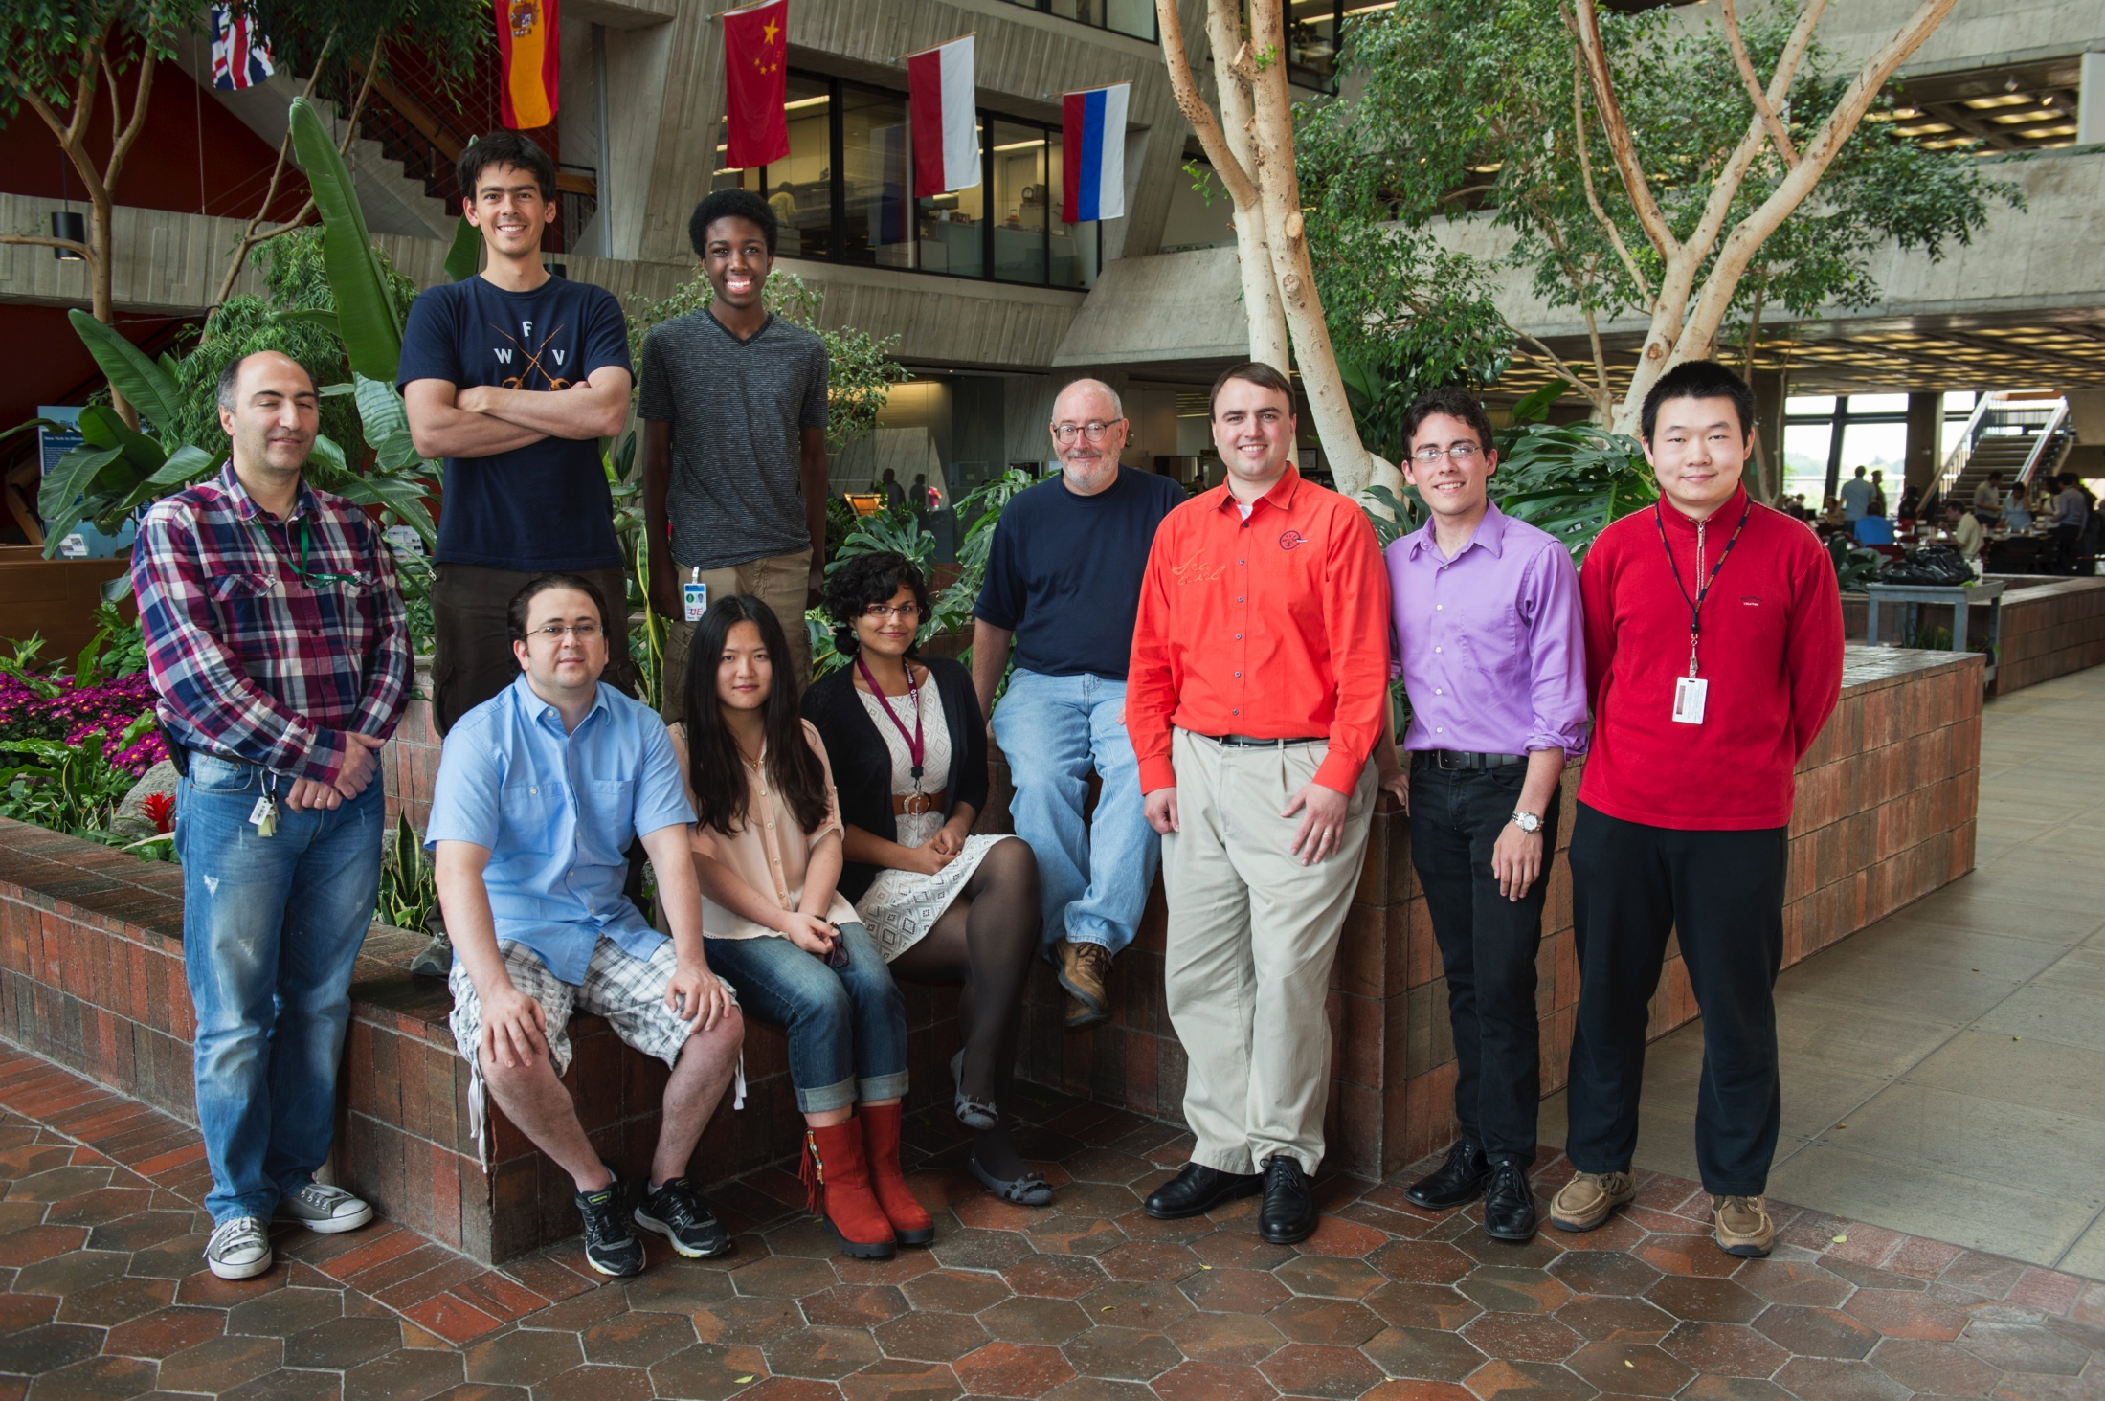
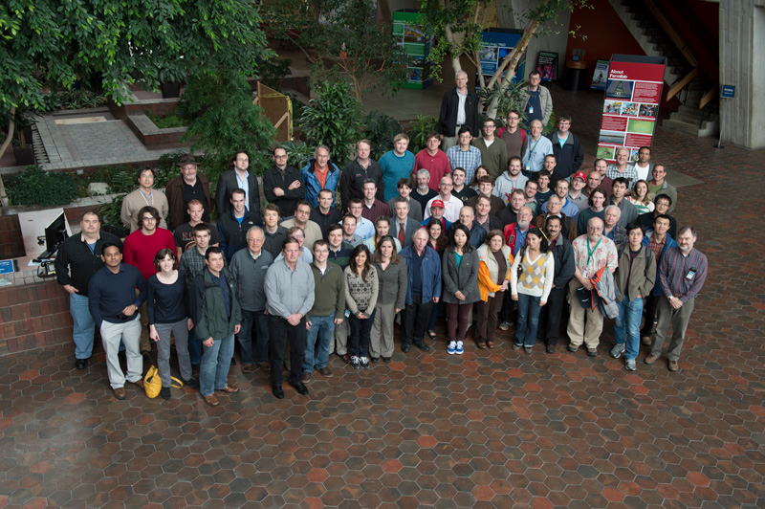
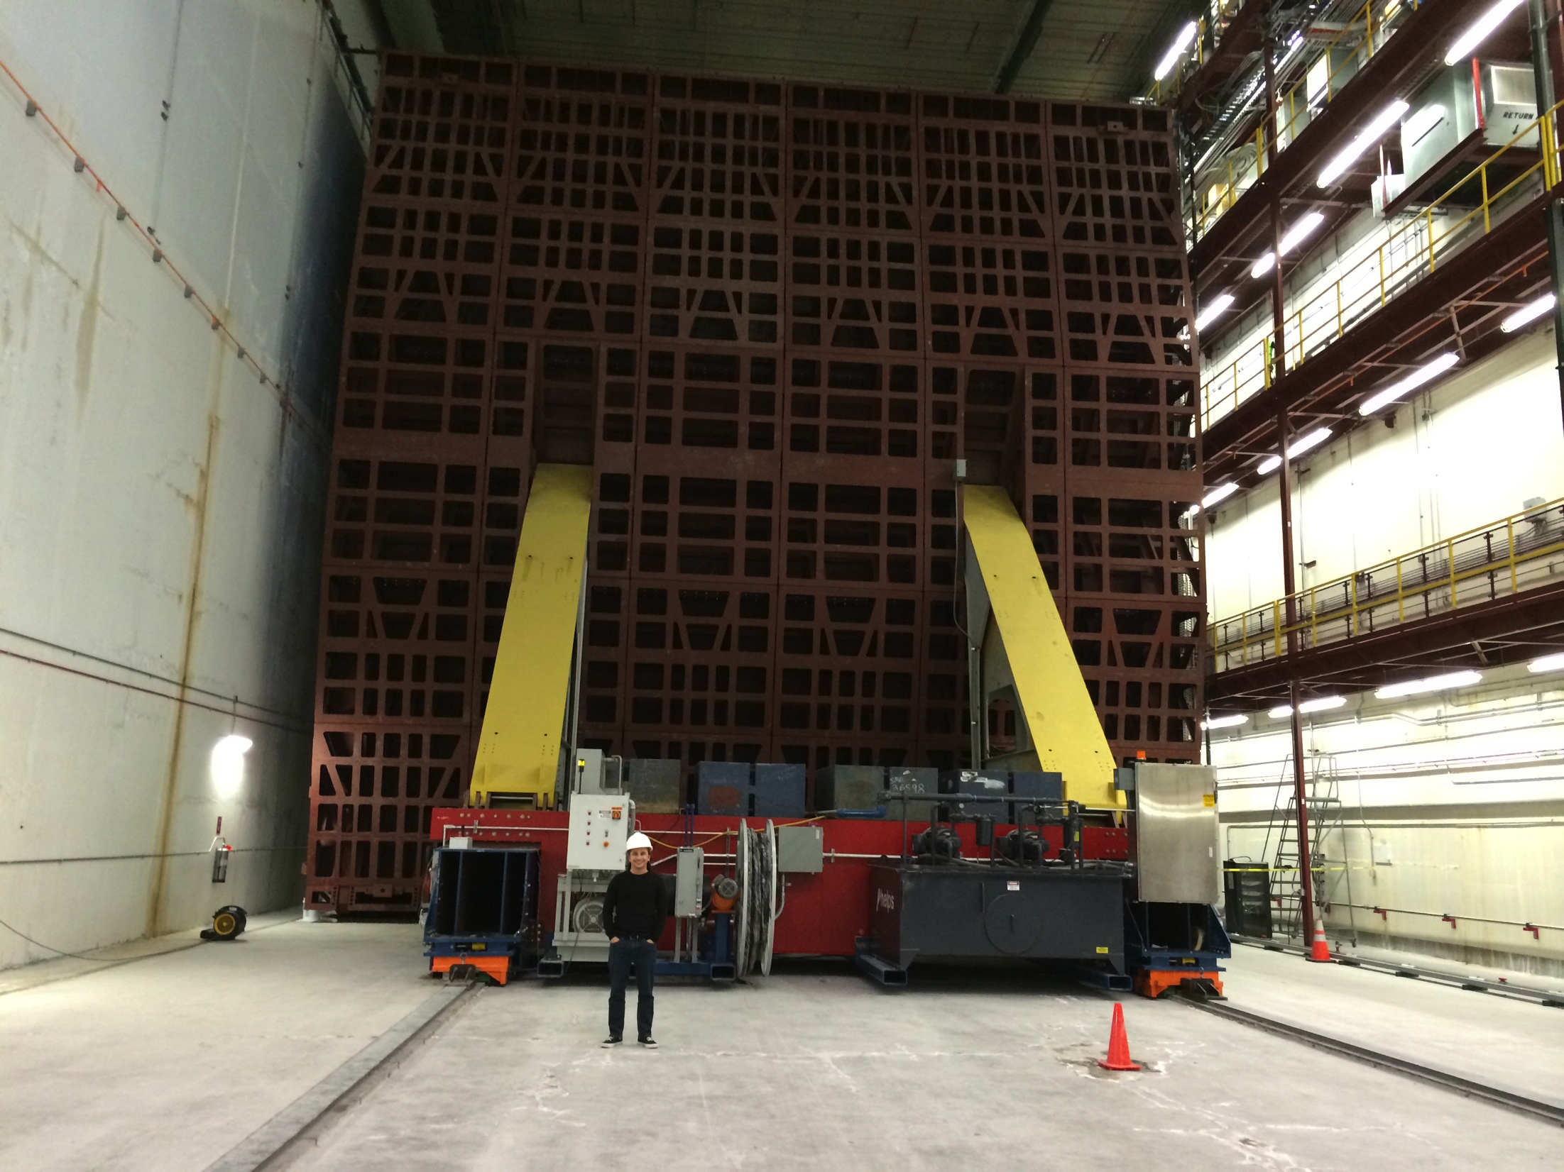


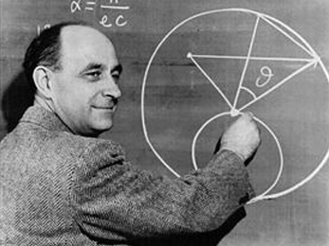
Acknowledgements
SIST Committee
Mentors:
Dave Peterson
Mayling Wong-Squires
SIST Final Presentation

Slide 27
EXTRAS/BackUP
SIST Final Presentation

Slide 28
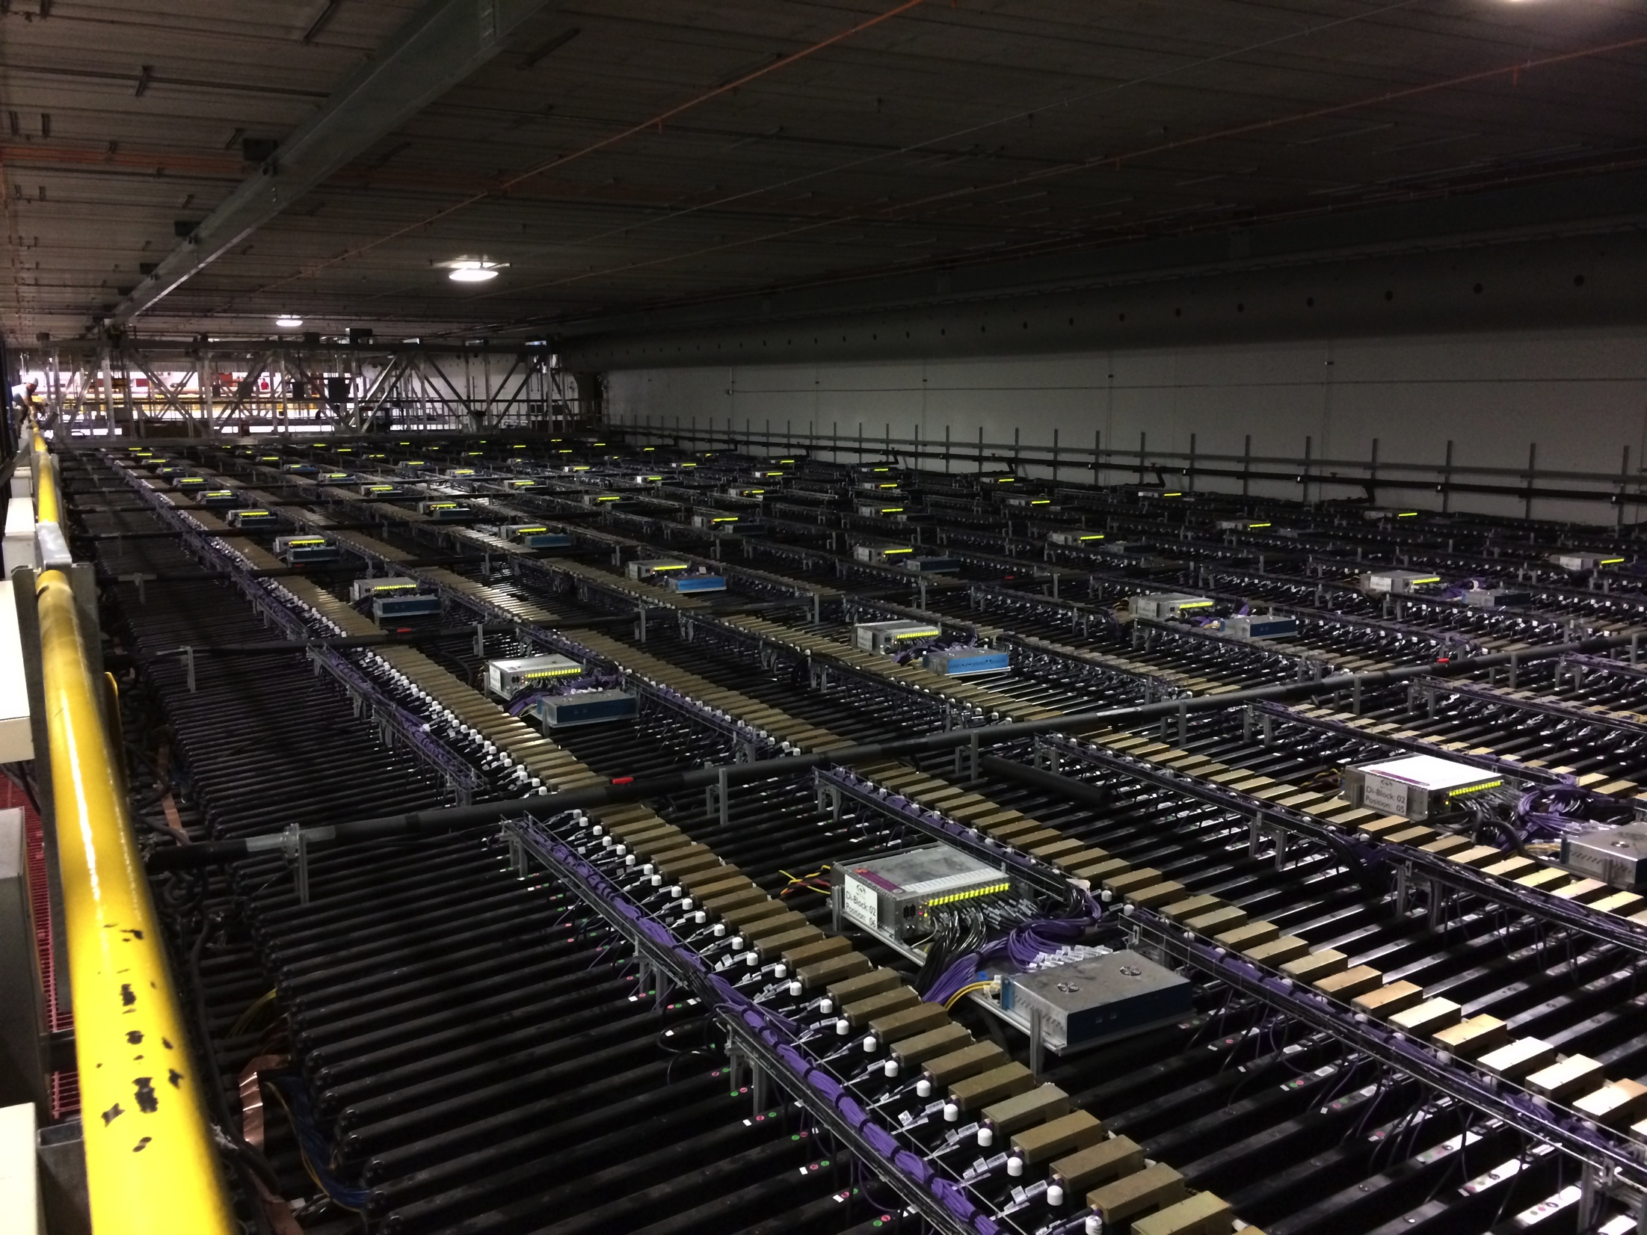
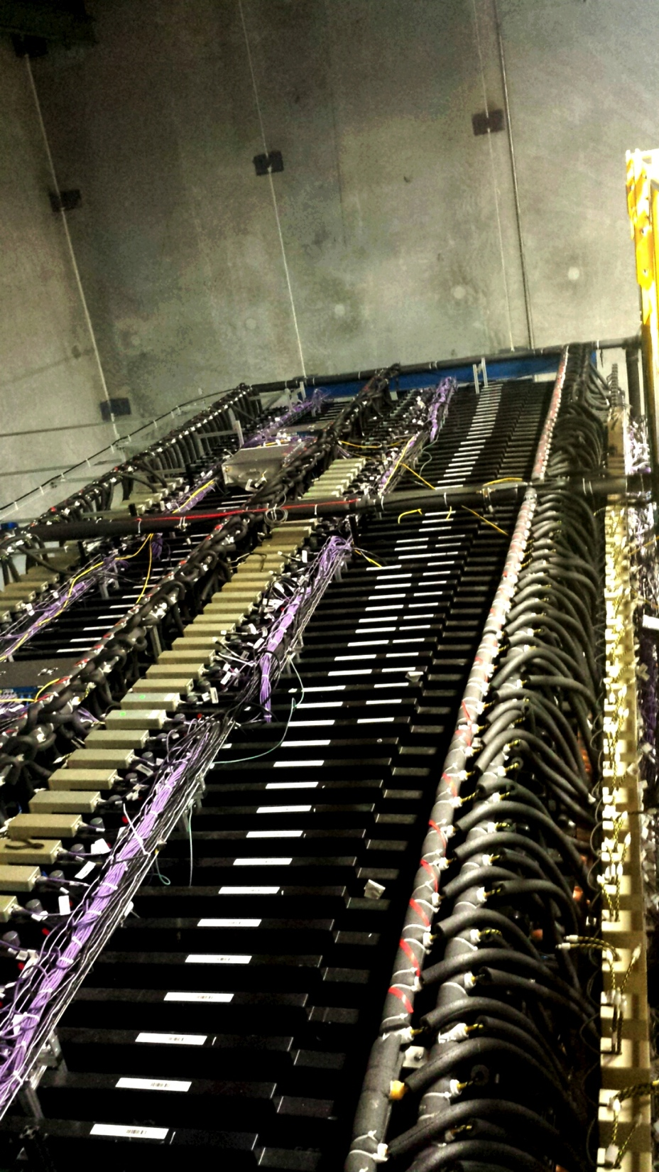
FAR DETECTOR vs NDOS
Notice the number of FEBs (Front End Board,
the gold colored boxes) on each detector.
Data sets are significantly larger in
Far Detector. But you can also see more particles in Far Detector
Aug. 4th, 2014
Mehreen Sultana
SIST Final Presentation

Slide 29
29
SIST Final Presentation

Slide 30
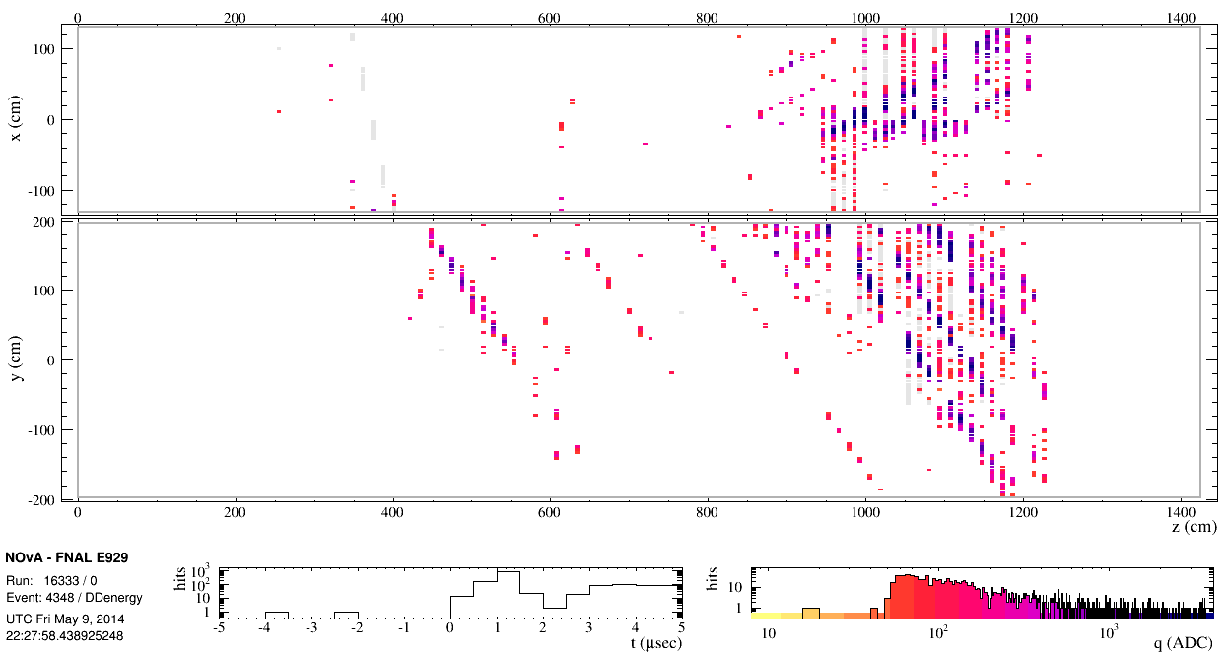
EVENT WITH
FEB FLASH

Slide 31
HoughTransform

Slide 32
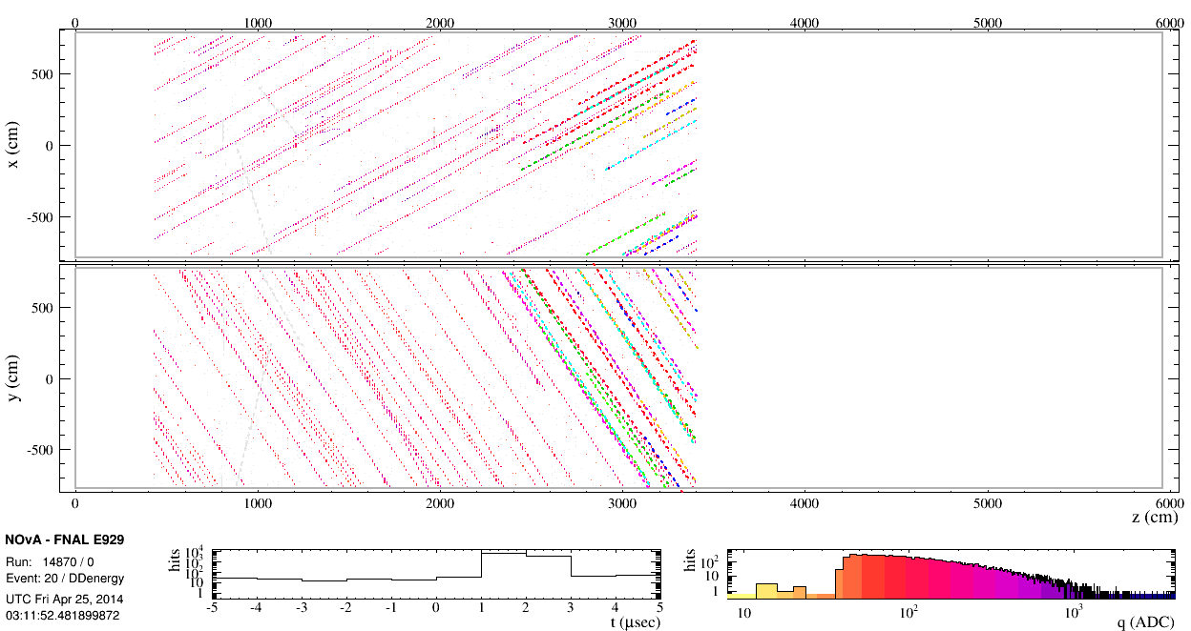
KalmanTrackMerge

Slide 33
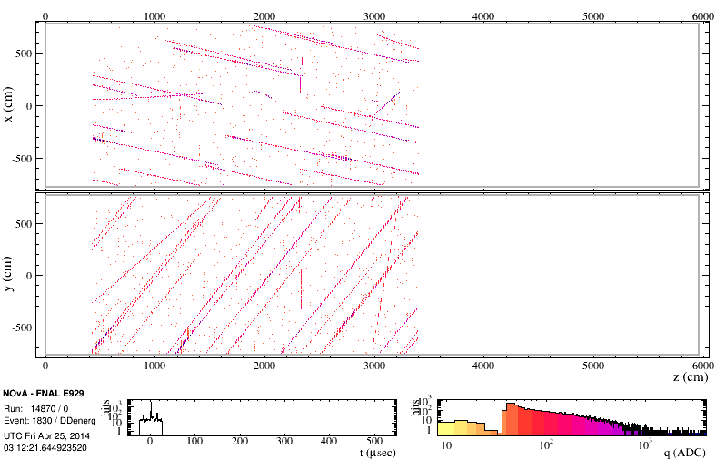
33

