Slide 1
Design of a Removable Decay Pipe Window for LBNF
Mauricio Villa
Dave Pushka, Eric James
GEM Summer 2014
Notes:
Long Baseline Neutrino Facility
Highest intensit neutrino beam from here to South Dakota

Slide 2
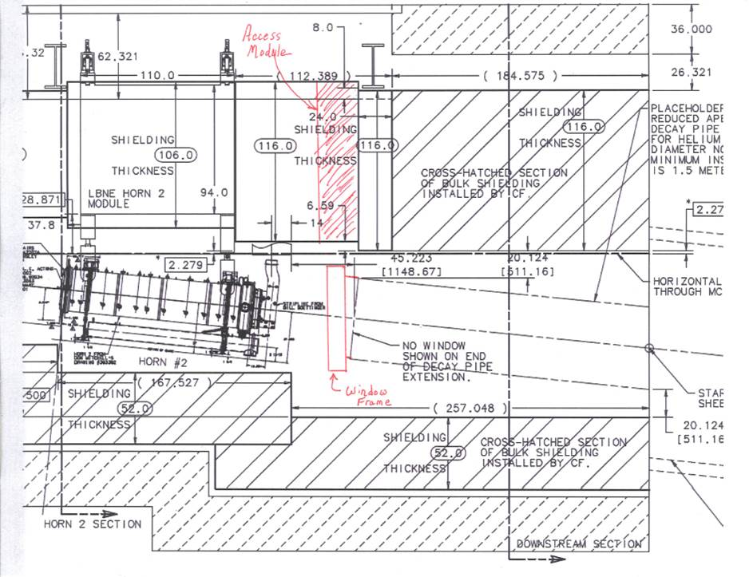
Project Specifications
Positive Helium pressure 5psig
Operation at 700 kW and 2.3MW
Window diameter of 1 meter
Previous analysis suggests that window should be curved and made of beryllium
Remotely Removable
Notes:
Positive helium pressure to manage small leaks
Energy effects window material selection, cooling, and shape of window. Curved because greatly reduces normal operating steay-state stress values
Looked at materials like titanium, aluminum, and beryllium
Image of proposed decay pipe configuration (tens of feet underground)
Want to be able to remove window without sending somebody down there due to high radiation.

Slide 3
Design Challenge
5psig,
1 meter diameter opening (window)
Leak rate less than 10^-6 Std.cc/sec
O-ring can’t be elastomer!
Remotely apply/remove seating force
Remotely extract/position window
Proposed Solution: Helicoflex Seal

Slide 4
Helicoflex Design Guide
Notes:
Now, ive only been an engineer for 3 months, but in my extensive experience, the loads required when using orings are usualy driven by the pressure you are tying to seal…. Not in this case!!
I did preliminary calculations using the design guide, then contacted supplier. We both agreed, based on our requirements, that we would need a 130,000lb load!!!
Difficult to work with supplier, didn’t really have much info.
So, decided its time to do some testing!!

Slide 5
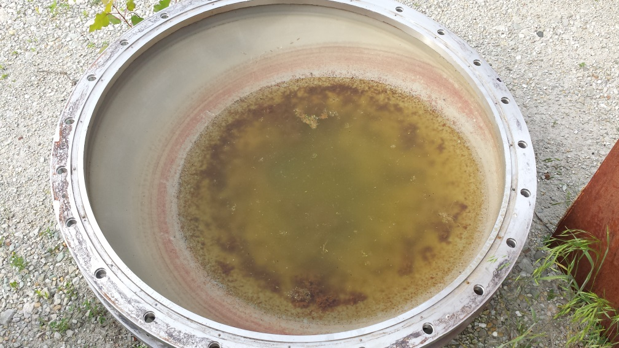
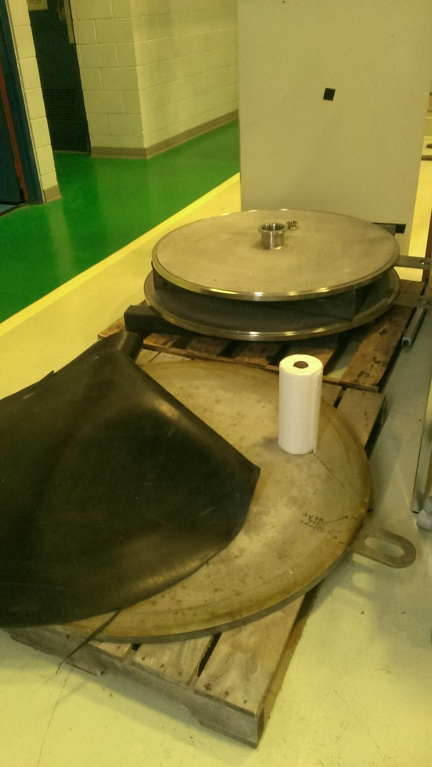
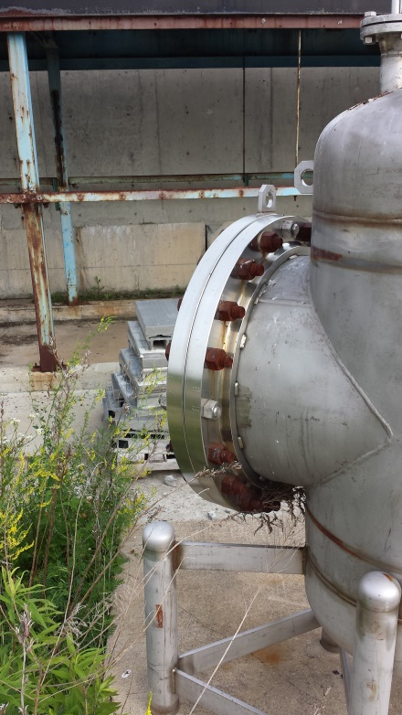
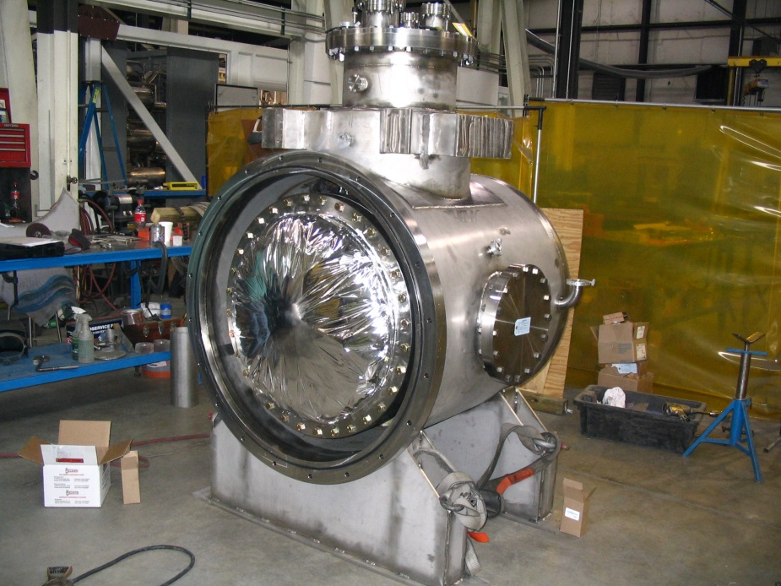
Possible testing Flanges
JUST NASTY
INCONVENIENT
WARPED
Notes:
Dave asked around, and drove around looking for a flange we could …borrow… to test the seal
The bottom one looked the most promising buttt…..

Slide 6
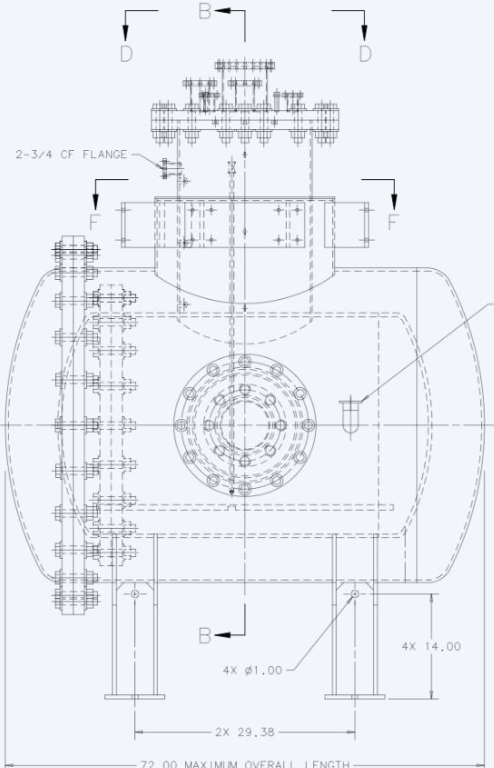
The vessel with the flange is INSIDE another vessel!
Notes:
Did a little more digging, and realized that the groove for the seal was on a vessel that was inside another vessel!
However, the engineering gods were shining upon us

Slide 7
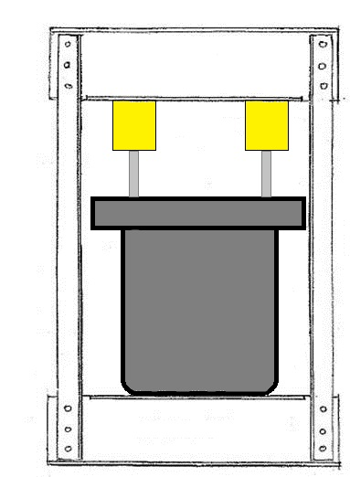
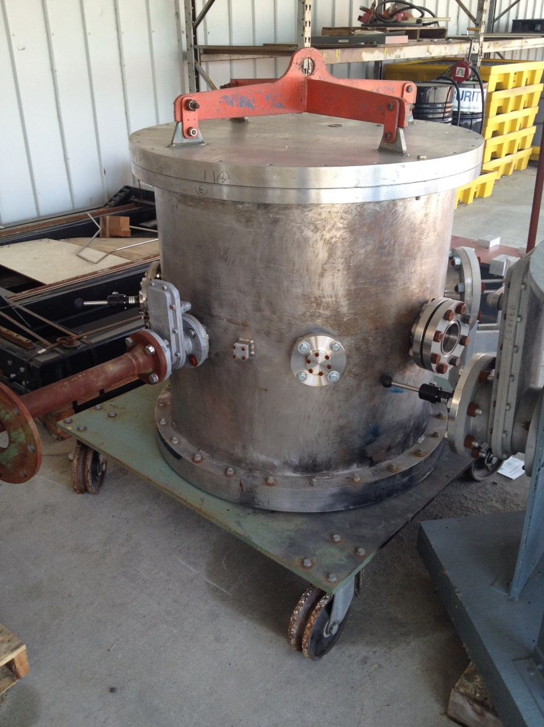
Houston, we have lift off!
Notes:
About a 3000lb vessel showed up from NASA!
Flange diameter of 41.25 in, which is very close to the 42in diameter we would use

Slide 8
Helicoflex Engineering Drawing
Notes:
Took measurements of the vessel and asked the supplier to design a seal for it.
At this point, realized that the required load was increased from 130,000lbs to 180,000 lbs due to the larger cross-section of the seal

Slide 9
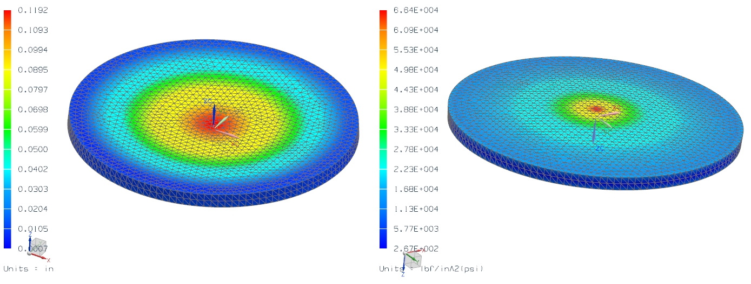
Plate Analysis
Notes:
About 6% difference in displacement and 12% difference in stress between hand calculation and simulation.
Could be a result of ….
Different values for Poisson ration and modulus of elasticity

Slide 10
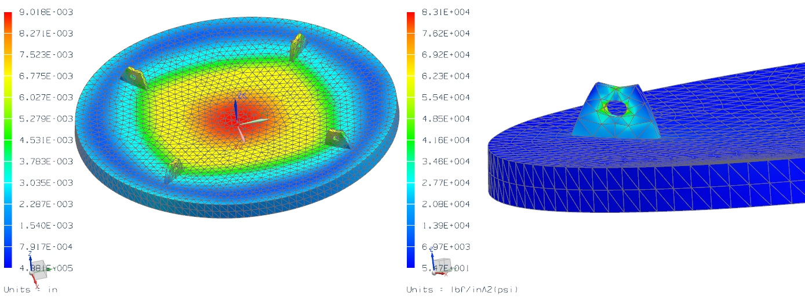
Notes:
Tried about 10 different loading options:
The three shown here, different combinations of distributed loads
According to ASME Section II Part D, the stress cannot exceed a little over 16 ksi.
Had to redo plate analysis when load was changed from 130,000 lbs to 180,000 lbs. Final configuration still adequate

Slide 11
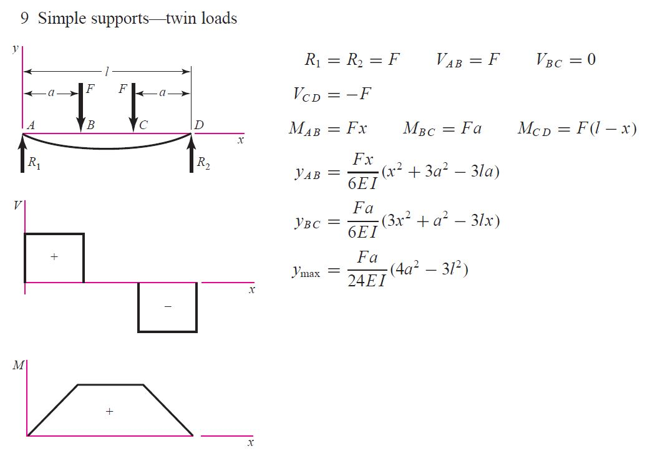
Beam Analysis
Failure Modes:
Tension rupture of angles
Bolt shear
Bolt bearing on angles
Shear yielding of angles
Shear rupture of angles
Block shear rupture of angles
Yielding due to bending of beam
Lateral torsional Buckling
Bolt bearing of beam web
Block shear rupture of beam web
Flexural rupture of coped section
Local web buckling at coped section
Shear yielding of web
Shear rupture of web

Slide 12
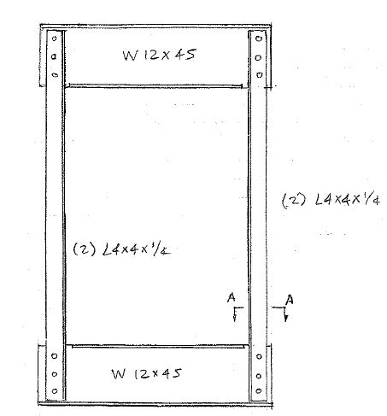
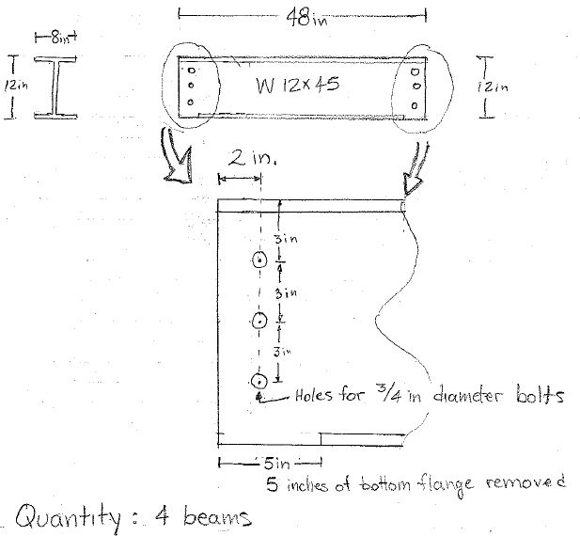
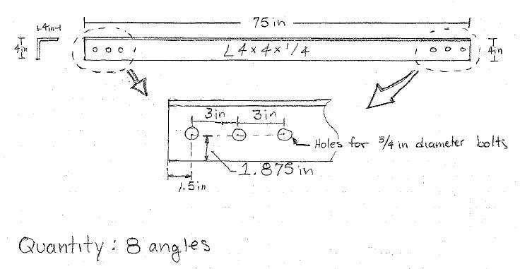
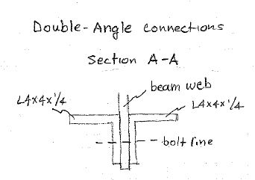
Notes:
Considerations:
-Geometry constraints (how many bolts can you fit)
-Don’t want to have to disassemble structure to remove vessel (realized this pretty late)
-but want to keep beam as short as possible to minimize bending stress

Slide 13
TA-DA!
Notes:
Found some extra material laying around, and two hard working gentlemen put this together for me
ALMOST screwed up. Luckily the guys that manufactured the frame are patient, and have crane!

Slide 14
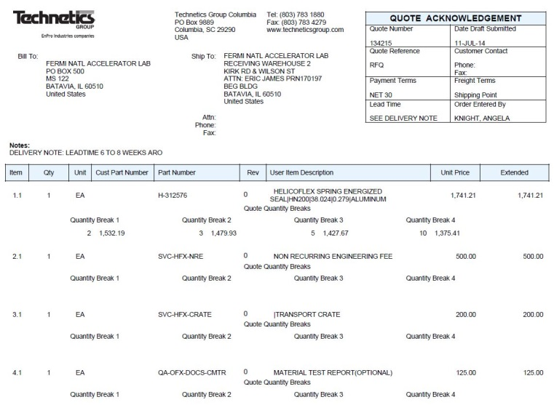
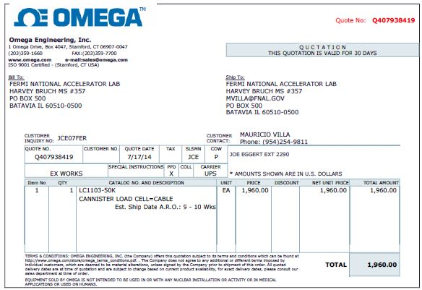
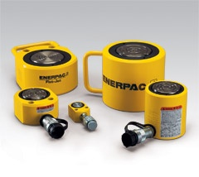
Next Steps for Seal Testing
Spec hydraulic system
Order Helicoflex Seals
Break some seals!!
Notes:
Goal isn’t actually to creak the seal (though we prob will)
-want to determine required load to receive an acceptable leak rate, which for us is on the order of 10^-6 cc/sec.atm
Now that the ball is rolling on the seal testing, we could redeirect our attention back to

Slide 15
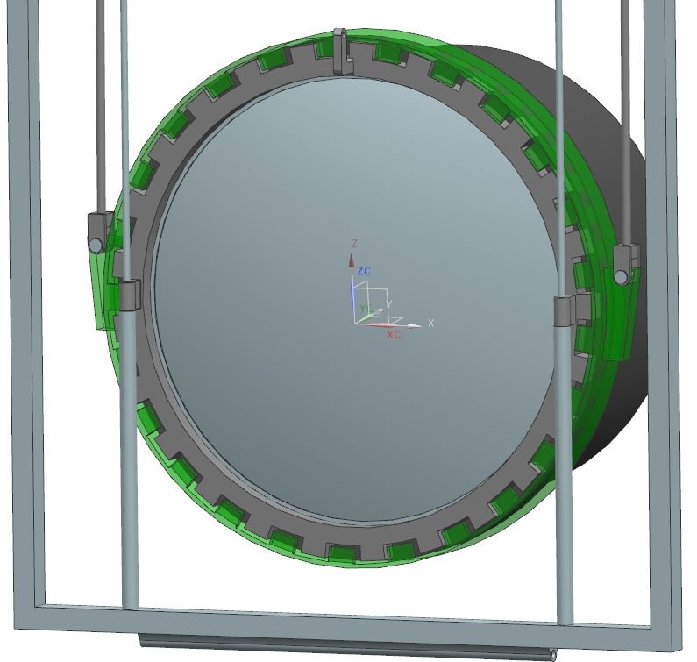
“Autoclave” Conceptual Design
Notes:
Steel shafts, bronze bushings
Window lifted using hydraulic system that would be located above ground

Slide 16
“Autcoclave” Conceptual Design
Notes:
Rotating ring is rotated using hydraulics, again located above ground
Advantage is that the seal does not experience the rotation (that’s bad for the seal)
Links allow for linear piston motion, allows rotation which will protect from extra loads are the rods
Use double acting cylinders
Beryllium window is “mounted” onto a frame
Frame slides up and down the lifting fixture
Has “hook” on top that will connect to another hydraulic system

Slide 18
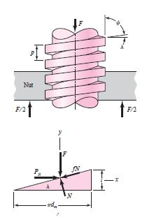
“Autoclave” Analysis
First-Order Analysis of "Autoclave" Closure
Helicoflex Seal Diameter | 42 | in.
Fraction of Circumference used by teeth | 0.4 | -
Bearing Pressure | 2000 | psi
Number of teeth | 20 | -
Inclination Angle | 0.8 | degrees
Static Friction Coefficient | 0.2 | -
Tooth Cicrcle Diameter | 42 | in.
Req. Compression Force | 173,246.27 | lbs
Contact Area | 86.62 | in^2
Tooth Width | 1.64 | in.
Tooth Length | 2.64 | in.
Tooth Height | 0.04 | in.
Total Force Requried to Tighten | 37,172.20 | lbs
Torque Required to Tighten | 780,616.12 | lbs in
 | 65,051.34 | lbs ft
Notes:
Other methods are still left to be considered: a wedge analysis, a four-bar mechanism, a robotic system that uses hydraulic wrench

Slide 19
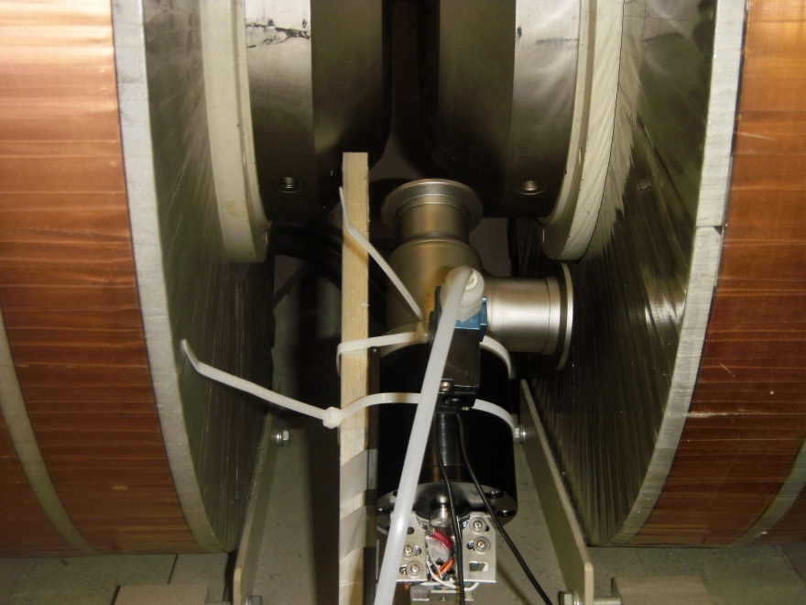
Valve Testing in Magnetic Field
Evaluate operation in fields ~1000 Gauss
Extensive engineering analysis for mounting mechanism
Both functioned normally…almost
Notes:
-made all pneumatic and electrical connections

Slide 20
Valve Testing in Magnetic Field
Evaluate operation in fields ~1000 Gauss
Both functioned normally…almost
Notes:
-made all pneumatic and electrical connections

Slide 21
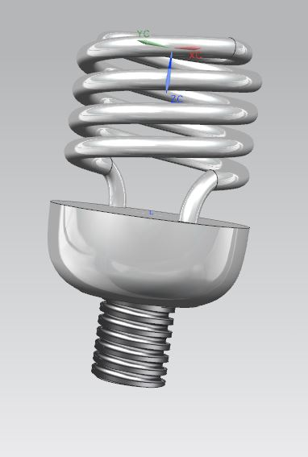
See, I learned something
Exposure to Siemens NX
Exposure to FEA (NX NASTRAN)
Conceptual Design Work
Documentation of Work (Engineering Notes)
Working with manufacturers, and engineers
Available Strength Design (ASD) Analysis
Notes:
Nx is solid modeling program

Slide 22
References
Deutschman, Aaron D., Walter J. Michels, and Charles E. Wilson. Machine Design; Theory and Practice. New York: Macmillan, 1975. Print.
Roark, Raymond J., and Warren C. Young. Roark's Formulas for Stress and Strain. 7th ed. New York: McGraw-Hill, 1989. Print.
Shigley, Joseph Edward., and Larry D. Mitchell. Mechanical Engineering Design. New York: McGraw-Hill, 1983. Print.
Steel Construction Manual. 14th ed. Chicago, IL: American Institute of Steel Construction, 2011. Print.

Slide 23
Questions?
A Special Thanks to…
Dave Pushka
Dianne Engram
Eric James
Elliott Mccrory
Linda Diepholz
The National GEM Consortium and Fermilab

