Slide 1
PIP and PIP-II Status and Plans
Sergei Nagaitsev
Fermilab PAC meeting
24 July 2014

Slide 2
Fermilab after the Tevatron
Fermilab operates the largest accelerator complex in the U.S., 2nd largest in the world (even after termination of the Tevatron)
Also part of oprations:
Proton Improvement Plan (PIP)
Muon Campus projects
Test facilities (magnets, SRF cavities)
Projects: Muon g-2, Mu2e, LBNF, MicroBooNE, LCLS-II (at SLAC), PIP-II
Programs: MAP, LARP, ILC
Research
Commercialization of our accelerator technologies.

Slide 3
Accelerator Operations
Fermilab operates a total of 16 km of accelerators and beamlines
A 400-MeV proton linear accelerator (0.15 km)
An 8-GeV Booster synchrotron (0.5 km)
An 8-GeV accumulator ring (3.3 km)
A 120-GeV synchrotron (3.3 km)
A Muon Campus Delivery ring (0.5 km)
Soon: Muon g-2 ring
Transfer lines and fixed target beam lines (8 km)
Two high power target stations, several low-power targets
And maintains
130 buildings, structures, service bldgs,…

Slide 4
Fermilab Accelerator Complex
Linac: NTF, MTA
BNB: MicroBooNE
NuMI: MINOS+, MINERvA, NOvA
Fixed Target: SeaQuest, Test Beam Facility, M-Center
Muon: g-2, Mu2e (future)
Also, test and R&D facilities:
ASTA
PXIE
CMTF
Various cryo test stands

Slide 5
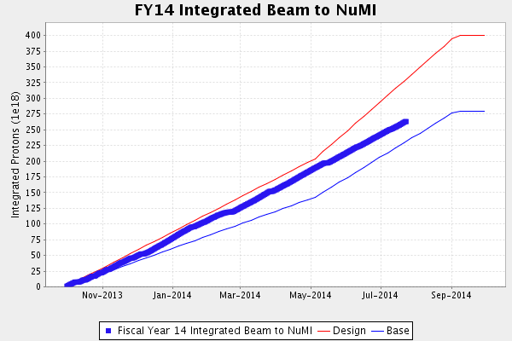
Present NuMI performance (protons on target)
FY14 performance metric: 3.2e20 POT

Slide 6
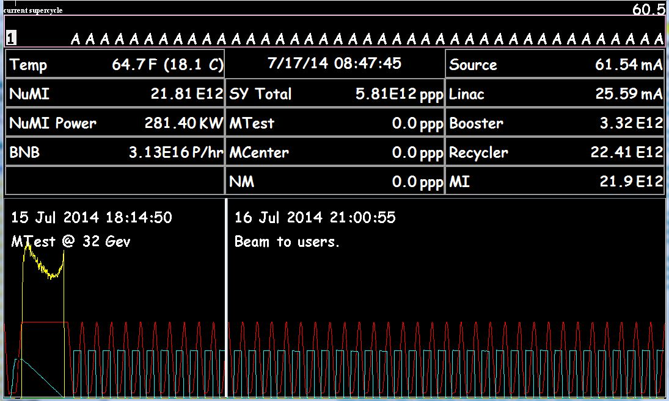
Recycler is now part of operations

Slide 7
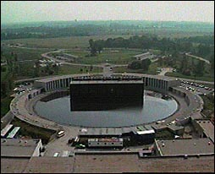
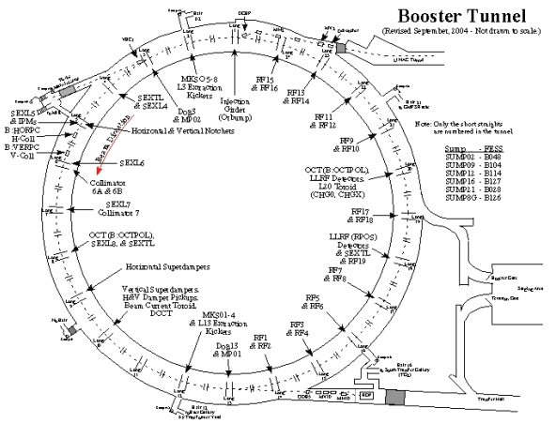
Fermilab Booster
Booster is a resonant machine running at 15 Hz
RF is pulsed, limited to ~7.5 Hz
at higher frequencies the cavities spark
at higher frequencies the tuners overheat
Refurbishment plan to achieve 15 Hz is part of PIP
There is an RF pre-pulse associated with beam cycles
It means that the beam pulse rate is less than 7.5 Hz

Slide 8
Proton Improvement Plan (PIP)
The PIP campaign has several goals:
Increased reliability of the Linac/Booster complex
Control of beam losses
Increased proton flux (15 Hz)
Main challenge: keep beam losses constant while increasing the protons on target
Beam loss limits are set at levels for personnel safety (ALARA) and equipment serviceability

Slide 9
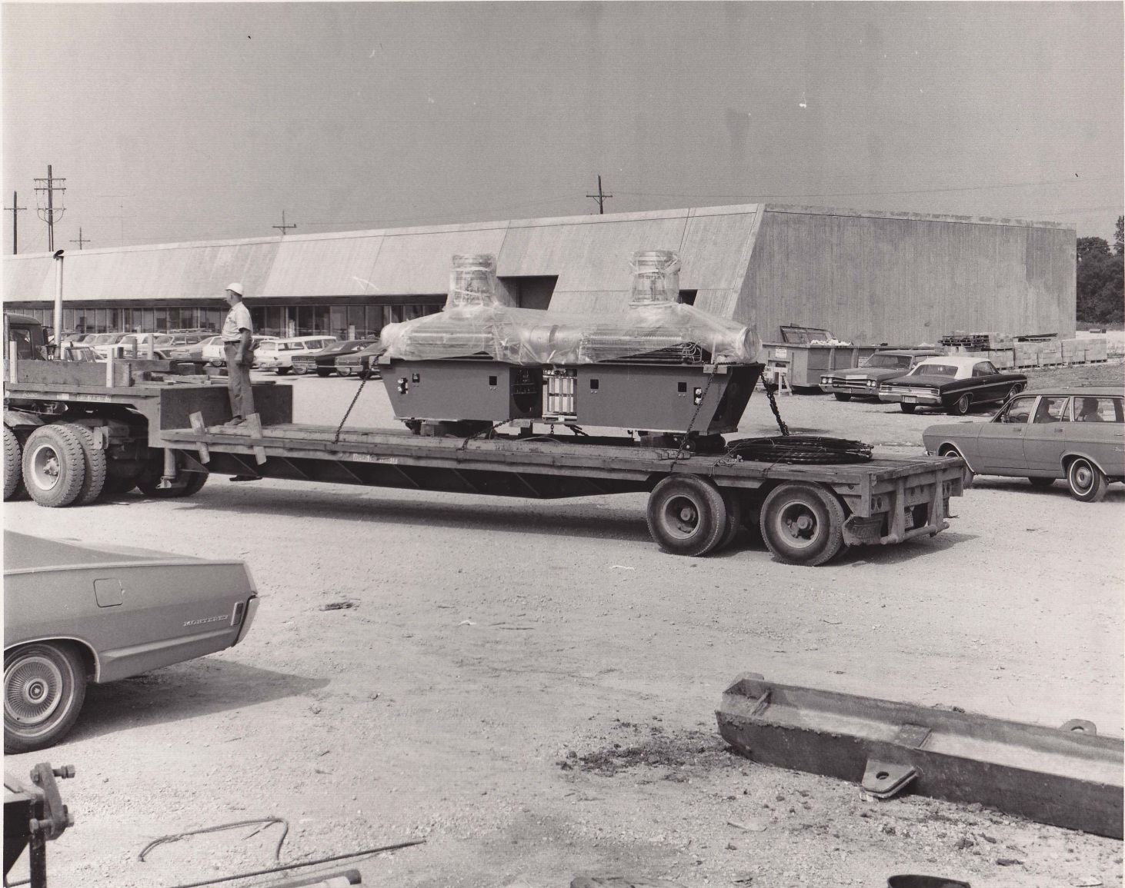
Booster RF cavities
July 1970 Flatbed semi delivering Booster RF cavity pair
Cavities built by GE

Slide 10
Booster rf cavities
Booster has 22 slots for rf cavities
We can not run (4.3e12) beam with fewer than 17 cavities.
We have 19 cavities on hand
At any given time: 17 are installed, 2 are out for repair
each cavity requires 3 tuners. Tuners require 3 weeks to rebuild during the 10-week refurbishment process.
Cavity #20 is an old 1st prototype cavity. It was restored and equipped with new tuners, and ready for testing

Slide 11
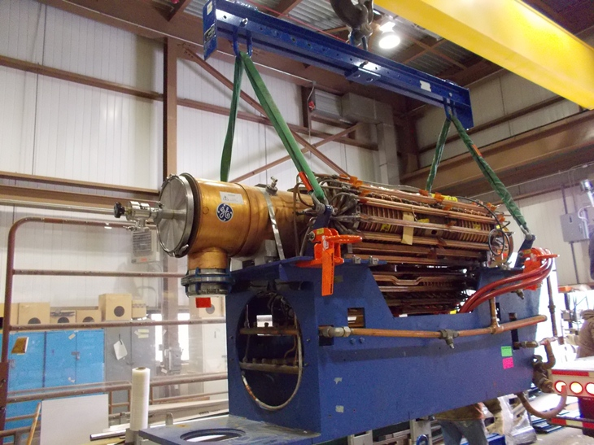
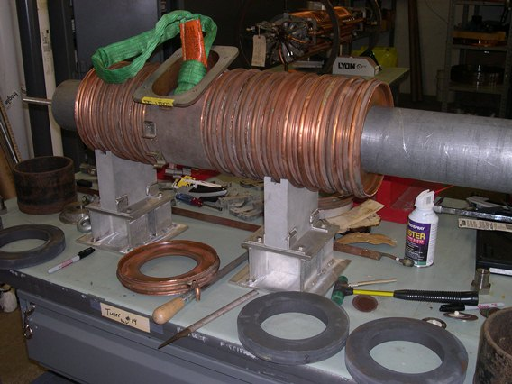
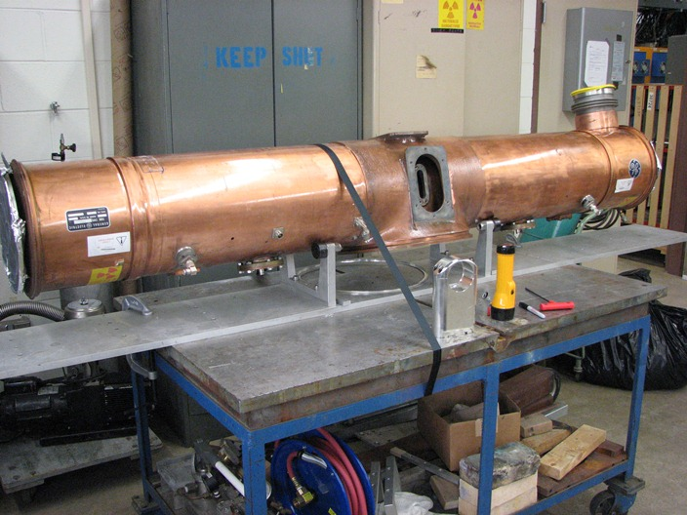
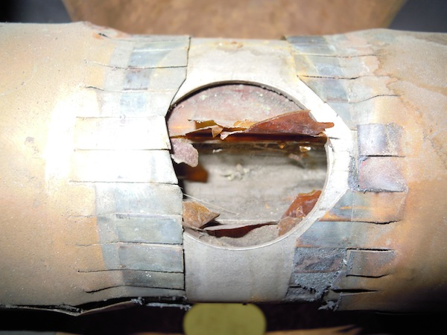
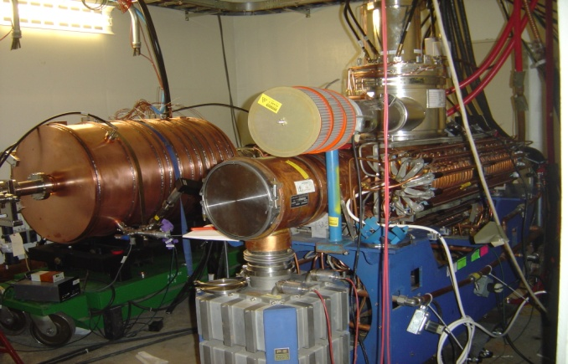
Booster PIP - Refurbishment of 40 year old cavities (facelift)
0
Weeks
10
Cool-down
Rebuild - Cones & Tuners
Re-Assemble
Remove Tuners
Rebuild Stems/Flanges
Testing
Cavity Removal
Cavity Removal - Stripping
Tuners Rebuild
Rebuild and Test

Slide 12
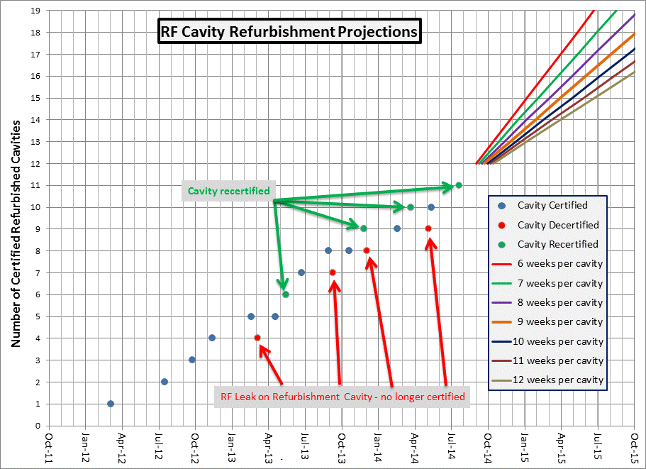
Booster PIP - Cavity Refurbishment Timeline

Slide 13
Refurbishment: “Fun” facts and beyond
All cavities in tunnel need to be refurbished before higher rep rate (15 Hz) is possible
After refurbishment is completed – higher flux will require time
After refurbishment is completed – the cavities will still be OLD
There is likely to be failures as cavities are run harder
Even if we have 20 cavities installed in the ring, this leaves us with no spares.
The plan is to procure 3 more cavities in FY16,17
same type as present cavities
larger bore
install 2 in ring as hot spares

Slide 14
PIP and PIP-II interaction
PIP original goals were:
Achieve 15 Hz Booster operation with beam
Operate Linac and Booster until 2025, then replace with Project X (8 GeV).
Several reliability issues were ignored because of the 2025 end date.
PIP-II is not replacing the Booster, only the linac
Need to reassess the PIP scope
Need to set a new end-date for the Booster (2030?)
Started regular meeting to coordinate PIP and PIP-II

Slide 15
PIP-II Physics Opportunities
LBNF
1.2 MW of beam power on day one; 2.4 MW ultimately
Flexible proton beam energy (60-120 GeV)
NuMI
1.2 MW beam power in the interim
Mu2e
30-50% increase in beam power immediately*
Potential for ~25-100 kW at 800 MeV
Current Mu2e configuration limits to 25-30 kW
SBN
30-50% increase in beam power immediately*
* Possible extension of Booster operations to 20 Hz is under consideration, but not incorporated into these estimates
Notes:
Per Bob B:
Shielding can be upgraded to accommodate ~25 kW
Instantaneous proton rate (measured over 1.7 usec) can go up about a factor of three (before problems with event pileup in the detector)

Slide 16
PIP-II Goals
Proton Improvement Plan-II supports these long term physics research goals while providing a platform for the future
Design Criteria
Deliver 1.2 MW of beam power at 120 GeV, with power approaching 1 MW at energies down to 60 GeV, at the start of LBNF operations
Support the current 8 GeV program, including Mu2e, g-2, and the suite of short-baseline neutrino experiments
Provide upgrade path for Mu2e
Provide a platform for extension of beam power to LBNF to >2 MW
Provide a platform for extension of capability to high duty factor/higher beam power operations
At an affordable cost to DOE

Slide 17
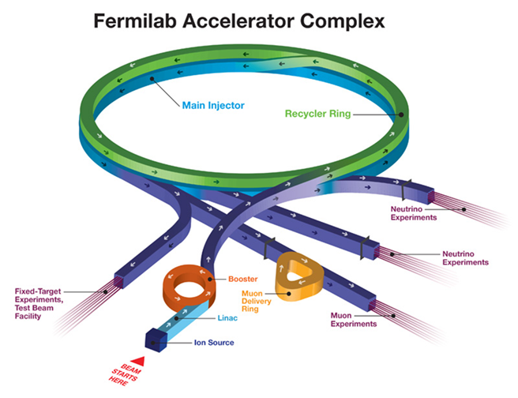
PIP/PIP-II Strategy
Increase Booster beam repetition rate to 15 Hz (PIP)
700 kW to NOvA concurrent with 8 GeV program
Increase Booster/Main Injector per pulse intensity by 50%; decrease MI cycle time modestly
Increase Booster injection energy
to ~800 MeV
Modest modifications to Booster/
Recycler/MI
To accommodate higher intensities
and higher Booster injection energy

Slide 18
PIP-II
We believe the most cost-effective means of achieving these goals is via an 800 MeV superconducting pulsed linac, extendible to support >2 MW operations to LBNF and upgradable to continuous wave (CW) operations
Builds on significant existing infrastructure
Capitalizes on major investment in superconducting rf technologies
Eliminates significant operational risks inherent in existing linac
Siting consistent with eventual replacement of the Booster as the source of protons for injection into Main Injector
Whitepaper available at
projectx-docdb.fnal.gov/cgi-bin/ShowDocument?docid=1232

Slide 19
PIP-II Performance Goals
Performance Parameter | PIP | PIP-II
Linac Beam Energy | 400 | 800 | MeV
Linac Beam Current | 25 | 2 | mA
Linac Beam Pulse Length | 0.03 | 0.5 | msec
Linac Pulse Repetition Rate | 15 | 15 | Hz
Linac Beam Power to Booster | 4 | 13 | kW
Linac Beam Power Capability (@>10% Duty Factor) | 4 | ~200 | kW
Mu2e Upgrade Potential (800 MeV) | NA | >100 | kW
Booster Protons per Pulse | 4.2×10¹² | 6.4×10¹²
Booster Pulse Repetition Rate | 15 | 15 | Hz
Booster Beam Power @ 8 GeV | 80 | 120 | kW
Beam Power to 8 GeV Program (max) | 32 | 40 | kW
Main Injector Protons per Pulse | 4.9×10¹³ | 7.5×10¹³
Main Injector Cycle Time @ 120 GeV | 1.33 | 1.2 | sec
LBNF Beam Power @ 120 GeV* | 0.7 | 1.2 | MW
LBNF Upgrade Potential @ 60-120 GeV | NA | >2 | MW
*LBNF beam power can be maintained to ~80 GeV, then scales with energy

Slide 20
PIP-II Site Layout (provisional)

Slide 21
PIP-II Status and Strategy
PIP-II is currently pre-CD-0
Complete concept exists
Documented in whitepaper; technical backup in PX RDR
R&D program underway
Front end (PXIE) and superconducting rf development
Strong endorsement from P5
Recommendation 14: Upgrade the Fermilab proton accelerator complex to produce higher intensity beams. R&D for the Proton Improvement Plan II (PIP-II) should proceed immediately, followed by construction, to provide proton beams of >1 MW by the time of first operation of the new long-baseline neutrino facility.
Applies in all budget scenarios considered.
Discussions with P5, Fermilab, and DOE/OHEP management have been in context of FY19 construction start
Consistent R&D deliverables list established
Preliminary discussions on potential international in-kind contributions
Aligned with LCLS-II and LBNF activities
Goals for the next year
Release PIP-II specific RDR
Maintain PXIE and SRF development on established schedules
Support DOE in the development of Mission Need Statement
Establish PIP-II Office, within Accelerator Division

Slide 22
PIP-II Collaboration
Collaboration MOUs for the RD&D phase (through CD-2) :
National IIFC
ANL ORNL/SNS BARC/Mumbai
BNL PNNL IUAC/Delhi
Cornell UTenn RRCAT/Indore
Fermilab TJNAF VECC/Kolkata
LBNL SLAC
MSU ILC/ART
NCSU
Ongoing collaboration/contacts with RAL/FETS (UK), ESS (Sweden), SPL (CERN), RISP (Korea), China/ADS
Annual Collaboration Meeting (June 3-4 at Fermilab)
https://indico.fnal.gov/conferenceDisplay.py?confId=8365

Slide 23
PIP-II International Contributions
Discussions at agency and laboratory levels indicate that an 800 MeV SC linac could attract significant in-kind contributions from India/Europe/Asia
SC accelerating structures
RF sources
Instrumentation
Magnets/power supplies
Significant R&D collaboration for >5 years with India
Discussions at DOE-DAE level on potential Indian in-kind contributions

Slide 24
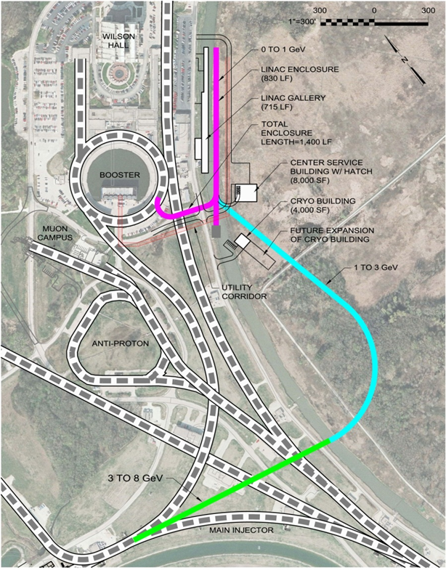
Flexible Platform for the Future
PIP-II Inherent Capability
~200 kW @ 800 MeV
×10 Mu2e sensitivity
2 MW to LBNF
Flexibility for future experiments
Muons, Kaons @100’s kW
Compatible with muon acceleration
needs (Mark P talk)

Slide 25
Summary
The Fermilab accelerator complex can be upgraded to establish LBNF as the leading long-baseline program in the world, with >1 MW at startup (2025)
The Proton Improvement Plan-II (PIP-II) is a complete, integrated, cost effective concept, that meets this goal, while
leveraging U.S. superconducting rf investment,
attracting international partners,
providing a platform for the long-term future
PIP-II retains flexibility to eventually realize the full potential of the Fermilab complex
LBNF >2 MW
Mu2e sensitivity x10
MW-class, high duty factor beams for rare processes experiments
We have received a positive recommendation from P5 and are working with Fermilab and OHEP management to move forward.

Slide 26
Backup Slides

Slide 27
PXIE @ CMTF
LEBT
RFQ
MEBT
HWR
SSR1
HEBT
40 m, ~25 MeV
PXIE will address the address/measure the following:
LEBT pre-chopping
Vacuum management in the LEBT/RFQ region
Validation of chopper performance
Bunch extinction
MEBT beam absorber
MEBT vacuum management
Operation of HWR in close proximity to 10 kW absorber
Operation of SSR with beam, including resonance control
Emittance preservation and beam halo formation through the front end

Slide 28
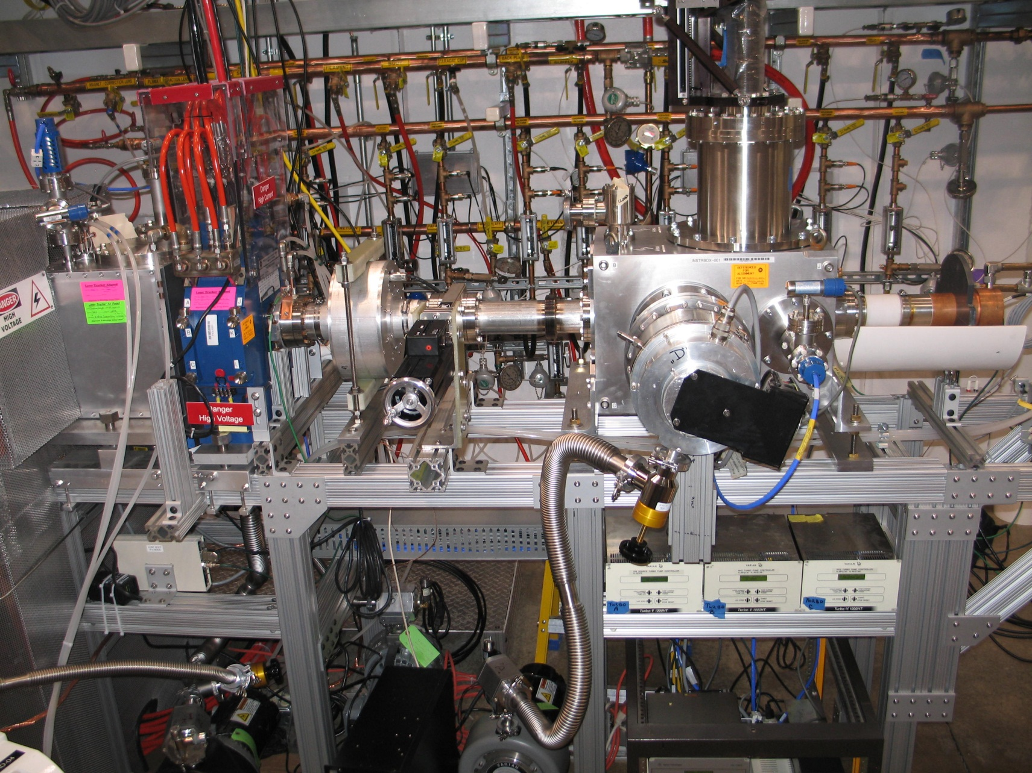
PXIE
30 keV
2.1 MeV
10 MeV
25 MeV
LEBT
RFQ
MEBT
HWR
SSR1
HEBT
Collaborators
ANL: HWR
LBNL:LEBT, RFQ
SNS: LEBT
India (BARC): MEBT

Slide 29
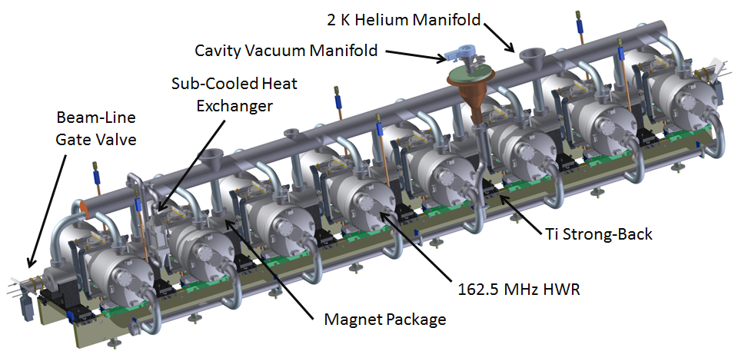
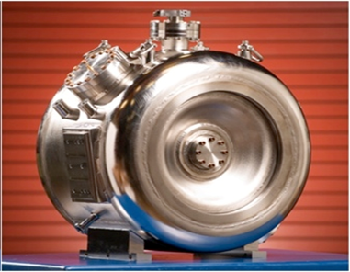
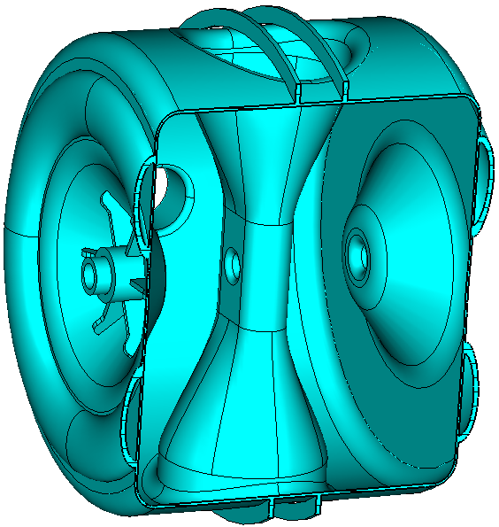
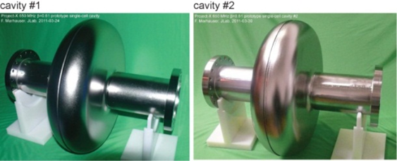
SRF R&D
HWR
SSR1 SSR2
LB650
HB650

Slide 30
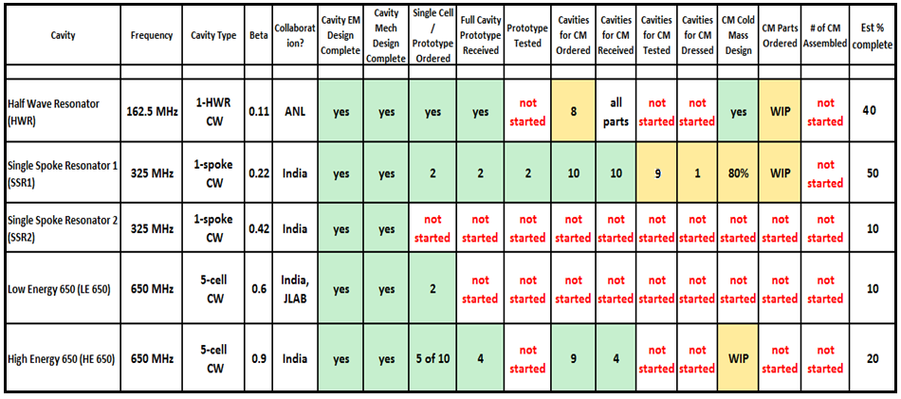
SRF Development Status

Slide 31
SRF R&D: Q0
Nitrogen-doped 9-cell cavities vs typical 120C bake (2K)
Q₀
E_{acc} [MV/m]

Slide 32
PIP-II Linac Technology Map
PXIE
IS
LEBT
RFQ
MEBT
β=0.11
β=0.22
β=0.51
β=0.61
β=0.9
RT
SC
162.5 MHz
0.03-11 MeV
325 MHz
11-177 MeV
650 MHz
177-800 MeV
Section | Freq | Energy (MeV) | Cav/mag/CM | Type
RFQ | 162.5 | 0.03-2.1
HWR (β_{opt}=0.11) | 162.5 | 2.1-11 | 8/8/1 | HWR, solenoid
SSR1 (β_{opt}=0.22) | 325 | 11-38 | 16/8/ 2 | SSR, solenoid
SSR2 (β_{opt}=0.51) | 325 | 38-177 | 35/21/7 | SSR, solenoid
LB 650 (β_{G}=0.61) | 650 | 177-480 | 30/20/5 | 5-cell elliptical, doublet
HB 650 (β_{G}=0.9) | 650 | 480-800 | 24/10/4 | 5-cell elliptical, doublet

Slide 33
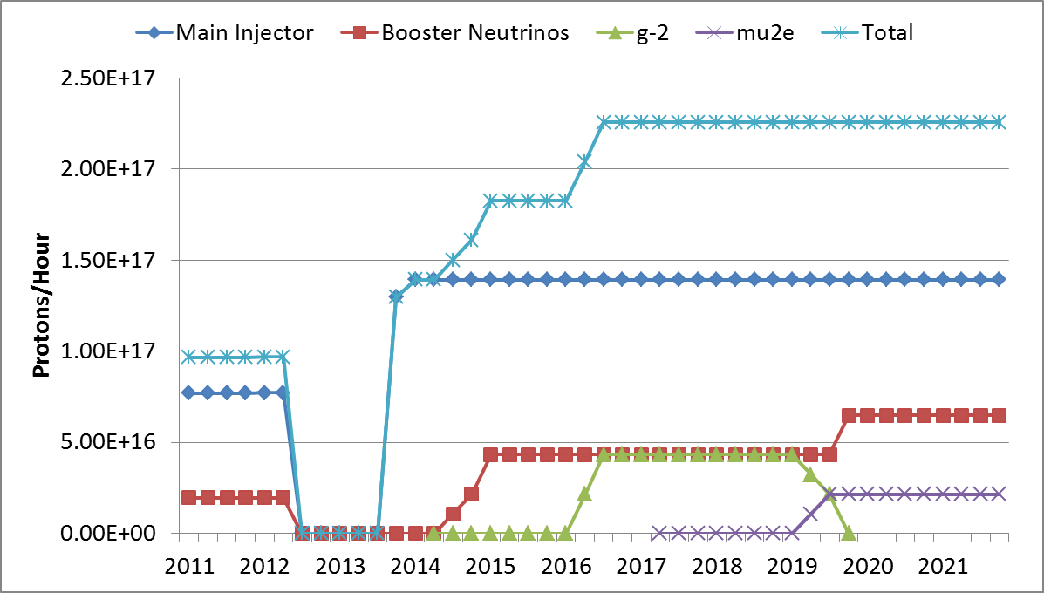
Proton Demand
NOvA
8 GeV ν
g-2
Mu2e

Slide 34
Cryogenic System
Required to support 5% cryogenic duty factor
Configuration capable of 10-15% with more pumping
160 – 240 kW beam power at 800 MeV

Slide 35
Mu2e w/ PIP-II
Can operate PIP-II linac up to ~15% duty factor with cryogenic system as designed
RF system as designed can support 2 mA (averaged over 1 μsec) at 15% duty factor
RFQ can supply 10 mA
MEBT chopper can provide arbitrary bunch patterns for separation at downstream end of linac.
Mu2e Operations:
10% micro-duty factor (100 ns×1 MHz)
13.5% macro-duty factor (9 ms×15 Hz)
10%×13.5%×10mA×800 MeV = 108 kW

Slide 36
Mu2e w/PIP-II
9 ms, 1 mA (Mu2e)
1 ms, 2 mA (Boo)
 |  |  |  |  |  |  |  |  |  |  |  |  |  |  |  |  |  |  |  |  |  |  |  |  |  |  |  |  |  |  |  |  |  |  |  |  |  |  |  |  |  |  |  |  |  |  |  |  |  |  |  |  |  |  |  |  |  |  |  |  |  |  |  |  | . | . | .
67 ms
100 ns, 10 mA
6 ns
 |  |  |  |  |  |  |  |  |  |  |  |  |  |  |  |  |  |  |  |  |  |  |  |  |  |  |  |  |  |  |  |  |  |  |  |  |  |  |  |  |  |  |  |  |  |  |  |  |  |  |  |  |  |  |  |  |  |  |  |  |  |  | . | . | .
1 μs

