Slide 1

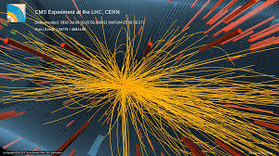



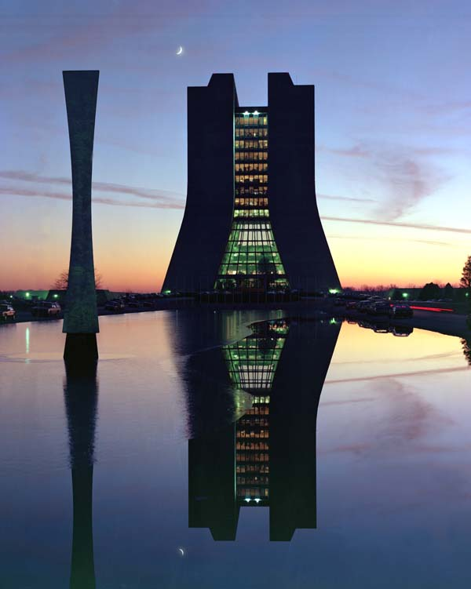
Triggers, Data Acquisition and Data Processing: Part 1
HCPSS 2014
Sarah Demers
Yale University

Slide 2
Definitions
Trigger
Data Acquisition
Data Preparation

Slide 3

A Note On Pedagogy…
apple
friend
cranky
yellow
breath
a_pl_
frie_d
c_anky
ye_lo_
brea_h

Slide 4
Definitions
Trigger
Selects (filters) wanted events
Data Acquisition
Delivers and stores wanted events
Data Preparation
Prepares data for analysis

Slide 5
Documentation
ALICE
  Technical Design Report https://edms.cern.ch/document/456354/2
ATLAS
  ATLAS HLT, DAQ and DCS Technical Design Report http://atlas-proj-hltdaqdcs-tdr.web.cern.ch/atlas-proj-hltdaqdcs-tdr/
  Overall ATLAS Technical Design Report http://atlas.web.cern.ch/Atlas/GROUPS/PHYSICS/TDR/access.html
CMS
  Trigger System Technical Design Report https://cds.cern.ch/record/706847/files/cer-002248791.pdf
  Software and Detector Technical Design Report https://cds.cern.ch/record/922757/files/lhcc-2006-001.pdf
LHCb
  Trigger System Technical Design Report http://cds.cern.ch/record/630828/files/lhcc-2003-031.pdf
  Technical Design Report http://cds.cern.ch/record/630827/files/lhcc-2003-030.pdf

Slide 6

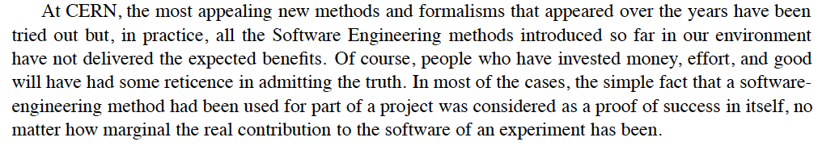
Really? All that documentation?
These TDRs represent just a fraction
of the information available.
Beware the differences between
design and implementation – always
best to find performance documents.
Some of the text may be juicier than
you expect…

Slide 7

Designing a Trigger/DAQ System
The Incomplete Standard List of Questions
Physics: What measurements do I want to do with the detector?
Accelerator Conditions: How much time between collisions? How many overlapping interactions? Radiation doses to electronics?
Detector: Number of channels? Length of time for readout of each sub-detector?
Hardware capabilities: How many menu items? What algorithms are fast enough?
Software Constraints: How long do the algorithms take to run? How much information do they need for reasonable performance?
Political and budget constraints: Which group/country builds what? How much
will it cost?
The specific:
“Constraints of floor space and cooling capacity, in particular in the underground experimental cavern and adjoining service rooms, limit the number of racks available to the HLT/DAQ system.”
ATLAS DAQ TDR

Slide 8
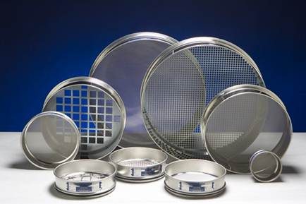
A Staged-Approach
Successive layers of triggers, with more complete information and more time
Hardware Triggers
with local information
Software Triggers
with more time and
more information
Reject early
and
reject often!

Slide 9
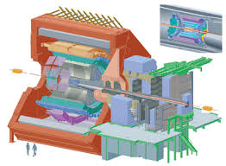
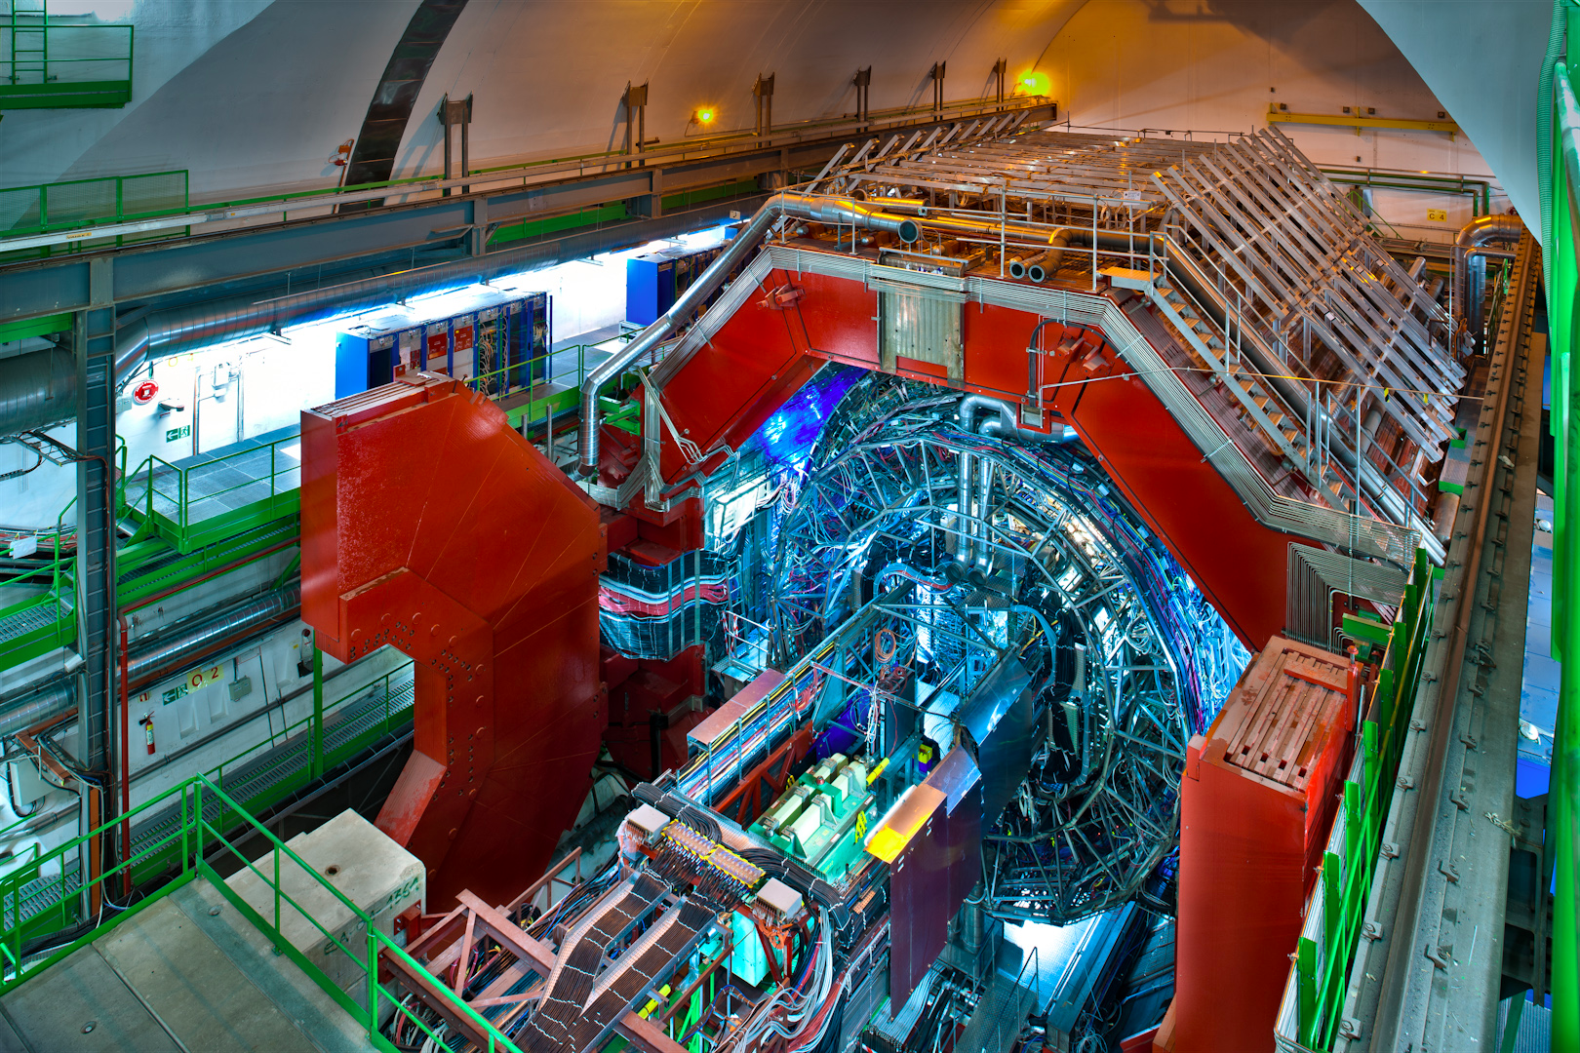
ALICE

Slide 10
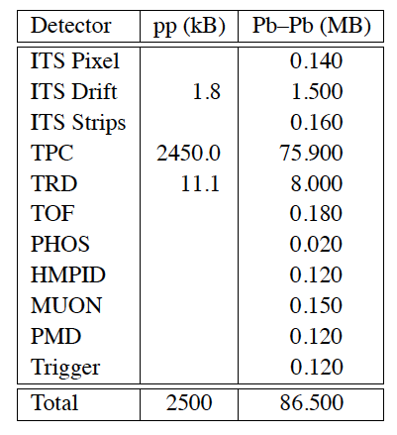
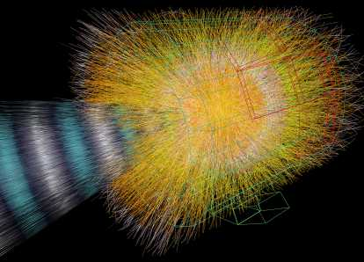
ALICE Trigger/DAQ Design
Expected Event Size from Different Running Modes
Goal: Be able to run in three modes
DAQ-only
DAQ + HLT Active
DAQ + HLT Enabled

Slide 11
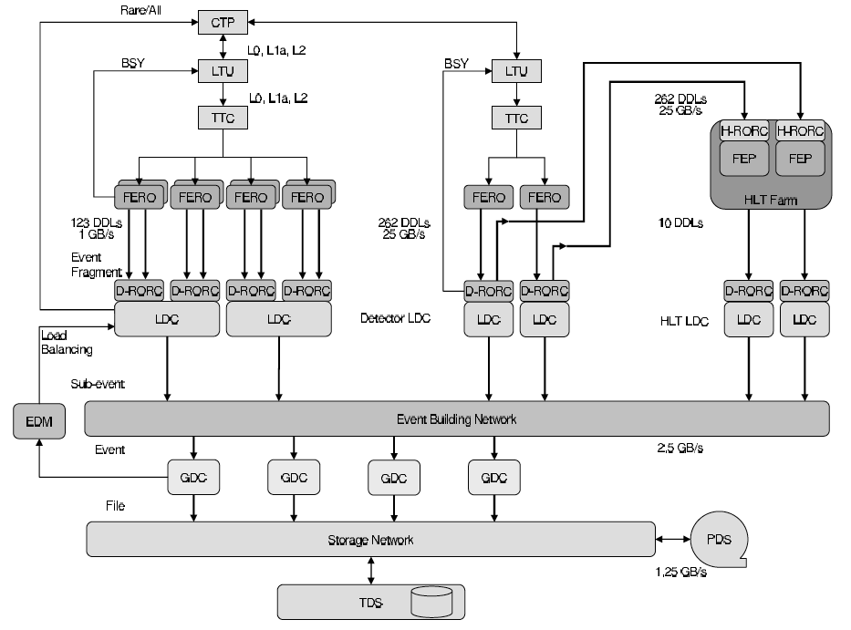
ALICE DAQ Architecture

Slide 12

Field Guide: Reading the flow Diagrams
Define the acronyms.
Follow the event fragments in DAQ and in the trigger.
Are data fragments pushed or pulled through the system?
At what stage are events assembled (built)?
Where is the brain of the trigger?
What are the bandwidth limitations?
What are the timing requirements?
What rejection factor is required at each level?

Slide 13
ALICE DAQ Architecture
CTP: Central
Trigger Processor
LTU: Local Trigger
Unit
TTC: Timing, Trigger
and Control
FERO: Front-end
readout
DDL: Detector
data links
D-RORC: DAQ
Readout Card
LDC: Local Data
Concentrators
(PCs)
GDC: Global Data
Concentrators
EDM: Event
Destination Manager
PDS: Permanent
Data Storage

Slide 14
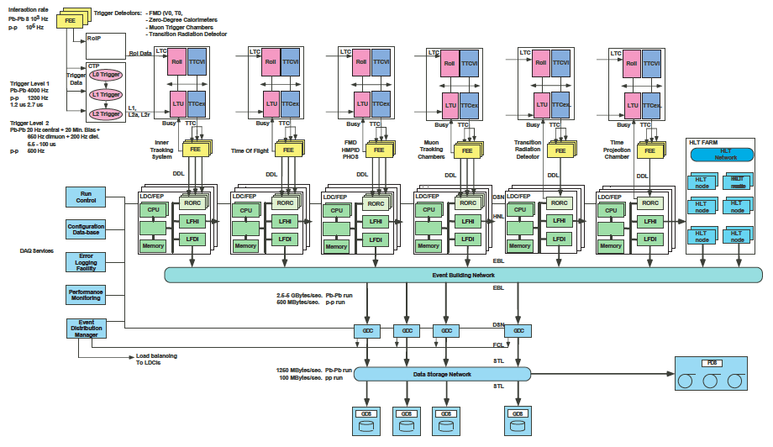
pb-pb: Interaction Rate of 1 X 10³ Hz, L1 Accept of 4000 Hz
pp: Interaction Rate of 1 X 10⁶ Hz, L1 Accept 1000 Hz
pb-pb: 2.5 – 5 GB/s,
pp: 500 MB/s
1250 MB/s: Pb-Pb run
100 MB/s: pp run

Slide 15
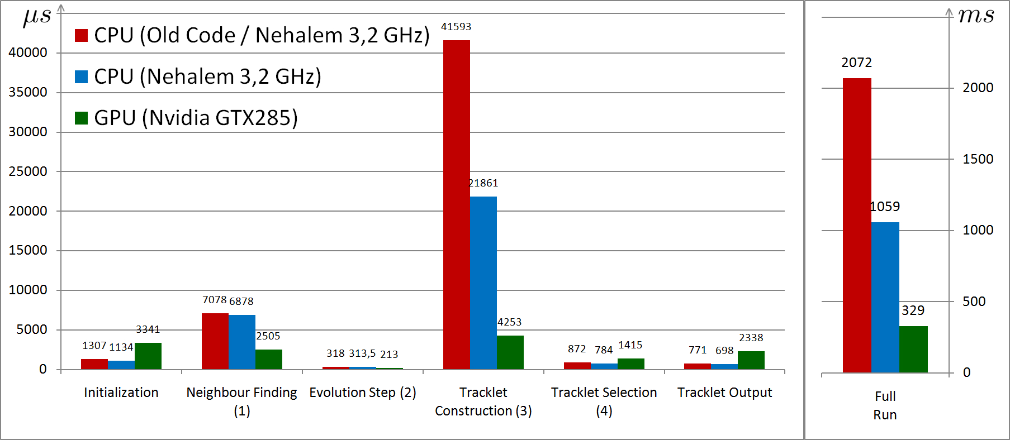
ALICE Tracking on GPUs
(Graphics Processing Unit)

Slide 16
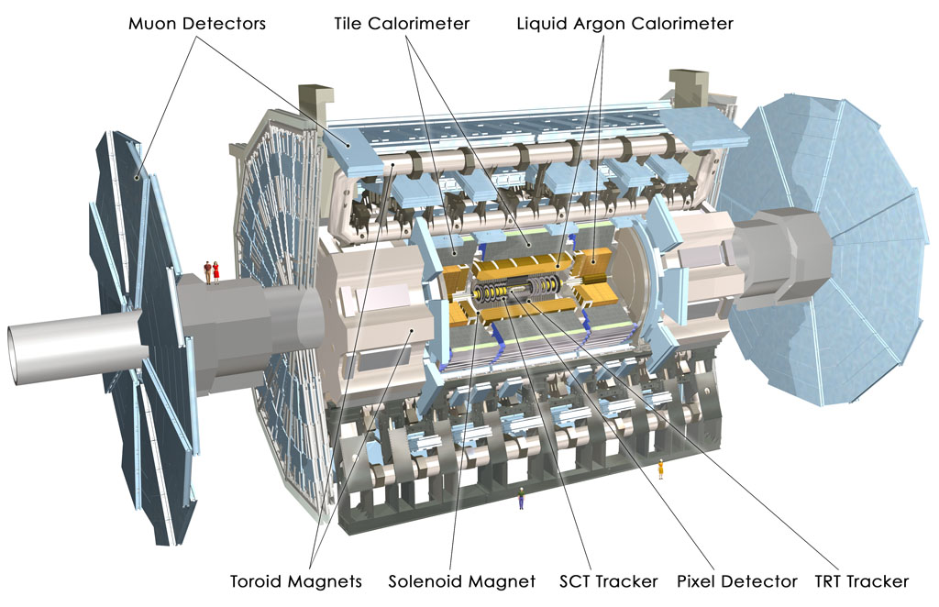
ATLAS

Slide 17
ATLAS 3-Level Trigger System
Level 1
Hardware Trigger
Latency: < 2.5 μs
Rate Reduction: 20 MHz -> 75 kHz
Level 1 passes along not just the thumbs up (something
you’ve defined interesting has happened!) but also the RoI -
where that event of interest occurred in the detector.
Level 2
Software Trigger
Time per event: 75 ms
Rate Reduction: 75 kHz -> 6.5 kHz
The entire event is assembled and available at the stage
of the final trigger level.
Event Filter
Software Trigger
Time per event: 4 s
Rate Reduction: 6.5 kHz -> 1 kHz

Slide 18
ATLAS

Slide 19
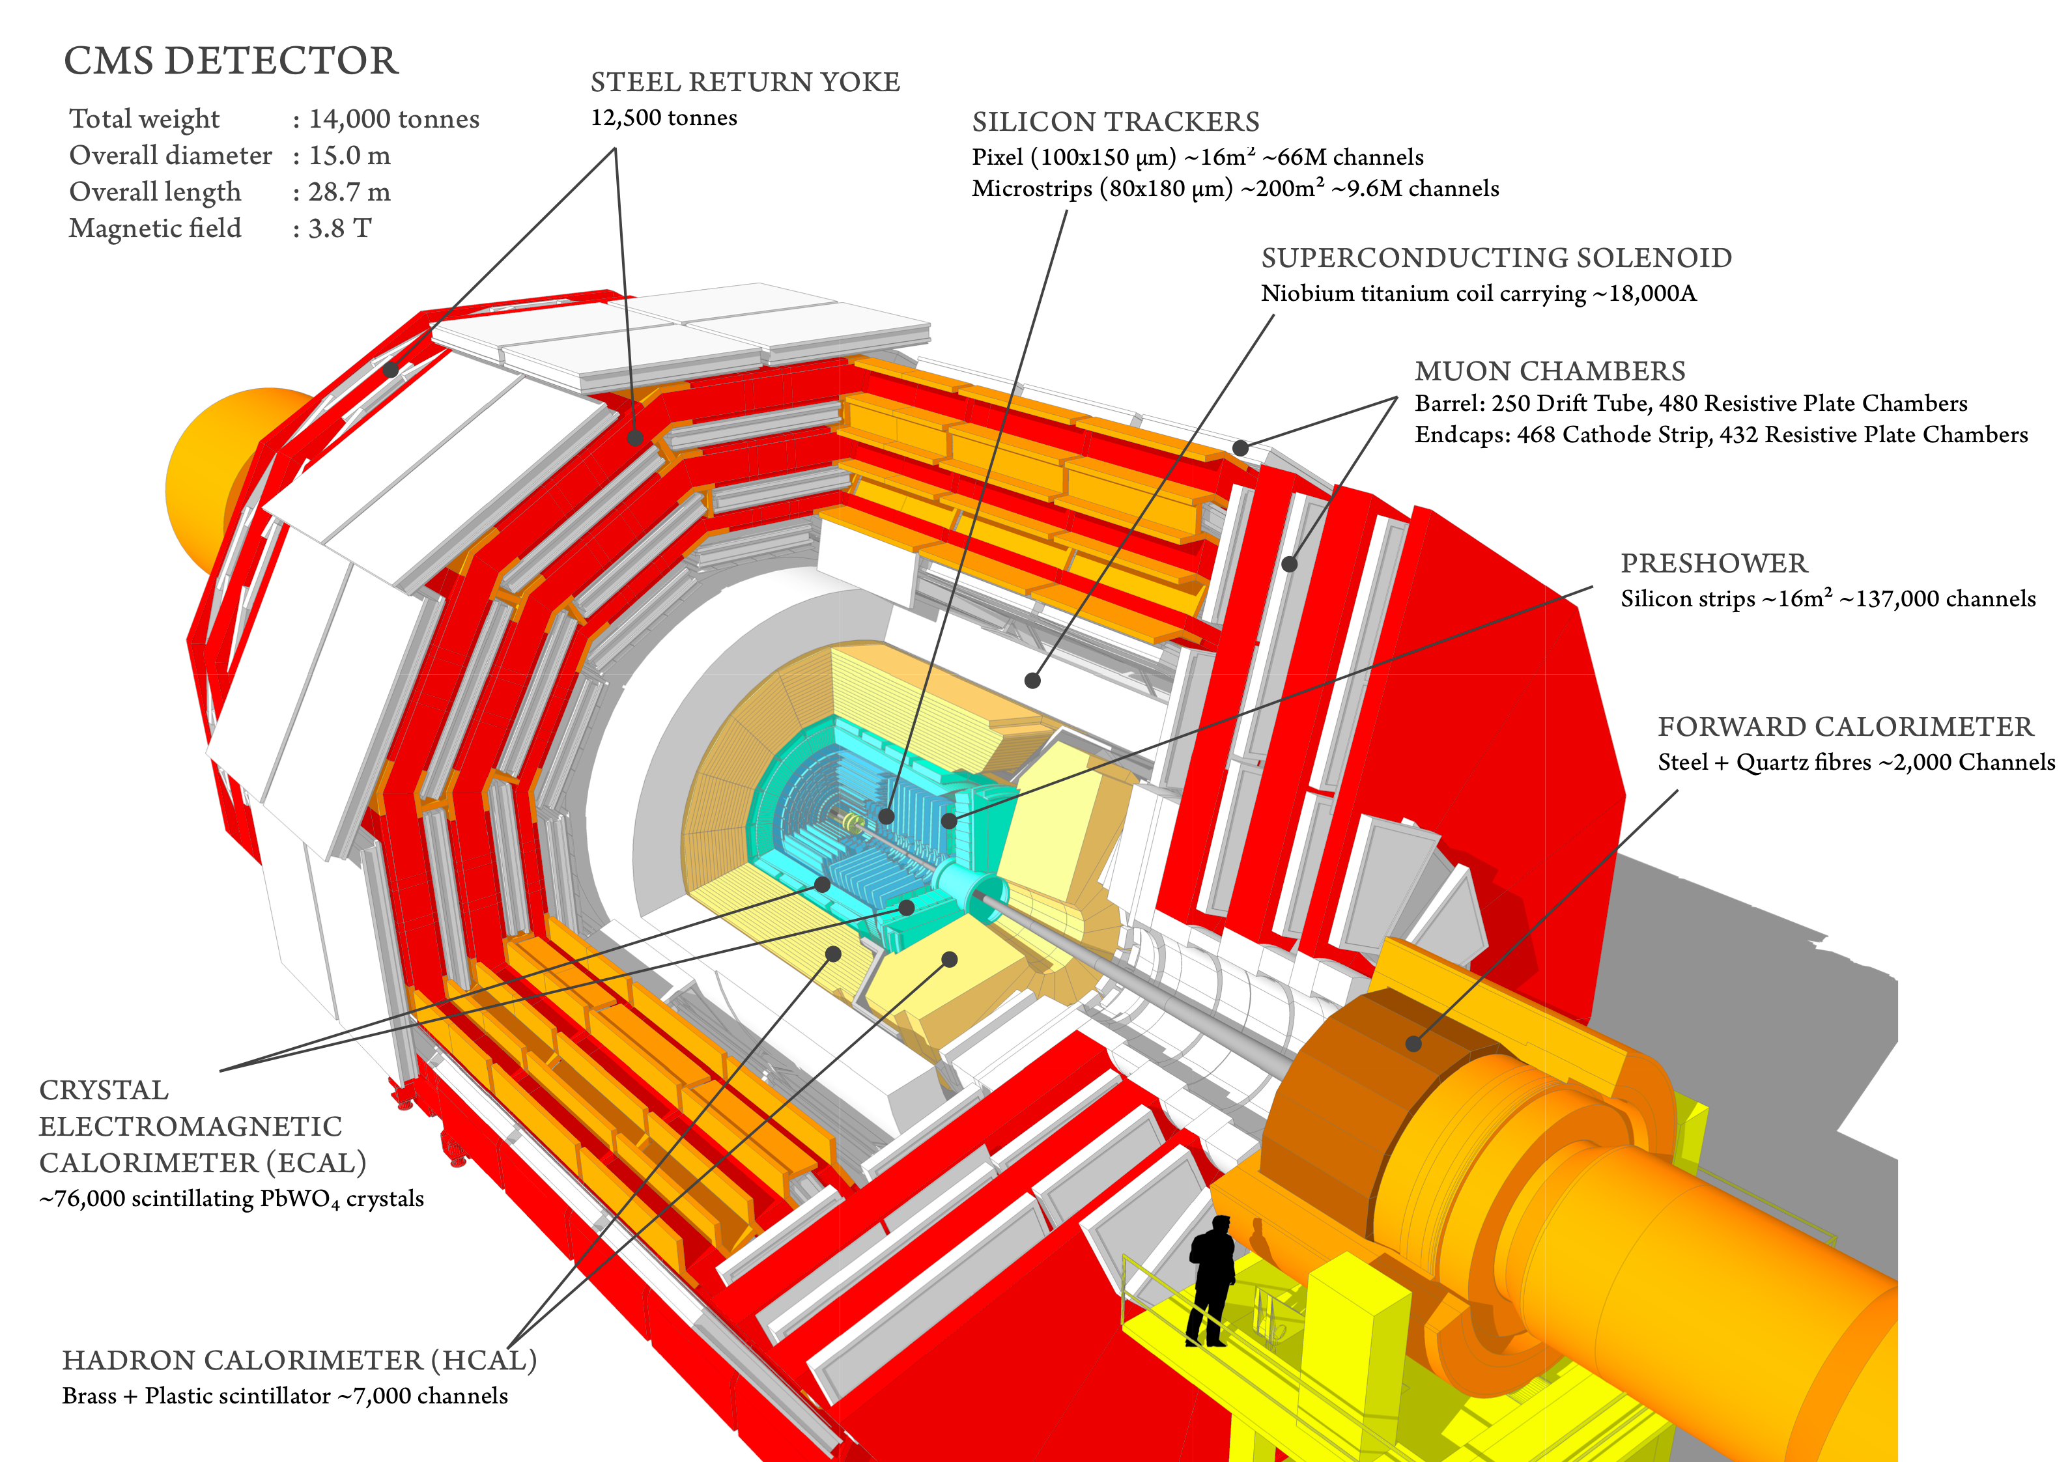

Slide 20
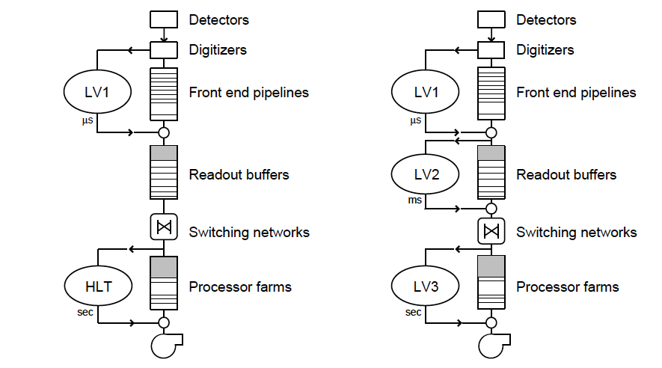
CMS: The Two-Level Trigger
CMS Design Three-Level Trigger

Slide 21
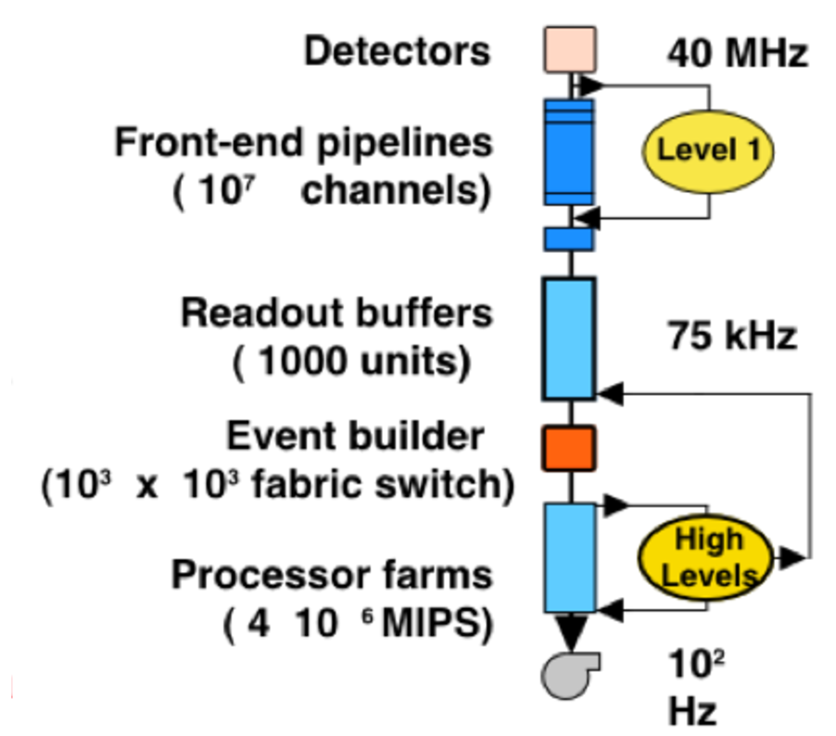
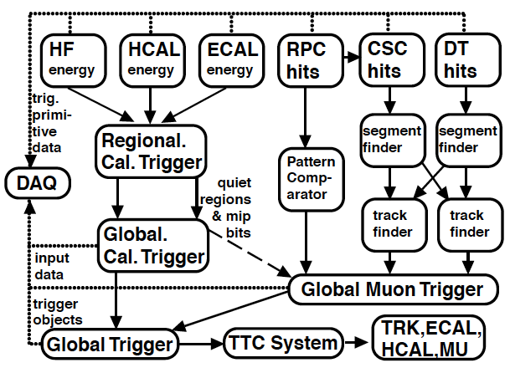
CMS DAQ
Architecture
L1 Trigger

Slide 22
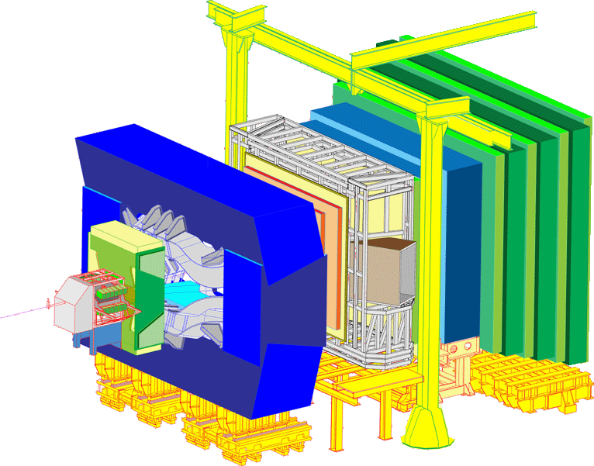
LHCb

Slide 23
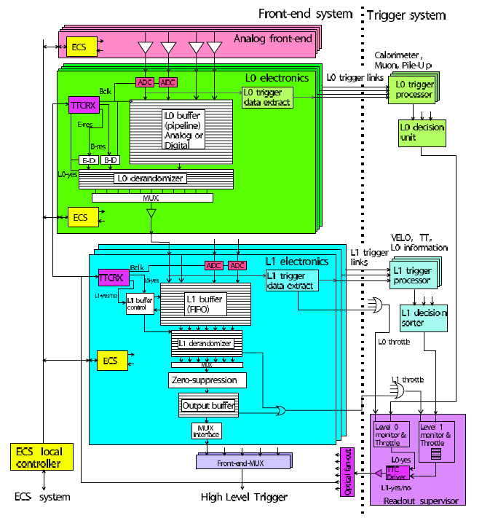
LHCb

Slide 24
Trigger Selection:
Object- vs. Event- Based
Objects
e
μ
γ
τ
b-jets
jets
Event Info
MET
SUM ET
# Tracks
Centrality
Correlations
Angular distributions
Mass
Monitoring and Support Triggers
Zero Bias
Minimum Bias
Empty Bunches
…

Slide 25
Level 1 Triggering:
Et tu, inner detectors?!
Objects
e
μ
γ
τ
b-jets
jets
Event Info
MET
SUM ET
# Tracks
Centrality

Slide 26
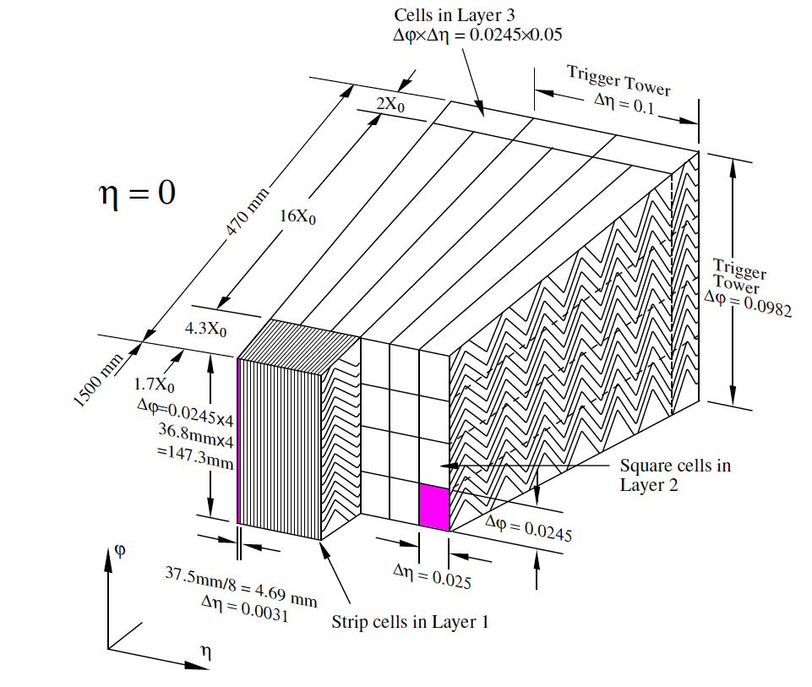
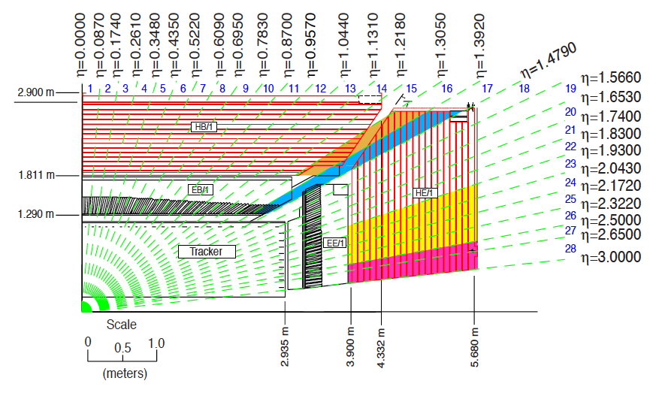
Level 1 Triggering:
Calorimeter Granularity
Objects
e
μ
γ
τ
b-jets
jets
Event Info
MET
SUM ET
# Tracks
Centrality
ATLAS
CMS

Slide 27
Level 1 Triggering:
Imposing Calorimeter Isolation
Separating objects like electrons, photons and taus from the jet backgrounds
is helped by imposing isolation requirements
EM
Trigger Towers
HAD
Trigger Towers
Example:
The ATLAS L1 Tau Trigger
Threshold
Calculation
=
2 Adjacent EM
Trigger Towers
2x2 HAD Towers
behind them

Slide 28
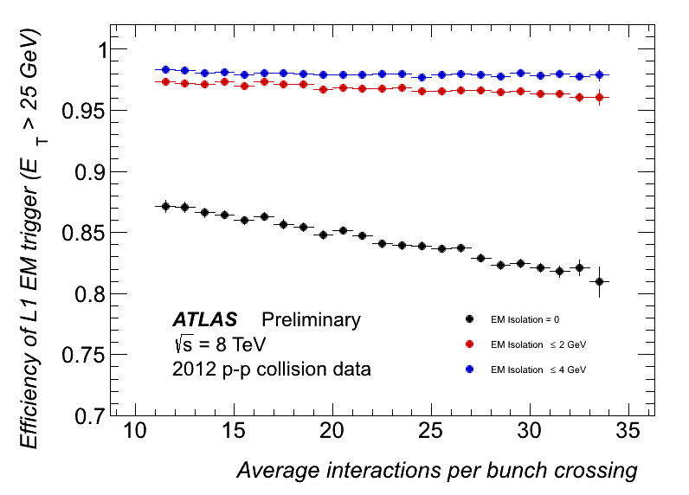
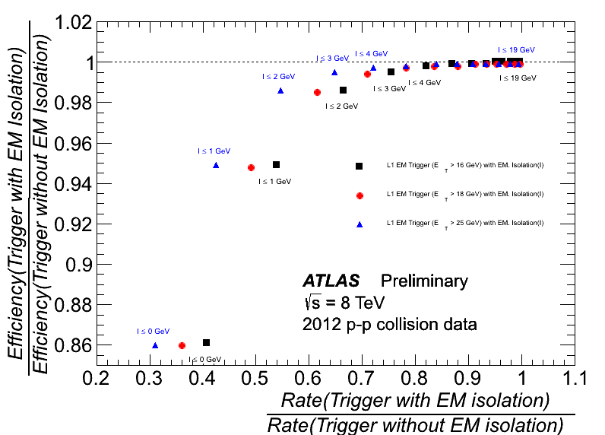
Level 1 Triggering:
Imposing Calorimeter Isolation
Separating objects like electrons, photons and taus from the jet backgrounds
is helped by imposing isolation requirements
Rate Reduction?
16, 18, 25 GeV thresholds,
efficiencies for 30 – 100 GeV objects
Impact of pile-up?
2 or 4 GeV in iso region
0 GeV in iso region

Slide 29
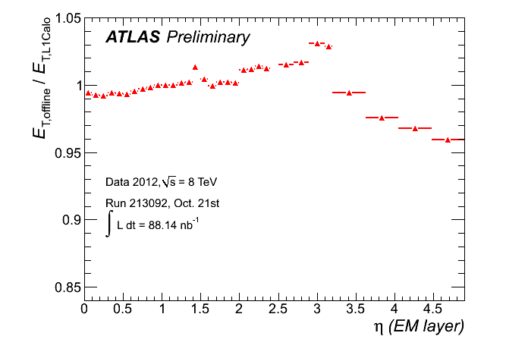
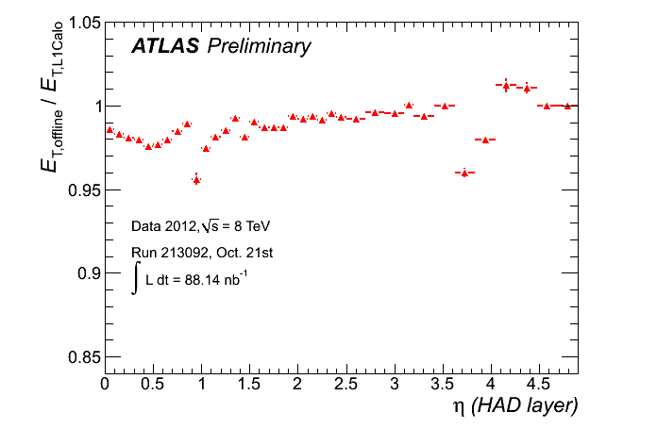
Level 1 Triggering:
E_{T} Calculation
Differences with the offline in different eta slices

Slide 30
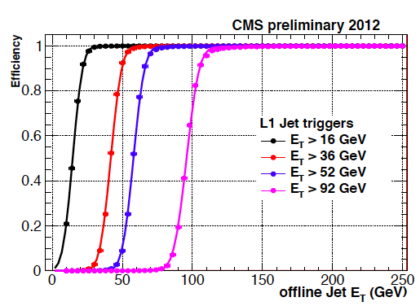
Level 1 Triggering
Jets

Slide 31
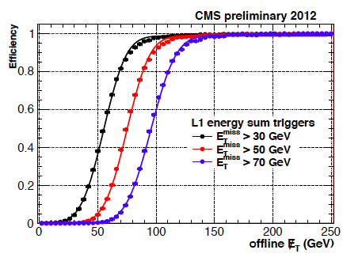
L1 Missing ET
Missing Corrections for muons, energy scale of clusters (physics objects), pile-up, …

Slide 32
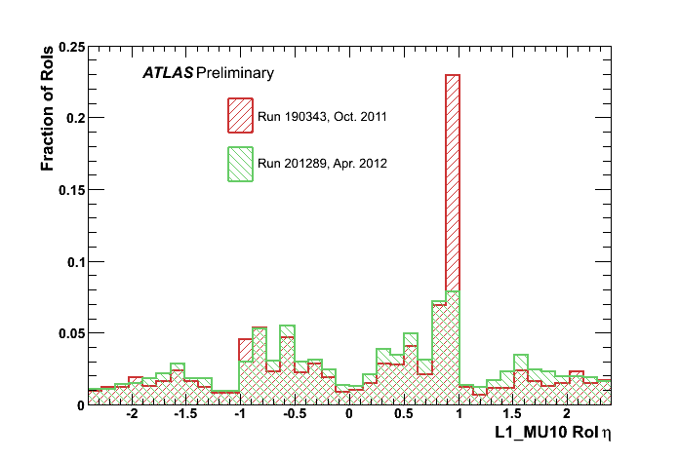
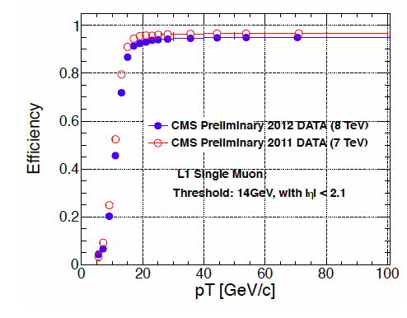
L1 Muon Trigger
ATLAS had an area without sufficient
shielding – shielding added before 2012 run
CMS improved assignment
of muon p_{T} for 2012

Slide 33
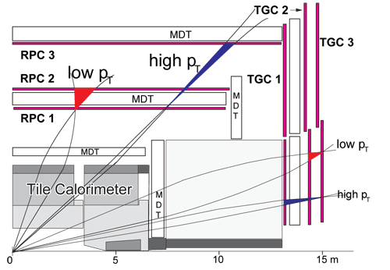
L1 Muon Trigger: ATLAS
RPC: Resistive Plate Chambers TGC: Thin Gap Chambers

Slide 34
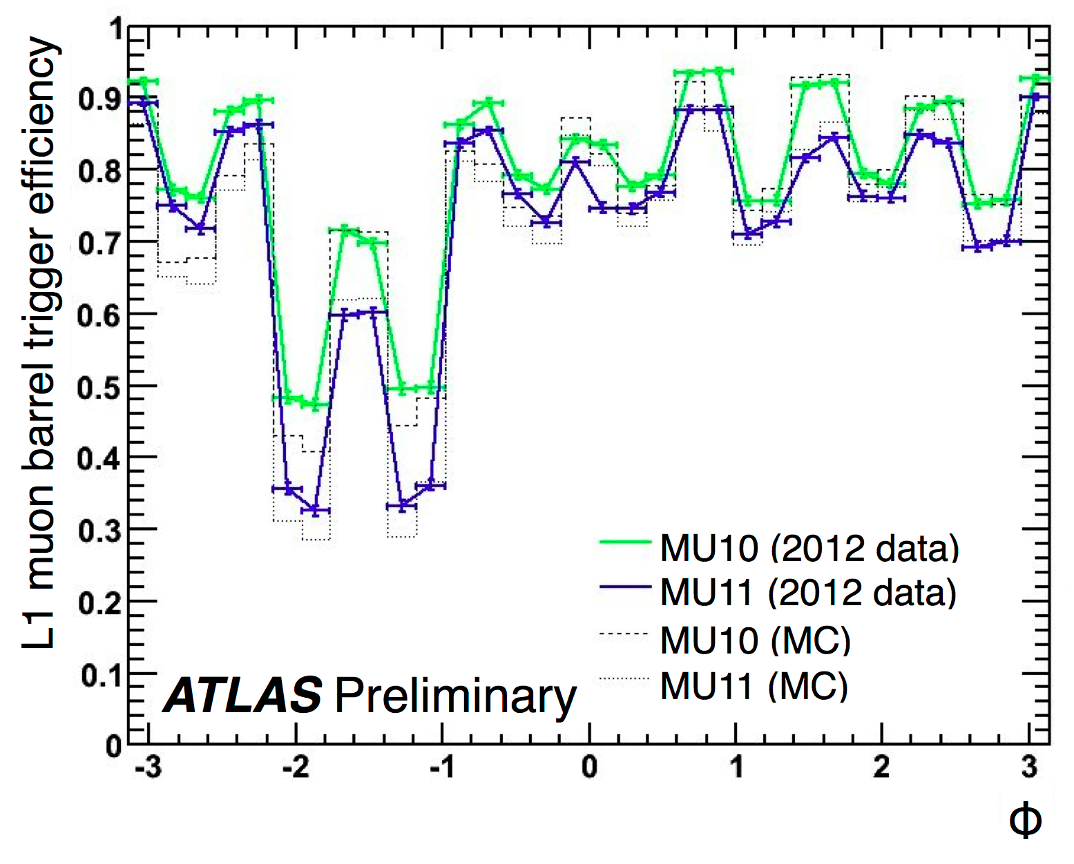
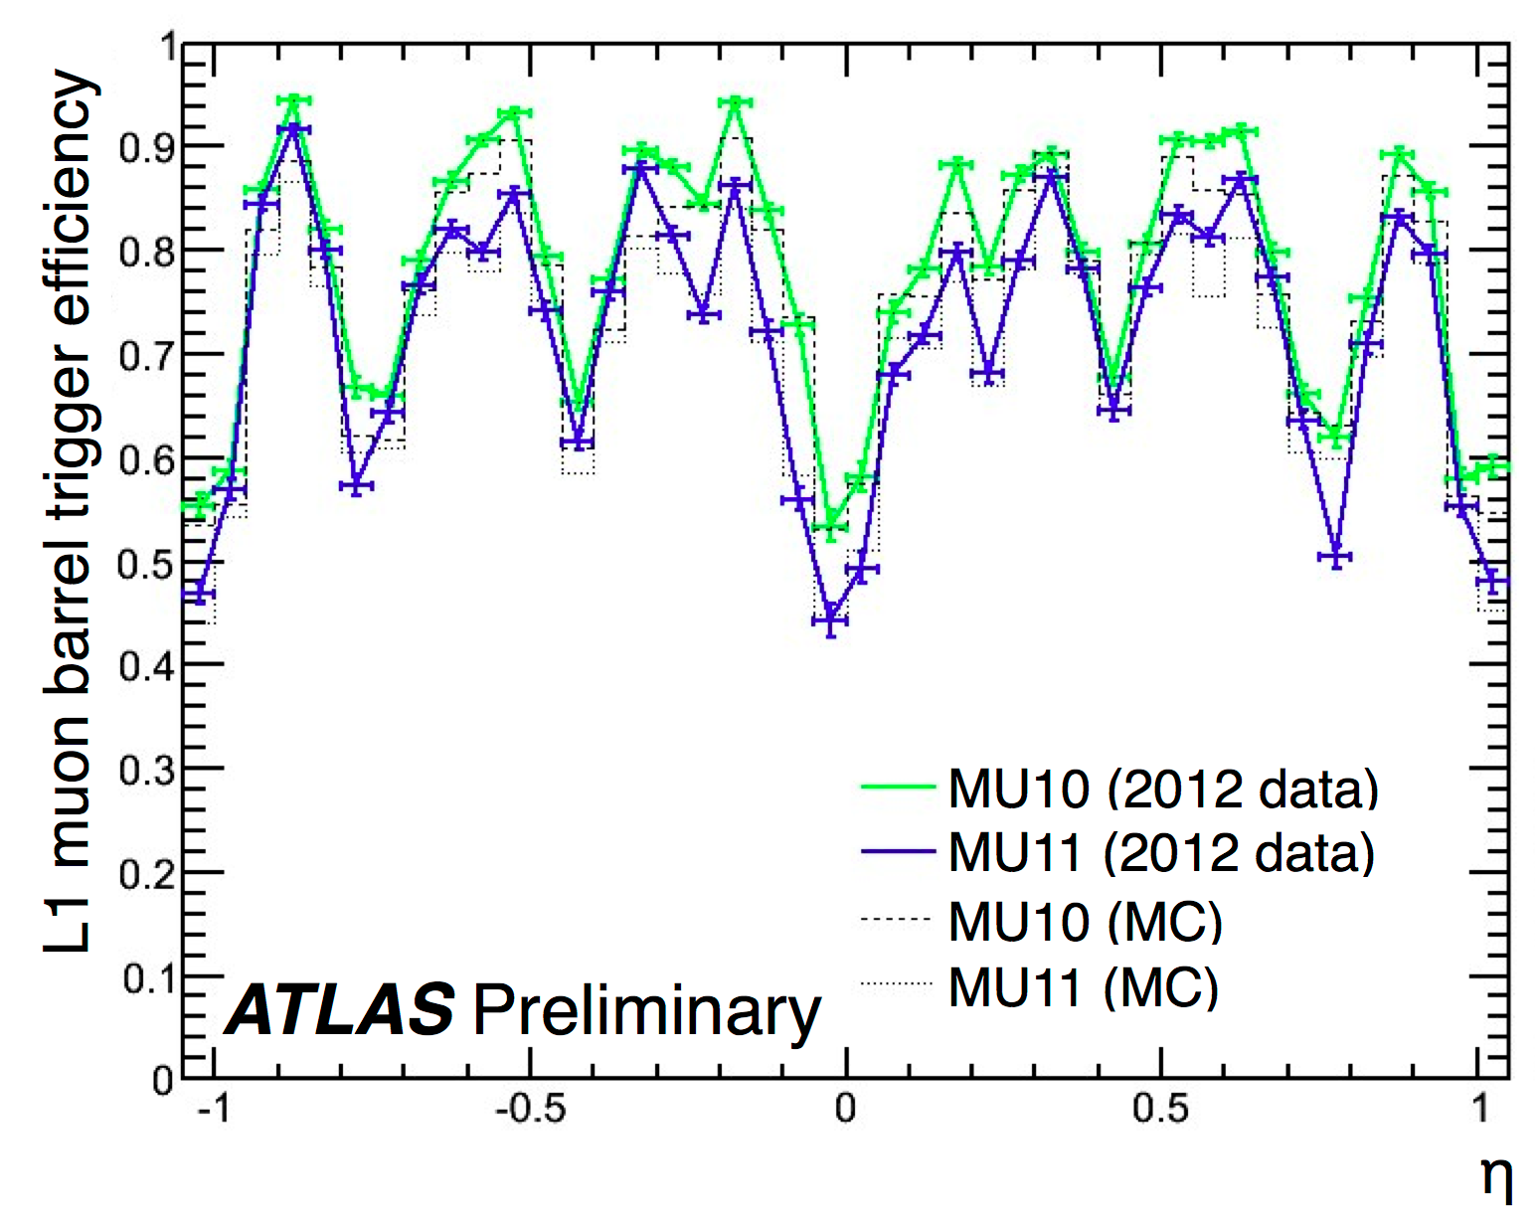
L1 Muon Trigger: ATLAS
Expect physics to be
symmetric in phi
(just gravity breaking
symmetry)
“Feet”: ATLAS Mechanical Supports
Again, losses due to mechanical supports –
areas where we do not have muon trigger
instrumentation
Efficiencies for > 15 GeV muons

Slide 35
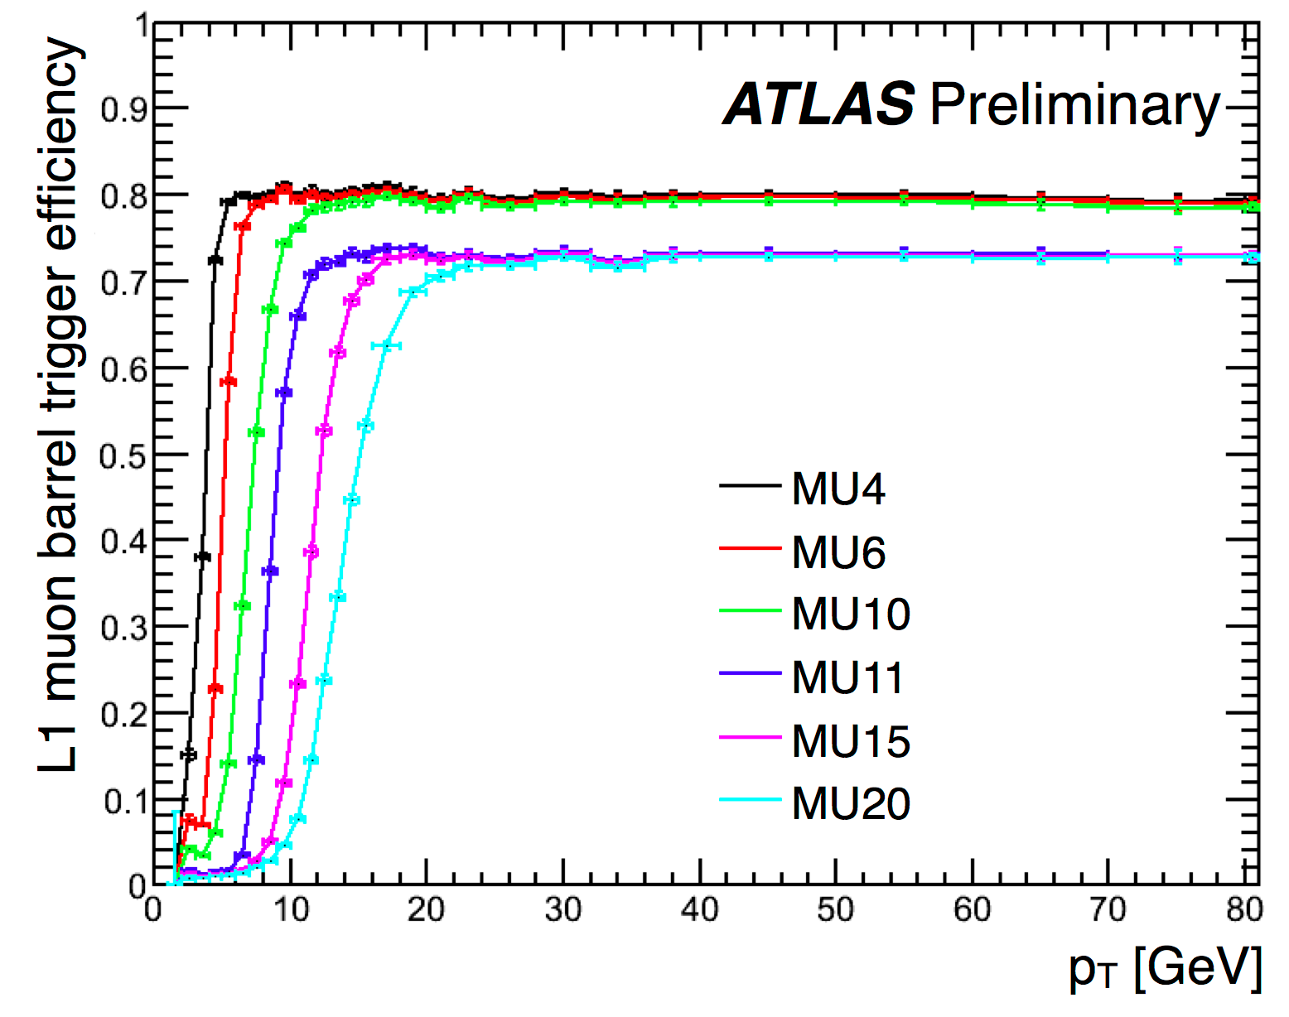
L1 Muon Trigger: ATLAS

Slide 36
L1 Muon Trigger: ATLAS
Lower p_{T} thresholds
require coincidences
in two RPC chambers
Higher p_{T} thresholds
require coincidences
in three RPC chambers

Slide 37
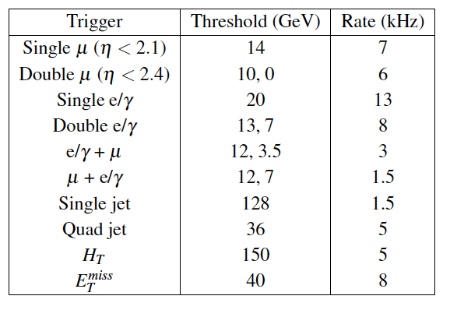
L1 Triggering
Menus and Rates
CMS 2012:

Slide 38
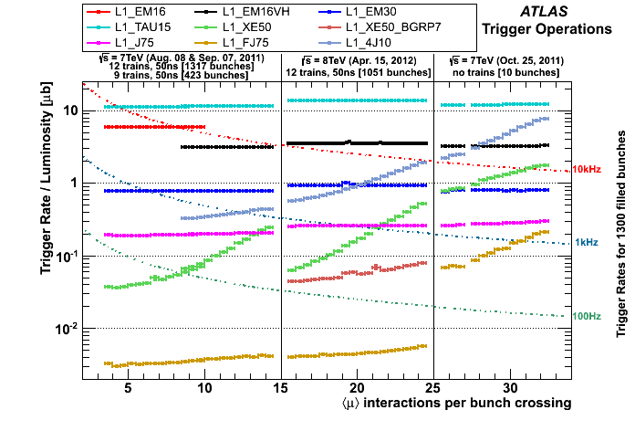
ATLAS Performance

Slide 39
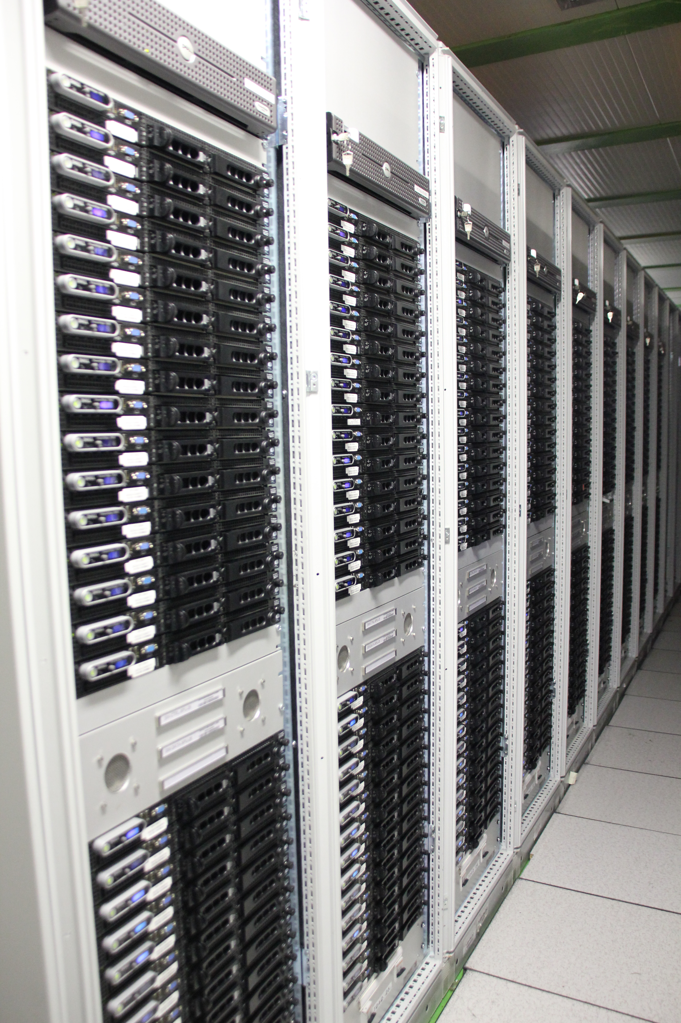

High Level Trigger:
Software Reconstruction
Region of Interest Information available at L2
Full Event available at Event Filter (L3)
Full event available
ATLAS CPU Farm
What information does the
High Level Trigger need to
begin data-taking?

Slide 40
Getting Configuration Info to FARM
The LHC is delivering stable collisions, you have chosen the trigger menu
that you want to use, your CPU farm is eagerly awaiting your instructions,
you hit RUN.
. . .
And wait 45 minutes?
ATLAS Database Proxy
for HLT Farm

Slide 41

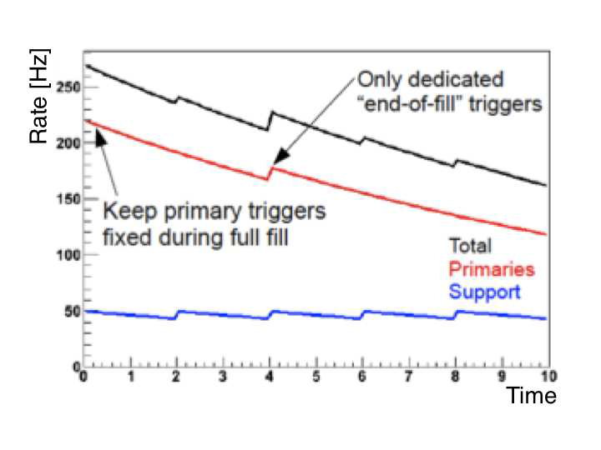
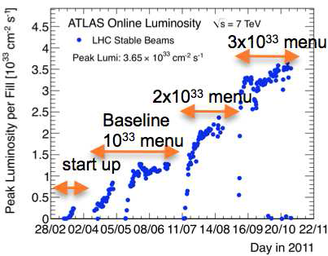
Prescales
poor man’s rate reduction
or
providing back-up triggers for analysis
Luminosity Profile
Over the course of a year…
Over the course of a run…

Slide 42

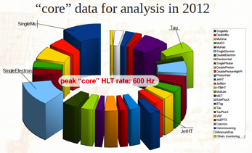
Building a Trigger Menu
Level 1 has hardware limitations
96 items for ATLAS – results in some compromises!
In 2011 running, ATLAS had 300 trigger chains.
In 2012 there were 700.
Low threshold, non-isolated leptons, please!
CMS rate allocation

Slide 43
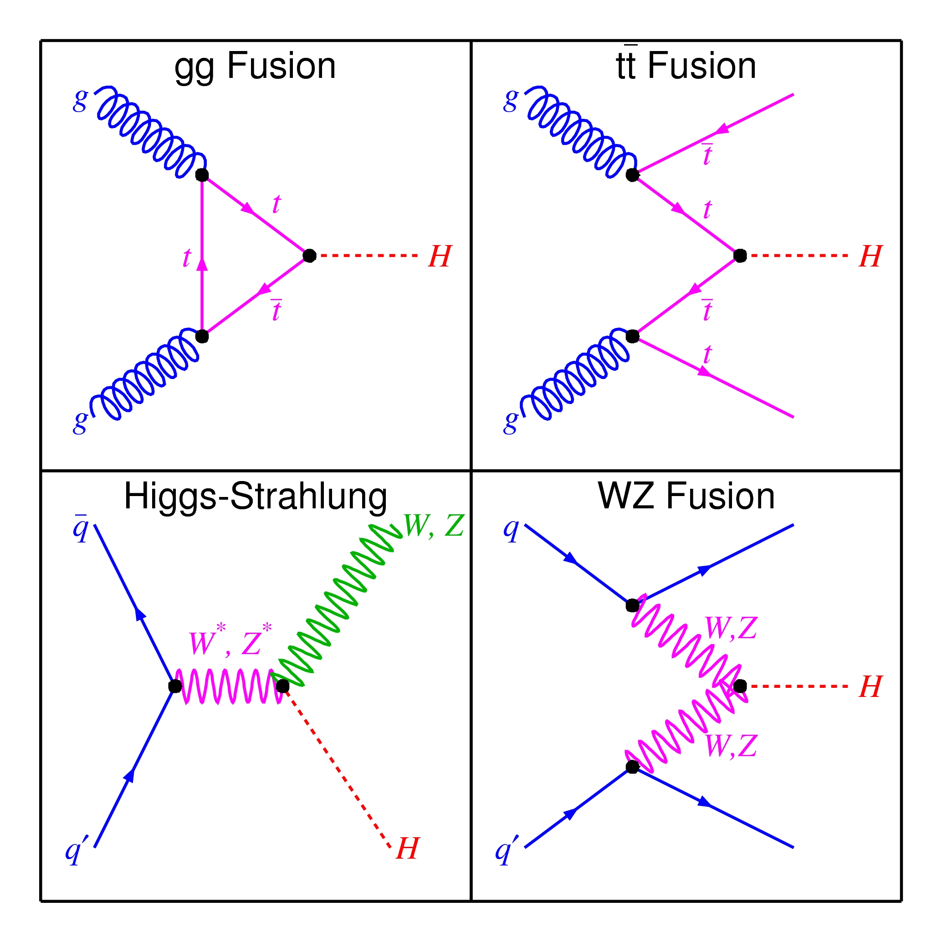
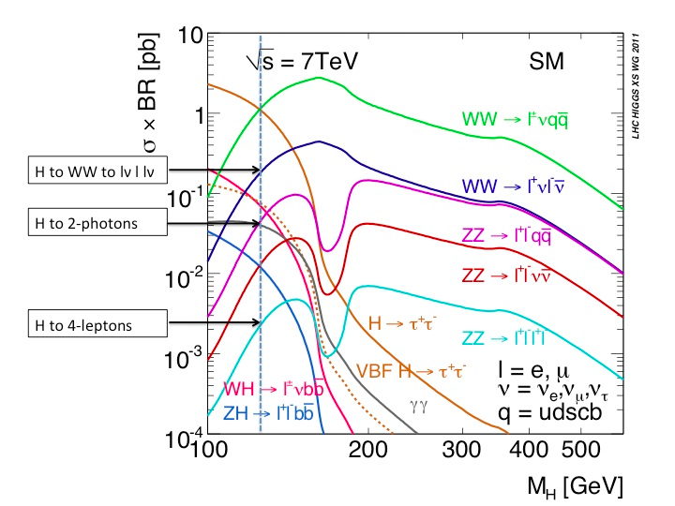
Case Study: Triggering on the Higgs
Higgs Production
Higgs Decay

Slide 44
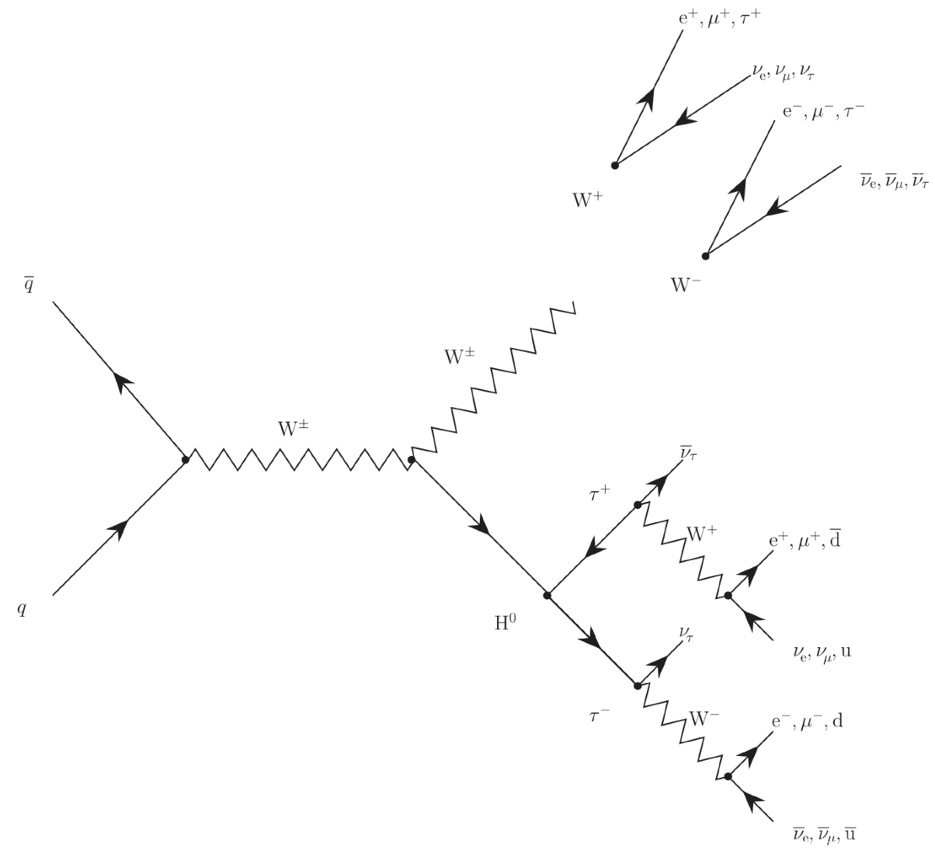
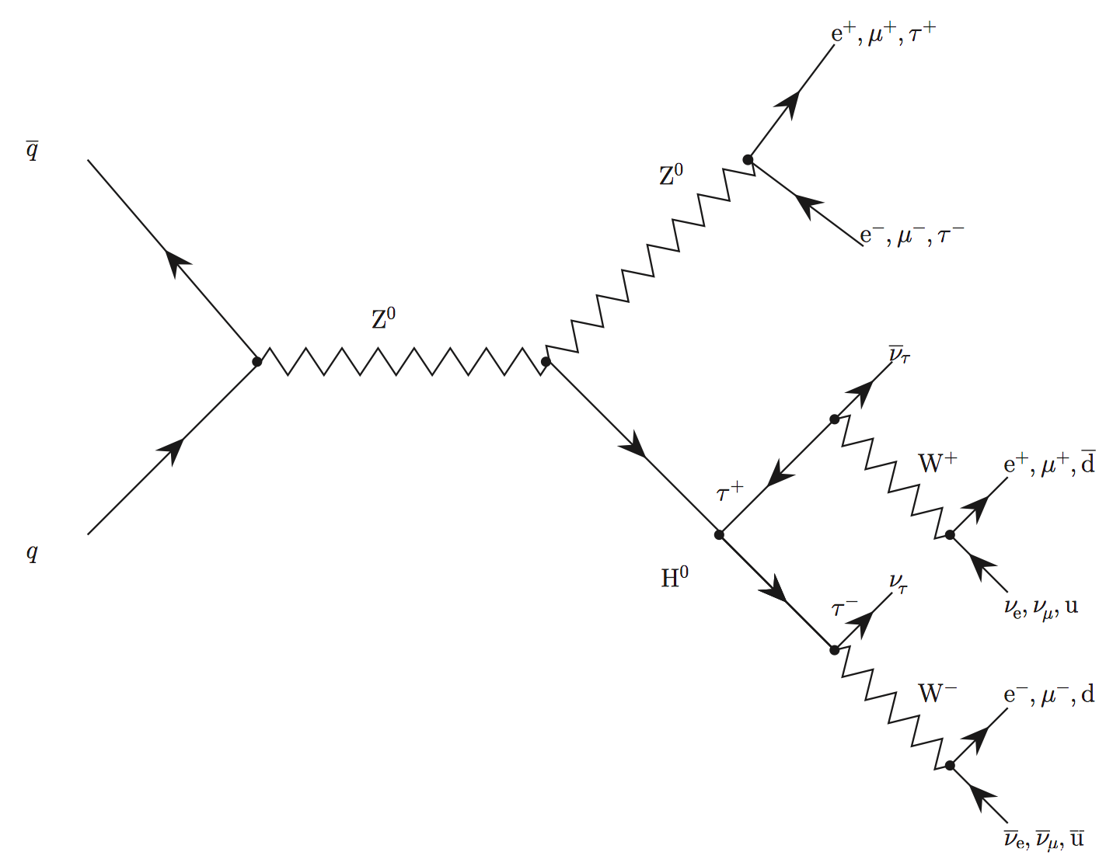
Pick one production mode (VH) and one decay mode (tau pairs)
ZH
WH
Thanks to Eran Rea for Diagrams!

Slide 45
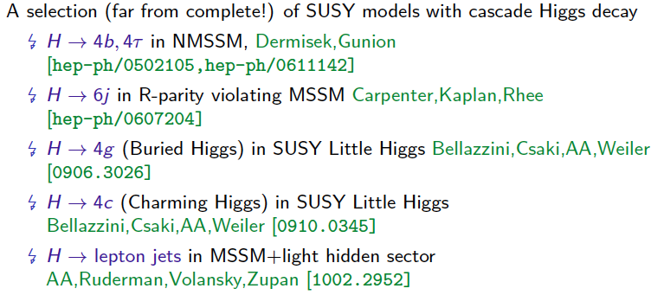
and add in possible cascade decays…
Examples from Adam Falkowski’s slides

Slide 46

Evaluating Performance
Operations
Deadtime, busy, run start/stop
Algorithms
Timing
Efficiency
Purity
Response to Instantaneous Luminosity
Response to pile-up
Physics
Were the triggers used in analyses?

Slide 47
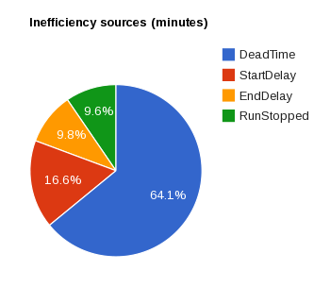
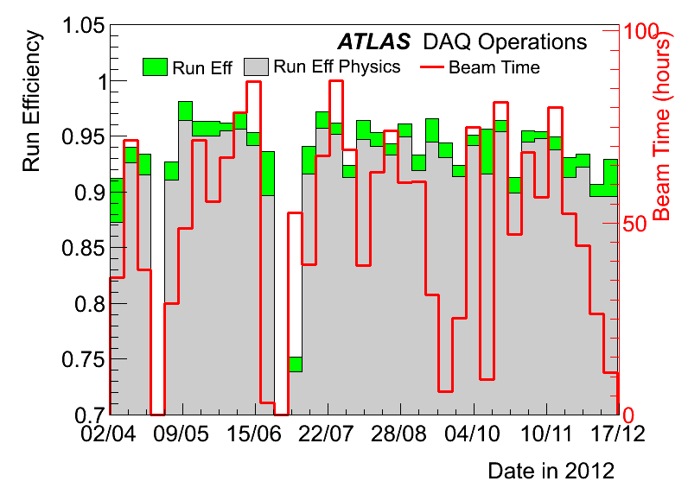
2012 ATLAS
Performance
Running and not busy: 94.4 %

Slide 48
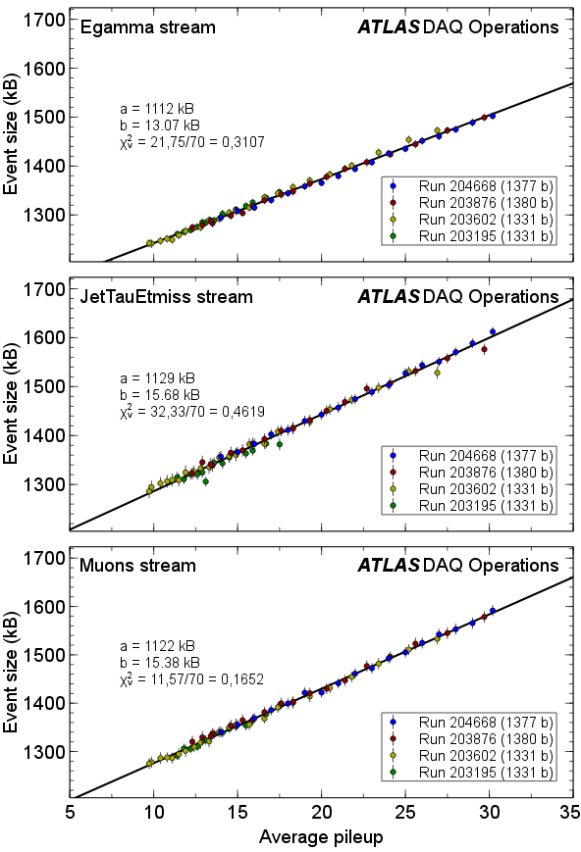
2012 ATLAS
Performance
(Sobering) event size coming out of
SFO (HLT/DAQ) as a function
of pile-up
Still, much less than the
O(100) MB at ALICE pb-pb

Slide 49
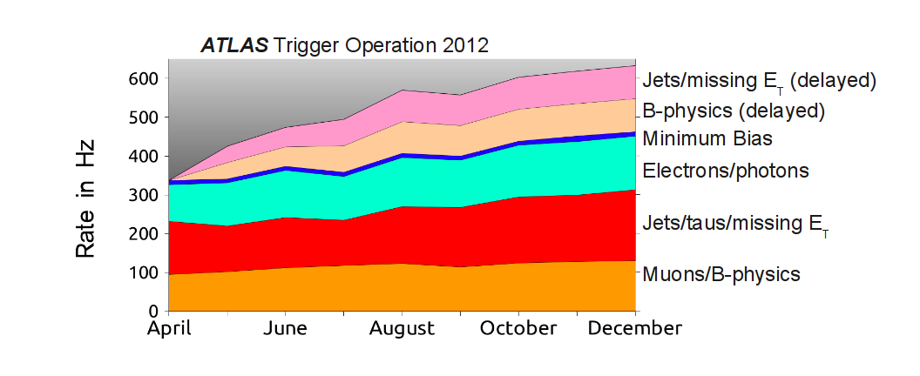
Performance
(ATLAS)

Slide 50
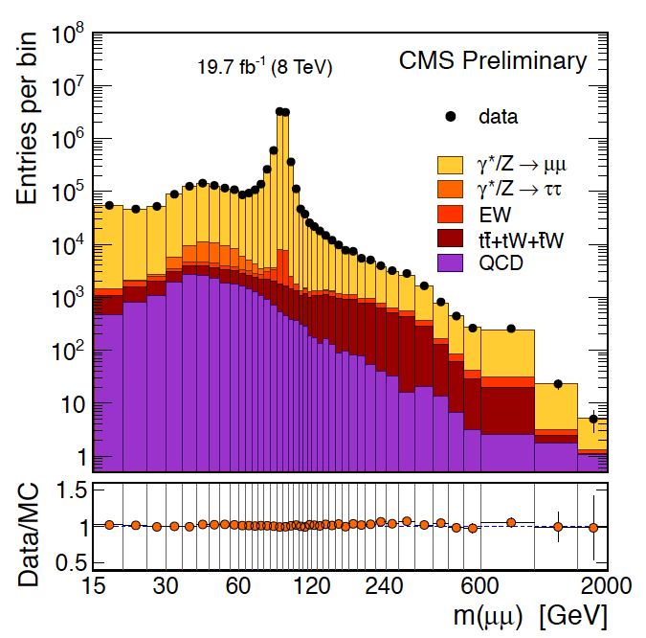
Measuring Algorithm Performance:
Tag and Probe
Tag: passes trigger
tight identification cuts
e/μ
Z
e/μ

Slide 51
Measuring Performance:
Tag and Probe
Tag: passes trigger
tight identification cuts
e/μ
Z
e/μ
Require ee / μμ pair to
- have opposite charge
- give Z mass

Slide 52
Measuring Performance:
Tag and Probe
Tag: passes trigger
tight identification cuts
Probe: unbiased object
with known ID
e/μ
Z
e/μ
Require ee / μμ pair to
- have opposite charge
- give Z mass
Can even do this for hadronic tau decays!
What about high pT objects?

Slide 53

Tomorrow…
Data Preparation and analysis
What keeps trigger people up at night?
Trigger/DAQ upgrades

