Slide 1
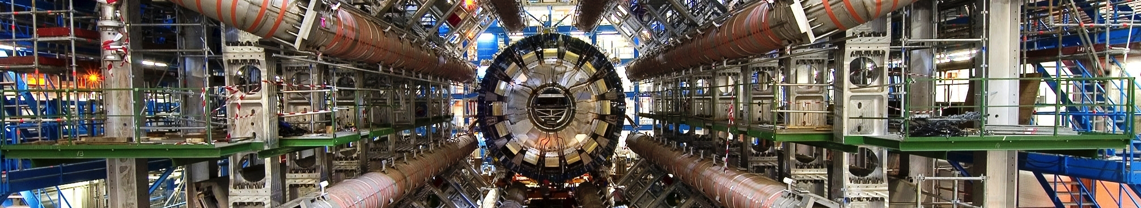
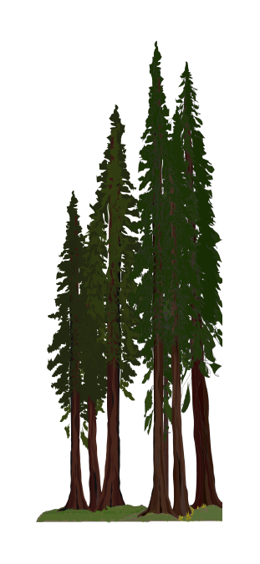

Event Reconstruction and Particle Identification
Part Two
Jason Nielsen
Santa Cruz Institute for Particle Physics
University of California, Santa Cruz
Hadron Collider Physics Summer School
August 21, 2014

Slide 2
Outline for Today
Neutral particle ID techniques (γ ,π⁰, K, Λ,…)
  V0 identification with tracking detectors
  Photon vs. Electron shower shapes
Electron reconstruction
  Converted photon reconstruction
  Isolation requirements and calculations
Muon reconstruction
  Combined reconstruction and measurements
  Punch-through and charge mis-identification
Measurements of particle ID efficiencies and fake rates
  Tag-and-probe methods
  “Matrix methods”
Introduction to Particle Flow algorithms
  Practical examples and results from particle flow

Slide 3
Neutral Particle ID: γ, π⁰, K⁰, Λ⁰, n
Short interlude on neutral particles, before electrons and muons
Neutral particles with no tracks must be distinguished by their calorimeter signatures
Fortunately, many of these neutral particles decay before the calorimeter, so they can be reconstructed appropriately
Key points:
  γ/π⁰(γγ) discrimination depends on shower shape and isolation
  K⁰/Λ⁰ hadrons decay non-promptly to charged particles
Won’t say much about neutrons today
  No use case for specific neutron PID (unlike π⁰ in τ lepton decay)
  Included naturally in the neutral hadronic shower component (but be careful about EM energy scale vs. hadronic energy scale)

Slide 4
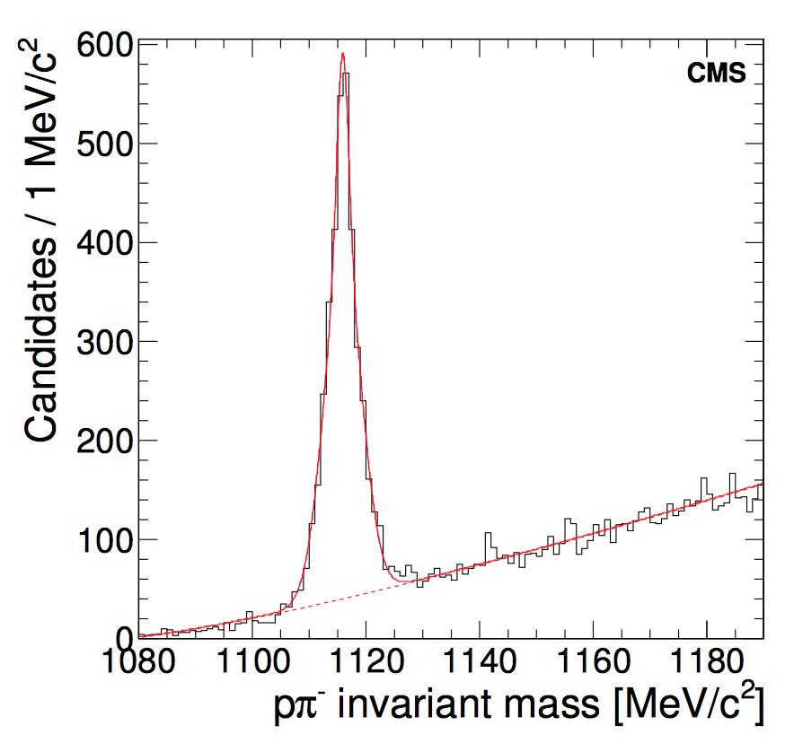
K⁰ mesons and Λ⁰ baryons
Weakly decaying neutral particles with unusually long lifetimes:
  K⁰_{S} cτ = 2.7 cm; dominant decay to π⁺π⁻
  Λ⁰ cτ = 7.9 cm; dominant decay to p⁺π⁻
Two oppositely-charged tracks vertexed
  No particle ID required; mass peak suffices
Require vertex to be displaced from IP
  CMS requires 15σ (vertex + beamspot uncerts.)
Mass comparison with simulation
  Magnetic field
  Track fitting
  Material description
Will need to identify and remove V⁰ vertices when tagging b-decay vertex

Slide 5
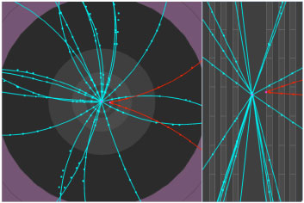
Reconstructed K⁰ decay
In this case, decay vertex is at first silicon pixel layer

Slide 6
Photon ID
Often combined as “e\γ ID” because of nearly identical showers
Backgrounds to be rejected:
  Non-prompt γ/π⁰ from hadronic jets
  Hadronic particles with early-initiated showers
Shower development was covered in J. Mans’s lectures
  We will focus on shower shape variables that discriminate against backgd
Converted vs. unconverted photons
  Inner tracker material can result in photon conversions to e⁺e⁻ pair
  Electrons are bent in the magnetic field
  CMS ECAL is inside magnetic field, so electrons in shower also bend
  Reconstructing conversions requires special tracking (not inside-out)
Define two (and sometimes three) different levels of photon ID
  Loose identification: used for trigger selection, rough sample construction
  Tight identification: used for final offline selections, comparison with loose

Slide 7
Prompt γ vs. π⁰ Decays
“Prompt” γ are produced in the hard scatter instead of in shower
  Probe of electroweak couplings; important background to searches
  To be distinguished from γ in jets, decays of other particles
π⁰ mesons nearly always decay to 2γ with cτ = 25 nm
  Photons would have same calo shape as prompt photons
  Fortunately m_{π} is small enough that the 2 photons end up together in calo
  No tracks to vertex, but we can treat this calo cluster as a single object
What are the differences between γ and π⁰ in the detectors?
  Distribution of energy in electromagnetic calorimeter
  Prompt γ are isolated from other particles, while π⁰ are not isolated
π⁺
π⁻
π⁺
π⁻
π⁰
or even
γ
π⁺
π⁺
π⁰
π⁺
π⁰
π⁺

Slide 8
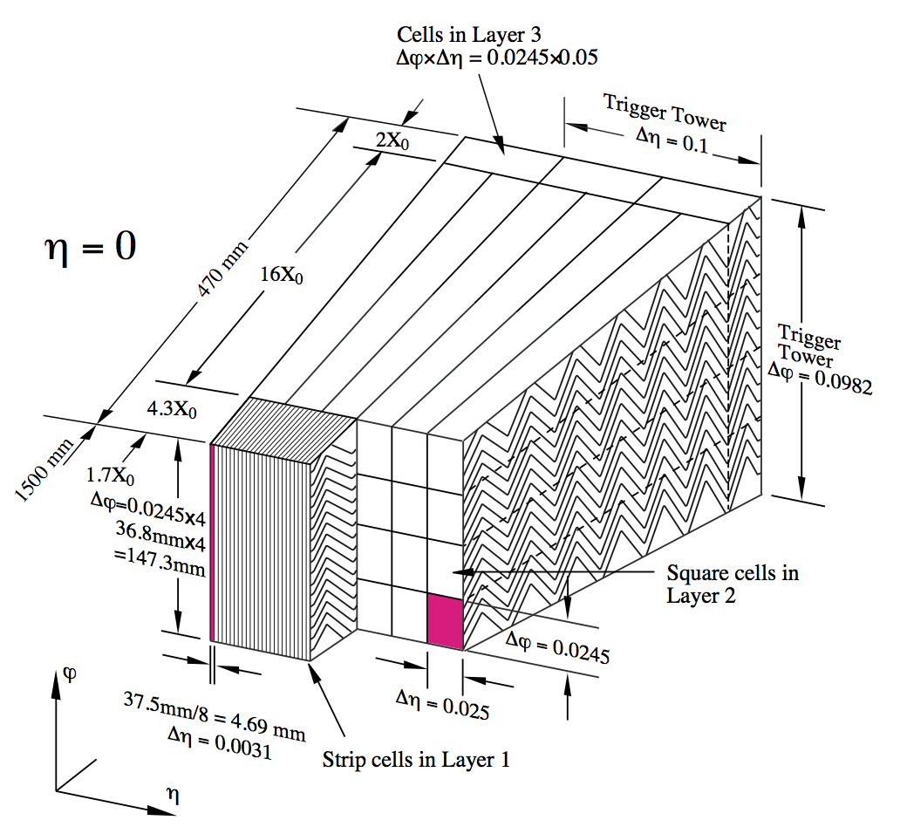
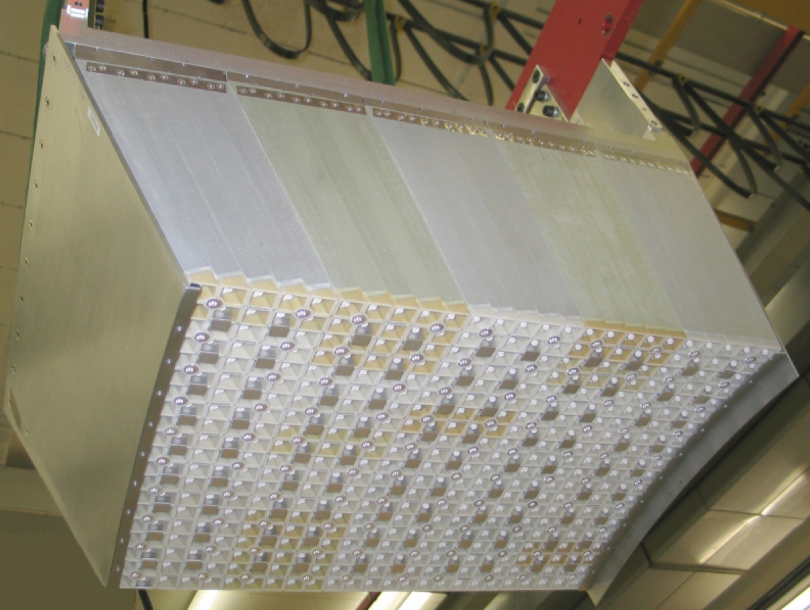
Calorimeter Geometry and γ/π⁰ Separation
ATLAS
CMS
Layer 1 segmentation:
  0.0031 x 0.1 in η-φ
Collects all brem photons in a given η strip
Not segmented in r
  0.0174 × 0.0174 in η-φ
Total is 25.8 X₀ deep
  Pb-Si preshower 2+1 X₀

Slide 9
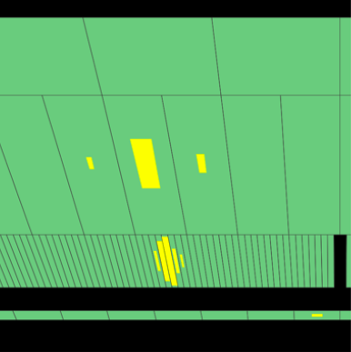
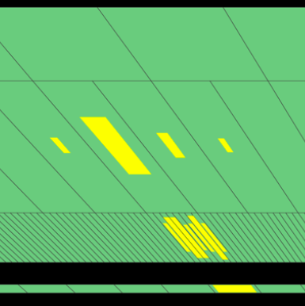
ATLAS γ/π⁰ Events
Use finely segmented first layer to observe clear separation of EM clusters from π⁰ decay (only showing cal cells with E>200 MeV)
Combined energy deposit in second layer used to determine total energy of original π⁰. No energy leaked into 3rd layer or HCAL

Slide 10
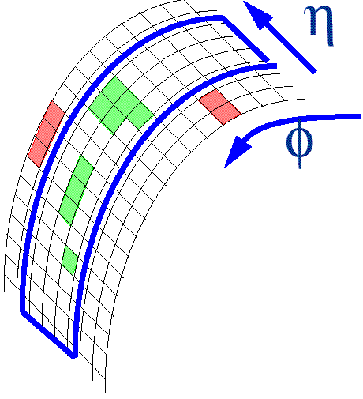
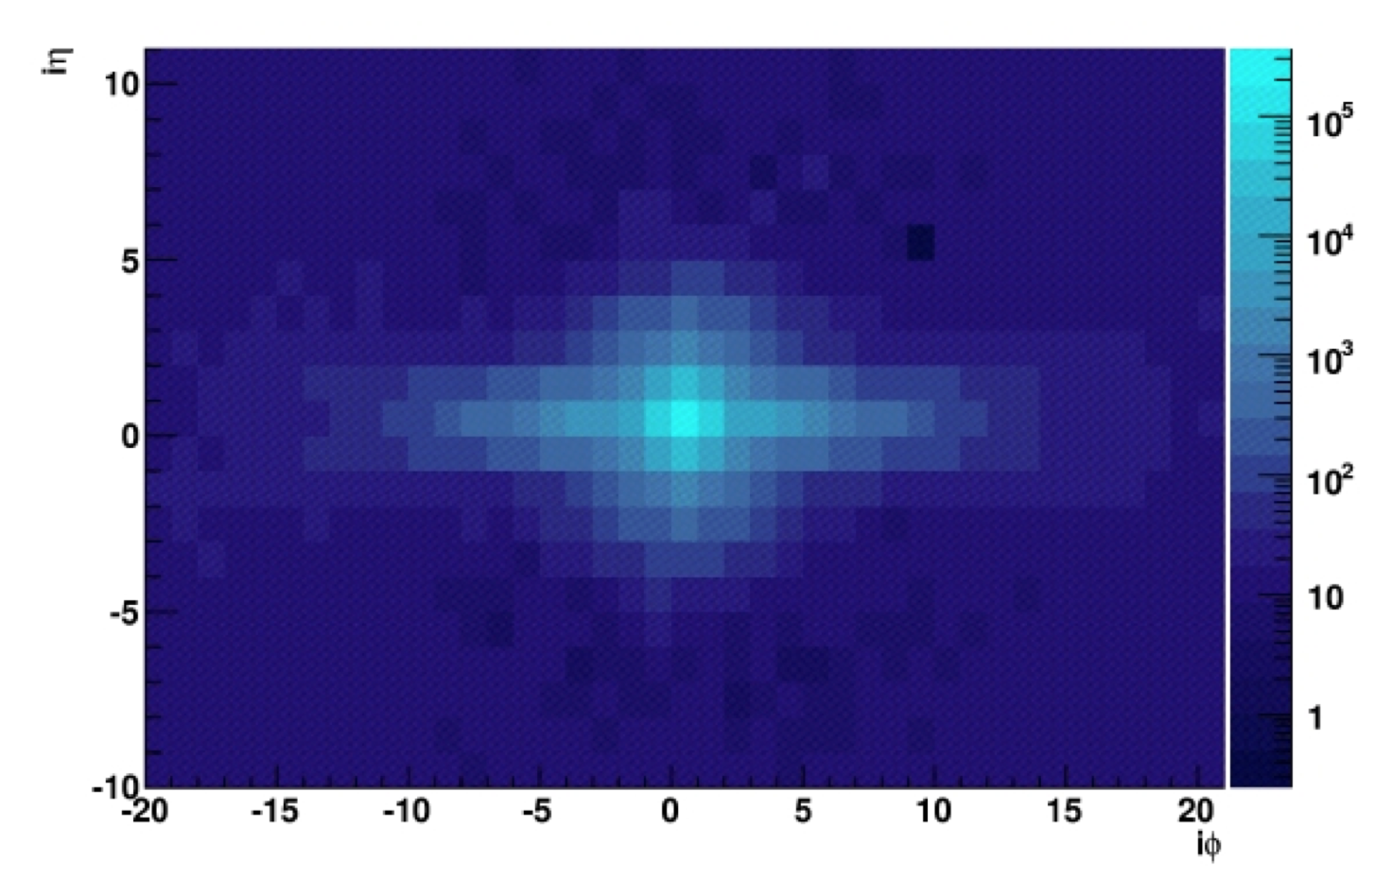
Electron/Photon ID: Shower Shape
CMS has unique feature: ECAL shower is inside strong B field
  Electrons/positrons in shower are spread into a long cluster in φ
Simple clusters around local maxima are merged into superclusters of variable size
  Use size information as discriminant
E_{T}
Tracker
Strips
p_{T}
•
Pixels

Slide 11
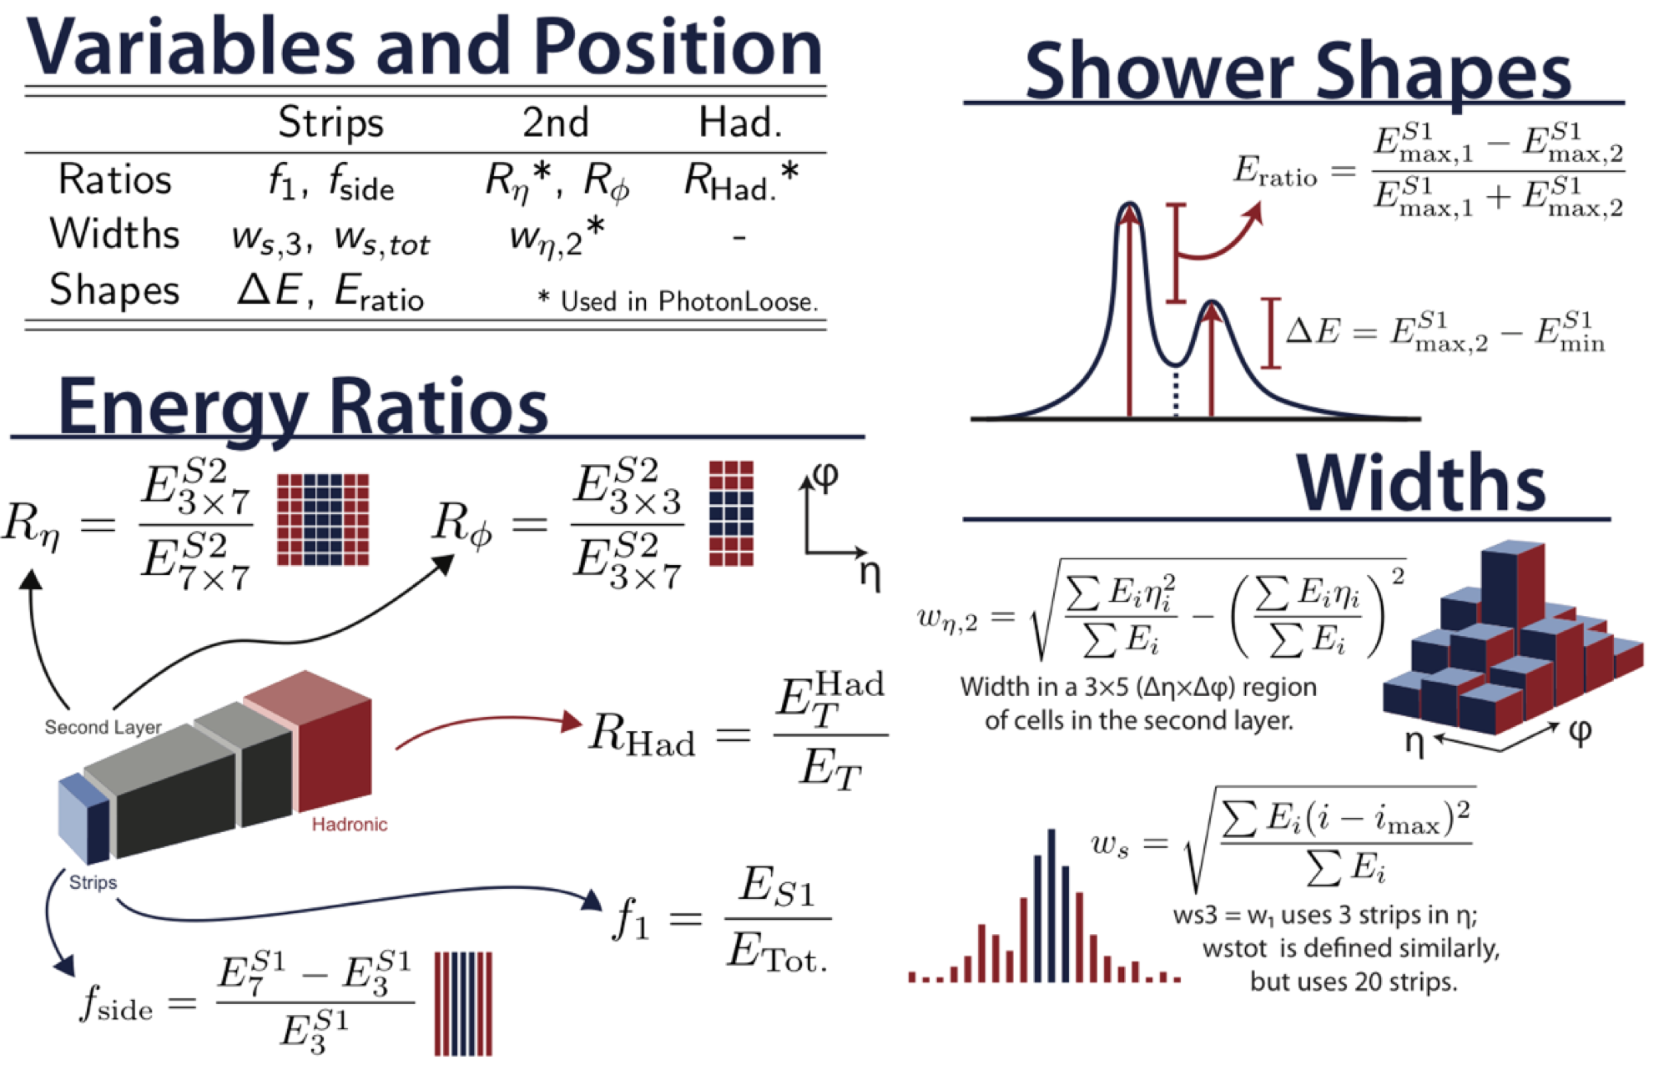
Photon ID: Shower Shape Variables
ATL-COM-PHYS-2013-60, Phys. Rev. D 83, 052005

Slide 12
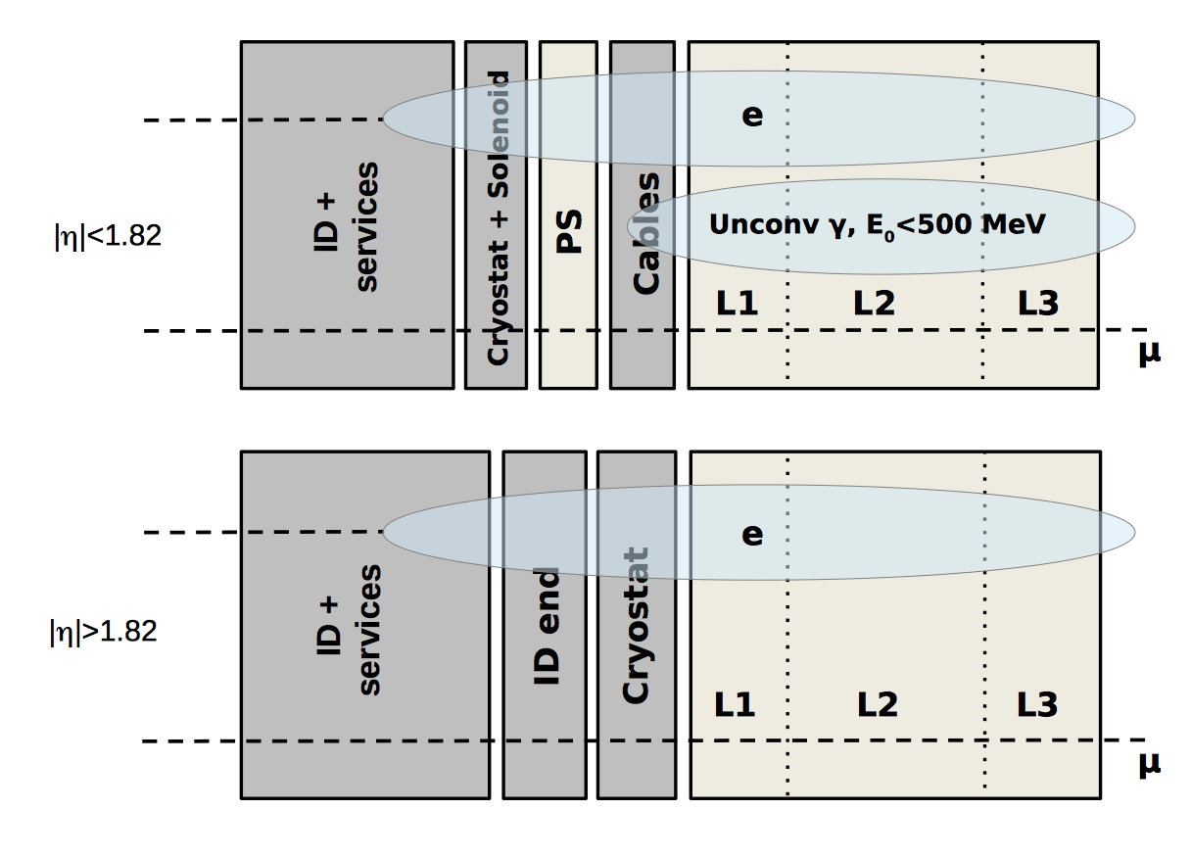
Electron ID
arXiv:1407.5063
Varying levels of Electron ID
Loose selection [also trigger]:
  Simple common e/γ requirements on hadronic leakage, shower width
Medium selection:
  Width measurement with strips
  Track-shower matching
Tight selection:
  Tight track-shower matching
  Inner pixel hits, transition radiation
  Isolation requirements
Final electron momentum and position are weighted combination of measurements from the tracking system and calorimeters
  Must model uncertainties as a function of energy and detector region

Slide 13
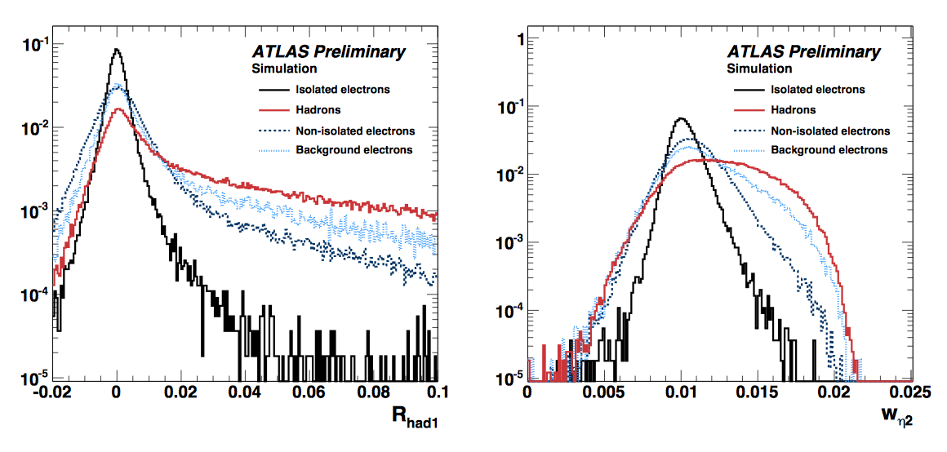
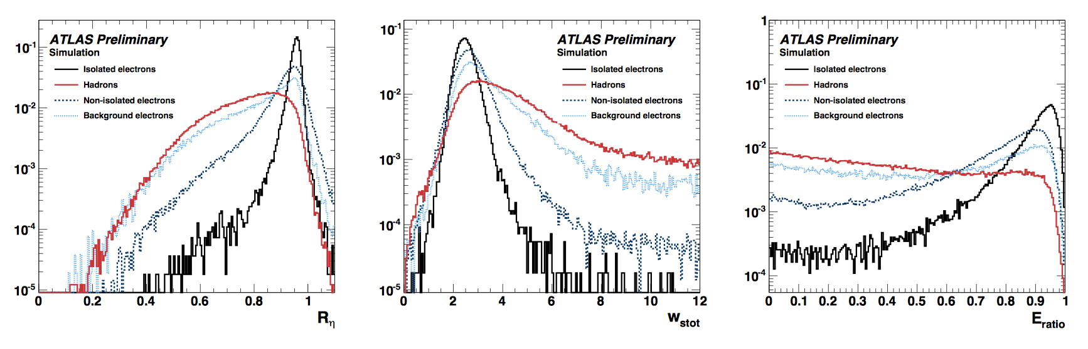
Electron ID Shower Shapes
Electrons are contained in ECAL
Narrow shower
Ideally, a single high-energy strip
ATLAS uses strips for finer resolution
From J. Alison
leakage fraction into HCAL
shower width
Energy in 3x7/7x7
Width (2nd moment) in strips
Difference in 2 highest E strips

Slide 14
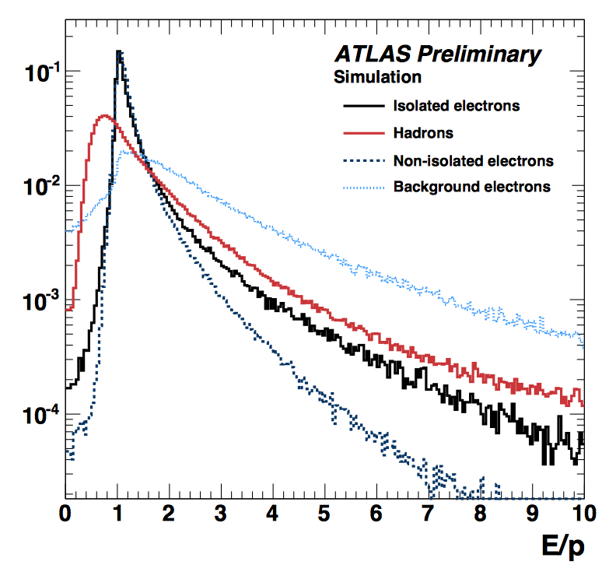
Electron ID: Tracks and E/p
Track energy and extrapolation must match ECAL cluster
Andi Salzburger talked about recovering the bremsstrahlung radiated by the electron: Gaussian Sum Filter extension to Kalman

Slide 15
Momentum Calibration
Use known mass resonances to calibrate electron momentum
  J/ψ and Z di-electron spectrum
Proof of correct calibration
  Data/MC agreement
  Reasonable bias and pulls
These plots all use GSF fitting
ATLAS-CONF-2012-047

Slide 16
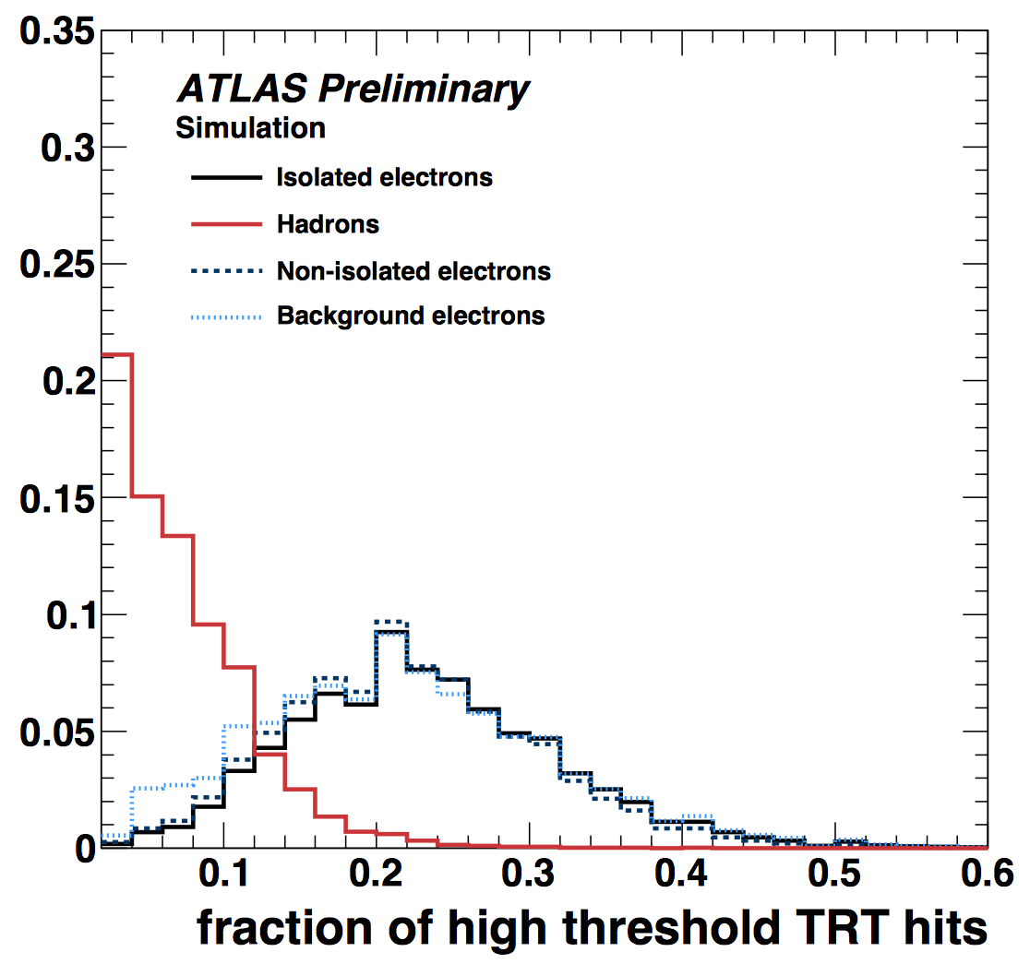
Transition Radiation for Electron ID
Input: total TRT hits, ratio of hits above High Threshold (6 keV)
  Part of multivariate ID, no cut values
HT ratio (for electrons from Z decay) varies slowly with pileup

Slide 17
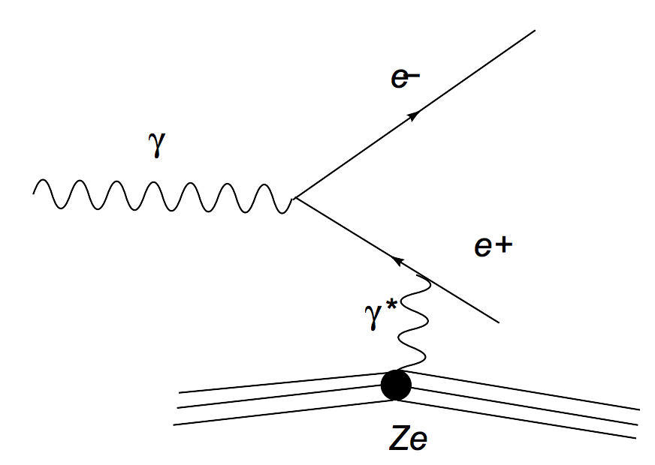
Photon Conversion to e⁺e⁻ Pair
Momentum must be shared by recoiling nucleus
  X₀ depends on material, density
Same as first part of EM shower
  Silicon detector as “pre-shower”
Vertex strategy is similar to V⁰ reconstruction (use as cross-check)
In many cases, the converted photons are easier to measure as a positron-electron pair

Slide 18
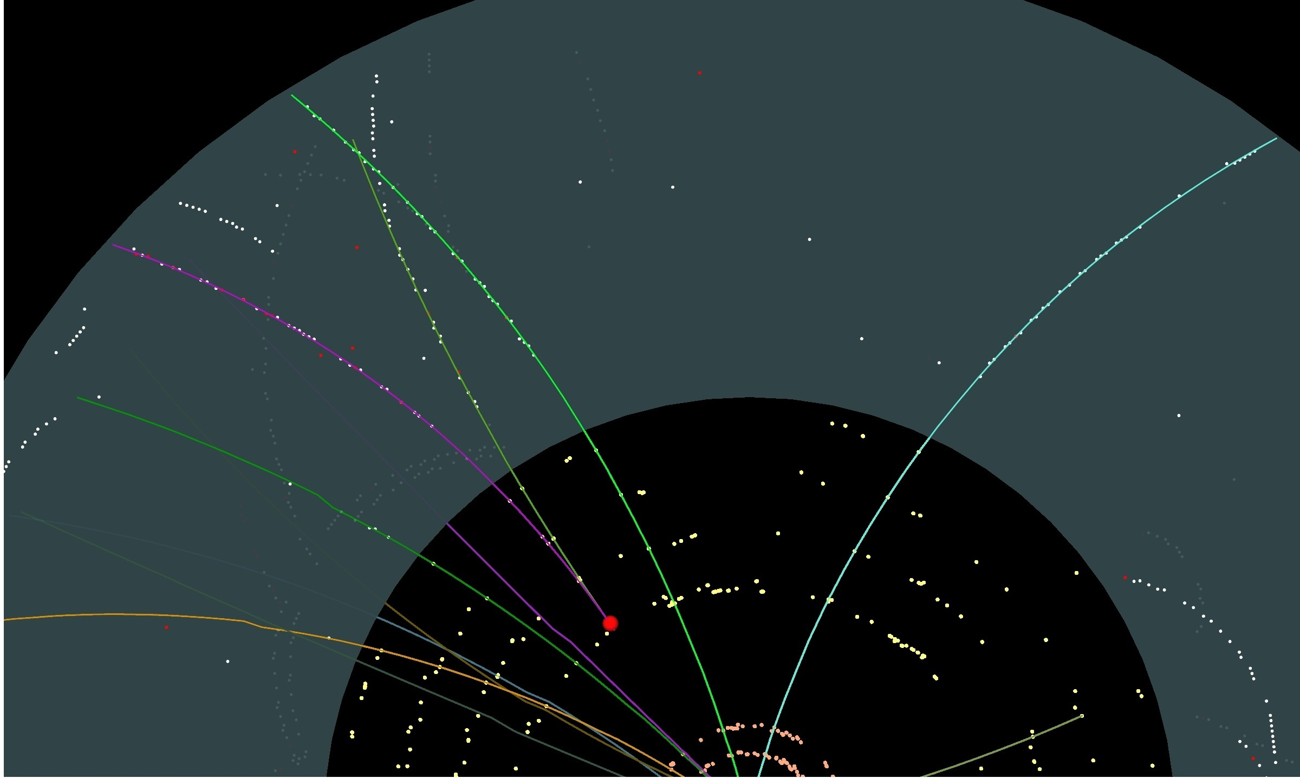
Conversion in ATLAS Silicon Detector

Slide 19
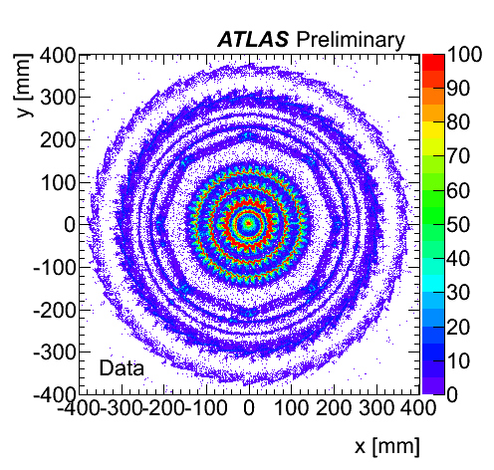
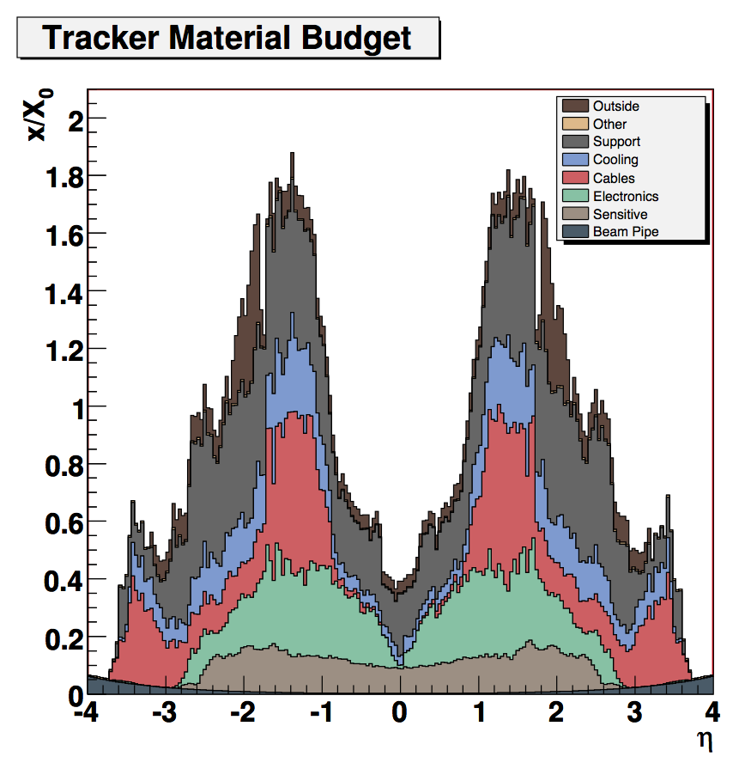
Dependence on Material
Direct measurement of differential material in-situ
Radial resolution: O(3mm)
Feed back into Kalman filter
CMS

Slide 20
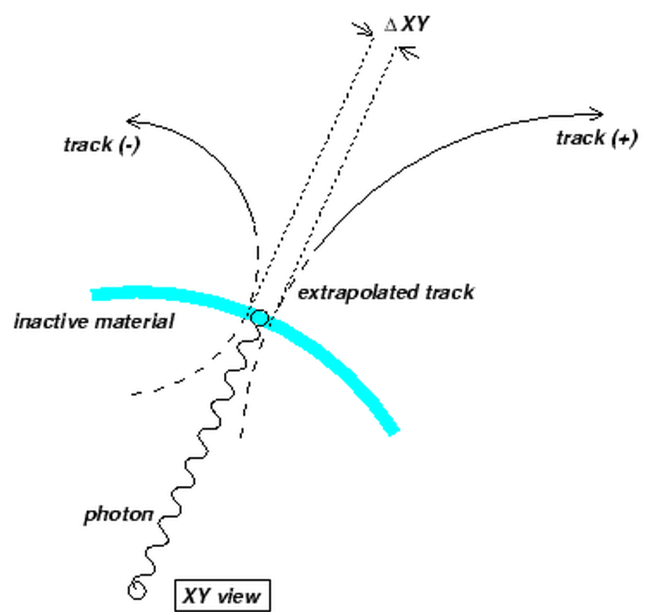
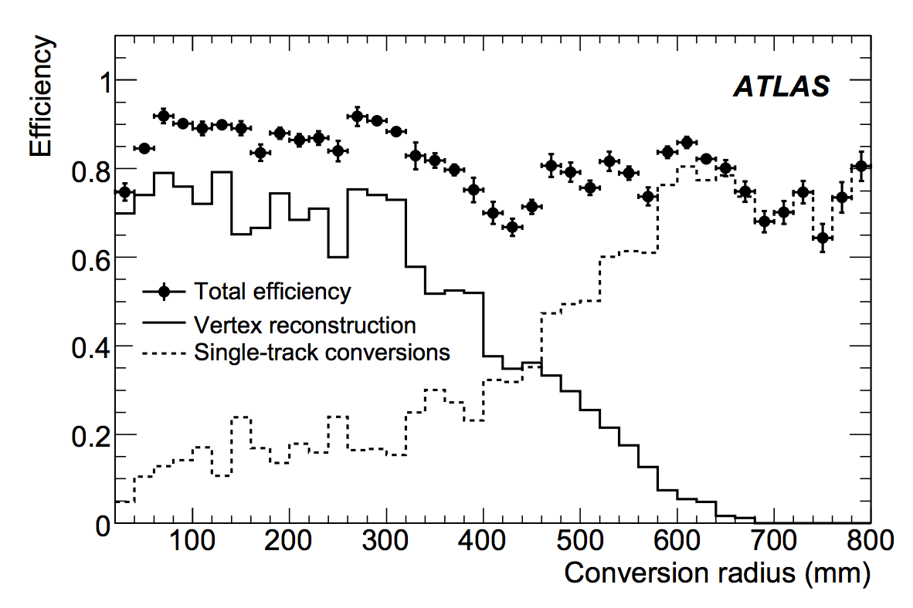
Reconstructing Converted Photons
Characteristic ΔXY=0 and Δθ=0
Select electron tracks (incl. TR HT cut)
Vertex fit is another fast Kalman filter
  Apply constraints (common vertex pos. and opening angle) using Lagrange multipliers
  DCA is used as first estimate of vertex pos.
(W. Verkerke)
Conversions at large radius may have tracks merged into 1 trk
Asymmetric conversions may have only 1 trk passing p_{T} cuts
Single-track conversions: electrons with no hit in 1st layer

Slide 21
Isolation Requirements for Photons
“Prompt” or “direct” photons are isolated from jet activity
Need isolation metric insensitive to soft activity
Cone isolation based on:
  Tracks: sum p_{T} around γ
  Calo cells/clusters: sum E or E_{T}, not including the photon
Isolation needs to account for
  Soft underlying event
  Pileup correction in calo
  Jets and other particles
Tune cone sizes to minimize effects of pileup and jet activity in the event
γ
Isolation
Cone
ΔR=0.4
Signal Cone
ΔR=0.06
γ
Isolation
Cone
ΔR=0.4

Slide 22
Muon Reconstruction: Motivation
Maintain good resolution for 1 TeV muons from Higgs decays and exotic resonance decays
  Electron resolution from calorimeter improves as E^{-0.5}
  Muons are limited to tracking resolution (geometric effects)
Maintain good efficiency for soft muons (<5 GeV) that will curl up inside calorimeters
  Low-p_{T} muons from b-jets
  Low-p_{T} muons from H(ZZ) decay
electrons
muons

Slide 23
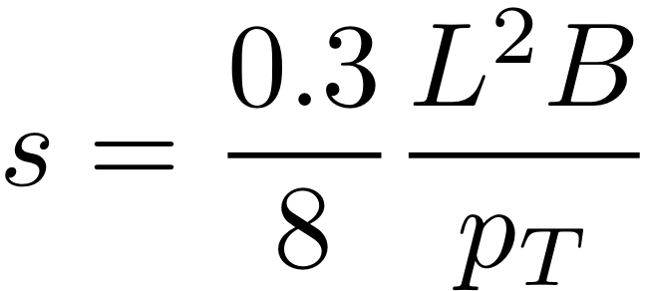
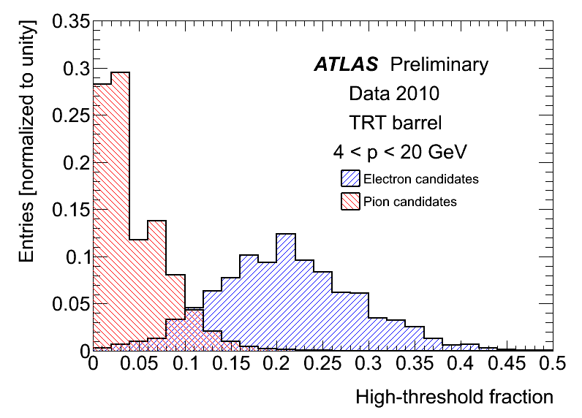
Challenge of High-Momentum Muons
Detector gives the sagitta measurement, which is translated to curvature
Measuring sagitta of 1 TeV muon requires large L and large B
  Different approaches for ATLAS and CMS
Ultra-high energy muons radiate photons!
L
s
B

Slide 24
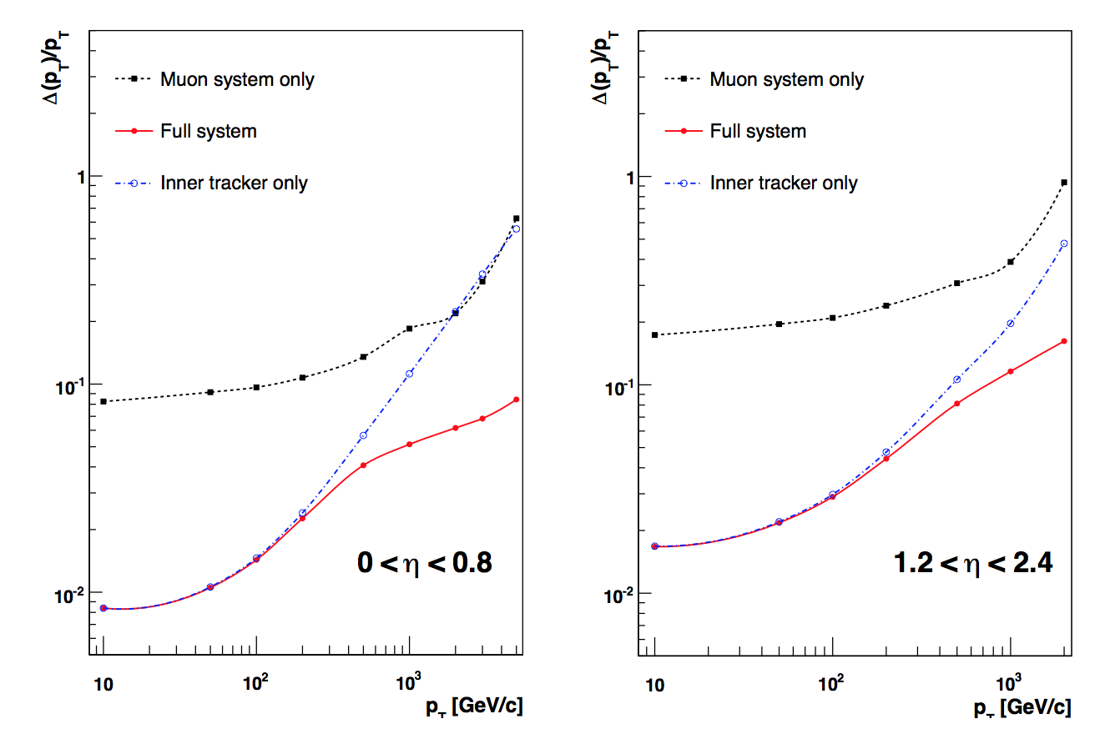
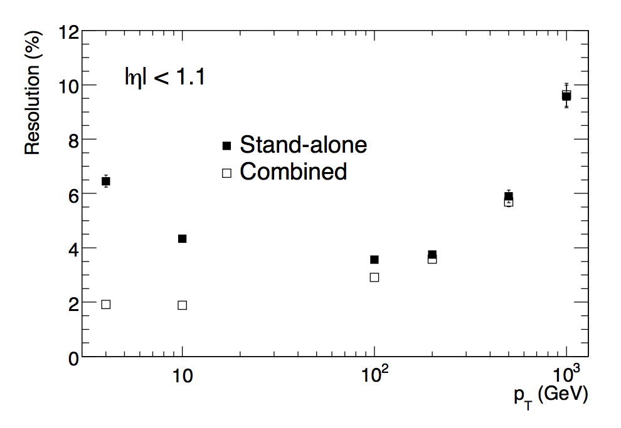
Standalone vs. Combined Reconstruction
CMS
Extrapolate inner track to muon chambers to match segments and form combined/global tracks
Good low-p_{T} resolution depends on inner track
  Excellent hit resolution
  No gaps in coverage
  Large CMS tracker
Good resolution at p_{T}=1 TeV
  Still CMS silicon tracks!
  For ATLAS, stand-alone muon spectrometer
ATLAS

Slide 25
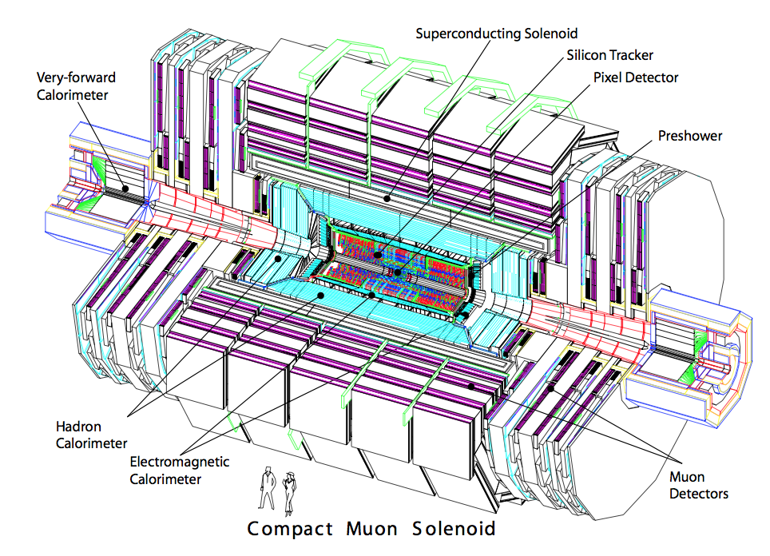
Extended Muon Coverage
Muon chambers are always at large radius for particle ID purposes
  Requires large surface area for complete solid angle coverage
  Therefore requires inexpensive detector technologies
  Inevitable holes for cables and cooling going to inner detectors
  Different magnetic field configurations and radiation environments require different technologies

Slide 26
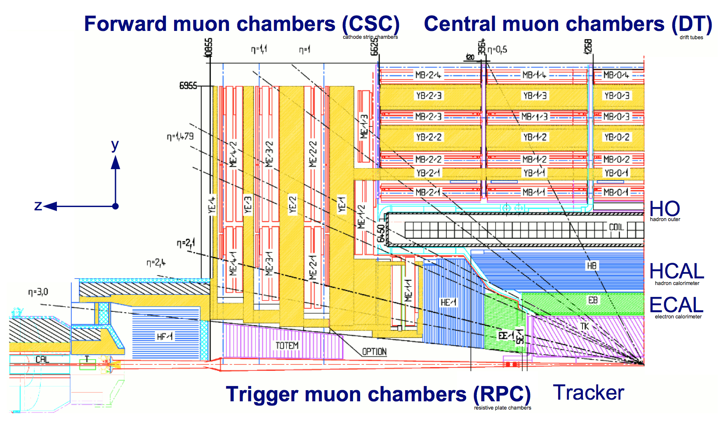
CMS Muon Coverage
Challenge to maintain consistent coverage over all η

Slide 27
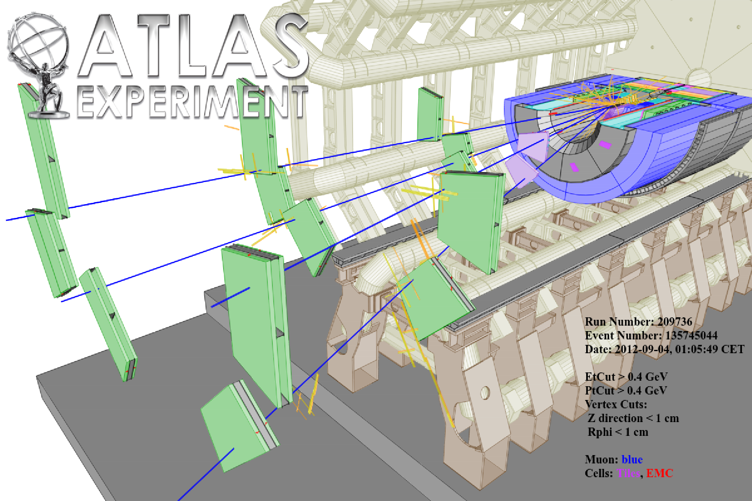
Higgs Decay in Forward Region

Slide 28
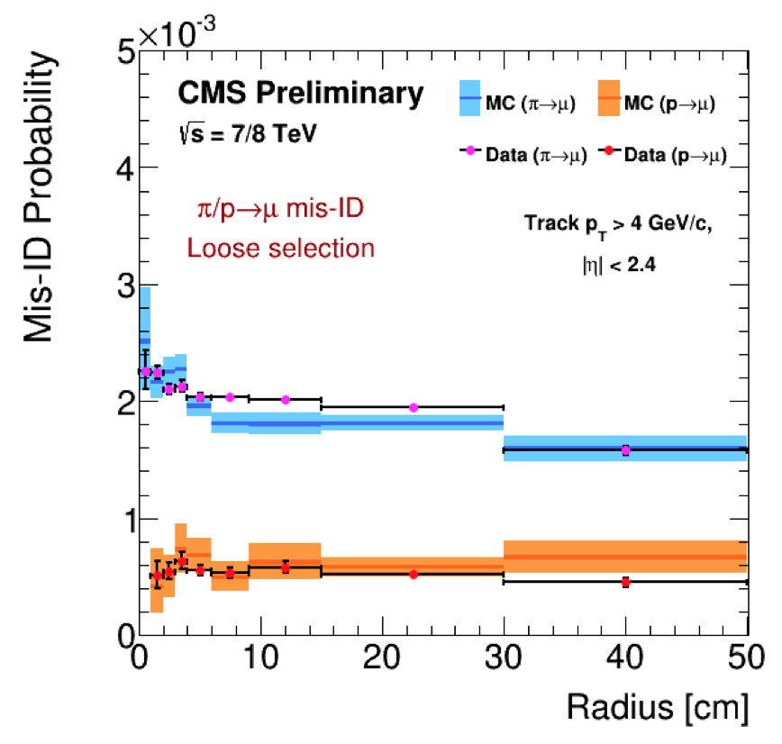
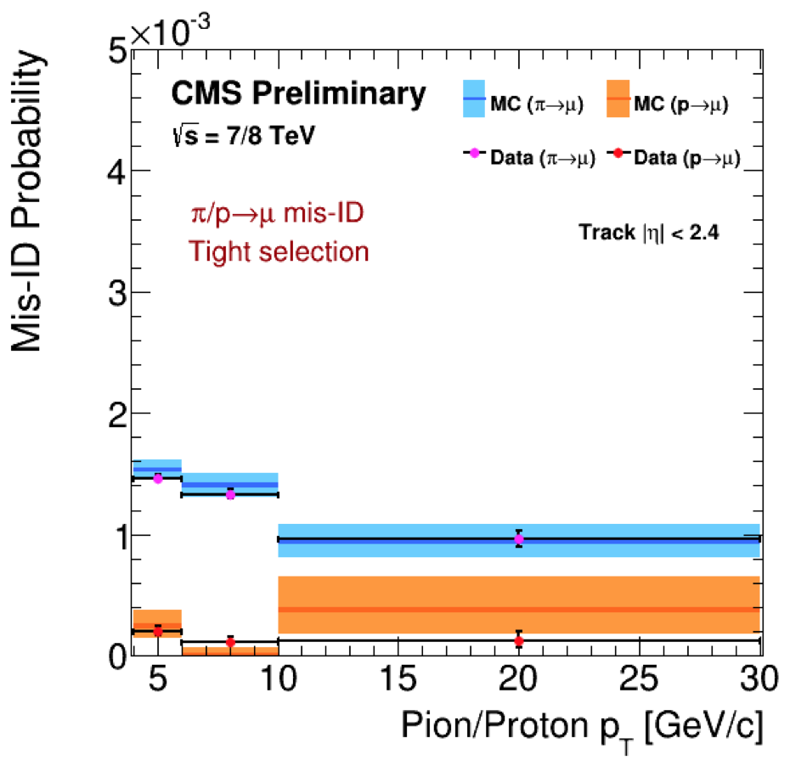
“Punch-Through” Effects: Muon Mis-ID
Are the muons from the hard scatter really the only particles making it all the way out to the muon system?
At least three other possibilities (total <1% for CMS):
  “Decay-in-flight”: true muons produced in decays of heavy flavor or even from decays of π produced in hadronic shower (cτ_{π} = 8 m) [biggest effect]
  “Punch-through”: hadronic shower penetrates entire HCAL. Survival probability goes as exp(-L/λ), with interaction length λ
  “Sail-through”: particle does not initiate hadronic shower [very unlikely for these large cross section interactions]
But be careful: the Run 1 CDF detector was limited to 80 cm of iron
  Fe: 132 g/cm² / 7.87 g/cm³ = 17 cm interaction length
  So there were perhaps 6-7 interaction lengths in front of the muon system (compare to 16 for CMS); this was fixed for Run 2

Slide 29
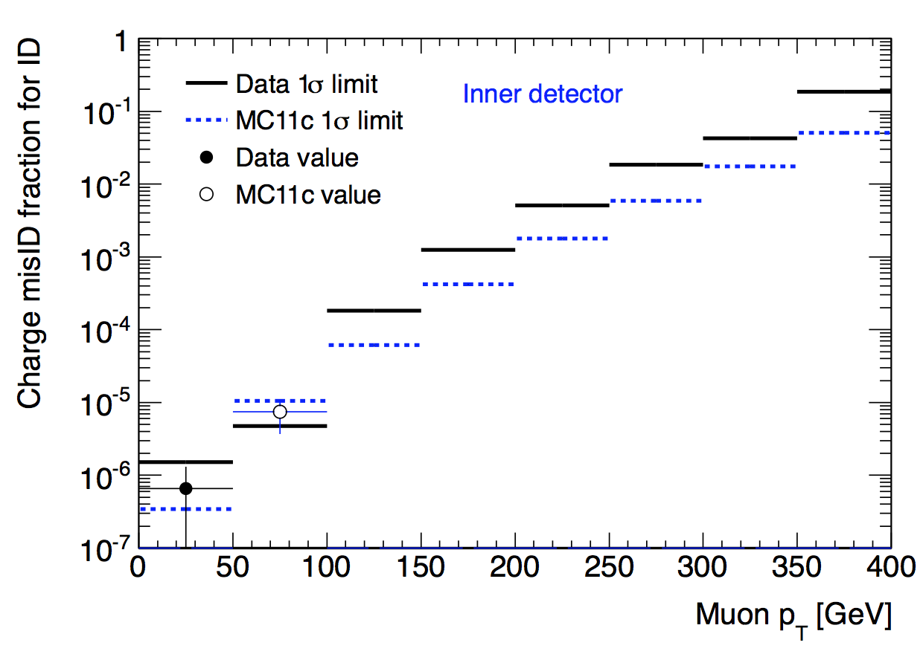
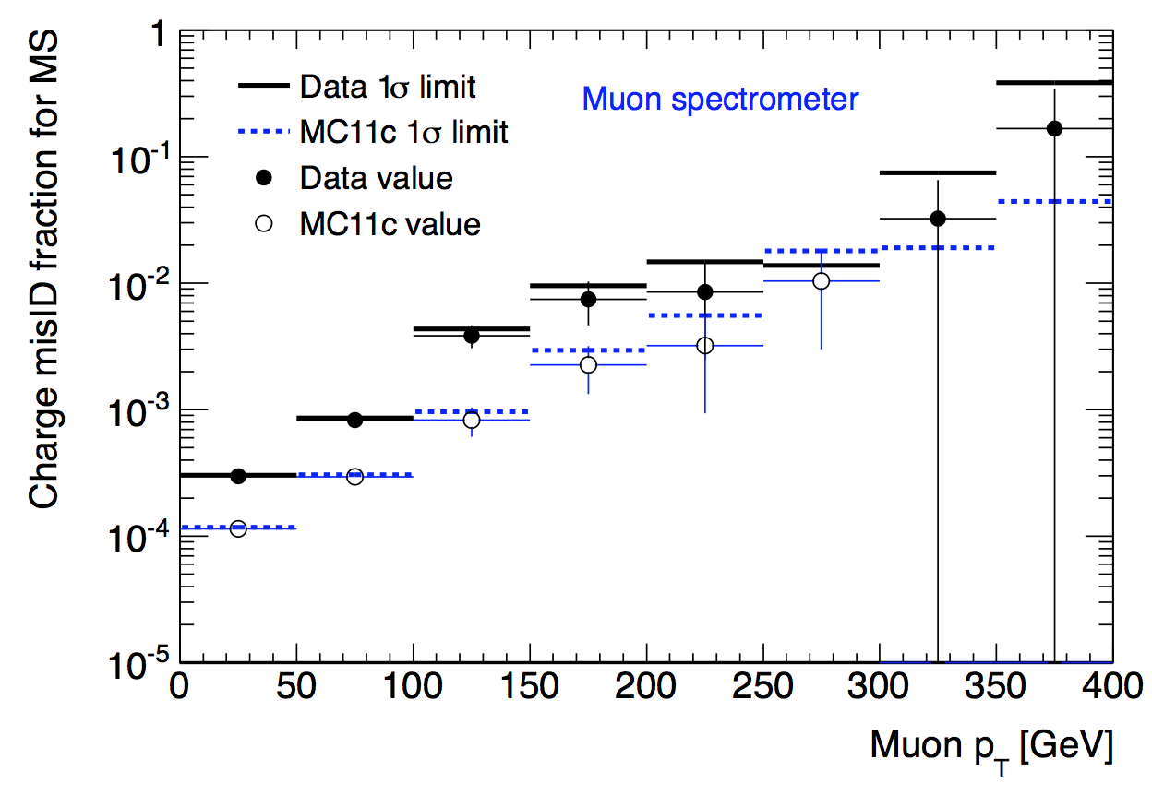
Charge Mis-Identification
L. Skinnari
Detector measurement of sagitta is actually curvature
For very high-p_{T} tracks, curvature resolution can lead to charge flipping
  Electrons have additional bremsstrahlung mechanism
Estimate from muon pairs under the Z mass peak
  Assumed to be oppo-sign pairs
These rates are most important for searches for same-sign lepton pairs
  Compare inner silicon tracker and muon spectrometer

Slide 30
Efficiency and Fake Rate Estimates
Monte Carlo simulations are effective for estimating simple rates
  Geometric acceptance
  Reconstruction efficiency (modulo data/MC scale factors, usually close to 1)
  Number of hits in tracker
Not so effective for estimating fake rates because of
  Fragmentation functions and soft particle isolation
  Tails of shower shape distributions
  Rare reconstruction effects or physical processes
  Distributions for complicated quantities (missing E_{T}, MVA outputs)
Preferred method is to measure efficiency scale factors and fake rates from in-situ data samples
  Somehow this is more true at hadron colliders than e⁺e⁻ colliders
  Sometimes not even possible because of limited sample at edges of kinematic phase space; show extrapolation is reasonable

Slide 31
Tag-and-Probe Methods
ATL-COM-PHYS-2014-118
If a muon and another particle happen to combine to m_{Z}, what is the other particle?
  “Tag” a lepton with tight ID
  Fixes flavor of partner “probe”
Measure efficiency of tight ID on the “probe” particles,
  This depends on loose efficiency being as near as possible to 100%
For practical purposes, derive scale factors for use on MC
  Allows extrapolation into more complicated phase spaces
  Points out improvements needed in generator and simulation

Slide 32
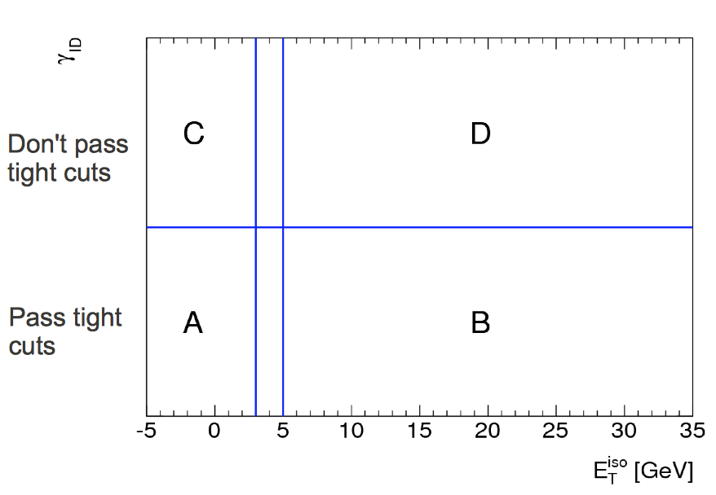
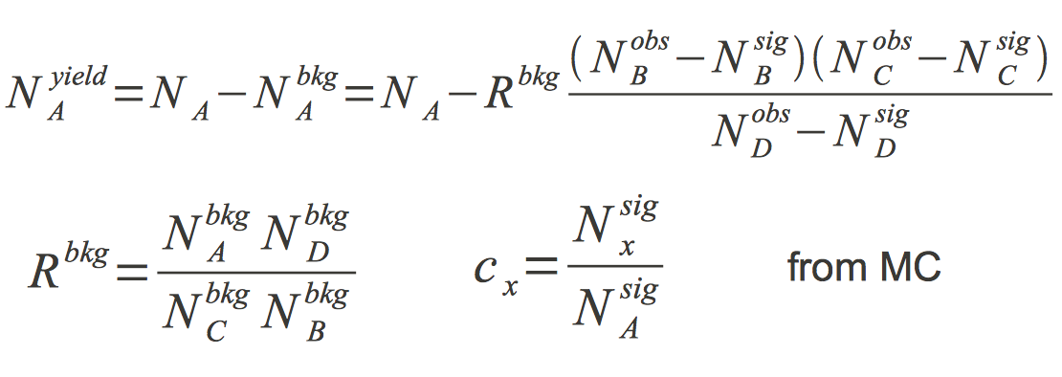
“ABCD” or “Matrix” Methods
Assume ID requirements (shower shape, etc.) are not correlated with isolation E_{T}
Measure extrapolation factor between background-dominated regions C,D
Apply factor to data in B to find background in A
More complicated versions subtract known signal contamination in B,C,D

Slide 33
Particle Flow
Calorimeter fluctuations contribute to large uncertainties for measurements of low-energy particles: 1/N = 1/√E effect
  Results in large uncertainties for jet energy and missing E_{T} measurements
Can we use the tracking measurements instead to find the energies of the low-energy charged particles? Still need calo for neutrals…
This method has been used successfully at e⁺e⁻ collider experiments
  Can it possibly work at a hadron collider? YES – CMS has made it work
Expect improvements where there is a mix of low-p_{T} charged and neutral particles in close proximity
  Hadronic jets, tau lepton signatures, missing E_{T} measurements
  Typical jet composition is 60% charged, 25% photons, 15% neutral hadrons

Slide 34
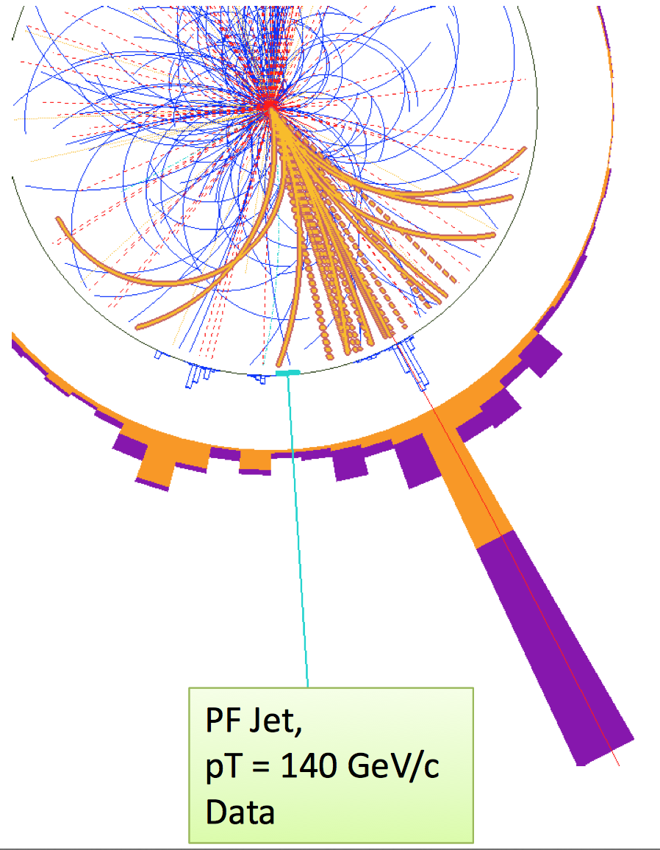
Detector Requirements
Need to spread out charged particles to avoid merging
Highly granular calorimeter
High-resolution tracker
Particle ID w/o extra material
High B field at large radius
  CMS: 3.8 T x 1.3 m
  ATLAS: 2.0 T x 1.2 m
  D0: 2.0 T x 0.8 m
Very efficient tracking algos
Physicist requirements: several years to tune the algorithms and minimize mis-associations!

Slide 35
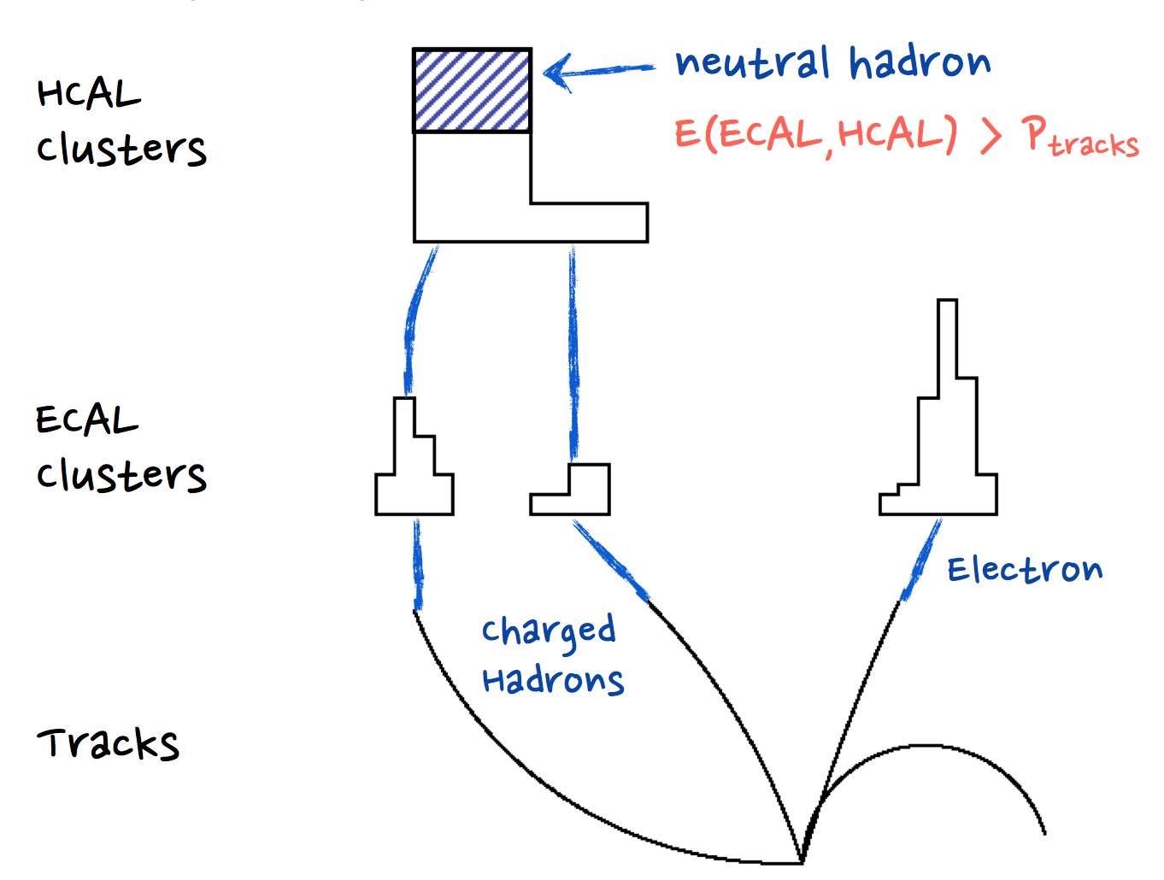
Basic Concepts for Particle Flow
Diagrams from R. Cavanaugh and P. Janot

Slide 36
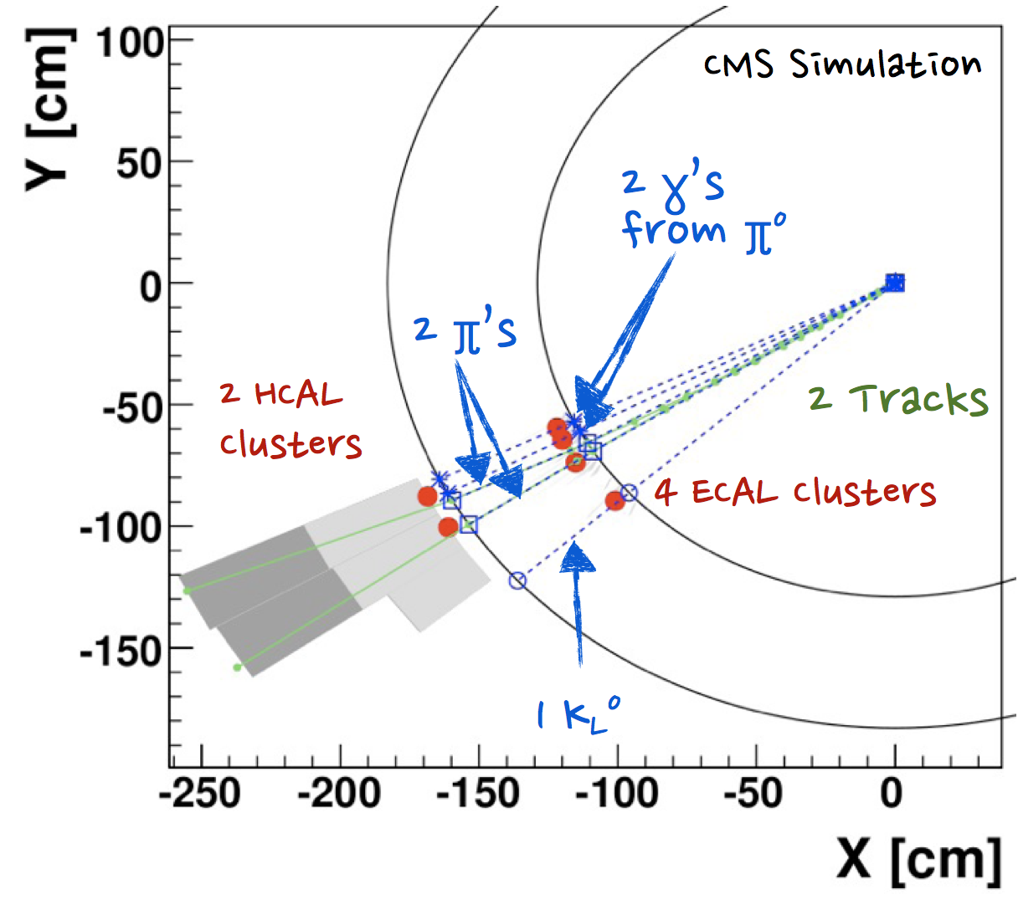
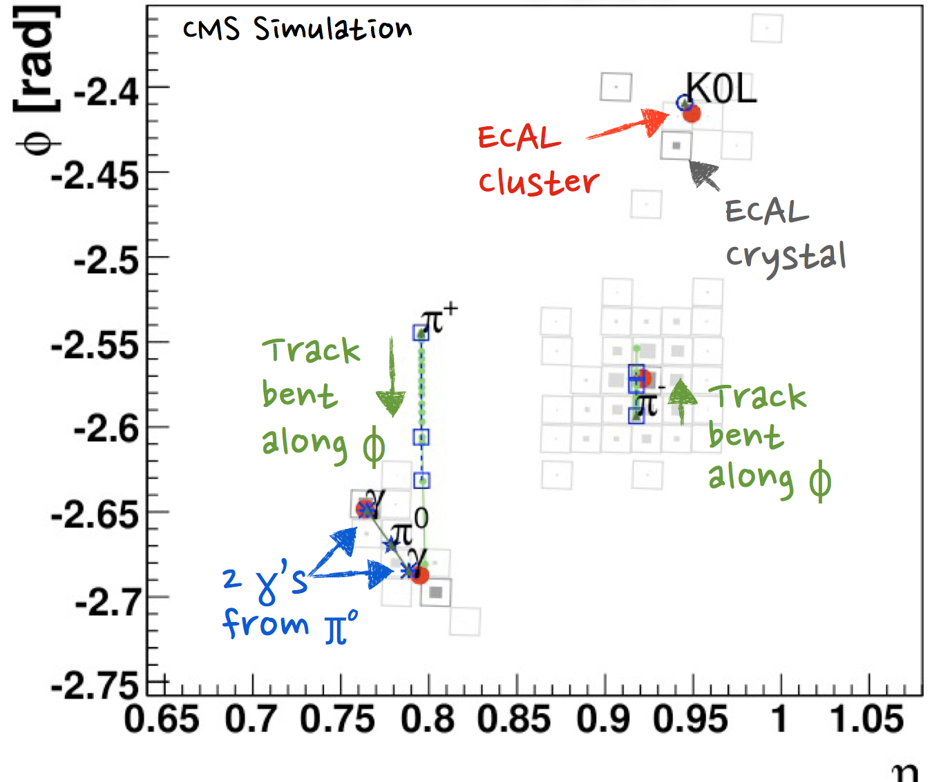
Matching Tracks to Calorimeter Cells
Link algorithm produces “blocks” of inputs (track/ECAL/HCAL)
  Extrapolate track to ECAL shower max and HCAL 1λ
  Link to the cluster at that position
  Also extrapolate track tangents to recover bremsstrahlung from electrons
  Link ECAL and HCAL clusters when their boundaries overlap
  Link to muon standalone tracks using a matching χ²
Excess energy in the clusters gives rise to a “particle-flow neutral hadron” or “particle-flow photon”, depending on ECAL or HCAL

Slide 37
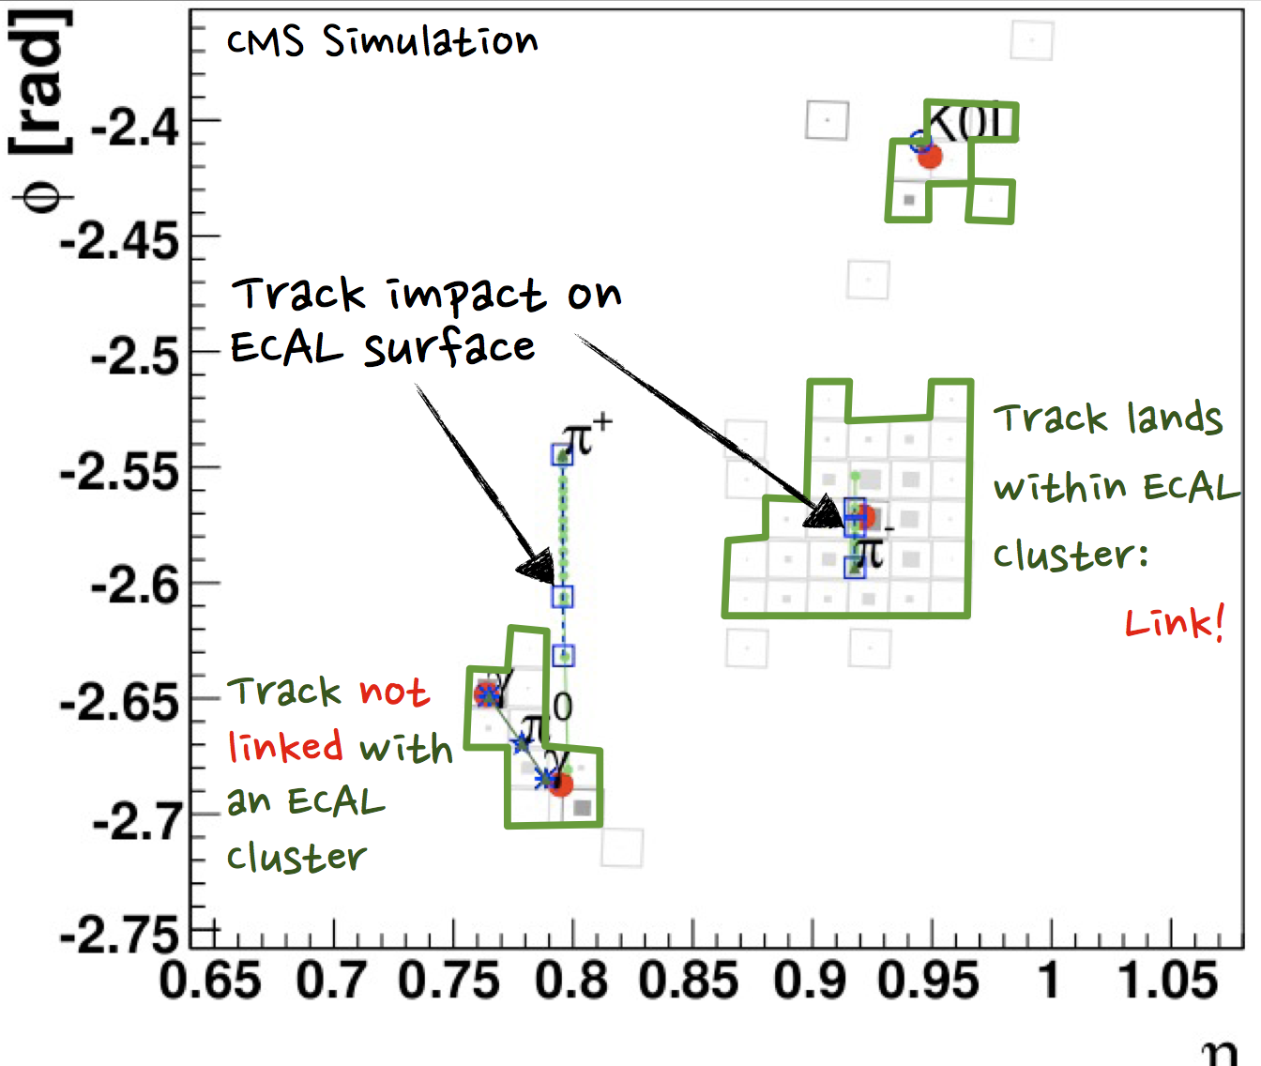
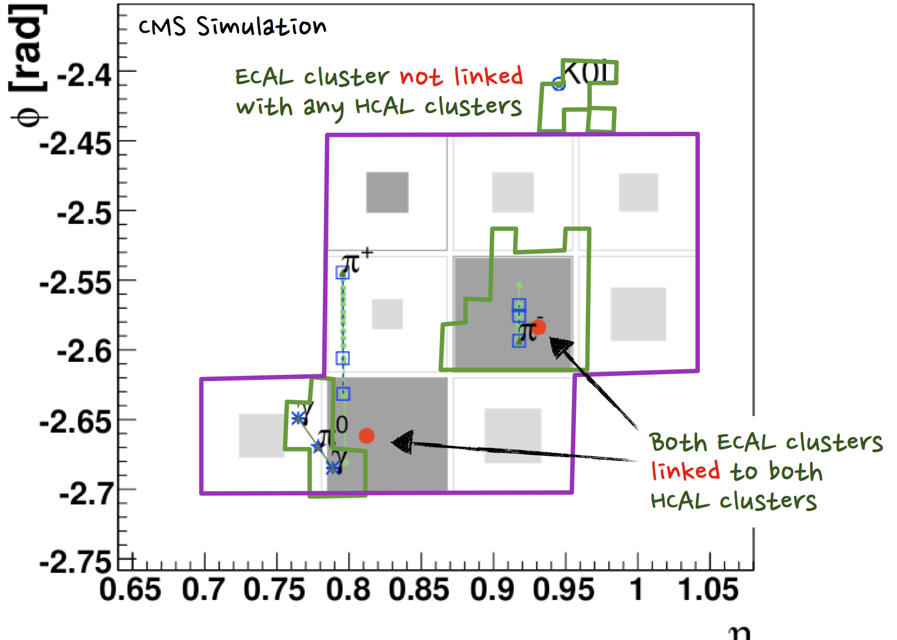
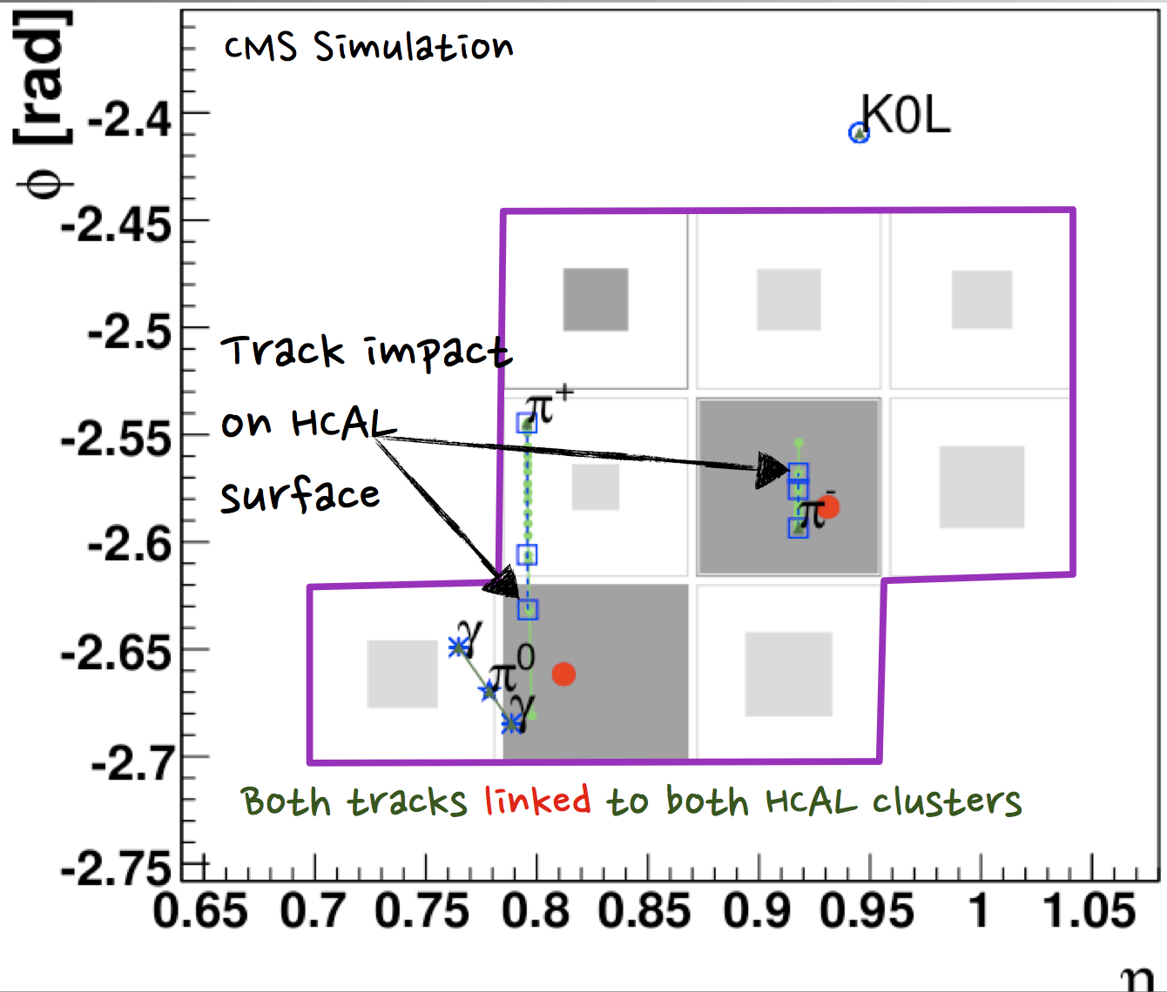
Particle Flow Algorithm
Track-ECAL linking
ECAL-HCAL linking
Track-HCAL linking

Slide 38
Particle Flow Sequence
Find and “remove” muons (σ_{track})
Find and “remove” electrons ( min[σ_{track}, σ_{ECAL}] )
Find and “remove” charged hadrons (σ_{track})
Find and “remove” converted photons ( min[σ_{track}, σ_{ECAL}] )
Find and “remove” V0’s (σ_{track})
Find and “remove” photons (σ_{ECAL})
Left with neutral hadrons (10%) (σ_{HCAL} + fake)
  Same relative uncertainty on these remaining hadrons, but the total contribution to the jet/event energy has been significantly reduced
Final steps are to combine particles that have been found into a total jet/tau/event energy

Slide 39
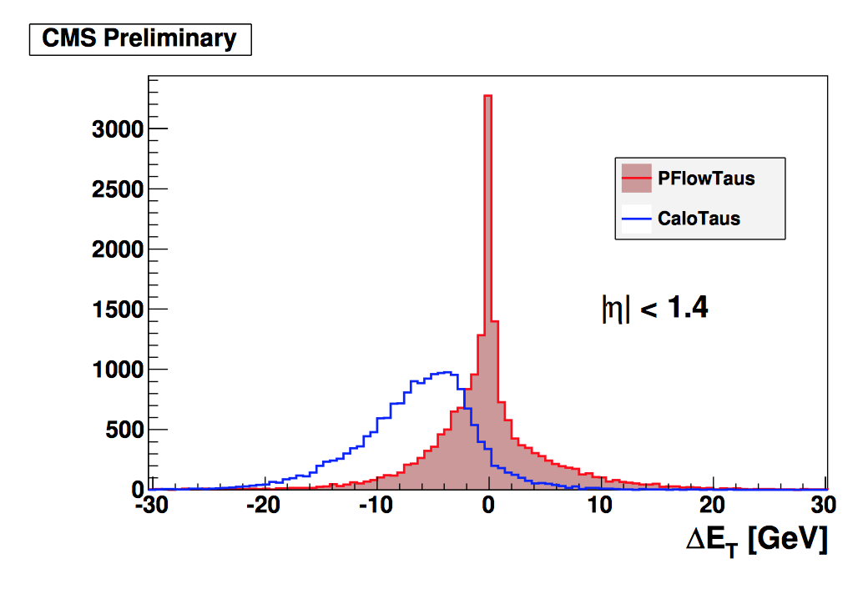
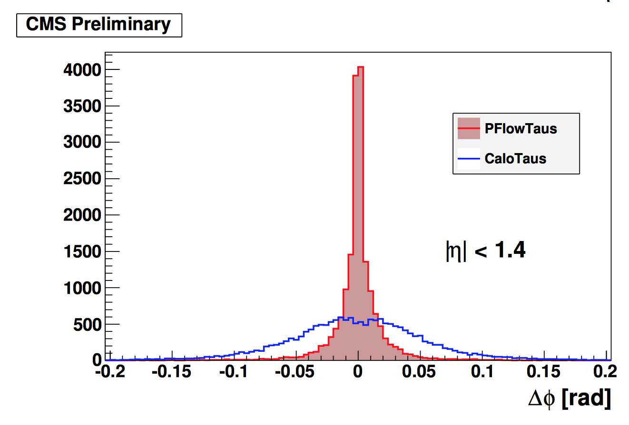
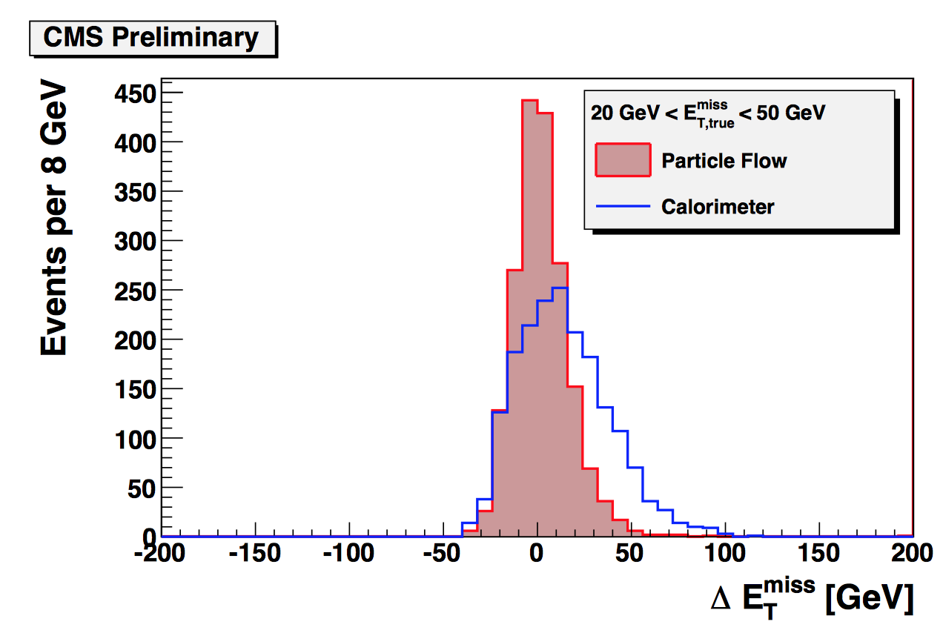
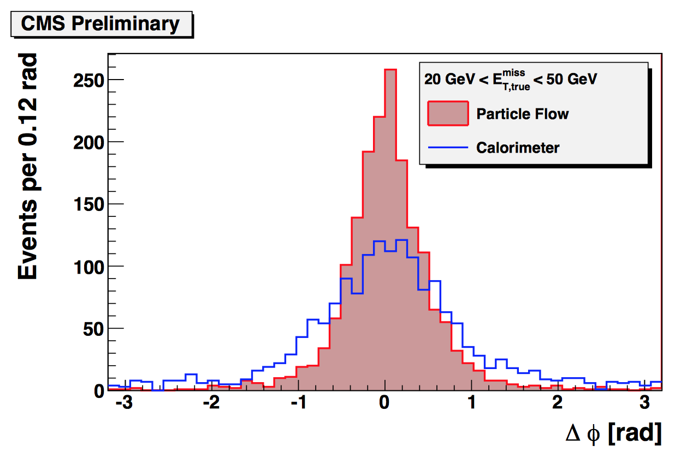
Performance of Particle Flow Algorithm
Striking improvements in tau and missing E_{T} energy and direction

Slide 40
Summary of Today’s Topics
Neutral particle ID includes calorimeter and tracking
  Unconverted and converted γ, π⁰, V⁰ decays
Requirements on e/γ shower shapes depend on detector geometry
  Common requirements to reject π⁰ decays and other jet deposits
  Isolation requirements required for prompt photon selection
Photon conversions are a winning ID strategy!
  Clean reconstruction using powerful new silicon tracking systems
  Combination of tracker+calorimeter is still best at high energy
Muon reconstruction combines inner and outer tracking results
Leverage tight vs. loose selections to measure ID efficiency
  Variations on “matrix method” solve systems of equations for contributions
Particle flow algorithms are the cutting edge for detectors with good tracking efficiency; potential to improve jet/MET resolution

Slide 41
Plan for Tomorrow
Jet reconstruction
  Jet clustering algorithms and calculations
  Jet cleaning (calorimeter effects)
  Pileup subtraction and assignment techniques
Tau lepton reconstruction
  Tau lepton decay signatures
  Tau lepton identification algorithms
Heavy-flavor tagging
  Geometry of heavy-flavor hadron decays
  Multivariate techniques and calibration
W boson and top quark tagging
  Jet grooming techniques, boosted jet shape calculations
  Top-tagging algorithms
Missing E_{T}

Slide 42
Guide to Further Reading
Lectures by Rick Cavanaugh at HCPSS 2012: https://indico.fnal.gov/sessionDisplay.py?sessionId=11&confId=5615
Public results of reconstruction performance in experiments:
  ATLAS: https://twiki.cern.ch/twiki/bin/view/AtlasPublic/WebHome#Combined_Performance_Groups_Simu
  CMS: http://cms.web.cern.ch/org/cms-papers-and-results
  ALICE: https://twiki.cern.ch/twiki/bin/view/ALICEpublic/ALICEPublicResults#Physics_Working_Group_PP
  LHCb: http://lhcbproject.web.cern.ch/lhcbproject/CDS/cgi-bin/index.php

