Slide 1
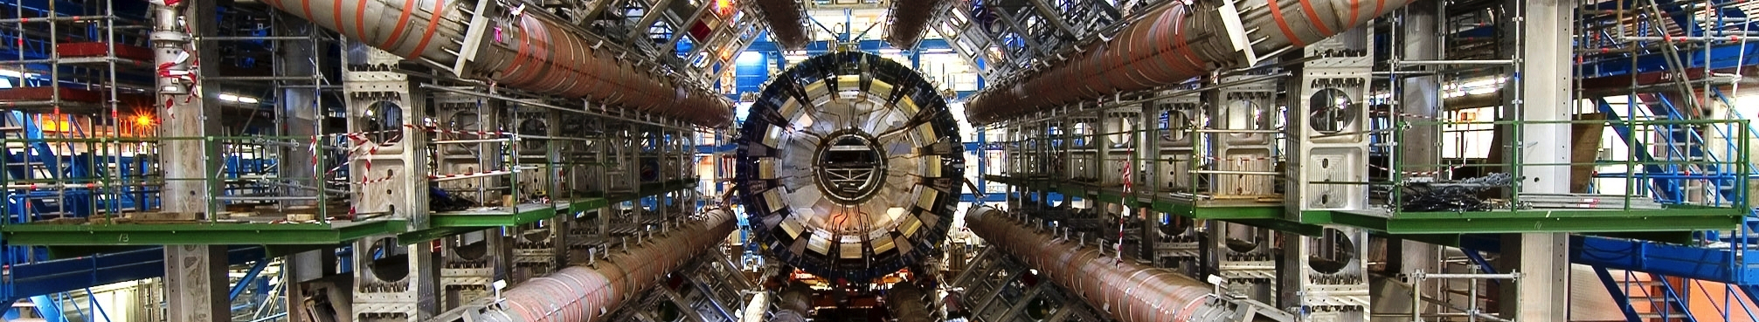


Event Reconstruction and Particle Identification
Part Three
Jason Nielsen
Santa Cruz Institute for Particle Physics
University of California, Santa Cruz
Hadron Collider Physics Summer School
August 22, 2014

Slide 2
Outline for Today
Jet reconstruction
  Jet clustering algorithms, calculations, calibrations
  Jet cleaning (calorimeter effects)
  Pileup subtraction and assignment techniques
Tau lepton reconstruction
  Tau lepton decay signatures
  Tau lepton identification algorithms
Heavy-flavor tagging
  Geometry of heavy-flavor hadron decays
  Multivariate techniques and calibration
W boson and top quark tagging
  Jet grooming techniques, boosted jet shape calculations
  Top-tagging algorithms
Missing E_{T}

Slide 3
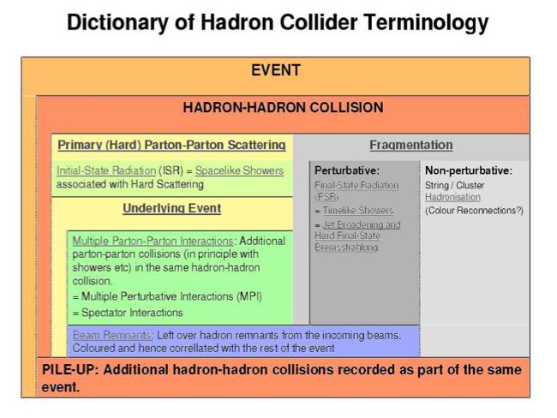
Definition of Proton-Proton Interactions
P. Skands et al., hep-ph/0610012

Slide 4
Tagging Multiple-Particle Signatures
Today: particle ID for particles with complicated decay signatures
  Tau leptons, b hadrons (b quarks), W bosons, top quarks, neutrinos
High-mass particles with short lifetimes
  Particles do not interact in detector
  Multiple particles in final state can be reconstructed to mother particle
These complicated reconstruction/particle ID challenges are still under heavy development by experiment (and theory)
  Only recent hadron colliders have made it possible to study these particles
  High LHC energies imply high-pT production, leading to boosted signatures

Slide 5
Jets: As Observed
Partons may be real, too, but jets are what we see in experiment
  Result of boosted partons radiating, then hadronizing
  Clustering is, in some way, an attempt to “undo” these processes
We do not expect a perfect one-to-one correspondence, except possibly for high-p_{T} well-separated partons
  Relation between the two should be calculable on average to be useful
  Notions of jet-parton duality are good rules of thumb
Experimentalists are becoming more savvy about jet algorithms and how to compare measurements and calculations
  Cutting-edge calculations are often parton-only, so seek a middle ground in which to compare results
  Particle-level results should be independent of all detector effects
  But what is clustered? Particles or calorimeter energy deposits?

Slide 6
Experimental Requirements
Detector Independence — There should be little or no dependence on detector segmentation, energy response, or resolution.
Minimization of Resolution Smearing — The algorithm should not amplify the inevitable effects of resolution smearing and angle biases.
Stability with Luminosity — Jet-finding should not be strongly affected by multiple hard scatterings at high beam luminosities (i.e., jets should not grow to excessively large sizes because of additional pp interactions).
Resource Efficiency — The jet algorithm should identify jets using a minimum of computer time.
Reconstruction Efficiency — The jet algorithm should identify all physically interesting jets (i.e. jets associated with partons).

Slide 7
Components of Jet Algorithms
Physical process from parton to hadrons is hadronization; in jet clustering, we seek to reverse the physical process
  Both of these depend on the art of non-perturbstive QCD
Three parts of any jet reconstruction algorithm:
  Which input particles to cluster? Truth, cells, clusters, tracks?
  In what order should particles combined into a jet?
  How should the particle 4-momenta be combined?
    This one is simple: everyone agrees we should add 4-momenta vectorially.
Look for jet algorithms that are fast, robust under particle boosts (along z), collinear and infrared safe (see Fernando’s lectures)

Slide 8
Jet Clustering: Algorithms
Class of algorithms that combine nearest particles first, instead of fixing seed and cone (mimic parton shower)
  Cambridge/Aachen algorithm: combine particles nearest each other in (η,φ) space (minimum d_{ij})
  “kT” algorithm: preference for combining lower-momentum particle pairs first, then moving on to higher-momentum pairs until only beams are left
These algorithms correspond to p=0 and p=1 in
  What about p=-1? Is this a physical choice of p?
Anti-kt algorithm collects particles around the hardest particle first
  Guarantees “cone-like geometry” with well-defined borders around the highest-kT particles.
  Maintains the infrared safety and collinear safety of sequential recombination family

Slide 9
Jet Energy Calibration
Correct detector-level jet energy to the particle level
  Correct for varying detector response (dijet balance) due to non-linearity, uninstrumented regions (cracks)
  Average correction for EM+HAD contributions (γ+jet balance assumes known EM scale energy of photon)
  Overall absolute scale calibration using γ+jet events
  Correct for average loss of particles due to B field, average gain from contributions of underlying event
Corrections add uncertainties to “Jet Energy Scale / Calibration”

Slide 10
Jet Cleaning
Require charged tracks, ECAL+HCAL contributions, all in time with beam crossing
  Rejects cosmic background, calorimeter noise, and beam backgrounds, respectively
This still leaves pileup contribs.

Slide 11
Pileup Jets
Use to mitigate jet counting migration: 1->2, etc.
For p_{T}<25 GeV, pileup jets are the largest single source of jets!
  Low p_{T} jets overlap to form high p_{T}
Use jet shape and vertex properties to flag pileup PF jets
  Number of primary vertices
  Δz: distance from highest-pT charged PF to the primary vertex (PV)
  β: fraction of charged PF from PV
  Radial width: flat for pileup jets

Slide 12
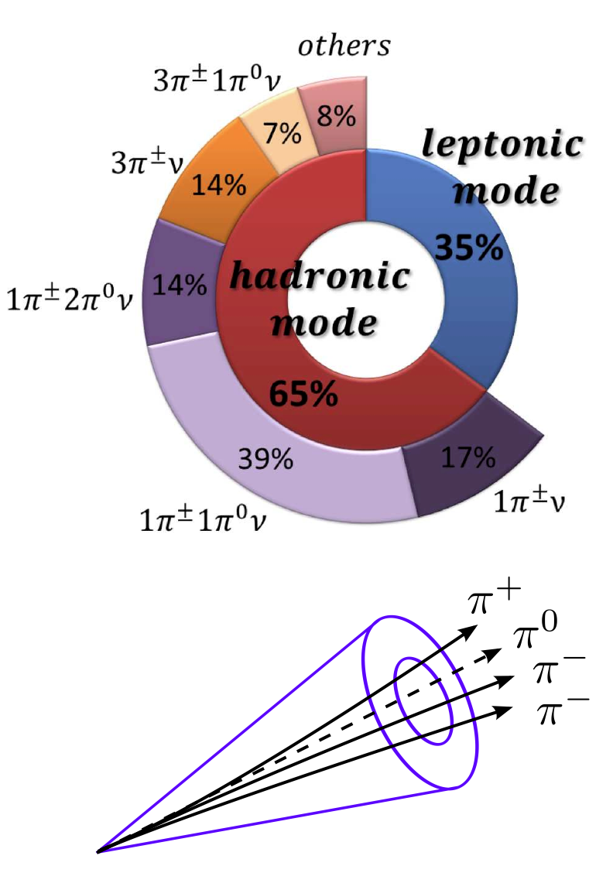
Tau Lepton Signatures
Only lepton massive enough to decay hadronically (1.8 GeV)
65% hadronic decays
  50% 1-prong, 15% 3-prong
Decay in beam pipe cτ=87 μm
Signature: narrow jets with 1 or 3 tracks, possibly with neutrals
Important particle for neutral and charged Higgs decays
How to address the large multijet background, which also has many narrow jets?
Slide from R. Reece

Slide 13
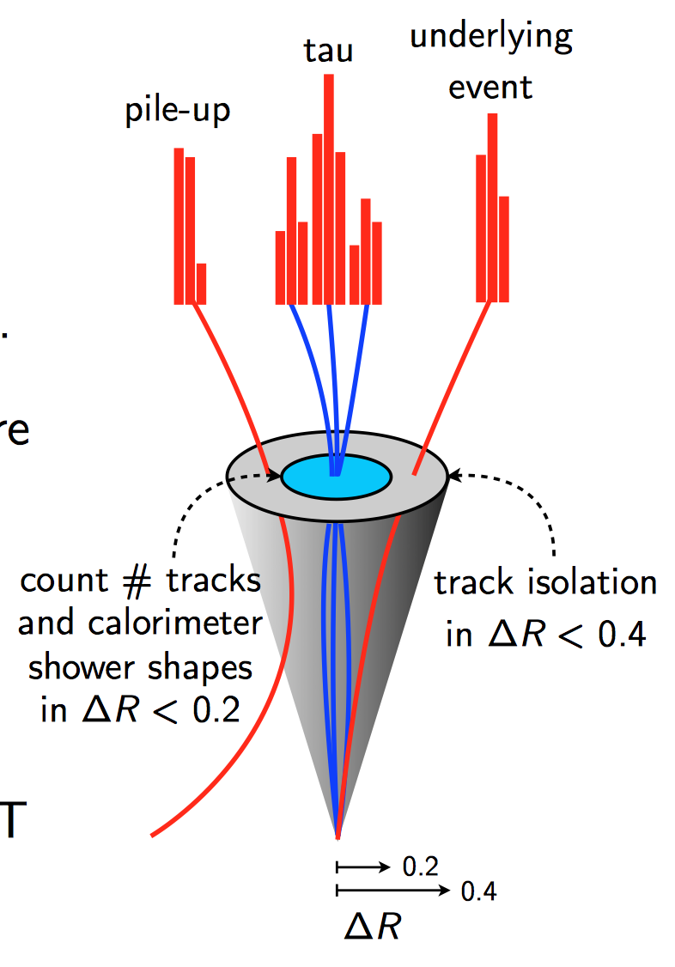
Tau Lepton Reconstruction
Seeded by anti-kt jets (R=0.4) of 3-D topological calorimeter clusters
Define the four-momentum as the jet axis with a tau-specific calibration
Associate tracks with the jet that are consistent with the chosen vertex
Calculate characteristic variables from combined calorimeter and tracking information
Put in multivariate estimator ;-)
Slide from R. Reece

Slide 14
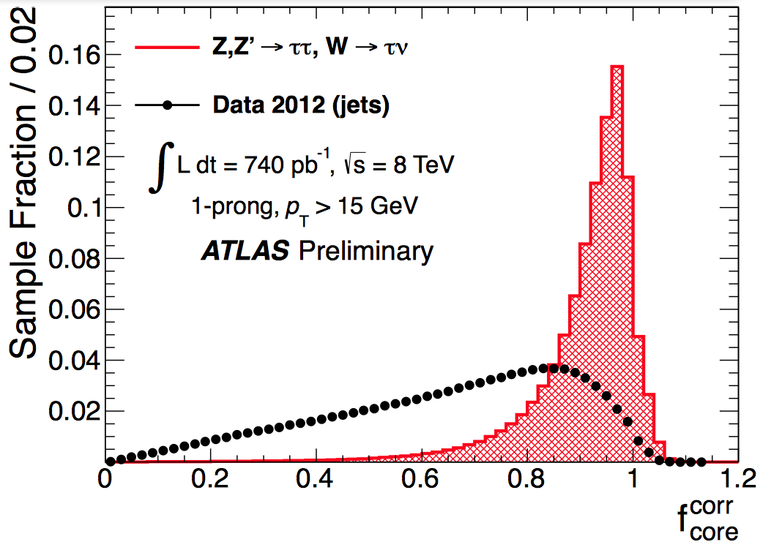
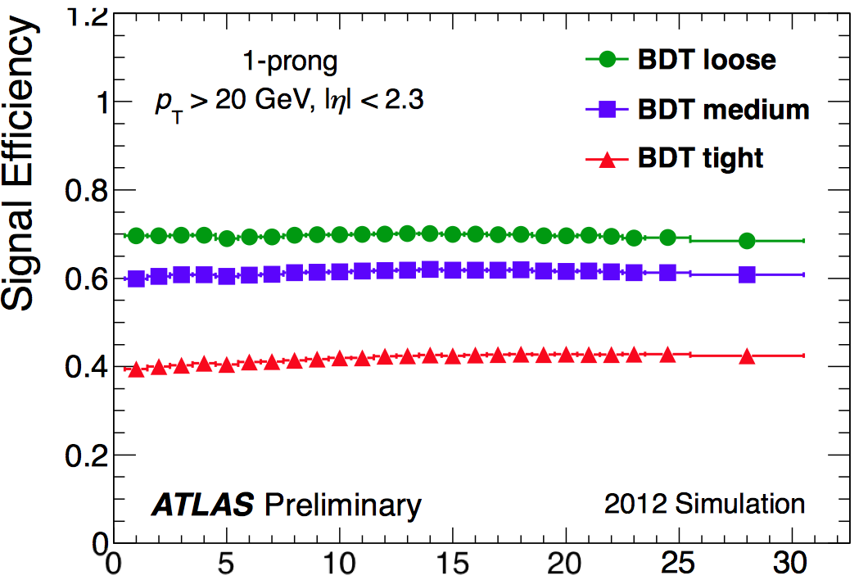
Multivariate Tau ID
Combine key variables like core energy fraction, decay length significance, and jet track width
Fit to Ntrack distribution gives background and signal contributions for efficiency measurements
Nvtx

Slide 15
Heavy Flavor Tagging
Important particle ID for Higgs decays and stop decays
  Tag of jet flavor possible for b (and sometimes c) unlike for uds
b quarks (& B/Λ_{b} hadrons) have following special properties:
  Long-lived (due to CKM suppression)
  Massive with respect to decay products
  Semileptonic decays through spectator
  High multiplicity decays
Compare cτ_{b}=500μm with cτ_{c}=310μm and cτ_{τ}=90μm
  Major difference in number of particles in jet
  Difference in masses – is it important? Think about γ boost factors

Slide 16
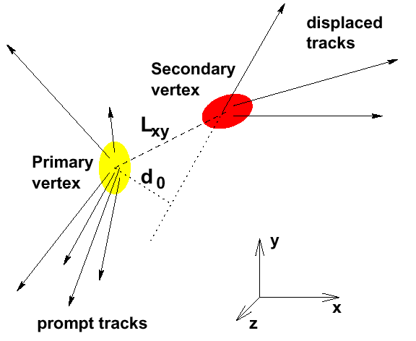
Geometry of b/c Hadron Decays
Decay products point back to Secondary Vertex, not PV
  Measure the decay length L_{xy} or impact parameter d₀
Need measurements with precision 10% x O(300μm)
  Note that charm d₀, L_{xy} are essentially the same as for B

Slide 17
Discriminating b jets from uds jets
Impact parameter likelihood
  Product of each track’s incompatibility with originating at primary vertex
Secondary vertex decay length significance
  Measures separation between SV and PV: L/σ_{L}
  Geometry of b and c decay vertices: constrained to lie along line of flight
Soft lepton identification from semileptonic HF decay
  Typically muons @ few GeV
Vertex mass calculation
  Direct comparison of quark masses m_{b}, m_{c}, m_{uds}
Number of tracks associated with vertex
  Favors higher-multiplicity B decays
Multivariate techniques
  Include all of the above, plus total track multiplicity in jet and jet width

Slide 18
Multivariate Techniques
Each b-tagging algorithm has its own complicated output
  Decay length significance (2-D or 3-D)
  Impact parameter-based probability
  Internal neural network output
Several taggers can be combined if their power is complementary
  IP3D gives impact parameter probability
  JetFitter classifies jets by number of vertices and number of tracks in each vertex
Training combined neural network on b-jet signal vs. light (udsg) background
  Reduced performance at high p_{T} is due to merged pixel clusters and pattern recognition

Slide 19
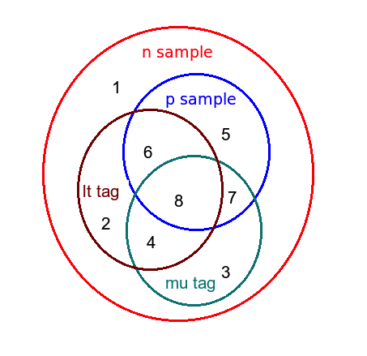
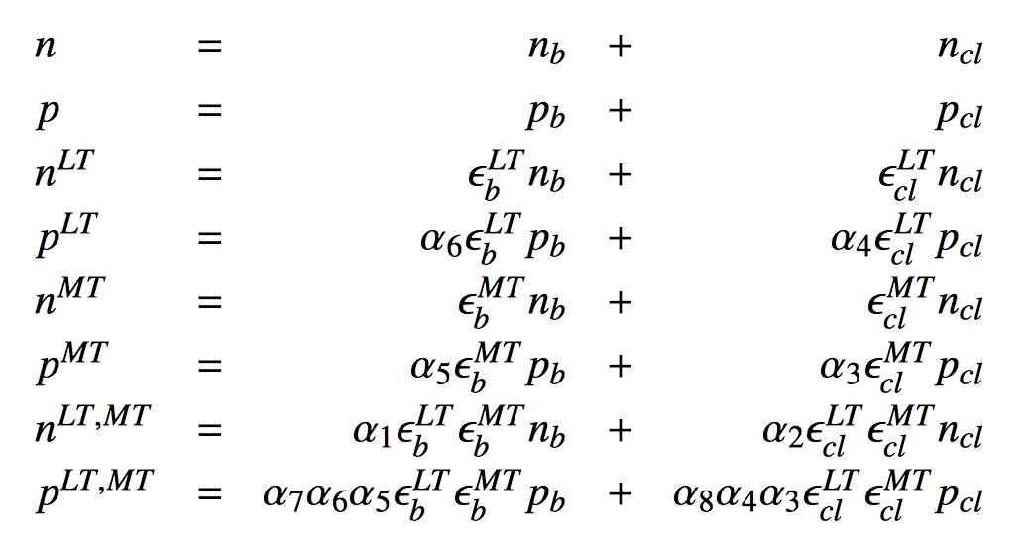
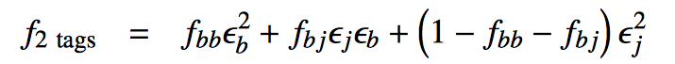
Measuring b-tag Efficiency and Fake Rates
Challenge: produce pure b-jet sample for efficiency measurement, or play samples of different composition against each other
“System 8”: 3 uncorrelated criteria:
Lifetime tag, muon p_{T} relative to axis, opposite-side b-tag
Select for top pair dilepton events, in which the only high-p_{T} jets are b-jets
ATLAS-CONF-2014-004
μ
p_{T}^{rel}

Slide 20
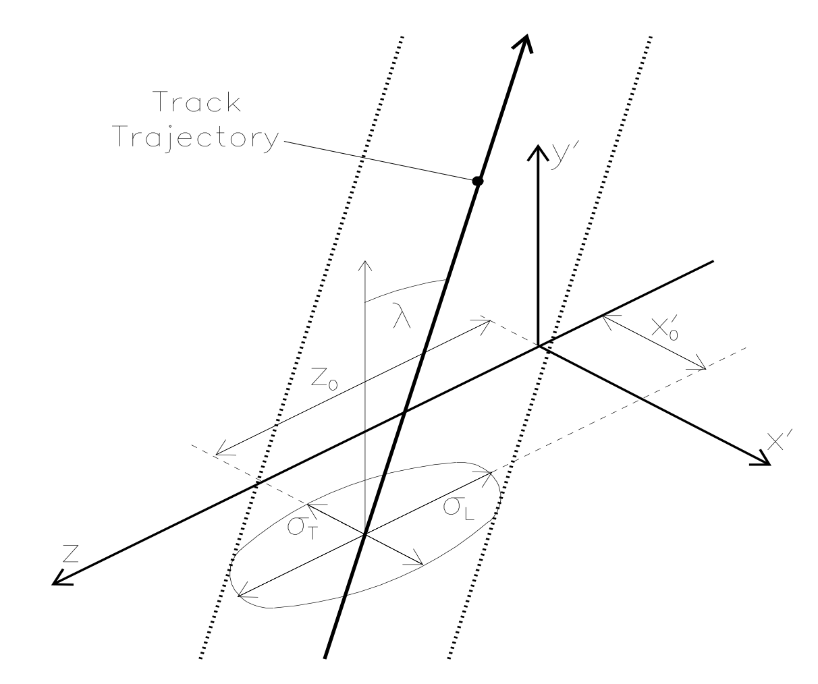
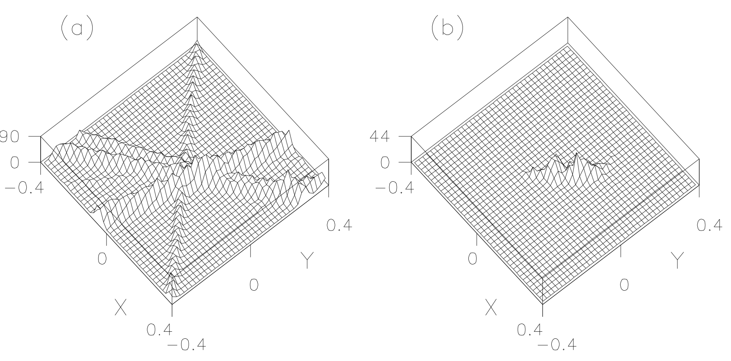
Probability Flux Tube Calculations
Create a Gaussian probability tube around each track in the jet
  Depends on estimate of resolution at each point along the track: full error matrix
Sum probabilities for each point on a 2- or 3-D spatial grid to find vertex
  May be slow in large volume, but O(Ntrks)
Track sum
Vertex sum
Figures from SLD

Slide 21
Quark-Gluon Tagging
Many measurements and searches can benefit from identifying jets from initial-state quarks from gluon jets
Main differences have to do with jet shape and track multiplicity
  Light (uds) jets fragment to small number of hadrons
  Gluon jets, especially at high p_{T}, tend to have high multiplicity
Continuous variables: “girth” (p_{T}-weighted summed radius)
Discrete variables: number of tracks, number of Akt 0.1 subjets

Slide 22
W Boson Tagging
For 13 TeV, many analyses with W bosons move to boosted regimes, where SM backgrounds are reduced
  WH measurements
  WW measurements and high-mass searches
  Boosted top quark decays
Hadronic decays of W bosons may be boosted into a single (fat) jet
  Typical size of this jet is ΔR>2/γ, where γ is boost factor of W
  How can we separate these “W-jets” from light uds jets and b-jets?
Several well-motivated handles to quantify substructure
  Main observable is the mass of the boosted (fat) jet
  Jet pruning techniques serve to reduce the mass of QCD light jets while maintaining the high mass of the W-jet
  Mass drop observable contrasts fat jet mass with subjet masses
  Jet variables are intended to be robust against pileup contributions

Slide 23
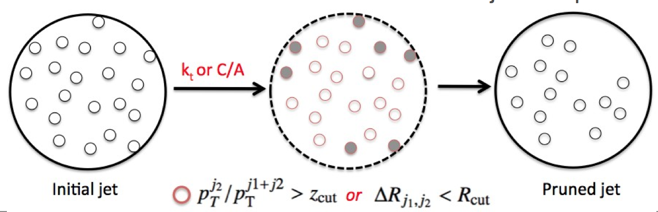
Jet Pruning Techniques
Selective removal of jet constituents from initially clustered jet
  Reclustering with C/A but vetoing soft or wide-angle combinations
E. Thompson
“Subjettiness”: undo the last prune/clustering to get two subjets
Ratio is small when consistent with 2 subjets

Slide 24
Jet Mass Measurements
Mass of original fat jet is very different for W jets and light jets (even w/ pileup)
Pruning only serves to enhance this effect by removing wide angle particles
For mass drop measurement, go back one step to the final 2-subjet stage
Mass drop focuses on main subjet mass
  Small μ when W decays to ud or cs
Combine these techniques
  Prune first, then make mass drop cut, then calculate subjettiness with pruned particles

Slide 25
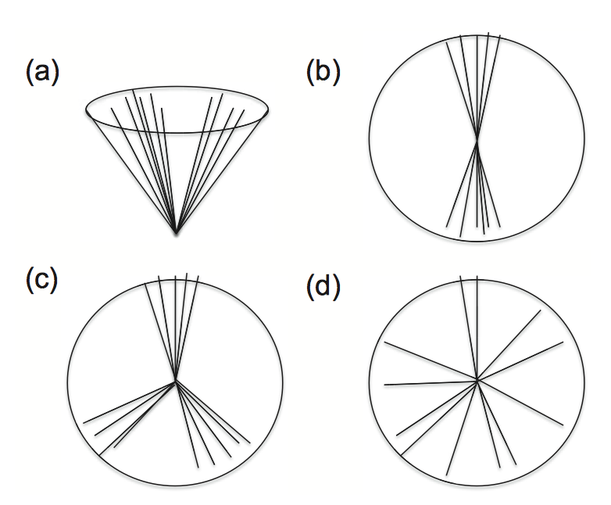
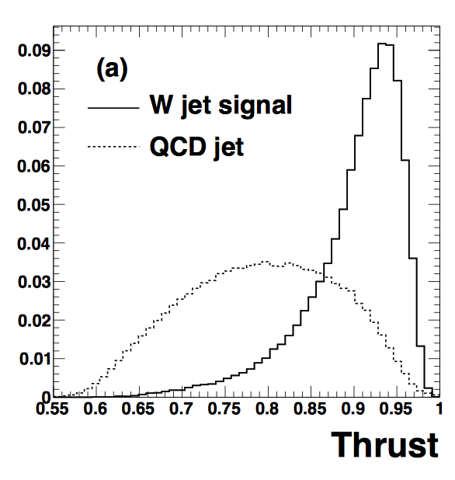
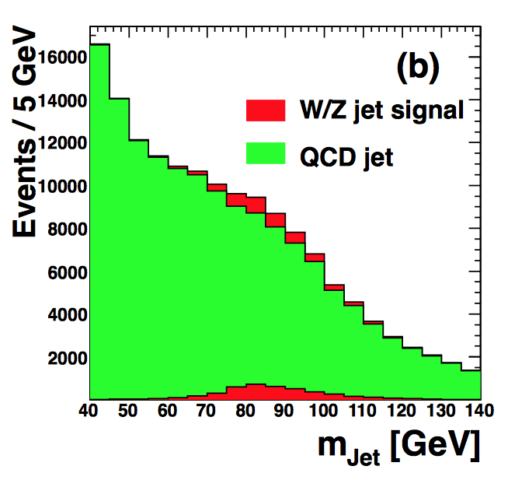
Boosted Jet Shape Techniques
Completely different approach: look at jet in its own rest frame
  Is it a dijet-like geometry? No jet clustering
If we treat this boosted jet like a mini-event, is it linear (W-jet, a&b) or spherical (QCD jet, c&d)?
Chen, PRL 85, 034007 (2012)
Find thrust axis to maximize T

Slide 26
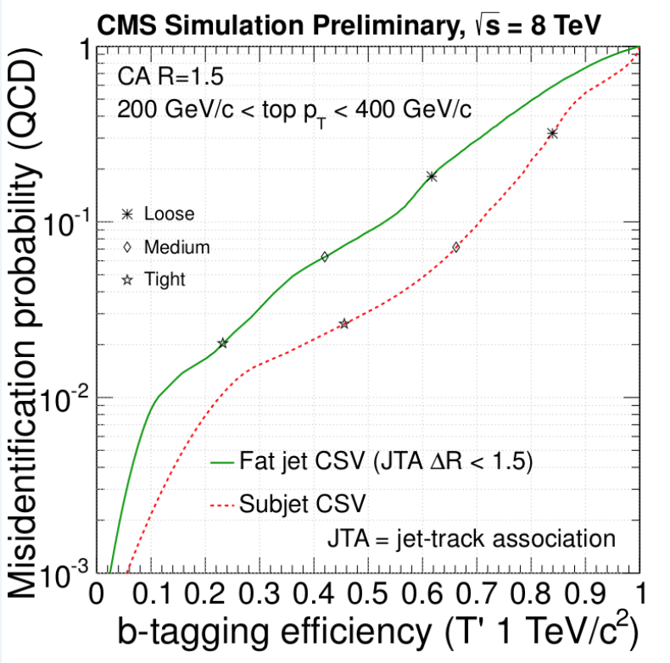
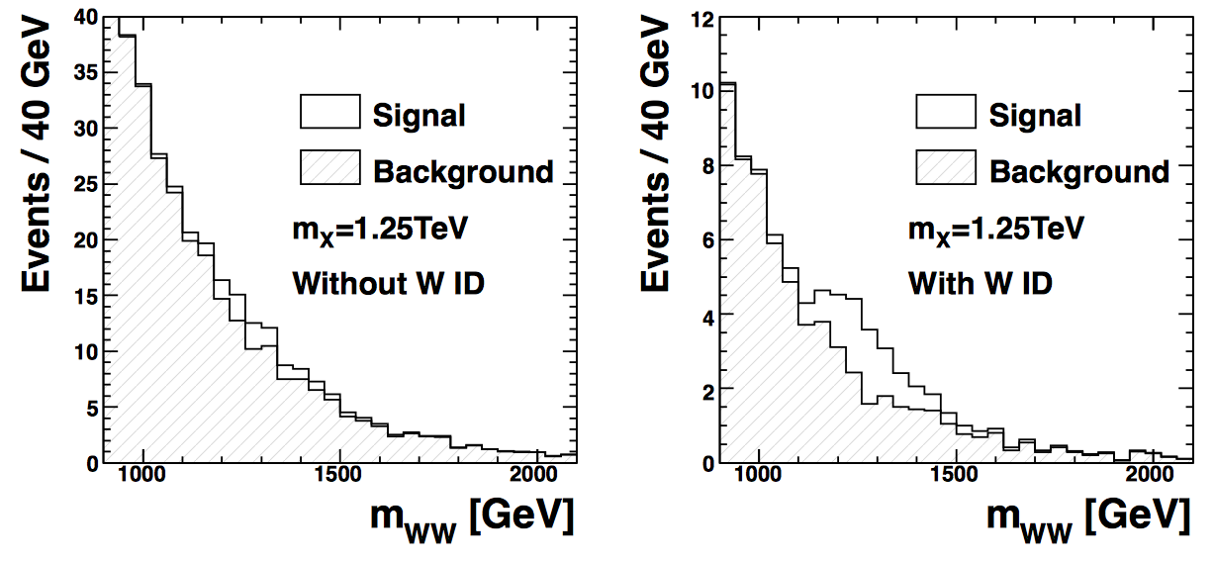
Results for Boosted W Bosons
W-tagged sample is not as pure as the b-tagged sample, but impressive!
Use the W-tagger to pick out a resonant WW signal at high mass (boosted W jets)
W-tag
b-tag

Slide 27
Top Quark Tagging
CMS PAS JME-13-007
If boosted W boson can be identified in a single jet, why not top?
Boosted top quarks could be produced in decays of ultra-high-mass exotic resonances (Z’) or high mass stops
Why top? Striking hadronic decay signature, even more distinct that b-quark decays
  Boosted W boson jet and high-p_{T} b jet
High mass of top quark means jet width is increased relative to W
  Typical C/A jet radius is 0.8 or even 1.5 (HEP Top Tagger)
Several algorithms have been developed, tested, combined
  All depend on the jet substructure and mass drop from top to W to udcs
  B-tagging the subjets is not trivial; ongoing improvement to define subjets based on tracking alone
Look at two examples: CMS Top Tagger and HEP Top Tagger

Slide 28
Top Quark Tagging Methods
CMS Top Tagger (JHU Top Tagger ) [Kaplan et al., PRL 101 (2008) 142001]
  Declusters the C/A R=0.8 jet until it finds two subclusters which are
    well separated:
    contain a significant fraction of the hard jet:
Calculate variables using subclusters (subjets) as components
  Jet mass, with subclusters combined
  Minimum pairwise mass of three leading subclusters
  “N-jettiness” measures the N-jet hypothesis inside boosted jet: note τ₃/τ₂

Slide 29
Top Quark Tagging Methods
HEP Top Tagger [Plehn et al., JHEP 1010 (2010) 078]
  Complex combination of mass drop and filtering
Slide from CMS
m₁<0.8m_{j}
“no more than 5”

Slide 30
Top Quark Tagging Performance
Combined taggers include other variables and subjet b-tagging
Best-performing algorithm depends on kinematic (top p_{T}) regime

Slide 31
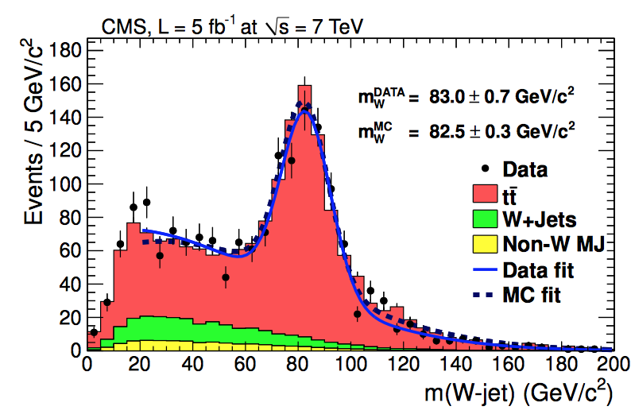
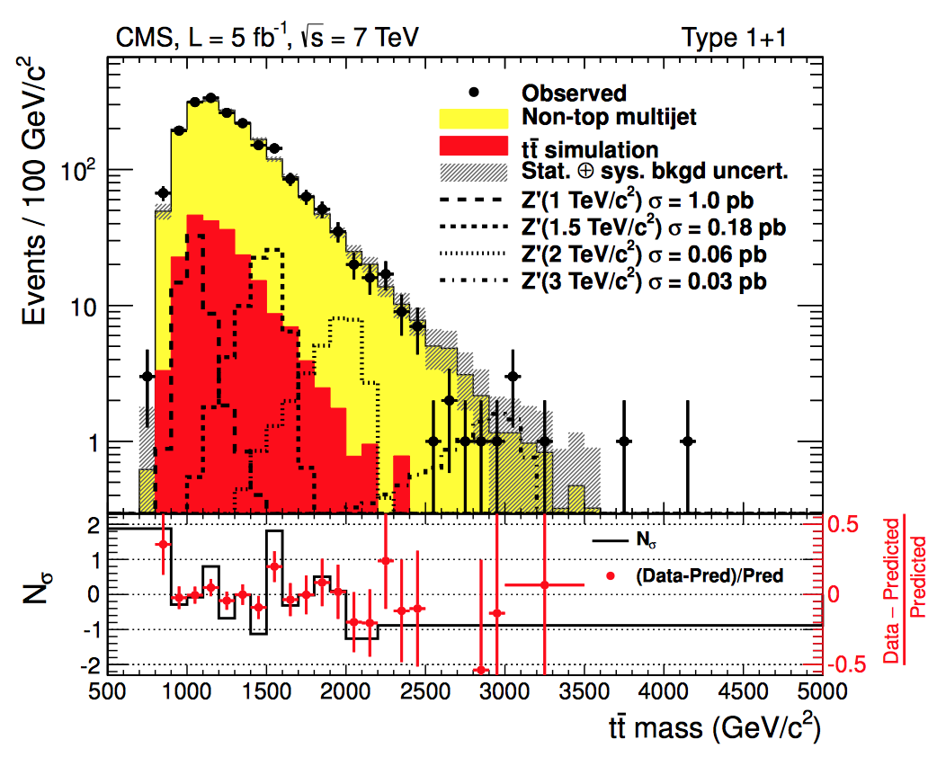
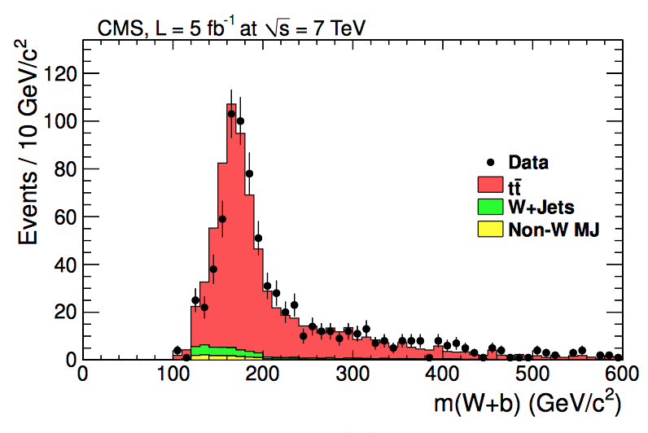
Results Using Top Quark Tagging
“Search for anomalous tt production in the highly-boosted all-hadronic final state” [JHEP 09 (2012) 029]
  Optimized for Z’ masses greater than 1 TeV
  Simplified version of the HEP Top Tagger w/ mass drop and pruning
Fully-merged jets channel

Slide 32
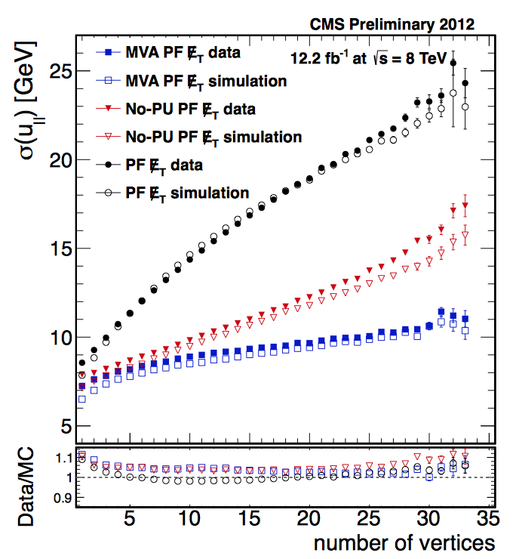
Missing E_{T}
I’ve left this for last because it is the opposite of everything we’ve discussed: “non-particle-ID” and “non-reconstruction”
Nevertheless, it is particle ID for neutrinos and dark matter particles
  These neutral particles do not decay and do not shower hadronically
Particle Flow helps MET reco by removing/calibrating soft particles
Each pileup adds 3.5 GeV in quadrature to MET resolution
CMS No-Pileup algorithm deweights particles that are likely to have come from a pileup vertex
  Big reduction in MET in Z(μμ) events

Slide 33
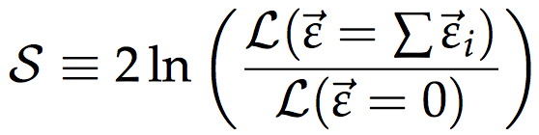
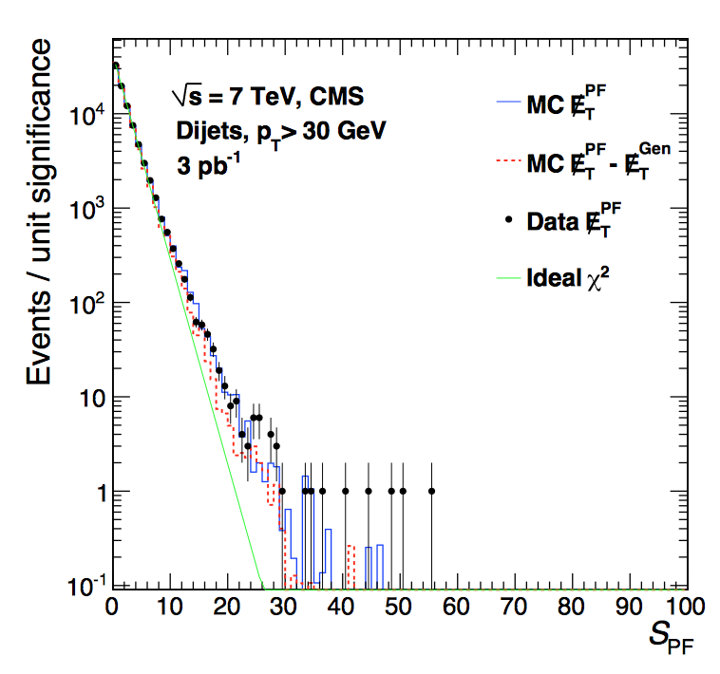
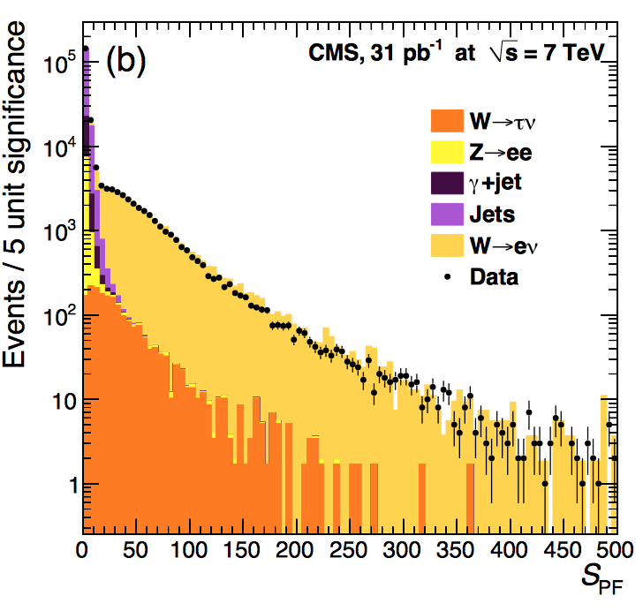
Missing ET Significance
Developed at Tevatron to quantify: how consistent is a single event with the MET=0 hypothesis?
  Include somehow the resolution effects in the missing E_{T} variable
  This requires a resolution calculation for each individual contribution: jets, single charged particles, neutral calorimeter clusters (even PF particles)
Build a product of many Gaussian resolution functions into a likelihood, and calculate the ratio
Dijet events
W events

Slide 34
Summary of Today’s Topics
Reconstructed jets associated with partons from hard scatter
  Key point: well-behaved algorithm to unravel non-perturb. QCD step
  Jet cleaning, calibration, and pileup subtraction improve this connection
Tau lepton reconstruction
  Leptonic or hadronic decays require different algorithms and techniques
  Hadronic decay signatures are skinny (mini-) jets
Heavy-flavor tagging has applications in searches and Higgs
  Discriminating variables take advantage of long lifetime and large mass.
  Multivariate techniques can even distinguish b quark from gluon jets
W boson and top quark tagging for highly-boosted states
  Groomed or boosted jets show W bosons decaying inside a single jet
  Top-tagging algorithms are based on jet substructure and kinematics
Missing E_{T}
  Improving resolution allows us to associate missing E_{T} with neutrinos or LSPs

Slide 35
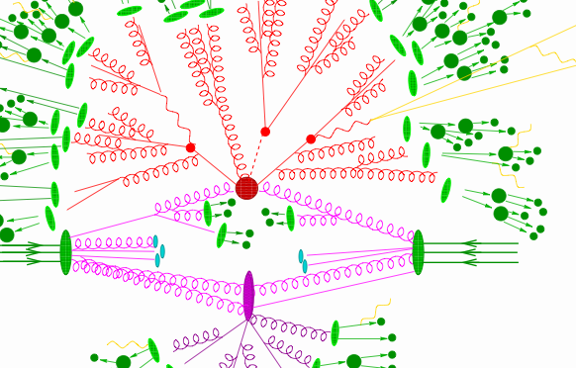
Good Luck

Slide 36
Guide to Further Reading
Jets:
  Lectures in this school by Fernando Febres Cordero
  G. Salam, “Toward Jetography,” arXiv:0906.1833
Tau identification:
Heavy-flavor / gluon jet tagging:
  Gallichio and Schwartz, “Quark and Gluon Tagging at the LHC ,” arXiv:1106.3076
  G. Piacquadio’s thesis: CERN-THESIS-2010-027
W/top tagging:
  Ellis, Vermilion, and Walsh, “Pruning as a Tool for Heavy Particle Searches,” hep-ph/0912.0033

