Slide 1
Parametric X-Ray Radiation
Todd Seiss
Mentor: Tanaji Sen
Fermilab
Lee Teng Summer Intern Program

Slide 2
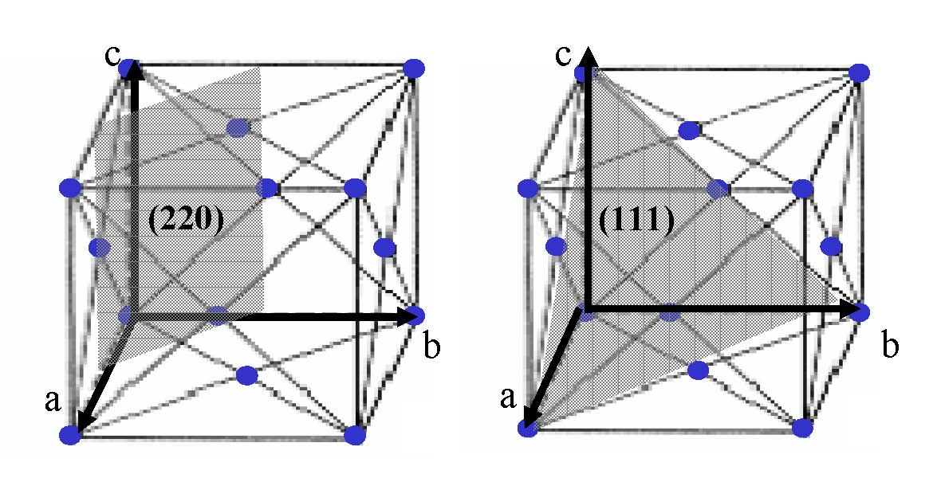
Theory
The atoms in crystals are arranged into repeating parallel crystal planes.
Photo: Sones, Block, and Danon. Development of a Tunable Xray Source:
Technical Report. RPI. 2004.

Slide 3
Theory
These planes can act as mirrors for reflecting x-rays, but a given plane will only reflect one particular resonant frequency.
The electric field around an electron is made of virtual photons of many different frequencies.
When an electron passes through a crystal, the virtual photons at the resonant frequency for the crystal planes are diffracted.

Slide 4
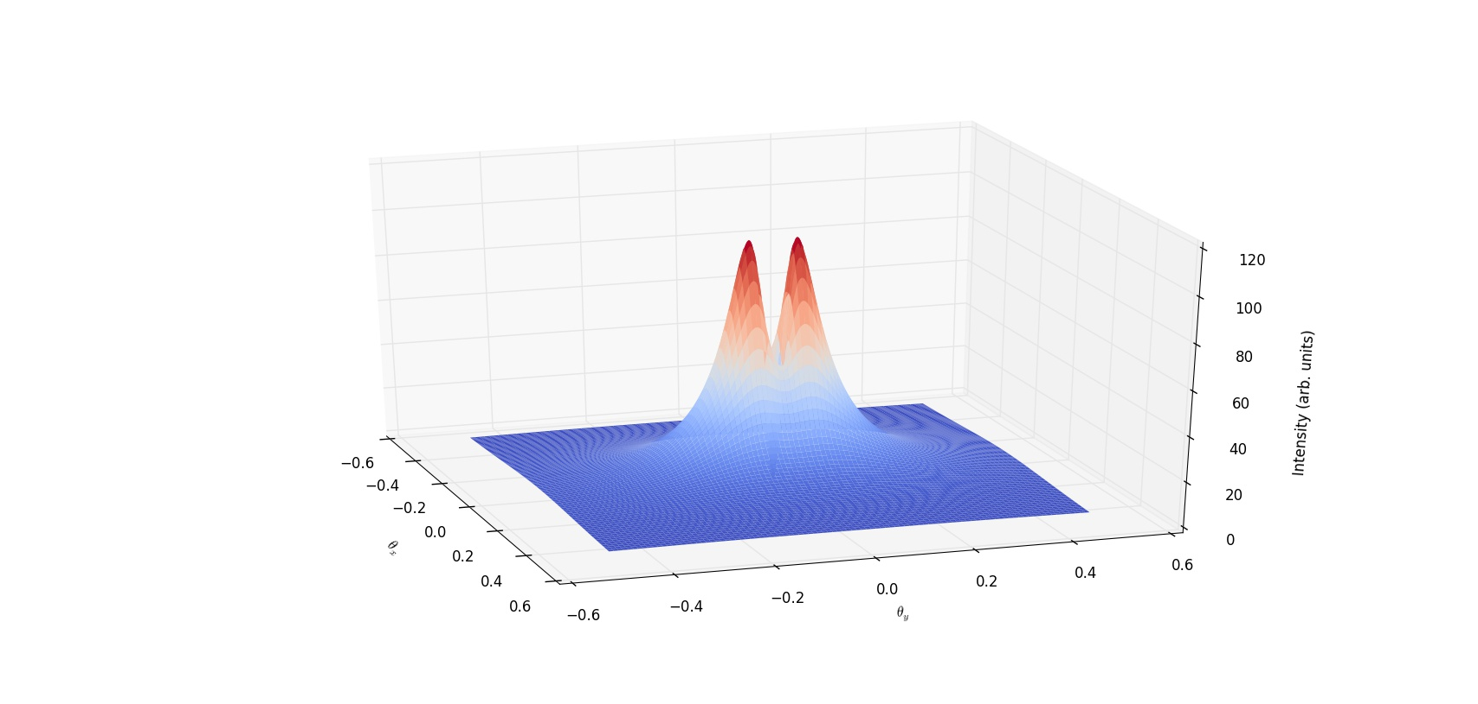
Plots

Slide 5
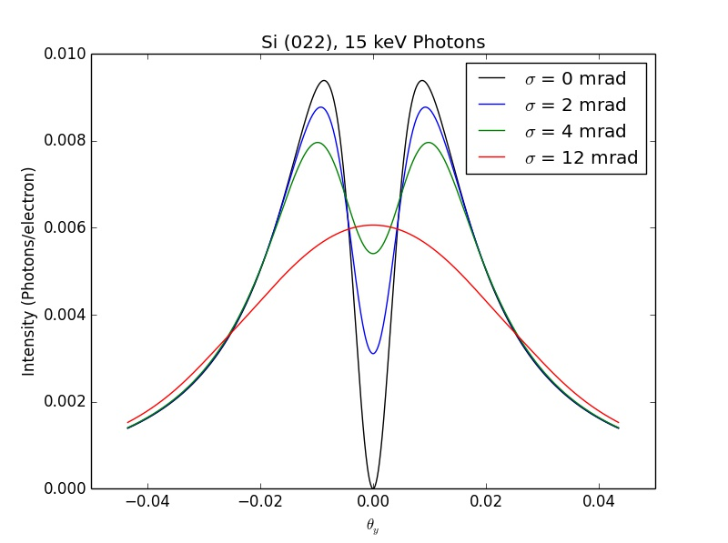
Plots

Slide 6
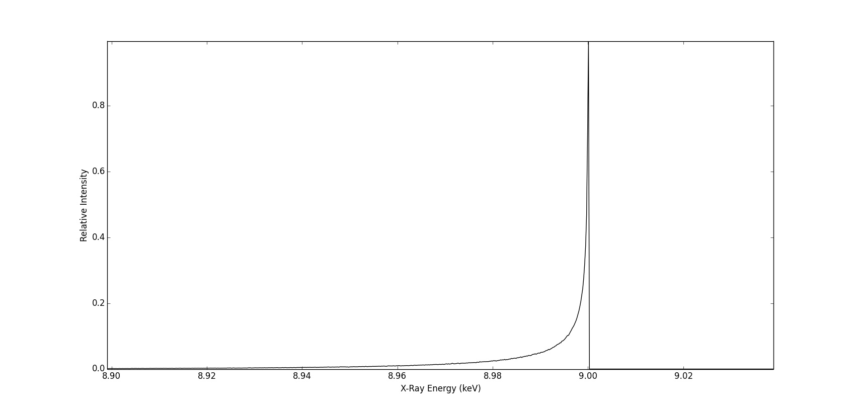
Plots

