Slide 1
Dielectric sample test and preparation for MTA beam test
Huy Phan
McDaniel College, Fermilab
Advisor: Katsuya Yonehara

Slide 2
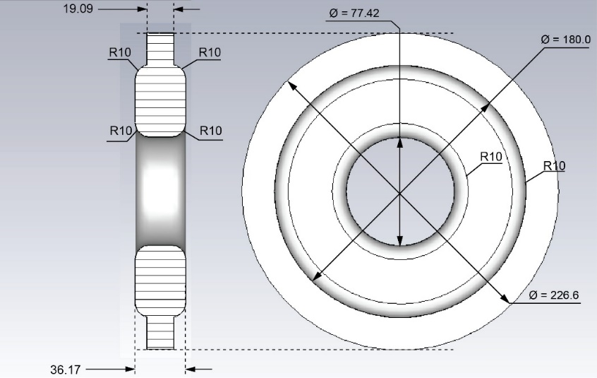
1/ Test materials to be used as insert rings in Helical Cooling Channel for proposed muon collider
  Insert dielectric ring inside the cavity to reduce its radius and fit into the helical cooling channel of the muon accelerator
  Sample test: measure the loss tangent and dielectric constant of alumina and other material sample

Slide 3
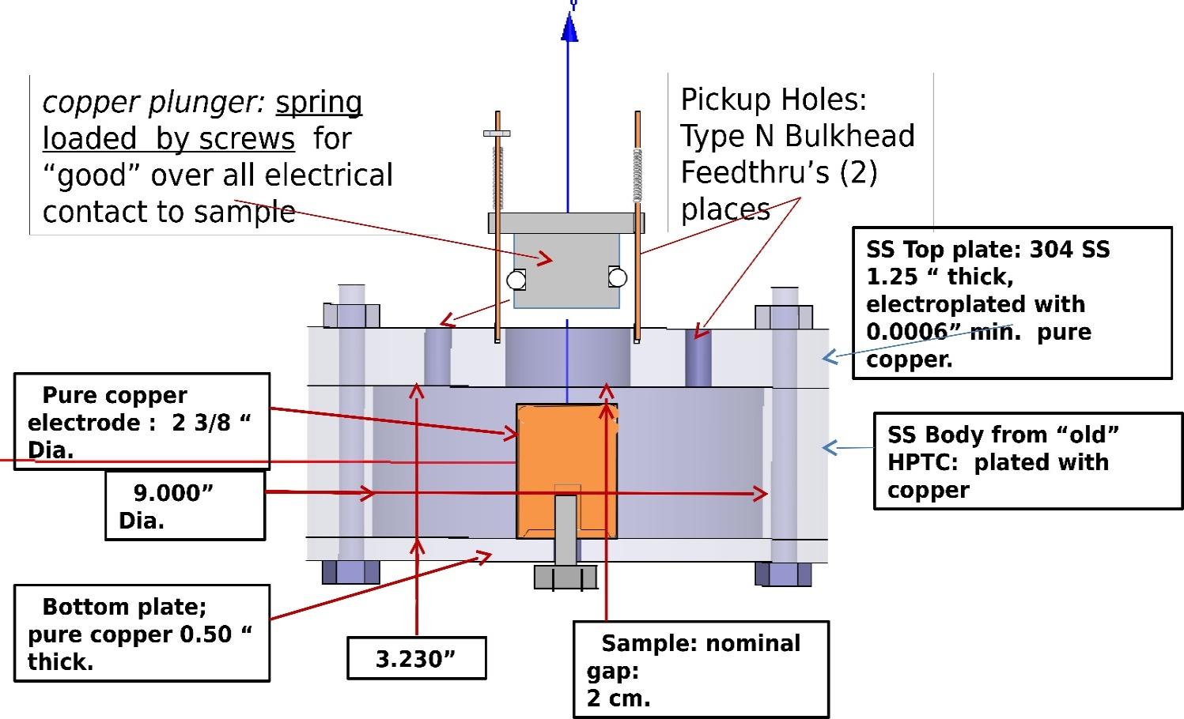
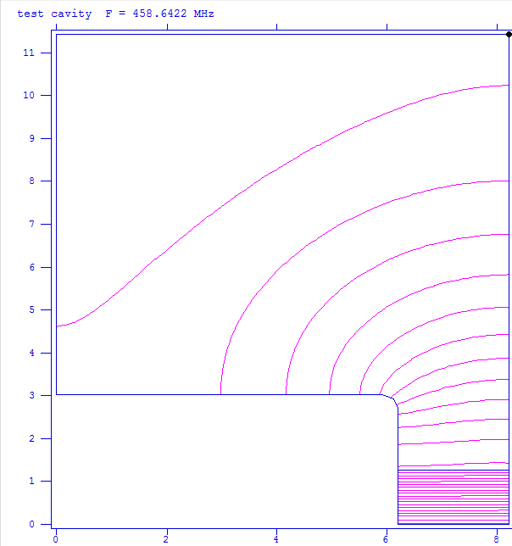
  Method: using Poisson/Superfish simulation to calculate expected Q-factor and resonant frequency => compare with measurement values
  More data is being taken => analysis follows shortly
  Alumina (Al₂O₃) is most possible candidate

Slide 4
2/ Investigate thermal stress on the ring to prepare for beam test
Electric field heats up dielectric material
Heat diffusion equation:
Temperature rises to max 0.2K per pulse, steady-state temperature reaches max at ~400K
Thermal stress is minimal for 15Hz pulses

Slide 5
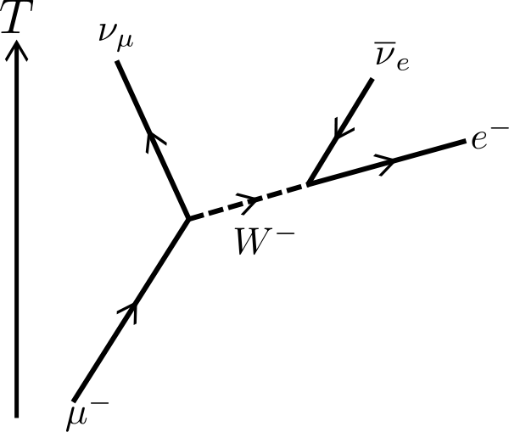
3/Design beam diagnostics for HCC
Ideas: using ionized electrons and/or decay electron to monitor the beam
Energy spectrum of electron can give information about beam profile

