Slide 1
Study of High T_{c} Superconducting MgB₂ Thin-Film Coated RF Cavities
Goal: To optimize a resonator to test the quality of a coupon of MgB₂
Ashley Ernst
Lee Teng Undergraduate Fellowship in Accelerator Science and Engineering
Supervisors: Dr. Ali Nassiri and Dr. Bob Kustom
Argonne National Laboratory
Advance Photon Source
Accelerator Systems Division, RF Group

Slide 2
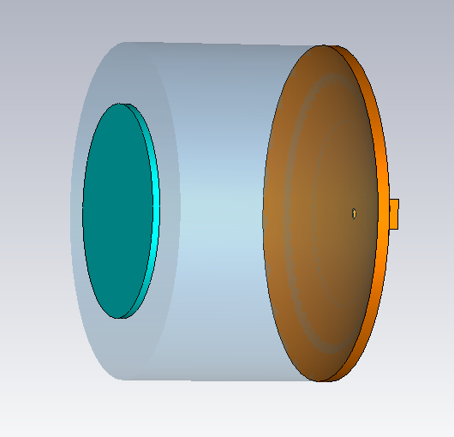
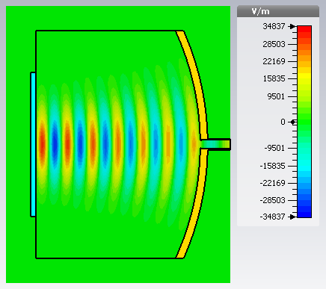
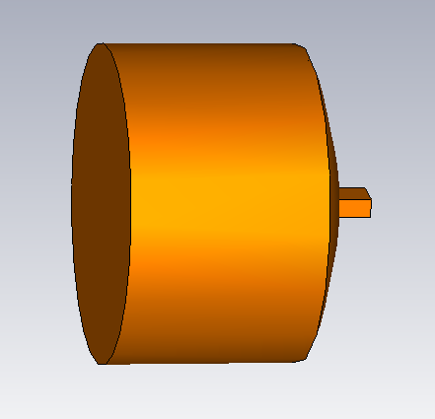
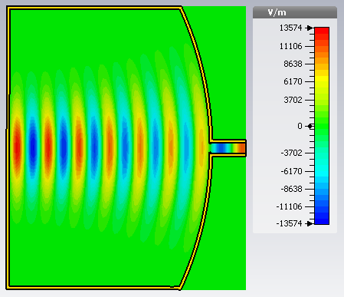
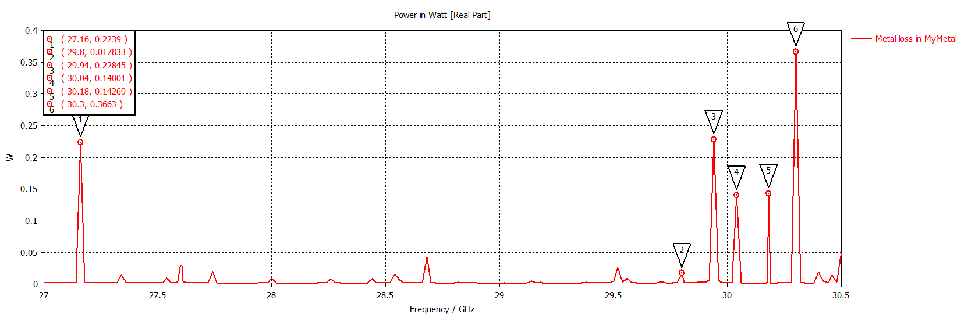
Simulations
Varied dimensions of the Fabry-Perot open resonator (left) to find optimal design
  Radius of mirror
  Height of curvature
  Radius of sample
  Separation
Power dissipation in the sample was not large enough
Too much power is radiating out
Closed resonator (left) and the electric field pattern of one of the modes (right)
Mode is present
Power dissipation is small
Open Resonator at 29.80 GHz
Closed Resonator at 29.80 GHz

Slide 3
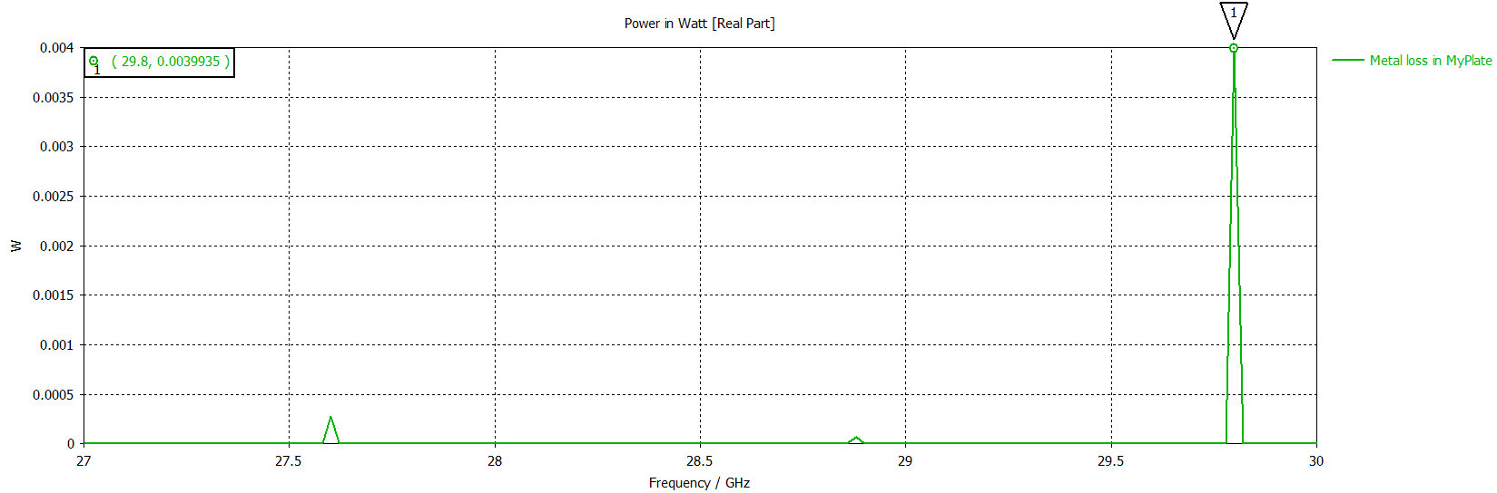
By the end of the summer…
Find an optimal resonator design where an adequate amount of power is dissipated onto the sample.
Potentially run a test of the resonator design to measure the quality factor of the coupon
Ultimately, this project is helping to determine the feasibility of using MgB₂ for cryogen-free RF systems
Power lost in sample for an open resonator. Total power is 0.50W.

