Slide 1

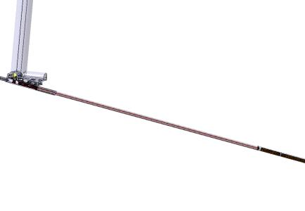
Engineering studies for the Conceptual design of the LBNO Facility
F. Sanchez Galan (CERN)
on behalf of the CERN Secondary Beam Working Group,
With contributions from B. Biskup, D. Brethoux, M. Calviani, N. Charitonidis, DAES,
I. Efthymiopoulos, B. Feral, J.A. Osborne, RAL, D. Smargianaki, C. Strabel, P. Velten, V. Venturi, H.Vincke.

Slide 2
Lay out, overview
Horn, reflector, target, striplines
Target chamber
Decay pipe
Hadron stop
Timeline
Conclusions
Outline

Slide 3
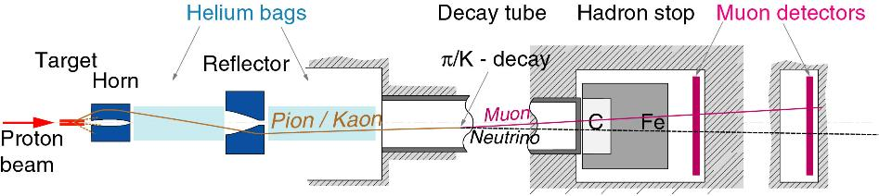
Lay-out, overview
Helium tanks
Near detector
291 kA @ 50 GeV 281 kA @ 400 GeV
Φ = 3 m water cooled steel tube, surrounded by 150 cm concrete;
~9 m³ cooled graphite, followed by iron blocks;
167 kA @ 50 GeV 198 kA @ 400 GeV

Slide 4
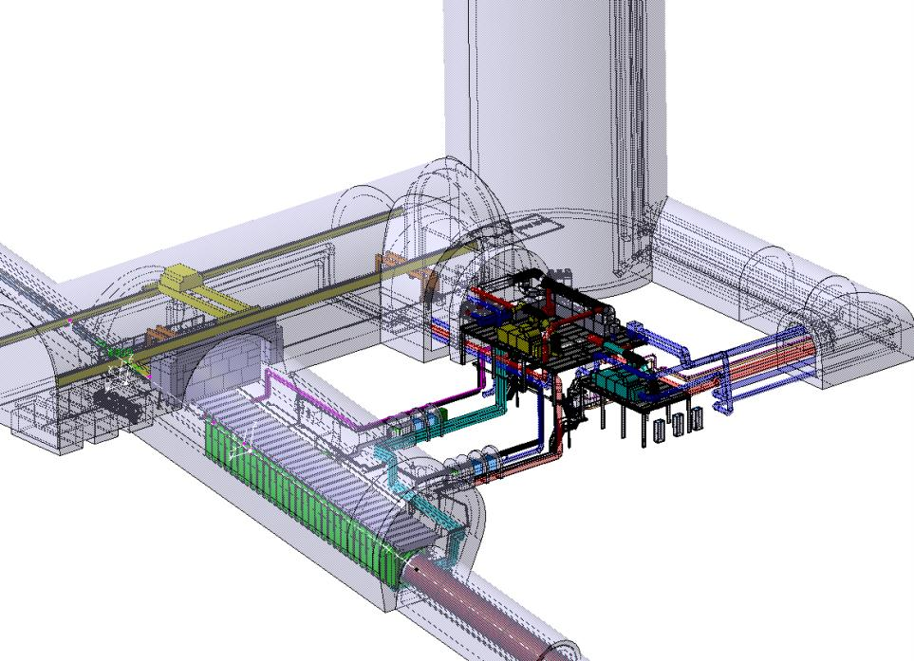
Lay-out, overview
Underground layout designed in close contact with Radioprotection (See talk H. Vincke).
Integration of services.
Horn, target, reflector, striplines

Slide 5
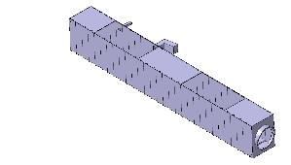
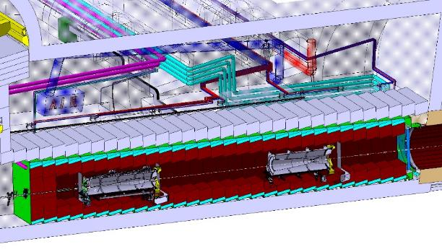
Lay-out, overview
He vessel at target chamber
Openings for maintenance operations
Target, Horn and reflector and ancillary systems design and integration.
Integration of services

Slide 6
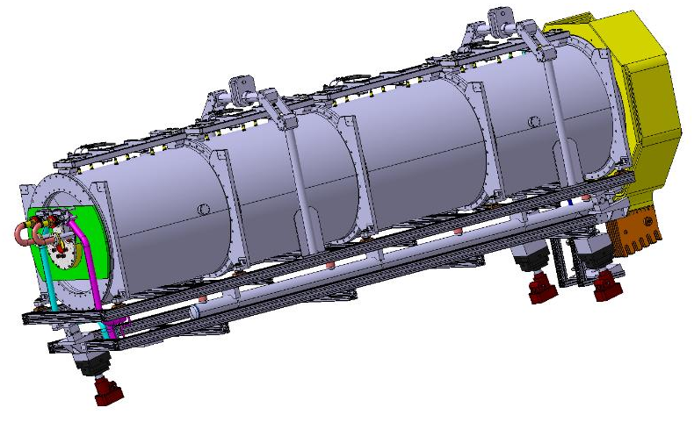
Horn and reflector
Target integration.
Insertion to horn & plug-in at the hot cell
Work done in collaboration with RAL

Slide 7
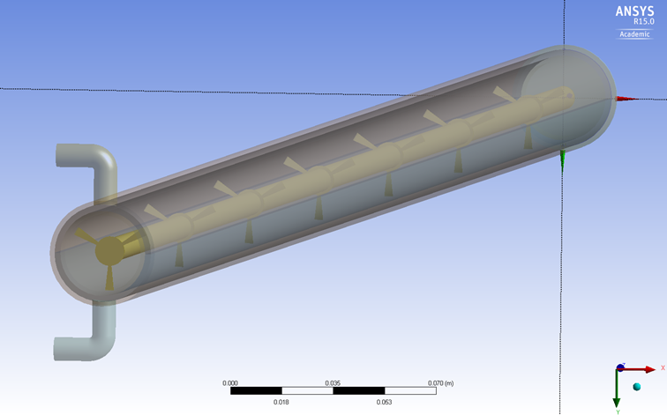
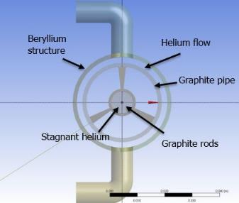
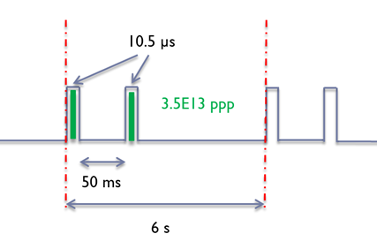
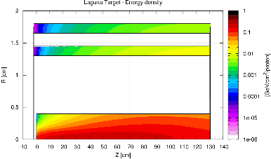
Target
Target design was splitted between CERN-STI Phase 1 (400GeV) and RAL (50 GeV)

Slide 8
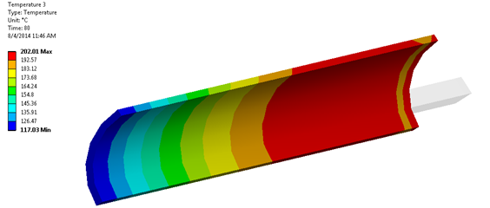
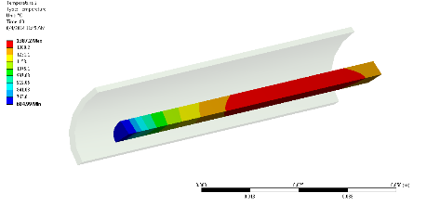
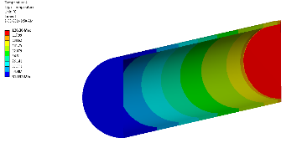
Target
Steady-state results, Trod 1387 C, inner C pipe 202, inner Be pipe 126 C
Work done in collaboration with RAL

Slide 9
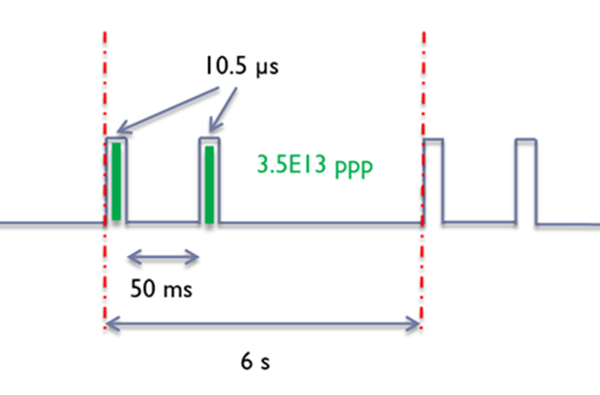
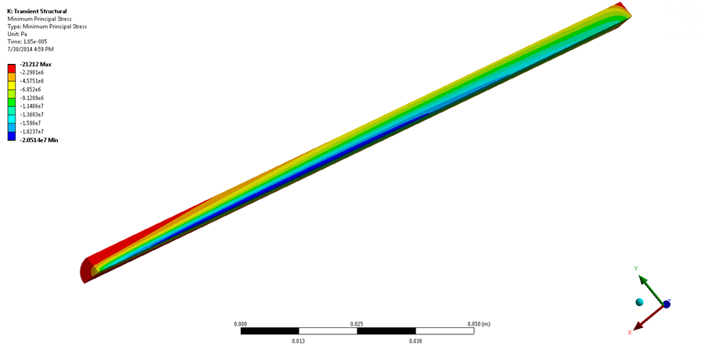
Target
Transient results, T1 608 C, T2 362 C, T3 807 C
Maximum equivalent stress around 20 MPa during cycles, below the stress range fatigue limit for Graphite.
Maximum displacements around 0.45 mm

Slide 10
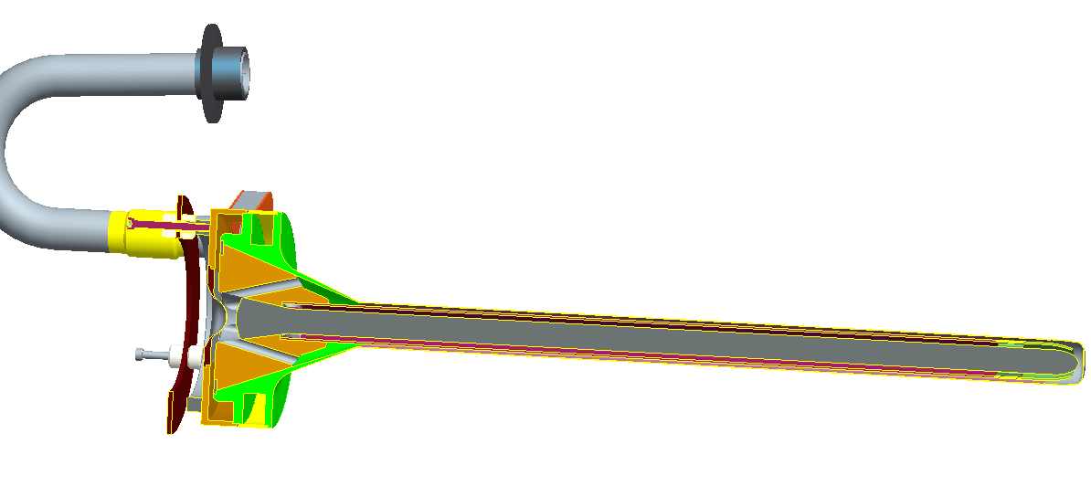
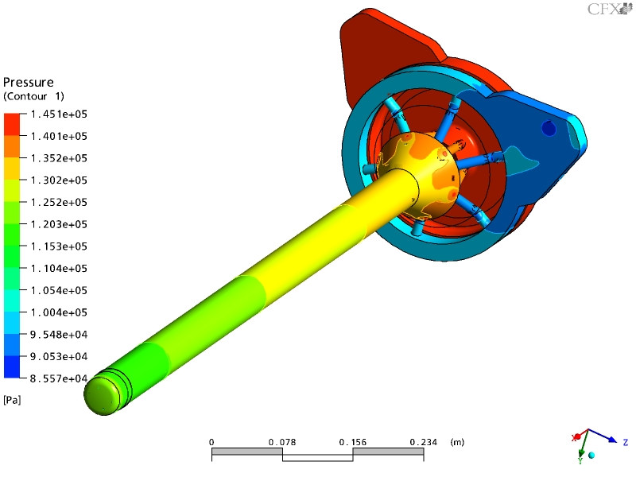
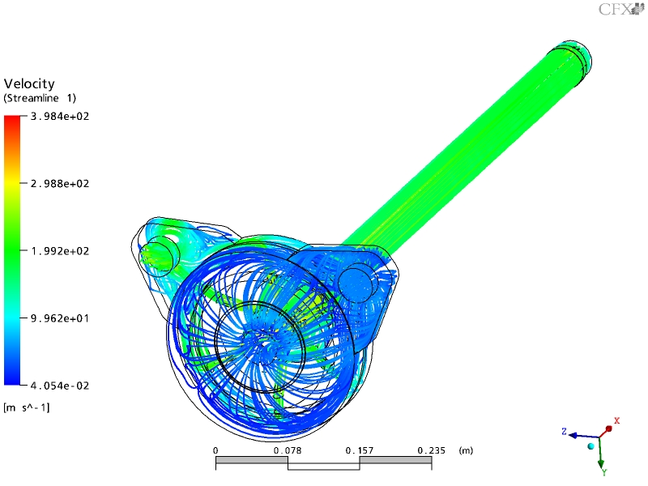
Monolithic (peripherally cooled) target à la T2K
T2K
Beam 30GeV, 750kW
Target 23kW, 8 MPa stress
Graphite core
Ti-6Al-4V shell
Helium cooling velocity streamlines
Maximum velocity = 398 m/s
M.Fitton
C.Densham

Slide 11
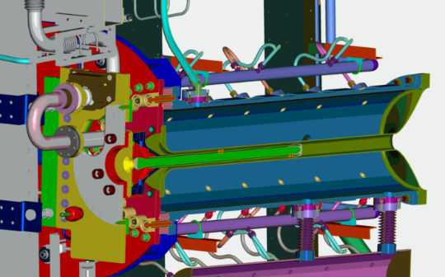
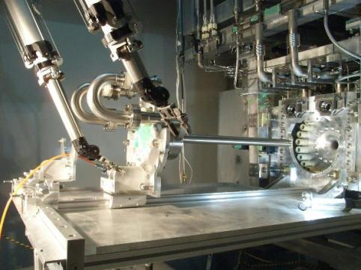
T2K-like Target & horn (50 GeV)
π
p
π
RAL
Helium cooled solid graphite rod
Design beam power: 750 kW (heat load in target c.25 kW)
Beam power so far: 230 kW
1st target & horn just replaced after 4 years operation, 7e20 p.o.t.
Target exchange system

Slide 12
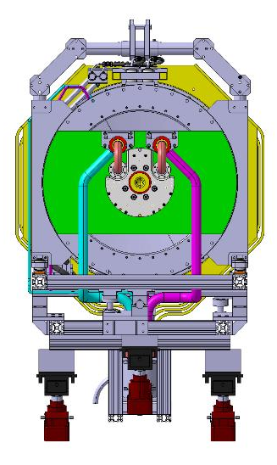
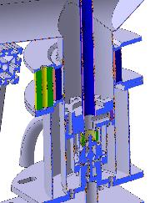
Horn, target integration
Target helium feeds
Horn plug-in helium & water feeds
Work done in collaboration with RAL

Slide 13
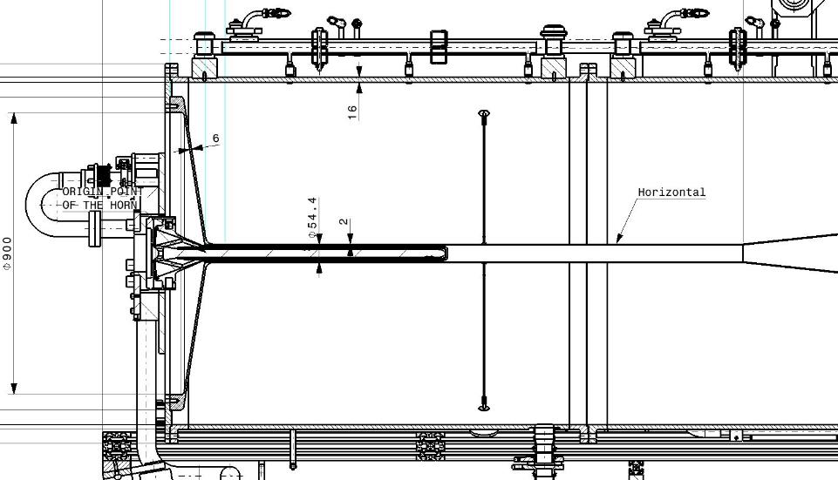
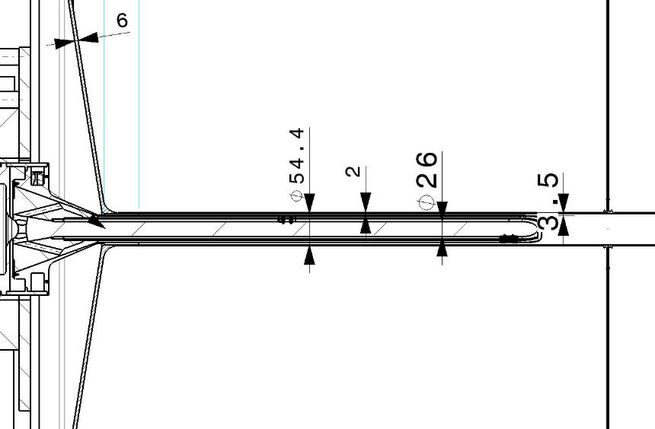
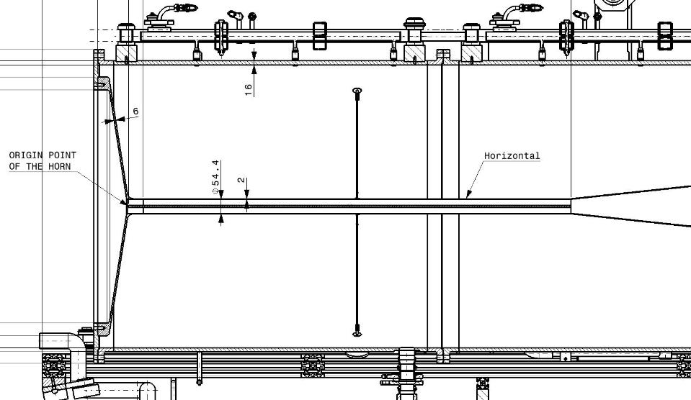
Horn, target integration
Target integration
Work done in collaboration with RAL

Slide 14
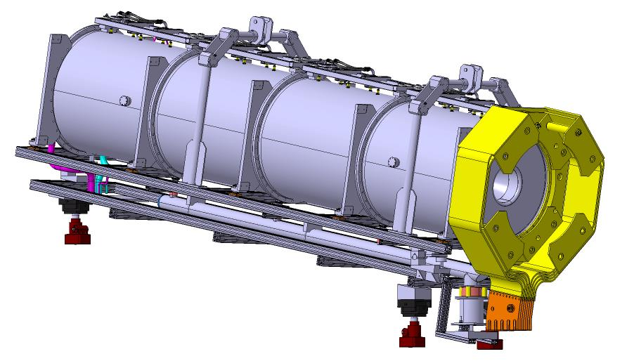
Horn and reflector, ancillary systems.
Plug-in systems, RH vertical movement.
He and water feeds /outlets
Striplines connection.

Slide 15
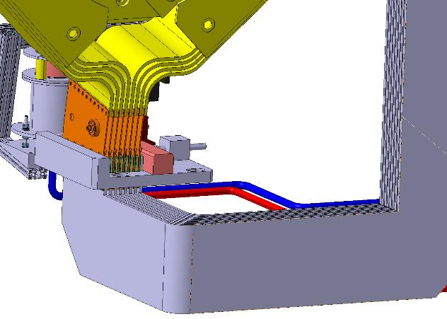
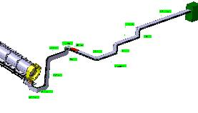
Striplines remote connection
Vertical insertion
Clamping with a vice system

Slide 16
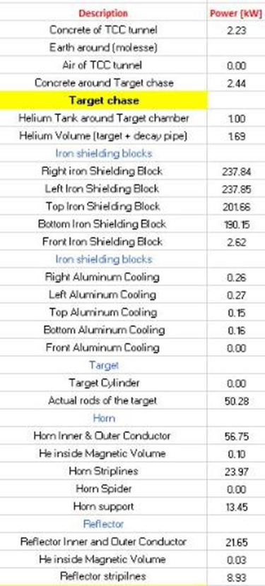
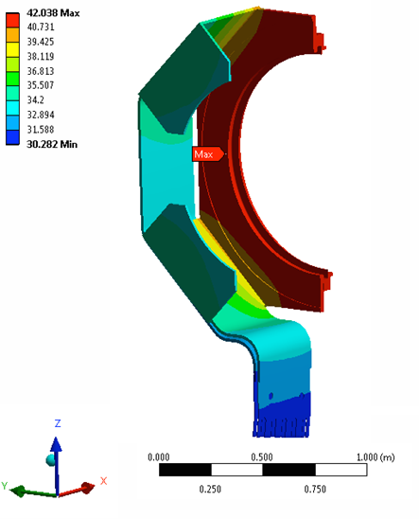
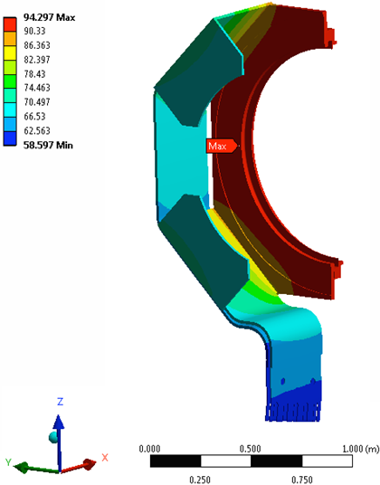
Striplines thermal analysis
With a ‘normal’ He cooling, maximum temperatures are within acceptable values: below 50 C for phase 1 and below 100 C for phase 2

Slide 17
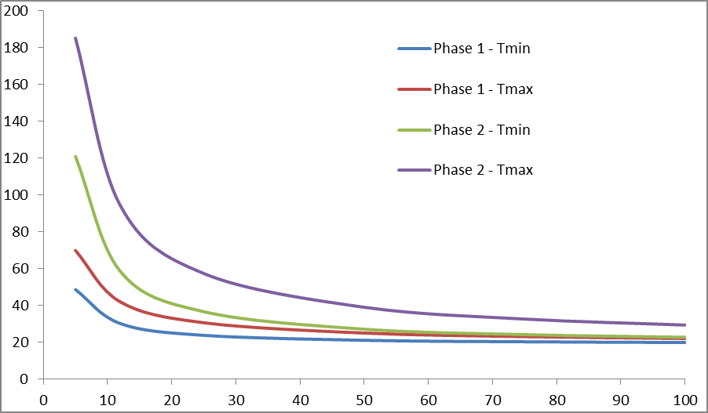
Striplines remote connection
There’s a good margin to improve cooling if required.

Slide 18
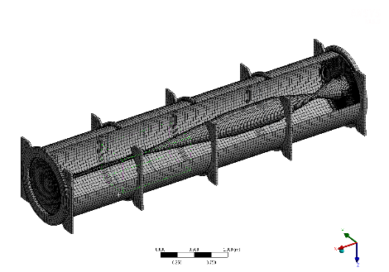
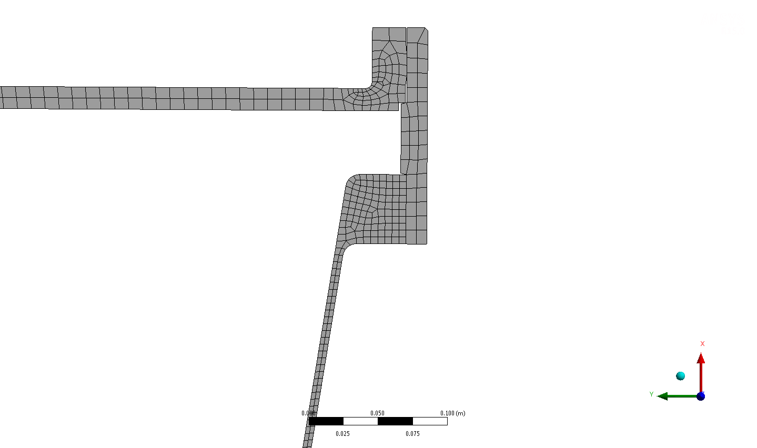
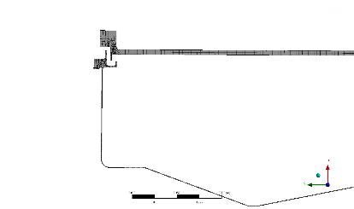
Horn and reflector
Thermo-structural analysis
Energy deposition for the entire horn: 56.75 kW
Max energy deposition: at target end ~ 110 W/cm³

Slide 19
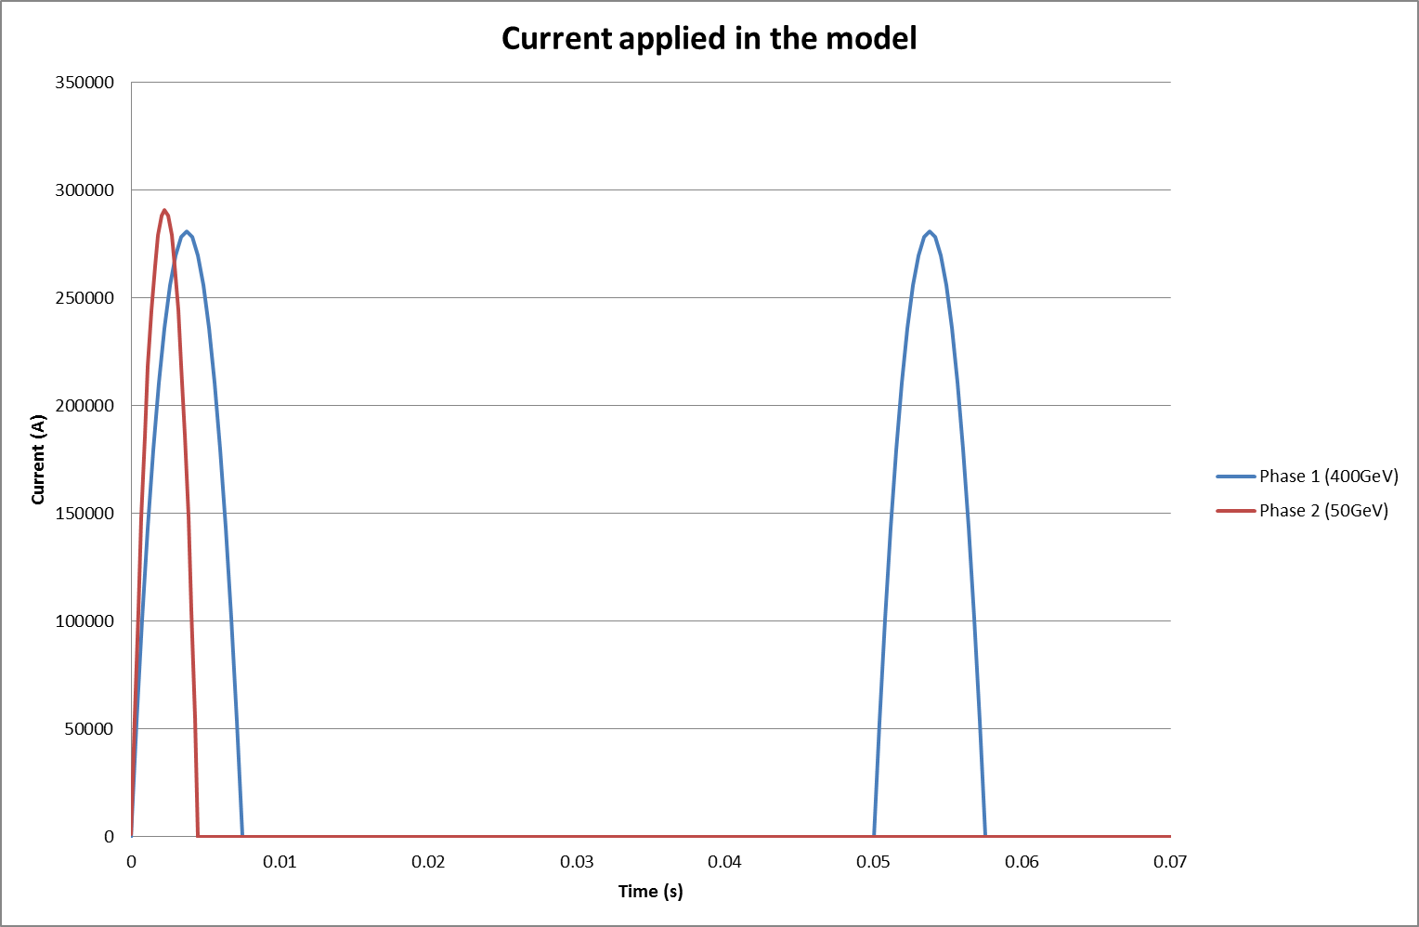
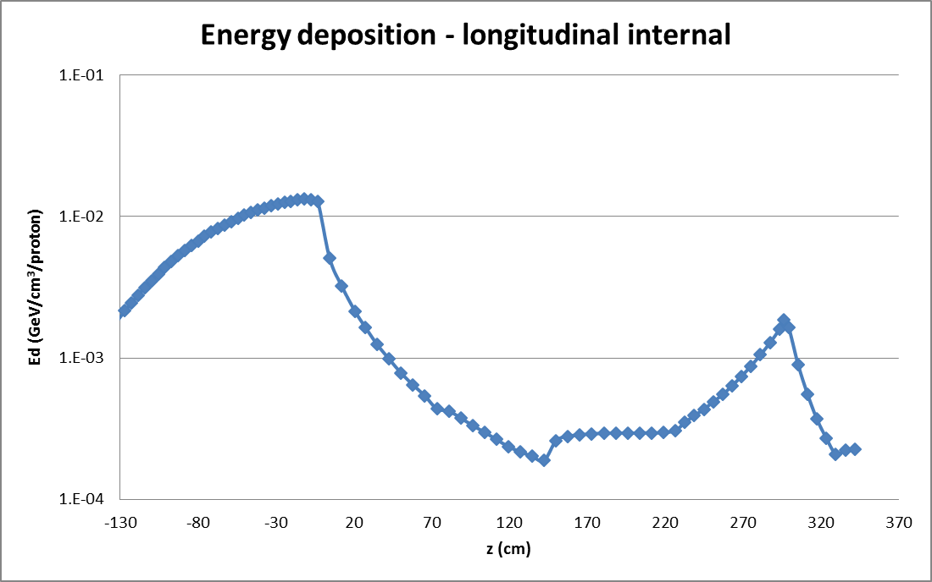
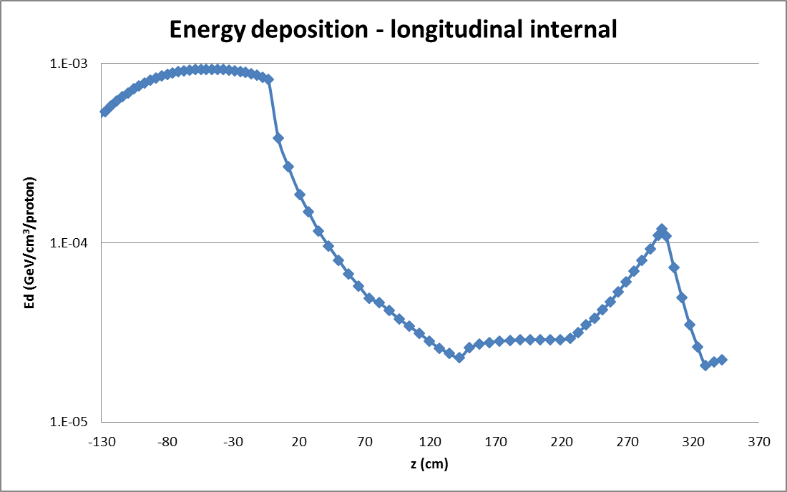
Horn thermal analysis
Phase 1 : Beam from SPS @ 400 GeV
6 s cycle
two extractions/cycle separately by 50 ms
beam pulse during 10 us in each extraction
3.5 10¹³ protons/extraction (7.0 10¹³ protons/cycle)
average beam power 750 kW
Phase 2 : Beam from HP-PS @ 50 GeV
- 1 s cycle
- single extraction per cycle
- beam pulse during 4 us
- 2.5 10¹³ protons/cycle
- average beam power 2.0 MW
Phase 1
Phase 2

Slide 20
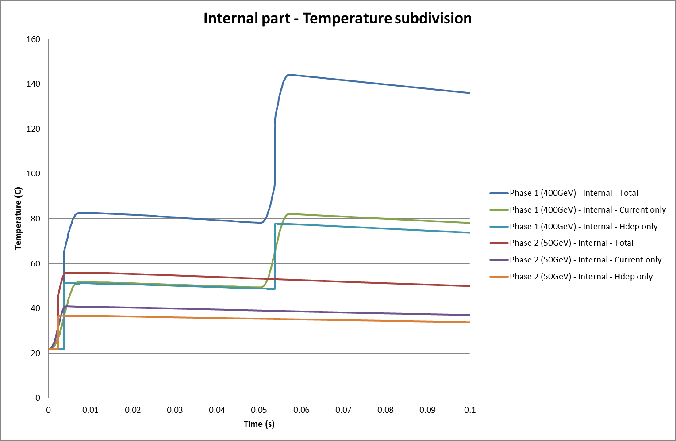
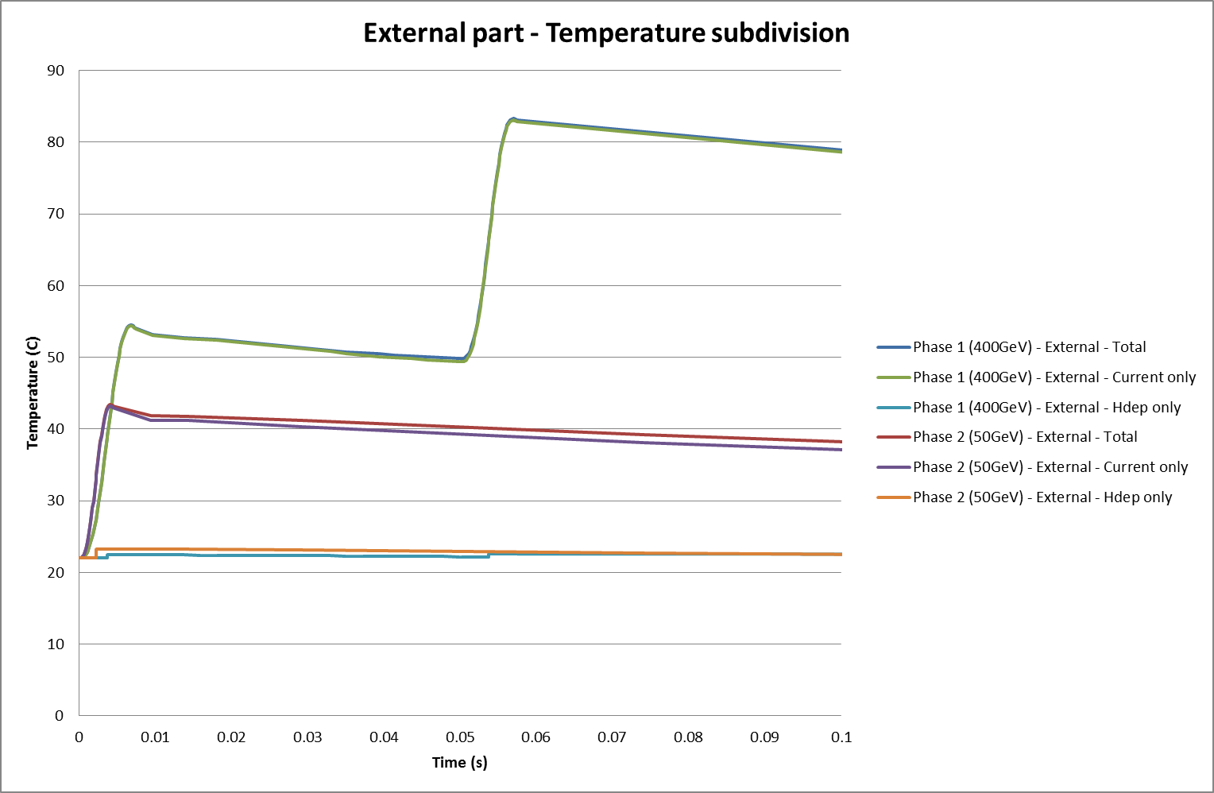
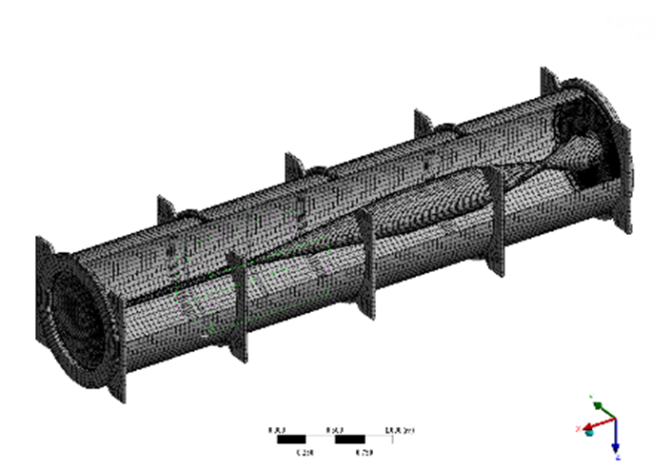
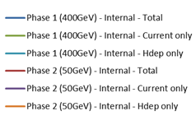
Horn thermal analysis

Slide 21
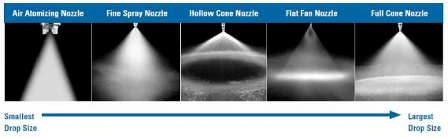
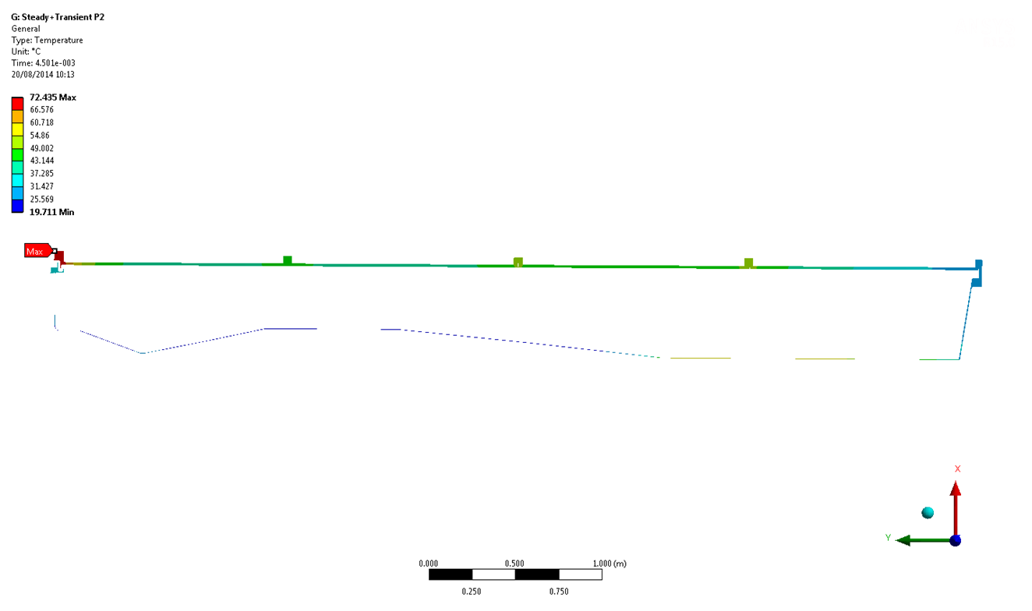
Horn thermal analysis
Convection:
Inner conductor 10 kW/m² K
Outer conductor 100 W/m² K
The maximum temperature in steady state is 83°C for the 400GeV beam and 73°C for the 50GeV beam
For the 400GeV beam, the temperature reaches 162°C during a short time.
For the 50GeV beam, the temperature remains always below 75°C, even during a pulse.

Slide 22

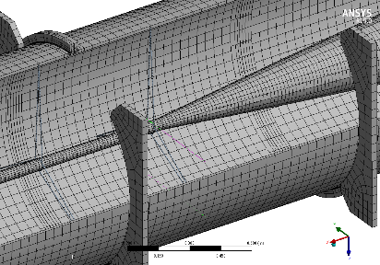
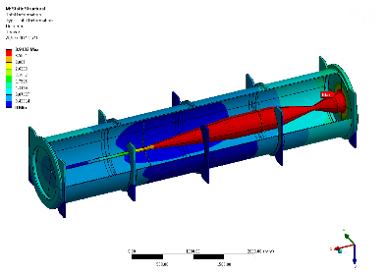
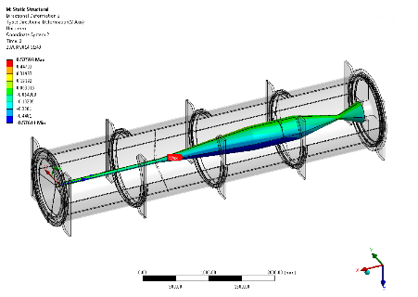
Horn structural analysis
Maximum lateral displacement
3.9 mm during pulse
Maximum vertical displacement
0.5 mm during pulse
Images from P. Sabbagh, DAES

Slide 23
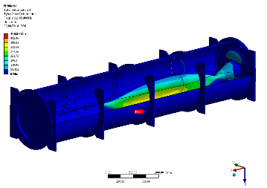
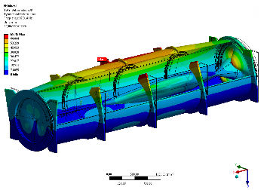
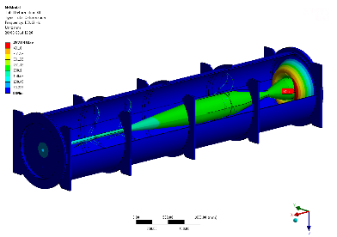
Horn structural analysis
Vibration modes start at 93 Hz (main in the range 93-120 Hz)

Slide 24

Horn structural analysis
The equivalent stress reaches for 400GeV 100MPa in the internal part of the horn, 132MPa in the exit cover and 30MPa in the front cover.
At 50GeV, those values are much smaller (31MPa, 119MPa and 28MPa respectively).
Stress values are acceptable

Slide 25




Maintenance of horn + target
9th NBI @ Fermilab, 23-26 Sept 2014 F. Sanchez Galan

Slide 26

Maintenance of horn + target
Concrete shielding wall has to be opened
9th NBI @ Fermilab, 23-26 Sept 2014 F. Sanchez Galan

Slide 27

Maintenance of horn + target
Top concrete blocks have to be removed partially
Helium vessel has to be opened
Top iron blocks & cooling plates removed
All operations have to be done remotely
9th NBI @ Fermilab, 23-26 Sept 2014 F. Sanchez Galan

Slide 28

Maintenance of horn + target
horn & target loaded on gantry crane
Water and electrical connectors are automatically released during lifting operation
9th NBI @ Fermilab, 23-26 Sept 2014 F. Sanchez Galan

Slide 29

Maintenance of horn + target
horn & target transportation back to
Transport cavern
9th NBI @ Fermilab, 23-26 Sept 2014 F. Sanchez Galan

Slide 30

Maintenance of horn + target
horn & target transportation back to
Transport cavern
9th NBI @ Fermilab, 23-26 Sept 2014 F. Sanchez Galan

Slide 31

Maintenance of horn + target
horn & target transportation directly to morgue
9th NBI @ Fermilab, 23-26 Sept 2014 F. Sanchez Galan

Slide 32

Maintenance of horn + target
horn & target lowered in the morgue
9th NBI @ Fermilab, 23-26 Sept 2014 F. Sanchez Galan

Slide 33

Maintenance of horn + target
horn & target transportation to the hot cell
9th NBI @ Fermilab, 23-26 Sept 2014 F. Sanchez Galan

Slide 34

Maintenance of horn + target
horn & target transportation using remotely operated “lifting table” vehicle – omnidirectional.
https://www.youtube.com/watch?v=2O8Cj0XiRIM#t=152
9th NBI @ Fermilab, 23-26 Sept 2014 F. Sanchez Galan

Slide 35

Maintenance of horn + target
horn & target with transport vehicle
9th NBI @ Fermilab, 23-26 Sept 2014 F. Sanchez Galan

Slide 36

Maintenance of horn + target
horn & target to hot cell
9th NBI @ Fermilab, 23-26 Sept 2014 F. Sanchez Galan

Slide 37

Maintenance of horn + target
horn & target inside hot cell
9th NBI @ Fermilab, 23-26 Sept 2014 F. Sanchez Galan

Slide 38


Heat loads in shielding elements
A detailed model of the whole geometry has been done in Fluka, including:
Target chamber shielding elements

Slide 39


Heat loads in shielding elements
Internal elements: horn, reflector, striplines

Slide 40

Heat loads in shielding elements
Decay tunnel

Slide 41

Heat loads in shielding elements
Hadron stopper

Slide 42


Heat loads in shielding elements
870 kW Iron
0.8 kW Al
80 kW Horn+striplines
5 kW Target
30 kW Reflector+striplines

Slide 43


Temperature profiles: Target Chamber (4/4)
Around 4% of the generated Heat is removed by the Helium, 96% by water cooling

Slide 44


Decay pipe
3 m diameter
Water cooled
Helium bag

Slide 45



Decay pipe cooling
With the chosen configuration (32 cooling channels, contact surface 20 mm) the decay pipe temperature is around 42 C. The highest temperatures (around 75 C) are reached in the surrounding concrete.

Slide 46


Decay pipe
Upstream shutter allows to keep He inside the decay pipe when opening the target chamber vessel
5 m long tube sectors welded, U water connections (T2K-like).

Slide 47

Hadron stop (CNGS-like dump)

Slide 48



Hadron stop (CNGS-like dump)

Slide 49



Hadron stop (CNGS-like dump)
Steel shielding
Aluminium water cooled sinks
Energy deposition (FLUKA)
Graphite core

Slide 50



Temperature estimations: Hadron stop
Graphite block, Al water cooled plates (CNGS-like)

Slide 51


Temperature estimations: Hadron stop
Heat generation (from Fluka)
Maximum temperature at graphite 110 C for the 50 GeV case

Slide 52


Temperature estimations: Hadron stop
Heat generation (from Fluka)
Maximum temperature at graphite 118 C for the 400 GeV case

Slide 53

Temperature estimations: Hadron stop
Temperature in the graphite is far below 400°C (criteria for graphite) and the temperature in the aluminium plates remains around 30°. Even with a reduced water flow the margin is adequate.

Slide 54

Possible CN2PY timeline

Slide 55

Conclusions
Helium bags at target and decay pipe reduce RP issues. Remote operation foreseen for maintenance operations.
Acceptable values of cooling parameters, well known manufacturing methods available. No show stoppers.
Integration of elements and general services outlined.
A sound technical design for the secondary beam lines.
Ready for detailed design..

Slide 56
Spare slides

Slide 57



Preferred manufacturing method : Cylindrical sections with hydro formed or welded-U channels along each decay pipe section length, connected by U pipes between sectors. To be welded in-situ.
Picture from CNGS
Effectiveness of Hydro forming Versus Alternative Water Cooling
 | Surface Area Coverage | Operating Temperature | Ratio of Cooling Area to Cost
Hydra~Cool | Excellent | Excellent | Excellent
Machined in Trace | Excellent | Excellent | Poor
Dimple Plate | Excellent | Excellent | Good
Double Walled | Excellent | Excellent | Poor
Welded C Channel | Good | Good | Good
Wrapped Tube | Poor | Poor | Poor
Pictures & table from www.lesker.com

Slide 58


Slide 59


Hydra~Cool Features
Hydra~Cool is a technically superior and cost effective method of water cooling vacuum chambers.
This revolutionary new method of water-cooling is made by welding a trace to a chamber and then using water pressure to hydro-form the water channel. By utilizing radius bends instead of square corners, it improves water flow and eliminates low flow and stagnant areas. When coupled to a full penetration weld, this reduces the chances of crevice crack corrosion and extends the working life of the chamber.
Hydra~Cool gives you the ability to approximately double the surface area being cooled over conventional ‘C’ channel style water cooling. This high surface area coverage possible with this method also makes it an affordable alternative to double walled cooling.

Slide 60
Minimal requirements for water cooling
( Heat transfer coefficient )
A heat transfer coefficient of 2 kW/m2/K was considered in all calculations.
For a 20 mm Din pipe, this is achievable with speeds above 0.35m/s (pressure drop around 1 mbar per meter)
For a 20x4mm rectangular channel, this is achievable with speeds above 0.35m/s (pressure drop around 1 mbar per meter)

