Slide 1
LBNE 1.2MW Target
NBI 2014
Presented by Brian Hartsell

Slide 2
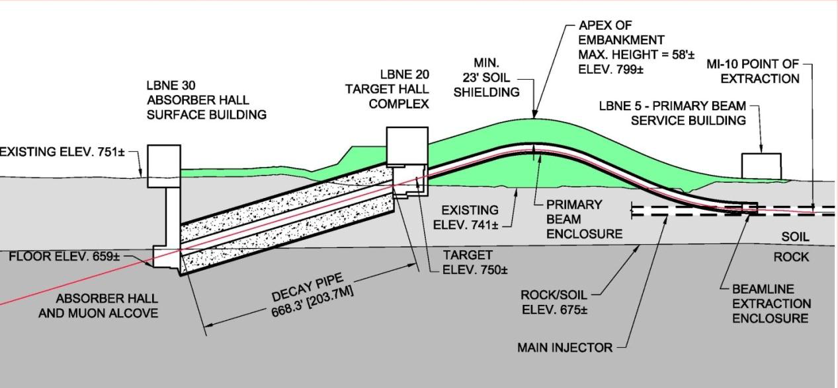
LBNE Target - Introduction
Target
Relevant parameters for 1.2MW target operation:
120 GeV: 7.5e13 ppp, 1.2 sec cycle time
80 GeV: 7.5e13 ppp, 0.8 sec cycle time

Slide 3
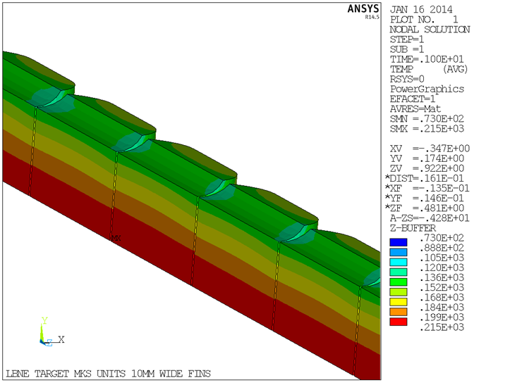
First pass - scaling up the NuMI target
Based on the original NuMI LE target design from IHEP.
Increase the beam sigma from 1.3mm to 1.7mm to give the same peak proton flux (700kW NOvA to 1200kW LBNE)
Simply scaling up the target results in temperatures at the water line interface that are too large (>150C)

Slide 4
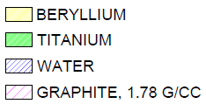
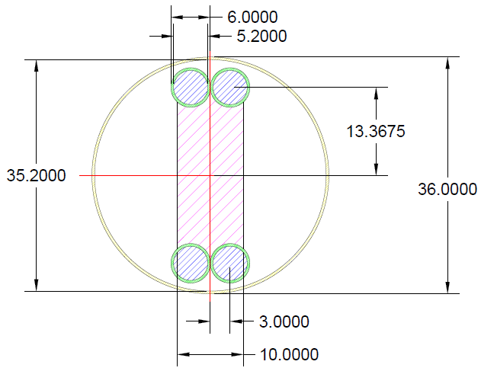
LBNE Target - Geometry

Slide 5
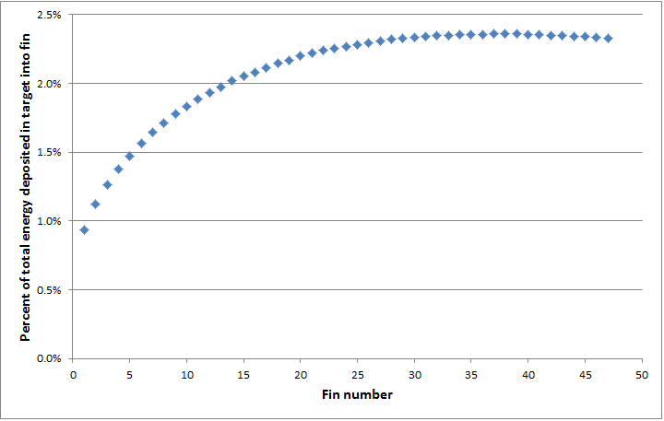
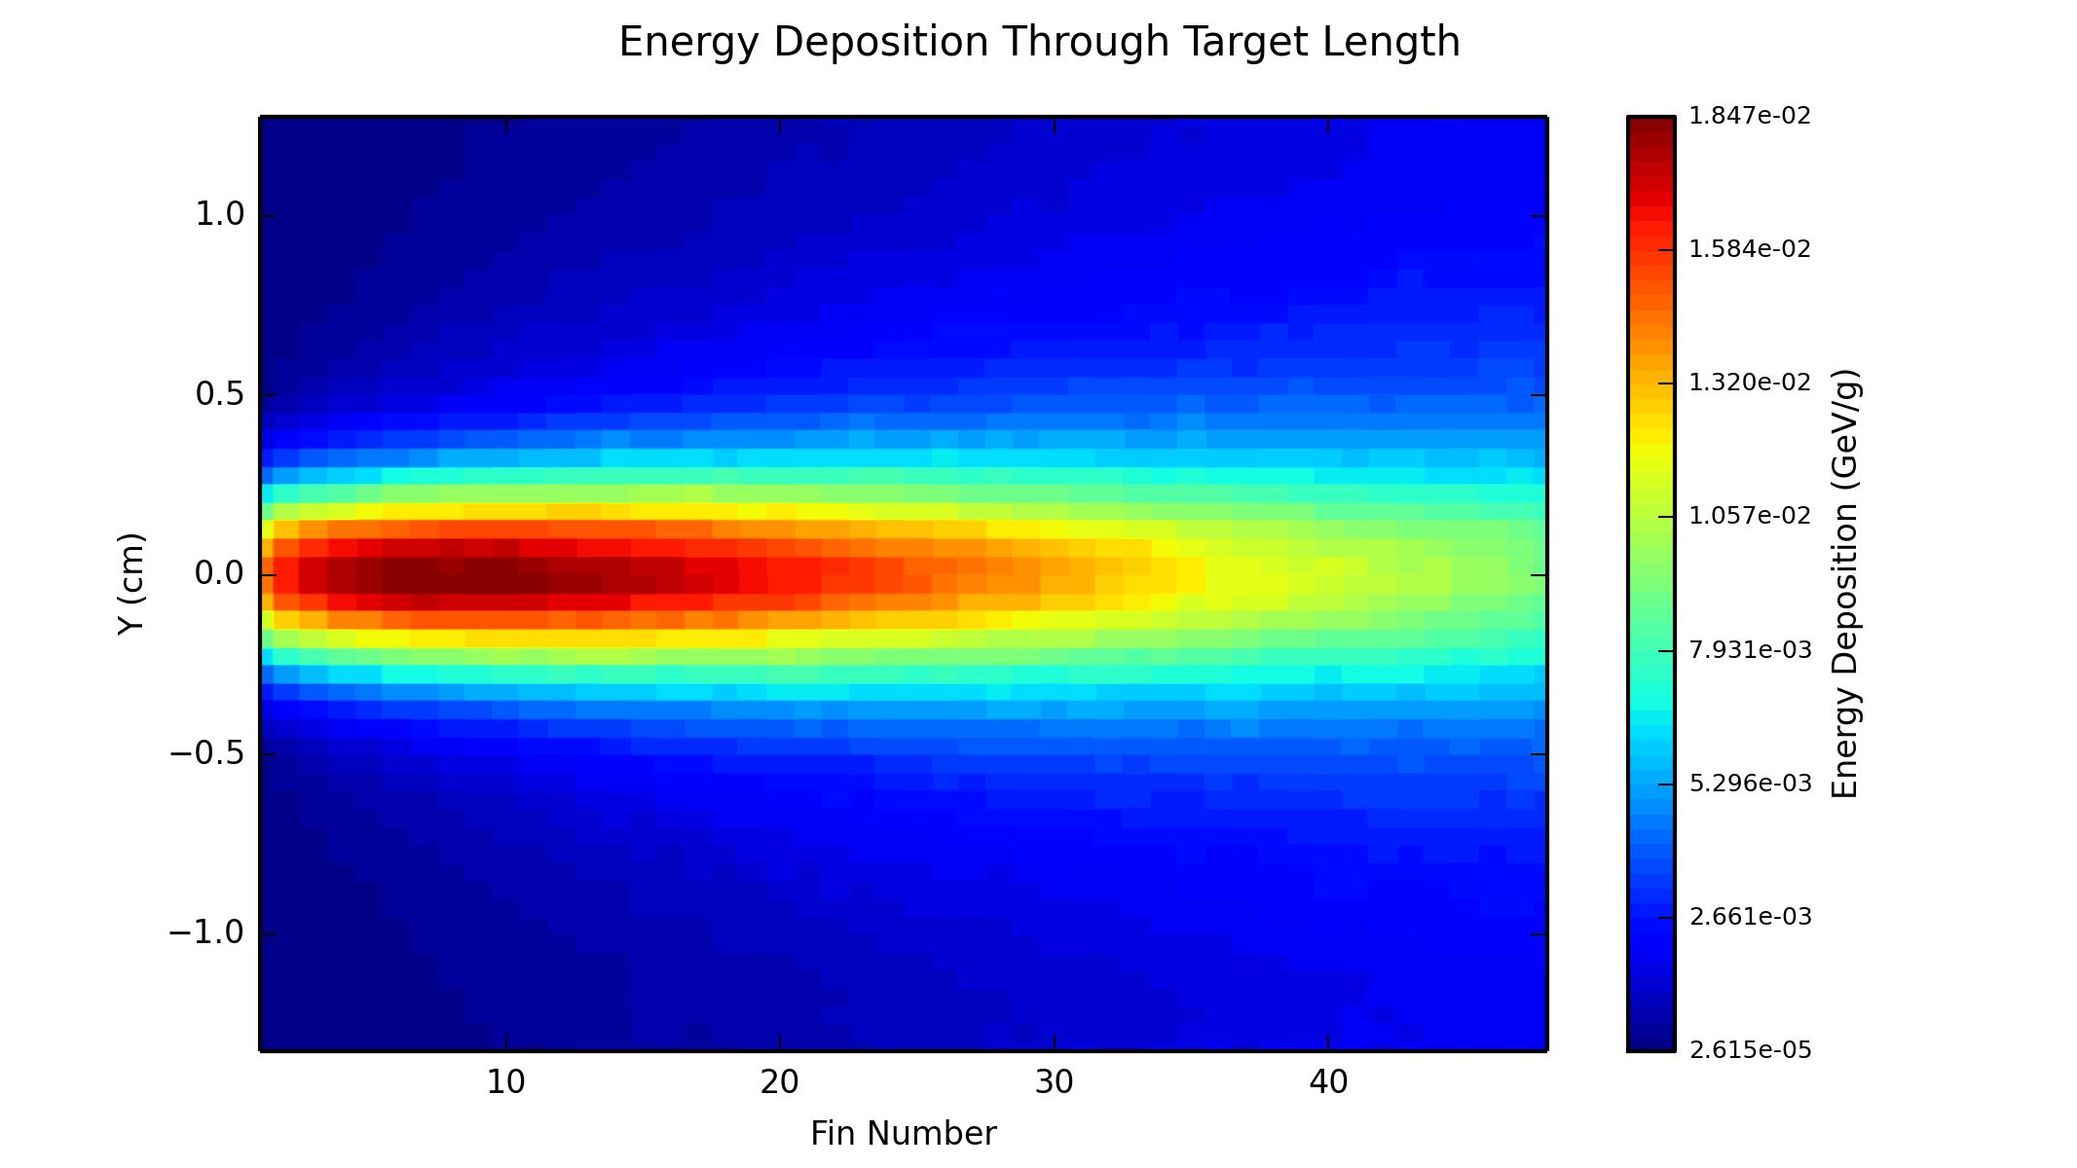
Energy Deposition
Analysis provided by Diane Reitzner
1 & 3 sigma energy deposition peaks at fin 8
Total heat load: 12kW
~11kW to graphite, ~1kW to Ti/Water

Slide 6
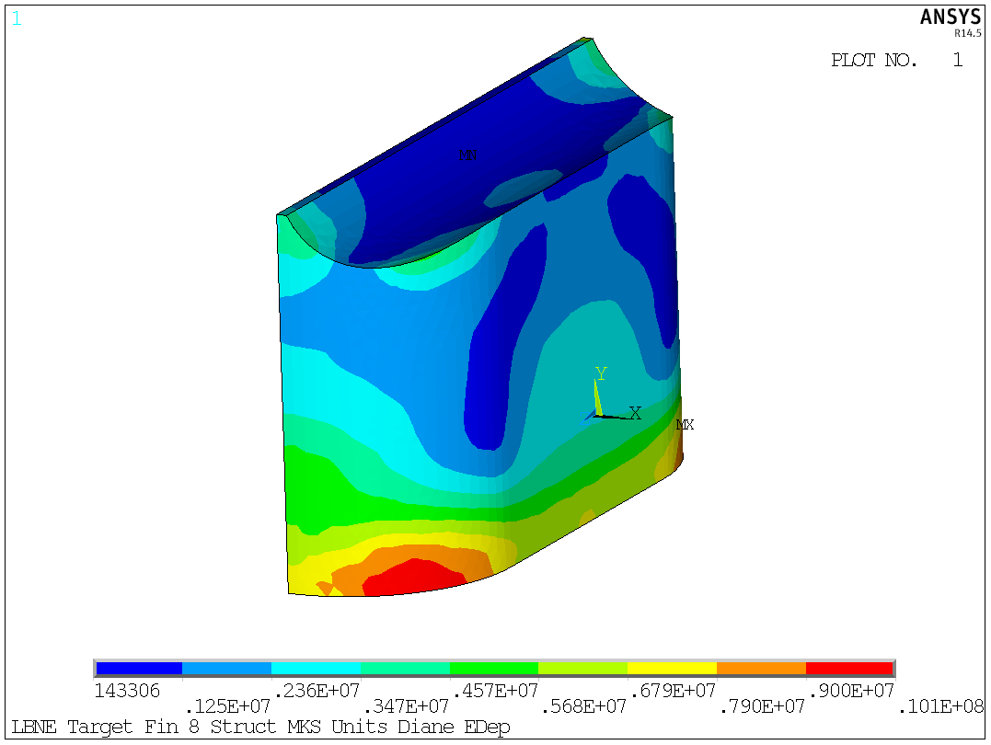
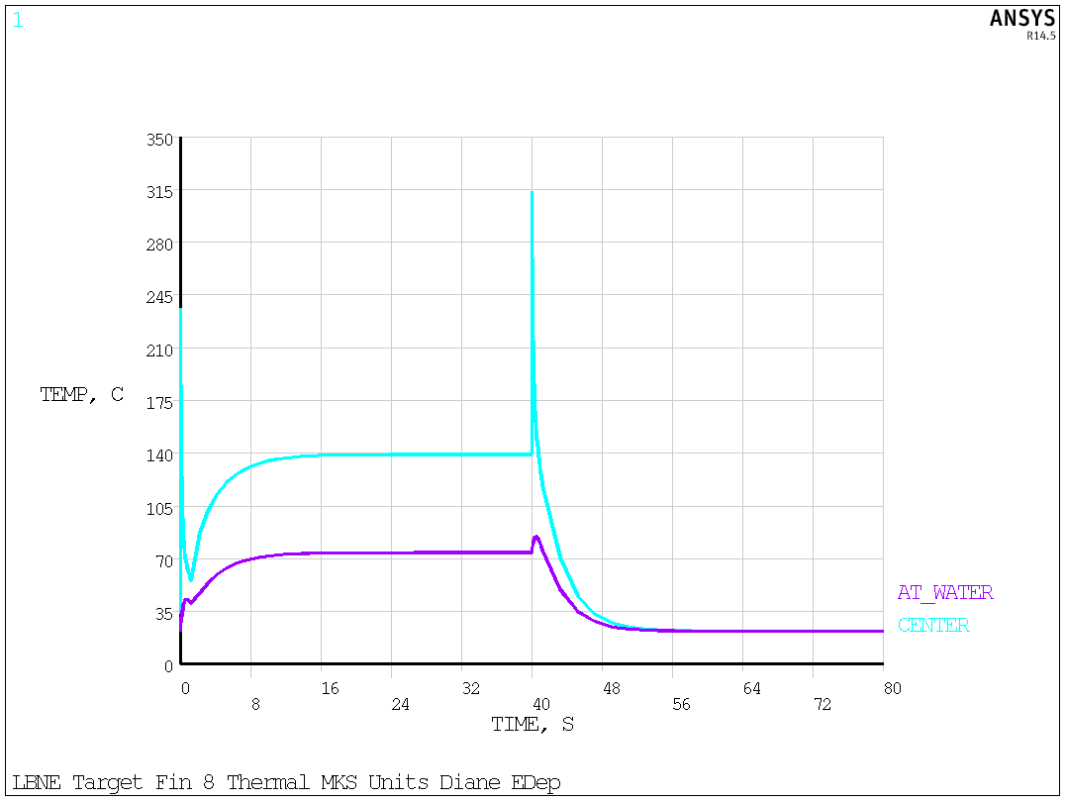
Fin 8 Stress/Temperature
Fin 8 chosen due to highest temperature and largest temperature gradient. Fairly simple model of one pulse at room temperature, warm to steady state, another pulse, and cooling to room temperature.
Maximum Von-Mises stress is ~10MPa while yield is near 80 MPa.

Slide 7
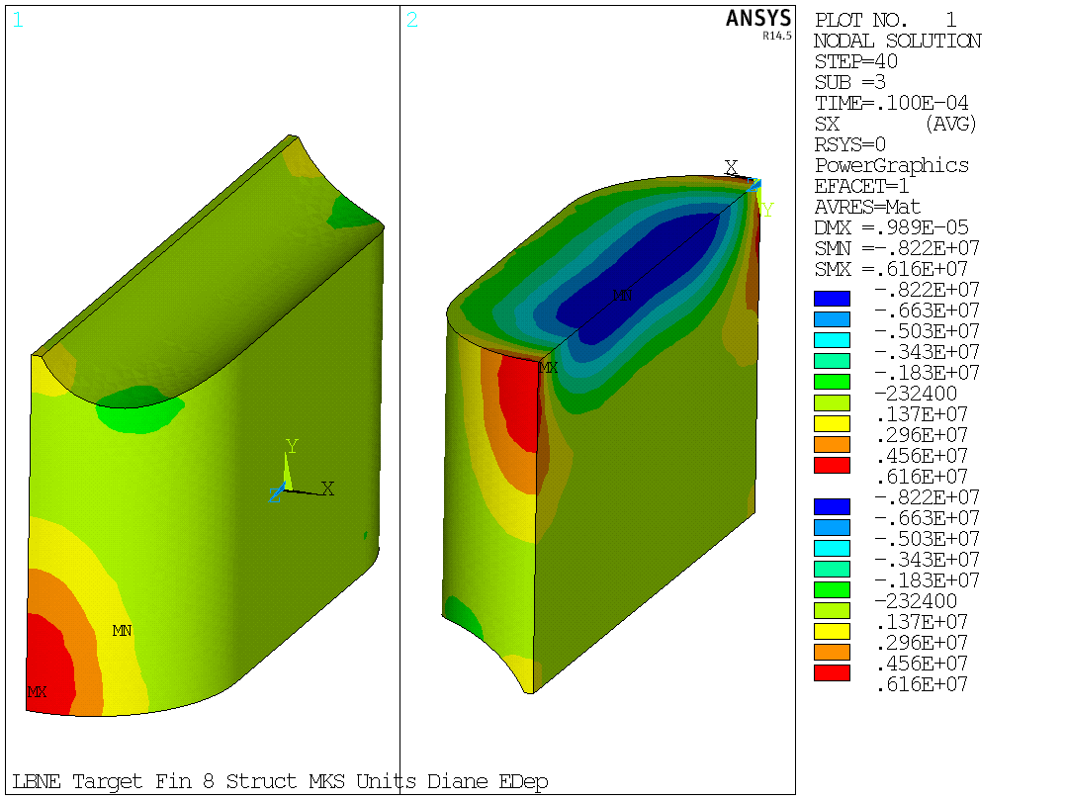
Stress Components
Generated these plots in response to the discussion yesterday afternoon.
X component of stress

Slide 8
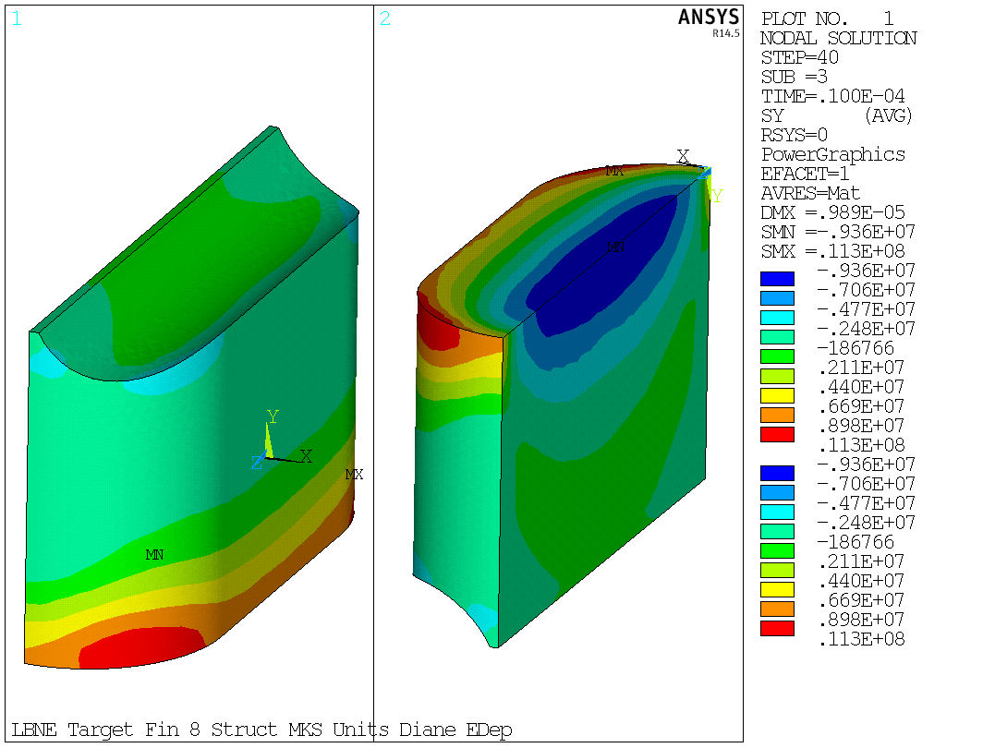
Stress Components
Y component of stress

Slide 9
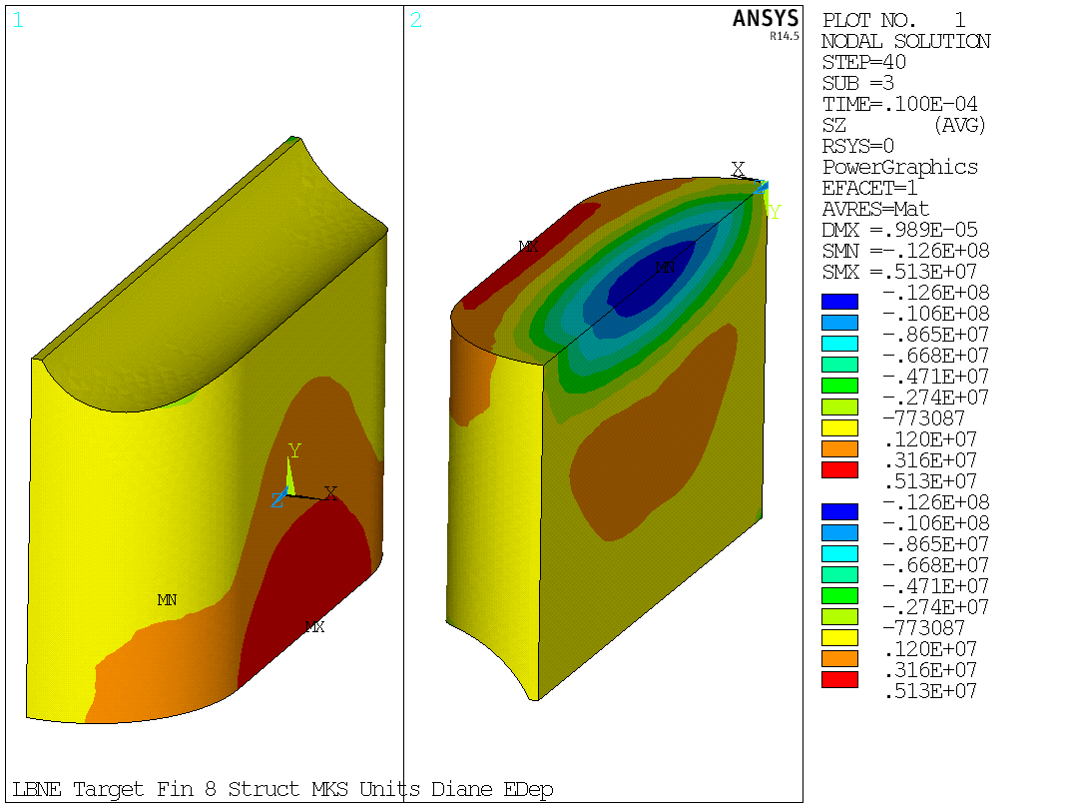
Stress Components
Z component of stress

Slide 10
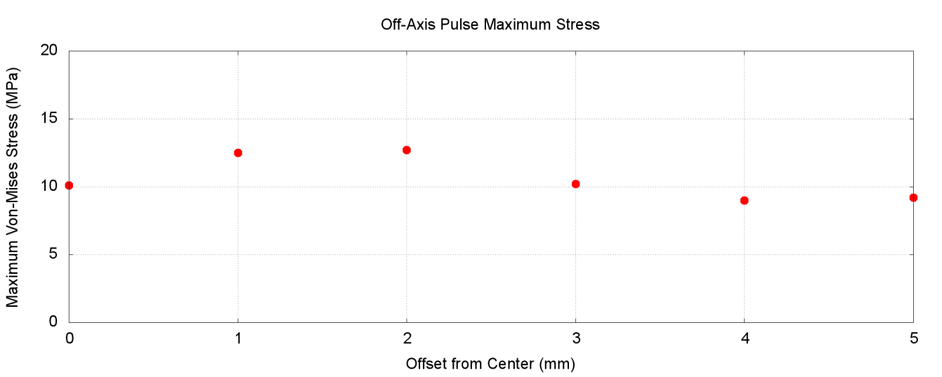
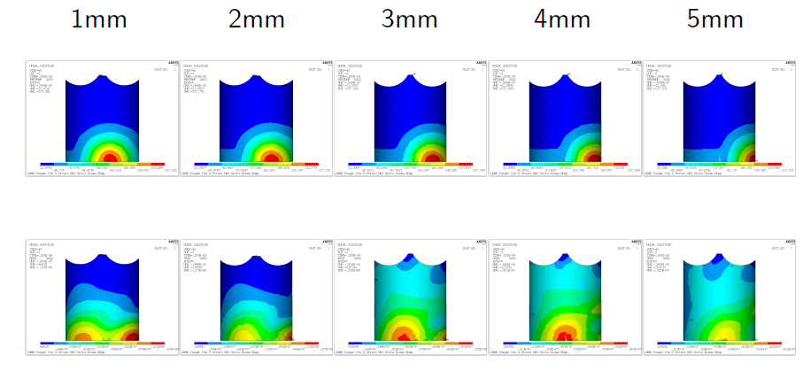
Off-Center Pulse Effects
Find expected stress from a single pulse of an off-center beam in the X direction
Beam Offset
Thermal
Structural
VM Stress

Slide 11
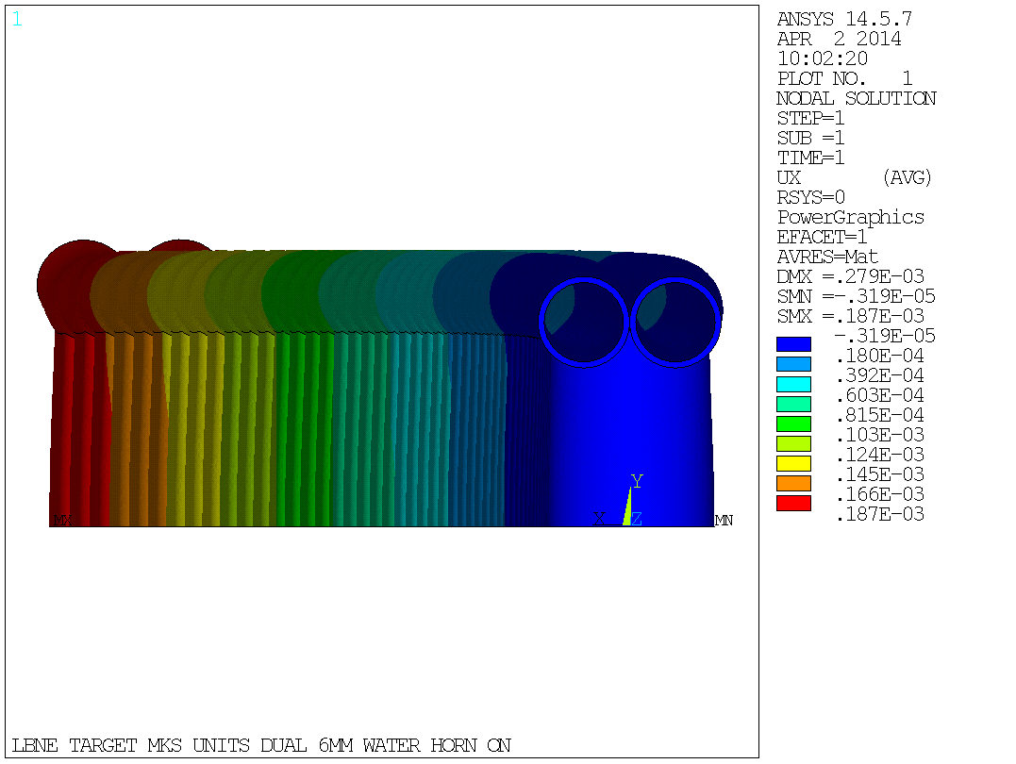
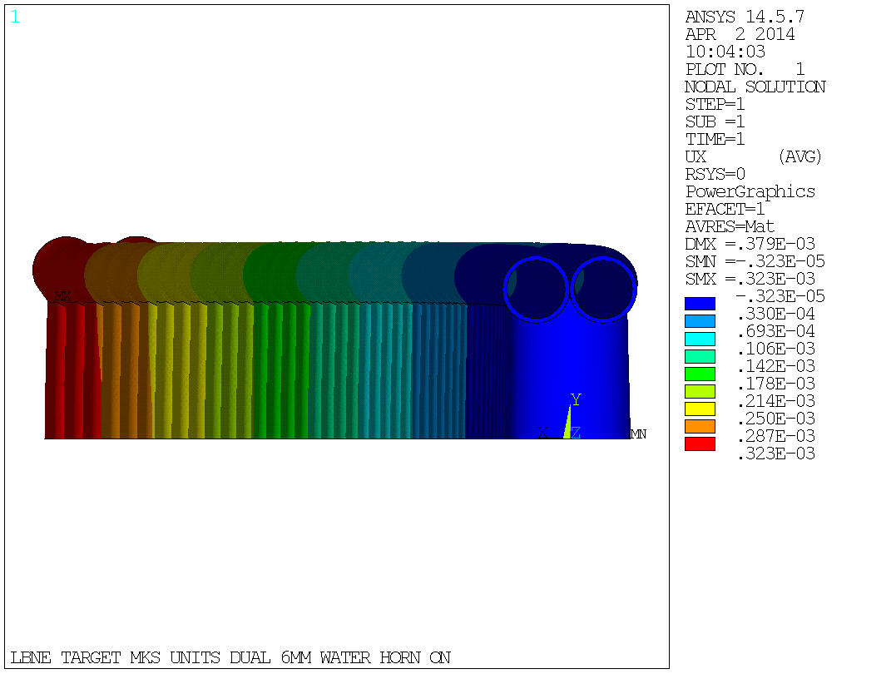
Off-Center Pulse Effects
Modeled the steady-state deformation of sustained off-center pulses.
Deformations are exaggerated by a factor of 200 for visual effect.
1mm offset
0.19 mm deformation
2mm offset
0.32 mm deformation

Slide 12
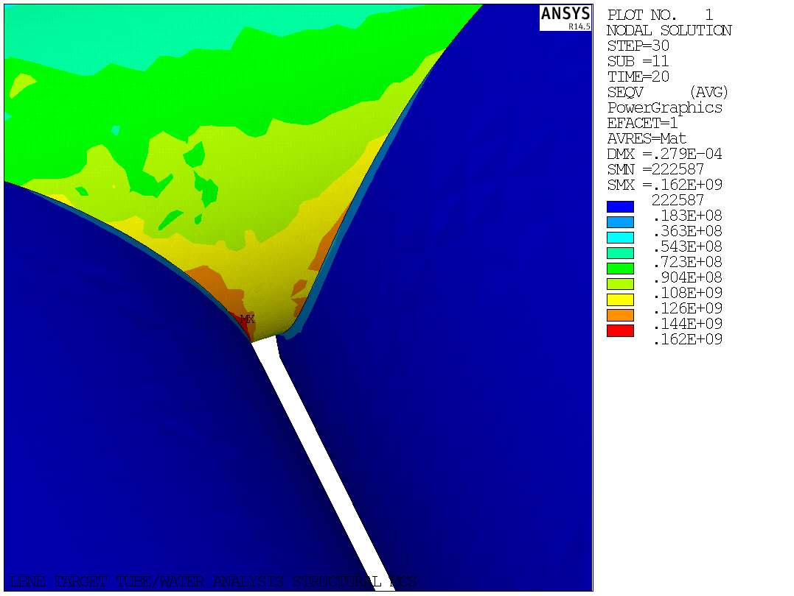
Ti Water Lines
Grade 2 Titanium water lines are chosen based on a report by the RAL group (O. Caretta, T. Davenne, C.J. Densham). Originally this model was intended to evaluate the water hammer effect from the beam impact.
Most interesting part of this model wasn’t the water hammer, but the stress between the fins.
Stress concentration introduced by the sharp transition between fin and water line – safety factor of 2.4 to fatigue as modeled

Slide 13
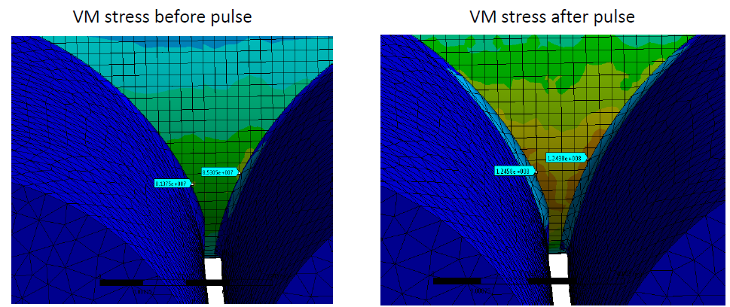
Ti Water Lines
Water line model was refined to include a 0.005” fillet introduced by the brazing process for a more realistic evaluation of the safety factor.
Increased fatigue safety factor to 3.2.

Slide 14
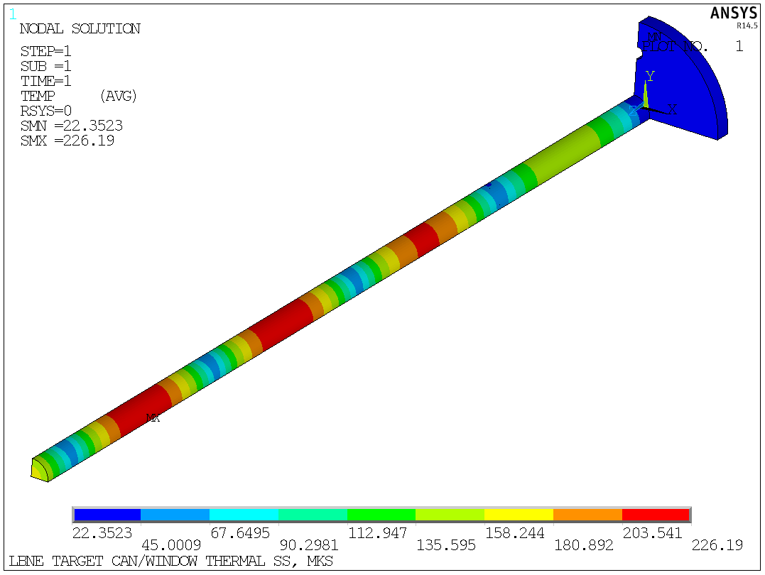
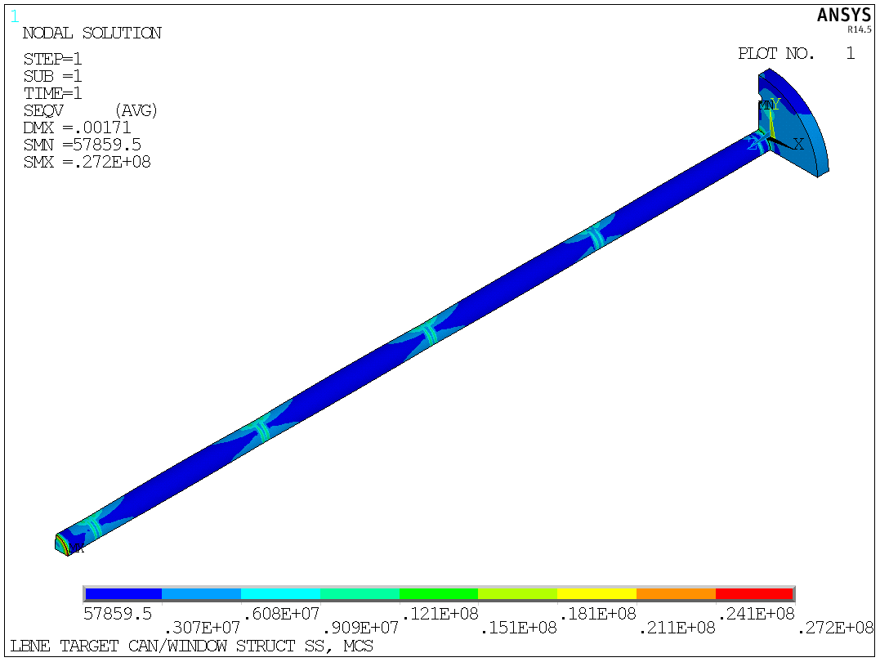
Target Canister
The target canister and downstream window will be constructed from Beryllium for less heading due to the beam interactions.
Look at temperatures and stresses in this canister.
Cooling only provided by water loop on the target and the connection to the base.
Resulting temperatures (~225C) and stresses (27 MPa) are low.

Slide 15
Safety Factors Rollup
Location | Material | Stress | Criteria | Safety Factor
Worst Case Fin | Graphite | 10.5 MPa | UTS - 80MPa | 7.6
Fin, Off-Center Pulse | Graphite | 12.7 MPa | UTS - 80MPa | 6.3
Water Line, Pulsed | Titanium Grade 2 | M-96MPa, Alt-23MPa | Goodman @ 90C (mean temp) | 3.2
Can | Beryllium | 25.9 Mpa | Yield - 218 MPa @ 185C | 8.4
Window | Beryllium | 27.2 MPa | Yield - 218 MPa @ 185C | 8.0

Slide 16
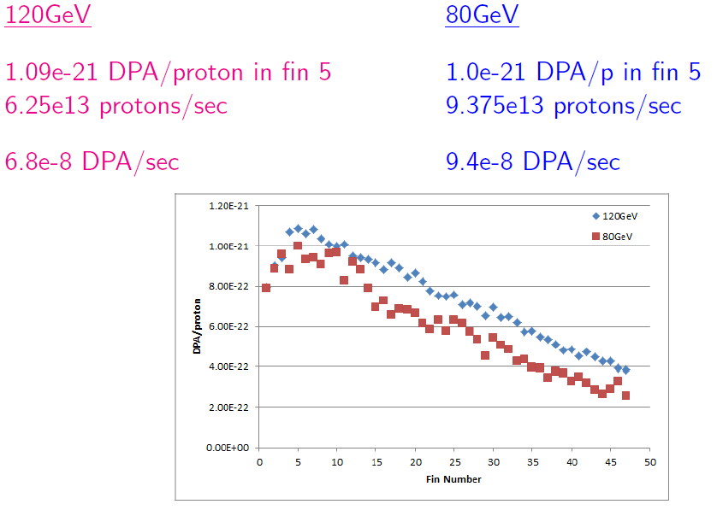
Target DPA
Notes:
120 gev – 1 dpa/yr using 1.5e7 sec/yr
80 gev – 1.4 dpa/yr

Slide 17
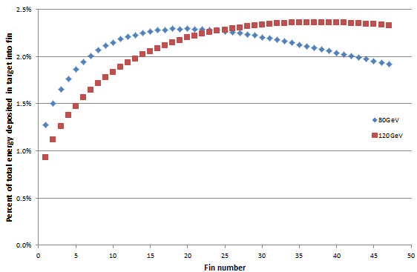
Conclusions and To-Do
A workable design has been presented with acceptable safety factors
80 GeV FEA work still to be done.

