Slide 1
Future Target Concepts for LBNE
Presented by Tristan Davenne
Work by:
Chris Densham, Otto Caretta, Tristan Davenne, Mike Fitton, Peter Loveridge and Geoff Burton
High Power Targets Group
Rutherford Appleton Laboratory
Pat Hurh, Bob Zwaska, Kris Anderson
Fermilab
9th International Workshop on Neutrino Beams and Instrumentation
Fermilab
25th Sept 2014

Slide 2
Outline
LBNE Conceptual Design Study
Design Challenges at 2.3MW
- Heat transfer
- Energy deposition in water
- Stress in a beryllium cylindrical target
- Effect of off centre beam target
- Segmentation to reduce stress
Numi Target Studies
Alternative Target Concepts
- Peripherally cooled shrunk fit segments
- Directly cooled segmented target
- Figure of Merit comparison
- High z cooling tube or downstream plug
Induction heat transfer rig
Summary - Questions

Slide 3
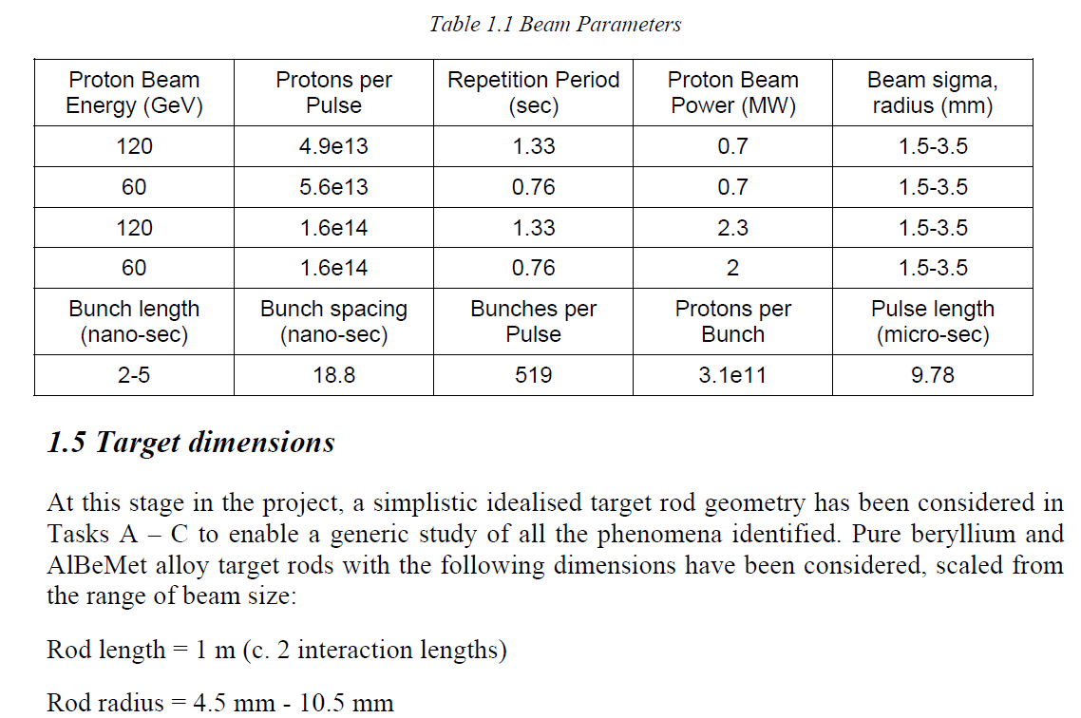
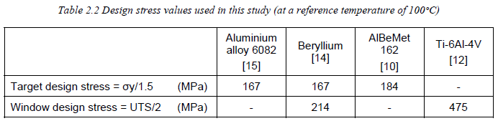
Conceptual Design Study of the Long Baseline Neutrino Experiment (LBNE) Target and Beam Window
Nov 2010
Target radius = 3 x beam sigma

Slide 4
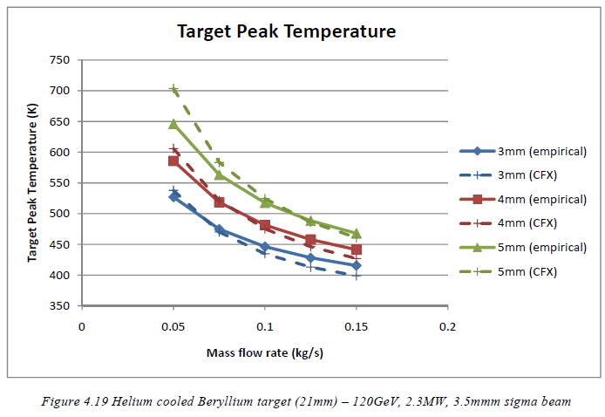
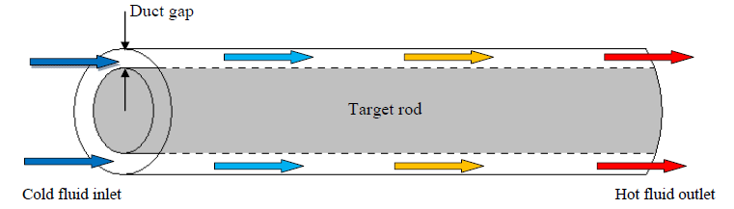
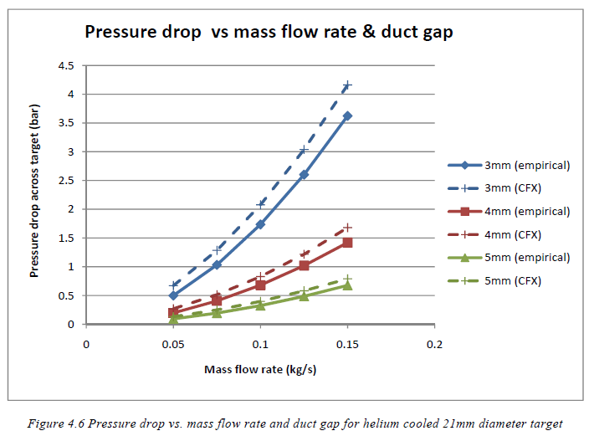
2.3MW Design Challenges – Heat transfer
At 2.3MW pressurised gas cooling (10bar) or water cooling required
Peak Beryllium temperature around 180°C

Slide 5
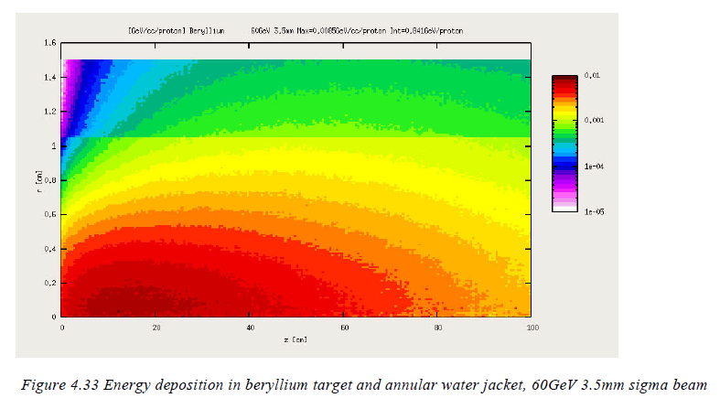
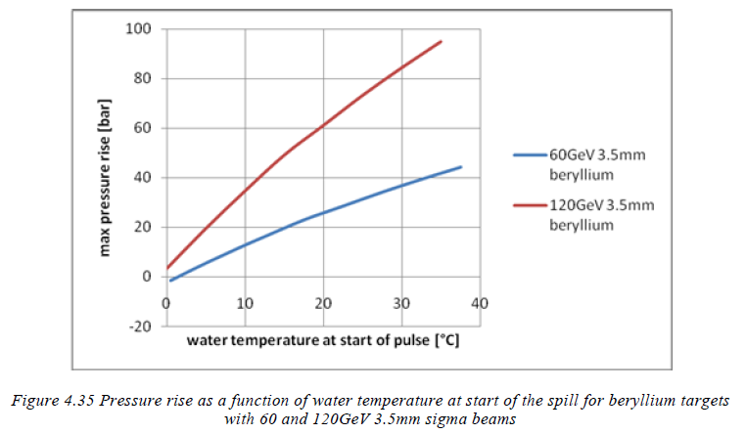
2.3MW Design Challenges – Energy deposition in water
Significant energy is deposited in a peripheral water flow resulting in a temperature jump and potential for a sudden pressure jump
Predicted pressure rise depends on water temperature and water circuit rigidity but at 2.3MW as potential to be tens of bar
Cooling water absorbs useful pions

Slide 6
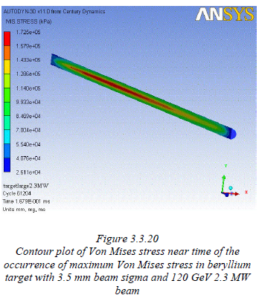
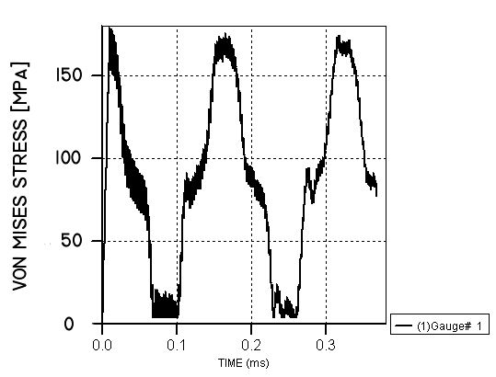
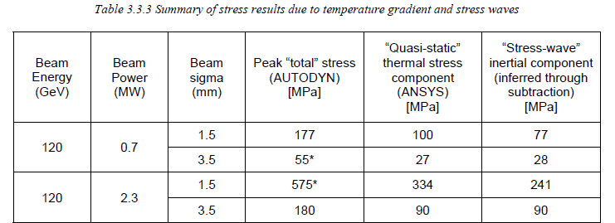
2.3 MW Design Challenges – Stress in a beryllium cylindrical target
Significant longitudinal dynamic stress component generated in 1m long beryllium cylinder. Total stress exceeds design stress at 2.3MW
Stress will be lower and safety margins potentially better with graphite

Slide 7
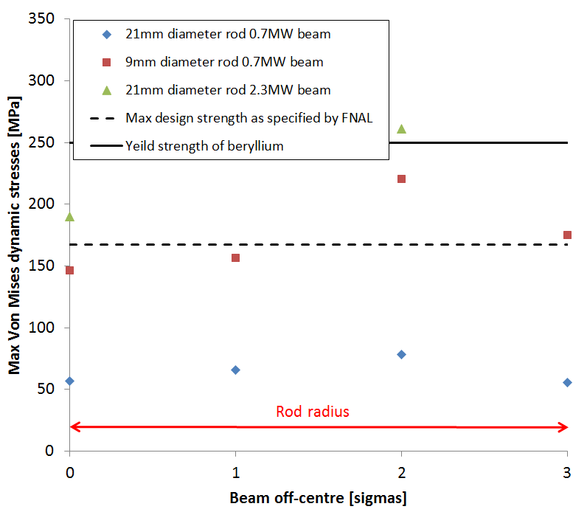
Design Challenges – Effect of off centre beam on a cylindrical target
Off centre beam increases stress on a cylindrical target, some designs which fall within design stress with on axis beam are pushed over the limit with an off centre beam

Slide 8
Segmentation to reduce stress
sphere radial oscillation period – d/c_{l}
cylinder radial oscillation period – d/c_{s}
Double hump curve for peak stress in a cylinder as a function of energy deposition time
Total stress made up of quasi-static component, longitudinal dynamic component and radial dynamic component
Peak Stress
Cylinder longitudinal oscillation period – l/c_{l}
Reducing the target size reduces expansion time and dynamic stress components
Static component
Beam Spill duration
Energy deposition time
Fermilab already have significant experience of segmented targets with water cooled graphite designs used by Numi and Nova

Slide 9
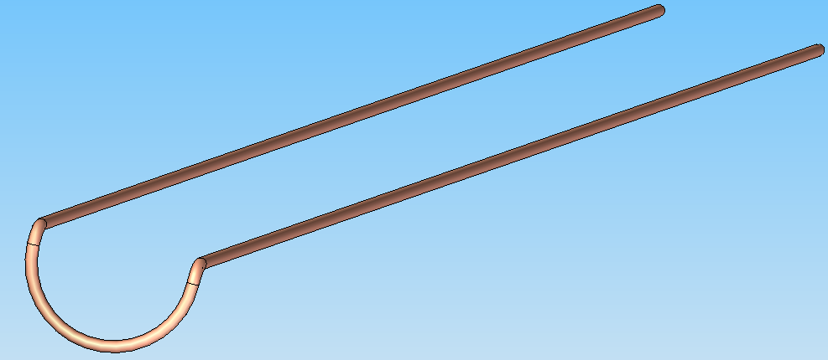
Numi target studies
Numi beam predicted to result in significant pressure spike in water and cyclic stress in cooling pipes
Predicted pressure pulse of 25bar with 400kW beam
Use of titanium single pass tubes proposed to improve safety margins – removing questions over welded joints
At 2.3MW water pressure spike thought to be a serious risk area
Figure 20 Proposed retrofit single component titanium cooling pipe

Slide 10
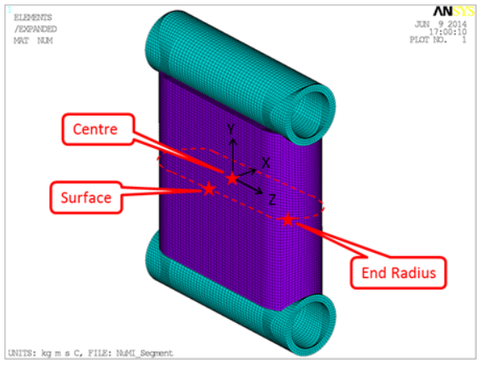
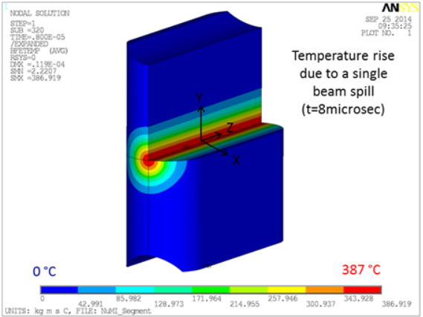
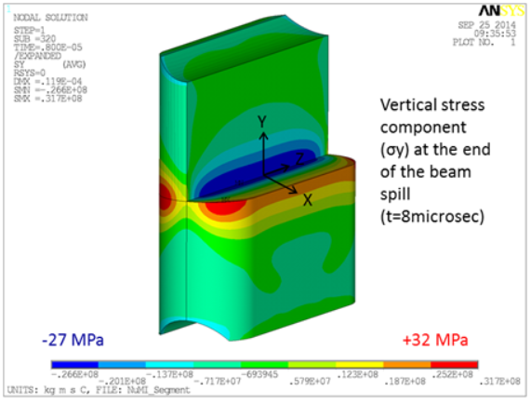
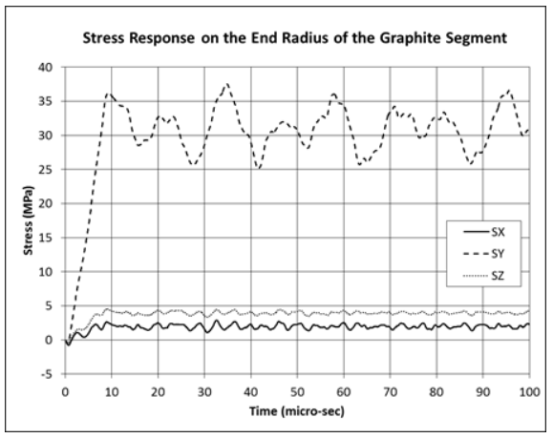
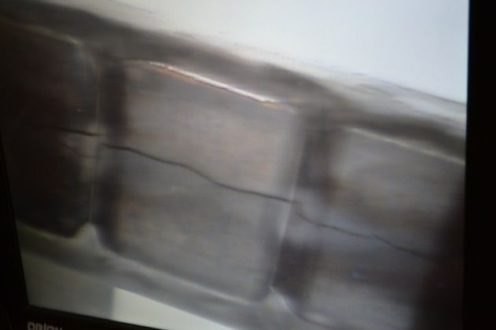
Numi target studies
Stress after pulse from 400kW beam – 1mm beam sigma
Stress calculation assumes normal (unirradiated) graphite material properties, radiation damage may be highest at water cooling operating temperatures
Stress calculated based on beam spill applied to fin initially at uniform temperature, any residual thermal stress from last pulse?
Cyclic fatigue loading of a brittle material
Peter Loveridge
Autopsy of NT-03 (photo courtesy of V.Sidarov)

Slide 11
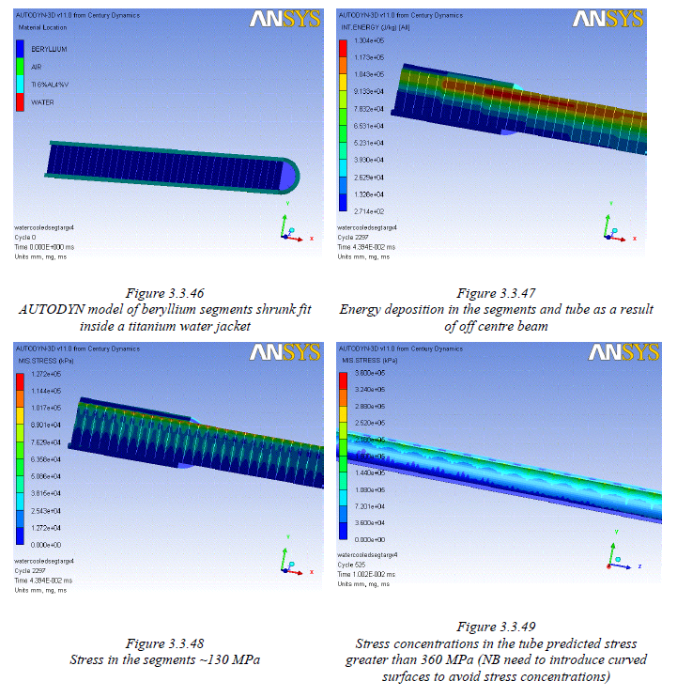
Target concept 1: Peripherally cooled shrunk fit segments
Segmentation reduces dynamic stress component
Good accommodation of off centre beam
Cooling through outer tube adds conduction path between coolant and segments
Cooling with pressurised gas of water possible
Differential expansion between segments and tube may result in stress concentrations in tube
Doesn’t require braising of target segments to cooling tubes

Slide 12
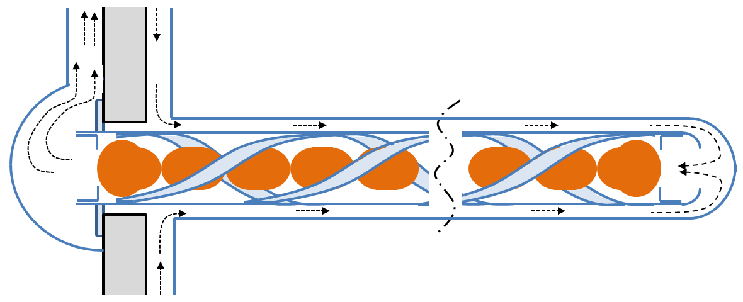
Target Concept 2: Directly cooled segmented target
Target segments mounted in helix. Coolant flows around and between segments directed by retaining helix.
Target segments held in place by tight fit within helix with small expansion space between segments to avoid repetitive contact.
Minimal contact points between spherical segments and helix and helix and outer tube to reduce differential expansion.
Various segment shapes under consideration.

Slide 13
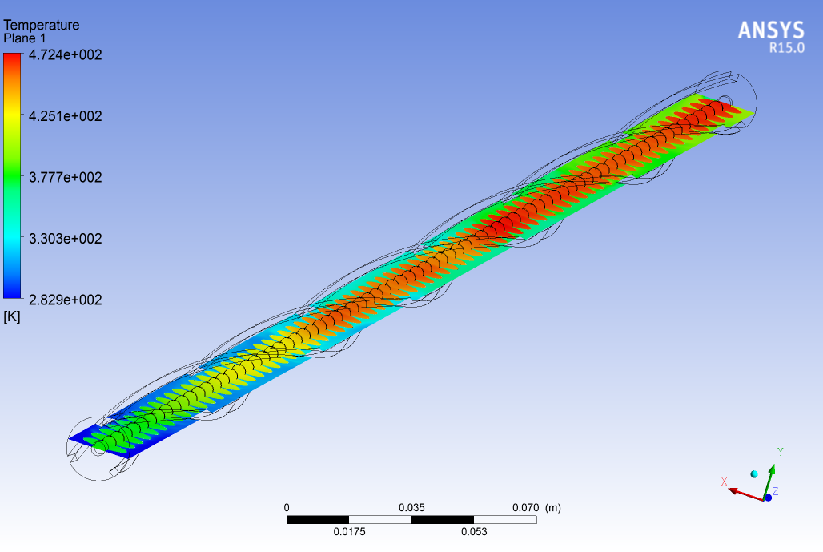
Target concept 2: improved heat transfer
13mm diameter sphere, 2.16mm beam sigma
4mm diameter helix tube
30mm diameter should be possible including return flow
Increased heat transfer area as compared to a cylinder, reduced helium flow requirement
For 2.3MW beam, Heat load ≈ 10kW, Max beryllium temperature – 200°C with 17g/s helium and pressure drop of 1bar, 10bar operating pressure.

Slide 14
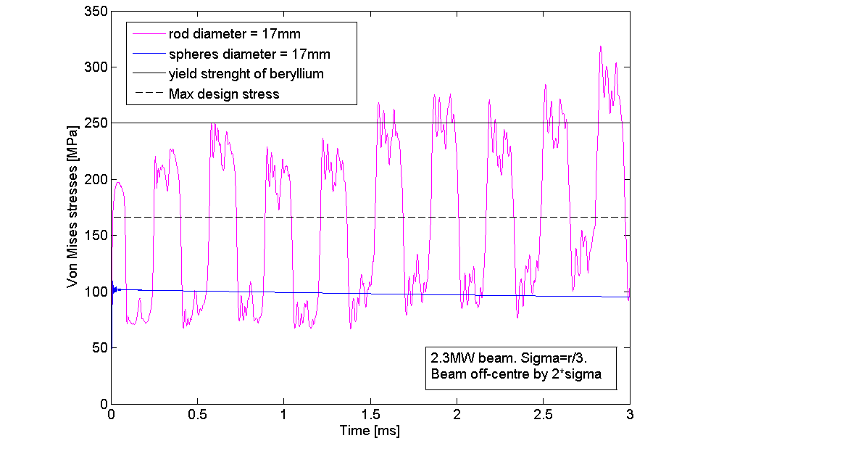
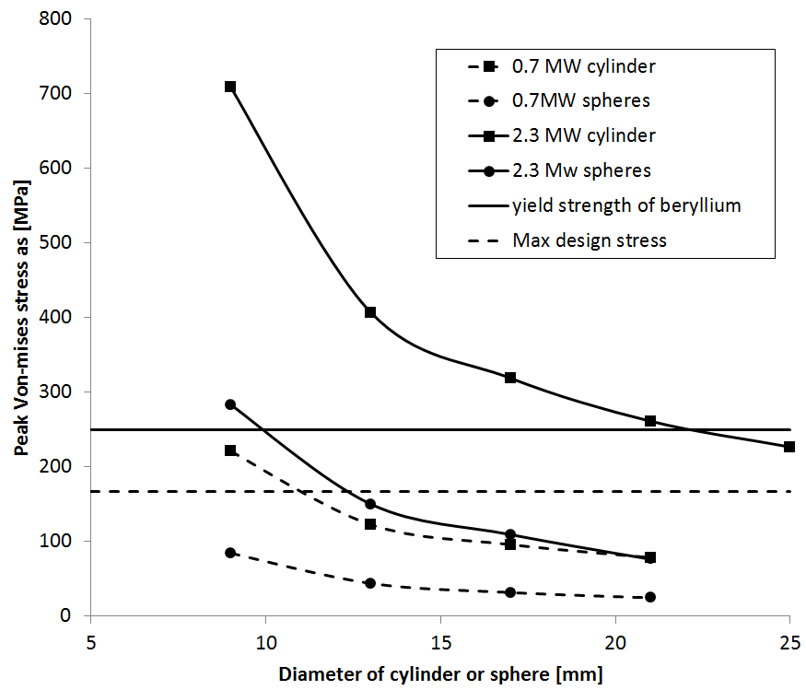
Target concept 2: Reduced stress
Longitudinal dynamic stress component eliminated
Insensitive to off centre beam
At 2.3MW a beryllium target would have to be longitudinally segmented

Slide 15
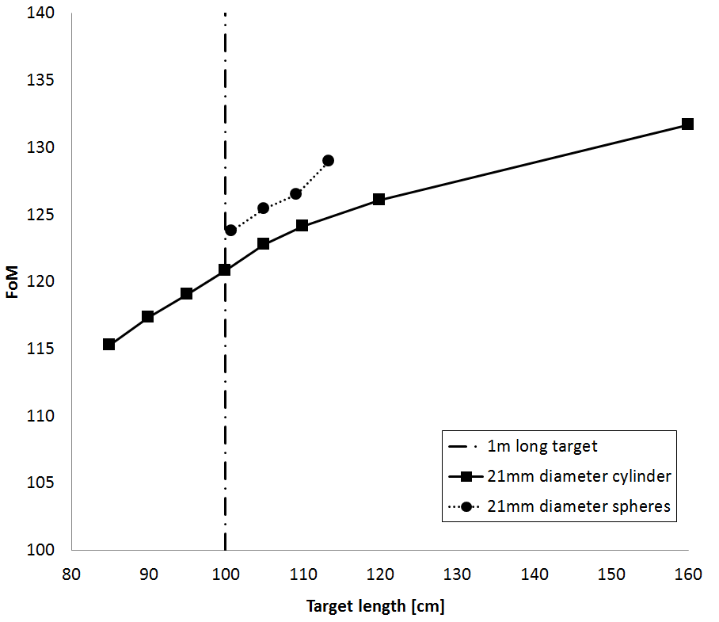
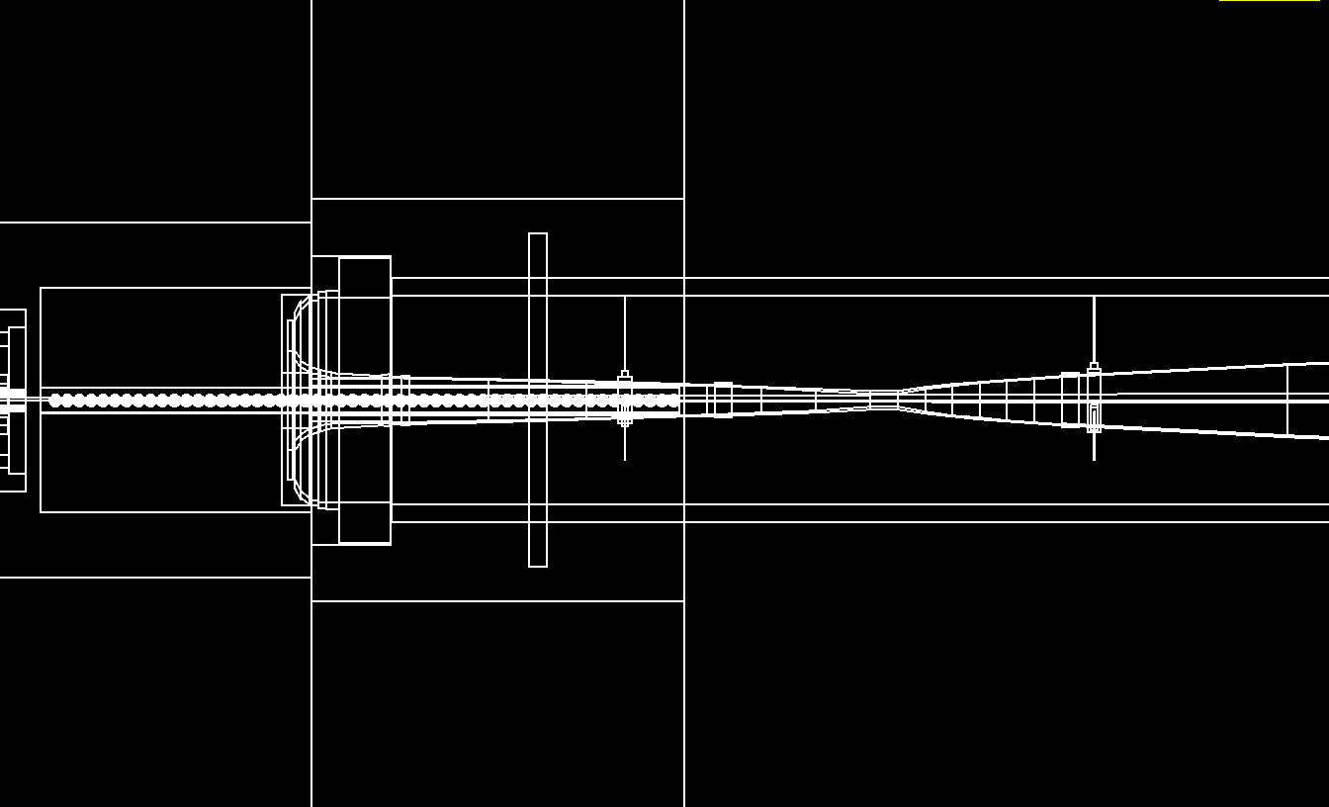
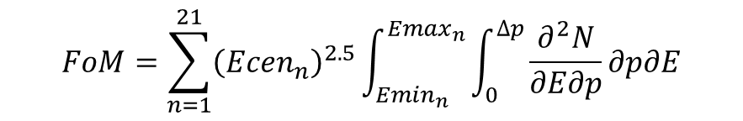
Figure of Merit comparison – devised to provide simple evaluation of target concepts
$$FoM=\sum_{n=1}^{21}{{\left({Ecen}_{n}\right)}^{2.5}\int_{{Emin}_{n}}^{{Emax}_{n}}{\int_{0}^{∆p}{\frac{∂^{2}N}{∂E∂p}∂p∂E}}}$$
Bob Zwaska
Count number of pions in useful energy range and with focusable transverse momentum
FoM study indicated that a segmented array of spheres has comparable (maybe better) useful pion yield than a cylinder. A more detailed study by Alberto Marchionni and his summer student Quynh Nguyen also had positive results fro a sphere target
FoM study also showed a small reduction in pion yield due to the presence of water as compared to gas cooling

Slide 16
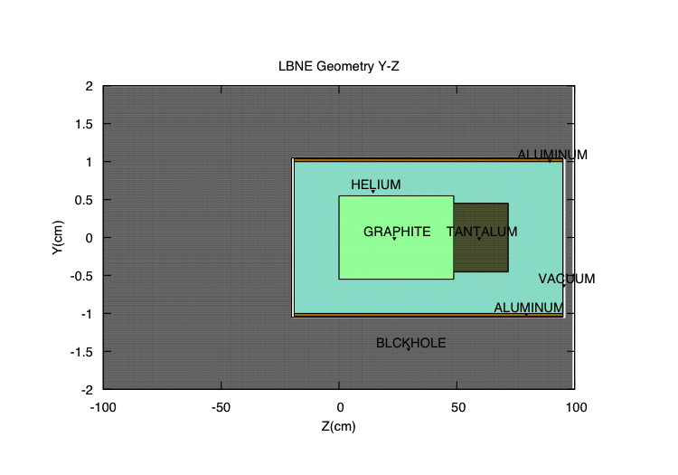
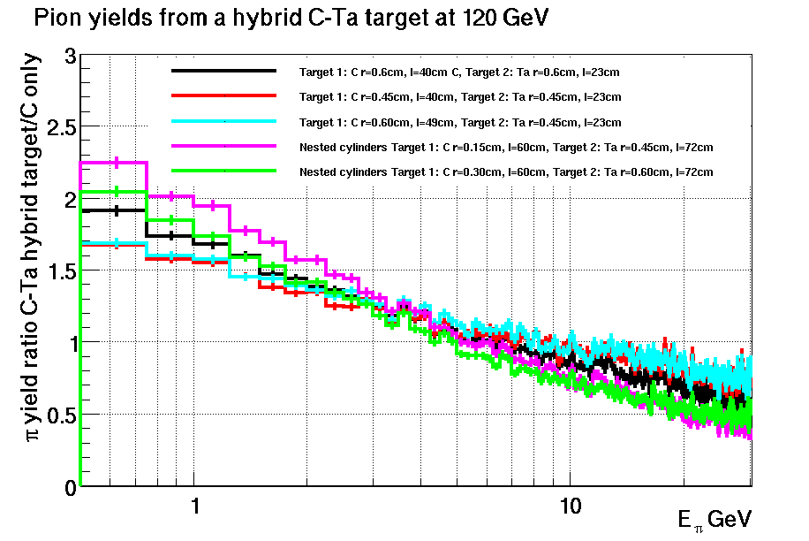
High z cooling tube or downstream plug?
Mary Bishai
A high z plug downstream of the target and/or high z target outer tube shown to increase pion yield relative to a 2 interaction length graphite target.
Graphite cylinder inside a tantalum tube gives best increase in yield

Slide 17
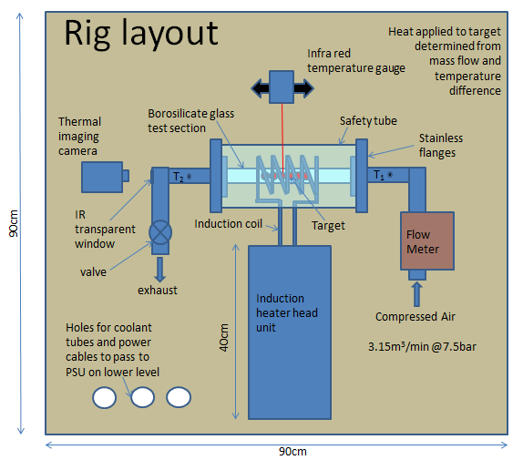
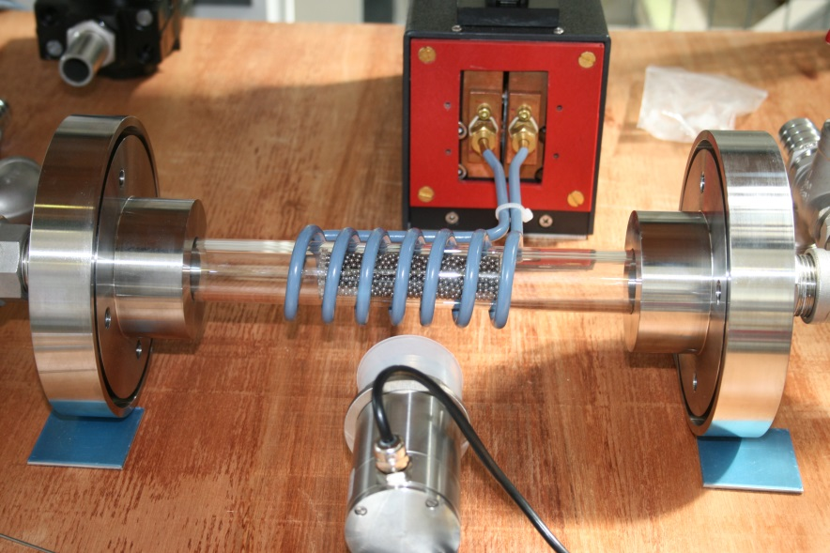
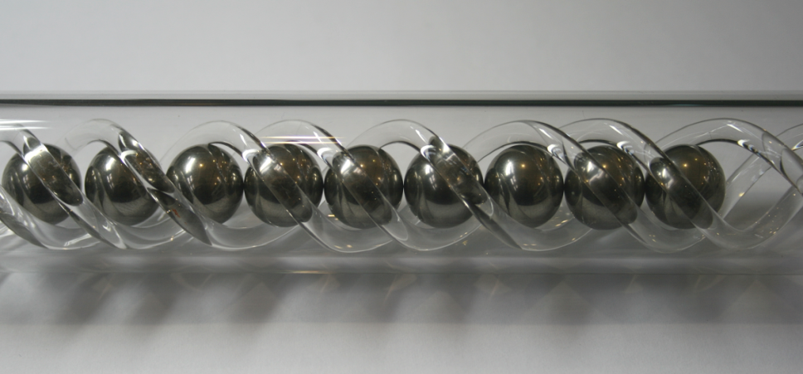
Induction heat transfer rig
Facility | Peak power density kW/cc
LBNE 2.3MW Be | 0.18-0.6
Euronu | ≈2
ESSnuSB | ≈3.3
ISIS | 0.45
SNS | 0.4
ESS | <ISIS?
10kW 450kHz induction heater should enable heat deposition in the order of kW/cc
Sphere array target for heat transfer testing

Slide 18
Summary - Questions
Pressurised gas cooling seems to offer a potential alternative to water cooling at 2.3MW and mitigates the risk of cyclic pressure loads induced by beam heating of cooling water.
The predicted dynamic stress levels in a cylindrical beryllium target subjected to the 2.3MW LBNE beam are in excess of the design stress limit specified in our conceptual design study. Target segmentation would be required to reduce inertial components of stress.
Two concepts for segmenting a beryllium target have been presented.
The first consists of beryllium slugs shrunk fit in a cooling tube, is compatible with water or gas cooling and provides cylindrical geometry .
The second consists of direct cooling of target spheres, only compatible with pressurised gas cooling, offers increased heat transfer surface area and tolerance to off axis beam. Useful pion yield comparable or greater than a cylinder. (how does pion yield compare to a numi style target?)
While we can see possible design solutions at 2.3MW with a beryllium target stress levels and safety margins may be improved with graphite. Is radiation damage much worse with graphite as compared to beryllium? Could a T2K style graphite target work for LBNF 1.2MW or higher?
A Induction heat transfer rig is being setup at RAL at the moment with the idea of testing heat transfer rates in a range of different geometry targets.

Slide 19
