Slide 1
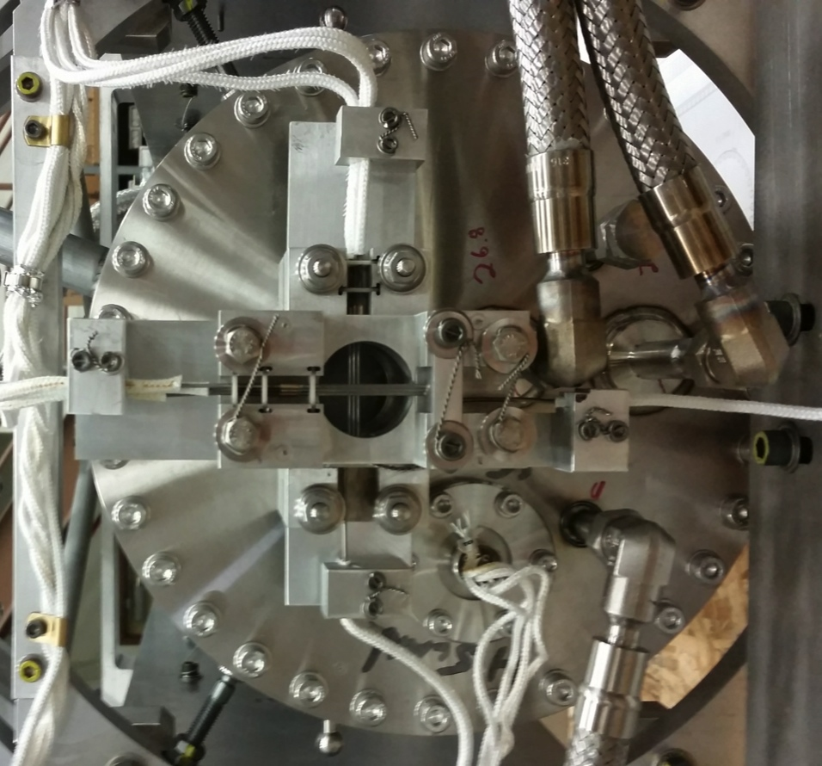
The NOvA Medium Energy Target Design and Construction Experience
Patrick Hurh
Fermilab
24 September 2014
NBI Workshop 2014

Slide 2
Overview
Origins
Design/Analysis
Construction
Summary
Many Thanks and Credit To:
M. McGee, R. Stewart, J. Wilson, FNAL design/eng team
R. Ford, M. Stiemann, F. Schneider, Keith Anderson, FNAL technical team
M. Fitton*, J. O’Dell, T. Davenne, RAL
V. Garkusha, IHEP
*Provided several slides

Slide 3
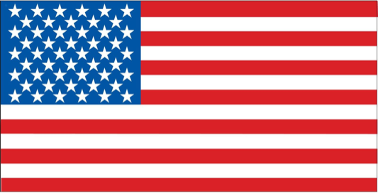
Origins
Design originated at IHEP, Russia, in 2006-2009
Medium Energy Target for NuMI beamline at higher beam power
Resulted in analysis reports, a 3-D model, and associated drawings
Picked up by Michael McGee of Fermilab, who worked with Rod Stewart to “translate” the model/drawings
Performed thermal and stress analysis of target components
Modified/Re-designed several features
Manufactured, assembled and tested first target at RAL (STFC) under direction of Michael Fitton.
Identified several improvements/corrections
Developed construction techniques in parallel with Fermilab team led by M. McGee

Slide 4
NuMI versus NOvA
NuMI- Low Energy Configuration
Target inserted into Horn 1 Inner Conductor
NOvA- Medium Energy Configuration
Target well US of Horn 1

Slide 5
Design & Analysis

Slide 6
Design & Analysis

Slide 7
Design & Analysis

Slide 8
Design & Analysis

Slide 9
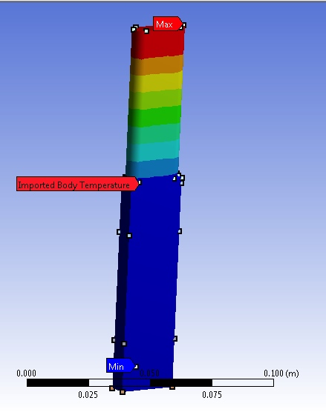
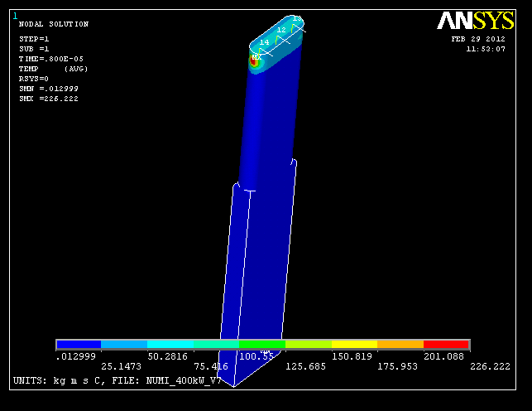
Target Fin Thermal Analysis
Table from 2006 IHEP Report assumes:
5.5e13 ppp
(9.0e13) ppp
1.2 s rep rate
Actual NOvA Beam:
Energy: 120 GeV
Sigma: 1.3 mm
4.8e13 ppp
1.3 s rep rate
Confirmed by RAL analysis:
672˚ C “steady-state”
226˚ C “jump”

Slide 10
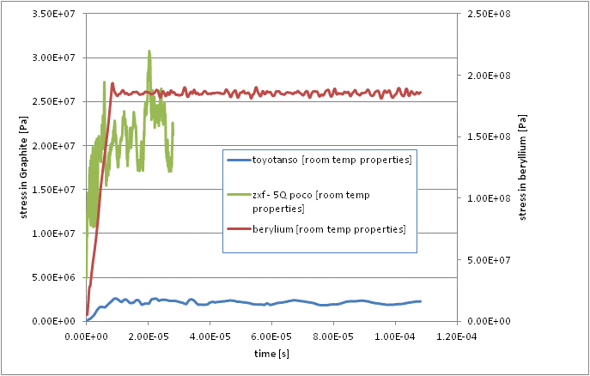
Target Fin Stress Analysis
2006 IHEP Report:
~32 MPa (@P4)
5.5e13 ppp
Confirmed by RAL analysis:
~30 MPa peak stress (R.T. properties)
Note Be fin is ~190 MPa (R.T. properties)
Note IG-43 is ~3 MPa (R.T. properties)

Slide 11
Target Beam Windows - Thermal
US Window: (0.25 mm thick) 24 ˚C to 66 ˚C
DS Window: (1.25 mm thick) 57 ˚C to 67 ˚C
Analysis by M. McGee (FNAL)

Slide 12
Target Beam Windows – Stress
US
Safety Factor of ~4 on yield
DS
Analysis by M. McGee (FNAL)

Slide 13
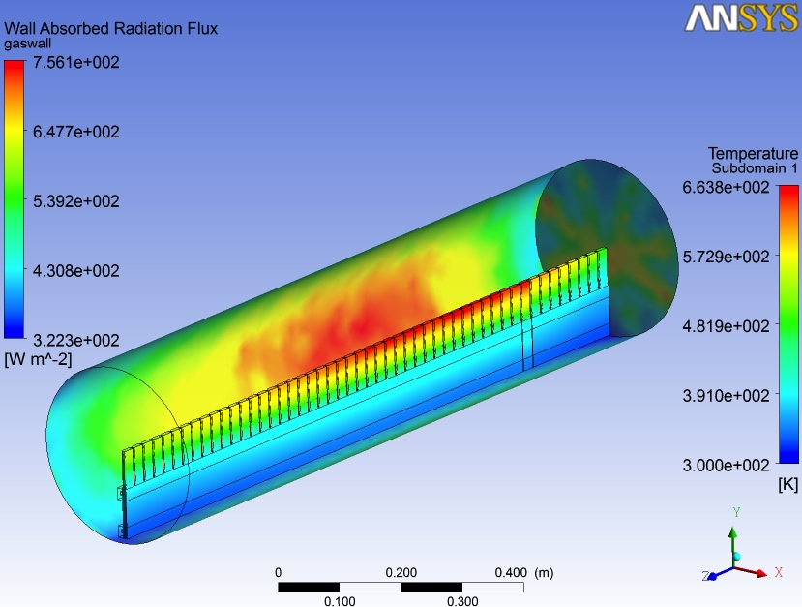
Outer Vessel - Thermal
ANSYS CFX Simulation of natural convection and radiation inside target vessel. Used to estimate target fin operating temperatures and emissivity requirements of outer vessel.
Typical Heat Balance
Total Heat load =7482W
Heat conducting down fins to main cooling rail =6867W
Heat radiating from fins to the outer vessel =476W
Convection and conducted through helium from the fins to the outer vessel =139W
Analysis by T. Davenne (RAL)

Slide 14
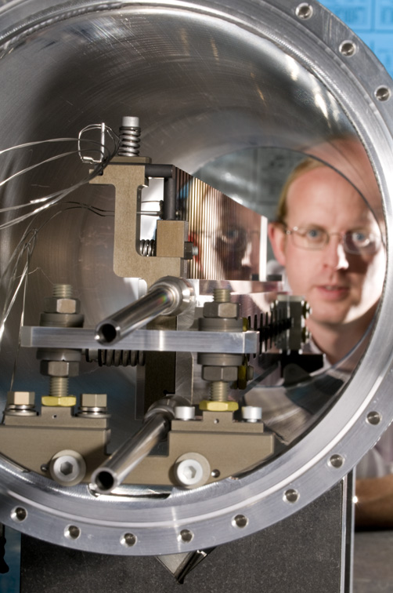
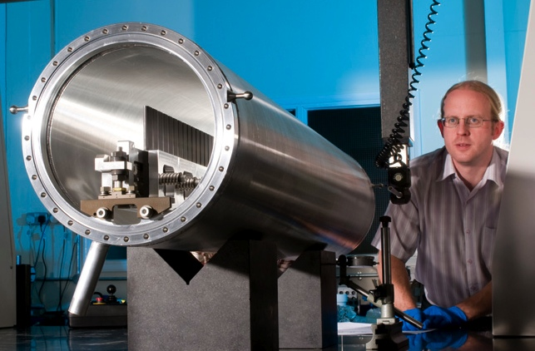
Construction
MET-01 Manufactured by STFC (currently installed)
MET-02 Manufactured by Fermilab
MET-03 Manufactured by STFC, Modifications, 1) Internal welds of outer vessel removed, 2) Outer vessel anodised
MET-04 Manufactured by Fermilab
Apologies to Fermilab Team – Slides are RAL-centric, but parallel development efforts were made at Fermilab!!
Slide provided by M. Fitton (RAL)

Slide 15
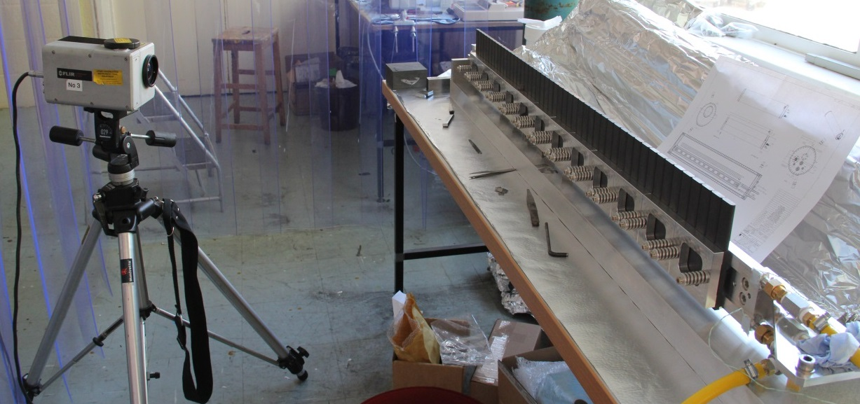
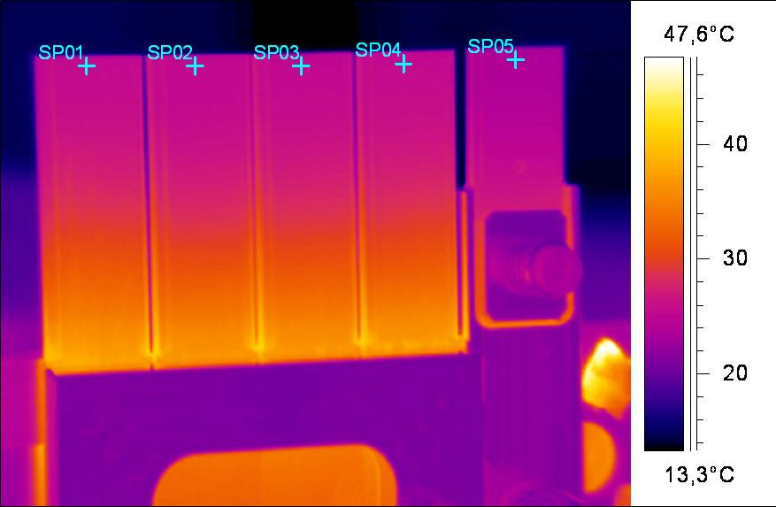
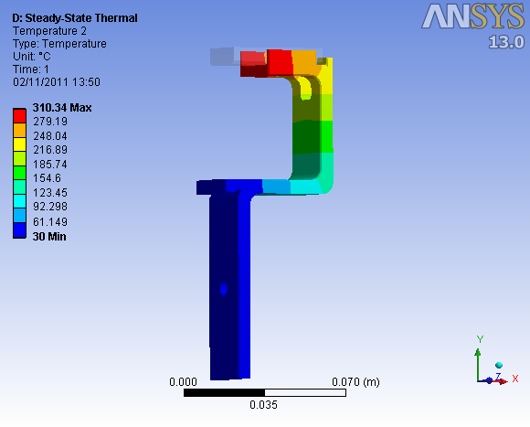
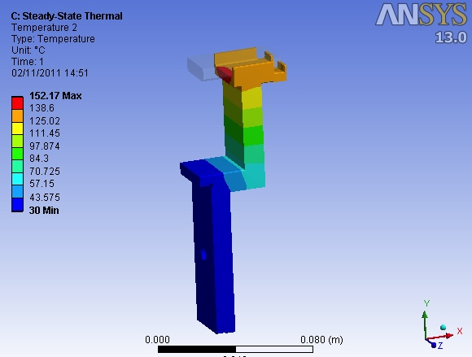
NOVA tests and analysis
Measurement of heat transfer to target fins using thermal imaging camera. Consistent contact across all graphite fins confirmed but also identified thermal issue with cooling of horizontal budal monitor fin.
Horizontal budal bracket redesigned by thickening material and shortening conduction path. Simulation shows this more than halves the operating temperature.
310°C
152°C
Slide provided by M. Fitton (RAL)

Slide 16
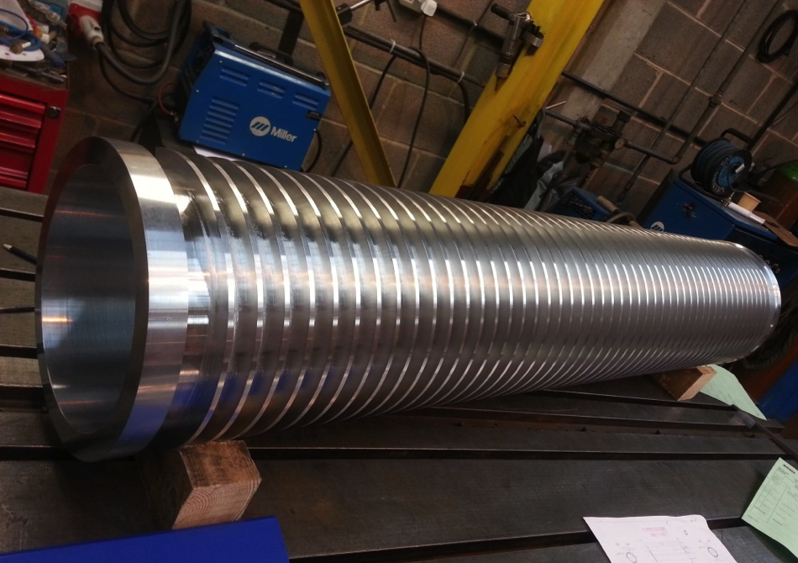
Outer vessel
Water cooled vessel of the NOvA target.
Design modified after MET-01 so there are no internal welds.
MET-03, Only 2 external welds
Slide provided by M. Fitton (RAL)

Slide 17
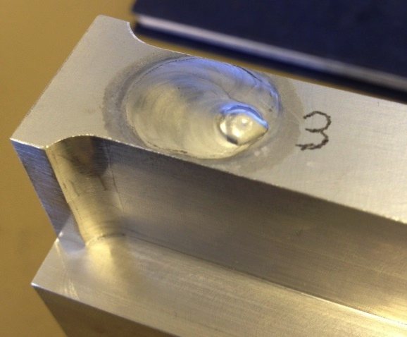
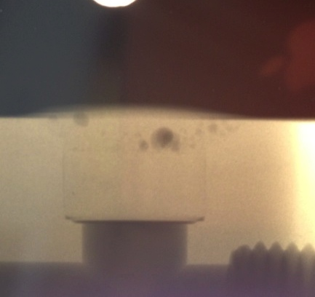
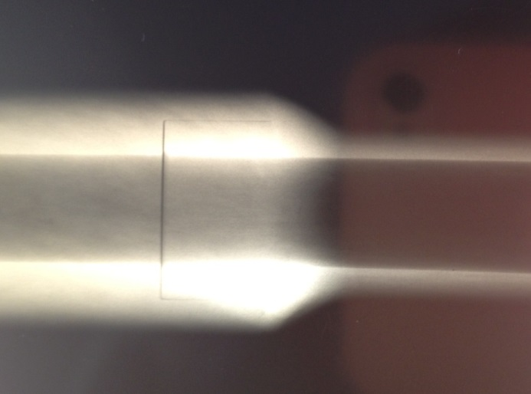
NOVA welding development
High quality welds (NAS 1514 Class II or better) in 6061 aluminium proved very difficult to produce consistently for plug weld.
By visual inspection welds look very good.
Radiography reveals significant porosity
Parameters explored to optimise weld:
Cleaning (including etching)
Filler wire selection
Pre-heating
AC current/balance Gas (Helium/Argon Blend)
Slide provided by M. Fitton (RAL)

Slide 18
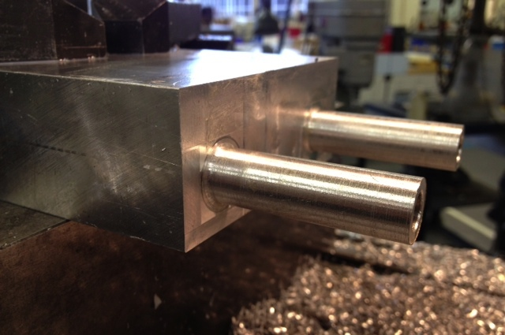
NOVA welding development
First step – reduce number of Aluminium from water cooling circuit.
Original design – 9 Aluminium welds
Fermilab Notes:
Use of extruded bar resulted in better straightness of gun-drilled holes
Outside rail dimensions finished after drilling to put holes in best true location
AL-SS Roll bonded plate replaced with friction welded blanks
Modified design – 3 Aluminium welds
Blind gun drilled holes, with single cross drill
Pipe stubs machined into rail
Slide provided by M. Fitton (RAL)

Slide 19
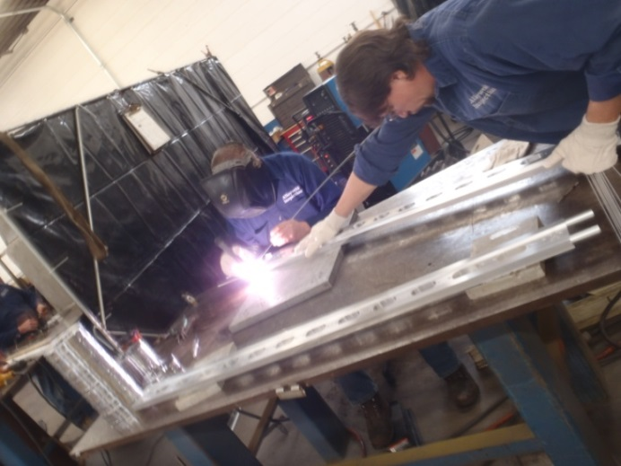
NOVA welding procedure
CLEANING
Applied to all parts and welding rods
Degrease using Trichloroethylene (TCE) a vapor solvent for organic materials
Alkaline bath w/ pH 11-11.5 (for 5 min)
Tap Water Rinse (ambient) to remove residual alkaline solution (for 5 min)
Nitric Acid Etch 38-48% Nitric, 0.7-0.9% HF-3 (for 2.5 min)
DI water Rinse (for 5 min) at ~ 90 F
Oven dry at 130 F (for 30 min)
WELDING
AC TIG (HF Impulse) Welding
Plug Weld Parameters: Pos electro +170/ Neg. electro -180, balance 80% & 130 Hz frequency
Socket Weld Parameters: Pos electro +100/ Neg. electro -120, balance 80% & 130 Hz frequency
Tungsten cup #5, flow 25 – 30 scfm (75% He/25% Ar) gas purge
Note: This welding procedure was developed by Fermilab with input from RAL and the welding vendor, Alloyweld
Slide provided by M. Fitton (RAL)

Slide 20
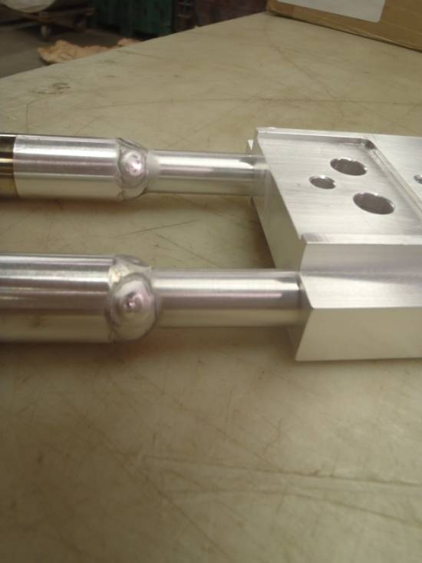
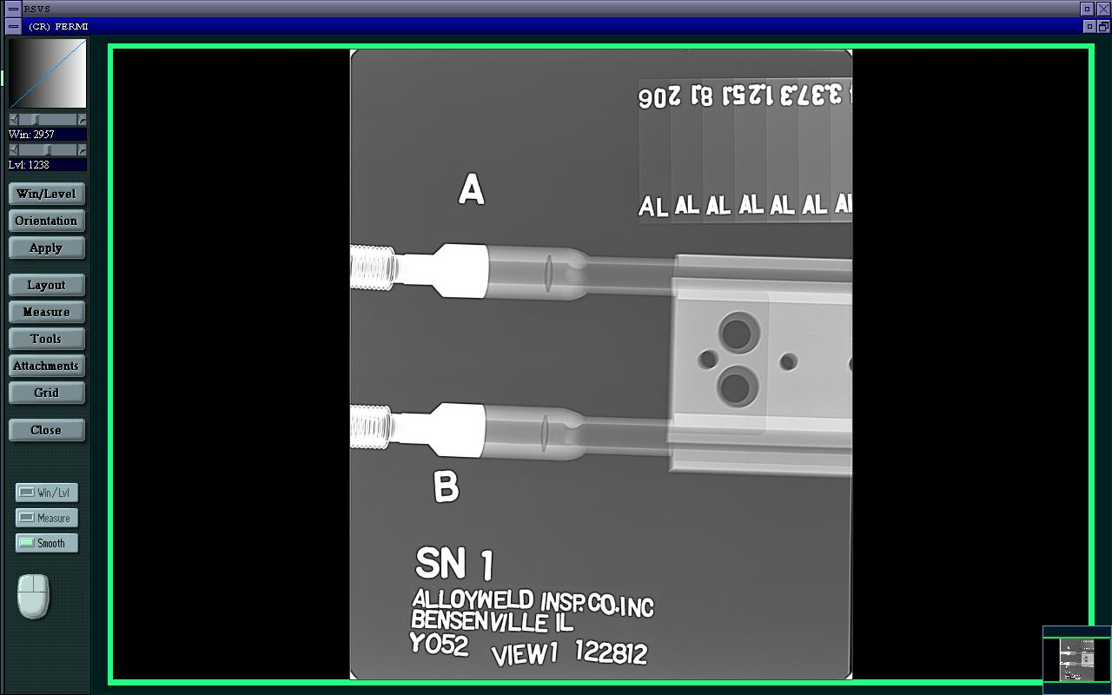
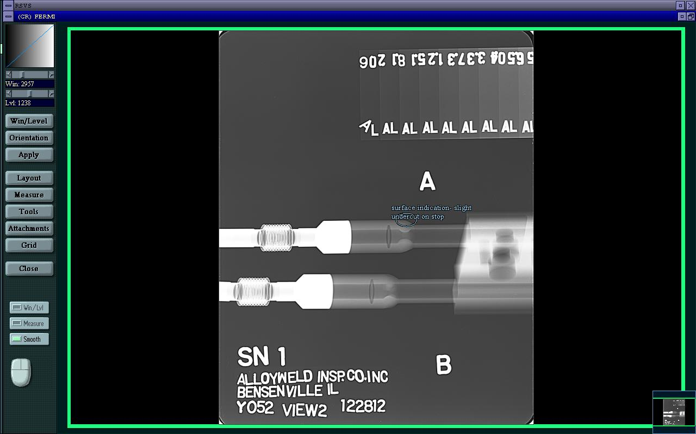
QA- Welding radiography
Achieved NAS-1514, Class I Certification for cooling rail
Slide provided by M. Fitton (RAL)

Slide 21
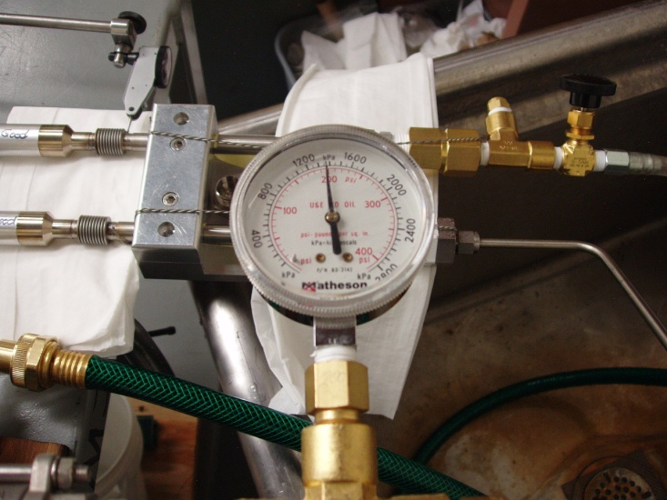
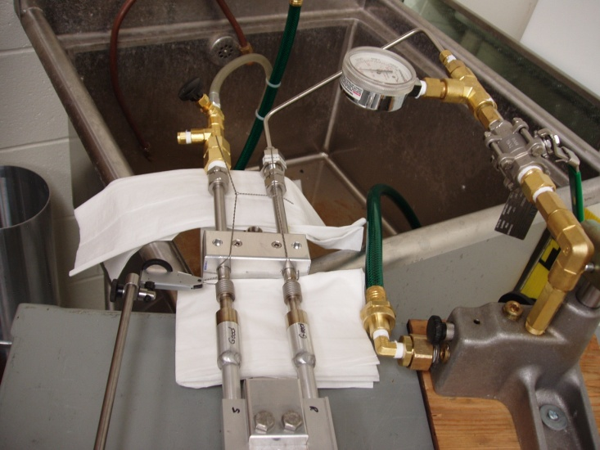
QA - Hydrostatic Pressure testing
Cooling rail tested to 200 psig
Outer vessel tested to 90 psig
Much higher than expected operational pressure.
Testing for leaks and weakness
Photos of pressure testing at Fermilab
Slide provided by M. Fitton (RAL)

Slide 22
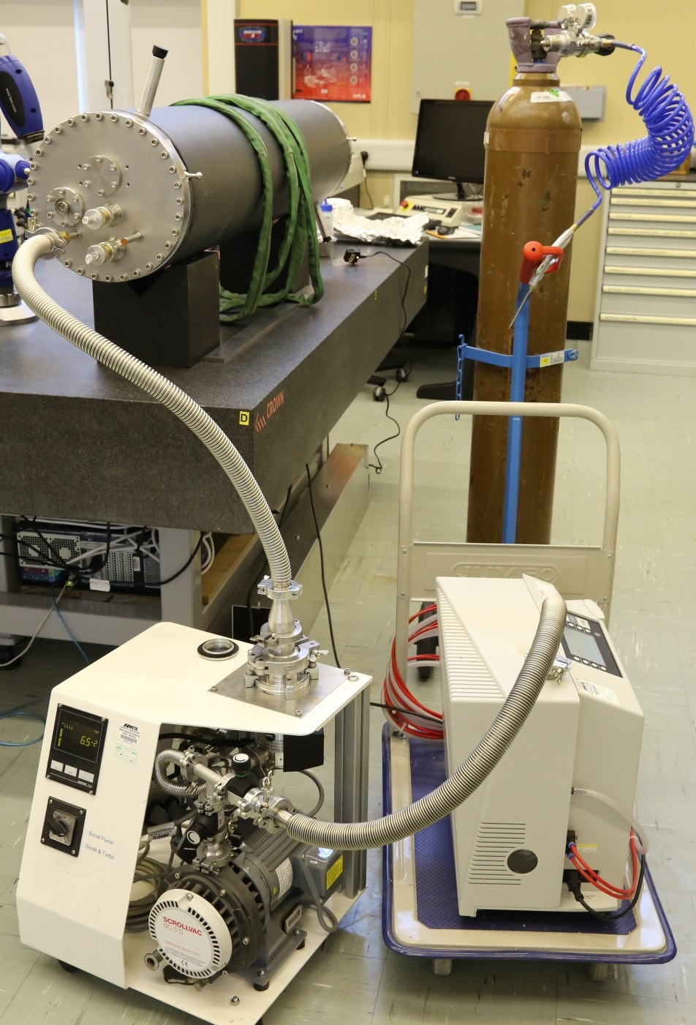
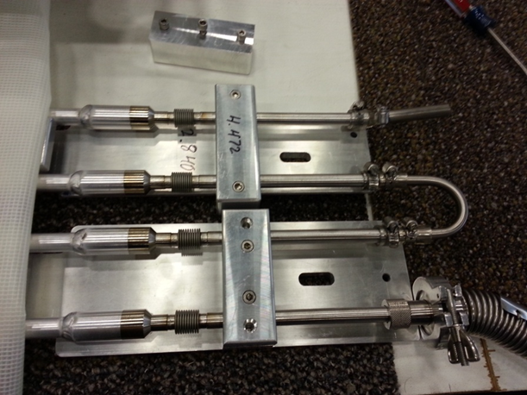
QA – Helium leak check
All components and complete assembly helium leak checked.
Specification:
Total leak rate < 1x10⁻⁹atm.cm³/sec
Slide provided by M. Fitton (RAL)

Slide 23
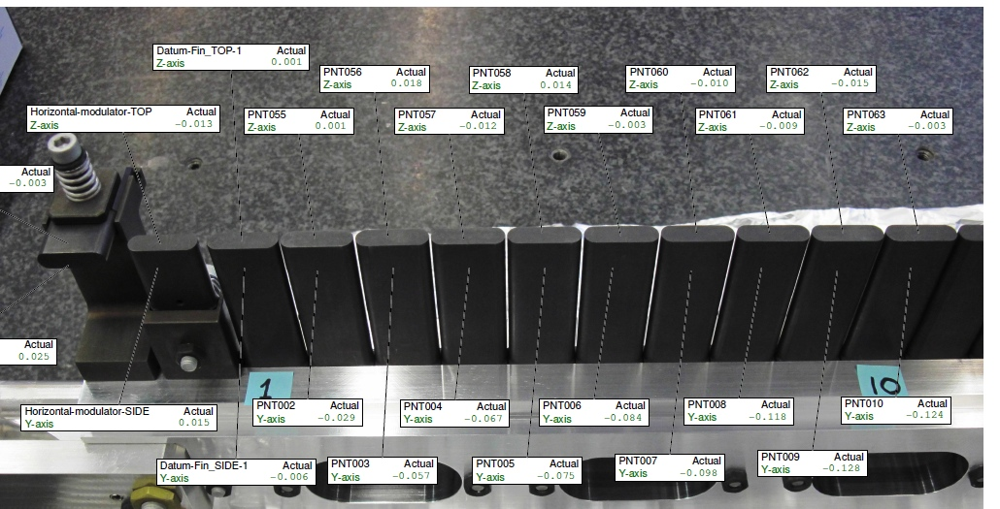
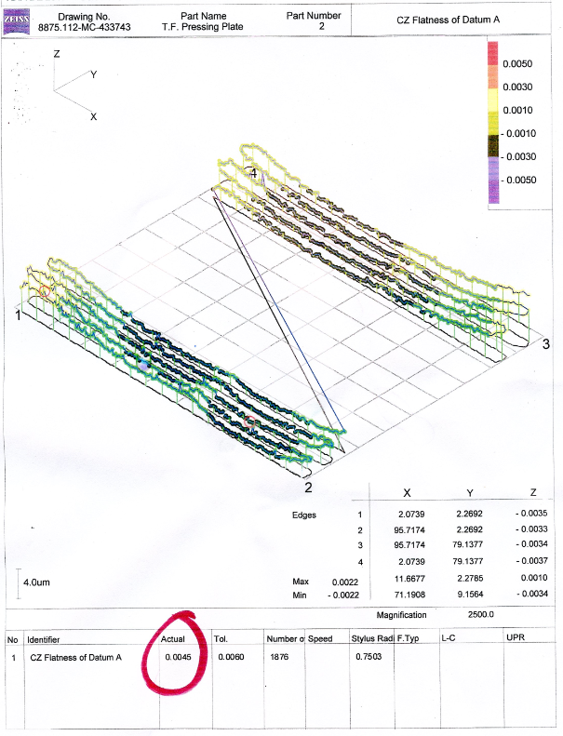
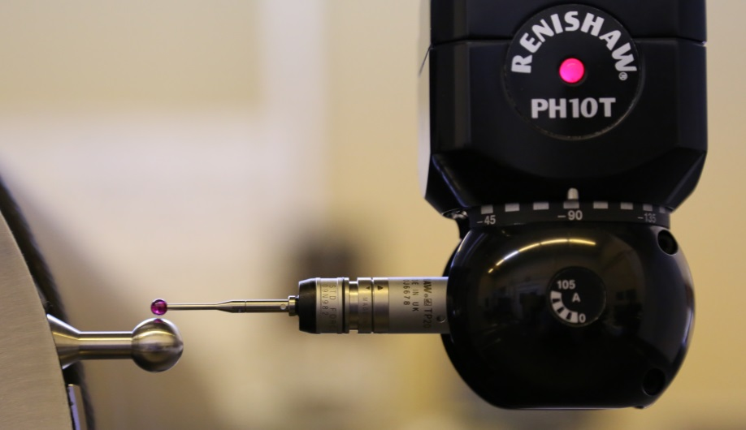
QA - Metrology
Careful measurements using Coordinate Measuring Machine (CMM)
Graphite fin tip alignment and straightness
Tooling balls
Roundness and position
Pressing plate (4.5μm flatness)
Slide provided by M. Fitton (RAL)

Slide 24
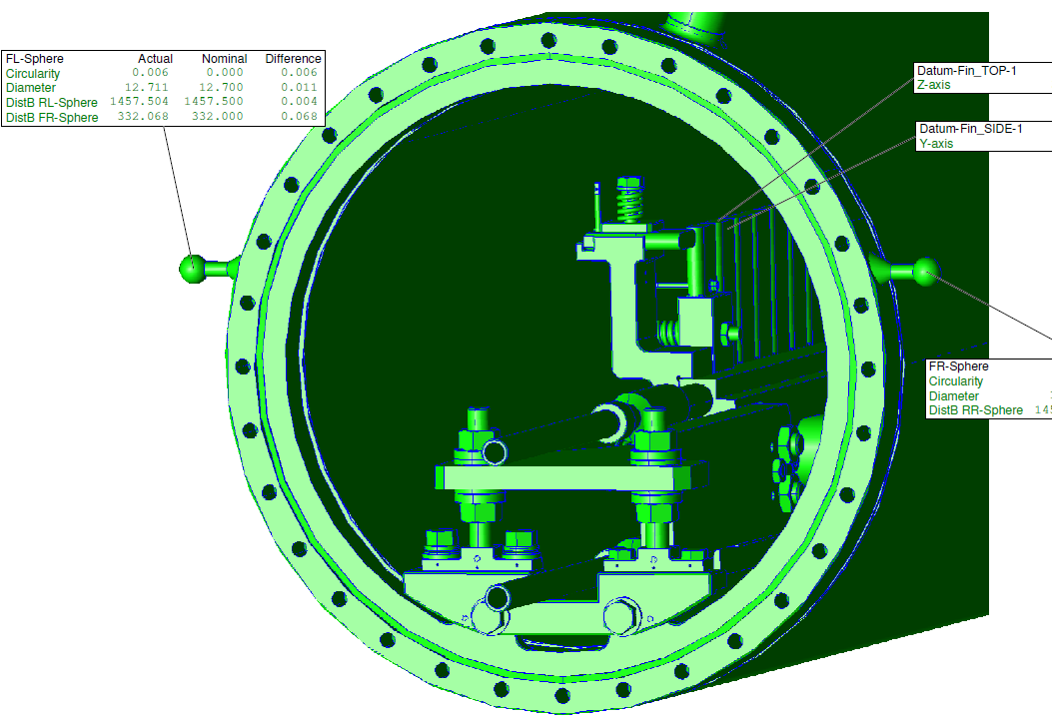
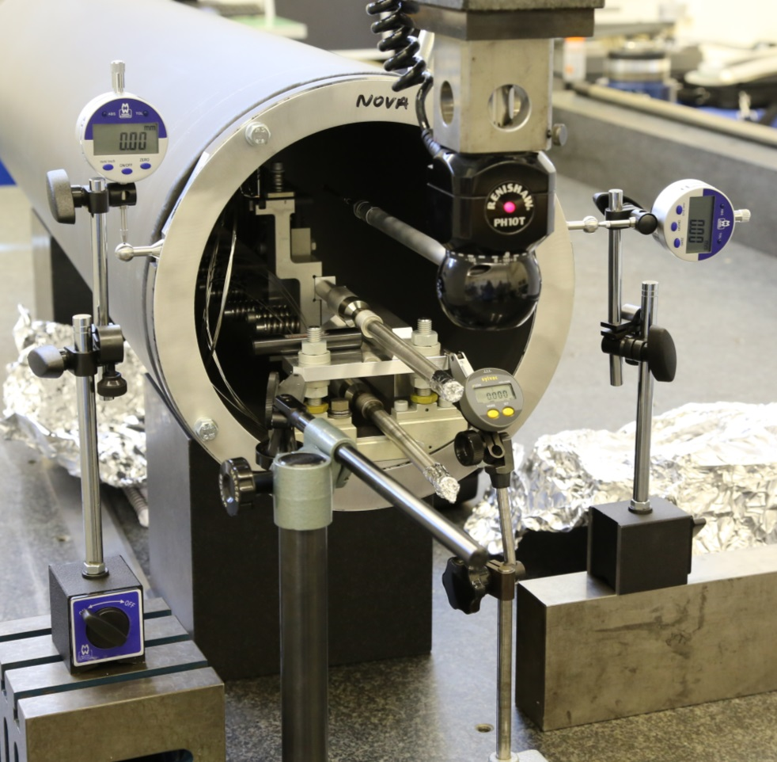
Alignment
Target rail aligned in outer vessel using large CMM and long probe
Clocks used to ensure outer vessel has not moved during adjustment
Slide provided by M. Fitton (RAL)

Slide 25
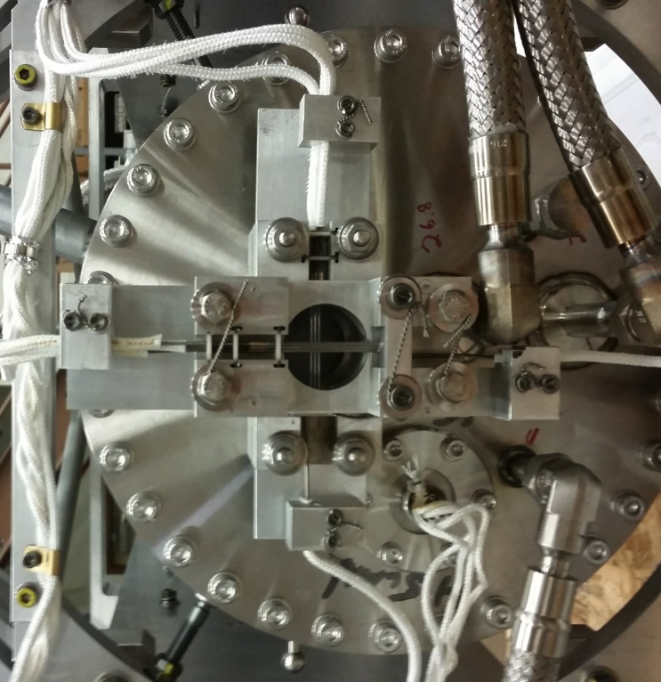
Conclusion
Release of Horn 1 insertion constraint enabled the design of a robust target capable of operation at 700 kW beam power
Successful completion of multiple targets was dependent upon developments and creativity of skilled teams at both Fermilab and Rutherford Appleton Laboratory (RAL-STFC)
MET-01 has seen:
Average Beam Power of ~260 kW
Max Beam Power of ~368 kW
Resulting in 3.3 x 10²⁰ POT
Upgrades still ongoing
Latest is the thermometer based beam position monitor (see J. Hylen talk…. NEXT!)

Slide 26
Back-up

Slide 27
Radiation Damage in Graphite

