Slide 1
Fermilab Remote Handling:
Component Lifecycle from
Failure to the Grave
NBI 2014 – Remote Handling
FNAL, September 23-26, 2014
Ryan Schultz
Vladimir Sidorov

Slide 2
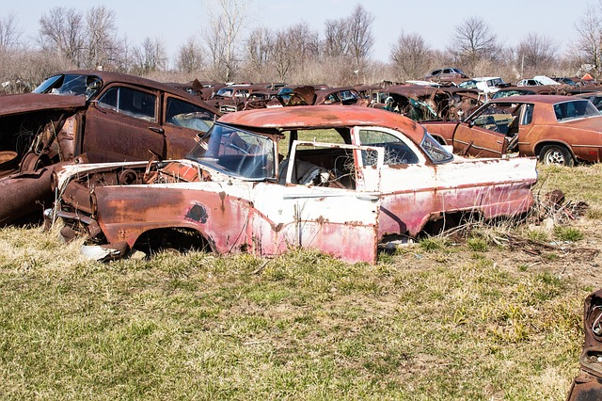
The long-term storage needs of highly activated beam-line components from AD target hall facilities will likely exceed the current capacity at Fermilab within 5 years.
Fermilab Long Term Radioactive Storage Task Force, 2014

Slide 3
Component Lifecycle
Target Hall
  Operation -> Failure
  TH Morgue
C0 Remote Handling Facility
  Autopsy
  Repair
C0 Long Term Component Storage
  … stored for a long time
Offsite Disposal Facility
Similar progression for all Fermilab target halls

Slide 4
Remote Operations
Target Hall
C0 RHF
C0 LTCS
Disposal
Highly radioactive components
  1 Rem = 10 milli-Sievert
All operations done ---remotely---
  Shielding & distance, limited time
Viewing through cameras
  Shielding & distance, limited time
  Lots of cameras…

Slide 5
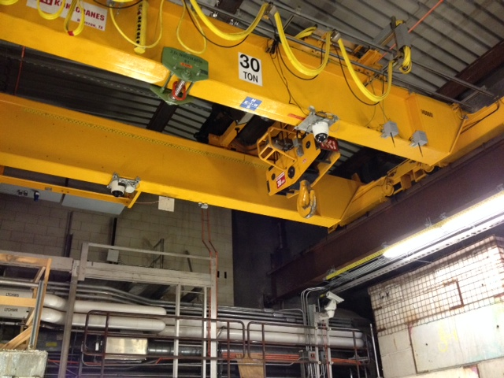
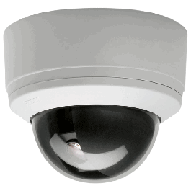
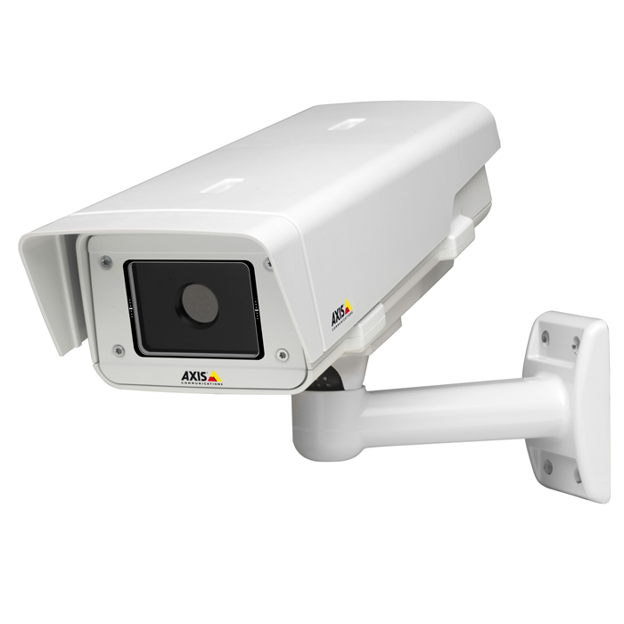
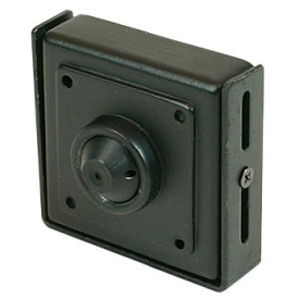
Horn on hook
Target Hall
C0 RHF
C0 LTCS
Disposal

Slide 6
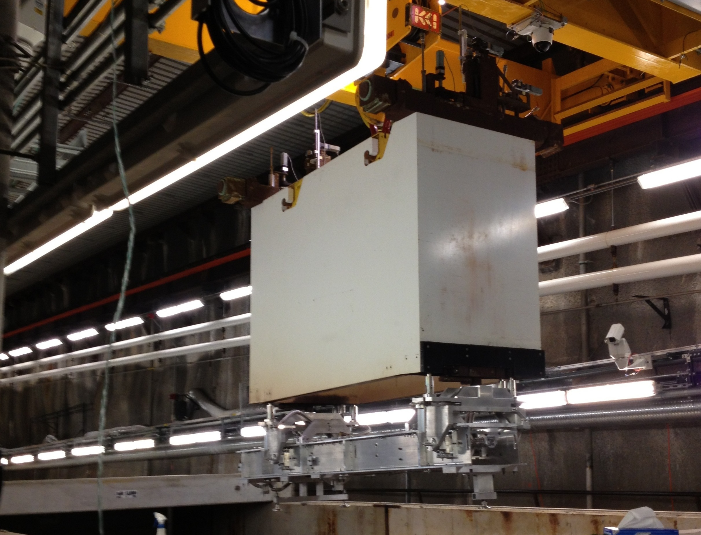
Horn on hook
Target Hall
C0 RHF
C0 LTCS
Disposal

Slide 7
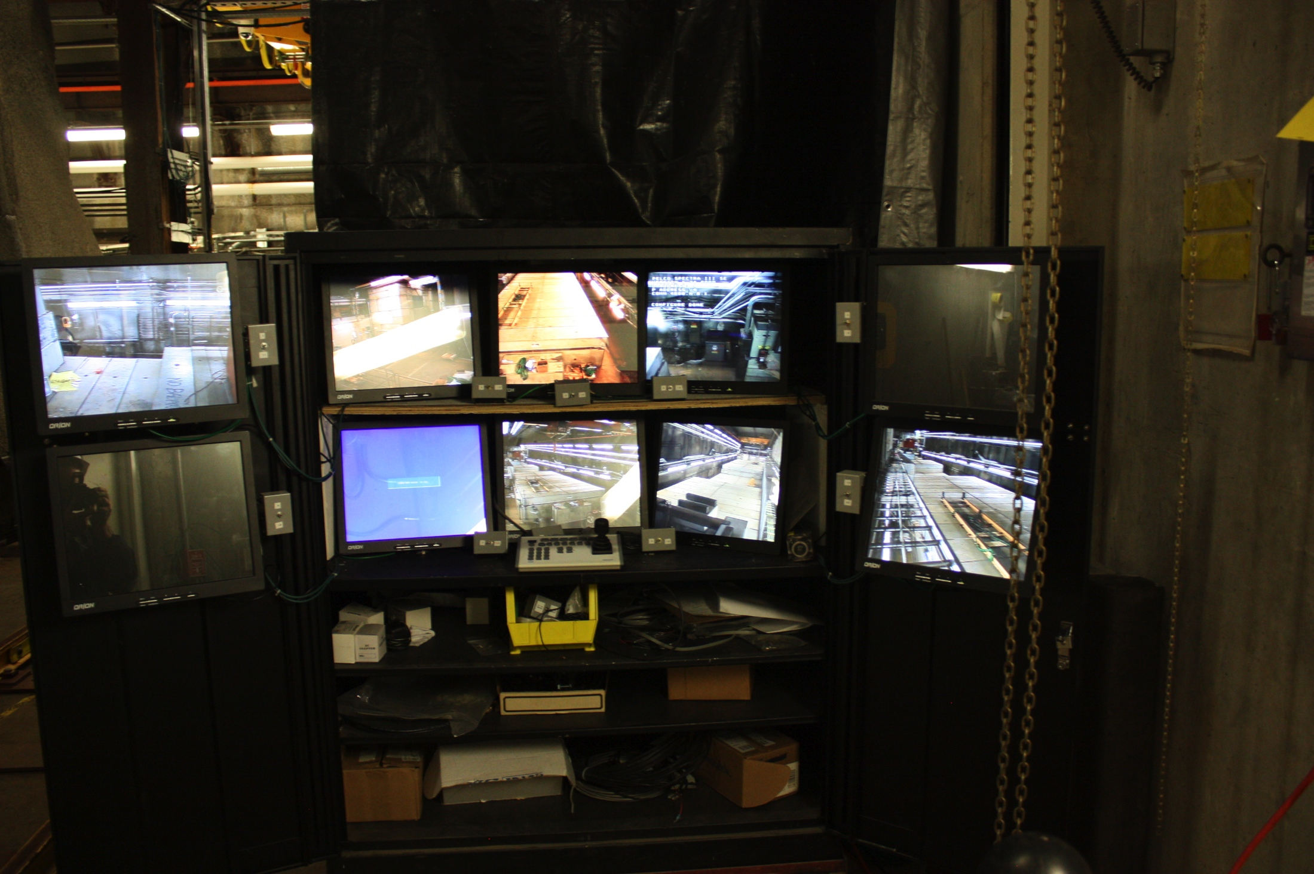
Target Hall
C0 RHF
C0 LTCS
Disposal

Slide 8
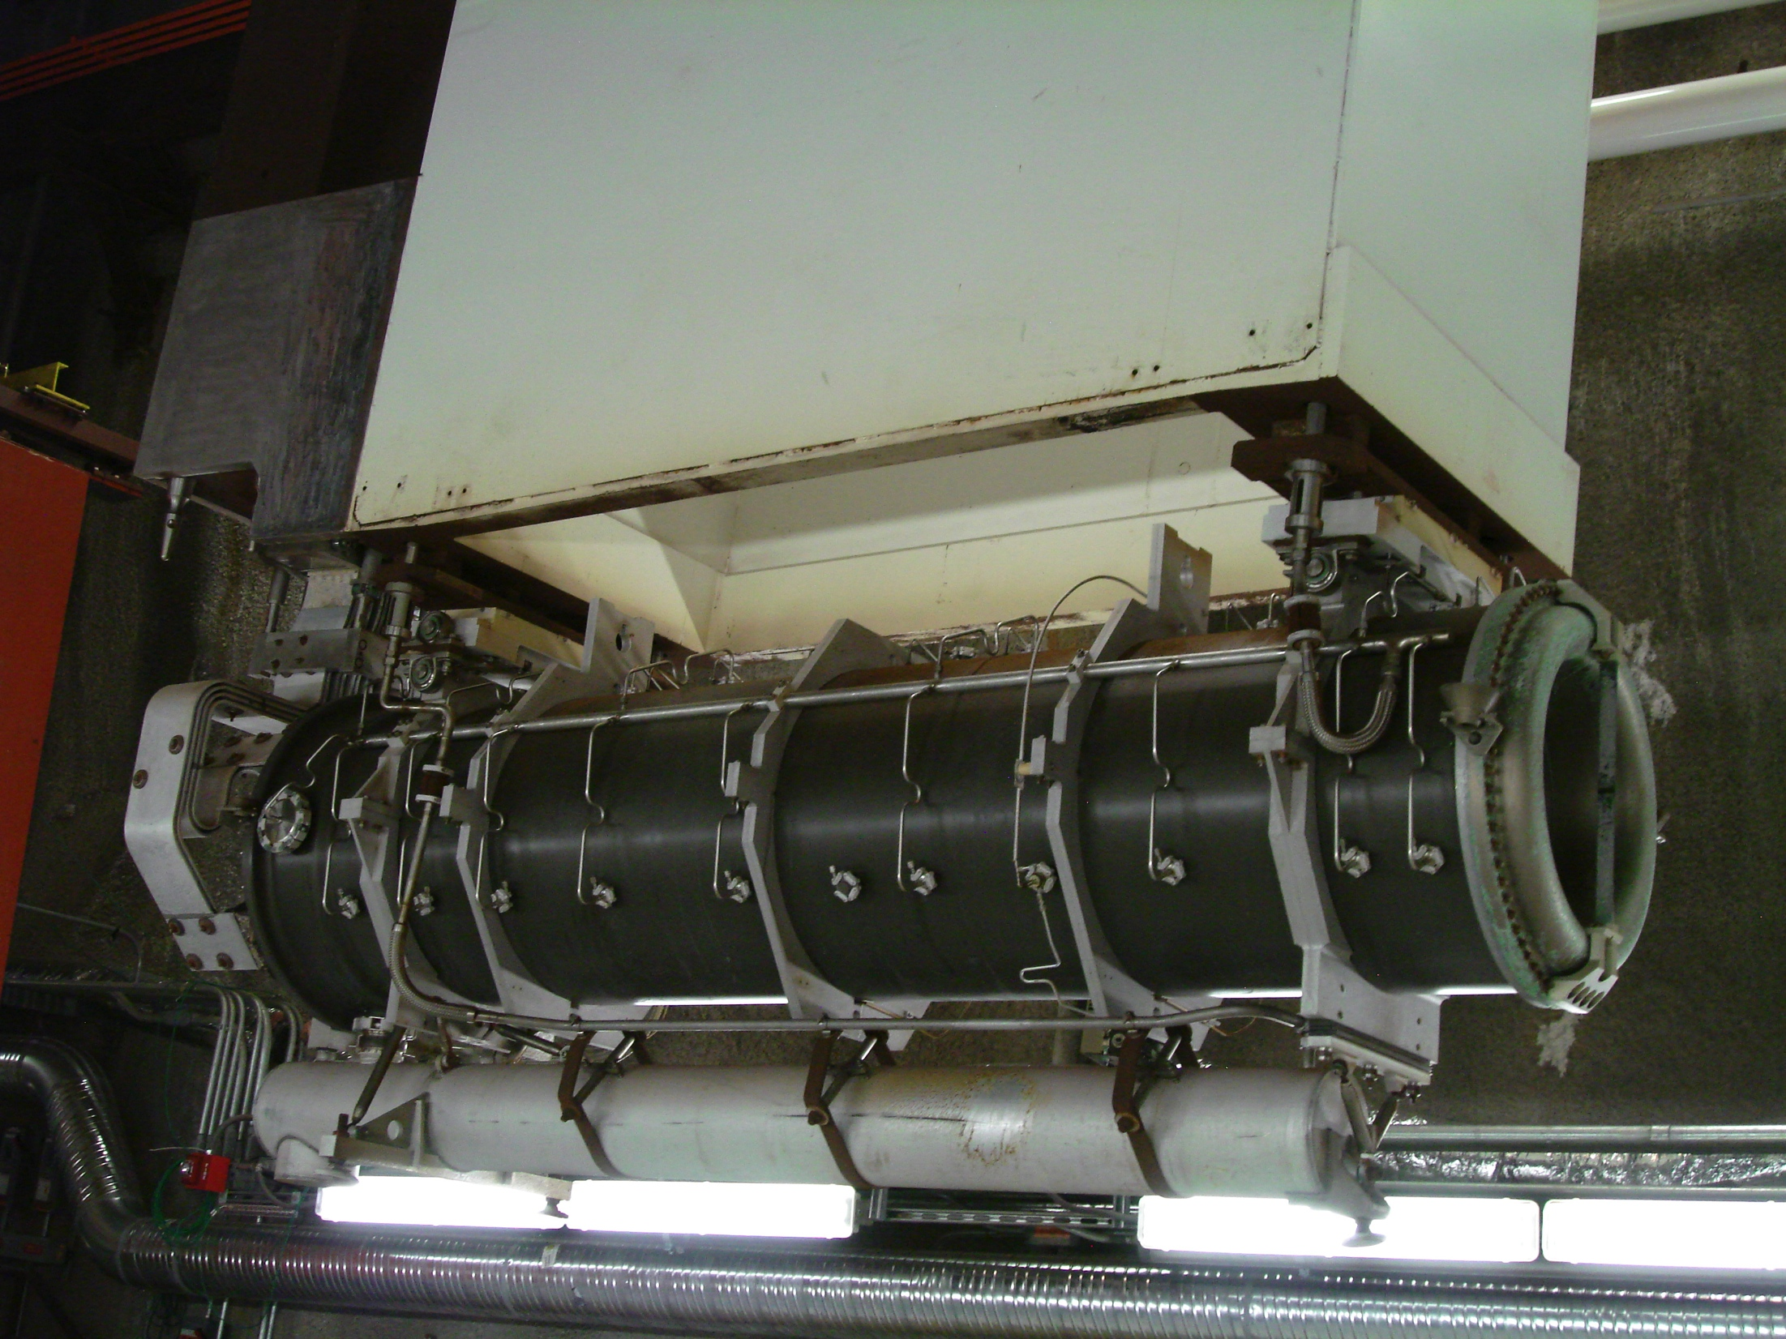
Horn on hook
Target Hall
C0 RHF
C0 LTCS
Disposal

Slide 9
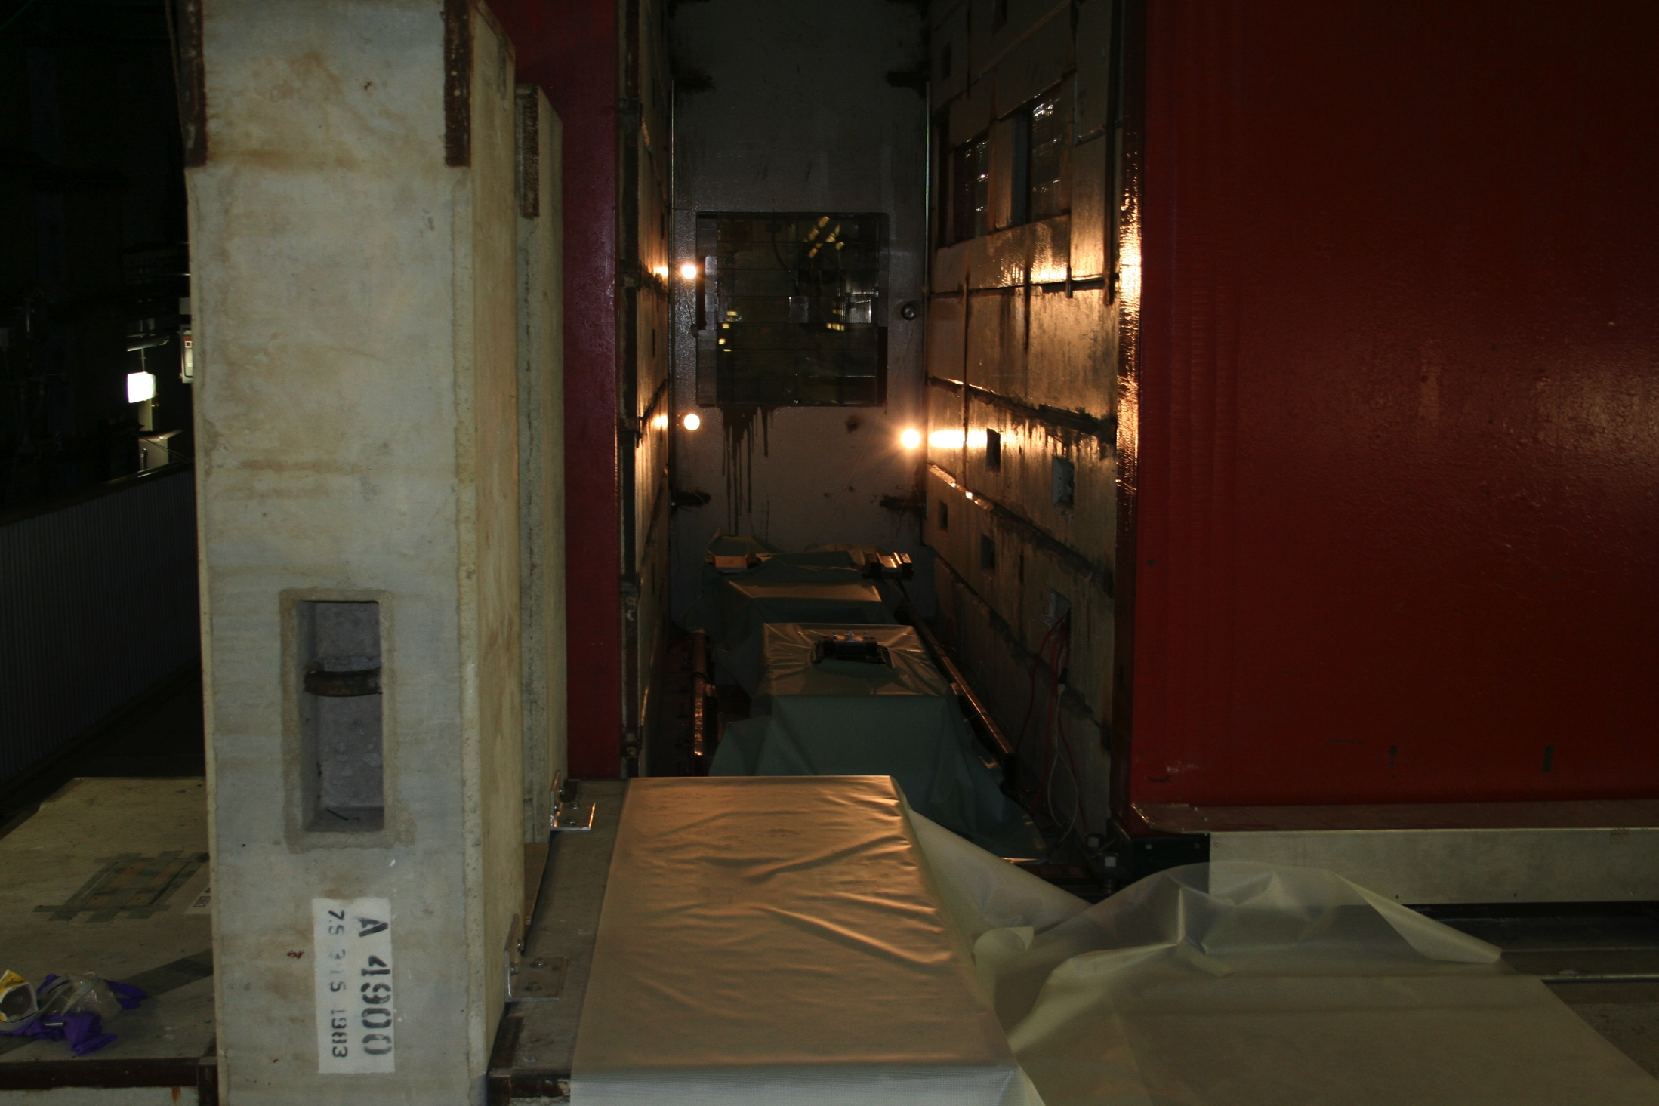
Morgue
Target Hall
C0 RHF
C0 LTCS
Disposal
Target Hall Hot Cell
  PRIMARILY used for component change-out
  Movable table
  Lead glass windows for viewing
  Not designed for repair
dsd
sdsd

Slide 10
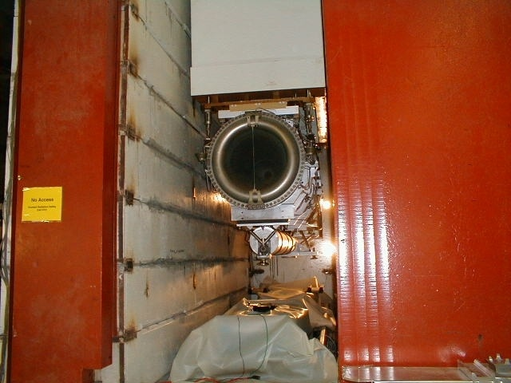
Morgue
Target Hall
C0 RHF
C0 LTCS
Disposal
  NuMI, using temporary shielding:
    Repair leaking water lines and ceramic isolators
    Un-stick target drives.
    Sudo target autopsy through DS window
    Fixed a Gig-leveling foot
  Temporary, never used for storage
      Once operation done, moves onto…

Slide 11
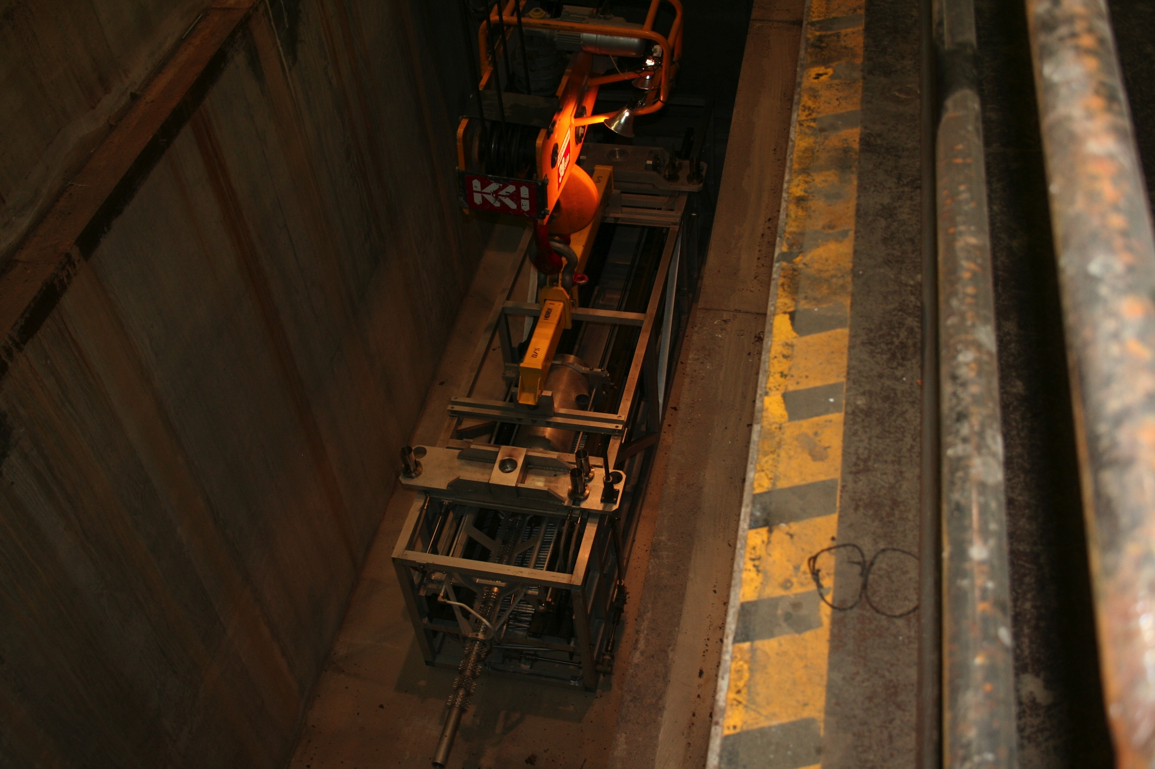
Morgue
Target Hall
C0 RHF
C0 LTCS
Disposal
Target Hall Morgue
  NuMI morgue can hold 3 items
    Typically Horn, Target, SL Block
  LBNF morgue assumes 2 years of storage
  Mu2e does not have a morgue
dsd
sdsd

Slide 12
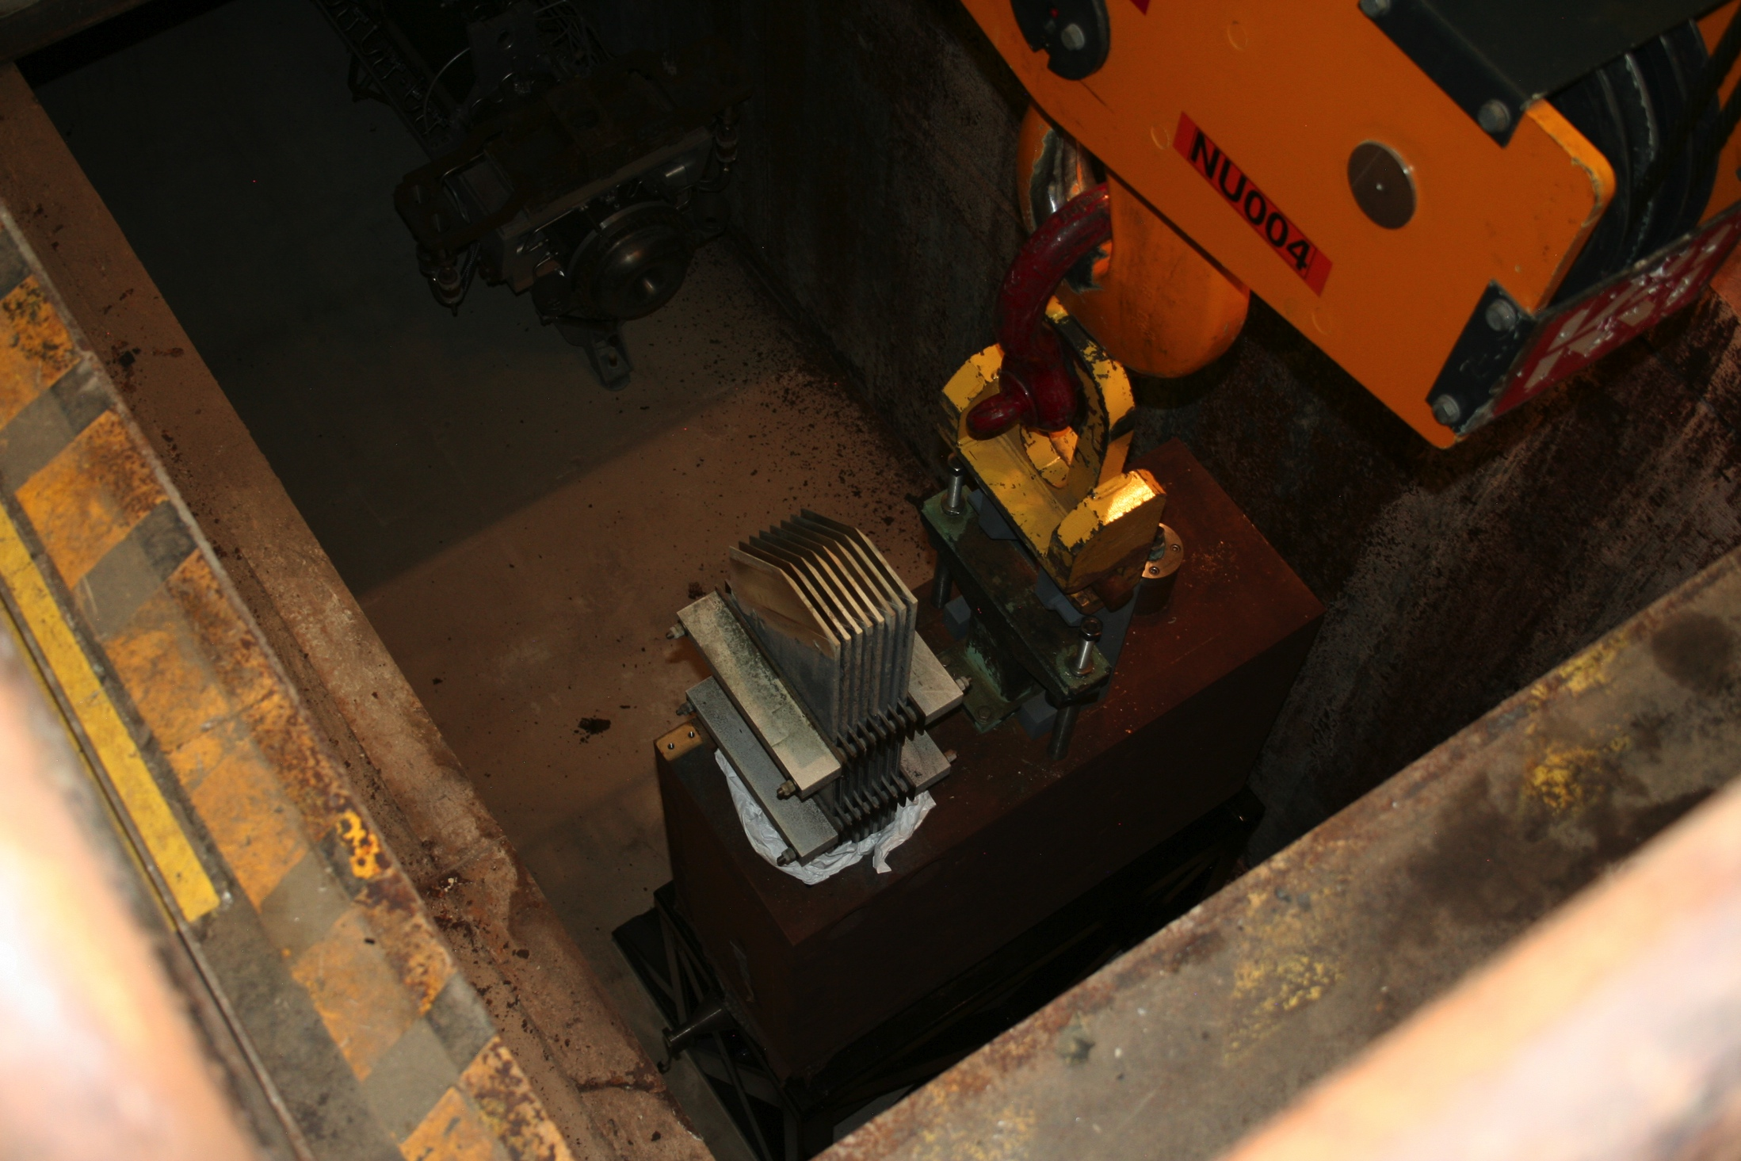
Morgue
Target Hall
C0 RHF
C0 LTCS
Disposal
Short Term Storage
  1-2 years
Then it is moved to its next destination…

Slide 13
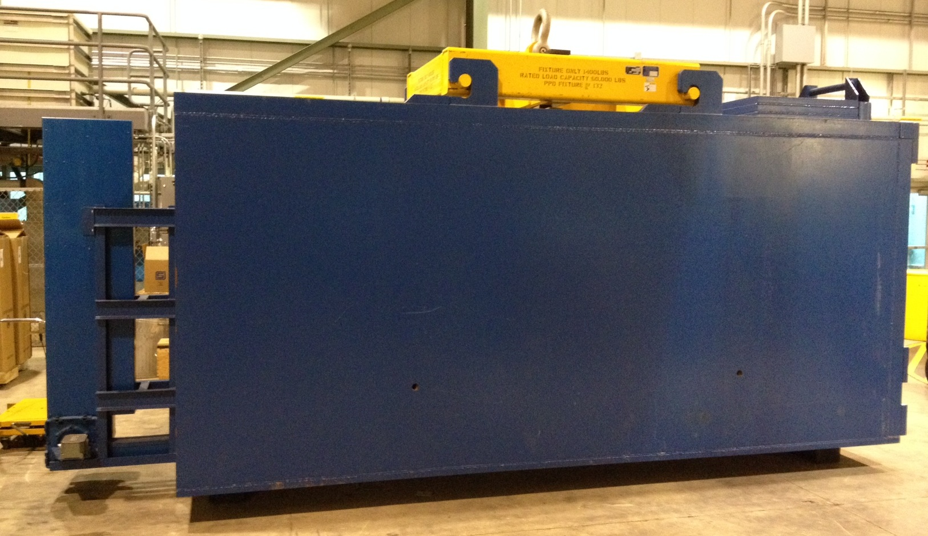
Blue Transport Coffin
Target Hall
C0 RHF
C0 LTCS
Disposal
Serapid Chain Drive
4” Thick Steel
100 R/hr device down to 1000 mR/hr
Notes:
100 R/hr component down to 300 mR/hr @ 1 ft

Slide 14
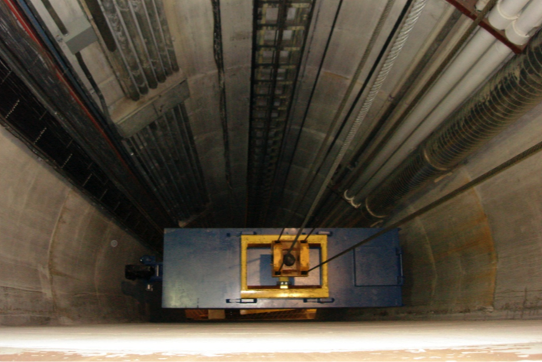
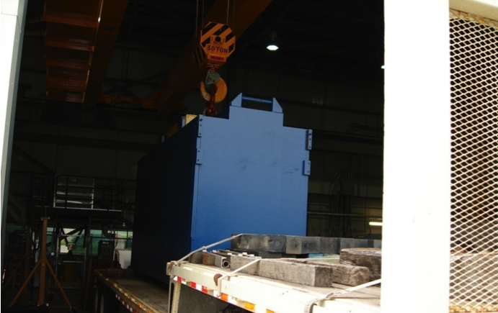
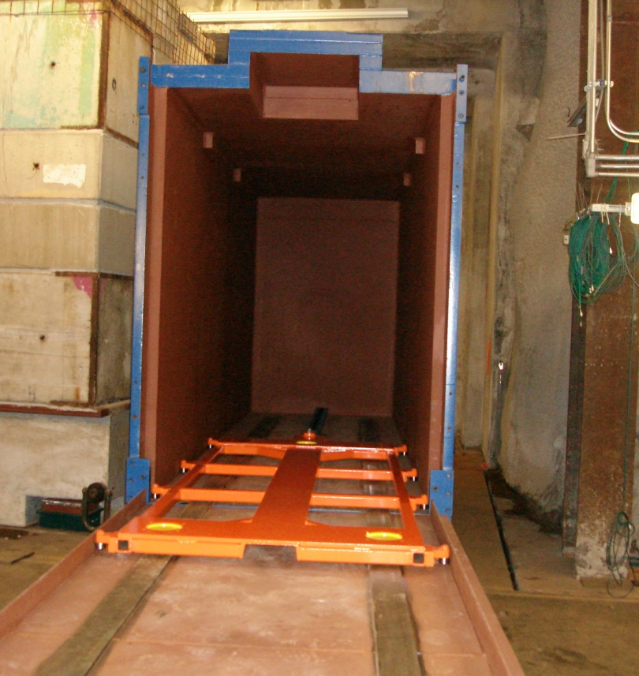
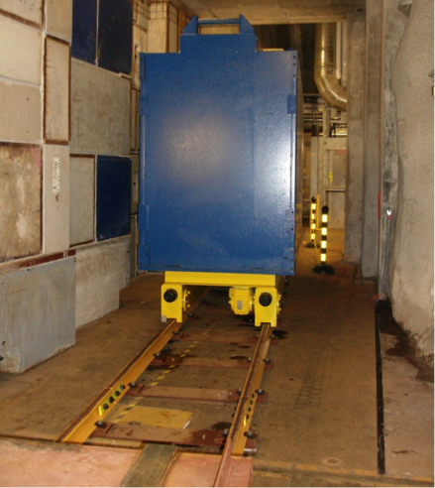
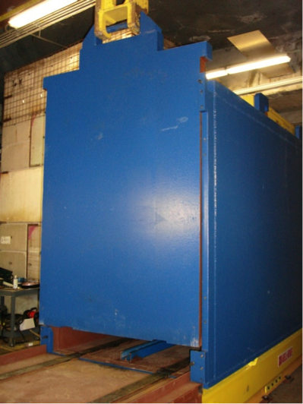
Target Hall
C0 RHF
C0 LTCS
Disposal
dsd
sdsd

Slide 15
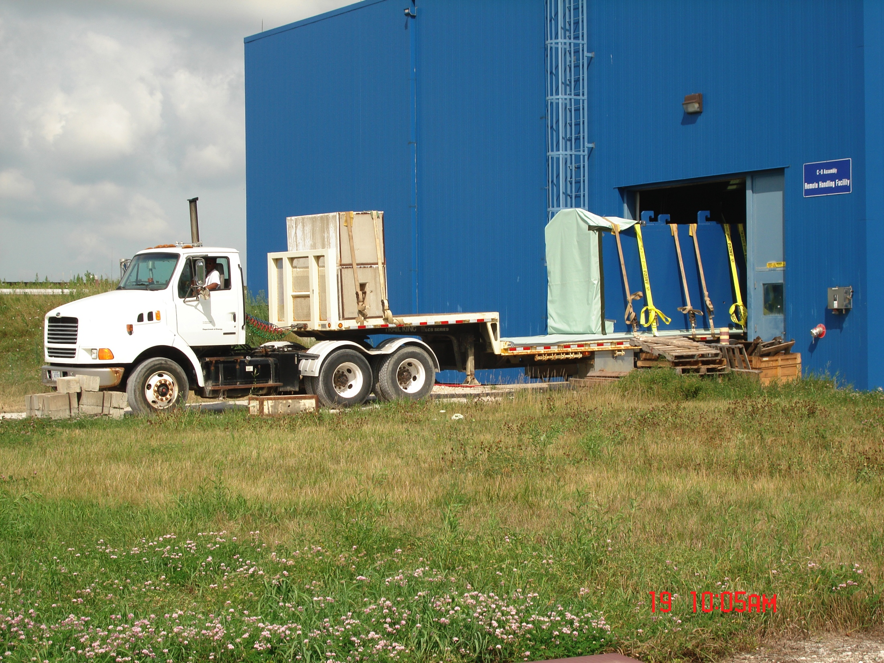
Blue coffin on truck
Target Hall
C0 RHF
C0 LTCS
Disposal
Shield blocks to
protect driver
dsd
sdsd
120,000 lb total weight
Notes:
120,000 lb

Slide 16
Blue coffin on truck
Target Hall
C0 RHF
C0 LTCS
Disposal
dsd
sdsd
Notes:
120,000 lb

Slide 17
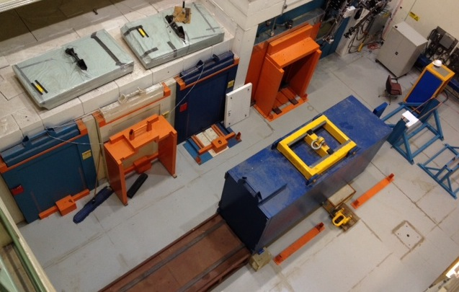
Target Hall
C0 RHF
C0 LTCS
Disposal
C0 Remote Handling Facility
  3 Storage Bays, 10” steel doors
    500 R/hr component down to < 10 mR/hr
    Short Term Storage
  Hot Cell
    (2) Master-slave Telemanipulators
    10 Ton Bridge Crane
    2 Ton Gib Crane
    Lead-Glass Window (24” x 36”)
      200 R/hr device down to 1 mR/hr

Slide 18
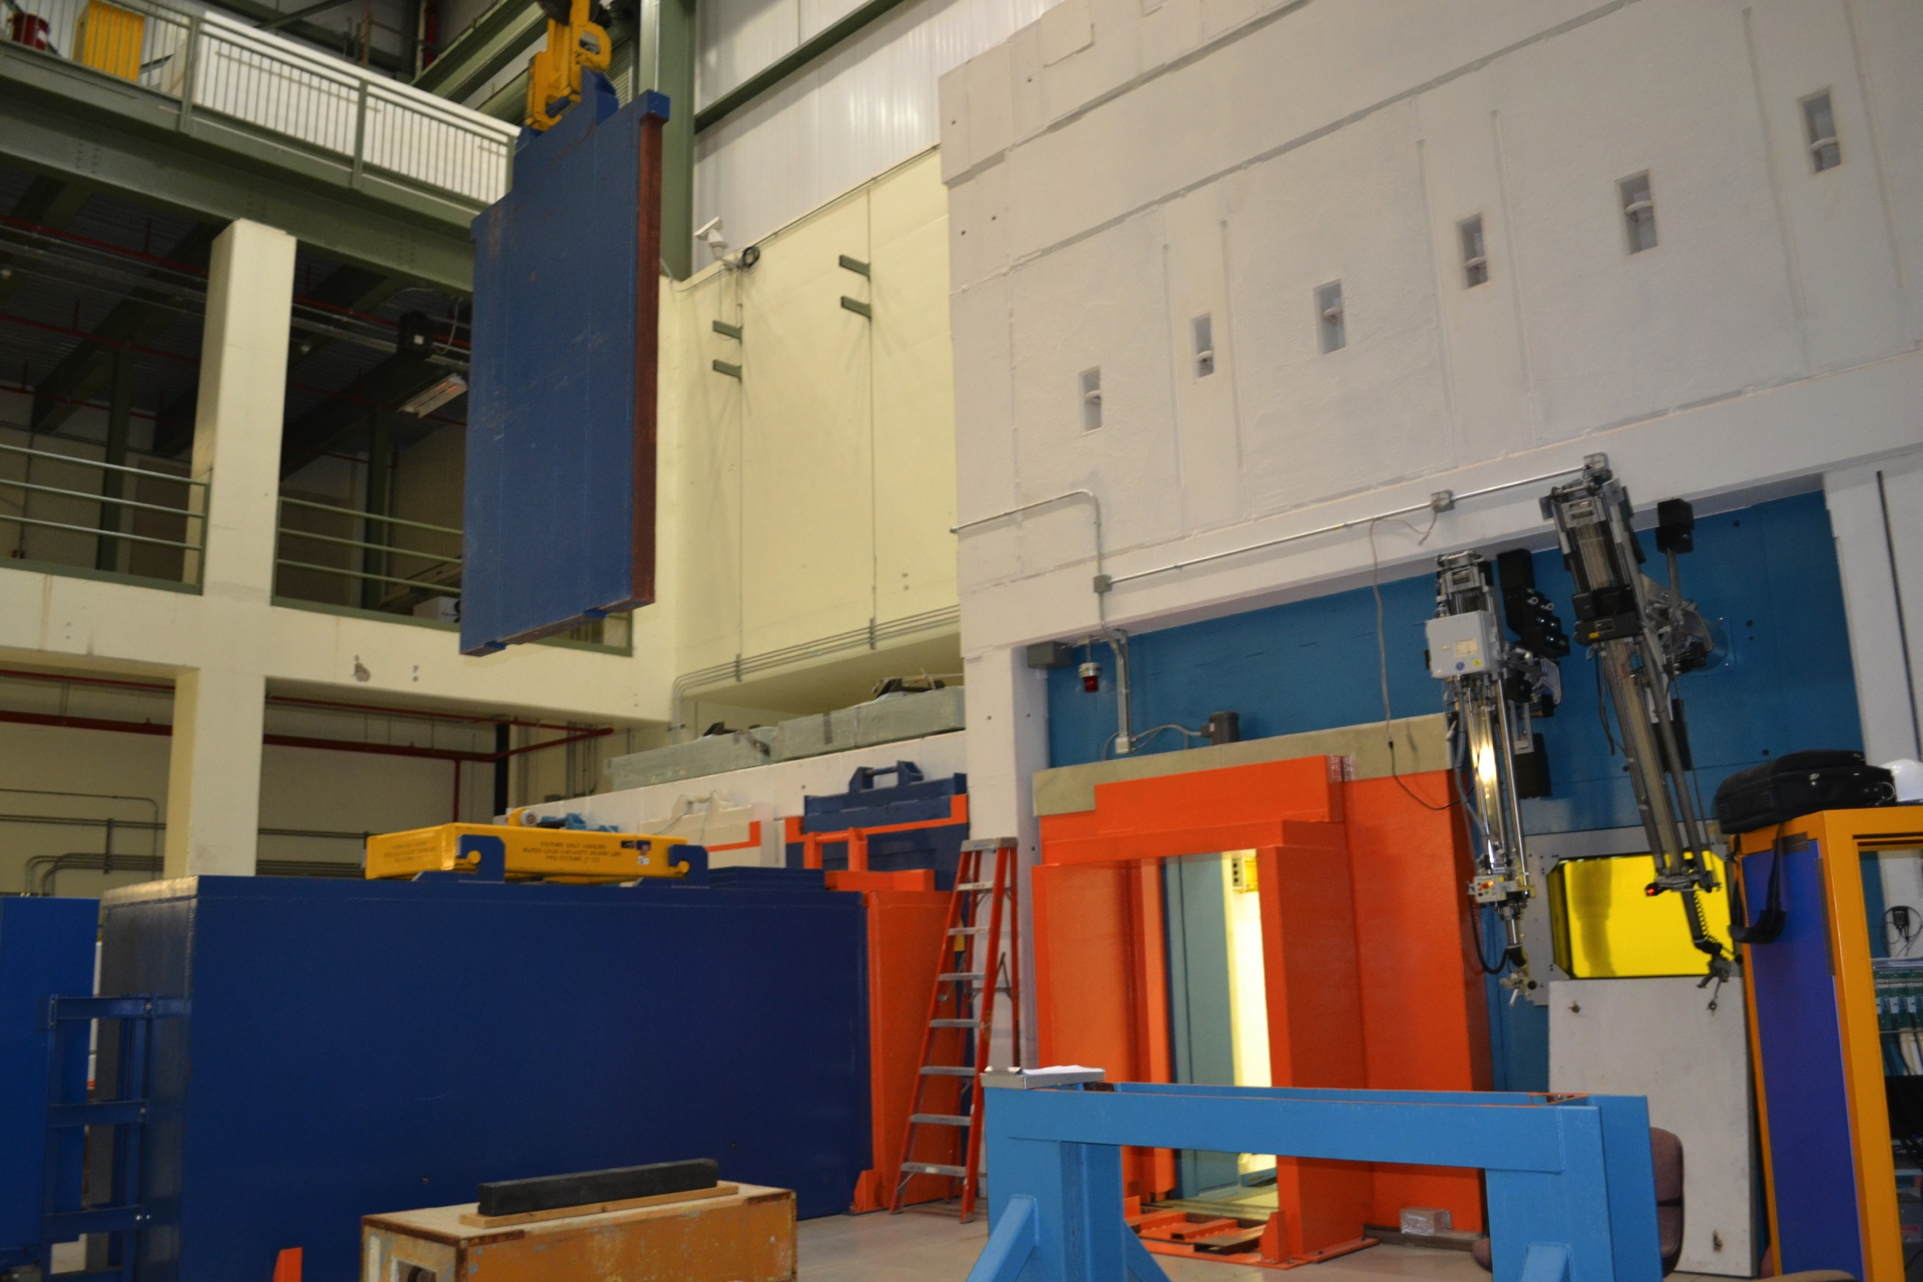
Target Hall
C0 RHF
C0 LTCS
Disposal

Slide 19
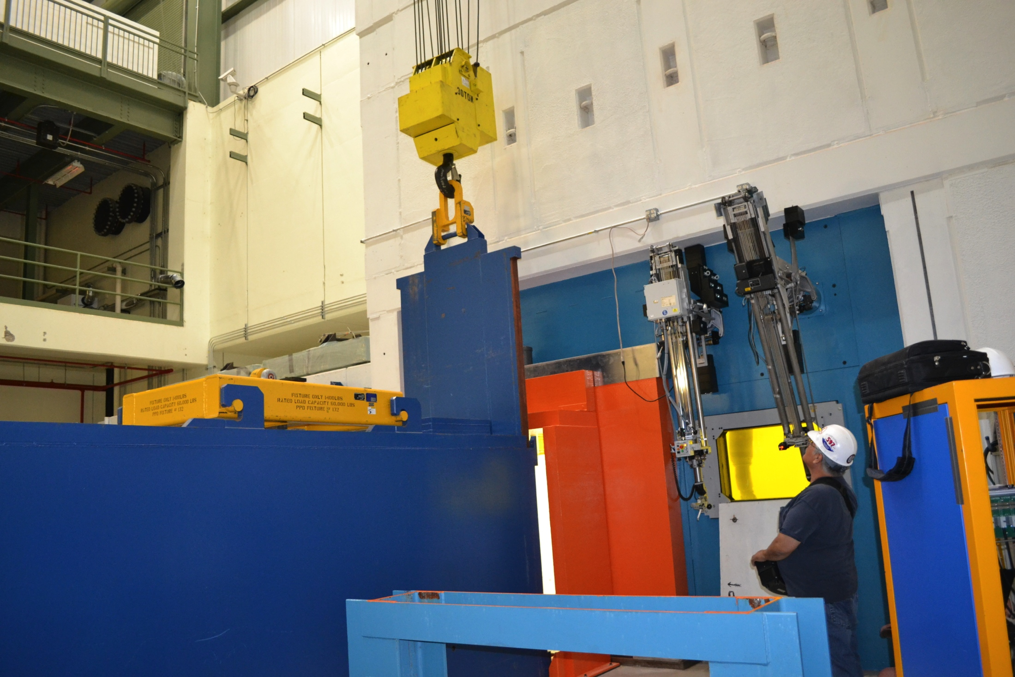
Target Hall
C0 RHF
C0 LTCS
Disposal

Slide 20
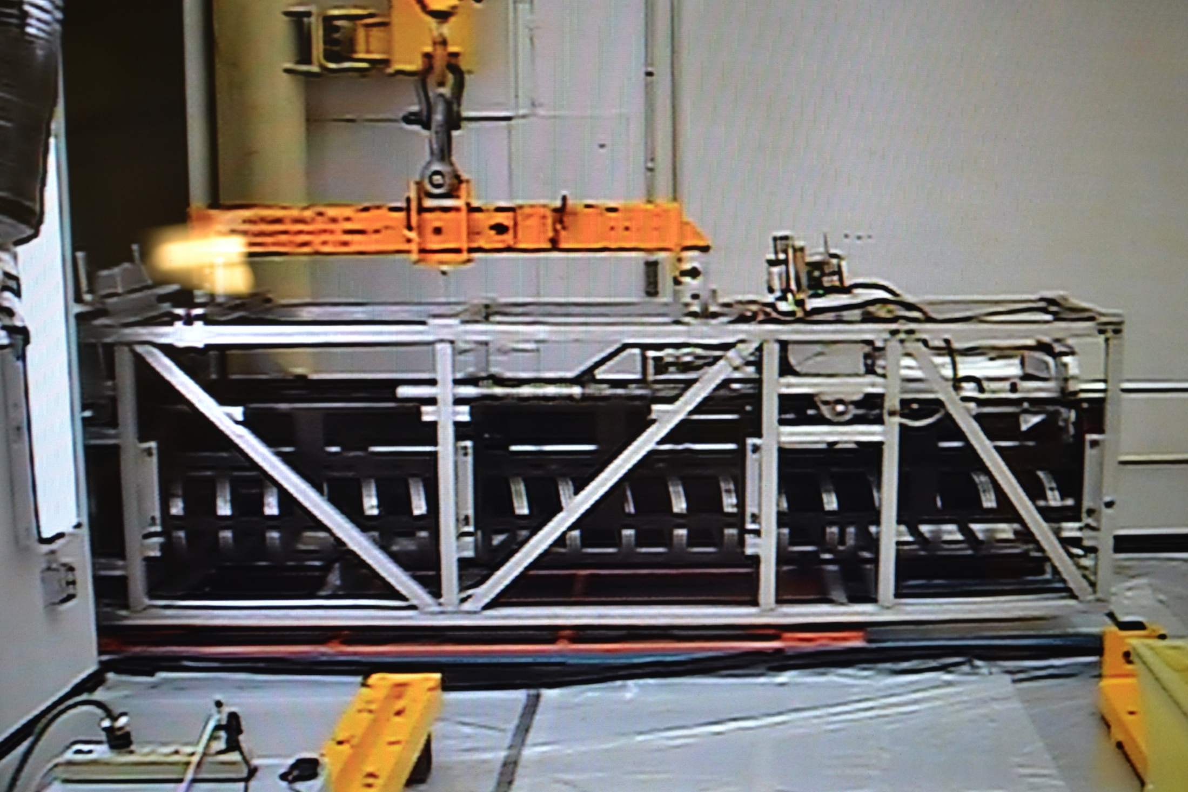
Target Hall
C0 RHF
C0 LTCS
Disposal

Slide 21
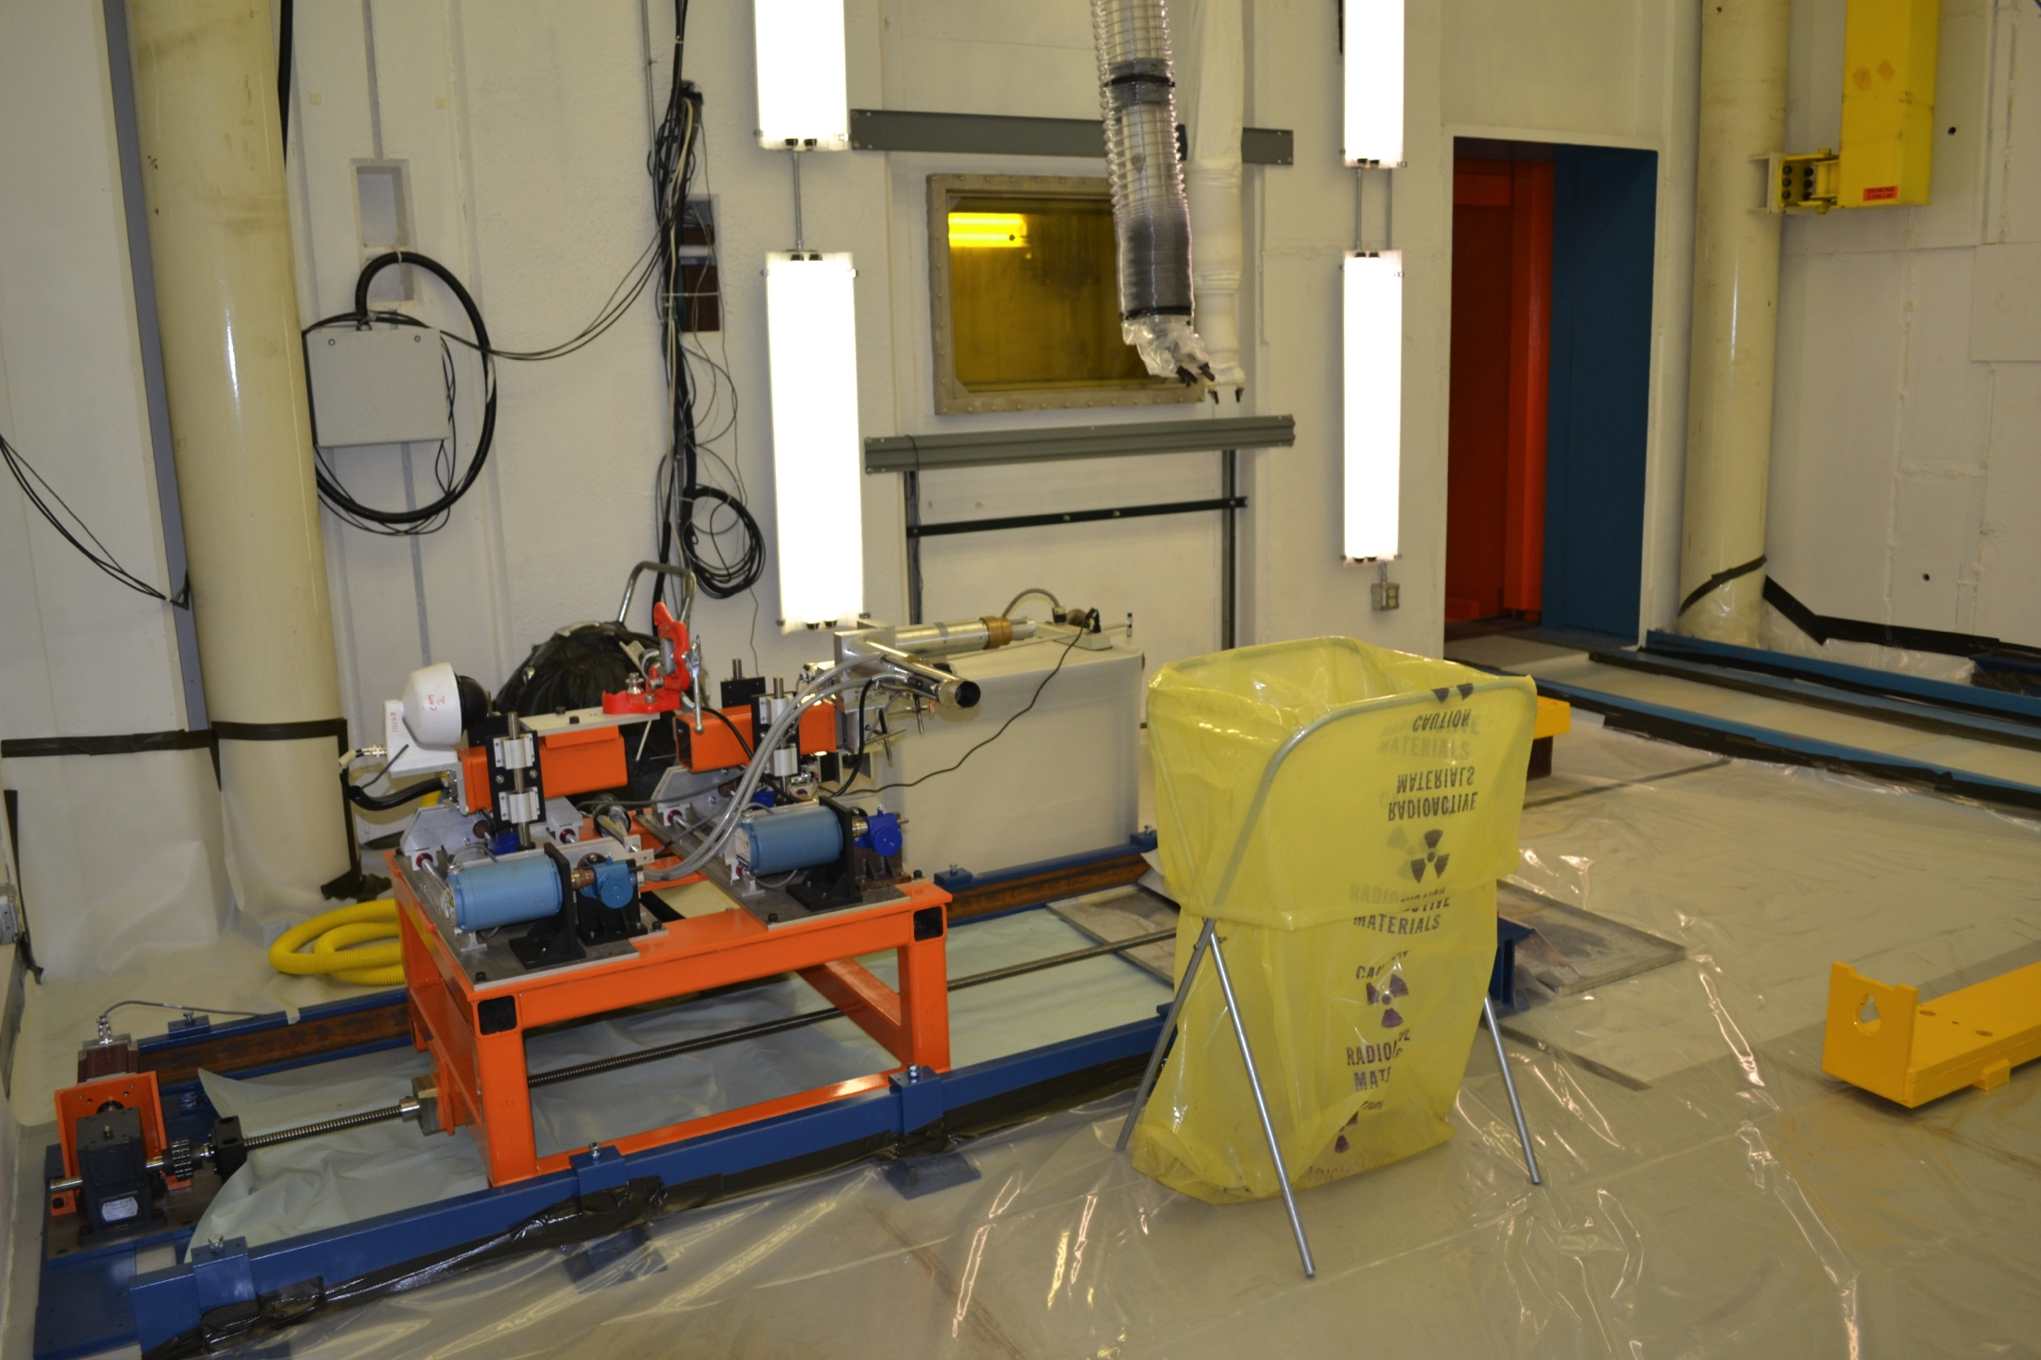
Target Hall
C0 RHF
C0 LTCS
Disposal

Slide 22
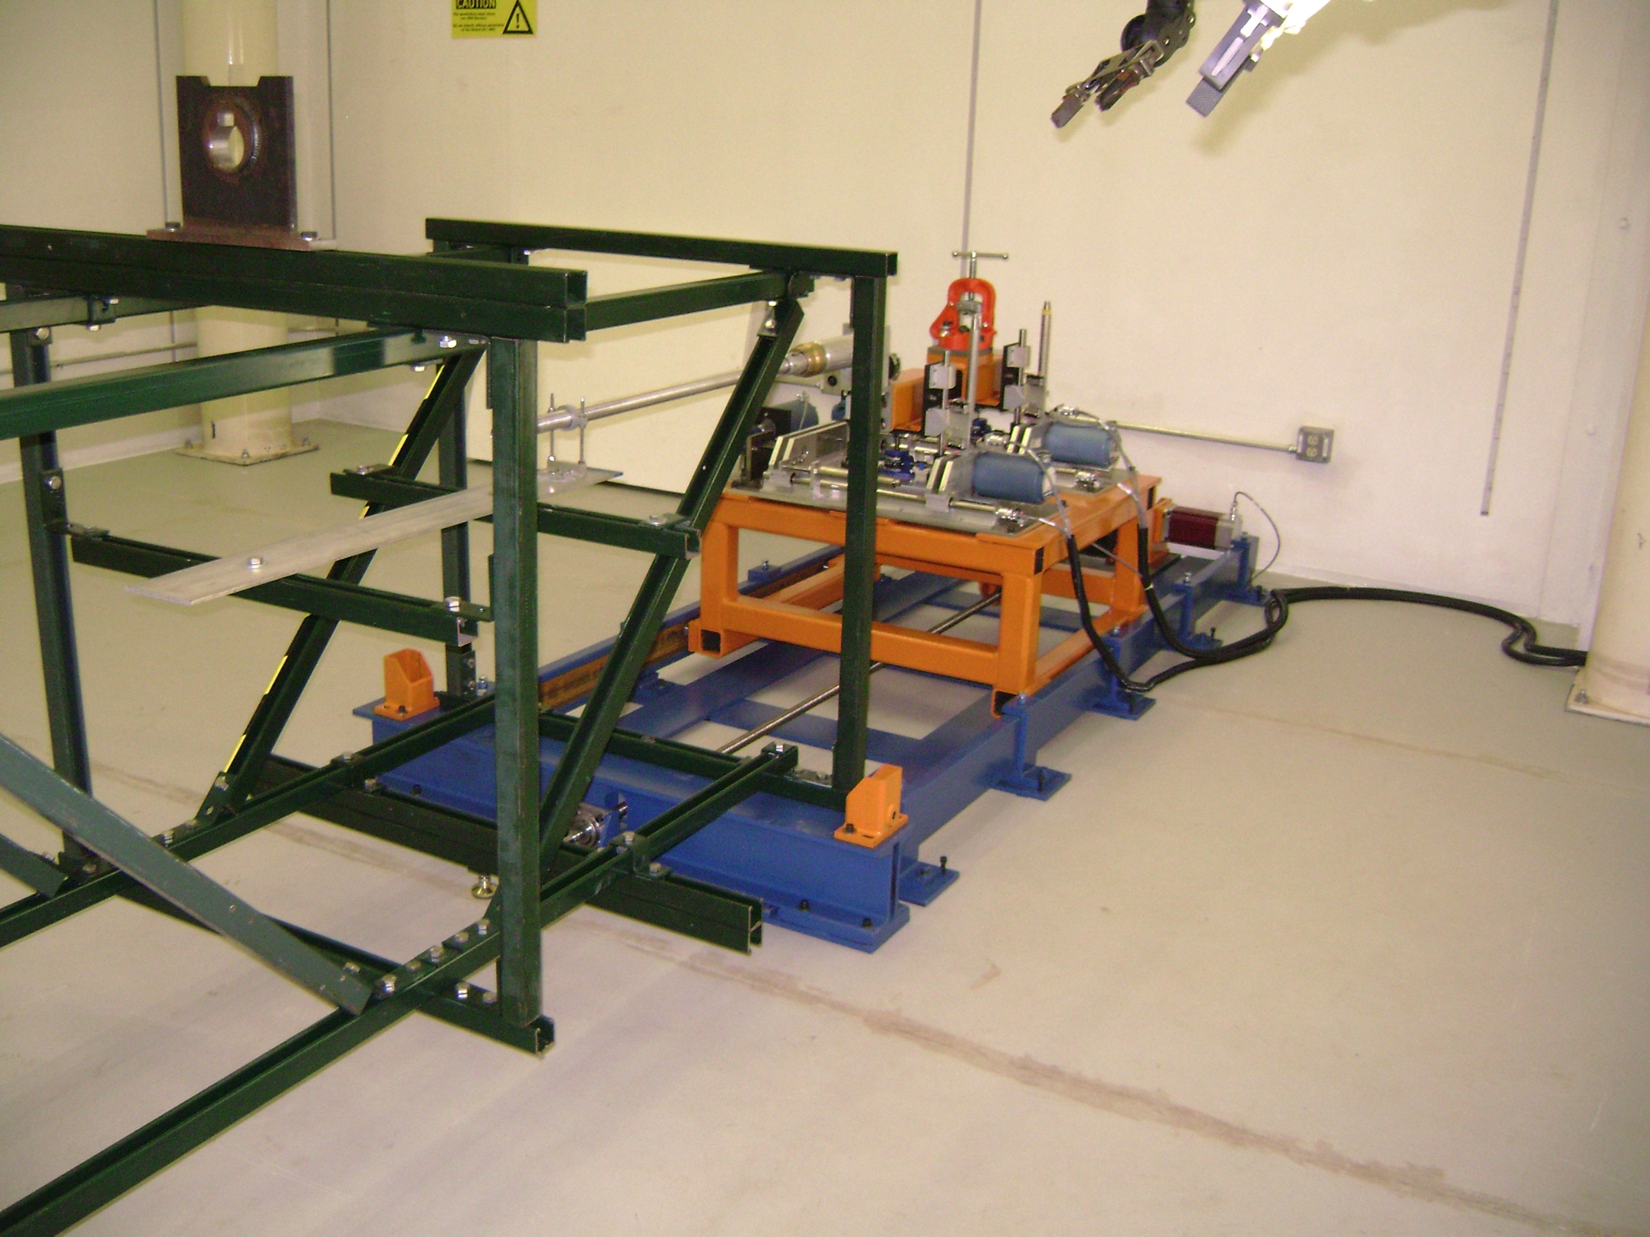
Target Hall
C0 RHF
C0 LTCS
Disposal

Slide 23
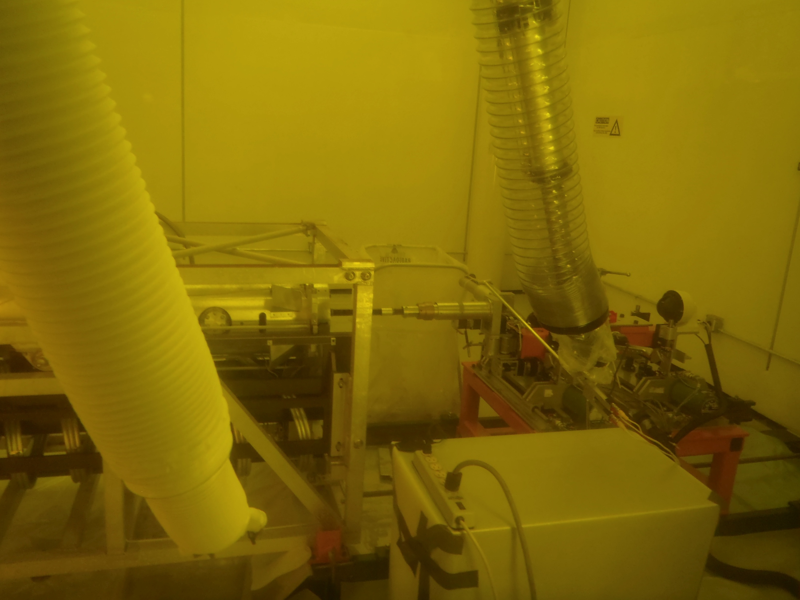
Target Hall
C0 RHF
C0 LTCS
Disposal
Target Autopsy Goals
  Extremely Gentle Dismantling
  Minimize forces on the patient
  Extract fins without damaging

Slide 24
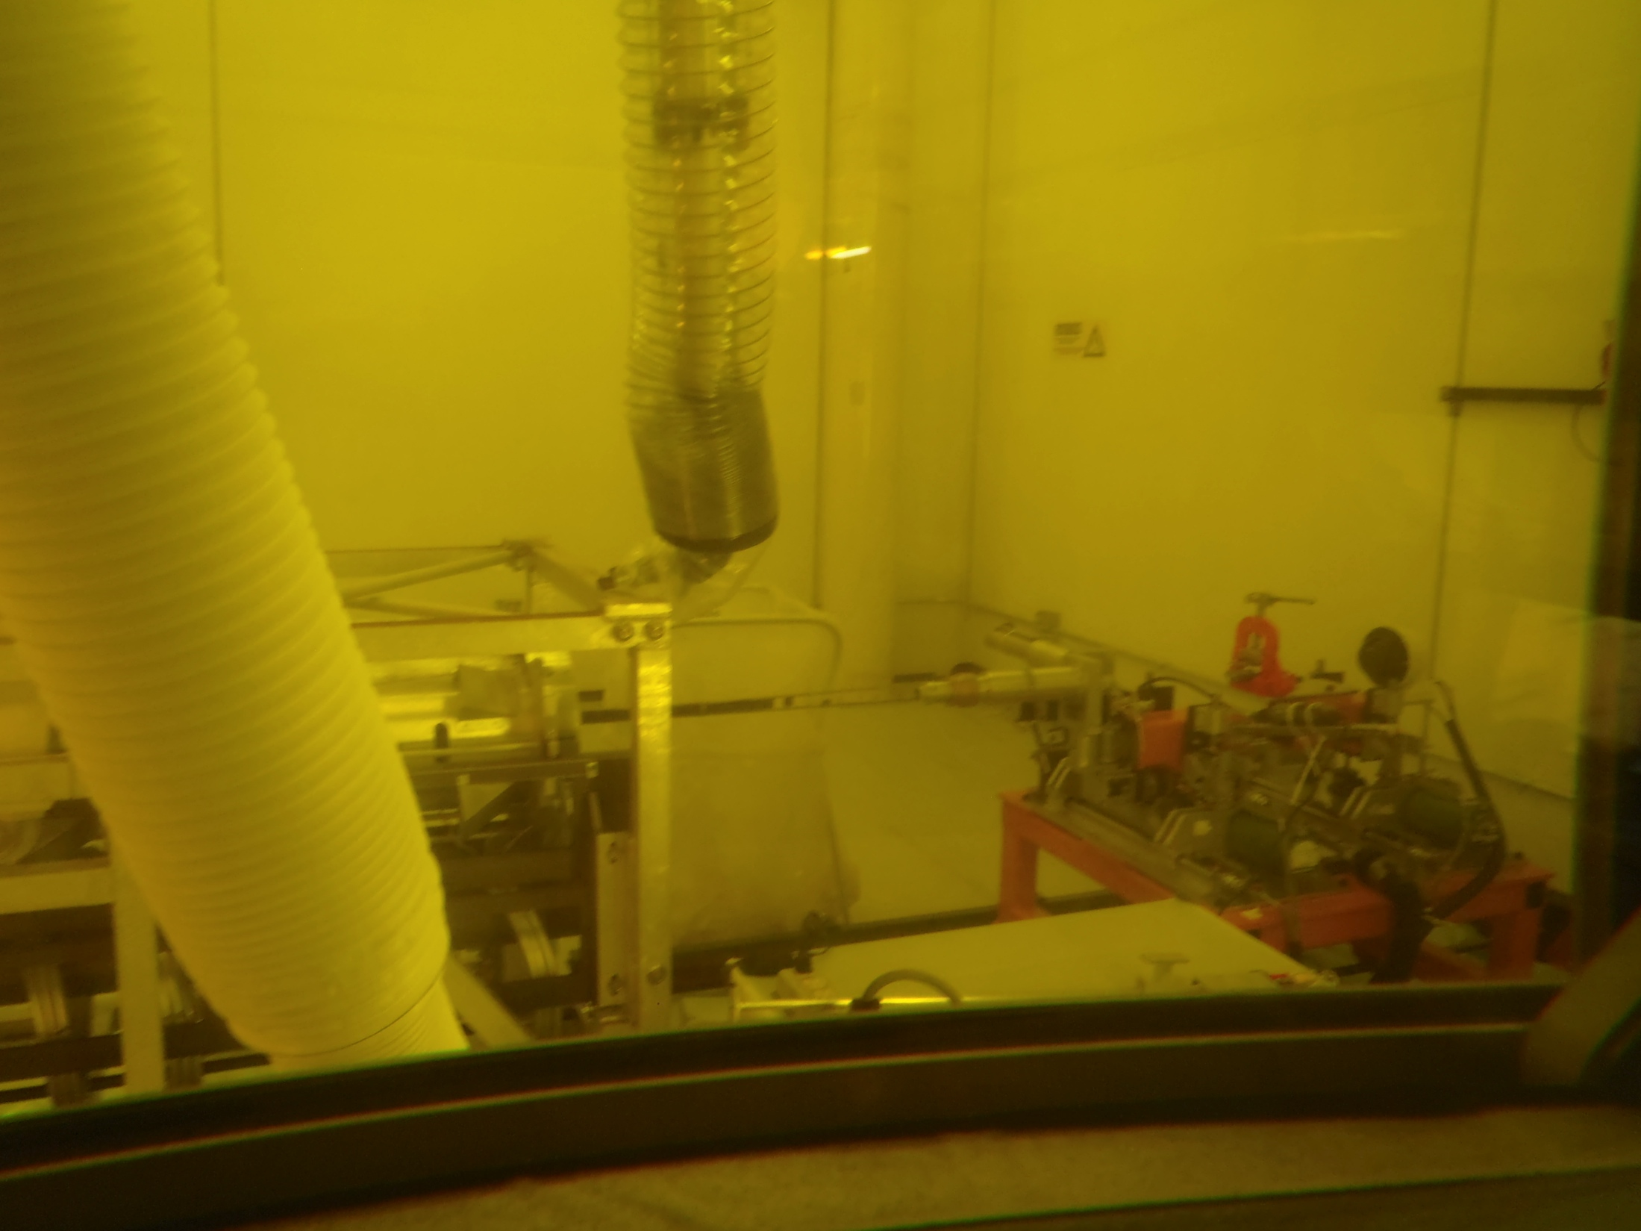
Target Hall
C0 RHF
C0 LTCS
Disposal
NT-03 Autopsy Lessons Learned
  Gained experience in Hot Cell
    with telemanipulators
    with cutting methods
    contamination control
  Target Autopsies are very difficult

Slide 25
Target Hall
C0 RHF
C0 LTCS
Disposal
C0 Hot Cell Future Use
  Continue Target Autopsy R&D
  Autopsy NT-02 & NT-07
  Component Repair
  Disposal Prep
    Disassembly
    Volume Reduction

Slide 26
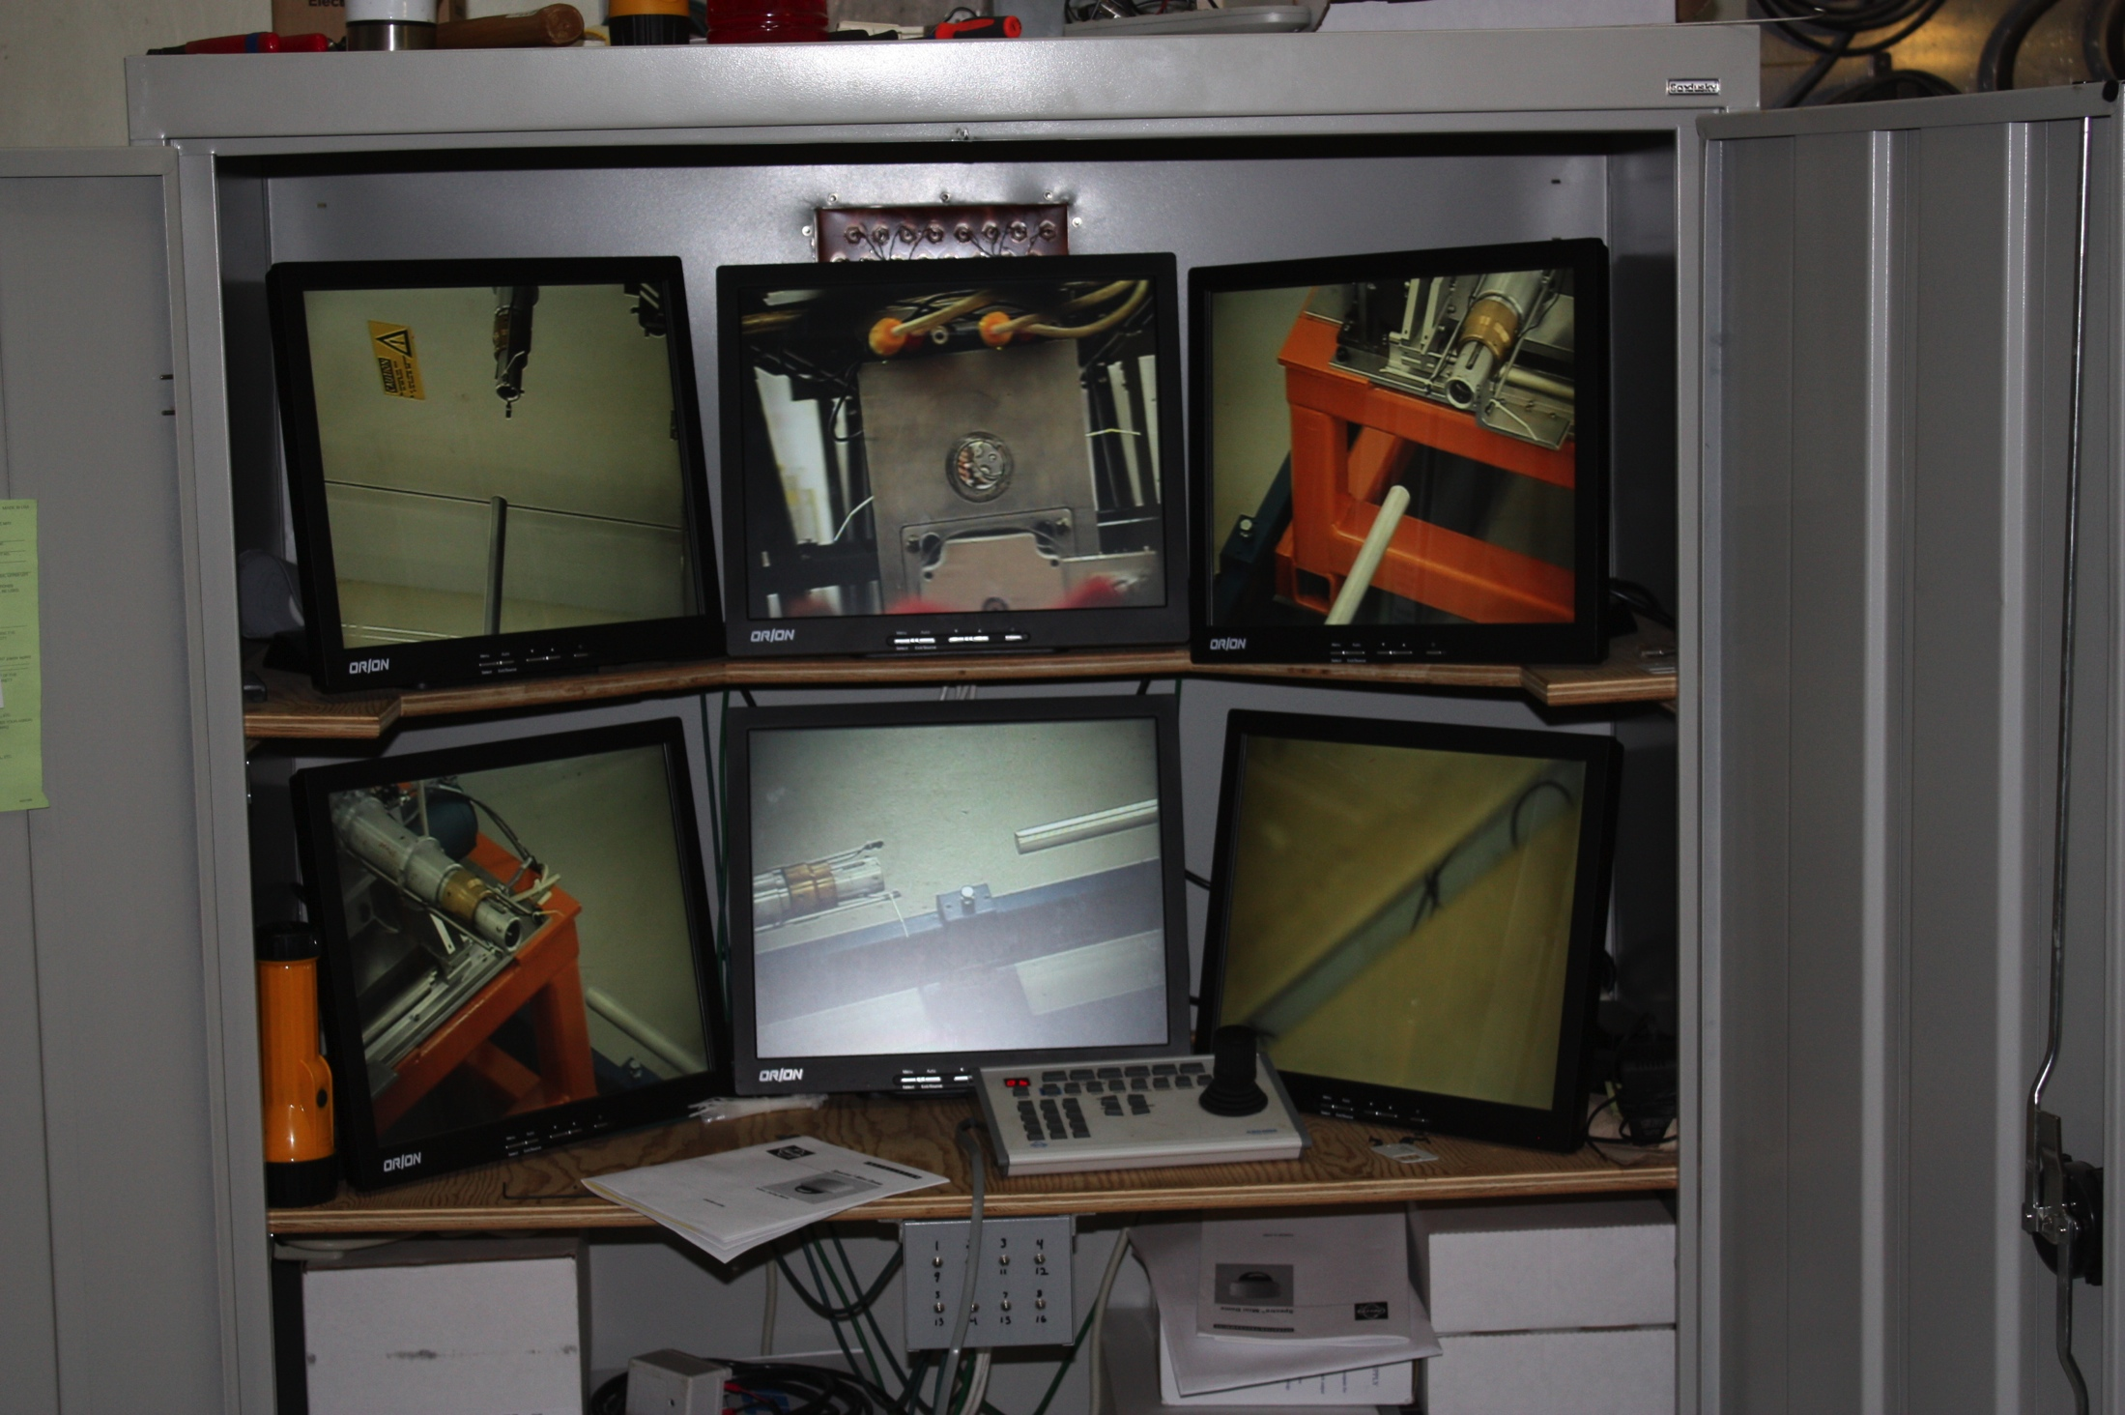
Target Hall
C0 RHF
C0 LTCS
Disposal

Slide 27
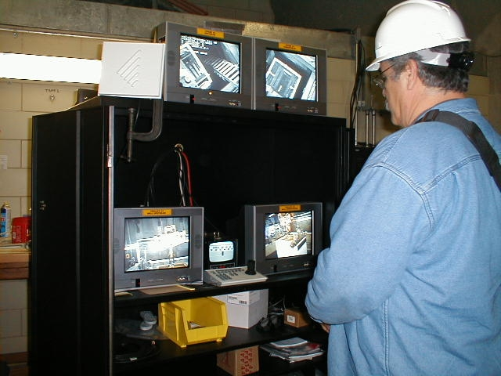
Target Hall
C0 RHF
C0 LTCS
Disposal

Slide 28
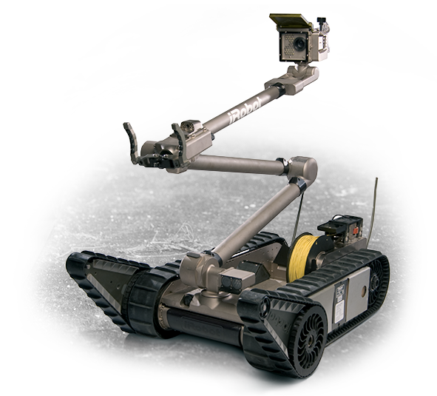
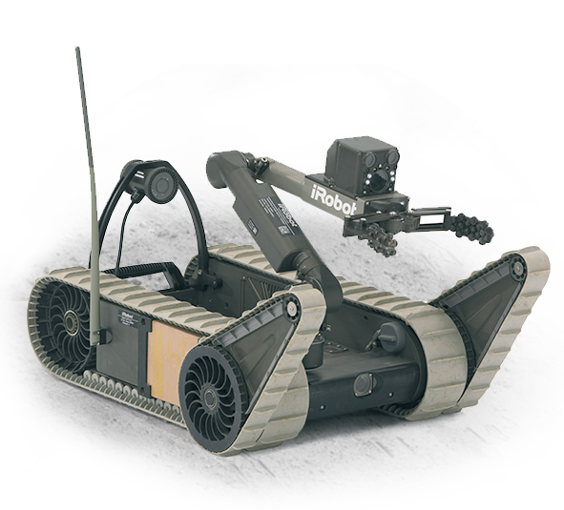
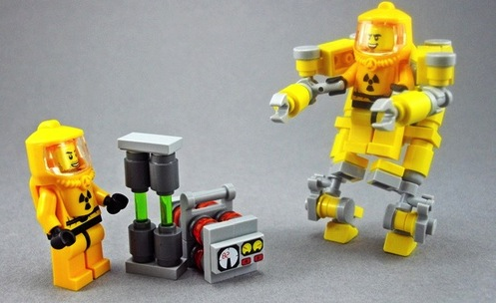
HAZMAT Robots
Target Hall
C0 RHF
C0 LTCS
Disposal
Radiation Environment Uses
  Non-fixed camera angles
  Non-fixed telemanipulator origin
  Remote radiation measurements
    CBRNe configuration

Slide 29
Target Hall
C0 RHF
C0 LTCS
Disposal
C0 Remote Handling Facility
… is not for Long Term Storage.

Slide 30
C0 Long-Term Component Storage
Target Hall
C0 RHF
C0 LTCS
Disposal
  Adjacent to C0 RHF (15’ away)
  Radioactive Component Storage
  Long Term: 5-15 years
  Stored for disposal, not future use
    Un-useful: beyond repair/autopsy

Slide 31
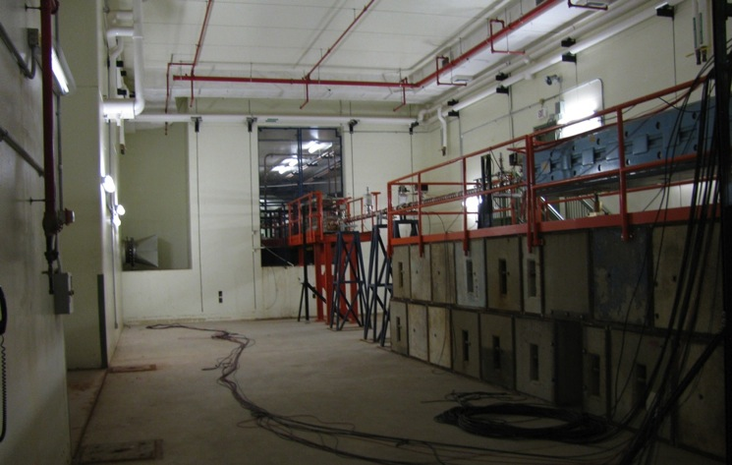
C0 Detector Hall
Target Hall
C0 RHF
C0 LTCS
Disposal
  Three year project
    Removal
      13’ thick plug wall
      Beam-line components
      HVAC, sprinklers, LCW
      Steel structures and stairs
    Fill in doors/openings with concrete
    Install a 20 Ton Crane
    Add support structures
      Walls, lights, cameras, rails, etc.

Slide 32
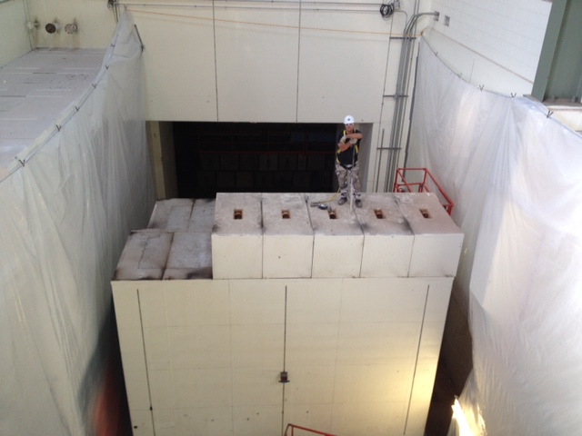
Cutting Wall
Target Hall
C0 RHF
C0 LTCS
Disposal

Slide 33
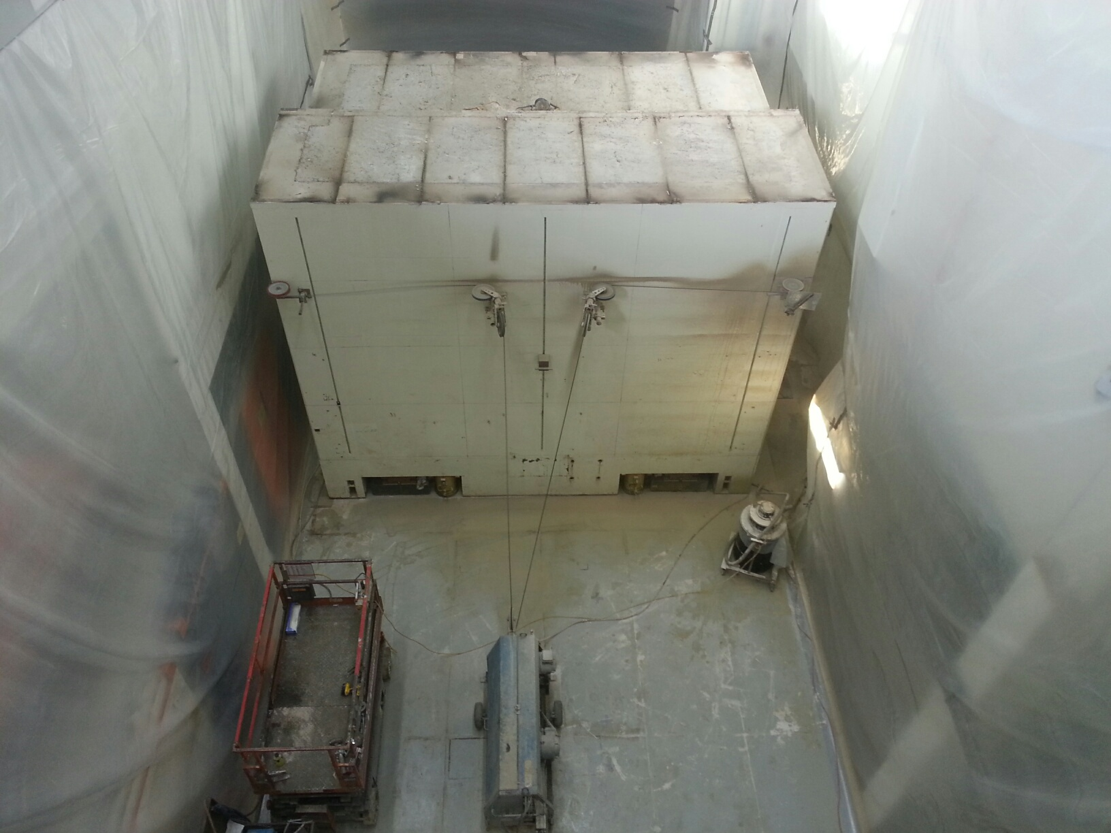
Cutting Wall
Target Hall
C0 RHF
C0 LTCS
Disposal

Slide 34
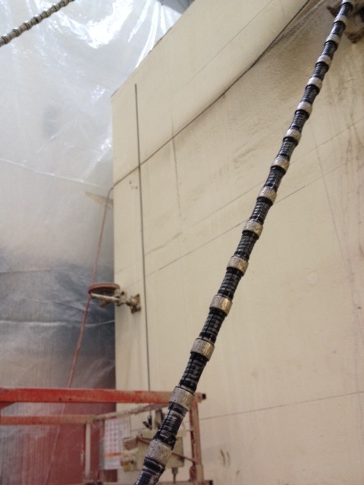
Target Hall
C0 RHF
C0 LTCS
Disposal
  Fun Facts:
  speed = 1 rev / s
  4 horizontal cuts
  5 vertical cuts
  36 pieces + base

Slide 35
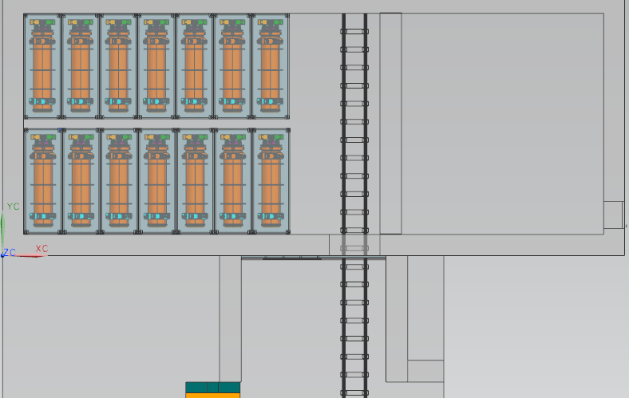
C0 Long-Term Component Storage
Target Hall
C0 RHF
C0 LTCS
Disposal
Operations Control
Crane Maintenance
Store 24 horn-sized objects

Slide 36
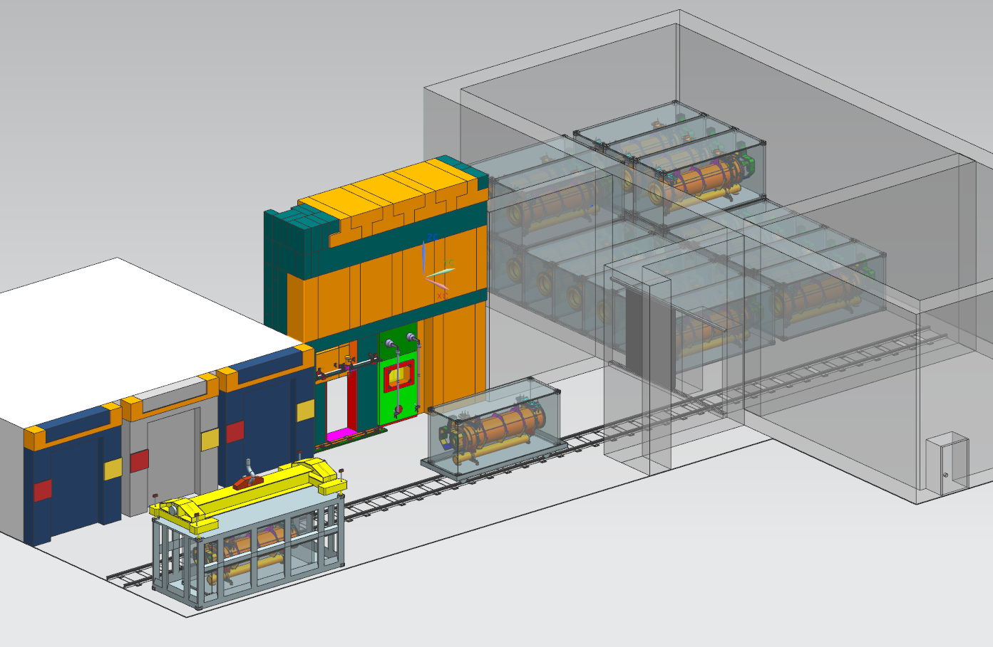
Target Hall
C0 RHF
C0 LTCS
Disposal
C0 LTCS: 20 Ton Crane
C0 RHF: 30 Ton Crane
C0 Long-Term Component Storage
  Operational by FY17
  Components are minimally shielded
    Thin contamination container package
  Store for a long, long time… until…

Slide 37
… the grave
Target Hall
C0 RHF
C0 LTCS
Disposal

Slide 38
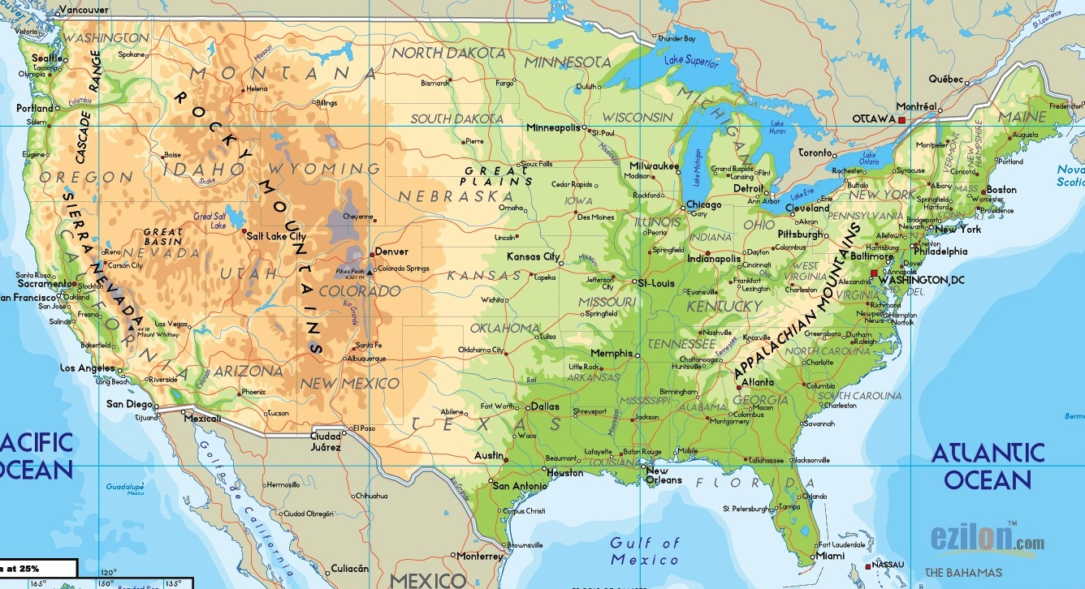
Target Hall
C0 RHF
C0 LTCS
Disposal
Private facilities
  Energy Solutions
  Waste Control Specialists
Nevada National Security Site
  Government facility
  Under National Nuclear Security Administration
  Affiliated with DOE
  Fermilab disposes for FREE
Energy Solutions
Fermilab
Nevada National
Security Site
Waste Control
Specialists

Slide 39
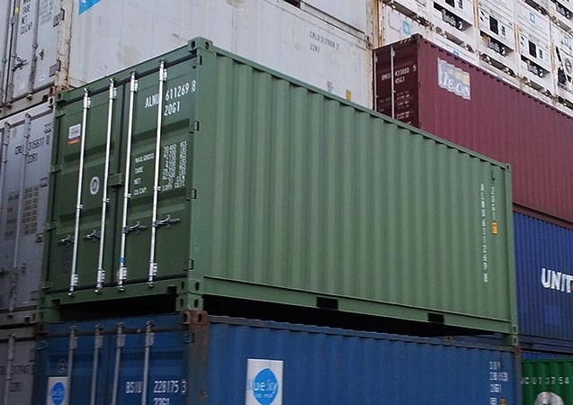
1
Target Hall
C0 RHF
C0 LTCS
Disposal
  Intermodal Shipping Container
  DOT 7A Type A

Slide 40
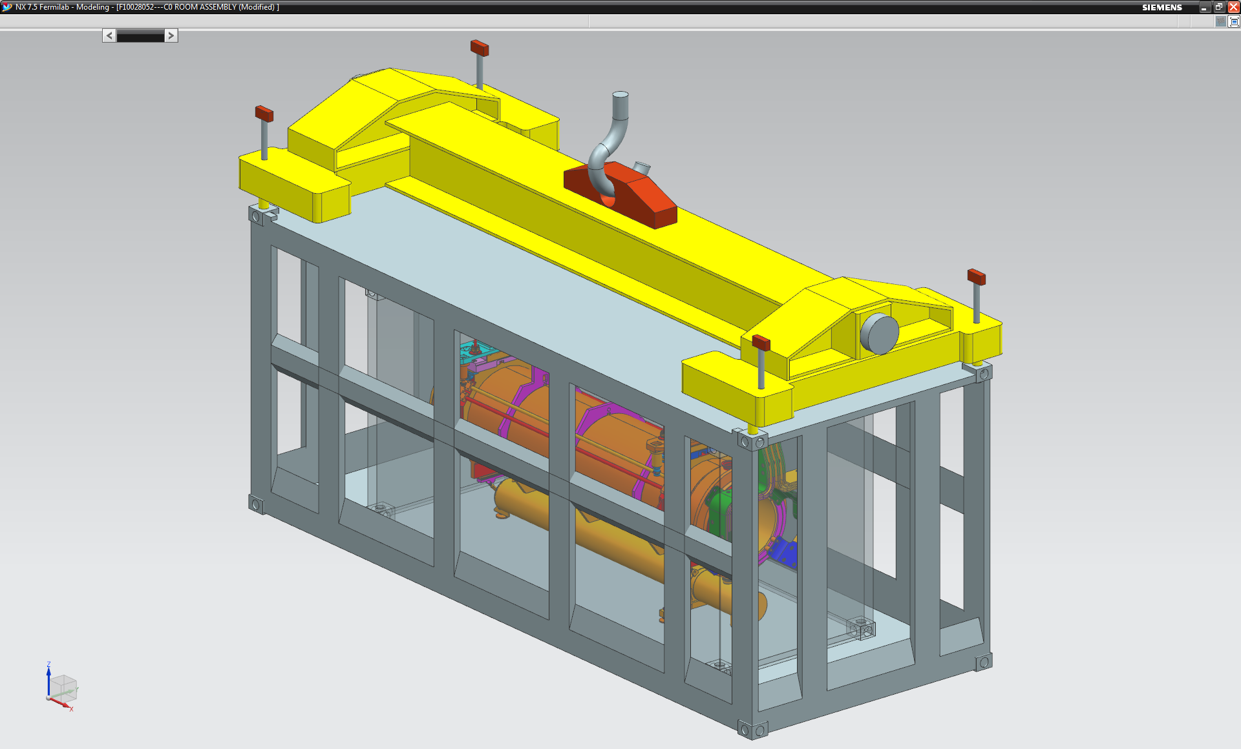
Target Hall
C0 RHF
C0 LTCS
Disposal

Slide 41
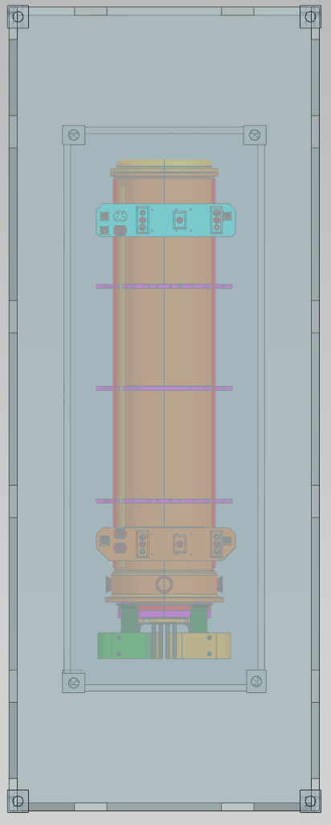
Shipping Constraints
Target Hall
C0 RHF
C0 LTCS
Disposal
Heavy-tested intermodal capacity
  67,000 lb
  Allows 3” of shielding for a horn size object
  Over-load permits required
200 mR/hr @ ft anywhere around the truck
  3” attenuates by 27x
  Distance attenuates another 1.5x
Maximum horn shipping dose rate
  ~8 R/hr @ 1 ft

Slide 42
Nested Containers
Target Hall
C0 RHF
C0 LTCS
Disposal
Inner Containment Package
  IP-1: Thin sheet metal, no shielding.
  Stored long-term at C0 LTCS
  Gets disposed of at burial site
3” Removable Cask
  Braced & bolted down inside Intermodal
  Provides shielding
Heavy-tested Intermodal
  DOT 7A Type A (IP-3)
  Provides extra distance, little shielding

Slide 43
Disposal at NNSS
(Long Term)
Target Hall
C0 RHF
C0 LTCS
Disposal
Up Front Investment
  7A Intermodal Shipping Container $35k
  3” Inner Cask $60k
  Profile Development $15k
  Total Investment $110k
Per shipment Costs
  Disposal Fee* FREE
  Loading Certification, Administration, etc $65k
  Disposable IP-1 Package $20k
  Shipping $15k
  Total per shipment $100k

Slide 44
PH2-01 Disposal
Target Hall
C0 RHF
C0 LTCS
Disposal
  Disposal Fee* FREE
  7A Intermodal Container Purchase $35k
  Loading Certification, Administration, etc $80k
  IP-1 Package, 2” thick $40k
  Shipping $15k
  Total $170k
    2nd Shipment like this $120k
  This needs to happen soon!
    Winter or spring 2015

Slide 45
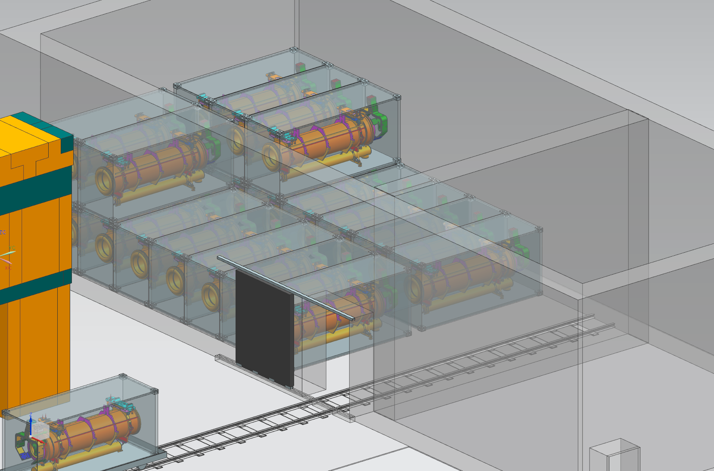
700 kW NoVA -> 1.2 MW LBNF -> 2.4 MW LBNF
Target Hall
C0 RHF
C0 LTCS
Disposal
Radioactive Storage Model
  Assume:
    Lifetime: 1 year (targets) & 3 year (horns)
    Half life: 1 year (targets) & 2 years (horns)
    Ship at 8 R/hr
  Store horns for 7-9 years, then ship
    Maximum occupancy plateaus in 2037 for 15 large components (horn/targets)

Slide 46
Target Hall
C0 RHF
C0 LTCS
Disposal
700 kW NoVA
1.2 MW LBNF
2.4 MW LBNF

Slide 47
Target Hall
C0 RHF
C0 LTCS
Disposal
Long Term Plan for Radioactive Components
  Target Hall Morgue
  C0 Remote Handling Facility
    Repair, autopsy, short-term storage (3 bays)
  C0 Long Term Component Storage
    stored for a long, long time
  Disposal at NNSS

Slide 48
Target Hall
C0 RHF
C0 LTCS
Disposal

