Slide 1
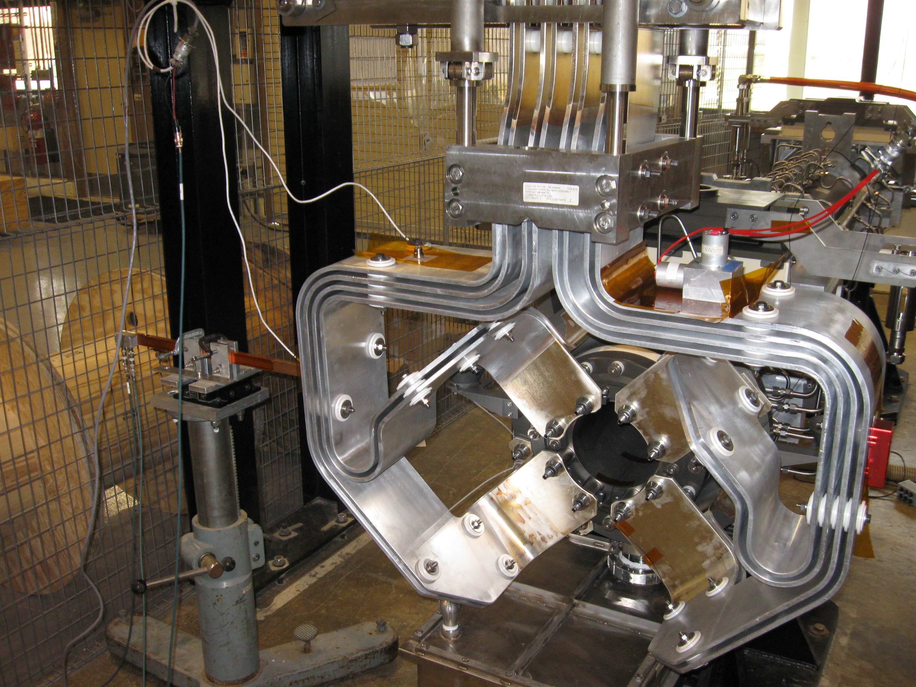
NuMI/NOvA Horn 1 Stripline Vibration Measurements
Kris Anderson
Fermi National Accelerator Lab
25-September-2014
NBI Workshop 2014

Slide 2
Overview
Some Background Information Regarding Horn 1 Stripline Analysis 400kW >> 700kW Operation
Design Upgrades for 700kW NOvA Operation
Motivation for Modal Characterization and Pulsed Operation Vibration Measurements
Summary of Modal and Operational Vibration Results
•Modal and Vibration Measurements and Data Reduction Conducted Under Contract with S&V Solutions, Sycamore, IL
Principal, David Larson
• ANSYS Analysis Results Conducted by Yun He, Fermilab

Slide 3
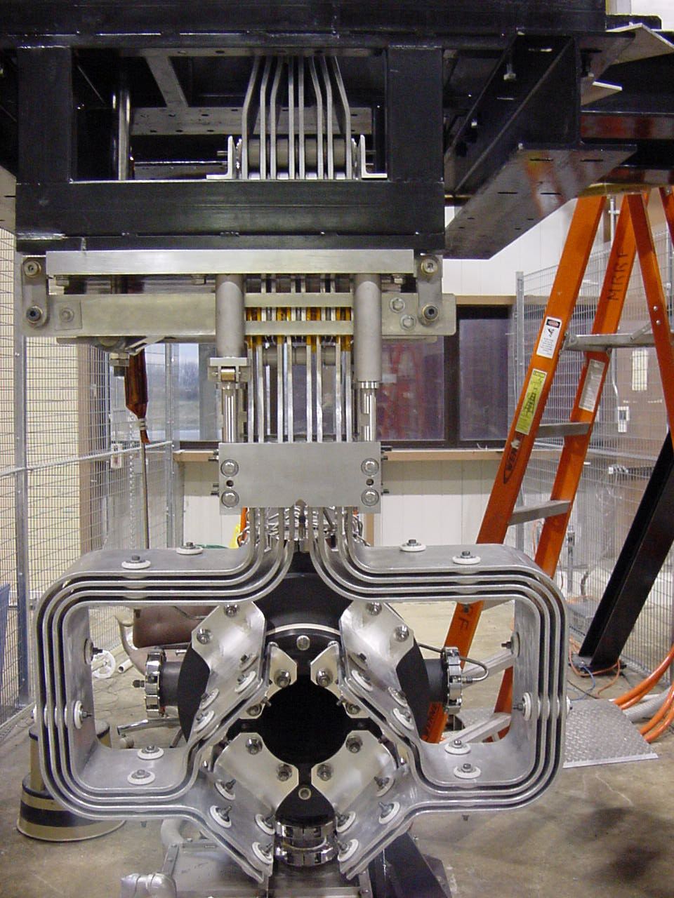
400kW NuMI Horn 1
400kW Horn Stripline Features
• Designed for 4E13 protons/pulse
• Cycle time 1.86 sec
• 10µsec beam spill
• 200kA peak current pulse
• Originally 5.2 msec pulse width for
resonant extraction
• Later changed for 2.3 msec pulse
width for fast extraction
• Design allows conductor “flex” for
horn motion relative to positioning
module for beam-based alignment
• Reliable operation from 2005 thru
2012 NOvA reconfiguration
Compact Routing @ Horn DS Face

Slide 4
Analyze 400kW Stripline @ 700kW Operation
Model of NuMI Style 400kW Beam
Stripline Configuration Used for
Generating ANSYS Mesh
-Included thermal boundary conditions
at downstream end of horn
Summary of 700 kW Operation Heat Loads
Air Cooling
And Beam
Direction

Slide 5
Analyze 400kW Stripline @ 700kW Operation
•Existing 400kW Design
T_{max} = 167ºC
•Enhanced Cooling on
Downstream End of
Horn
T_{max} = 141ºC
Problems:
- Aluminum creep
- Increased Electrical
Resistivity f(T)

Slide 6
Proposed Design for 700kW Operation
•“Fan out” conductors to better locate into target chase airflow stream and place
material farther from beam centerline for reduced beam heating
• Design proposed and generated by David Tinsley of Fermilab

Slide 7
400kW Stripline vs. 700kW Stripline

Slide 8
ANSYS Results New 700kW Beam Stripline
• T_{max} now 82ºC (higher heat
transfer coefficient in direct
air stream, ~ factor 2x)
•Fatigue analysis for 10M
cycles reveals acceptable
safety factor
(Electrical pulse heating +
Electromagnetic force +
Beam Heating)
• Small magnitude of
alternating stress

Slide 9
Dynamic Effects -- Vibration
• What about dynamic effects not captured in ANSYS models?
• Can run ANSYS modal analysis to obtain mode shapes
and corresponding natural frequencies of structure
- Typically a linear analysis and does not account for
complex boundary conditions or reveal damping
• Can run ANSYS harmonic and/or transient dynamic
analysis but these can be complicated by localized
damping, complicated restraint boundary conditions,
and modal participation relative to input forcing
function

Slide 10
Sorting Out Dynamic Effects
In November of 2013 S&V Solutions (David Larson) and I met and discussed the possible goals of a vibration analysis project to characterize the dynamic response of the NuMI/NOvA 700kW horn 1 (PH1-05) stripline
Measurement Objectives
Perform a full modal analysis and extract a set of modal parameters for the strip line assembly.
Measure operating vibration data on the stripline conductors under typical running conditions
Perform an analysis of operating vibration in terms of modal participations and decay rates

Slide 11
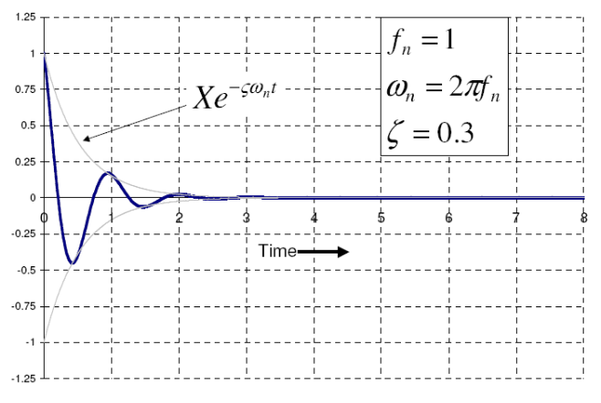
Modal Damping: Time Domain Natural Response
Lightly damped (about 10%). Modal pattern repeats about 10 cycles before decaying to essentially zero motion.
Heavily damped (about 30%). Modal pattern repeats about 2.5 cycles before decaying to zero motion.

Slide 12
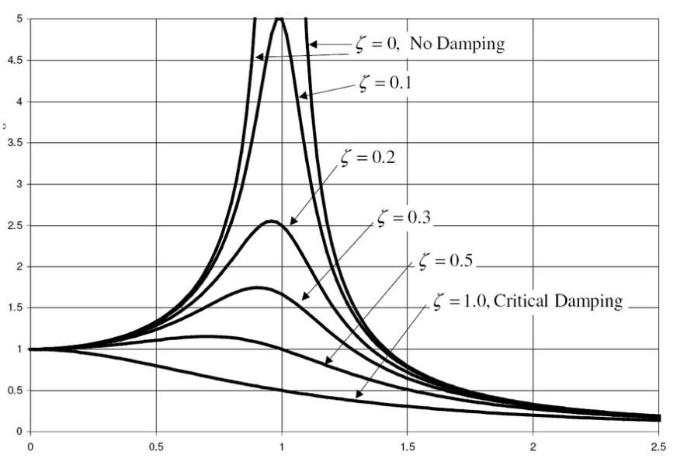
Modal Damping: Frequency Domain
Lightly damped (about 10%). Modal pattern repeats about 10 cycles before decaying to essentially zero motion.
Response/Forcing
Heavily damped (about 30%). Modal pattern repeats about 2.5 cycles before decaying to zero motion.
Relative Frequency (ω/ω_{n})

Slide 13
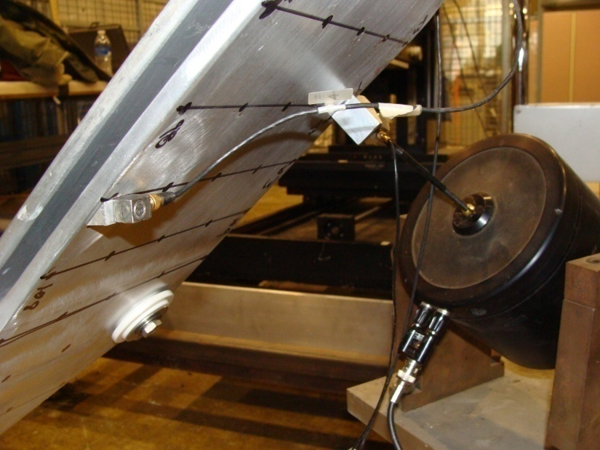
Approach for Stripline Modal Testing
Approximately 200 points were selected from the existing FEA wireframe model and were used to create the EMA model. A 10 lbf dynamic force shaker was used with broad-band white noise forcing to excite the modes of the stripline (right).
The shaker was attached to the stripline using an oblique mounting block and a piezo-electric force transducer (below).

Slide 14
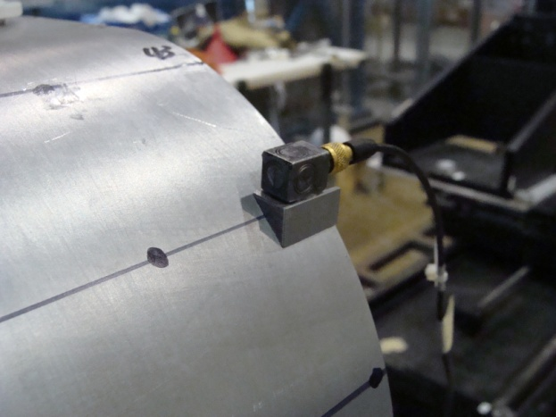
Measurement Transducers: Force and Acceleration
Z
For modal data acquisition a global coordinate frame of reference preserving directionality was used (photos to right).
For live firing data acquisition a local coordinate system was used (z-axis normal to stripline conductor surface).
In all cases the response transducers were oriented to an orthogonal coordinate system so that directional information in the resulting mode shape functions was preserved.
The force transducer remained fixed in one location during the 200 triaxial measurements.
Y
X
Z
Y
X

Slide 15
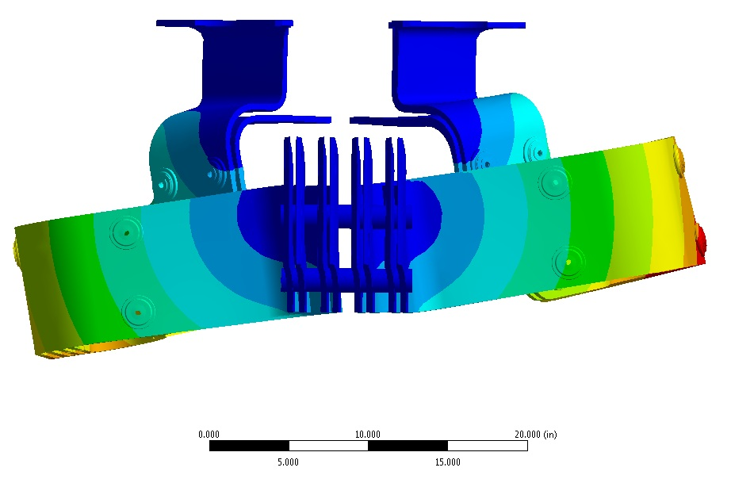
Example of Sorting Out Dynamic Effects
This is a 35 Hz Mode
Simulated Using
ANSYS
Generally lower frequency modes
are accompanied by larger
structural deflections that
correspond to larger stresses
• Just FYI- This mode was confirmed with real modal measurement
along with calculating corresponding damping coefficient
• Question: Will this mode participate in real horn-pulse operation?

Slide 16
Sorting Out Dynamic Effects
35 Hz Mode
Animation from
Modal Testing

Slide 17
Results of modal testing: resonant frequencies & modal damping: layer #1 (Outer-most conductor layer, beam left)
Note: Are lightly damped modes of concern
(e.g., 120 Hz, 424Hz)?
Need to acquire real horn pulse operation data

Slide 18
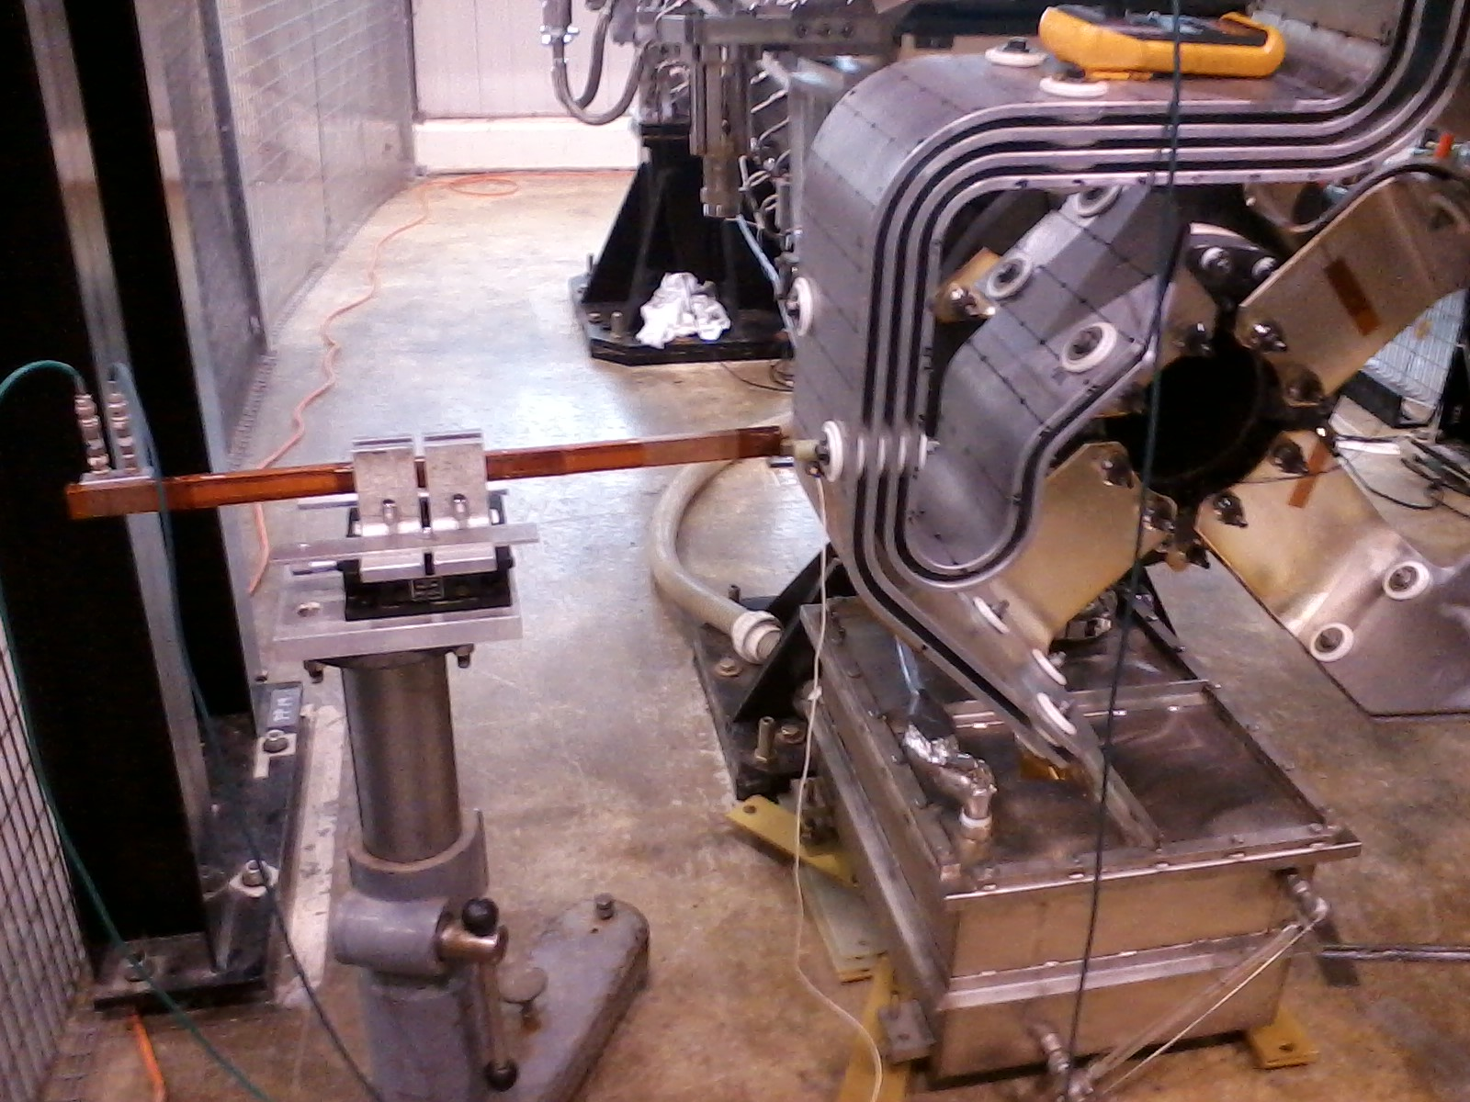
Accelerometer Cross Check with Direct Displacement Non-Contact Transducer -- the Eclipsometer – a dynamic displacement pickup direct measurement of displacement = f(t)
Thin SS blade/vane mounted on G10 cylinder secured with epoxy to stripline (provides secure mount and electrical isolation)
Courtesy of Dr. Frank Nezrick

Slide 19
Performance Benchmark of Eclipseometer with the Calibrated Electrodynamic Shaker/Amplitude Response
Excellent agreement between the accel (double integrated) and the eclipseometer at various 100 Hz amplitudes.

Slide 20
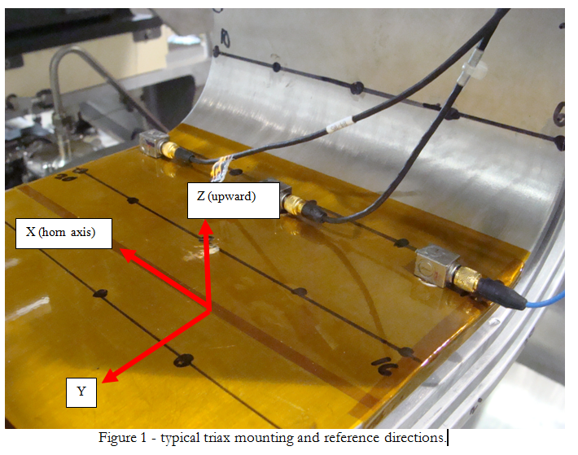
Typical Test Setup for Accelerometers: Used for Live Horn Pulse Comparison of ∫∫Accel vs. Eclipseometer
Used 0.005” thick
Kapton tape for
electrical isolation
of accelerometers
(650V Cap Bank)

Slide 21
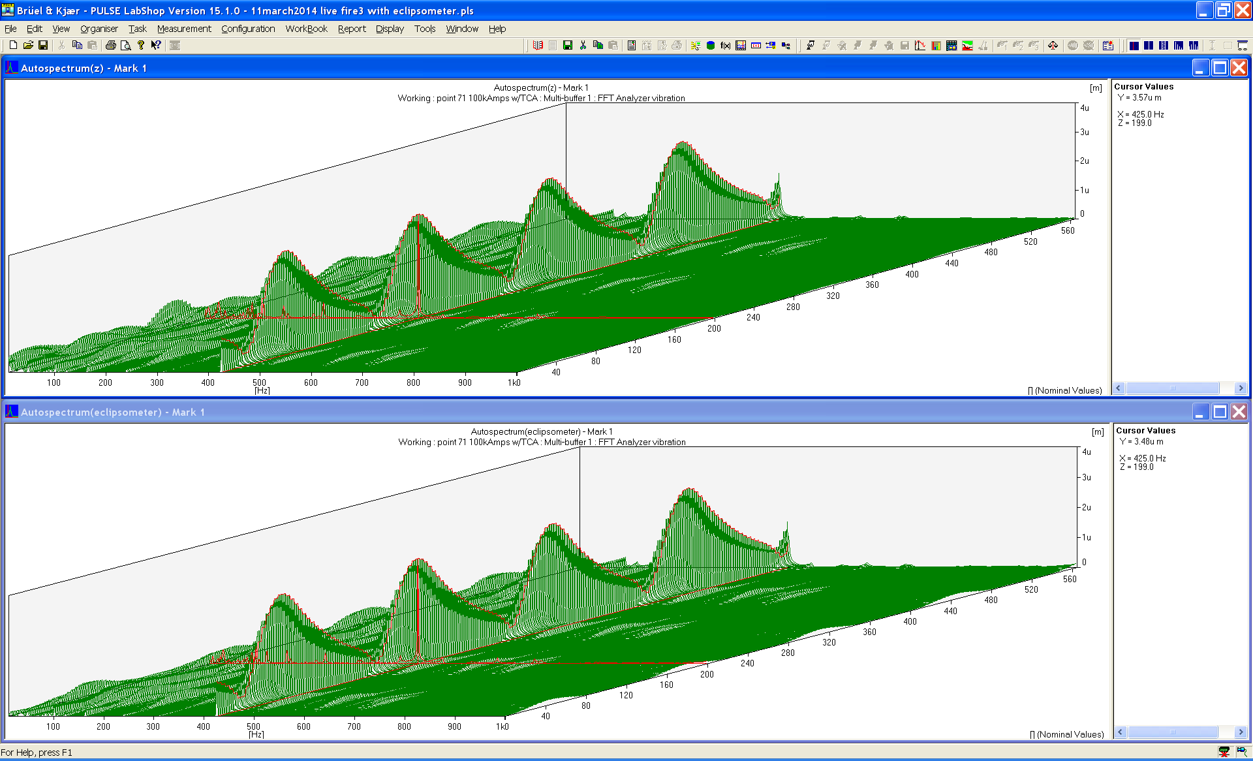
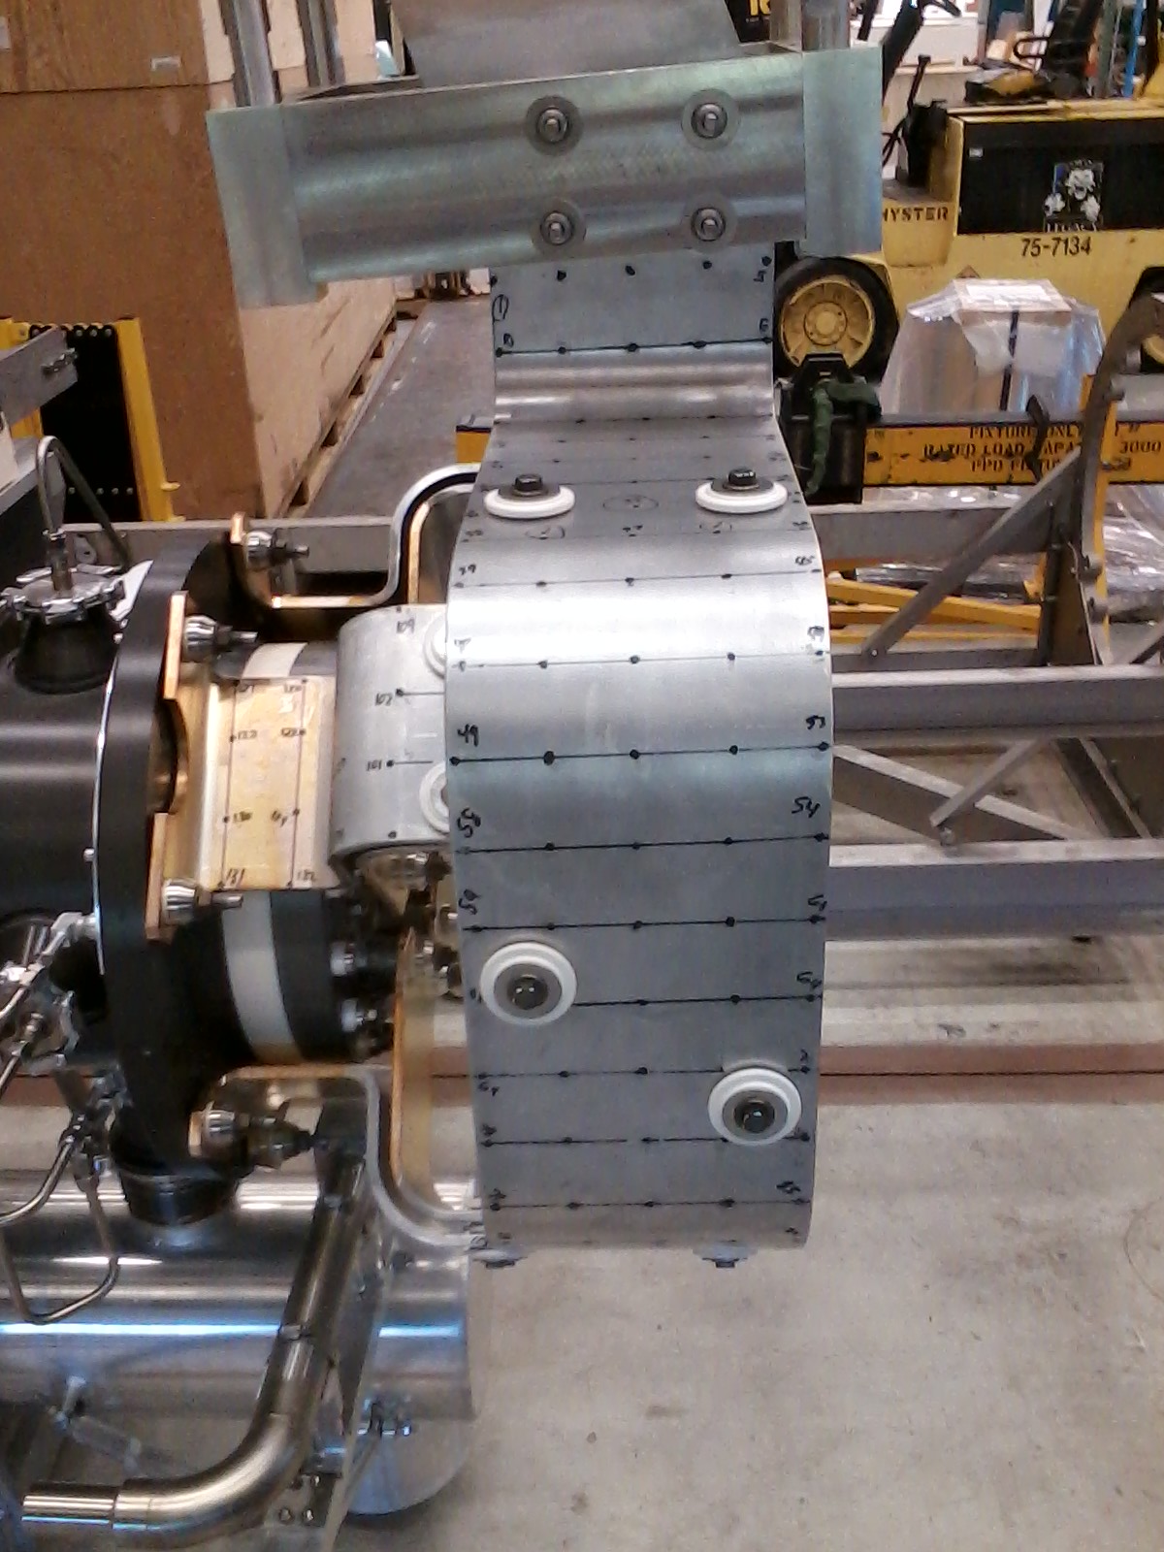
Live fire comparison of ∫∫accel vs. Eclipseometer- 100 kA
Plot Slice at 424 Hz - (Measurement location 71)
Accelerometer Z (Normal) axis: 3.57 µm RMS
Eclipseometer Z (Normal) axis: 3.48 µm RMS

Slide 22
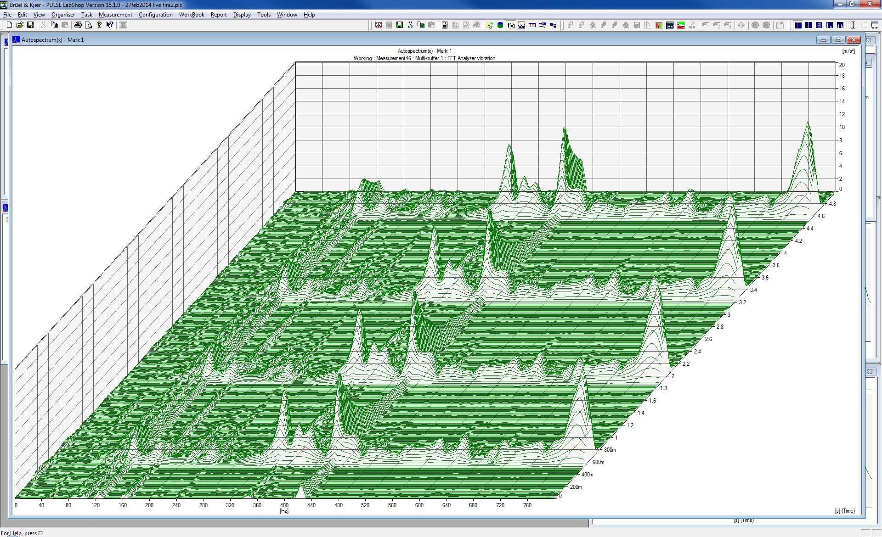
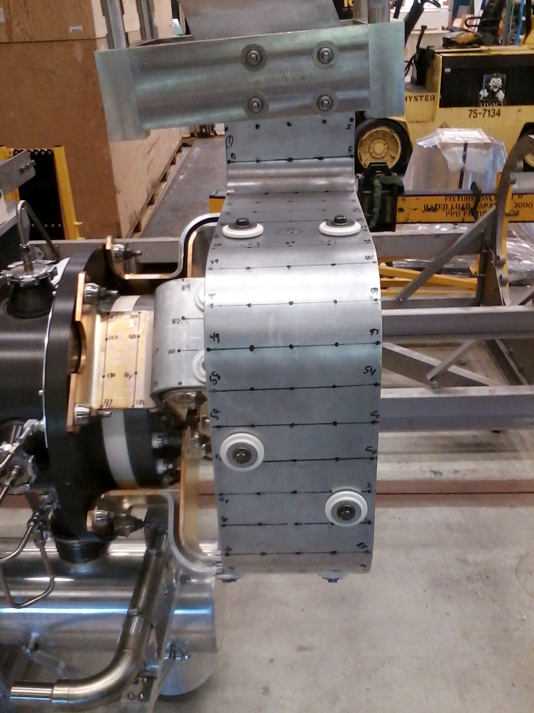
Live Fire Operating Motion –Typical data – 200 kAmps, 1.33 Hz repetiton rate, modal measurement location 46
Acceleration (m/sec²)
time (seconds)
frequency (Hz)

Slide 23
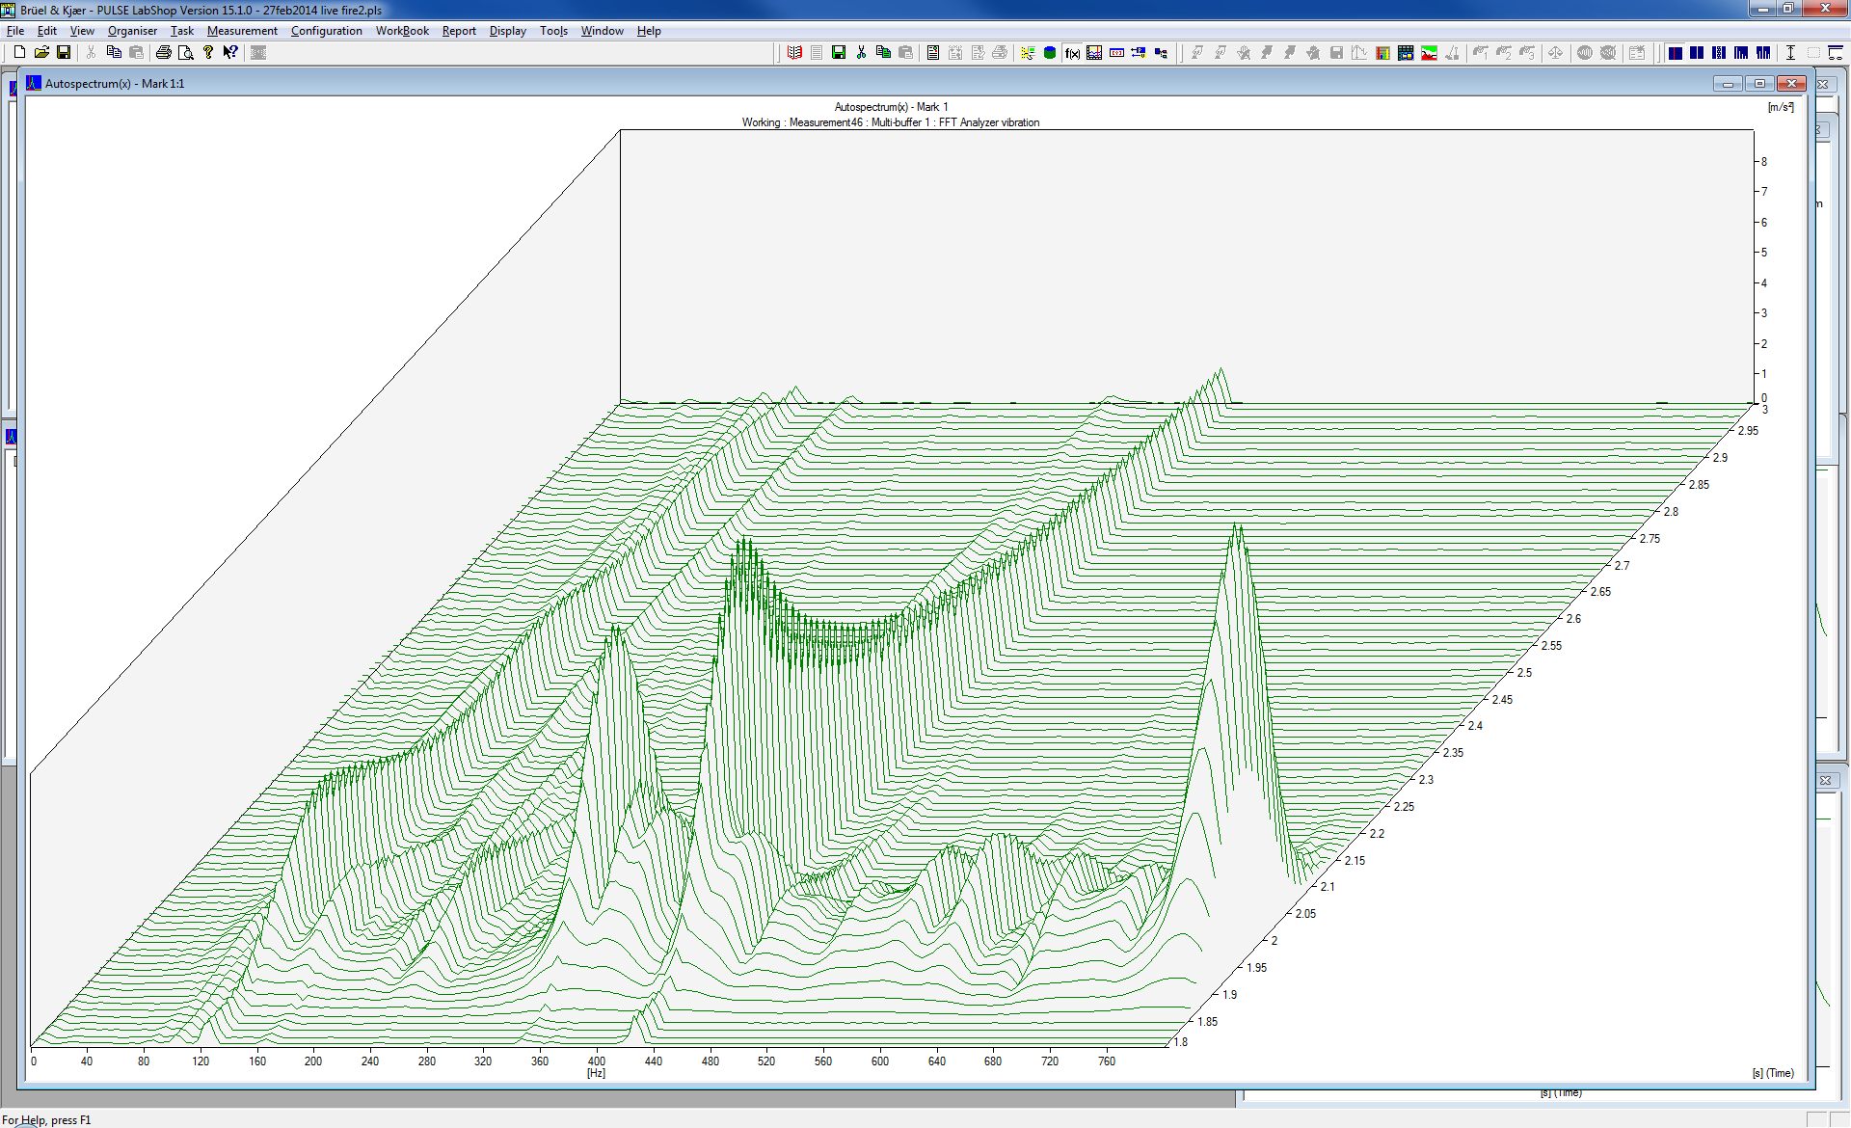
Live Operating Motion –Expanded time scale – 200 kA, 1.33 Hz repetition rate, Modal measurement location 46
lightly damped mode at 424 Hz (takes a long time to decay)
highly damped mode at 788 Hz (decays quickly)
Time axis expanded to show t=1.8 sec to t=3.0 sec. One can see that some modes of vibration “ring down” faster than others. This is due to the variation in modal damping for the modes.

Slide 24
Sample data reduction to calculate total displacement
Double integrate acceleration in all three directions
Calculation a vector sum of the 3 orthogonal directions
Convert from RMS to peak to peak by multiplying by (2*√2), assumes sinusoidal motion
Use resulting total max displacement of 30.21µm for stress/strain calculations
 | RMS displacement | P to P displacement
X1 | 3.30 | 9.31
Y1 | 5.00 | 14.10
Z1 | 8.88 | 25.04
vector total | 10.71 | 30.21

Slide 25
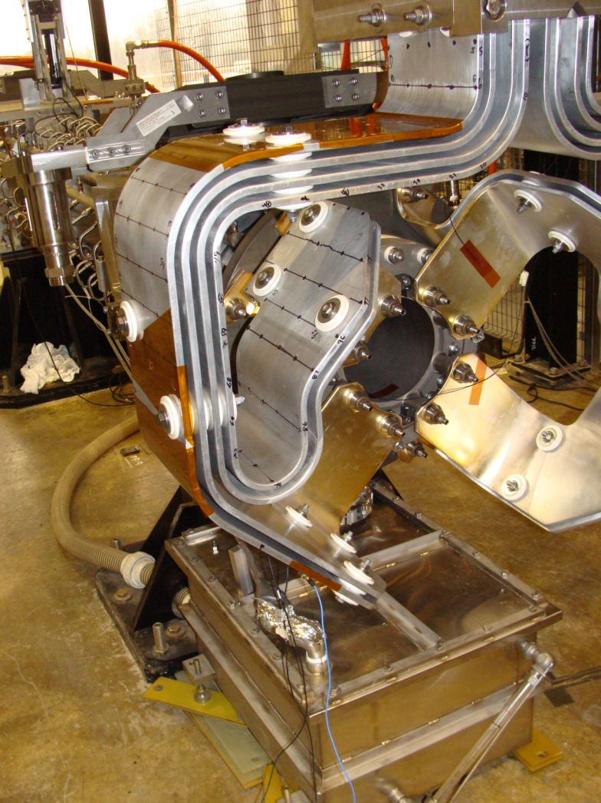
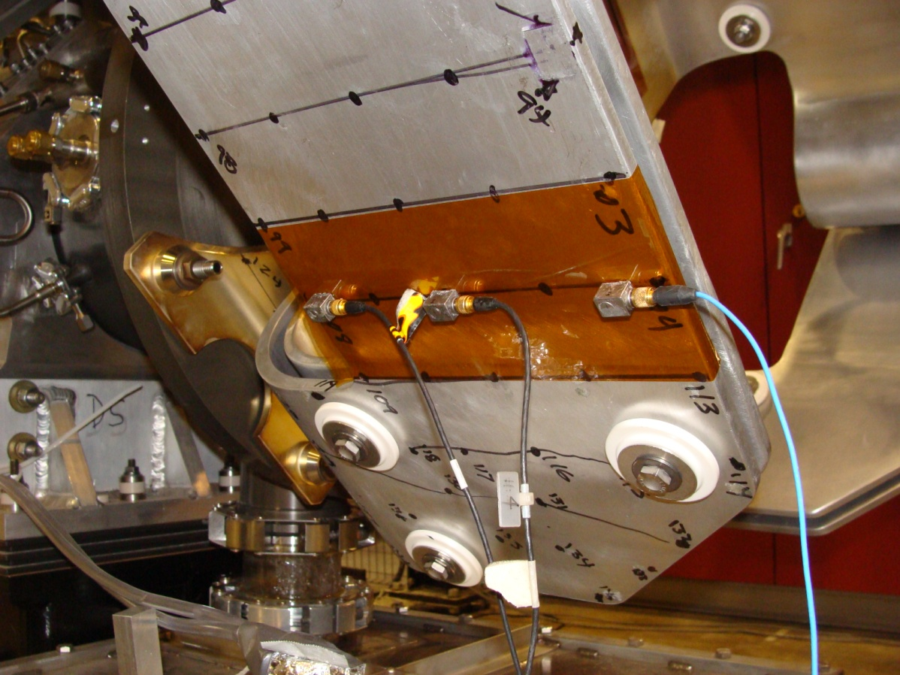
Test #6: Accelerometer locations @ position of maximum measured displacement
These values are the 20 Hz to 1600 Hz total peak to peak displacement in milli-inches
 |  | vector sum | vector sum | vector sum
 |  | X1, Y1, & Z1 | X2, Y2, & Z2 | X3, Y3, & Z3
test6 | 50 kA | 0.597 | 0.623 | 0.562
 | 100 kA | 1.845 | 2.032 | 1.583
 | 200 kA | 5.869 | 6.462 | 5.002

Slide 26
Mode Shape Animation Stripline layer #1 Mode Shape 424 Hz

Slide 27
Spectrum of Motion @ test #6 locations
Dominant Displacement
Peaks @ 122Hz and 424Hz

Slide 28
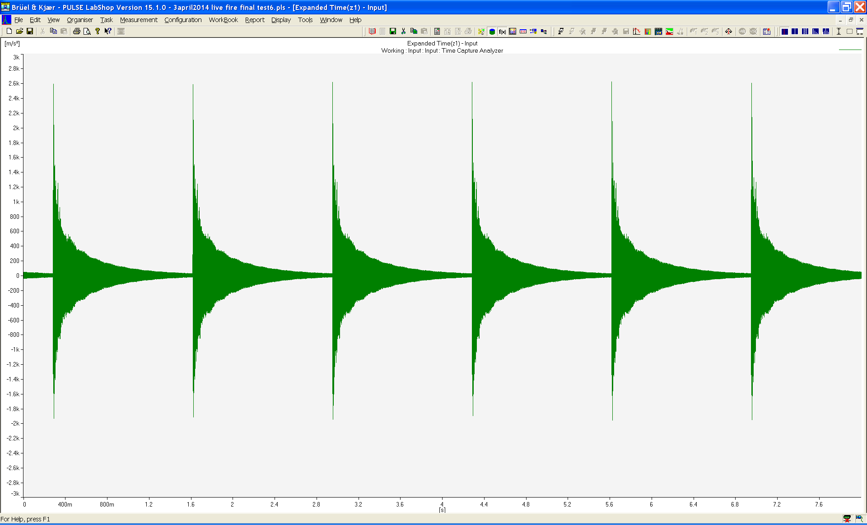
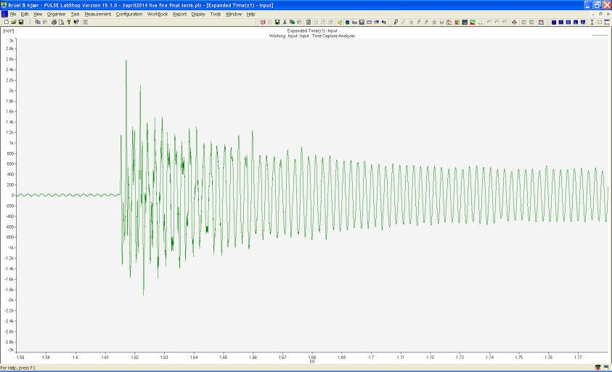
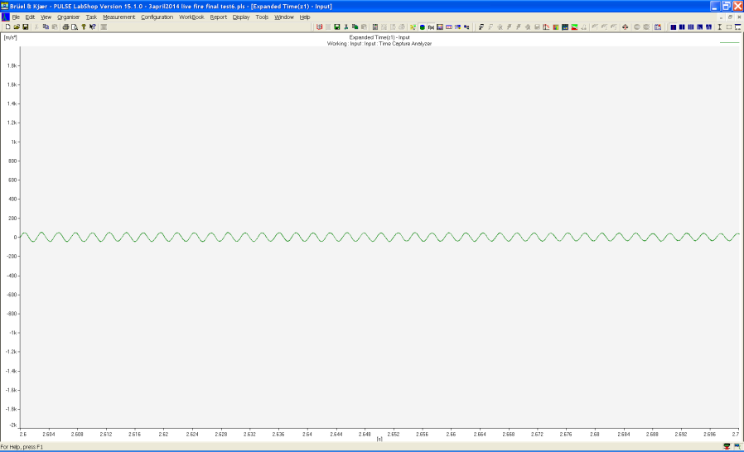
Acoustic Signature Cross-Check
Time trace of acoustic measurement
Expansion of final portion of ring-down
showing contribution of a single lightly
mode (424Hz)
Expansion of initial portion of ring-down
showing contribution of highly damped modes

Slide 29
Conclusions
The stripline is a complex structure with multiple unique boundary conditions and large variations in modal damping
Under pulsed operation, conductor motion generally increases with current level but does not closely follow the Lorentz force relationship for the simple case of parallel current carrying conductors, i.e. displacement ≠ f(I²)
The modal analysis results identified low frequency modes in the range of 30 to 80 Hz
These modes were of concern due to their potential to cause large deflections
It was found that the 850μsec MI-8 horn test stand pulse is too short to “wake-up” the low frequency modes
Longer pulse widths may result in more low frequency modal participation; determination requires testing and/or detailed modeling
NOvA 700kW horn 1 pulsed operation displacements tend to be dominated by two lightly damped modes at 122 and 424 Hz.

Slide 30
Conclusions
• Largest motion measured during pulse operation roving with 3 triaxial accelerometers across conductor was measured during pulsed operation Test #6 in the vicinity of modal test points 70 thru 74 (lower beam-right stripline flag) and is normal to stripline with peak to peak displacements of 140 to 160 µm
Acoustic measurements support the previous conclusions
Since the 424 Hz mode is very lightly damped it requires further investigation if cycle time is decreased from 1.33 sec to 0.8 sec as proposed for LBNF operation

Slide 31
Future Work
Make an assessment of stress and resulting fatigue life based on the measured displacement data.
Continue investigation of the relationship between pulse width and cycle time and stripline dynamic response.
Narrow pulse width does not appear to excite low frequency modes
Lightly damped modes coupled with short cycle time would tend to result in larger response due to building of response
Investigate Laplace transform model to further understand pulse width effect on stripline motion
An extensive amount of data was acquired in addition to the subset presented herein. Raw time series have been archived for all measurements and are useful for further detailed analysis. These series are available in UFF and MATLAB formats.

Slide 32
Fundamentals of Normal Mode Testing
A swept sine forcing is applied to the rectangular plate. The plate response is presented in the time domain (blue trace) and in the frequency domain (red trace). If the response is measured at a number of points on the plate (i.e., a grid) one can easily extract the 4 modes shown above by comparing magnitude and phase of the response functions.

Slide 33
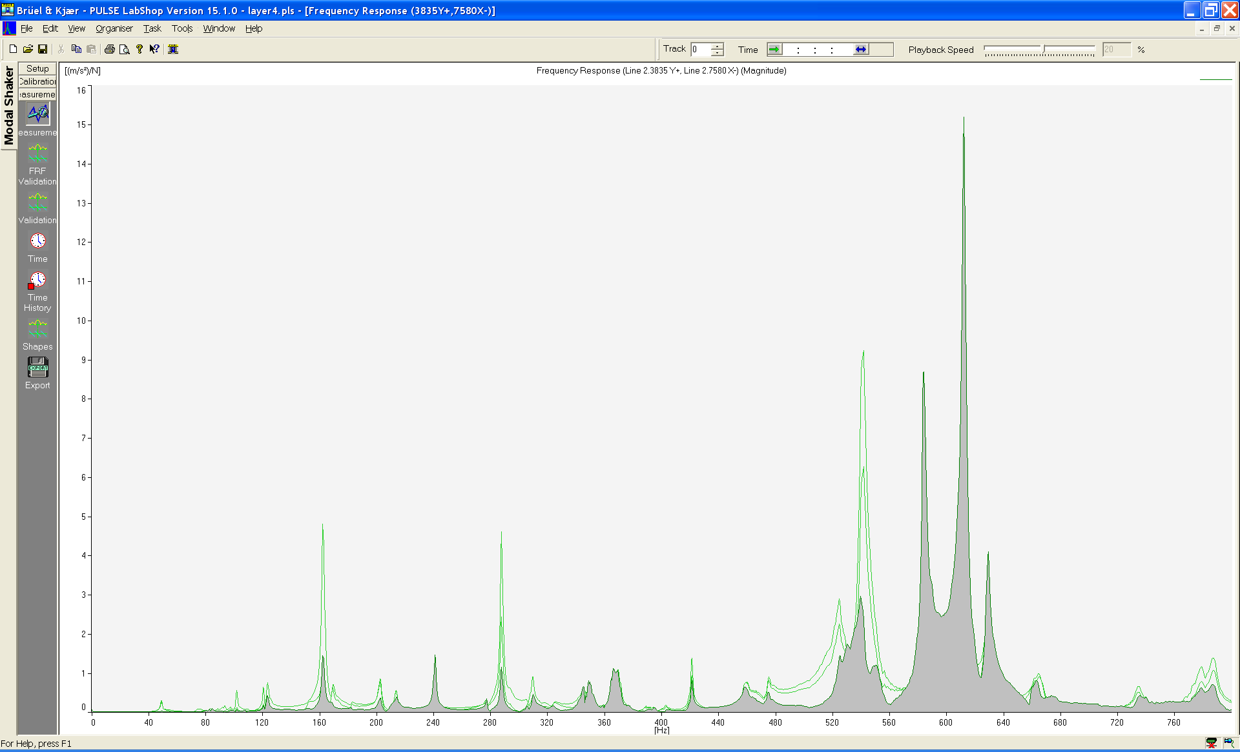
Typical Output of Modal Frequency Response Function
Response/Forcing (m/s²)/N
Screen shot from
Data acquisition system
Lightly Damped
Mode
A sample of the resulting FRF where the Z axis motion is highlighted in grey. Each of these FRF measurements is the result of 10 seconds of averaging as the structure responded to the white noise forcing.
Moderate
Damping
Frequency Sweep (0 to 800Hz)

Slide 34
Backup: Live Operating Motion- Displacement data by test#
 |  | vector sum | vector sum | vector sum
 |  | X1, Y1, & Z1 | X2, Y2, & Z2 | X3, Y3, & Z3
test1 | 50 kA | 2.6 | 2.7 | 3.8
 | 100 kA | 7.8 | 8.4 | 8.7
 | 200 kA | 29.1 | 31.5 | 31.9
test2 | 50 kA | 5.1 | 4.6 | 6.1
 | 100 kA | 11.6 | 12.0 | 13.9
 | 200 kA | 40.3 | 42.1 | 51.8
test3 | 50 kA | 5.4 | 4.9 | 6.5
 | 100 kA | 10.1 | 10.4 | 11.5
 | 200 kA | 30.1 | 33.3 | 33.8
test4 | 50 kA | 4.9 | 5.7 | 6.4
 | 100 kA | 11.5 | 15.5 | 12.6
 | 200 kA | 28.0 | 47.6 | 29.9
test5 | 50 kA | 6.7 | 7.4 | 7.3
 | 100 kA | 14.7 | 19.5 | 13.2
 | 200 kA | 43.7 | 62.9 | 36.0
test6 | 50 kA | 15.2 | 15.9 | 14.3
 | 100 kA | 46.9 | 51.7 | 40.3
 | 200 kA | 149.3 | 164.4 | 127.3
test7 | 50 kA | 5.6 | 5.7 | 6.4
 | 100 kA | 13.5 | 13.8 | 14.2
 | 200 kA | 48.9 | 49.7 | 55.2
test8 | 50 kA | 3.5 | 3.6 | 3.9
 | 100 kA | 9.6 | 11.1 | 19.3
 | 200 kA | 34.4 | 46.2 | 40.7
these values are the 20 Hz to 1600 Hz total peak to peak displacement in micro-meters, by direction, with vector sums added. Red values are the largest motion seen.
164.43 micro meters peak to peak = about 6.4 milli-inches peak to peak

