Slide 1
The Need for Interlock Protection for Megawatt Proton Beams
Sam Childress
Fermilab

Slide 2
A New Threshold
Historically, we have provided the needed radiation safety protection for our proton beam systems by application of passive shielding, determined by comprehensive calculations to meet the requirements of the Fermilab Radiological Control Manual [FRCM]. Typically, this has included beam enclosure shielding sufficient for a 1 hour full intensity beam loss. Where this was not feasible, the shielding was augmented by interlocked detectors at discrete locations outside the shields to insure needed protection.
As our proton beam powers have reached hundreds of kilowatts [350 kW for NuMI; to 700 kW near term for NOvA], and with our Long Baseline proton beam components located on steep slopes in long narrow tunnels, we now have the reality where a single lost beam pulse can destroy a beam component, and also extended close in manual rigging for several days can be needed for a magnet replacement.
We also must transport and target many 10’s of million high intensity beam pulses – more than 70 million to date for NuMI. This places severe constraints on allowable beam transport loss per pulse to maintain the low residual radiation requirements for safe beam enclosure work.

Slide 3
Determining Allowable Primary Beam Loss
To make this concern quantitative, MARS calculations have been done for two beam loss examples, using a detailed model of a portion of the Main Injector cross-section beam enclosure [proposed for LBNE primary beam], and considering residual activation levels which could be incurred with either a 0.4 - 0.7 MW proton beam [NuMI/NOvA] or a 2.4 MW beam [LBNE]
Scenarios considered are:
Extended duration loss of 3 parts per thousand of the beam at a single point. For this calculation we assumed a beam loss duration of 30 days.
This is a very plausible beam loss scenario, which might not be noticed for an extended time. As example, with HV or data link failure for one group of loss monitors. This amount of lost beam could readily be missed by an intensity monitor comparison.
Loss of the entire beam for one hour at a single point location along the primary transport.
While this very extended beam loss is not very credible at these intensities, as a single lost full beam pulse can destroy a vacuum chamber, it is what purely passive shielding systems have been historically designed for.

Slide 4
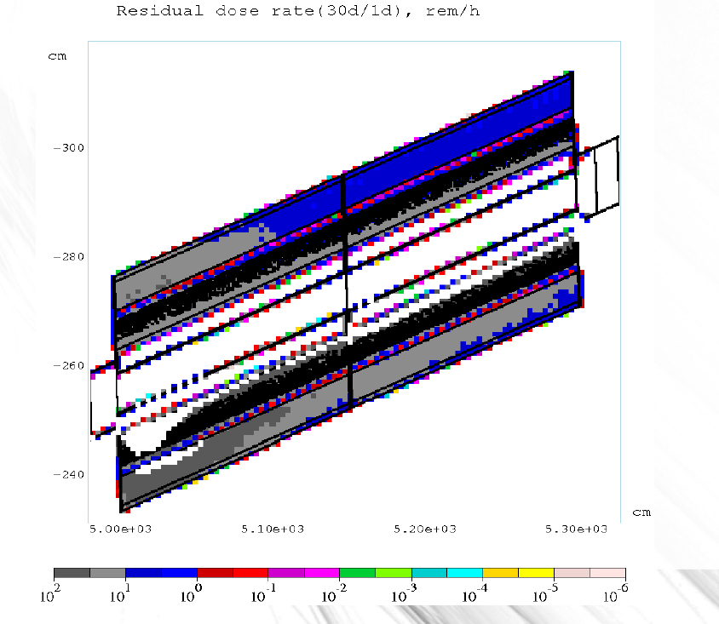
Residual Dose Rates in Rem/hr for a (30d/1d) Beam Loss of 3 Parts per Thousand at 2.4 MW. Beam Lost on a Quadrupole Magnet

Slide 5
Beam Loss Calculation Results
For the first Scenario, where there is accidental beam loss at 0.3% of a 2.4 MW beam for 30 continuous days, the peak contact dose after 24 hours of cool-down (30d/1d) is:
For tunnel walls, 500 mrem/hr [5 mSv/hr] over a 20 ft region of the tunnel, and > 100 mrem/hr over a 50 ft. tunnel region.
For the hottest magnet, 50 Rem/hr [ 0.5 Sv/hr] over several feet of magnet steel, and > 10 Rem/hr over most of a 10 ft. magnet.
With the very difficult work conditions involved for close in rigging efforts on a steep slope, experts have indicated “Under these conditions we cannot change out a magnet”. Magnet steel cool-down is also very slow. Even after waiting 6 months with no beam, a magnet would still be at > 3 Rem/hr [ 30 mSv/hr] in the hottest region.
This is a fractional beam loss which historically was not at all rare, but at this beam power can not be allowed to occur.

Slide 6
Beam Loss Calculation Results [continued]
For the calculated Scenario of a full beam loss in one location for 1 hour (assumption used many times for passive only shielding calculations), the calculated peak contact residual activation doses are:
For tunnel walls, 5.0 Rem/hr. [50 mSv/hr]
For the hottest magnet, 500 Rem/hr. [ 5.0 Sv/hr]
In such a scenario, people could not even approach the affected tunnel region.
For the more realistic localized beam loss of 0.3% over 30 days, we would have an extremely serious radiation and personnel safety issue if we worked to replace a magnet within a time of many months after the beam loss occurrence. This could be a radiation safety challenge more serious than we have previously experienced at Fermilab.

Slide 7
Operational NuMI Beam Loss Requirements
Agreement with ESH&Q and mechanical support experts has been reached that an upper acceptable limit for magnet activation in our steep slope [ NuMI or LBNE ] beam enclosures is 50 mrem/hr. [0.5 mSv/hr] to enable safe magnet replacement.
For the 0.4 MW design deep NuMI beam, maximum allowable primary beam transport beam loss was set due to passage of the unshielded intense beam through a protected aquifer region. This limit was a fractional maximum beam loss of 1 E-05, which has been rigorously enforced by an ”in the tunnel” Scarecrow ionization chamber radiation safety detector. This limit is also in good agreement with that needed for control of residual activation.
To stay well below this limit, we set a design operational limit of 1 E-06 fractional beam loss for NuMI.
This has worked extremely well with typical operational fractional beam loss of < a few xE-07, including for beam extraction from the Main Injector.
Residual activation levels for the NuMI primary beam transport have consistently been < 1 mrem/hr. [ < 10 µSv/hr ]

Slide 8
NuMI Beam Profile View
For NuMI we have a deep beam facility mined in underlying rock strata with the design driven by length of the decay pipe (675 meters). Initially we started with a similar design for LBNE.

Slide 9
Integrated Systems for Preventing Beam Loss
NuMI Experience
The combination of NuMI beam power plus severe beam loss constraints necessitated a broad set of upgrades and careful techniques to achieve beam loss control significantly beyond previous high intensity primary beam designs. Included were:
Comprehensive beam permit system with over 250 parameters verified prior to each beam extraction.
Beam loss greater than a preset level (typically 5 Rads/sec) for any BLM inhibits next pulse extraction. BLM placement provides significant redundancy for sensing beam loss.
Solid beam transport stability, with major power supply regulation to < 50 parts per million.
Improved beam optics design, with some limits for what could be achievable posed by the NuMI facility design.
Fully automated NuMI primary beam position control (Autotune), with no manual adjustment of beam positions required during operation.
Primary extraction channel and transport component apertures sized to be larger than the Main Injector dynamic aperture. > 500 π mm-mrad, and capable of accepting a range of extracted beam conditions.
Enforced in a fail safe manner by “ in the tunnel” radiation safety detector.

Slide 10
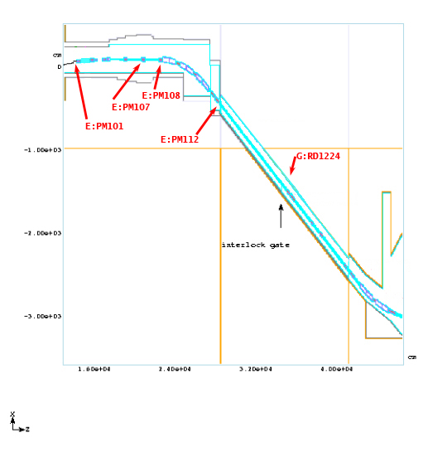
NuMI Tunnel Geometry Showing Profile Monitor and Interlocked Detector Locations

Slide 11
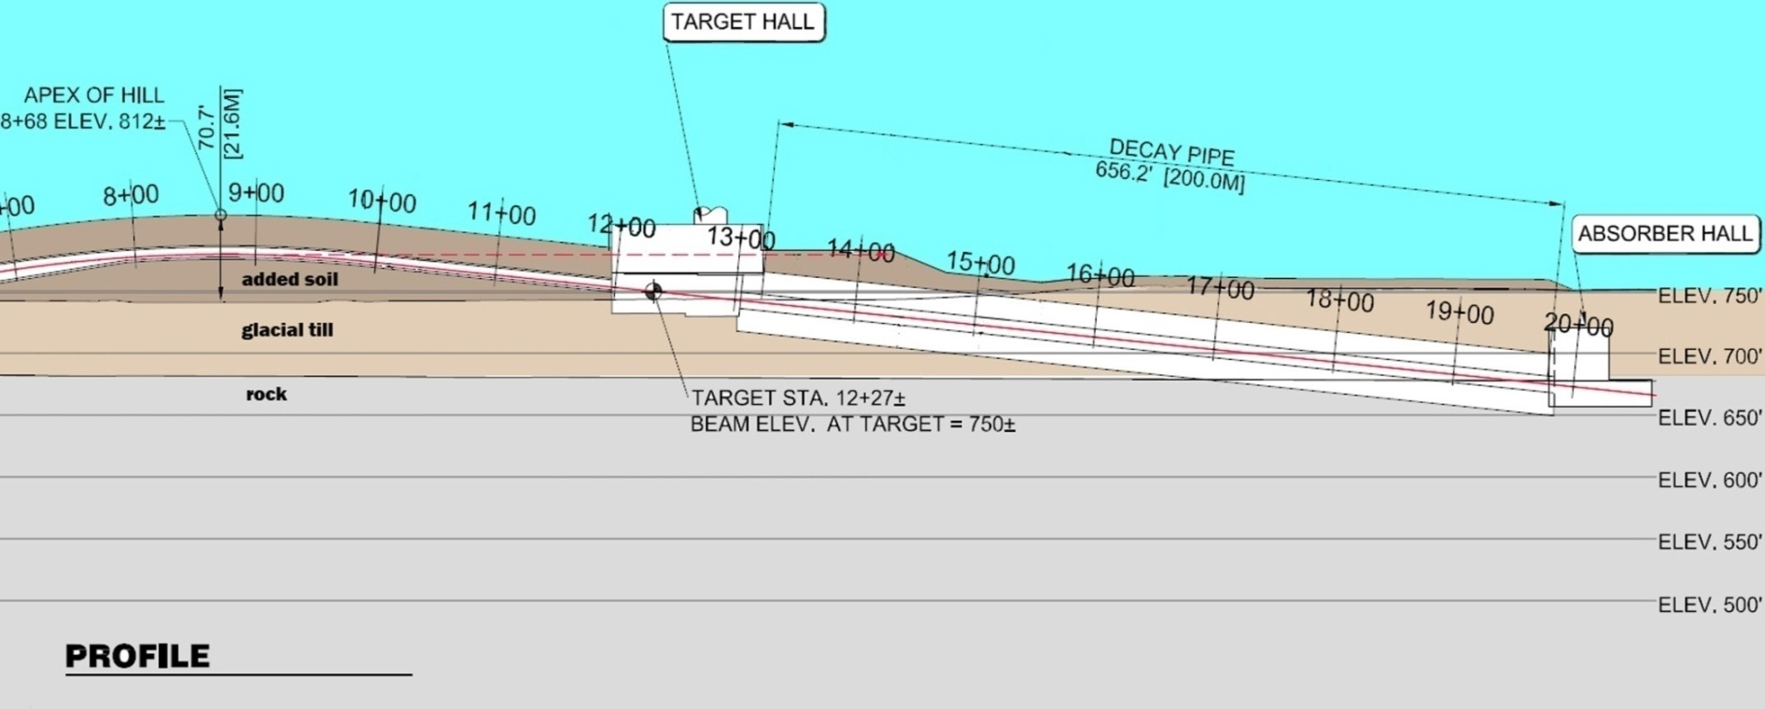
Profile View for Shallow LBNE Beam Facility
Added soil
200 meter decay
Glacial till
Rock
Much shorter decay than NuMI (now ~ 200 m) enables target hall elevation placement out of under-lyimg rock. Design is chosen to balance construction requirements for elevated proton beam versus decay region and absorber located partially in rock. Advantages of significantly reduced cost [ > $ 125 million savings] and improved tritium mitigation compared to a NuMI style deep beam design for LBNE.
11

Slide 12
Requirements for LBNE Proton Beam Loss
At 2.4 MW, to limit maximum beam component activation levels to < 50 mrem/hr, required is to maintain DC beam loss to lower than one thousand times less than the example calculated [0.3% beam loss] – see Slide #5.
This then is an upper allowed limit of ~ 2E-6 fractional beam loss.
We plan to maintain all of the capabilities to control beam loss currently in use for NuMI, plus
Improved major power supply regulation - < 10 parts per million
Improved beam optics [J. Johnstone], not constrained by the long carrier tunnel drift region as in NuMI.
For NuMI, residual activation is consistently < 1 mrem/hr. Now, will have ~ 6 times the beam power
We no longer have the severe NuMI ground water protection constraint, but will maintain and enhance the use of “ in the tunnel” radiation safety detectors to ensure the needed beam loss criteria are rigorously maintained.

Slide 13
Projected Discrete Interlocked Detector Locations for LBNE Proton Beam
T. Leveling talk presents plans for a continuous radiation safety monitor currently being developed.

Slide 14
Thanks to many people working with the NuMI beam system and with design plans for the next generation 2+ MW Fermilab proton beam.
Special thanks to Kamran Vaziri for his thoughtful inputs and to Igor Tropin for MARS beam loss calculations.

