Slide 1
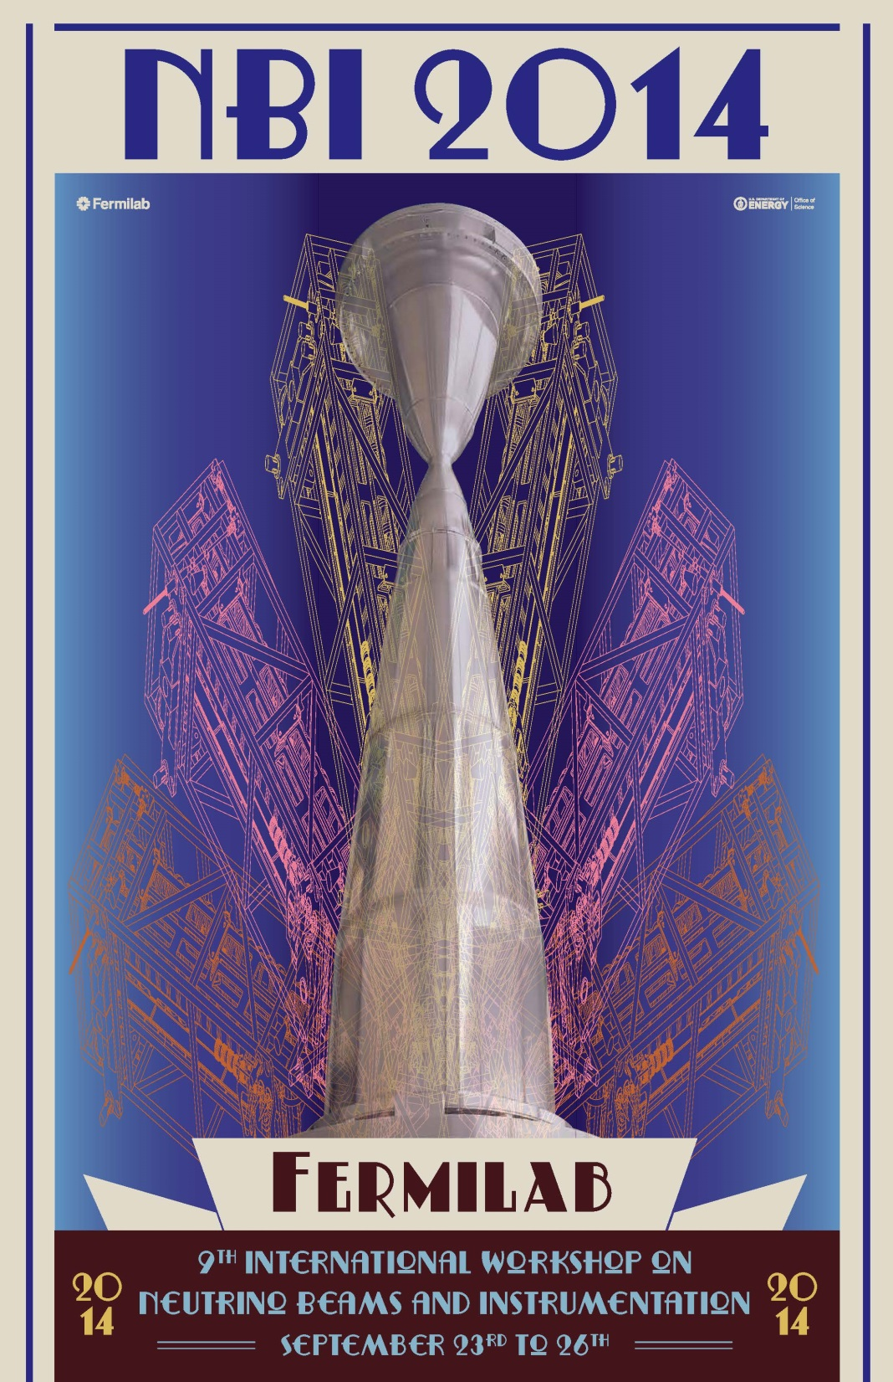

Slide 2
NBI Logistics
Please sign-in at the registration desk
Sign-up for tours Wednesday afternoon (1:30-5:15)
Sign-up for Wednesday workshop dinner (7pm)
Speakers: please upload talks to Indico
Alternatively, email to Bob or Alberto
Please stay to time – chairs will help
Workshop photo today @ 3:20 in front of Wilson Hall
Do photo before getting coffee

Slide 3
NBI Basics
Access to the Fermilab site is open from either the east or west gate. You should be able to gain access with a US driver's license or your passport. See here for more information:
http://www.fnal.gov/pub/visiting/hours/index.html
All sessions will be held in the 1 West conference room at Fermilab. It is located on the west side of the 1st floor in Wilson Hall (the high-rise). It is immediately adjacent to the cafeteria. There are electrical connections below each seat for laptop connections. There will be no other activities in this room for the week outside of our workshop.
Each day's session starts at 8:30 am. Registration will start before the first session on Tuesday morning. The registration desk will be next to the conference room, on the south side. Please check-in at the desk - there will be sign-up sheets for the tours and dinners. On-site registration is available for those who were not able to register online. Coffee will be served at mid-morning and mid-afternoon breaks.

Slide 4
NBI Basics
Speakers will be able to upload their talks if they register with the Fermilab indico system using the email address we have. Please feel free to upload your material yourself. If you are unable to use this system, please email your talk to us <alberto@fnal.gov> <zwaska@fnal.gov> , or provide it on a memory stick. Please try to keep to the indicated times on the schedule. We have several fixed points and cannot withstand going much behind schedule.
The registration tables will be staffed throughout the workshop by Fermilab's professional conference office: Cynthia Sazama, Suzanne Weber, and Melody Saperston. Please feel free to ask questions of them - if they don't know the answer they will likely be able to direct you to someone who does.
We will have a workshop photograph at 3:20 pm, Tuesday, September 23. The photo will be taken on the front steps of Wilson Hall and immediately precede our mid-afternoon coffee break. Please proceed immediately to the photo so we can enjoy our coffee and stay on schedule for the afternoon.

Slide 5
NBI Basics
Lunch (and breakfast) are available from the Fermilab cafeteria. It opens at 7:30am. Our lunchtime varies by day, but will be around 12:30. Dinner will need to be found elsewhere. We will have a substantial reception Tuesday evening, and a group dinner Wednesday at Greek Islands in Chicago www.greekislands.net . Many dining options are available in the Fermilab area. Please ask us for suggestions if you are in need; resources such as yelp.com also provide good options.
We will have an opening day reception September 23 at 6pm on the 15th floor of Wilson Hall. Drinks and appetizers will be served. There is no additional cost for this reception.
Wednesday afternoon we have the opportunity for a limited number (26) of tours of the target/horn factory and NuMI underground facility. Please sign-up for the tours at registration. For those who will not take part in the tours, the afternoon will be free for other activities at Fermilab or a self-guided excursion. Please note that you need to wear sturdy walking shoes (no pointed heels or open toes) and be able to walk ~ 2 km underground. There will be a required safety briefing at 1:30 pm Wednesday afternoon in 1 West. Participants will be shuttled to the locations and we anticipate finishing by 5:15 pm.

Slide 6
NBI Basics
Wednesday evening we will have a group dinner at the Greek Islands restaurant in Chicago - www.greekislands.net , 200 South Halsted St., Chicago, IL. 60661. The reservation will be made for 7 pm - please sign-up at registration to be included in the reservation. The restaurant is located in the Greektown neighborhood of Chicago, just west of downtown. We have not organized transportation. Please carpool as necessary and let us know if you need a ride - we can help you find a driver. Driving time without traffic is about an hour, anticipate an extra 15-30 minutes in the early evening rush. Public transportation from the suburbs is possible using the Metra commuter train, but will likely be impractical for this trip.
The workshop program will conclude by 3:30 pm on Friday. A wine-and-cheese reception will follow until 4 pm when Alberto Marchionni will deliver a public seminar on the history and prospects of neutrino beams.
The Fermilab wireless network is open to visitors, but requires registration. Either multiple 24-hr registrations can be used, or a slightly more detailed long-term registration. See here for more information:
http://fermi.service-now.com/kb_view.do?sysparm_article=KB0010214

