Slide 1
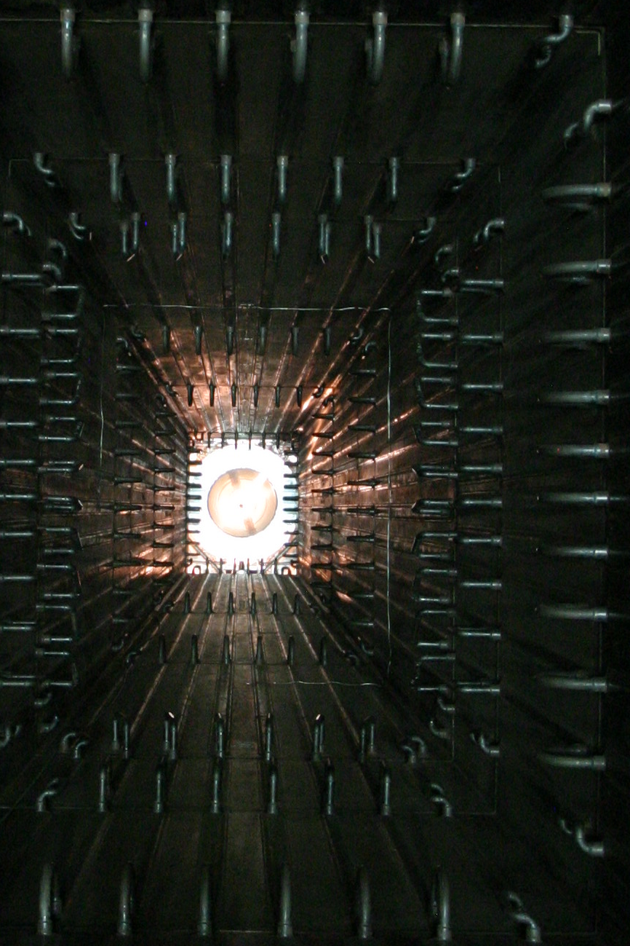
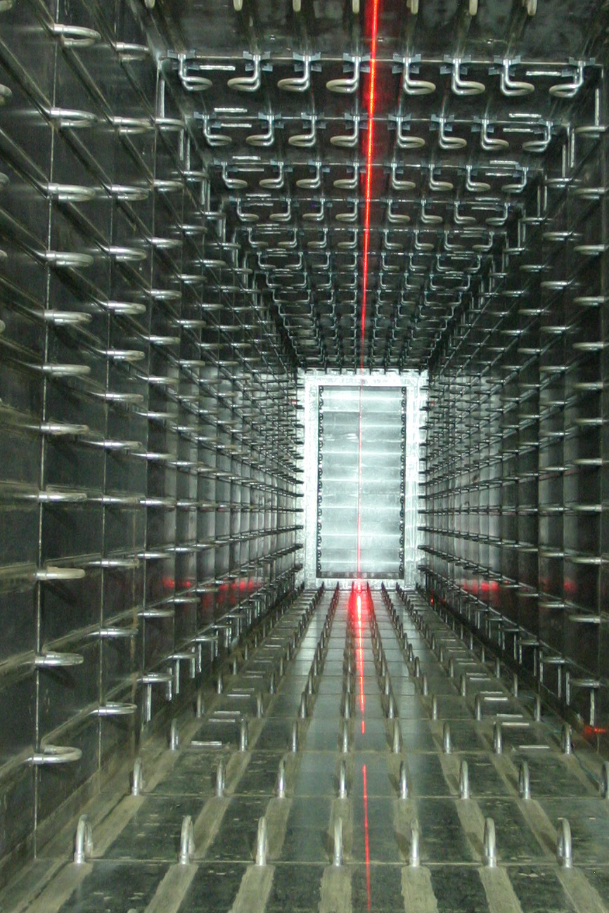

Status of Long-Baseline
Neutrino Oscillation Experiments in Japan
T. Ishida
Neutrino Section, J-PARC Center, KEK
on behalf of the neutrino beam group

Slide 2
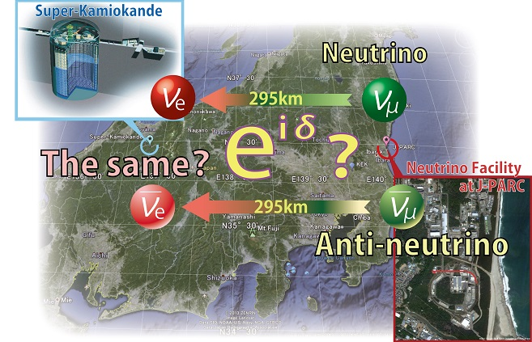
Contents
Neutrino experimental facility at J-PARC
Status of the facility since NBI2012
Physics reach of T2K / J-PARC to Hyper-K
Summary

Slide 3
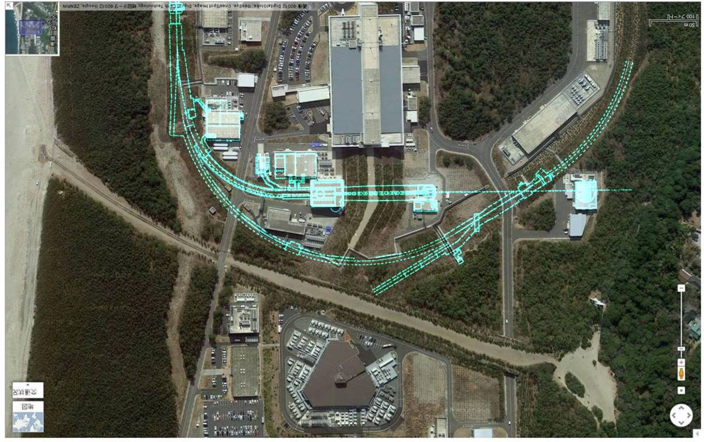
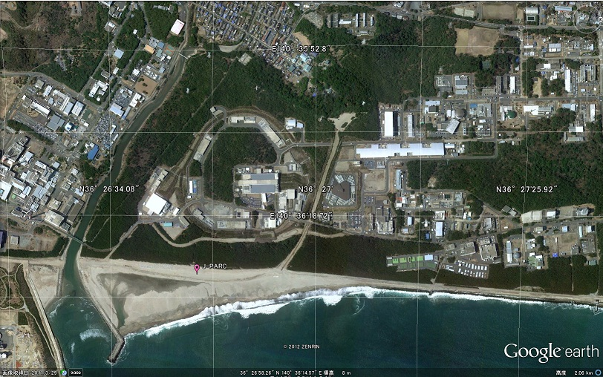
1. Neutrino experimental facility at J-PARC
Conventional (horn-focused) beam-line, designed/constructed for T2K long base-line neutrino oscillation experiment & for its future upgrade to Hyper-Kamiokande
RCS
N
Near Neutrino
Detectors
Beam
Dump
Decay
Volume
Muon
Monitors
Target
Horns
ν
μ
π
Main
P
295km
To Kamioka
Ring
110m
Primary
Beam-line
280m
J-PARC, Tokai
MLF
Extraction
Point

Slide 4
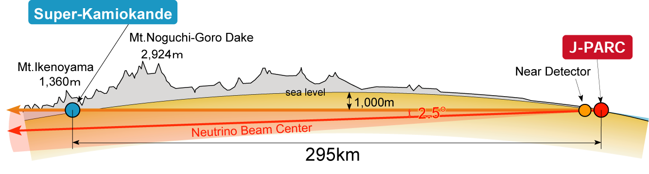
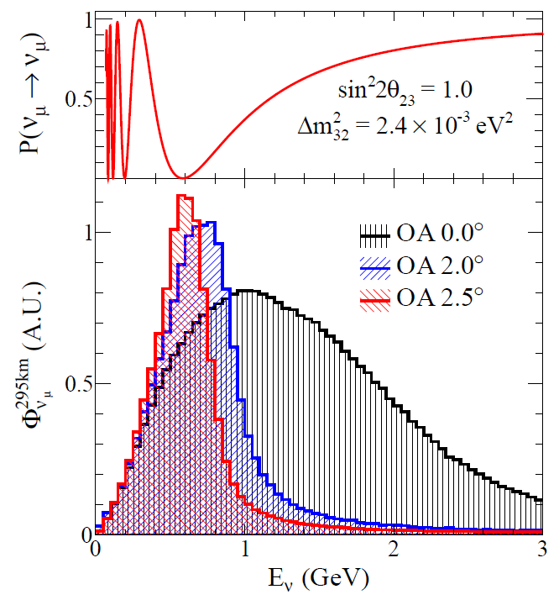
Schematic overview: Tunable off-axis beam
π
Near
detectors
p
μ-monitor
ν
Oscillation
Maximum
off-axis
on-axis
2.0~2.5º
Decay volume
0m
120m
280m
295 km
Conventional “horn-magnet-focused” ν beam
  30GeV Protons on a graphite target
  daughter π⁺ → μ⁺+ν_{μ}
First application of Off-Axis(OA) beam: 2.0~2.5º wrt. the far detector direction
  Low-energy narrow-band beam
  peak tuned to oscillation maximum
  Small high-energy tail: reduce backgrounds

Slide 5
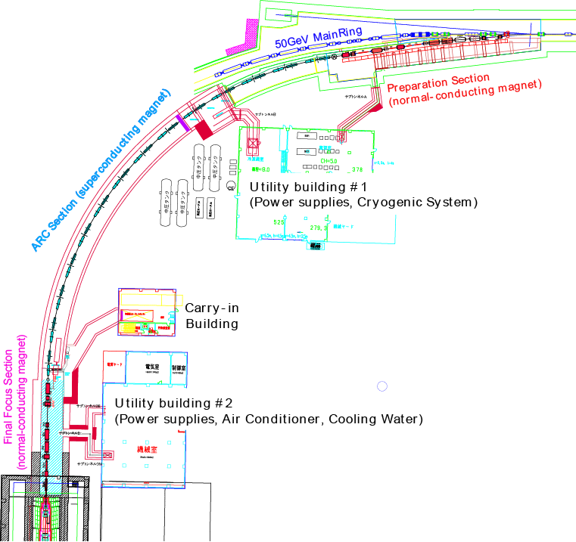
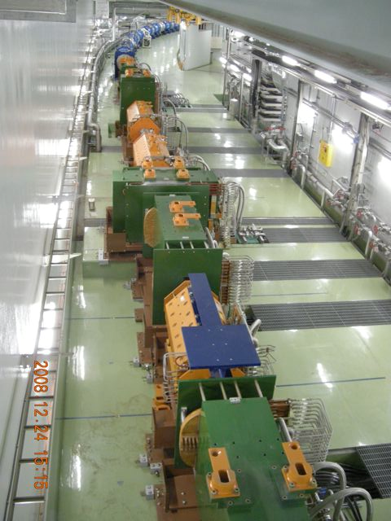
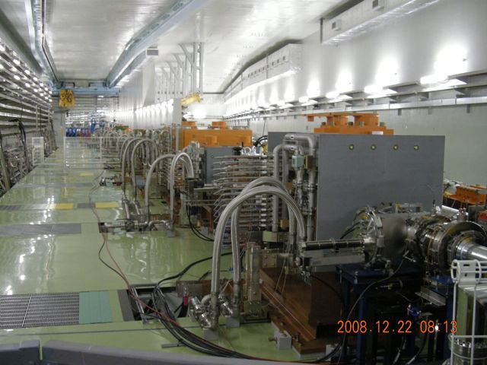
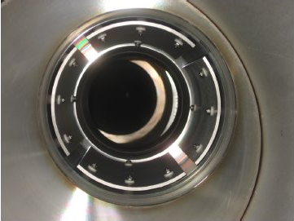
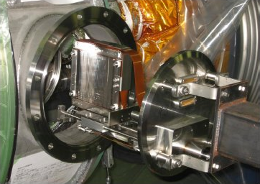
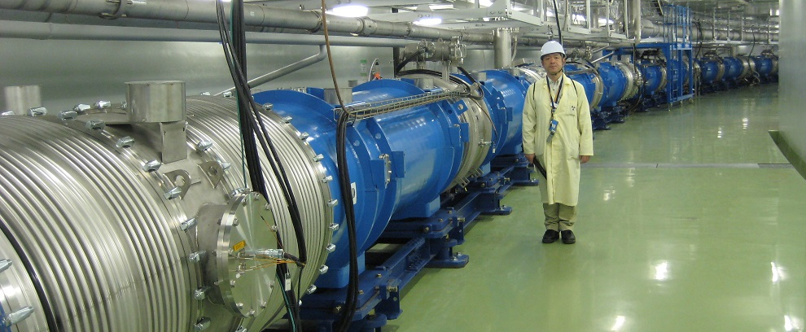
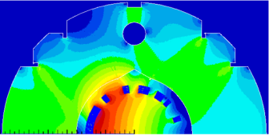
Primary beam-line
Final focusing (FF) section
10 normal conducting magnets
Preparation section
11 normal conducting magnets
Arc section
28 Super-conducting Combined Function Magnets (SCFM)
Beam Monitors
5 CTs/21 ESMs/19 SSEMs/ 1 OTR / 50 BLMs
⇒ M. Friend/M.Hartz

Slide 6

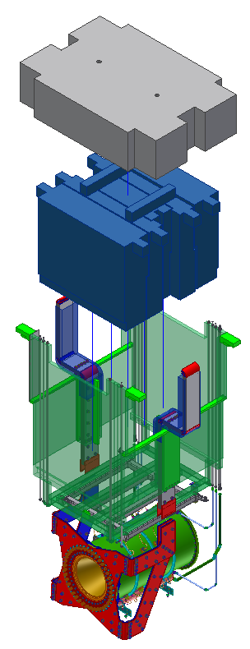


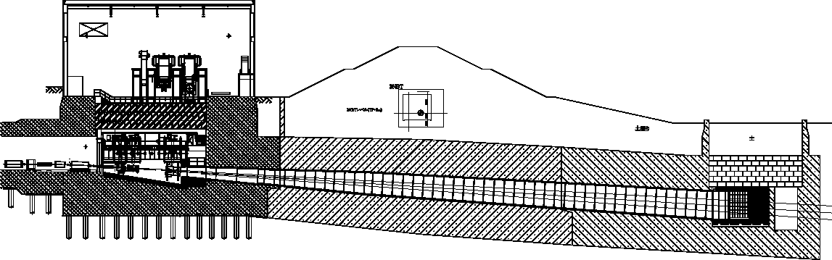

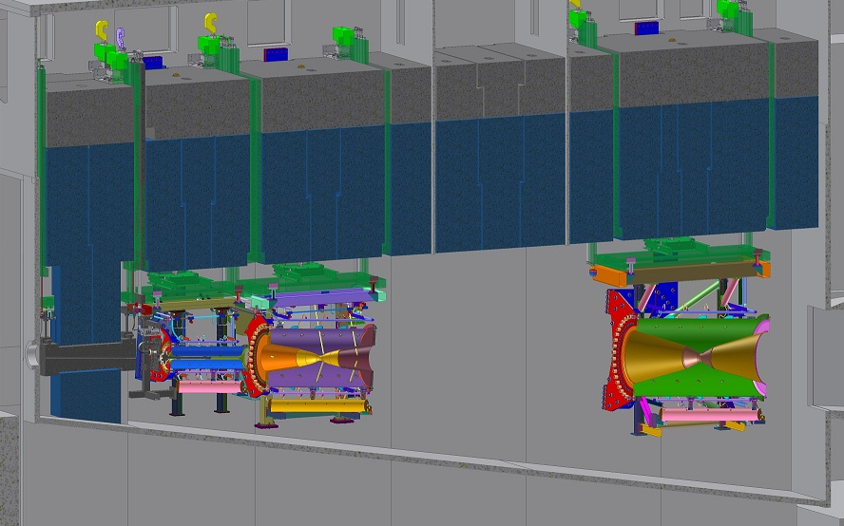
Secondary beam-line/Target Station
Helium Vessel
L=110m, V=1,300m³
Concrete
blocks
Beam Transport
From RCS to MLF
Target Station
1.0m
Beam Dump
Decay Volume
OA
2º
2.5º
Water-cooled
iron cast blocks
2.3m
[3º]
Hadron Absorber
15.0m
Beam
window
Support
Module
Horn-3
Horn-1
Horn-2
Remote
disconnection
Baffle
OTR
Target

Slide 7
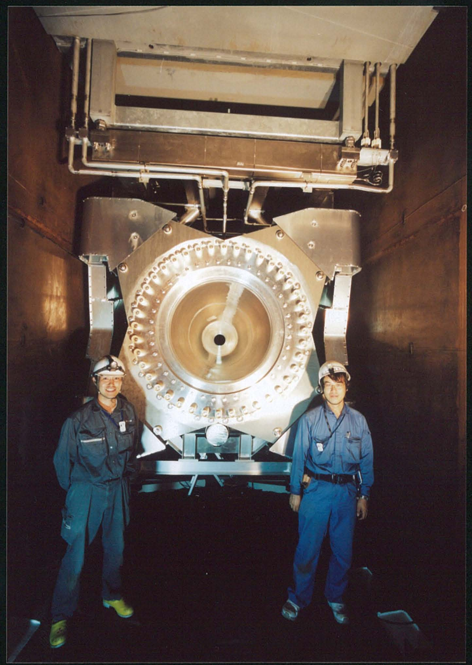
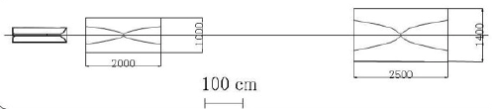
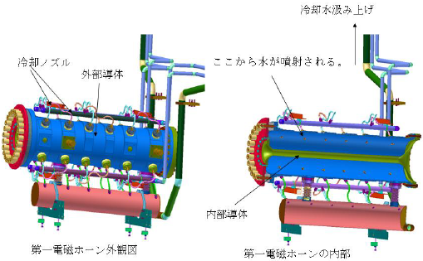
Electromagnetic horns
⇒ T. Sekiguchi / E.Zimmerman
1st(installed) Horn-3
In TS He vessel
Horn-1
Horn-2
Horn-3
1400
Target
Cooling
Nozzle
Outer
Conductor
Water spray holes
Inner
Conductor
Water drain tank
Aluminum alloy A6061-T6
  Inner conductor: t3mm, outer: t10mm.
320kA pulsed current (250kA in use so far)
  Max field: ~2.1T, pulse width: 2~3ms
Spraying water to inner conductor
  15kJ (beam) + 10kJ (Joule)=25kJ
  Keep <80℃：cooling capacity ~2MW
Alignment : 0.3mm(x), 1mm(y,z)
Sep., 2009

Slide 8
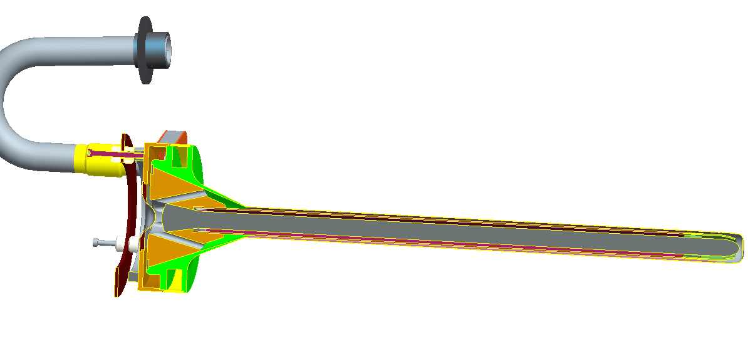
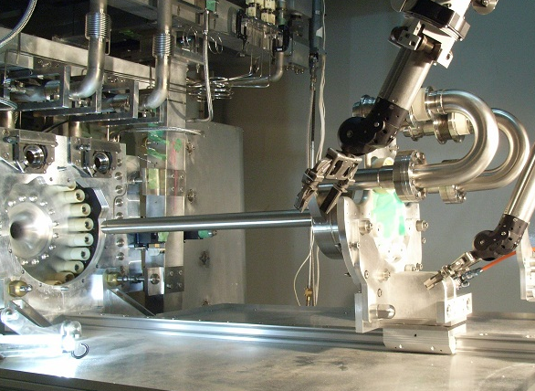
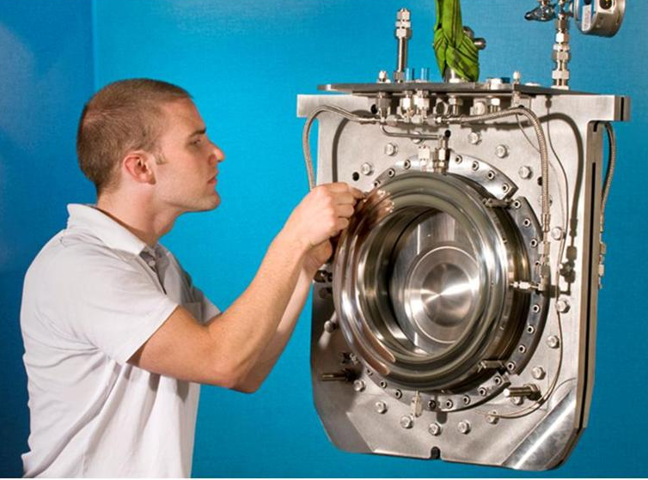
Target / beam window
⇒ C.J.Densham / T.Nakadaira
Graphite core
IG-430U
26mmφ x ~90cm
Graphite IG-430U
Graphite
sleeve
Ti-6Al-4V
(0.3mmT)
( 26mmφ x 910mm )
Ti-6Al-4V
(0.3mmT)
2 mm gap
Ti-6Al-4V shell
(0.3mmT)
He-gas cooling
Designed for old parameters of MR 750kW beam: cycle: 2.1s, PPP: 3.3x10¹⁴
Present expected parameters: Doubled rep-rate, MR cycle: 1.3 s, PPP: 2.0x10¹⁴
60%
reduction

Slide 9
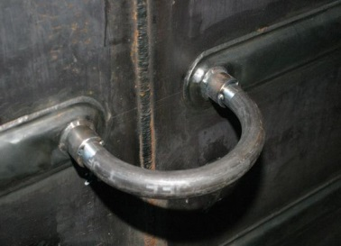
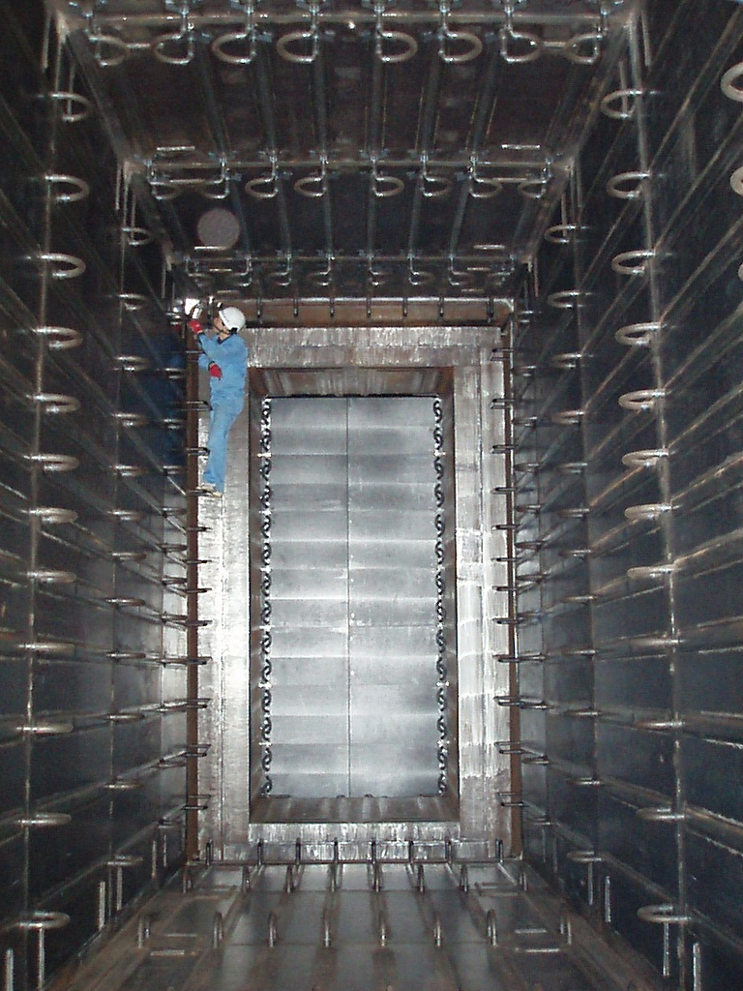
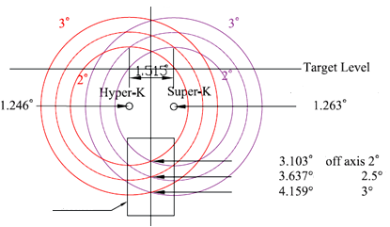
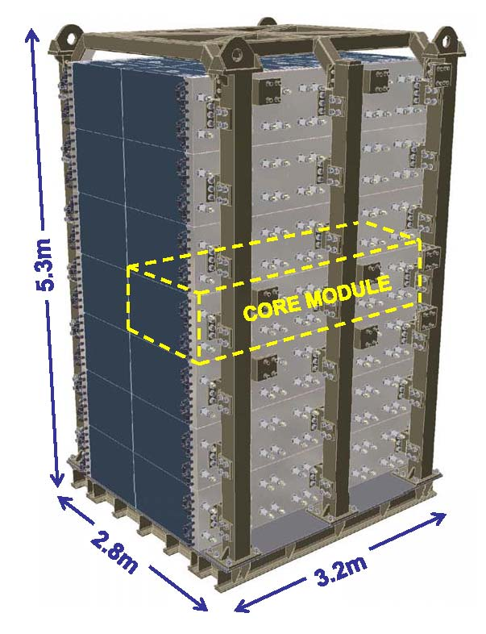
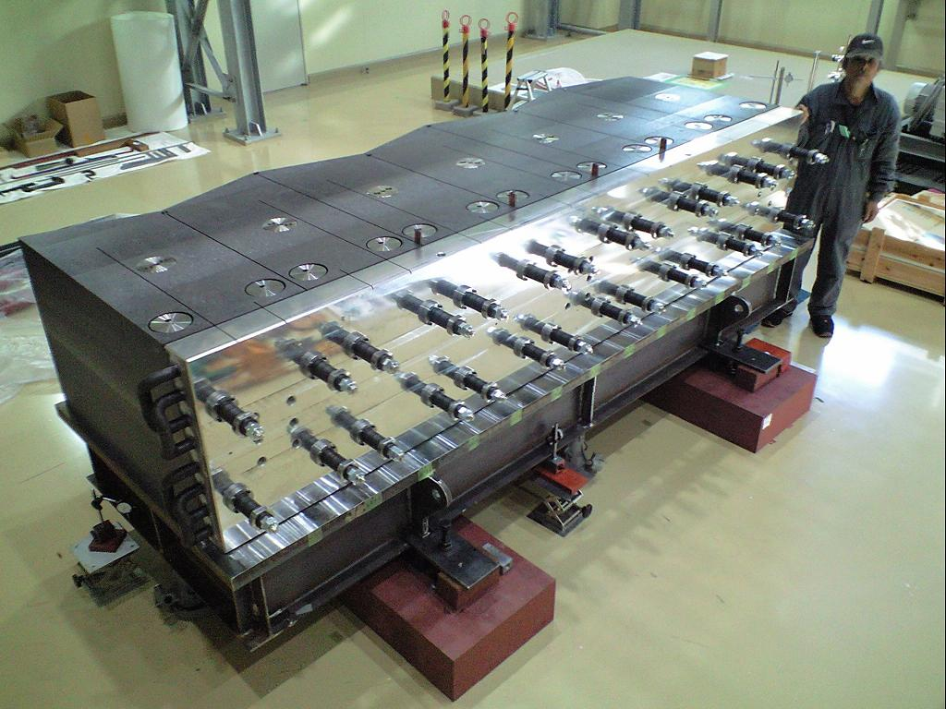
Decay volume / hadron absorber
Steel plates(16mmT)
cooled by water circuits
94m-long tunnel with rectangular cross section (1.4m_{w}×1.7m_{h} → 3.0m_{w}×5.1m_{h}), filled with He (1atm)
Covered off-axis region : 2.5±0.5°(2.0~3.0°)
No access possible: designed for 3~4MW beam
Plate Coil
SGP
10K-25A
Same off-axis angle
to SK and to Hyper-K
DV
7 extruded large
graphite blocks
Aluminum cast
water cooling plate
Slide support frame
⇒ NBI2010

Slide 10
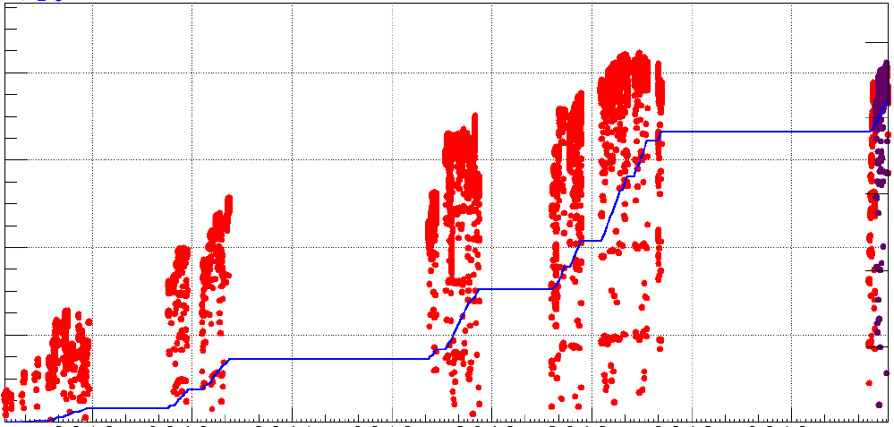
2. Status of the facility since NBI2012
Rep=3.52s
→50kW
[6 bunches]
3.2s→3.04s
→145kW
2.56s
→190kW
2.48s
→235kW
2.48s
235kW
x10¹⁹
[kW]
6.57x10²⁰pot
May.8,’13
7.39x10²⁰pot
^{incl.}0.51x10²⁰ anti-ν
^{until} Jun.26,’14
250
80
200
3.01x10²⁰pot
Jun.9,’12
60
May.26’14
150
Accumulated # of Protons
Beam Power
1.43x10²⁰pot
Mar.11,’11
Hadron Hall accident (May 23)
40
Oct.17
Run-1
Mar.8’12
100
20
Recovery from the earthquake
50
Run-2
Run-3
Run-4
Jul.19’13
Run-5
0
0
2010
2011
2012
2013
2014
NBI2012
T2K reported electron neutrino appearance
with > 7σ significance
Until Run-4: Accumulated pot: 6.57x10²⁰
# of pulses for the 1st set of horns and target : 1.2x10⁷
Long shutdown after R4 (Hadron hall accident) is devoted to replace all 3 horns
Until Run-5: Accumulated pot : 7.39x10²⁰, including 0.51x10²⁰ of anti-ν mode operation.

Slide 11
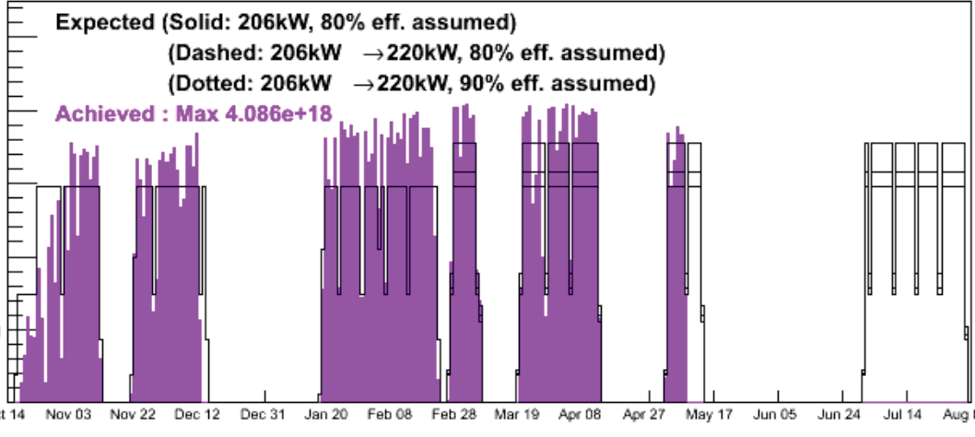
MR Fx beam delivery status [Run-4]
x10¹⁸
5
Hadron hall accident
(May 23)
4
3
Delivered POT/day
2
1
0
Oct14
Dec31
Mar19
Jun06
Original schedule for R#4: Oct. 2012 ~ end of July 2013
  Requested: >8x10²⁰ POT ⇒ Allocated FX user time: 3624hours (151days)
  Expected POT = 7.54x10²⁰ [assume 206kW x 80% running time efficiency ]
Stable operation at 230kW running time efficciency: 83%
  >1.2x10¹⁴ppp : the world record of extracted protons per pulse for synchrotrons
  As of May 16, delivered POT： ~6.7x10²⁰ > expected : ~6.5x10²⁰

Slide 12
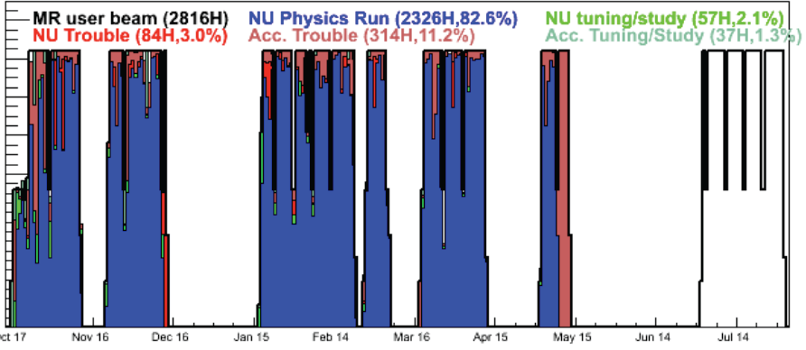
Run time usage [Run-4]
[min.]
1400
1200
1000
800
600
400
200
0
Oct17
Dec16
Feb14
Apr15
Jun14
From Oct.ʼ12 to Mayʼ13, overall running time efficiency was ~82.6%
  Physics run: 2,326 hours over 2,816 hours of MR user beam
Troubles at the neutrino facility was 3% (84 hours)
  Prefilters of degassing system of He vessel cooling water were clogged (Nov,2013, ~8 h x 2 )
  Vacuum leak at primary beam-line due to beam hit (Dec.12,’13 ~35 h)
  Network trouble (~2.5hours)

Slide 13
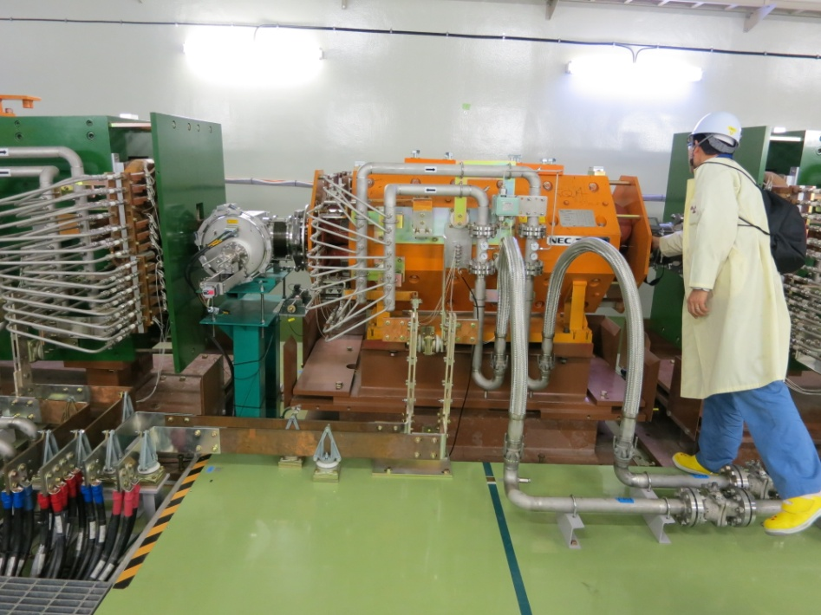
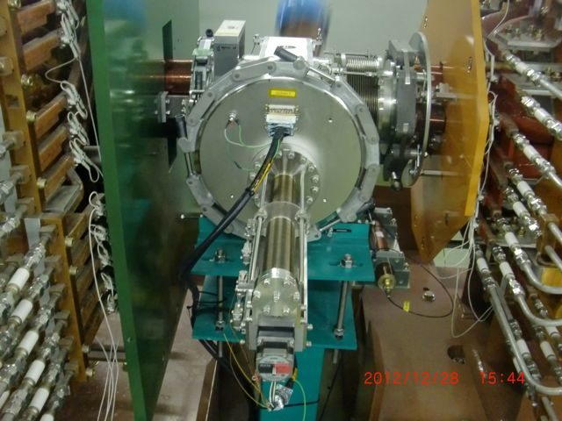
Accidental beam hit & vacuum leak [Dec.12, 2012]
Final Focusing Section: 4xQ / 1x(H+Steering) / 2x(V+Steering)
Trouble happened during beam tuning to increase power (210→217kW)
  Unexpected turning-off of 1 bending magnet (FVD1, 25mrad bend) without alarm
  Beam hit the beam duct and beam monitors (SSEM/ESM).
  The vacuum leak at a feed-through of ESM.
ESM
FVD2
FQ4
FVD1
SSEM
Bellows

Slide 14
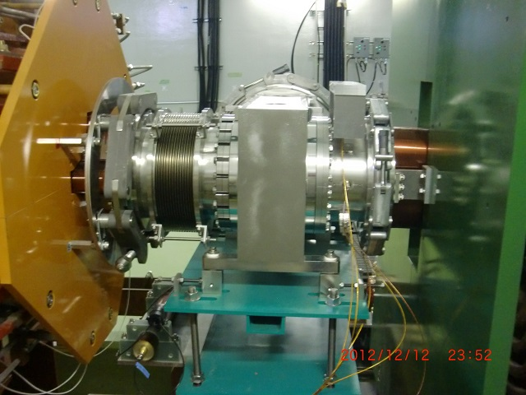
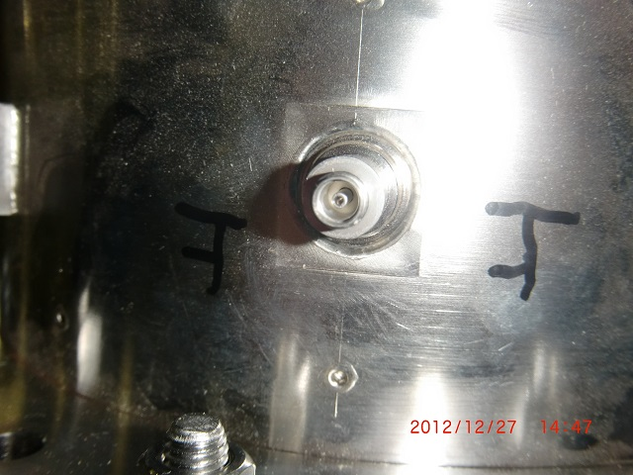
The feed-through causing vacuum leak
Fixing work was completed during new-year holidays of 2013: Replace the broken ESM by spare
The problematic feed-through was on top of ESM.
No damage can be identified with eyes.

Slide 15
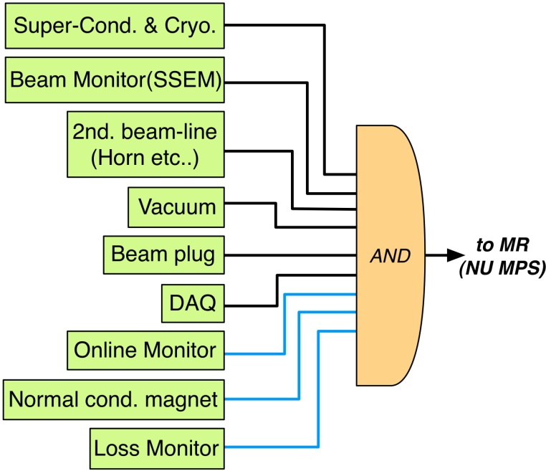
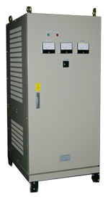
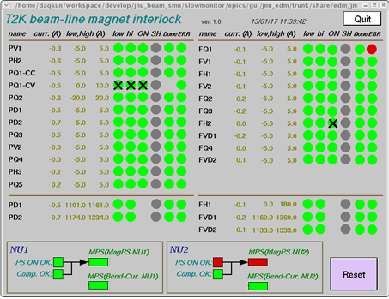

MPS interlock improvements
Change MPS logic
  to use always all interlock, except for beam loss monitor
Doubling of NC magnet power supply interlock
  In addition to the existing interlock of current fluctuation, implement an interlock for the absolute current of bending magnets
※masked for
beam tuning/study
For PD1,PD2, FVD1, FVD2, & FH1
Current indicator
New Interlock
Shunt output
PS Control
System
DCCT
Old Interlock

Slide 16
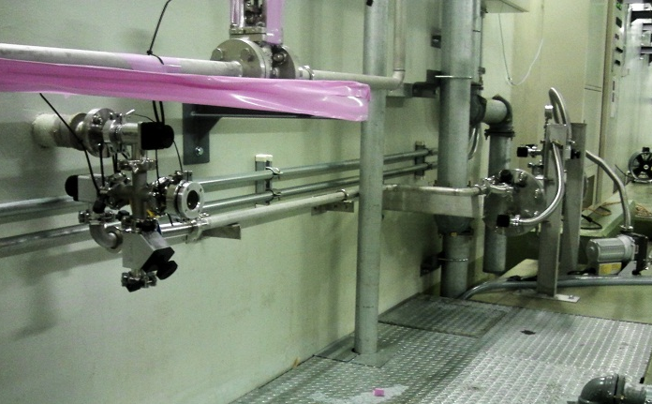
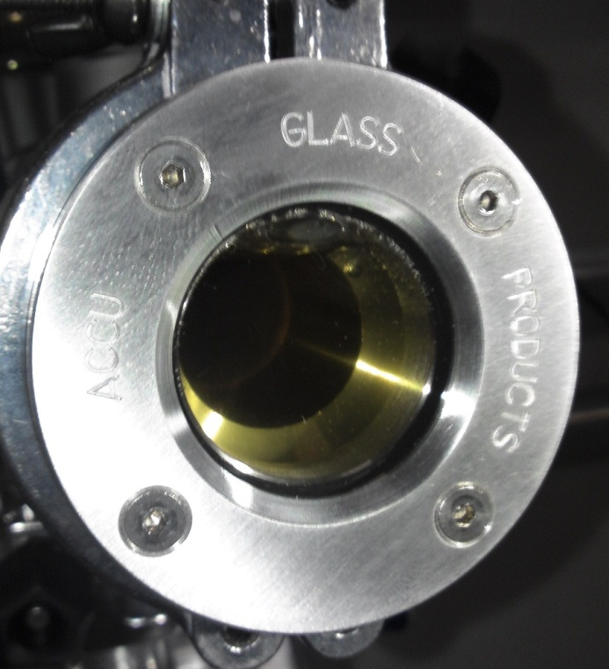
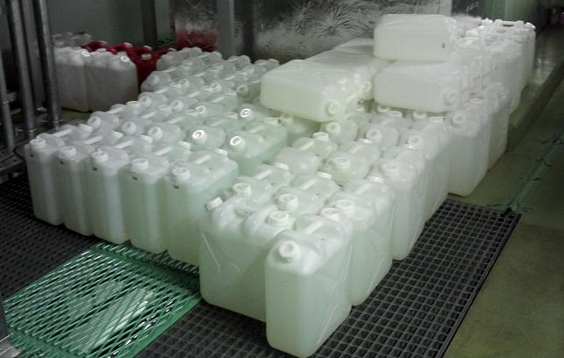
Horn water leak and drainage from He vessel
Since October 2012, water leak occurred at Horn CW system.
  ~10L/day (~5L/day w/o beam)
  due to temperature or vibration(?)
On Jan.2013 the drain port of the vessel at TS B2F was opened.
  Water comes out.
  Transparent, with tiny yellow color.
  possibly no corrosion at the vessel.
  In total only 55L. pH: 8~9
  ³H: ~4kBq/cc, ⁷Be, ²²Na
Dew condensation continuously comes out to a drain tank, installed at the outlet of He compressor.
  ~120L / 2 weeks, ~10L/day
  Comparable to the leak rate.
We decided to continue R#4 with periodically draining water.
Drain port of He Vessel
Drain tank
View port
  Temporarily kept at B1F floor in many 20L plastic containers

Slide 17
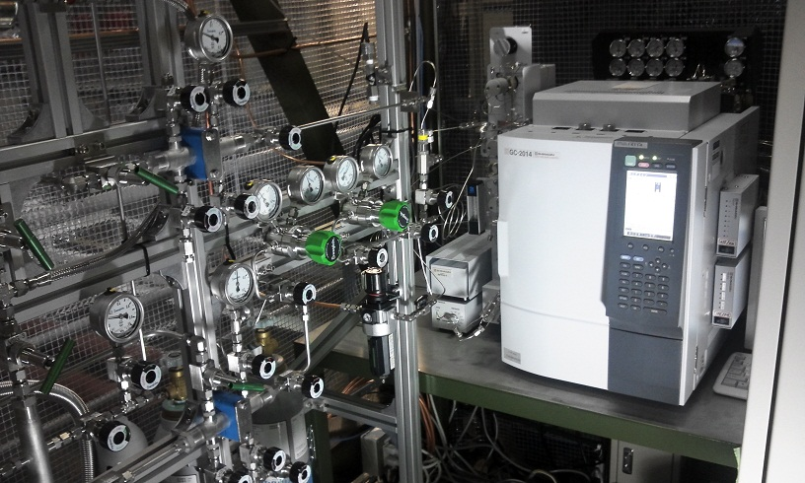
Hydrogen Production in Horns
After beam power reaches to >200kW, hydrogen production in horn cover gas became biggest problem.
  Cover gas is circulating through H₂-O₂ recombine system.
  For the 1st set of horns, only one port available for charging He gas.
  Forced flushing was only possible with water port, when beam is off.
On Feb.~Mar.2013 gas chromatograph was installed to TS 1F.
  H₂ after 1 week of 220kW beam: 1.6% ⇔explosion limit >4% )
  After a few times of forced flushing, it reduces to ~0.4%.
We decided to flush horn cover gas in every week basis, on accelerator maintenance day, during R#4
  This limits maximum acceptable beam power to ~300kW
gas chromatograph at TS-1F
Coolant Helium gas for target, beam window, and He vessel
Cover gas of horn cooling water

Slide 18
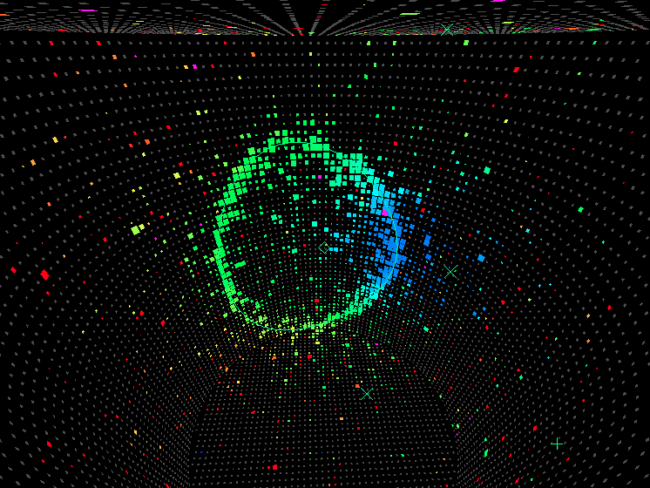

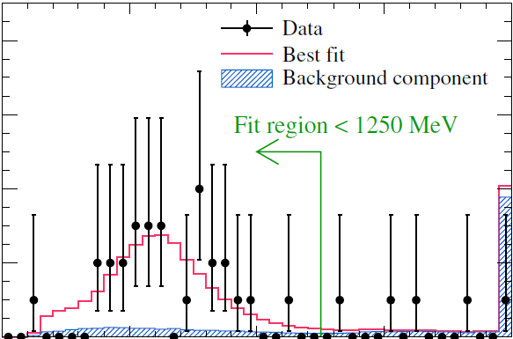
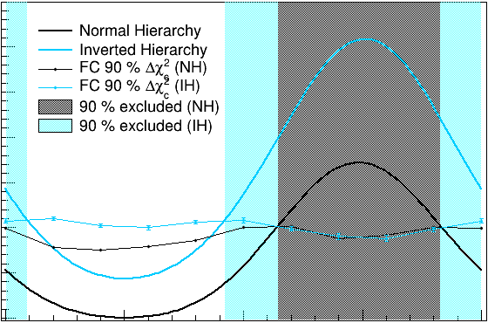
ν_{e} appearance observation July 19, 2013
Definitive observation on ν_{μ} turning to ν_{e} (Run-1~4 data : 6.6×10²⁰pot)
  Neutrino experiments come closer to see CPV in lepton sector !
  With 10 times more data (7.8×10²¹ p.o.t.), T2K has the opportunity to establish evidence (~3σ) of CPV.
A prompt realization of the design beam power of 750 kW is highly desired to the J-PARC Main Ring and the neutrino experimental facility
⇒T.Koseki/T.Nakadaira
A power upgrade to Mega-Watt class beam will directly enhance reach of the future project: LBL from J-PARC to Hyper-Kamiokande
8
28 events
4.92±0.55_{BG}
6.57×10²⁰pot
Δχ²
6
# of ν_{e} events
6
Appearance signal
7.3σ
Significance
EXCLUDED
at 90%CL !
4
4
PRELIMINARY
2
2
0
0
0
0.5
1.0
Eν(GeV)
-π
-1/2π
0
1/2π
π
⇒ Phys. Rev. Lett. 112, 061802 (2014)
δ_{CP}
⇒ arXiv:1405.3871 [hep-ex]

Slide 19
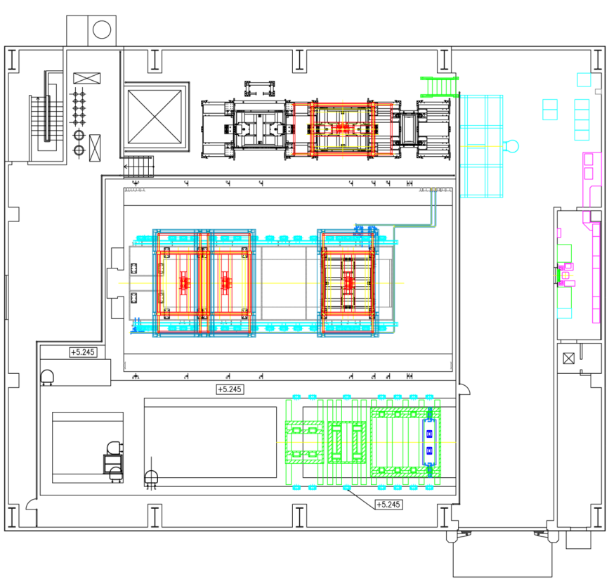
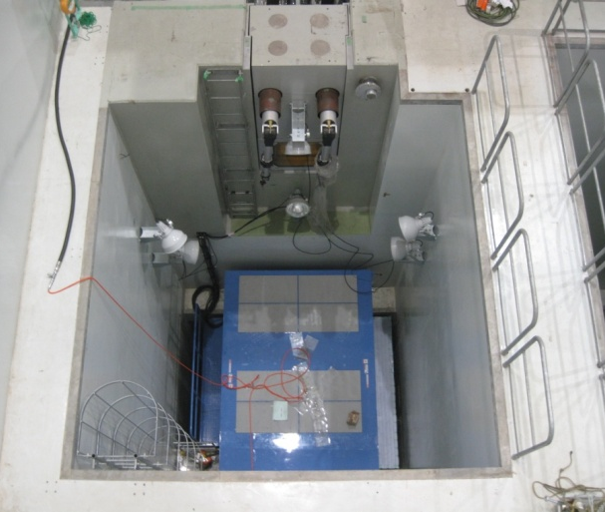
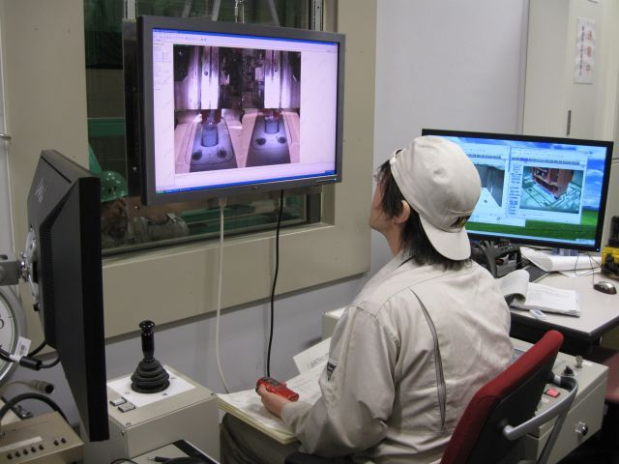
Replacement of horns (2013 shutdown)
Originally we scheduled to replace Horn-2/-3 in 2013 summer shutdown.
Hadron hall accident ⇒ we encountered unexpectedly long shutdown
Many reasons to replace all horns:
  Water leak somewhere of horns
  H₂ production from horn conductor-cooling water (limit beam up to 300kW)
  Stripline cooling capacity (up to 400kW )
We decided to replace all horns to improved spares for higher power operation
Maintenance area
Horn dock
Control room
Manipulator
Service pit
Beam
Lift table
Every process managed remotely at control room
Storage area
34m

Slide 20
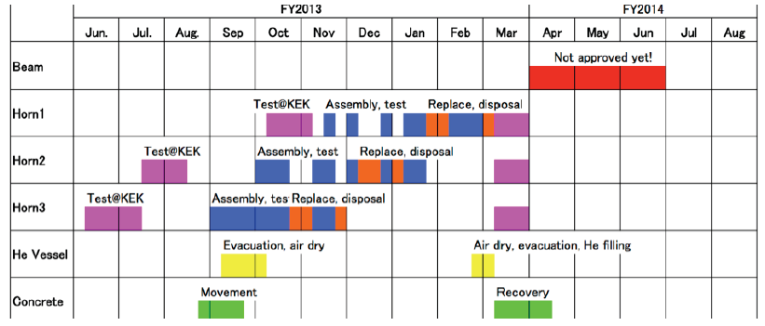
Replacement of Horns (cont.)
Tremendous amount of works started from Jun 2013:
  Test at KEK⇒transport to Tokai⇒assemble to support module⇒test
  He vessel evacuation/dry air flushing ⇒open vessel
  Cooling water dilution/drainage ⇒ disassemble pipes/bus-bars
  Remove old horn⇒ inetall new horn ⇒ dispose old horn
  Reassemble pipes/bus-bars⇒test⇒close vessel⇒evacuation/fill He
Very aggressive (crazy?) schedule as of October 2013

Slide 21

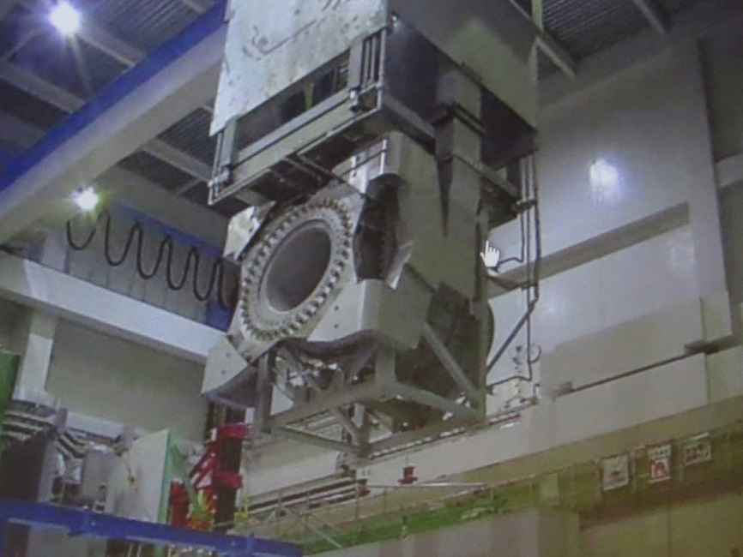

Remote maintenance
⇒
Insert new horn 2 (Feb.10)
Insert new horn 3 (Nov.29)
Take out old horn 3 (Nov.26)
Scheme worked in perfect manner
  It only took a few hours to take out each old horn to maintenance area
Started from Sep. ⇒completed on April
  Only one month of delay
Residual dose of Horn-1: ~150mSv/h
  6.7x10²⁰pot after 1year cooling
Radiation level at border of control area
  ~2.5μSv, (4μSv/h max) [ Horn-2 ]

Slide 22





Works at primary line
The bombarded final bend (FVD2) was rolled out from beamline [Oct. 2013] ⇒no damage was found.
For bends (PD1, PV2, FVD1, FVD2 ), stainless steel ducts were replaced with titanium alloy ones (Oct.~Nov. 2013)
4 ESMs downstream of the bends were rotated by 45 deg (Nov.~Dec. 2013)

Slide 23


T2K Run-5
Beam Tuning, 2014/05/18 B @ CCR
Beam commissioning started from May16,2014
Very careful beam studies
  Beam-based-alignment of secondary line w/ horn off (Beam scan)
  MUMON measurement guaranteed relative alignment of new set of horns wrt the baffle collimator is < 2mm
  ⇒T.Hiraki
Physics run with anti-neutrino mode operation was started on June 4, 2014
On June 8, 1st beam-induced candidate event was observed at Super-Kamiokande
0.51x10²⁰ of anti-ν mode operation by June 26

Slide 24


3. Physics reach of T2K/J-PARC to Hyper-Kamiokande
J-PARC PAC May.2014 (C.K.Jung)
Expected Δχ² for δ_{CP}=0 hypothesis as func. of POT
(90°,IH)
(-90°,NH)
100%nu
50%/50%
100% nu
50%/50%
⇒a paper for T2K(+NOvA) future sensitivity studies to be appeared on arXiv very soon

Slide 25


Sensitivities in combination with NOVA
Rejecting δ_{CP}=0
Rejecting incorrect MH
T2K 50%/50%
T2K 50%/50%
True NH
True IH
Based on NOVA’s TDR: 1.8×10²¹ POT for ν and 1.8×10²¹ POT for anti- ν modes.
Dashed (solid) curves: normalization systematics (not) considered

Slide 26

LBL experiment from J-PARC to Hyper-Kamiokande
Super-K 50(22.5fid)kt
1Mt(560kt)
750kW
～２MW

Slide 27


Hyper-Kamiokande Project
P58: A Long Baseline Neutrino Oscillation Experiment Using J-PARC Neutrino Beam and Hyper-Kamiokande was presented at 18th J-PARC PAC (May 2014) with many updates on sensitivities to δ_{CP} based on the recent progress
  With integrated beam power of 7.5MW×10⁷s (1.56x10²² POT), CP violation will be established (>3σ) for 76% of δ_{CP} space.
  ⇒LoI can be found at J-PARC PAC page.
You can find further information on 5th Hyper-Kamiokande Open Meeting at Vancouver (July 2014)
  ⇒http://indico.ipmu.jp/indico/conferenceDisplay.py?confId=34
HKOM5＠UBC/TRIUMF
~100 participants
WG: 12 countries, 67 institutes, 240 peoples

Slide 28
4. Summary
Operational status of the neutrino experimental facility:
  ~230kW continuous operation for the T2K experiment has been realized since Oct. 2012 to May 2013 (Run-4)
  With this much of beam power, we encountered many serious troubles:
    Vacuum leak at primary beam-line due to accidental beam hit
    Horn water leak
    Hydrogen production in horn cover gas ………
  Thanks to the struggles we observed ν_{e} appearance with7.3σ significance.
    We highly appreciate strong supports from NBI community !
  Many works during shutdown 2013 ~ 2014
    Replacing all horns / improve MPS / replace beam ducts…
  Anti-neutrino mode running was started from Run-5 (end of May~June 2014).
    Accumulated pot : 7.39x10²⁰, with 0.51x10²⁰ of anti-ν
We are expecting much more outputs
  T2K+NOVA has good opportunity to observe CPV / MH with 2~3σ significance
  For the next period Oct. 2014 – Jun. 2015 (Run 6),T2K requests 4.4 x 10²⁰ POT [4.0 x 10²⁰ anti nu-mode]
  Hyper-K project requests 7.5MW×10⁷s for the neutrino facility to establish CPV

