Slide 1
The CERN Neutrinos to Pyhäsalmi – CN2PY LBNO Beam
I. Efthymiopoulos, F. Sanchez-Galan – CERN
September 23, 2014

Slide 2
Many thanks to all colleagues who participated in the study
A.Alekou, Y.Papaphilippou, J.Alabau-Gonsalvo, R.Steerenber, A.Lachaize, R.Garodby, E.Shaposhnikova, I.Efthymiopoulos, F.Sanchez-Galan, F.Antoniou, M.Calviani, P.Velten, V.Venturini, H.Vincke, C.Strabel, B.Ferral, D.Smargianaki, N.Charitonidis, B.Biskup, C.Lazaridis, B.Goddrad, W.Bartmann, A.Parfenova, D.Berthoux, S.Gilardoni, P.Vojtyla, J.Osborne, M.Manfredi, L.Faisandel, F.Gerigk, J.M.Cravero, F.Velotti, A. Huschauer, D.Missiaen, M.Jones - CERN
E.Noah, A.Curioni, Y.Karadzhov, T. Stainer, A.Blondel – Univ. of Geneva
C. Densham, M. Fitton - RAL - Oxford, UK

Slide 3
Outline
The LAGUNA-LBNO Design Study
CERN v to Pyhäsalmi (Finland)
Beam design
Underground structures
Target cavern handling
Decay pipe
Hadron stop

Slide 4
The LAGUNA-LBNO Design Study
EU/FP7 funded design study [Sep’14 – Aug’14]
Scientific goals:
Extends previous LAGUNA site investigation study for deep underground Science Facilities for ν-physics, proton decay
Technical feasibility of a next generation ν-observatory with large-volume detectors
Prospects for next generation LBL flavour oscillations with ν-beams from accelerators
Cost optimization
Risks identification and mitigation
Gathering of EU ν-community interested on such projects

Slide 5
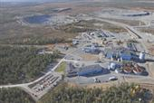
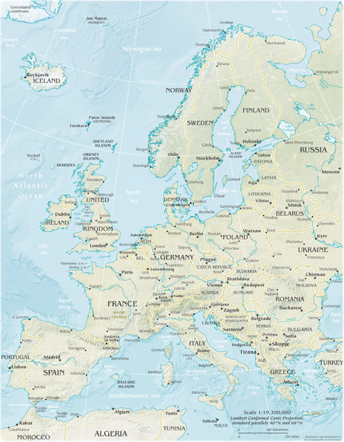
The LBNO Study - CN2PY LBL ν-beam
CERN Neutrinos 2 PYhäsalmi beam
Phase 1 : proton beam extracted beam from SPS
400 GeV, max 7.0 10¹³ protons every 6 sec, ~750 kW nominal beam power, 10 μs pulse
Phase 2 : use the proton beam from a new HP-PS
50(30,70) GeV, 1.33 Hz, 1.9 10¹⁴ ppp, 2 MW nominal beam power, 4 μs pulse
alternative option: upgradedSPS
CN2PY baseline also compatible with a NF option
Pyhäsalmi
2300 km
Starting beam parameters
400 GeV protons from SPS (initial)
Survey info:
CERN (TCC2 target station -NA) 46°15'26.27"N, 6° 3'8.19"E
Inmet Mine (Finland): 63°39'30.92"N, 26° 2'47.65"E
distance: 2296 km
dip angle : 10.4 deg, 181 mrad
Neutrino beam at Pyhäsalmi (θmax ≈ 30 MeV/Eν) : 14÷34 Km for E_{ν} 2÷5 GeV
CERN

Slide 6
The Pyhäsalmi detectors

Slide 7
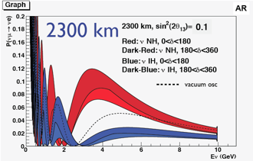
CERN ν-beam to Pyhäsalmi - CN2PY
Requirements - design challenges for the beam
Primary beam
match of the beam parameters to the target for both beams (400 & 50 GeV)
Secondary beam elements [400 ⬌ 50 GeV beam]
focusing system design for both 1st and 2nd maximum [~4, 1.5 GeV Eν]
sufficient shielding to contain the produced radiation
including muons, water and soil activation (H3 and NA22 production)
beam elements : target and horn(s)
similar size to fit in the same infrastructure
same relative positions? or allow variations already from the design phase
remote handling possibilities ⬌ flexibility in the design
Decay volume, dump, muon monitoring and near detector
same length or intermediate dump?
dump length vs muon monitoring and near detector location
Determine CP-violation and mass degeneracy by spectrum measurement and resolve degeneracies and so called “π-transit” effect
arXiv:0908.3741.v1 for “Magic distance”
arXiv:1312.6520 on LBNO physics reach in CP-violation and MH determination
A. Rubbia, LAGUNA
LBNO/CN2PY Talks @ NBI2014:
ν-beam design highlights (this talk)
RP & Environmental Aspects (H. Vincke)
ν-beam Engineering Aspects (F. Sanchez-Galan)
Target Considerations 50 GeV beam (C. Densham)

Slide 8
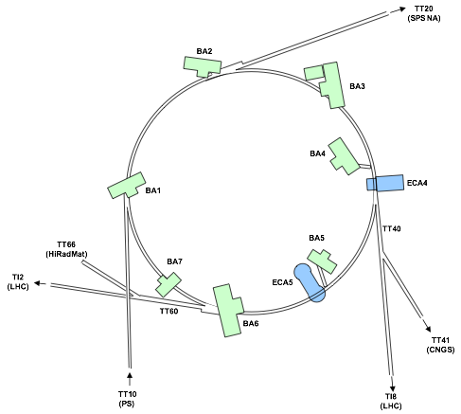
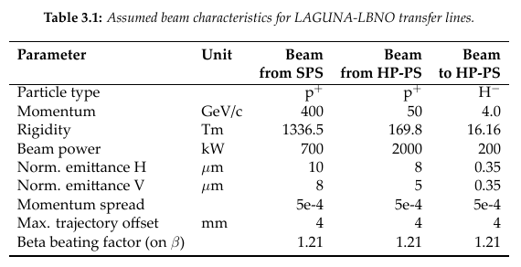
CN2PY Beam Transfer Options
Option B: use LLS2/TT20
Constraints:
Use same target area for the two phases : 400 & 50 GeV
Target and near detector cavern in CERN-land
Beam from SPS
Option A: extraction from LSS6
similar as for CNGS in LSS4
Option B: extraction from LSS2
non-local extraction concept developed and tested with real beams!
Use of superconducting magnets for the transfer lines
Beam from HP-PS
Use the LP-SPL as injector
H- injection : multi-turn, charge exchange with foil or laser stripping
Option A: use LSS6/TI2
CNGS

Slide 9
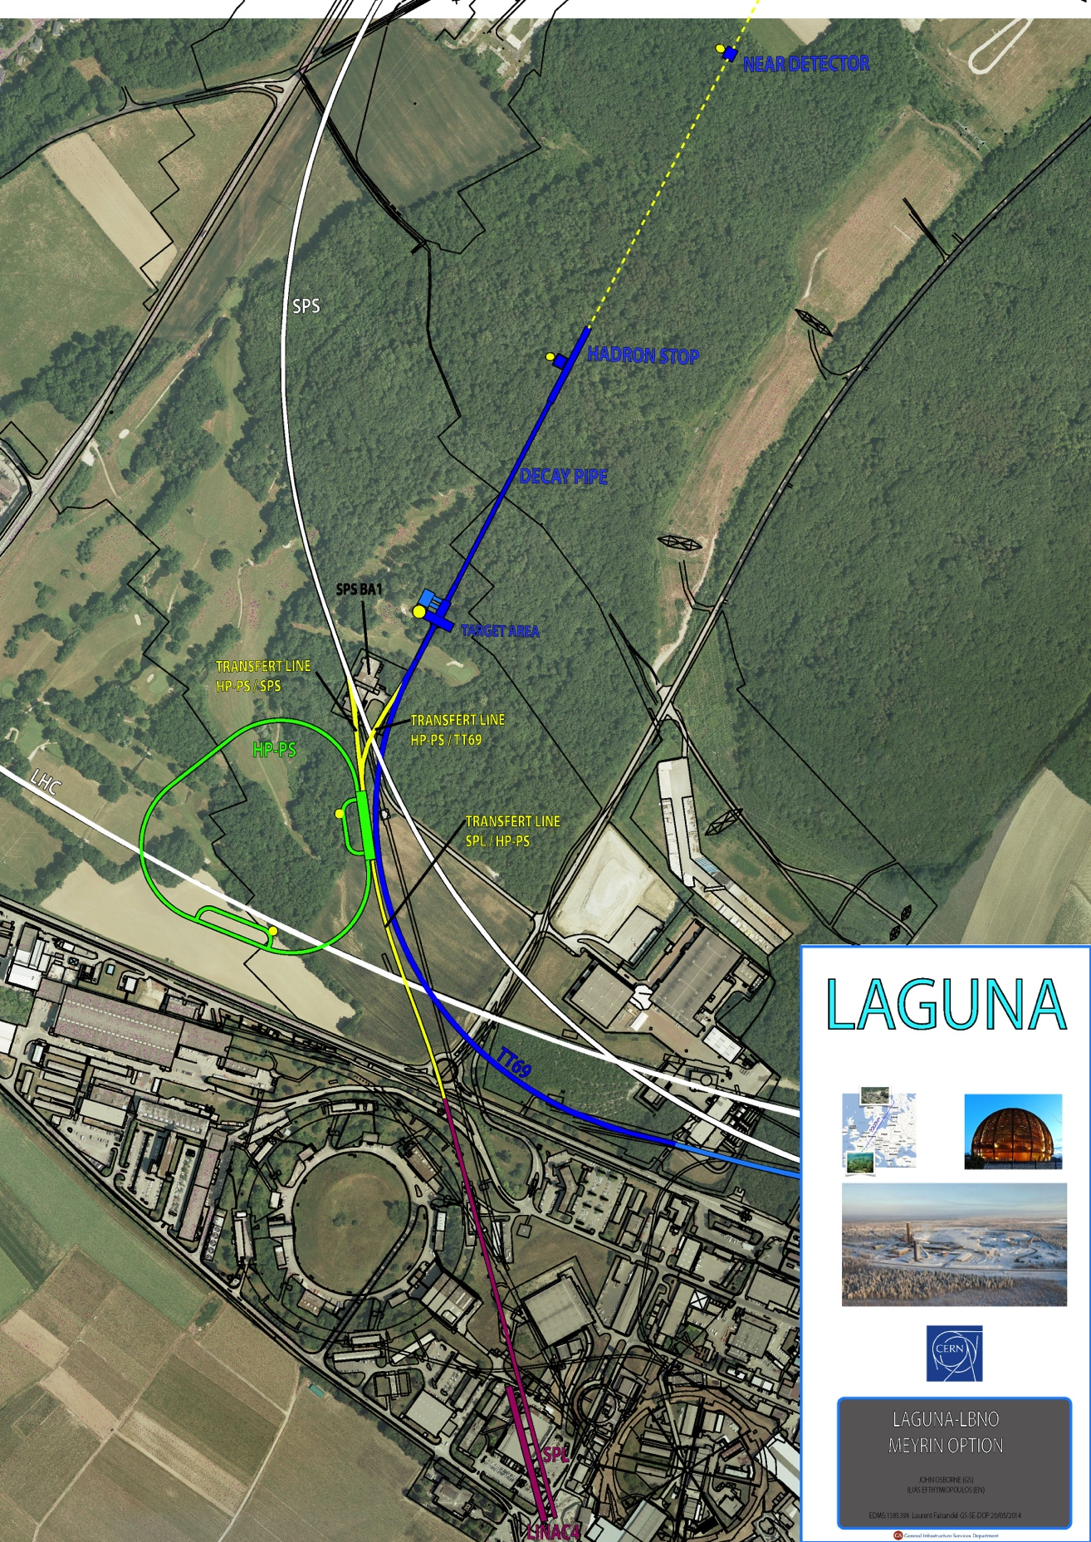
CN2PY Option A - LSS6 Extraction
New TT69 beam line
continued from existing TT66 beamline (HiRadMat)
will eventually require a switch between TT66 and TT69, with a lateral displacement of TT66 for HiRadMat
FODO arc with 35 m half-cell length, 6 dipoles per half-cell
Superconducting dipoles assumed for the TT69 arc
4.0 m long magnetic
could probably be increased (but sagitta increases with L2)
4.6 T field
13.85 mrad bend angle per dipole
6.9 mm sagitta
H/V aperture of ~40 mm (good field region)
Field quality requirement ΔB/B0 ~ 2e-4
Similar beam transport lines exists elsewhere; developing a know-how at CERN with superconducting (or super-ferric) magnets may be interesting beyond LBNO
HP-PS
SPL

Slide 10
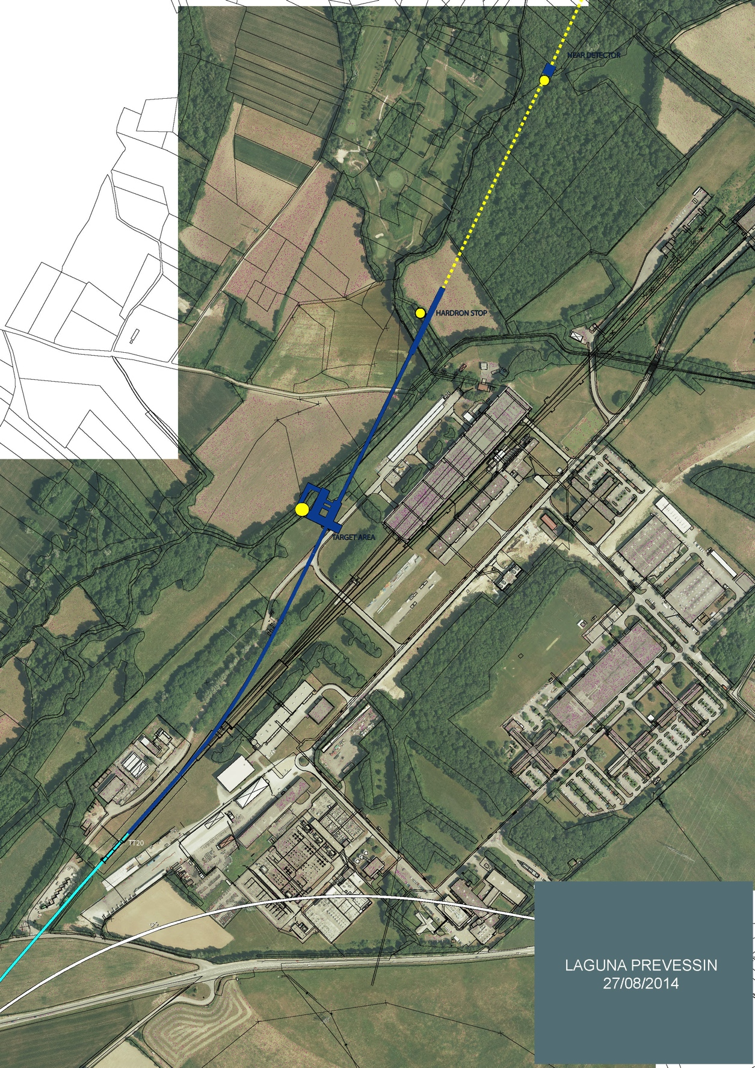
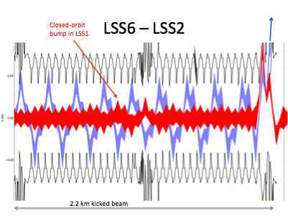
CN2PY Option B – LSS2 Extraction
Neutrino beam line out of TT20 beam to North Area FT targets
Use kickers in LLS6 & LSS2 to extract the beam (non-local extraction)
Synergy with other projects - CENF

Slide 11
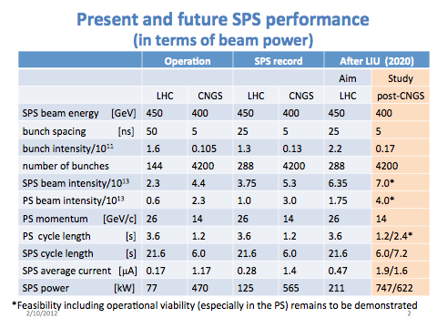
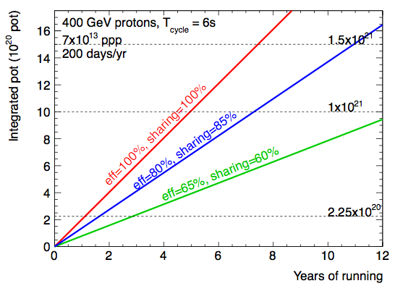
CN2PY – HI Beams in SPS
R. Garoby, S. Gilardoni, E. Shaposhnikova,- LiU-LLBNO/CERN

Slide 12
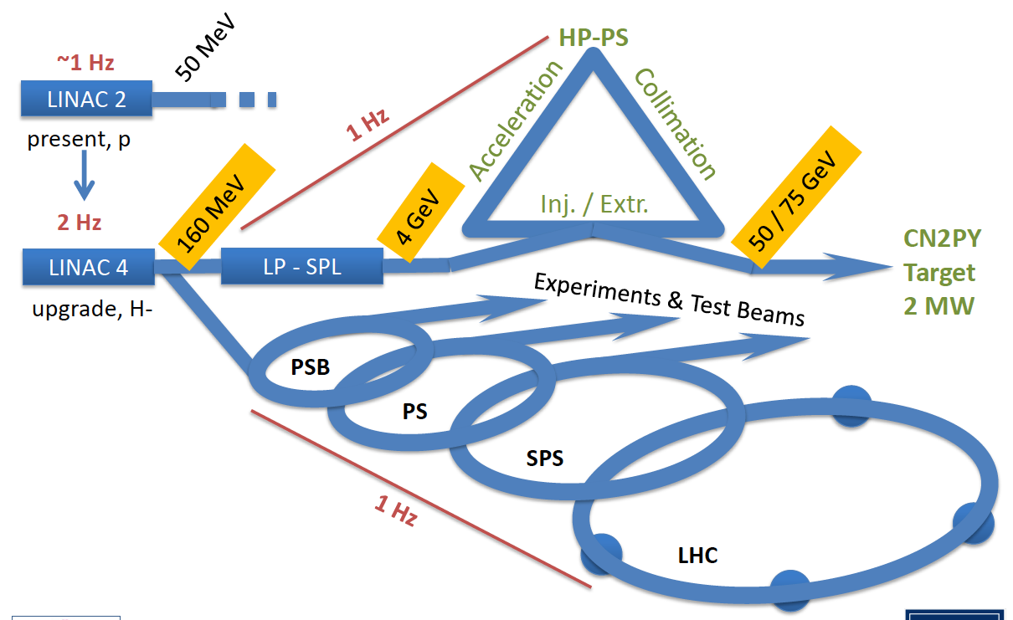
CN2PY Phase 2: HP-PS Design
Possible CERN accelerator landscape including the new HP-PS

Slide 13
HP-PS Parameters
Two options for consideration
LP-SPL Parameter | Values | Units
Kinetic Energy | 4 | [GeV]
Beam power | 0.144 | [MW]
Repetition rate | 2 | [Hz]
Beam pulse length | 0.9 | [ms]
Average pulse current | 20 | [mA]
Peak pulse current | 32 | [mA]
Protons per pulse | 1.13 E14
Peak power per cavity | 0.5 | [MW]
HP-PS Parameter | 50 GeV | 75 GeV | Units
Inj. / Extr. Kinetic Energy | 4 / 50 | 4 / 75 | [GeV]
Beam power | 2 |  | [MW]
Repetition rate | 1 |  | [Hz]
f_{rev} / f_{RF} @ inj. | 0.234 / 39.31 |  | [MHz]
RF harmonic | 168 |  | -
f_{rev} / f_{RF} @ extr. | 0.238 / 40.08 | 0.238 / 40.08 | [MHz]
Bunch spacing @ extr. | 25 |  | [ns]
Total beam intensity | 2.5 E14 | 1.7 E14 | -
Number of bunches | 157 |  | -
Intensity per bunch | 1.6 E12 | 1.1 E12 | -
Main dipole field inj. / extr. | 0.19 / 2.1 | 0.19 / 3.13 | [T]
Ramp time | 500 | 500 | [ms]
Dipole field rate dB/dt (acc. ramp) | 3.5 | 5.5 | [T/s]
(*) For the 2.5E14 ppp required for HP-PS, a possible solution is to increase the pulse length
HP-PS: Options
50 GeV : more convenient HW parameters but more demanding beam dynamics
dipole magnets ~available (FCM R&D)
75 GeV : more demanding magnet parameters but reduced beam intensity

Slide 14
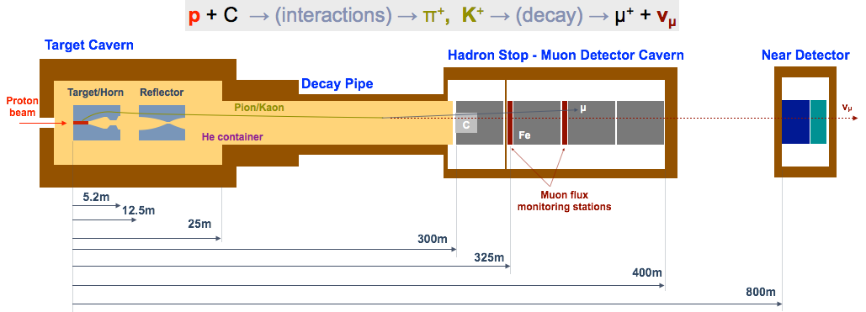
CN2PY v-beam design
Conventional neutrino beam ( 50% of a Super-Beam !)
Constraints/challenges:
have the same layout for 400 & 50 GeV beams
control or radiation environment (2 MW beam power !)
ν-flux optimisation for both oscillation prob. maxima
steep slope of 18%
Additional considerations
The length of the hadron stop and near detector location determined by the μ flux limit requirement for the 400 GeV case (< 9 μ/m²/spill)
Additional μ flux monitoring stations must be foreseen for the 50 GeV operation
CN2PY ND Concept
Courtesy : E. Noah

Slide 15
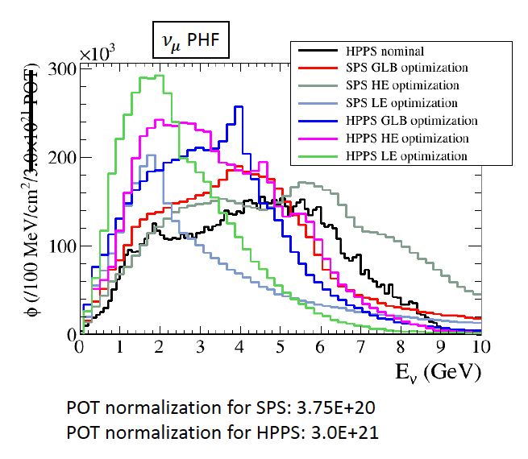
CN2PY ν-beam optimisation
Beam target and focusing system optimization using Genetic Algorithm
Multi-variable analysis of horn/reflector parameters
Optimization:
use GLOBES to maximize the δ_{CP} sensitivity at the FD
HE-optimization: maximum yield of ν-s in the rane [1-10]GeV
LE-optimization: maximum yield of ν-s in the range [1-2] GeV
New optimization for CDR, using additional engineering constraints:
R_{min} horn ~27mm
Same relative position horn/reflector for 400/50 GeV beams
Target length <1.3 m

Slide 16
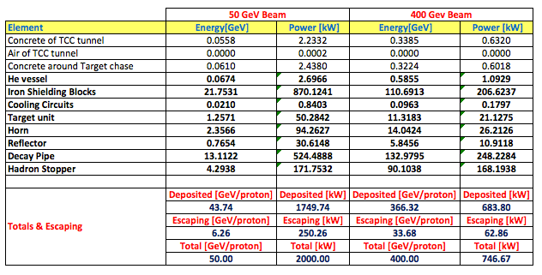
CN2PY ν-beam layout
Key challenges: 18% slope & high-radiation due to the 2 MW beam
Follow similar solutions as for CNGS + gained experience
Optimize underground structures to limit cost – large depth
FLUKA study

Slide 17
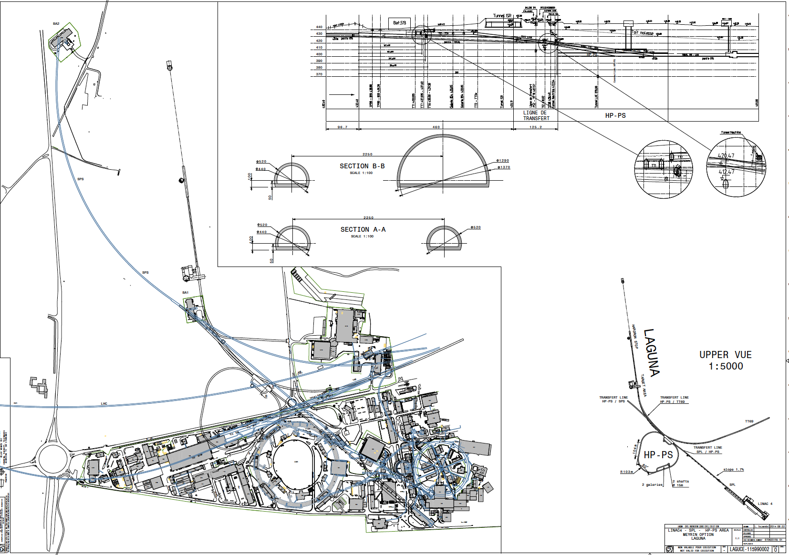
CN2PY – Option A layout

Slide 18
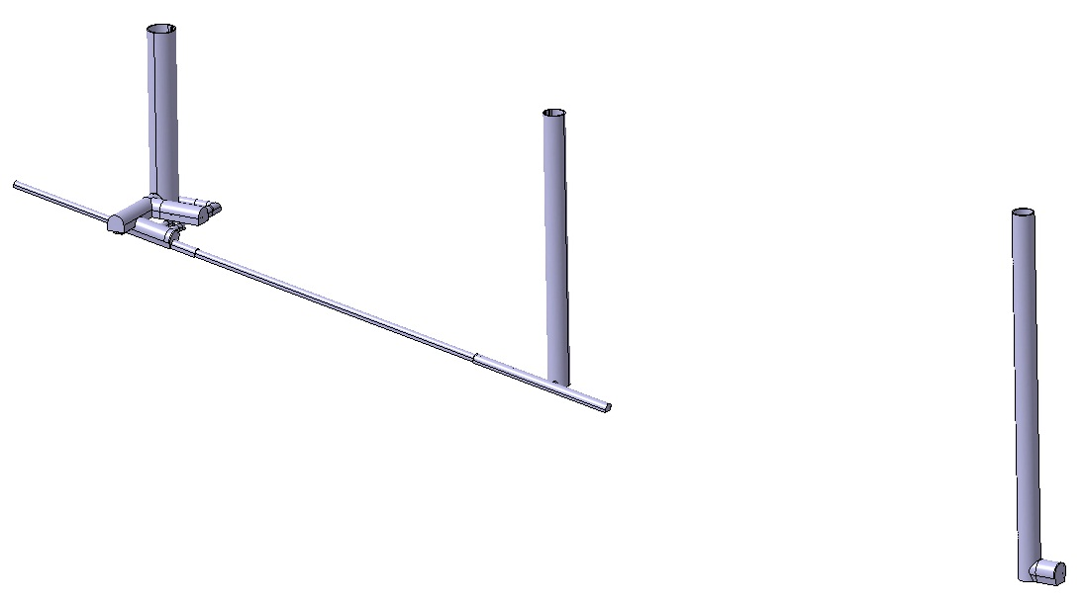
CN2PY – ν-beam underground structures
Main access shaft
Hadron stop
Access shaft
Proton
beam tunnel
140 m
ND access shaft
216 m
Target Cavern &
Service areas
292 m
Decay pipe
Hadron stop
18%
Near detector cavern

Slide 19
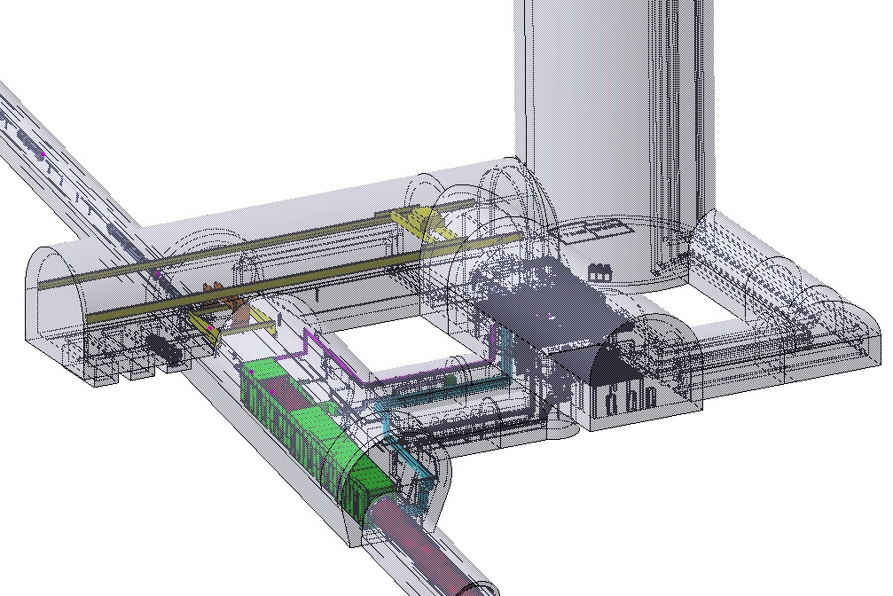
CN2PY – ν-beam underground structures
Access shaft
Morgue
Service cavern
Target Cavern

Slide 20
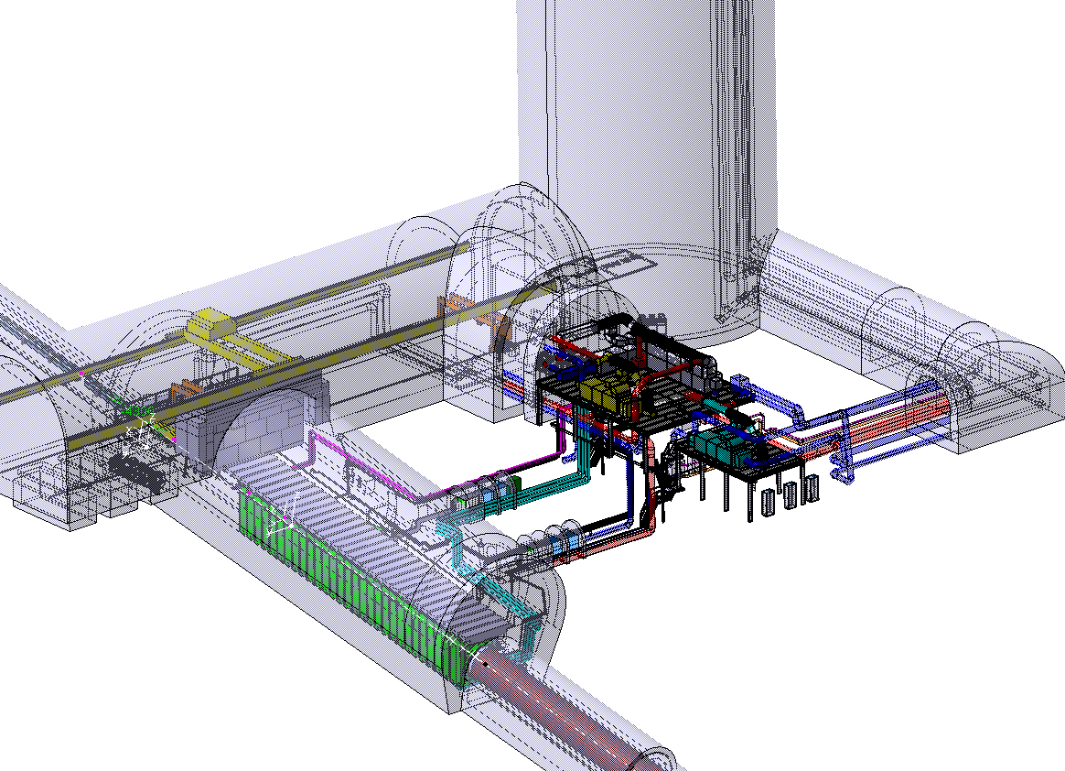
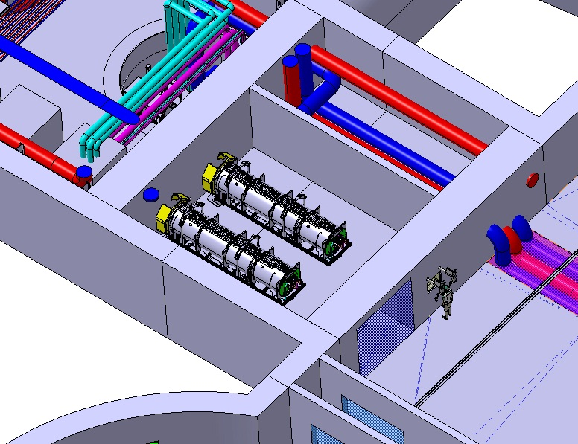
CN2PY – Design Overview
He container to optimize for the radiation environment
Includes the decay pipe (3m diam, 275m long)
water cooled side shielding
Fe blocks + Al cooling modules
fixed installation, no movements, inside He vessel
forced He cooling for beam elements
Target, horn striplines
remote handling for installation/exchange operations
use plug-in systems for components
service module that can be exchanged
Hot cell for target/horn exchange

Slide 21
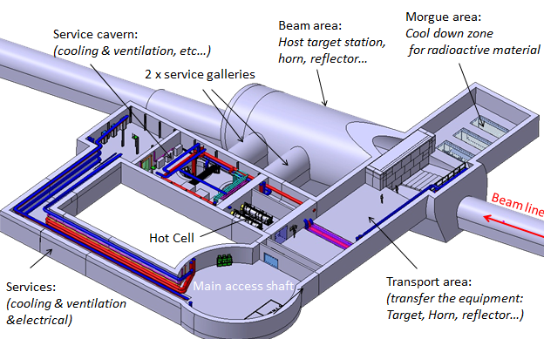
CN2PY- Experimental area

Slide 22
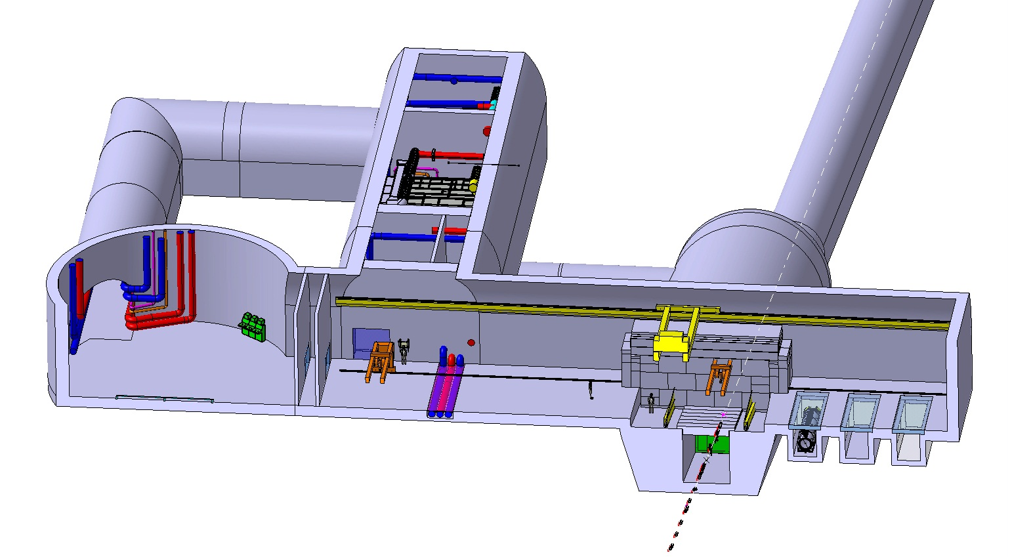
CN2PY – Handling at target and experimental areas
Control room for the cranes
& transport vehicle
Morgues

Slide 23
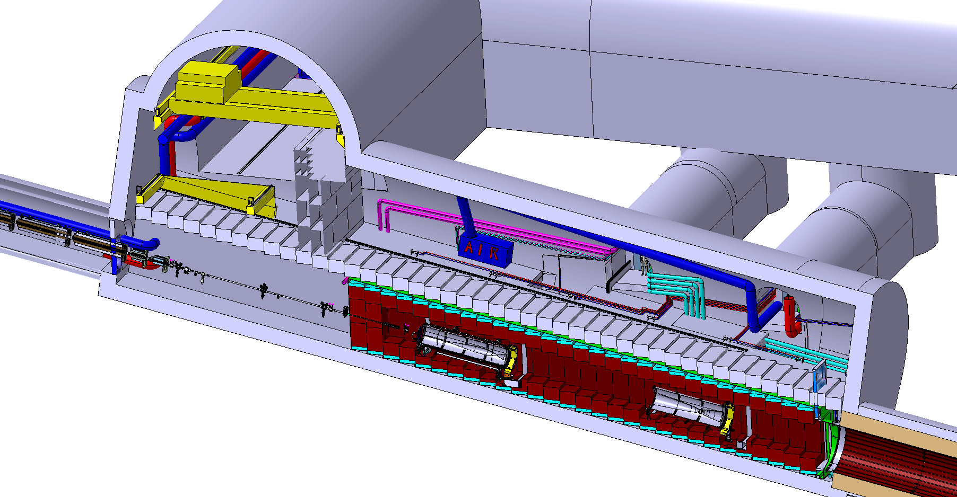
CN2PY – Target Cavern
Beam line
target station & horn assembly
reflector
Decay pipe
23

Slide 24
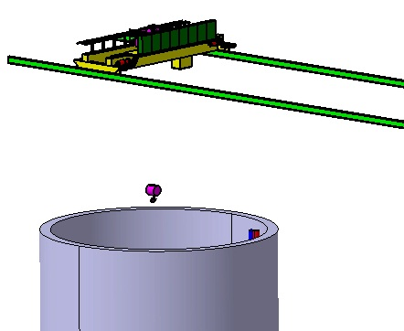
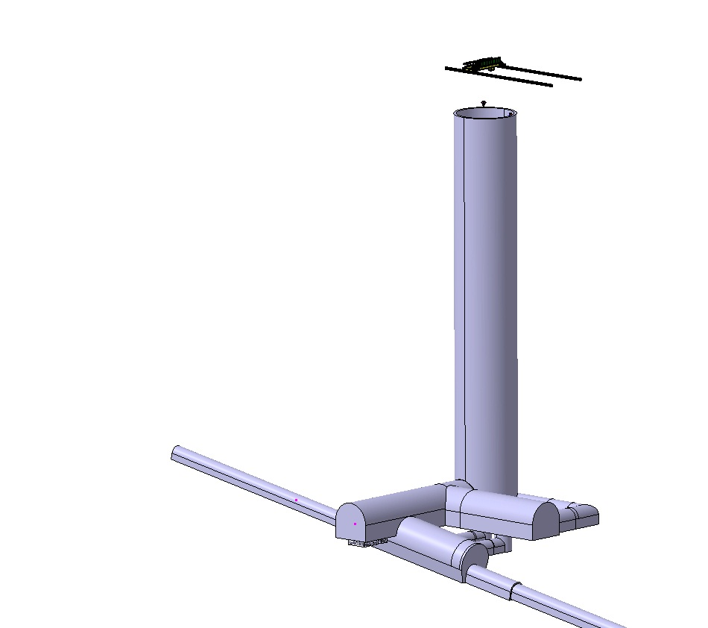
CN2PY – Target Cavern Handling
Access shaftt overhead crane
Characteristics
Height: 140m
Lifting capacity: 40T

Slide 25
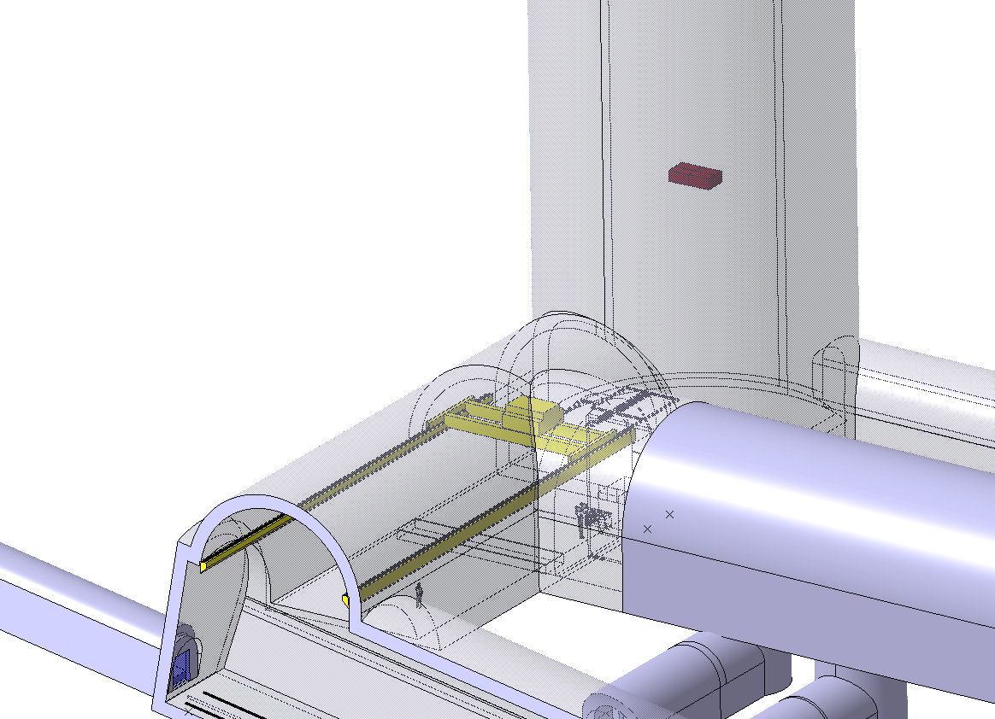
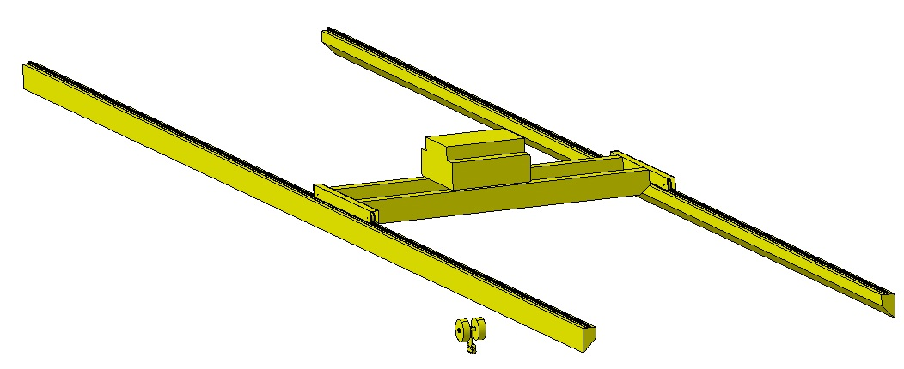
CN2PY – Target Cavern Handling
Overhead crane for transport tunnel
Remotely operated with cameras electrically operated hook
Lifting capacity ; 40 T

Slide 26
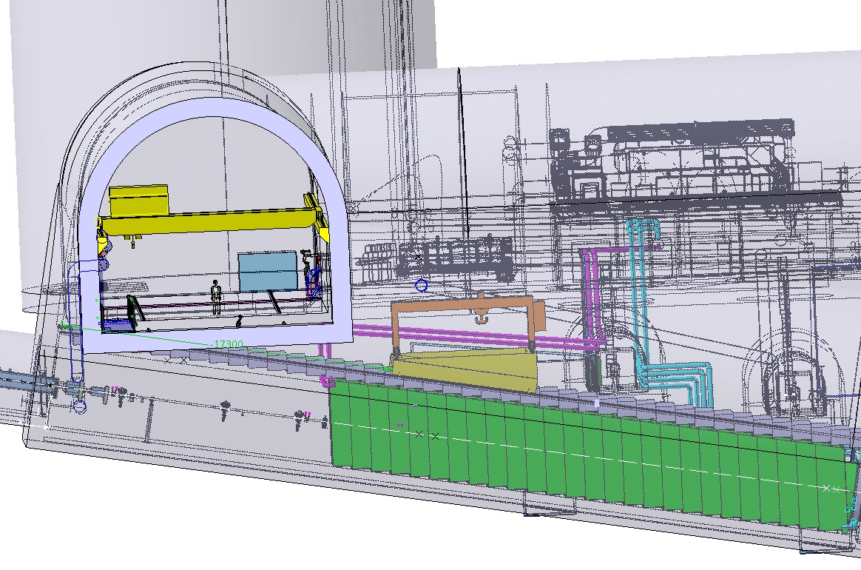
CN2PY-Target cavern handling
40 ton Remotely operated gantry crane
cameras
electrically operated hook
cable driven trolley.
NBI 2014- Fermilab, 23-Sep-2014

Slide 27
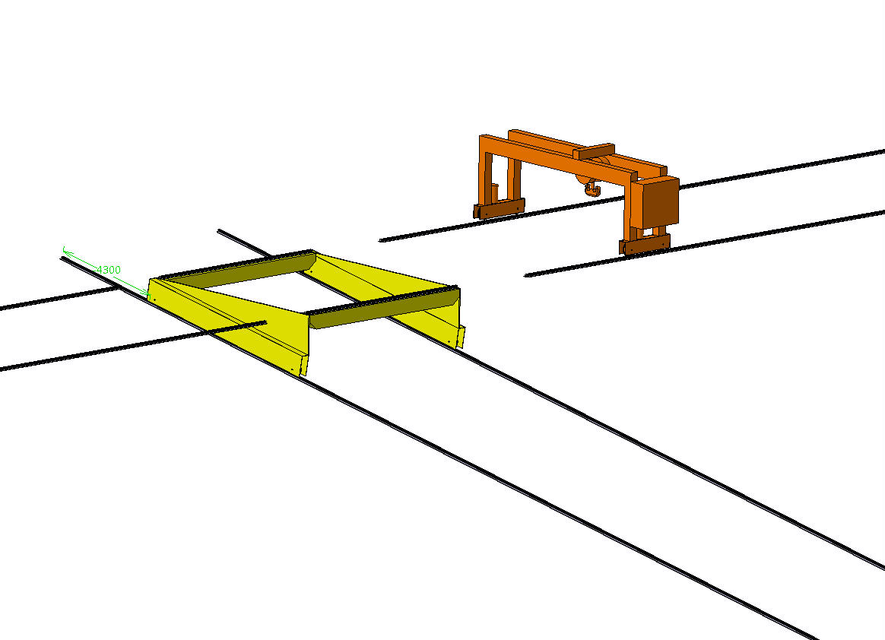
CN2PY – Target Cavern Handling
Gantry crane
Pulling cables
To main access shaft
Dual motors
To Morgue
rails
Trolling
Trolley
I. Efthymiopoulos, F.Sanchez Galan - CERN
NBI 2014- Fermilab, 23-Sep-2014

Slide 28
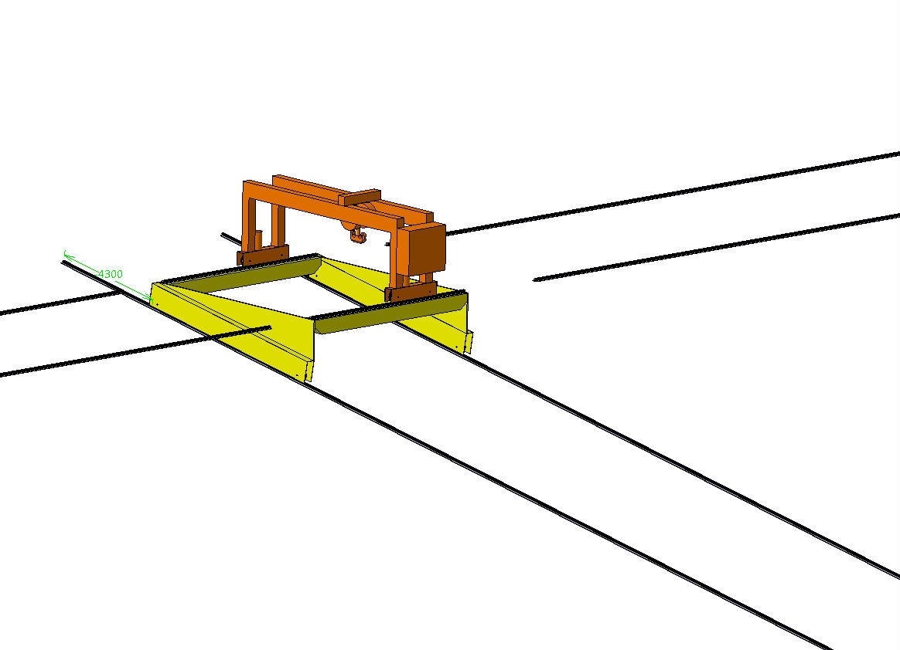
CN2PY – Target Cavern Handling
To main access shaft
To Morgue
NBI 2014- Fermilab, 23-Sep-2014

Slide 29
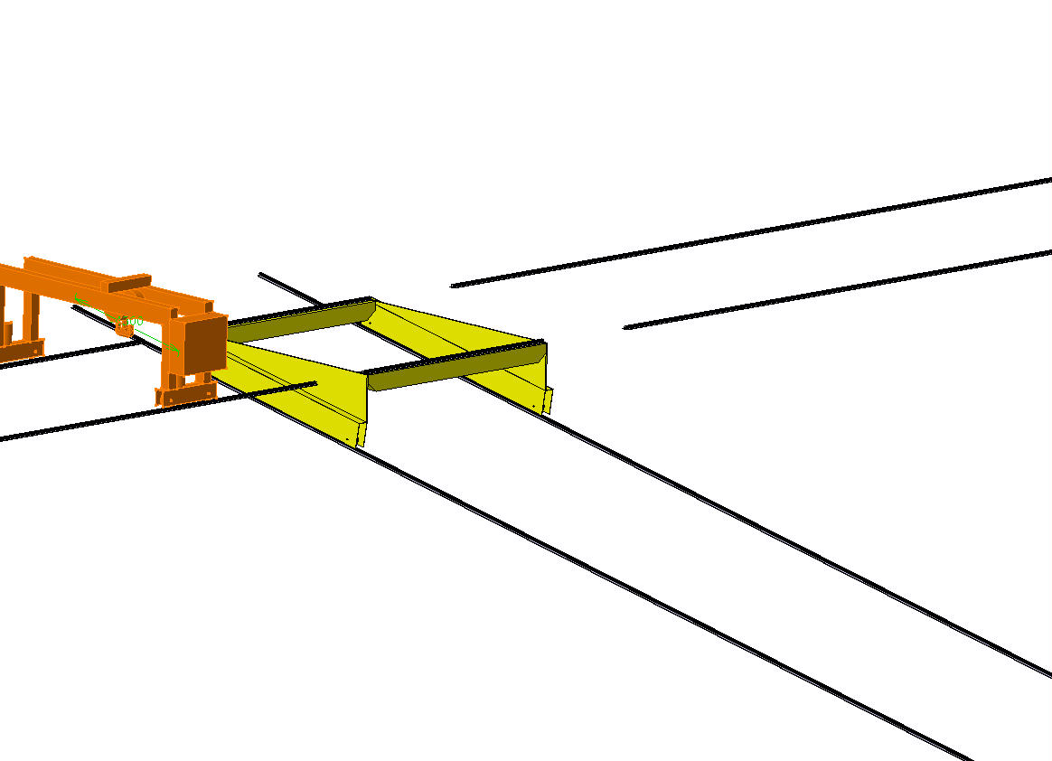
CN2PY – Target Cavern Handling
To main shaft
To Morgue
NBI 2014- Fermilab, 23-Sep-2014

Slide 30
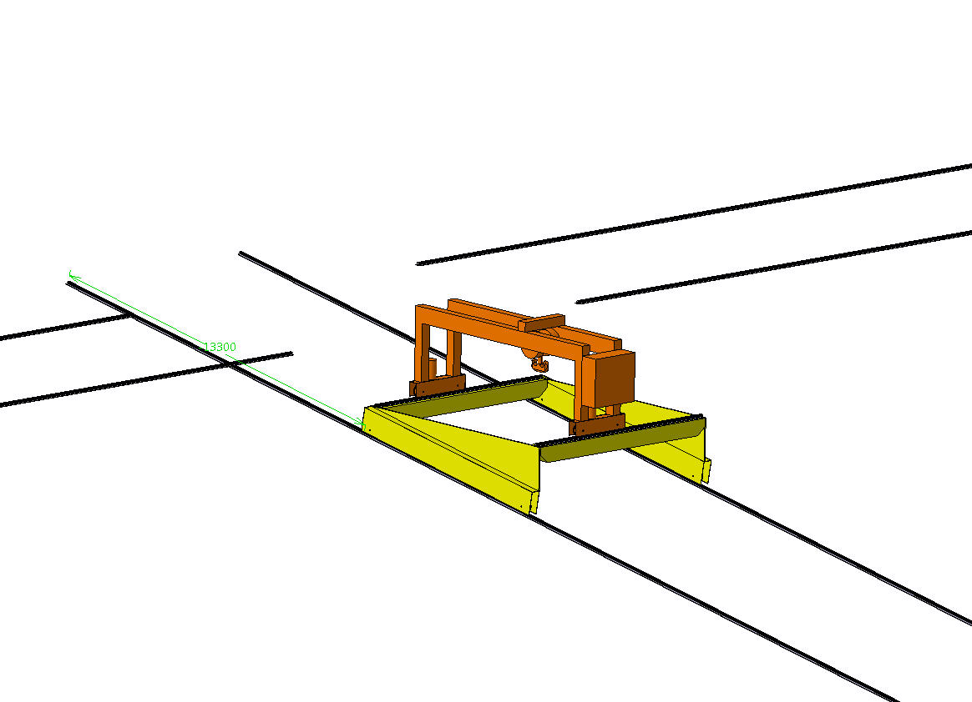
CN2PY – Target Cavern Handling
To main shaft
To Morgue
NBI 2014- Fermilab, 23-Sep-2014

Slide 31
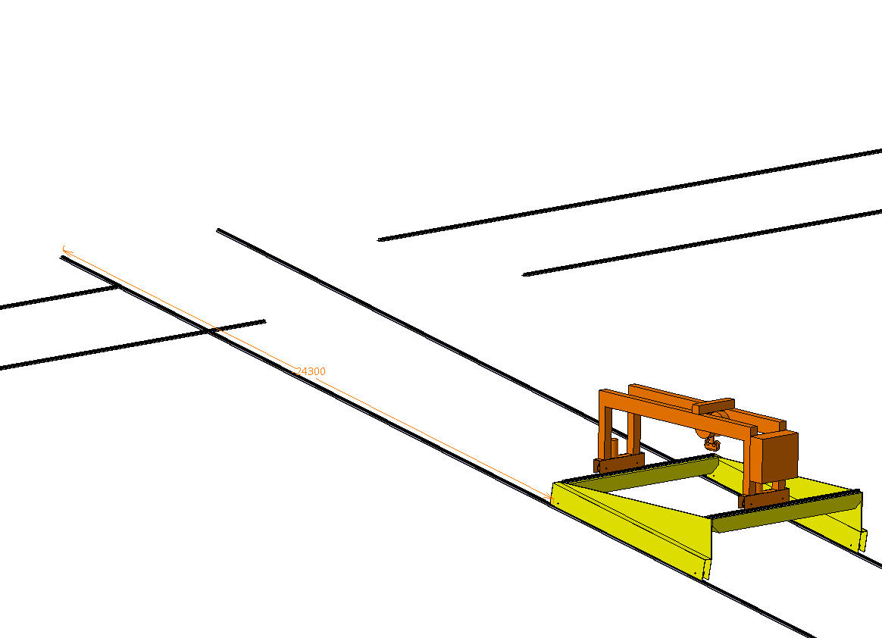
CN2PY – Target Cavern Handling
To main shaft
To Morgue
NBI 2014- Fermilab, 23-Sep-2014

Slide 32
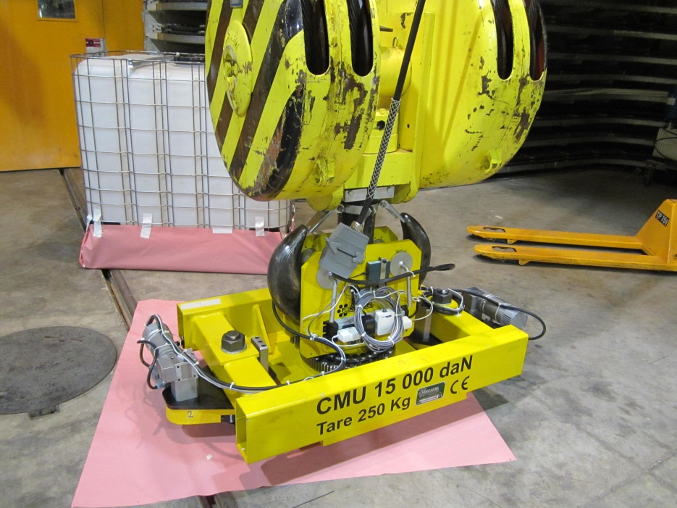
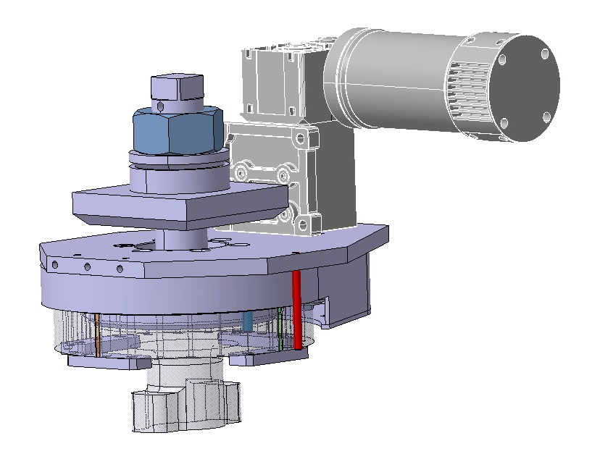
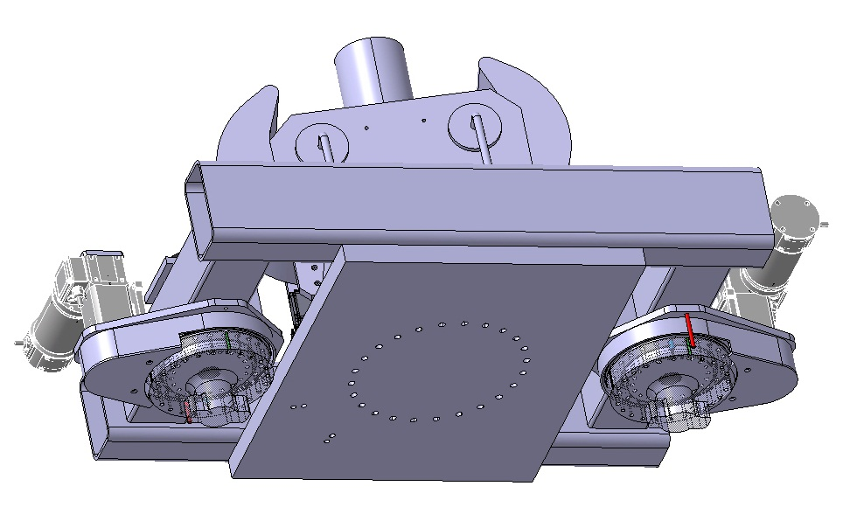
CN2PY – Target Cavern Handling
Remotely operated electrical hook
Developed for the HiRadMat Project by Jean-Louis Grenard EN/HE

Slide 33
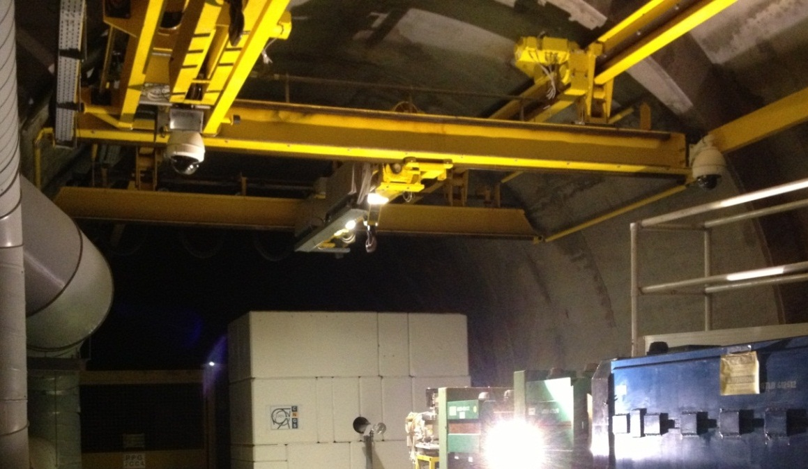
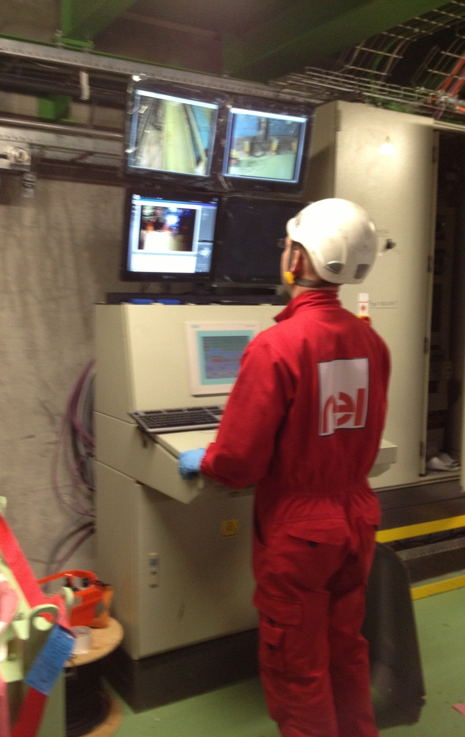
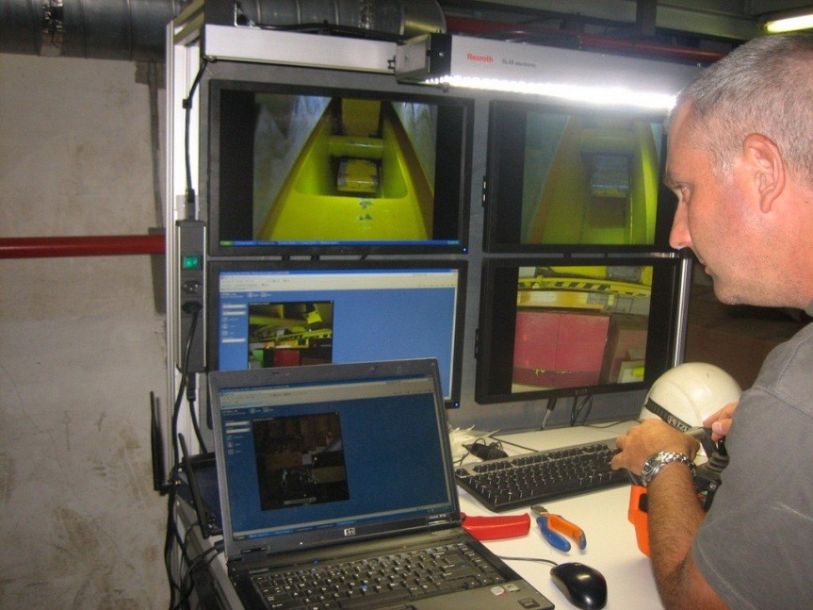
CN2PY – Target Cavern Handling
HiRadMat crane
CNGS crane

Slide 34
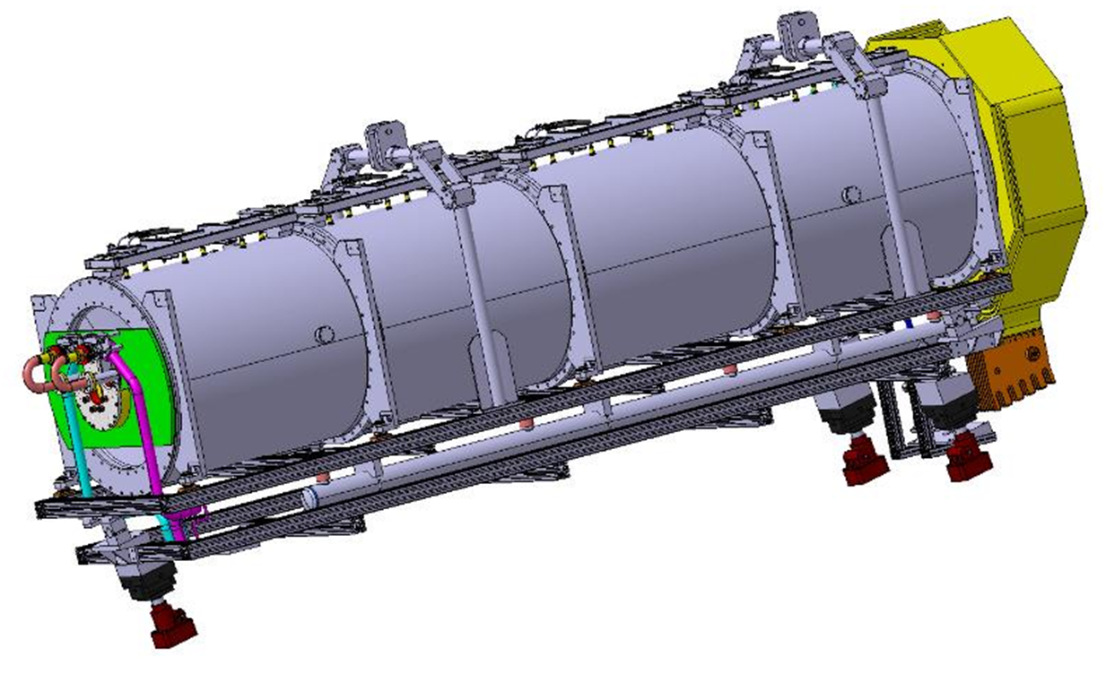
CN2PY- Horn & Reflector
Phase 1 : Beam from SPS @ 400 GeV
6 s cycle
two extractions/cycle separately by 50 ms
beam pulse during 10 us in each extraction
3.5 10¹³ protons/extraction (7.0 10¹³ protons/cycle)
average beam power 750 kW
Phase 2 : Beam from HP-PS @ 50 GeV
- 1 s cycle
- single extraction per cycle
- beam pulse during 4 us
- 2.5 10¹⁴ protons/cycle
- average beam power 2.0 MW
Integrated target
Remote installation with quick supply feeds

Slide 35
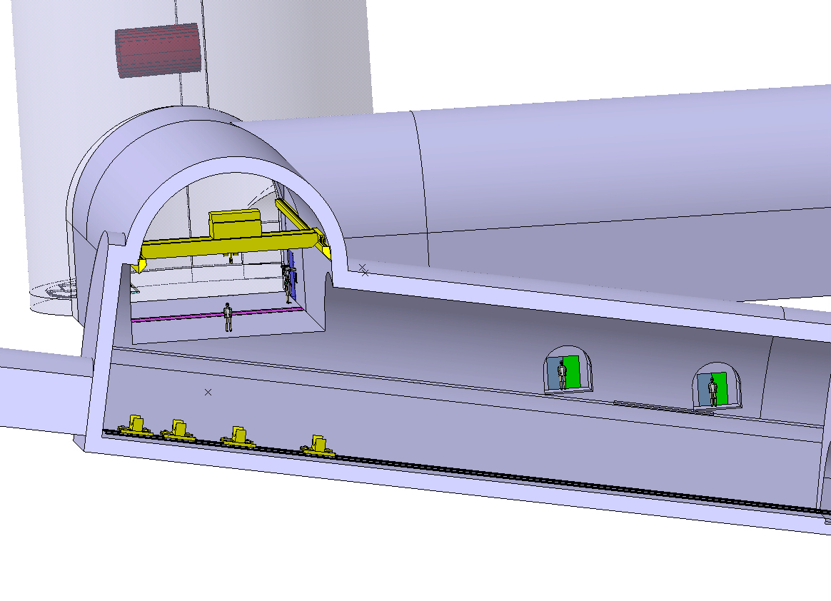
CN2PY – Decay pipe installation
Decay pipe lowered from the surface
Photo shows CNGS decay pipe

Slide 36
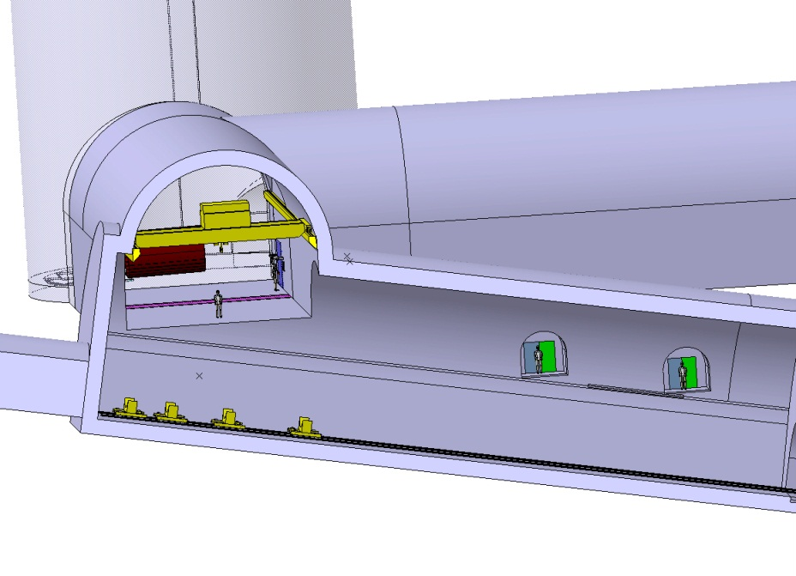
CN2PY – Decay pipe installation
Pipe are lifted individually with the cavern crane
Rails (only during installation)
Wagons
(cable drum powered)

Slide 37
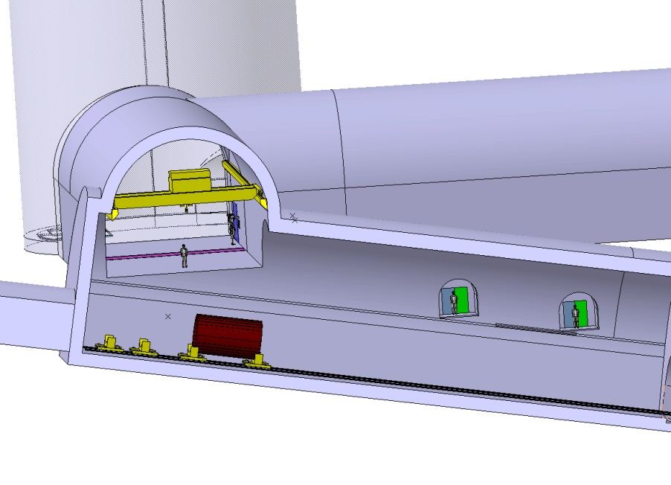
CN2PY – Decay pipe installation
Welding of 3 decay pipe parts is conducted underground before transportation
First pipe is placed on convoy with the cavern crane

Slide 38
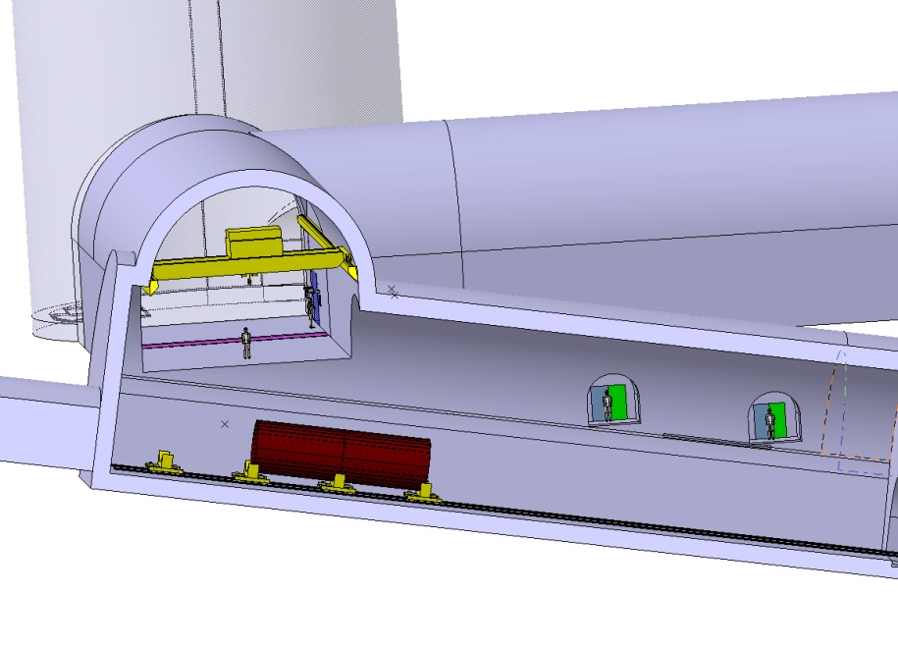
CN2PY – Decay pipe installation
Second pipe is placed on convoy with the cavern crane and welded to previous on

Slide 39
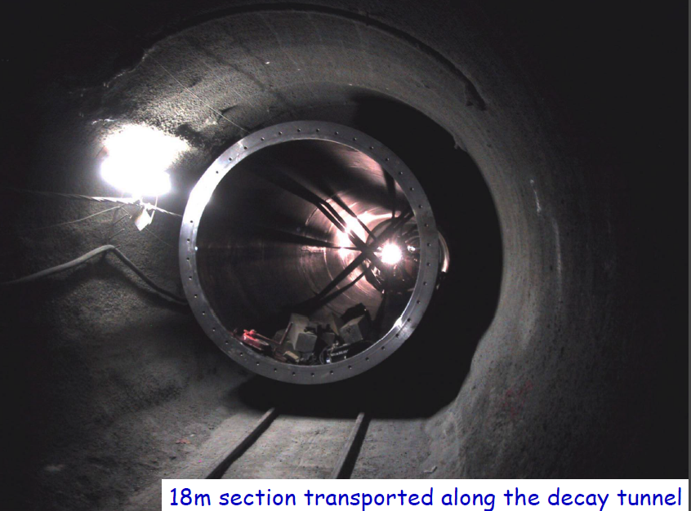
CN2PY – Decay pipe installation
CNGS
New for CN2PY:
Welding of cooling pipes (from inside)
Install the He service lines
Outside before the decay pipe

Slide 40
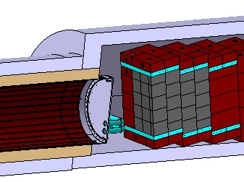
CN2PY – Hadron stop & Near Detector
Position determined by the 400 GeV operation
For a passive solution ~100 m of Fe shield required
Could be build with the same technology as for CNGS
Graphite core, embedded in cooling modules

Slide 41
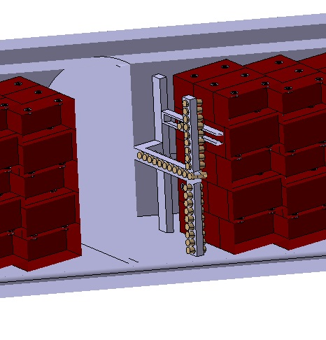
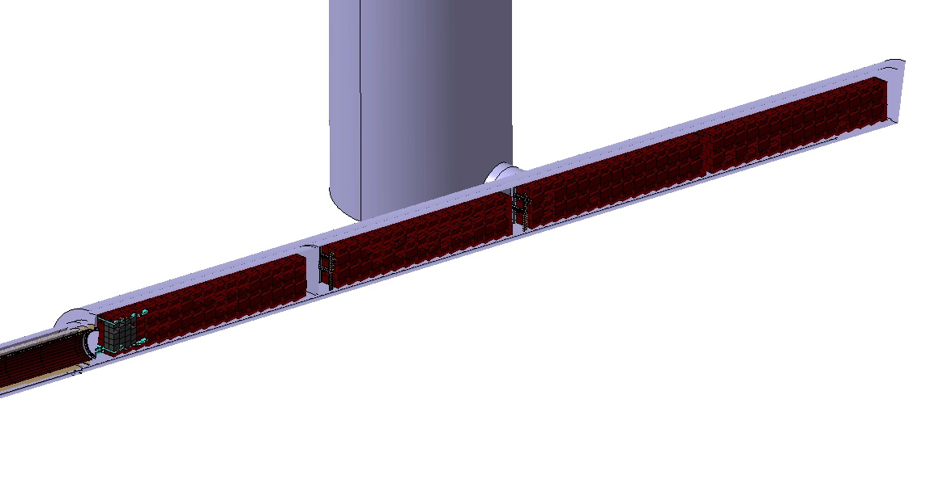
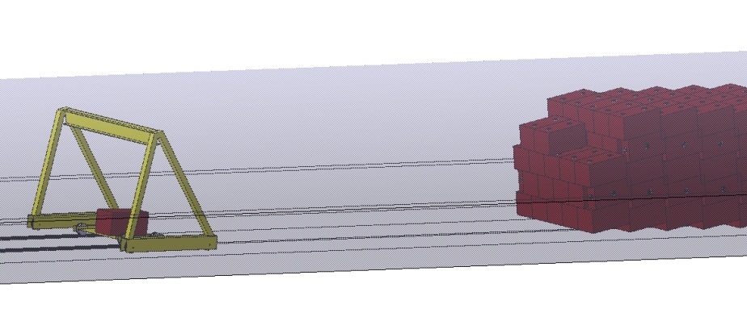
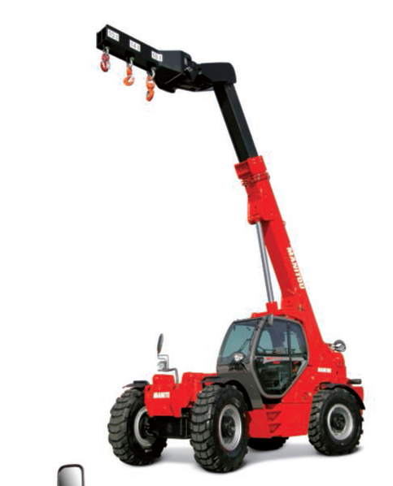
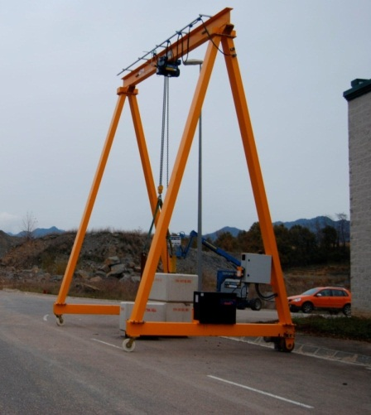
CN2PY – Hadron Stop
Installation of 100 m long dump!
Blocks are installed using a “portable” gantry crane (to be dismantled after installation)
Top layer of blocks to be handled with diesel crane used for mine

Slide 42
CN2PY – Hadron stop & Near Detector
The option of using a toroid magnet also evaluated
works, must balance gained cost (if any) to complexity

Slide 43
CN2PY – Muon stations
Two muon stations foreseen at 25 and 50 m depth in the hadron stop
Same technology as for CNGS can be used
Ionization chambers or diamond detectors
Verify beam alignment with 400 and 50 GeV beams
Monitor overall alignment and horn/reflector displacement
CNGS

Slide 44
CN2PY – Near Detector
Near detector shaft:
15m diameter
~290m deep
Halimak type elevator + stairs
Pressurised TPC + calorimeter
MIND module

Slide 45
Summary
The possibilities for a future long-baseline ν-beam from CERN to a far site in Europe to study the CPV and Mass Hierarchy in the Neutrino Sector were studied in the framework of the LAGUNA-LBNO EC/FP7 Design Study
The study includes a conceptual design of a new High-Power proton synchrotron to be used as proton driver providing a 2 MW beam in the range of 50-75 GeV.
The study builds upon the experience and available expertise at CERN from CNGS and the design of hadron machines, and is done in view of promoting solutions and technologies as well as synergies with other projects in the Lab
The findings of this study are documented in the CDR report of LAGUNA-LBNO, soon to be released.

Slide 46
The LAGUNA-LBNO DS Deliverables – Goal achieved!!

Slide 47
Many thanks to all colleagues who participated in the study
A.Alekou, Y.Papaphilippou, J.Alabau-Gonsalvo, R.Steerenber, A.Lachaize, R.Garodby, E.Shaposhnikova, I.Efthymiopoulos, F.Sanchez-Galan, F.Antoniou, M.Calviani, P.Velten, V.Venturini, H.Vincke, C.Strabel, B.Ferral, D.Smargianaki, N.Charitonidis, B.Biskup, C.Lazaridis, B.Goddrad, W.Bartmann, A.Parfenova, D.Berthoux, S.Gilardoni, P.Vojtyla, J.Osborne, M.Manfredi, L.Faisandel, F.Gerigk, J.M.Cravero, F.Velotti, A. Huschauer, D.Missiaen, M.Jones - CERN
E.Noah, A.Curioni, Y.Karadzhov, T. Stainer, A.Blondel – Univ. of Geneva
C. Densham, M. Fitton - RAL - Oxford, UK

