Slide 1
Proton Improvement Plan (PIP)
Keith Gollwitzer
Proton Source Department, Accelerator Division
9th International Workshop on Neutrino Beams and Instrumentation
23 September 2014

Slide 2
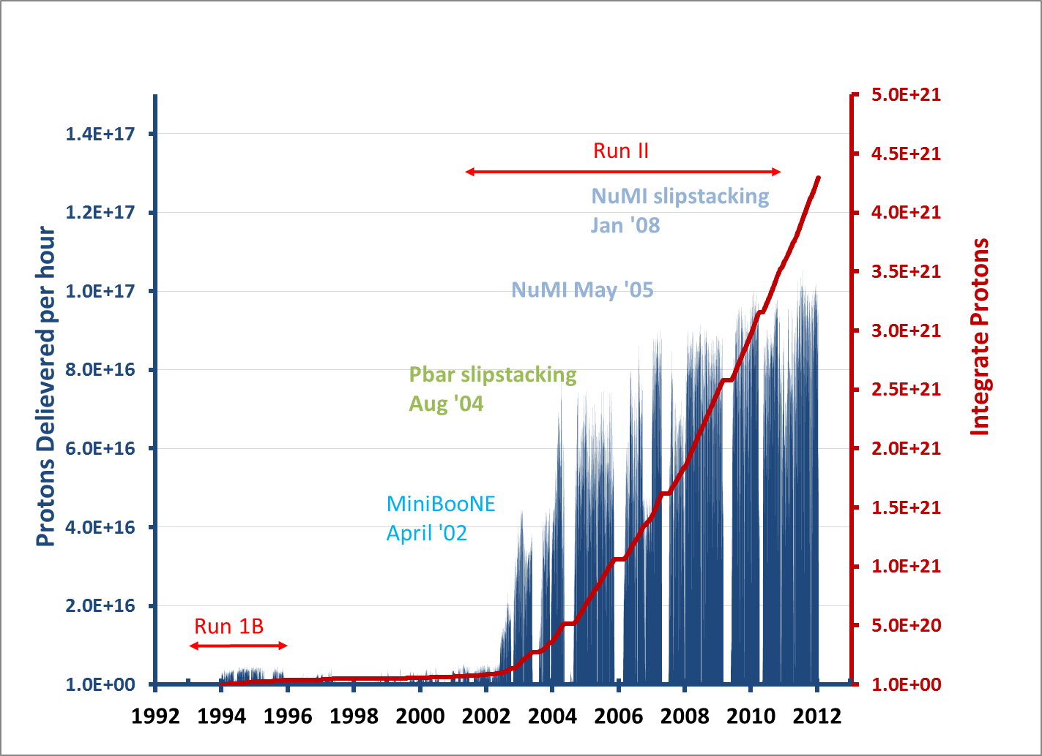
Historical Beam Throughput of Proton Source Before PIP
After PIP, maximum flux could be 2.7e17/hr

Slide 3
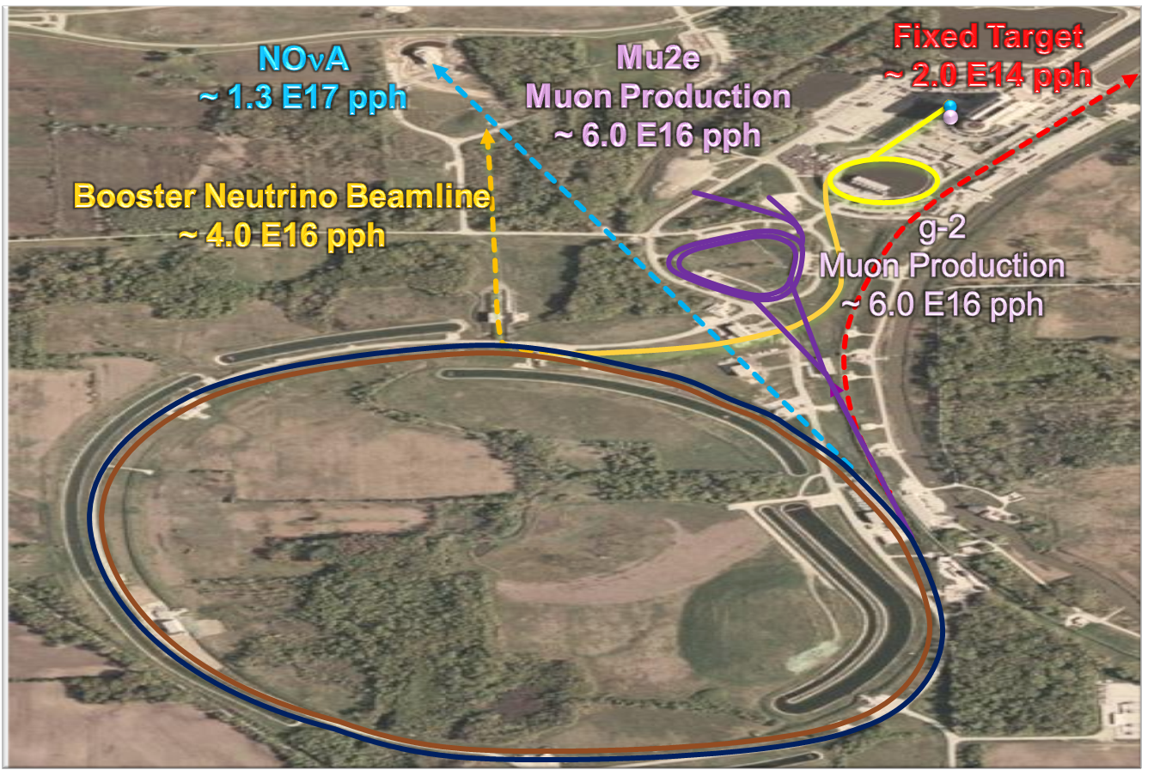
Known PIP Customers

Slide 4
Proton Improvement Plan
Proton Improvement Plan (PIP) initiated in 2012 with the goal to update and improve the proton source machines to support the laboratory programmatic goals until middle 2020’s
Proton Source Machines
Reliability
Maintainability
Capability

Slide 5
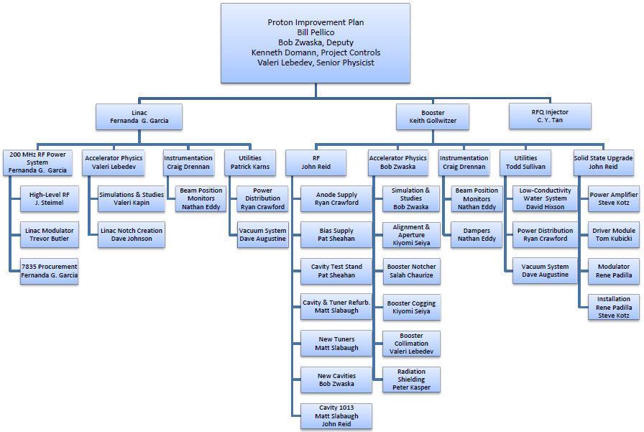
PIP consists of 31 tasks

Slide 6
Path to Higher Proton Throughput and Reliability
Losses
Flux
Viability
Linac Modulators
Shielding Improvements
LCW systems
RFQ Injector
Collimation System
Transformers
BPM systems
Linac Notching
Linac HP RF
Anode Supplies
Booster Notcher/Absorber
New Tuners
Bias Supplies
Beam Physics/Optics
Booster Solid State
Cogging
New Cavities
Dampers
Booster Cavity
Refurbishment

Slide 7
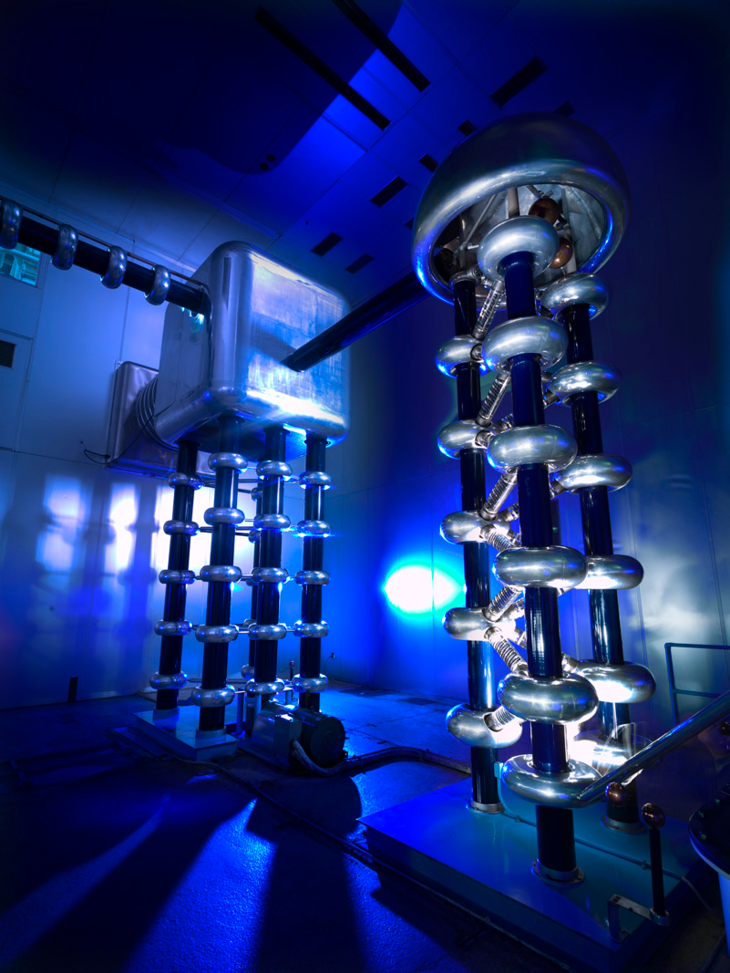
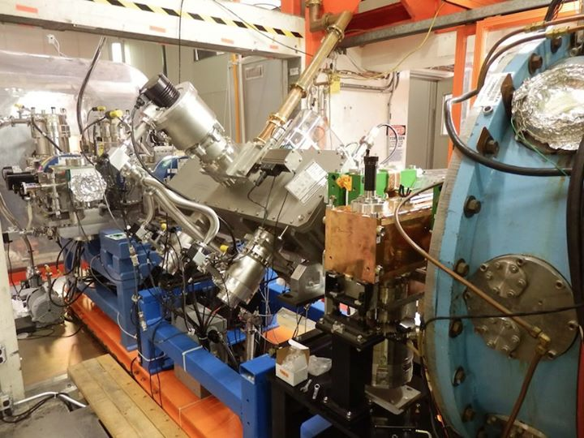
Example of Modernization (Viability)

Slide 8
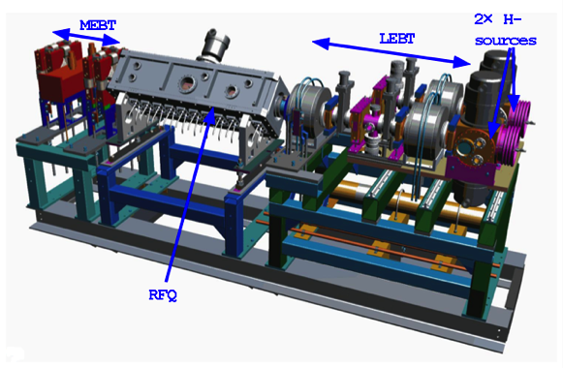
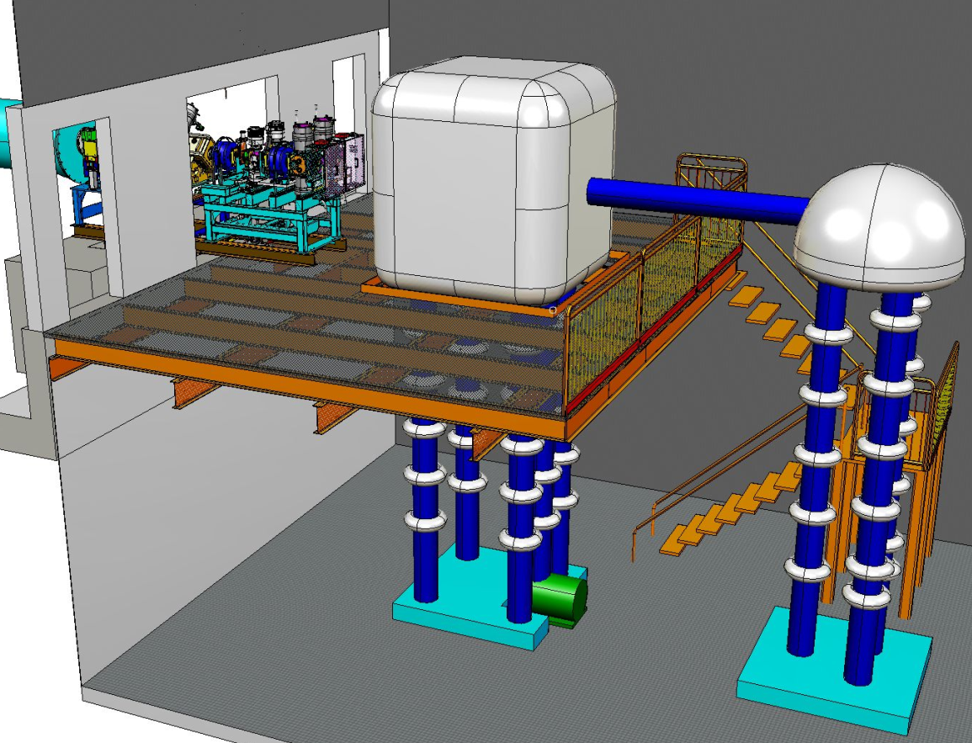
The RFQ Injector Line
Operation for more than a year

Slide 9
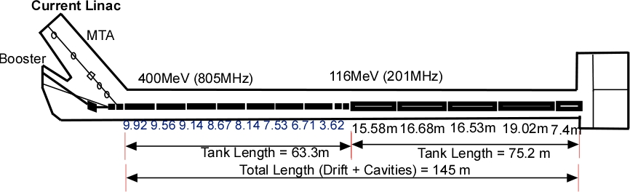
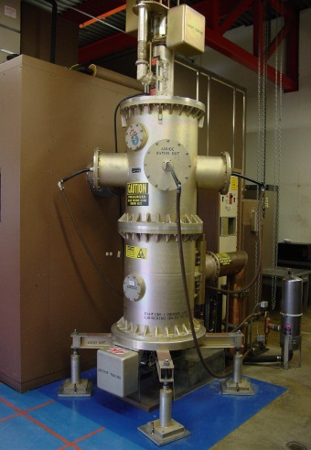
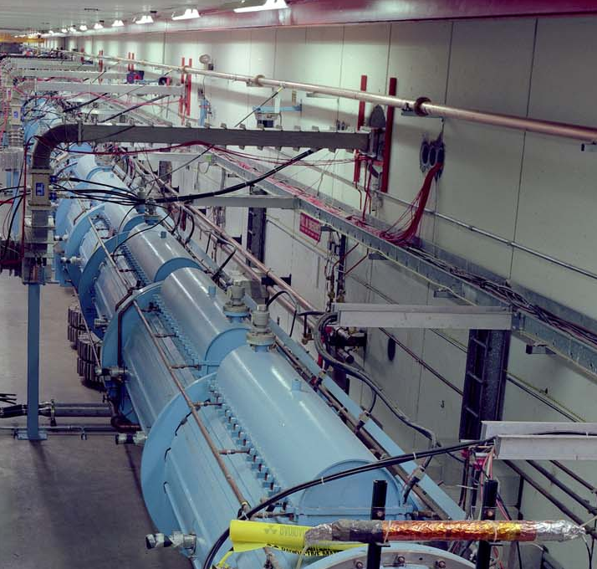
PIP - Linac
Modulator &
7835 Socket
RFQ
7835 systems
PIP -- Linac Tasks
  200 MHz PS Prototype
  200 MHz PS Modulator
  7835 Tube Acquisitions
  Laser Notching
  Water Systems
  Vacuum Systems
  BPM System
  Accelerator Physics
Low Energy Linac

Slide 10
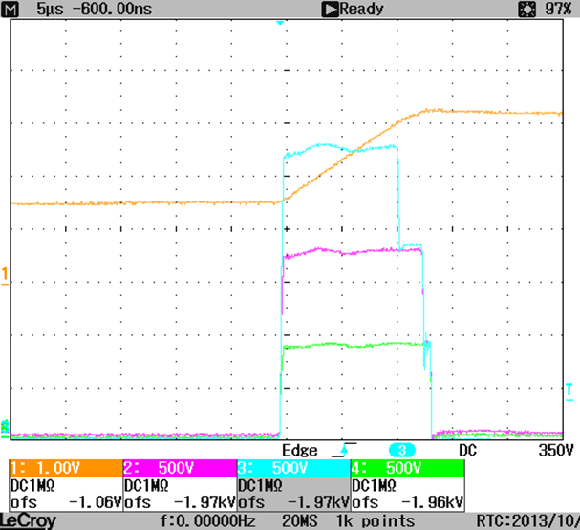
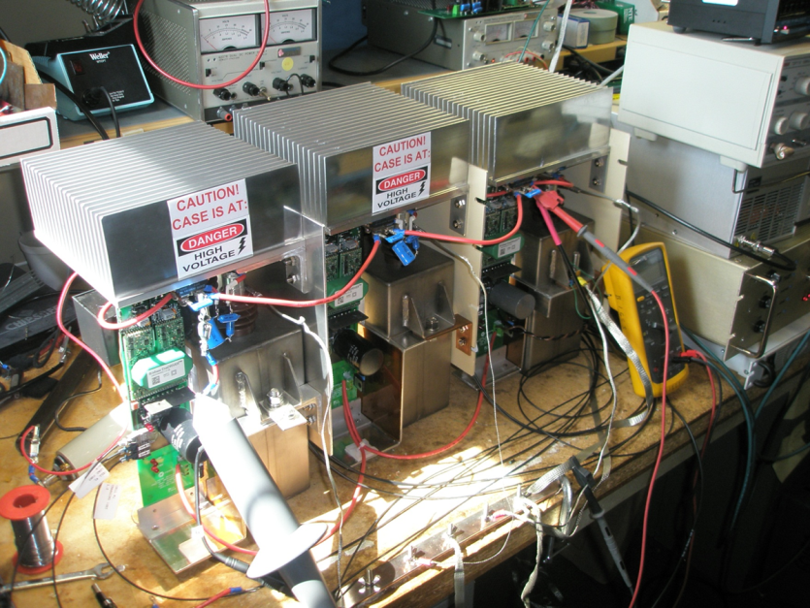
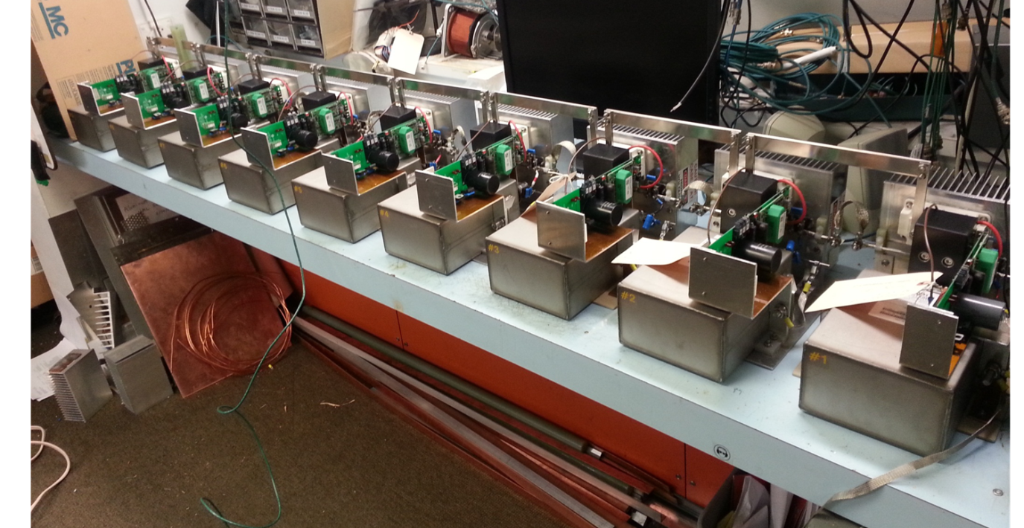
Upgrade Linac Modulators
3-cell simultaneous turn-on at 300 amps.
3-cell testing complete
9-cell testing complete
Construction of 25-cell is underway
Final design will be 40-cell
9-cell Demonstration

Slide 11
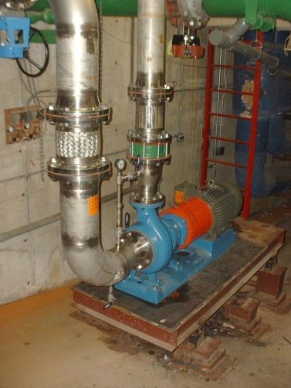
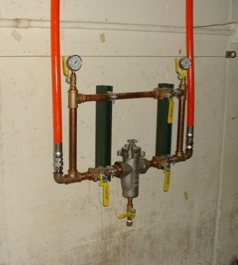
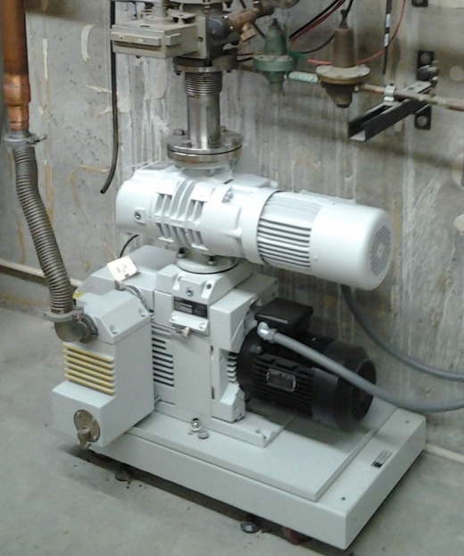
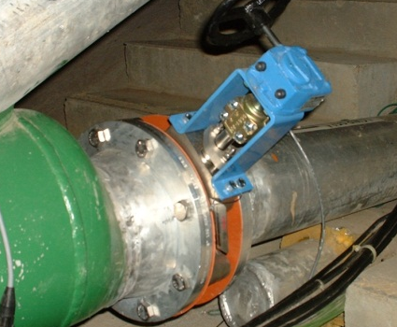
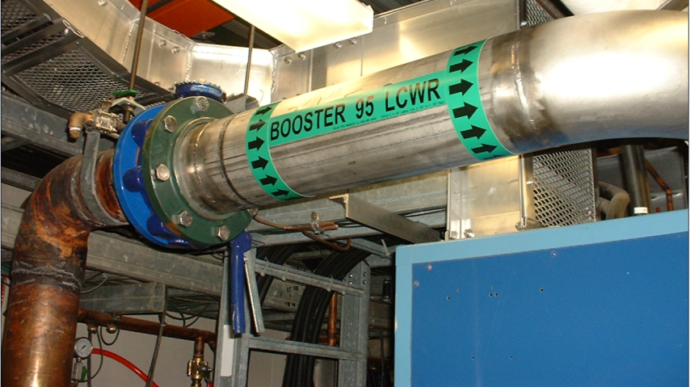
Replacement of Infrastructure
Roughing Station
Isolation Valve
Accessible Filtering
40+ year old items in both Linac & Booster replaced
Isolation Valve
New LCW Return System

Slide 12
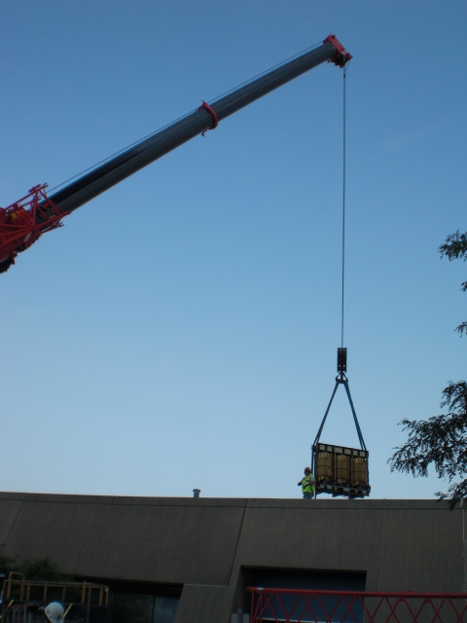
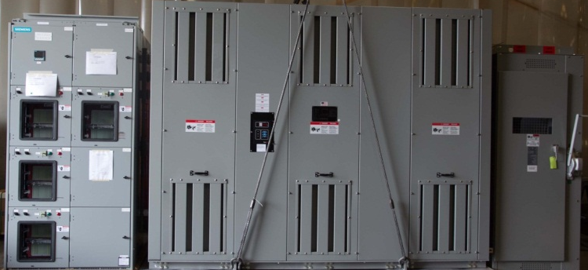
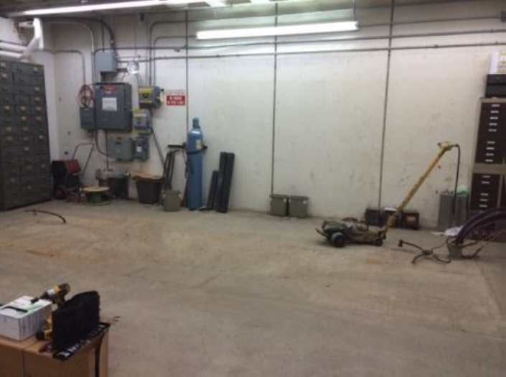
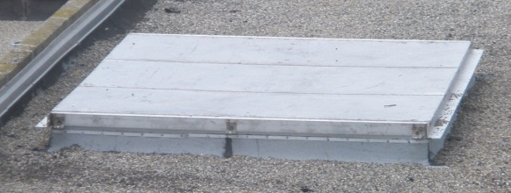
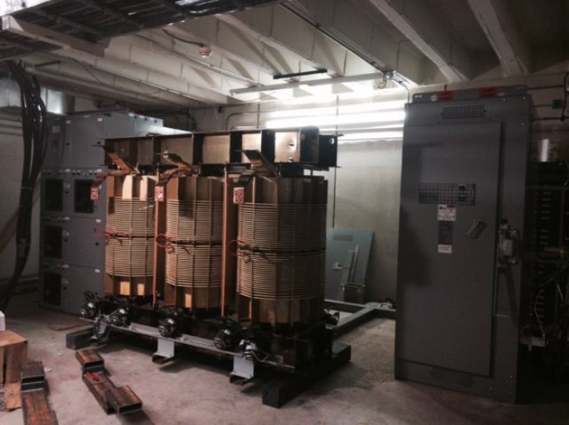
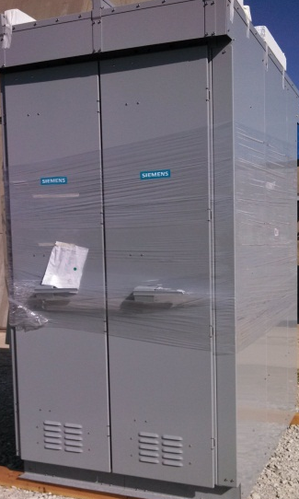
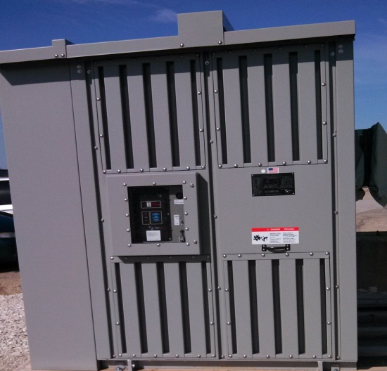
Electrical Transformers
Roof hatch required to lower new Linac transformer to basement
Linac basement space cleared Sep 2014
Two transformers for Booster installation within the next few weeks

Slide 13
Booster RF Cycle Rate Previous to PIP & Desired

Slide 14
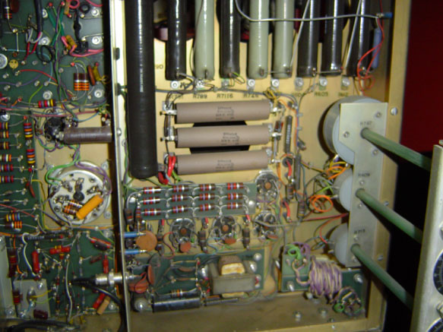
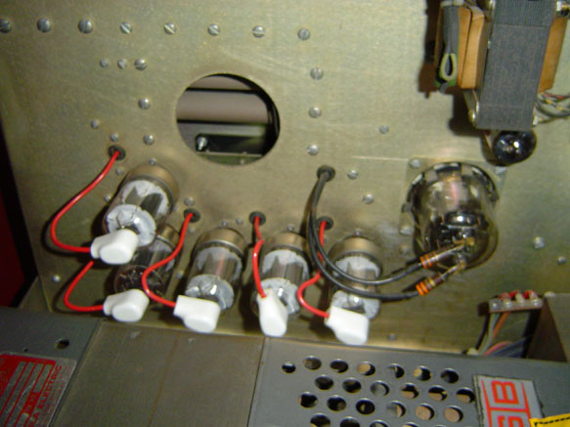
Booster RF Power System
Original system had many power tubes
Replaced
  Final amplification stage sat on cavity in the tunnel -- radiation environment (20 power tubes)
    Tube lifetime issues leads to worker radiation exposure
Replaced entire amplification chain with Solid State power system

Slide 15
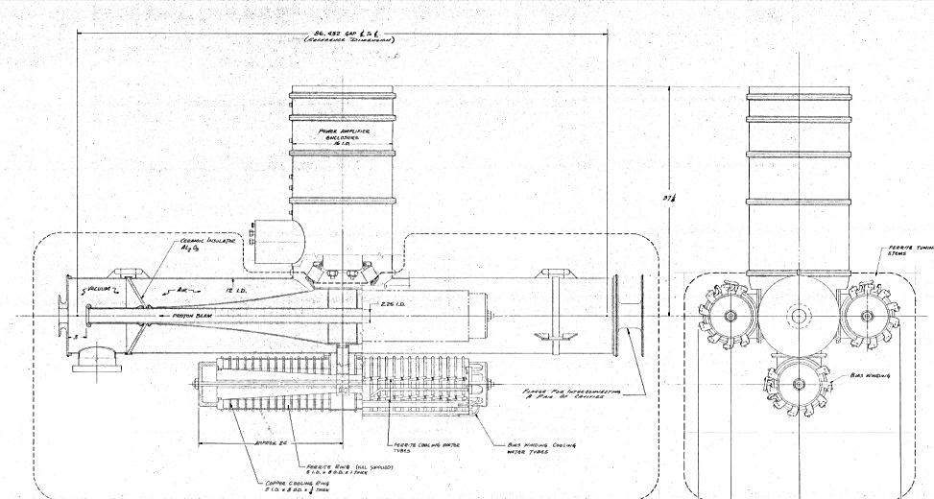
Booster RF Cavities and Tuners
3 tuners per cavity
Reworked tuners in the 1970’s
Disconnected tuners’ inner-cooling lines in 1970’s due to leaks and was not needed for ~1Hz
Many in-situ fixes of vacuum and water leaks over the years
Failures were shown to be over heating at junctions of tuners and cavity

Slide 16
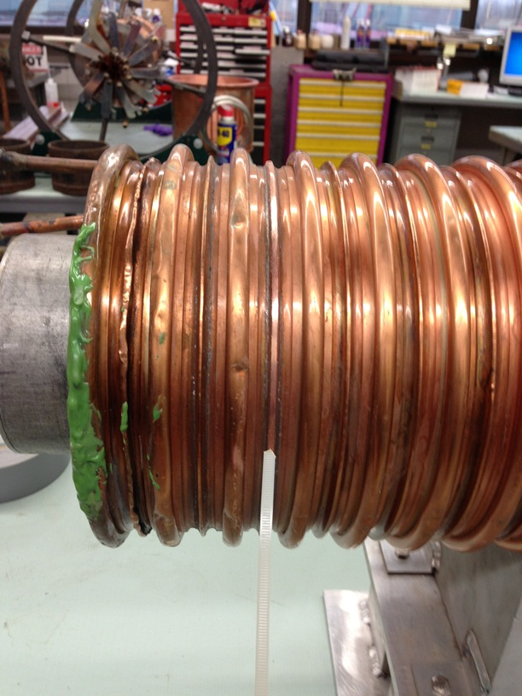
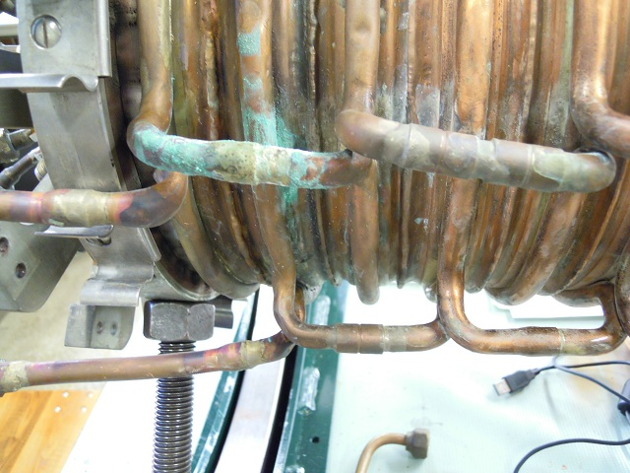
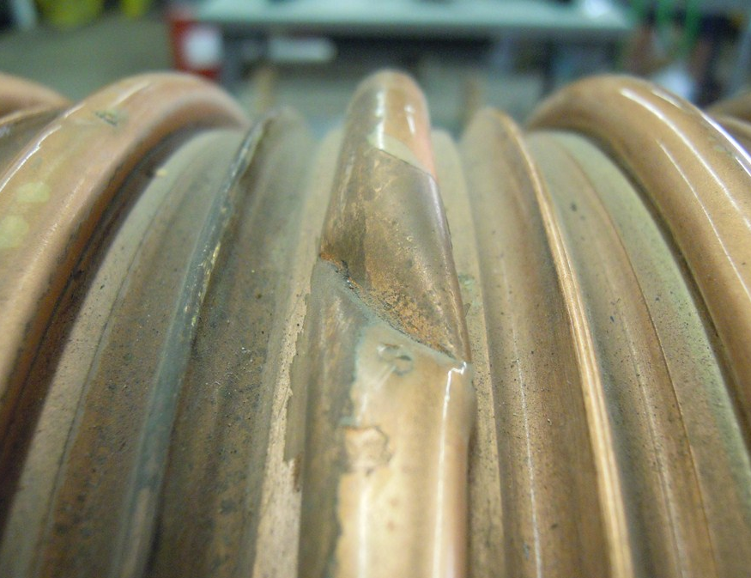
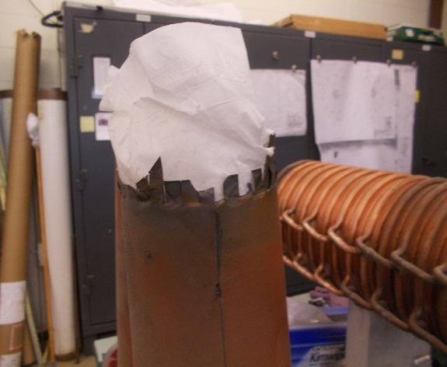
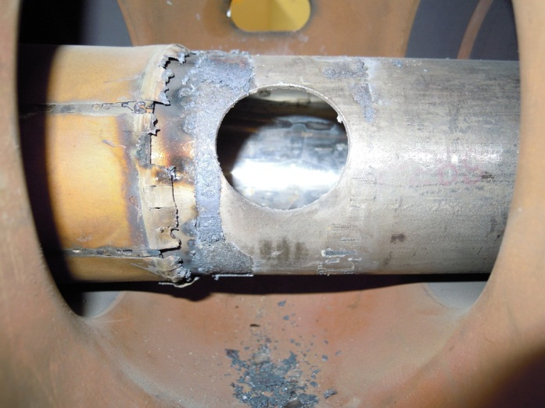
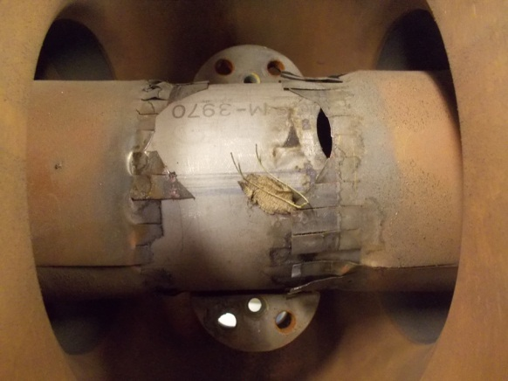
Tuner “Findings”

Slide 17
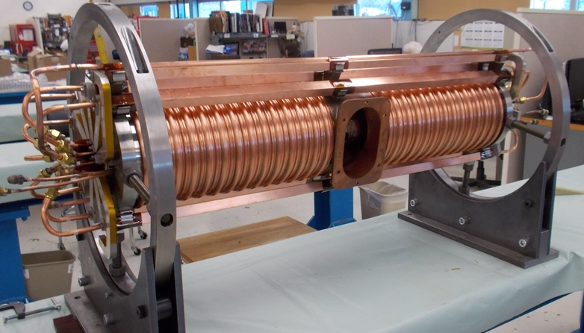
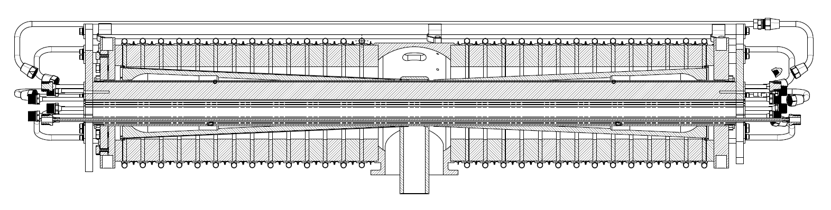
Tuners
Each tuner:
500+ pieces
150 ft+ tubing
50+ water connections
44 in long
650 lbs
Cooling lines
Cones
Ferrite
Contact surfaces

Slide 18
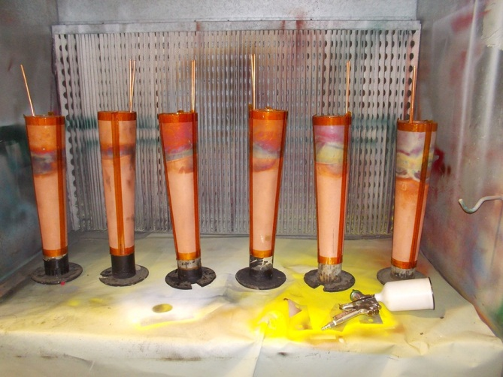
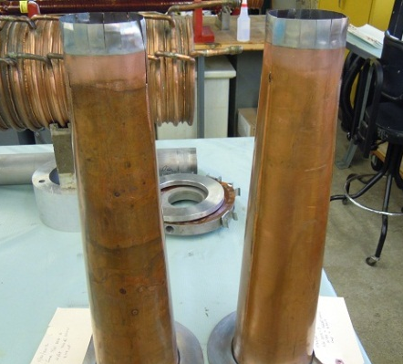
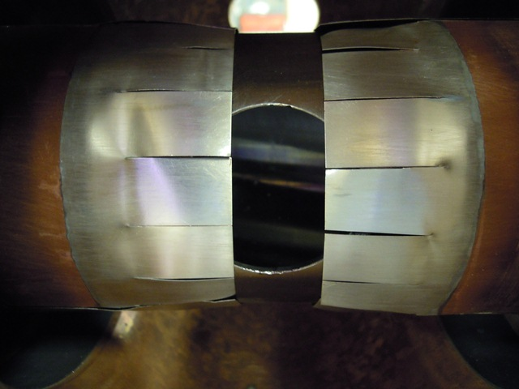
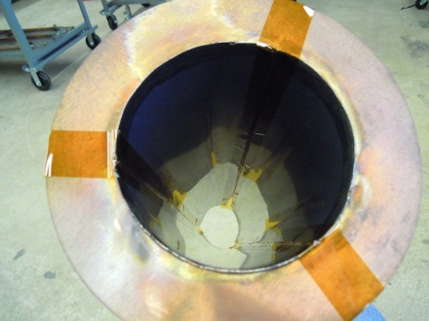
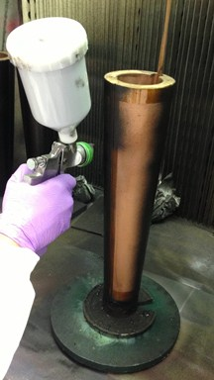
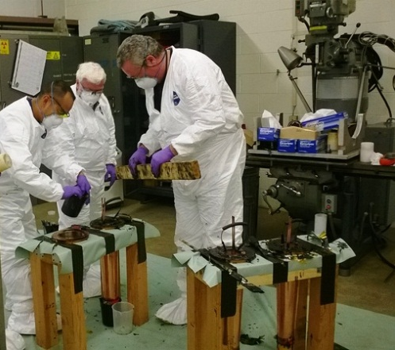
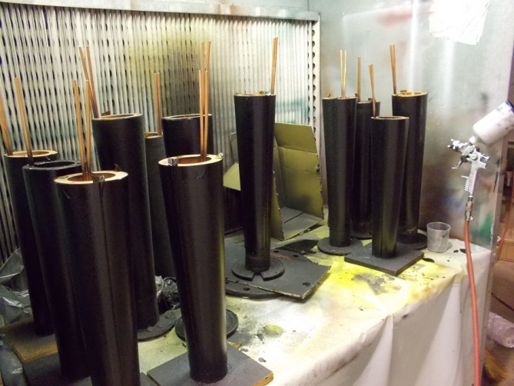
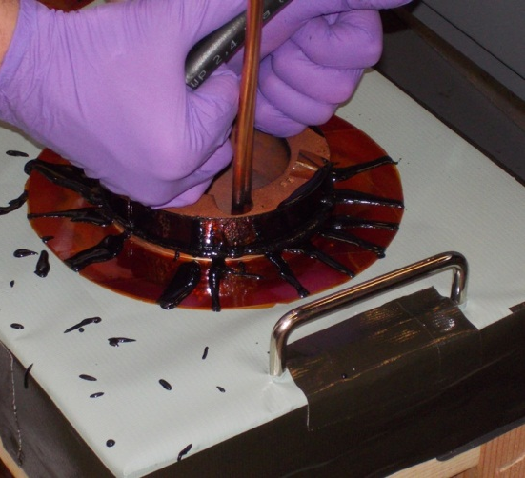
Tuner Refurbishment - Cones
A 10 step process

Slide 19
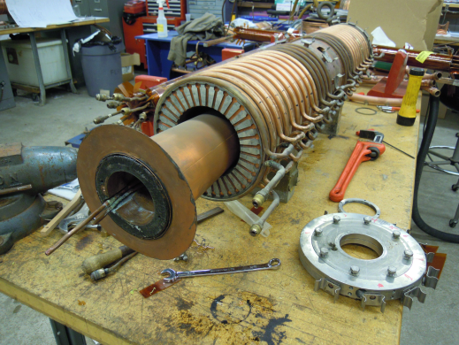
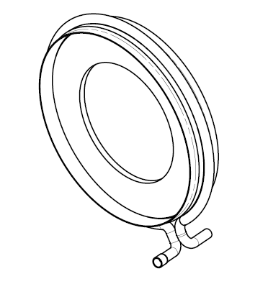
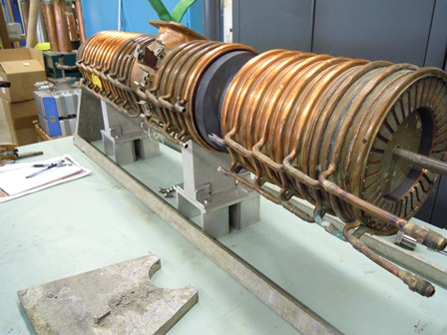
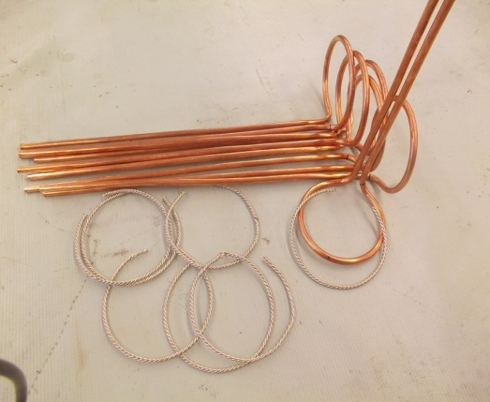
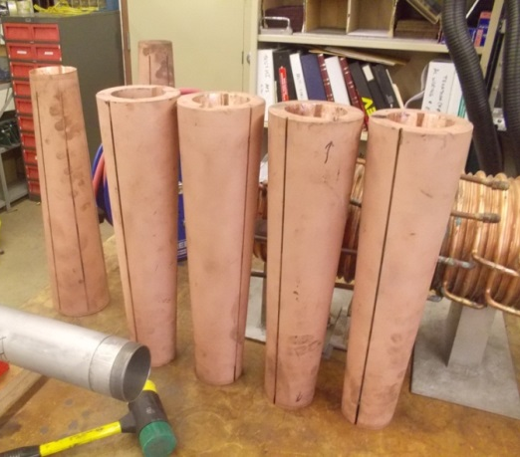
Tuner Refurbishment
There is a copper shell with cooling line for each ferrite
Chipped ferrite or cooling line issues can lead to grinding off welds that have to be re-welded later

Slide 20
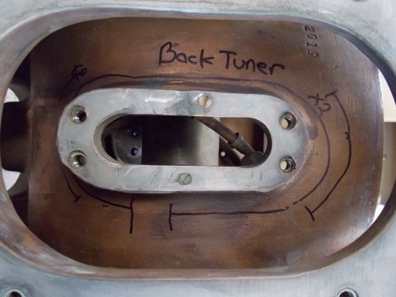




Cavity refurbishment

Slide 21

Certifying a Cavity Every 9-10 Weeks

Slide 22
15 Hz Operations and Beam Loss
17 refurbished RF cavities needed to go beyond historical rate of 7 Hz
  Anode supply replacement and bias supply upgrade also need to be complete
Expect to reach 17 cavities summer-fall of 2015
After new radiation shielding assessment is approved, then can
  Increase Booster cycles with beam
  Monitor beam loss
    Currently ~10% of injected beam is lost in Booster
      Doubling flux means throughput efficiency has to go from 90% to 95%

Slide 23


Flux increase - Losses
2011
PIP Goal is 270e15/hr
2010
Protons per hour E15
2005
Beam Loss (Operational Limit 525 Watts)

Slide 24





Notcher & Absorber
Bunches Removed
The above plot shows current notch simulation
Shorter kickers will have faster rise times, cleaner notch and reduced kick on circulating beam.
Testing complete of 4 short kickers – 2 more later
Absorber
Controlling the loss at 400MeV instead of 8GeV
Booster Short Kickers – drop in replacements
1.1 Meter
New pulserNOvA style
Power Loss

Slide 25


Notcher & Absorber Controlling Beam Losses
Decrease of ~1200mrem/hr
Rad Survey Data
Dec 2013
The plot above shows the difference between two rad surveys after running similar flux for a week. The new system has greatly reduced residual activation in several areas of Booster.
The new absorber system directs the beam to an absorber – old system was not designed for high flux and the kicked beam ‘notch’ into collimators was uncontrolled
Collimators
New Absorber

Slide 26



Notch @ 750 KeV

Slide 27



Accelerator Physics
5.8E12
5 mm
Pre-transition
bump
Aperture and orbit control
Magnetic Cogging
Lattice corrections
  Beta Beating
  Higher harmonic control – coupling, chromaticity and tunes
  Lots of new software
Dampers – upgrades
Collimation
RFQ injector lattice and capture
Radial
Feedback
Intensity
3.8E12
-10 mm
Beam losses
Linac Orbit
Better tune control at high energy
Booster Tunes

Slide 28




Booster Alignment/Aperture Scans
Before
After
The aperture scans has successfully increased the acceptance
Found Restrictions
Corrected Misalignments.
More moves are planned but smaller
New software is fast and easy to use
Upper
Lower
Short 14

Slide 29


New Cavities and Harmonic Cavity
Specifications for Design of New Accelerating Cavities for the Fermilab Booster underway with testing of current cavities to confirm modeling.
Harmonic cavity work is underway to help with beam capture, transition and possibly extraction.
  Based upon work at TRIUMF and LANL
  Simulations look promising
  University interest – Illinois Institute of Technology
55 KV,15Hz
Thermal Profile
Magnetic loss density (100 kV)

Slide 30

Radiation Shielding
Passive Shielding is not enough
Several rounds of scans have been performed
Understanding of loss points set locations for discrete detectors
Will test Total Loss Monitor (TLM) system (Fri. morning – Leveling)
Assessment Beam Parameters
Shielding Requirements
Longitudinal Shielding Summary
Transverse Shielding Summary
Labyrinths and Penetrations
Air Activation
Ground Water and Surface Water
Soil Activation
Muons
Residual Dose Rates
Active Shielding Controls

Slide 31
Summary
PIP has been on going to do the following:
  Double the flux
    Support beam on all 15 Hz cycles
  Keep the Proton Source viable/reliable through the middle of the next decade
    Replace/upgrade obsolete components & technology
  Control the beam losses such that the activation does not become worse than today
    Will strive to control and cut beam losses to decrease worker exposure to activated equipment
Starting in 2012, the PIP is a multi-year campaign to achieve Fermilab’s physics goals for the next decade

