Slide 1
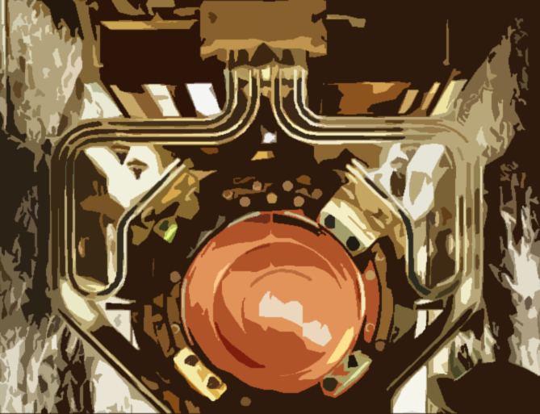
50 years of accelerator-based neutrino beams, and more to come
A. Marchionni, Fermilab
September 26, 2014

Slide 2
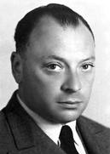


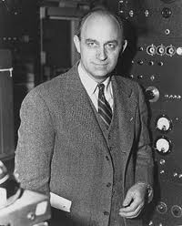
The first GIANT steps in ν physics
Zeitschrift für Physik, 88 (1934) 161

Slide 3
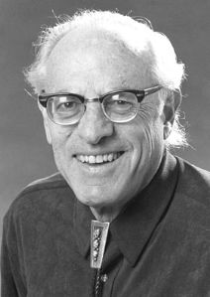
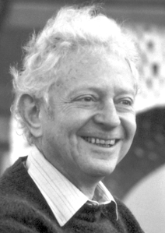
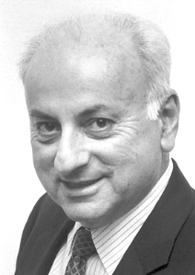

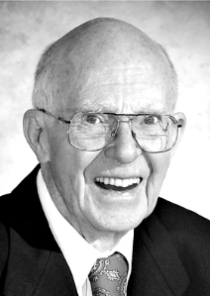
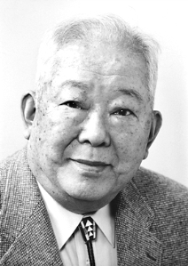
The Nobel ν prizes
Physics 1995
FREDERICK REINES
for the detection of the neutrino (1953-1956)
Physics 1988
LEON M LEDERMAN, MELVIN SCHWARTZ and JACK STEINBERGER
for the neutrino beam method and the demonstration of the doublet structure of the leptons through the discovery of the muon neutrino (1962)
Physics 2002
RAYMOND DAVIS Jr. and MASATOSHI KOSHIBA
for pioneering contributions to astrophysics, in particular for the detection of cosmic neutrinos
Homestake (1970-1995), Kamiokande (1983), Kamiokande-II (1985), Super-Kamiokande (1996)

Slide 4
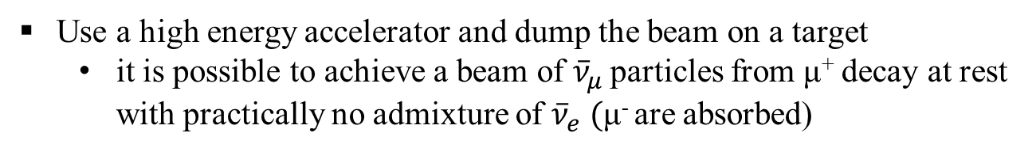
The first concepts for an accelerator-based ν beam - I
Electron and muon neutrinos
Why?
Are ν_{e} (emitted in β decay) and ν_{μ} (emitted in π→μ decay) identical particles?
Is ν_{μ} + p → e⁺ + n happening?
B. Pontecorvo, Sov. Phys. JETP 37 (1960) 1236
Use a high energy accelerator and dump the beam on a target
  it is possible to achieve a beam of ${\overline{ν}}_{μ }$particles from μ⁺ decay at rest with practically no admixture of ${\overline{ν}}_{e} ($μ⁻ are absorbed)
The LSND strategy…

Slide 5
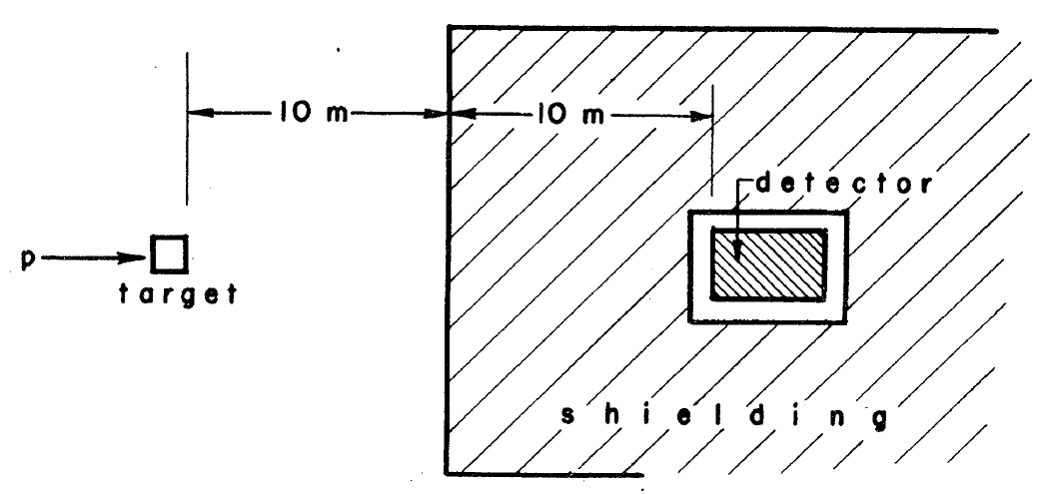
The first concepts for an accelerator-based ν beam - II
Is it possible to use high energy ν’s to study weak interactions?
5 x 10¹² 3 GeV protons, 10 ton detector
I = # protons/unit time
I/10 π´s with E_{π} ≥2 GeV in ~2 steradians
10 m decay length, 10 m shielding
1 cm² detector @ 20 m → 2.5 x 10⁻⁷ steradian
cτ_{π} = 7.8 m → γcτ_{2GeVπ} ≈ 110 m → 10% π’s decay
M. Schwartz, Phys. Rev. Lett. 4 (1960) 306
10 ton
σ ~ 10⁻³⁸ cm²
<E_{ν}> ≈ 427 MeV
π⁺→μ⁺ν, assume 2 GeV π
dN/dE
(dN/dE)_{ν} is flat in the lab system: decay angular distribution in the π rest frame is isotropic and energy independent from decay angle
854 MeV
E_{ν}
~1 ν int./hour
Yes!

Slide 6
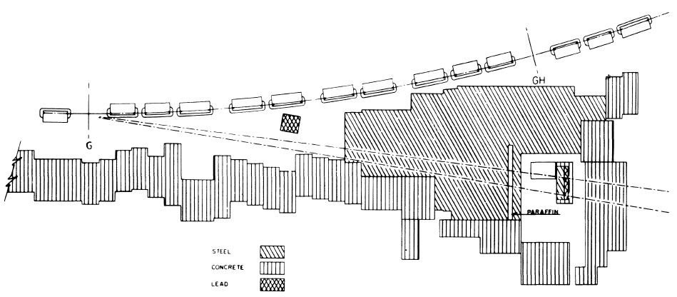
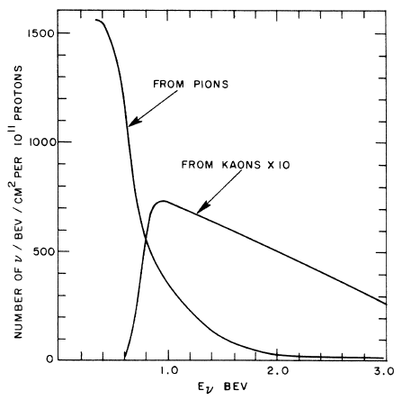
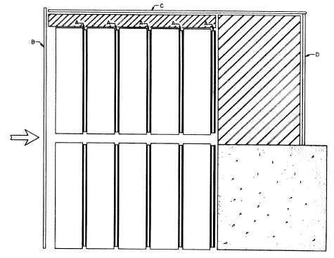
The first ν beam… at BNL, and the discovery of ν_{e} ≠ ν_{μ}
Brookhaven AGS, 15 GeV protons
2-4 x 10¹¹ protons/pulse
νʼs from π and K decays
21 m
G. Danby et al., Phys. Rev. Lett. 9 (1962) 36
13.5 m
Array of 10 one-ton aluminum spark chambers
anti-coincidence slabs
triggering slabs
Exposure of 3.48 x 10¹⁷ protons
34 single μ, p_{μ} > 300 MeV
22 ʻvertexʼ events
6 ʻshowerʼ events, not consistent with μ’s

Slide 7
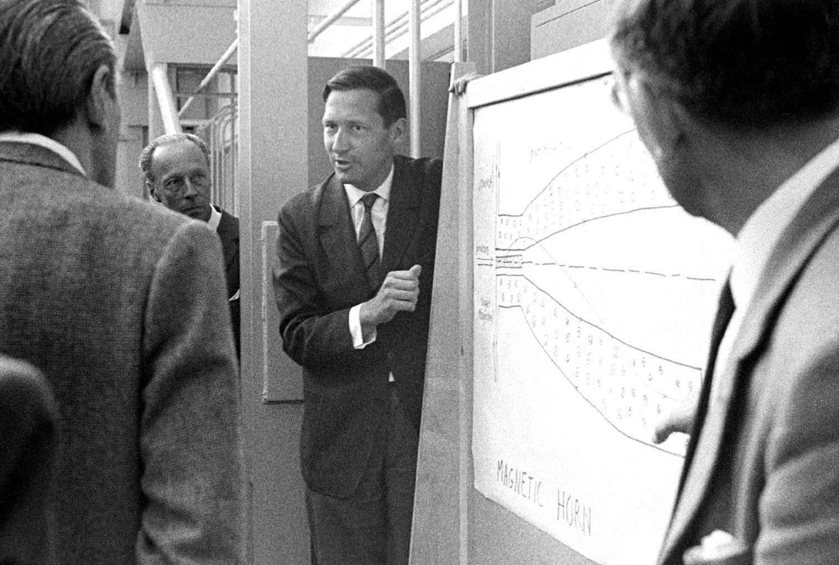
The first concept of a horn
Divergent beams of charged particles can be made nearly parallel by a magnetic horn that is analogous to an internally reflecting conical surface in geometrical optics
S. van der Meer
A directive device for charged particle and its use in an enhanced neutrino beam
CERN 61-7

Slide 8
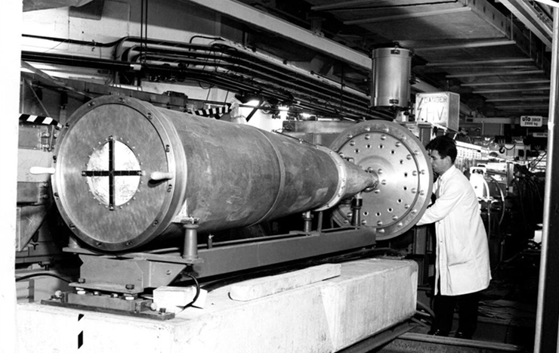
Development of the first ν beam at CERN PS
300 kA current, of ~180 μs half-sine wave duration
cooled between pulses by spraying demineralized water on it
M. Giesch et al., NIM 20 (1963) 58
inner conductor shape calculated to give nearly exact focusing after 1 reflection only for all particle momenta produced at an angle corresponding to maximum production
developed “fast ejection” scheme to extract beam in 2.1 μs

Slide 9
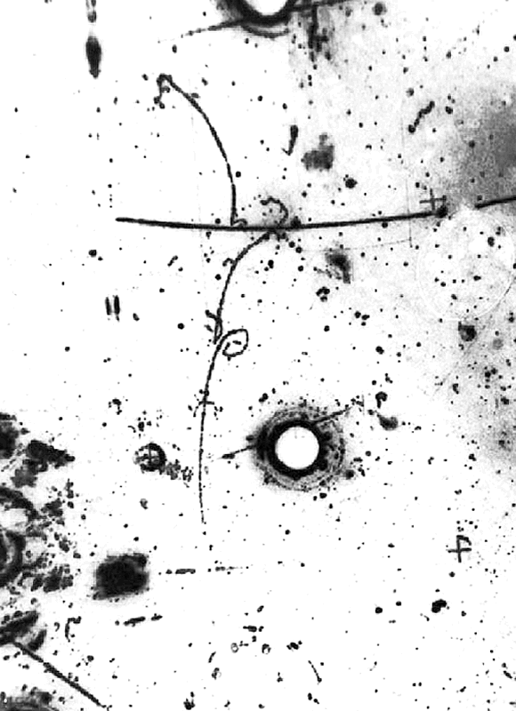
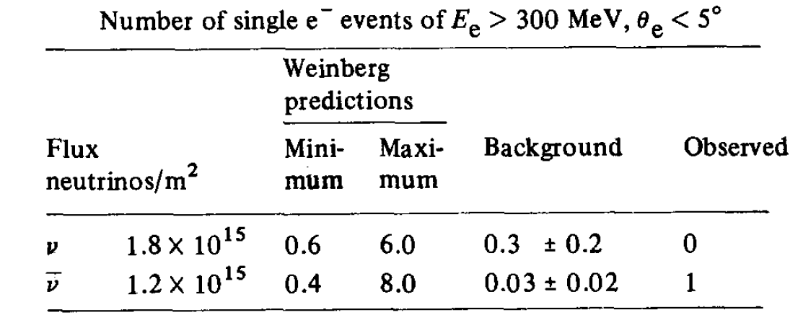
The discovery of weak neutral currents
Gargamelle bubble chamber with freon CF₃Br, X₀ = 11 cm
useful volume 6.2 m3, 4.8 m long
F.J. Hasert et al., Phys. Lett. B46 (1973) 121
Exposed to both ν and ν beams at the CERN PS
Electron energy 385 ± 100 MeV
Angle to beam axis 1.4^{°+1.6}_{-1.4}
@ 90% CL, 0.1<sin²θ_{W}<0.6

Slide 10
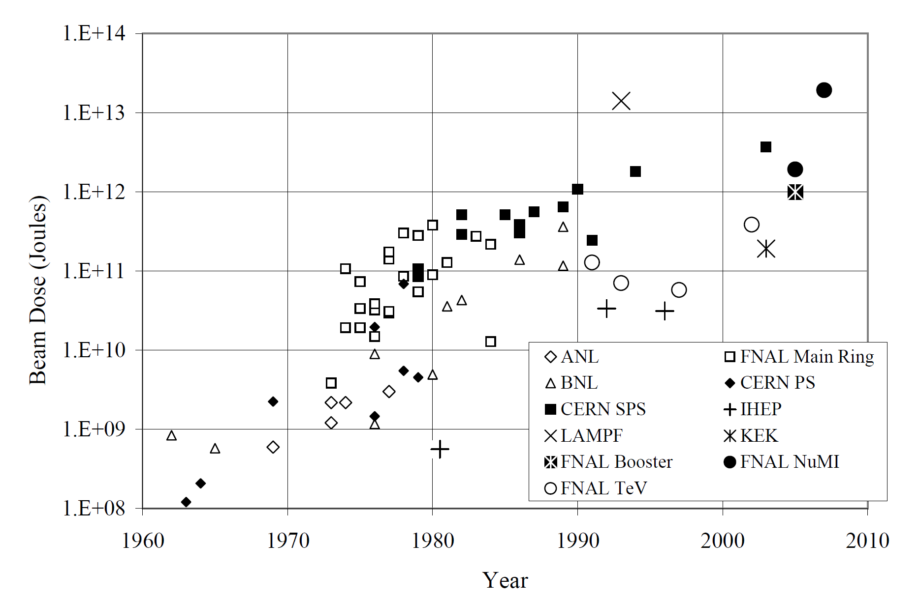
Neutrino beams: beam power and running time
S. Kopp Phys. Rept. 439 (2007) 101

Slide 11
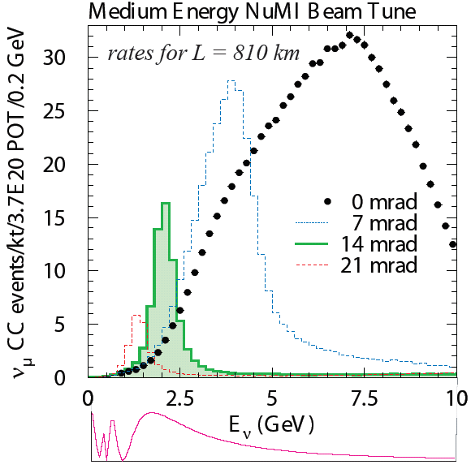
Neutrino beam configurations: on axis, off-axis
NOvA
For a given θ≠0, a large range of pion energies contributes to a small range of neutrino energies

Slide 12
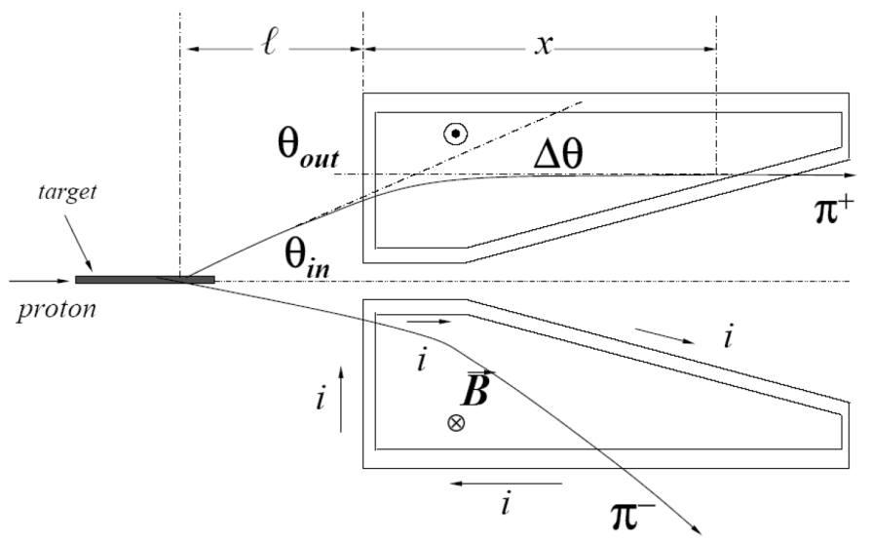
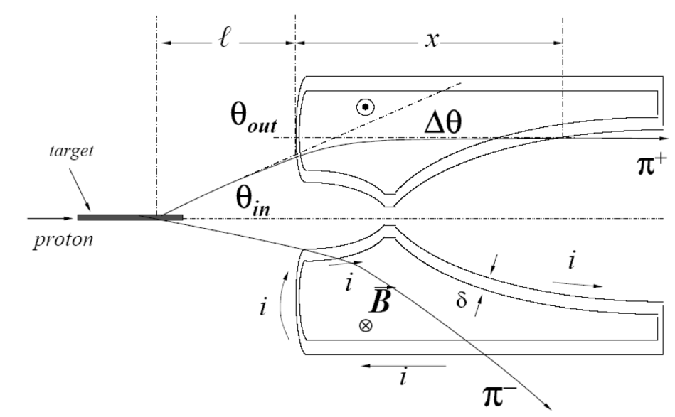
Focusing devices (Horns)
Focuses all momenta for a given angle of pion into the horn. It produces a broad band beam.
With a parabolic shaped horn inner conductor, the horn behaves like a lens (p_{t} kick proportional to the distance from the axis), with a focal length proportional to the momentum

Slide 13
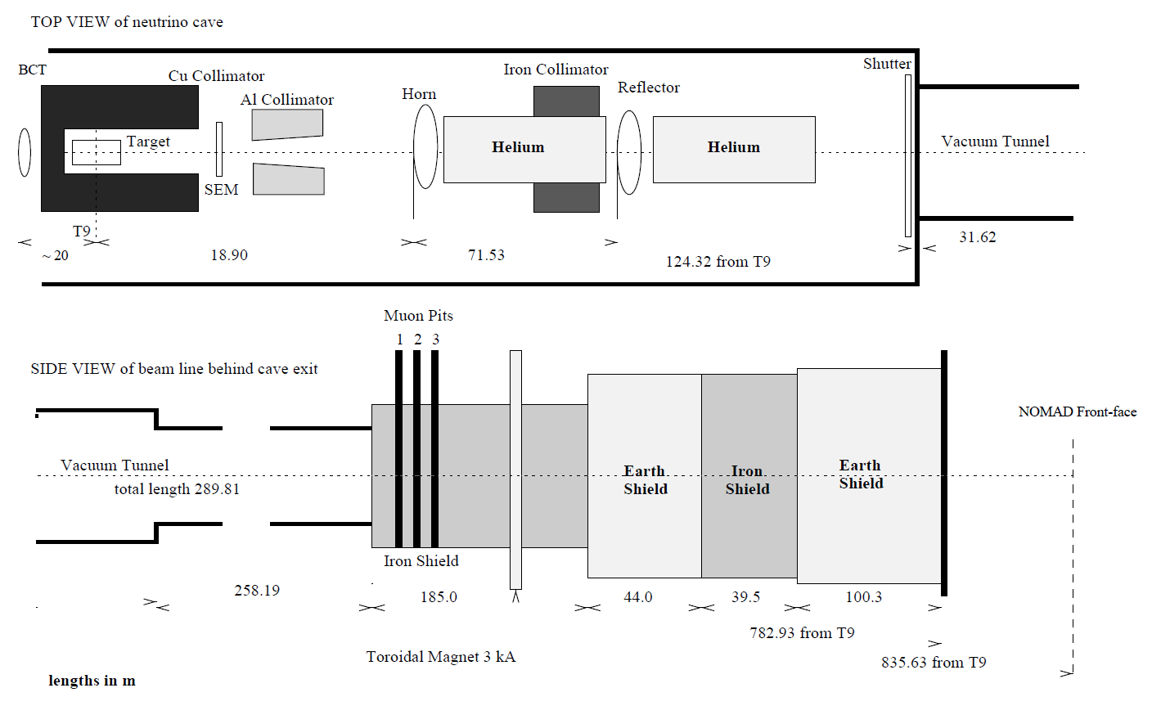
The CERN WANF ν beam
450 GeV protons impinging on a beryllium target
protons are extracted in two 4 ms long spills separated by 2.6 s
the target is made up by 11 beryllium rods, 10 cm long and 3 mm in diameter, separated by 9 cm gaps

Slide 14
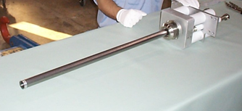
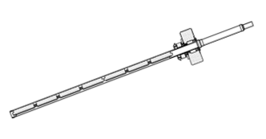
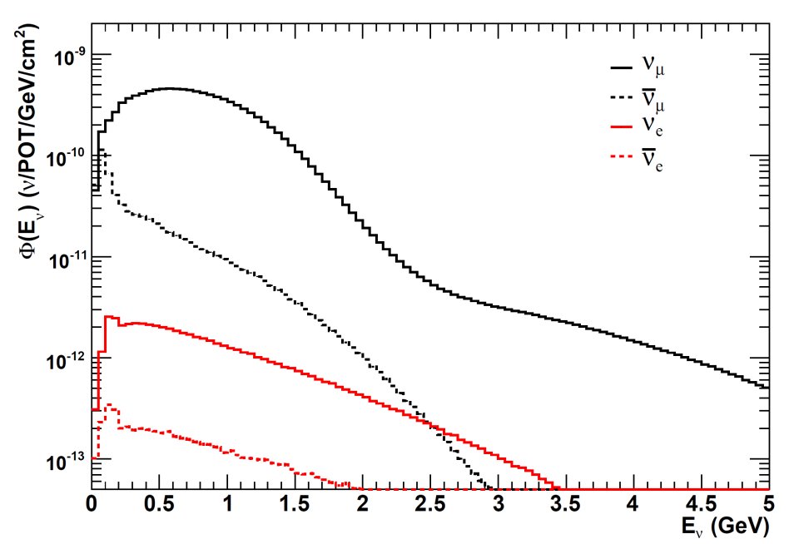
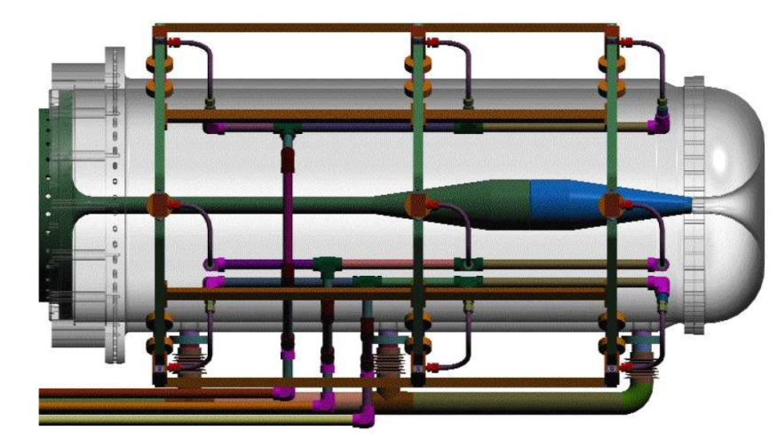
The FNAL Booster ν beam
Since April 2002
Beryllium target
7 rods 10.2 cm long, 0.96 cm Ø
170 kA @ 15 Hz
designed for 5 pulses/s
Horn pulses
1st horn: 97x10⁶
2nd horn: ~0.3x10⁹

Slide 15
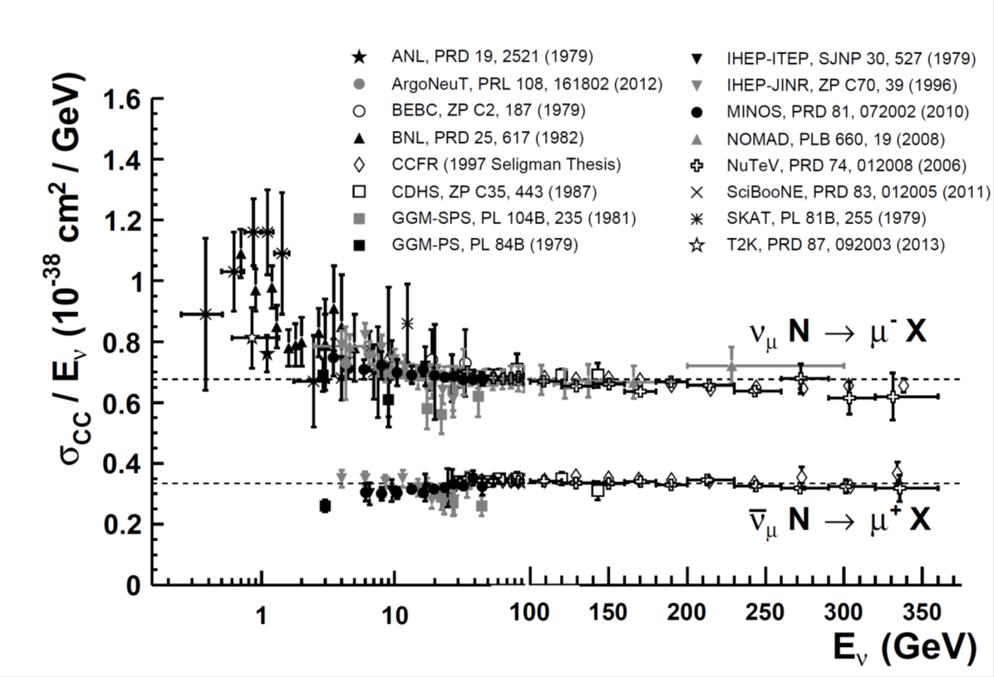
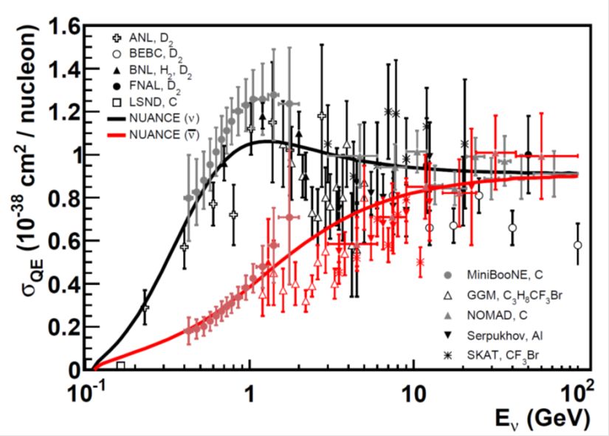
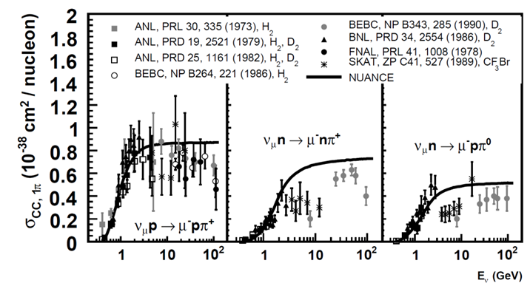
ν Cross Section measurements
DIS
QE
1 π
G.P. Zeller PDG 2014

Slide 16
The search for ν oscillations at short baselines

Slide 17
SBN@FNAL: chasing the LSND anomaly

Slide 18
The beam dump experiments
'beam dump‘ experiments: an intense beam of high energy protons is absorbed in a thick, dense target
motivation: discover new particles and new effects
sensitive to short lived particles, down to small cross section, whose decay modes include neutrinos in the final state
  provided the first evidence of charm production in hadronic interactions
  measurement of the ratio of electron- to muon-neutrino rates as a test of e-μ universality (BEBC, CDHS, CHARM, FFMOW)
sensitive to “other” penetrating particles…
  Search for Dark Matter with MiniBooNE: recently running BNB with off-axis beam

Slide 19
DONUT: the discovery of ν_{τ}
800 GeV
protons
1 m long
tungsten dump
9 ν_{τ} events with an estimated background of 1.5 events
τ→e+ν_{τ}+ν_{e}

Slide 20
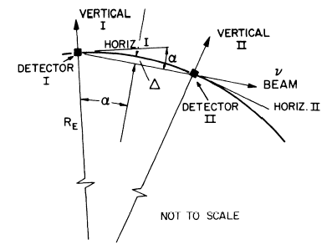
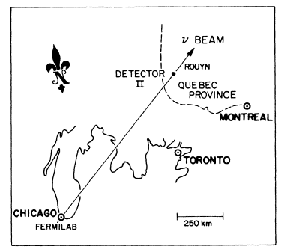
The first idea for a long baseline ν beam
A.K. Mann, H. Primakoff “Neutrino oscillations and the number of neutrino types”, Phys.Rev. D 15 (1977) 655
L= 1000 km, α=78 mrad, Δ=19 km
Δm² in eV², L/E in km/GeV
“None of our speculations on the lower limit of the oscillation length at p_{ν}≤20 GeV appears to be significantly larger than the distance between the accelerator and the distant detector (1000 km)”
“It is perhaps worth mentioning again that any actual neutrino-oscillation phenomenon might conceivably provide another means of observing CP violation”

Slide 21
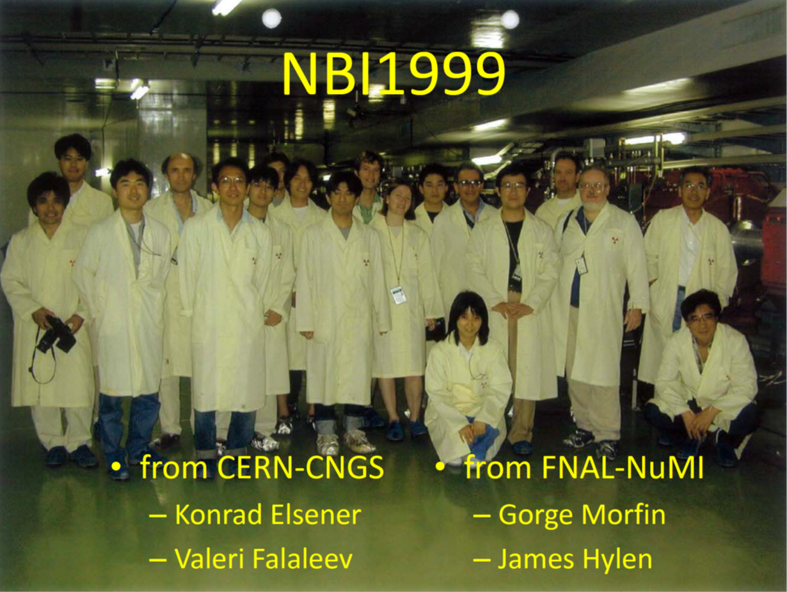
Organized by K. Tanaka

Slide 22
The KEK ν beam
First beam: March 1999
K. Tanaka

Slide 23
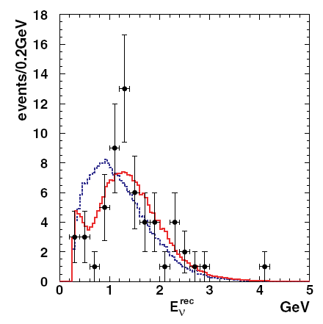
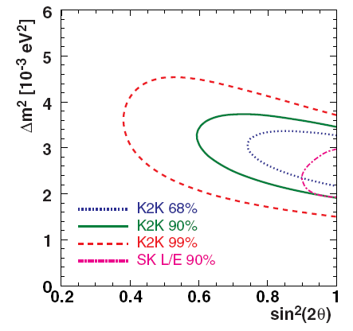
Results from the KEK experiment
ν_{μ} beam from K2K with L=250 km
‘Near’ detector + ‘Far’ Super-K detector
accumulated 0.9x10²⁰ 12 GeV protons over ~5 years
1-ring μ-like events
58 observed events
Phys. Rev. D74 (2006) 072003
Best fit parameters:
Maximum mixing
Δm² = 2.8 x 10⁻³ eV²
112 FC events observed
158±9 FC expected (no osc)

Slide 24
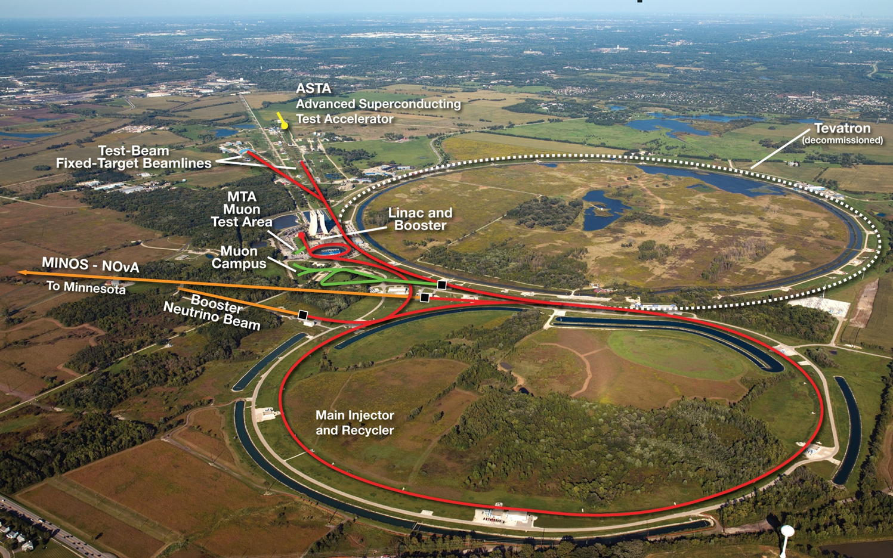
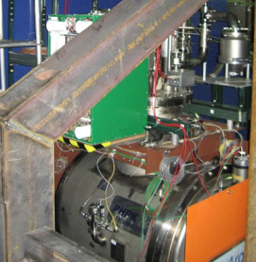
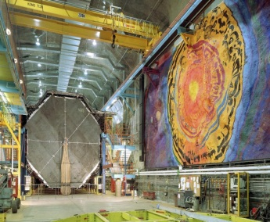
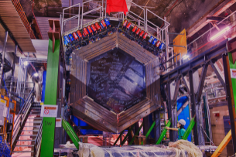
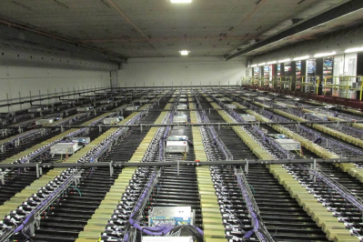
Experiments on the NuMI line
(Neutrinos at the Main Injector)
ArgoNeuT
MINOS(+) 732 km
MINERvA
NOvA 810 km
14 mrad off-axis

Slide 25
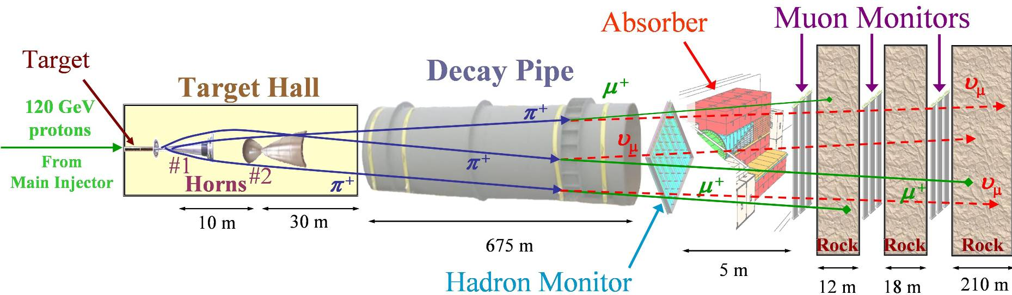


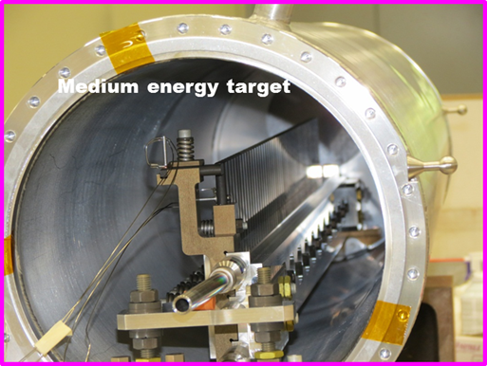
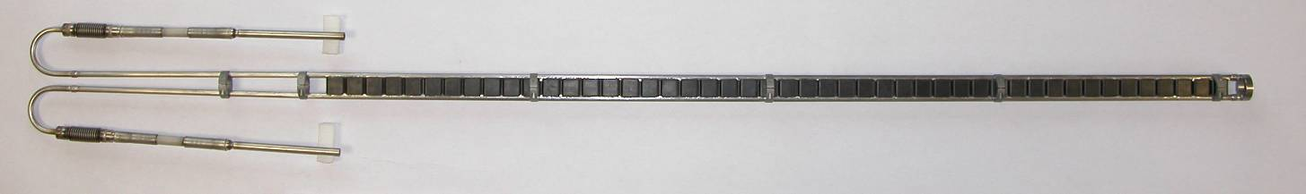
The NuMI ν beam
Water-cooled segmented graphite target
  47 2.0 cm segments; total length of 95.4 cm
2 parabolic horns carrying
  Up to 200 kA current provides up to 3T fields
  Target can be remotely positioned up to 2.5m upstream of the first horn to change beam energy
Low energy target

Slide 26
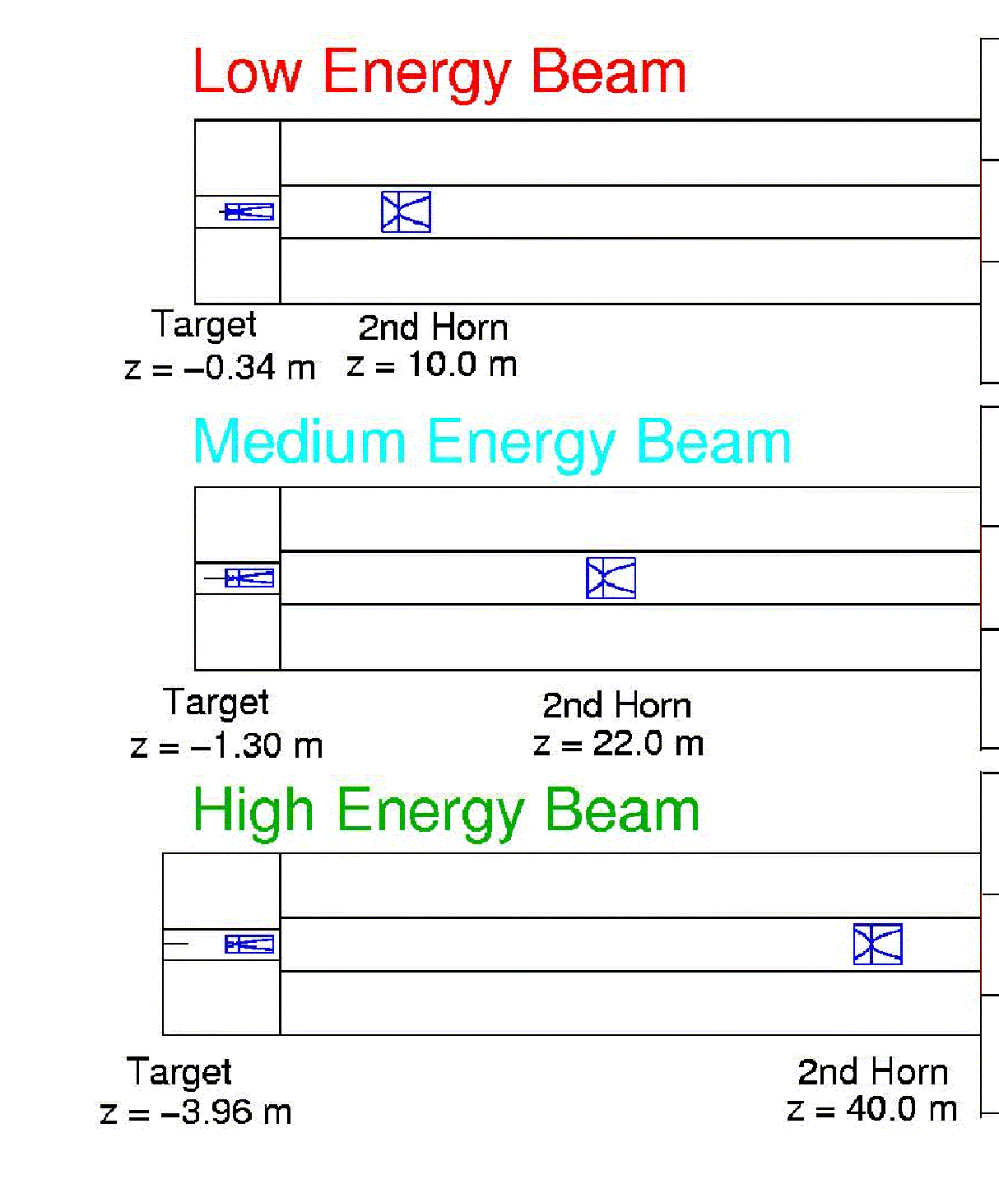
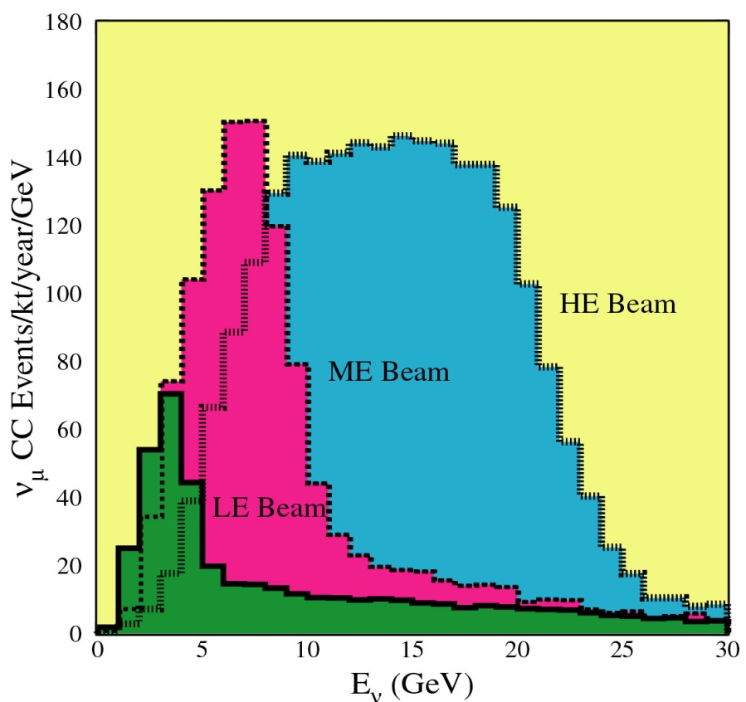
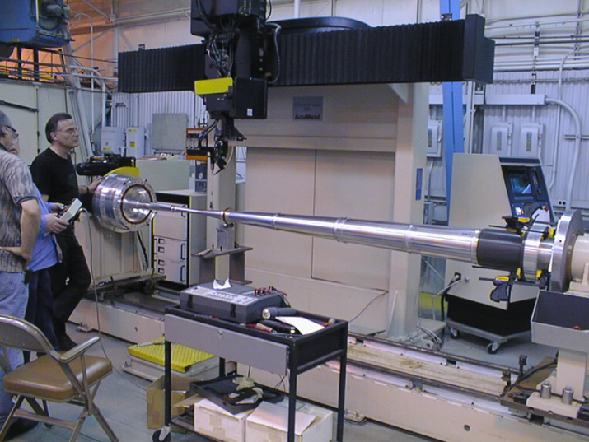
NuMI: variable energy beam
Far detector event spectra
3.8×10²⁰ pot/year
Parabolic inner conductor
Fully optimized spectra for each energy are obtained by moving the target and the 2nd horn, but most of the effect is due to the position of the target
in LE configuration, 2/3 of the target length is positioned inside the 1st horn

Slide 27
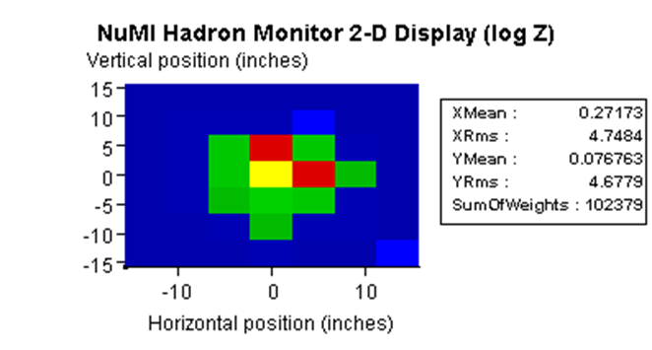
NuMI commissioning (2004-2005)
10th beam pulse !

Slide 28
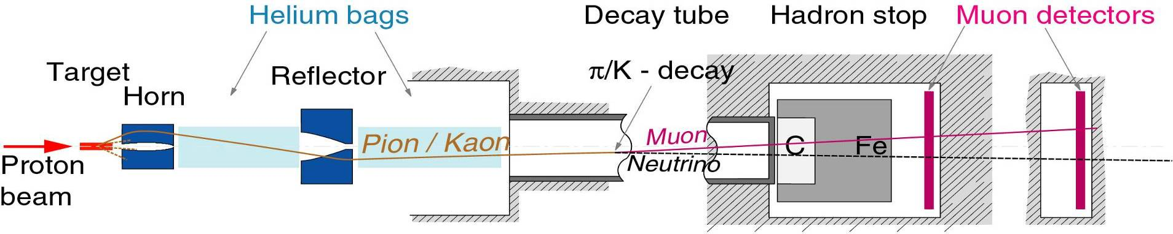
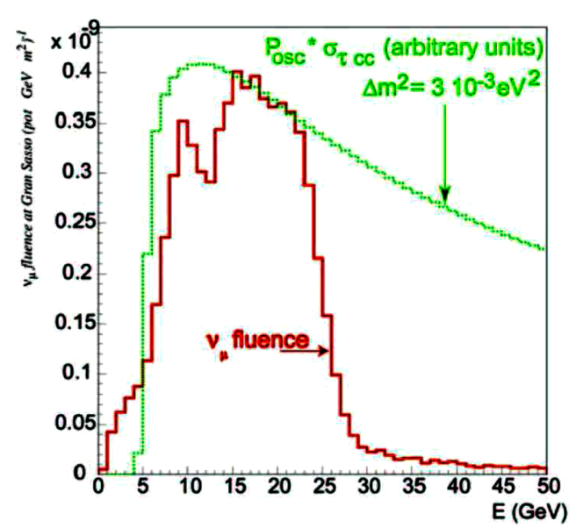
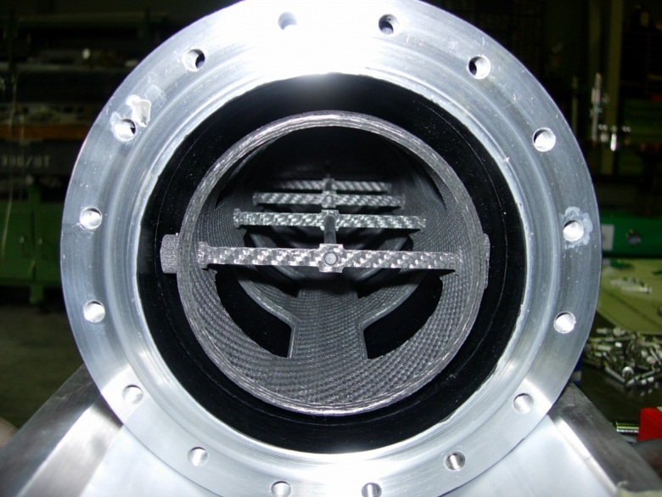
The CNGS ν beam
400 GeV/c
2.7m
43.4m
100m
1095m
18m
5m
67m
5m
13 graphite rods, 10 mm long, 5 mm Ø
in He atmosphere
Target configuration for high energy beam
Graphite rods
T_{graphite} ~ 990 ˚C
T_{C-C} ~ 375 ˚C
T_{He} ~ 365 ˚C

Slide 29
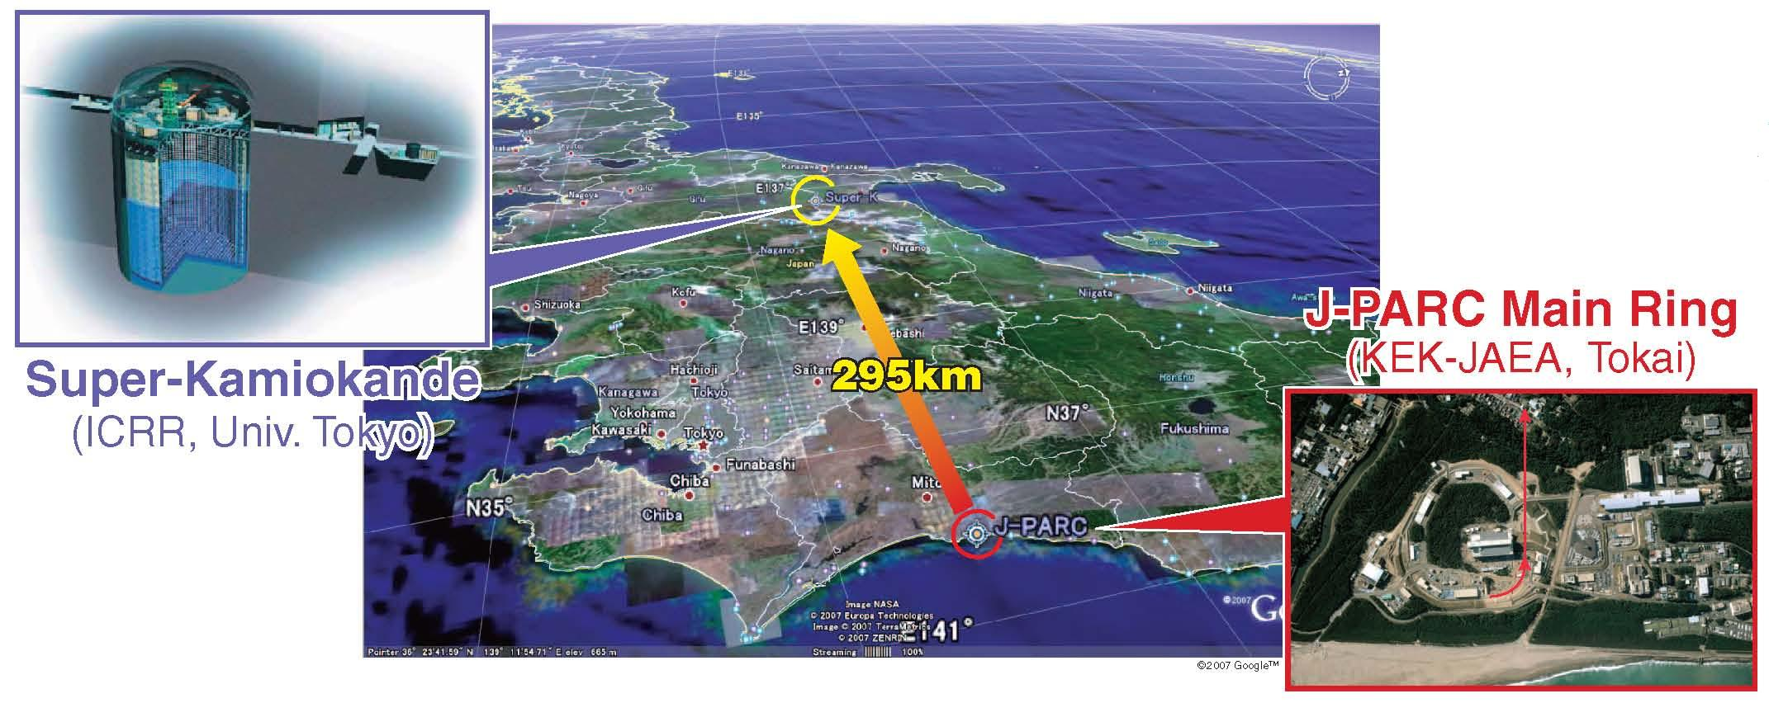

Tokai-to-Kamioka (T2K) experiment
30 GeV

Slide 30


The J-PARC ν beam

Slide 31




Present ν Facilities Summary

Slide 32
The ν_{μ} disappearance at the atmospheric Δm²
T2K
MINOS
MINOS
MINOS+

Slide 33
The leading ν_{μ} oscillation
CNGS OPERA
OPERA, arXiv:1407.3513
A ν_{τ} candidate in τ⁻→μ⁻ channel
ν_{μ} → ν_{τ} oscillations are established
with a significance of 4.2 σ
PRD 89, 051102(R) (2014)

Slide 34


First indications of electron neutrino appearance
T2K
T2K, PRL 107, 041801 (2011) MINOS, PRL 107, 181802 (2011)
Expected a background of 1.5±0.3 events

Slide 35
The sub-leading ν_{μ} oscillation

Slide 36

CP violation search…
2300 km
LBNO
LBNE

Slide 37
Main challenges in intense ν beams
Performance and reliability of high intensity proton accelerators. It takes time to reach the design values
Transport of high intensity proton beams to a target with minimal losses. A loss of a substantial fraction of the beam would melt the beam pipe, damage magnets, instrumentation...
Radiological aspects (prompt radiation, activation, groundwater protection, air activation) and control of corrosion (due to production of ozone and nitric acid in air)
Design of target and focusing system for high beam power
  Target survivability at high beam power (thermal shock stresses and radiation damage).
  Monolithic or segmented? Which cooling? Which material?
  Horn stresses due to beam energy deposition, magnetic stresses, Joule heating due to current
Cooling of the facility (target hall, decay pipe, beam absorber). If you dump 2 MW beam, you need a way to remove that power
Design of the beam dump at the end of the decay pipe

Slide 38

The FNAL accelerator upgrade
The Recycler (8-GeV) proton ring is now operational:
  Recently achieved 360 kW on target for NovA
  Aiming at 420 kW in 2015 and 700 kW in 2016
Proton Improvement Plan (PIP) has several goals:
  Increased reliability of the Linac/Booster complex
  Increased proton flux (15 Hz Booster operation)
PIP-II plans to build an 800 MeV superconducting pulsed linac (2023)
  1.2 MW to LBNE
PIP-III – Booster replacement. Linac or Ring? 2.4 MW to LBNF

Slide 39
The J-PARC accelerator upgrade
RCS
3 GeV
New 8 GeV Booster Ring
RCS 3 GeV
Main Ring
30 GeV
Mid-term Plan (by 2017): achieve 750 kW by increasing the rep rate from 0.4 Hz to ~1 Hz. Replace magnet PS’s and RF cavities.

Slide 40


The LBNE Facility Design
NEAR DETECTOR
Kirk Rd
Main Injector
Main Injector
60 ≤ E_{beam} ≤ 120 GeV
1.2 MW initially, upgradeable 2.4 MW

Slide 41

The LBNE
Neutrino Beamline
Target
Air & ater-cooled
Air-cooled
Water-cooled

Slide 42

Target Hall/Decay Pipe Layout
Decay Pipe concrete shielding (5.6 m)
Work Cell
helium-filled Decay Pipe
air-filled
4 m
204 m
steel
Geomembrane barrier system to keep groundwater out of decay region, target chase and absorber hall
Baffle/Target Carrier
Target Chase: 1.6 m/1.4 m wide, 24.3 m long

Slide 43


The LBNO facility design

Slide 44




High power targets
LBNE
NuMI-like design
T2K target, graphite, He cooled
Spherical array target, Beryllium, He cooled
RAL design

Slide 45




High power target materials R&D
RaDIATE
Collaboration
addresses radiation damage in several high power target
candidate materials aiming to determine useful lifetimes (includes graphite and beryllium)
High Intensity Beam Single Pulse Test @ CERN’s HiRadMat Facility
explore the onset of failure modes (crack initiation, fracture) of various beryllium grades/forms exposed to a high intensity, highly focused beam at the CERN SPS

Slide 46



High power beam dumps
CNGS beam Dump
Graphite blocks
T2K
LBNE design

Slide 47
ν recommendations from P5
• Recommendation 12: In collaboration with international partners, develop a coherent short- and long-baseline neutrino program hosted at Fermilab.
• Recommendation 13: Form a new international collaboration to design and execute a highly capable Long-Baseline Neutrino Facility (LBNF) hosted by the U.S. To proceed, a project plan and identified resources must exist to meet the minimum requirements in the text. LBNF is the highest-priority large project in its
timeframe.
• Recommendation 14: Upgrade the Fermilab proton accelerator complex to produce higher intensity beams. R&D for the Proton Improvement Plan II (PIPII)
should proceed immediately, followed by construction, to provide proton beams of >1 MW by the time of first operation of the new long-baseline neutrino facility.
• Recommendation 15: Select and perform in the short term a set of small-scale short-baseline experiments that can conclusively address experimental hints of physics beyond the three neutrino paradigm. Some of these experiments should use liquid argon to advance the technology and build the international community for LBNF at Fermilab.

Slide 48

A neutrino physicist once asked…
YES… we can surely shoot a neutrino beam up there

Slide 49

Thank You

