Slide 1
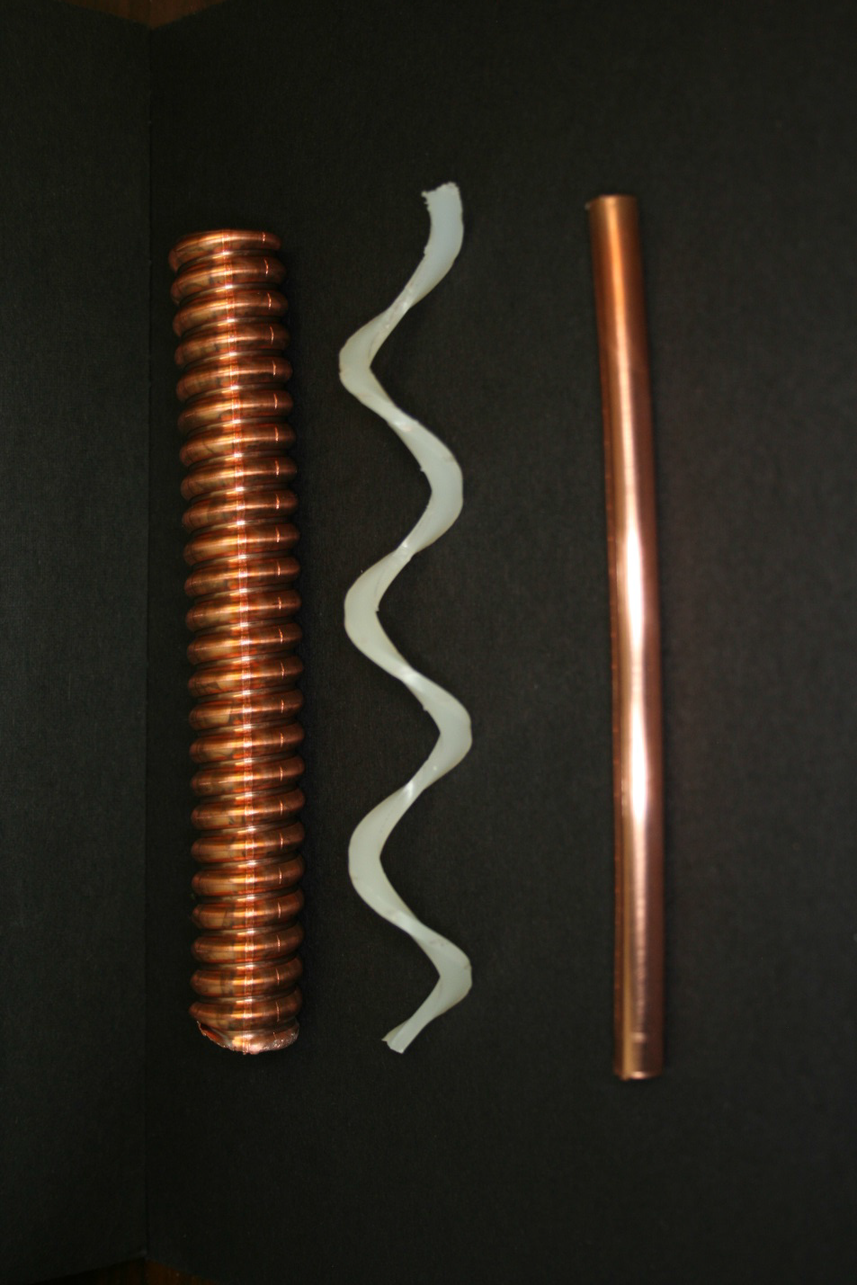
Total Loss Monitor Radiation Safety System
Neutrino Beams and Instrumentation Workshop 2014
A. Leveling
9/26/14

Slide 2
background:
At Fermilab, high power beams are being planned for existing facilities which have insufficient passive shielding, e.g.,
Muon Campus(13 W -> 8 kW)
Booster (~35 kW -> 80 kW)
Main Injector (700 kW -> 2 MW)
Supplemental shielding addition is not possible and/or very costly and/or impractical
Historically, Fermilab has used passive shielding in conjunction with interlocked radiation detectors to provide comprehensive protection necessary to meet the requirements of the Fermilab Radiological Controls Manual (FRCM)

Slide 3
Motivation for TLM:
Large numbers of additional interlocked detectors (chipmunks) would be required for some installations, e.g.,:
Muon campus (42->200 - mu2e experiment)
Booster (48->? – PIP/PIP-II)
AD received encouragement from the Fermilab ESH&Q Section in May 2011 to pursue development of a long detector system

Slide 4
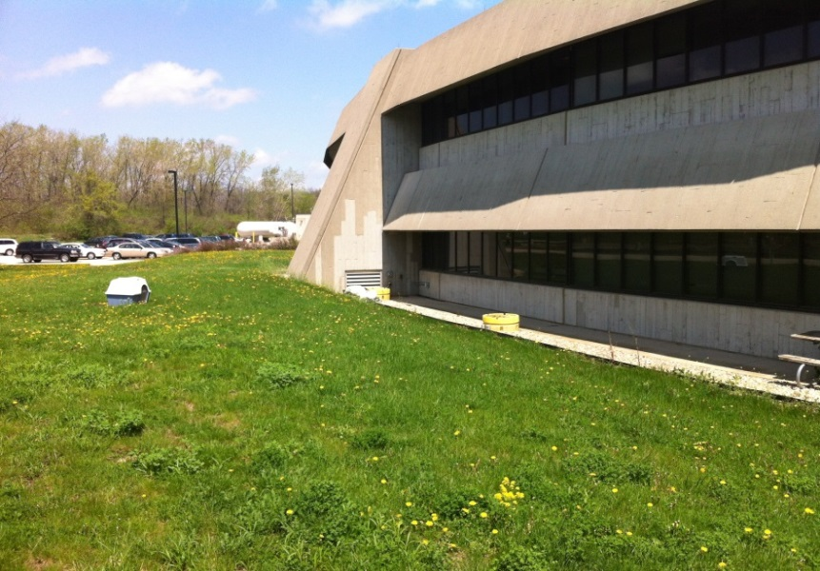
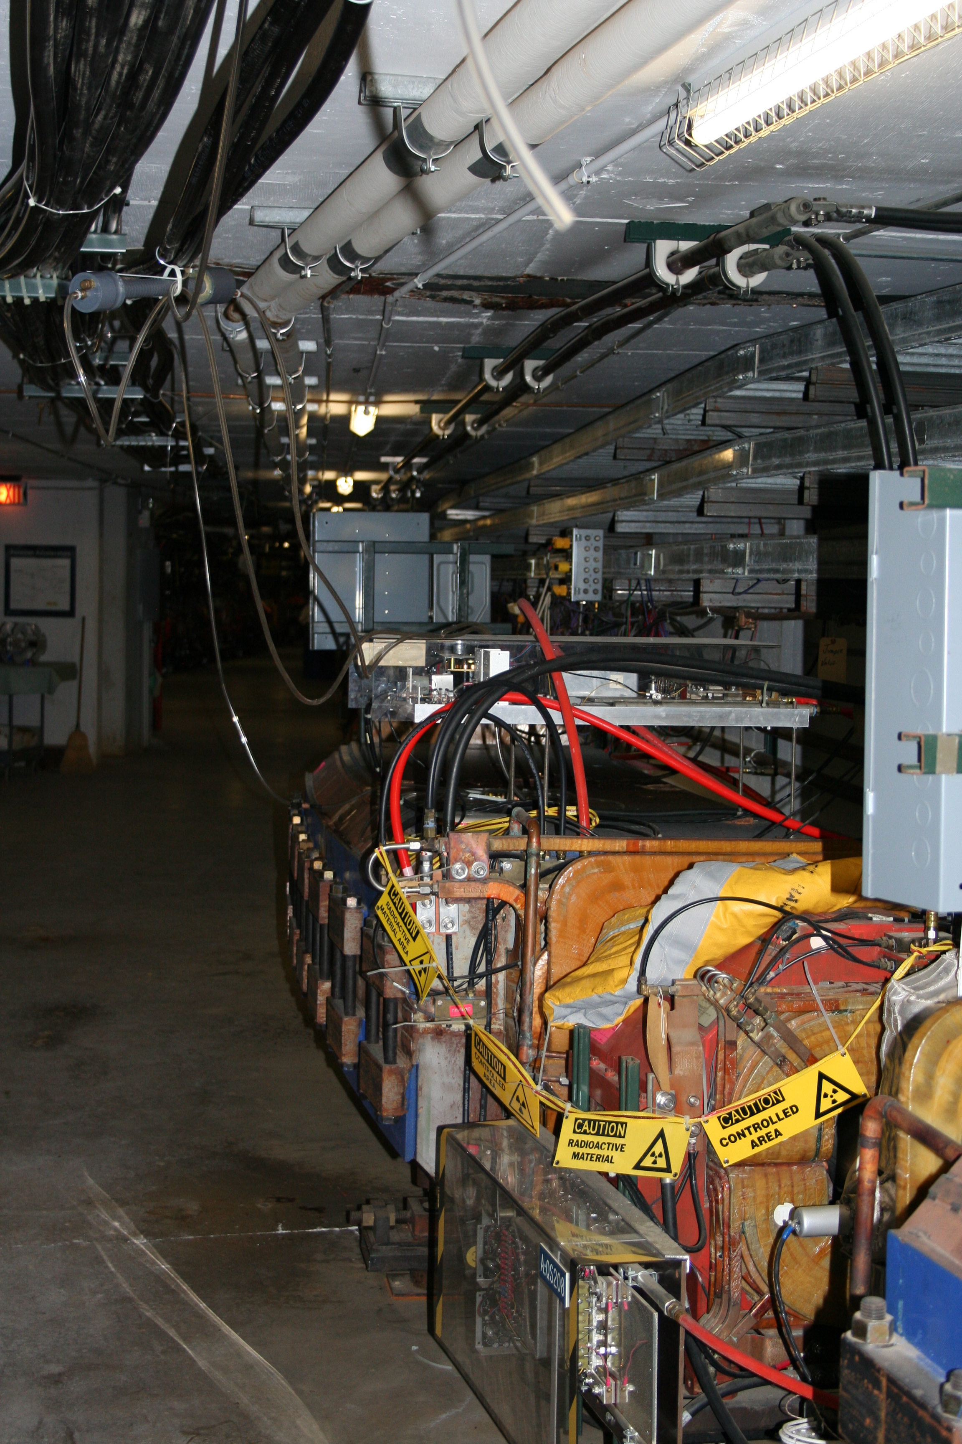
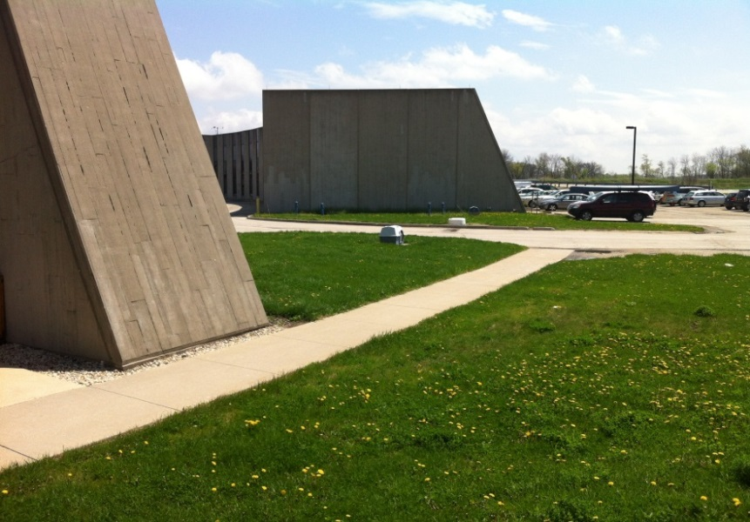
Examples of Chipmunk and TLM installations
Chipmunks provide
discrete, above-ground
coverage
3 parallel TLM detectors
125’
250’
350’
Pbar
A2B7
magnet
Scheme works fine for known limiting apertures
TLM provides
continuous, in-tunnel
coverage

Slide 5
TLM system diagram
Detector works in ion chamber mode
800 volt detector bias
Argon/CO₂ detector gas
Nominally 25 cc/min
Electrometer output is calibrated in units of nC/TTL pulse
Heartbeat provided by 10 Tohm resistor (83 pA = 5 nC/min)

Slide 6
TLM system design requirements:
Limit beam losses to the level of 1 watt/meter
The TLM electrometer must be able to collect charge with a 100% duty factor, i.e., no dead time for integrator reset
TLM system must connect directly to the existing Radiation Safety System (RSS), via existing radiation interlock cards
Include a rigorous testing program and calibration schedule
The response of the TLMs must be characterized and /or predictable for a wide range of beam loss conditions
The TLM system must be fail safe; i.e., the (RSS) must be disabled if:
TLM chassis loses power
Motherboard voltages go out of tolerance
TLM detector is disconnected from its electrometer
TLM heartbeat is lost (provided by 83 pA leakage current)
TLM bias voltage falls outside tolerance
The TLM gas flow is lost, (nominally 25 cc/min)

Slide 7
Setting TLM trip levels:
Determine the worst case beam loss condition by:
Evaluation of the possibilities, then
MARS simulation(s), and/or
Measurement
The worst case condition includes consideration of:
Beam enclosure geometry
Maximum beam intensity lost (MBL)
Beam energy
Amount of shielding present

Slide 8
Setting TLM trip levels:
Posting and controls for region determined allowable beam intensity lost (ABL)
The TLM response to the worst case condition (TLM_{max}) is determined by:
Measurement, or
By MARS simulation
TLM trip level is set by scaling:
Trip Level = TLM_{max} x ABL / MBL

Slide 9
TLM trip level philosophy:
The trip level has to be safe AND it has to allow normal losses with reasonable margin for variances in operation
Avoid spurious/unnecessary system trips
TLM cannot distinguish between single point, localized losses and losses distributed over its entire length
This implies the trip levels are conservative
Trip levels are to be determined by the laboratory’s well-developed, shielding assessment process

Slide 10
Possible applications:
Limit effective dose rate outside of radiation shields
Implicitly includes control of radiation skyshine
Limit beam loss to 1 W/m
Limit surface water, ground water, and/or air activation

Slide 12
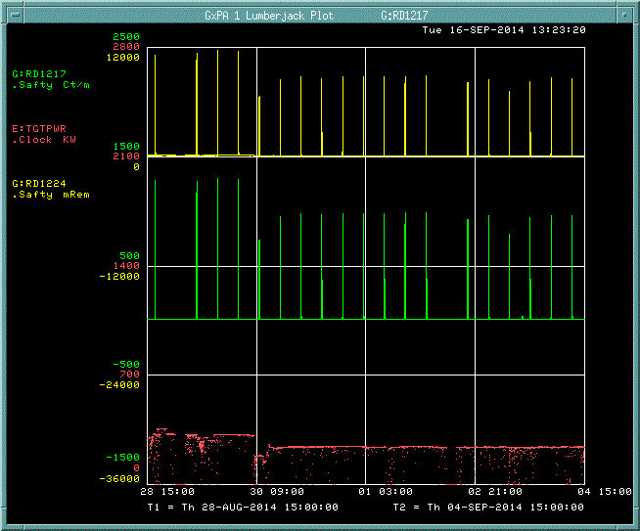
Example application: NuMI groundwater protection
Scarecrow in NuMI tunnel
(existing GW protection)
800’ TLM response
NuMI beam power
A seven day operating period August 20 -> September 4, 2014

Slide 13
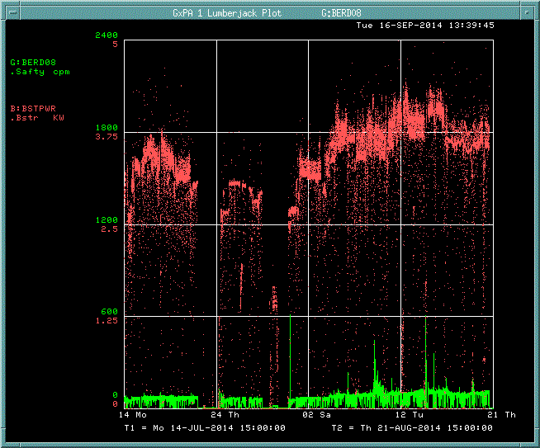
Example application: Booster shielding
Proposed TLM trip limit
Booster beam power
180’ TLM response
A thirty-eight day operating period July 14 -> August 21, 2014

Slide 14
Timeline:
Development began in May 2011
Extensive detector response testing October 2011 to present
Preliminary approval granted by Fermilab ESH&Q in May 2014
Full demonstration application begins October 2014
Entire Booster Ring covered by 8 systems
In parallel with the existing system of 48 chipmunks
One redundant detector cable
Accelerator Division will seek final approval of the system in CY2015

Slide 15
Extra slides

Slide 16
Detector Cable
HJ5-50, HELIAX® Standard Air Dielectric Coaxial Cable, corrugated copper, 7/8 in,
black PE jacket

Slide 17
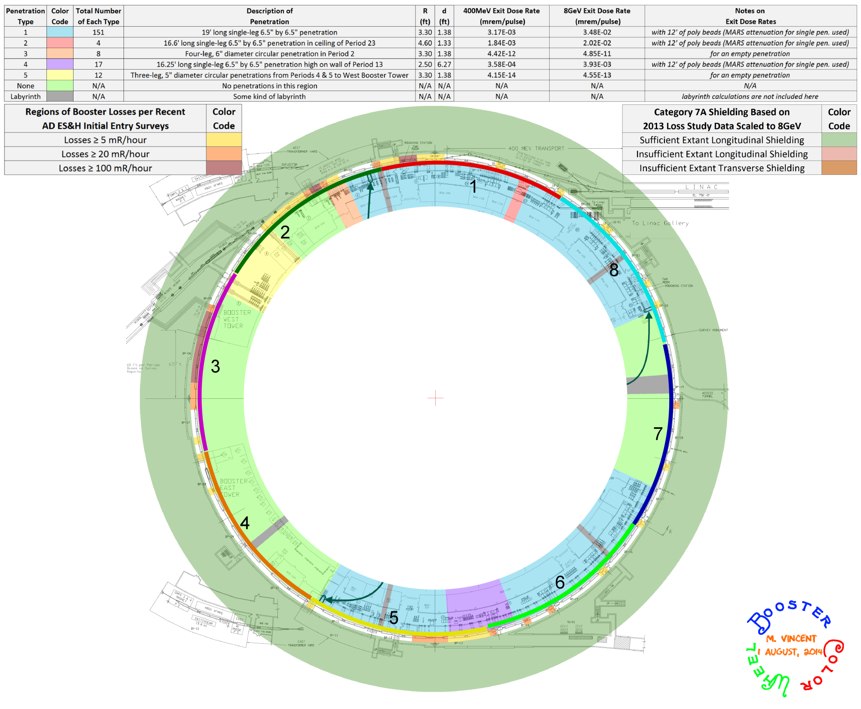
Booster TLM installation plan

Slide 18
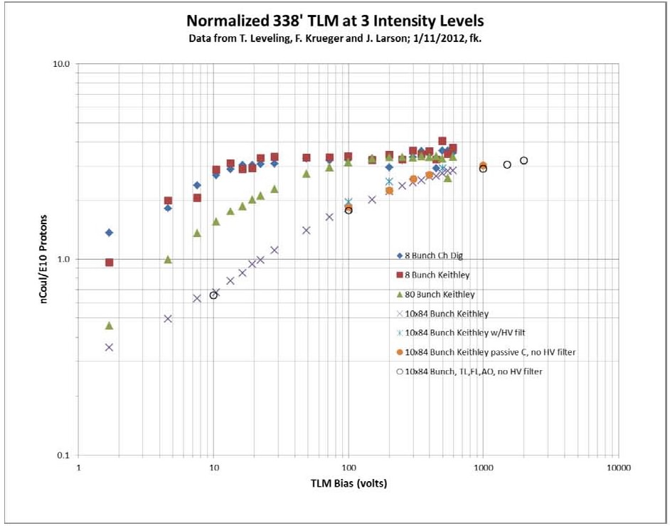
TLM response to 8 GeV proton beam loss at A2B7 magnet at Accumulator
Argon detector gas

Slide 20
Critical shielding thickness
A layer of shielding which must be present to limit the delivered dose over an interval at which the TLM system can respond
The resulting dose that could be delivered must fall below limits established by the Fermilab Radiological Controls Manual for the desired posting and occupancy condition

