Slide 1
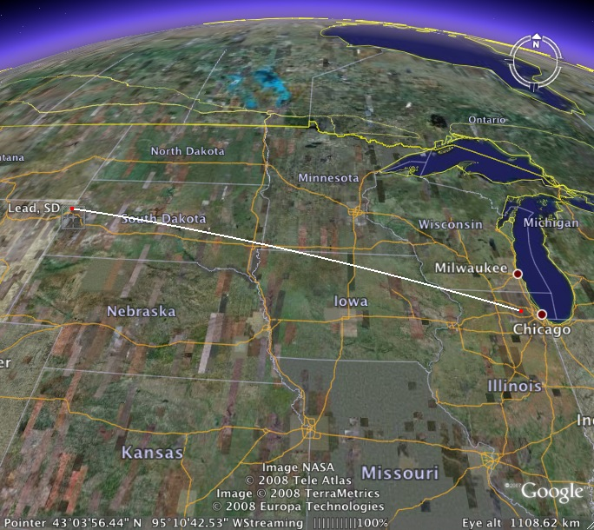
Long-Baseline Neutrino Experiment
LBNE Lattice & Line Design
John A. Johnstone
Fermilab
JJohnstone@fnal.gov
September 24th, 2014
9th Neutrino Beam & Instrumentation Workshop
September 23-26th 2014

Slide 2
Ovtline
Design Overview
Trajectory
Magnets
Optics
Lattice Functions
Beam Envelope & Magnet Apertures
Final Focus & Spot Size Tuning
MI-10 Extraction
Summary
Other Stuff
Sensitivity to Gradient Errors
Trajectory Control
Power Supply Ripple Effects
Known Interferences
Magnet Parameters

Slide 3
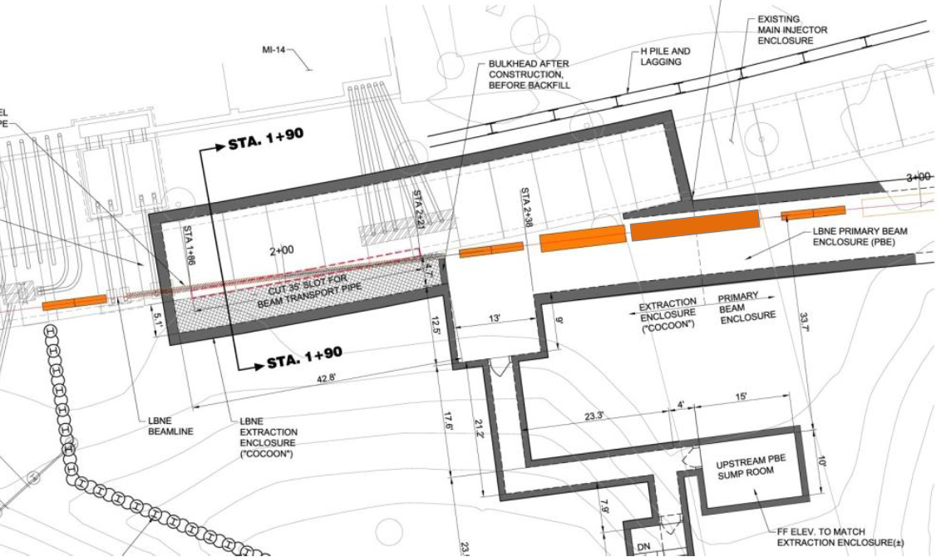
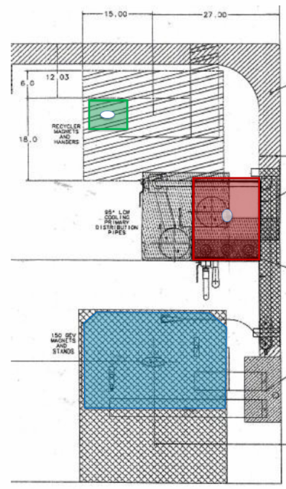
MI-10 Tunnel → LBNE Enclosure Transfer
Q205
RECYCLER
CARRIER PIPE
Q204
LBNE Q204
INJECTOR
Transport from the existing MI tunnel enclosure into the new LBNE enclosure showing the carrier pipe connecting the MI-10 & LBNE enclosures (left), and separation of Q204 at the u/s end from the Main Injector & Recycler Rings (right).

Slide 4
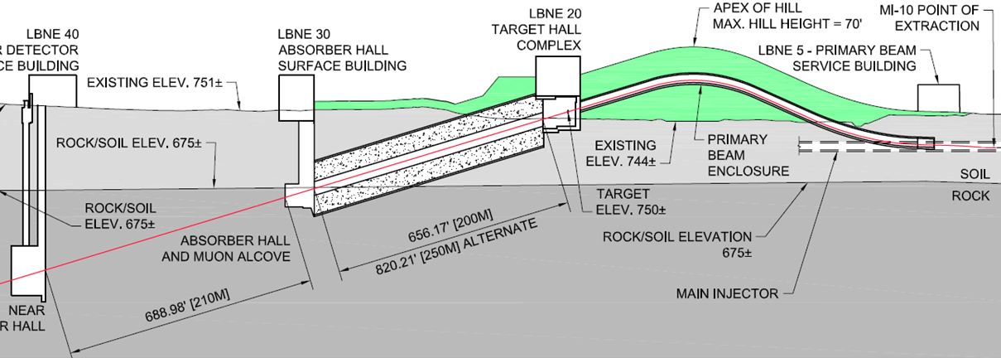
Primary Beam & Hill Cross-section
THE PRIMARY BEAMLINE EXTRACTS PROTONS FROM MI-10 & TRANSPORTS TO THE TARGET ABOVE GRADE
BLC apex elev. @ 30 ft above grade
Target elev. @ 10 ft above grade

Slide 5
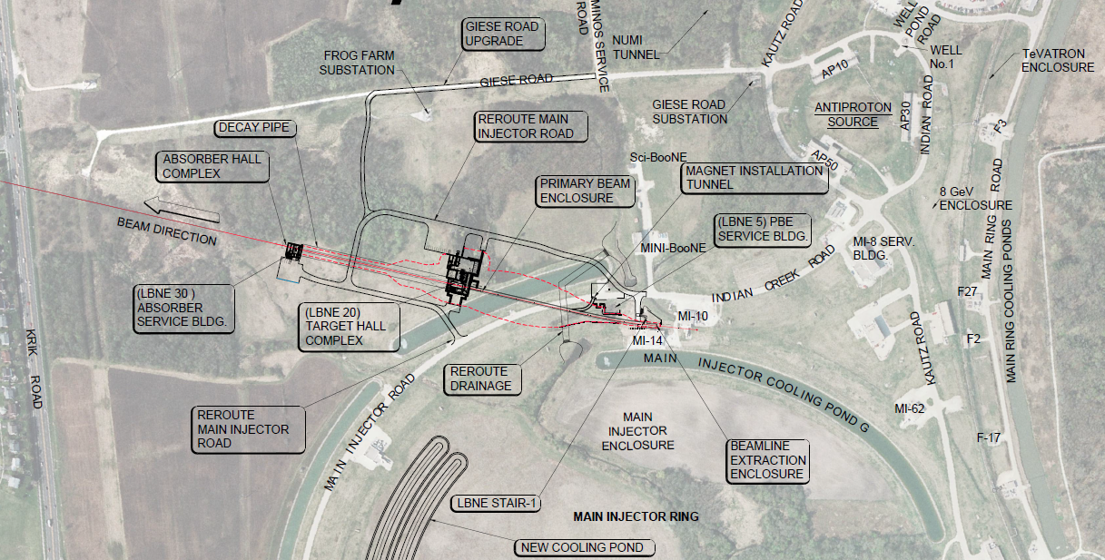
Aerial View of LBNE Trajectory
?

Slide 6
Trajectory
Beam is extracted vertically from MI-10 via 5 horizontal kicker modules d/s of MI quad Q100, and 3 Lambertsons plus a C-magnet straddling MI Q102.
A rolled dipole steers the beam through the enclosure wall, while bisecting the MI & Recycler magnet elevations.
In the LBNE tunnel the beam is bent 7.2º horizontally to align with SURF in South Dakota, and upwards by 143 mr. A second series of vertical dipoles bend the beam down through 244 mr to complete vertical alignment to SURF, with φ = -101 mr.
Target elevation is fixed at 750 ft (~10 ft above grade) & maximum BLC elevation is 770 ft (~3 stories above grade).
Distance from MCZERO to center of LAr FD = 1286873.765 m ±

Slide 7
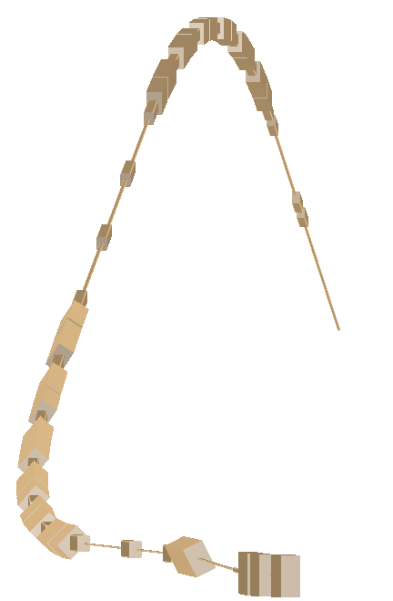
LBNE – the Ride
WCD
*
Beam Direction
~732 m
TARGET
*
33 kt LAr
MI-10

Slide 8
Magnet Complement
All major magnets are well-understood, proven designs
In the main body of the line all dipoles are Main Injector-style IDA/IDB (6m) & IDC/IDD (4m) magnets
Quadrupoles are all of the MI-style 3Q120 (3.048 m) or the shorter 3Q60 version (1.524m)
New IDS trims have 3” pole tip gap & design spec of 250 μr (RMS).
IDA/IDB sagitta = 11.7 → 18.6 mm c.f. 16 mm design nominal
IDC/IDD sagitta = 5.2 → 8.3 mm c.f. 7 mm design nominal
Magnet | Common Name | Steel Length | Strength at 120 GeV | Count
Kickers | NOvA extraction type | 1.295 m | 0.0589 T | 5
ILA | MI Lambertson | 2.800 m | 0.532 / 1.000 T | 3
ICA | MI C Magnet | 3.353 m | 1.003 T | 1
IDA/IDB | MI Dipole 6 m | 6.100 m | 1.003 – 1.604 T | 13
IDC/IDD | MI Dipole 4 m | 4.067 m | 1.003 – 1.604 T | 12
QQB | MI 3Q120 quadrupole | 3.048 m | 9.189 – 16.546 T/m | 17
QQC | LBNE 3Q60 quadrupole | 1.524 m | 11.135 – 17.082 T/m | 4
IDS | LBNE trim dipoles | 0.305 m | Up to 0.365 T | 23

Slide 9
Optics
To avoid losses the beam size in the LBNE transfer line can not exceed that of the Main Injector circulating beam.
The ultra-clean transport requirements virtually compel the lattice to be configured from distinct optical modules.
Every focusing center has a dual-plane BPM & dipole corrector
Every half-cell has space reserved for a multi-wire or other diagnostics.
Spot-size on target must be tunable over a wide range: from σ ~ 1.0 → ~4.0 mm to accommodate a beam power upgrade to 2.4 MW.
Physics dictates it must also be continuously tunable over the range 60 → 120 GeV/c for optimizing the neutrino oscillation spectrum.
Satisfying the above conditions requires that the final focus β* be tunable over a range x32 (!).
___________________________________________________________________________________________________
Subsequent discussions , unless stated otherwise, assume nominal MI beam parameters of ε₉₉= 30π μm (normalized) & Δp₉₉/p = 11.e-4, with σ* = 1.50 mm.

Slide 10
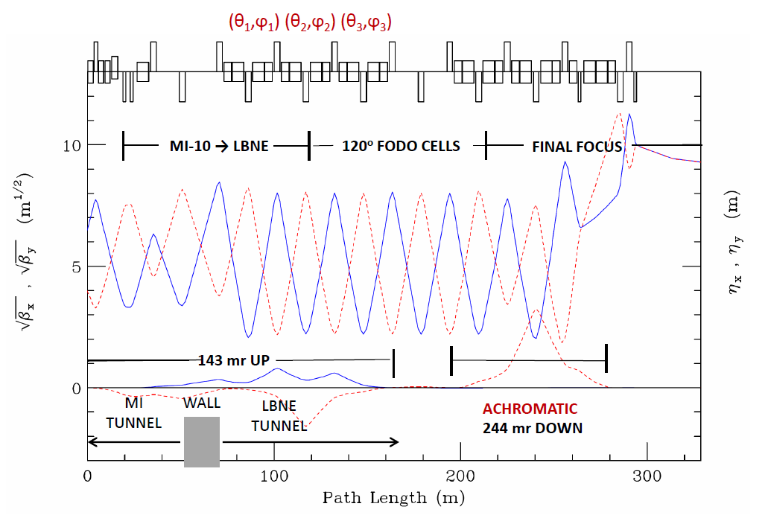
Lattice Functions
Horizontal (solid) and vertical (dashed) lattice functions of the LBNE transfer line
The final focus is tuned for σ_{x} = σ_{y} = 1.50 mm at 120 GeV/c with β* = 86.33 m and nominal MI beam parameters ε₉₉ = 30π μm & Δp₉₉/p = 11x10⁻⁴

Slide 11
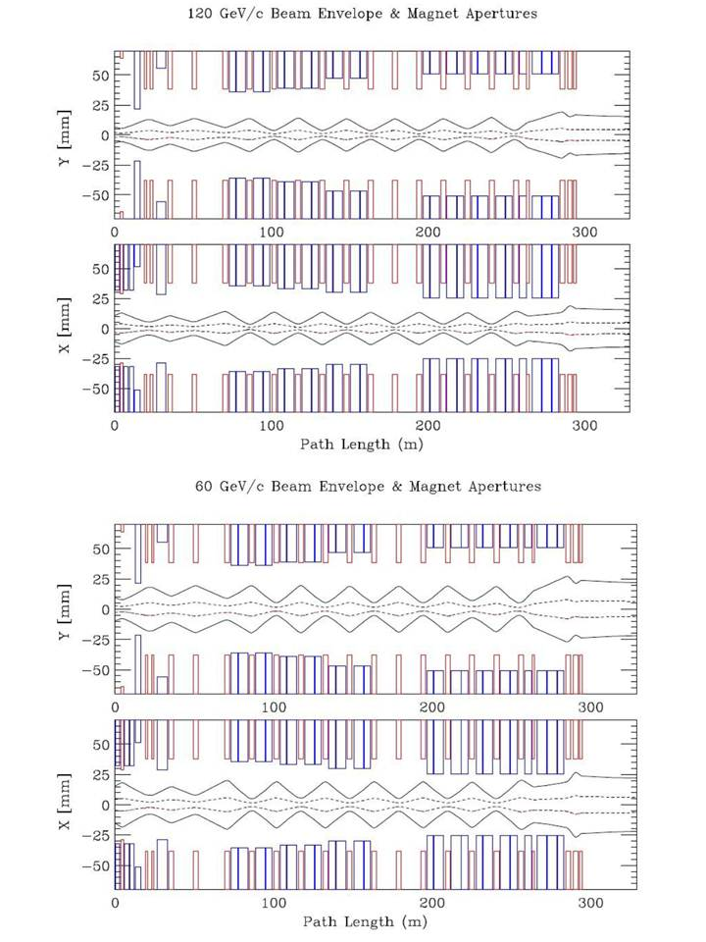
Beam Envelopes & Magnet Apertures
Dipole apertures, shown in blue, include the effects
of sagitta & rolls.
Quadrupole apertures are red.
The 99% envelopes (dashed) represent nominal MI beam parameters
[ ε₉₉ = 30π μm & Δp₉₉/p = 11.e-4 ];
The 100% envelopes (solid) correspond to the MI admittance at transition .
[ ε₁₀₀ = 360π μm & Δp₁₀₀/p = 28.e-4 (γ_{t} = 21.600) ]
The beamline can transport, without losses, the worst quality beam that the MI could conceivably transfer.

Slide 12
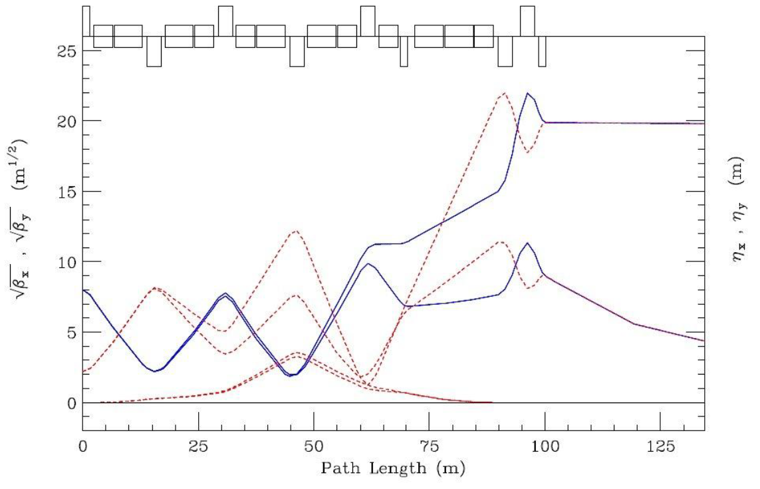
Final Focus & Spot-Size Tuning
120 GeV : σ* = 3.2mm
60 GeV : σ* = 1.0mm
η_{y}
The extremes shown correspond to: 60 GeV/c with σ* = 1.0mm; β* = 19.184m and βmax = 104m (lower), and; at 120 GeV/c with σ* = 3.20mm; β* = 393 m and βmax = 483 m (upper). Horizontal values are displayed as solid curves & vertical values are dashed.
In principle the spot –size can be tuned to σ* = 4.00mm, but the 3.20mm limit arises from the 360π mm-mr horizontal acceptance of the final down bend.

Slide 13
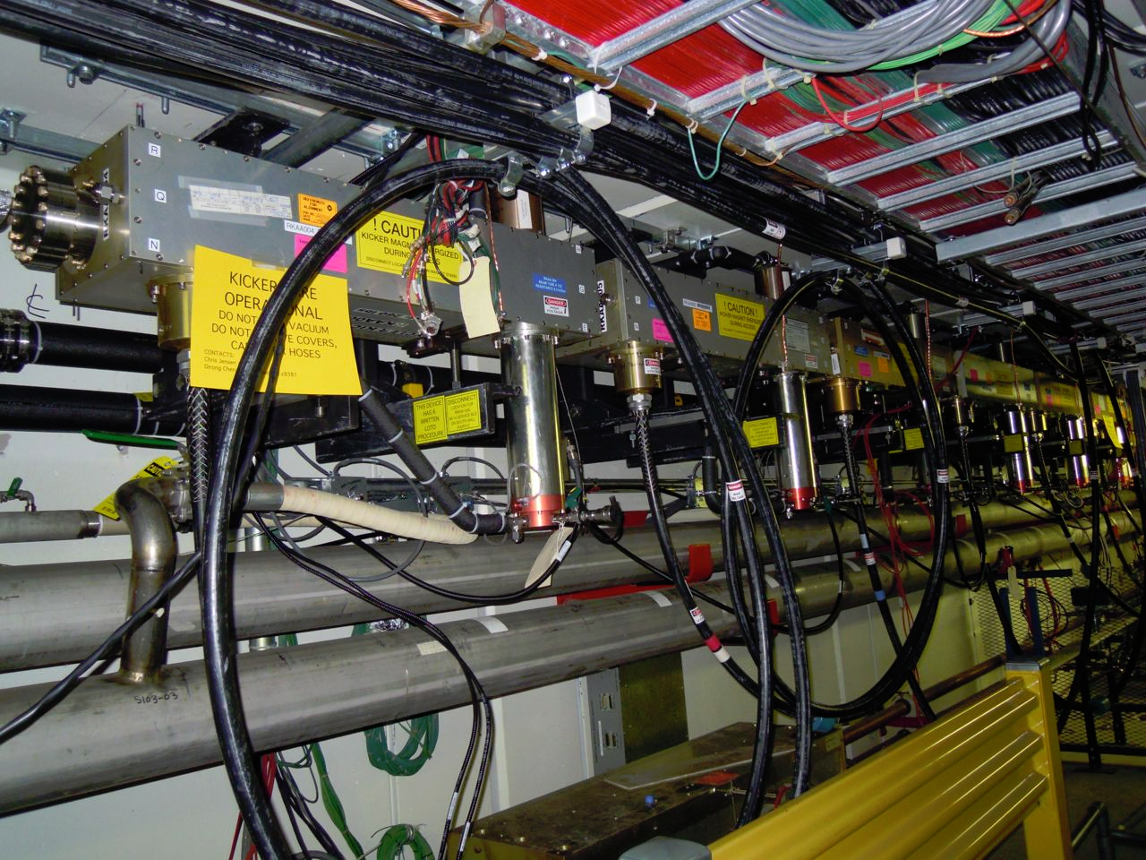
MI-10 Extraction
WCD
*
~732 m
*
MI Q104 looking upstream

Slide 14
Extraction Element Configuration
LBNE extraction Lambertsons and C-magnet straddling MI quad Q102
LBNE extraction elements and their configuration are clones of those found at other MI extraction points.

Slide 15
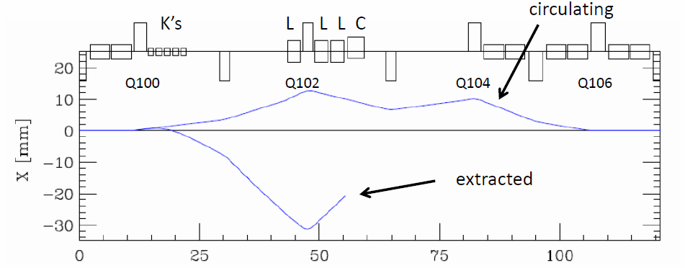
Closed Orbit & Extraction Trajectory through MI-10
Circulating & extracted beam trajectories through MI-10
Closed Orbit Bump Quad Offsets
(mm)
Q100 2.064
Q102 2.358
Q104 2.171
Q106 2.164
Extracted Beam Elements
Q100 2.064 mm
Kickers 5 x -190.0 μr (0.693 kG/module)
Q102 2.358 mm
LAM1 0.523 T
LAM2&3 0.998 T
C-MAG 0.998 T

Slide 16
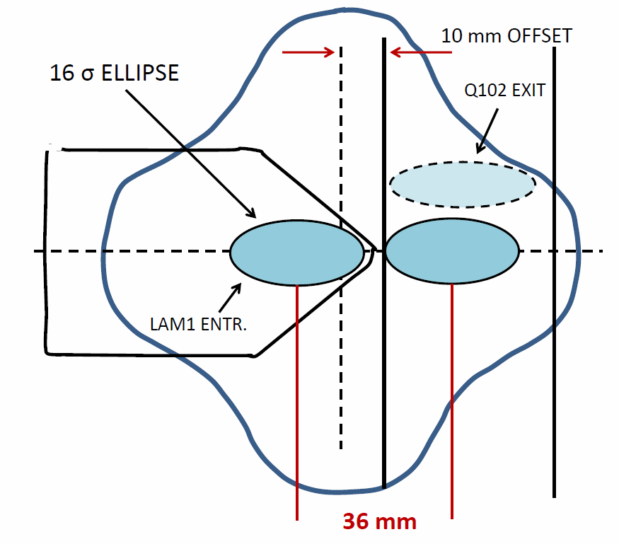
Beam-Beam Separation in Quad 102
Large Aperture Quad
5⁵/₈ x 5⁵/₈ Star Chamber
Circulating & extracted beams through Lam1 & Q102
Closed orbit bump is created by transverse offsets of focusing quads.
Kickers create 36.2 mm separation at the 1st Lambertson entrance between circulating & extracted beams.

Slide 17
MARS Extraction Tracking
Normalized 100% beam emittance is ε₁₀₀ = 360π mm-mr
10,000 points are selected on a surface in 4-dimensional (x,x’;y,y’) phase space
Extraction tracking is from the u/s end of Q100 to the end of the 3rd Lambertson

Slide 18
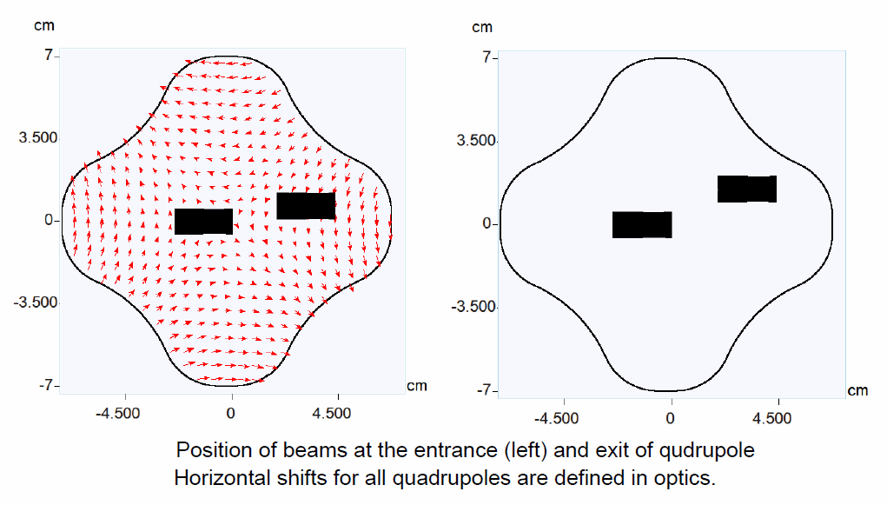
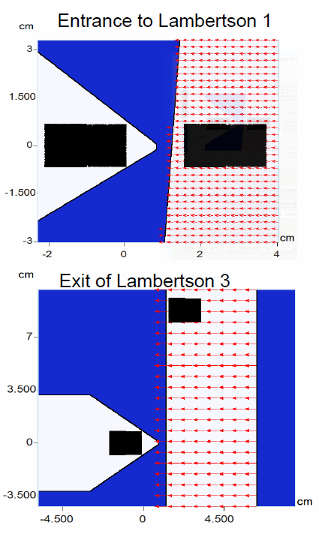
Beam-Beam Separations from MARS
There is sufficient aperture to provide loss-free extraction of a normalized ε_{N} = 360π µm emittance beam (10.6 σ)

Slide 19
Summary
Beam is extracted at MI-10 & transported to a target above grade.
The lattice design is comprised entirely of proven MI-style magnets.
MI-10 extraction configuration & the beamline provide for loss-free transmission of a 10.6σ beam.
The final focus is continuously tunable from σ* = 1.00 → 4.00 mm over the entire momentum range 60 → 120 GeV/c
Ω

Slide 20
Other Stuff
Sensitivity to Gradient Errors
Trajectory Control
Power Supply Ripple Effects
Known Interferences
Magnet Parameters

Slide 21
Sensitivity to Gradient Errors
Not An Issue!
Experience has shown the MI-style 3Q120 quadrupoles to be of very high accelerator quality^{Ϯ}
σ(ΔG/G) ∼ 0.08% or less, which can be reduced even further for the FODO section with only rudimentary sorting.
A simple thin-lens calculation predicts that even the largest error-wave generated in the 99% beam envelope [±3.74mm at β = 59.6m] would be < 70 microns.
_________________________________________________________________
Ϯ Magnet Test Facility measurement data base.
21

Slide 22
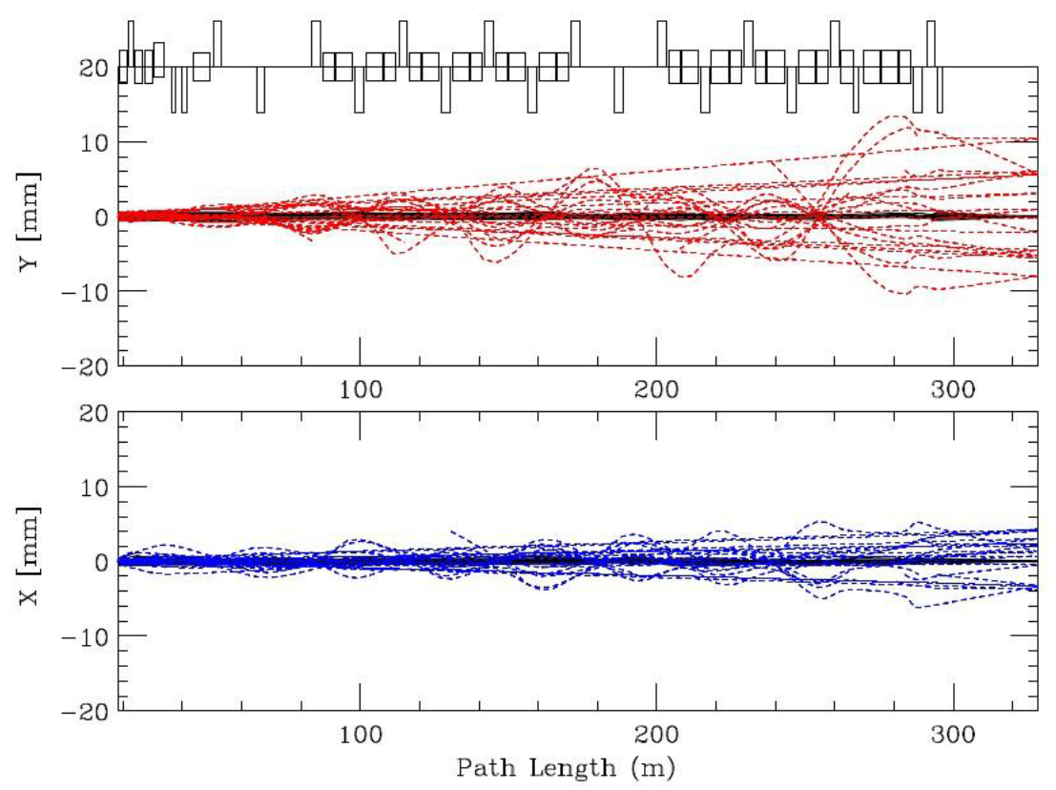
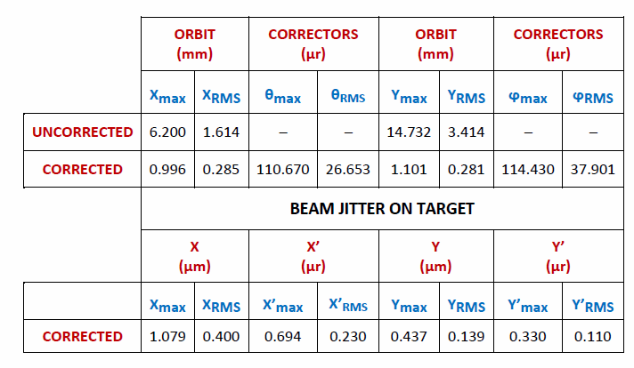
Trajectory Control
Misalignments (including BPM’s)
σ(Δx,Δy) = 0.25 mm
σ(ψ_{roll}) = 0.50 mr
Dipole Field Errors
σ(ΔB/B) = 10e-4
Uncorrected/corrected trajectories with random misalignments and dipole field errors
The plot begins at the u/s end of the 1st Lambertson.
New IDS design spec is 250 μr (RMS).
22

Slide 23
Known Interferences
C-magnet – MI Beamtube ✓
Q201A/B – MI Q103 ✓
HT201A – MI Beamtube ✓
VT203 – MI Tunnel Wall ✓
Q204 – LBNE Enclosure Wall ✓
V217A/B Overlap ✓
LBNE – Recycler Co-existence

Slide 24
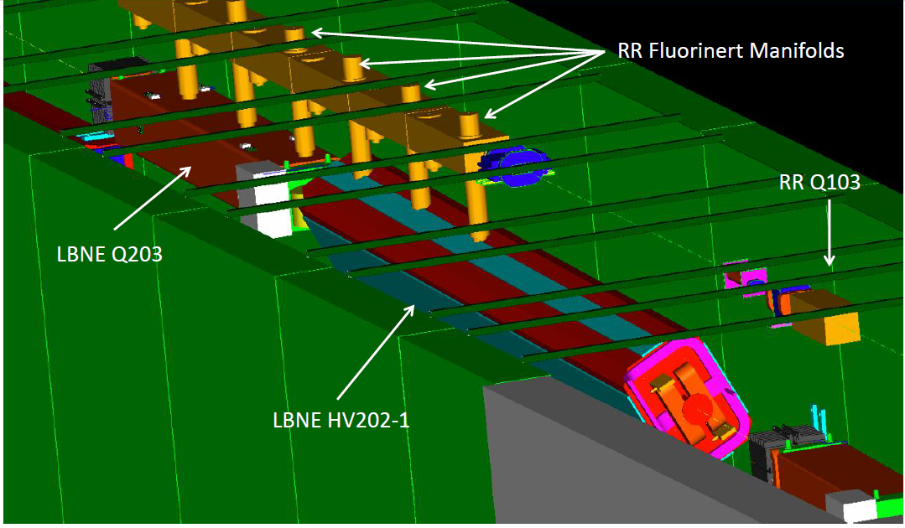
LBNE– Recycler Co-existence
Coraggio ! Avanti !

Slide 25
Magnet Parameters
DIPOLE TYPE (#) | L (m) | B (T) | TILT (deg) |  | QUAD NAME (#) | TYPE | L (m) | G (T/m)
MI-10 EXTRACTION → LBNE
LAM1 | 2.8000 | 0.53242 | −90.000
 |  |  |  |  | Q102 | 3Q84 | 2.134 | +16.16016
LAM12 (2) | 2.8000 | 1.00000 | −90.000
V100 | 3.3528 | 1.00284 | −90.000
MATCH FROM MI → LBNE FODO LATTICE & 143 mr UP BEND
 |  |  |  |  | Q201→202 | 3Q60 | 1.524 | −11.13509
IDA/B | 6.09981 | 1.22335 | +62.844
 |  |  |  |  | Q203 | 3Q120 | 3.048 | +12.48756
 |  |  |  |  | Q204 | 3Q120 | 3.048 | −9.18907
 |  |  |  |  | Q205 | 3Q120 | 3.048 | +13.06221
IDC | 4.06654 | 1.38347 | −44.126
IDB | 6.09981 | 1.38347 | −44.126
 |  |  |  |  | Q206 | 3Q120 | 3.048 | −13.52413
IDA | 6.09981 | 1.38347 | −44.126
IDD | 4.06654 | 1.38347 | −44.126
 |  |  |  |  | Q207 | 3Q120 | 3.048 | +16.16931
IDC | 4.06654 | 1.10813 | −48.179
IDB | 6.09981 | 1.10813 | −48.179
FODO CELLS
 |  |  |  |  | Q208 | 3Q120 | 3.048 | −15.83240
IDA | 6.09981 | 1.10813 | −48.179
IDD | 4.06654 | 1.10813 | −48.179
 |  |  |  |  | Q209 | 3Q120 | 3.048 | +15.83240
IDC | 4.06654 | 1.00297 | −56.109
IDB | 6.09981 | 1.00297 | −56.109
 |  |  |  |  | Q210 | 3Q120 | 3.048 | −15.83240
IDA | 6.09981 | 1.00297 | −56.109
IDD | 4.06654 | 1.00297 | −56.109
 |  |  |  |  | Q211→213 (3) | 3Q120 | 3.048 | ±15.83240
244 mr ACHROMATIC DOWN BEND & FINAL FOCUS ON TARGET
IDC | 4.06654 | 1.60431 | +90.000
IDB | 6.09981 | 1.60431 | +90.000
 |  |  |  |  | Q214 | 3Q120 | 3.048 | −13.96520
IDA | 6.09981 | 1.60431 | +90.000
IDD | 4.06654 | 1.60431 | +90.000
 |  |  |  |  | Q215 | 3Q120 | 3.048 | +16.54570
IDC | 4.06654 | 1.60431 | +90.000
IDB | 6.09981 | 1.60431 | +90.000
 |  |  |  |  | Q216 | 3Q120 | 3.048 | −15.26976
IDA | 6.09981 | 1.60431 | +90.000
IDD | 4.06654 | 1.60431 | +90.000
 |  |  |  |  | Q217 | 3Q120 | 3.048 | +13.81046
IDC/D | 4.06654 | 1.60431 | +90.000
 |  |  |  |  | Q218 | 3Q60 | 1.524 | −17.08214
IDA/B | 6.09981 | 1.60431 | +90.000
IDA/B | 6.09981 | 1.60431 | +90.000
IDC/D | 4.06654 | 1.60431 | +90.000
 |  |  |  |  | Q219 | 3Q120 | 3.048 | −10.53138
 |  |  |  |  | Q220 | 3Q120 | 3.048 | +15.80329
 |  |  |  |  | Q221 | 3Q60 | 1.524 | −13.39482

Slide 26
Backoff Interference Pictures

Slide 27
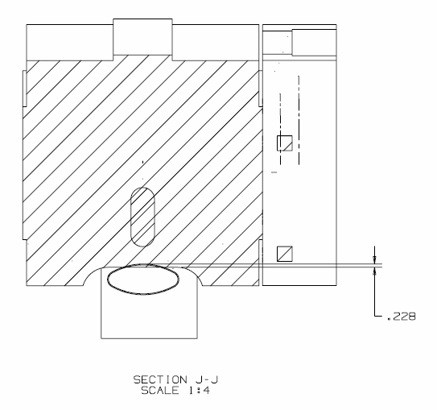
C-magnet – MI Beamtube

Slide 28
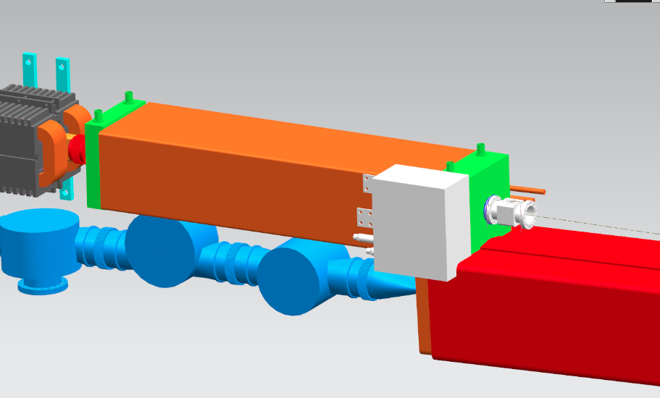
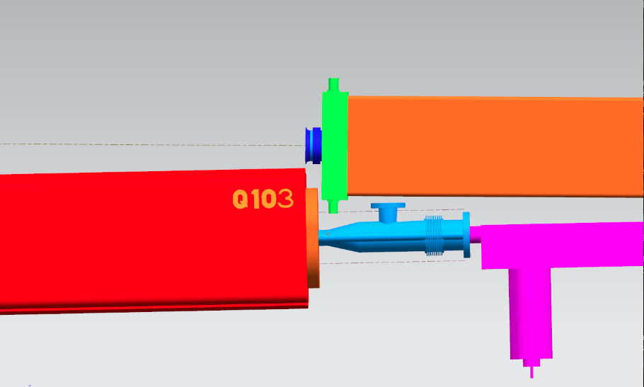
Q201A/B – MI Q103 & HT201A – MI Beamtube

Slide 29
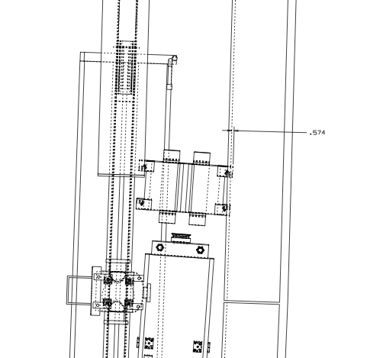
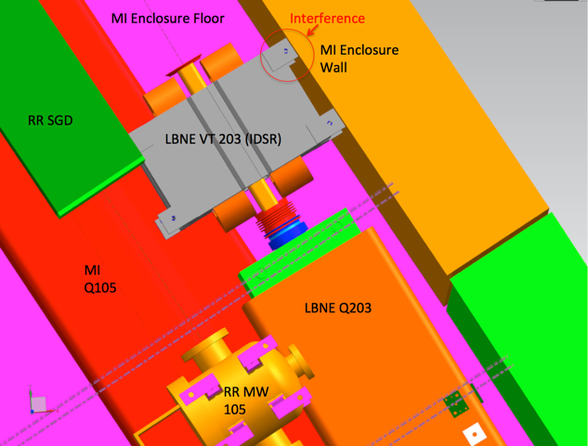
VT203 – MI Tunnel Wall

Slide 30
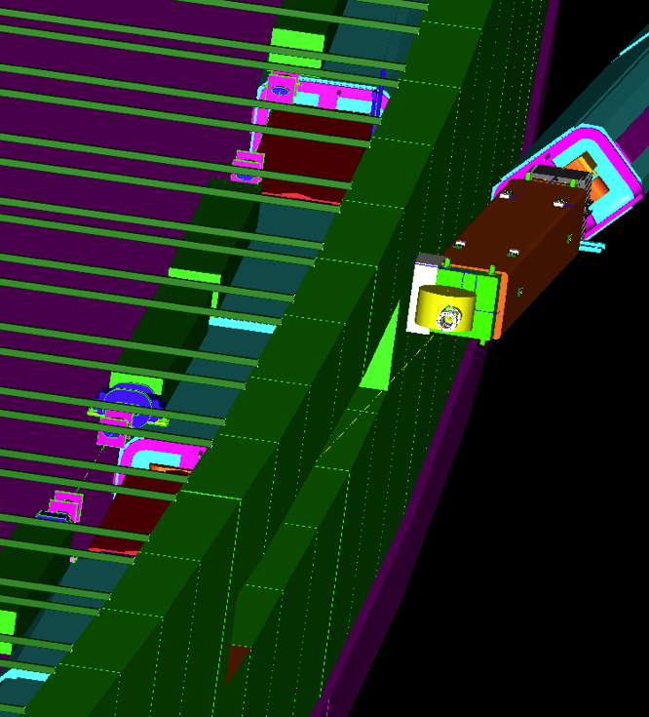
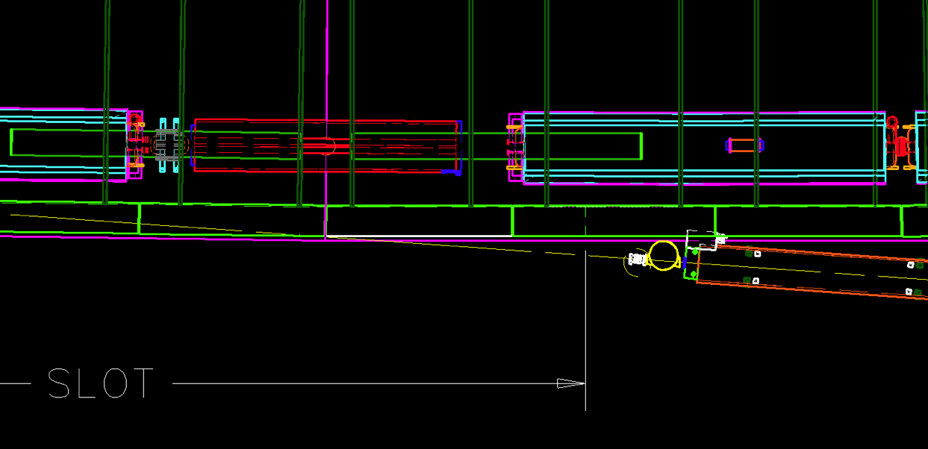
Q204 – LBNE Enclosure Wall

Slide 31
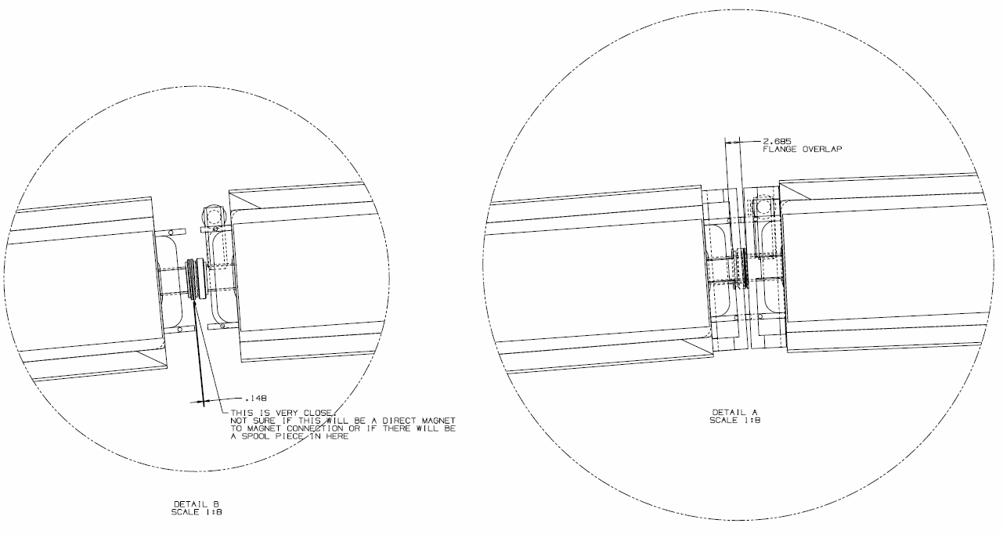
V217A/B Overlap

