Slide 1
PROFILE MONITORS
FOR
700 + kW PROTON BEAM
G. Tassotto, S. Childress, D. Jensen, D. Schoo
Sept 24, 2014
NBI2014

Slide 2
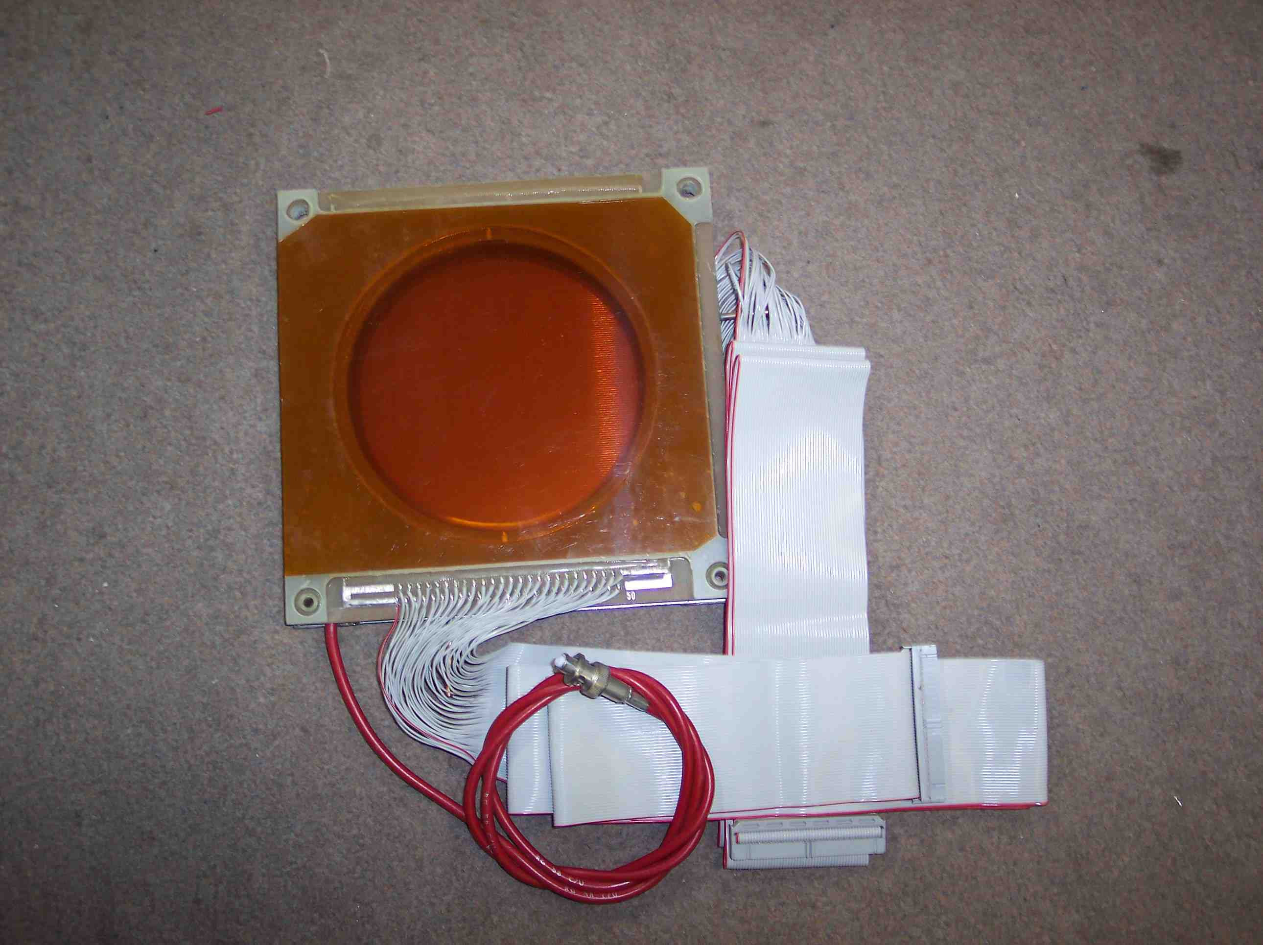
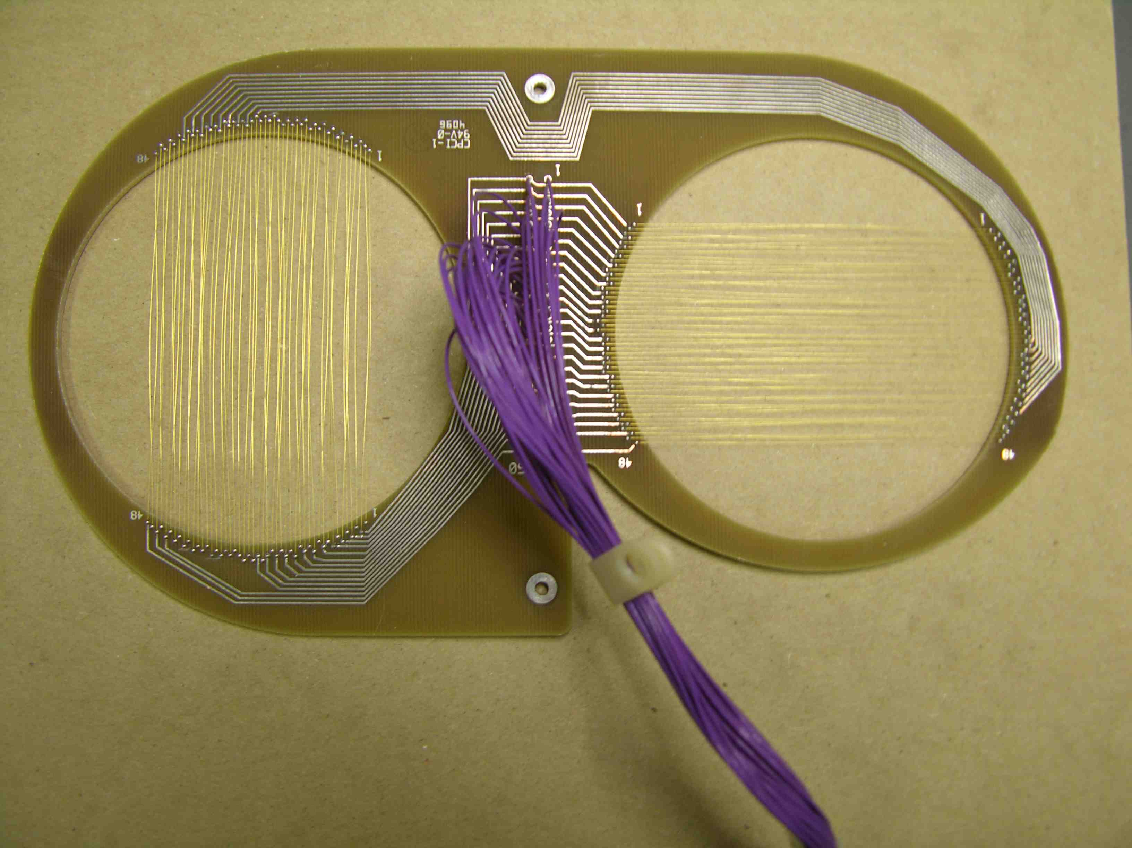
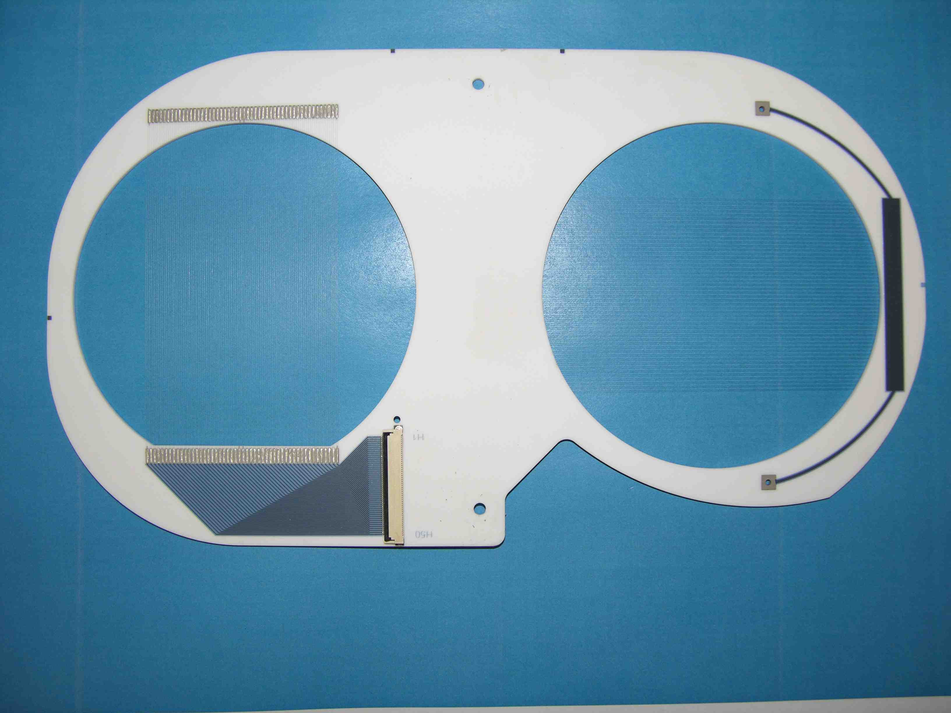
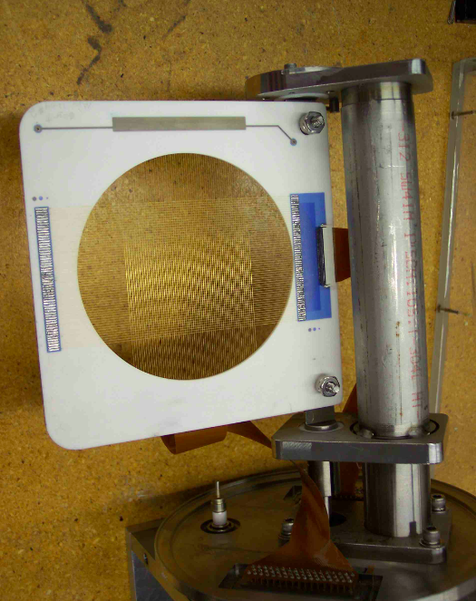
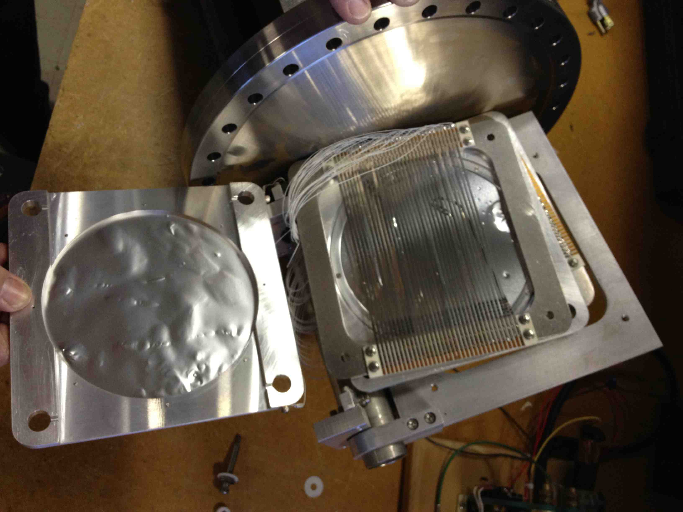
Evolution of Fermilab Secondary Emission Profile monitor
Prior to NuMI:
Fixed Target Beamlines – The FNAL design saw a transformation from SWICs to SEMs where the vacuum windows and bias foils were deleted from the original SWIC design for two reasons:
  much less beam scattering.
  negligible signal change when a clearing field was applied to the foils.
  Fig. 1, 2 and 5 show a SWIC, a vacuum can that houses SEM board.
  Material - Started with 75 μ AuW wires at a pitch of 0.5 to 2 mm depending on beamline requirements. Special case is KTeV where the wire pitch was 125 μ for the target and 250 and 500 μ for the beamline detectors.
AD Transfer Beamlines - Separate H,V planes on a G-10 frame. Later the frame was replaced with ceramic board. Also used 25 μ Ti wire wound at 2 wires/pad to increase signal while minimizing material. Key improvement “Flash-test” (Fig. 3, 4).
Pbar Beamline – Designed in early ‘80’s. The detectors were designed for 2 and 3 mm pitch using 10 μ thick Ti strips (Fig. 6).
Fig. 1 FNAL SWIC
Fig 2 Typ. Vac Can
Fig. 3 8 GeV transfer line (G-10)
Fig. 4 8 GeV transfer line ceramic
2 - 25 u wires/pad
Fig. 5 Ceramic frame
Fig. 6 Pbar SEM 3 mm pitch

Slide 3
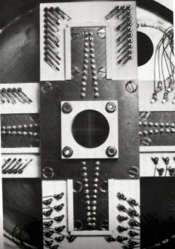
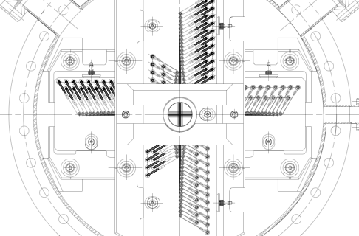
Pbar Target SEMs
First detector was designed by J. Krider, C. Hoivat and Curtis Crawford for position resolution of 20 μ in 1986 [1]:
Specifications:
- 24-100 μ Dia. Ti wire/plane. The 12 center
wires have a pitch of 250 μ, the outer 500 u.
- 3-50 μ Ti electron collection foils
- Spring Tension: 50 g
Fig 7 shows the construction of the first SEM
A new detector was built by Patrick Hurh in the nineties [2] having the following specifications:
- 16 center Ti wires 50 μ Dia., pitch 125 um.
- Outer region 14 wires at a pitch of 250 um.
Resolution in position of the wires is maintained by two “V” shaped arrays of stainless steel pegs inserted into the ceramic board. Each wire is bent around a peg, crimped to a spring.
The springs supplied around 95 g of tension.
Fig. 8 shows the central section of the upgraded Pbar SEM.
Fig. 7 First Pbar SEM
Fig. 8 Upgraded Pbar SEM FNAL DRW # 322402

Slide 4
Some NuMI Requirements & Specifications
Profile monitors have a dual use application in the 0.4 – 0.7 MW 120 GeV NuMI/NOvA primary proton line. An essential requirement has been to be able to use them readily at operational beam power.
  Determination of beam size and shape along the transport and for targeting. This provides the primary diagnostic for emittance and optics understanding.
  Continuing precision calibration for the BPM’s and BLM’s. This imposes additional requirements for profile monitor position reproducibility vs. BPM accuracy
A robust solution for moving profile monitors in or out of the intense beam seamlessly has been implemented, utilizing the combination of:
  vacuum can mounted at 45 deg.
  ceramic C-frame wire mount also at 45 deg.
resulting in horizontal and vertical beam profile measurements.
Monitors are automatically moved into the beam on a once per shift basis.

Slide 5
SPECIFICATIONS DETAILS
  Must withstand beam heating by the 700 kW beam, and radiation dose of ~ 1x 10²⁰ protons /cm². Secondary emission properties should not age significantly in the NOvA beam.
  Required fractional beam loss < 2.5x10 ⁻⁶ for beam transport and < 5.0 x10 ⁻⁶ for targeting monitors.
  No material should be exposed to the beam during monitor movement beyond that of the SEM signal strips.
  Accuracy for placement of monitors into the beam should be < 20 µm, for a lifetime total of 20,000 insertions.
  Gas load after 100 deg. C bake-out of < 3x10⁻⁷ Torr liters/sec. All gaskets/seals should be metal.

Slide 6
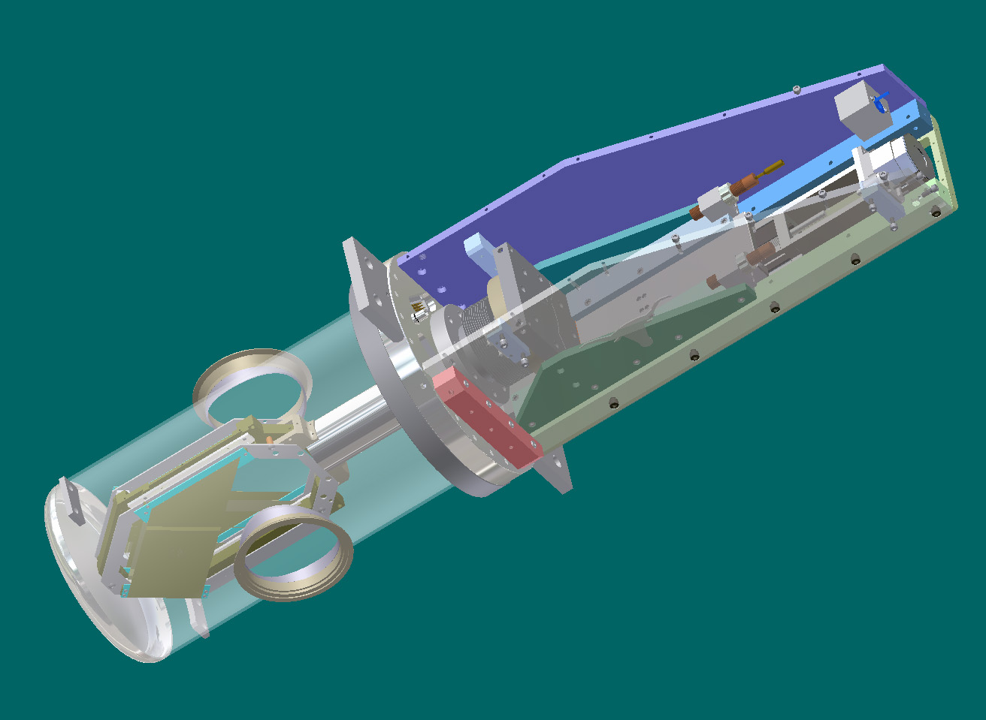
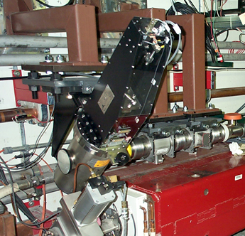
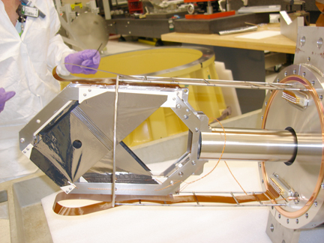
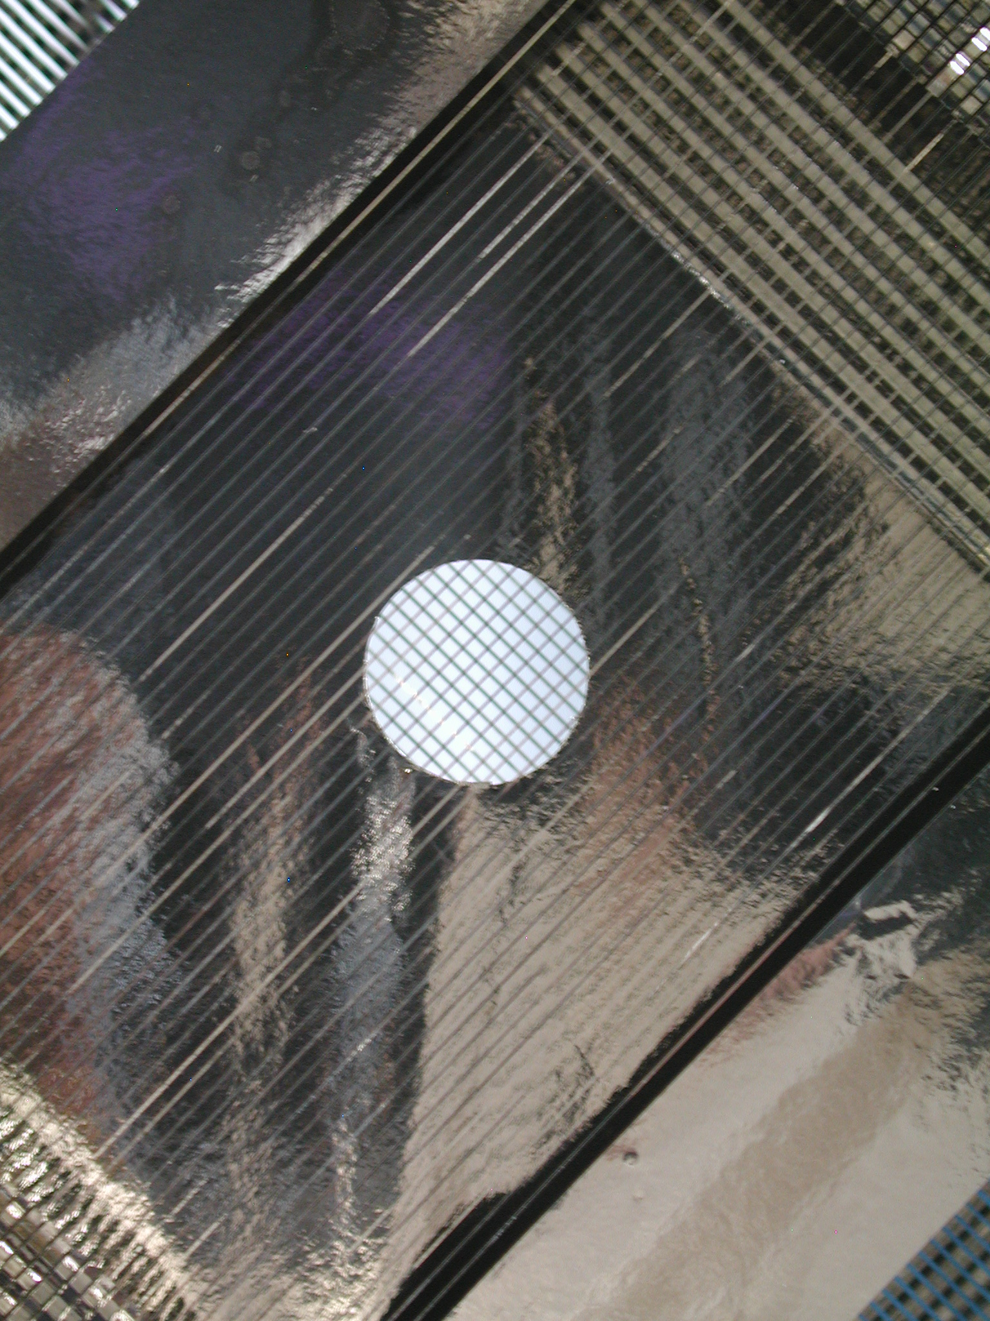
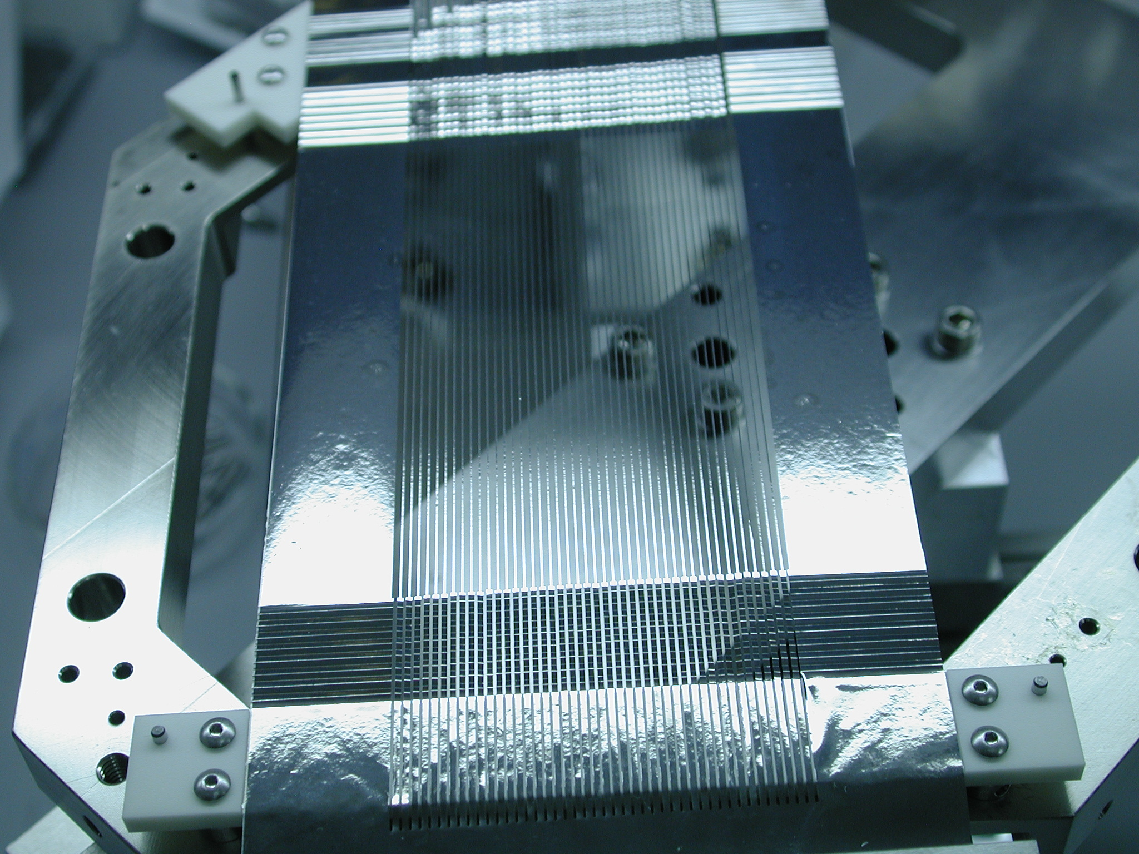
Early NuMI Profile Monitor R&D
Initial design work was performed by University of Texas, Austin (UTA).
Key features:
  Linear drive
  5 um Ti strips, 150 u wide
  Clearing field foils (3)
  Strip tension using “accordion” imparts 1-2 g tension
Target SEM was stationary and operated flawlessly for many years.
Beamline SEMs developed operational problems:
  Linear drive took many pulses to move the detector IN/OUT of the beam. 10X too much mass in beam during motion requiring to stop the beam
  Too little tension on the strips which caused them to randomly short to each other during motion
For more information about UTA SEMs see DIPAC2007.
Fig. 9 UTA SEM design
Fig. 12 PM-101 installed
Fig. 10 Ti foil ass’y
Fig. 11 Clearing field foil
Fig. 13 Accordion spring system

Slide 7
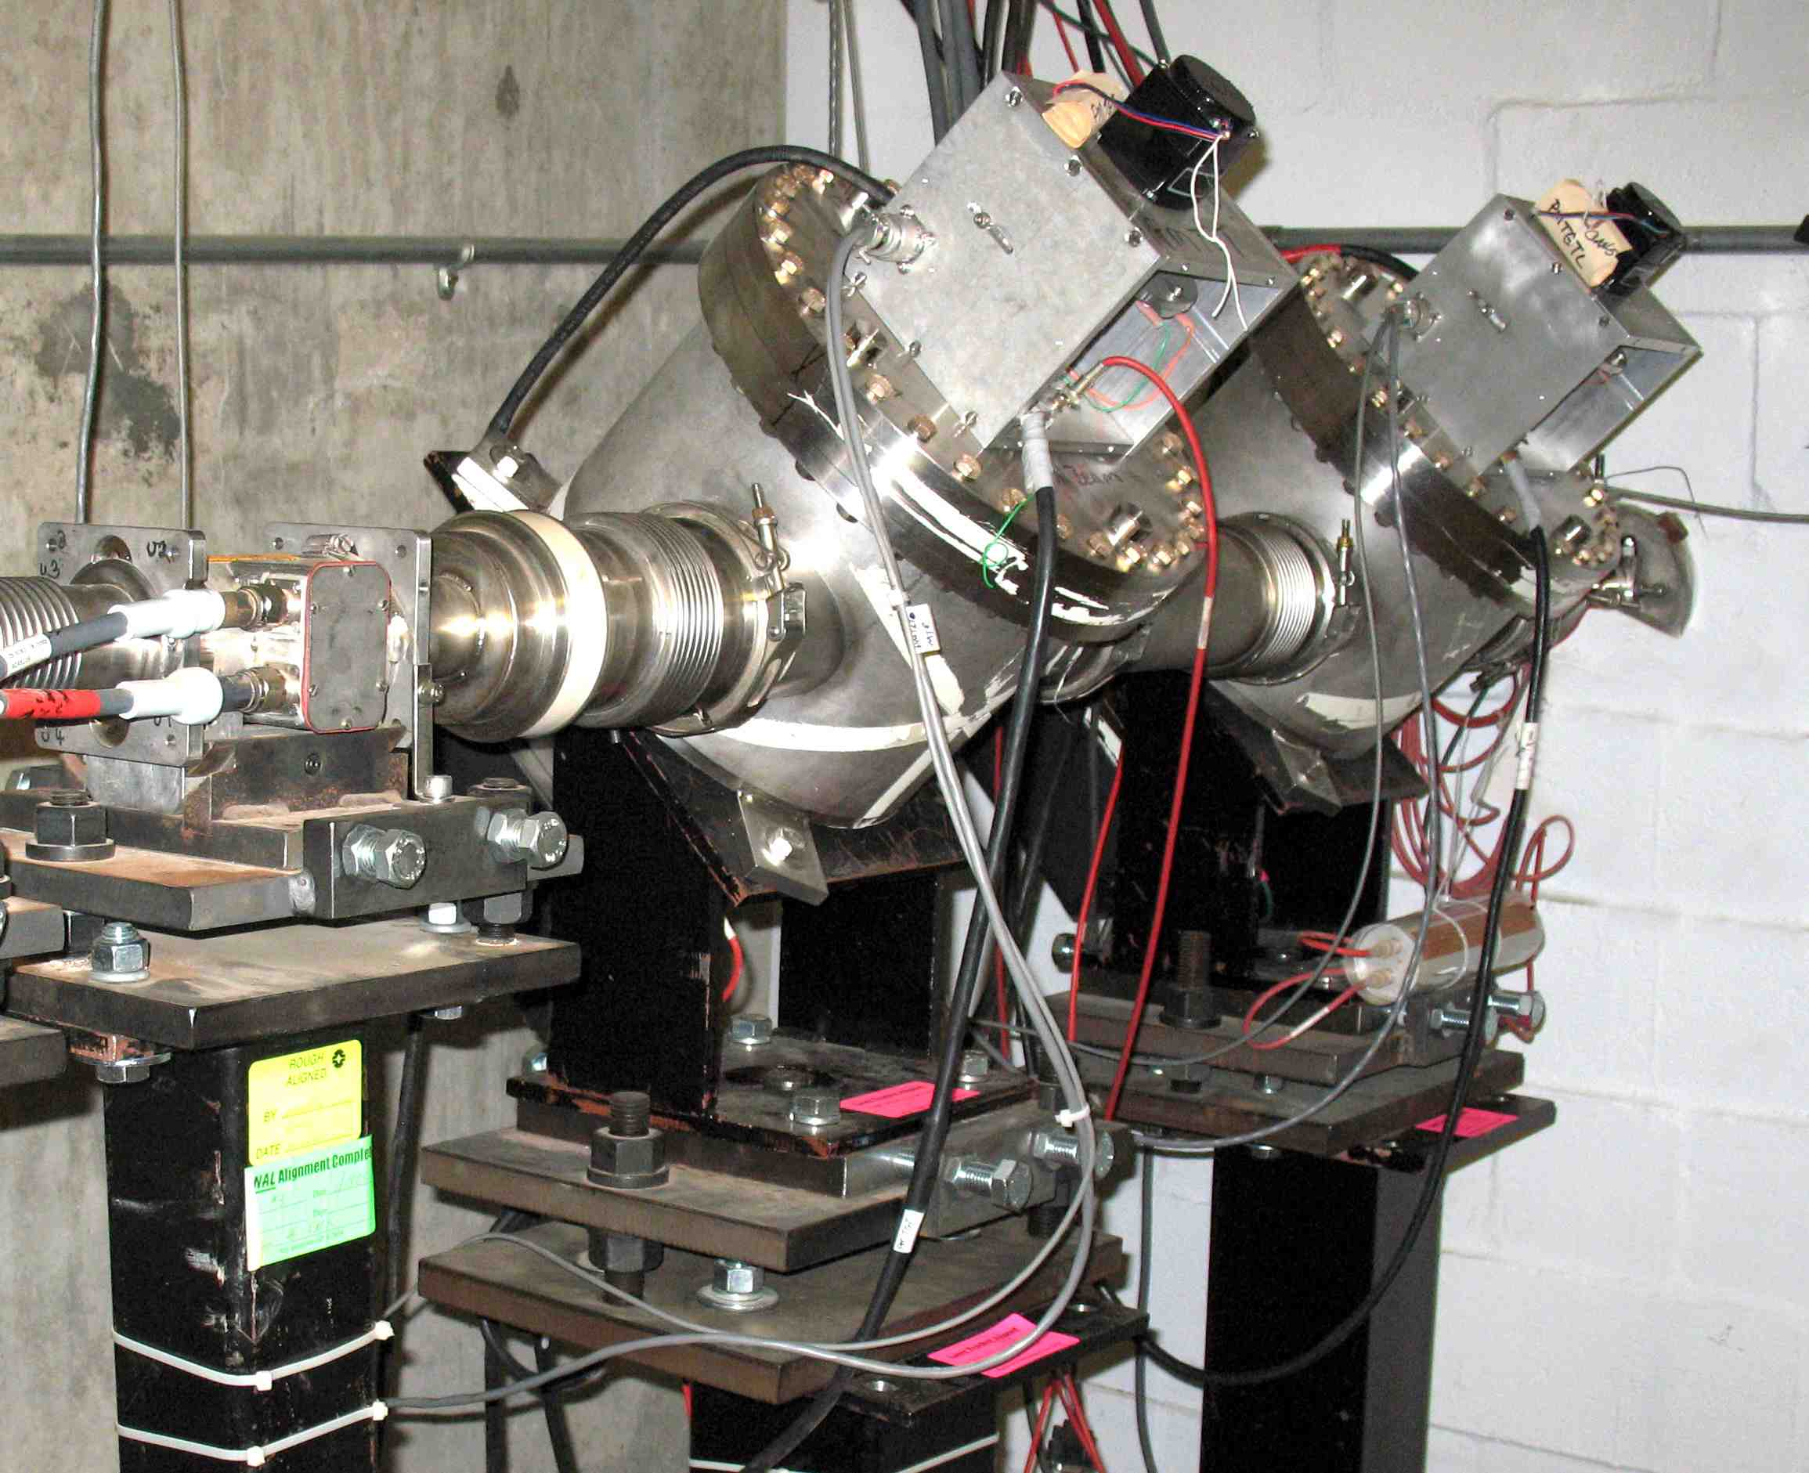
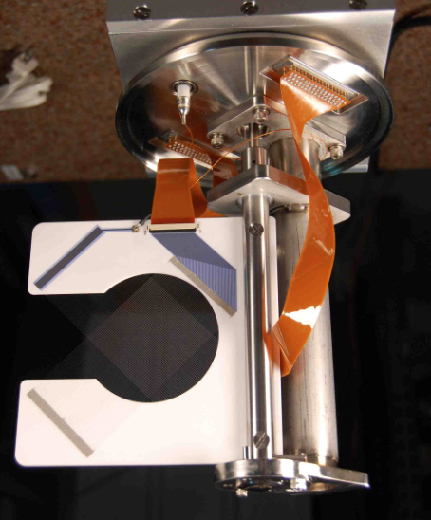
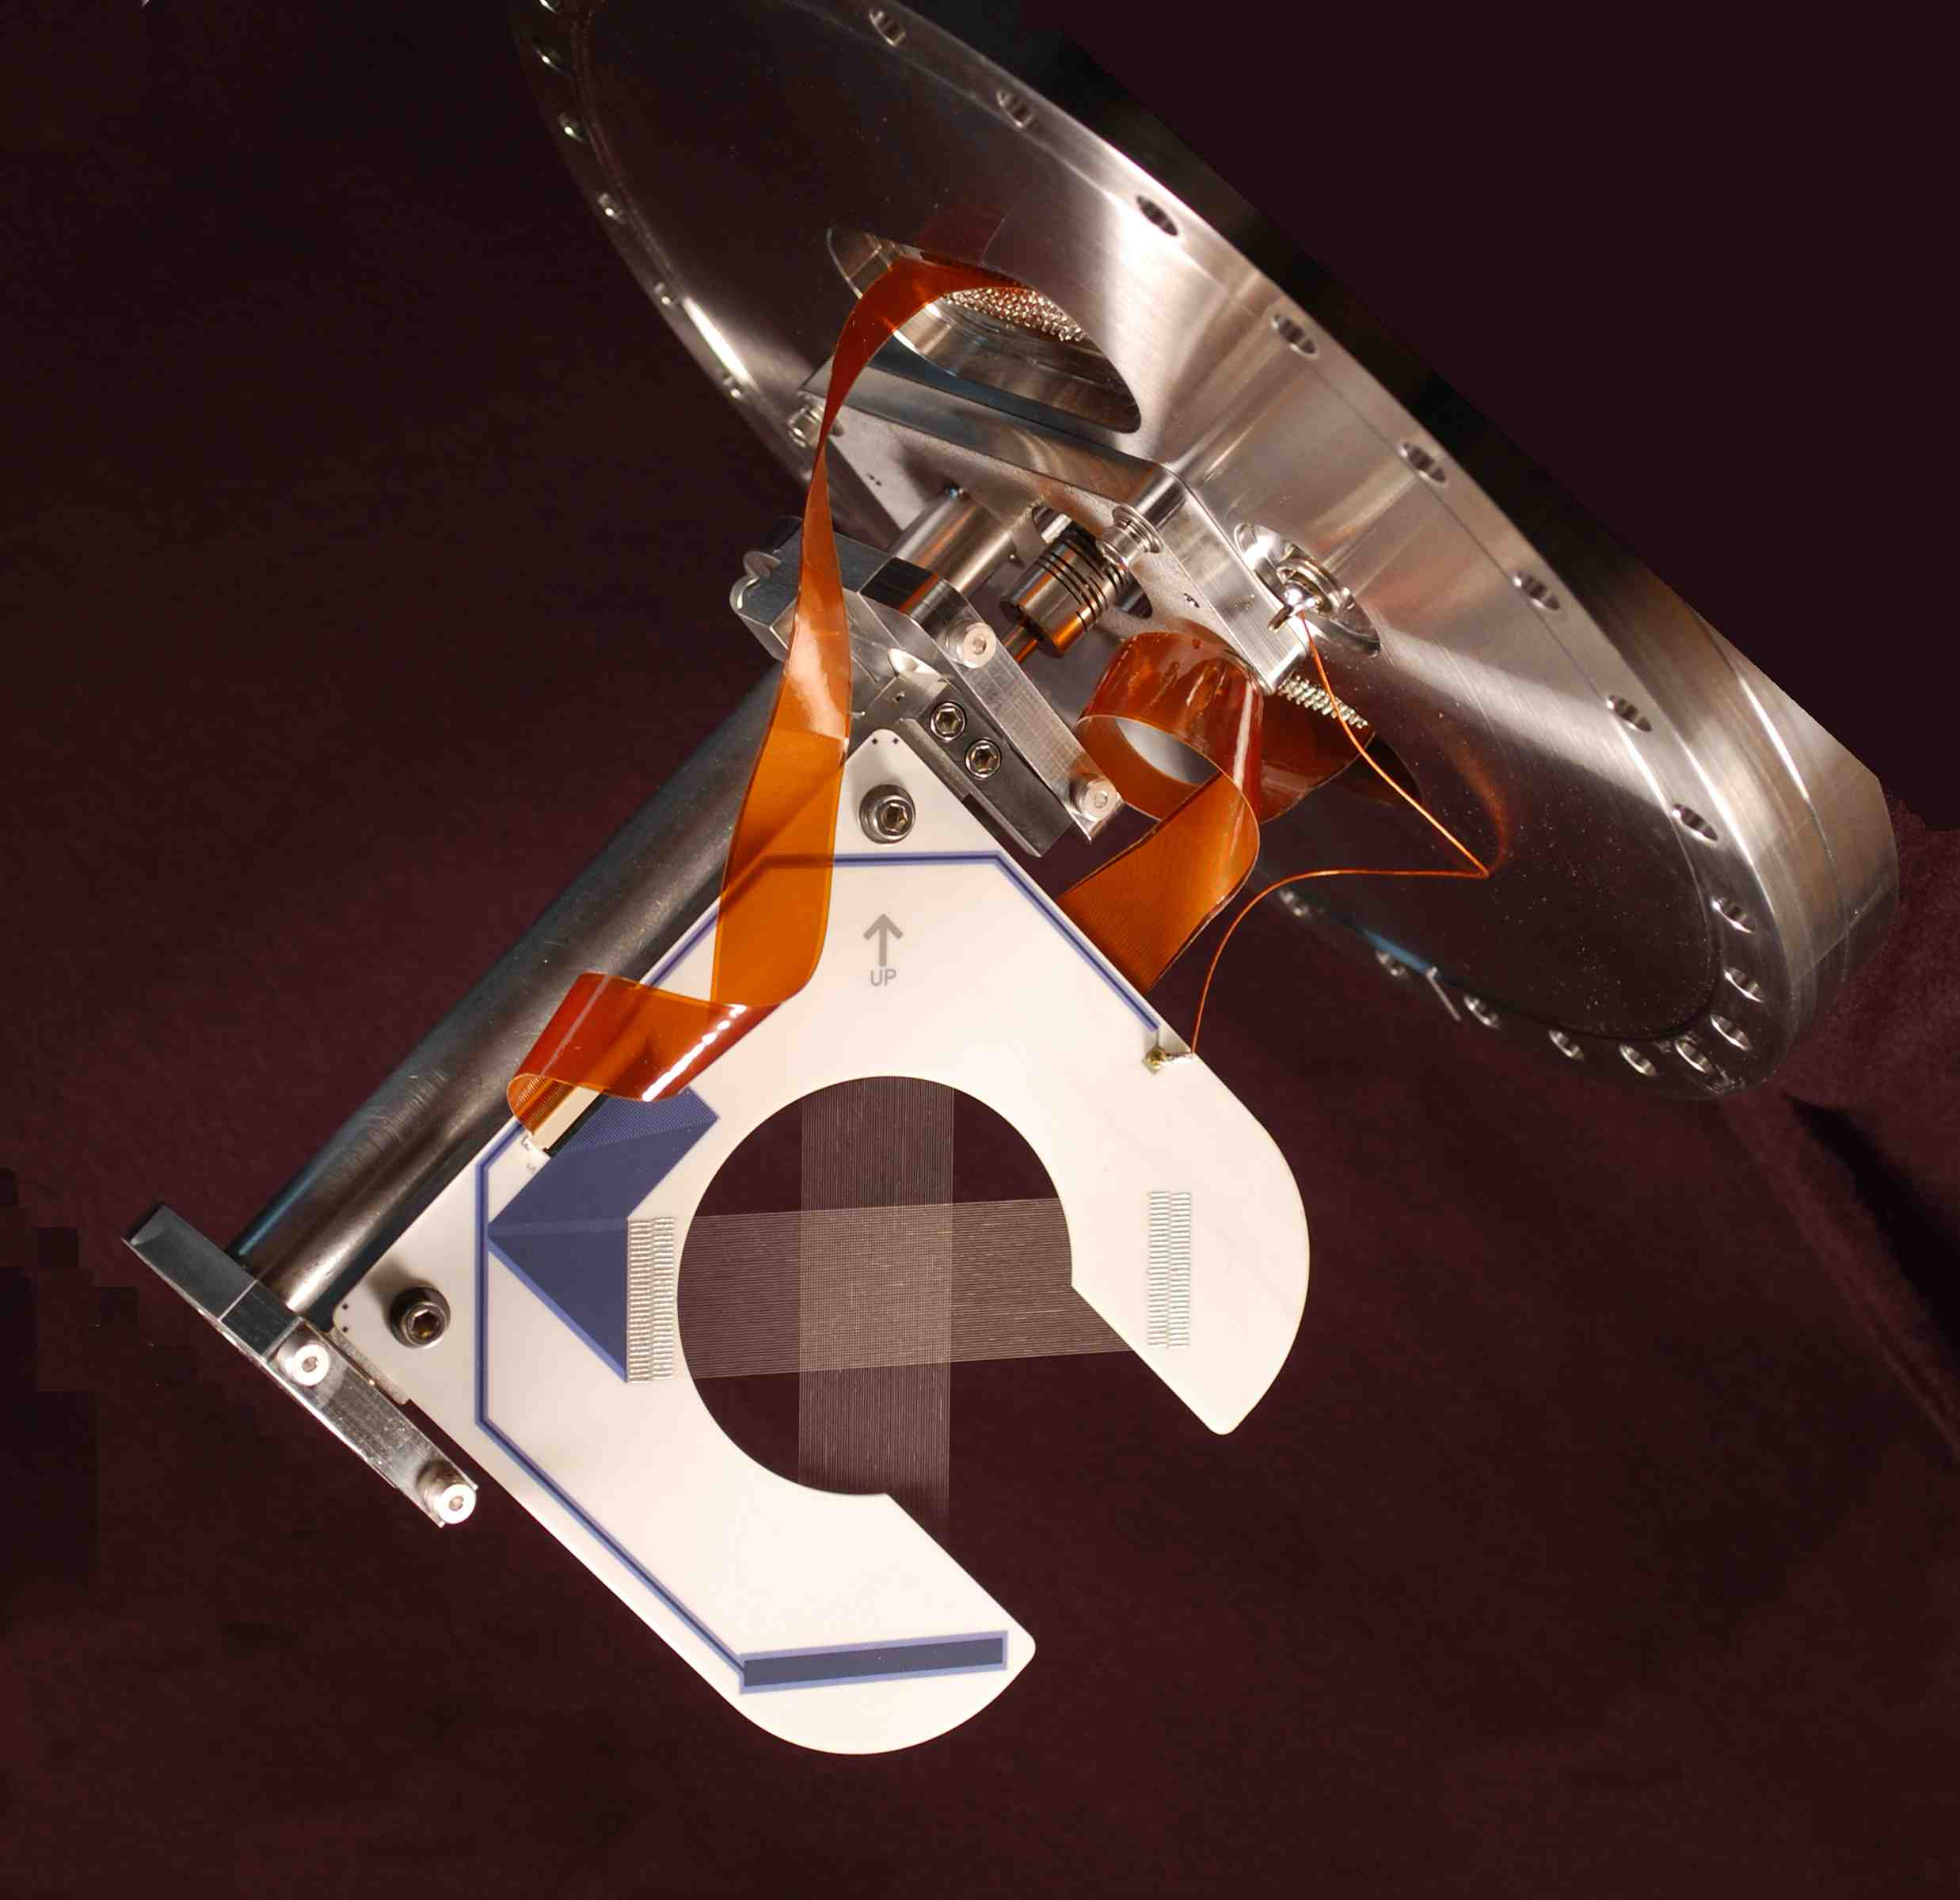
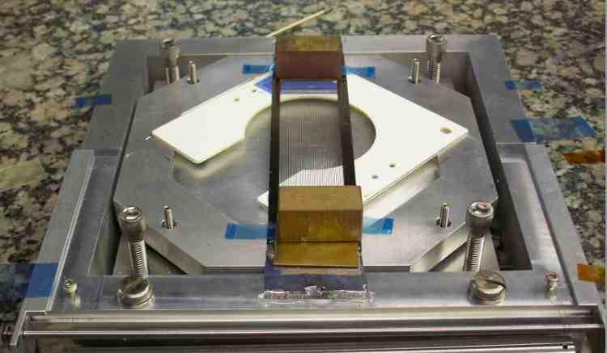
NuMI/NOvA Profile Monitor Development
Following the original monitor limitations, we performed R&D to improve the reliability of the moveable SEMs & to reduce SEM grid mass.
Upgraded NuMI/NOvA Profile Monitor Design:
Rotary instead of linear drive.
  More robust version of existing Fermilab rotary drive design.
  Mount vacuum can at 45 deg. with ceramic C-frame SEM grid mount also at 45 deg. Enables seamless insertion of monitor during beam operation.
  Tested to 500,000 cycles with no noticeable drive degradation or positioning accuracy.
Wires instead of foils for operational intensity monitors.
  Enables reduced SEM grid mass, but more robust.
  Do not need the extra signal provided by foils.
  Conductive epoxy, EPO-TEK H20E used to insure mechanical and electrical contact for SEM grid.
Fig. 14 shows the target station with 2 SEMs: the first has 20 μ Ti (grade 5) wires, used for actual beam. operation, and the second has 75 μ Ti (grade 1) used for optimizing tuning at low intensities [3].
Fig. 15 shows a 1 mm pitch wire plane ass’y. Fig. 16 shows a 0.5 mm pitch target wire plane.
Fig. 17 show the set up used for assembling 7.5 μ Ti foil strips. Planned for the low intensity tgt. monitor.
Fig. 14 NuMI Target Station
Fig. 15 1 mm pitch
Fig. 16 TGT SEM, 0.5 mm pitch
Fig. 17 Ti foil ass’y

Slide 8
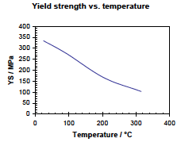
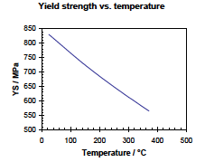
Properties for Different SEM Materials
Wire/Strip Atomic number Atomic mass density(g/cm³) Melting point(C/F) Emissivity
W 74 183.4 19.3 3410 / 6170 0.27
Ti 22 47.8 4.54 1660 / 3020 0.3
C (filament) 6 12 2.25 3545 / 6413 0.77
Yield strength for Ti wire options
Ti grade 1 has the mechanical properties listed above.
Charts of yield strength vs. temperature stop around 300 C.
By using a Ti grade 5 (Ti-6AL-4V) the yield curve is much higher.
A tension of about 20 g/wire is applied to the 25 μ wires.
A tension of 16 g is applied to 20 μ Ti grade 5 wires.
For a ΔT of 300^{ο} C yield strength change is 62% for Ti grade 1 and 31% for Ti grade 5.
The 300^{ο} C residual strength is 4.4 times greater for Ti grade 5.
Ti - Grade 1
Ti alloy - Grade 5

Slide 9
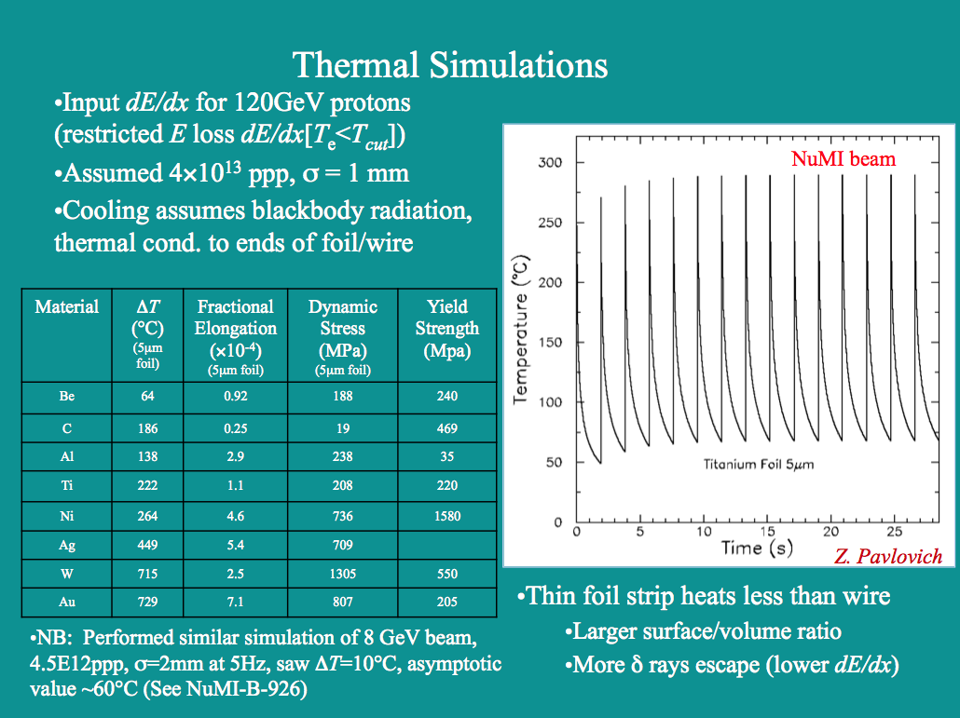
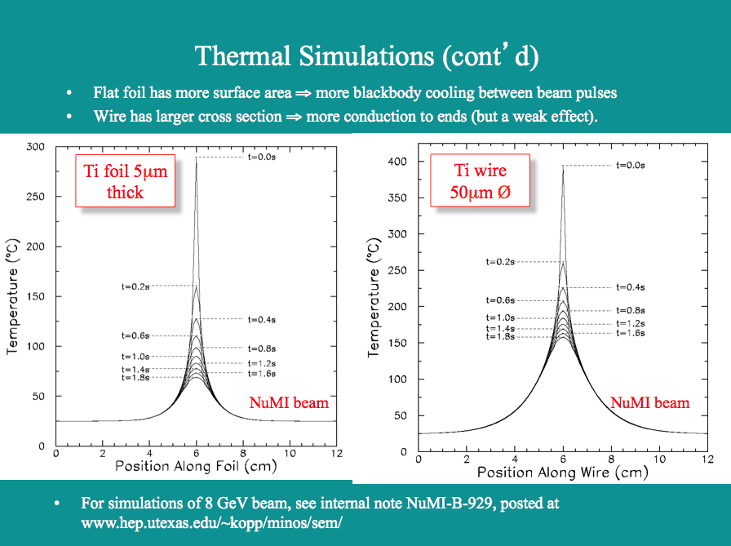
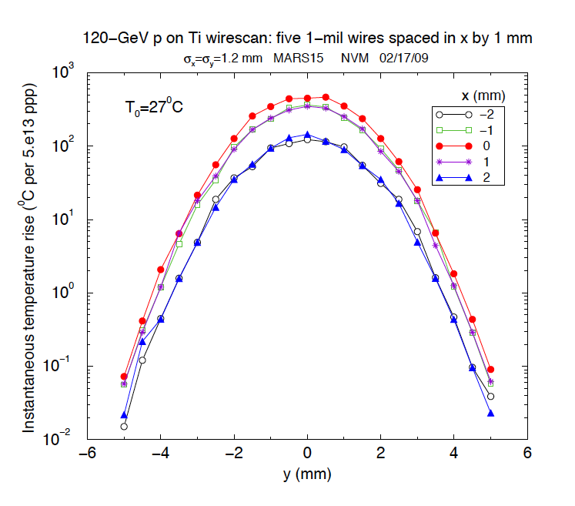
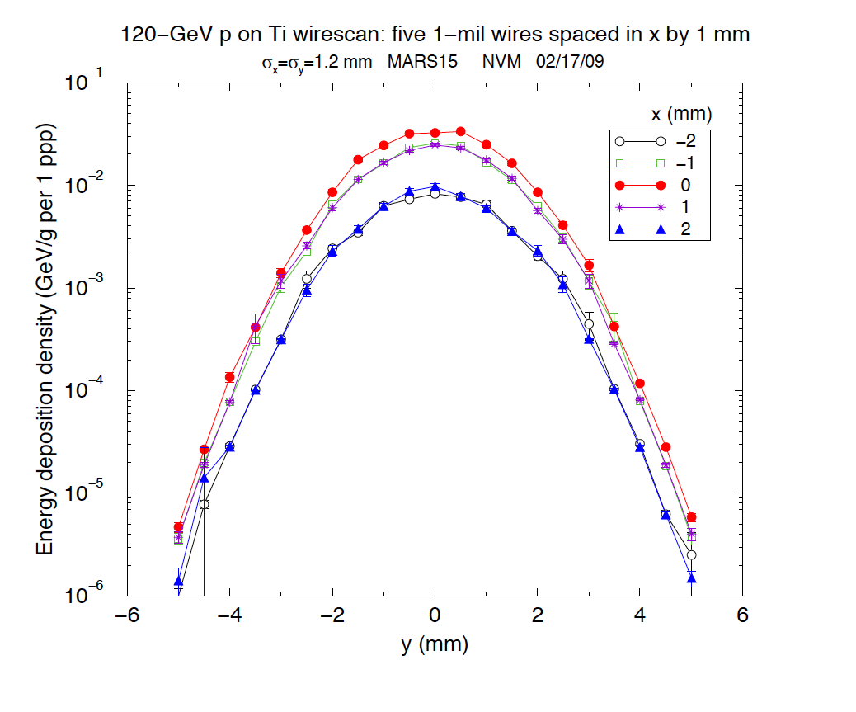
Wire Heating Simulations
Both UTA and Fermilab performed simulations. UTA simulated the temperature raise of 5 μ foil and 50 μ Ti wire. Data from: www.hep.utexas.edu/~kopp/minos/sem/
Shown to the right is the Temperature analysis using MARS15 for a 25 μ Ti wire made by Nikolai Mokhov.
The temperature rise (left plot) and the energy deposition (right plot) for a single pulse at the NoVA beam energy are shown. The center wire (red) show a temperature raise of about 450 degree C. for a 120 GeV beam pulse of 5 x 10¹³.

Slide 10
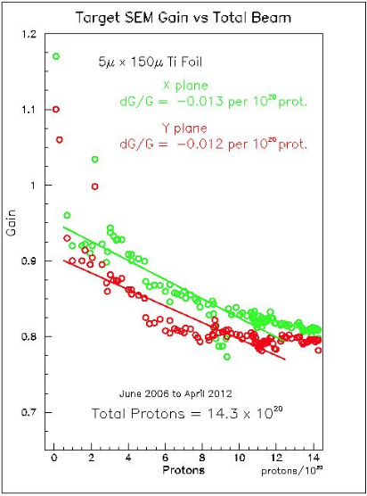
SEM sensitivity vs Beam Exposure
Measurements for the target SEMs have been made for Ti (wires and strips) and Carbon [4].
SEM 118, 33 u carbon
Total POT = 4.5 x 10²⁰
Original UTA SEM 5 u thick foil
Total POT = 14.2 x 10²⁰
New SEM 20 u Ti grade 5
Total POT = 3.5 x 10²⁰
SEM sensitivity ages much more slowly as exposure increases.
Measurements made by Doug Jensen

Slide 11
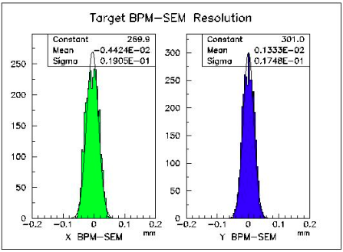
BPM – SEM Beam Resolution
The plot below shows data comparison between the target BPM and SEM. Measured beam positions agree within 20 μm rms for 1 hour of data considered.

Slide 12
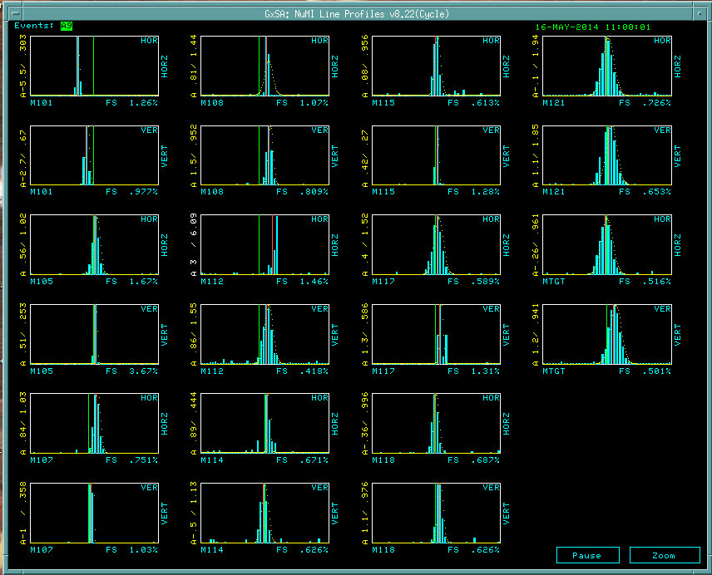
Profile Monitors in the NuMI Beam
The list below shows the present SEM materials in the NuMI beam. Various material combinations have been installed to determine the robustness of each.
Below-right a display of the detectors is shown having the following proton beam parameters:
Energy: 120 GeV
Intensity: 3.2 x 10¹³ POT
Cycle time 1.33 sec
Name | Material/Dimension | Wire pitch (mm) | Comment
PM-101 | 25µ Dia. Ti wire | 1mmV, 1mmH | Grade 1
PM-105 | 5µ thick Ti foil | 1mmV, 1mmH | Foil
PM-107 | 33µ Carbon filament | 1mmV, 1mmH
PM-108 | 25µ Dia. Ti wire | 1mmV, 1mmH | Grade 1
PM-112 | 20µ Dia. Ti wire | 1mmV, 1mmH | Grade 5
PM-114 | 20µ Dia. Ti wire | 1mmV, 1mmH | Grade 5
PM-115 | 33µ Carbon filament | 1mmV, 1mmH
PM-117 | 33µ Carbon filament | 1mmV, 1mmH
PM-118 | 33µ Carbon filament | 1mmV, 1mmH
PM-121 | 20µ Dia. Ti wire | .5mmV,.5mmH | Grade 1
PM-TGT | 20µ Dia. Ti wire | .5mmV, .5mmH | Grade 5
PM-TGTL | 75µ Dia. Ti wire | .5mmV, .5mmH | Grade 1

Slide 13
Conclusions
We have proven that these profile monitors are reliable and can be exercised repeatedly without failure. They are readily moved seamlessly in or out of the beam during high intensity operation.
The multiwire detectors can be baked at 100 degree C. Vacuum level reached is into mid 10 ⁻⁹ Torr thereby satisfying vacuum requirements.
Given the temperature rise estimates made and the beam results obtained so far we are confident that the 20 μ Ti grade 5 will survive the 700 KW beam.
R & D will continue to make sure that SEM grids will survive a 2 MW beam, consists of:
- Model the Temperature rise for Ti grade 5 and carbon
monofilaments. In the latter case, devise a manufacturing process
to lay 48 wires (possibly having a diameter as low as 5 μ) across
the ceramic board.
- Continue beam testing to verify survivability.

Slide 14
References
[1] J. Krider & C. Hoivat, “A multiwire Secondary Emission Beam Profile Monitor with 20 um Resoluton,” Nuclear Instruments and Methods in Physics Research, A247, pp. 304-308(1986)
[2[ P. Hurh et al, “A 10 um Resolution Secondary Emission Monitor For Fermilab’s Targeting Station,” 1993 PAC, pp. 2459-2461.
[3] http://www.fwmetals.com/
[4] http://www.specmaterials.com/
AKNOWLEDGEMENTS: We would like to acknowledge the effort done by many people in Fermilab too numerous to list.

