Slide 1
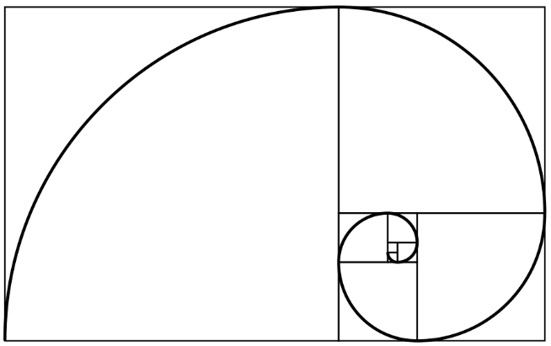
The IsoDAR Target at KamLAND for NBI2014 and now for something completely different…
I SODAR
@ kamland
L. Bartoszek
BARTOSZEK ENGINEERING
With contributions from the DAEdALUS/IsoDAR collaboration
9/25/14

Slide 2
What is IsoDAR?
IsoDAR is:
A search for sterile neutrinos
A Decay At Rest neutrino source next to the KamLAND detector (or one like it)
A step in the development of the DAEdALUS experiment
The IsoDAR cyclotron is the injector for the DAEdALUS cyclotron
10 milliamps of 60 MeV protons, 600 kW on the target, CW

Slide 3
Schematic of IsoDAR
_
Proton beam → ⁹Be → n → captures on ⁷Li → ⁸Li → ν_{e}
many
meters
few
meters
Scintillator
A source of
protons
Be target
embedded
in sleeve
The proton-producing machine (cyclotron) is separate from the neutron-producing target to avoid:
Activation of the machine so it can be serviced
Unwanted backgrounds to the antineutrino flux

Slide 4
IsoDAR Configuration at KamLAND
Target
Cyclotron
Plan view
Beam Transfer Line
KamLAND detector
Elevation view

Slide 5
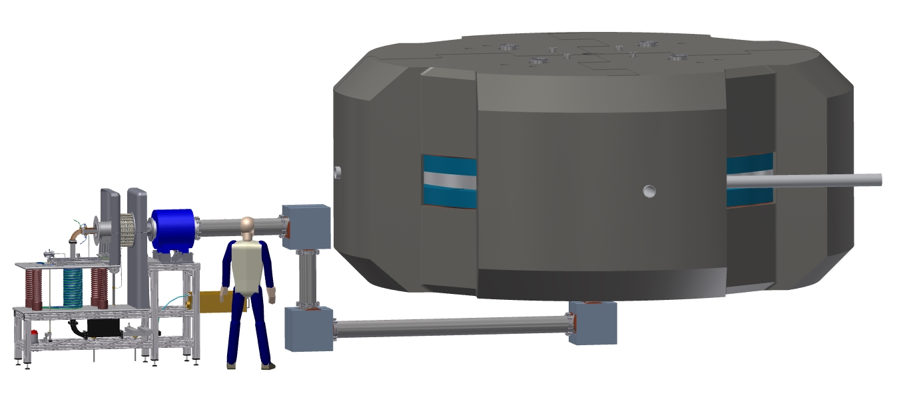
The IsoDAR Cyclotron and Ion Source
~ 6 meters
Cyclotron
Low Energy Beam Transfer Line
Ion Source

Slide 6
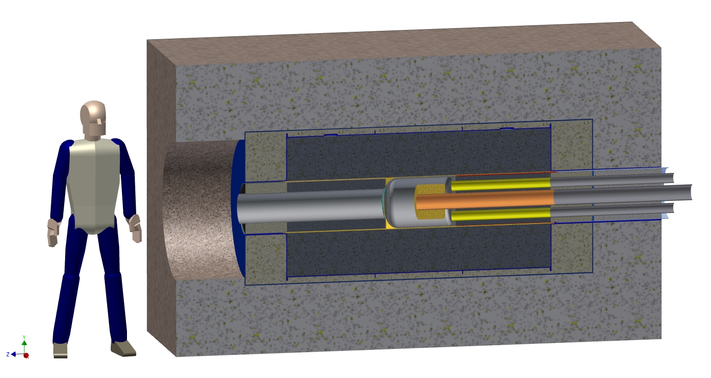
Cross-section of the KamLAND target
Target assembly
Beam line and window assembly
Concrete
⁷Li (FLiBe) in tank
Graphite in container

Slide 7
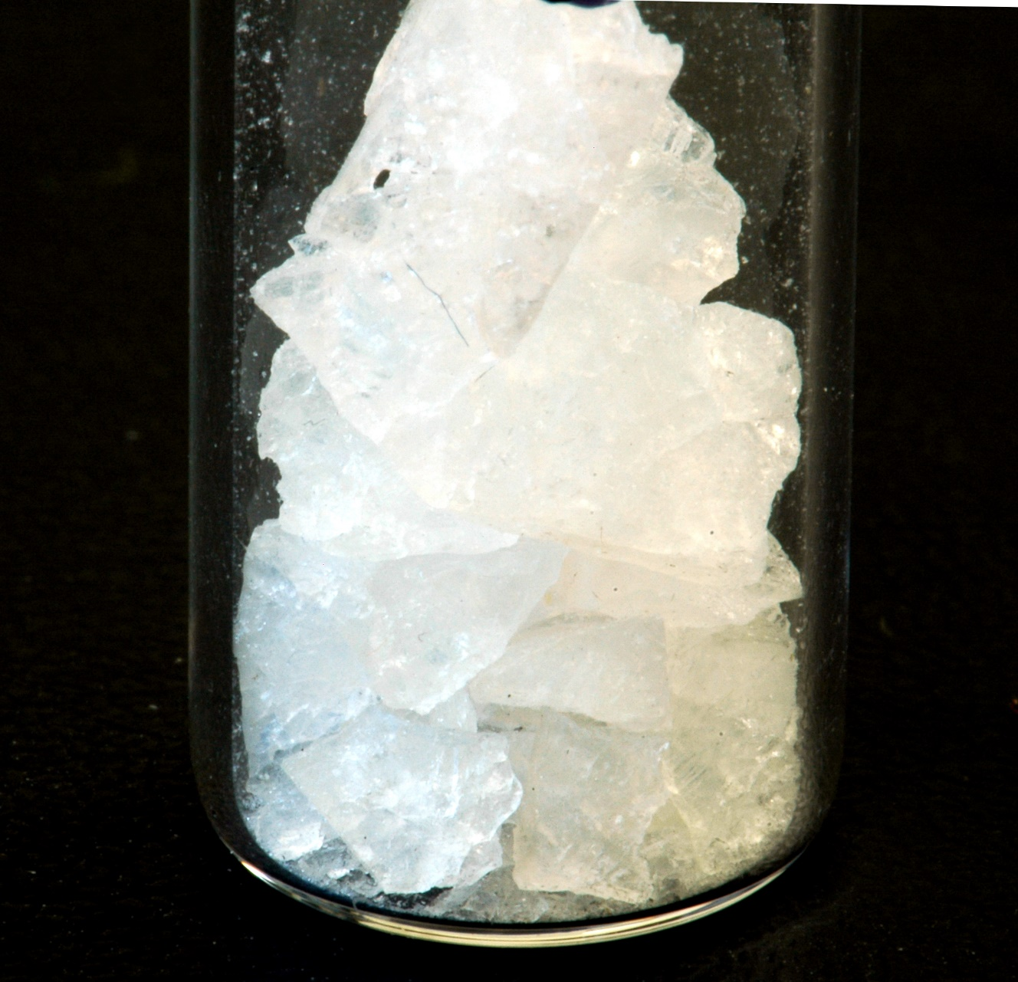
What is FLiBe?
“FLiBe is a salt made from a mixture of lithium fluoride (LiF) and beryllium fluoride (BeF₂). It has been used in the Molten Salt Reactor Experiment.
The low atomic weight of lithium, beryllium and to a lesser extent fluorine make FLiBe an effective neutron moderator. As natural lithium contains ~7.5% lithium-6, which tends to absorb neutrons producing alpha particles and tritium, nearly pure lithium-7 is used to give the FLiBe a small cross section.”
--from the Wikipedia
We need the isotopically pure Li-7 to absorb neutrons, become Li-8, and decay producing anti-electron neutrinos.
"Purified Flibe" by Bckelleher - Own work. http://commons.wikimedia.org/wiki/File:Purified_Flibe.JPG#mediaviewer/File:Purified_Flibe.JPG

Slide 8
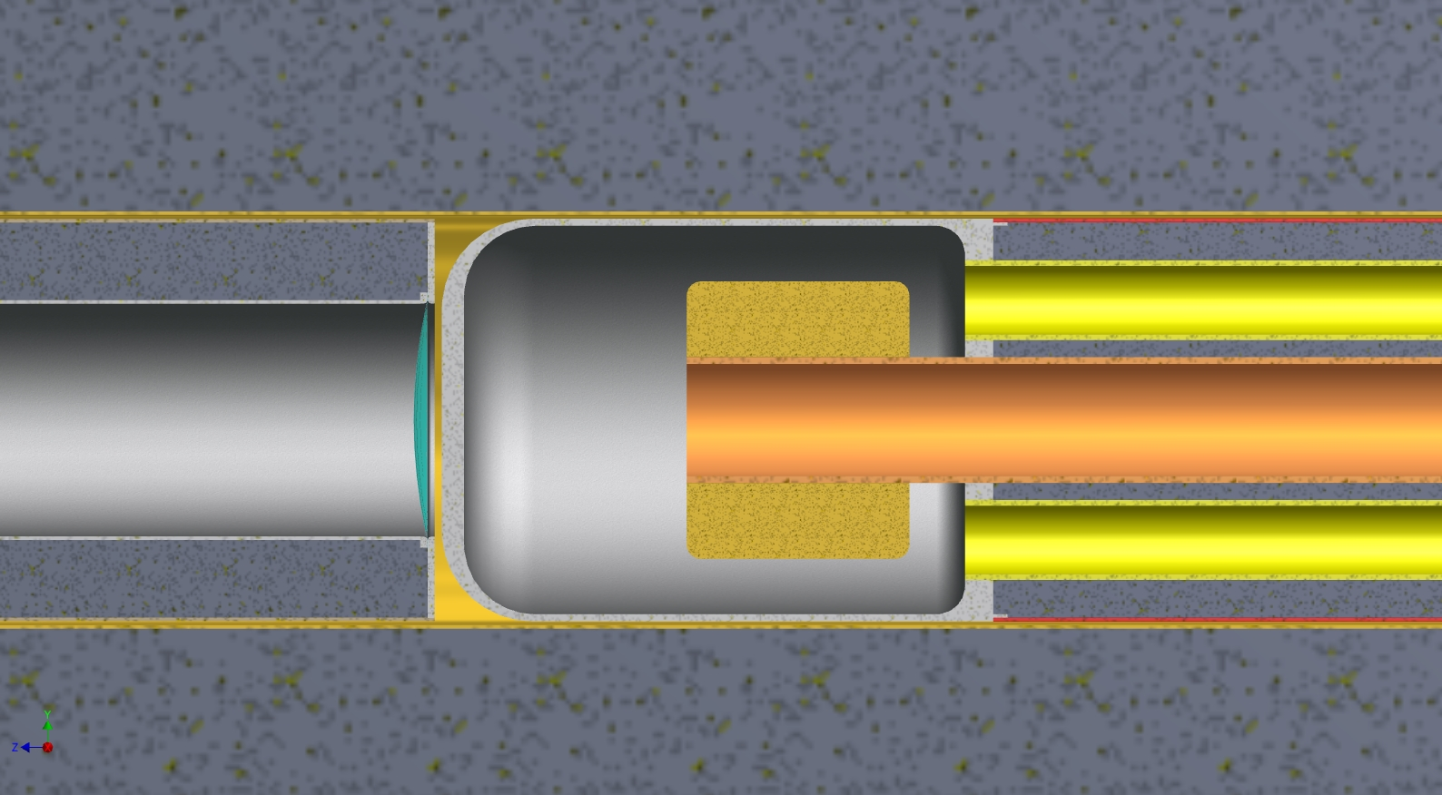
Close-up section view of beryllium water vessel
FLiBe
BEAM
4” pipe
Be block
This is the target disk of Be <2cm thick, 20 cm diameter
FLiBe
All the metal inside the Li/FLiBe is beryllium to allow neutrons to get into the FLiBe. Arrows indicate water flow.

Slide 9
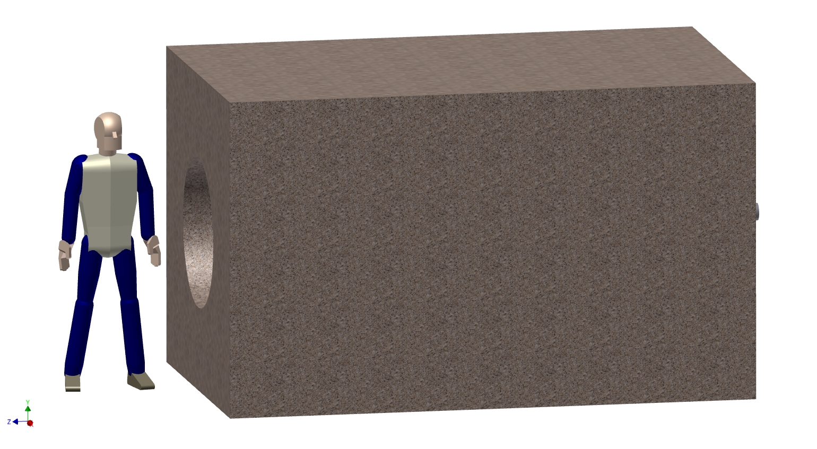
Outside view of target, everything opaque
31.8 tons of concrete in the outer block (not counting the concrete in the target module.)

Slide 10
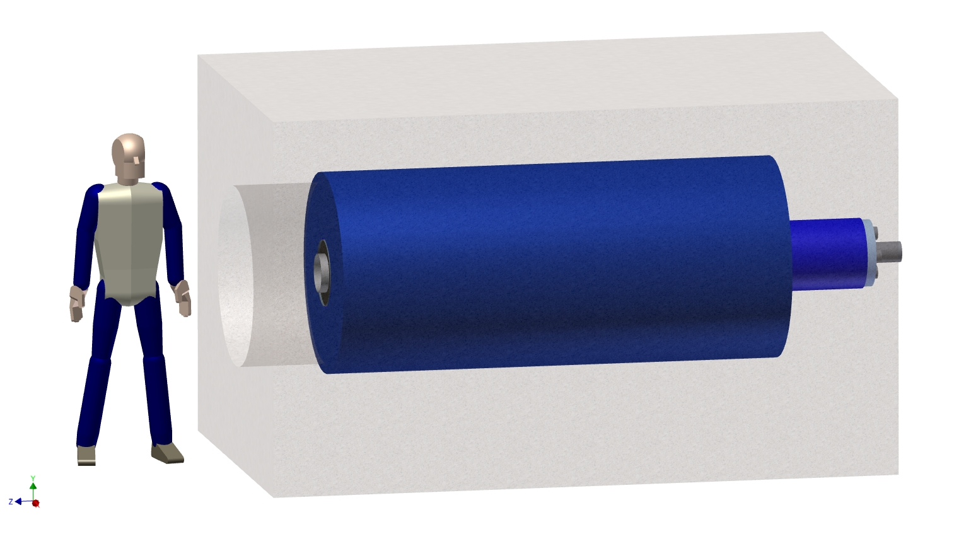
Concrete shield made transparent showing the graphite container
We need to decide if we need dense bricks of nuclear graphite, or can we get away with packing graphite powder around the FLiBe tank? The bricks will be more expensive but denser.

Slide 11
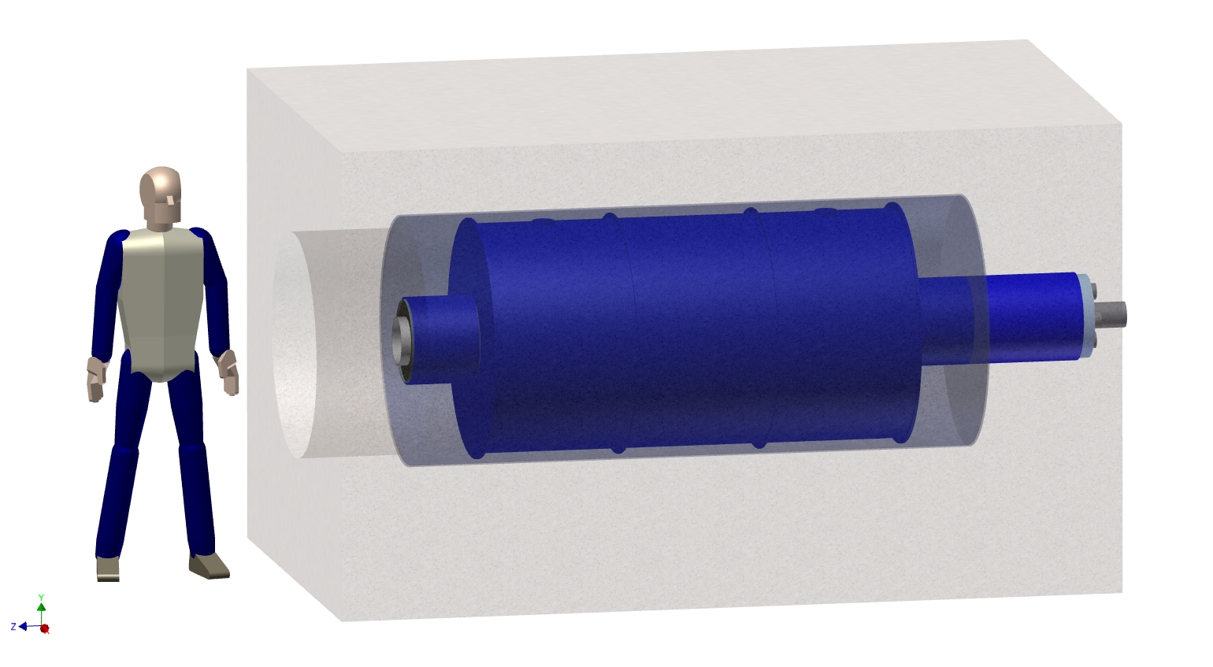
Graphite and its container made transparent showing the Li/FLiBe tank
At this point, FLiBe looks more benign than elemental Lithium. Either one can be cast inside this tank, but to cast the lithium the whole thing has to be done in an inert atmosphere making it much more complicated.

Slide 12
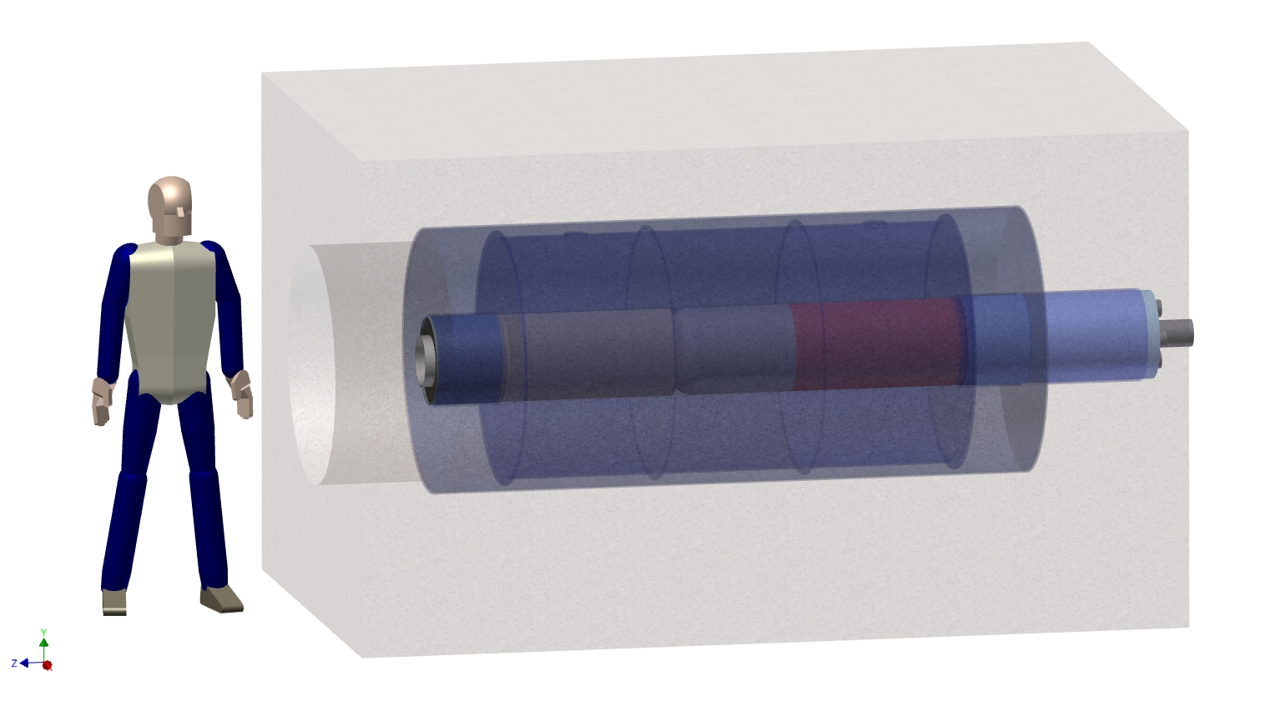
FliBe tank made transparent showing the beam line module and the target module

Slide 13
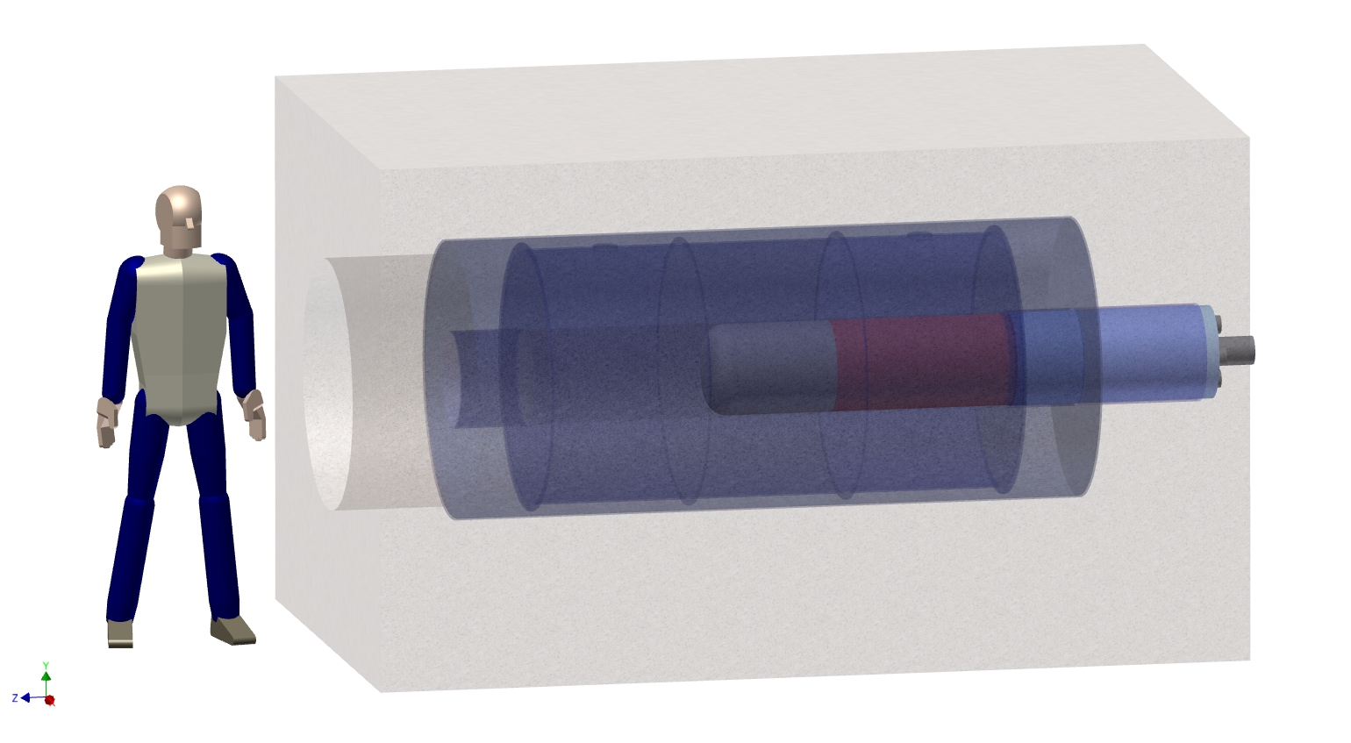
Beam line module turned off showing only target in place

Slide 14
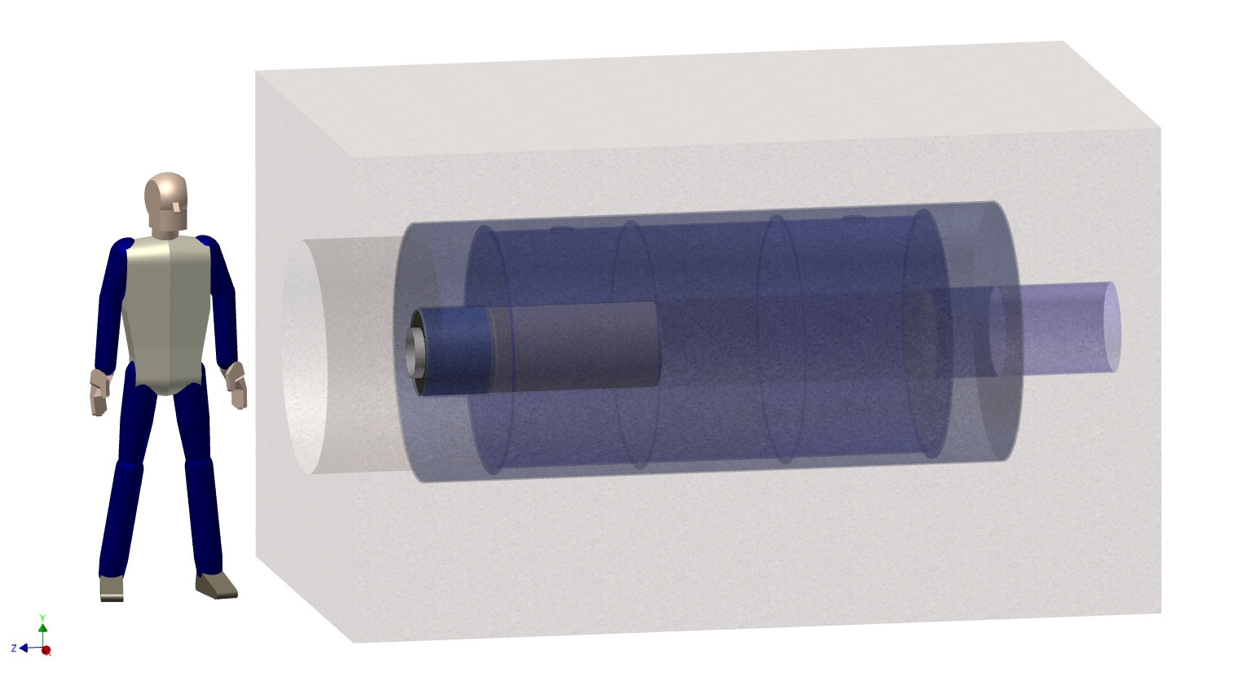
Target turned off showing beam line module in place
In this design either module can be in or out completely independently of the other. The design philosophy was to put layers of FLiBe and graphite in each module to avoid gaps.
There may be a problem with the beam window in this design getting too hot, or the air gap contributing to air activation. We are looking at evacuating the space around the target.

Slide 15
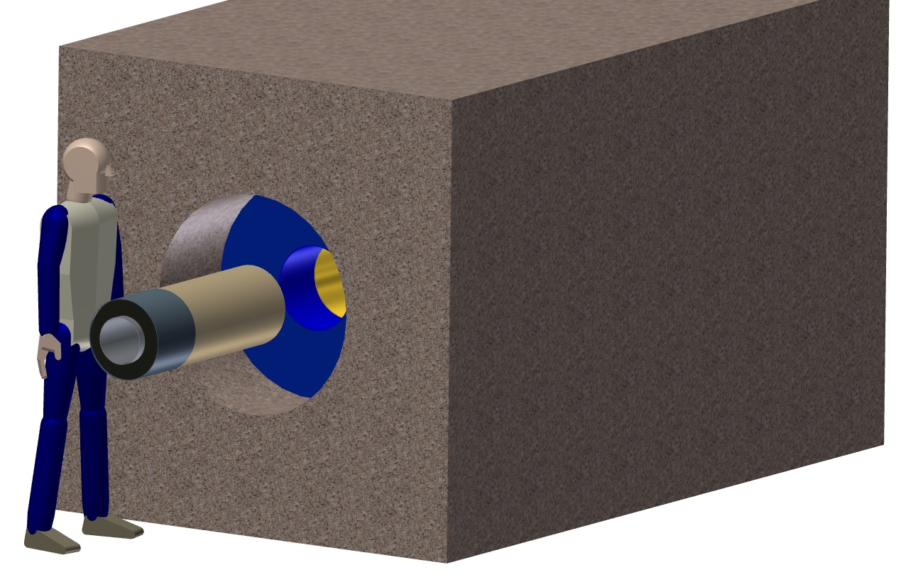
Showing the Beam line module ready for insertion into the target
The beam raster magnets that exist in the hole in the concrete need to be removed to replace this module. How hot will it be to expose the Be target core? Need remote handling?
The module as shown weighs 178 lbs. It will need a rail system to guide it into the opening.

Slide 16
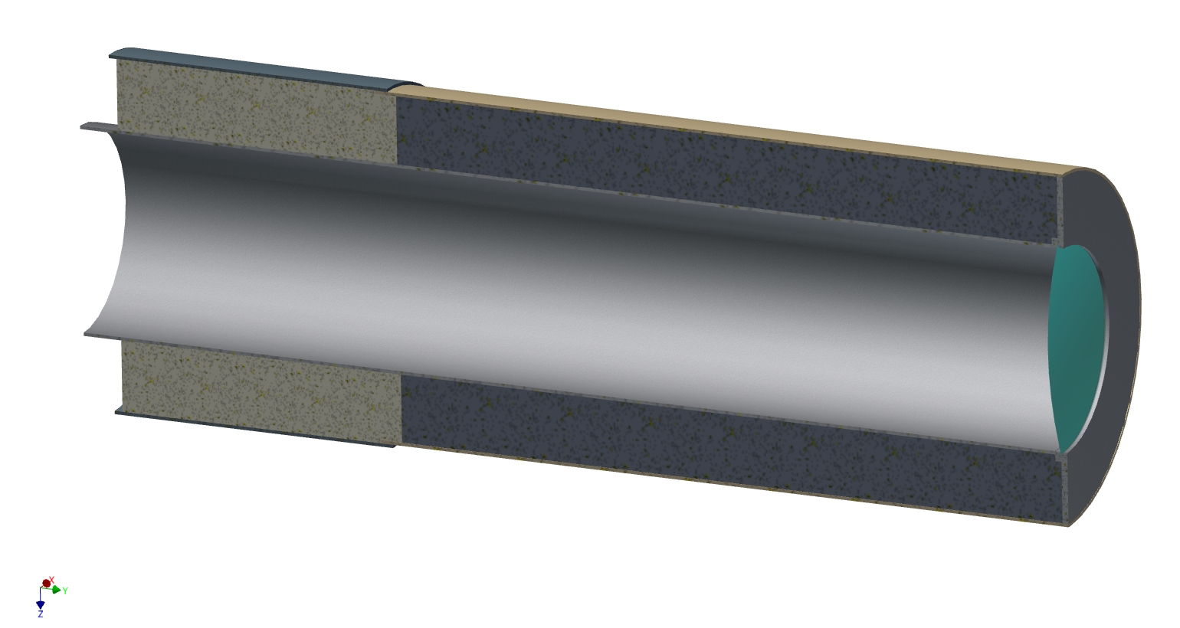
Section view of the beam line module showing the FliBe and graphite
Steel tube brazed to Be tube
Li/FLiBe slug
Graphite slug
Be tubes and thin window
We need to look at the energy deposition in the thin window and check whether air activation will be an issue. This work is in progress.

Slide 17
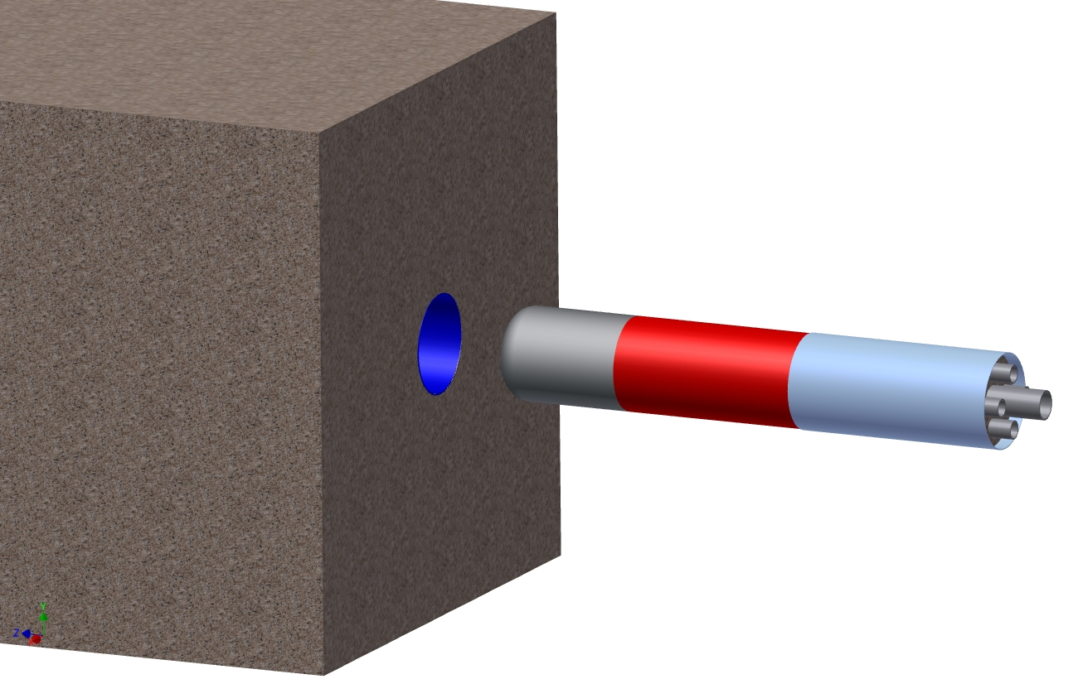
View showing the target module (“torpedo”) ready for insertion
We are just starting to look at the remote handling issues and are very open to comments from the experts.
Target module weighs 609 lbs. It needs to be retracted into a coffin for disposal. It will also need a rail system for guidance.

Slide 18
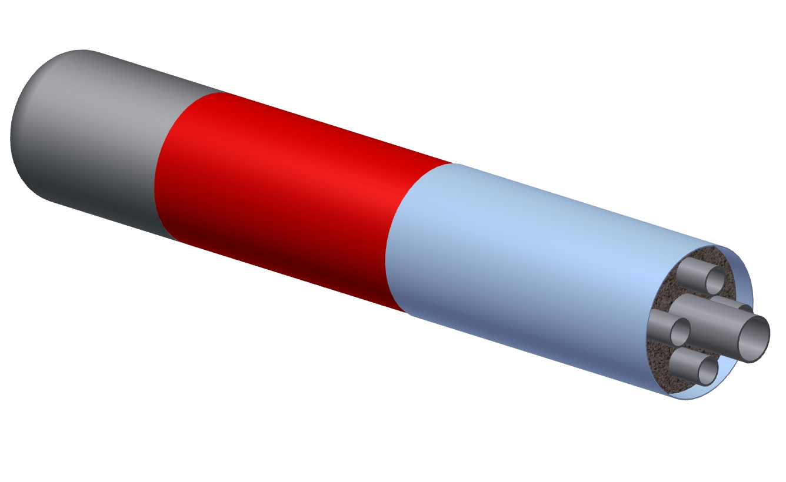
View of the different sections of the target torpedo
All beryllium
Steel for parts not in contact with water, stainless steel for water pipes

Slide 19
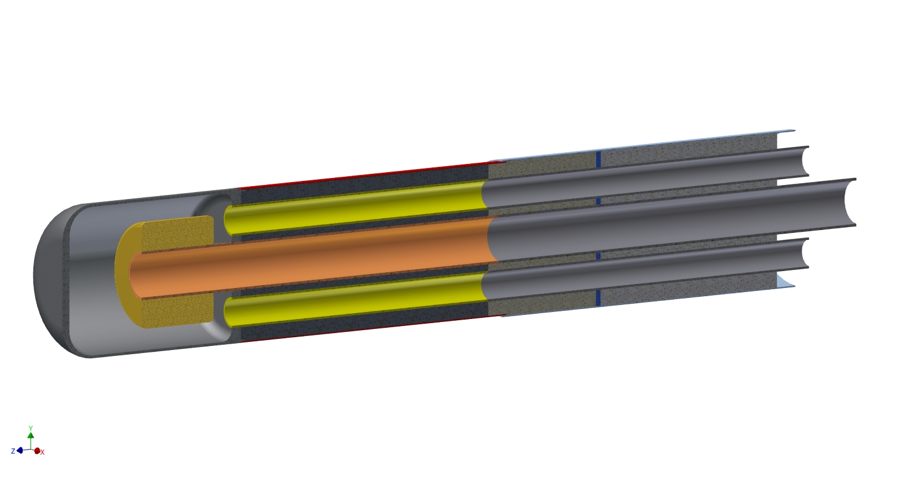
Section view of the Target torpedo
Beryllium water vessel with integrated target disk
concrete
graphite
Li/FliBe
This flange contains the graphite
4” pipe water inlet
2.5” pipe water outlets
Boundary between beryllium and steel sections

Slide 20
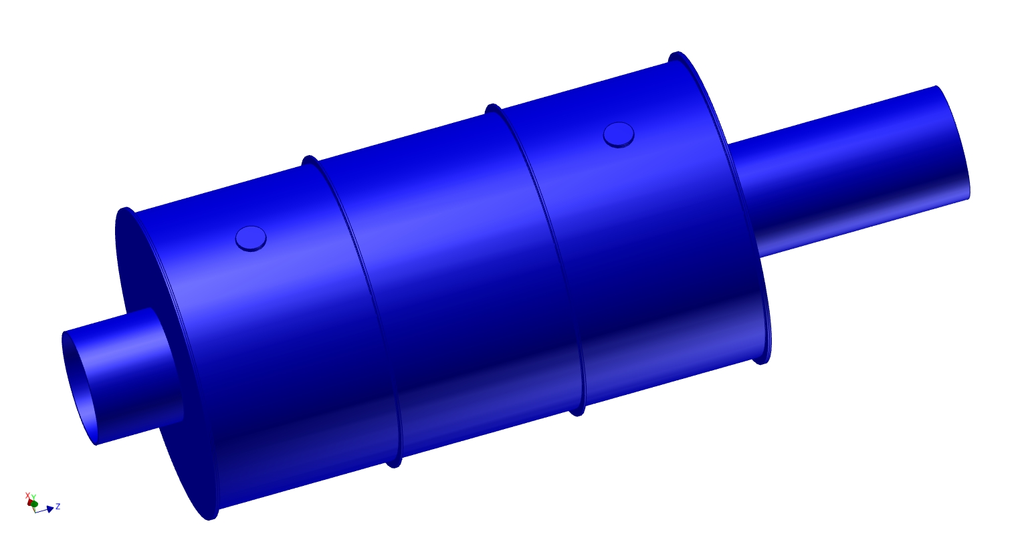
Outside view of Li/FLiBe casting tank
The capped off ports are where you would insert molten metal/FLiBe
This is a steel fabrication (with a central beryllium tube) that weighs 1,042 lbs.

Slide 21
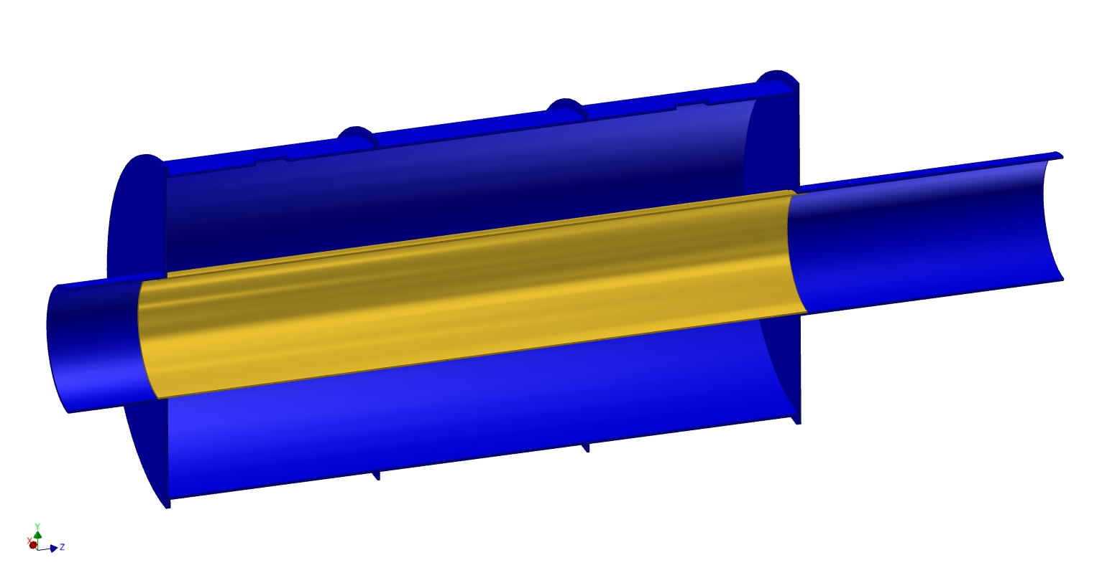
Section view of the FLiBe tank showing the beryllium tube brazed in the center to create the center section that the beam line and target modules insert into

Slide 22
Summary of Be manufacturing techniques
Beryllium fabrication and joining techniques:
The joints shown are either brazed or electron beam welded
The vessel is a powder metallurgy product
The tubes could be extrusions

Slide 23
The thermal problem
The IsoDAR target does not resemble existing NuMI, T2K or MiniBooNE targets
It resembles a scaled up version of the target described in:
Brandon’s paper was about an accelerator and target designed for Boron Neutron Capture Therapy at MIT.

Slide 24
Submerged Jet Impingement cooling
We need to remove 300 kW of heat from Be and 300 kW in water deposited by 10 mA of protons at 60 MeV
Technique is to flow sub-cooled water fast over a hot surface to sweep away bubbles coming from boiling
Normal forced convection in water achieves h ≈ 5 kW/m²-K
Submerged jet impingement achieves h ≈ 250 kW/m²-K (50X better cooling)

Slide 25
What has been achieved previously:
“Submerged jet-impingement cooling has been tested in order to remove heat at fluences approaching 6 kW/cm².”
“A 17 mm diameter (.67”) jet of water impinging normally on a target has effectively removed 5.07 kW/cm²…”
We will scale up the concept in prototype to measure larger scale cooling parameters
Other geometries have been used to extract similar levels of heat so there are existence proofs

Slide 26
Parameters based on paper
Optimum diameter for the cooling nozzle is ½ that of the area being cooled.
This means our nozzle diameter is 10 cm (4 inch sched 40 pipe)
Optimum Z/D spacing is 1
The nozzle is a Z distance equal to D back from the back side of the target disk
If the water velocity is 35 m/s, then we need 4,500 GPM flow through the 4 inch pipe.
We are studying erosion

Slide 27
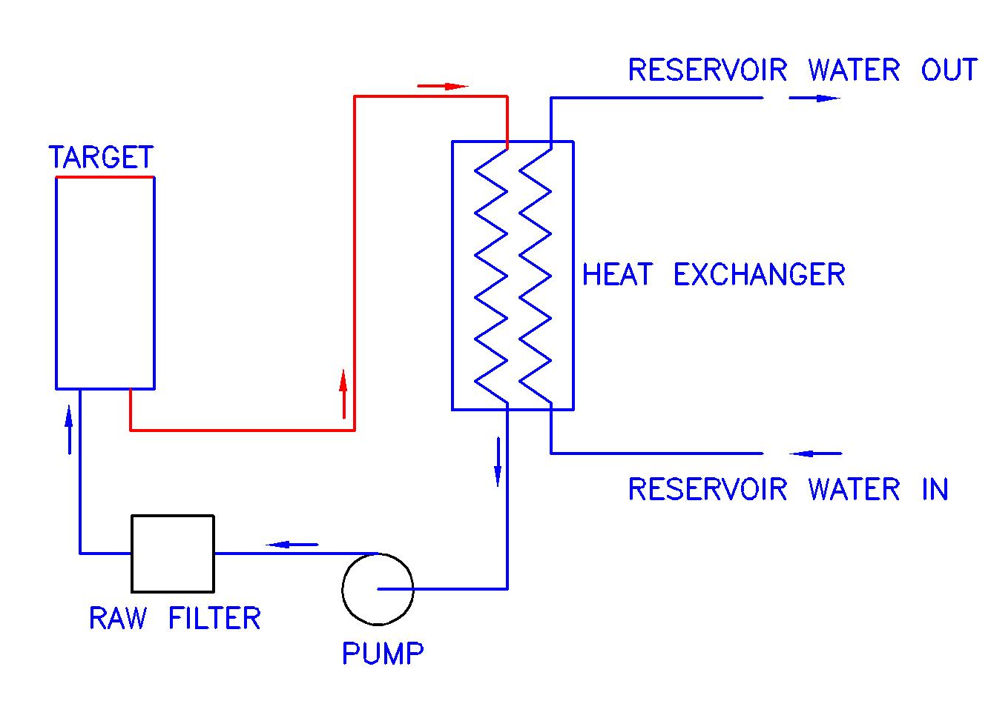
Schematic of a simple plumbing system
Beam
Components to produce a static water pressure increase not shown

Slide 28
Summary
We have a lot of work to do to mesh a small accelerator complex into the mine tunnel at KamLAND
Any advice you can give us on remote handling and activation issues is most appreciated

