Slide 1
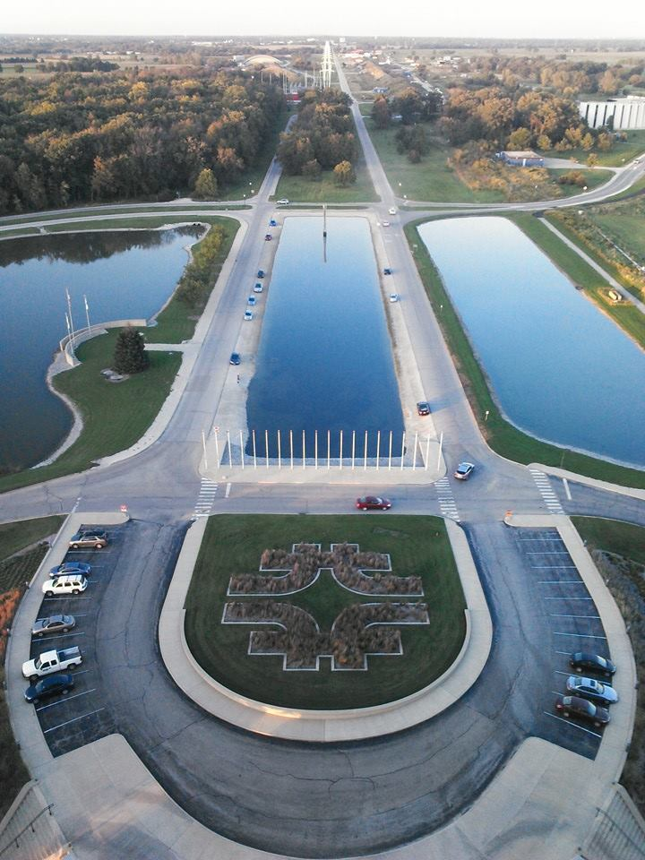
Operational Status of
Decay Volume Helium Vessel at J-PARC
Neutrino Experimental Facility
T. Ishida
Neutrino Section, J-PARC Center, KEK
on behalf of the neutrino beam group

Slide 2
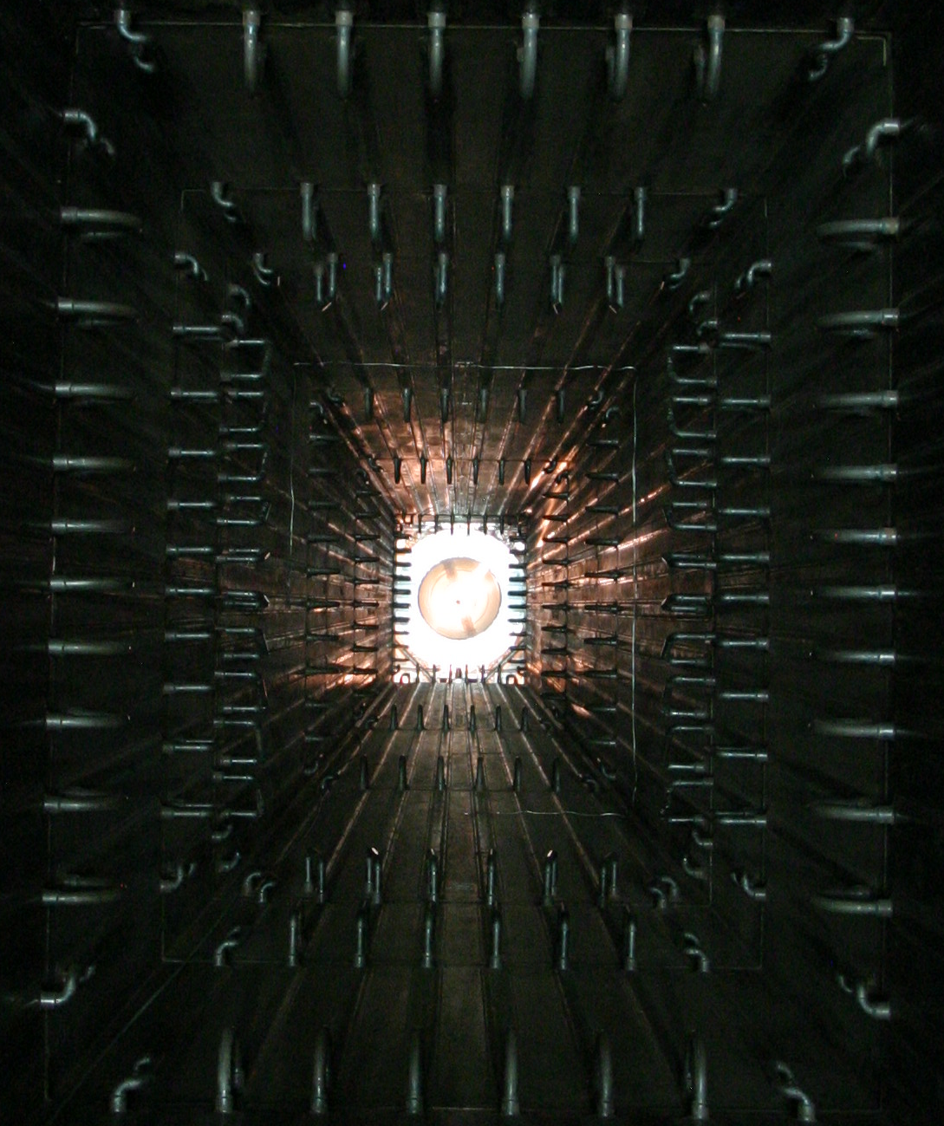
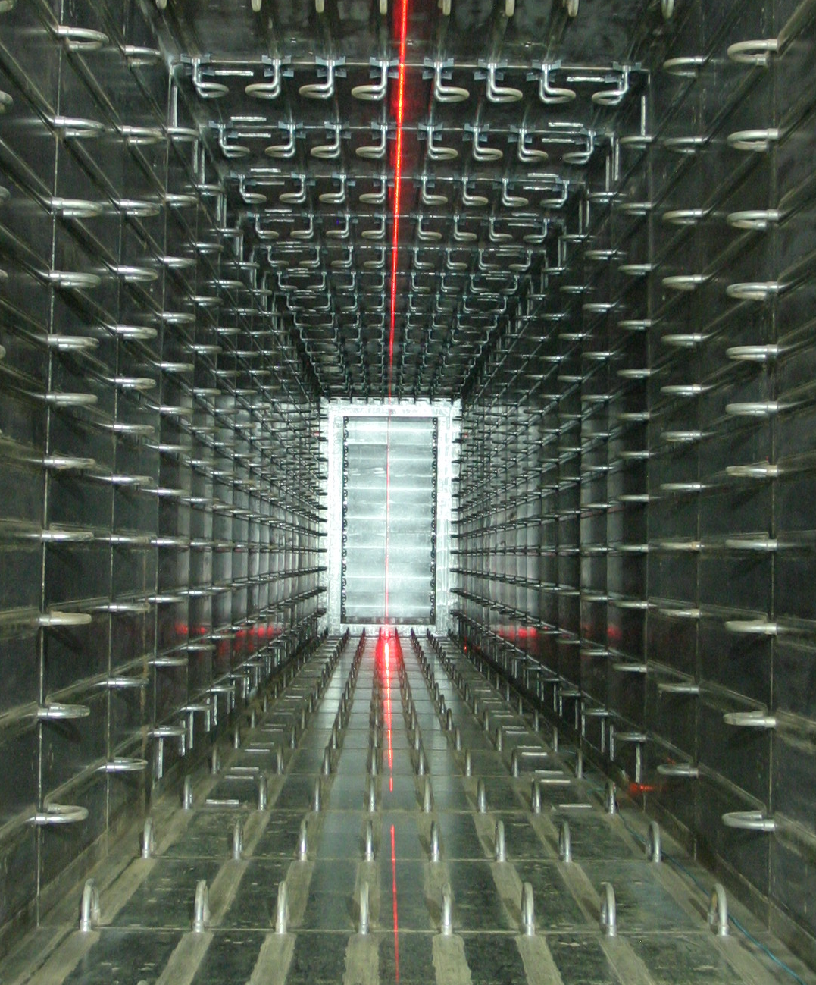
Contents
The Helium Vessel at J-PARC neutrino beam-line
Status of water cooling
Status of Helium atmosphere in the vessel
Summary

Slide 3
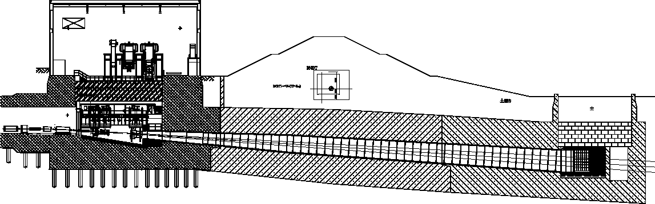

1. The Helium Vessel at J-PARC neutrino beam-line
Vessel filled w 1atm. He gas
L=~110m,V=1,300m³
Target Station
Beam Transport
From RCS to MLF
Beam Dump
Decay Volume
OA2º
OA2.5º
OA3º
6m-thick concrete wall
Target Station(TS), Decay Volume(DV) & Beam Dump(BD) all enclosed in a gigantic vacuum/helium vessel, made of carbon steel plates.
  Water cooling through plate coils welded on surface
  Upstream cooling system at TS / downstream system at a utility bldg. (NU3)
He gas filling after evacuation
  Entire structures were rigidly built with thick plates (100mm for TS / 16mm + anchors for DV / 200mm for BD), welded together with deep grooves.
He circulation by a helium compressor at TS: Flow rate = ~1,600Nm³/h
  Inlet plays role as coolant of horn strip-line cooling duct.
  No forced circulation for DV/BD (piping at BD exist for future use)

Slide 4
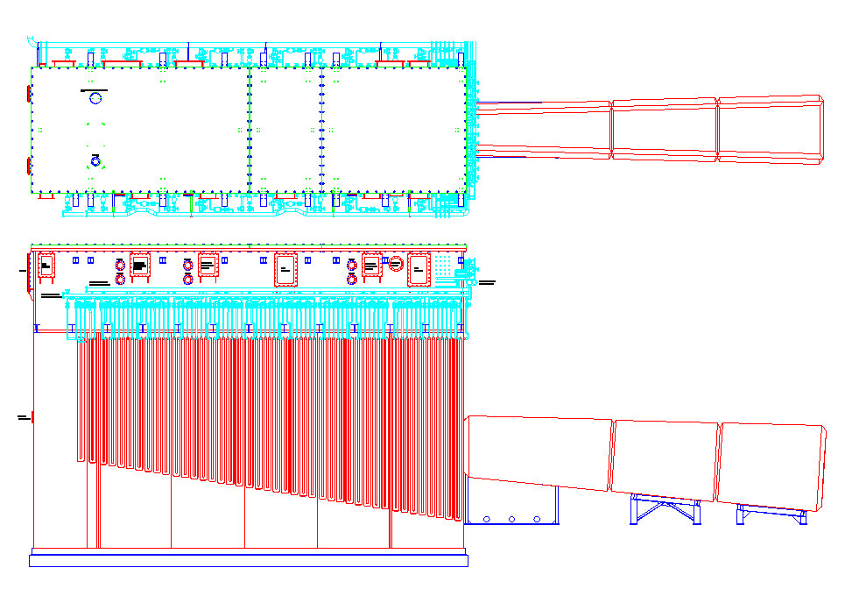
Helium Vessel at TS
Top lids
(3 pieces of 120mm-thick Aluminum )
OTR window
4.4 m
Target Station: 300t
Upstream DV: 170t in total
Flanges for the busbar of the horns
Valves
200mm-thick iron plates with
plate coil water paths
Recycled from K2K ND (MRD)
10.6 m
15.0 m

Slide 5
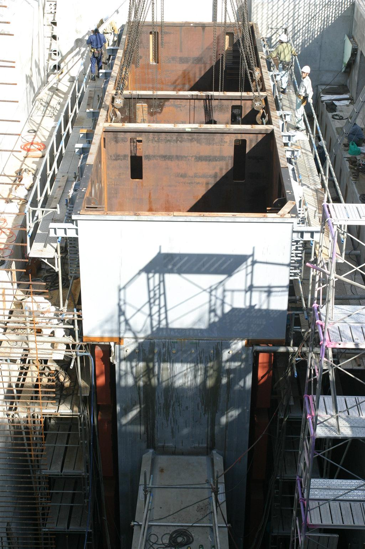
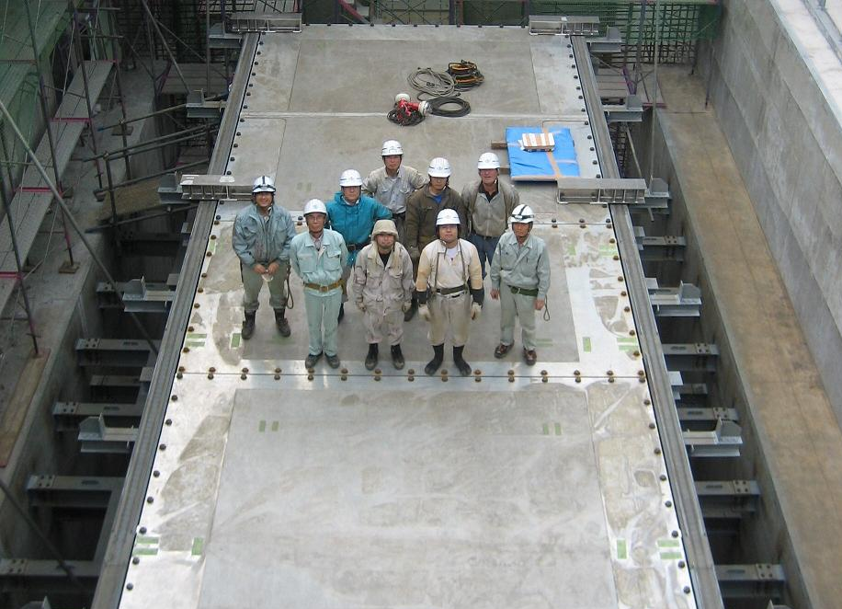
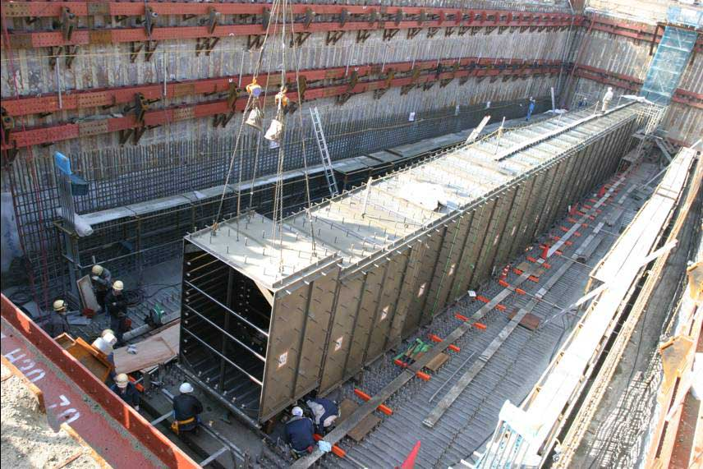
TS/DV Helium Vessel Construction
TS
Top lids
(3 pieces of 120mm-thick Aluminum )
DV
Upstream DV
Support anchors
Embedded in concrete wall
Oct.05’07

Slide 6
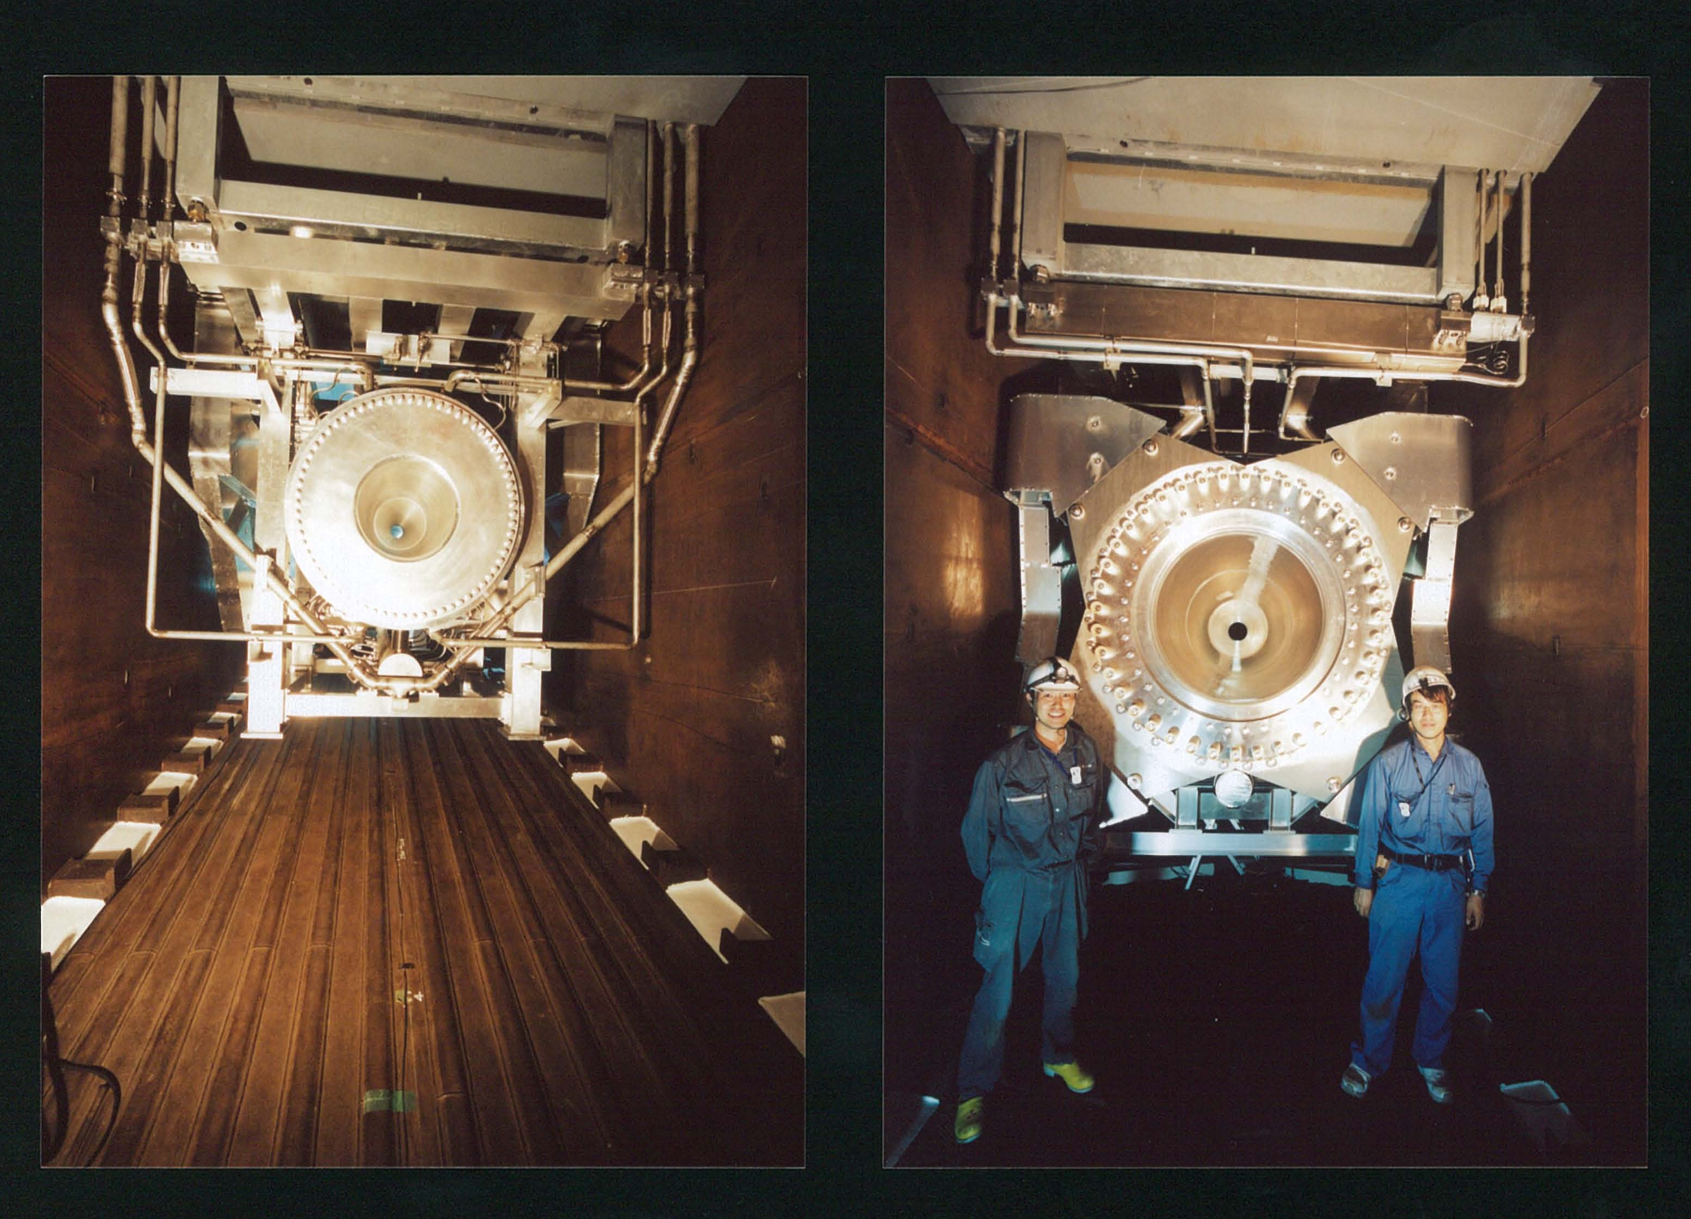
Inside of TS vessel
Horn-2
[downstream]
Clearances ~30mm
Horn-3
[upstream]
Plate coils
bus-bar cooling ducts = helium inlet to the vessel
Photos on Sep., 2009 (before Physics Run)

Slide 7
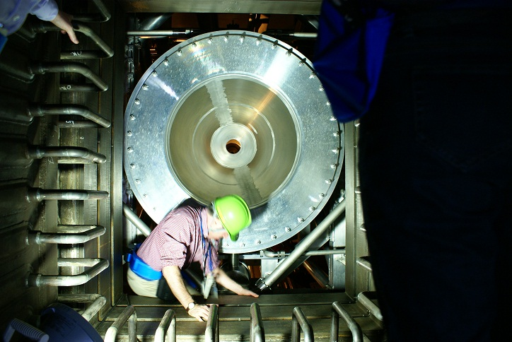
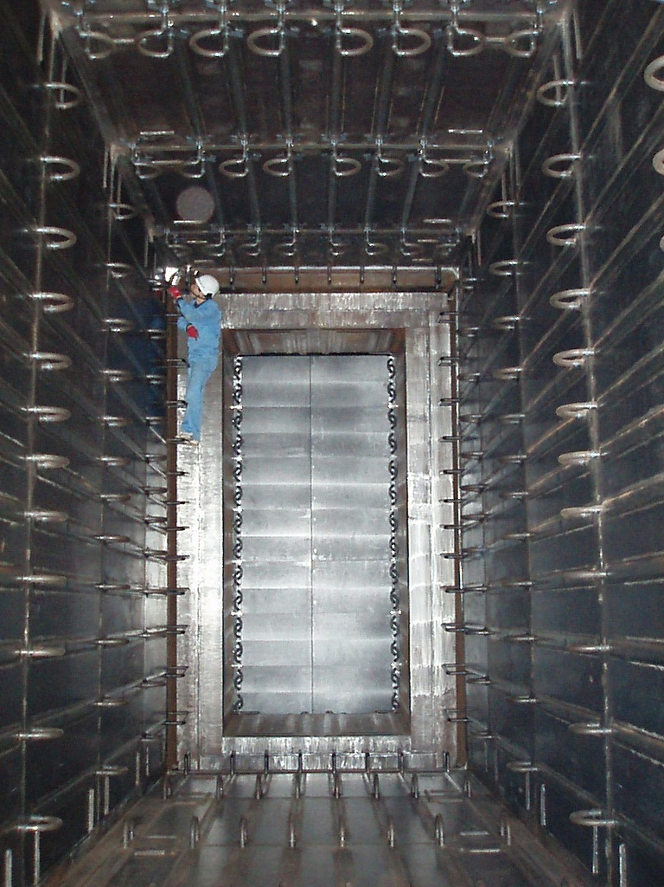
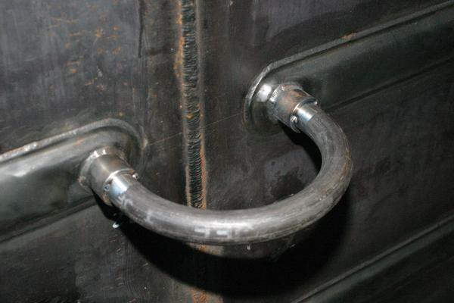
Inside of decay volume
1.4m
  entrance
  downstream end
BD upstream
inner-vessel shield
Hadron absorber
1.7m
2009/9/26
5.1m
“Plate Coil”
Water cooling
channel
U-shaped
pipe connection (25A)
3.2mm
3.0m
2009/2/27
  Water circuits are separated to upstream and downstream.
  Each composed of 20 circuits – 40 water channels.
16mm

Slide 8
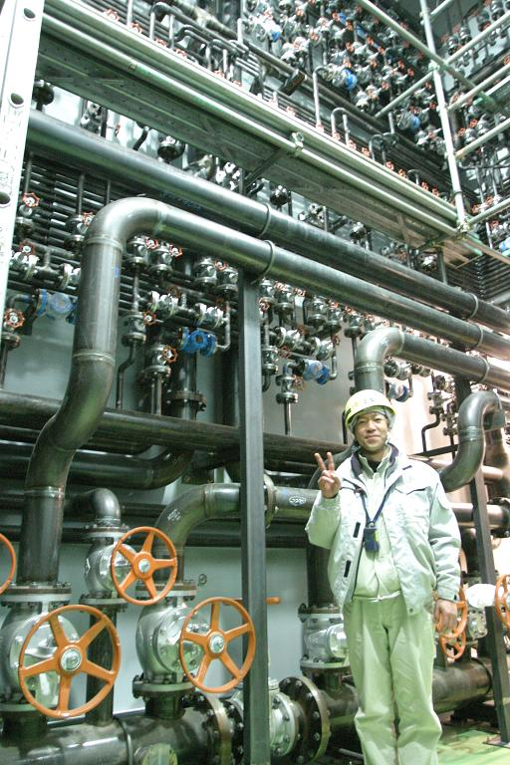
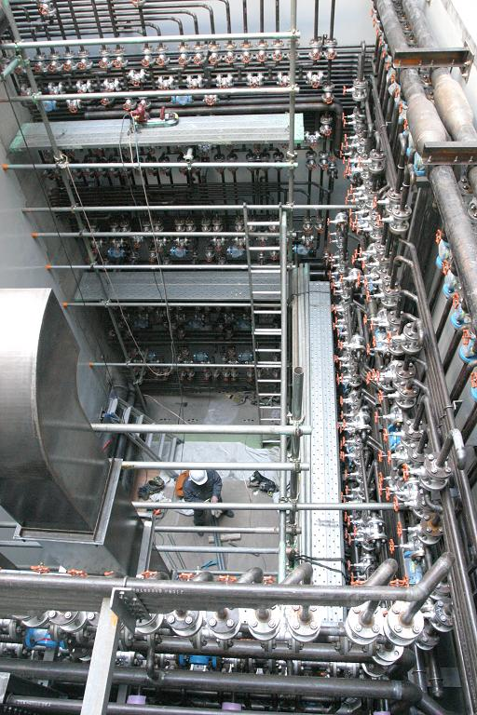
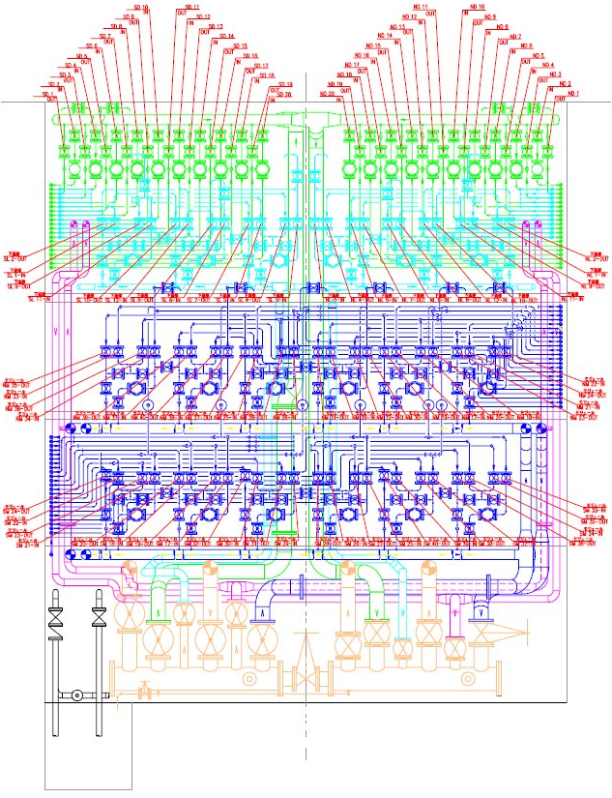
Plumbing at muon pit
[West side wall]
  To Decay Volume
  (downstream)
TP
-5.1m
  To BD
  Upstream shield
  To Absorber
  cooling modules
Control water flow of 260water channels (130 circuits), ~500 Valves (25A)
Though it is designed to use half of the circuits for 750kW beam, we forced to use all channels with low flow rate.
  It may cause troubles for carbon steel, if we remove water from the channels.
TP
-12m
  Supply
  header
  Return
  header

Slide 9
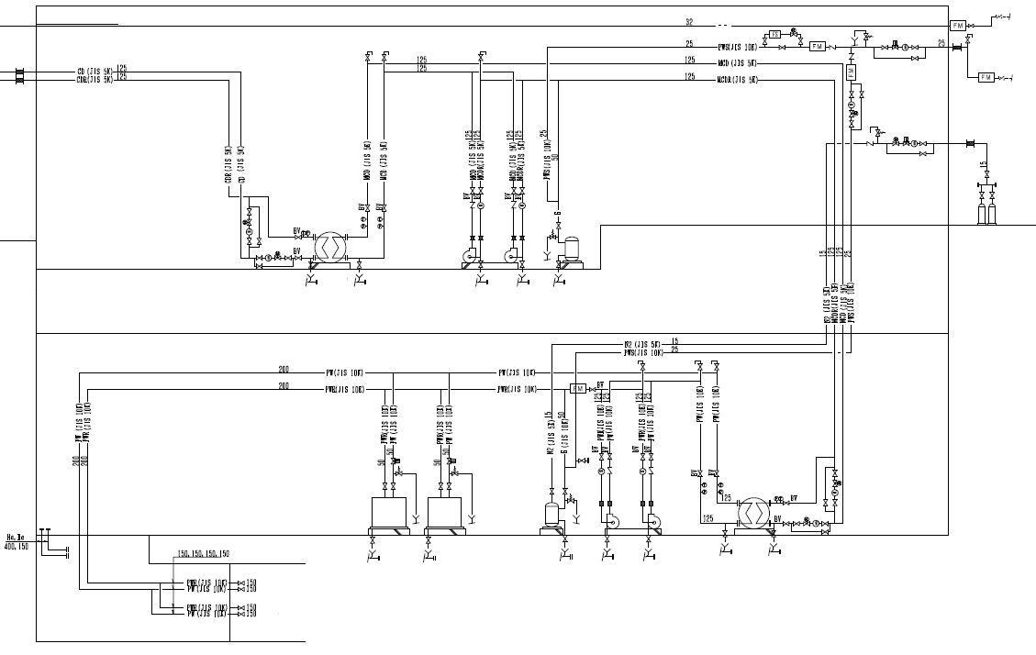
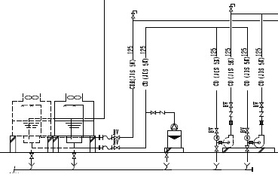
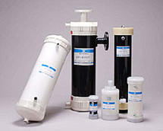
Cooling Water System [NU3: downstream DV+BD]
  Industrial
  water
  supply
  Outside
  yard
  [GL]
  Purified
  water
  supply
  Tertiary
  Cooling
  towers
  Expansion
  tank
  N₂ gas
  supply
  for ET
  Hot
  machine
  room
  [1F]
  Heat
  exch.
  Degasifier
  Hollow fiber membrane
  [+ 0.3um Pre-filter]
  ※ key component ※
  to prevent corrosion
  Secondary
  Exp. tank
  [Water supplier]
  [B1F+4.5m stand]
  Centrifugal
  pumps
  Hollow
  fiber
  membrane
  Superhot
  machine
  room
  [B1F]
  HEX
  Primary
  (irradiated)
  Ion-exchange resins
  [+ 0.5um Pre-filter]
  ※ NOT USED ※
  It may cause damage
  to carbon steel
  DV/BD
  Muon pit
  [B2F]
  Header

Slide 10
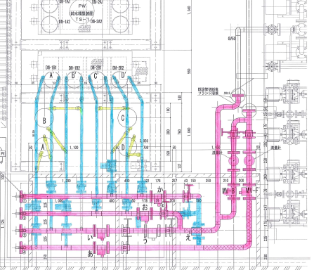
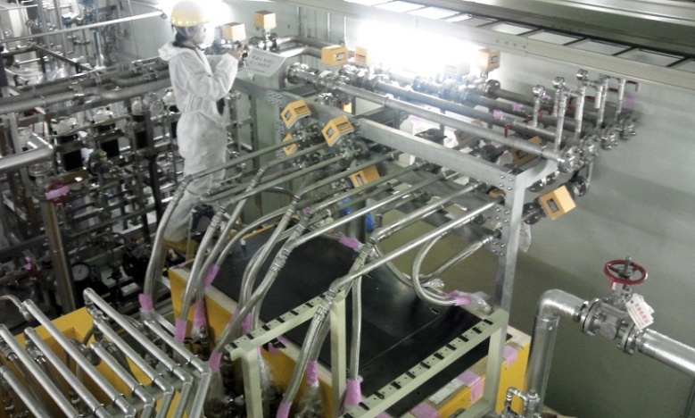
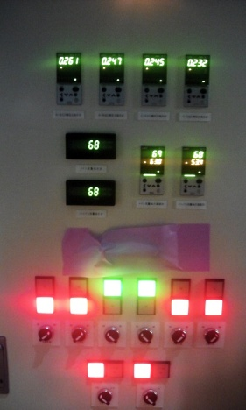
2. Status of Water cooling [after NBI2012]
Filter A’~D’
Filter A~D
Pre-filters for the degassifier (5um⇒1um) was installed to TS CW system in summer 2012 (similar system to NU3)
They effectively absorb the radio-active particulate in the water (⁷Be), but frequently clog up.
  Powder of carbon steel (black skin)
Exchange/tuning of filters caused 8hrs x 2 beam loss in Nov. 2012 runs (Run-4)
New system was installed during the 2012 winter shut-down.
  Remote controls, such as switching to a spare set of reserve filters / opening bypass line, are possible without disturbing beam runs.
Degassifier

Slide 11
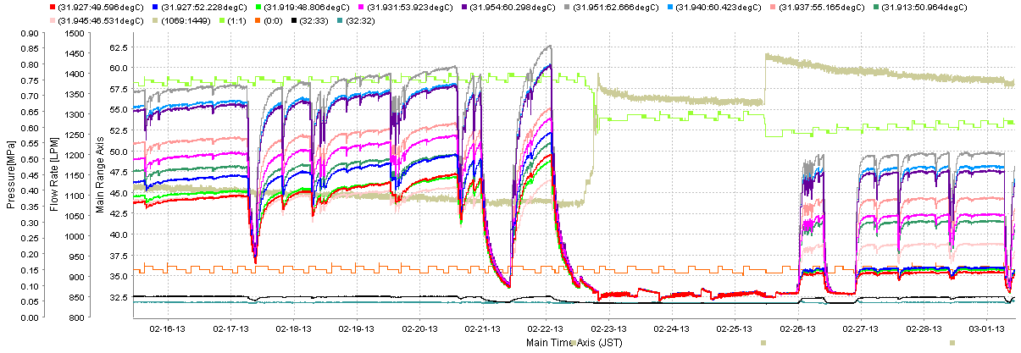
Decrease of cooling water flow rate at NU3 (Feb.2013)
62.5℃
0.75MPa
Pressure at inlet increases
1,400ℓ/min
Absorber core temperatures
47.5℃
0.6MPa
Tuning
Flow Rate
Flow rate decreasing
1,100ℓ/min
2/16
2/20
2/24
2/26
3/1
Drop of cooling water flow rate observed for DV He vessel and beam dump.
The black powder may clog up the water paths / valves.
It was found that flow rate ~0 for some of channels
  After adjusting the flow rate of each channel, flow rate stabilized.

Slide 12
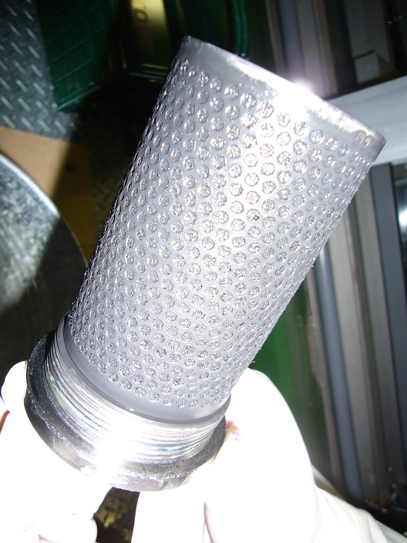
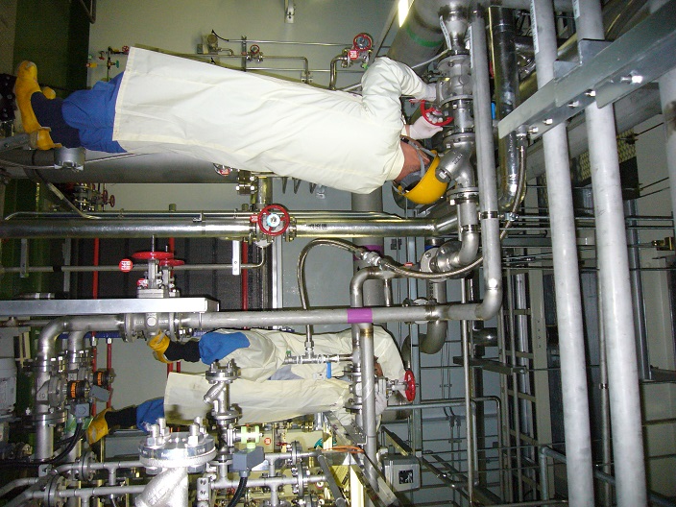
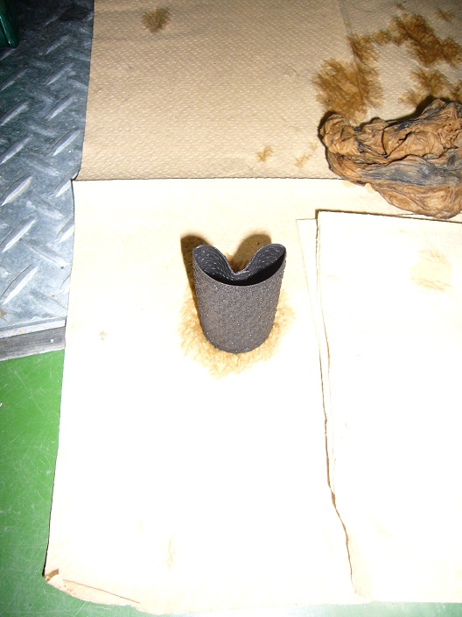
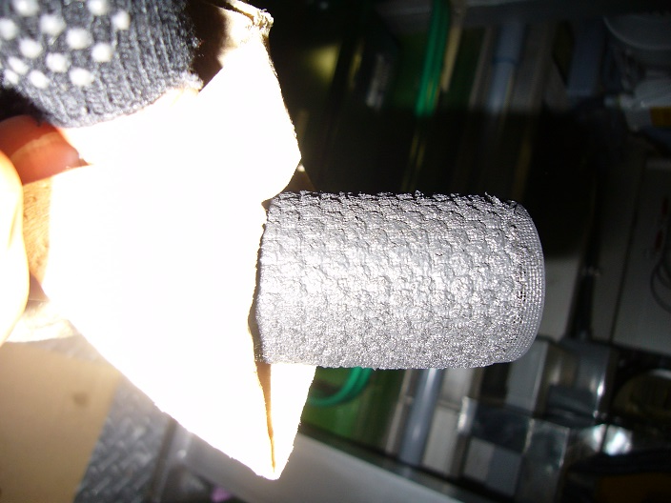
Flow rate decrease at degasiffier (NU3) [Mar 2014]
Y-strainer
Reducing valve
(+small strainer)
Flow rate <100l/min
(nominal 135)
Pressure after reducing valve 0.1MPa (0.3MPa)
Y-strainer
Small strainer

Slide 13
Radioactivity in cooling water (NU3)
Radioactive nuclei in the primary cooling water
  Run-4: Oct. 2012 ~ May. 2013, 3.6x10²⁰pot, -230kW
  On Dec. 2012 we disposed some amount of water to boot up water dilution process and to prepare for the summer maintenance in 2013.
  Only ³H is beyond limit for disposal.
  The 0.3um pleats filters in front of degasiffier seems to be very effective to adsorb/concentrate ⁷Be
  So far daughters of Fe is not serious problems.
  In sometime future it will be necessary to use ion exchanging resins before drainage.
Spc. | 3H | 7Be | 22Na | 43K | 52Mn | 54Mn
Bq/cc (Dec.2012) | 740 | 1.0 | 0.045 | - | 0.046 | 0.12
Bq/cc (May.2013) | 500 | 1.2 | 0.045 | 0.1 | 0.11 | 0.13
Disp.limit | 60 | 30 | 0.3 | 3 | 0.5 | 1
Life | 12.3y | 53.2d | 2.6y | 22.3h | 5.6d | 312d

Slide 14
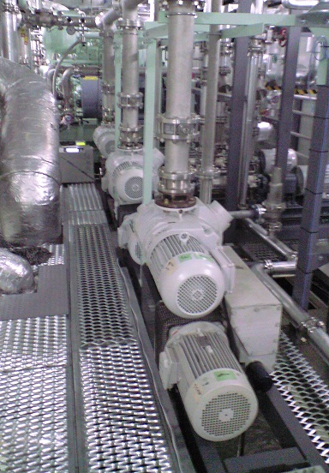
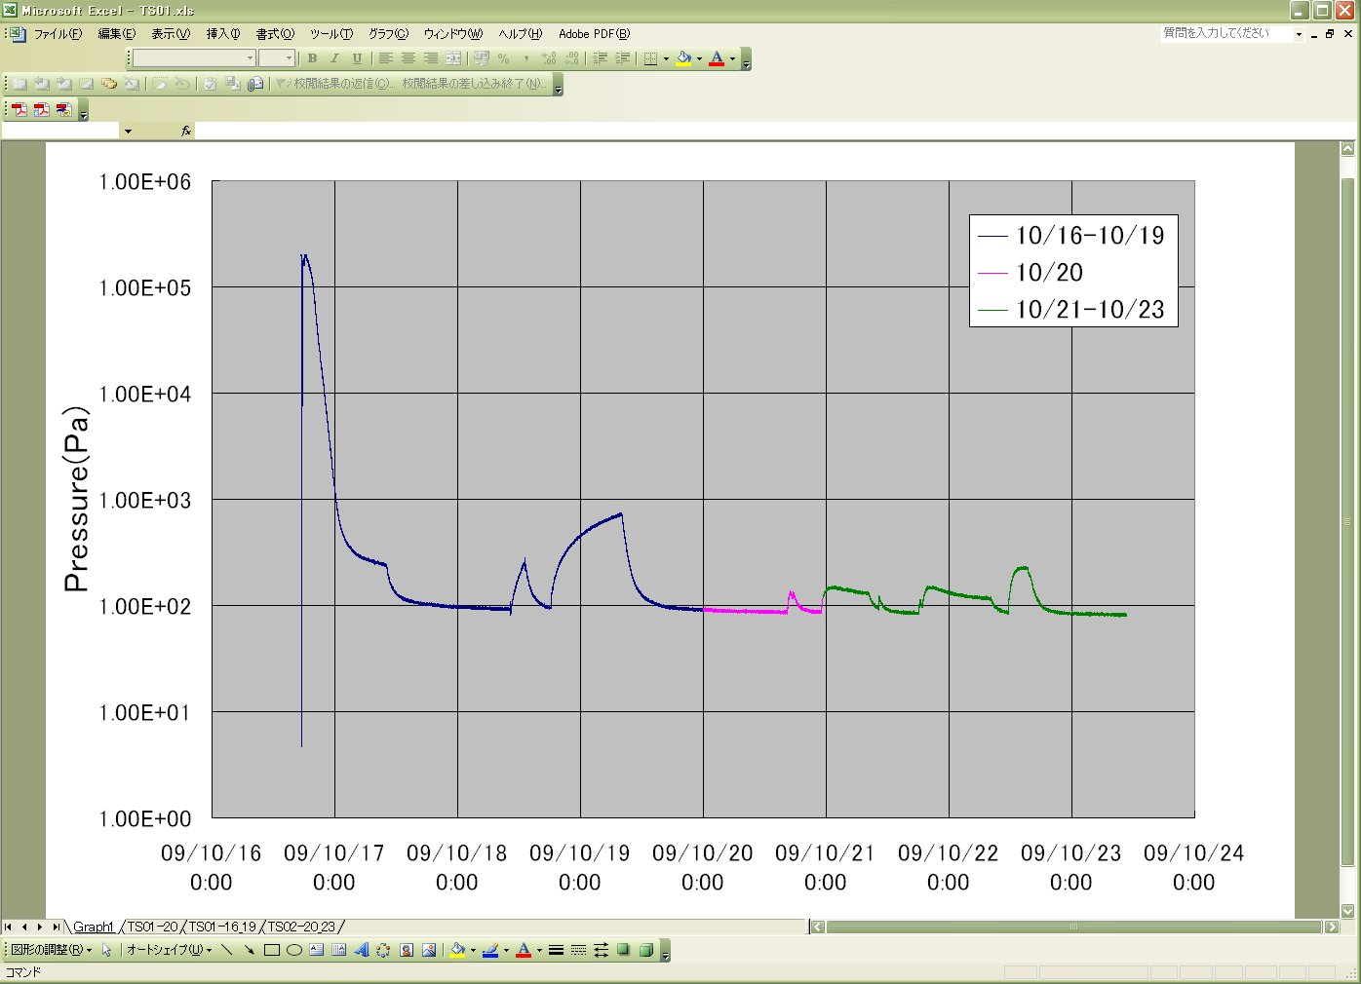
3. Status of Helium atmosphere in the vessel
2009
Aggravation rate= 46Pa/h
20 Pa・m³/s
He gas filling
~2days to reach to <100 Pa
81 Pa
Mechanical-booster pumps
@ TS B1 stand
By evacuation we reach to <100Pa (0.1%) with a few days ~ a week
  Vacuum was saturated by outgas (20 Pa・m³/s), possibly from vessel surface / concrete shield blocks in the TS vessel
Tiny amount of air leak at BD vessel: 10⁻²~10⁻¹ Pa・m³/s=1~10ppmO₂/day.
  air contamination suppressed by keeping slightly positive pressure wrt. atmosphere.
  O₂ contamination < 100ppm for entire beam period
The dew point (humidity) in the vessel was saturated in a week after gas filling
  Source of Tritium (HTO) production
  From concrete surface ? Water leaking ?
  ⇒ From Oct. 2012, we faced to water leak from Horn(s)

Slide 15
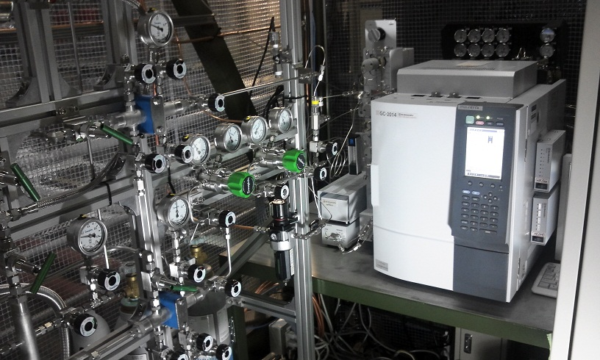
Gas chromatograph measurement [Apr.2013]
On Feb.~Mar.2013 gas chromatograph was installed to TS
  Helium vessel(Apr.2013):
  N₂ 1,500 ppm
  O₂ 20 ppm
  CH₄ 30 ppm
  CO₂ /CO 0 ppm
Consistent to the reach of evacuation
Oxygen is low enough.
gas chromatograph at TS-1F
Coolant Helium gas for target, beam window, and He vessel
Cover gas of horn cooling water

Slide 16


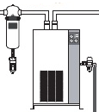


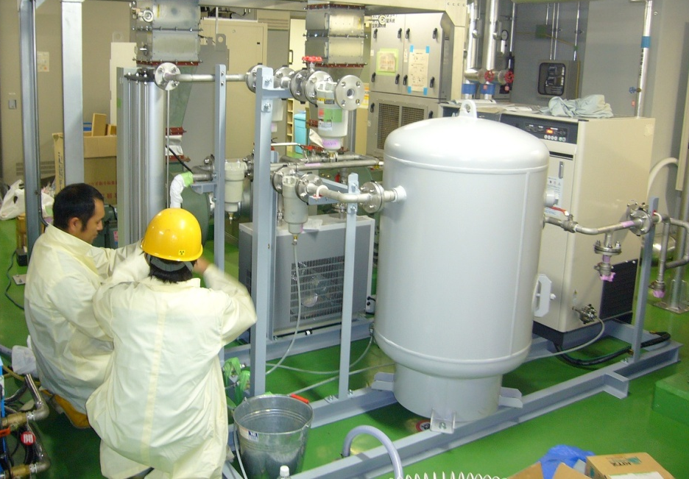
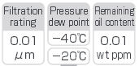
Dried Air Supplier @ NU3
Before opening He vessel, we need to dry up inside of vessel to avoid suffering internal exposure by ³H (HTO).
³H level in the vessel is much higher than that in 2011.
  2011: ~1300mBq/cm³ after 1.4x10²⁰ POT
  2012: ~1100mBq/cm³ after 1.6x10²⁰ POT
  2013: ~1900mBq/cm³ after 3.6x10²⁰ POT
In 2011, it took 3 weeks to reduce ³H level from 1.3Bq/cc to 0.2Bq/cc
We have reinforced dried air supplier at NU3: higher flow rate & lower dew point.
Compressor
2.4m³/min
(was 1m³/min)
400 L
Air
tank
Heatless
Air Dryer
(new)
Refrigerated
Air Dryer
Low dew point
clean air

Slide 17
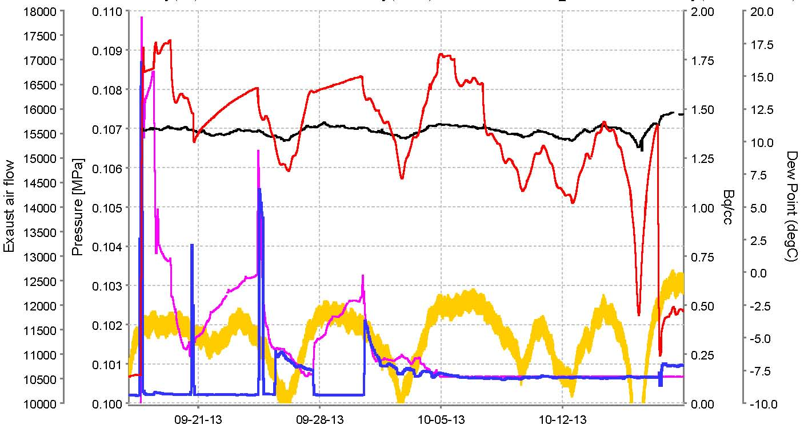
Drying He Vessel [Sep. 2013 -]
Exhaust f
airflow
[m3/h]
9/17~20
9/24~27
9/30~10/17
0
P Vessel
[MPa]
3H [Bq/cc]
Dew P [degC]
P atm
[MPa]
Vessel evacuation on Sep.12-13, drying vessel by air supplier at NU3 started on Sep.17.
  Dew point >20℃→-20℃,
  ³H 1.8 Bq/cc → 100mBq/cc (2011: 210mBq/cc)
Vessel was opened on Oct.17 (One month)

Slide 18
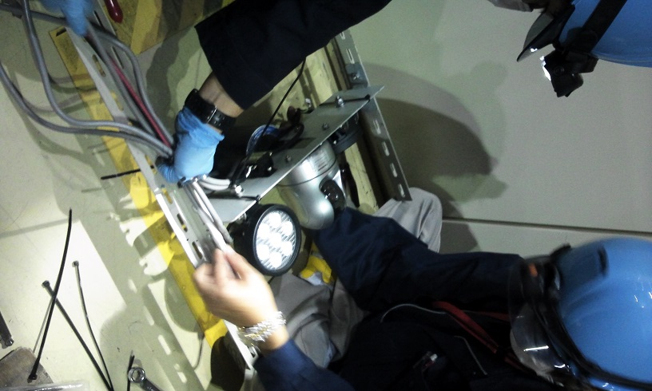
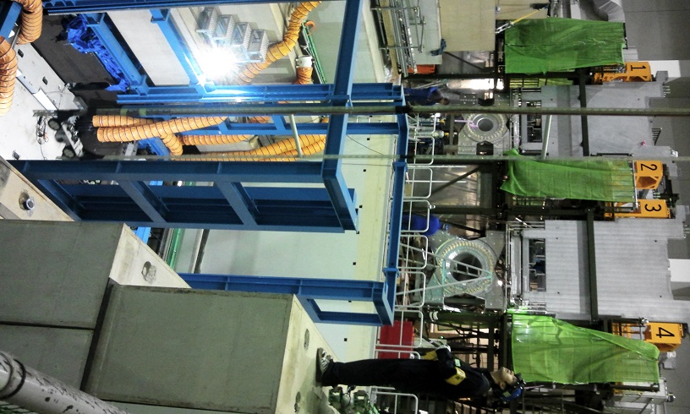
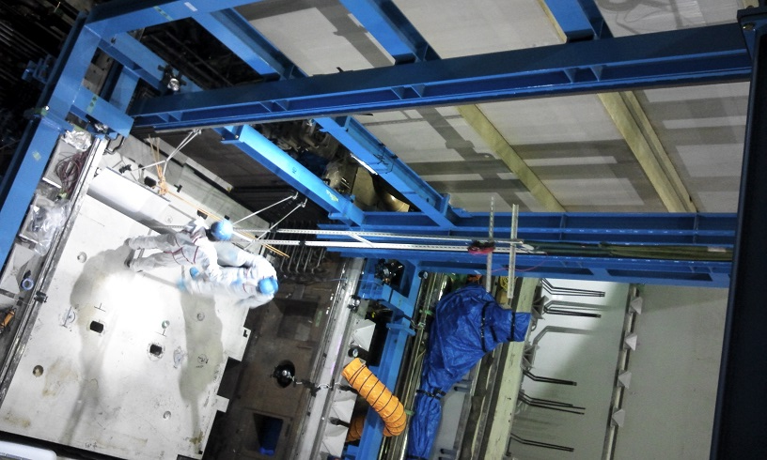
BD/DV Inspection [Nov.27, 2013]
After old Horn-3 was moved to maintenance area, we set web camera on the beam-line and inspect DV/BD status

Slide 19
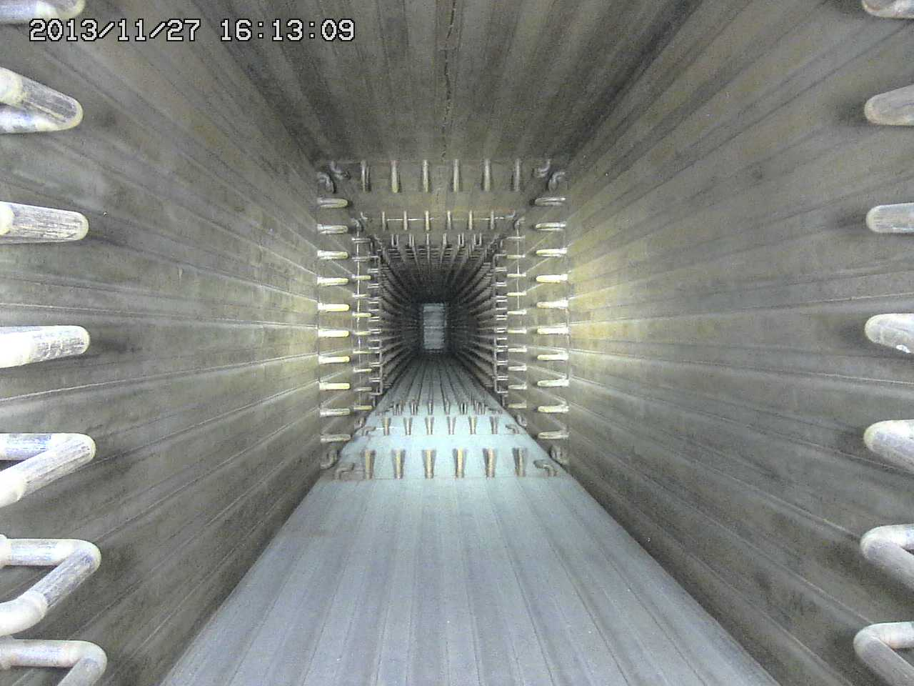
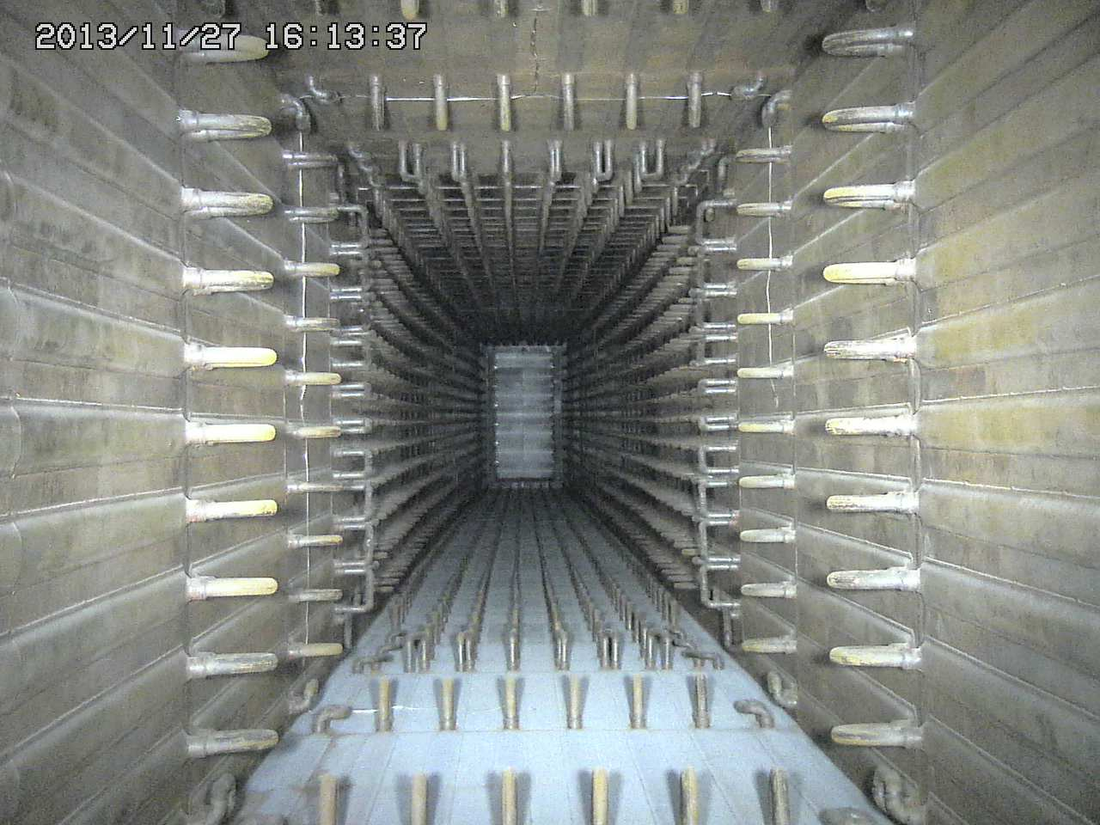
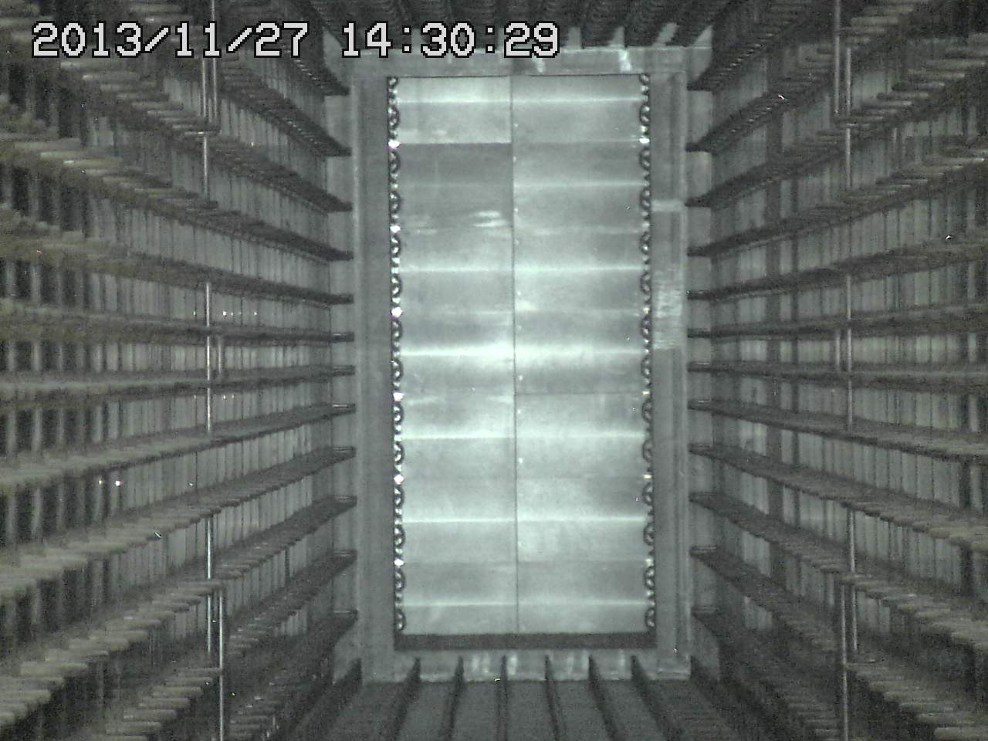
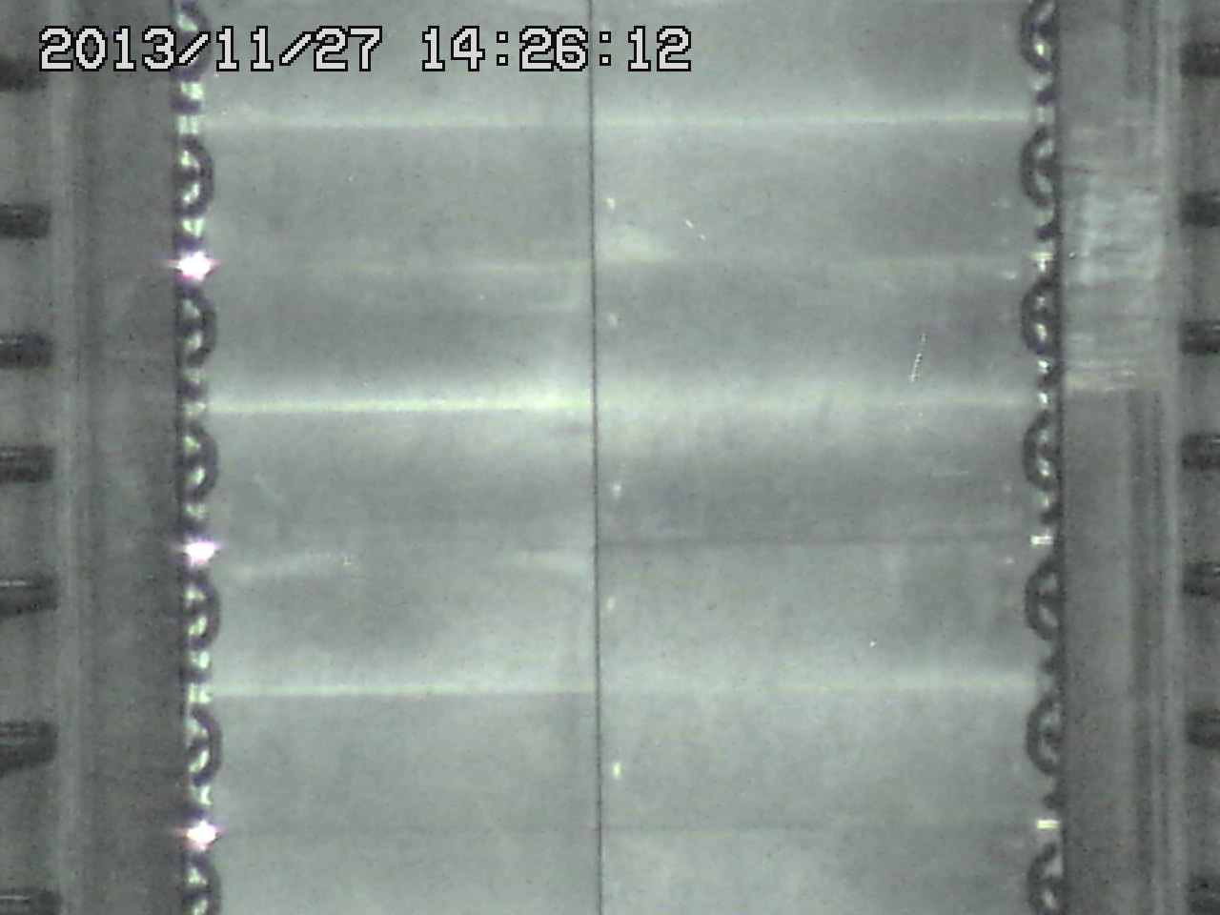
BD/DVは健全

Slide 20
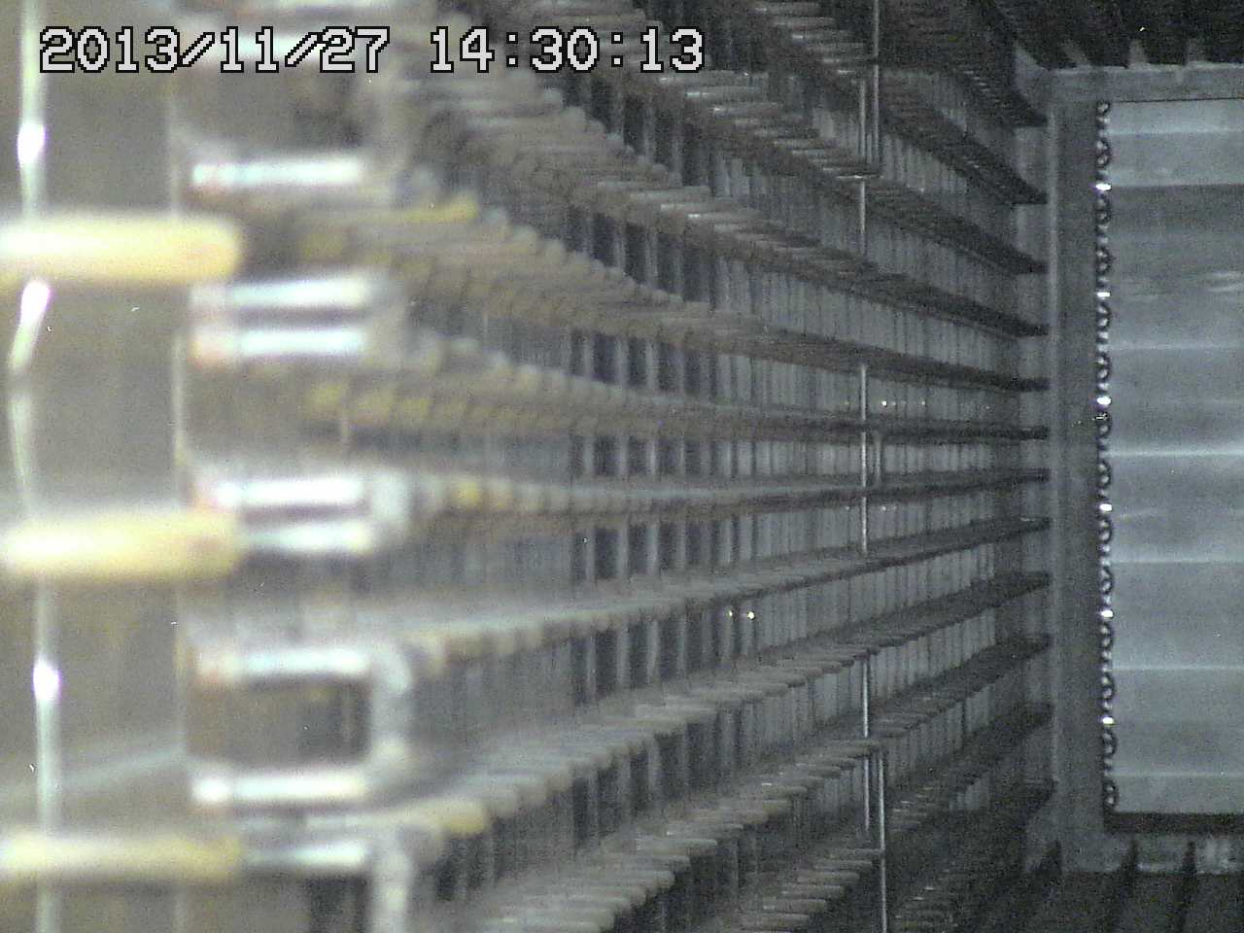
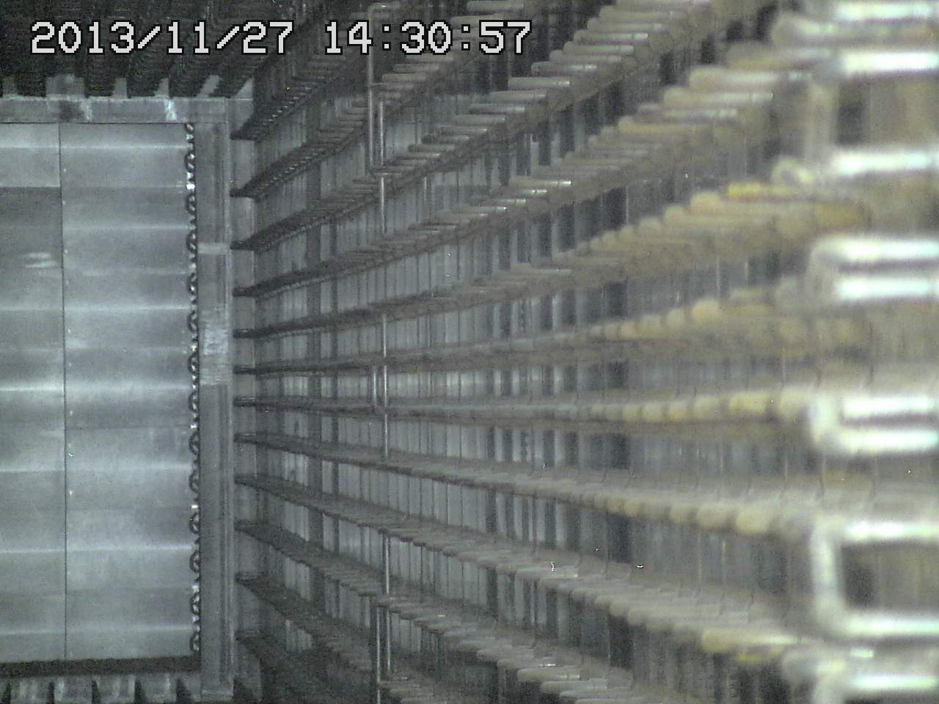
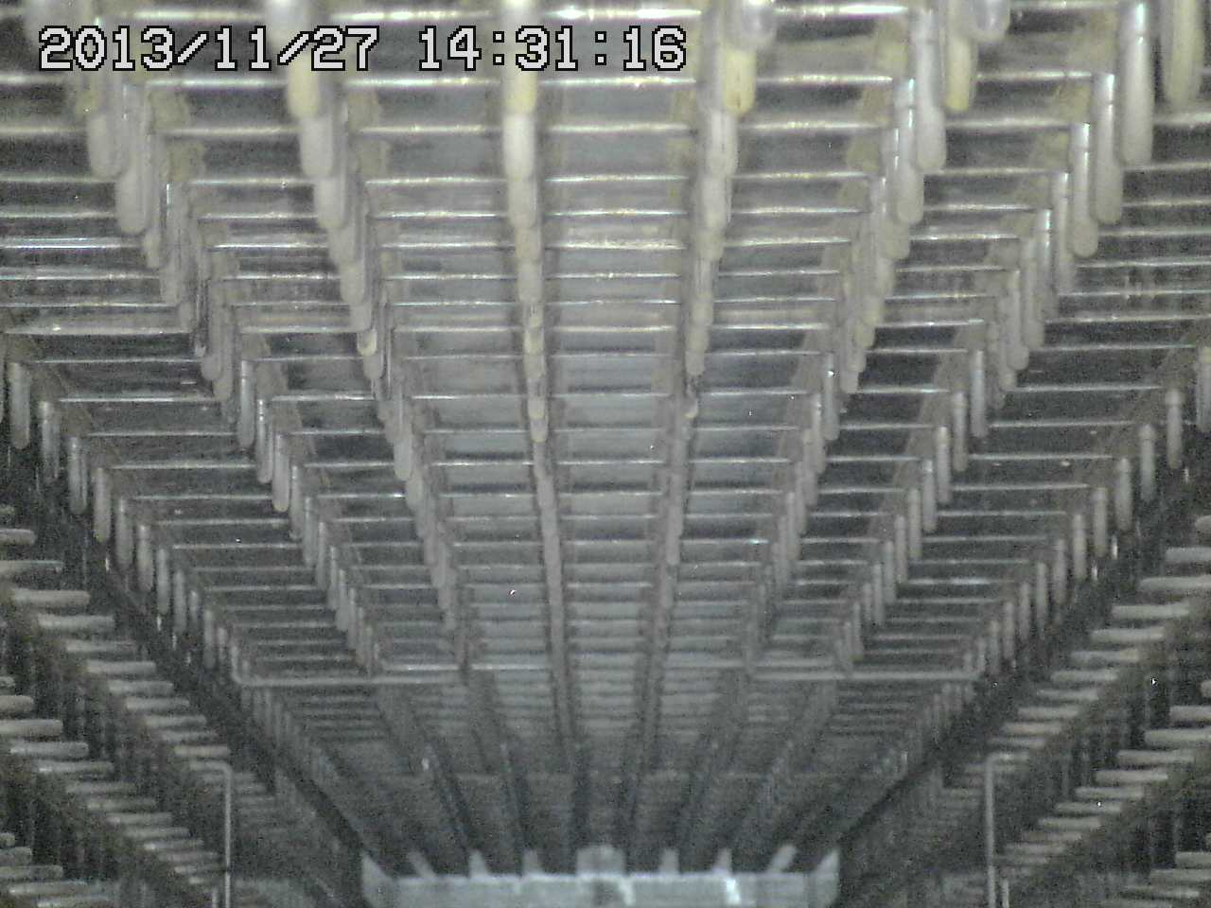
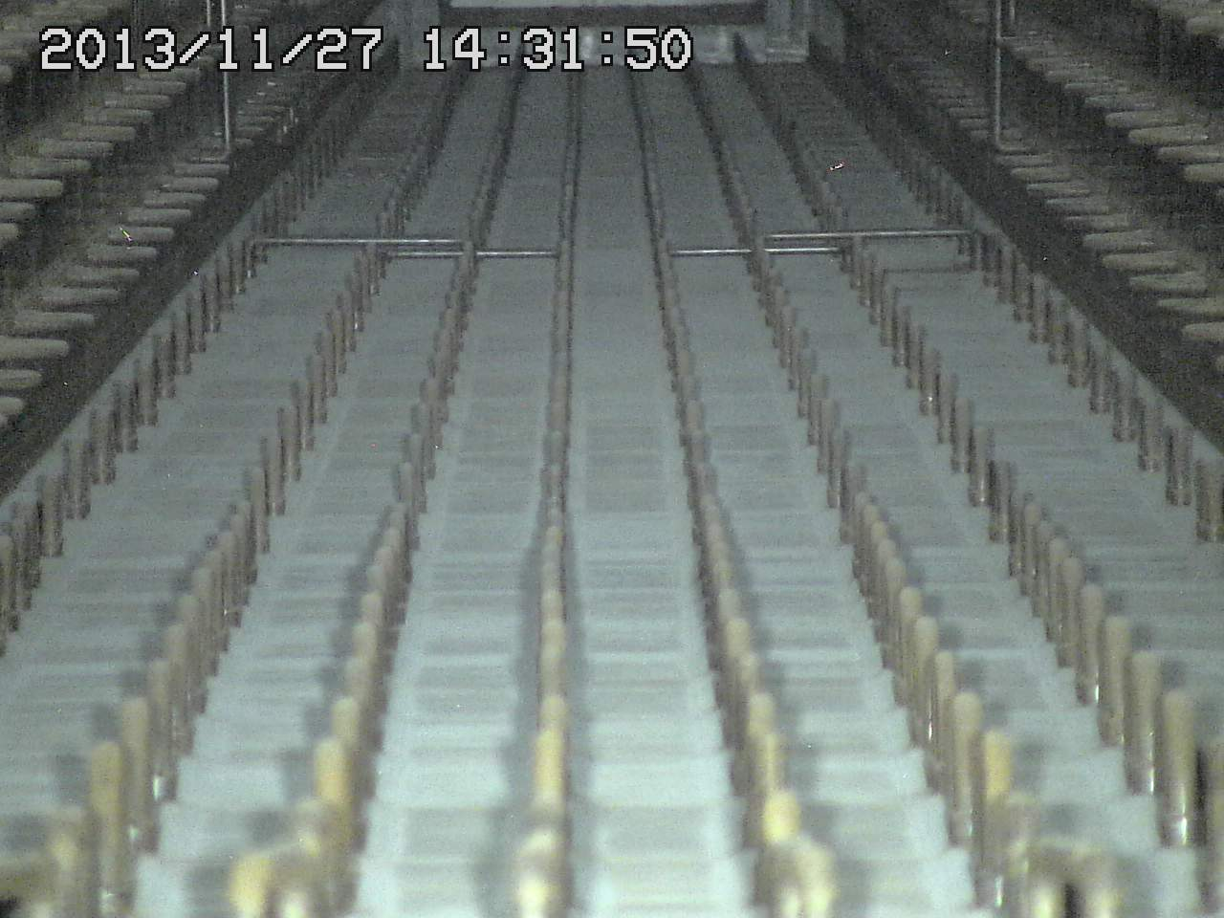

Slide 21
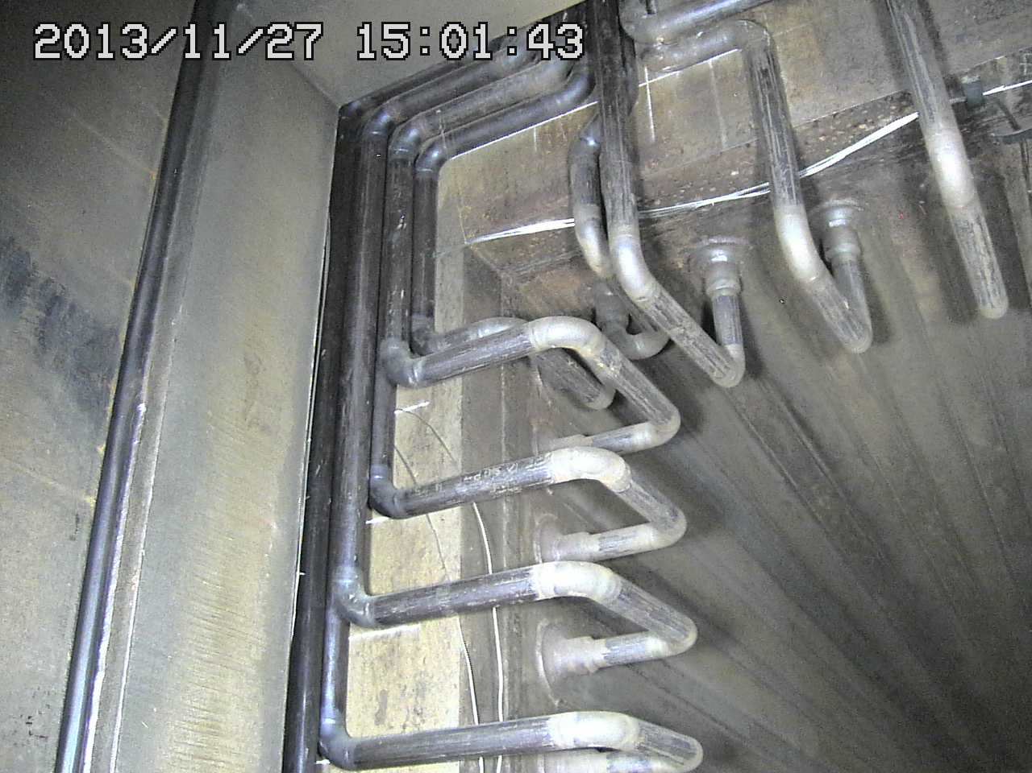
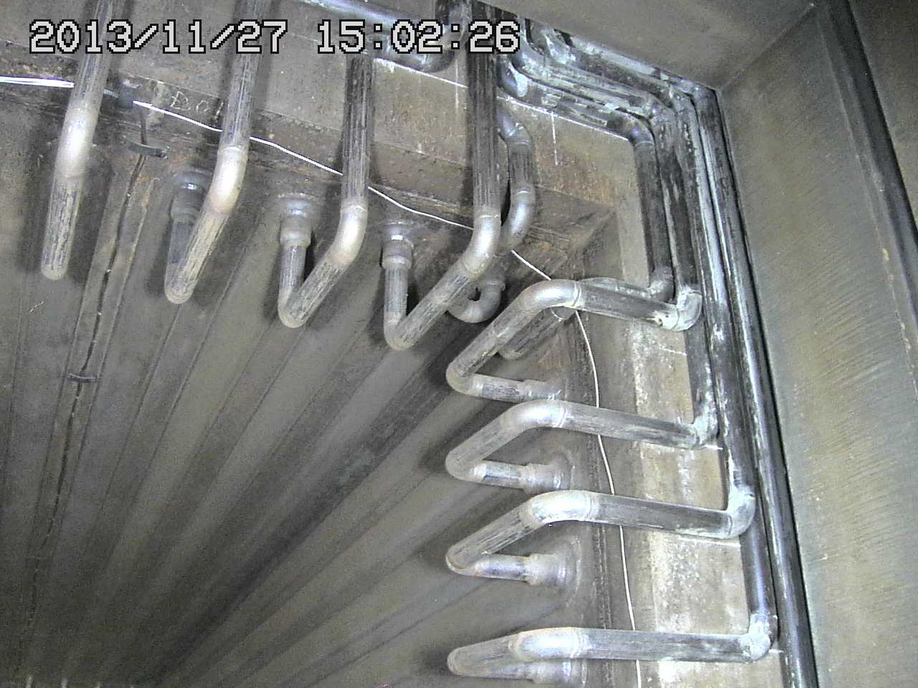
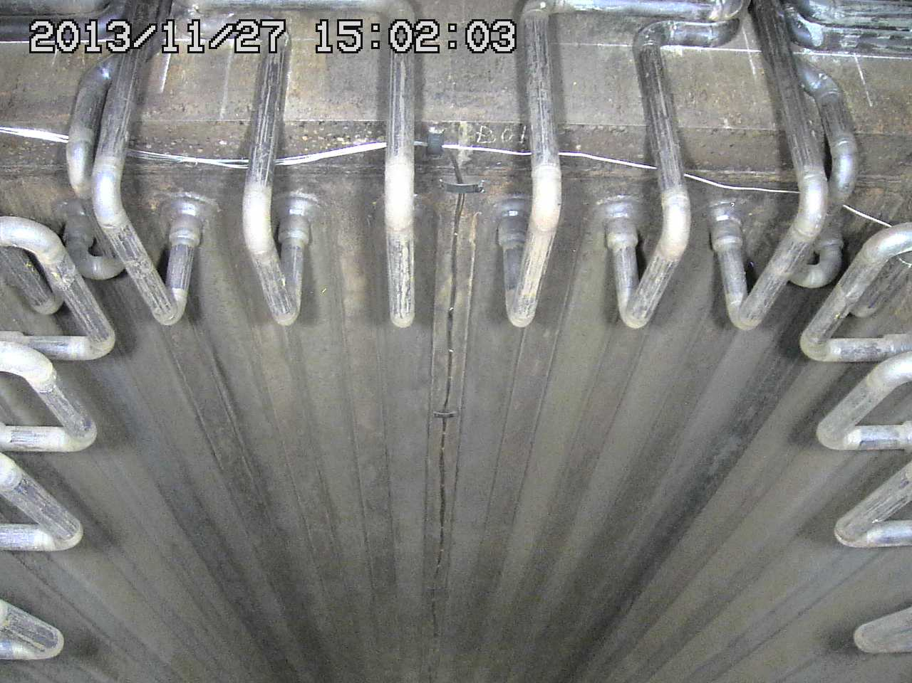
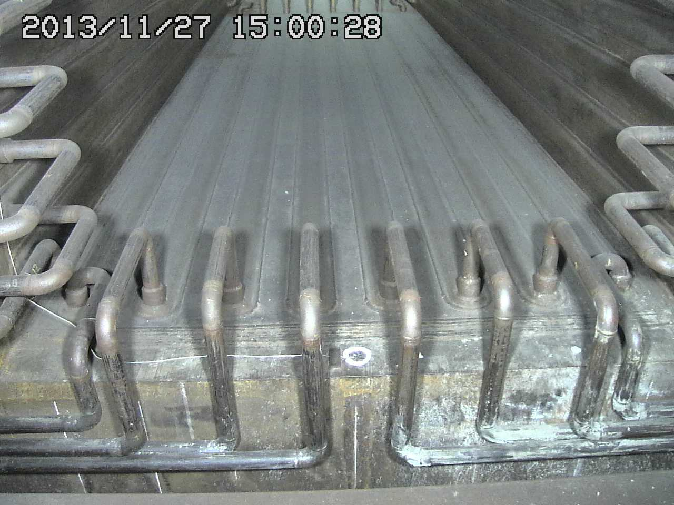

Slide 22
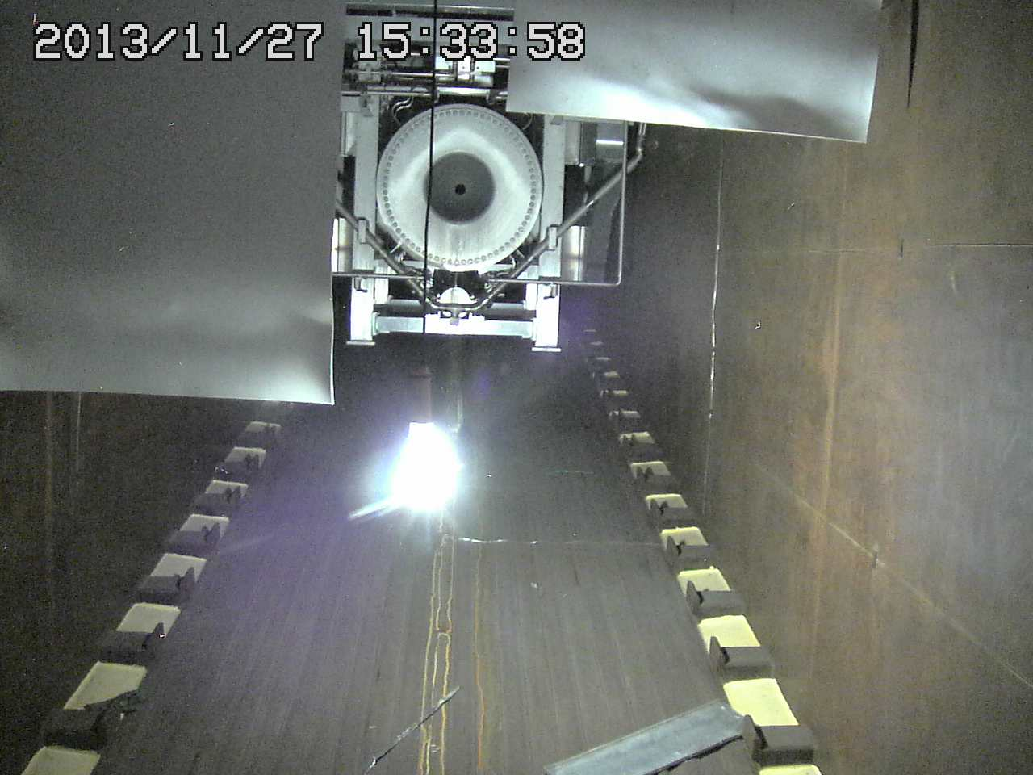
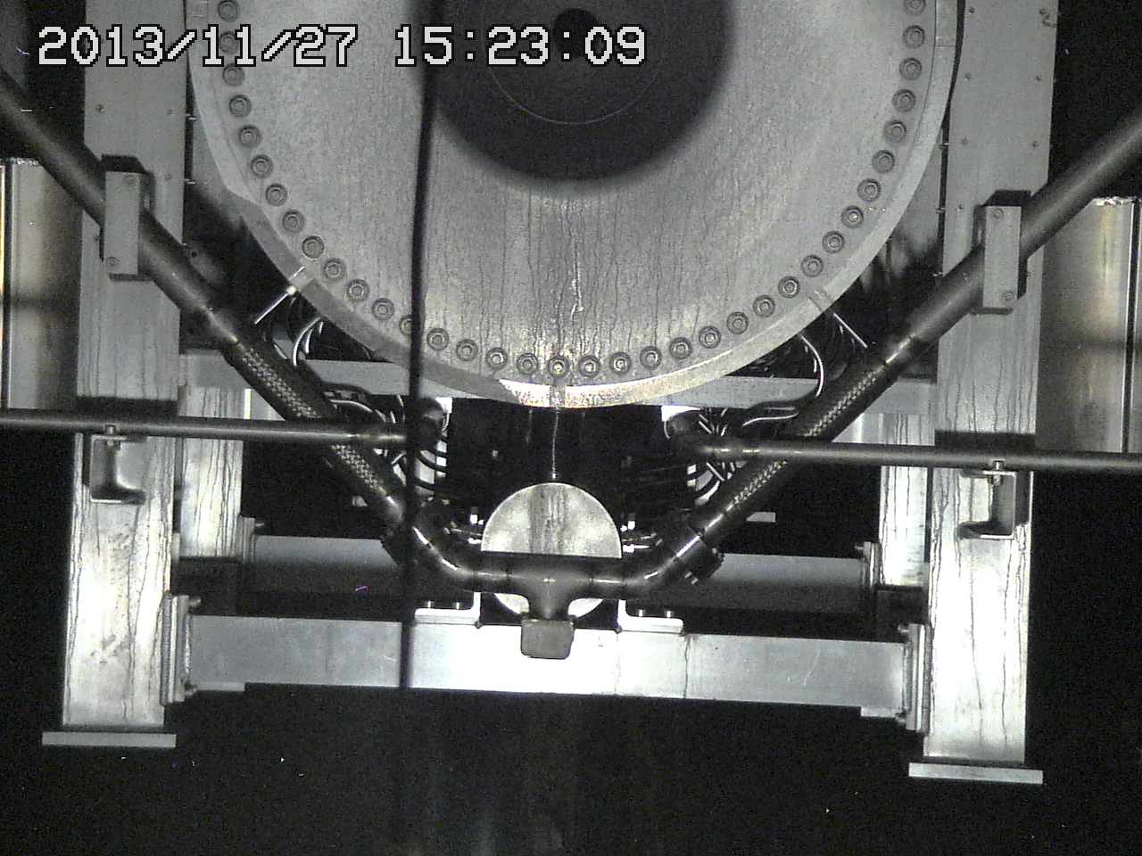

Horn-2 dew condensation
Imprint of dew condensation was clearly identified at the surface of Horn-2
It was acting as dehumidifier of the helium vessel…

Slide 23



Imprint of puddle at bottom of TS vessel
Dirty powder layer due to water drainage from horn leak plus dew condensation (?)

Slide 24


Replacing Heat Exchanger (TS) [Dec.2013]
ΔP became >0.4MPa, possibly due to clogging of black iron powder
  Residual dose: O(100uSv/h)
We replaced with
new one.
  →ΔP < 0.1MPa

Slide 25
Source of Vessel Humidity ?
Dew point= 25~26 deg.C.
  Outgas from surface of wall/concrete blocks ?
    Wall: ~3x10⁻⁴ Pa・m³/s/m² → Vessel (1,700m²) 0.6 Pa・m³/s
    Concrete Block: ~1x10⁻² Pa・m³/s/m² → Shield(240m²) 3 Pa・m³/s
    The values are still not so consistent to 20 Pa・m³/s.
    It is curious that the outgas lasts whole the run ?
Run-4: horn water leak = the source of the humidity !
  The humidity cause dew condensation to horns
  It can become critical problem on its performance and life limitation!
During 2013 maintenance we realized many bad SWL connections for the iron shield blocks in the TS vessel.
  We tried to fix them all but not in perfect manner.
  Typical dew point: 14℃(May.28)⇒25℃(Jun.26, 2014)
  ※ For Run-5 we raised up temperature of coolant water to horn H/X and after cooler of He compressors from 22→25℃ (Aug. 2013) to avoid dew condensation (temporal solution)

Slide 26




Bad SWL connections for iron shields

Slide 27
Summary
Evacuation and He filling: it takes a week to make vacuum level < 100 Pa (~1,000ppm of air).
  Oxygen < 100 ppm for entire beam periods: prevent NOX production and oxidation of the apparatus inside.
  Validated by gas-chromatograph measurements.
  We successfully used 1st set of horns, target, window, OTR, DV for 5 years.
Due to the saturation of humidity in the vessel helium, before opening vessel to start maintenance, we need to dry HTO.
  We improved the dried air supplier at NU3 and finish the process in a month.
  Situation will be improved by fixing bad SWL connections of shield blocks.
  We raised up horn cooling water temperature to stop dew condensation.
For cooling water circuits (made of carbon steel), powder of iron black skin clogs up filters/HX…/strainers/valves not a few times.
  We continuously reinforce the system (automated filter exchange etc.)

Slide 28


Test Outgas Measurements
60 kg scale
dM =1g
495Φｘ1,000L
V=0.192 m³
S=1.94 m²
Block w paint
V=6e⁻³ m³
13 kg
Reduced
-3g /day by
evacuation
Pump
N₂ gas for purge
BG 12Pa/h =3.3x10⁻⁴ Pa・m³/s/m² → Vessel (1,700m²) 0.6 Pa・m³/s
Block 47(-12)Pa/h = 1.0x10⁻² Pa・m³/s/m² → Shield(240m²) 3 Pa・m³/s
The values are still not consistent to 20 Pa・m³/s, but maybe comparable.
    Cf. Block weight: 0.023%/d →Shield(130t) 45 Pa・m³/s (assume all vapors remain)

Slide 29

Cooling water flow at TS
He compressor (after coolers)
ToHorn
CW H/X
7℃
12℃
22→25℃
31℃
From ＮＵ２
32℃
[radioactive]
2nd H/X
target
Ｈｅ compressors
Helium
Vessel
Decay
volume
Iron
shields

