Slide 1
Analysis of Radionuclide Activation in the NuMI Decay Pipe Shield
S. Diane Reitzner
NBI 2014
23-09-2014

Slide 2
Outline
Introduction
NuMI beamline
Activity found in the NuMI decay pipe shield
Simple MARS model of NuMI for radionuclide production calculations
Comparison of data to MARS
Conclusion

Slide 3
Introduction
Tritium is highly mobile.
Can transmit as gaseous hydrogen (HT) or as water (HTO)
Able to transfers from one medium to another.
Is difficult to contain.
Important to understand tritium production and behaviour in beamline shielding.
Use core samples collected in 2006 and 2010 from the NuMI decay pipe shield for tritium studies.
Test MC method to predict tritium production.
Use non-tritium radionuclides as benchmark.

Slide 4
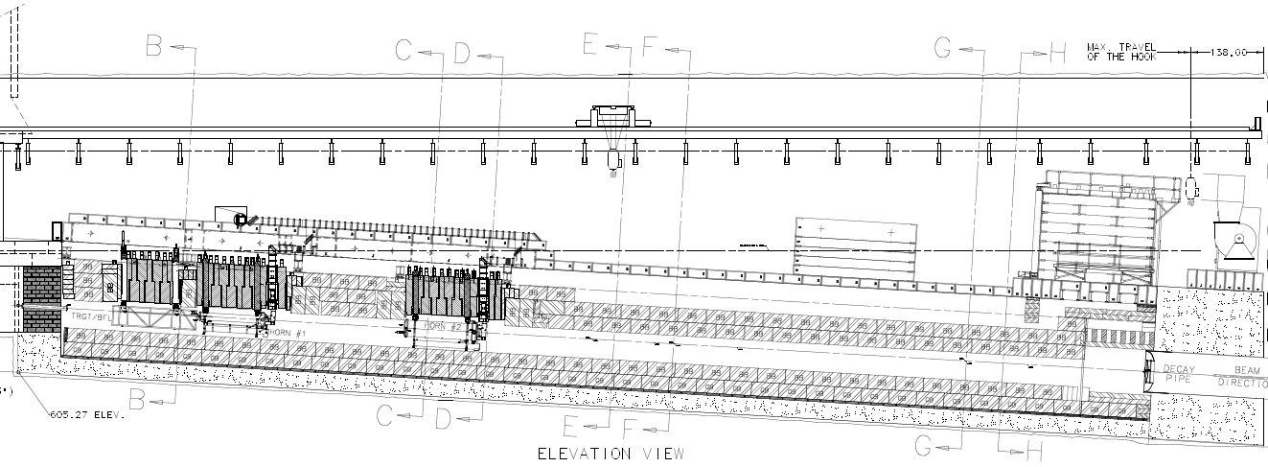
NuMI Target Hall
Target/Baffle Carriage
Graphite Target
120 GeV
proton beam
Decay
Pipe
Horn 1
Focus resultant
pions and kaons
Horn 2
Steel Shielding
Flowable Fill
ρ= 2.2 g/cm³
NuMI Beamline is subject to inflow of ground water.
Provides an easy route for tritium migration.
Dehumidifiers in target hall are used to remove water from the air.
Air from the target hall is moved down the decay pipe passageway.

Slide 5
Dolomite
2.9 m outer
radius of shield
98 m
To Target
Hall
93 m
2 m diameter pipe
Decay Pipe Walkway
NuMI Decay Pipe
675 m long
Neutrinos to MINOS in Soudan MN
3.7 m outer
radius of shield
249 m
To Absorber Hall
683 m
2.1 m outer
radius
Pions and kaons
decay to neutrinos and muons

Slide 6
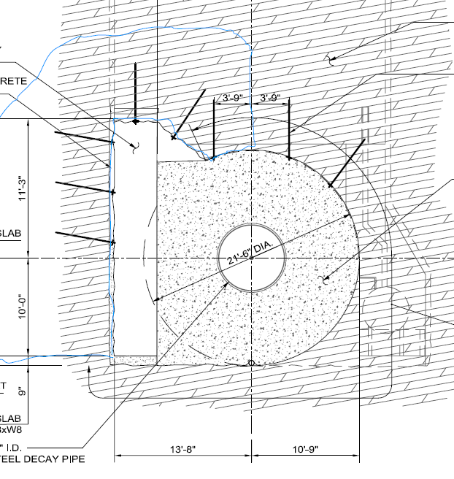
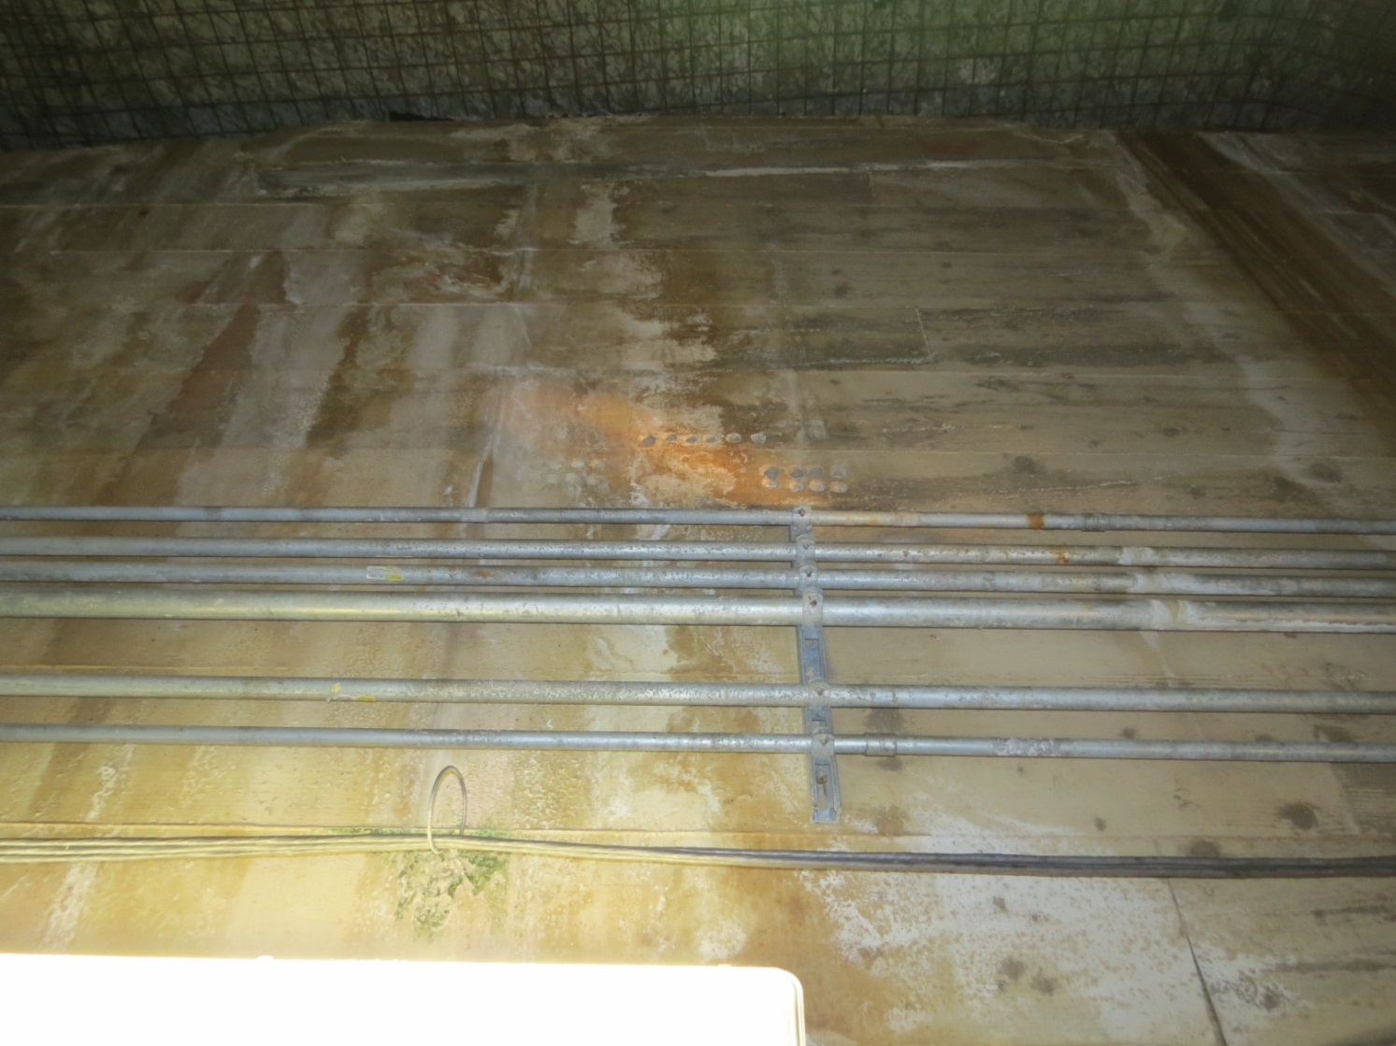
Sample Locations
Decay pipe walkway
Decay pipe cross section. The red lines show locations of samples.
Face of the decay pipe shield where some core samples were collected

Slide 7
Data Analysis
Several samples collected at different depths from each sample location.
Sample collection occurred after several days of beam off.
Samples first analyzed using a high purity germanium detector for radionuclide activity.
⁷Be, ²²Na, ⁵⁴Mn, ⁴⁶Sc, ⁶⁰Co, ¹³⁴Cs and ¹⁵²Eu where found.
Tritium’s low beta endpoint energy and no decay gamma means that it cannot be counted directly from the samples.
Tritium was leached from the samples and the leachate analyzed using a Tri-Carb LSC analyzer.
Not all tritium is collected from a single leaching process.
²²Na was also detected in the leachate

Slide 8
Activity at Upstream End of Decay Pipe

Slide 9
Tritium Activity at Upstream End of Decay Pipe in 2006
ST9.99 2006
Direct Production
Absorption
Depletion

Slide 10
Tritium Activity at Upstream End of Decay Pipe
2006
No dehumidifiers in target hall
375 days total, 75 days beam off
2010
Dehumidifiers in target hall
1899 Days total, 28 days beam off

Slide 11
Tritium Activity at Downstream End of Decay Pipe
2006
No dehumidifiers in absorber hall
2010
Dehumidifiers in absorber hall

Slide 12
²²Na Gamma vs Leachate
2006
Upstream, thin shield
2010
Upstream, thin shield

Slide 13
Leaching Fraction for ²²Na

Slide 14
MC Analysis
Direct inventory of tritium is difficult to do for shielding
Diffusion effects at surface
Not all tritium leached from shielding for analysis.
Try using MARS to predict tritium activity in shielding.
Test against other radionuclide production found in the shielding.
Deduce leaching fraction for tritium by comparing activity ratios of tritium to other radionuclides
Use simple geometry model of NuMI target hall and decay pipe.
Extract out star densities in decay pipe shield for nuclide spatial distributions.
Extract nuclide production per star for R>1.7 m.

Slide 15
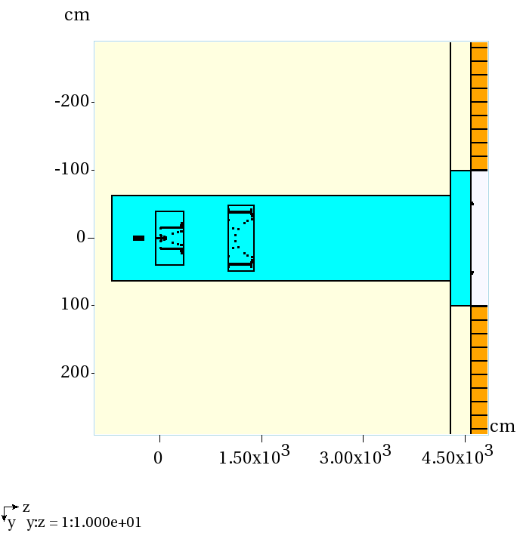
NuMI Target
Hall in MARS
Baffle
Target
Decay Pipe
Entrance
Horn 1
Horn 2

Slide 16
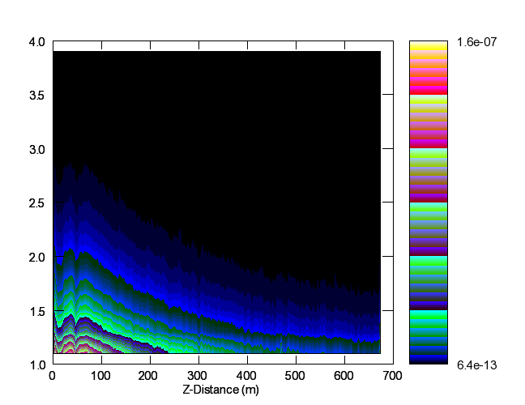
Star Density per Proton in the Decay Pipe Shield
stars/cm³ per proton
Radius (m)

Slide 17
Nuclide Production Calculation
Extract nuclide production per proton for R>1.7m
Use DETRA to calculate activity A_{tot}.
Intensity based on NuMI POT data.
Integrate over 375 days to compare to 2006 results
300 day beam on
75 day s beam off
Use Ratio of stars per bin over stars for R>1.7 m to scale activity.

Slide 18
2006 ⁷Be Radial Distribution

Slide 19
Radial Distribution Fits
MARS Fit:
$a_{1}e^{−b_{1}r}+a_{2}e^{−b_{2}r}$
Identify first term with rapid drop-off at small radius
Identify second term with attenuation at large radius
b₁ = 0.077±0.002, b₂ = 0.024±0.001
Data Fit:
Core samples not deep enough to fit the first term
$a_{2}e^{−b_{2}r}$
b₂ = 0.0229±0.0011

Slide 20
Nuclide Activity Comparison
Nuclide | MARS Activity (pCi/g) | DATA Activity (pCi/g) | MARS Ratio ⁷Be/X | Data Ratio ⁷Be/X
⁷Be | 454±91 | 346±52 | 1 | 1
²²Na | 111±22 | 78.7±11.9 | 4.1±0.7 | 4.4±0.9
⁵⁴Mn | 25.1±5.0 | 19.7±3.0 | 18.1±3.4 | 17.6±3.7
³H | 229±46 | 57.9±0.9 | 2.0±0.4 | 6.0±0.9
The activity at R=2.1 m and Z=93m (from Horn 1) in the NuMI decay pipe for 300 days of beam on followed by 75 days beam off.
Activities for ⁷Be, ²²Na, and ⁵⁴Mn agree with the activity seen in the core samples.
Ratio of ⁷Be/²²Na, ⁷Be/⁵⁴Mn agree very well with data.
MARS reports greater activity for tritium
Tritium underreported in data as a single leach cycle does not collect all of the tritium

Slide 21
Prediction of Leaching Fraction using MARS
Unknown value of leaching fraction L_{3H}
Lower bound of 0.10 from ²²Na data.
Past experience with soil and sand show that L_{22Na} is smaller than L_{3H}
Upper bound of 0.81 from multi leaching data assuming that all the tritium is collected in two leaching processes.
Use ratio of ⁷Be/³H from MARS to predict L_{3H}
$L_{{}_{}^{3}H}= \frac{({{}_{}^{7}{Be}}/{{}_{}^{3}{{H)}_{MARS}}}}{({{}_{}^{7}{Be}}/{{}_{}^{3}{{H)}_{DATA}}}}$

Slide 22
Predicted Leaching Fraction
Location from Horn 1 | Year | Radius | ⁷Be/³H from Data | Estimate L_{3H}
93 m | 2006 | 2.1 m | 6.0 | 0.33±0.09
683 m | 2006 | 1.5 m | 8.0 | 0.25±0.07
93 m | 2010 | 2.1 m | 2.9 | 0.41±0.11
98 m | 2010 | 3.0 m | 1.8 | 0.66±0.17
249 m | 2010 | 3.0 m | 2.9 | 0.41±0.11
693 m | 2010 | 1.5 m | 3.0 | 0.40±0.10
Average |  |  |  | 0.41±0.14
Ratio of ⁷Be/³H from MARS:
2006: 2.0
2010: 1.2

Slide 23
Conclusions
Activity in samples taken from the NuMI decay pipe shielding in 2006 and 2010 demonstrate the mobility of ³H.
Fixed nuclides like ⁷Be and ²²Na can be used to benchmark Monte Carlo codes used for radionuclide production in shielding.
MARS prediction of nuclide distributions match data.
Predicted activity of fixed nuclides agree with data.
Comparison of tritium activity predicted by MARS to the activity seen in the samples implies that only 41% of the tritium collected in the deep samples.

