Slide 1
LBNE 2.4MW Absorber
NBI 2014
Presented by Brian Hartsell
Contributions by: Kris Anderson, Yury Eidelman, Jim Hylen, Nikolai Mokhov, Igor Rakhno, Salman Tariq, Vladimir Sidorov

Slide 2
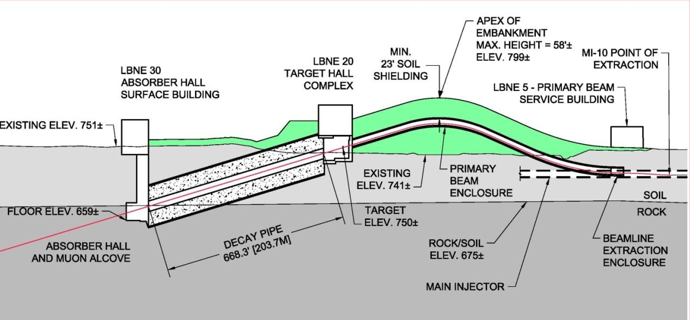
LBNE Absorber - Introduction
Target
Beam
Absorber and Absorber Hall
Purpose of absorber (a.k.a. beam dump) is to stop left-over beam particles, and provide radiation protection to people and ground-water.
Needs to absorb ~800kW of beam power when running at 2.4MW proton beam with water cooling.

Slide 3
Absorber Requirements
Ability to handle full range of 2.4MW beam
  60 to 120 GeV
  1.5e14 ppp
  0.7 sec cycle time (60GeV) to 1.2 sec (120 GeV)
Configured for the worst case decay pipe
  204m in length, helium filled
Lifetime of 30 years, minimal maintenance
Tolerant of any beam accident conditions

Slide 4
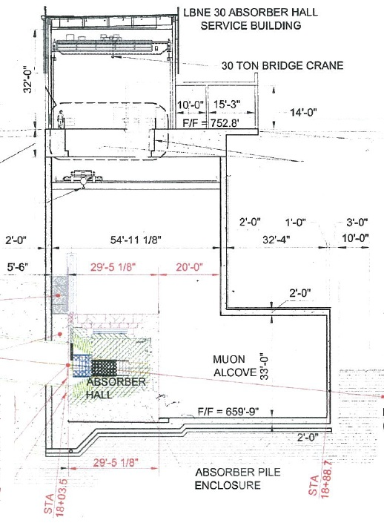
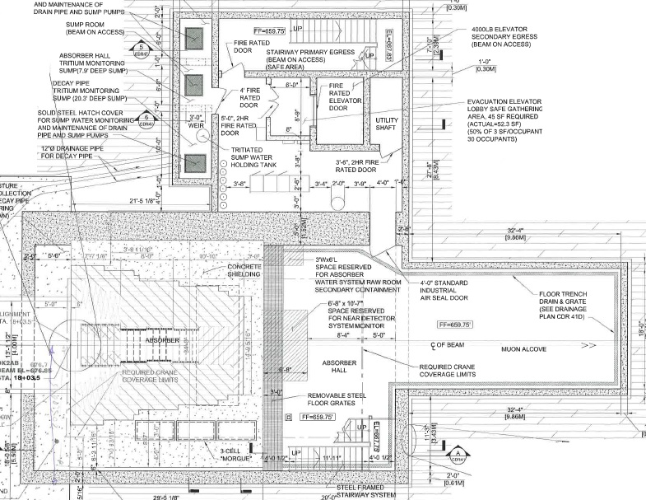
Absorber Hall

Slide 5
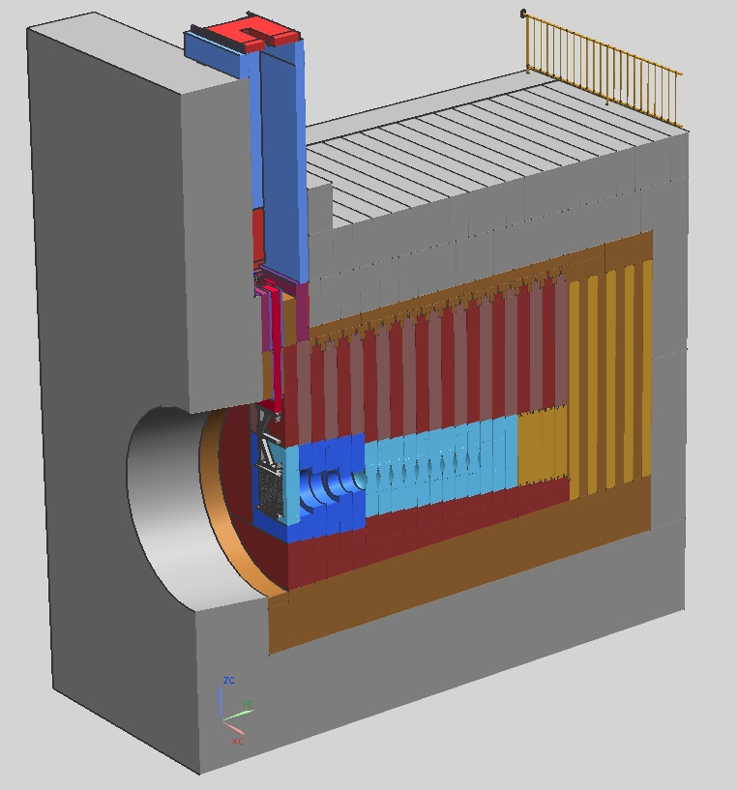
Absorber layout
Poured concrete volume: 24000 ft³
Steel shielding: 5,000,000 lb
Aluminum: 77000 lb
Beam
Spoiler
Aluminum core
Water-cooled steel
Image from: Vladimir Sidorov

Slide 6
Desirable material properties for core
Good resistance to thermal impulse (combination of heat capacity, thermal expansion coefficient, modulus of elasticity and yield strength, ductility)
Low density (to spread out shower, decrease energy deposition density)
High thermal conductivity (to conduct heat to water cooling lines)
High radiation damage resistance
High corrosion resistance
Tolerant of high temperatures
Low toxicity (avoid mixed waste if possible)
Good creep and fatigue resistance
Reasonable expectation that it would last the life of the facility
Conducive to modular design, to facilitate replacement of failed section if necessary
Low cost
Slide from: Jim Hylen

Slide 7
Material selection – look at low density materials
Beryllium would be the ideal selection, except for cost and toxicity
Graphite is a good material, but would probably have to be encapsulated and covered in an inert atmosphere since it oxidizes to a gas
Aluminum
  Forms a protective solid oxide layer as it oxidizes, preventing further oxidation
  Allows for simple modular construction and the possibility for replacement – no need for encapsulation
  Gun-drilled water lines provide simple connection of cooling water to core
  Has excellent thermal conductivity
  Is significantly more radiation resistant than graphite
  Is not toxic
  Is reasonably inexpensive
  Has worked well for NuMI (we have experience)
Issues for Aluminum
  Need to keep temperature lower than other materials (avoid creep and fatigue)
  Less resistance to thermal impulse
Slide from: Jim Hylen

Slide 8
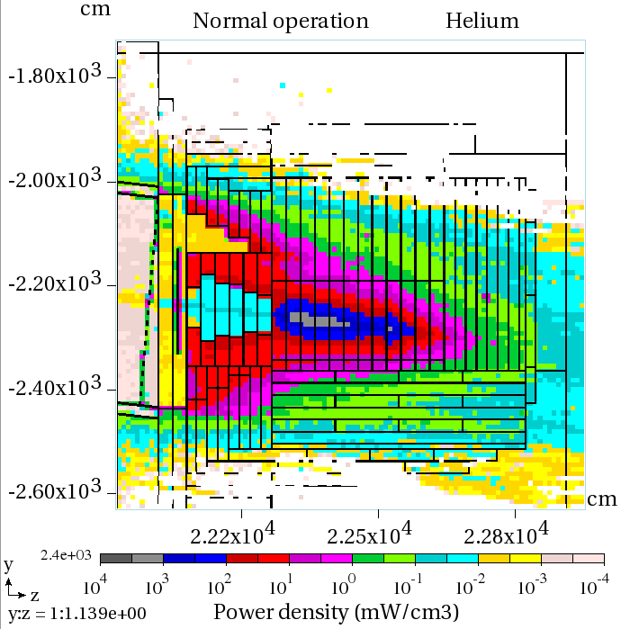
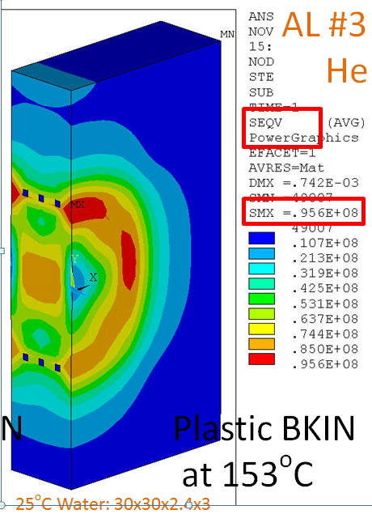
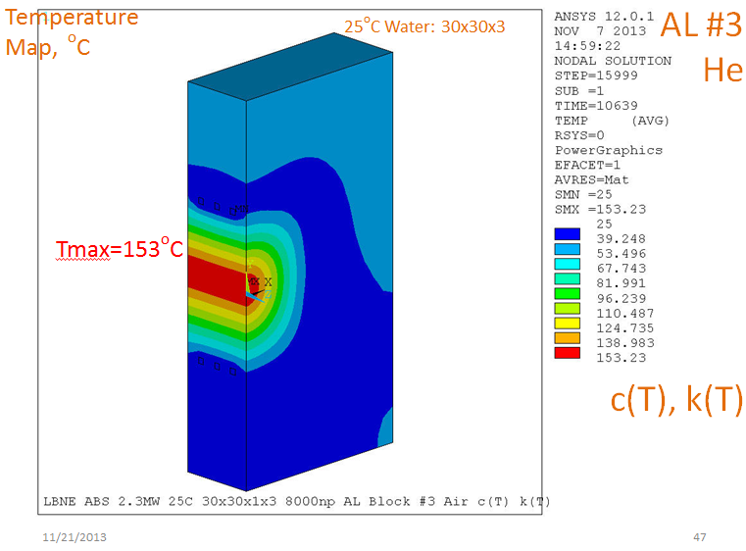
Core Analysis – Previous Work
Previously configured and analyzed (N. Mokhov, I. Novitski, I. Rakhno, I. Tropin) using a solid Al core
Good start, room for further optimization and simulation updates

Slide 9
What do we want to achieve?
Improvements to model
  Convection at the water lines instead of fixed temperature
  Cylindrical, gun drilled water line array
Keep Al under 100C for creep and to preserve the temper
  Probably on the conservative side, but that’s good for a 30 year life absorber..

Slide 10
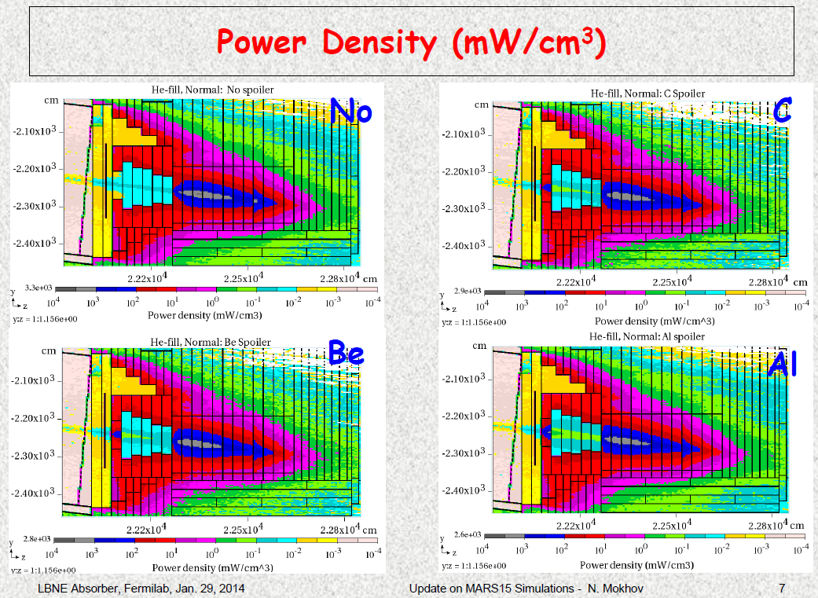
Addition of a ‘spoiler’
Start the shower and allow it space to spread out, reducing peak energy deposition in the downstream blocks.

Slide 11
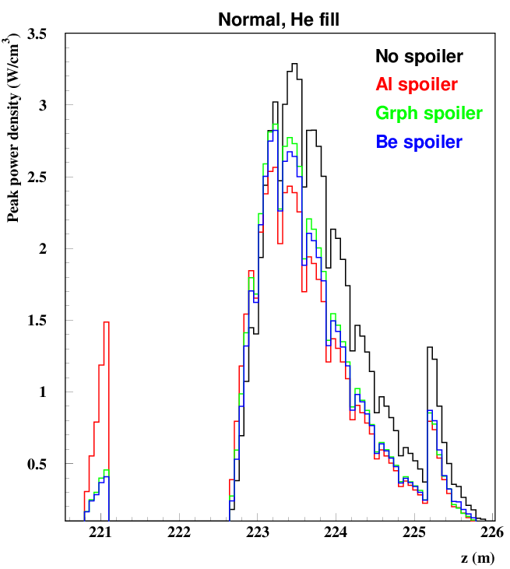
Addition of a ‘spoiler’
Addition of an Al spoiler shows a reduction in peak energy deposition to 75% of the previous no-spoiler case.
Image from: Nikolai Mokhov

Slide 12
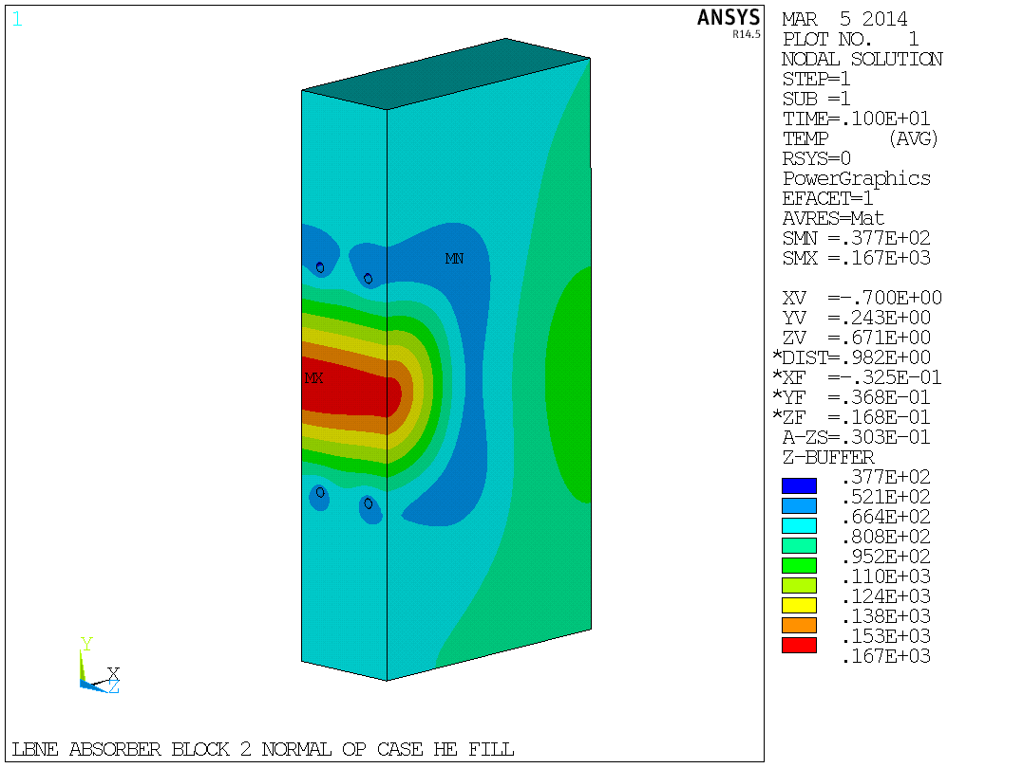
ANSYS Thermal Results – Single Spoiler
Using realistic model conditions (convection coefficient on water lines, temperature dependent properties for Al, cylindrical water line geometry), peak temperature of 167C. Too high!

Slide 13
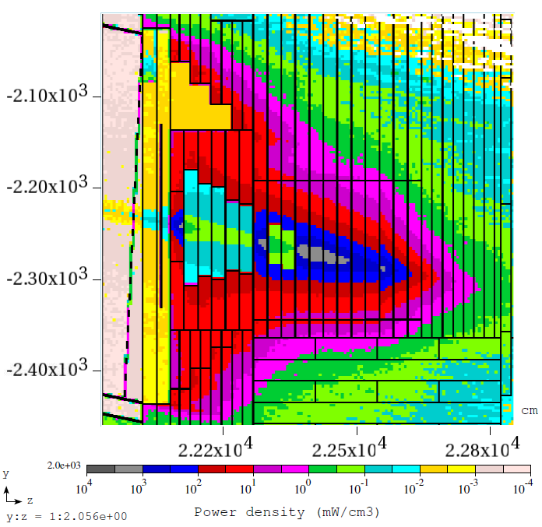
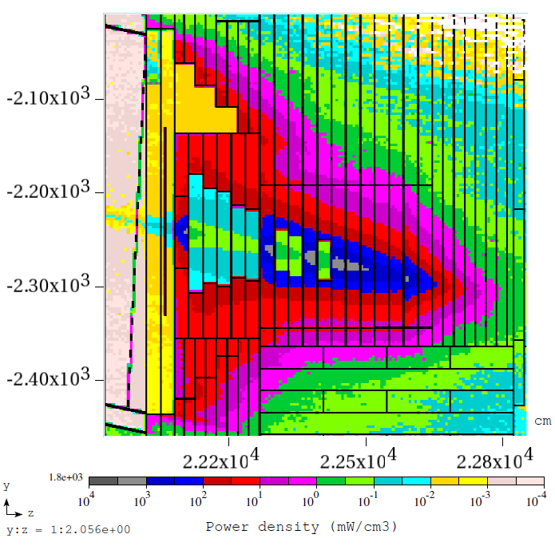
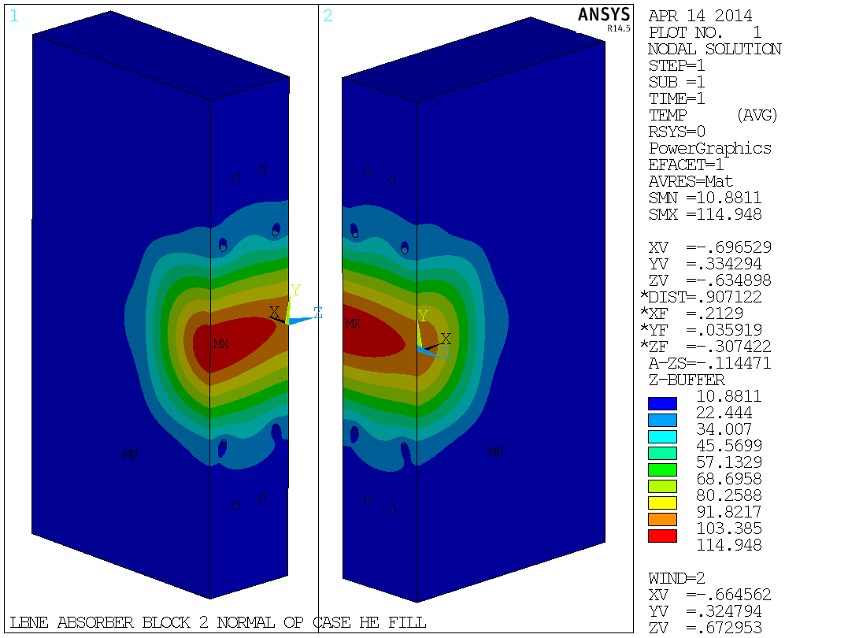
Iterations – multiple spoilers
Two
Spoilers
115C – getting closer
Three
Spoilers
MARS runs from: Igor Rakhno

Slide 14
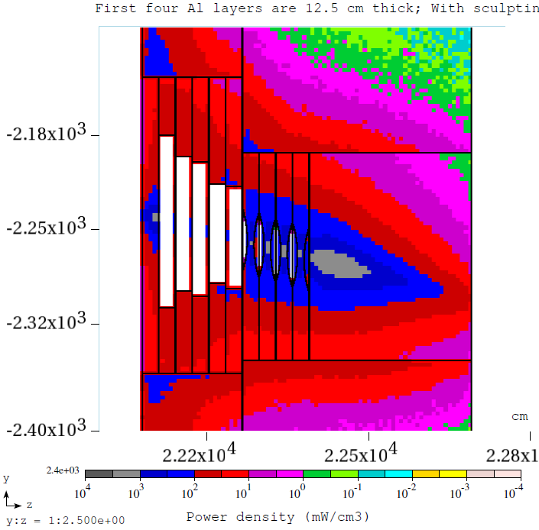
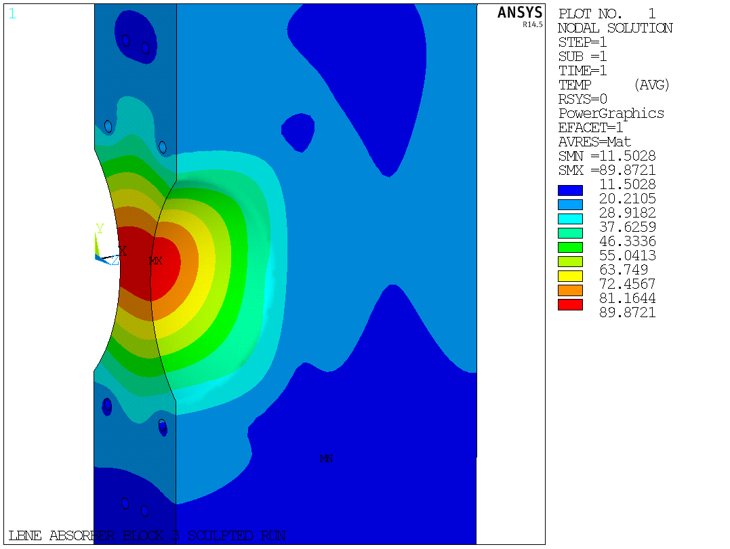
Iterations – Sculpting with Single Spoiler
90C – success
MARS runs from: Igor Rakhno
But… the temperature here is too high.

Slide 15
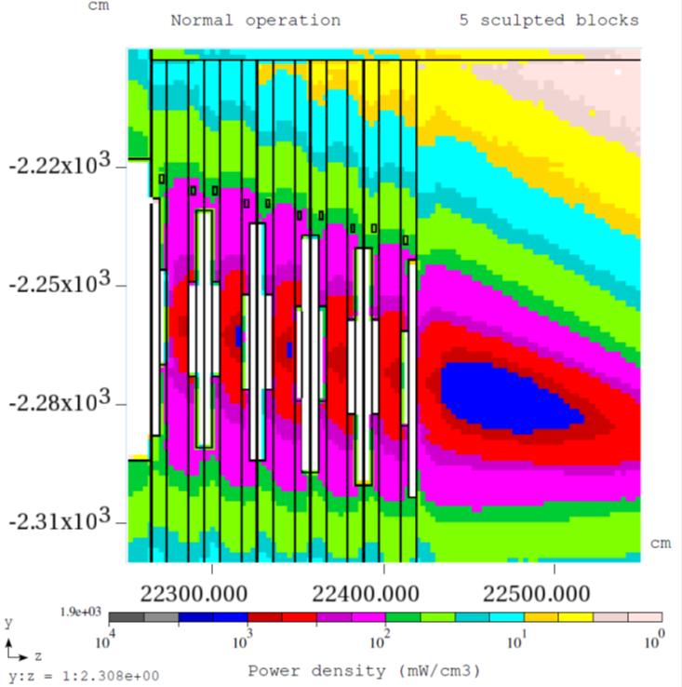
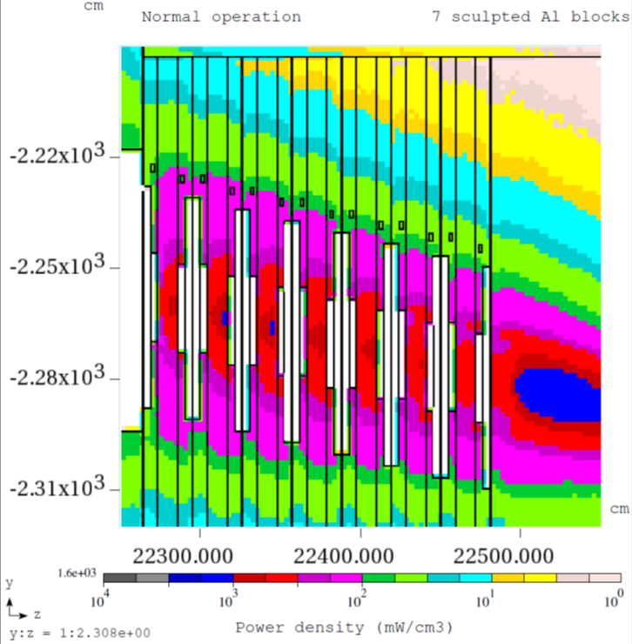
Iterations - Sculpting
MARS runs from: Igor Rakhno
Spoiler details & number of sculpted Al blocks | In spoiler | In sculpted Al | In solid Al, downstream of sculpted Al | In 1st Fe block
Al 12” & 4 | 1.1 | 1.2 | 2.1 | 0.8
Al 12” & 5 | 1.1 | 1.1 | 1.9 | 1.1
Al 12” & 7 | 1.1 | 1.2 | 1.6 | 2.2
Al 12” & 9 | 1.1 | 1.2 | 1.0 | 5.3

Slide 16
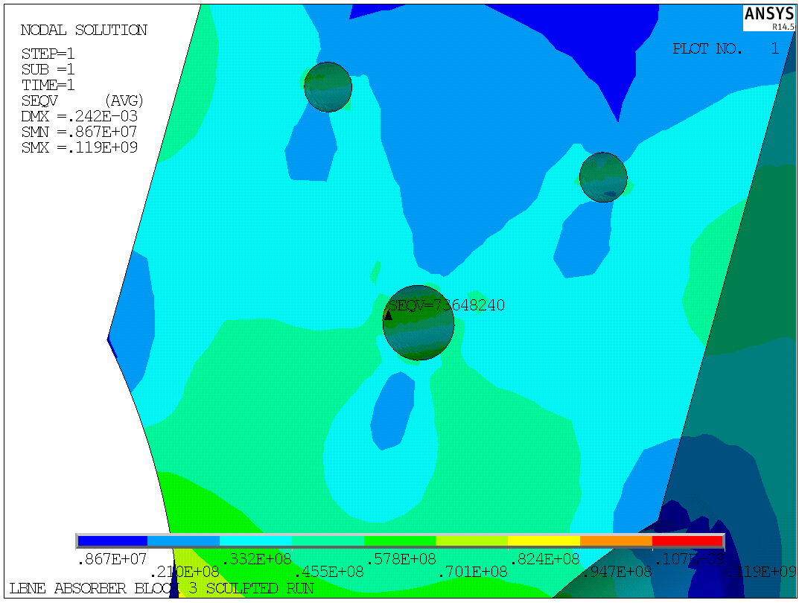
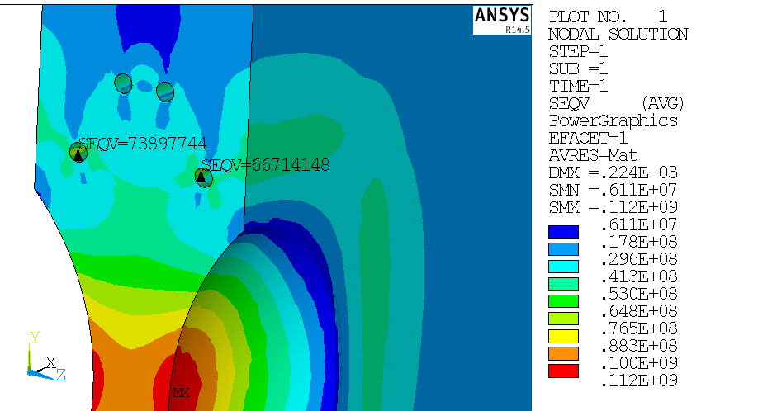
Water line and sculpting optimization
Description |  | Max Water Line VM Stress
 | 4-1" WLs In-Line at 30cm (Original config presented 7/7) | 112
 | Down-Up-Up-Down (30cm/35cm spacing) | 94
 | Down-Up-Up-Down (30cm/40cm spacing) | 74
V configuration
 | Base (1.5" Dia WL, 30cm Large WL, 40cm Small WLs) | 73
 | Base w/ 1.25" Dia Large WL | 90
 | Base w/ 1.0" Dia Large WL | 80
 | Invert V - Small WLs at 30cm, Large at 35cm | 92
Notes:
Down water line effects

Slide 17
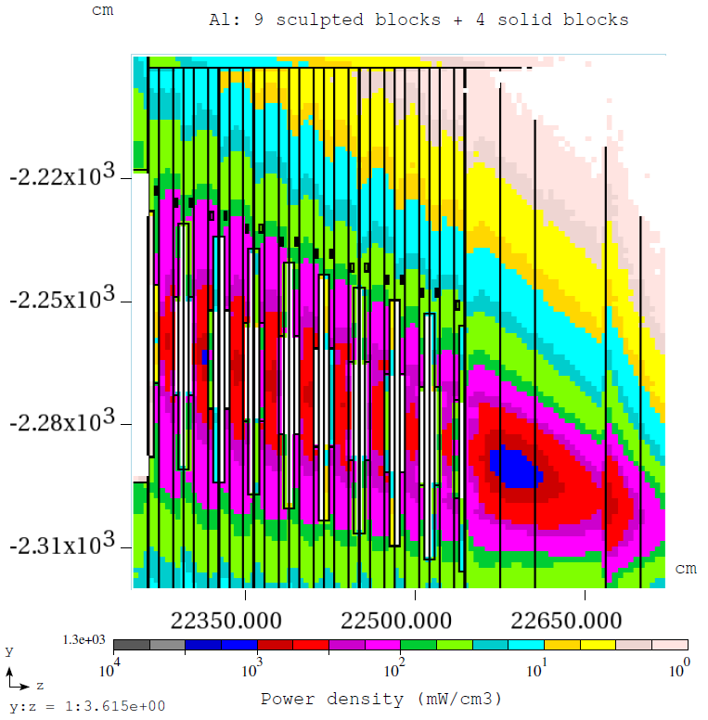
Final Configuration
9 sculpted blocks
4 full Al blocks
Lengthened by 5’ from the CD1 baseline configuration
MARS runs from: Igor Rakhno

Slide 18
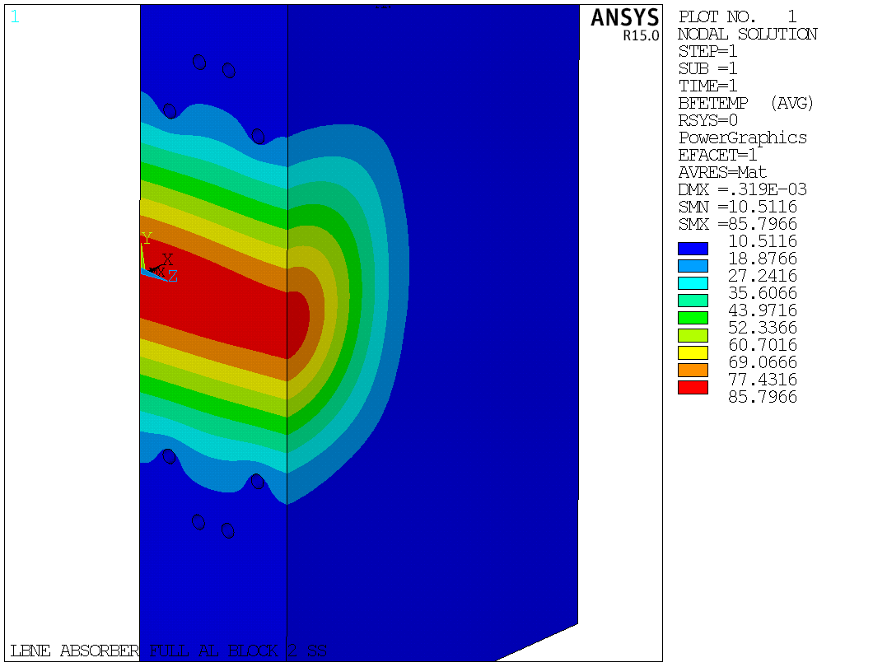
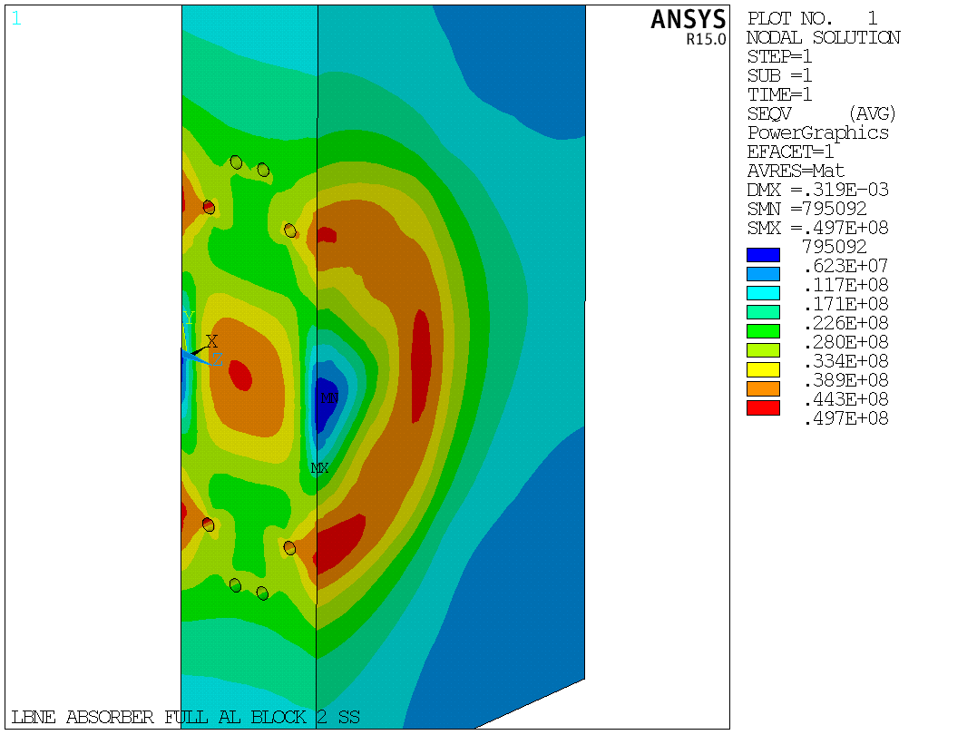
Final Configuration - Analysis
Thermal and structural analysis for maximum energy deposition areas: sculpted block, core block, and steel block.

Slide 19
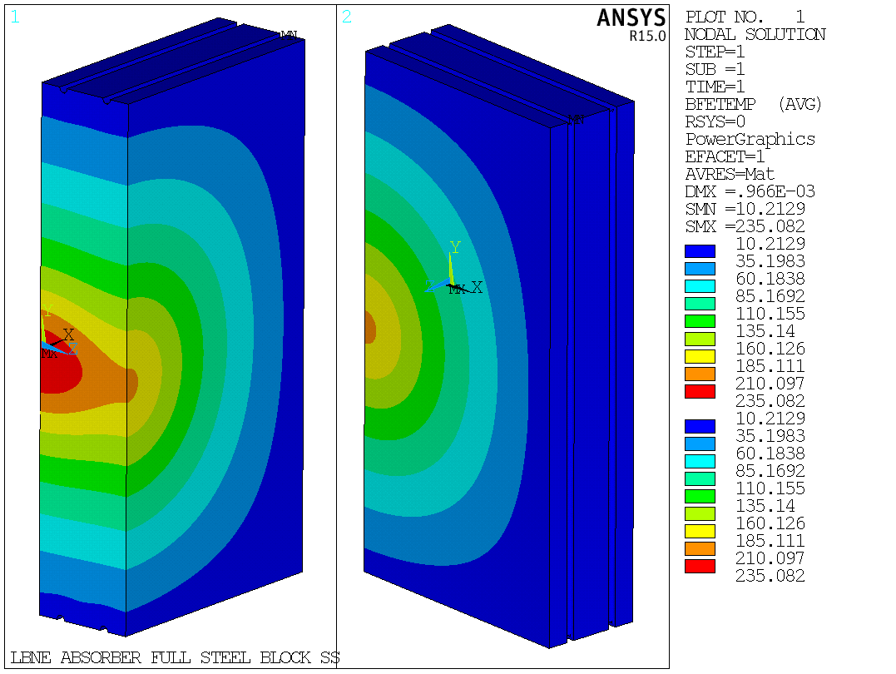
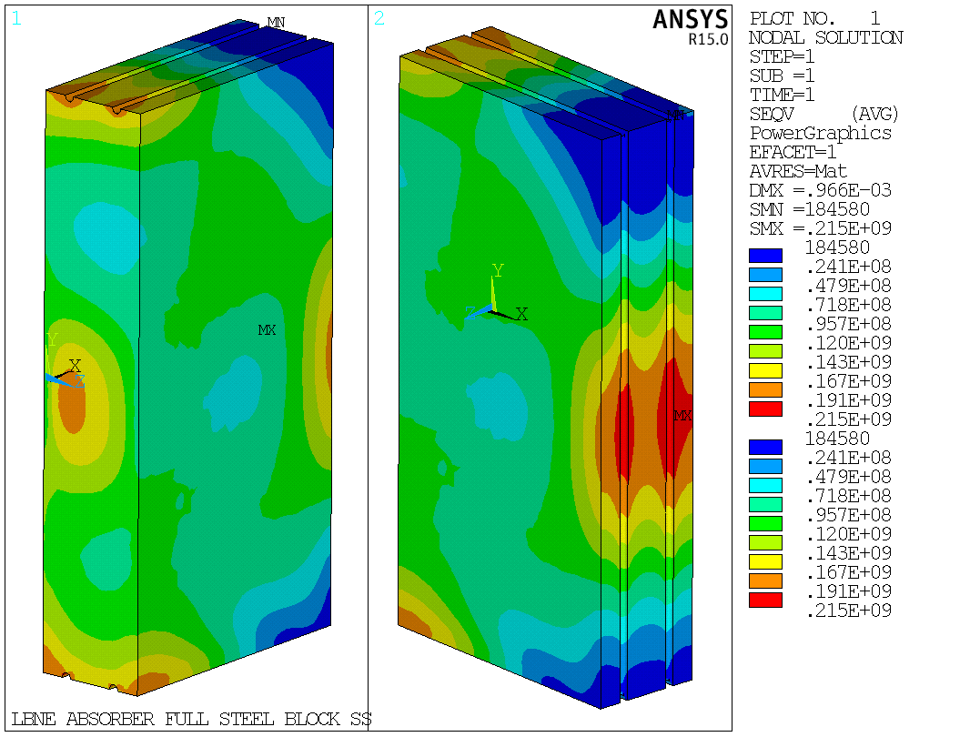
Final Configuration - Analysis
Thermal and structural analysis for maximum energy deposition areas: sculpted block, core block, and steel block.

Slide 20
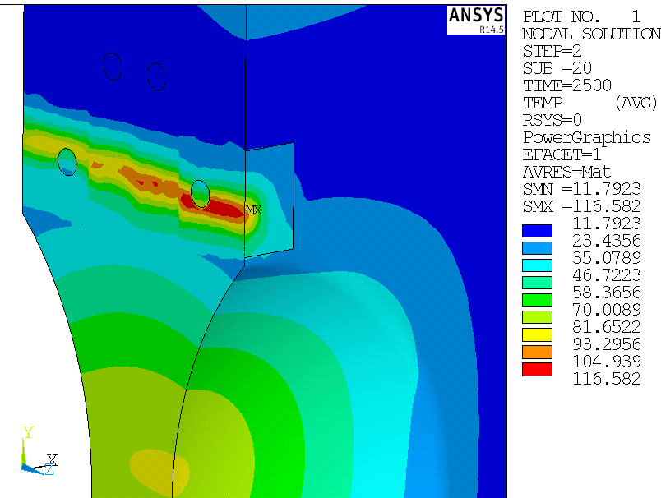
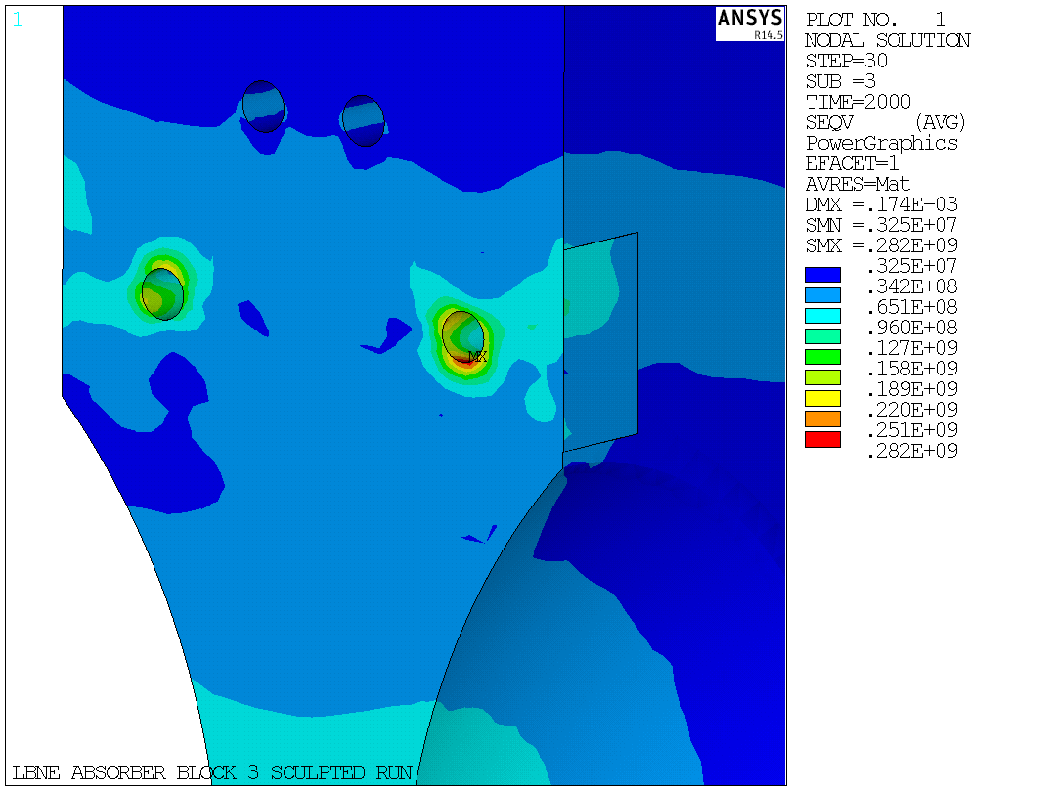
Accident conditions
Two cases:
  On-axis: Target is ‘missing’ and beam travels through the sculpted area of the core. (Results not yet available)
  Off-axis: Beam is mis-steered around the target but misses the baffle. Worst case for the absorber is hitting the water line.

Slide 21
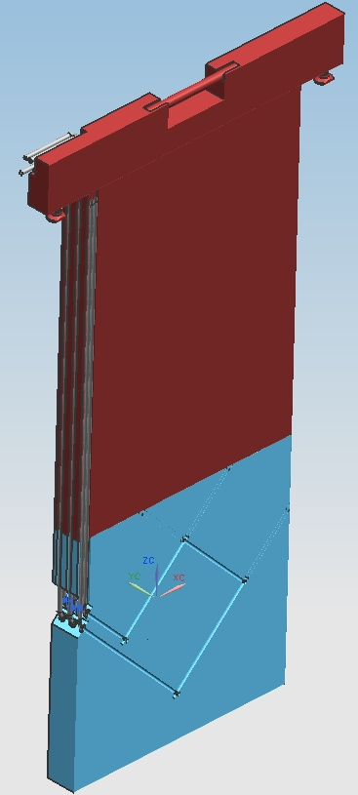
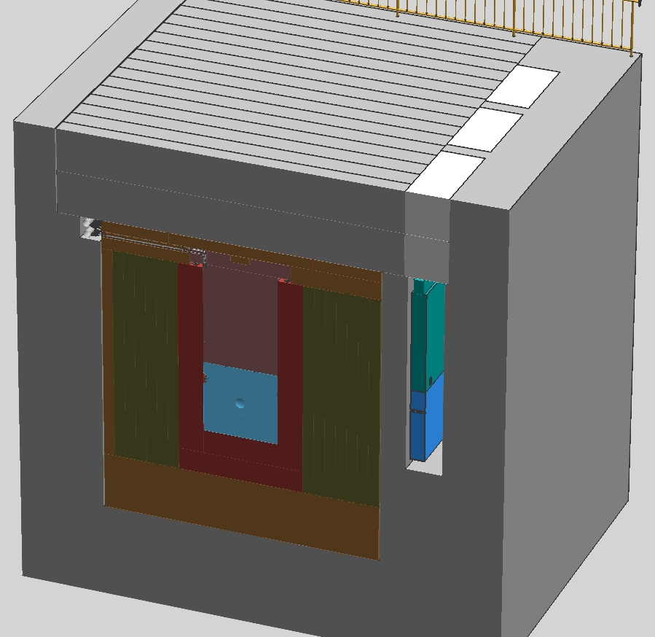
Mechanical design
Each block is removable and replaceable
Images from: Vladimir Sidorov
Gun drilled water cooling loops

Slide 22
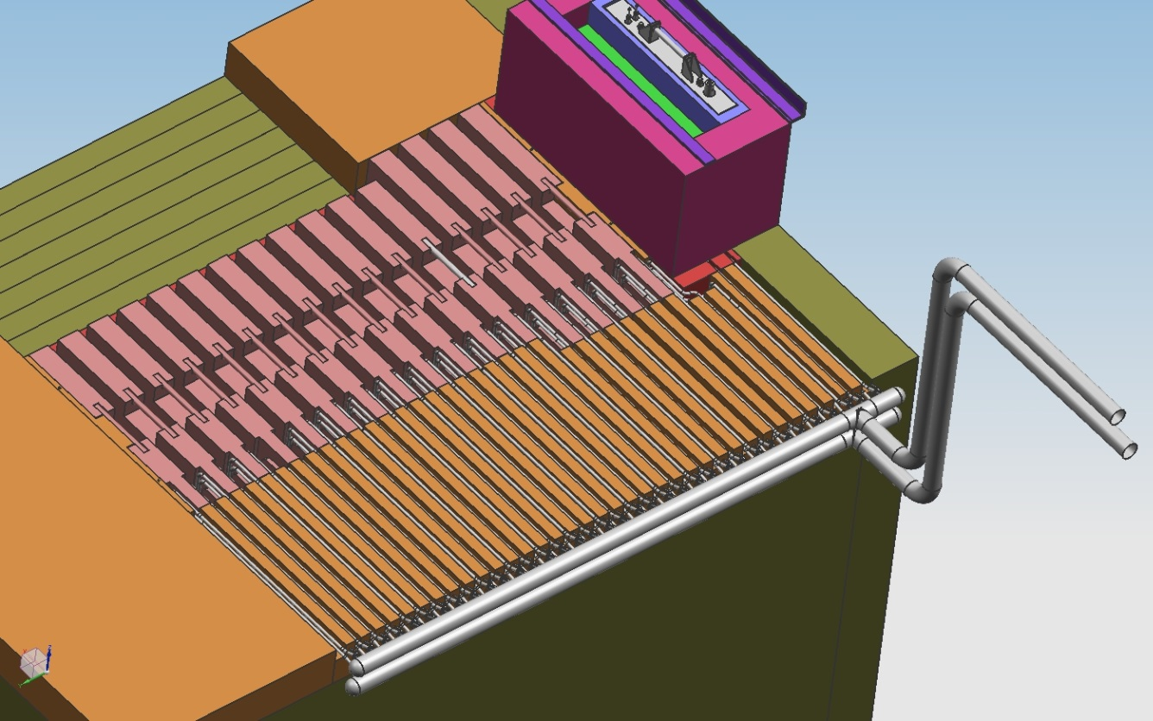
Mechanical design
Images from: Vladimir Sidorov
8-1” diameter water lines (4 in/4 out) leading to each block.
Flow rate of 20gpm to each line

Slide 23
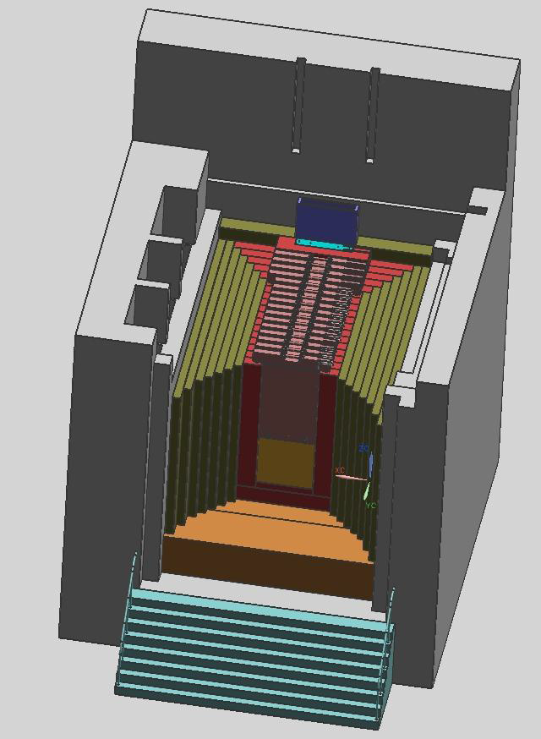
Mechanical design
Stackup of core blocks, outer steel shielding, and concrete shown on image at the right.
Morgue areas shown on the left side.
Images from: Vladimir Sidorov

Slide 24
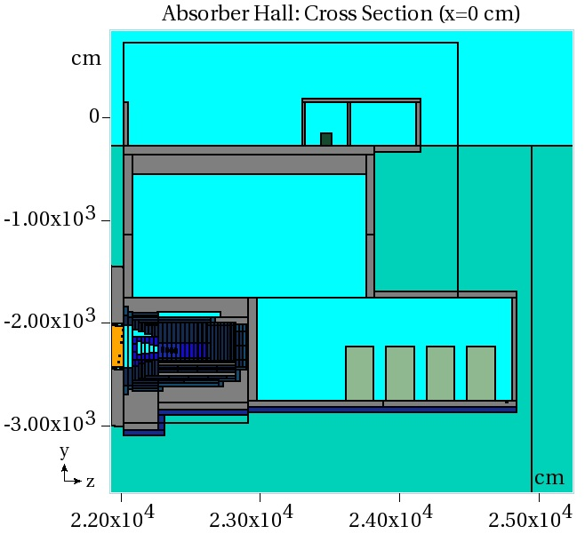
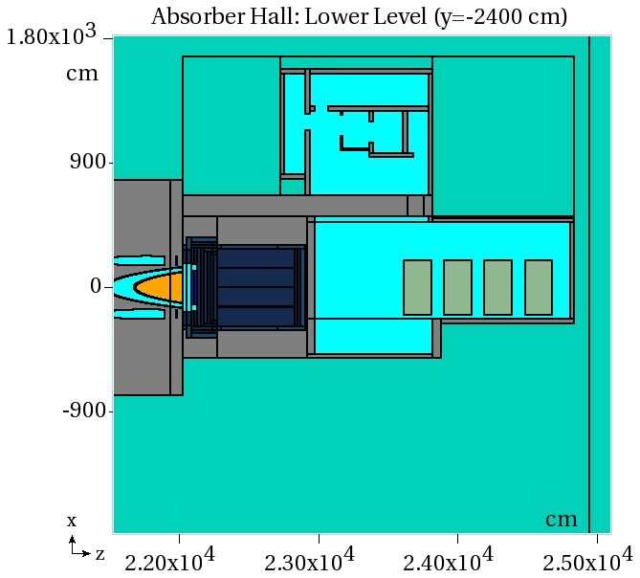
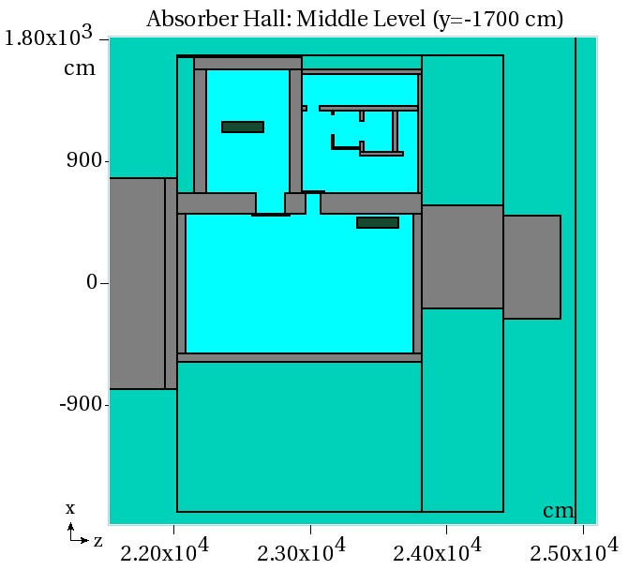
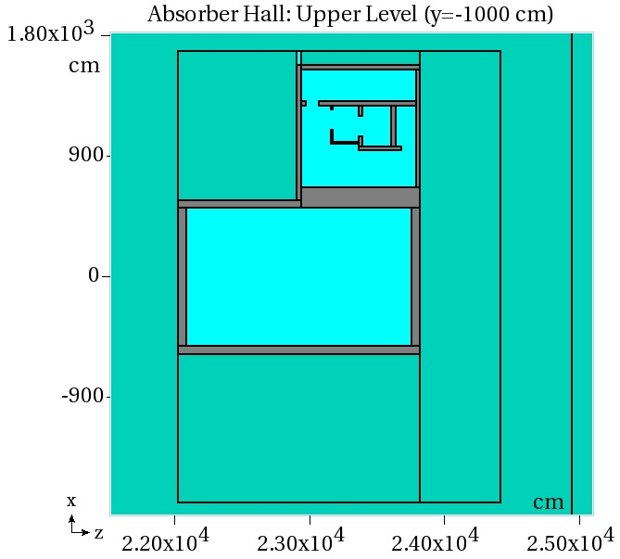
Radiological - Geometry
Images from: Yury Eidelman

Slide 25
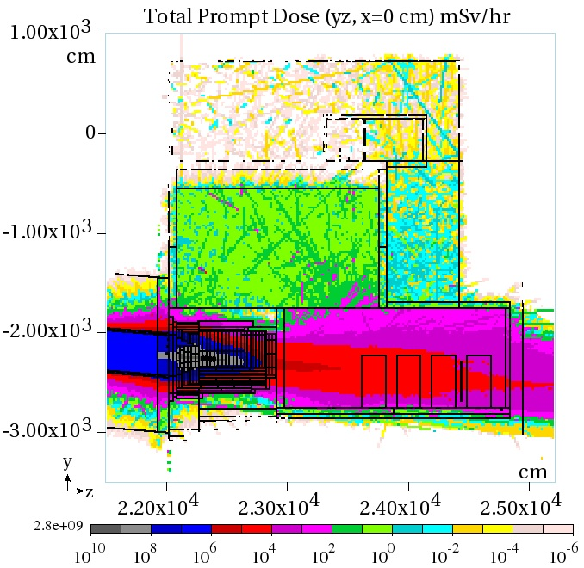
Radiological – Prompt Dose
Images from: Yury Eidelman

Slide 26
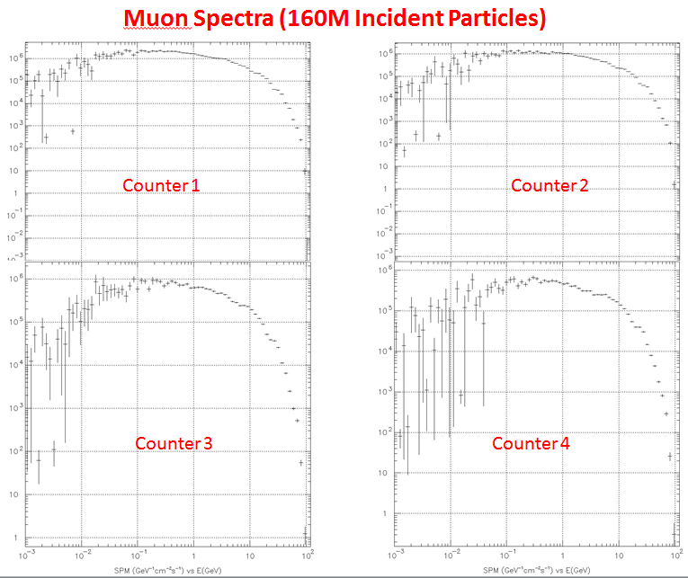
Radiological – Muon Monitor
Plots from: Yury Eidelman

Slide 27
Three independent systems provide redundancy to pull beam permit quickly in non-normal condition
Safety Systems
Beam position monitors upstream of target
  Pull beam permit after 1 beam spill if proton trajectory is off, misses target
Thermocouples in absorber core
  with thermocouple on-axis in shower, provides fast response (detect Energy deposition in thermocouple itself)
Muon monitor after absorber combined with Toroid proton monitor before target
  Can pull beam permit after 1 beam spill, if muon response is not proportional to number of protons in spill
Slide from: Jim Hylen

Slide 28
Conclusions and To-Do
A viable Al core configuration has been rapidly developed through multiple iterations in only 9 months.
Now that the core configuration has been finalized, work on the radiological and mechanical design portions can continue more quickly and with greater certainty.
Additional analysis needs to be done for the 60 GeV case.
Upcoming core review in November.

