Slide 1
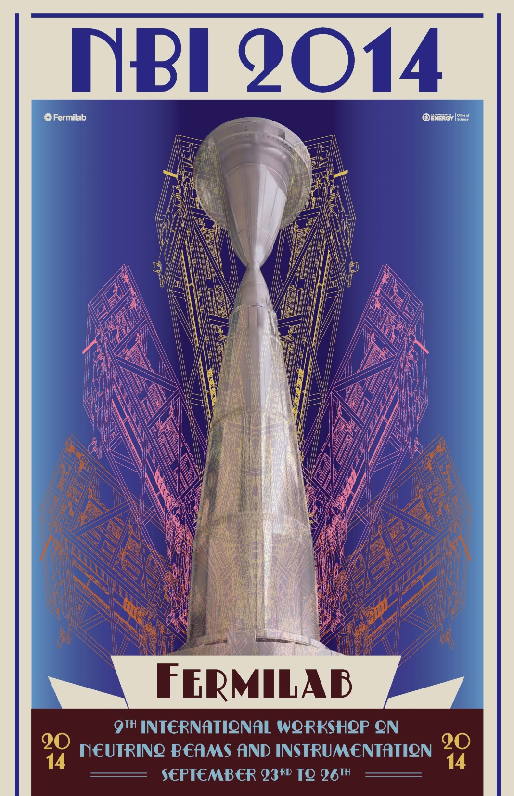
Farewell!
A full four days
  Plus pre-meetings on Monday
  Plus post-meetings tomorrow
Personally, a very stimulating week
Hope that the Indico repository is a resource far into the future

Slide 2
Recap:
68 Attendees
51 Presentations
Tour of NuMI underground and target/horn factory
Reception sponsored by URA/FRA
Dinner on a Greek Island

Slide 3
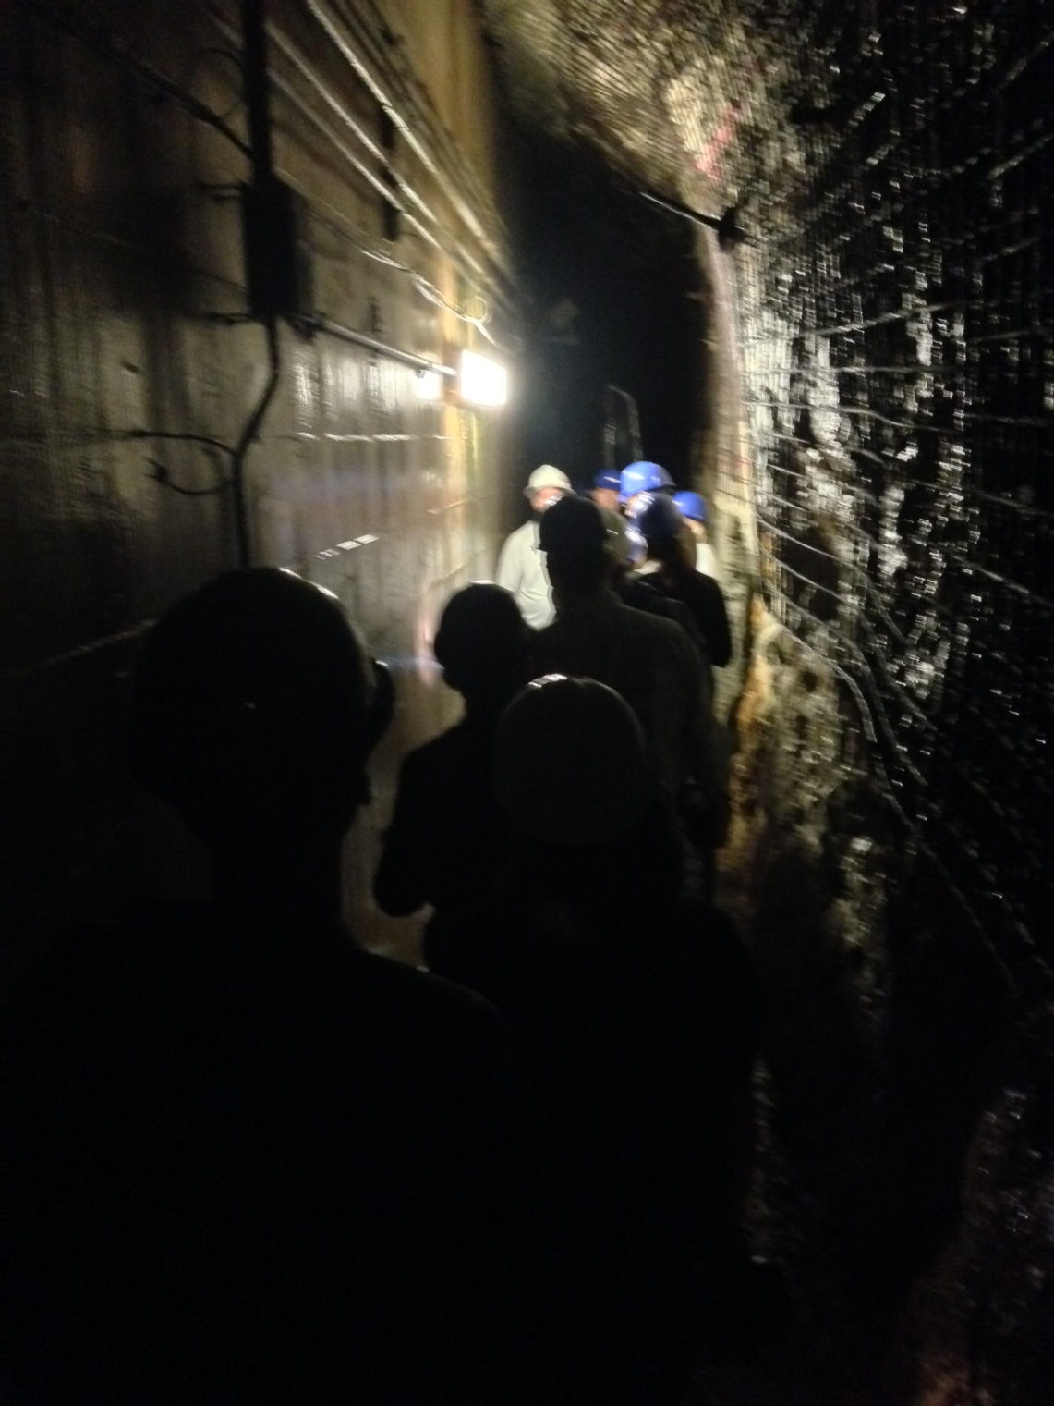
Thanks:
Mike Andrews
Tony Busch
Jim Hylen
  For organizing a unique NuMI tour
Also thanks to:
  Kris Anderson, Cory Crowly, Steve Hahn, Frankie Kelly, Gordon Koizumi,

Slide 4

Thanks:
Vaia Papadimtriou
  For putting together a very pleasant dinner

Slide 5
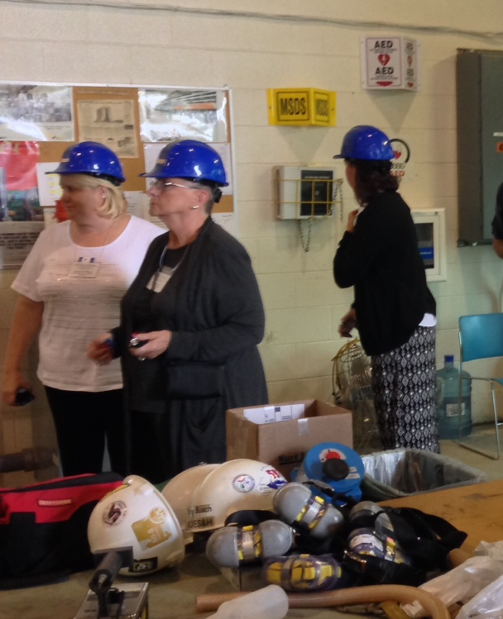
Thanks:
Melody Saperston
Cynthia Sazama
Suzanne Weber
For organization, support, help, idea, …
… And for letting us drag them underground

Slide 6
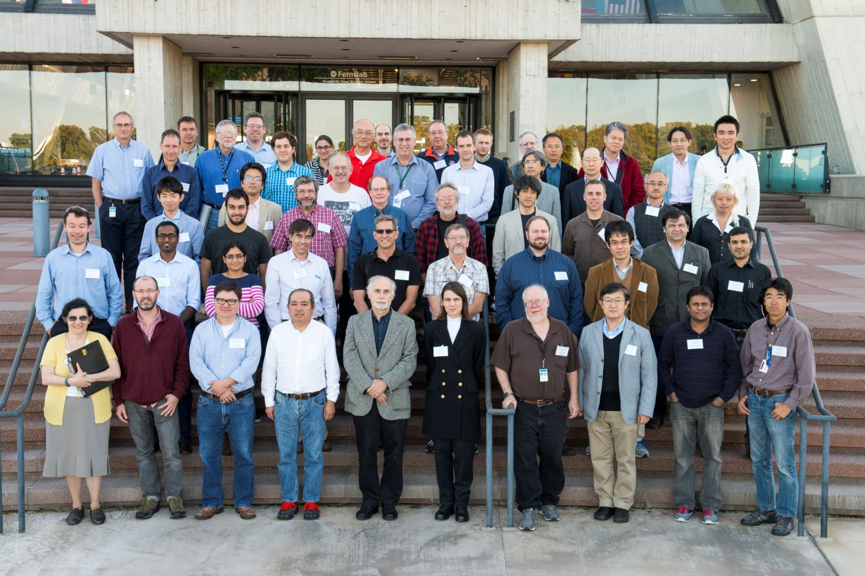
Thanks:
All of you!
Presentations summarizing vast efforts

Slide 7
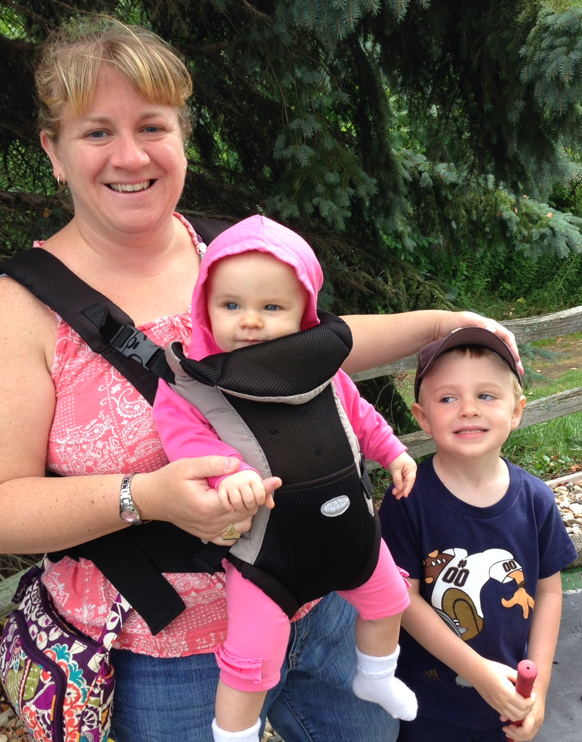
Personal Thanks:
Gail, Patrick, & Abby
  For support, understanding, and dealing with my absence

Slide 8
One more note…
Then, Alberto’s Wine & Cheese Seminar @ 4pm
  a.k.a. Joint Experimental-Theoretical Seminar

