Slide 1
Vision for US Modeling and Design Tools for Long Term Accelerator R&D
P. Spentzouris, with input from J-L. Vay et al (LBNL), C. Ng et al (SLAC), W. Mori (UCLA), J. Cary (Univ. of Colorado & Tech-X)

Slide 2
Presentation guidance
Goals for medium- and long-term U.S. program
Scope of the current medium- and long-term program
Execution plan and resources necessary for this program
Impact of R&D (this area) on training
Impact of potential funding increase in long-term R&D

Slide 3
Motivation
Modeling and design tools are necessary for
  optimizing the performance of existing accelerators
  optimizing the design and cost of future accelerators
  developing new, cost effective, accelerator techniques and technologies.
P5 report:
  Accelerator Research:
    “The future of particle physics depends critically on transformational accelerator R&D to enable new capabilities and to advance existing technologies at lower cost. “
  Computing:
    “The use of high-performance computing, combined with new algorithms, is advancing full 3-D simulations at realistic beam intensities of nearly all types of accelerators.”
    “This will enable “virtual prototyping” of accelerator components on a larger scale than is currently possible.”

Slide 4
Vision
Create a fully coordinated national program providing the community with a comprehensive, interoperable set of numerical tools for multi‐scale, multi‐physics accelerator design, to enable
  “Virtual Prototyping” of accelerator components
  “Virtual Accelerator Modeling” of beam dynamics
Our strategy is to build a collaboration that will develop, maintain and support a common set of libraries and codes capable of utilizing high-performance computing
  To enable long-term planning required for long-term applications across all accelerator R&D thrusts

Slide 5
Accelerator Modeling and Design Tools:
Current Program

Slide 6
Development drivers for numerical tools
Development of physics models is driven by accelerator science needs
Code sophistication (multi-physics, …) is driven by design tolerances (beam loss, stability, …)
High-performance-computing (HPC) needs are driven by the demand for sophisticated, higher fidelity simulations
R&D on numerical algorithms is driven by the evolution of computing architectures and HPC
  There is always tension between the need to “keep up” with computing technologies and “support” applications using current codes

Slide 7
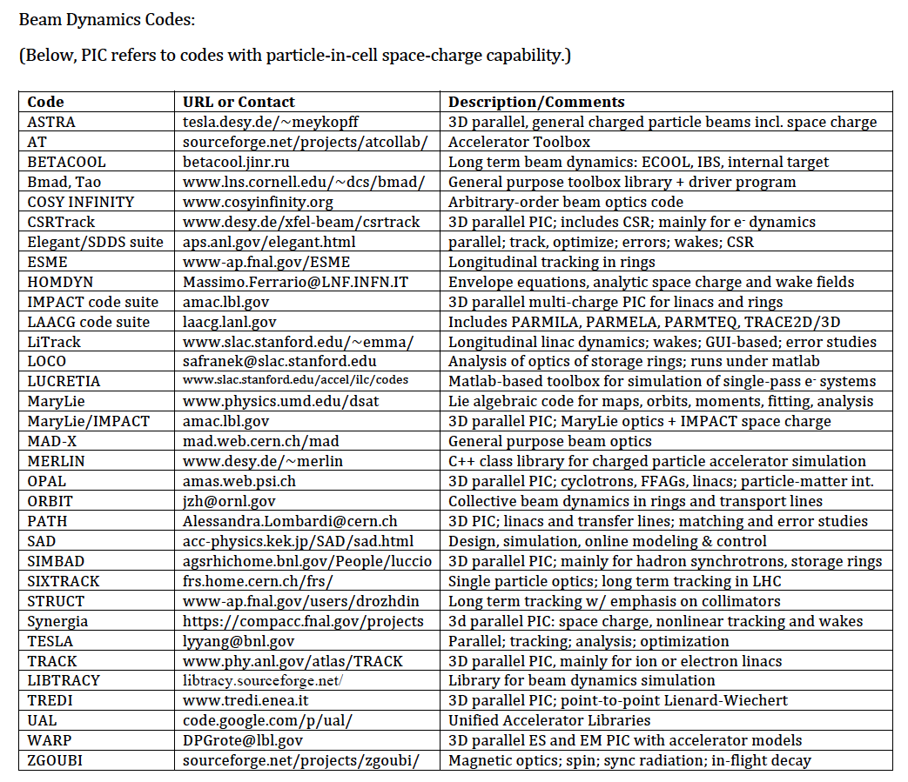
Many codes “available” for research
Covering different focus areas
  beam dynamics, accelerating structures, plasmas
Some specialized to a particular type of accelerator
Some to particular physics, with different approximations
Few are frameworks capable of incorporating multi-physics
There is no overall coordination
  Inefficient use of resources, difficult to support, thus difficult to use
~70 different codes , U.S. and international, not all actively developed and maintained
List of codes from the accelerator handbook (x3)

Slide 8
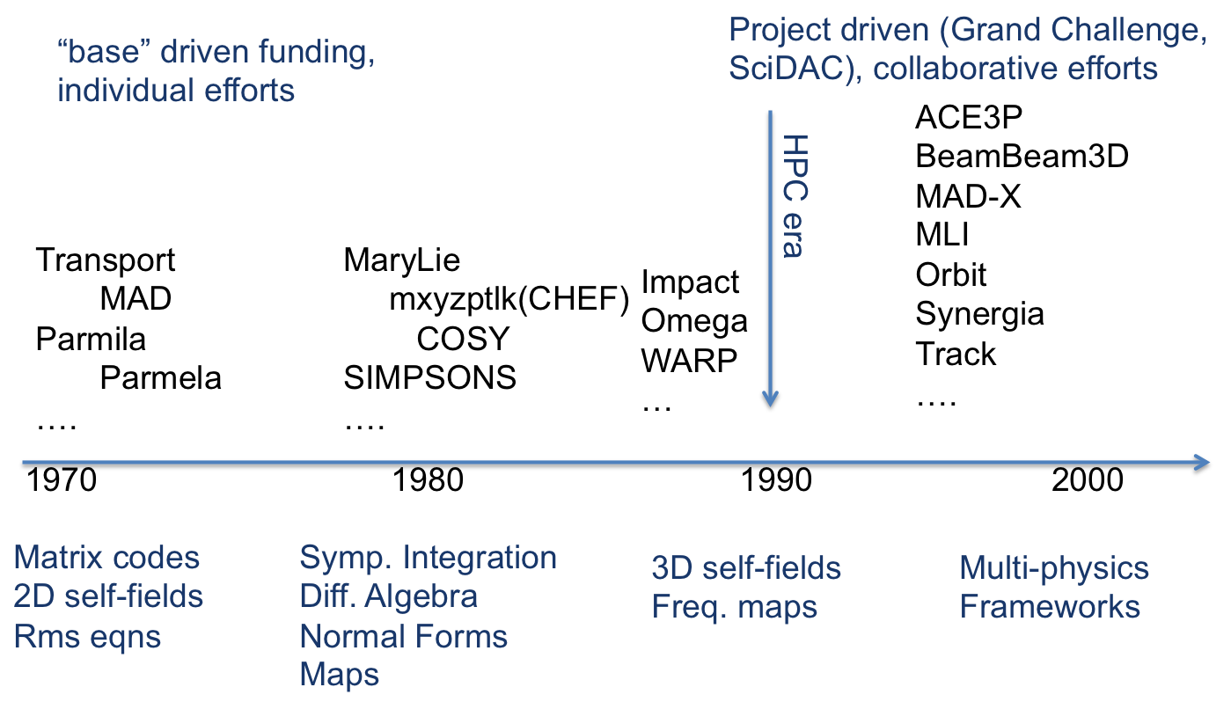
Evolution of numerical tools timeline (a simplified view…)
➔
➔

Slide 9
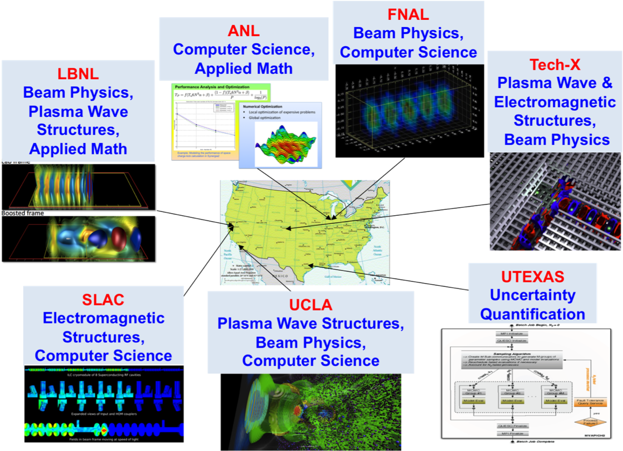
Coordinated efforts for Modeling and Design in the last decade: ComPASS
ComPASS, funded by SciDAC, develops modeling and design tools with emphasis on HPC
GARD (or predecessor) and projects (in more recent years) support applications
Code maintenance and user support not explicitly funded, thus not adequate
SciDAC: Scientific Discovery through Advanced Computing
ComPASS: Community Project for Accelerator Science and Simulation
ComPASS is the only current development activity organized as a national project

Slide 10
ComPASS under SciDAC
ComPASS goals (2007 SciDAC2 proposal):
  “Our vision is to develop a comprehensive suite of interoperable accelerator modeling tools which will enable Virtual Prototyping of the design and optimization of accelerator components, and multi-physics Virtual Accelerator Modeling…”
  well matched to the 2014 P5 recommendations
SciDAC is a partnership of ASCR with other DOE offices, now in its 3rd cycle (5 year cycles). ComPASS under
  SciDAC2 a partnership of ASCR, HEP, NP, and BES, at ~$3M/year
  SciDAC3 just ASCR and HEP, at $1.8M/year (50/50 split)
    The HEP share comes from Comp. HEP, not GARD.
  SciDAC enables collaboration and leveraging of non-HEP resources, but not truly programmatic for accelerator science
    difficult to sustain a program with long term goals if many different funding sources with different funding cycles, etc
To support long-term accelerator R&D we need a healthy GARD program for this activity area

Slide 11
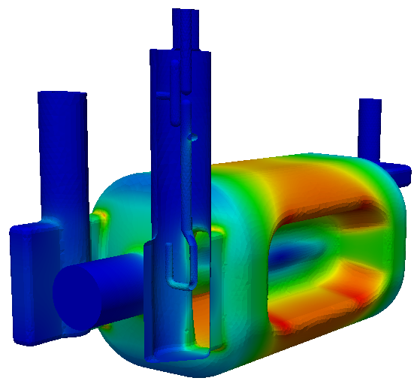
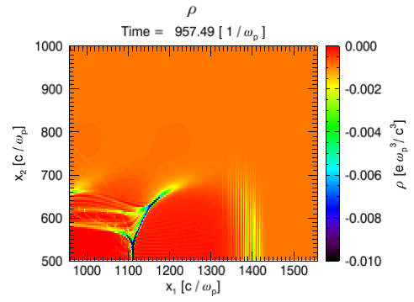
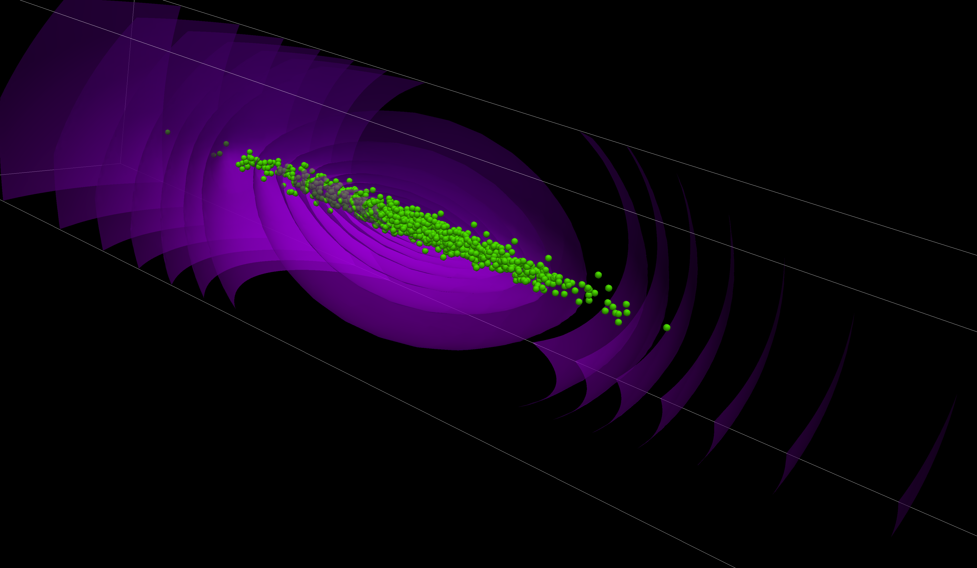
Codes currently (partially) supported under ComPASS
ComPASS toolkit: ACE3P (SLAC), Osiris & QuickPIC (UCLA), Synergia (FNAL), Vorpal (Tech-X), Warp (LBNL), in 3 focus areas
Accelerator structure focus
  Cavity modeling
    Interaction of fields and particles with environment
  Multi-physics analysis
    Integrated EM, thermal and mechanical effects
  Applies to all GARD thrust areas
Beam Dynamics focus
  Single and multi-particle dynamics and collective effects
  Multi-physics, multi-scale modeling
  Applies to all GARD thrust areas
Plasma focus
  Laser and beam-driven wakefields in plasmas
  Multi-physics and scale
  Applies to the Advanced Accelerator Concept thrust
Although they share low-level numerical algorithms, the physics, and numerical optimization have different requirements, thus require separate development effort

Slide 12
Many more codes with broad applicability are currently actively developed and used
Codes that have HPC capabilities (partially developed under SCiDAC in the past), i.e.
  IMPACT and BeamBeam3d (LBNL)
Codes initially developed to target a particular need for one application, i.e.
  Elegant (APS control room), Orbit (SNS design)
  also codes developed for the Muon Accelerator Program
    G4beamline, …
University developed beam dynamics codes
  COSY-INFINITY (MSU), MaryLie (Maryland)
Specialized codes for activation and shielding calculations
  MARS
…

Slide 13
Capabilities
State of-the-art codes, such as the ComPASS codes, are able to
  simulate multi-particle and collective effects with millions of macro-particles, using higher-order optics
  model complete accelerator structures with complicated shapes and millions of degrees of freedom
  Model laser and beam propagation in plasmas and relevant physics
ComPASS codes have been (and are) used for every HEP high-priority operations or design application, e.g.
  PEP-II, ILC, LHC, FNAL Run II accelerators, FNAL PIP I and II, experiments at FACET and BELLA, MAP,… (and also non-HEP, such as CEBAF, RHIC, SNS, LCLS, …)
This is an excellent demonstration of the effectiveness and reach of a coordinated program

Slide 14
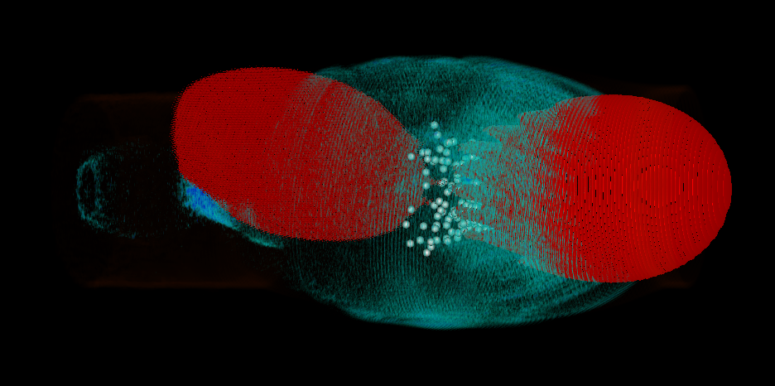
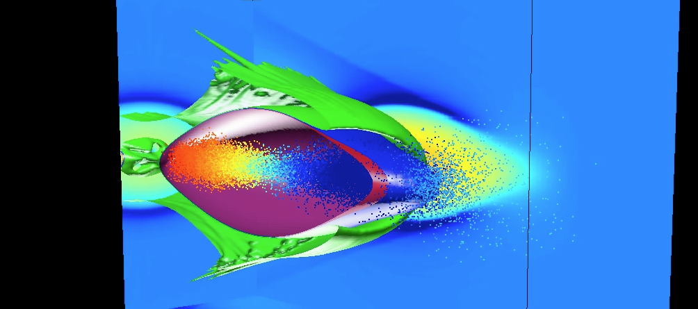
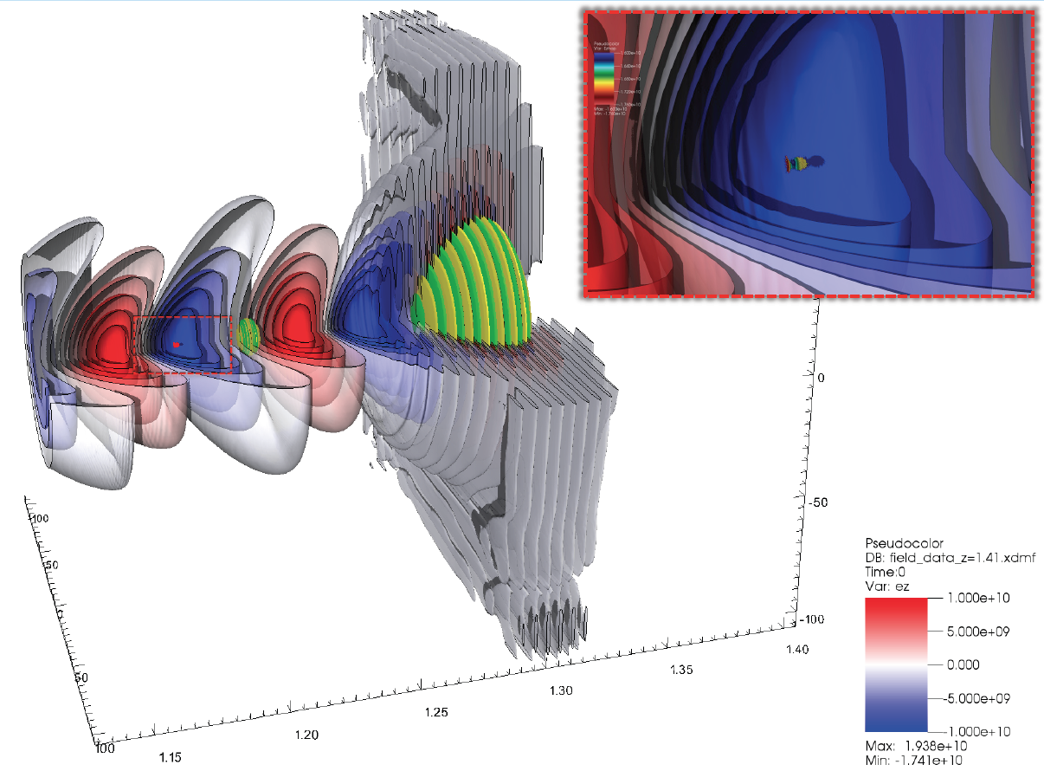
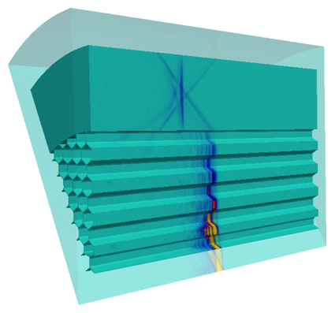
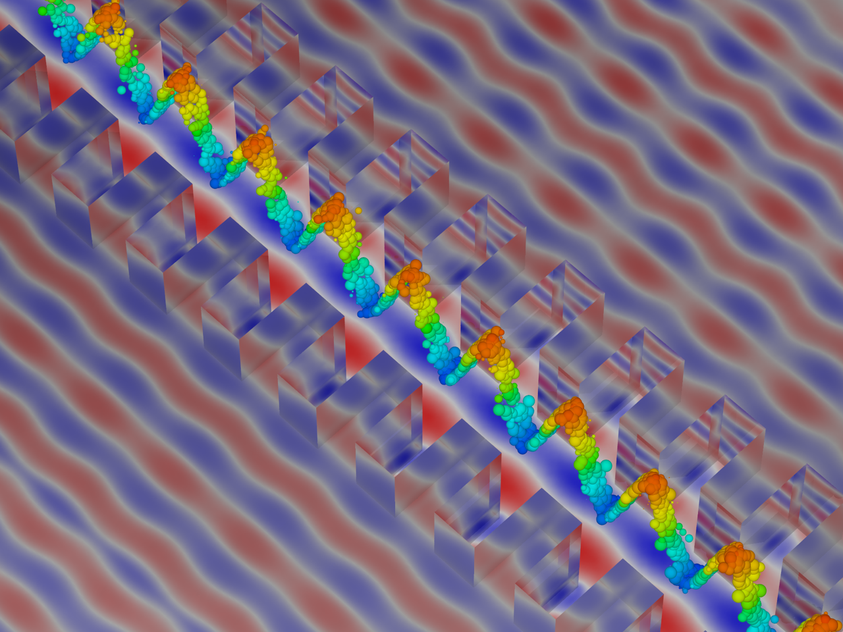
Examples of Advanced Accelerator Concept applications
Plasma-based acceleration:
  support the BELLA (laser) and FACET (beam) experimental programs
  improve staging for future lepton collider concepts.
Dielectric laser acceleration:
  design structures able to accelerate high quality beams
FACET stage, QuickPIC
Colliding pulse injection,
Vorpal
2-color injection, WARP
PBG wakefield, ACE3P
Dielectric grating structure
Vorpal
Notes:
(a)3D Silicon Woodpile Photonic Crystal waveguide,
(b)2D Glass Photonic band-gap (PBG) hollow--‐core opCcal fiber.

Slide 15
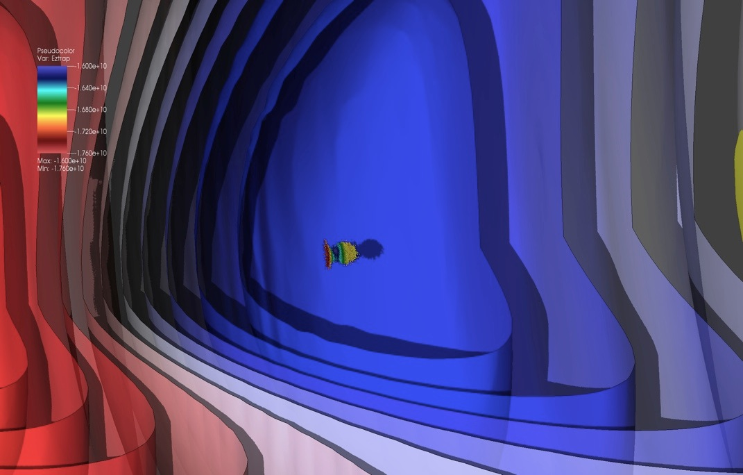
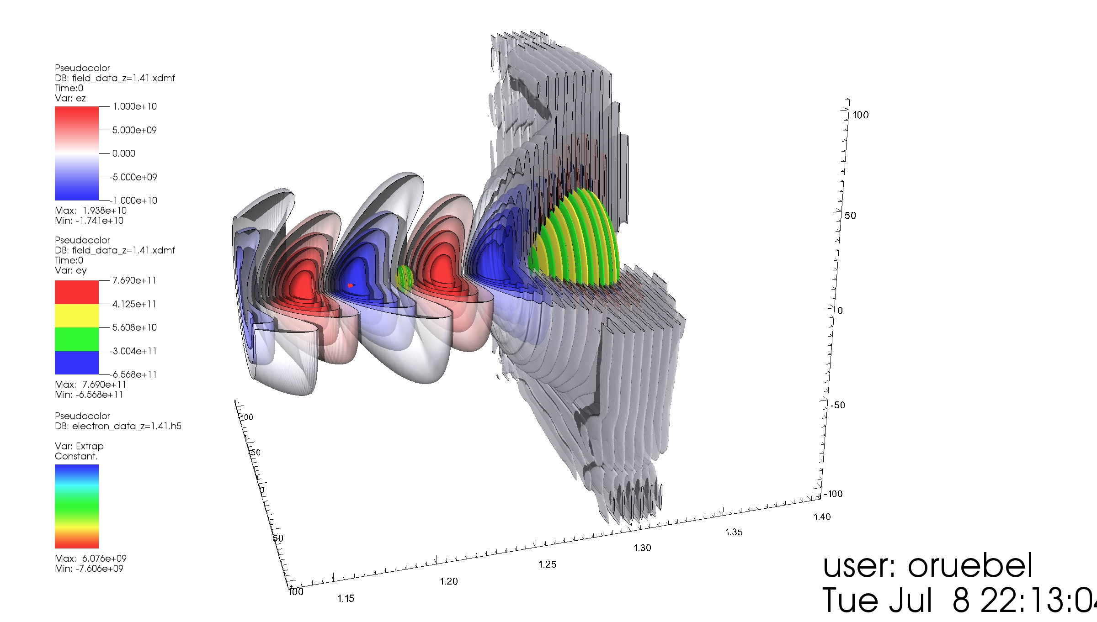
Multi-scale 3-D simulations validate a new concept for injection of very high-quality beams*
High quality injected beam
Pump laser pulse
Plasma
Injection laser pulse
Simulations: Warp
Visualization: VisIt
- Pump laser pulse creates accelerating wake in plasma.
- Injection laser ionizes pocket of Krypton gas, creating very high-quality electron beam.
- Electron beam is accelerated to high energy in short distance by wake.
Parametric runs necessitated over a million hours; typical 3-D run around 100k core-hours.
*L.-L. Yu, E. Esarey, C. B. Schroeder, J.-L. Vay, C. Benedetti, C. G. R. Geddes, M. Chen, and W. P. Leemans, Phys. Rev. Lett. 112, 125001 (2014)

Slide 16
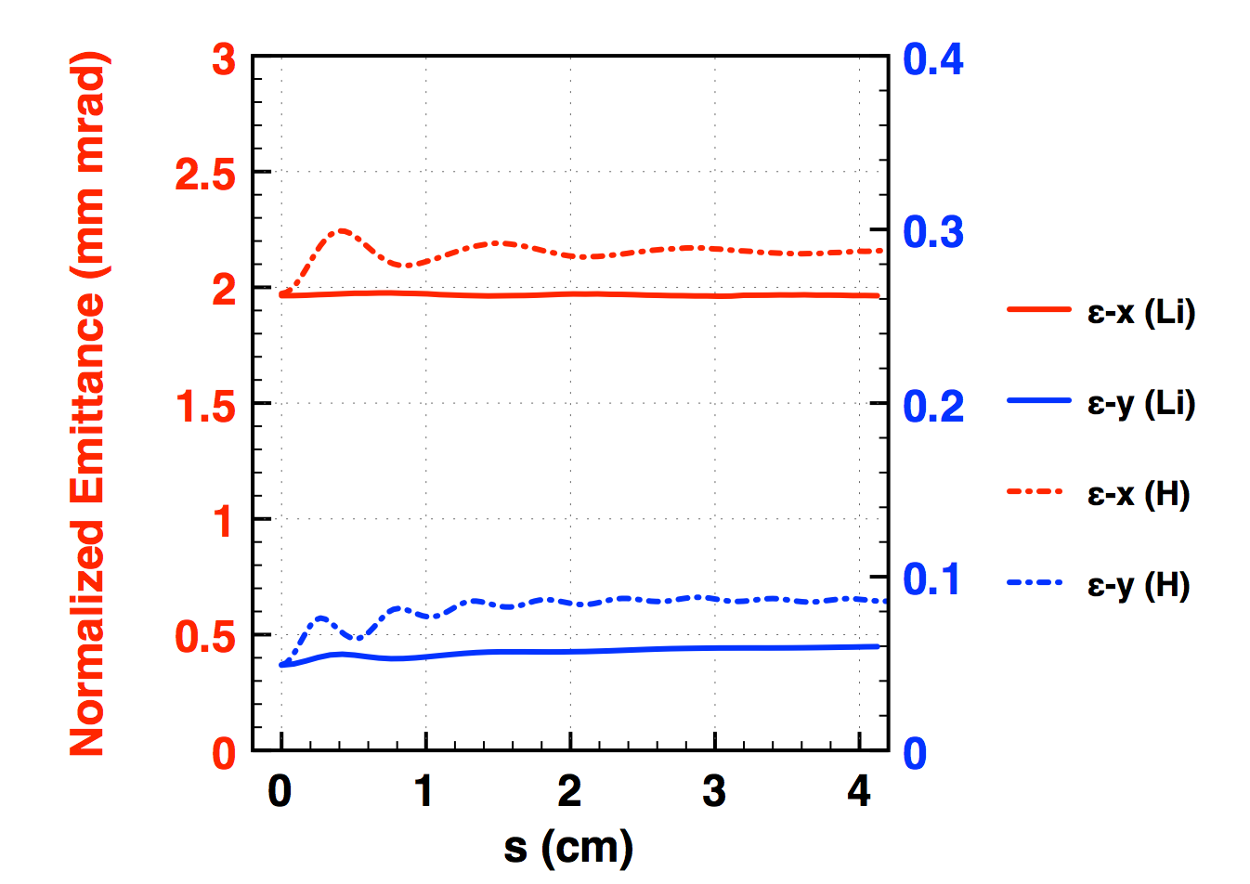
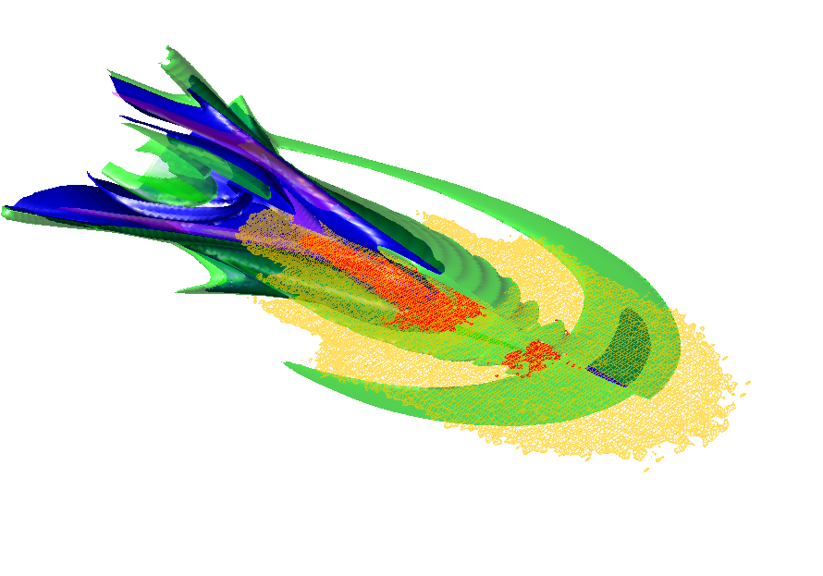

Large scale simulations show that emittance growth from ion motion is less severe than expected in PWFA blowout regime
Density Isosurfaces of the Ion Collapse
in a Hydrogen Plasma
Beam Emittance
Ion Density Isosurfaces
Resolution:
σx / Δ⊥ = 75.9
σy / Δ⊥ = 12.0
In Li, the emittance in x does not change, and in y direction it only increase by 20%.
In H, the emittance in x increase by 10%, and in y direction it increases by 70%.
Electron Beam with Asymmetric Spot Size
Trailing Beam: σ_{z} = 10.0 μm , N = 1.0 x 10¹⁰ ,
σ_{x} = 0.463 μm , εNx = 2.0 mm∙mrad ,
σ_{y} = 0.0733 μm , εNy = 0.05 mm∙mrad
Υ = 48923.7 (25 GeV), Plasma Density : 1.0 x 10¹⁷ cm⁻³
This study required QuickPIC runs with 16384 x 16384 x 2048 cells on 32768 processors
W. An et al.

Slide 17
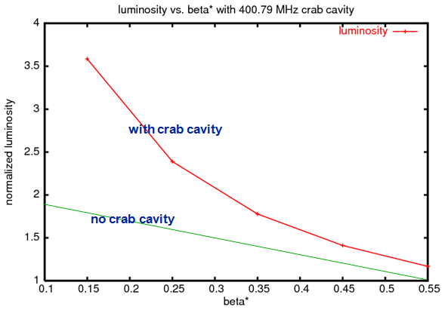
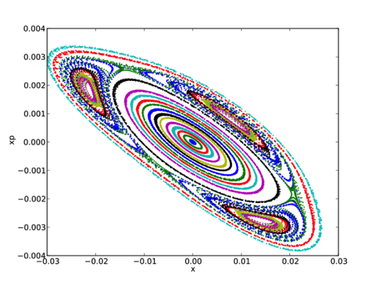
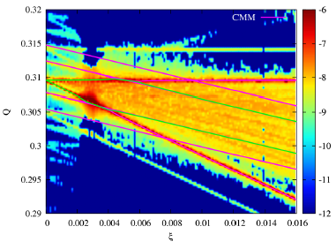
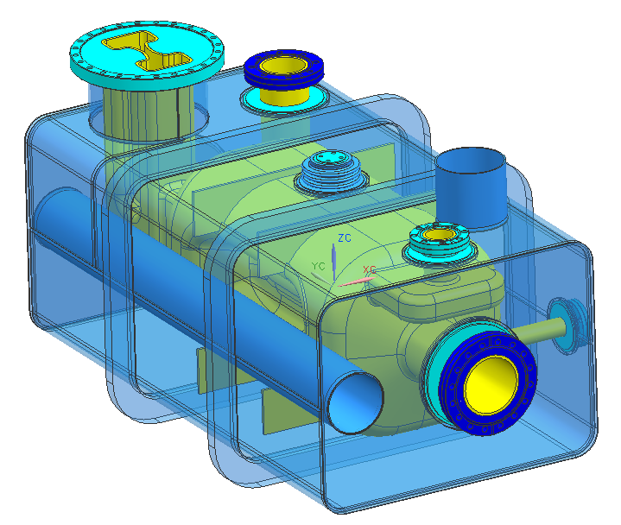
Advanced Modeling Benefits LHC and LHC Upgrades
LHC upgrades are a high priority for the US program
BeamBeam3D is used to support
LHC and LHC upgrade with Crab Cavity
Collaboration with CERN scientists to utilize Synergia for the LHC Injector Upgrade (LIU). Massive simulations to validate using GSI SIS18 ring data
71 steps/turn
100k turns
7,100,000 steps
4,194,304 particles
29,779,558,400,000 particle-steps
1,238,158,540,800,000 propagator calls
HL-LHC – Prototyping of crab cavity using ACE3P
Synchro-betatron modes as a function of
the beam-beam parameter at LHC.
S. White et al., PRST-AB 17, 041002, 2014.

Slide 18
MARS: interaction region design for the LHC
MARS simulations in 1996 to 2003 helped design the optimal high-luminosity Interaction Regions IR1 and IR5 of LHC, including their absorbers, and predict superconducting magnet short-term (quench stability) and long-term (lifetime) performances.
“MARS predictions of 16 years ago of energy deposition in the low-beta quads agree within 20% with recent measurements in the real LHC machine. No beam-induced quench has been observed at LHC”. Lucio Rossi, talk at Fermilab, February 2014.
One and a half decades ago there was no experimental data above 1 TeV to verify the code’s physics models. Today – working on the HiLumi LHC upgrade – FLUKA and MARS codes are benchmarked in the TeV energy range.
MARS provides another demonstration of the effectiveness and reach of a long development program (over 30 years development)

Slide 19
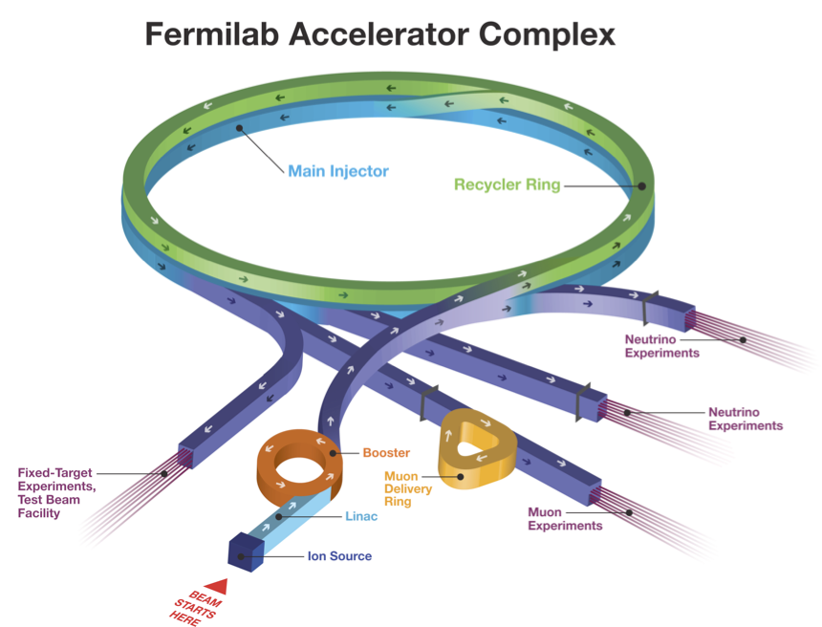
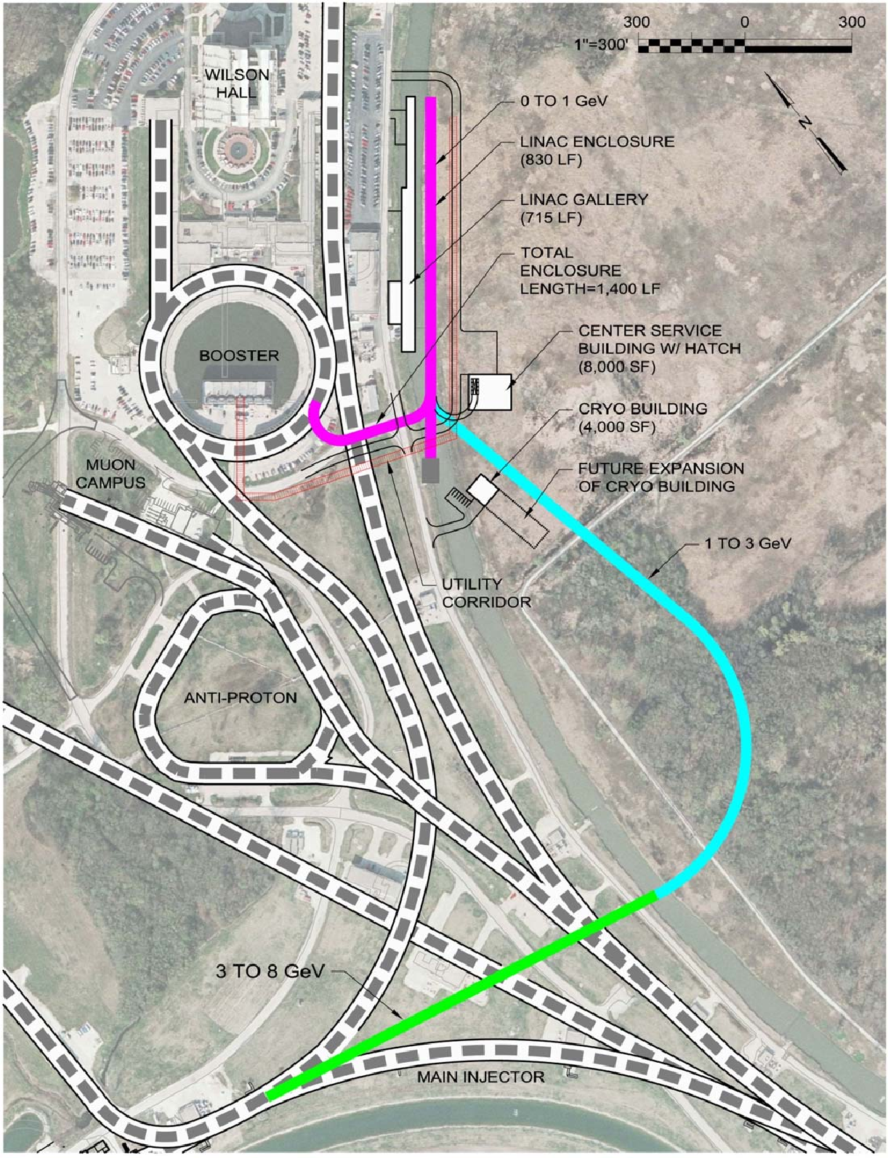
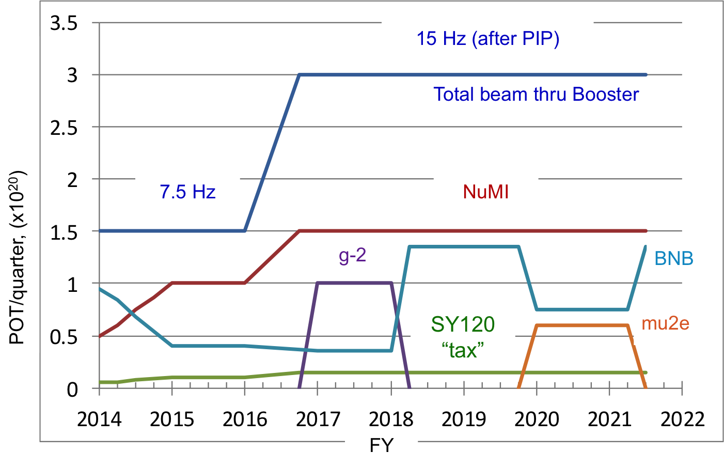
Examples of applications for high-intensity beams
Fermilab Proton Improvement Plan (PIP)
  Booster, Main Injector (MI), Recycler: instability control and mitigation, loss minimization
Mu2e upgrades
  Delivery Ring extraction design
New srf Linac (PIP-II)
  Linac design: wakefields
Power increase: 300 kW to 700 kW to 1.2 MW

Slide 20
Full cryomodule model for PIP-II
PIP-II – Trapped mode in PIP2 650 MHz cryomodule consisting of 8 SRF cavities
MP locations
SciDAC collaboration in scalable solvers enables fast solution in such large problems using ACE3P. It took 3 min to calculate a mode frequency and its damping using 300 cores, 1.1 Tbytes of memory for a mesh with 14M degrees of freedom on the NERSC Edison supercomputer.

Slide 21
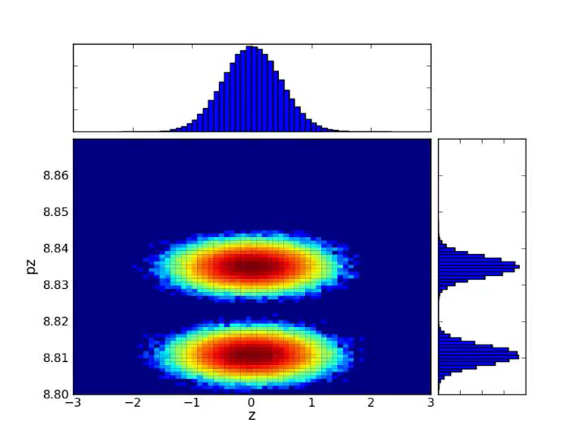
Recycler slip-stacking
Slip-stacking of Booster bunches increases intensity downstream
  In the past, done in the MI
Under PIP, slip-stacking moved to the Recycler to increase the MI ramp rate (thus beam power)
  Must model the whole process to characterize localized losses and evaluate mitigation techniques
  A very complex model, the simulation campaign underway
    Include apertures, field measurements, impedance, …
Synergia simulations

Slide 22
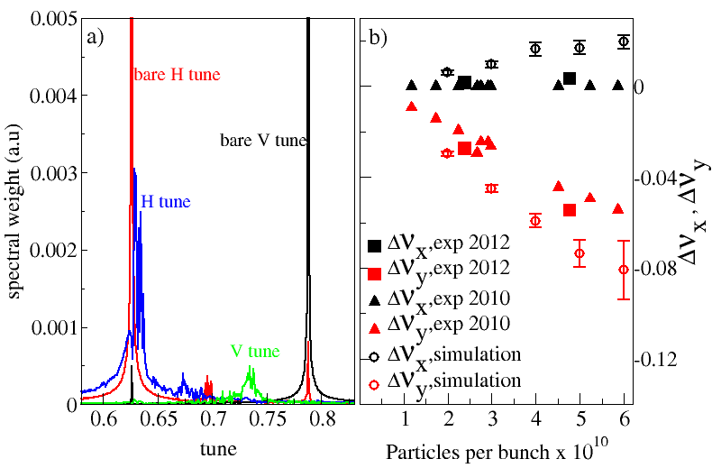
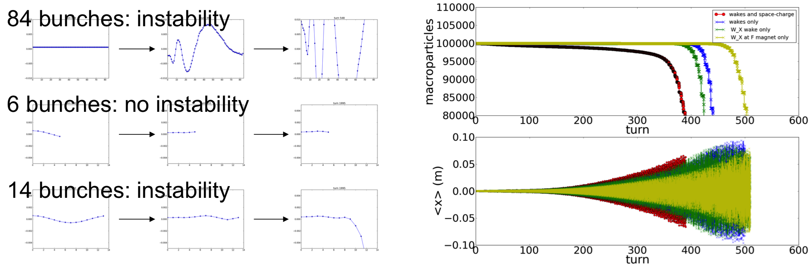
Booster PIP
Horizontal plane coherent instability near injection
  Mitigated by empirically changing chromaticity at a counterintuitive value
Synergia multi-bunch simulations revealed the source of the wakefield-caused instability
  Work closely with machine physicists to collect data for validation
  Excellent example of the impact of long-term R&D on short term activities
A. Macridin, et al., PRST-AB 16, 121001 (2013)

Slide 23
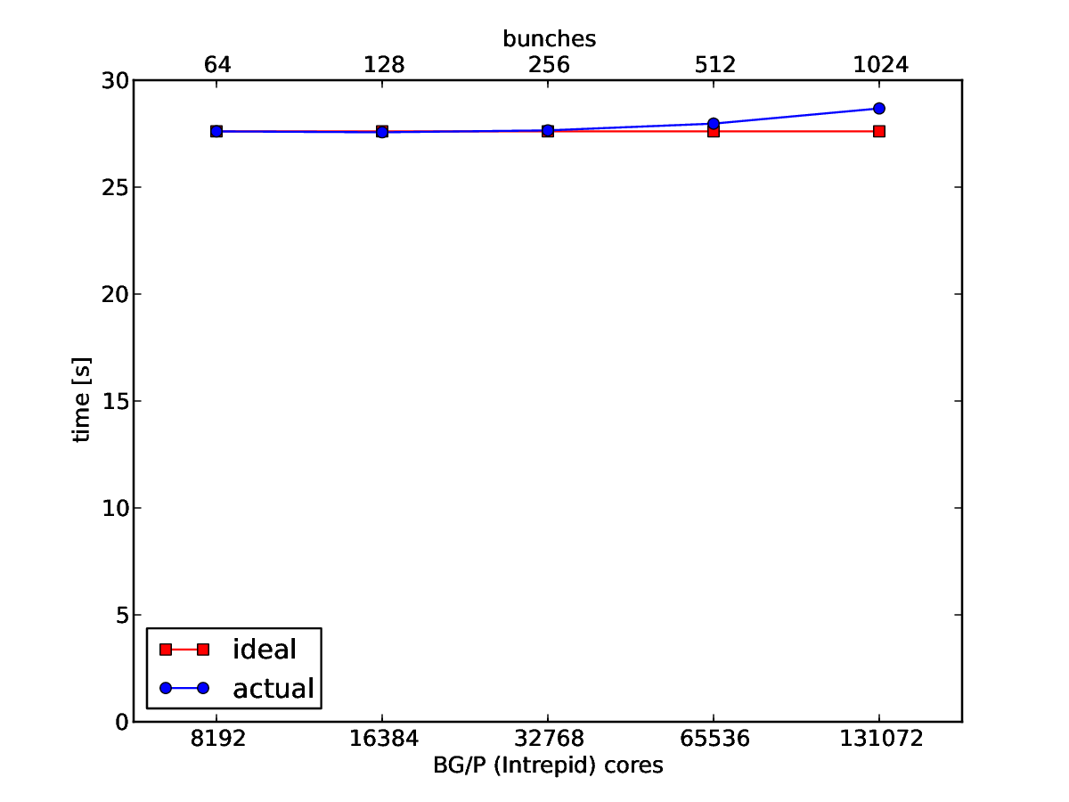
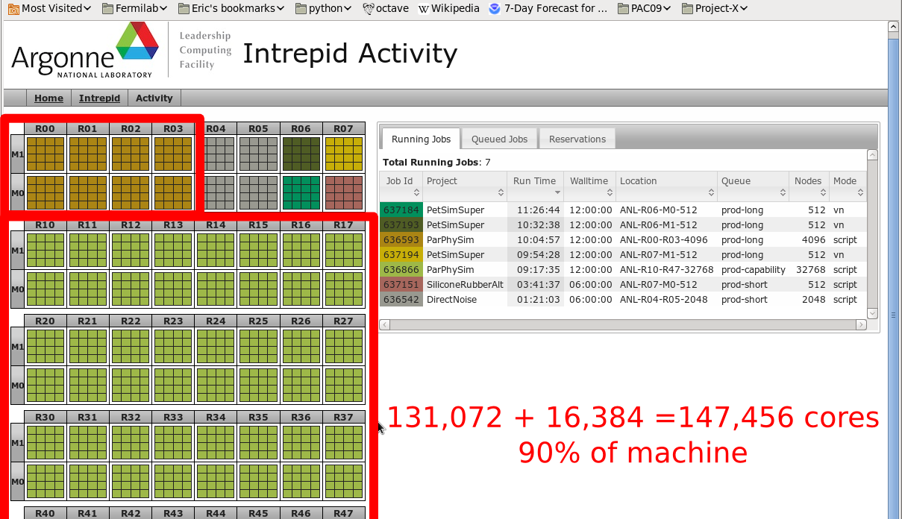
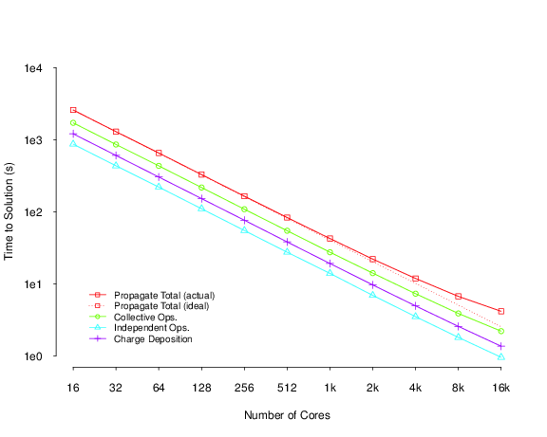
Very large computations: Synergia simulation campaign for PIP (I & II)
Single job size for production
  Booster 20k core
  MI/Recycler 64 k core
  Optimization scans 131k core
12 month simulation campaign used 80M core hours at the ANL Leadership Computing Facility (LCF)
Weak scaling from 8192 to 131072 cores
Strong scaling from 16 to 16,384 cores
Note, time allocation to LCFs through competitive proposals; success depends on code scaling and performance

Slide 24
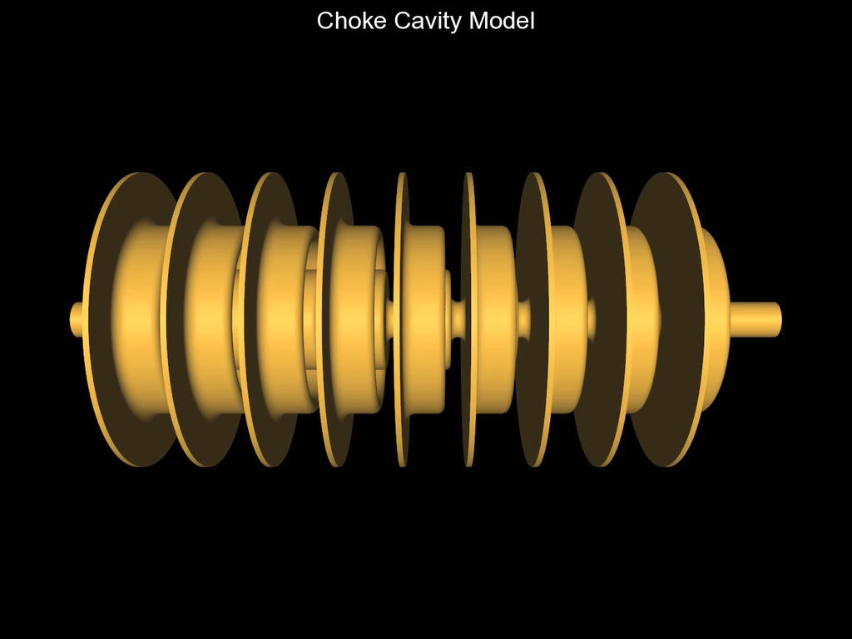
Virtual Prototyping using ACE3P
Optimize the performance of the choke mode cavity for high gradient acceleration by improving the damping of the higher-order dipole modes.
Parallel computation with advanced shape optimization techniques allows fast turnaround time to obtain the best design.

Slide 25
Community support, training and education
Web based documentation and code downloads. Examples:
  blast.lbl.gov (LBNL BLAST code set)
  https://web.fnal.gov/sites/Synergia/SitePages/Synergia%20Home.aspx (FNAL Synergia framework)
  https://confluence.slac.stanford.edu/display/AdvComp/Materials+for+cw11 (SLAC ACE3P framework, documentation and tutorials)
  http://www-ap.fnal.gov/MARS/ (MARS code system)
No rigorous user support process
Codes used at USPAS, while developers serve as instructors
Very rarely, code workshops and tutorials
  SLAC group a notable exception, holds them regularly
Few universities provide academic computational accelerator physics training (e.g. MSU), some train students on computation through participation in research programs (e.g. UCLA at FACET)

Slide 26
Accelerator Modeling and Design Tools: Moving Forward

Slide 27
R&D Drivers
New accelerator designs and concepts have increasingly stringent performance requirements, calling for
  Higher fidelity, faster codes
New computing architectures require changes in computational paradigm
  New numerical algorithms, workflows, infrastructure
Need to provide better training and user support while maintaining development effort

Slide 28
Guided by the P5 recommendations
Recommendation 14 : Upgrade the Fermilab proton accelerator complex… to provide proton beams of >1 MW…
Recommendation 23 : Support… accelerator science… through advanced accelerator facilities … Strengthen national laboratory-university R&D partnerships…
Recommendation 26 : Align the present R&D program with the P5 priorities …outcomes and capabilities that will dramatically improve cost effectiveness for mid-term and far-term accelerators.
Recommendation 29: Strengthen the global cooperation…to address computing and scientific software needs, and provide efficient training in next-generation hardware… Investigate models for the development and maintenance of major software….

Slide 29
Snowmass 2013: capability requirements for future accelerators
High intensity accelerator needs
  quantitative beam loss characterization and mitigation
  ability to compare beam diagnostics data to simulated data
High Energy accelerator needs
  beam stability characterization
  ability to produce end-to-end designs
  new physics model capabilities (e.g., radiation, scattering)
All applications
  control room feedback: fast turnaround of simulations
  integrated / multi physics modeling: improve algorithms to take advantage of massive computing resources
  common interfaces, geometry and parameter description, workflow tools from tablet to supercomputer.
  better numerical models (less numerical noise)
Requirements point to complex models in need of HPC

Slide 30
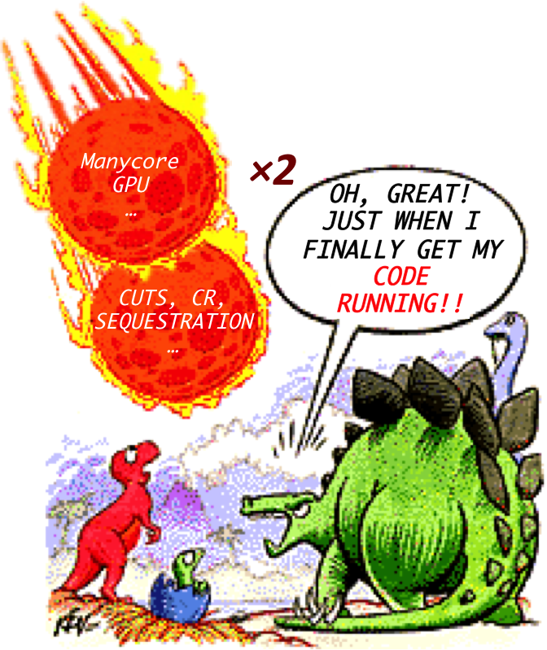
Challenge: change of computing paradigm
We spent the last decade optimizing our codes on distributed memory systems. However, due to commercial pressure, computing architectures are moving to multi-core systems and accelerators (GPUs, …)
  Shared memory, vectorization, multi-level parallelism
Changes in programing paradigm needed
  But, a great opportunity for multi-physics, multi-scale simulation leading to “Virtual accelerator” modeling
Continuing R&D on new architectures necessary
Notes:
Since you are more familiar with the requirements on the accelerator side

Slide 31
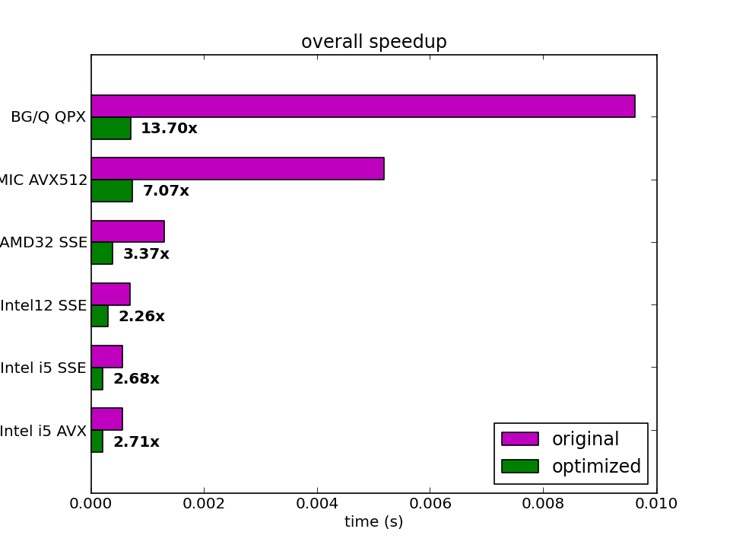
Already progress under SciDAC/ComPASS on GPU (CUDA) and MIC based systems
  Explicit vectorization of Synergia leads to a large performance enhancement on each architecture, but, requires a lot of effort!
  GPU-enhanced Synergia achieves better overall performance with 4 GPUs than an 128 node Linux cluster
First production Synergia runs on the GPU: Mu2e extraction
ASCR funded work at FNAL

Slide 32
CAMPA
Running multi-physics codes on the next generation of supercomputers requires large investment
  need for better integration of modeling efforts and planning
No platform for sharing code or providing support
  elements exist in projects such as ComPASS, but not globally
New LBNL-SLAC-FNAL initiative: Consortium for Advanced Modeling of Particle Accelerators (CAMPA) aims to
  develop, maintain & support an integrated suite of codes
  train the next generation of computational physicists in accelerator modeling on the latest hardware
Modest initial investment
  First year activity $250k in FY14 by LBNL-SLAC
  Second year activity $500k in FY15 by LBNL-SLAC-FNAL

Slide 33
CAMPA strategy
CAMPA Strategy
Building on the success of ComPASS, organize efforts from LBNL-SLAC-FNAL to work on
  Interoperability of existing codes and capability consolidation
  Common workflow, interface, data representation, analysis tools
Coordinate with other national projects (SciDAC, SBIR,…) and University (NSF) efforts to develop
  new physics and numerical models
  porting to new hardware
Develop infrastructure and user support process
  Code distribution, release and documentation standards, repositories,…

Slide 34
University role
University participation is essential for success, providing access to
  students and post docs: the health of our field depends on training young scientists on all aspects of our activities
  funding sources not available to labs (such as NSF)
University computational physicists have well established connections to both lab and university experimental programs, increasing collaboration possibilities
Universities provide access to multi-disciplinary research
  Increasing program breadth and innovation possibilities
For universities, a coherent program will provide
  The means to support technical staff, not done traditionally in academia
  The visibility necessary to attract the best students

Slide 35
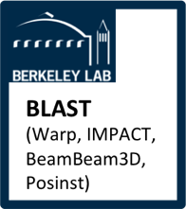
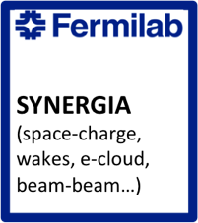
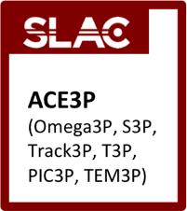
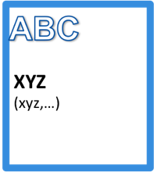
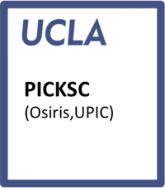
CAMPA could help establish a broader forum
CAMPA fits in larger picture
HEP Forum for Computational Accelerator Physics
HEP
NSF
ASCR
CAMPA
Partnerships with math and CS, such as SciDAC
…
…
Common set of libraries (numerical algorithms, physics, utilities, …)
Could also expand - or link - to other DOE programs (BES, NP, FES) accelerator activities.

Slide 36
Forum for Computational Accelerator Physics (scenario C)
With more resources available, consortium could expand to create a forum. Participating institutes would:
  contribute to a common set of libraries of numerical tools
  maintain and support these libraries and provide consultation.
  sponsor student and computational researcher fellowships
In order to create such an organization, we need
  Incentives (funding, enhanced opportunities for research,…)
  An inclusive governance model
The forum should be funded for developing and deploying the common infrastructure
  software libraries, repositories, code release and testing, user support and documentation, and fellowships
This funding is in addition to development funding (at todays SciDAC levels) and CAMPA interoperability effort [scenario B]

Slide 37
Modeling and design tools applications
Development driven by the needs of long-term program (P5)
  Design of multi-MW facilities, 100 TeV scale pp and TeV scale lepton colliders
Development also benefits mid-term activities, as more advanced tools become available
For the success of modeling and design applications it is essential to work closely with machine physicists
  FNAL team experience with RUN II and PIP, LBNL with BELLA, SLAC with MI, UCLA with FACET,… supports this.
Applications should be driven by individual partnerships of computational teams with accelerator projects and facilities, according to accelerator R&D priorities and individual group research interests

Slide 38
Accelerator Modeling and Design Tools:
Application focus and resource needs

Slide 39
FNAL vision, assets, and strategy
FNAL vision, within the national program, is to
  become a “center of excellence” for numerical simulations of high-intensity beams and beam-material interactions (energy deposition and radiological effects) to support multi-MW driver design, while enhancing capabilities of the mid-term program
Main emphasis on numerical tools for R&D studies for a ring multi-MW driver option
  Quantitative beam loss prediction
  Passive and active mitigation techniques
  New design concepts
Utilize the multi-physics Synergia framework, MARS (and other codes -through CAMPA- where appropriate)

Slide 40
FNAL development focus
Co-processor algorithms, capable of multi-million step simulations for accurate beam loss modeling in Synergia. Data driven model validation at FNAL accelerator complex
Improved MARS models for highly-accurate large scale simulation of beam interactions with accelerator and target components.
Interface Synergia with MARS for accurate characterization of activation and for design of shielding, collimators, …
Common interfaces and data representations for interoperability between Synergia and other codes (CAMPA)
Numerical models for non-linear elements in Synergia. Data driven model validation from the IOTA facility
Detailed RF models in Synergia for linac simulations
User and application deployment support and consortium infrastructure support

Slide 41
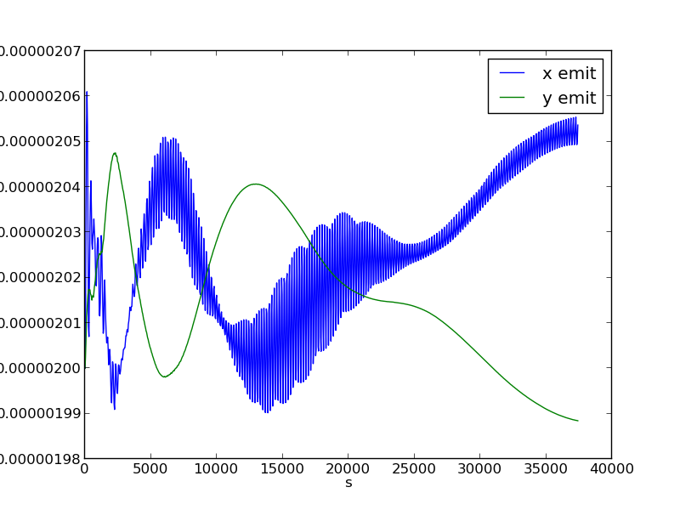
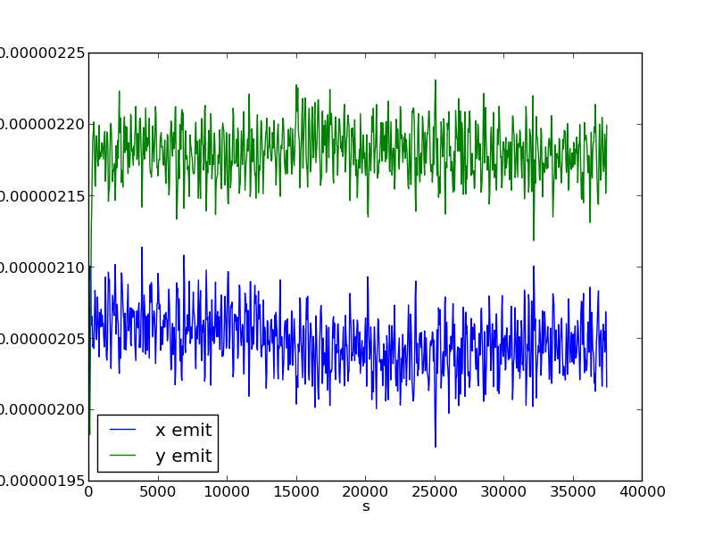
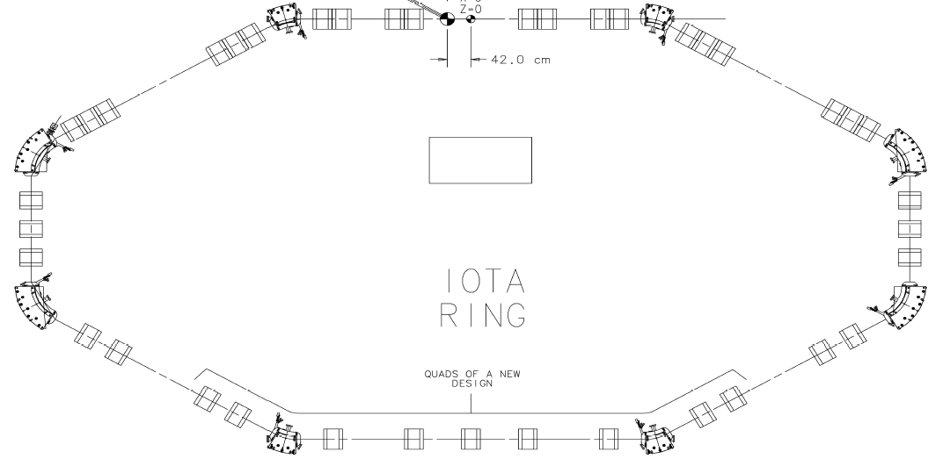
FNAL application focus
Booster, Recycler, and MI applications at 700KW operation (guidance for loss modeling studies).
PIP-II accelerator chain for performance optimization, leading to 1.2MW.
Support of the IOTA R&D program (see A. Valishev’s talk)
Support of instability and halo control experimental program (see B. Zwaska’s talk)
Design concept development for the next-generation booster for a post-PIP-II multi-MW accelerator complex upgrade.
Support upgrades of existing and design of next-generation proton-proton colliders.
Synergia simulations of IOTA, D. Bruhwiler

Slide 42

LBNL vision, assets and strategy for accelerator modeling
LBNL Center of excellence in accelerator/plasma modeling & hub for computational accelerator physics
  Berkeley Lab Accelerator Simulation Toolkit spans breadth of DOE/SC
    Intense multiphysics beam dynamics (space charge, beam-beam, ecloud), Advanced light sources, Plasma based accelerators
  Breakthrough algorithms – e.g. boosted frame, spectral Maxwell solver
  Worldwide users: > 40 institutes use BeamBeam3D, IMPACT, Posinst, Warp (blast.lbl.gov)
    current HEP: BELLA, LHC, ILC, Tevatron, MI, NML injector, SPS, PS, CESR-TA, MAP
      e.g.: beam-beam for increased Tevatron luminosity, SPS/LHC e-cloud modeling/mitigation
    current NP: FRIB, RHIC, eRHIC, ELIC, BES: LAS, APS, SNS, LCLS, NSLS-II, LCLS-II, FES: NDCX-II
Team work for integration of multi-physics packages & algorithmic advances
  Established CAMPA collaboration (LBNL+SLAC+FNAL) for integrated accelerator modeling
    White paper of CAMPA, input to P5 & to Snowmass: http://hifweb.lbl.gov/public/CAMPA/white_papers/
  Strong computational collabations: e.g. NERSC, LBNL Computer Science Division, U. Md…
Implementation requires core programmatic support of several FTE (+ postdocs):
  new algorithms/physics/architectures, modularization, validation and maintenance
  documentation, distribution (incl. website), user support, training and management
  Funding-dependent additional efforts: integration of additional codes, consolidation, innovative accelerator concepts & technologies (not covered by existing projects), improved human interface

Slide 43

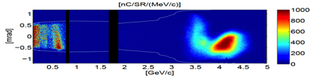
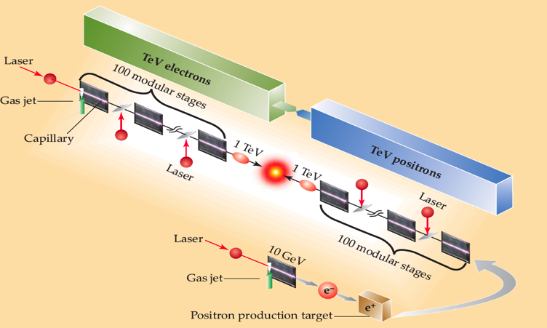
Future-generation accelerators at dramatically lower cost advances in modeling will offer new opportunities
Multi-GeV beam/laser plasma accelerators
Accelerator: EM + plasma + beam
  Current: PIC-MPI: meter scale, 10 GeV, ε~0.1µm
Target plasma + guide: hydrodynamics
  Current: 1D MHD plasmas, commercial gas flow
Accelerator: EM + plasma + beam
  Current: PIC-MPI: meter scale, 10 GeV, ε~0.1µm
  Goal: 100 m scale, 1 TeV, ε~0.01µm
    Radiation, scattering, e+ production
Target plasma + guide: hydrodynamics
  Current: 1D MHD plasmas, commercial gas flow
  Goal: 3D shaped plasmas + kHz operation + heat
Beam transport + focusing
  Goal: fs, kA beams, focusing and intera
High average power lasers
  Goal: materials, dammage, optical propagation
FACET
BELLA
Laser-plasma (LPA) collider concept:
100x 10 GeV stages (1m ea.), injector, focus, e+
Talks: Leemans, Esarey, Joshi, Downer…
[SLAC meeting]
Advances in computers & algorithms:
real-time of single stages on clusters,
design of colliders on supercomputers.
Beam driven-plasma collider concept:
40x25 GeV stages (1m ea.), injector, focus, e+
LPA example

Slide 44
Future-generation accelerators at dramatically lower cost advances in modeling will offer new opportunities
Multi-GeV laser plasma accelerators
Accelerator: EM + plasma + beam
3-D full PIC
FACET
K-BELLA
Collider
σ_{x,beam}~1μm
L_{acc}~1m
σ_{x,beam}~0.1μm L_{acc}~100m
BELLA
Now
Lab frame
10⁴ cores
~ 1year
~ 10⁴ year
Laser-plasma (LPA) collider concept:
100x 10 GeV stages (1m ea.), injector, focus, e+
impractical
Now
Boosted frame
10⁴ cores
~ 1hour
~ 1 year
Talks: Leemans, Esarey, Joshi, Downer…
[SLAC meeting]
parametric studies
impractical
Goal 2024
Boosted frame
10⁶ cores
<1min
~ 3-4 days
real-time on supercomputers
~OK
Goal 2024
Boosted frame
+ AMR + env.
10⁶ cores
<10ms
~ 1 hour
real-time on clusters
parametric studies on supercomputers
Advances in computers & algorithms:
real-time of single stages on clusters,
design of colliders on supercomputers.
Notes:
Bella: Nx=100*Ny=100*Nz=10,000*Nt=40e6~40e14
Colider: Nx=1000*Ny=1000*Nz=10,000*Nt=40e6*Nstages~100~40e18
Bella ~ 1e8 CPU-hour in lab frame
Collider ~ 1e12 CPU-hour in lab frame
Bella ~ 1e4 CPU-hour in boosted frame
Collider ~ 1e8 CPU-hour in boosted frame

Slide 45
SLAC R&D Plans
Key thrusts of advanced accelerator computation at SLAC
  Maintain ACE3P as the premier parallel EM software for accelerator modeling through development of novel numerical algorithms in coordination with SciDAC.
  Collaborate under the CAMPA initiative on code integration in EM and beam dynamics for enhancing accelerator system simulation.
  Medium-term Plan
  Develop a multi-physics modeling toolset including integrated EM, thermal and mechanical effects for SRF cavities.
  Integrate ACE3P with IMPACT for system-scale accelerator simulation.
  Implement new algorithms in ACE3P for efficient and accurate modeling of space-charge dominated devices such as klystrons.
  Collaborate with CS/AM scientists in nonlinear eigensolver and parallel adaptive mesh refinement for virtual prototyping of accelerators.
  Code support for ACE3P user community (~50 users & growing).
  Long-term Plan
  Develop parallel optimization for multi-physics modeling of accelerators.
  Perform simulations for accelerator projects such as PIP2 and ILC to ensure operation reliability for specified machine design goals.

Slide 46
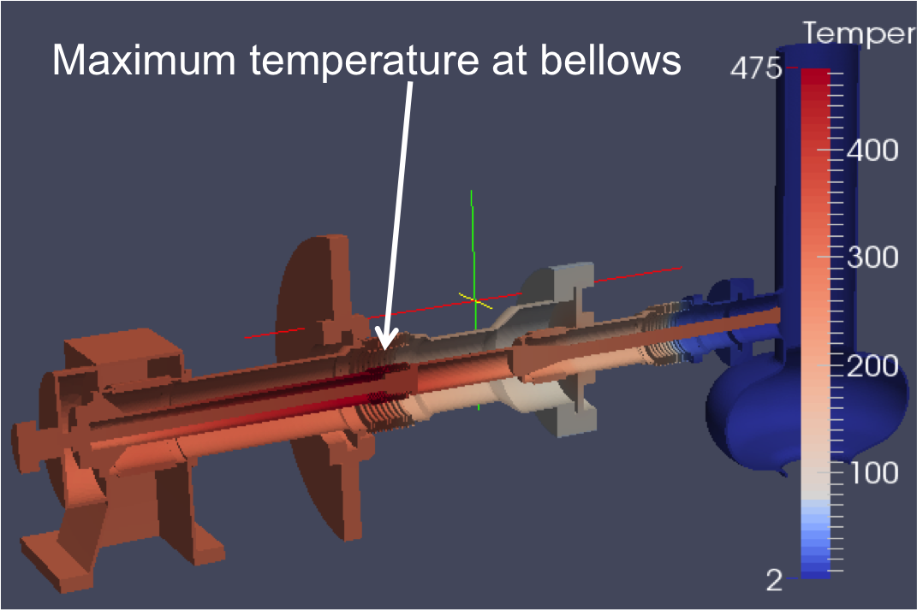
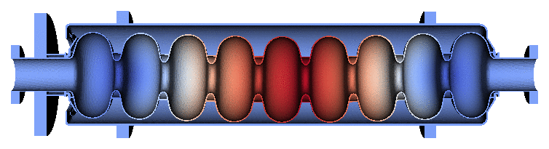
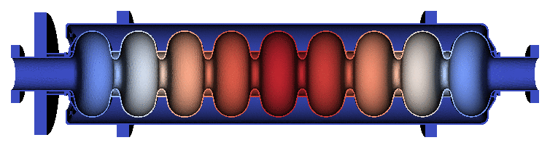
Multi-Physics Analysis for SRF Cavities
Develop an integrated modeling toolset including EM, thermal and mechanical effects for SRF cavities with emphasis on enhancing the following simulation capabilities.
Study effects of cavity imperfection on higher-order-modes.
Simulate dark current in cryomodule and evaluate its radiation effects through the cavity wall.
Determine Lorentz force detuning and study microphonics of SRF cavities for pulsed and CW operations.
Temperature distribution in TTF coupler
Mechanical modes of dressed TTF cavity
ACE3P multi-physics modeling
Aim at providing a transformative modeling capability that can facilitate a full, realistic design for optimal machine performance and operation reliability.

Slide 47
Resource needs (US wide)
 | Scenario B (FTE) | Scenario C (FTE)
Development for AA | 3 | 4
Development for multi-MW | 3 | 4
Development for structures | 3 | 4
Development for energy deposition | 1 | 2
Common Interfaces | 1.5 | 2
Common Libraries | 0 | 2
User Support | 0 | 1
Students | 4 | 10
Comp. Accel. Fellows | 0 | 4
postdocs | 4 | 8
Summary of resource requests assuming effort in accelerator R&D thrusts remains the same as today. If will be adjusted if the overall program changes.

Slide 48
Summary
Machines planned under the P5 advised program have increased complexity and stringent design requirements
  need for multi-physics models and HPC capabilities
Evolution of computing architectures requires continuing R&D on numerical algorithms
To move forward we need a coherent, coordinated program
  Start with a consortium of developers (building on ComPASS success)
  Funded at the same level as the current individual efforts and projects, with modest increase for interoperability/coordination
  If additional funding, establish a forum to develop and maintain common numerical and physics libraries
    With increased training and education reach, through fellowships and additional opportunities for students, through enhanced University participation

Slide 49
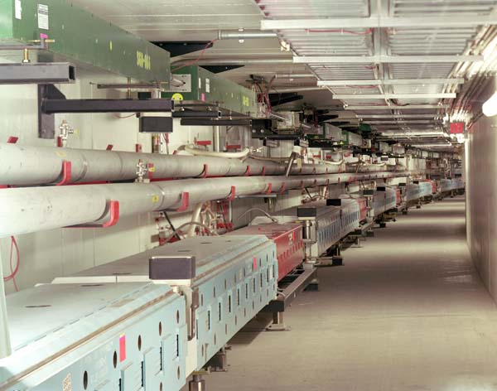
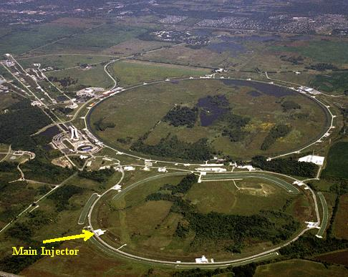
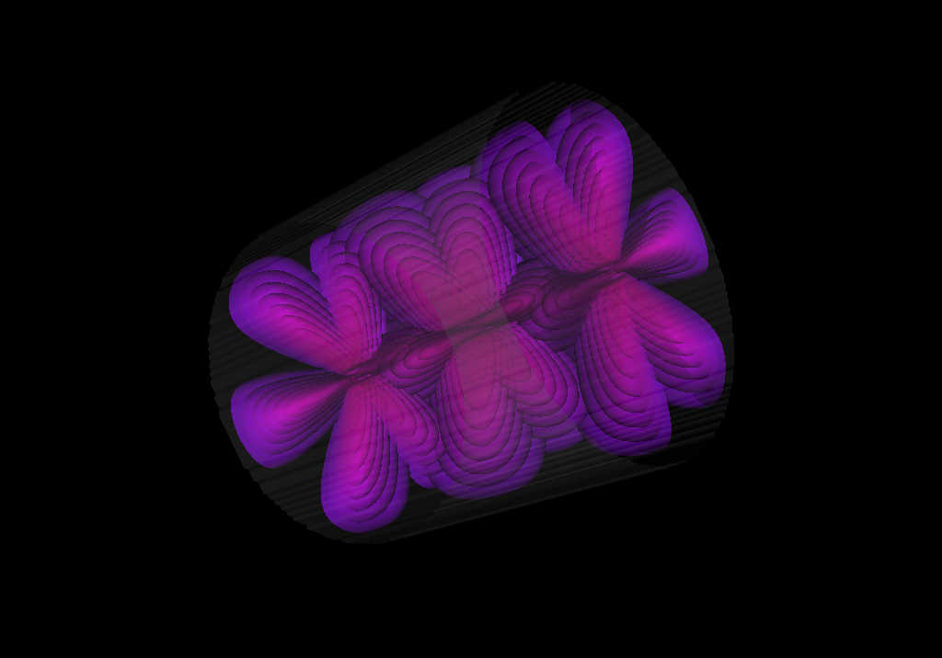

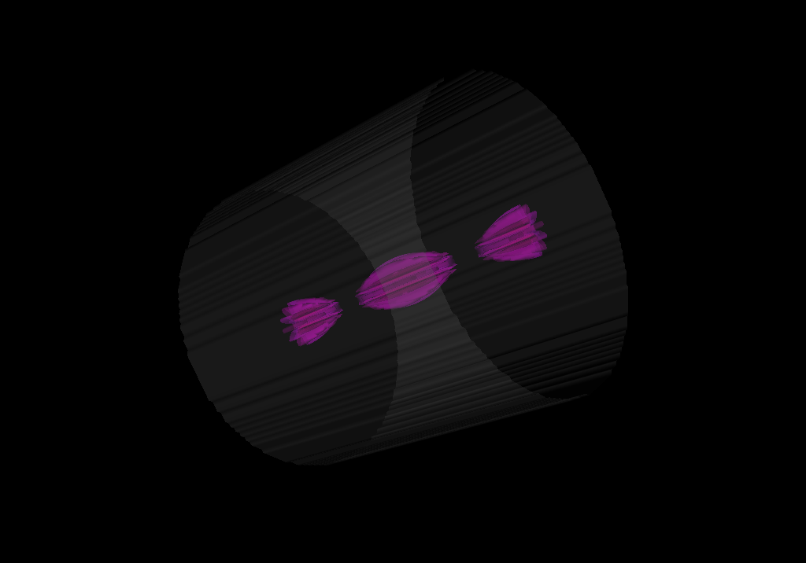
Why HPC: accelerator numerical models span a wide range of physics and scales
Wide range of scales:
  accelerator complex (10³m) → EM wavelength (10²-10 m) → component (10-1 m) → particle bunch (10⁻³ m) → beam in plasma wakefields (10⁻⁸)
Advancing accelerator science requires development of a wide range of mathematical models and numerical algorithms!

Slide 50
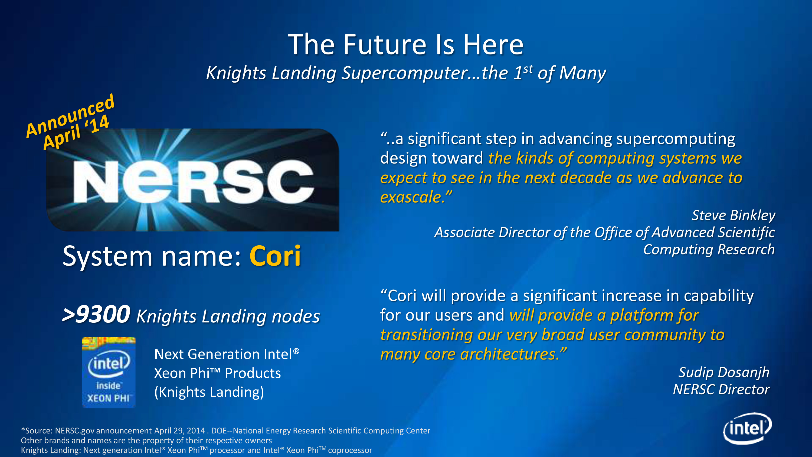
Readiness for exascale computing on new architectures essential for Virtual Accelerator Modeling and Prototyping
Impact (LBNL), Synergia (FNAL), and WARP (LBNL) selected for the NERSC Exascale Science Applications Program (NESAP)
  early access to new architecture with help from NERSC, Cray & Intel staff
Synergia and OSIRIS (UCLA) already ported on GPU and MIC
CAMPA could provide the means to
  Propagate know-how to other codes and, eventually,
  development of common infrastructure optimized for new architectures

Slide 51
MARS
MARS15 is a general purpose Monte-Carlo code for simulation of hadronic and electromagnetic cascades that is used worldwide for shielding, accelerator and detector applications.
  Originated in 1974 at IHEP (Russia) and is developed since early 80’s at Fermilab
  Used in design of numerous accelerator systems and machine-detector interfaces in USA (Tevatron, Main Injector, Muon Collider, ILC etc.), Japan (J-PARC) and Europe (LHC, GSI, PSI, ESS etc).
  Success proven by performance of the above systems and by overwhelming performance in international benchmarking over last two decades.
Current State
  It is unique in quality of description of physics processes from multi-TeV energies down to a fraction of electron-volt, with user-controlled possibilities to enhance certain phase-space regions.
  It is unique in modeling of the 3D magnetic systems ranging in size from many kilometers to microns in the same setup, e.g. the entire 27-km LHC collider with tiny machine and detector components of interest.
  40 MARS installations worldwide with 300 users at ~33 Labs/Universities.

Slide 52
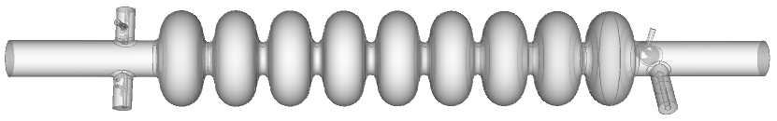
First-Year Accomplishments under CAMPA
LBNL and SLAC have started integrating ACE3P EM and BLAST beam dynamics codes’ simulation capabilities.
ACE3P and IMPACT for beam dynamics simulations with realistic models of electromagnetic elements - Impacts our ability to confidently predict performance including nonlinear effects.
Cavity geometry modeled with ACE3P to produce a 3D field map, followed by IMPACT tracking of a low energy beam using the field map
BLAST codes integration for electron cloud simulation
  Modularization of IMPACT mapping routines for future inclusion in multibunch Warp-Posinst ecloud effects simulations
ACE3P and Posinst for secondary electron emission
    Enables high fidelity modeling of realistic secondary electron emission provided by Posinst on accurate representation of cavity surface in ACE3P simulation.
  User support including email & phone exchanges, documentation and workshops

