Slide 1
Muon Accelerator Activities for the General Accelerator R&D Portfolio presented to the HEPAP Accelerator R&D Sub-Panel
Mark Palmer
Fermilab
August 27, 2014

Slide 2
Outline
P5 Context and MAP
Context of Proposed Work
Proposed Activities
Advanced Concepts for Muon and Neutrino Sources
RF in Magnetic Field
Conclusion

Slide 3
P5 Context and MAP

Slide 4
Muon Accelerator Activities in GARD
P5 Recommendations Relevant to Muons
Recommendation 25: Reassess MAP. Incorporate into the GARD program the MAP activities that are of general importance to accelerator R&D, and consult with international partners on the early termination of MICE.
Recommendation 26: Pursue accelerator R&D with high priority at levels consistent with budget constraints. Align the present R&D program with the P5 priorities and long term vision, with an appropriate balance among general R&D, directed R&D, and accelerator test facilities and among short-, medium-, and long-term efforts. Focus on outcomes and capabilities that will dramatically improve cost effectiveness for mid-term and far-term accelerators.

Slide 5
Other Relevant P5 Comments
Neutrino Factories in the Report:
Neutrino factories based on muon storage rings could provide higher intensity and higher quality neutrino beams than conventional high power proton beams on targets. This concept would be attractive for an international long-baseline neutrino program offering more precise and complete studies of neutrino physics beyond short-term and mid-term facilities.
The construction of PIP-II and the beamline for LBNF will be major advances in accelerator technology in the areas of SCRF and targetry and lay the foundation for a possible future neutrino factory.
Comments from Joe Lykken addressing the MAP Collaboration https://indico.fnal.gov/getFile.py/access?contribId=13&sessionId=0&resId=0&materialId=slides&confId=8326
“This was a programmatic recommendation about the advisability of carving out MAP as a directed R&D program, versus supporting MAP activities within GARD”
“The P5 plan launches the U.S. toward a long term comprehensive neutrino program”
“This program should include a home for people thinking about neutrino factories”

Slide 6
Context of proposed work

Slide 7
The Issues I
Precision and Accuracy
The usual metric for a neutrino experiment: Beam Power × Detector Mass × Operation Time
Ultimately, the validity of our oscillation measurements is determined by our:
Understanding of the source (ie, the beam)
Understanding of the interactions in the detector
And neutrino oscillation experiments are targeting understanding at the <1% scale
In disappearance measurements, strong cancellation of systematics can be achieved by measuring:
The event rate before oscillation at near detector
The oscillated event rate at a far detector which has identical technology and acceptance
In appearance measurements, this cancellation does not apply, and one requires:
Precise knowledge of the source flux
Precise knowledge of the energy-dependent cross-section × efficiency, σ_{α}(E)ε_{α}(E), for each mode

Slide 8
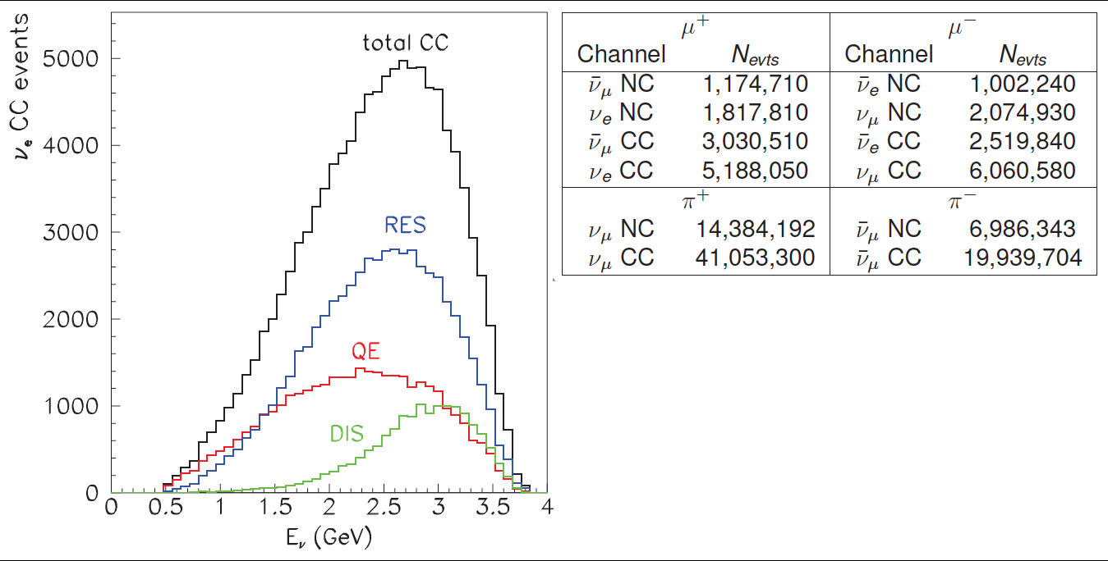
The Issues II
Generally, 1% level understanding appears to be a significant challenge for ν superbeams
Muon beams can provide sources of neutrinos that have both precision and accuracy
High production rates
Well-understood source systematics
Precisely measured beams (to <1%)
With automatic cross-checks
Interlocking appearance, disappearance and conjugate modes
Thus leading to the best possible measurements…
Example: nuSTORM Collaboration, 2013

Slide 9
Performance Benefits from Precision ν Sources

Slide 10
Proposed Activities

Slide 11
The Proposed Activities
While a directed facility R&D effort no longer fits within the US HEP portfolio, MAP management feels that two component activities that are key to enabling a long-term neutrino factory capability deserve consideration for GARD funding starting in FY16:
MAP’s Muon Accelerator Staging Study has identified a staged and more cost-effective approach to achieving NF capabilities. The design effort for these capabilities is closely aligned with plans for US long baseline neutrino capabilities. Thus, research into Advanced Concepts for Muon and Neutrino Sources should be continued to ensure an optimal path beyond LBNF.
Key progress has been made over the last 3 years to provide the necessary technology solutions for the cooling channels required to provide high brightness muon beams. The RF in magnetic field R&D program is at a critical junction in terms of developing our understanding of operating high field RF cavities in magnetic fields. Thus, these efforts should be continued to obtain the next set of experimental results and enable an option for muon accelerator based capabilities beyond LBNF.

Slide 12
Activity 1: Advanced Concepts for Muon and Neutrino Sources
The long-term future of our domestic HEP program is now firmly focused on short- and long-baseline neutrino physics capabilities
As noted by P5, while the near-term effort may not require NF capabilities, these capabilities point the way to controlling systematics, thus providing the ultimate high precision and accuracy measurements for the field.
Thus we feel that there should be a GARD-supported activity to
Continue to develop these concepts;
Ensure that a viable path to these capabilities is preserved within the US program; and
Enable their implementation when they are needed

Slide 13
High Intensity Muon Sources
High Intensity R&D Activities:
Energy deposition
Gas-filled cavities in buncher/rotator
Cost/performance tradeoffs

Slide 14
Bright Muon Sources
MAP cooling effort has been remarkably successful
Technology: experiments show
HPRF can prevent breakdown & operate at high beam intensity
dielectrics have the potential to reduce cavity size in cooling systems
careful cavity design prevents continuous gradient loss at high B
Design:
realistic designs to "bottom" of cooling diagram cool ε_{6D} by 5 orders of magnitude!
In contrast to MAP cooling effort which considered entire cooling system for collider, the refocused effort under GARD would emphasize this region which impacts the cost, staging and performance of a future neutrino factory
Would also enable consideration of other potential applications of cold muons such as a Mu2e upgrade

Slide 15
An Advanced Neutrino Source
NuMAX Staging:
Commissioning
1MW Target
No Cooling
10kT Detector
NuMAX+
2.75 MW Target
6D Cooling
34kT Detector

Slide 16
Summary: Advanced Concepts for Muon and Neutrino Sources
Bright muon sources serve as the basis for the ultimate neutrino source capabilities
A small and tightly focused effort to continue the design and simulation efforts warrants consideration in the GARD portfolio
Estimated effort in FY16: 8 FTEs
This effort will also serve to ensure that plans maintained in a consistent fashion with the evolution of the Fermilab accelerator complex
Thus ensuring that a viable option to achieve these capabilities is preserved

Slide 17
Activity 2: RF in Magnetic Field R&D
Muons have short lifetime (2.2 μs @ rest) and must be manipulated quickly
High gradient RF cavities compensate for lost longitudinal energy in low Z absorbers
Strong magnetic field to confine muon beams
LH Absorbers
RF Cavities
SC magnets

Slide 18
RF Thrusts in MAP
Mission:
Design, construction and testing of high gradient NCRF cavities and demonstrate their RF operation in strong magnetic field.
Goals:
∼ 25 MV/m at 805 MHz @ 3T
∼ 16 MV/m at 201 MHz @ 3T
Thrusts:
Vacuum RF cavity development
Utilize SCRF surface preparation
Detailed simulation to characterize performance-limiting issues in magnetic field
High Pressure gas RF cavity
Suppress the effects of dark current with HP H₂ gas
Using HP H₂ gas to cool muons
Support for the implementation of the MICE RF system

Slide 19
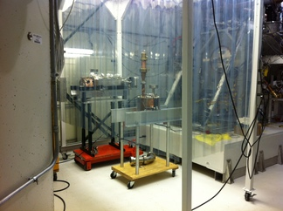
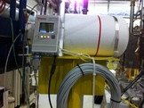
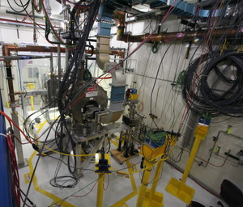
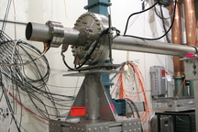
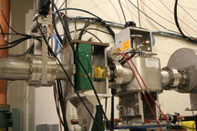
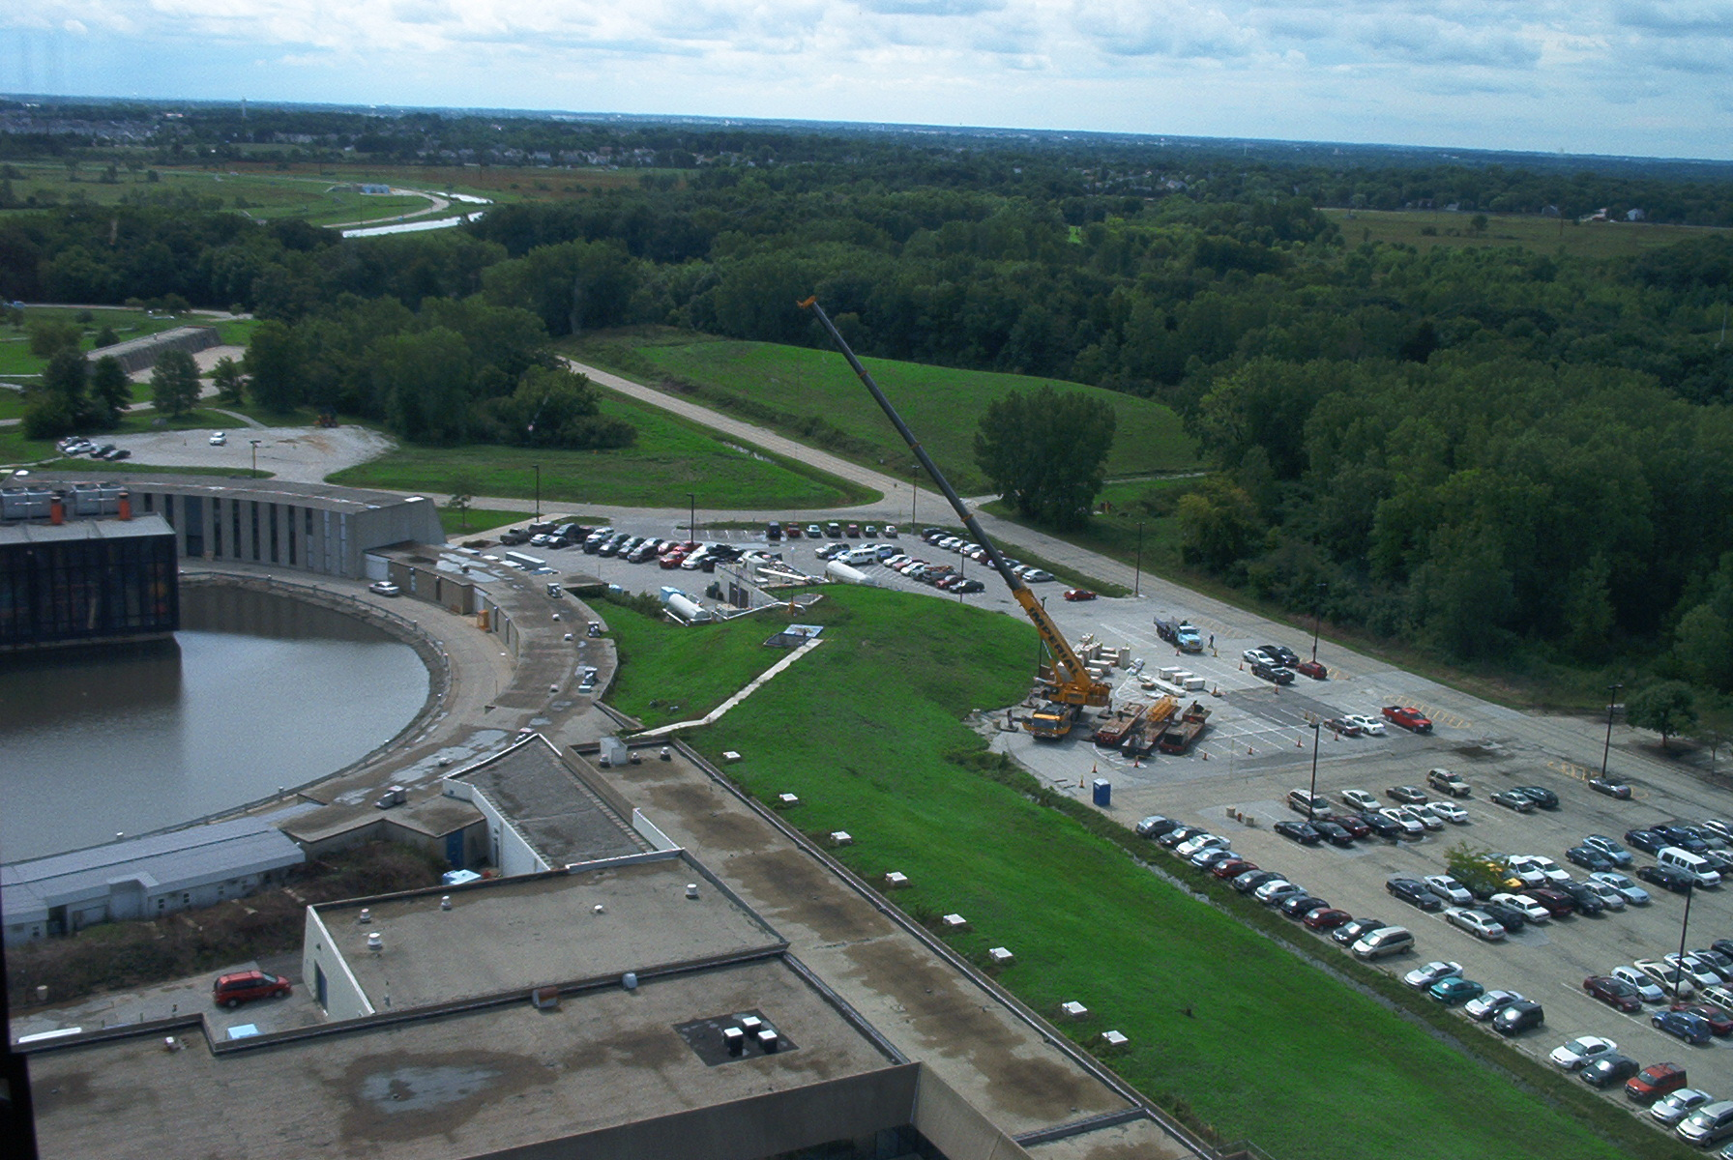
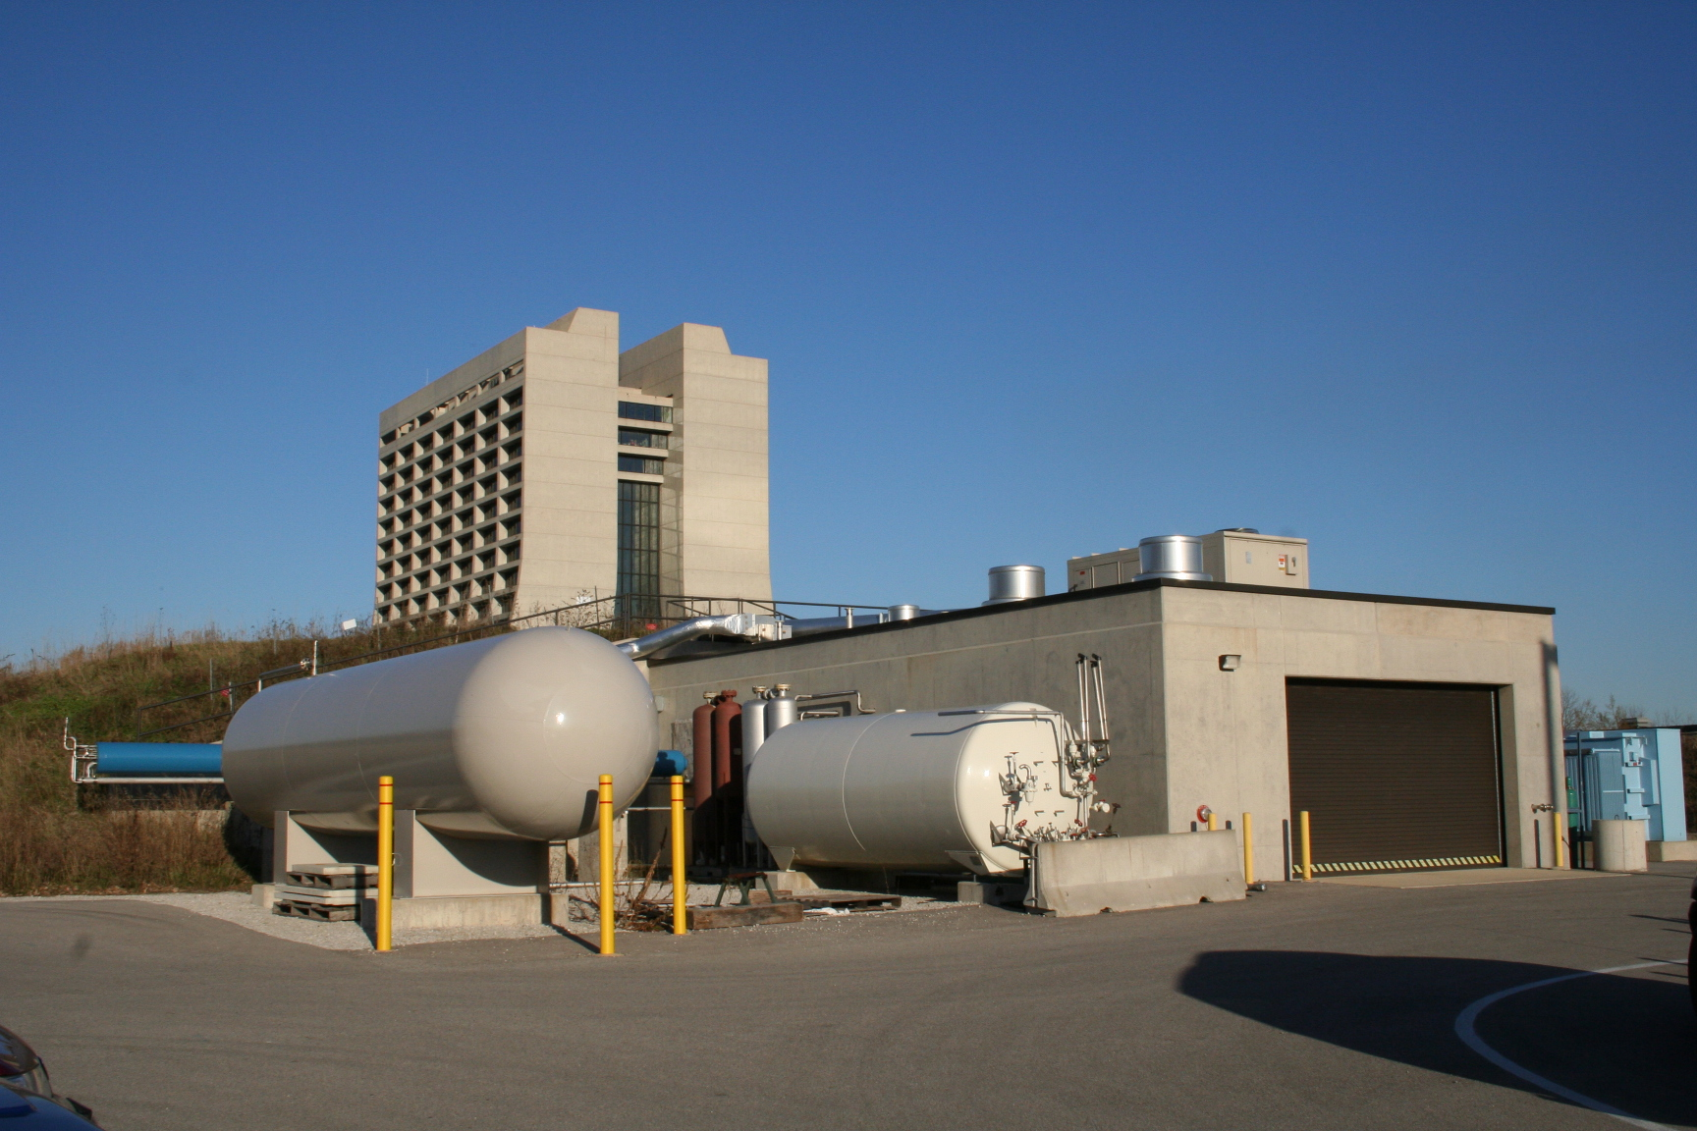
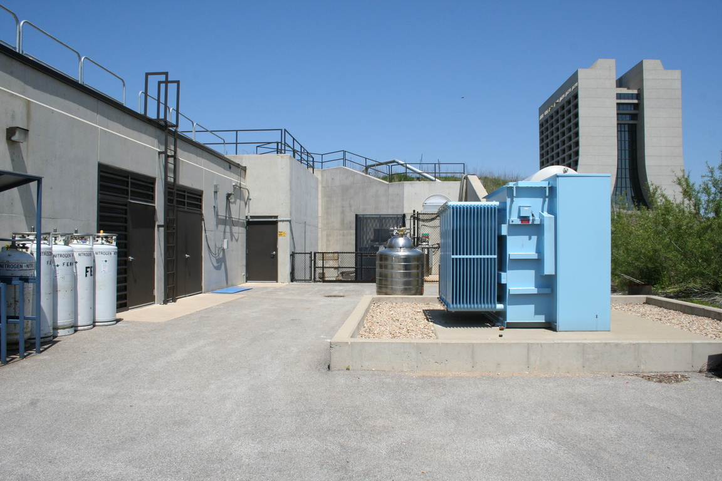
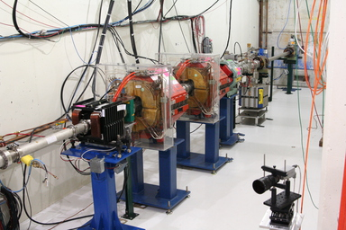
MuCool Test Area (http://mice.iit.edu/mta/)
Dedicated facility at the end of the Linac for MuCool R&D
RF power
12 MW @ 805 MHz
4.5 MW @ 201 MHz
Large-bore 5T SC solenoid
Larger one (CC) on the way
Cryogenic plant
400-MeV H⁻ beamline
Class-100 portable clean room
H₂ safety infrastructure
Extensive diagnostics
Combination of capabilities unique in the world
Well-matched to the proposed program

Slide 20
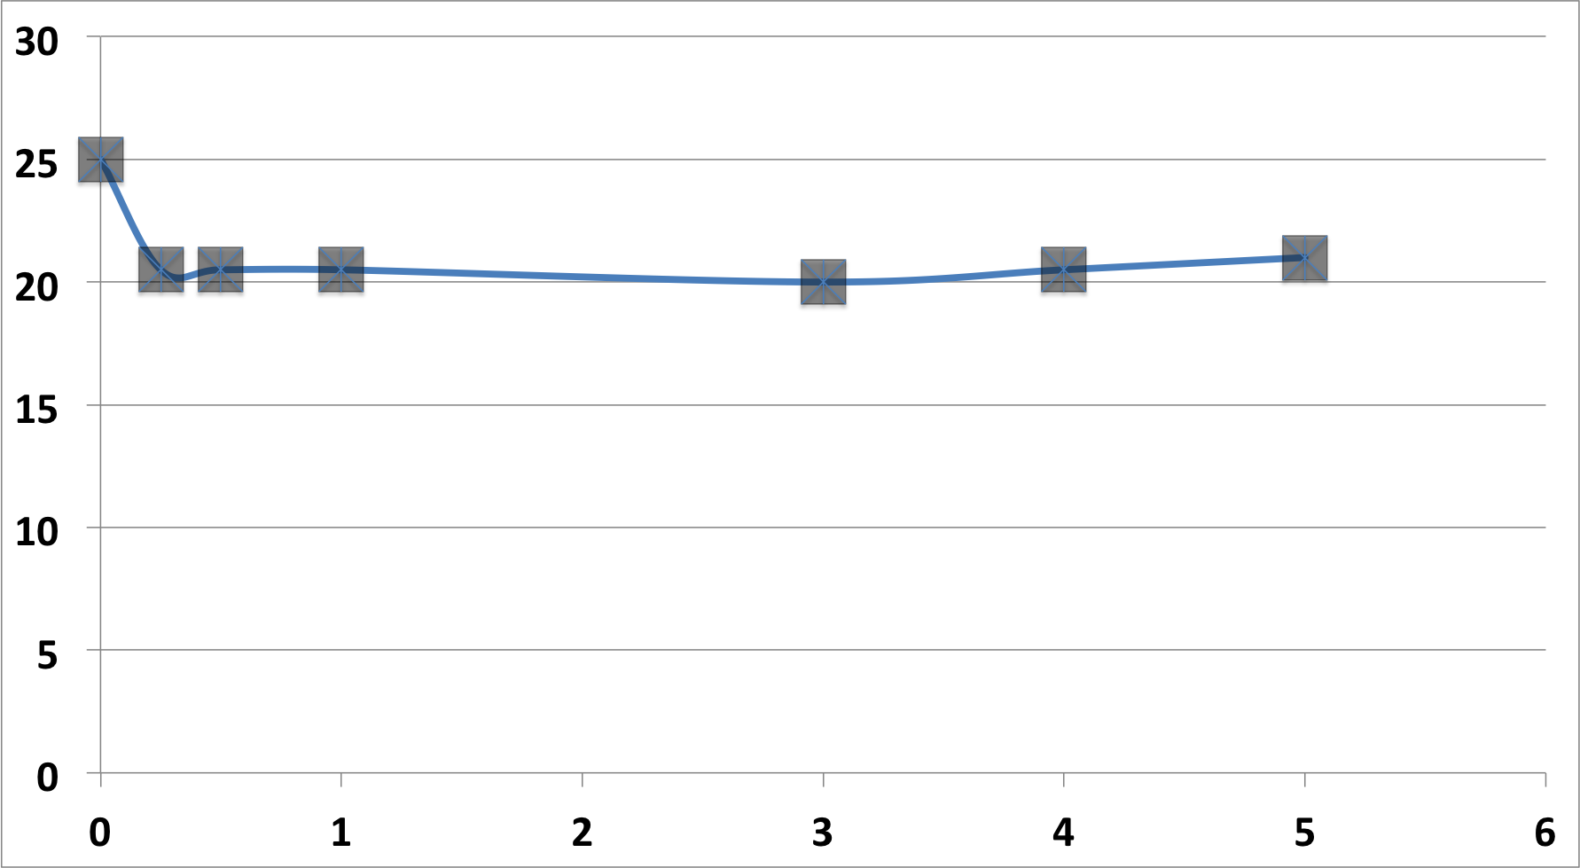
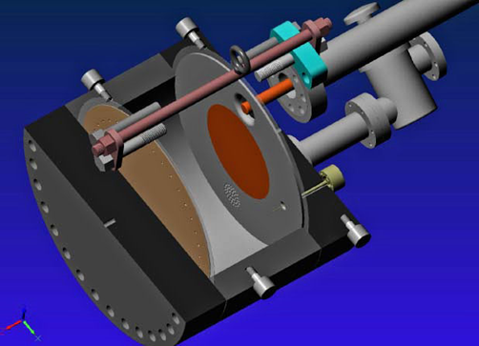
Recent Vacuum RF Cavity R&D Results
Study a new structure: All Seasons Cavity (ASC)
Modular pillbox with replaceable endplates
Designed for both vacuum and high pressure
316SS with 25-um Cu coating and 3.9/6.6/2.7-cm-thick center ring/outer/inner plates
Q ∼ 28k, frequency 810.+ MHz and 1.2 MW @ 25 MV/m
In contrast to tests with earlier cavities, the ASC performance is consistent with our basic physics model for cavity operation in magnetic fields
Max. Stable gradient (MV/m)
Operated in magnet: 25 MV/m at B=0
Re-run with RF pickup
Confirmed B=0 data 20-22 MV/m to 5T
B(T)

Slide 21
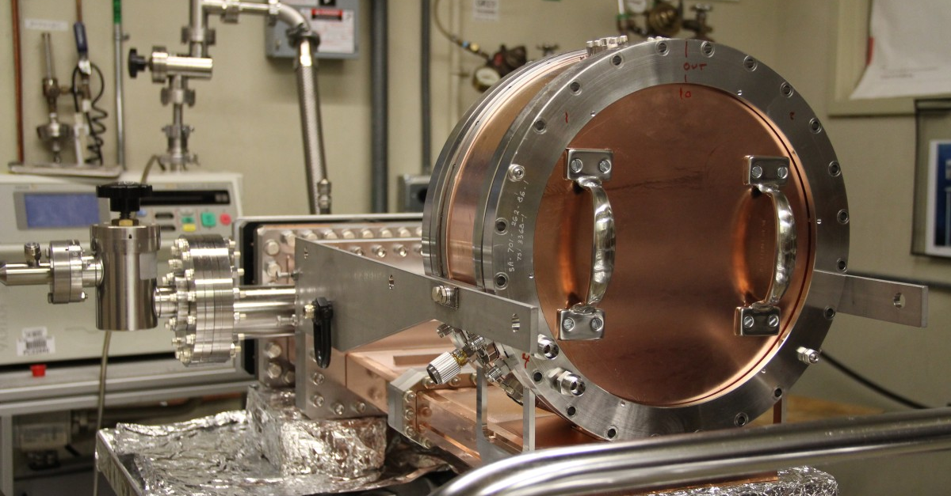
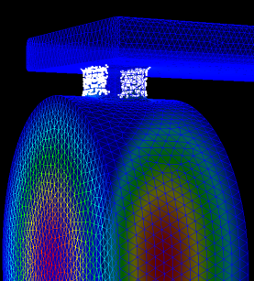
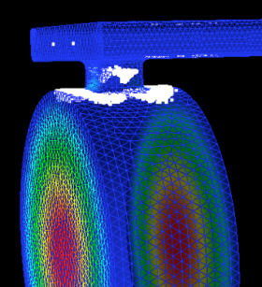
The Modular Cavity Design
Previous vacuum cavity experimental results limited by field emission/dark current at high peak field regions (coupling slot and iris)
Surface damage at coupling slot and beam iris regions
Contaminated coaxial & loop coupler/ceramic RF windows (201-MHz)
Develop a new cavity to enable a systematic experimental study of the gradient-limiting and damage effects
Modular design for easy assembly, inspection, parts replacement
Replaceable endplates (vary materials and surface treatments)
Coupling iris moved to center ring and field reduced (more realistic design for a cooling channel)
RF design validated by detailed simulation
Design incorporates all lessons learned
Ready to begin systematic test program
MP with & without external B field

Slide 22
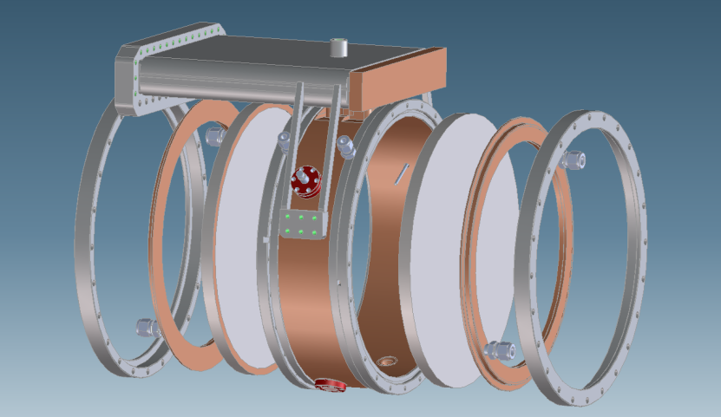
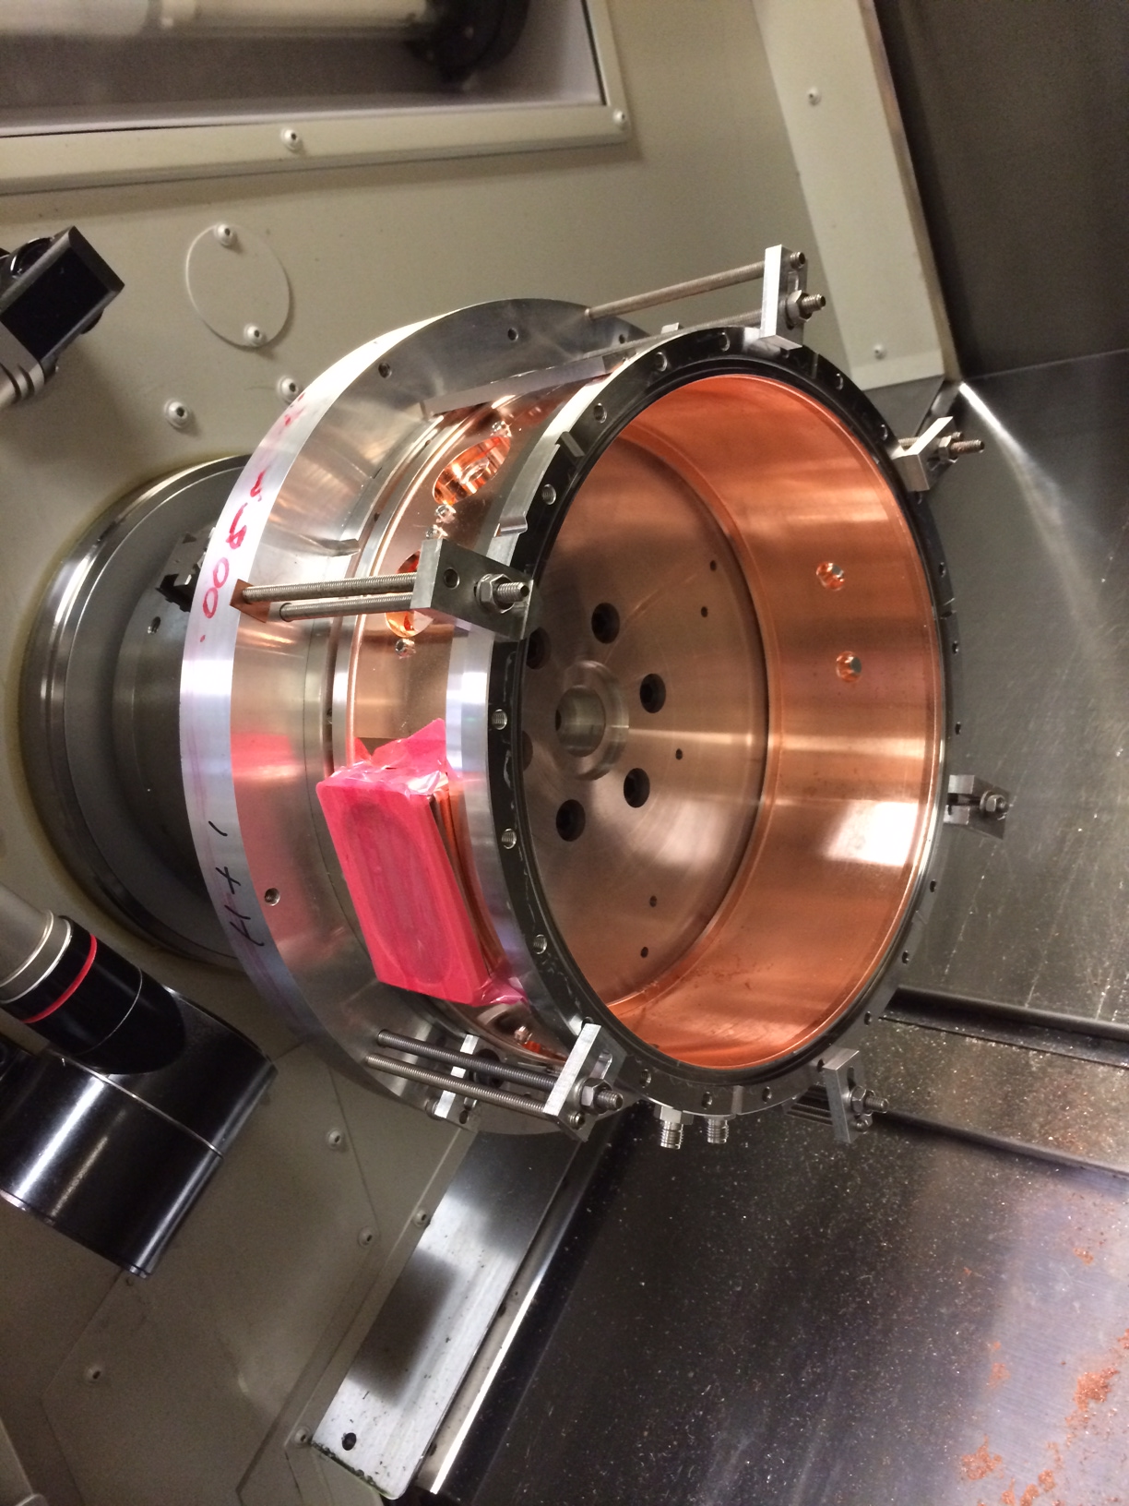
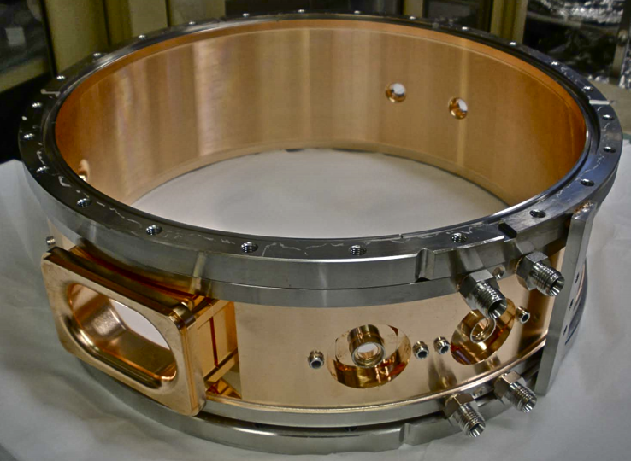
Cavity Preparation at SLAC [Now at FNAL being prepped for operation at the MTA]

Slide 23
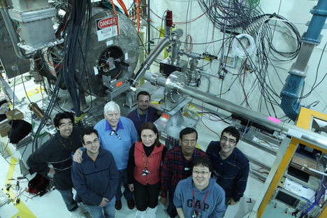
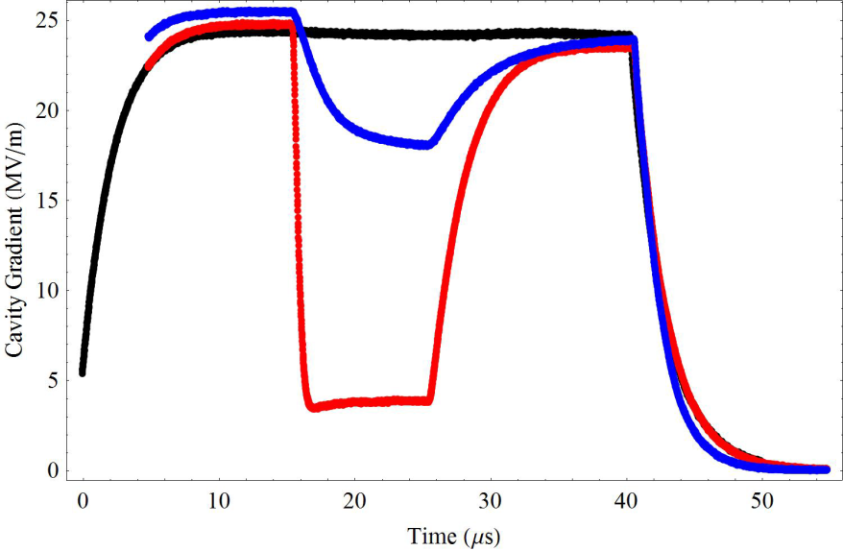
High Pressure H₂ Filled RF Cavity
HPRF demonstrated a solution for RF in a strong magnetic field
Fundamental Question: “What happens when intense beam passes through cavity?”.
Beam testing at MTA and testing results published
M. Chung et al., PRL 111, 184802, 2013
Quantitative theory validated by measurement of energy in H2/D2+dopant
Electronegative dopants turn mobile ionization electrons into heavy ions, reducing RF losses by large factor
Beam
1470psi H₂ a w/beam a add 1% dry air

Slide 24
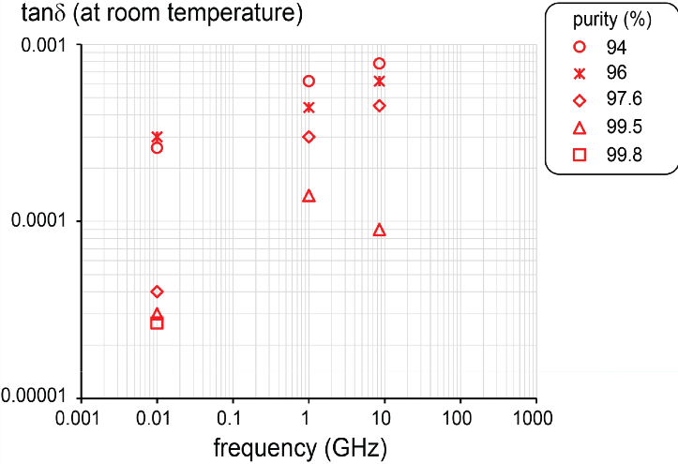
High Pressure H₂ Filled RF Cavity
We have demonstrated an ionization cooling solution using HPRF cavities
The results extrapolate well to Neutrino Factory operation (and to a range of MC beam parameters)
Includes beam-induced plasma loading of the RF system
Bunch intensity limits evaluated
Compact dielectric-loaded HPRF cavity structures represent the next key step in development
Dielectric material tested up to equivalent of ∼ 25 MV/m on axis acceleration gradient with 99.8 % Al2O3 (Alumina) (Dr. K. Yonehara)
New Test Result (FY14): Alumina
▵
This measurement
(Preliminary)
▵ 99.5

Slide 25
Summary: RF in Magnetic Field R&D
Completing key elements of the MAP-developed experimental program in the MTA are key to enabling a future muon accelerator capability a NF option as noted by P5
Furthermore these studies will expand our fundamental understanding of breakdown behaviors in RF cavities
Important fundamental knowledge for accelerator physics
Taking the present opportunity to leverage the investment in capabilities that has been made in the MTA would be a wise GARD investment
Estimated FY16 Effort: ~10 FTEs
Re-constituting the full range of MTA capabilities non-trivial if abandoned
Critical results achievable on the 2-3 year timescale

Slide 26
Conclusion
With the recent P5 recommendations, the US HEP program is focused on the delivery of long- and short-baseline neutrino oscillation capabilities
Enabling the precise and accurate measurements required for a long-term future likely rests on the development of muon accelerator capabilities
The two activities that we have proposed for inclusion in the GARD portfolio starting in FY16 both represent enabling research to be able to deploy those capabilities when required
Recommendation from August 12-14, 2014 DOE Review: “Move forward with Non-MICE MAP activities according to normal DOE R&D guidelines within the advanced concepts activities of GARD.”
[Also see the supporting materials uploaded along with this talk]

