Slide 1
SRF Science:
Discoveries and New Horizons
Alexander Romanenko
Fermilab
27 Aug 2014

Slide 2
What is SRF Science about?
Surface resistance
Q ~ 1/R_{s}
  R_{s}(T) = R_{BCS}(T) + R_{residual}
Fundamental part described by Bardeen-Cooper-Schrieffer (BCS) theory
Residual resistance due to other contributions

Slide 3
Outline
Two recent transformational breakthroughs at Fermilab
  Surpassing fundamental BCS limit for RF losses!
    Ultra-high Q by doping
    Game changing implications
  Further reduction of RF losses by magnetic flux expulsion
    Lowering residual resistance
Nb3Sn – proof-of-principle for Q>10¹⁰ at 4.2K operation at 1.3 GHz
Understanding the science (new physics) behind the breakthroughs
  Near, mid, long term R&D outline
Multidisciplinary effort: superconductivity, materials science
Collaboration with universities
  Wide network
    Cornell, SLAC, JLab, ANL, UIUC, UChicago, MSU, IIT, NHMFL, SLAC (USA); TRIUMF, UBC, Western Univ, Univ of Toronto (Canada); PSI, CERN (Switzerland); INFN (Italy); DESY, HZB (Germany)
  5 PhD students in Basic SRF R&D at FNAL alone

Slide 4
First revolution
Surpassing the BCS limit for RF losses by doping

Slide 5
Nitrogen doping: a breakthrough in BCS resistance (Q)
Record after nitrogen doping – up to 4 times higher Q!
This was the highest Q possible up to last year
Standard state-of-the art preparation
1.3 GHz
A. Grassellino et al, 2013 Supercond. Sci. Technol. 26 102001 (Rapid Communication) – selected for highlights of 2013

Slide 6
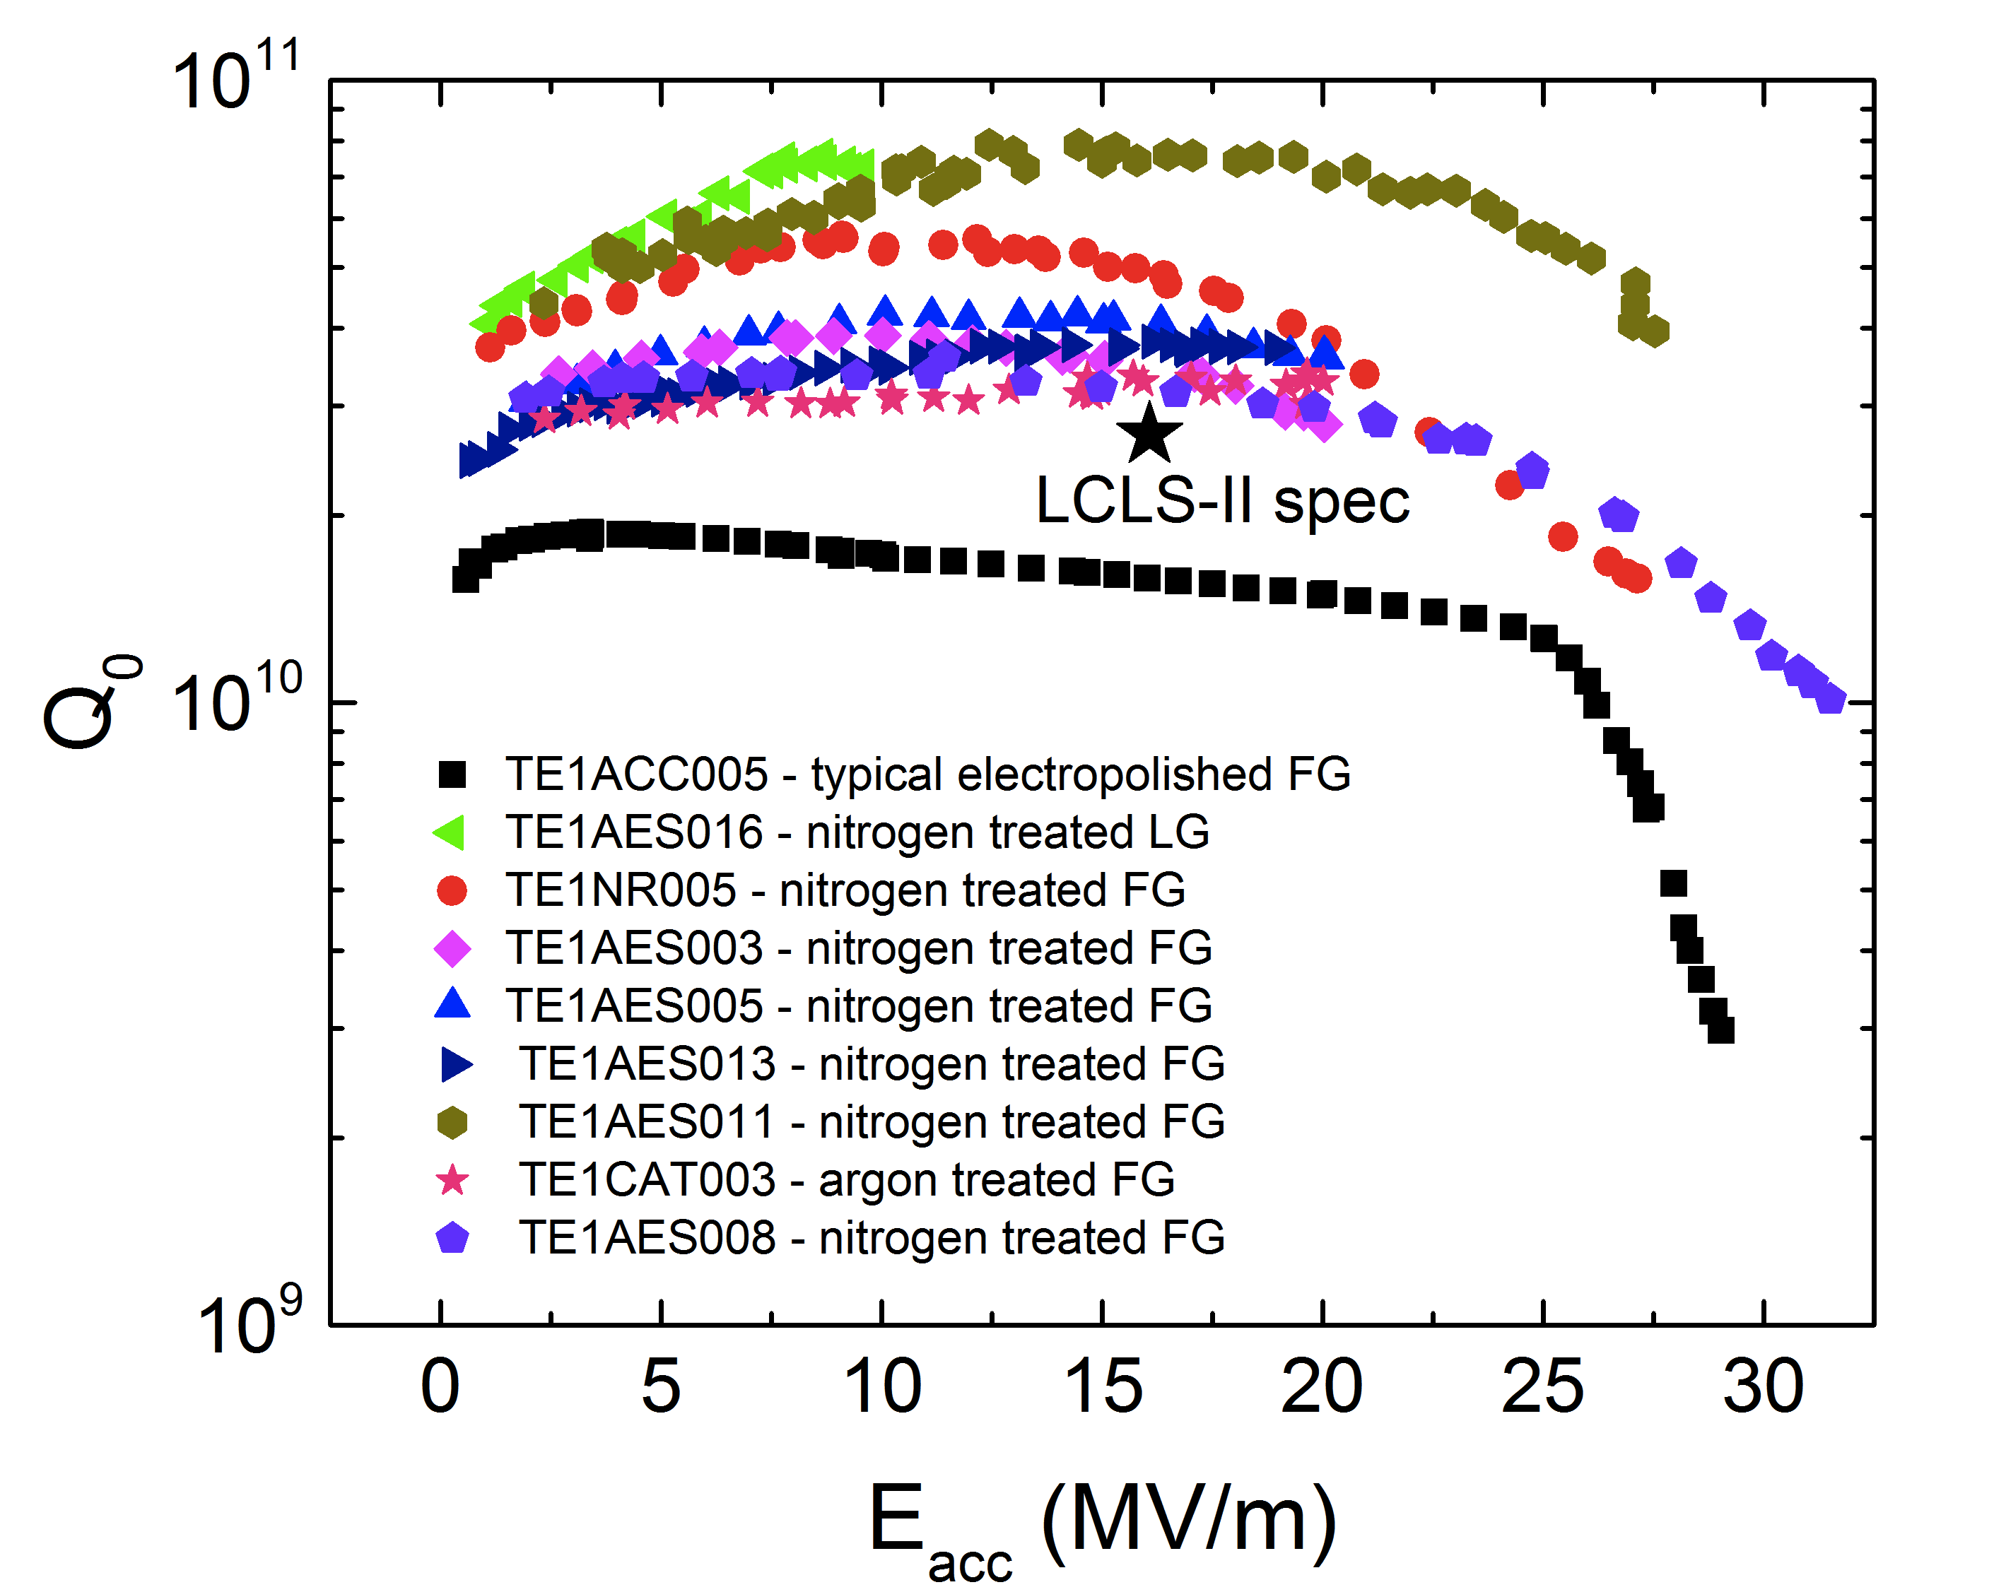
Nitrogen doping – process is reproducible
Record Q
Injection of small nitrogen partial pressure at the end of 800C degassing, followed by EP-> drastic increase in Q
Anti-Q-slope
Demonstrated on many 1-cell and 9-cell 1.3 GHz cavities
T=2K
A. Grassellino et al, 2013 Supercond. Sci. Technol. 26 102001 (Rapid Communication)

Slide 7
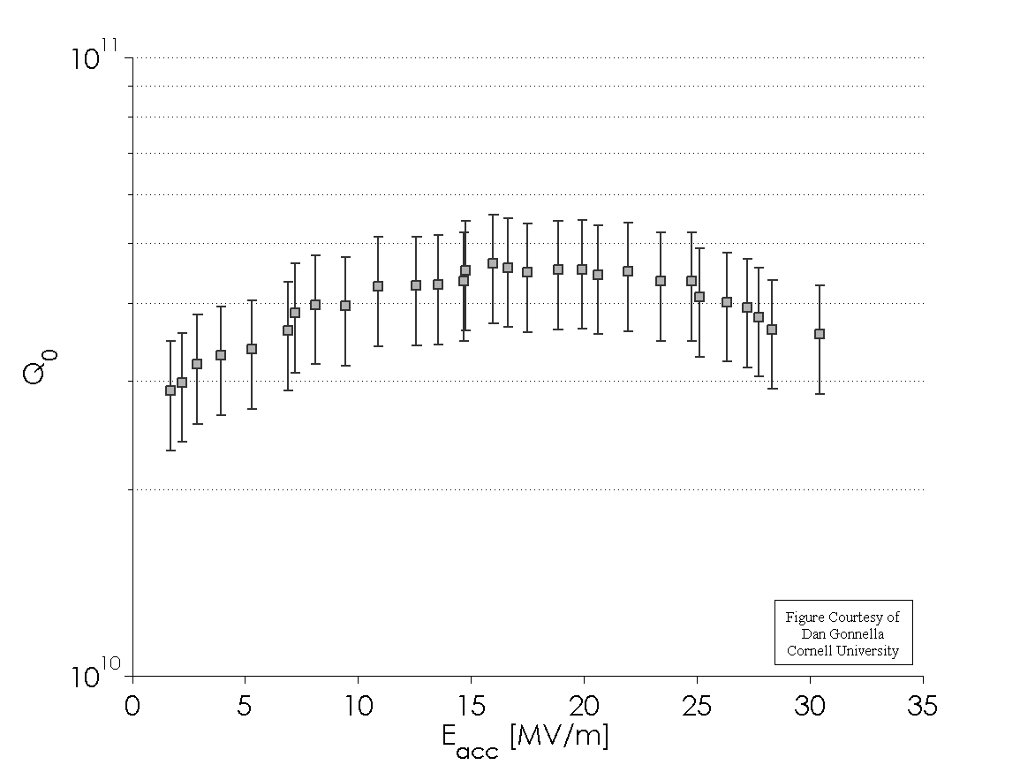
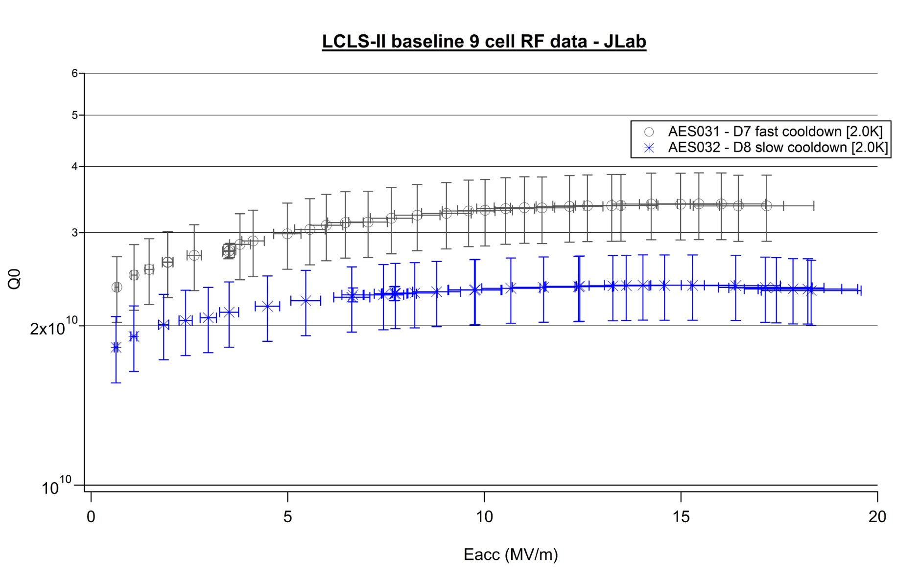
Reproduced at other labs in 1- and 9-cells
Cornell
JLab

Slide 8
Physics - BCS limit has fallen – WHY? WE NEED TO FIND OUT
Anti-Q-slope emerges from the BCS surface resistance decreasing with field
This is what BCS theory predicted to be the lowest possible surface resistance -> we breached it!
A. Grassellino et al, 2013 Supercond. Sci. Technol. 26 102001 (Rapid Communication)
A. Romanenko and A. Grassellino, Appl. Phys. Lett. 102, 252603 (2013)

Slide 9
Implications
LCLS-II at SLAC
  Adopted N doping as a baseline
    2x higher Q leads to a factor of 2 decrease in required refrigeration => 1 cryoplant less = savings of ~50-100M$ in capital costs + 10s of M$ in operational costs
PIP-II at FNAL
  Increase of duty factor from 5% to 30% desired by Mu2e becomes possible with doubling the Q
In general, CW operation becomes possible for short-pulse machines => future high power beams
High gradient/high Q becomes possible => future e+e- machines at drastically reduced costs

Slide 10
Second revolution
Achieving the ultra-low residual resistance by efficient flux expulsion

Slide 11
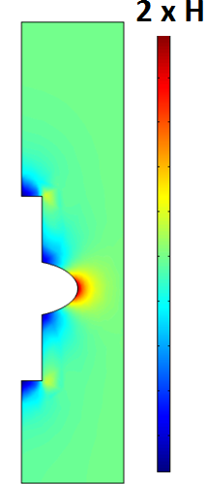
Magnetic probes reveal the new physics
Full expulsion of the magnetic field should give ~2x higher field at the equator in superconducting state
It turns out the expulsion efficiency can be controlled by the cooldown procedure (fast/slow, uniform or not)
Efficient flux expulsion
H
Poor flux expulsion
Fluxgate
magnetometers
A. Romanenko, A. Grassellino, O. Melnychuk, D. A. Sergatskov, J. Appl. Phys. 115, 184903 (2014)

Slide 12
Leads to high Q
Flux expelled efficiently
Flux mostly trapped

Slide 13
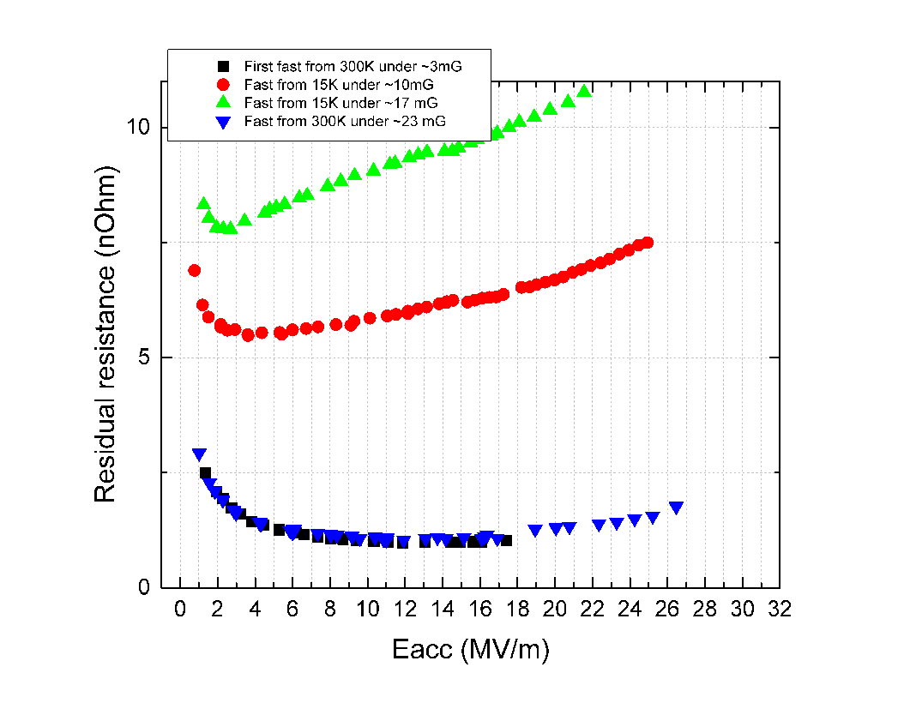
Optimal cooling conditions produce record high Qs even when ambient fields are large – WHY? WE NEED TO FIND OUT
Q=2.7e11 in 23mG!

Slide 14
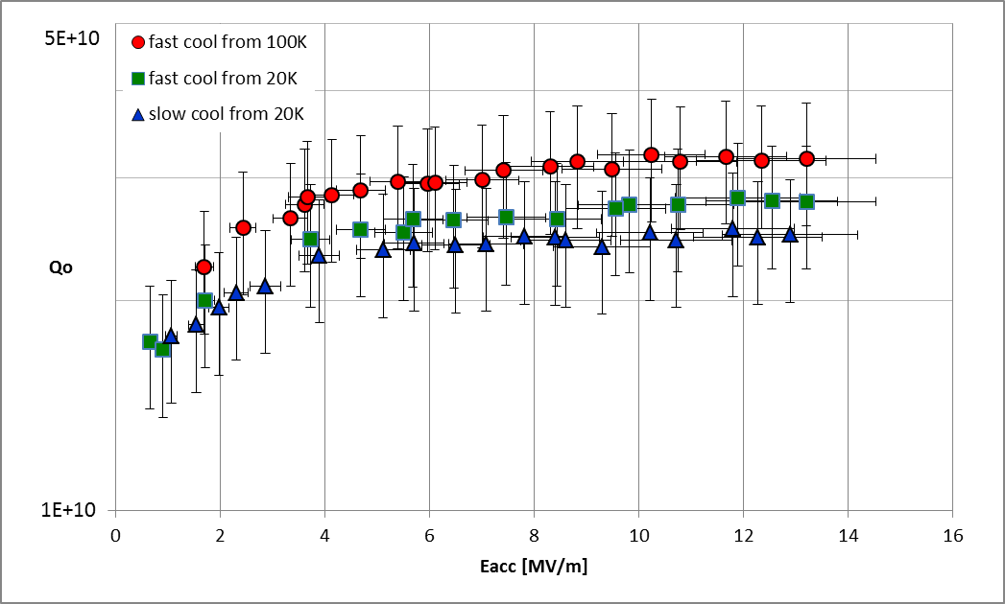
Confirmed at Cornell and JLab
Cornell HTS data on a 9-cell
JLab VTS data on a 9-cell

Slide 15
Third revolution on the way?
High Q Nb3Sn at 4.2K

Slide 16
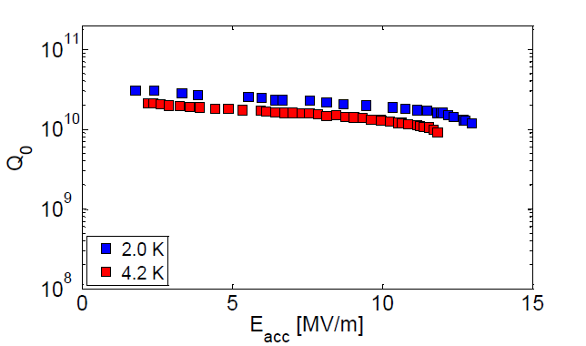
Nb3Sn instead of Nb
Performance at 4.2K comparable to Nb at 2K!
We need to extend this to 30+MV/m
Cornell University
Courtesy of S. Posen

Slide 17
Our plan to uncover physical mechanisms

Slide 18
What is BCS missing?
B.P. Xiao, C. Reece, M. J. Kelley from JLab and College of William and Mary
  Momentum of Cooper pairs leads to an inversed field dependence of R_{BCS}?
  [B.P. Xiao et al, Physica C 490 (2013) 26-31]
A. Gurevich from ODU
  Time-dependent density of states leads to the effect?
  [A. Gurevich, Phys. Rev. Lett. 113, 087001 (2014)]

Slide 19
Understanding the role of doping – future plan
Understanding will show us what the ultimate limits are
  Guide us to best parameters or even higher Qs
R&D plan
  Short term
    Surface analytical studies on N treated samples and cavity cutouts
    Magnetic, electric, and thermal measurements to characterize the doping-induced changes
    Temperature mapping
  Mid term
    Explore other dopants (He, O, …)
    Explore other frequencies – is there a sweet spot?
    Doping also lowers residual resistance, we need to understand how and why
  Long term
    Extend the “high Q” miracle to high fields
      Understanding the localized quench origin
      May be coupled with new cavity shapes

Slide 20
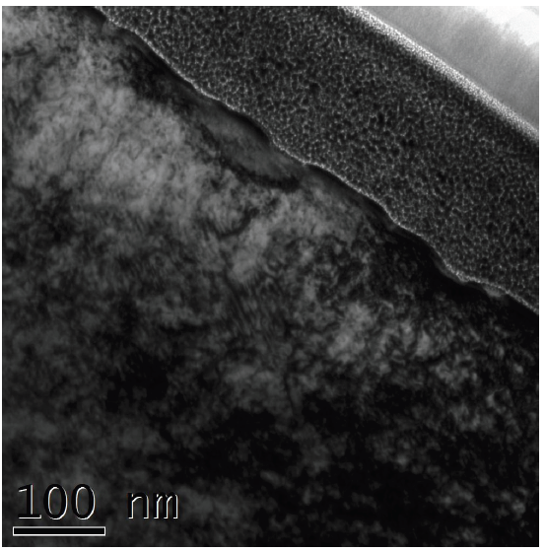
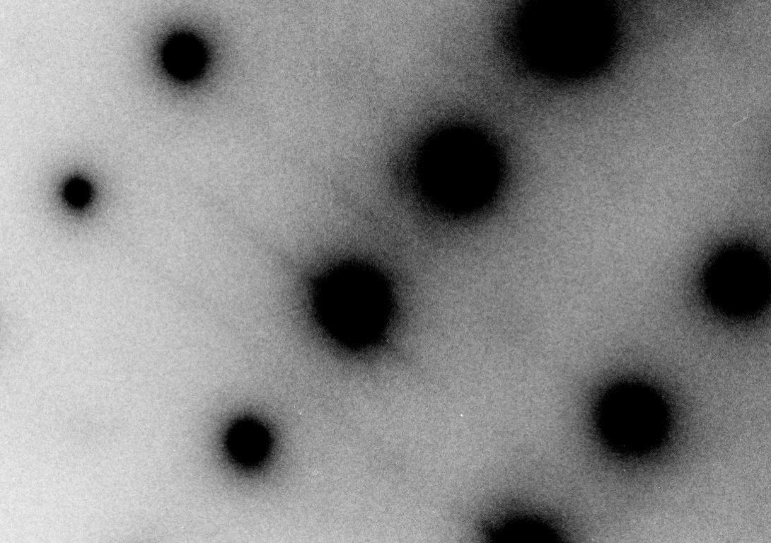
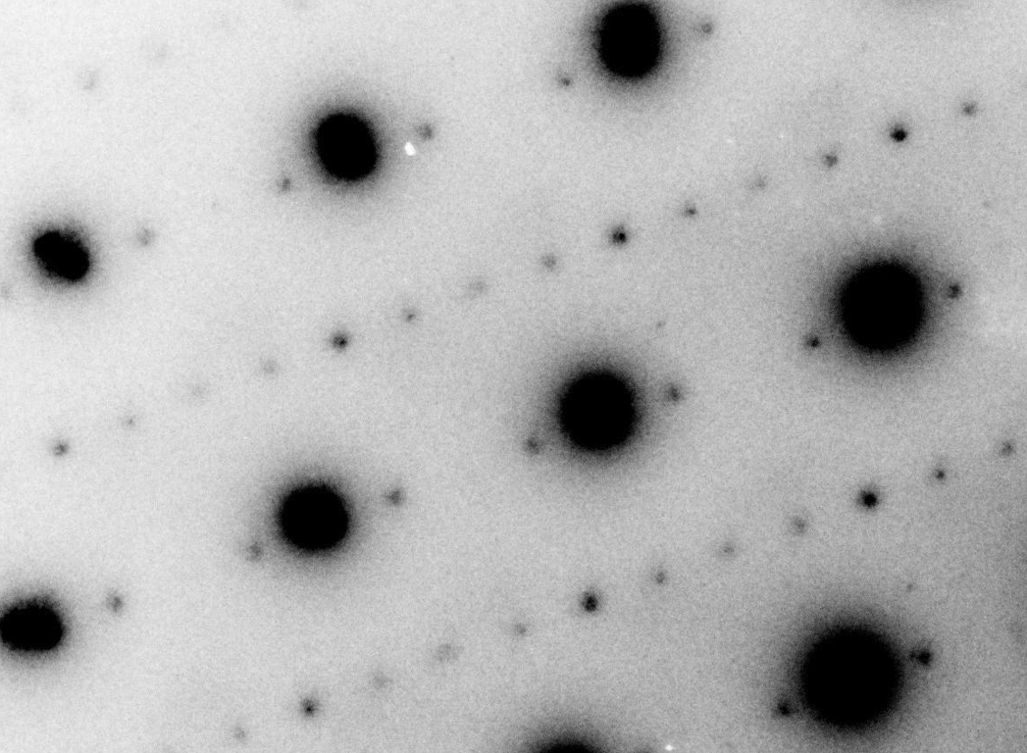
Nanostructural studies provide first clues
From current PhD thesis work of Y. Trenikhina (IIT/FNAL):
TEM on FIB-prepared cutouts
Electron diffraction patterns from the penetration depth taken at 94K reveal the difference
Cavity surface
Doped Nb
Nb lattice
Penetration depth
Secondary diffraction peaks appear signalling the formation of lossy niobium hydrides
Nb
Nb lattice
Non-doped Nb
Nitrogen doping may fully trap hydrogen => only intrinsic Nb behavior is then manifested?

Slide 21
Fundamental superconducting properties tell more
Muon spin rotation (muSR) on Nb pioneered at TRIUMF, now employed to measure the penetration depth
Penetration depth shorter than for standard treatment for ILC, corresponds to “intermediate” purity (electron mfp ~ 40 nm)
A. Romanenko et al, Appl. Phys. Lett. 104, 072601 (2014)

Slide 22
Low residual by flux expulsion – R&D plan
Near term
  Understand the depinning mechanism for flux expulsion
  Experiments with controlled thermal gradients (heaters) to map out in detail the required dT/dx and dT/dt
Mid term
  Explore if other methods of flux depinning may assist the thermal mechanism of flux expulsion (e.g. Lorentz force with RF or DC current)
Long term
  Develop effective strategies to relax magnetic shielding requirements for the future high intensity and high gradient accelerators

Slide 23
Nb3Sn – R&D plan
Near term
  Investigations of the temperature and field dependence of residual and BCS surface resistances to determine if the physics is similar to that of Nb
Mid term
  Temperature mapping diagnostics of cavities during rf tests to determine weak performing spots
  Dissect and analyze by surface analytical tools to determine gradient improvement strategies
Long term
  Re-iterate steps above until gradients above 80 MV/m can be demonstrated

Slide 24
Estimated FNAL Resources Need
 |  | FY15 | FY16 | FY17 | FY18 | FY19 | FY20
SRF Science Underlying the Performance of Superconducting Cavities | SWF | 1000 | 1020 | 1040 | 1061 | 1082 | 1104
 | M&S | 1000 | 1020 | 1040 | 1061 | 1082 | 1104
 | FTE | 4 | 4 | 4 | 4 | 4 | 4
 | **SUM DOLLARS | 2000 | 2040 | 2081 | 2122 | 2165 | 2208
M&S includes ~500k$/year to support university/partner labs collaborations

Slide 25
Summary
New era is starting in SRF with the high Q advances
  Excitement similar to the gradient advancement breakthroughs in the past
The new knowledge/technology provides ultra low surface resistance
  Enabling high intensity CW accelerators with much lower capital/operation costs
    E.g. LCLS-II, PIP-II
  Laying the foundation for higher gradient accelerators
Note: this is still only niobium!
  Nb3Sn just started to be seriously explored

Slide 26
THANK YOU!

