Slide 1
Vision for US Long-Term SRF R&D
H. Padamsee and A. Romanenko
HEPAP Accelerator R&D Subpanel
27 Aug 2014

Slide 2
Vision for US Long-Term SRF R&D
This is the “Golden Age” of SRF based Accelerators
The Fruits of GARD investments +…
Major new accelerators built in the US
  SNS, Jlab Energy Upgrade, ATLAS Upgrade at Argonne
SRF Accelerators “on the way” in the US
  FRIB at MSU, LCLS-II at SLAC, PIP-2 at FNAL (HEP)
SRF Based Accelerators World-wide
  LHC, XFEL, ESS, ISAC-II, ARIEL SPIRAL-2, ADS in China and India, ILC?

Slide 3
Successes of SRF R&D on Gradient Frontier
Scientific understanding of performance limiting mechanisms, and development of cures=>
  Multipacting…limited gradient to 3 MV/m
  Thermal breakdown of superconductivity…6 MV/m
  Field emission limits 10 – 20 MV/m
  Q disease due to H intake – Q falls at low field
  Q-drop at high fields – 25 MV/m
  Now 1.3 GHz cavities are capable of 35 – 42 MV/m!
  CM gradients reach 31.5 MV/m.
All above progress consequences of steady stream of SRF R&D
    Note CEBAF gradient in 1990’s was about 7 – 10 MV/m
    20 years later 2010, cavity gradient > 30 MV/m
    25 years later CM gradient reach > 30 MV/m
Many (> 15) SRF based PhD’s awarded
  Latest: Anna Grasselino, Alex Romanenko, Jens Knobloch, Yi Xie..

Slide 4
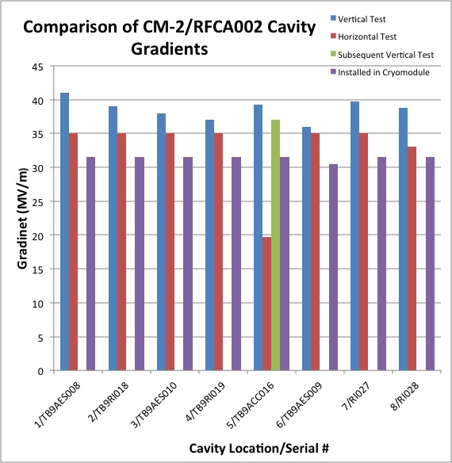
Fermilab CM2…Highest Gradient ILC–Cryomodule
ILC Milestone = 31.5 MV/m

Slide 5
(in the Complete Picture) Continue ILC R&D
Mike Harrison submitted to DOE
Proposal for continuation of ILC R&D Includes long term tests on high gradient CM2
Includes beam tests on CM2
  9 mA peak beam current will be available in FY15

Slide 6
Why We Must Re-Invigorate National SRF R&D
We followed the P5 recommendation to increase funding for PIP-II by temporarily reducing SRF
FY15 SRF now precipitously fallen to 1.5 M$ (loaded)… unsustainable!
Now is the time to…. Re-strengthen SRF R&D
Why?
So far SRF R&D focus has been:
  Gradient, gradient, gradient…
    more remarks about gradeint at end
The new R&D frontier will be:
  Cost, cost cost
    Emphasis on Cost for accelerator technologies pervades the P5 report
.

Slide 7
Connections to P5 Recommendations
Recommendation 26: …Focus on outcomes and capabilities that will dramatically improve cost effectiveness for mid-term and far-term accelerators.
Recommendation 23: …Strengthen national laboratory-university R&D partnerships, leveraging their diverse expertise and facilities.

Slide 8
HEP to Reap Benefits from SRF Cost Advances
Near-term, mid-term and long-term HEP projects
  Multi-megawatt proton accelerators beyond PIP-II - Neutrino frontier
    Multi-megawatt proton accelerators pursued for other applications
      SNS, ESS, ADS…
  Higgs Factories and beyond
    TeV scale colliders (upgrades for ILC?)
    Higgs Factory start for FCC
  Neutrino Factory
  How to cut costs?

Slide 9
A. Cut Refrigerator Costs (≈ x 2)
B. Cut Cavity Materials & Cavity Fabrication Costs ≈ x2
Refrigerator…both capital and operating cost
  CW and high duty factor acc. cost reduction of factors of 2
    E.g. LCLS-II plans on one refrigerator based on Q 3x10¹⁰ instead of 1x10¹⁰
Two New Breakthroughs in High Qs
  (=> lower RF losses)
1. N doping gives high Q values, even higher than the fundamental BCS limit!
  Demands deep physical understanding.
  What is missing in BCS?
2. Reduce “residual losses” by expelling magnetic flux
  leading to even higher Q values.

Slide 10
Motivation for Pursuing Science of High Q
Romanenko Talk
A primary objective of GARD as described in the 2015 DOE budget request to Congress
“HEP General Accelerator R&D focuses on understanding the science underlying the technologies used in particle accelerators and storage rings, as well as the fundamental physics of charged particle beams”.
Fundamental understanding will reveal
  What are the ultimate limits to the best Q?
  Find best parameters to optimize the preparation and cool-down protocol for highest Qs?
  Parameters to control the spread in Q

Slide 11
After Romanenko Talk - Review:
Overall cost proposal consists of two sub-programs
A. Cryogenic cost reduction through transformational High Q Discoveries
  R&D also needed to maintain the high Qs
  Extend high Q to higher frequencies
B. Cavity cost reduction through novel materials and fabrication methods
Proposal leverages existing collaborations

Slide 12
How to Consistently Maintain the High Q in Cryomodules?
Counteract Field Emission
  Collaboration with Jlab
Accidental dirt contamination during CM string assembly drops Q due to Field Emission (FE)
  E.g. CEBAF upgrade CMs: onset field for FE dropped from 18 MV/m in the vertical test to 13 MV/m in cryomodule
  E.g some cavities in FLASH (DESY) CM

Slide 13
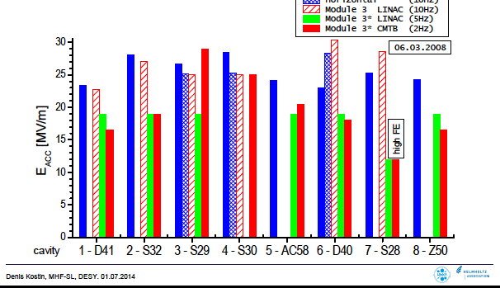
DESY FLASH Module 3*

Slide 14
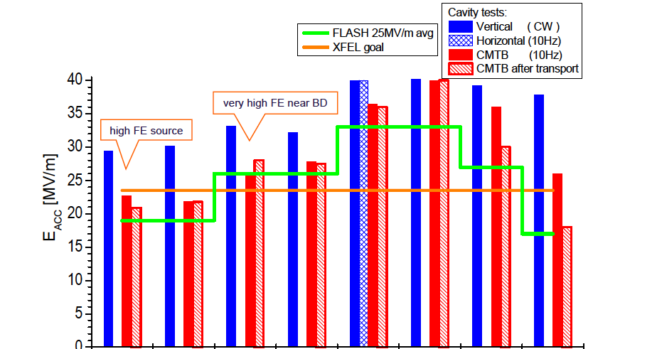
FLASH Module 8

Slide 15
Proposed R&D to Eliminate FE in CM (In-situ)
Develop practical methods to reduce field emission by in-situ cleaning of completed cavity-string assemblies, or inside CM.
  Short term
    Optimize “High power pulsed processing” routinely used in operating accelerators with available beam power
    Adapt CO2 snow cleaning developed at DESY from single cells to multi-cells
  Medium term
    Install higher power processing station, and “move” from CM to CM in tunnel
  Long term
    Apply CO2 Snow cleaning to cavity-string and cavities in CM

Slide 16
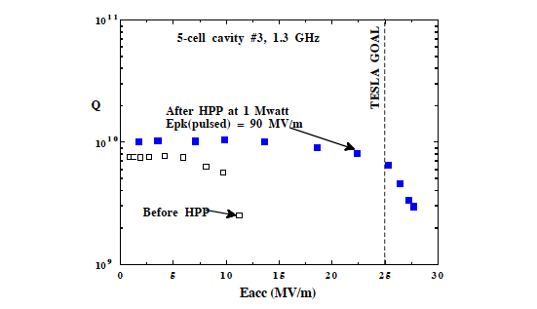
High Pulsed Power Processing FE Proven to Reduce FE

Slide 17
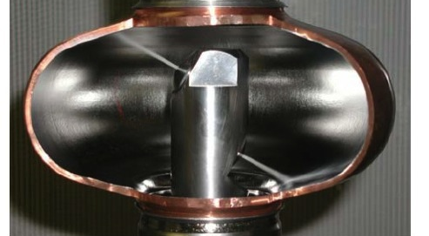
CO₂ jets cleaning single cell
Proven at DESY for FE Reduction

Slide 18
Additional Application of Cavity Cost Reduction through High Q
For TeV scale colliders
Double 1.3 GHz frequency, & apply high Q methods
Rationale
  smaller cavities, smaller cryomodule
Less materials, lower cost
Important reason for 1.3 GHz frequency choice was
BCS surface resistance increases af f²
  Leads to spontaneous thermal instability at high gradients
  G > 30 MV/m - due to BCS heating and thermal runaway
  But High Q via N-doping can enhance Q => x 4
  There should be no thermal instability at 2.6 GHz
Have to open aperture some to keep wakefields acceptable
Collaboration with Cornell…

Slide 19
B. General Cavity Material-Cost Reduction (x 4 )
Cost of bulk niobium is a major factor for SRF accelerators
  especially for low frequency (< 650 MHz)
  even for 1.3 GHz, Nb costs are substantial
  the required Nb per cell scales as 1/f².
Propose cost reduction via Nb-Cu Composite material
  Nb 1 mm/Cu 4 mm,
  X4 material reduction over bulk Nb
    Material made by explosion bonding Cu with high RRR Nb
1-cell and 3-cell cavities made by DESY, KEK, INFN
  Proof of principle to 40 MV/m established for Nb-Cu cavity
High quality surface preparation used
  as with bulk Nb cavities that show high performance

Slide 20
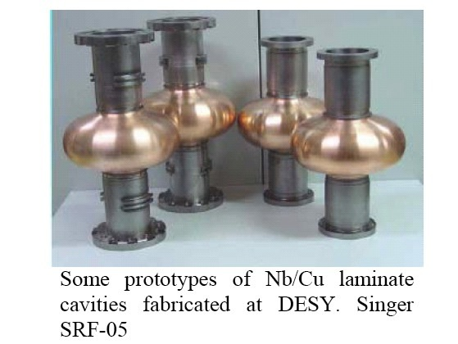
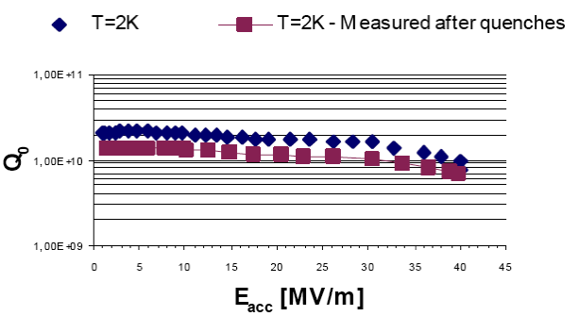
Proof of Principle
1-cell Nb-Cu Composite Hydroformed
Reaches 40 MV/m

Slide 21
Cavity Fabrication-Cost Reduction via
Seamless Techniques with Nb-Cu Composites
Eliminate expensive e-beam welding and trim machining of parts
Rapid production rate possible with spinning and hydrofm
Hydroformed and Spun 1-cell cavities already proven
  Hydroformed 3-cells Nb proved to > 35 MV/m
  Spun single cell Nb proved to 40 MV/m
  Spun 3-cell Nb under test at FNAL
Collaboration with Cornell, INFN, DESY, and KEK, US industry

Slide 22
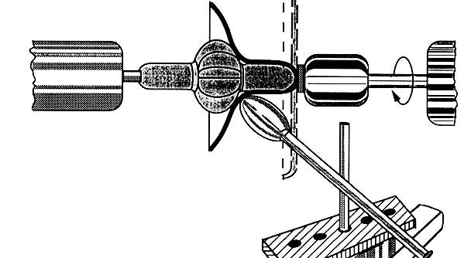
Principles of Hydroforming and Spinning

Slide 23
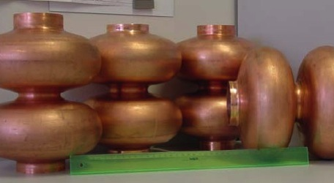
2-cell Nb-Cu Hydroformed

Slide 24
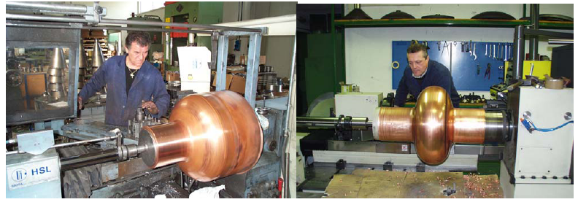
500 MHz Single Cell Spun from Nb-Cu Sheet

Slide 25
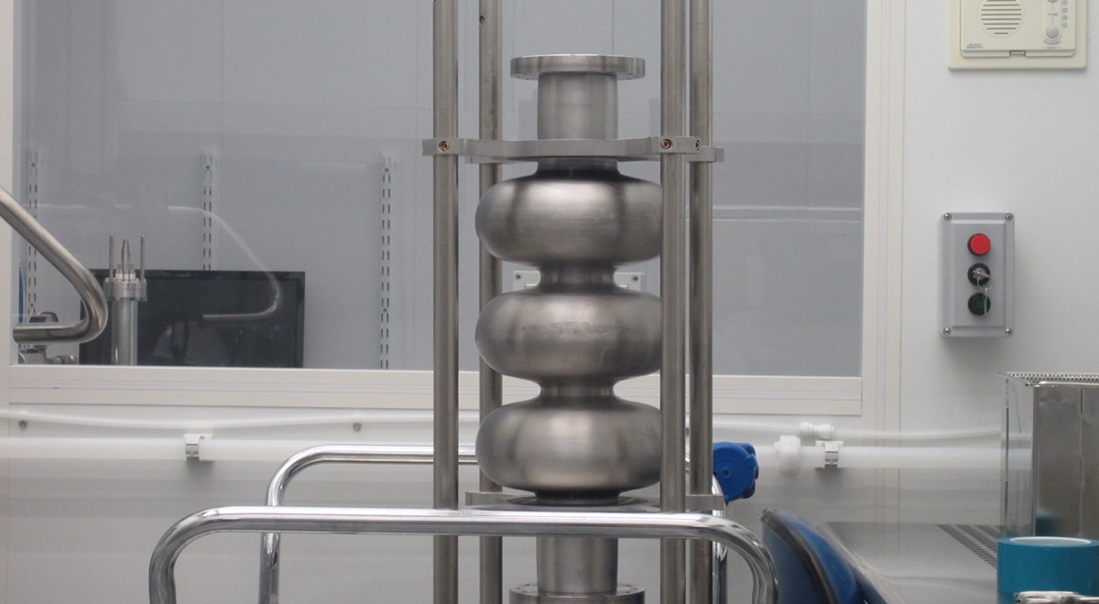
3-Cell 1.3 GHz Nb Cavity Made from Nb Tube by Spinning at INFN
Under preparation at FNAL

Slide 26
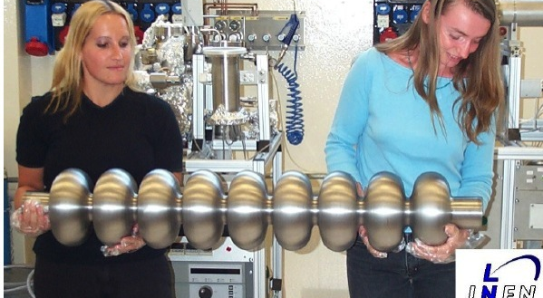
9-cell Nb Cavity Made by Spinning - INFN

Slide 27
Proof of Principle for Spinning
1.3 GHz Single Cell Nb Spun Cavity – 40 MV/m

Slide 28
Cavity Material and Fabrication - Cost Reduction: Plans
Overall goal is
  x 2 cavity cost reduction for cavity production
Short term
  Fabricate, process, and test 1-cell 650 MHz Nb-Cu composite cavities via spinning
  Thinning/delamination at beam tubes controlled by better die selection and larger area for starting material
Medium term
  Fabricate and test multicell composite cavities at various frequencies
Long term
  Involve industry for mass-production
  Apply High Q treatment to Nb-Cu composite cavities
    Lower the temperature of N-doping

Slide 29
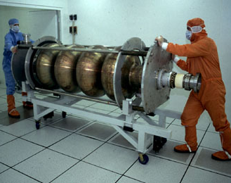
Nb/Cu Thin Films (Reprise)
Magnetron sputtered Nb films developed for 350 MHz LEP-2 CERN cavities
But they always show Q-slope with increasing accelerating field
Problem to solve

Slide 30
Energetic Deposition of Nb to Improve Films
Recent breakthroughs in Nb film deposition technology by energetic deposition of Nb
  at Jlab, Alameida Corp, ANL, LBNL, CERN…
High RRR (200 to 300) Nb and improved morphology
The RF properties of these films have yet to be tested!

Slide 31
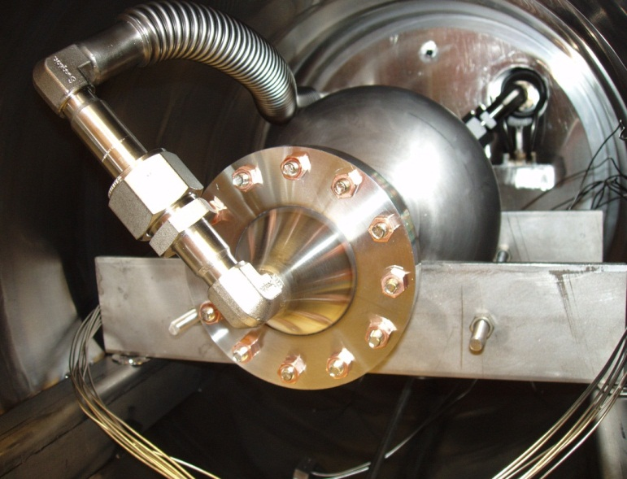
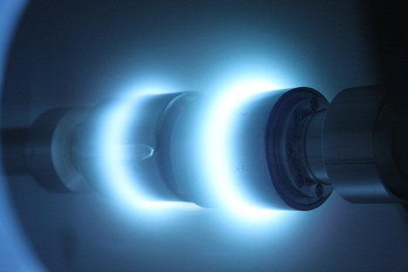
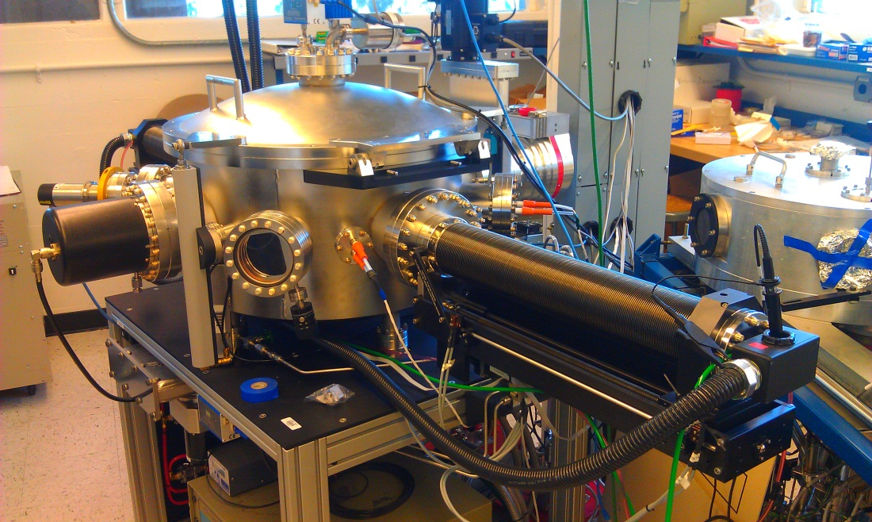
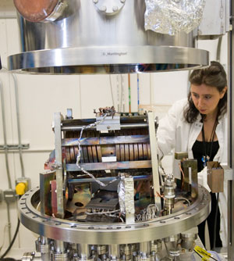
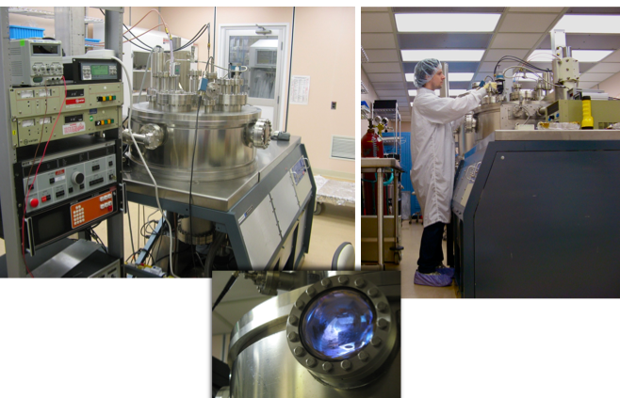
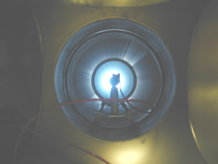
High Energy Nb Depostion - Coating Activities –
Can we get rid of that nasty Q-slope??
Cavity ALD at ANL
High-impulse deposition at LBNL
Film deposition at JLab
CED at AASC, 1st coated Nb-Cu cavity in hand, 2012

Slide 32
R&D Plan for Thin Films
Near-term
  Develop compact low frequency Nb host cavity to test high quality films on disks, 1.3 GHz and 650 MHz
  Disk geometry best for optimum deposition conditions for proof of priniciple test
Mid-term
  If RF surface resistance on disk samples confirmed to remain low at high fields
  Proceed to single cell 1.3 GHz Nb cavity coating
  1-cell 650 MHz Nb/Cu cavity coating
Long-term
  Multi-cell cavities with high quality Nb film on Cu
  Industrial involvement with low cost method
  Re-coat 300 LEP cavities if needed for circular Higgs Factor (pre-FCC)

Slide 33
Proposed Continuation of Gradient R&D (SLAC talk by Sergeii Nagaitsev)
Higher SRF gradients possible for TeV scale colliders
Proof of principle shown for path to 50 – 55 MV/m
  Collaboration with Jlab
  Using advance shaped cavities: re-entrant and low-loss
  Single cells of advanced shape demonstrate 50 – 55 MV/m
  Apply high Q techniques (Q x 4) to make higher gradients affordable
Nb3Sn 80 – 90 MV/m potential
  first promising evidence
  In collaboration with Cornell
  Sergeii N. will discuss these advances for TeV scale colliders in his SLAC presentation for that topic.

Slide 34
SRF R&D Resources Estimated Need…M&S includes funding for collaborators and students
 |  | FY15 | FY16 | FY17 | FY18 | FY19 | FY20
SRF Science Underlying the Performance of Superconducting Cavities | SWF | 1000 | 1020 | 1040 | 1061 | 1082 | 1104
 | M&S | 1000 | 1020 | 1040 | 1061 | 1082 | 1104
 | FTE | 4 | 4 | 4 | 4 | 4 | 4
 | **SUM DOLLARS | 2000 | 2040 | 2081 | 2122 | 2165 | 2208
 |  | FY15 | FY16 | FY17 | FY18 | FY19 | FY20
Very high gradient/high Q cavities for TeV scale e+e- colliders | SWF | 875 | 893 | 910 | 929 | 947 | 966
 | M&S | 1750 | 1785 | 1821 | 1857 | 1894 | 1932
 | FTE | 3.5 | 3.5 | 3.5 | 3.5 | 3.5 | 3.5
 | **SUM DOLLARS | 2625 | 2678 | 2731 | 2786 | 2841 | 2898
 |  | FY15 | FY16 | FY17 | FY18 | FY19 | FY20
Cost Effective SRF Technology for HEP Accelerators | SWF | 1875 | 1913 | 1951 | 1990 | 2030 | 2070
 | M&S | 2950 | 3009 | 3069 | 3131 | 3193 | 3257
 | FTE | 7.5 | 7.5 | 7.5 | 7.5 | 7.5 | 7.5
 | **SUM DOLLARS | 4825 | 4922 | 5020 | 5120 | 5223 | 5327
 |  | FY15* | FY16 | FY17 | FY18 | FY19 | FY20
TOTAL | SWF | 3750 | 3825 | 3902 | 3980 | 4059 | 4140
 | M&S | 5700 | 5814 | 5930 | 6049 | 6170 | 6293
 | FTE | 15 | 15 | 15 | 15 | 15 | 15
 | **SUM DOLLARS (k$) | 9450 | 9639 | 9832 | 10028 | 10229 | 10434
* - FY15 numbers reflect the required funding to support the effort

Slide 35
Summary of Cost Effective SRF R&D Proposal:
Transformational discoveries at Fermilab
Understand the science behind high Q
Cut the refrigerator size for future accelerators
Maintain high Q by eliminating FE in situ
Reduce cavity material and fabrication costs, overall goal x2
Support continued ILC R&D at some level
Continue gradient R&D: 35 -> 50 -> 90 MV/m
    Along with Q improvement of x 4

Slide 36
Back up slides

Slide 37
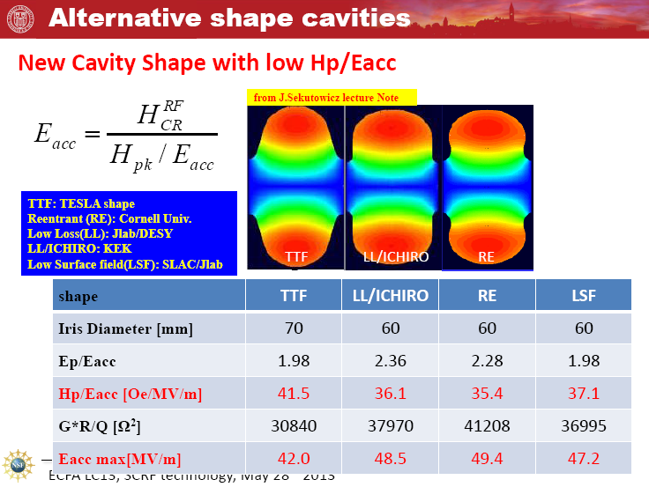
Paths to Higher Gradient for TeV Upgrade - in Hand
Need Support for further R&D

Slide 38
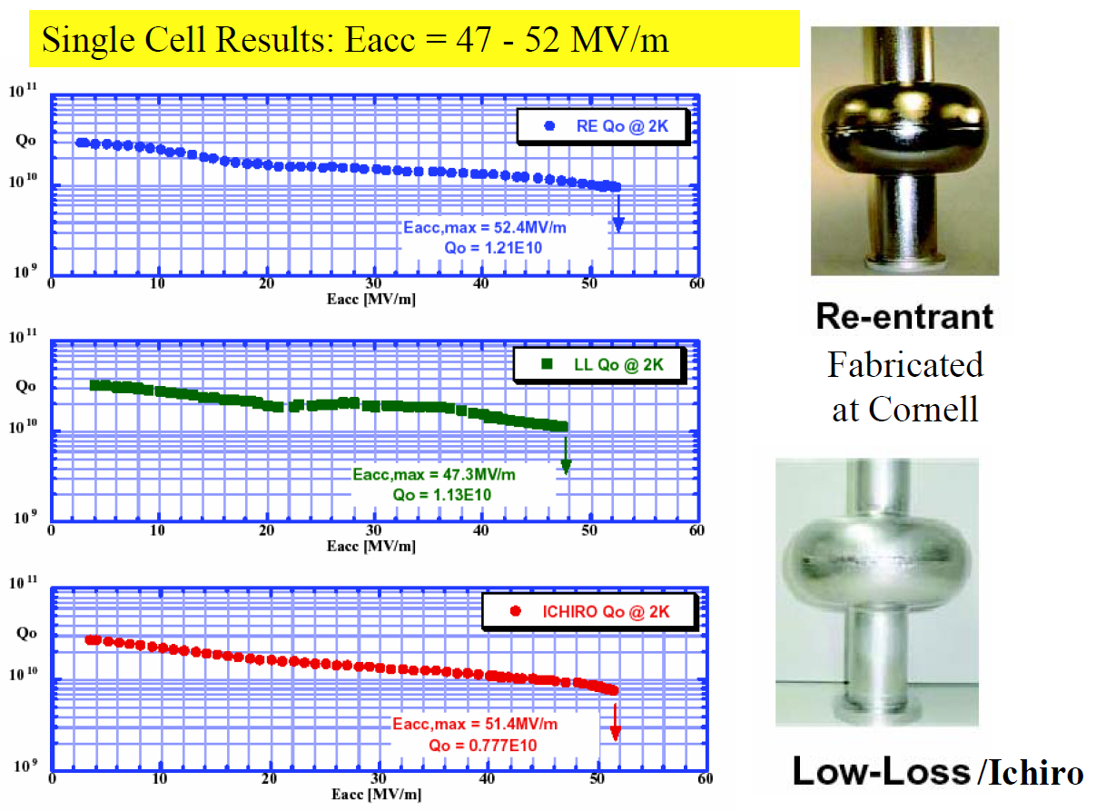
Shape optimization R&D for Single Cell Nb Cavities
Single cells 47 – 52 MV/m achieved

Slide 39
Cornell Re-entrant Shape Single Cell
58 MV/m !!

Slide 40
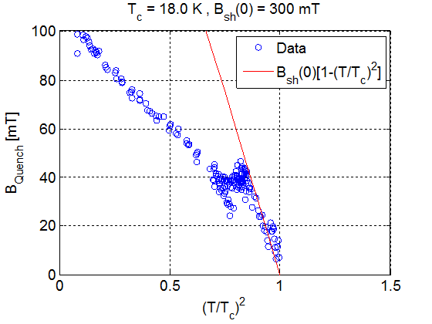
Long-term goals R&D program: 60 MV/m → 90MV/m
Using high power RF (MW) with short pulses, Cornell recently demonstrated (for T>6K) Nb3Sn follows the expected superheating field of the 18K superconductor.
When extrapolated to 2K this leads to surface magnetic fields of 300 mT as compared to Nb superheating field of 200 mT.
These results suggest that a well prepared Nb3Sn cavity with optimal shape will capable of reaching 80-90 MV/m and high Q (due to higher Tc of Nb3Sn)
With intense R&D, such new materials can outperform Nb.
Heating at defect takes over

Slide 41
Revolutionary Paths??
Multilayers, ALD, CVD….
    5 years.. no cavity results
    New fundamental studies contest benefits of multi-layer shielding
HTS
  YBaCuO
    Has nodes in energy gap leading to low Q
  MgB2
    Hc ranges from 0.26 – 0.6 (Nb, Hc = 0.2)
    Has two energy gaps
    Rs will be dominated by the lower gap = 2.3 meV, compared to Nb gap of 3.1 meV
  So Only Nb3Sn promises encouraging results

Slide 42
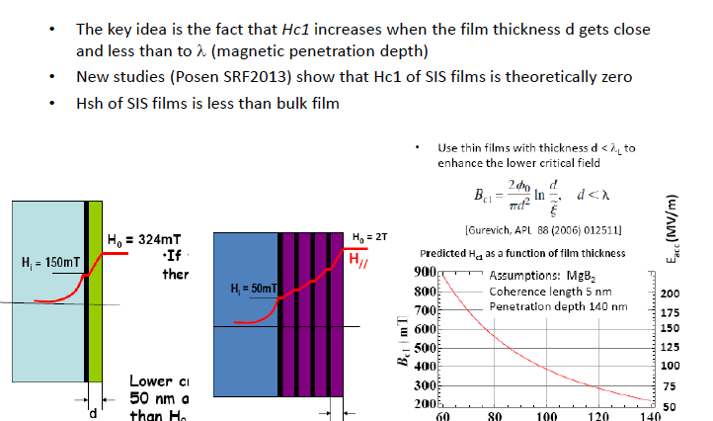
Multilayers

Slide 43
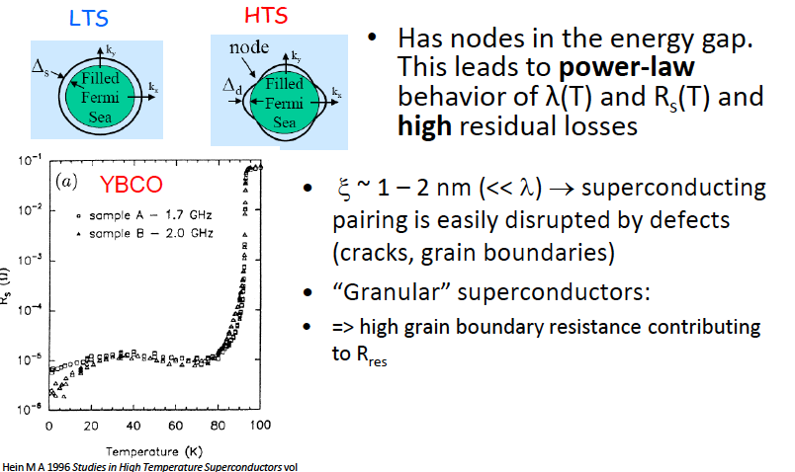
HTS not a good candidate

