Slide 1
University Contributions to Long Term Accelerator R&D
Sarah Cousineau
(with contributions from many others)
Fermilab P5 Review
August 27, 2014

Slide 2
Charge and Goals
Charge: Summarize university contributions to HEP accelerator R&D in the mid-U.S. region.
Outline:
What is the status of HEP-related university accelerator research in the mid-US region?
What are the highlights of the different programs?
How are the university programs contributing to Fermilab’s research goal?
Part I: List of programs, themes, funding sources.
Part II: Catalog of research highlights by theme
Part III: A brief look at how Fermilab’s university partnerships are aligned with the lab’s long term research vision.

Slide 3
PART I
List of programs, themes, funding

Slide 4
Research Themes
In general, the research can be broken down into 4 categories.
Superconducting Materials/SRF
Beam Dynamics
The development of SRF technology including new materials, production techniques, and effects of environment.
Beam dynamics studies, both experiment and simulation, for high intensity beams and for nonlinear lattices.
Novel Accelerator Technology
Machine Concepts
Novel accelerator technology which enables new or improved methods of acceleration, injection, or beam manipulation.
Proposals and research towards new types of accelerators which can serve the HEP mission.

Slide 5
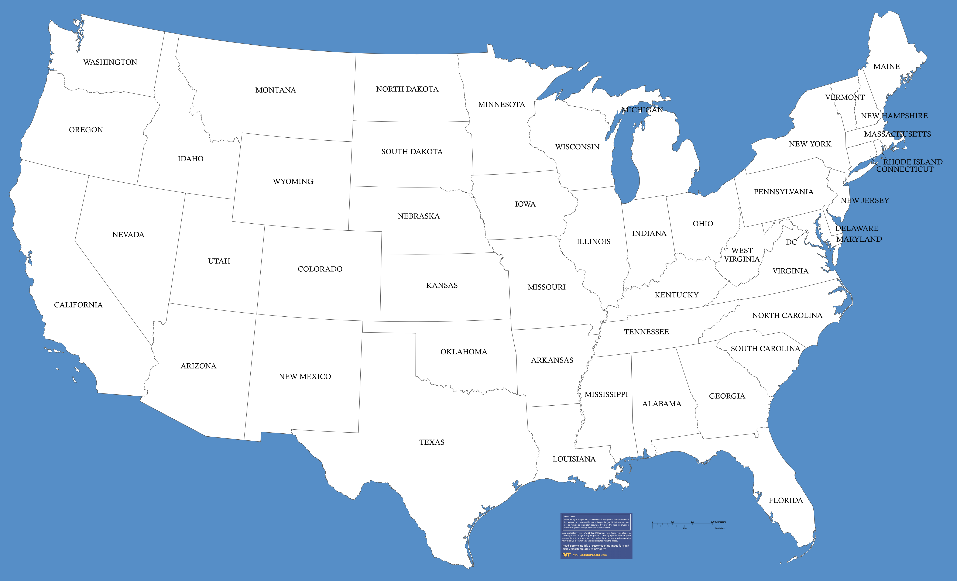
Geographical Distribution of Represented Universities
Mid-U.S. universities as well as East Coast universities with programs not included in BNL review

Slide 6
Summary Table of Represented Research
University | Primary Topic(s) | Funding Agency
IIT | SRF technology; machine concepts; Novel Accelerator technology | DOE-HEP grant, NSF
U. of Chicago | Beam dynamics (IOTA) | Fermilab, NSF, U. of Chicago
NIU | SRF technology; beam dynamics (IOTA); Accelerator technology | DOE-HEP grant, NSF, DOD, NIU
IU | Beam dynamics; machine concepts | DOE-HEP grant
U. of MD | Beam dynamics | DOE-HEP grant, NSF,ONR
U. Tenn. | Accelerator technology; beam dynamics | DOE-HEP grant
U. Wisc. | SRF technology | DOE-HEP grant
MSU | SRF technology; beam dynamics; machine concepts | DOE-HEP grant; NSF
U. Of Colorado | Beam dynamics; accelerator technology | DOE-SBIR
Colorado State | SRF technology | ONR, High-Energy Laser Joint Technology Office
Cornell | SRF technology | DOE; NSF
MIT | Machine concepts | NSF

Slide 7
PART II
Catalog of Research Program Highlights
(More details in the auxilliary slides)

Slide 8
Superconducting Materials / SRF
IIT (J. Zasadzinski; Fermilab collaboration):
New surface analysis probes, Raman and Tunneling Spectroscopies applied to the study of Nb for SRF cavity applications.
Insights into the Nb surface superconductivity have
helped development of a new fabrication method which gives high Q > 3x10¹⁰ at 15 MV/m, a critical milestone for LCLS II.
MSU (Thomas Bieler):
Understanding the variability in cavity performance when cavities are made with the same process.
Found that forming cavities from large grain Nb is more cost effective and leads to higher Q but performance is more variable.
Cornell (G. Hoffstaetter; Fermilab collaboration):
Development of very high Q cavities
Measurement of temperature dependence of the superheating field in niobium
Vertical-electropolishing of cavities resulting in ILC base-line specifications

Slide 9
Superconducting Materials / SRF
U. of Wisc (M. Jewell; Fermilab collaboration):
Identification of microstructural features that limit the mechanical performance of Bi-2212 superconductors for magnet applications
Evaluation of different Bi-2212 round wire processing routes w.r.t. mechanical behavior Investigation of alternative epoxy materials for magnet impregnation
Colorado State University (S. Biedron, A. Morin; Fermilab collaboration):
Machine learning based on resonance control of the ASTA RF Gun
Neural network based modeling of the system
Development of predictive control system
U. of Chicago (Young-Kee Kim; Fermilab collaboration):
Program to achieve ultra high quality factor in SRF niobium cavities
  Studies of RF cavities in high magnetic fields

Slide 10
New Machine Concepts
MIT (B. Barletta, J. Spitz; Collaboration with many universities and labs):
DAEδLUS program seeks to build a set of cyclotrons for use in HEP applications.
IsoDAR, representing the injector cyclotron design for the envisioned superconducting ring cyclotron, can be combined with an existing or planned neutrino detector to look for new physics.
This is a short-baseline neutrino oscillation program use cyclotron produced 8Li decay at rest.
Short term baseline neutrino factory called out in P5.
IIT (D. Kaplan, P. Snopok; Fermilab collaboration):
Hydrogen-pressurized RF cavities in strong magnetic fields
Analysis of Muon Ionization Cooling Experiment (MICE)
Cost-effective, staged implementation of muon accelerators
MSU (M. Syphers; Fermilab collaboration):
Investigating designs of all-electric storage rings for storing elementary particles or ions for detection of weak EDM signals, and assoc. hardware
Initial efforts to investigate next-gen hadron collider.

Slide 11
Novel Accelerator Technologies
U. of Tennessee (S. Cousineau; Fermilab and ORNL collaboration):
Preparing for a 2016 experimental demonstration of laser-assisted H- stripping for a 10 us, 1 GeV beam.
Parallel effort to develop laser power recycling cavity (in lab) needed for long pulse stripping.
IIT (L. Spentzouris; ANL collaboration):
Fabricate and test novel photocathodes.
Development of multilayered structures (improve cathode figures of merit)
Development of superconducting photocathodes
Work aimed at improving electron accelerators
U. of Colorado (J. Cary; SLAC, LBNL collaboration):
Developed object oriented simulation methods for plasma acceleration, cavity calculations
Developed hybrid dielectric/metal cavities now being built at multiple places
Developed EM algorithms now in wide use

Slide 12
Novel Accelerator Technologies
U. of Chicago (Young-Kee Kim; Fermilab collaboration):
Investigation of staged laser-plasma acceleration.
NIU (Philipe Piot; Fermilab collaboration):
Test of novel cathodes material in radio-frequency electron sources.
Exploration of ramped current-profile bunch production for beam driven acceleration with enhanced transformer ratio.
Exploration of "at birth" electron-beam shaping using shaped laser beam. A recent results was the production of uniformly-filled ellipsoidal bunch from a semi-conductor cathode.
Design of a high-gain single-pass broadband Ti:Sapph amplifier in support of a planned proof-of-principle experiment on optical-stochastic cooling at IOTA/ASTA.

Slide 13
Beam Dynamics Research
Indiana University (S.Y. Lee; collaboration with Fermilab, BNL, LANL):
Bunch broadening and longitudinal uniformization of beams by applying phase modulation to a double RF cavity system.
RHIC optics measurement and correction leading to luminosity and polarization performance improvement and minimization of beta-beat.
Work towards the realization of a muon beams storage ring design for the nuSTORM project.
Studying the effect of the envelope resonance on emittance growth.
Investigating the dynamic stability of slip stacking.
Understanding the third-integer coupling resonance crossing.
NIU (Philipe Piot; Fermilab collaboration):
Development of advanced phase space manipulations (some tested
experimentally over the years at the A0 photoinjector)
Round-to-flat beam transformation to produce compressed flat beam
Bunch shaping via phase space exchanger

Slide 14
Beam Dynamics Research
UMD (R. Kishek; Fermilab, ANL, LBNL collaboration):
Multi-faceted program to explore beam physics at high space charge
Demonstrated storage of high bunch charge (1.0 space charge tune shift)
Observed soliton wave train, multistream instability
Future direction is to reconfigure UMER as test bed for nonlinear optics.
U. of Tennessee (A. Aleksandrov; ORNL collaboration):
High intensity beam dynamics research with the new Integrated Front End Test Stand.
Proposing to do the first direct 6D phase space measurement of beam exiting RFQ to answer the age-old question, “Are we assuming reasonable initial beam distributions in our linac simulations?”

Slide 15
Beam Dynamics Research
MSU (M. Syphers; Fermilab collaboration):
Simulations and spin dynamics for the measurement of magnetic dipole moment of muon (g-2).
U. of Colorado (J. Cary; LANL, Fermilab collaboration):
Developed theory of nonlinear and corrective beam transport for halo mitigation.
Will propose to work with IOTA in next HEP funding round.
U. of Chicago (Young-Kee Kim; Fermilab collaboration):
Studies of Beam Dynamics at the Fermilab Booster Accelerator.
  Performing a proof-of-principle experiment for integrable accelerator lattice with highly non-linear optics (IOTA).

Slide 16
PART III
University alignment with Fermilab mid-term goals

Slide 17
Fermilab Collaborations with Universities
Universities are heavily engaged in the Fermilab research program. There are 10+ active and productive Fermilab-University research partnerships.
For Fermilab, students provide a means of focused research at reasonable cost.
From the university stand point, the benefit is clear:
“Overall our relation with Fermilab has been very beneficial to our
small university group: it gives us visibility and leverage as we have
access to state-of-the art hardware our university would never be able
to afford and also provides exposure to our students who collaborate
at Fermilab with experts in our field. “
-Philippe Piot, email correspondence

Slide 18
Examples of University Programs Directly Supporting Fermilab’s Plan for a Multi-Megawatt Machine
Key Research Goal
University Contribution(s)
IOTA R&D on integrable optics and space charge compensation
4 universities involved in IOTA nonlinear lattice work
Advancement in SRF technology to increase cost effectiveness
5 universities collaborating with Fermilab on this topic.
Advancement in H⁻ injection technologies (for synchrotron scenario) to accommodate > 1 MW
A Fermilab collaboration to advance the development of H⁻ laser stripping injection.
Advancement in beam stability and beam loss control to accommodate multi-megawatt beam.
3 universities involved high intensity beam dynamics studies

Slide 19
Summary
University programs in the mid (and Eastern) U.S. are contributing significantly to the HEP accelerator R&D program.
Most university accelerator physics programs are collaborations with DOE national laboratories.
10+ universities have active, productive research collaborations with Fermilab.
The Fermilabl/University collaborations are well aligned with Fermilab’s plans to develop cost-effective concepts toward a possible future multi-megawatt machine for neutrino production.

Slide 20
APPENDIX
Supplemental Materials

Slide 21
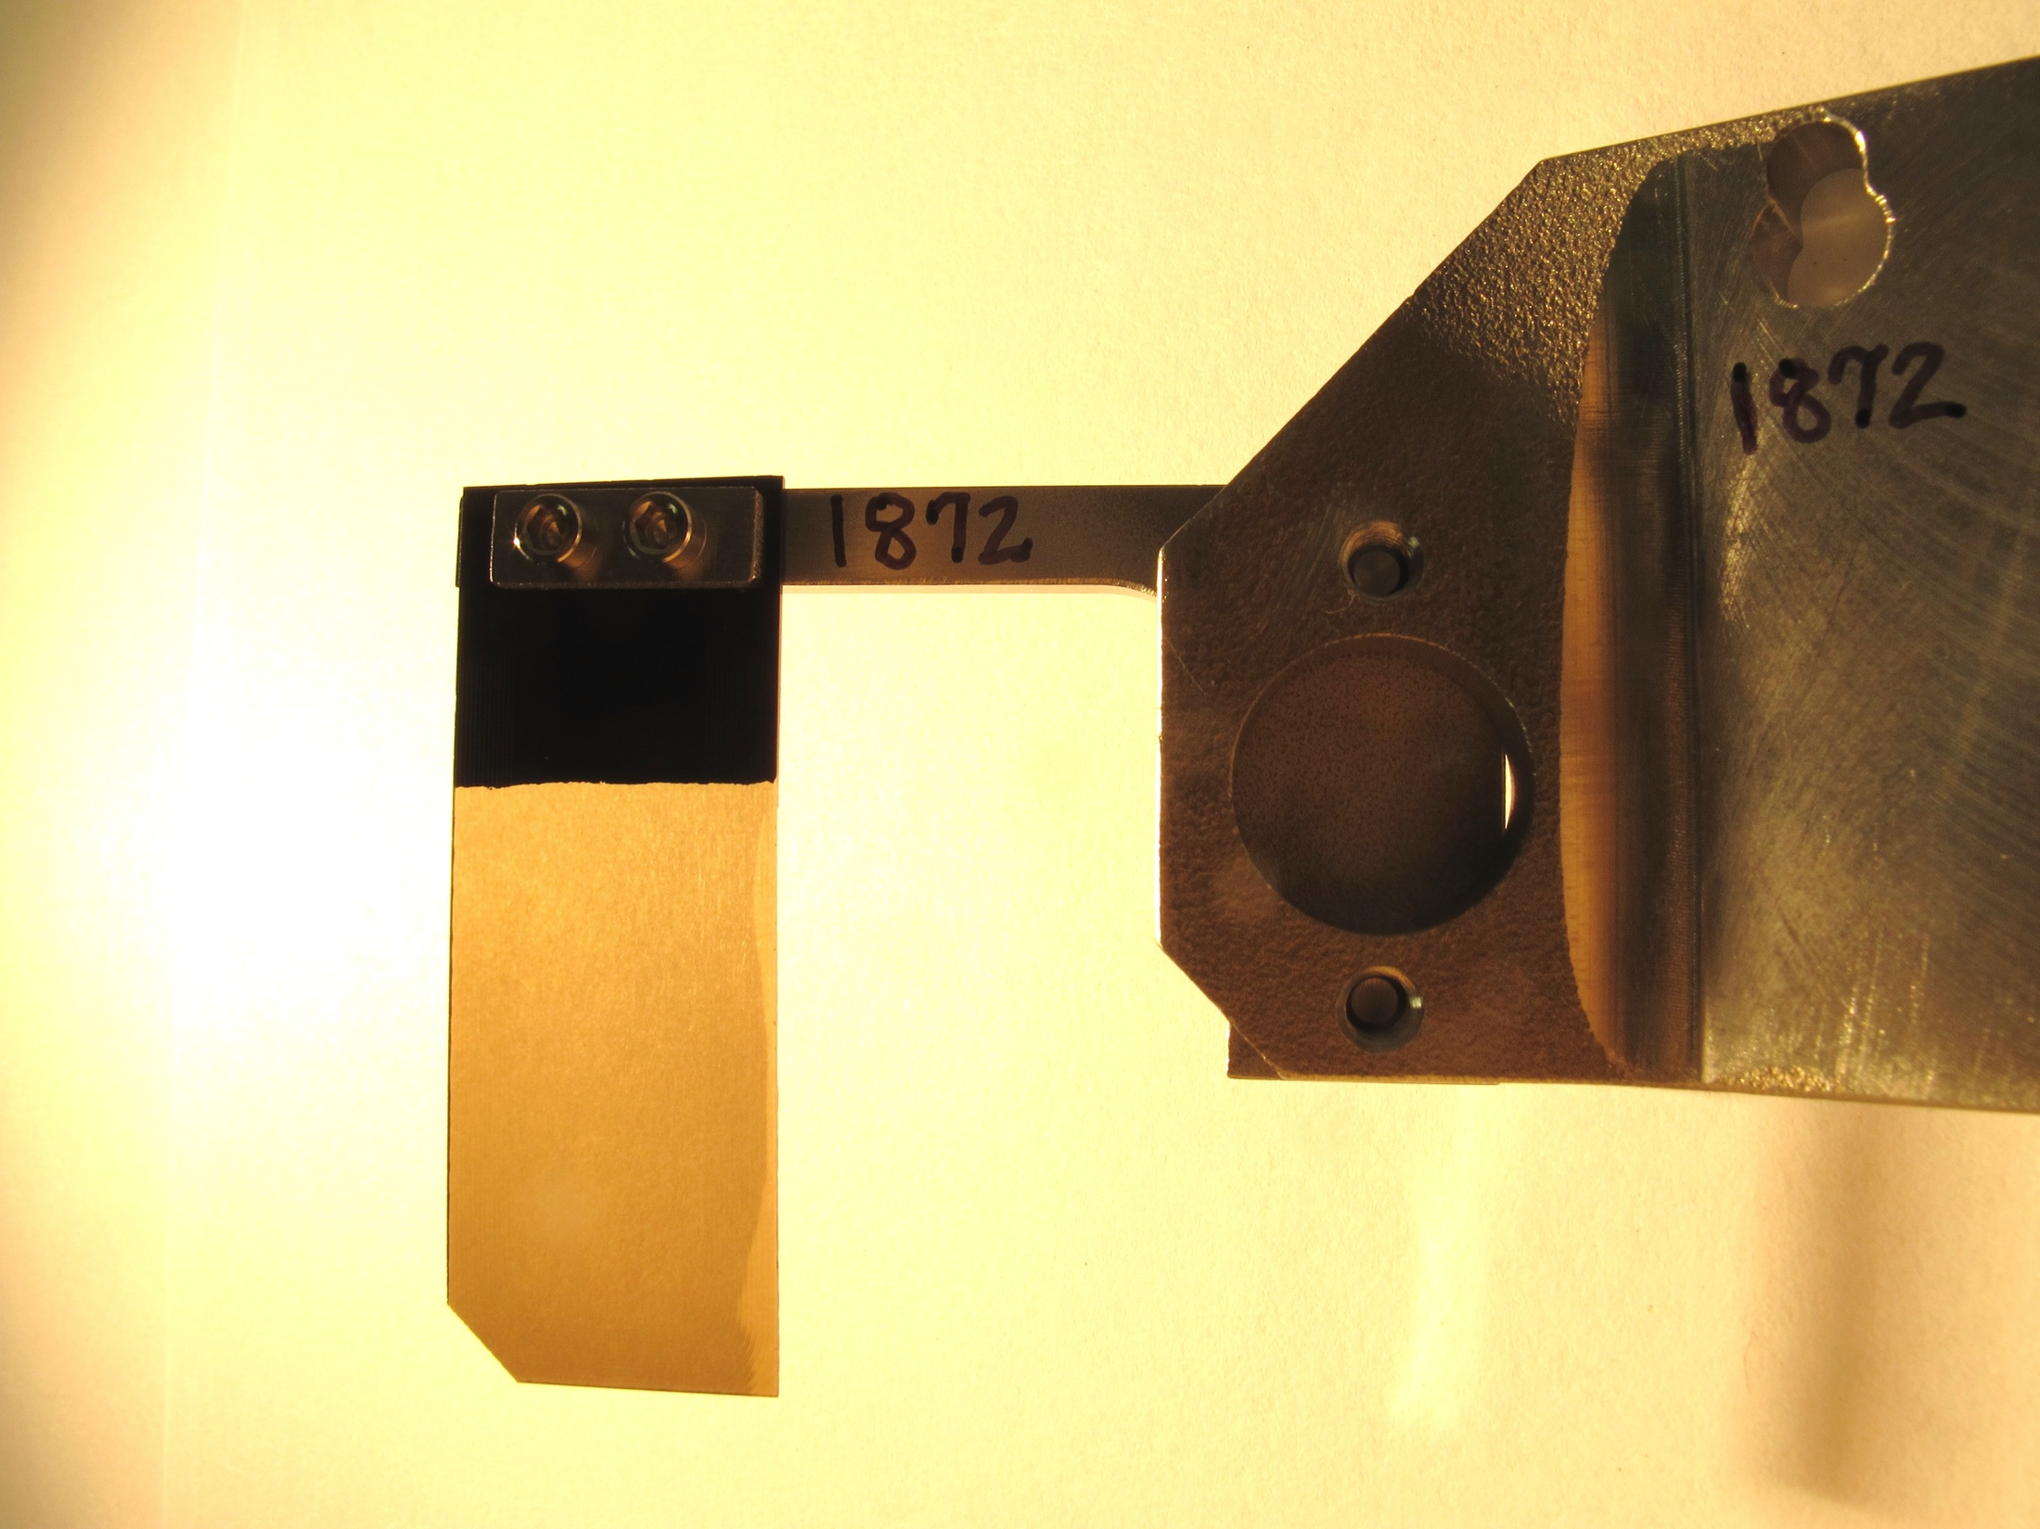
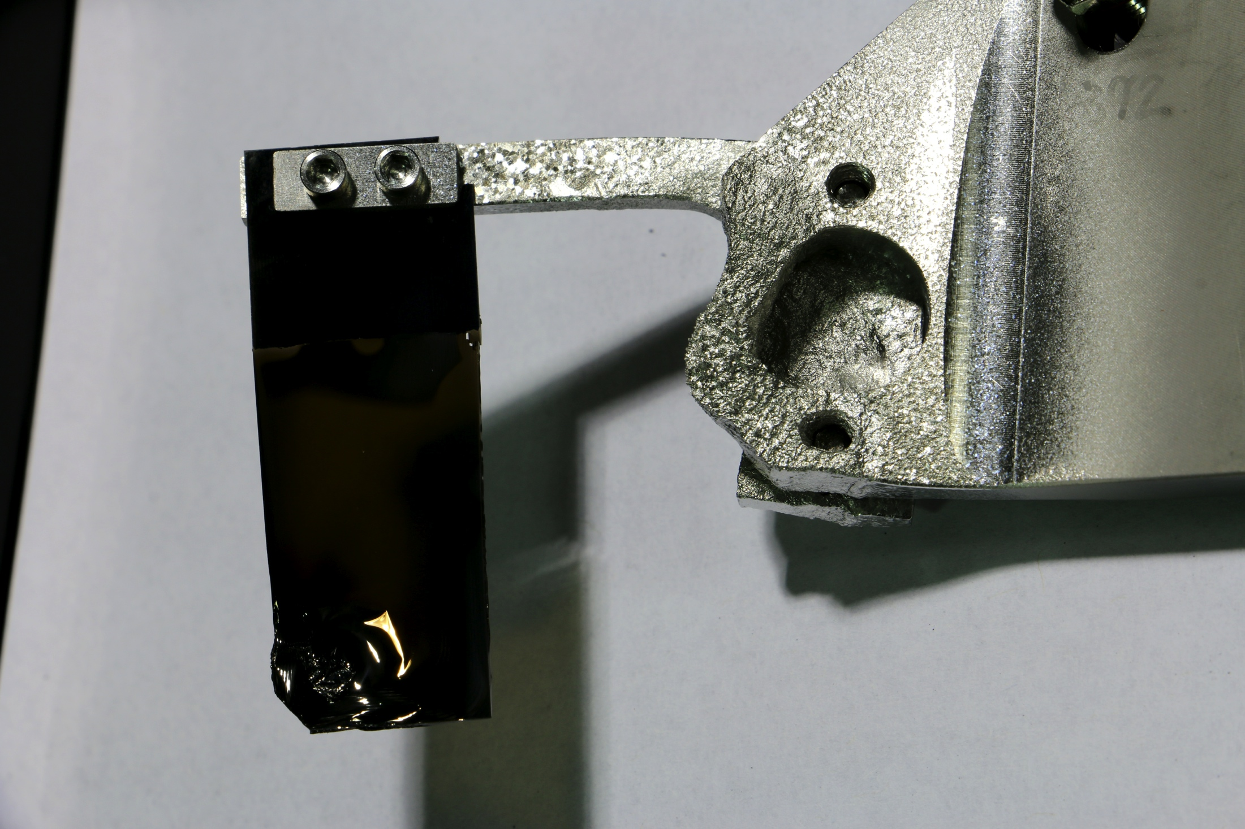


Motivation for H⁻ Laser Stripping Development
Injection foils may not survive in beam powers >1.5 MW.
Seeing many cases of foil damage at SNS – curling, tears, melting brackets, etc.
Damage increasing exponentially with higher beam power.
Due to injection beam loss, SNS injection region is hottest area in accelerator (~800 mrem @ 30 cm).
2014 SNS foil: 3 months in 1 – 1.4 MW beam
Before
After
Melted bracket
Curling

Slide 22
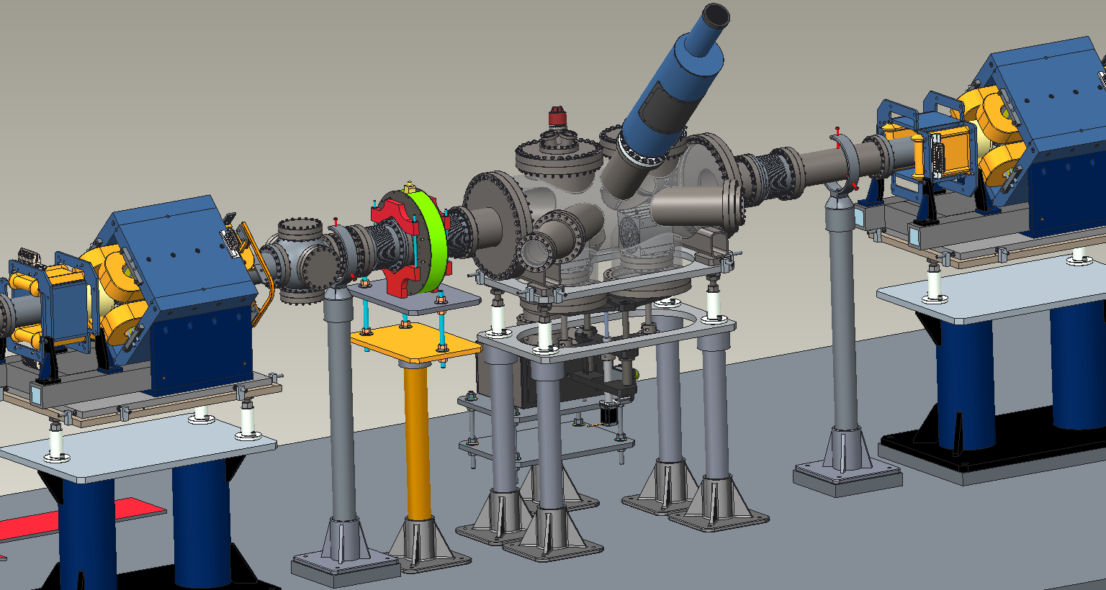
10 us Laser-Assisted H⁻ Stripping Demonstration
Preparations underway for 2016 demonstration of H⁻ laser-assisted stripping of a 10 us, 1 GeV H⁻ beam at SNS.
Parallel lab-based effort to develop a laser power recycling cavity for future stripping of ~1 ms pulse.
Eventual plans to mature system to HEP operational needs – injection painting, etc.
Final Design of Experimental Station
H⁻
Interaction Point
UV laser

Slide 23
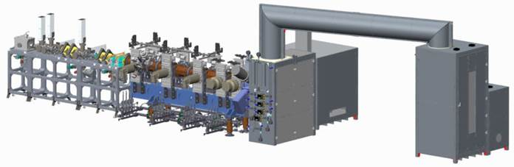
High Intensity Low Energy Linac Beam Dynamics
New Integrated Front End Test Stand at SNS (in place, awaiting accelerator readiness review):
  Up to 50 mA H⁻ or protons
  Electrostatic LEBT
  RFQ
  Diagnostics – 4D emittance station, BCM, etc.
U. of Tenn. collaboration to study high intensity beam dynamics in front ends.
Propose to do first direct measurement of 6D beam phase space.

Slide 25
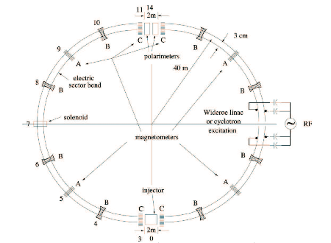
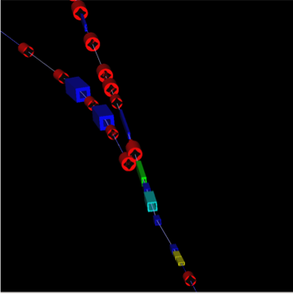
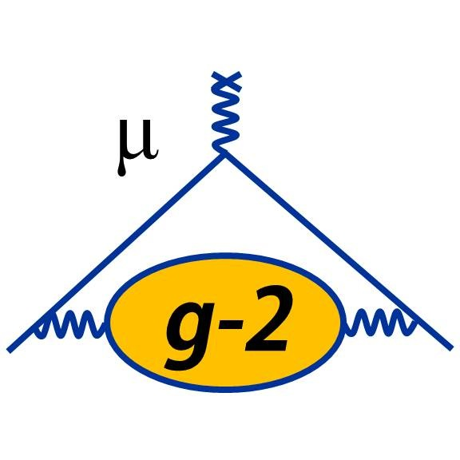
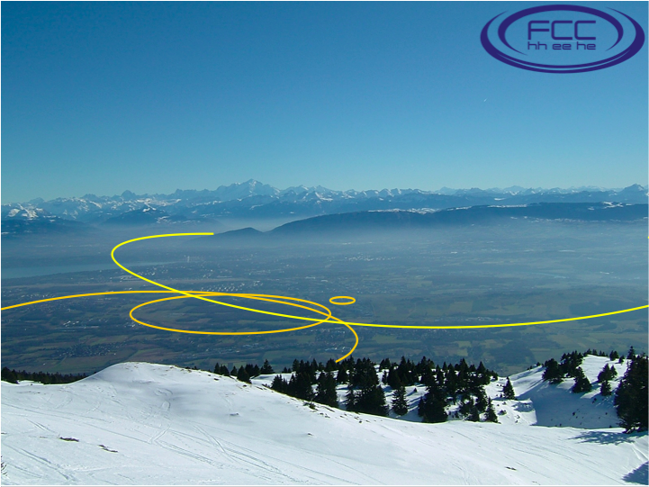
HEP-Related Activities at MSU
M. Syphers
Storage Rings for Electric Dipole Moment Measurements
  investigating designs of all-electric storage rings for storing elementary particles or ions for detection of weak EDM signals, and their associated hardware
  awaiting NSF funding for graduate student
Magnetic Dipole Moment of Muon (g-2)
  E989 (Fermilab); student working on beam line simulations and spin dynamics
  seed funding through MSU, seeking external support
Next-Generation Hadron Collider
  seeking funds (DOE) for U.S. participation in FCC study, other related U.S. activities

Slide 26
University of Maryland: Advanced Accelerator R&D
PIs: Kishek, Bernal, Koeth, Haber
Multi-faceted program to explore beam physics at high space charge
Experimental program on the University of Maryland Electron Ring (UMER)
  Transverse stability, halo, and resonances
  Longitudinal dynamics for long-bunch beams in induction accelerators.
Close-coupling with simulation (codes used: WARP, Elegant)
Collaboration with national and international laboratories
(FNAL, GSI, ANL, LBNL, Cockcroft Institute)
Student and postdoc training a key component
Recent accomplishments:
  Demonstrated beam storage with high bunch charge (1.0 space charge tune shift for 1000 turns)
  First observation of soliton wave train in an electron beam
  Observed a long-predicted multi-stream instability in coasting beams
  Completed experimental study on beam halos in space-charge-dominated beams
Future direction: reconfiguring UMER as a testbed for nonlinear optics.

Slide 27

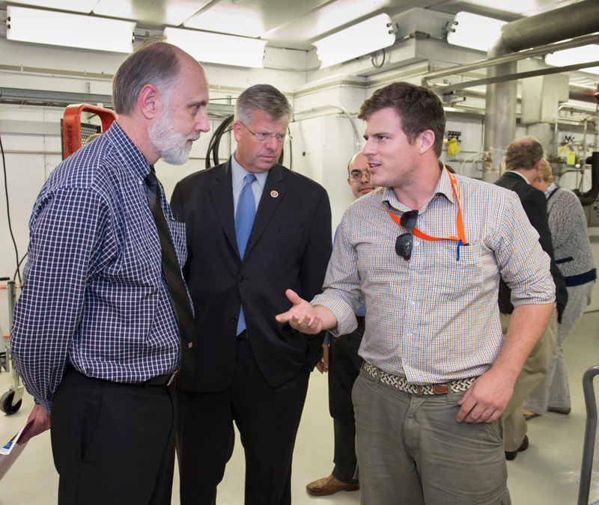
NIU-FNAL symbiosis
NIU-FNAL partnership provides unique
training opportunities to students,
Fermilab has infrastructures, facilities
and expertise not available at NIU,
NIU supplies students:
  5 NIU graduate students currently
  carry PhD research at the lab,
  3 PhD + 4 MS graduated in
  the 2006-2013 period based
  on research performed at Fermilab.
  undergraduates are also engaged
  in research relevant to Fermilab’s mission,
NIU-FNAL partnership has raised the visibility of NIU’s accelerator program:
  students applying to graduate school with interest in accelerator science is in constant increase,
  NIU President recently recognized Accelerator science as a pole of excellence and committed to increase the number of faculty in the next years.

Slide 28
University of Chicago
Faculty Advisor | Graduate Student * (*: thesis topic) | Research Advisor | Ph.D. date (expected)
Young-Kee Kim | Satomi Shiraishi ¹ Springer Theses Award | Wim Leemans, LBNL | Oct. 2013
 | Timofey Zolkin ^{2, 4} | Valeri Lebedev, FNAL | (Sept. 2014)
 | Alexander Vostrikov ³ | Alexander Romanenko, FNAL | (Spring 2015)
 | Sergey Antipov ⁴ | Sergei Nagaitsev, FNAL | (Spring 2017)
 | Alexey Kochemirovskiy ⁵ | Daniel Bowring, FNAL Pavel Snopok, IIT/FNAL | (Spring 2017)
1 master and 8 undergraduate students worked on accelerator projects (2003 – 2013)
Research topics
  Investigation of Staged Laser-Plasma Acceleration
  Studies of Beam Dynamics at the Fermilab Booster Accelerator
  Achieving ultra high quality factor in SRF niobium cavities
  Performing a proof-of-principle experiment for integrable accelerator lattice with highly non-linear optics (IOTA)
  Studies of RF cavities in high magnetic fields and 6D muon cooling

Slide 29
DOE funded HEP research
Fabricate and test novel photocathodes
Multilayered structures (improve cathode figures of merit)
Superconducting photocathodes
L. Spentzouris, , J. Terry, D. Velazquez, Z. Yusof, J. Zasadzinski
Material studies of SRF cavities
New surface analysis probes, Raman and Tunneling Spectroscopies,
have been applied to the study of Nb for SRF cavity applications
J. Zasadzinski, Y. Trenikhina, M. Warren
Muon beam research activities
Hydrogen-pressurized RF cavities in strong magnetic fields
Analysis of Muon Ionization Cooling Experiment (MICE)
Cost-effective, staged implementation of muon accelerators
D. Kaplan, P. Snopok, Y. Torun, B. Freemire

Slide 30
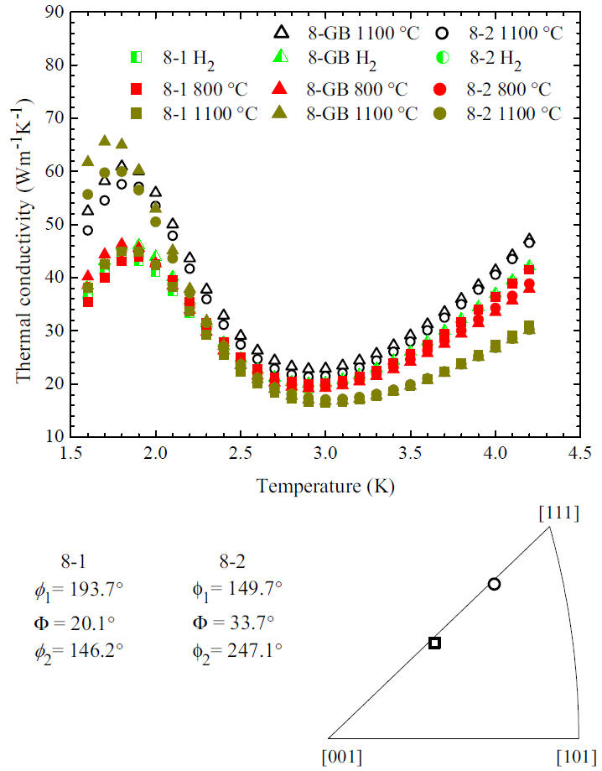
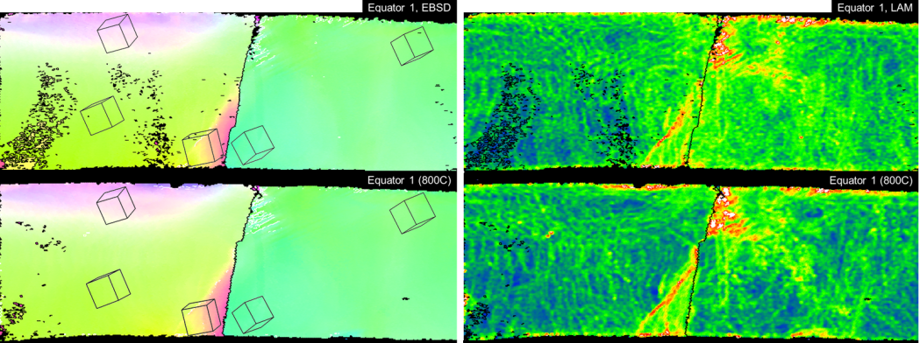
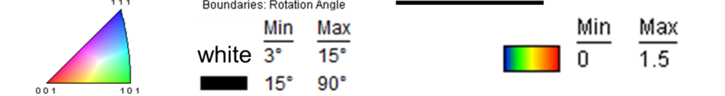
Origins of variability in cavity performance (when made with the same process) are not understood – Material Issues?
Forming cavities from large grain Nb leads to lower cost and higher Q, but performance is variable.
A high thermal conductivity, k, in Nb reduces the cost of the cryo plant; it is sensitive to H and crystal orientation (orientation triangle shows crystal heat flow direction).
  Initially annealed sample with high k at 2K was charged with H, heated to 800°C, but k was not improved, then heated to 1100° C, and one side of a bicrystal regained prior high thermal conductivity value, but not the other.
  Similar effects happen with straining.
Samples taken from equator of large grain cavity half, where hot spots commonly occur, show significant long range orientation gradients resulting from forming (left color map).
After 800°C anneal, little change in defect content (local lattice orientation gradients) near grain boundary (GB), indicated by red color features.
Bi-crystal
Grain Orientation Local Orientation Gradient
q → 1
2
As-
deformed
+ 800°
anneal
GB Equator GB
4mm
°

Slide 31
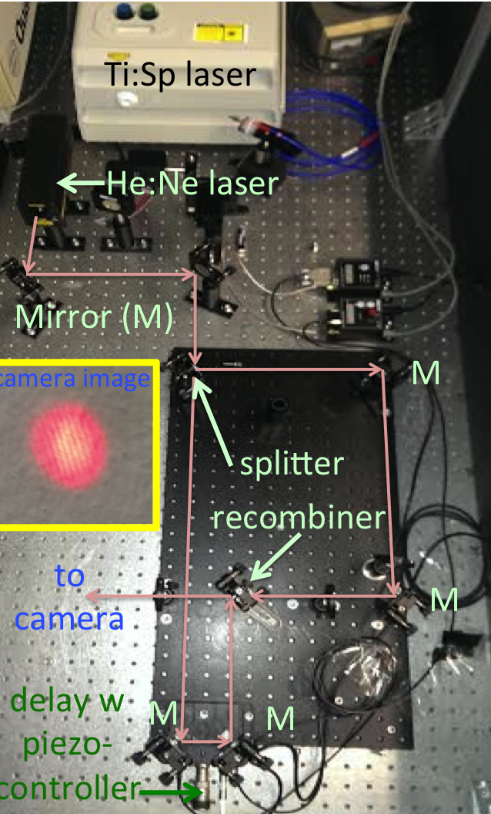
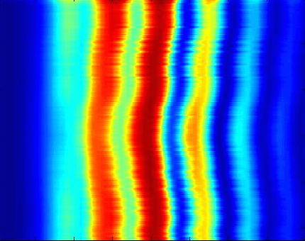
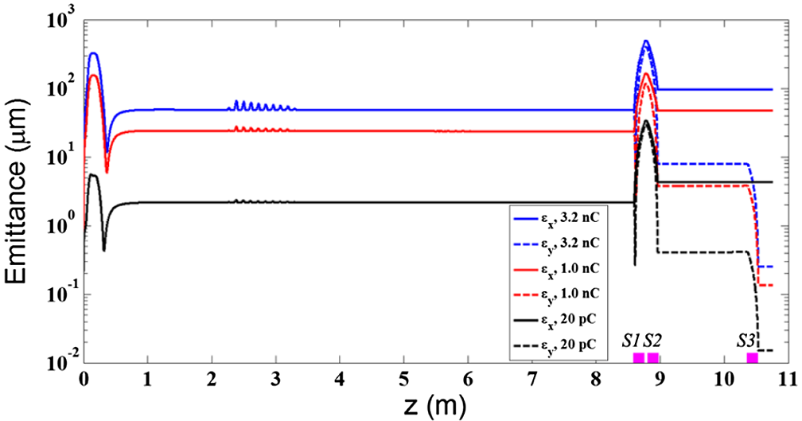
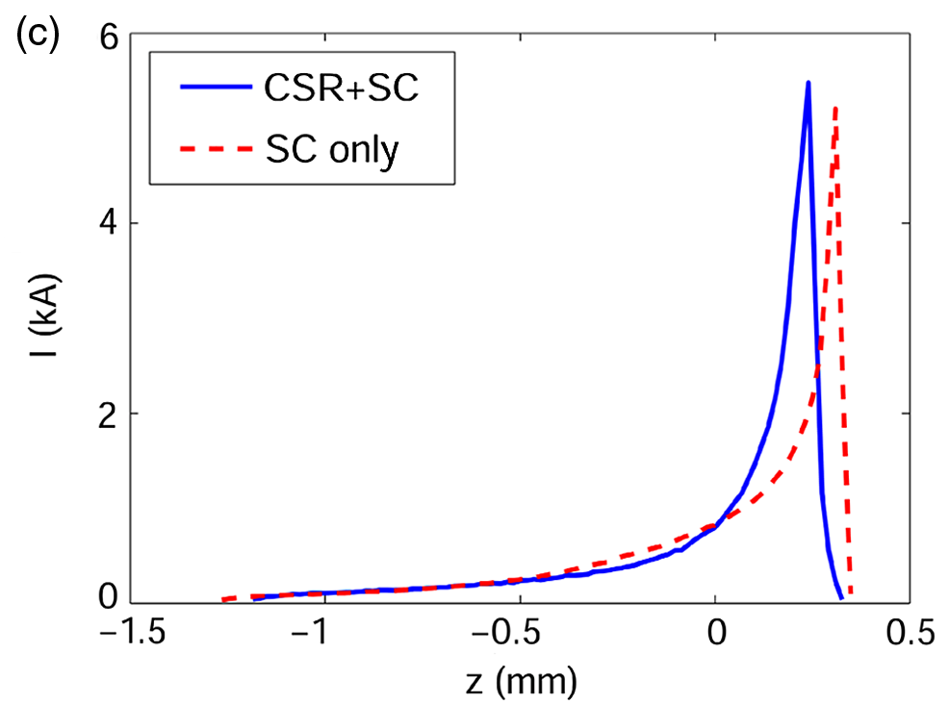
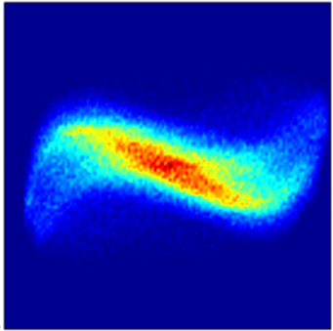
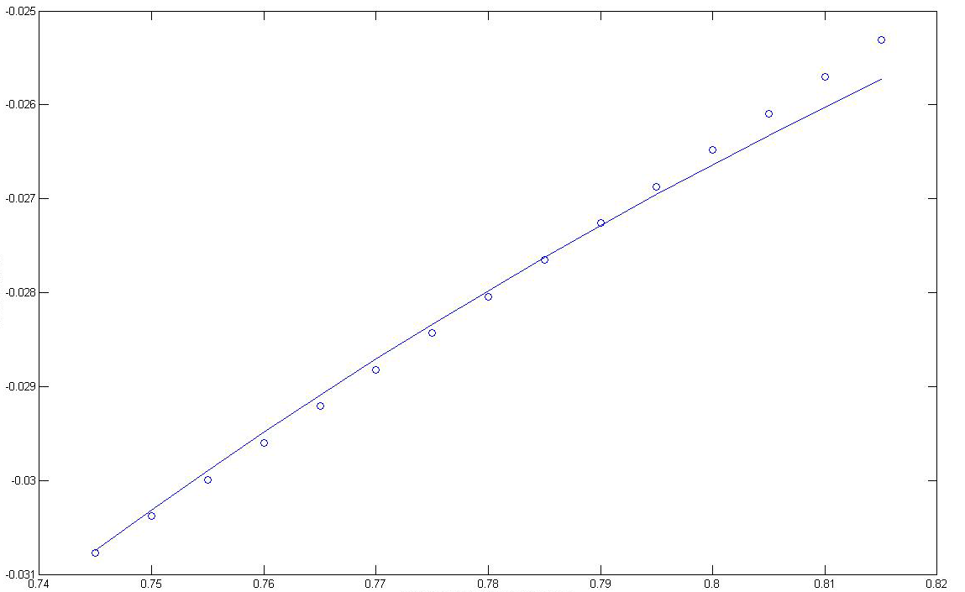
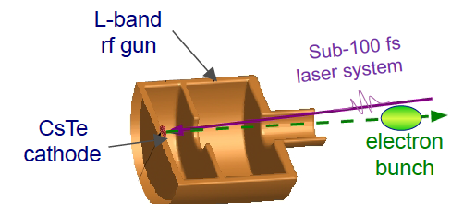
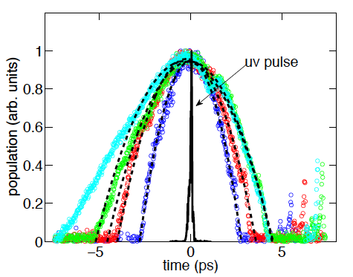


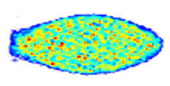


Snapshot of HEP-related researches
Phase space manipulations
  formation of compressed flat e- beam,
  transverse to longitudinal phase-space
  exchangers
R&D toward optical-stochastic cooling
at IOTA (seeded by an NIU grant)
time
CAM dominated beam
(x,y)
interference pattern
Nd:YAG
pump off
flat beam
production at
ASTA
dispersion (m⁻¹)
1 nC
o: meas.
- : Sellmeier
skew quads
wavelength (μm)
e⁻-beam shapers
  applications to beam-driven accelerators
  improve beam brightness (KV distributions)
field emission from patterned diamond
cathodes (w. Vanderbilt U) and carbon-
nanotube cathodes (w. RadiaBeam LLC)
measured
e- beam
t distrib.
cathode for RF gun
15 mA FE beam
current
time
time

Slide 32

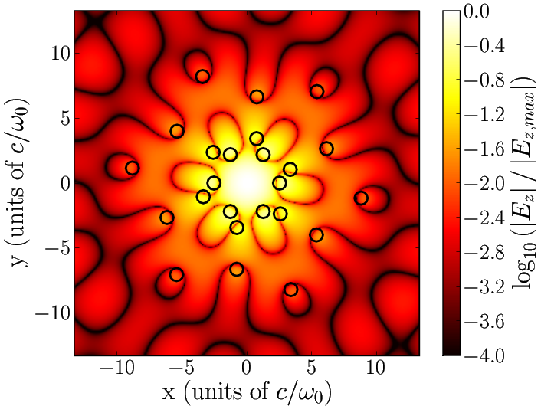
University of Colorado HEP work: Independent with impact
Developed object oriented simulation methods for plasma acceleration, cavity calculations (2 papers with total of 500 citations)
Developed hybrid dielectric/metal cavities now being built at multiple places (MIT, RadiaBeam, LANL)
Developed EM algorithms now in wide use
  DOI: 10.1016/j.jcp.2007.05.008: 41 citations
  DOI: 10.1016/j.jcp.2008.01.040: 23 citations in 5 years
  DOI: 10.1016/j.jcp.2010.12.005, DOI: 10.1016/j.jcp.2013.08.009
Developed theory of nonlinear and corrective beam transport for halo mitigation
  Increasing the dynamic aperture of accelerator lattices (Wan, Cary)
  “Control of beam halo formation …” (Sonnad, Cary)
Supervised 8 PhD’s, 3 masters, 5 postdocs through HEP support

Slide 33
What is the plan for accelerator physics at the Universities?
The health of the field requires some fraction of resources to go to independent, curiosity driven, accelerator physics research
There few to no examples of HEP funded, independent theoretical conventional accelerator physicists in AAU physics departments (there are several in advanced acceleration, a few affiliates from nearby labs)
This is way down from 10 years ago, when there was strong representation at AAU’s: UMd, UCLA, CU,
Given the P5 Rec 23, what will be done?

Slide 34
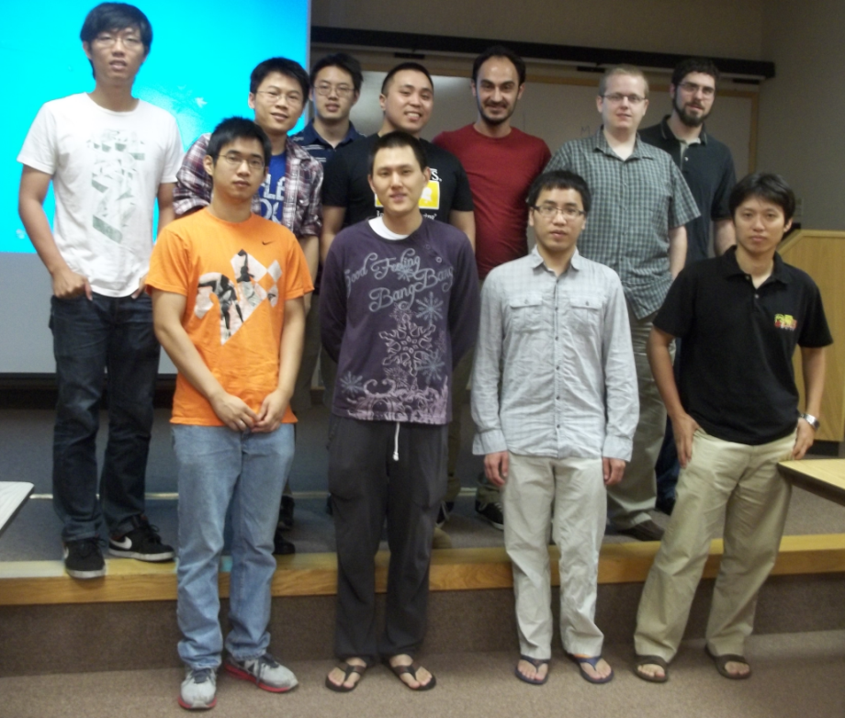
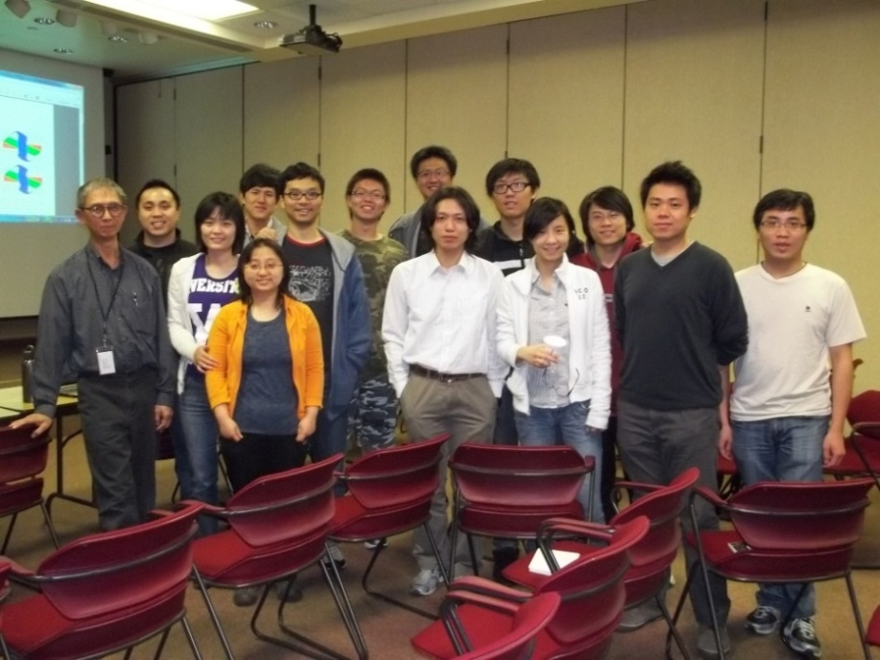
IU Accelerator and beam physics
DOE grant: DE-FG02-12ER41800 (Aug. 15, 2012- March 31, 2015)
Ph.D. granted in 2011-14
Zhengzheng Liu (MSU) 2011
Yichao Jing (BNL) 2011
Tianhuan Luo (LBNL) 2011
HungHuan Liu 2013
Alfonse Pham 5/2014
Zhenghao Gu 5/2014
SHEN, Xiaozhe 7/2014
FANG, Kun ~9/2014
Current Students
HungChun Chao
LIU, Ao
Duru, Alper
Kyung Ryun Hwang
Patrick McChesney
Jeff Eldred

Slide 35
Highlights from Cornell SRF Group

Slide 36
Highlights from Cornell SRF Group

Slide 37
MIT

Slide 38
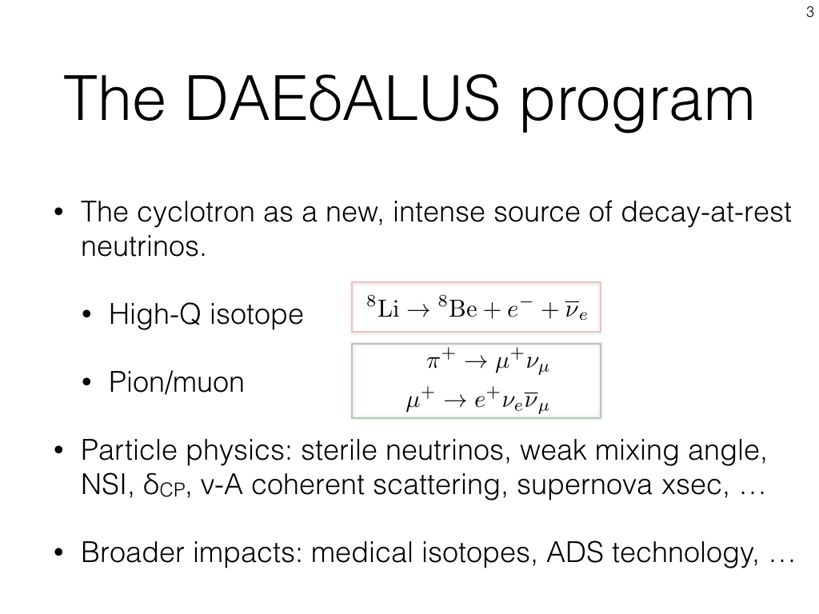
MIT

Slide 39
MIT

