Slide 1
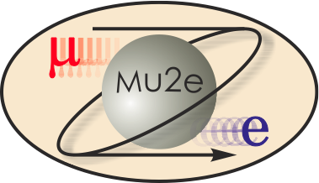
Mu2e Accelerator Upgrades Mu2e Independent Cost Review
U.S. DEPARTMENT OF
ENEGY
Office of
Science
S. Werkema
Mu2e Accelerator Upgrades Level 2 Manager
8/26/2014

Slide 2
Organization
475.2
Accelerator Systems
S. Werkema (FNAL)
475.2.1 Project Management
L3 – S. Werkema
CAM - S. Werkema
475.2.3 Instrumentation & Controls
L3 – B. Drendel
CAM - B. Drendel
475.2.4 Radiation Safety
L3 – T. Leveling
CAM - T. Leveling
475.2.5 Resonant Extraction
L3 – V. Nagaslaev
CAM – V. Nagaslaev
475.2.6 Delivery Ring RF
L3 – J. Dey
CAM – J. Dey
475.2.7 External Beamline
L3 – D. Still
CAM – D. Still
475.2.8 Extinction
L3 – E. Prebys
CAM – E. Prebys
475.2.9 Target Station
L3 – R. Coleman
CAM – R. Coleman

Slide 3
Requirements
The Mu2e Accelerator upgrades are driven by 8 requirements documents that are under Configuration Management.
Science Driven Requirements Mu2e-doc-4381
Proton Beam Requirements Mu2e-doc-1105
Beam Extinction Requirements Mu2e-doc-1175
Extinction Monitor Requirements Mu2e-doc-894
Production Target Requirements Mu2e-doc-887
Heat and Radiation Shield (HRS) Requirements Mu2e-doc-1092
Proton Absorber Requirements Mu2e-doc-948
Protection Collimator Requirements Mu2e-doc-2897
All of these documents are available on the review web site.

Slide 4
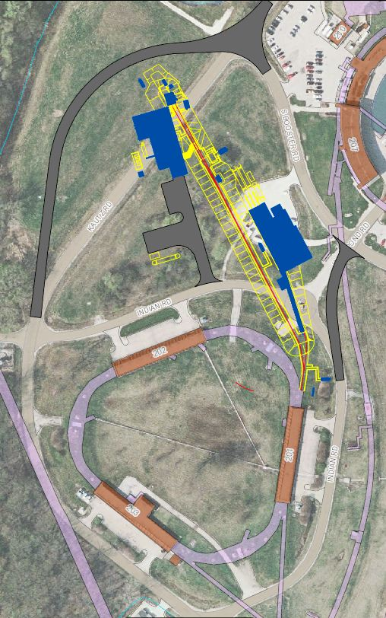
Scope Overview
×
475.02.08.03 Extinction Monitor
475.02.09 Target Station
Mu2e
Bldg
475.02.07 External (M4) Beamline
MC-1
Bldg
475.02.08.02 Extinction
475.02.03 Instrumentation & Controls
475.02.04 Radiation Safety
Everywhere
Delivery Ring
475.02.05 Resonant Extraction
475.02.06 Delivery Ring RF
Notes:
Note: The red X indicates that Kautz Road will not be routed around the Mu2e building (as is shown in this picture)

Slide 5
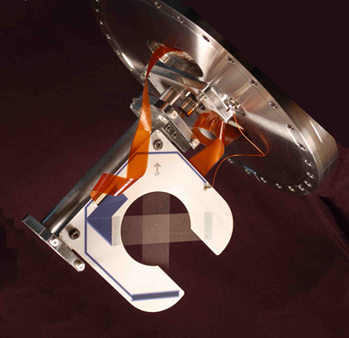
WBS 475.2.3 Instrumentation and Controls
Design and fabricate the equipment for the accelerator controls and instrumentation upgrades required for beam delivery to Mu2e.
Estimate to Complete from May 1, 2014:
475.02.03.01 Accelerator Controls ($274k)
475.02.03.02 Delivery Ring Instrumentation ($331k)
475.02.03.03 Extraction beamline Instrumentation($1,299k)
Technical Documentation* ($503k)
Basis of Estimate
Vendor quotes for materials
Understanding of the costs of implementation of similar
technology in other Fermilab beamlines.
*Technical Documentation includes costs of Technical Design Report preparation, Review preparation, BOE preparation and review, and project management costs for each Level 3
Multiwire Beam Profile Monitor

Slide 6
WBS 475.2.4 Radiation Safety
Design and implement the Radiation Safety upgrades that are required to permit an 8 kW increase in beam power and maintain the level of radiation protection required by the Fermilab Radiological Controls Manual.
Estimate to Complete from May 1, 2014:
475.02.04.01 AP1 Line to Delivery Ring Total Loss Monitor System ($73k)
475.02.04.02 Delivery Ring Radiation Safety Upgrades ($932k)
475.02.04.03 External Beamline Safety System ($316k)
475.02.04.04 Mu2e Safety Systems ($334k)
475.02.04.05 Technical Documentation ($366k)
Basis of Estimate
Known costs for fabrication and installation of prototype Total Loss Monitor radiation safety systems in beamlines at Fermilab
Shielding estimates based on implementation of similar structures for other projects at Fermilab (NuMI, NOvA).
Total Loss Monitor Detector

Slide 7
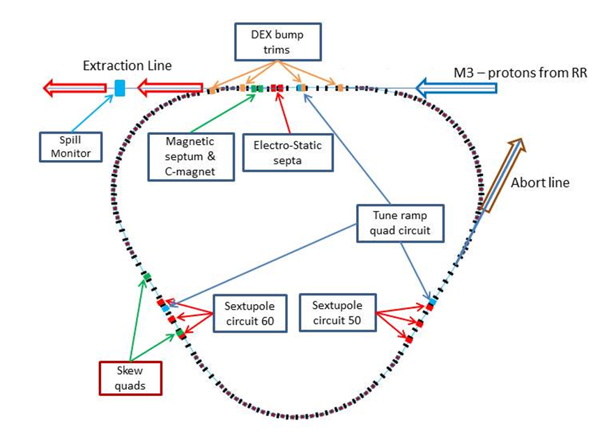
WBS 475.2.5 Resonant Extraction System
Design, manufacture, and installation of the systems necessary for the resonant extraction of beam from the Delivery Ring synchrotron.
Estimate to Complete from May 1, 2014:
475.02.05.01 General Design of Resonant Extraction System ($403k)
475.02.05.02 Electrostatic Septum (Mechanical) ($2,495k)
475.02.05.03 Magnets for the Resonant Extraction System ($914k)
475.02.05.04 Fast Feedback Devices for the Resonant Extraction System ($79k)
475.02.05.05 Fast Feedback Electronics for the Resonant Extraction System ($269k)
475.02.05.06 RF Knockout Kicker for the Resonant Extraction System ($172k)
475.02.05.07 Magnet Power Supplies for the Resonant Extraction System ($543k)
475.02.05.08 Technical Documentation for the Resonant Extraction System ($605k)
Basis of Estimate
Engineering estimates based on implementation of similar technology in other Fermilab accelerators and beamlines.
Magnet fabrication and refurbishment cost estimates based on historical procurement and labor records for fabrication of magnets of same type.

Slide 8
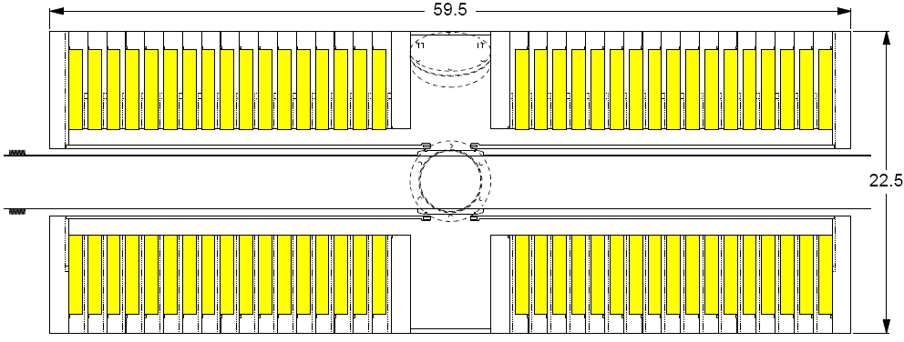
WBS 475.2.6 Delivery Ring RF System
Design and fabricate a 2.4 MHz RF system that synchronously captures beam from the Recycler Ring and holds it in a stationary RF bucket during resonant extraction.
Estimate to Complete from May 1, 2014:
475.02.06.01 Low Level RF System ($1,139k)
475.02.06.02 Delivery Ring RF Studies and Tuning ($214k)
475.02.06.03 Delivery Ring RF Cooling System ($346k)
475.02.06.04 Delivery Ring 2.4 MHz RF ($755k)
475.02.06.05 Technical Documentation ($145k)
Basis of Estimate
Engineering estimates based on implementation of similar technology in other Fermilab accelerators.
Low Level electronics cost estimates based on vendor quotes and recent experience with similar systems at Fermilab.
8 kW solid state driver amplifier cost estimate based on vendor budgetary quotes
Cross-section of 2.5 MHz RF Cavity

Slide 9
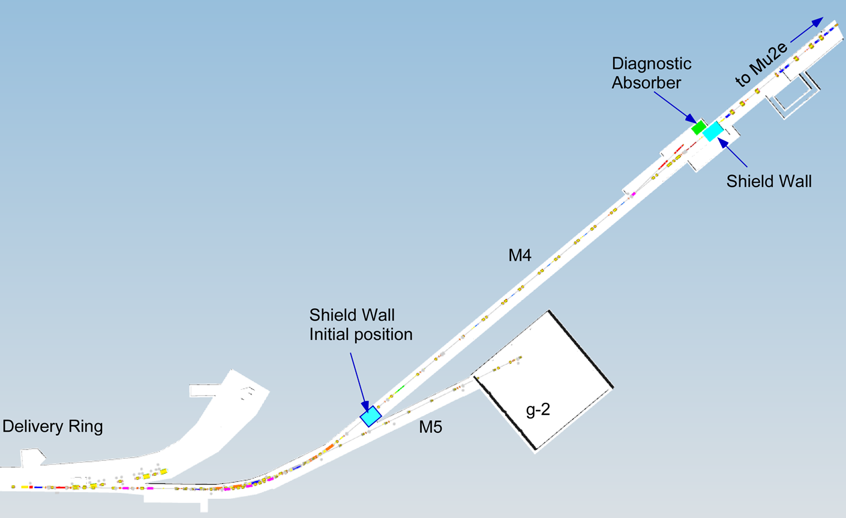
WBS 475.2.7 External Beamline
Design and implement the systems necessary to transport beam from the Delivery Ring synchrotron to the Mu2e proton target.
Estimate to Complete from May 1, 2014:
475.02.07.01 External Beamline Magnets ($1,499k)
475.02.07.02 External Beamline Magnet Power Supplies ($2,028k)
475.02.07.03 External Beamline Mechanical & Vacuum Systems ($1,357k)
475.02.07.04 External Beamline Diagnostic Absorber ($120k)
475.02.07.05 External Beamline Optics ($116k)
475.02.07.06 Oversight and Technical Documentation ($783k)
Basis of Estimate
Implementation of similar technology in other Fermilab beamlines.
Magnet fabrication/refurbishment costs based on manufacture or refurbishment of same-type magnets at Fermilab
Beamline component installation/re-installation costs based on costs of Muon Campus reconfiguration activities that are presently in progress.

Slide 10
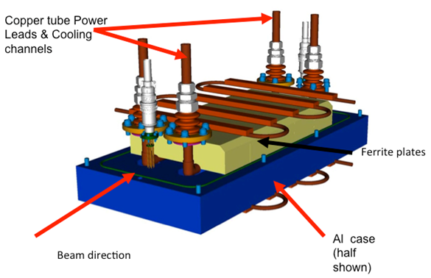
WBS 475.2.8 Extinction Systems
Design and fabricate the systems necessary for the extinction of out-of-time particles en route to the Mu2e proton target as well as the systems for monitoring the level of extinction achieved.
Estimate to Complete from May 1, 2014:
475.02.08.01 Internal Extinction System ($0k)
475.02.08.02 External Extinction System ($1,558k)
475.02.08.03 Extinction Monitoring ($1,155k)
475.02.08.04 Technical Documentation ($461k)
Basis of Estimate
AC dipole cost estimate based experience with a prototype magnet built at Fermilab
AC dipole power supply cost estimate based on engineering experience with similar technology and vendor quotes.
Extinction monitor M&S cost estimate based on catalog costs of off-the-shelf components
Extinction AC Dipole Magnet

Slide 11
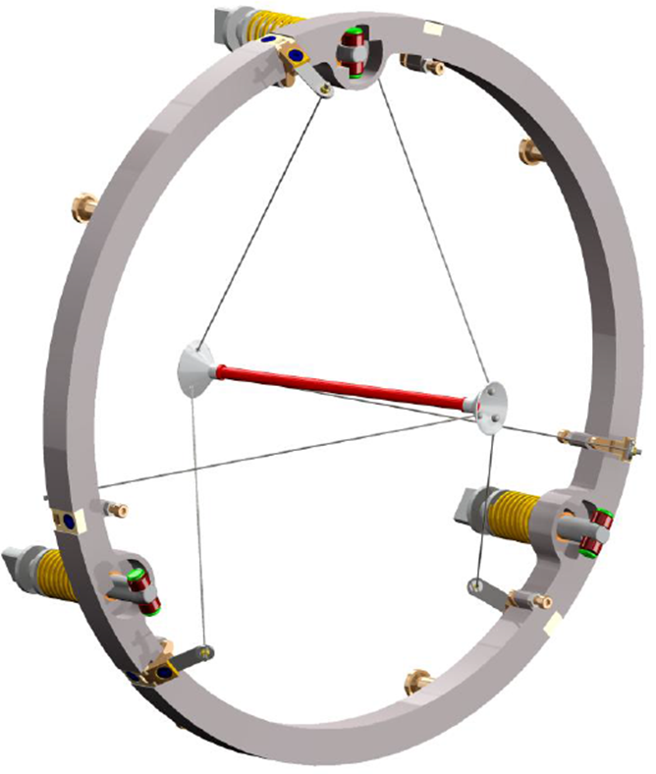
WBS 475.2.9 Target Station
Design, fabricate, and install the systems necessary for the proton target station, including the target, production solenoid (PS) heat and radiation shield (HRS), protection collimator, target handling, and the target beam absorber.
Estimate to Complete from May 1, 2014:
475.02.09.01 Simulations and Calculations ($1,397k)
475.02.09.02 Fabricate Target ($1,949k)
475.02.09.03 Target Handling ($2,585k)
475.02.09.04 Production Solenoid Heat & Radiation Shield ($2,778k)
475.02.09.05 Target Station Proton Beam Absorber ($331k)
475.02.09.06 Solenoid & HRS Protection Collimator ($327k)
475.02.09.07 Hatch Shielding Blocks ($0k)
475.02.09.08 Technical Documentation ($1,185k)
Basis of Estimate
Engineering estimates based on implementation of similar technology in other Fermilab beamlines, vendor quotes, and engineering experience.
Mu2e Proton Target
Notes:
The target station will be the focus of one of tomorrow’s drill-down sessions

Slide 12
Target Station Layout
There are five target station components:
Target
Target Remote Handling
Heat & Radiation Shield (HRS)
Proton Beam Absorber
Protection Collimator
PS
Notes:
PS = Production Solenoid

Slide 13
Risks
ACCEL- 015: Injection damper required for Delivery Ring
Orbit control may not adequately control beam trajectory and lead to excessive emittance dilution.
Risk Impact: $185k – cost to design and implement an injection damper in the Delivery Ring
Probability: Low
Mitigation: Injection studies during commissioning of Muon Campus beam prior to g-2 running
ACCEL-020: Cannot use TLMs (Total Loss Monitors) to control beam losses
TLMs not approved for use in a Fermilab radiation safety system
Risk Impact: $2,000k – Cost to fabricate approved monitoring system (chipmunks)
Probability: Very Low
Mitigation: TLMs have preliminary approval. TLMs are being installed in existing beamlines to be used alongside existing radiation safety systems. It is very likely that TLM use will be routine by the time they are needed for Mu2e.

Slide 14
Risks (Continued)
ACCEL-033: Inability to stage magnets from the Accumulator enclosure during g-2 operation
Insufficient resources or funding to move external beamline magnets into the beamline enclosure prior to g-2 beam operations
Risk Impact: $400k – alternative transport costs (cranes, access hatches)
Probability: Risk has been realized
ACCEL-038: Radiated Production Target will not survive design beam power
Calculations and prototyping demonstrate that radiative cooling will not be adequate for the production target.
Risk Impact: $175k – cost for forced cooled target R&D and testing
Probability: Low
Mitigation: Target prototype materials testing, oxidation resistant coatings, better PS vacuum
ACCEL- 151: Redesign the Remote Handling System for forced target cooling
Radiatively cooled target does not work in Mu2e environment, so cooling is required.
Risk Impact: $3,300k – Remote handling R&D and differential fabrication cost
Probability: Low
Mitigation: Target materials R&D at Rutherford Appleton Labs (see ACCEL-038)

Slide 15
Cost
475.02 Accelerator | Costs are fully burdened in AY $k
 | M & S | Labor | Base Cost | Estimate Uncertainty | % Contingency on ETC | Total
475.02.01 Accelerator Project Management | 74 | 3,395 | 3,469 | 344 | 14% | 3,813
475.02.03 Instrumentation and Controls | 775 | 1,633 | 2,407 | 527 | 26% | 2,934
475.02.04 Radiation Safety Improvements | 992 | 1,029 | 2,021 | 489 | 28% | 2,510
475.02.05 Resonant Extraction System | 1,628 | 3,853 | 5,480 | 1,626 | 34% | 7,107
475.02.06 Delivery Ring RF System | 775 | 1,825 | 2,600 | 541 | 23% | 3,141
475.02.07 External Beamline | 2,839 | 3,064 | 5,903 | 1,478 | 28% | 7,381
475.02.08 Extinction Systems | 1,473 | 1,707 | 3,179 | 780 | 30% | 3,959
475.02.09 Target Station | 5,922 | 4,629 | 10,551 | 2,768 | 30% | 13,319
475.02.10 Accelerator Conceptual Design/R&D | 660 | 4,386 | 5,045 |  |  | 5,045
475.02.99 Risk Based Contingency |  |  |  | 982 |  | 982
Total | 15,136 | 25,521 | 40,657 | 9,534 | 31% | 50,192

Slide 16
Quality of Estimate
Actual / P.O.
Preliminary
Advanced
99.5 % of Cost Estimates are at the Preliminary Design Level or Better

Slide 17
Summary
Estimates for Accelerator Upgrades are complete
99.5% of cost understood at the Preliminary Design level or higher
Estimates include lessons learned from recently completed NOvA accelerator upgrades
Risks understood, mitigated where possible. Cost set aside as contingency to cover residual risks.
Estimates are traceable
Comprehensive set of BOEs and backup information developed

