Slide 1
Challenges Summary
Contents
‘New’ Collider Projects that are already on their way:
Super KEKB
HL-LHC
➔ DA, beam-beam, space charge, e-cloud, lifetime
➔ SC magnets, SC RF [Crab Cavities & HHRF]
Collider Projects for the immediate Future (< 10 years):
Electron-Ion collider (MEIC, eRHIC, LHeC)
➔ ERL & pol.
Collider Projects for the near Future (> 10 years):
Linear Collider projects: ILC & CLIC
FCC-ee
CepC project
➔ cost, power, positrons
➔ beam lifetime, SC RF, cost
Super KEKB
➔ beam lifetime, SC RF, cost

Slide 2
Challenges Summary
Contents
Collider Projects for the long-term Future (> 20 years):
HE-LHC
FCC-hh
FCC-he
Chinese SppC project
➔ SC magnets (11T, 16T, 20T?)
➔ SC magnets, cost
➔ SC magnets, cost, power consumption
➔ SC magnets, cost
Collider Projects for the very long-term Future:
Muon collider
Collider based on Plasma-Wakefield acceleration
➔ target, cooling, fast cycling magnets, cost…
➔ ?????

Slide 3

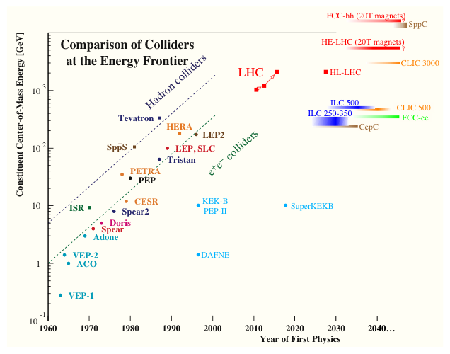

Past, Present, Future
FCC-hh16T magnets)
Tendency!
Ambitious Scope
High Costs
Long R&D times
(e.g. HL-LHC magnets > 25 years)
➜ Global Projects!
e⁺e‑ Linear Colliders
HE e⁺e‑ Storage Rings
HE pp Colliders
Notes:
But no funding!

Slide 4

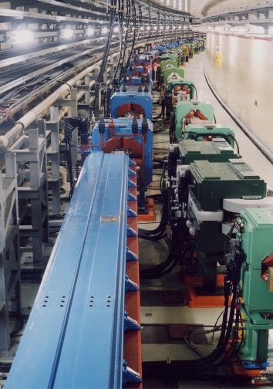

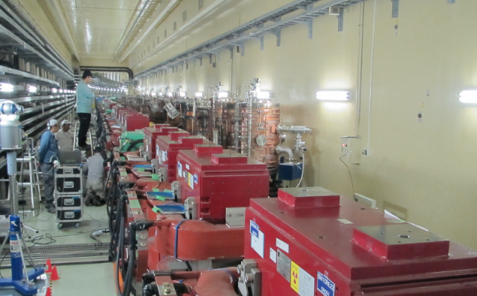
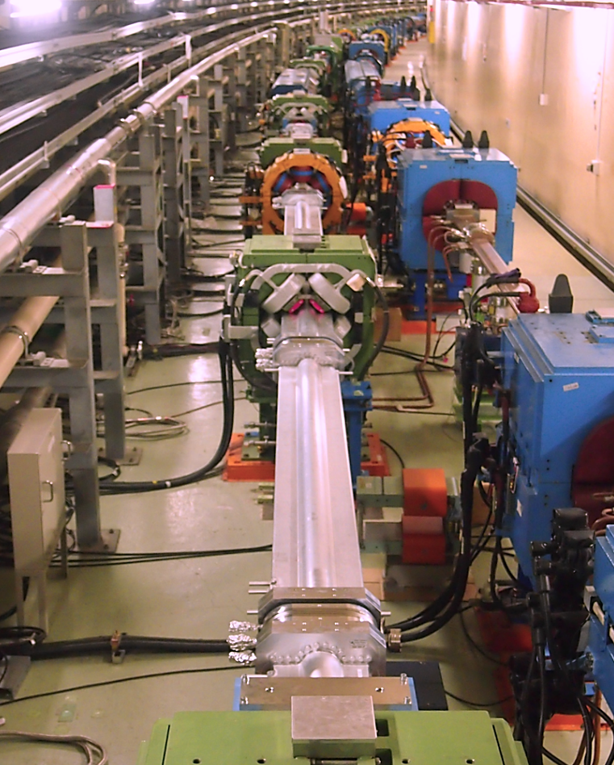
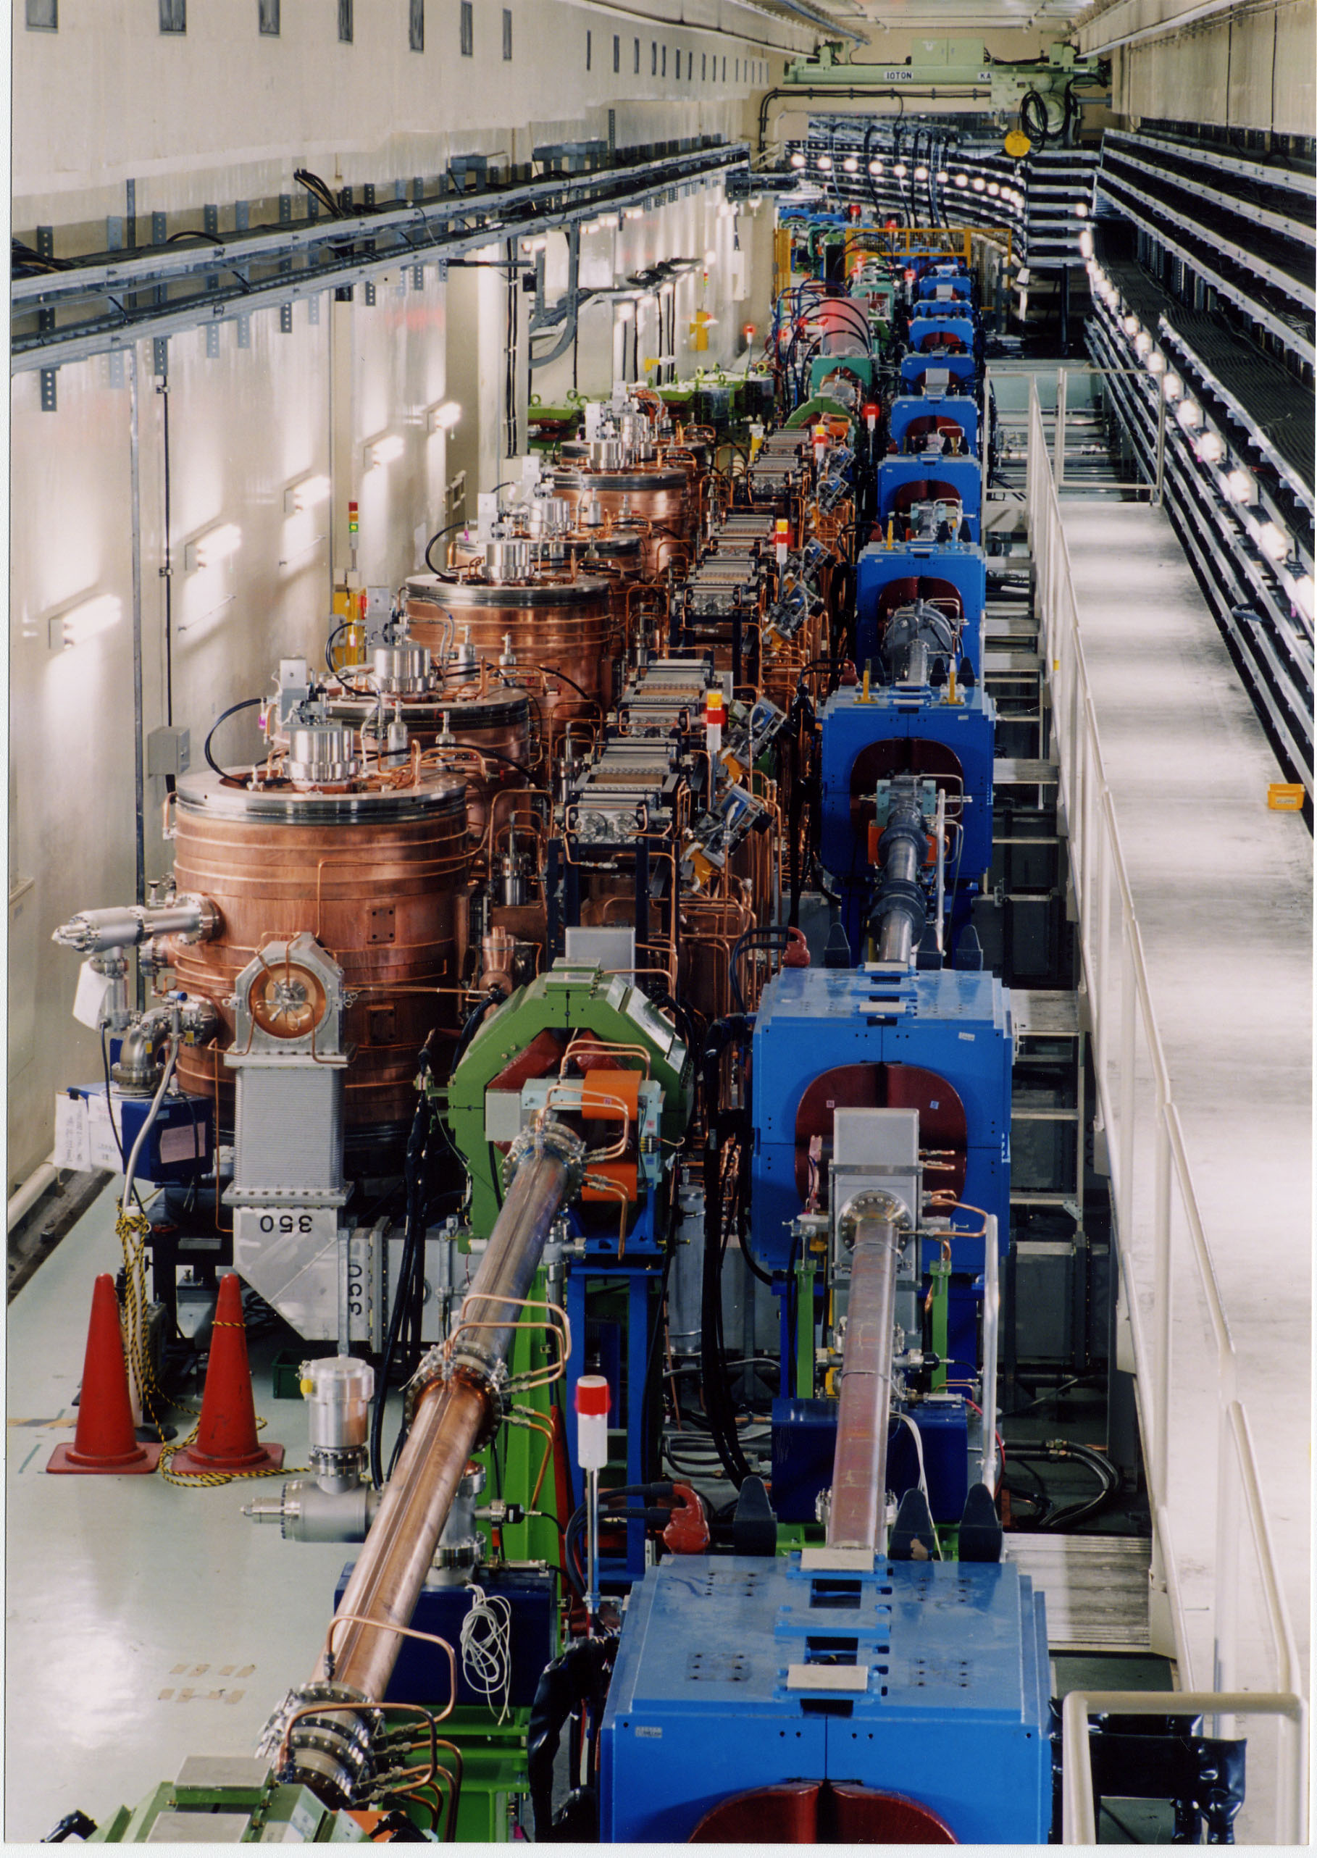
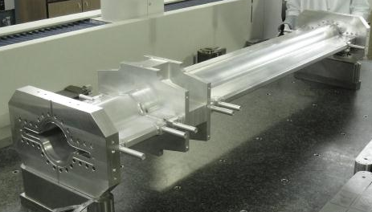
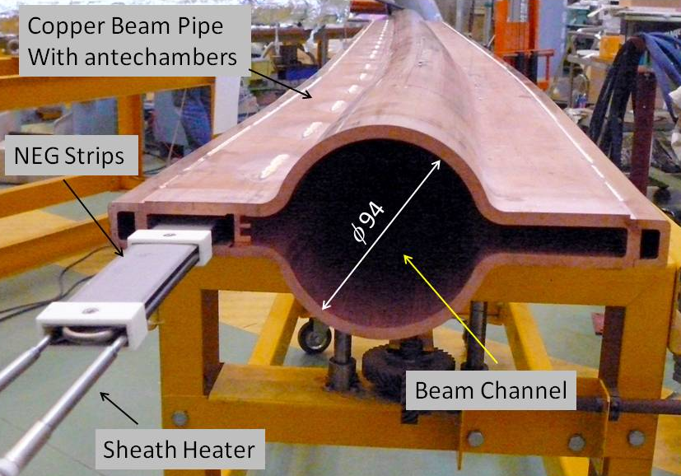
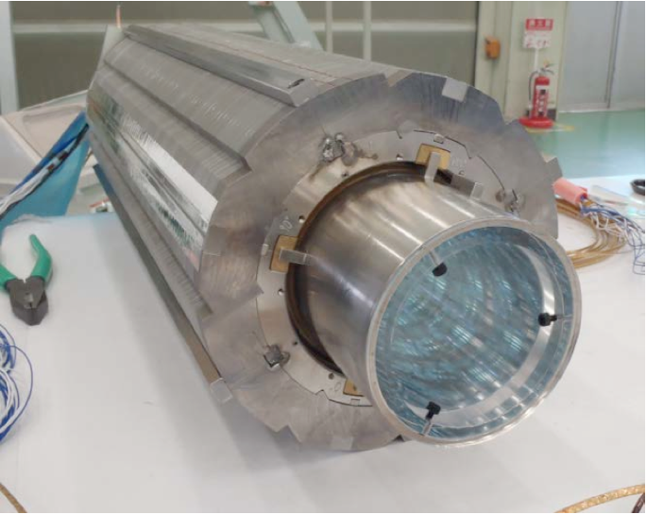
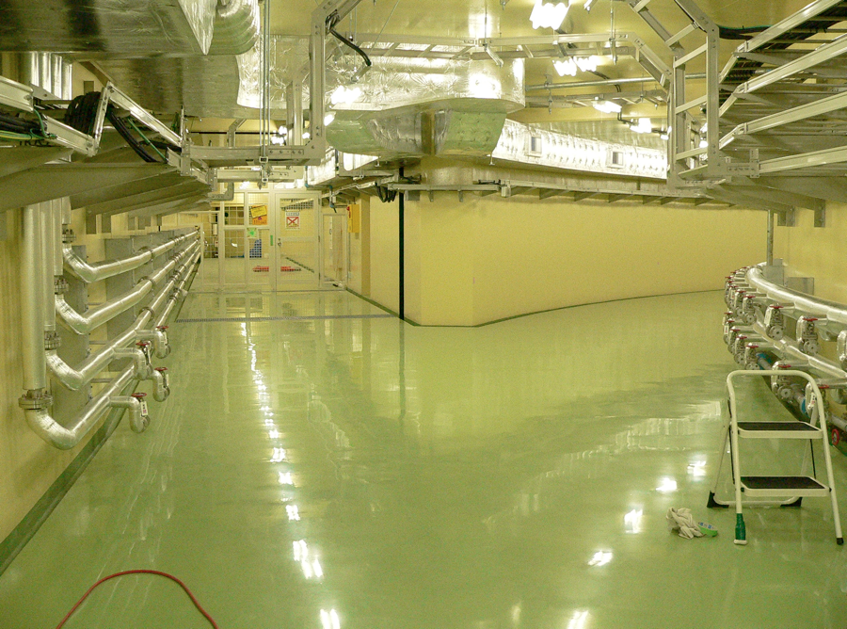
SuperKEKB
Redesign the lattice to squeeze the emittance
e⁺ 3.6A
Colliding bunches
e⁻ 2.6A
New S.C. final focusing magnets near the IP
KEKB to SuperKEKB
Nano-Beam scheme
extremely small β_{y}*
low emittance
Beam current double
New HER wiggler section
40 times higher luminosity
2.1x10³⁴ --> 8x10³⁵ cm⁻²s⁻¹
TiN-coated beam pipes with antechambers
Injector Linac upgrade
DR tunnel
New e+ Damping Ring
Reinforce RF systems

Slide 5
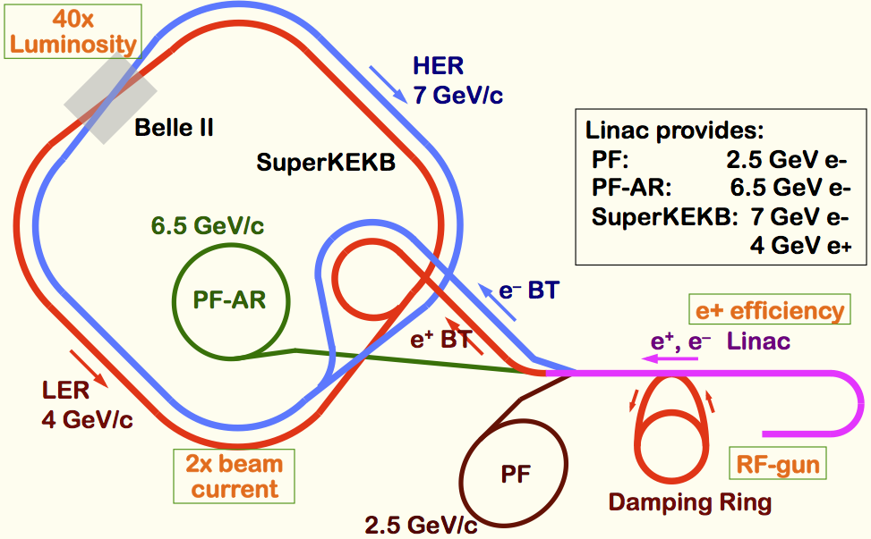
SuperKEKB: Injector
40-times higher Luminosity
  Twice larger storage beam → Higher beam current at Linac
  20-times higher collision rate with nano-beam scheme
    → Low-emittance even at first turn → Low-emittance beam from Linac
    → Shorter storage lifetime → Higher Linac beam current
Linac challenges
  Low emittance e-
    with high-charge RF-gun
  Low emittance e+
    with damping ring
  Higher e+ beam current
    with new capture section
  Emittance preservation
    with precise beam control
  4+1 ring simultaneous injection
Notes:
Higher Injection Beam Current
To Meet the larger stored beam current and shorter beam lifetime in the ring
4~8-times larger bunch current for electron and positron
Reconstruction of positron generator, etc
Lower-emittance Injection Beam
To meet nano-beam scheme in the ring
Positron with a damping ring
Electron with a photo-cathode RF gun
Emittance preservation by alignment and beam instrumentation
Quasi-simultaneous injections into 4 storage rings
SuperKEKB e–/e⁺ rings, and light sources of PF and PF-AR
Improvements to beam instrumentation, low-level RF, controls, timing, etc

Slide 6
Super KEKB:
Main challenges:
Dynamic aperture with strong beam-beam
IR optics with large momentum acceptance
Space charge effects (-> DA)
Small vertical beam size and y/x emittance ratio (0.3%)
e-cloud
beam lifetime (5min) and operation with ‘top-off’
experiment background

Slide 7
Goal of High Luminosity LHC (HL-LHC):
The main objective of HiLumi LHC Design Study is to determine a hardware configuration and a set of beam parameters that will allow the LHC to reach the following targets:
Prepare machine for operation beyond 2025 and up to 2035
Devise beam parameters and operation scenarios for:
# enabling at total integrated luminosity of 3000 fb⁻¹
# implying an integrated luminosity of 250 fb⁻¹ per year,
# design oper. for μ ≤ 140 (➔ peak luminosity of 5 10³⁴ cm⁻² s⁻¹)
> Ten times the luminosity reach of first 10 years of LHC operation!!

Slide 8
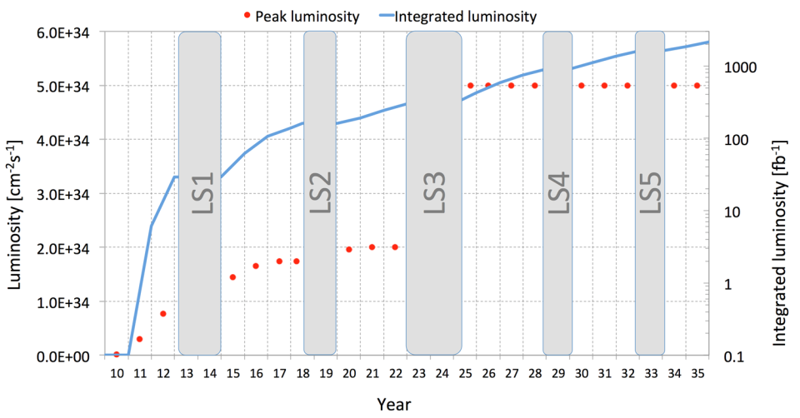
HL-LHC goal could be reached in 2036
How can we realize this jump
and steady accumulation of
Integrated Luminosity?

Slide 9
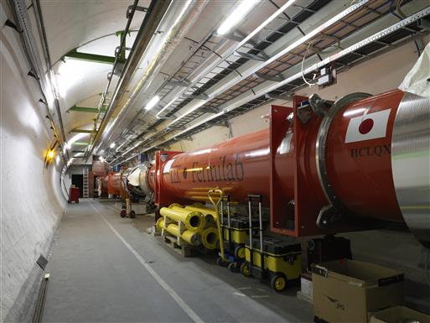

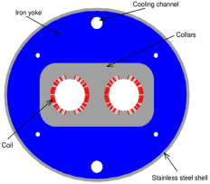

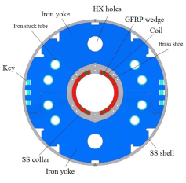
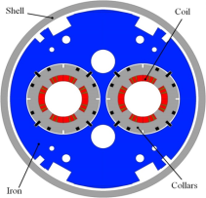
The critical zones around IP1 and IP5
ATLAS
CMS
3. For collimation we also need to change the DS in the continuous cryostat: 11T Nb₃Sn dipole
2. We also need to modify a large part of the matching section
e.g. Crab Cavities &
D1, D2, Q4 & corrector
New triplet Nb₃Sn
required due to:
-Radiation damage
-Need for more aperture
Changing the triplet region is not enough for reaching the HL-LHC goal!
More than 1.2 km of LHC !!
Plus technical infrastructure
(e.g. Cryo and Powering)!!

Slide 10


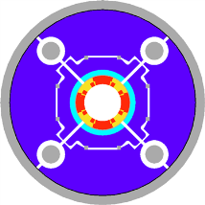
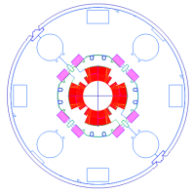
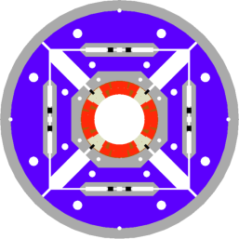
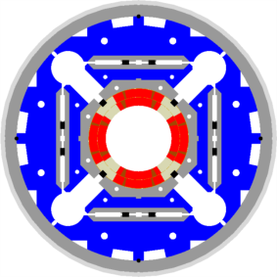

LHC low-β quads: steps in magnet technology from LHC toward HL-LHC
LHC (USA & JP, 5-6 m)
∅70 mm, B_{peak}∼ 8 T
1992-2005
LARP TQS & LQ (4m)
∅90 mm, B_{peak}∼ 11 T
2004-2010
> 10 years development for NbTi magnets
Ca. 20 years for Nb₃Sn magnet development!
LARP HQ
∅120 mm,
B_{peak}∼ 12 T
2008-2014
LARP & CERN
MQXF
∅150 mm,
B_{peak}∼ 12.1 T
2013-2020
HEPAP Accelerator Sub-Panel Road Trip, August 2014

Slide 11
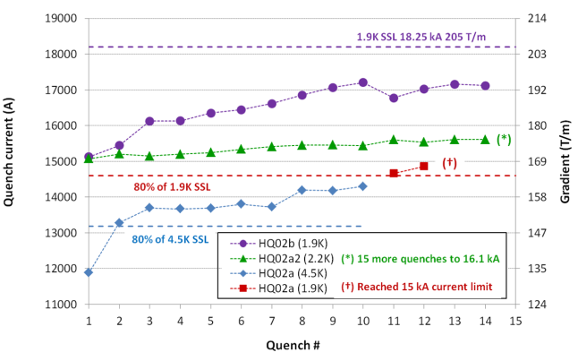
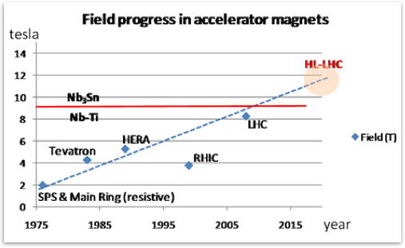
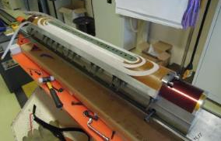
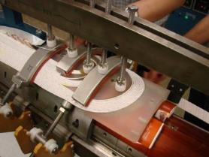
Progress with Triplet magnets:
CERN short coil
with Cu cable
LARP HQ
∅120 mm,
B_{peak}∼ 12 T
2008-2014
Short ➔ 4m
LARP & CERN MQXF
∅150 mm, B_{peak}∼ 12.1 T
2013-2020
HEPAP Accelerator Sub-Panel Road Trip, August 2014

Slide 12
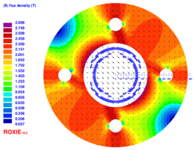
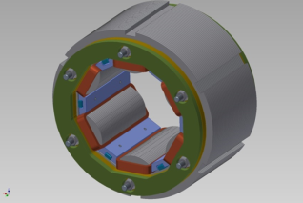
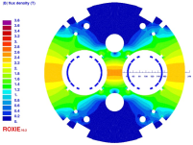
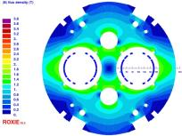
The HL-LHC Nb-Ti magnet zoo…
D1 (KEK)
Nested Orbit corrector (CIEMAT)
HO correctors: superferric (INFN)
D2 (INFN)
Q4 (CEA)
D2 corr

Slide 13
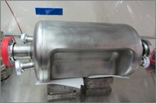
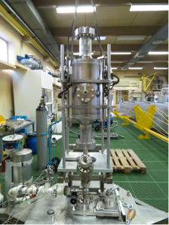
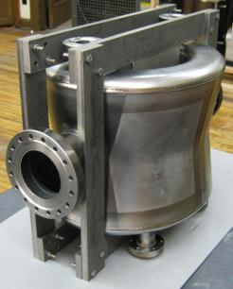
3 Crab Cavity prototypes:
RF-Dipole Nb prototype [ODU-SLAC]
4-rod in SM18 for RF measurements [Lancaster UK]
4-rod prepared for rinsing @ CERN
Concept of RF Power system
DQWR prototype (17-Jan-2013) [BNL]

Slide 14

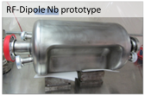
And excellent results: e.g. RF dipole > 5 MV
¼ w and 4-rods also tested (1.5 MV)
2 K result
4.2 K result
Quench
Initial goal was 3.5 MV
however ΔV > 5-6 MV would ease integration
JP Delahayen ODU 2013
5

Slide 15
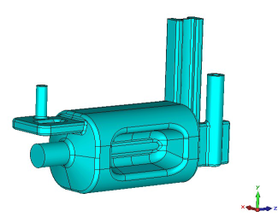
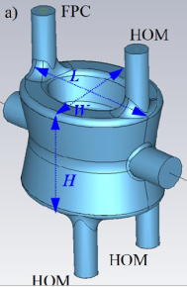
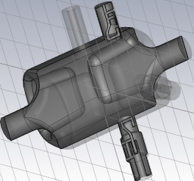
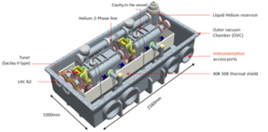
Latest cavity designs toward accelerator
3 Advanced Design Studies with
Different Coupler concepts
RF Dipole: Waveguide or
waveguide-coax couplers
Concentrate on two designs in order to be ready
for test installation in SPS in 2016/2017 TS
Validation with beam operation is vital!!!
Double ¼-wave: Coaxial couplers with
hook-type antenna
4-rod: Coaxial couplers with different antenna types
Present baseline: 4 cavity/cryomod
TEST in SPS under preparation for 2017
HEPAP Accelerator Sub-Panel Road Trip, August 2014

Slide 16
HL-LHC: Main Challenges
Developing new SC magnet technology (Nb₃Sn):
> 20 years of dedicated R&D!!
New triplet magnets optimized for >12T and large aperture
New 11T dipole magnets (field quality!)
Developing new SC RF technology:
1989 proposed for KEKB
Elliptical design for KEKB in 1991
Operational in 2007 ➔ 18 years for elliptical cavity
2001: proposed as an option for HL-LHC
LHC requires compact resonators and excludes elliptical design
2008 validation workshop for HL-LHC
Novel design approaches (double quarter wave resonators and 4-rod)
      ➔ welding, rinsing and surface treatment!
Operation in hadron storage ring ➔ noise!!
➔ > 20 years development time for HL-LHC cavities!
HEPAP Accelerator Sub-Panel Road Trip, August 2014

Slide 17

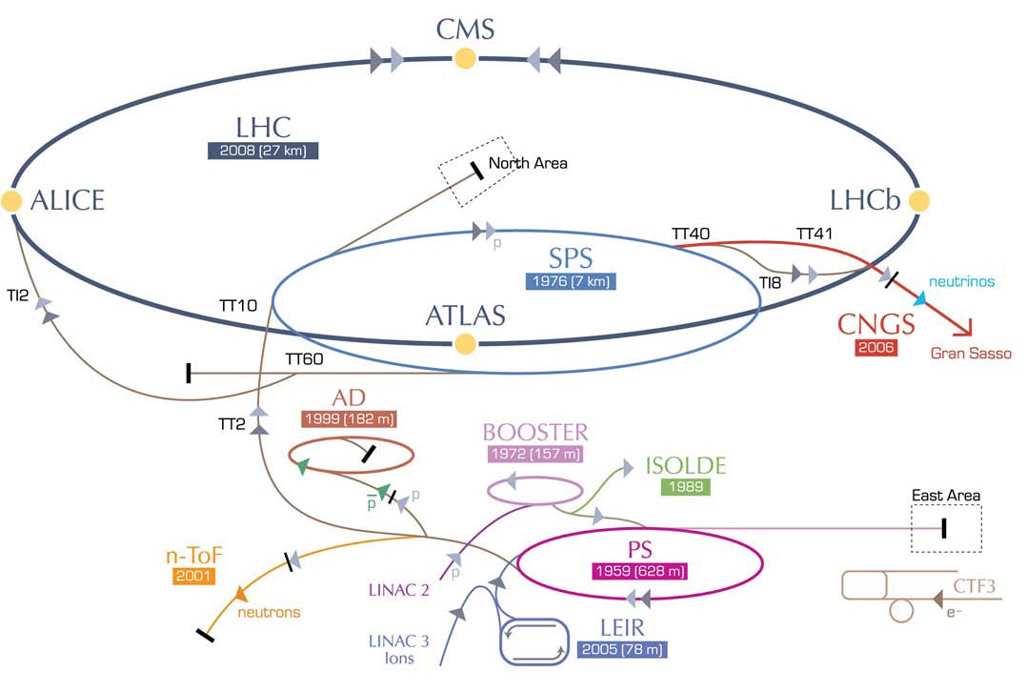
LHeC options:
RR LHeC:
new ring in
LHC tunnel,
with bypasses
around
existing
experiments
RR LHeC
e-/e+ injector
10 GeV,
10 min. filling time
LR LHeC:
Straight or
Recirculating
Linac;
RCL with
Energy Recovery
Operation
HEPAP Accelerator Sub-Panel Road Trip, August 2014
Oliver Brüning, CERN
17

Slide 18

LHeC: Baseline Linac-Ring Option
Super Conducting Linac with Energy Recovery
& high current (> 6mA)
Two 1 km long SC
linacs in CW operation (Q > 10¹⁰)
requires Cryogenic
system comparable
to LHC system!
10³⁴ cm⁻² s⁻¹ Luminosity reach | PROTONS | ELECTRONS
Beam Energy [GeV] | 7000 | 60
Luminosity [10³³cm⁻²s⁻¹] | 16 | 16
Normalized emittance γε_{x,y} [μm] | 2.5 | 20
Beta Funtion β∗_{x,y} [m] | 0.05 | 0.10
rms Beam size σ∗_{x,y} [μm] | 4 | 4
rms Beam divergence σ’∗_{x,y} [μrad] | 80 | 40
Beam Current [mA] | 1112 | 25
Bunch Spacing [ns] | 25 | 25
Bunch Population | 2.2*10¹¹ | 4*10⁹
Bunch charge [nC] | 35 | 0.64
10³³ cm⁻² s⁻¹ Luminosity reach | PROTONS | ELECTRONS
Beam Energy [GeV] | 7000 | 60
Luminosity [10³³cm⁻²s⁻¹] | 1 | 1
Normalized emittance γε_{x,y} [μm] | 3.75 | 50
Beta Funtion β∗_{x,y} [m] | 0.1 | 0.12
rms Beam size σ∗_{x,y} [μm] | 7 | 7
rms Beam divergence σ’∗_{x,y} [μrad] | 70 | 58
Beam Current [mA] | 430 (860) | 6.6
Bunch Spacing [ns] | 25 (50) | 25 (50)
Bunch Population | 1.7*10¹¹ | (1*10⁹) 2*10⁹
Bunch charge [nC] | 27 | (0.16) 0.32
Relatively large return arcs
ca. 9 km underground tunnel installation
total of 19 km bending arcs
same magnet design as for RR option: > 4500 magnets

Slide 19
LHeC: Summary
Challenge SC RF technology:
800 MHz high Q₀ cavities for CW op. with high gradient (> 18MV)
Challenge Energy Recovery Technology:
Beam-Beam interaction and parasitic operation to HL-LHC
Positron source
Multi-turn ERL, high energy, high beam current operation
Strong points:
Complementary to HL-LHC ➔ HL-LHC as precision machine
Full exploitation of LHC infrastructure
Higgs production
Moderate cost ➔ intermittent project option
gamma-gamma collider option

Slide 20
Output: Post-LHC high energy frontier machines
European Strategy for Particle Physics
High-priority large-scale scientific activities
After careful analysis of many possible large-scale scientific activities requiring significant resources, sizeable collaborations and sustained commitment, the following four activities have been identified as carrying the highest priority (the point below is the one relating to very high energy machines)
d) To stay at the forefront of particle physics, Europe needs to be in a position to propose an ambitious post-LHC accelerator project at CERN by the time of the next Strategy update, when physics results from the LHC running at 14 TeV will be available. CERN should undertake design studies for accelerator projects in a global context, with emphasis on proton-proton and electron-positron high energy frontier machines. These design studies should be coupled to a vigorous accelerator R&D programme, including high-field magnets and high-gradient accelerating structures, in collaboration with national institutes, laboratories and universities worldwide.
Notes:
Used as motivation/marching orders for FCC (high energy frontier hadrons and high field magnets) and CLIC (high energy frontier e-e+ and high gradient accelerating structures)

Slide 21
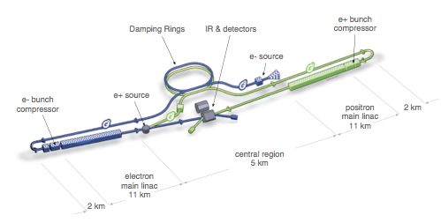

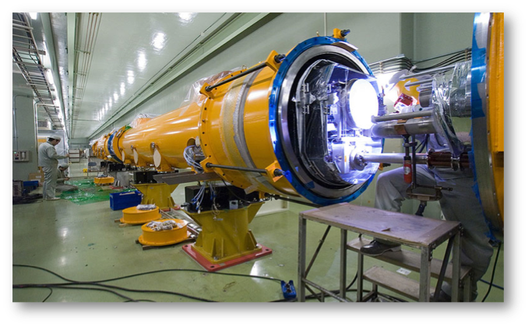

International linear collider
200-500 GeV cm (extendable to 1 TeV)
  L ~ 1.8×10³⁴ cm⁻²s⁻¹ (@ 500GeV)
  7.8 Billion ILCU + 23 Million p-hrs
>20 years R&D worldwide
  A truly global effort
  Over 2,000 man years
  >300 M$ globally
Cost driver: SRF technology
  17,000 1.3 GHz Nb cavities
  1,800 cryomodules
Mature SRF technology

Slide 22
ILC - a global project
courtesy: A. Yamamoto (KEK)

Slide 23
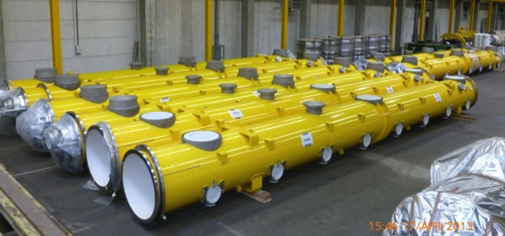
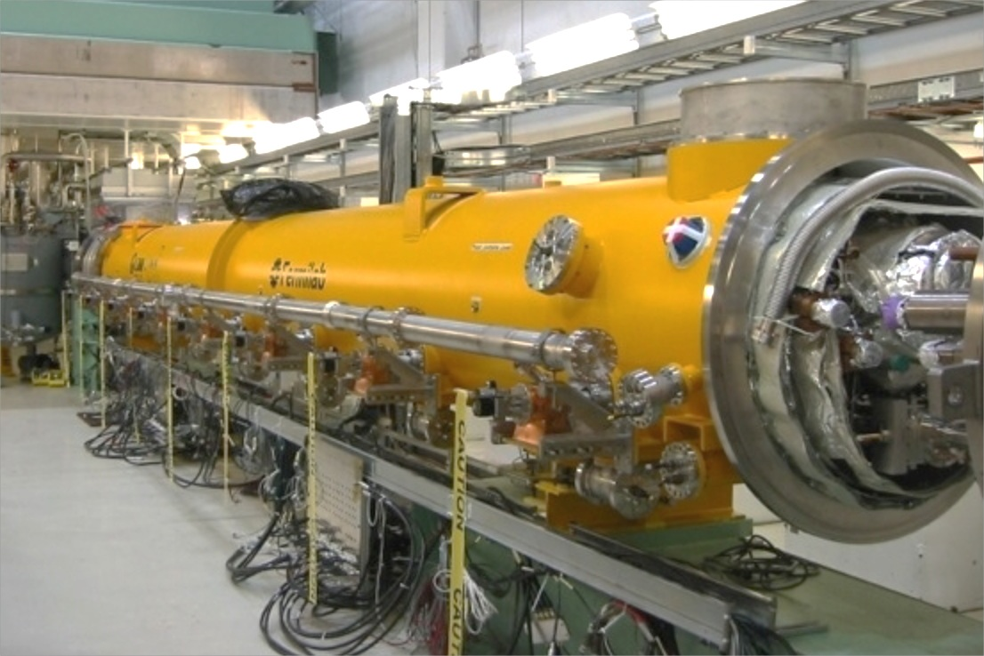

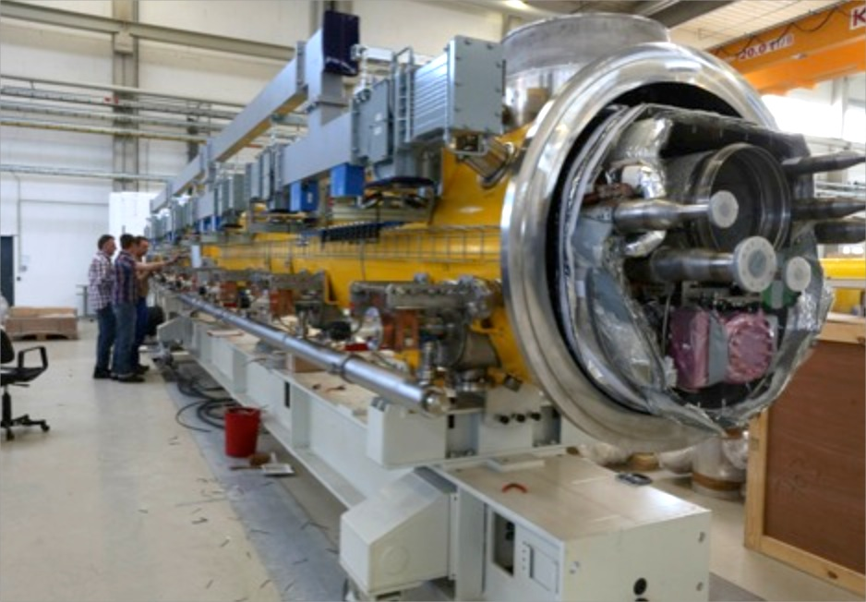

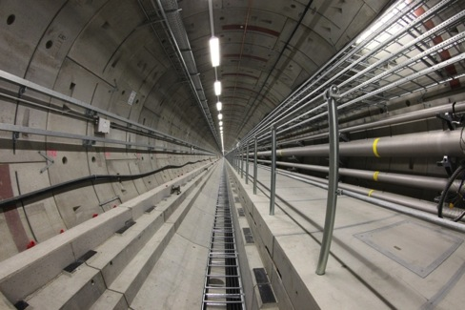
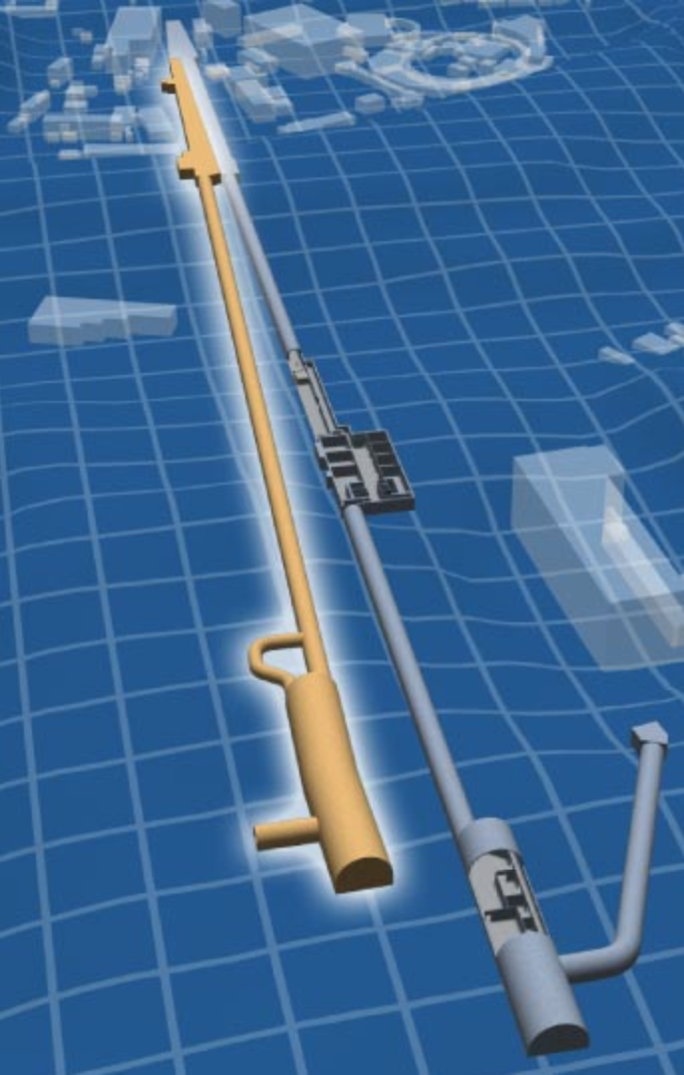
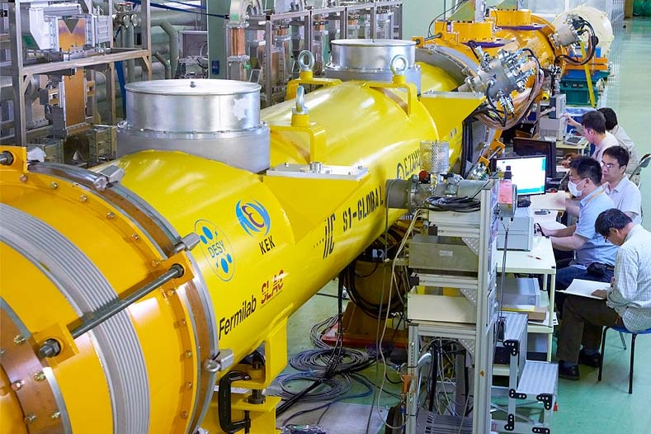
Largest deployment of this technology to date
100 cryomodules
800 cavities
17.5 GeV (pulsed)
Kitakami
proposed site
FNAL/ANL
SLAC
◉
◉
◉
◉
Cornell
◉
JLab
LAL/
Saclay
DESY
KEK
◉
◉
LCLS-II
INFN Milan
◉
preliminary data; results are not published
US infrastructure for
35 cryomodules
280 cavities
4 GeV (CW)
US and EU (industrial) production and test capacity.
Perfectly placed for start of ILC construction end
of this decade.

Slide 24
ILC: Summary
Challenges:
SC RF production [cost]
Accelerating field [energy reach]
Maximum energy (cost): 500 GeV CM (Higgs) ➔ 1TeV CM
Positron production
Main strong points:
European XFEL as technology demonstrator
Feedback options

Slide 25
CLIC
total length (main linac) ~11 (500 GeV) - 48 km (3 TeV)

Slide 26
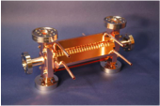
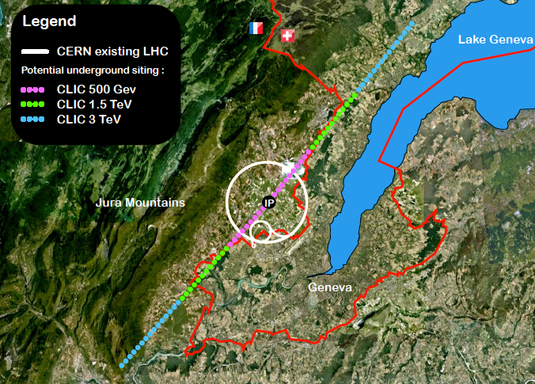
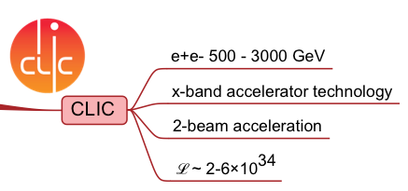
Compact LInear Collider (CLIC)
4.2-100A
G_{a} ~ 100 MV/m
3 TeV cm layout
LC represents a PARADIGM shift
0.5 TeV: 8,300 MCHF (ℒ ~ 1.4×10³⁴)

Slide 27
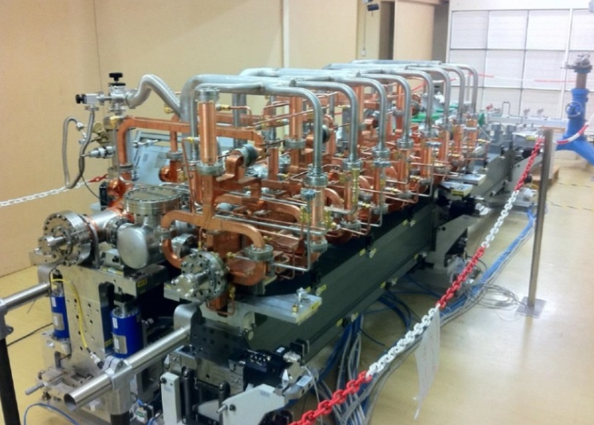
Compact LInear Collider (CLIC)
4.2-100A
G_{a} ~ 100 MV/m
3 TeV cm layout
LC represents a PARADIGM shift
0.5 TeV: 8,300 MCHF (ℒ ~ 1.4×10³⁴)

Slide 28
CLIC: Main activities and goals for 2018
Physics studies related to energy frontier capabilities and potential new physics as it emerges from LHC
Detector R&D compatible with CLIC specifications
High Gradient structure development and significantly increased test-capacity for X-band RF-structures
System-test programmes in CTF3, at ATF and FACET, as well as system-tests in collaborative programmes with light-source laboratories
Technical systems developments, related among others to complete modules, alignment/stability, instrumentation and power sources
A re-baselined staged project plan, cost and power optimisation, increased industrialisation effort for cost-drivers
Notes:
Number 3: high gradient structure, need 8 per 2m, gradient 100 MV/m
Number 4: CTF3 is at CERN, ATF at KEK, FACET at SLAC

Slide 29
CLIC Summary:
Main Challenges
Power consumption
Cost
Generation and preservation of low emittance beams (alignment)
Collision of beams with nm scale transverse size at the IP
Accelerating field and break down rate
Main strong points
Potential high energy reach: > TeV scale CM energies
Drive beam power concept

Slide 30
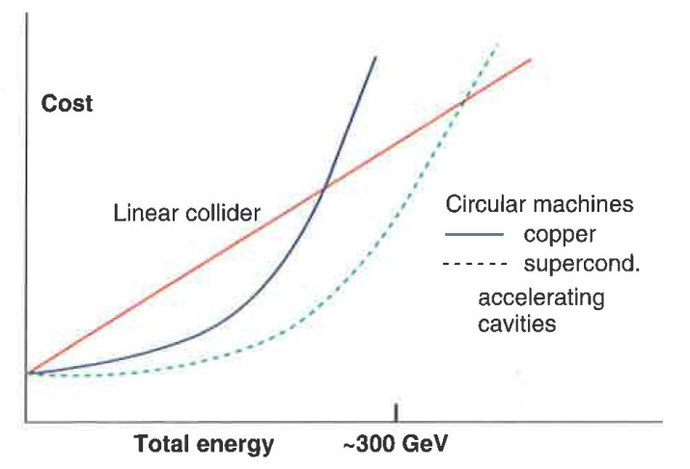
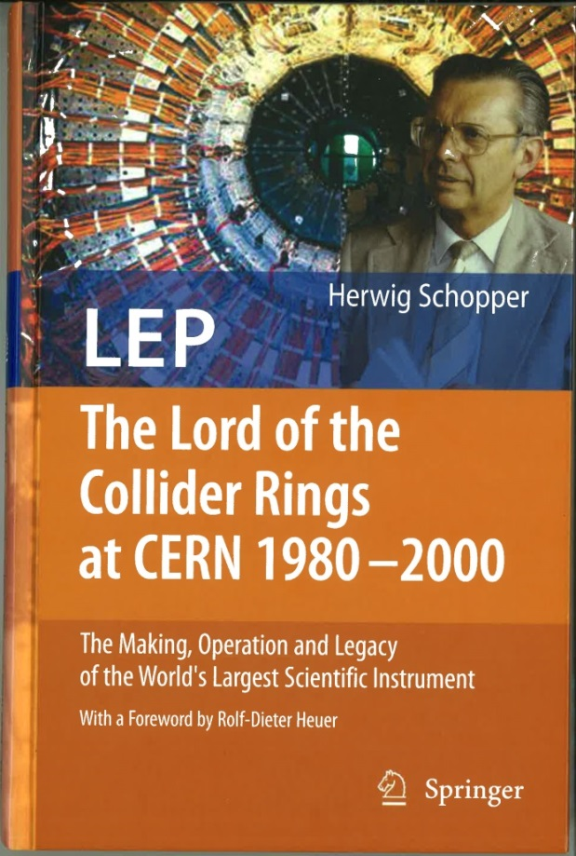
Circular e⁺/e⁻ Collider Options:
Up to a cm energy of ~350 GeV circular colliders with sc RF provide a competitive option
Herwig Schopper, LEP - The Lord of the Collider Rings at CERN 1980 - 2000, Springer 2009
with a foreword by Rolf-Dieter-Heuer

Slide 31

Design luminosity vs. energy
ultimate precision
at Z, WW, ZH ;
sensitive to New
Physics in multi-TeV range
constant power (≤2 x ILC500)
constant β_{y}
ultimate energy reach
up to 1 or 3 TeV ;
direct searches
for New Physics

Slide 32


Circular Lepton Colliders: Higgs & more
FCC-ee [CERN]
Ecm 90-350 GeV
C 100 km
L/ip 28-1.7×10³⁴ cm⁻²s⁻¹
Ib 1450-7 mA
PSR 100 MW
Ready for physics: 2030+ ?
CepC [IHEP]
Ecm 240 GeV
C 50 km (80km?)
L/ip 1.8×10³⁴ cm⁻²s⁻¹
Ib 17 mA
PSR 100 MW
Ready for physics: 2028+
Ecm 208 GeV
C 27 km
L/ip 0.01×10³⁴ cm⁻²s⁻¹
Ib 3.0 mA
PSR 22 MW

Slide 33

Chinese Circular e⁺/e⁻ Collider
Qinhuangdao (秦皇岛）
CepC, SppC
50 km
easy access
300 km from Beijing
3 h by car
1 h by train
70 km
Yifang Wang

Slide 34
Main parameters for CEPC
Parameter | Unit | Value | Parameter | Unit | Value
Beam energy [E] | GeV | 120 | Circumference [C] | km | 50.0
Number of IP[N_{IP}] |  | 2 | SR loss/turn [U₀] | GeV | 2.96
Bunch number/beam[n_{B}] |  | 50 | Bunch population [Ne] |  | 3.52E+11
SR power/beam [P] | MW | 50 | Beam current [I] | mA | 16.89
Bending radius [ρ] | m | 6200 | momentum compaction factor [α_{p}] |  | 4.00E-05
Revolution period [T₀] | s | 1.67E-04 | Revolution frequency [f₀] | Hz | 5995.85
emittance (x/y) | nm | 6.9/0.021 | β_{IP}(x/y) | mm | 800/1.2
Transverse size (x/y) | μm | 74.30/0.16 | ξ_{x,y}/IP |  | 0.097/0.069
Beam length SR [σ_{s.SR}] | mm | 2.12 | Beam length total [σ_{s.tot}] | mm | 2.42
Lifetime due to Beamstrahlung | min | 80 | lifetime due to radiative Bhabha scattering [τ_{L}] | min | 53.98
RF voltage [V_{rf}] | GV | 6.87 | RF frequency [f_{rf}] | GHz | 0.7*
Harmonic number [h] |  | 116747 | Synchrotron oscillation tune [ν_{s}] |  | 0.196
Energy acceptance RF [h] | % | 5.71 | Damping partition number [Jε] |  | 2
Energy spread SR [σ_{δ.SR}] | % | 0.13 | Energy spread BS [σ_{δ.BS}] | % | 0.07
Energy spread total [σ_{δ.tot}] | % | 0.15 | n_{γ} |  | 0.21
Transverse damping time [n_{x}] | turns | 81 | Longitudinal damping time [n_{ε}] | turns | 40
Hourglass factor | Fh | 0.704 | Luminosity/IP [L] | cm⁻²s⁻¹ | 1.77E+34
*Main ring rf frequency is changed to 650MHz and booster rf frequency is set to 1.3Ghz
The injection linac frequency is chosen 2856MHz

Slide 35
Comparison of key design parameters
Parameter | LEP2 | FCC-ee |  |  | ILC
 |  | Z | H | t | H | 500 | 1 TeV
E (GeV) | 104 | 45 | 120 | 175 | 125 | 250 | 500
<I (mA)> | 4 | 1400 | 30 | 7 | 0.000021 | .000021 | .000027
P _{SR/b,tot} [MW] | 22 | 100 | 100 | 100 | 5.9 | 10.5 | 27.2
P_{AC} [MW] | ~200 | ~260 | ~270 | ~300 | ~129 | ~163 | ~300
η_{wall→beam} [%] | ~30 | 30-40 | 30-40 | 30-40 | 4.6 | 6.4 | 9.1
N_{bunch/ring (pulse)} | 4 | 16’700 | 1’330 | 98 | 1312 | 1312 | 2450
f_{coll} (kHz) | 45 | 50000 | 4000 | 294 | 6.6 | 6.6 | 9.8
β*_{x/y} (mm) | 1500/ 50 | 500 / 1 | 500 /1 | 1000/1 | 13 | 11 | 11
ε_{x} (nm) | 30-50 | 29 | 1 | 2 | 0.04 | 0.02 | 0.01
ε_{y} (pm) | ~250 | 60 | 2 | 2 | 0.14 | 0.07 | 0.03
ξ_{y} (ILC: n_{γ}) | 0.07 | 0.03 | 0.09 | 0.09 | (1.12) | (1.72) | (2.12)
n_{IP} | 4 | 4 | 4 | 4 | 1 | 1 | 1
L_{0.01}/IP | 0.012 | 28 | 6.0 | 1.8 | 0.65 | 1.05 | 2.2
L_{0.01,tot} (10³⁴ cm⁻²s⁻¹) | 0.048 | 112 | 24 | 7.2 | 0.65 | 1.05 | 2.2

Slide 36
Circular e⁺/e⁻ Summary:
Main Challenges
Tunnel
SC RF
Short beam lifetime & top-up operation ➔ Super KEKB
Main strong points
Impressive performance track record for circular colliders
Potential synergy (tunnel) with future hh Collider project
Energy reach compatible with Higgs and top physics
Positron source requirements

Slide 37

e⁺ source – rate requirements
 | S-KEKB | SLC | CLIC (3 TeV) | ILC (H) | FCC-ee (H)
e⁺ / second | 2.5 x 10¹² | 6 x 10¹² | 110 x 10¹² | 200 x 10¹² | 0.05 x 10¹²
L. Rinolfi
X 18
X 33
/ 120
ILC e⁺ source design
ILC e+ source has no precedent; its performance can be verified only after ILC construction (needs >150 GeV e⁻ beam)

Slide 38
HE-LHC:
HE-LHC
20-T dipole magnets
SPS+
higher energy
transfer lines
2-GeV Booster
Linac4

Slide 39
HE-LHC and high energy hh Collider
HE-LHC
Use of existing tunnel infrastructure!
Can perhaps bring a factor 2-3 increase in CM collision energy
Magnet technology (15 T – 20 T)?!?
Investment (time & money) versus physics case?!?!
FCC-hh: High Energy Hadron Collider in larger tunnel
Still at early R&D and study stage (16T - 20 T magnets?)
(magnets, beam power and machine protection, injectors...)
New tunnel would provide synergies with other machines
(e.g. FCC-ee as a Higgs factory)

Slide 40

FCC:
FCC-hh
20-T dipole magnets
FCC-ee

Slide 41

Future Circular Collider (FCC) study ; goals: CDR and cost review for the next European Strategy Update (2018)
International collaboration :
pp-collider (FCC-hh) → defining infrastructure requirements
including HE-LHC option: 16-20 T in LHC tunnel
e⁺e⁻ collider (FCC-ee/TLEP) as potential intermediate step
p-e (FCC-he) option
100 km infrastructure in Geneva area
~16 T ⇒ 100 TeV in 100 km
~20 T ⇒ 100 TeV in 80 km
M. Benedikt

Slide 42

FCC global design study – time line
2014 |  |  |  | 2015 |  |  |  | 2016 |  |  |  | 2017 |  |  |  | 2018
Q1 | Q2 | Q3 | Q4 | Q1 | Q2 | Q3 | Q4 | Q1 | Q2 | Q3 | Q4 | Q1 | Q2 | Q3 | Q4 | Q1 | Q2 | Q3 | Q4
Prepare
Kick-off, collaboration forming,
→study plan and organisation
Ph 1: Explore options
“weak interaction”
Workshop & Review →identification of baseline
Ph 2: Conceptual study of baseline “strong interact.”
Workshop & Review, cost model, LHC results → study re-scoping?
Ph 3: Study
consolidation
4 large FCC Workshops distributed over participating regions
Workshop & Review
→ contents of CDR
Report
Release CDR & Workshop on next steps
  presently discussions with potential partners (MoUs)
  first international collaboration board meeting at CERN on 9 & 10 September 2014
M. Benedikt

Slide 43

FCC WBS top level
preliminary
> 600 work units
M. Benedikt

Slide 44

Chinese Accelerator based High Energy Physics:
CEPC+SppC
CEPC: Ecm=240GeV e+e- Circular Collider
SppC: Ecm=50-100TeV pp Collider
LC
CEPC+SppC will be constructed with international collaboration and participation
HIEPAF: High Intensity Electron Positron Accelerator Facility
BEPC
BEPC II
History of BEPC and BEPC II

Slide 45
Strategy on Future High Energy Colliders of China:
1) On “The 464th Fragrant Hill Meeting”, Chinese High Energy Physics Community arrived at the following consensus:
a) China supports ILC and will participate to ILC construction
with in-kind contributions and requests R&D fund from government
b) After the discovery of Higgs, as next collider after BEPCII in China, a circular e+e- Higgs factory（CEPC）and a Super proton-
proton Collier (SppC) afterwards in the same tunnel is an important option and historical opportunity.
2) During the meeting of Chinese High Energy Physics Association on “China High Energy Physics based on Particle Accelerators”, Feb. 28, 2014, it was concluded that:“Circular e+e- Circular Higgs Factory(CEPC) +Super pp Collider (SppC) is the first choice for China’s future high energy physics accelerator.
International collaboration and participation are necessary for implementation of the larger tunnel option and the SppC

Slide 46


Time Line Summary:
1980
1990
2000
2010
2020
2030
2040
LHC
Design,
R&D
Proto.
Constr.
Physics
HL-LHC
Design,
R&D
Constr.
Physics
LHeC/SAPPHiRE?
Design,
R&D
Constr.
Physics
ILC
Design, R&D
ee
Constr.
Physics
CLIC
Design, R&D
Constr.
Physics
CepC/
FCC-ee
Design,
R&D
Constr.
Physics
SppC/
FCC-hh FCC-he
Design,
R&D
Constr.
Physics

Slide 47

Muon Collider Concept:
MC on FNAL site
Proton source:
Up to 4 MW,
with 2±1 ns long bunches
Goal:
Produce a high intensity μ beam whose 6D phase space is reduced by a factor of ~10⁶ from its value at the production target
Fast acceleration mitigating muon decay
Collider up to 6-10TeV 2 detectors:
√s = 3 TeV
Circ: 4.5km
L = 3×10³⁴ cm⁻²s⁻¹
M.A.Palmer: Muon Accelerators for
High Energy Physics Applications:
nSTORM, NuMAX & Beyond…

Slide 48


Muon Colliders: extending high energy frontier
FCC 80-100km
Multi-TeV lepton collider (≤10 TeV cm)
No beamstrahlung
→ superb energy resolution
No synchrotron radiation
→ relatively small footprint (but no damping!)
Possibilities for cost and MW savings
Circular
Muons
Linear
Challenges: MANY!
J.P.Delahaye, IPAC14

Slide 49
Summary Common Key R&D Areas and Challenges
Developing new SC magnet technology (Nb₃Sn):
> 20 years of dedicated R&D!!
New triplet magnets optimized for >12T and large aperture
New 11T dipole magnets (field quality!)
Both R&D Areas have potential
impact beyond HEP
(e.g. SC-RF for High Power p-Linacs and SC magnets for medical applications etc.)
➜ Global Technology Needs with very large lead times!
Developing new SC magnet technology (Nb₃Sn):
> 20 years of dedicated R&D!!
New triplet magnets optimized for >12T and large aperture
New 11T dipole magnets (field quality!)

Slide 50

Sergei from Quo Nhon

Slide 51

PP colliders – HF SC Magnets
courtesy: L. Rossi (CERN)
13

Slide 52

SC Magnet Technology
First the SC cable, then the magnet
Nb₃Sn
  HL-LHC with 11-12T
  16 T for HEP
  Almost a commodity!
    15-20 t per year for MRI
    ITER needs 500 t
  ca x5 cost LHC Nb-Ti
HTS (needed → 20 T)
➔ on going R&D!
  Bi-2212: cost today 2-5x Nb₃Sn
  YBCO: cost today 10x Nb₃Sn
source: L. Rossi

Slide 53



Beautiful Place for a Science Center
Best beach & cleanest air
Summer capital of China
Starting point of the Great Wall
Wine yard

Slide 54
LHeC Design Challenges:
Ring-Ring:
Maximum beam energy & L are limited by SR radiation power
➔ ca. 100 MW for a luminosity of L = 5 10³³ cm⁻² s⁻¹ @ 60 GeV
Linac-Ring:
Maximum beam energy & L are limited by beam power
➔ > 1000 MW for a luminosity of L = 10³⁴ cm⁻² s⁻¹ @ 60 GeV!!!!
Recirculating Linac with Energy Recovery operation!!!
  Multiple use the SC RF structures (a la CBAF @ JLab)
  Decelerate the beam after collisions in the same structures to recover the beam energy ➔ the SC RF acts as a storage unit for the beam power.
  The beam is dumped only at low energies and the beam power can be transferred to the next beam passing through the linac!
54

