Slide 1
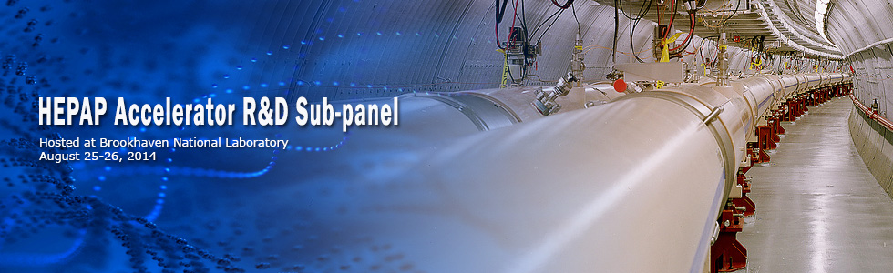
HOM-damped SRF cavities for future circular colliders
S. Belomestnykh
Brookhaven National Laboratory and Stony Brook University
August 25-26, 2014
BNL

Slide 2
Introduction
In this talk I will present accelerator R&D efforts on HOM-damped SRF cavities at two national labs, BNL and JLab, in the context of P5 recommendations.
These efforts are relevant to future energy frontier circular colliders.
The mid-term R&D is to develop compact SRF crab cavities for HL-LHC.
The long-term efforts are to develop SRF accelerating structures suitable for future e+e- and pp circular colliders: FCC-ee/FCC-pp and CEPC/SppC.

Slide 3
Medium-term accelerator R&D:
Compact crab cavities for HL-LHC

Slide 4
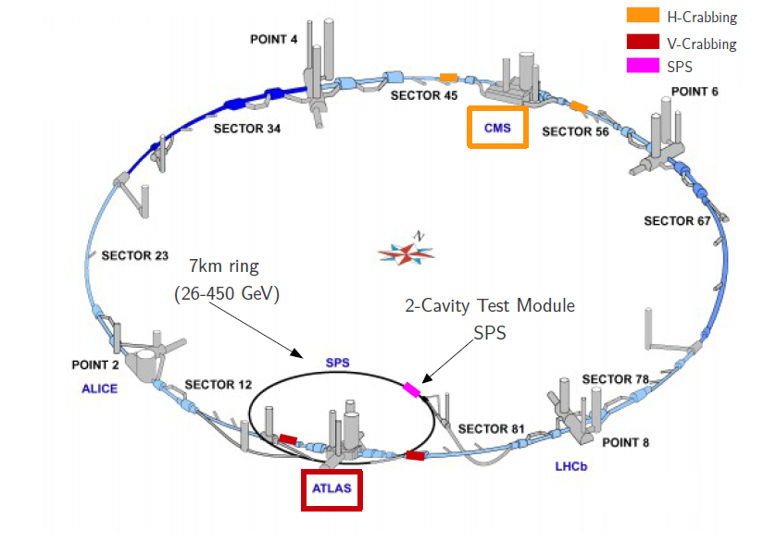
General requirements to HL-LHC crab cavities
Compact crab cavities are being developed in the USA as part of LARP in collaboration with CERN and UK.
RF frequency of 400 MHz.
Beam pipe aperture of 84 mm.
Adjacent beam pipe is at 190 mm.
Crossing angle of 0.59 mrad – need transverse kick of ~12 MV.
Both vertical (ATLAS) and horizontal (CMS) kicks are needed, and perhaps even in both planes if a “crab kissing” scheme is implemented.
Strong HOM damping to avoid coupled bunch instabilities of ampere-class beams in LHC.
The LARP R&D efforts will culminate in a beam test at SPS of a prototype 2-cavity cryomodule(s).
Eventually, total 32 cavities + spares = 40 “dressed” cavities are planned to be delivered by LARP.

Slide 5
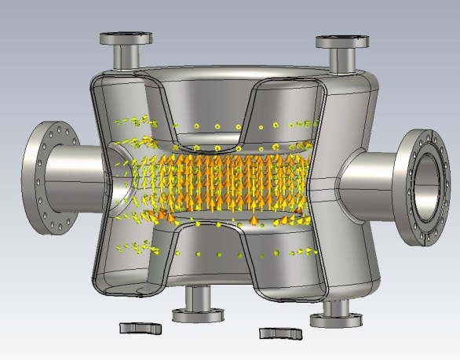
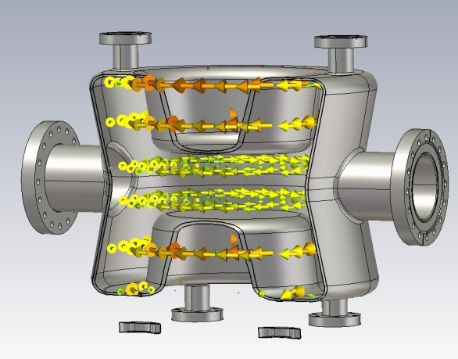
Proof-of-principle
Double Quarter Wave Crab Cavity
 | Unit | DQWCC
Fundamental Mode Frequency | MHz | 400
Nearest Mode Frequency | MHz | 579
Vertical Deflection Voltage | MV | 3.3
Rt/Q (Fund. Mode) | Ohm | 400
Epeak | MV/m | 44
Bpeak | mT | 60 on cavity 79 on port blending
Stored Energy | J | 12
A concept of using a quarter wave resonator as a crab cavity was proposed at BNL by Ilan Ben-Zvi in 2010. The concept was further developed in collaboration with CERN into a double quarter wave crab cavity (DQWCC).
A proof-of-principle DQWCC was fabricated by Niowave and the cavity was successfully tested at BNL last year, reaching a deflecting voltage of 4.6 MV.
Electric field (top) and magnetic field (bottom) of the fundamental mode.

Slide 6
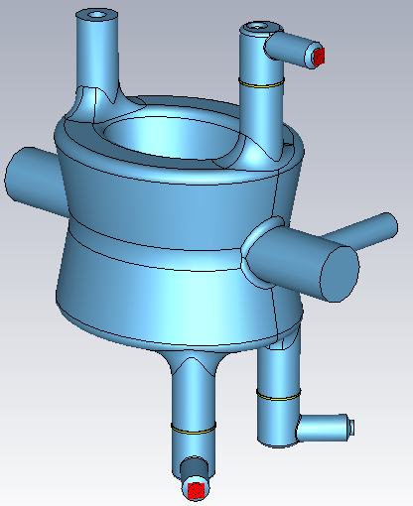
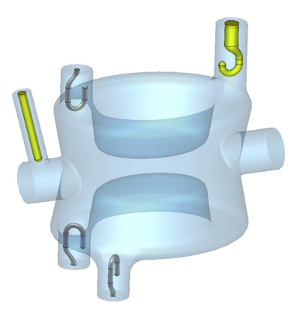
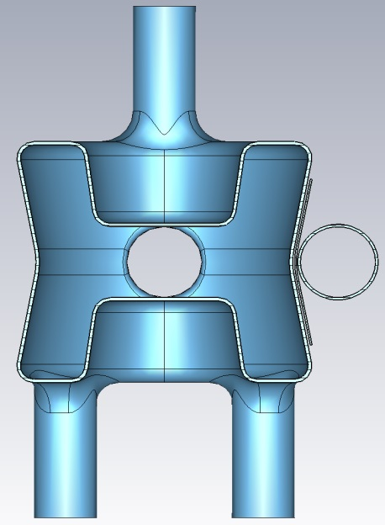
Prototype DQWCC for SPS test
FPC,
Qext = 8x10⁵
Pick-up,
Qext = 2x10¹⁰
HOM coupler
194 mm
140 mm
beam
HOM couplers
Based on our experience with the PoP cavity, the cavity for the SPS installation (prototype) has been optimized into a slightly more compact design with lower surface field.
There are 3 instead of 4 HOM ports. All ports are made bigger for better power handling.
FIGURES OF MERIT
Transversal R/Q | R_{t}/Q | 430 | Ohm
Geometry factor | G | 89 | Ohm
FIELDS
Maximum peak surface electric field* | E_{max} | 40.7 | MV/m
Maximum peak surface magnetic field* | H_{max} | 70.9 | mT
* For deflection voltage of 3.34 MV

Slide 7
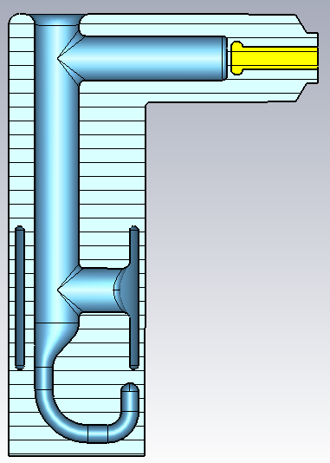
HOM damping for DQWCC
Cooling channel, diameter >10 mm
Cooling channel is capable of extracting 0.8 W power from HOM hook (~30 mW dynamic loss on each filter based on 20 nΩ resistance).
Band stop structure to provide minimum loss on Cu gasket (mW range RF loss).
Loss on Cu pin is negligible (µW range RF loss)
Coupling to 400 MHz: 7.9x10⁹ (1.1 W at each port to outside load).
Peak magnetic field on the cavity is 71.3 mT at 3.34 MV kick.
Peak magnetic field on HOM is 86% of that on cavity.
Designed to handle kW range HOM power per cavity.
Cu pin for RF feedthrough to outside load
Conflat flange to separate HOM filter from the cavity.

Slide 8
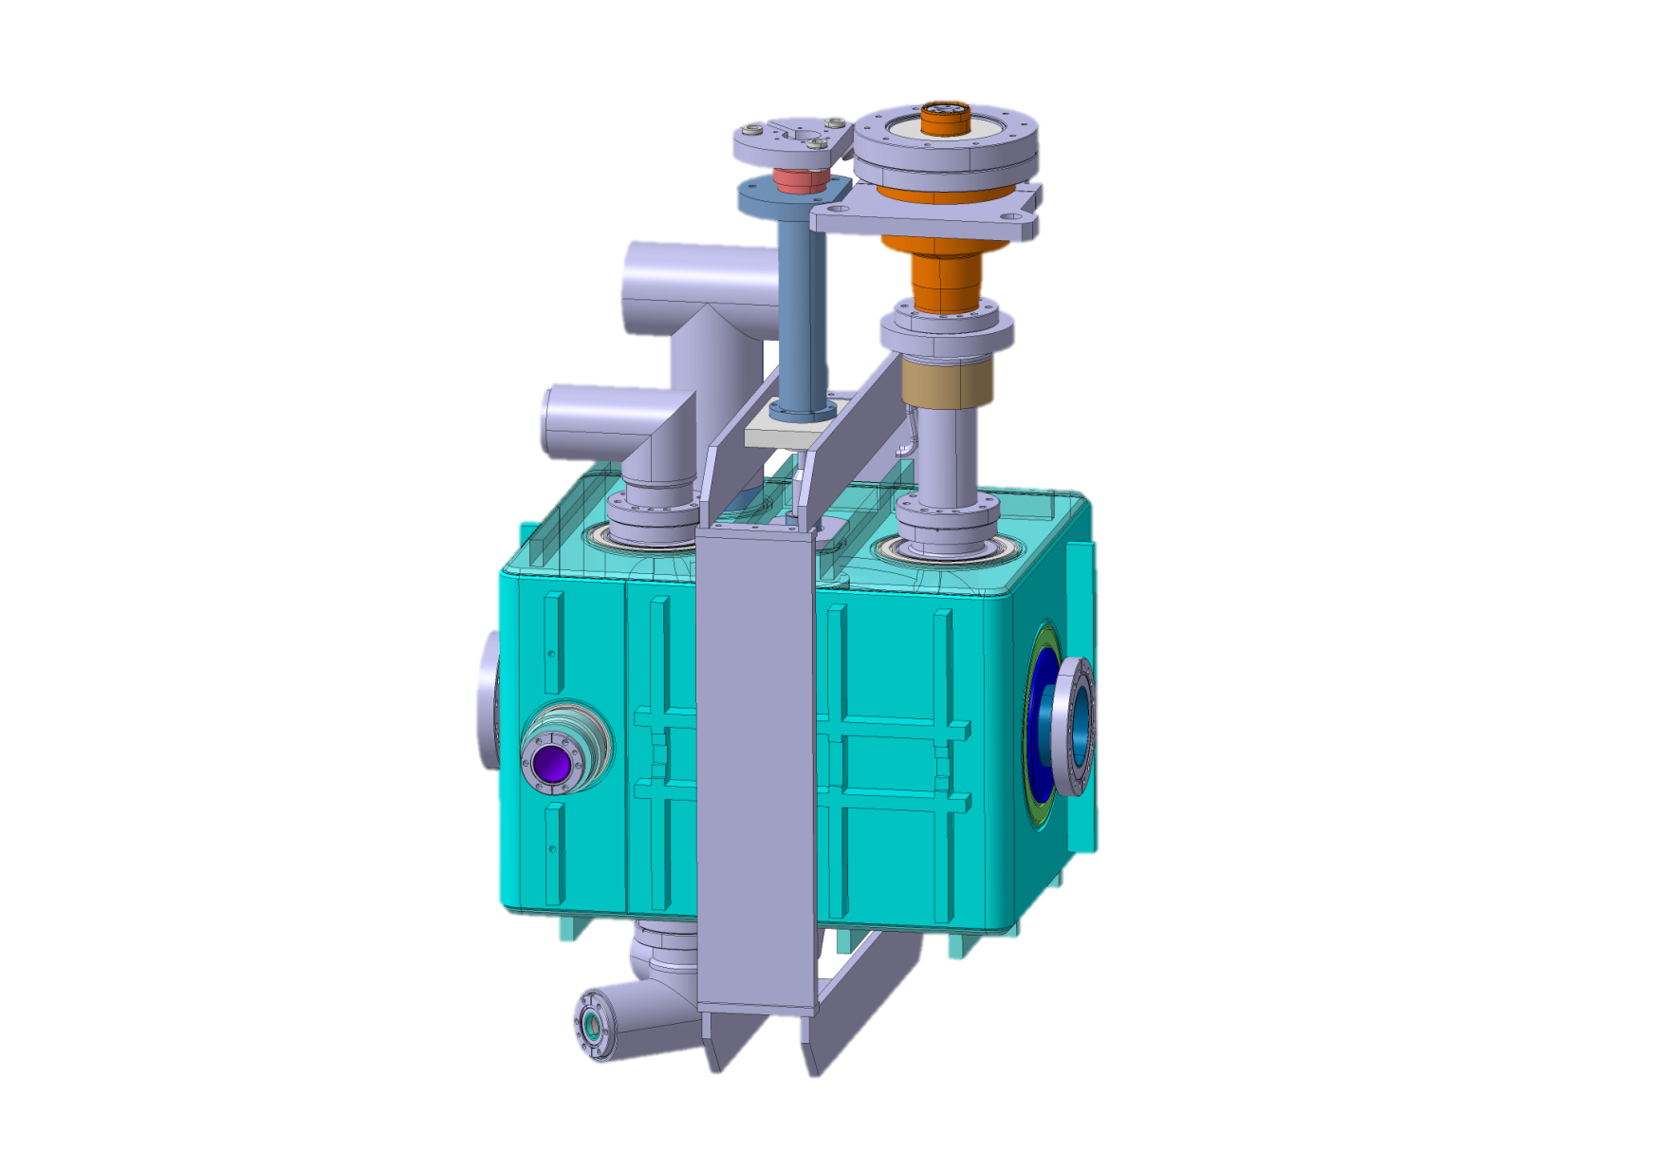
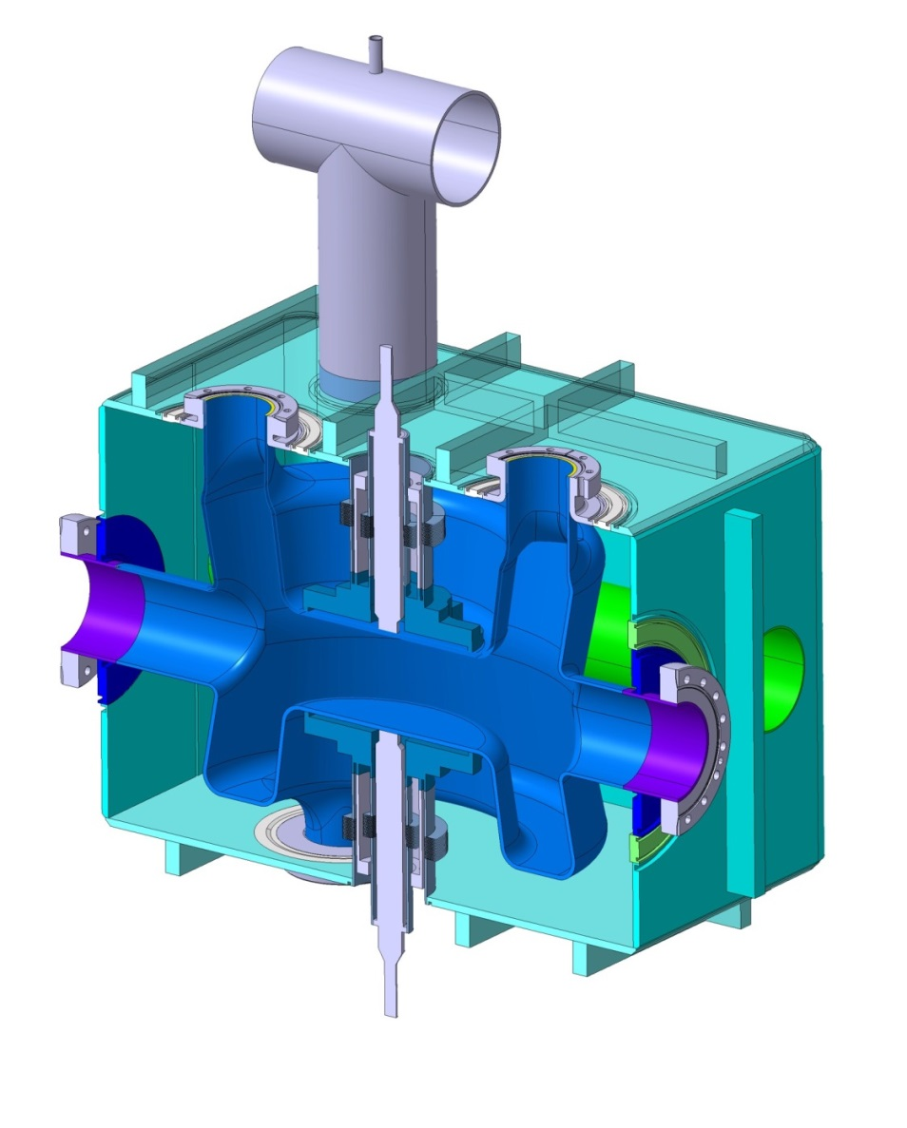
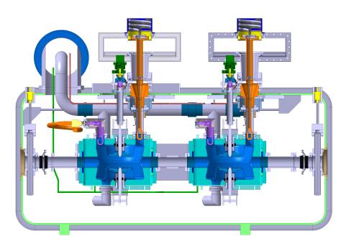
Dressed cavity
Cryo
jumper
Adjacent beam pipe through the vessel
HOM
FPC
390mm
beam
470mm
HOM x2
660mm
Integration into cryomodule →

Slide 9
Summary for DQWCC R&D
A concept of using a quarter wave resonator as a crab cavity was proposed at BNL by Ilan Ben-Zvi in 2010. The concept was further developed in collaboration with CERN into a double quarter wave crab cavity.
A proof-of-principle DQWCC cavity was successfully tested at BNL last year. The cavity was shipped to CERN for further testing.
A prototype cavity has been developed for testing at SPS in 2017-2018. Fabrication of two prototype cavities will begin soon at Niowave.
UK team (Lancaster University and Daresbury Lab) has joined our efforts recently and has made significant contributions, especially in the HOM coupler design.
SLAC provides support in 3D modeling using ACE3P suite of codes.
While our efforts were successful so far, further progress might be hindered by an insufficient funding of LARP in general, and its crab cavity R&D in particular (mostly M&S).
BNL and SBU established a Center for Accelerator Science and Education (CASE), which allows us to attract and involve SBU students in our research.
Developing crab cavities for HL-LHC is synergetic with BNL’s study of a future electron-ion collider eRHIC. The DQWCC cavity can be easily scaled to eRHIC frequencies for crab cavities. Also, similar cavities might be required for future HEP colliders like FCC, if a crab-crossing scheme is implemented there.

Slide 10
Acknowledgements (crab cavities)
BNL & SBU:
  I. Ben-Zvi, C. Marques (M.S. 2014), J. Skaritka, S. Verdú-Andrés (Toohig Fellow), Q. Wu, B. Xiao
CERN:
  L. Alberty, R. Calaga, O. Capatina, F. Carra, G. Foffano, N. Kuder, R. Leuxe, T. Renaglia
Lancaster University:
  G. Burt, B. Hall
SLAC:
  Z. Li

Slide 11
Long-term accelerator R&D:
HOM-damped accelerating structures for FCC-ee/FCC-pp and CEPC/SppC

Slide 12
General requirements to SRF systems of future energy frontier colliders
    Ultimate goal – 100 TeV pp colliders FCC-pp (CERN) and SppC (China).
    An e+e- collider (Higgs factory) in the same tunnel is an intermediate step a là LEP/LHC: FCC-ee and CEPC.
    There was a similar study of VLLC/VLHC in 2001.
    SRF systems:
      low frequency (400 to 800 MHz)
      strong HOM damping
      need better real estate gradient than that of LHC and B-factories
      very high HOM and RF power.
    Synergy with future electron-ion colliders MEIC and eRHIC.

Slide 13
Energy frontier circular colliders
2001 studies
Parameter | FCC-ee | FCC-pp | CEPC | VLLC | VLHC
Beam energy | up to 175 GeV | 50 TeV | 120 GeV | 185 GeV | 87.5 TeV
Circumference | 100 km | 100 km | 50 km | 233 km | 233 km
Total SR power | 100 MW | 4.8 MW | 100 MW | 100 MW | 2.1 MW
RF voltage | up to 11 GV | > 20 MV | 6.87 GeV | 4.66 GV | 200 MV
Beam current | up to 1.4 A | 500 mA | 16.6 mA | 12.5 mA | 68.9 mA
Eacc | up to 20 MV/m |  | 15 – 20 MV/m | 8 MV/m | 8 MV/m
HOM-damped
single cell cavities
HOM-damped
multi-cell (possibly)
cavities
State-of-the-art for linacs,
but need demonstration
on HOM-damped structures.
Unlike VLLC/VLHC cavities, these cavities will operate at 2 K

Slide 14
R&D at Jefferson Lab:
MEIC concept SRF systems
    JLab EIC concept is a high luminosity ring-ring collider.
    RF systems are extremely challenging:
      High beam current;
      High voltage;
      Not a lot of space (is there ever?)
      Large amount of RF power needed for synchrotron radiation.
    Requirements are similar to proposed Higgs factories.
    Nearest existing technology is from B-factories, but packing factor is too low.
    MEIC has additional demand of high frequency:
      750 MHz working design – in line with future HEP coliders, but
      1.5 GHz desired by physicists!
    New technology needed!

Slide 15
MEIC e Ring RF related parameters
Circumference | 1415.853 | m
RF frequency | 748.5 | MHz
Cavity active length | 0.2 | m
Cavity insertion length | 1.91 | m
Temperature | 2.1 | K
BCS resistance | 7.9 | nOhm
Residual resistance | 13 | nOhm
Surface resistance | 20.9 | nOhm
Geometric factor | 270 | Ohm
R/Q | 105 | Ohm
Q0 | 1.29E+10
Energy | 3 | 5 | 12 |  | GeV
Beam current | 0.24 | 3.00 | 0.11 |  | A
SR power per ring | 0.04 | 3.82 | 4.85 |  | MW
Energy loss per turn | 0.17 | 1.27 | 42.27 |  | MeV
Total RF voltage | 0.45 | 2.30 | 50.0 |  | MV
Cavity voltage | 0.45 | 0.29 | 2.50 |  | MV
Eacc | 2.27 | 1.44 | 12.5 |  | MV/m
Qext | 1.26E+04 | 6.58E+02 | 1.06E+05
Active Cavity Number | 1 | 8 | 20

Slide 16
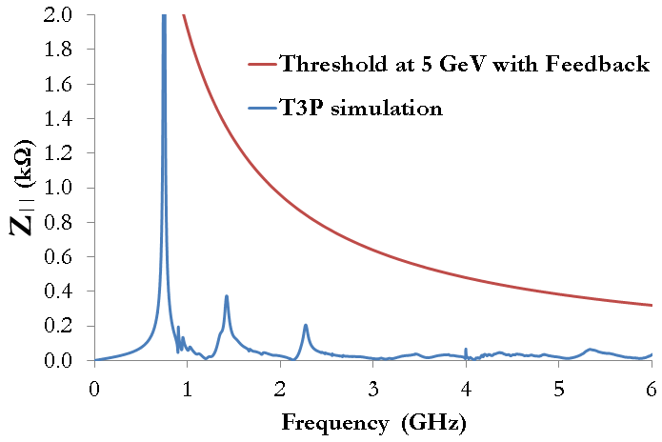
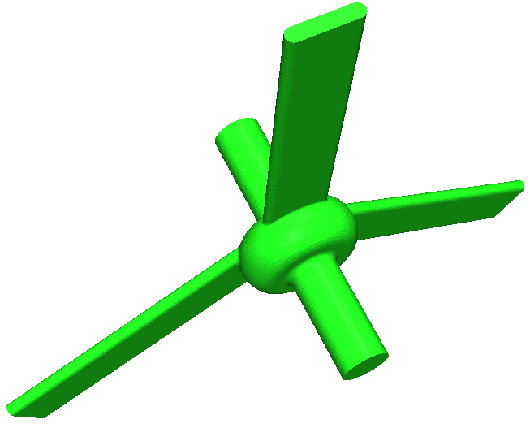
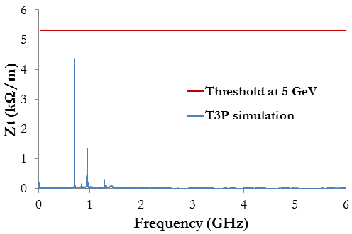
Impedance threshold in e Ring
“On-cell” damper concept can meet these requirements.
Waveguide HOM couplers can handle high power.
Many technical challenges remain!

Slide 17
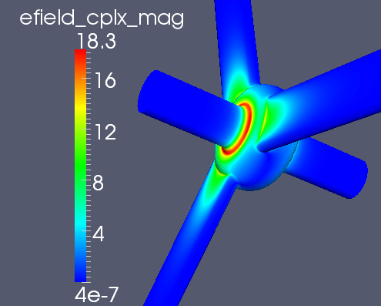
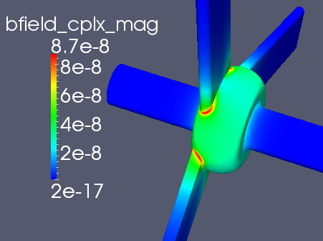
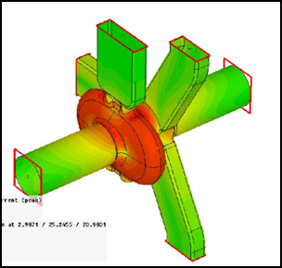
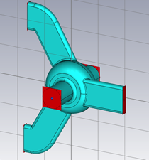
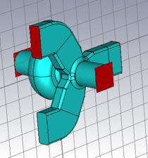
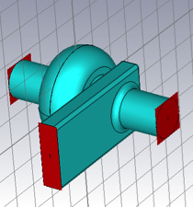
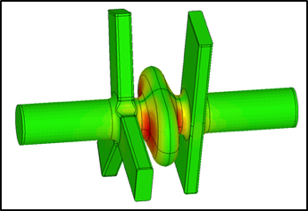
RF cavity geometry studies
750 MHz MEIC e-ring cavity concepts
ANL SPX 2.82GHz crab cavity with on-cell damper

Slide 18
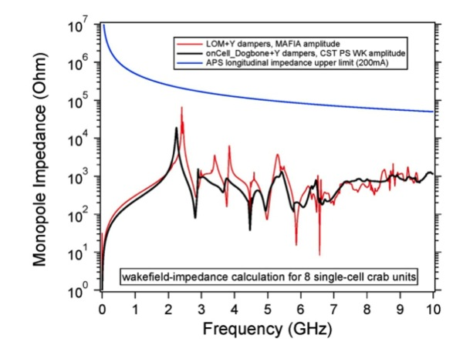
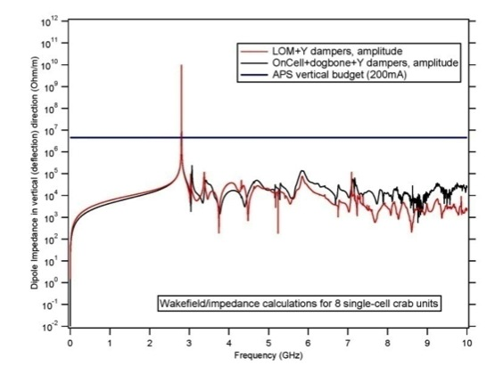
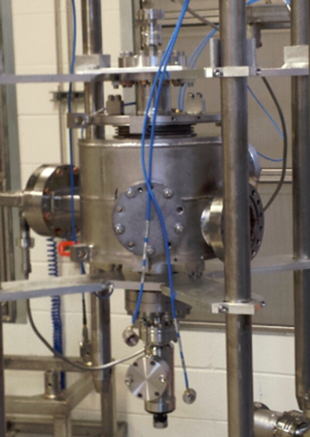
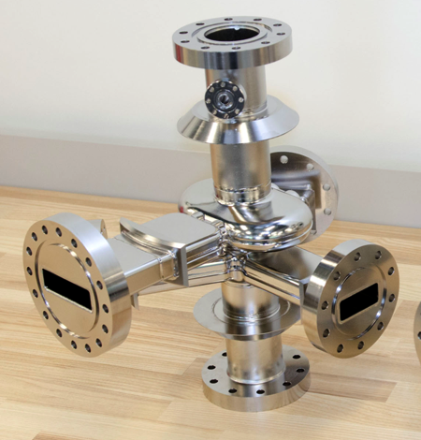
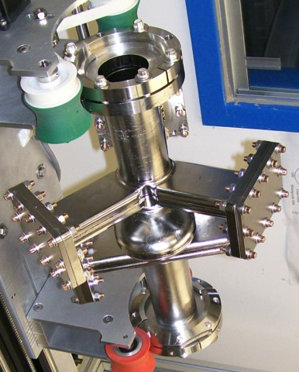
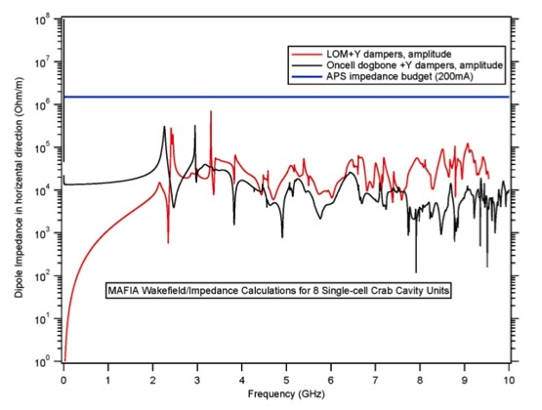
ANL-JLab Crab Cavity and Cryomodule Development for SPX
Monopole Impedance
Vertical Dipole Impedance
Stability Threshold
Stability Threshold
Horizontal Dipole Impedance
On-cell waveguide damper
Stability Threshold
Beam pipe waveguide dampers

Slide 19
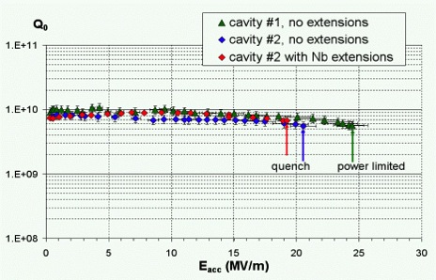
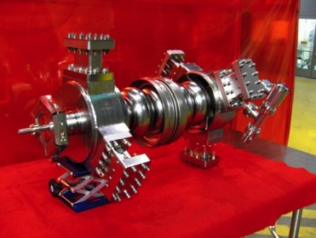
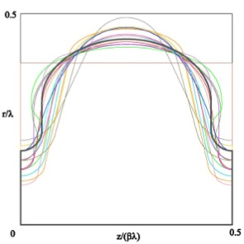
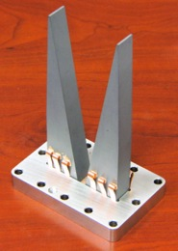
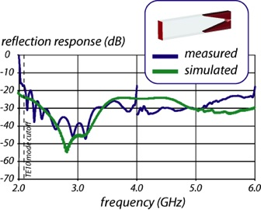
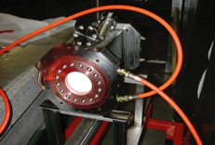
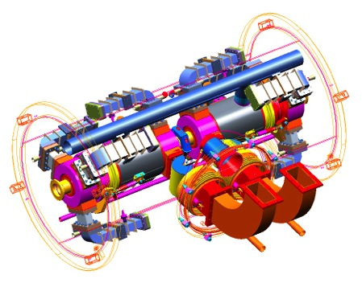
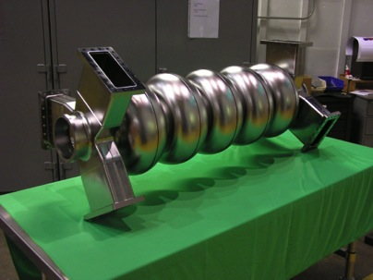
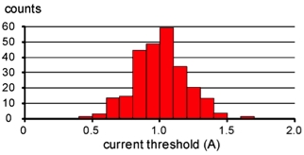
JLab high-current cavities
Two 1.5 GHz, one 750 MHz prototypes built and tested
  Results exceed requirements
  High power RF window demonstrated to > 60 kW CW
1.5 GHz ERL cavities
1.5 GHz ERL cavity
Shape optimization for BBU/HOM power
HOM load concept
1.5 GHz window
750 MHz ERL cavity
BBU simulations for 1.5 GHz ERL
Module concept

Slide 20
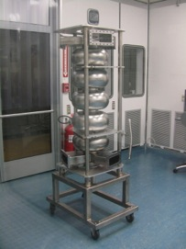
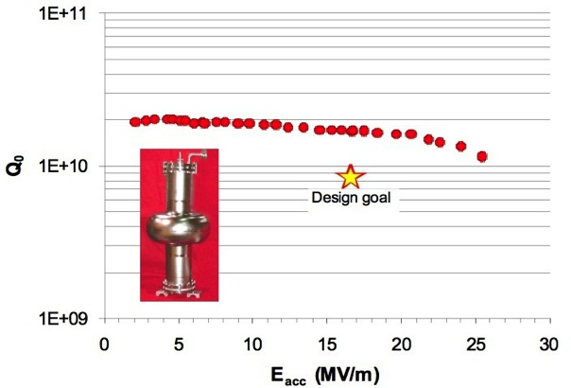
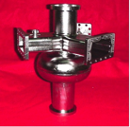
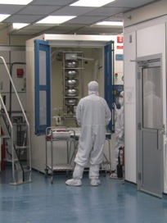
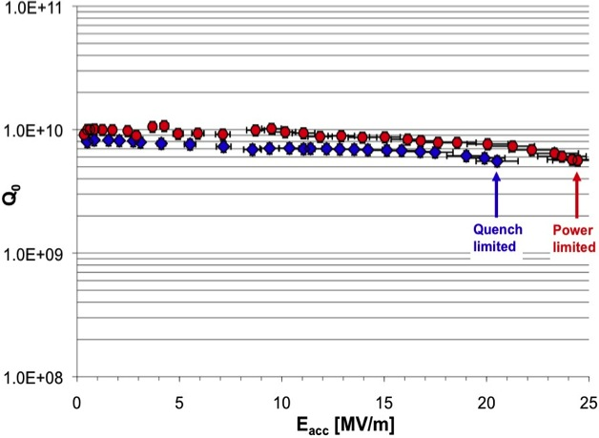
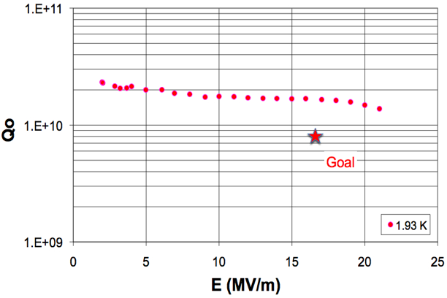
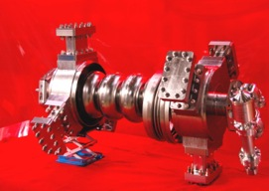
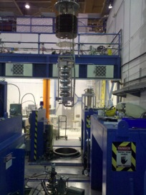
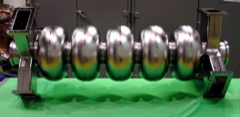
High-current cavity test results
1.5 GHz 750 MHz
Multipacting seen from low gradient but processed away

Slide 21
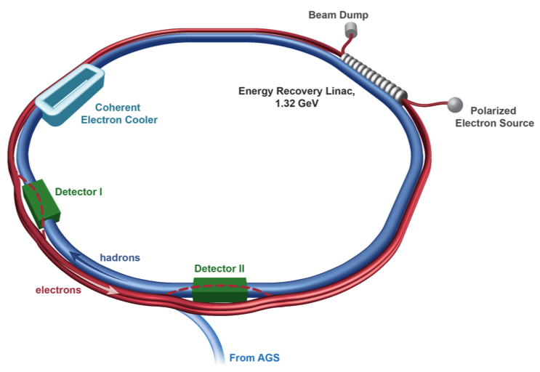
R&D at BNL:
HOM-damped cavities for eRHIC
Electrons for eRHIC experiments are accelerated in a non-scaling FFAG based ERL with 12 passes to reach 15.9 GeV or 16 passes to reach 21.2 GeV. The main linac parameters are:
Linac energy gain | 1.32 GeV
Number of passes | 16
Bunch repetition frequency | 9.38 MHz
Average beam current | 50 mA
RF frequency | 422 MHz
Number of SRF cavities | 40
Linac fill factor | 0.6
Accelerating gradient | 18.2 MV/m
Operating temperature | 1.9 K
Cavity Q at operating gradient | 5×10¹⁰
HOM power per cavity | 11.8 kW

Slide 22
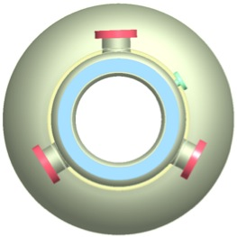
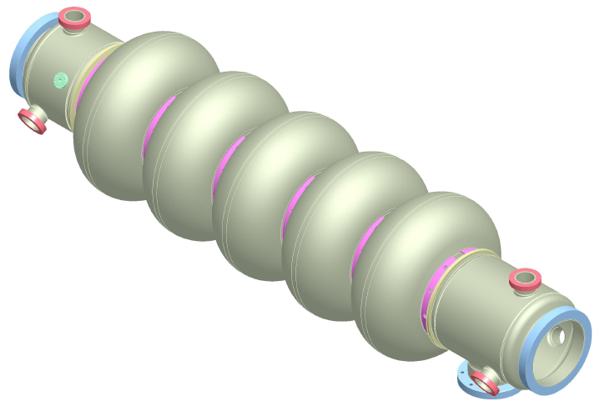
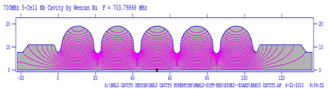
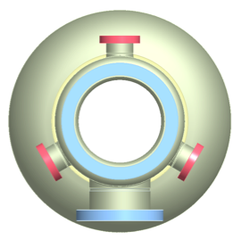

Five-cell cavity with strong HOM damping
HOM coupler ports
FPC port
Frequency | 703.8 MHz
R/Q | 506.3 Ohm
Geometry factor | 283 Ohm
Number of cells | 5
Flange-to-flange length | 1.58 m
Beam pipe radius | 0.11 m
Q | 4×10¹⁰
E_{pk}/E_{acc} | 2.46
B_{pk}/E_{acc} [mT/MV/m] | 4.26 mT/(MV/m)
Lorentz force detuning | 0.45 Hz/(MV/m)²
Loss factor for 2 mm bunch length | 3.96 V/pC
A five-cell 704 MHz SRF cavity (BNL3) has been developed at BNL for high current linacs.
Six antenna-type couplers will be attached to the large diameter beam pipes and will provide strong HOM damping while maintaining good fill factor for the linac.
Two HOM filters are currently under consideration: a high pass filter made of lumped elements and a dual-ridge waveguide filter.

Slide 23


BNL3 cavities
BNL3-1 cavity in the clean room at BNL
Two BNL3 niobium cavities have been fabricated to date: one by AES, Inc. (BNL3-1) and one by Niowave, Inc. (BNL3-2).
The BNL3-1 cavity reached 19.7 MV/m. Residual surface resistivity at low field is about 5 nOhm, in line with the eRHIC requirement.
This cavityis being incorporated into a cryomodule under fabrication for the CeC PoP experiment.
The second cavity will serve as a vehicle for further eRHIC related R&D, including HOM coupler tests.

Slide 24



2-stage filter HOM coupler
50 Ω transmission line to room temperature
D = 72 mm
Between the two notches, S21 < -65 dB, 1st HOM is at 0.82 GHz, S21 = -23 dB.
It has good damping at high frequencies.
Work on filter optimization continues.

Slide 25





Dual-ridge waveguide HOM coupler
More compact than rectangular waveguide.
Two M.S. SBU students worked on this approach. A very good coax-to-waveguide transition was developed.
Better transmission than that of the 2-stage coaxial coupler.

Slide 26

Dipole HOMs and BBU threshold
Calculated HOM parameters of several lowest dipole pass bands were used for BBU simulations, which predicted a threshold beam current higher than 50 mA even with no HOM frequency spread.

Slide 27
Summary for R&D of HOM-damped accelerating structures
JLab and BNL are working on their versions of a future electron-ion collider. Such a collider will require HOM-damped SRF accelerating cavities. Requirements to these cavities are very similar to the requirements of future energy frontier HEP circular colliders. This R&D might be useful in the future for a beam current upgrade of the intensity frontier proton linacs at Fermilab.
JLab is traditionally developing rectangular waveguide based HOM couplers. They work on designs for both single- and multi-cell structures and obtained good results in vertical cavity tests.
At BNL, we developed an HOM-damped 5-cell structure, BNL3, with HOM coupled out by antennae. Two BNL3 cavities were fabricated to date, one reaching accelerating gradient close to 20 MV/m. Two HOM coupler schemes are under consideration: a 2-stage coaxial filter and a dual-ridge waveguide filter.
Recently, our Chinese colleagues from IHEP expressed interest in our design and we are now participating in their efforts toward CEPC CDR. CERN (Erk Jensen) has also expressed interest in our R&D on HOM couplers.
Two SBU students have participated in developing an HOM damping scheme at BNL.
At the moment neither JLab nor BNL has HEP funding on SRF structures suitable for future circular colliders. Our efforts can go as far as they are in synergy with NP program on future EICs. However, funding there is also very limited allowing us mostly to do computer simulations and minimal hardware prototyping. Dedicated funding for long-term Accelerator R&D would accelerate our efforts a great deal.

Slide 28
Acknowledgements (HOM-damped accelerating cavities)
JLab:
R. Rimmer, H. Weng, C. Reece
BNL & SBU:
Wencan Xu, I. Ben-Zvi, E. Johnson (M.S. 2011), C. Marques (M.S. 2014), …

Slide 29
Thank you!

