Slide 1
Accelerator Test Facility
HEPAP Review, August 25 2014
Igor Pogorelsky

Slide 2
Outline
  ATF - Accelerator Stewardship facility
  ATF capabilities and history of achievements
  Present-day science program and productivity
ATF II - Upgrade plan
Science opportunities
Instead of Summary
    Upcoming 17th User Meeting and ATF II Upgrade Workshop
Notes:
CHANGE

Slide 3

The ATF Birth Certificate
1980:
M. Tigner Panel established the proposal-based long-range accelerator R&D program at HEP
1980’s:
ATF has been founded as a part of this program by two visionaries of accelerator science, Bob Palmer and Claudio Pellegrini.
ATF early years:
  1991 – 4 MeV gun
  1992 – 50 MeV linac
  1993 – start of e-beam/laser interaction experiments
  1995 – Inverse Cherenkov laser acceleration
    with 10 GW CO₂ laser
F
A
T
  ATF pioneered the concept of a user facility for advanced accelerator research.

Slide 4
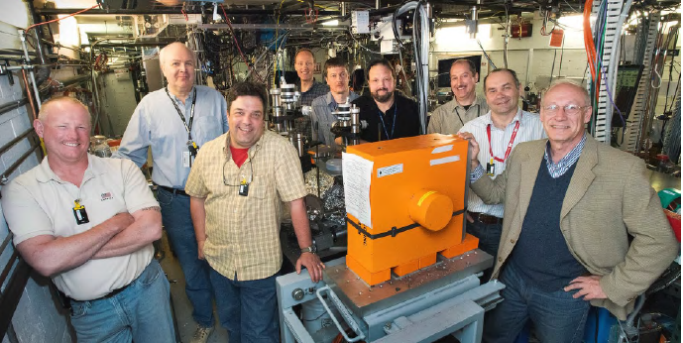
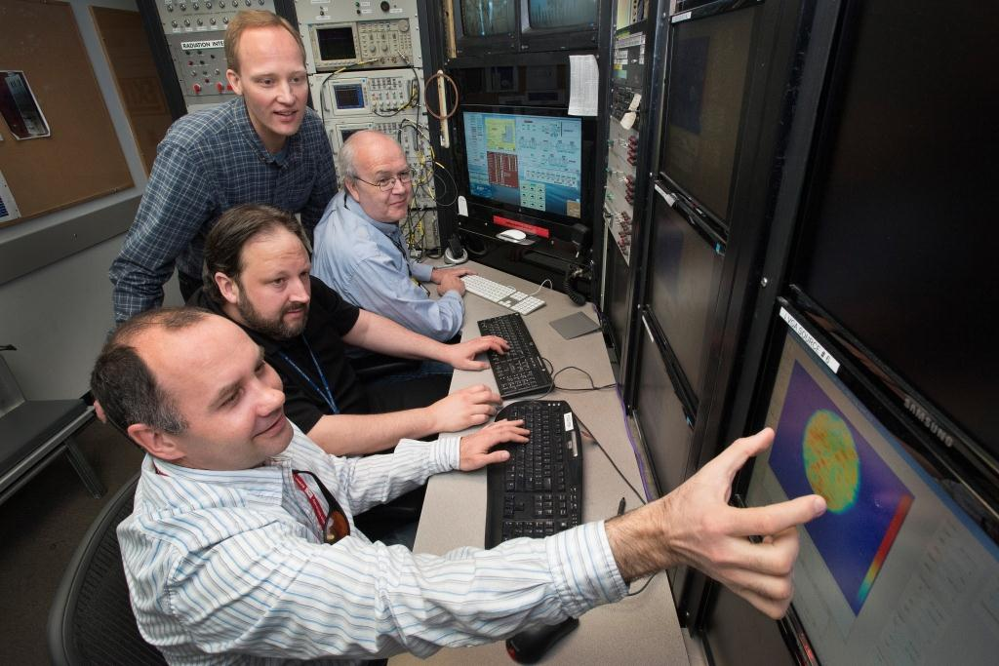
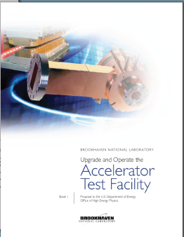
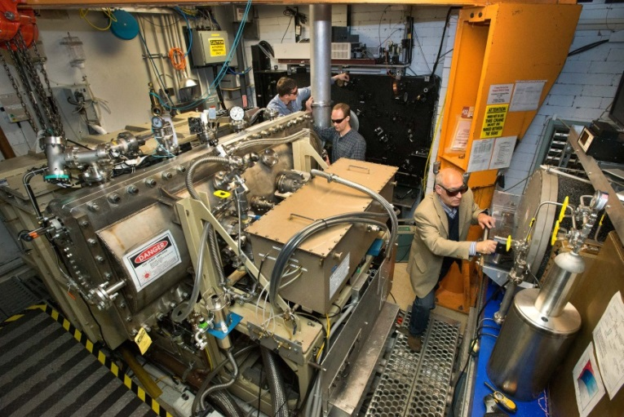
What the ATF is about?
High-brightness electron beams
Small staff, a lot of experience
Unique powerful lasers
  By hosting a free service, ATF enables diverse research groups to carry out their experimental work using high-performance accelerators and lasers.

Slide 5
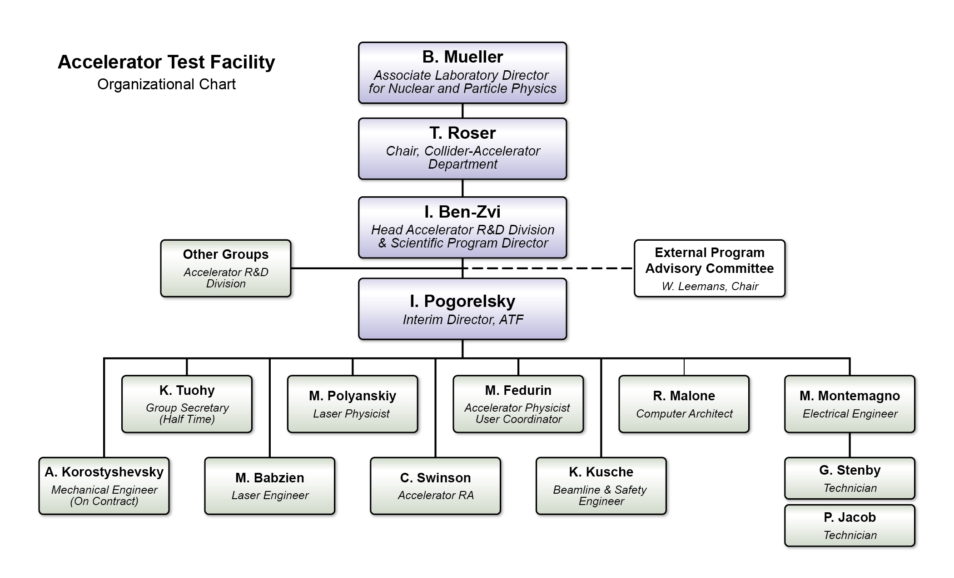
ATF organizational chart
  ATF is a proposal driven, Program Committee reviewed user facility.
Notes:
CHANGE

Slide 6
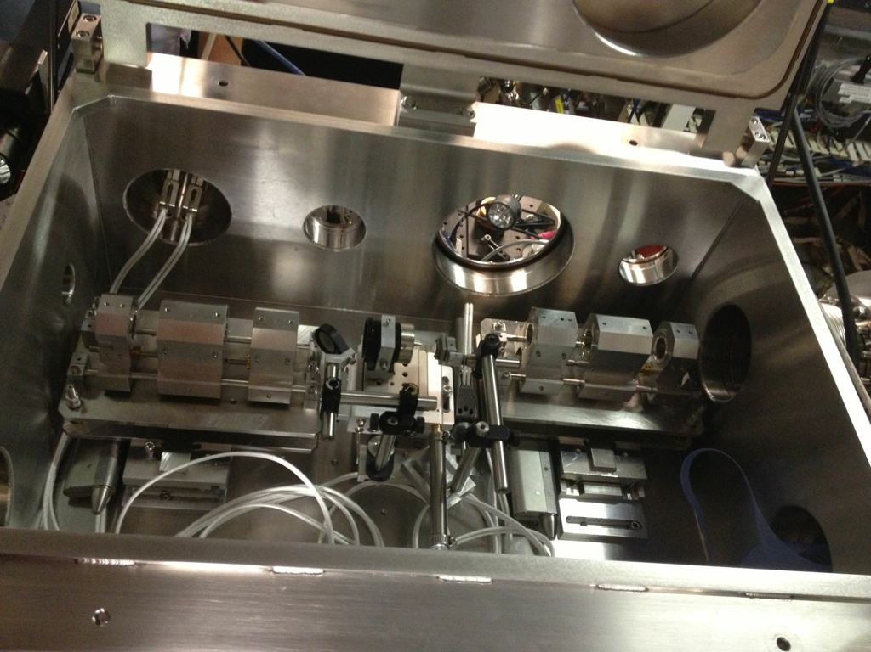
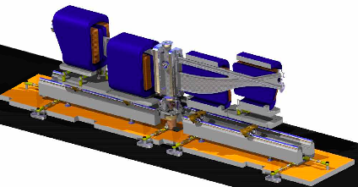
ATF provides 80 MeV e-beams
of low-emittance (μrad) and low-energy spread (0.1%)
tightly compressed and focused to enable
state-of-art research
in Plasma Wake Fields, Dielectric Wake Fields,
efficient interaction with laser beams, etc.
Mini-quads for σ_{x,y}=6 μm focusing
Chicane bunch compressor to σ_{z}=30 μm, 1.5 kA

Slide 7
2-TW, 3-ps CO₂ gas laser
a mighty tool for exploring
novel methods
of particle acceleration
and radiation sources.
CO₂ (λ=10 μm) advantages
as compared to solid-state (λ≈1 μm) lasers:
#1 favorable scaling of accelerating structures, better electron phasing into the field
#2 100 times stronger ponderomotive effects at the same laser intensity
#3 10 times more photons per Joule
#4 100 times lower critical plasma density

Slide 8
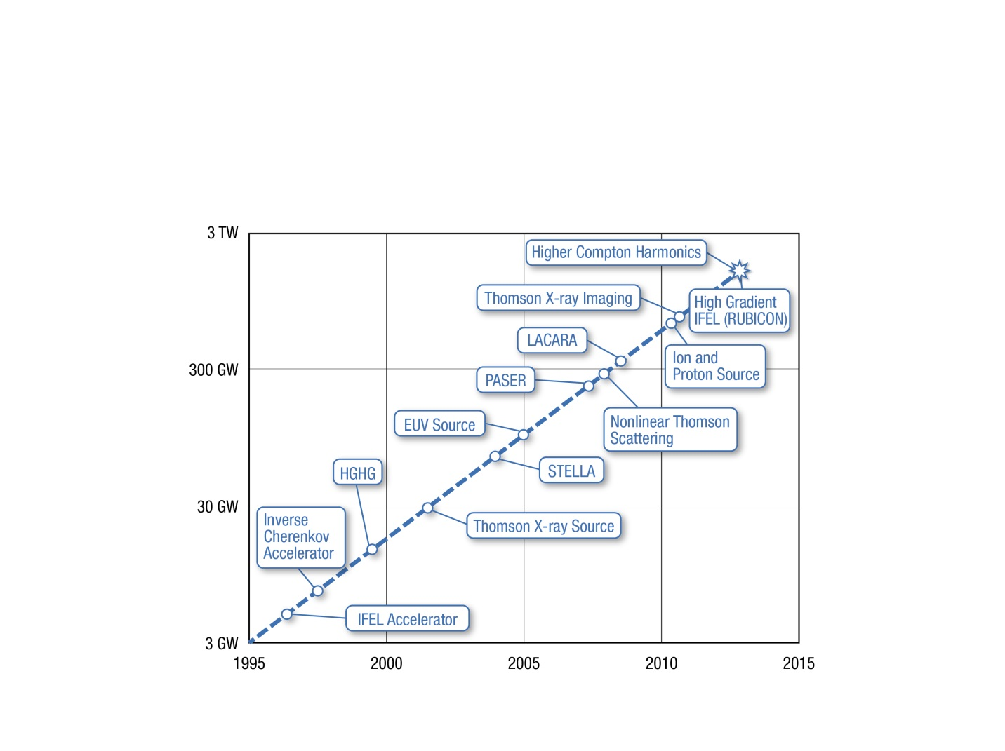
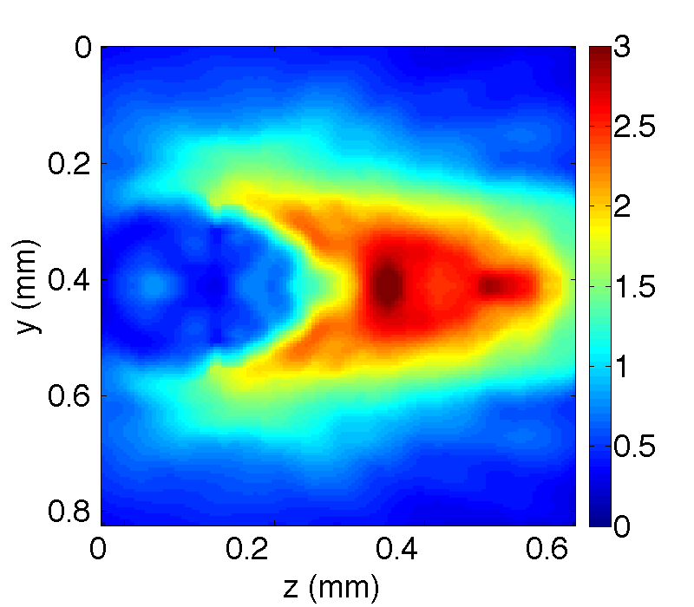
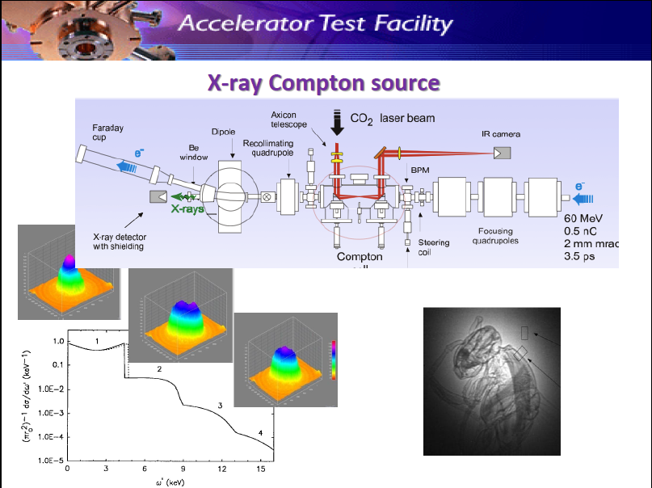
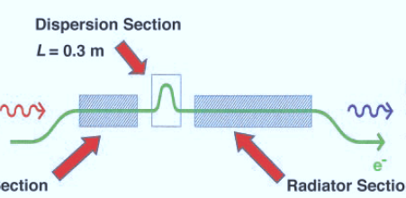
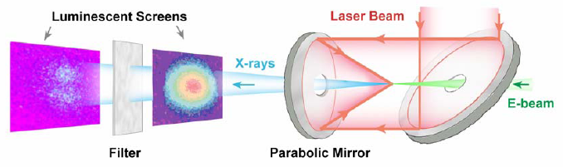
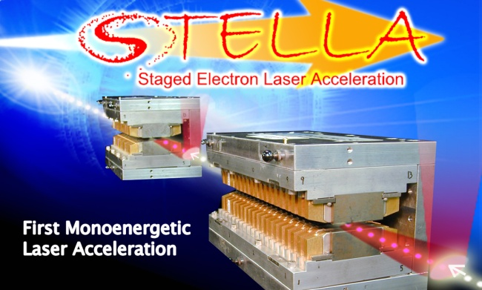
Incubator for new ideas and discoveries
Shock wave
laser
protons
plasma
Hydrogen

Slide 9
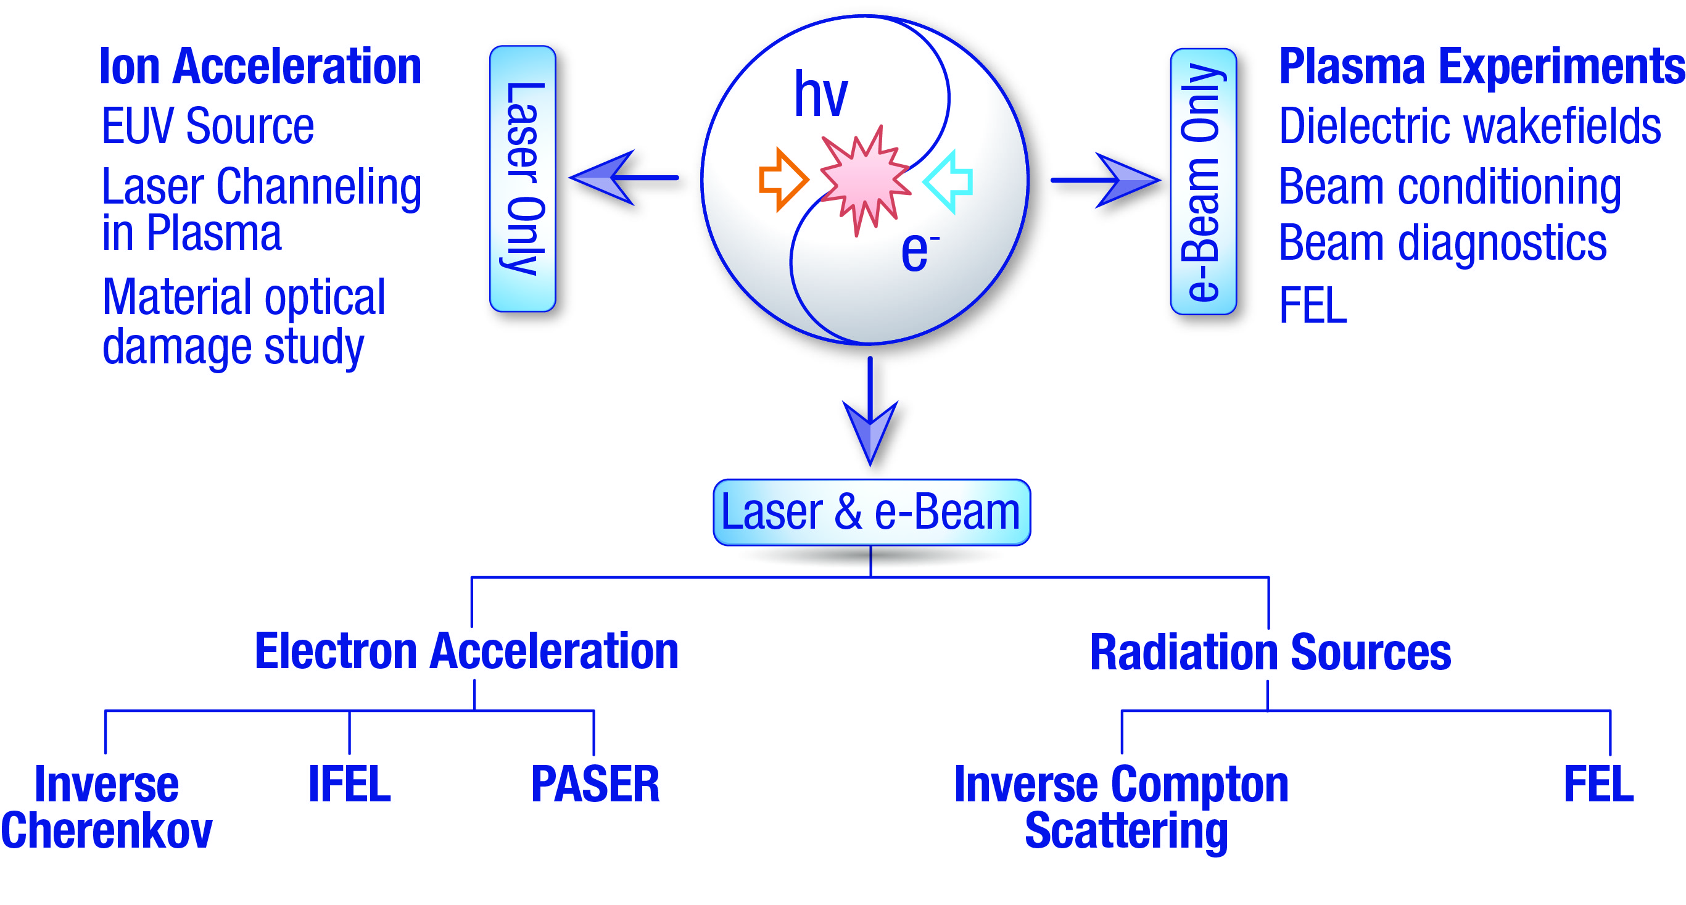
Diversity in addressing needs of the accelerator community

Slide 10
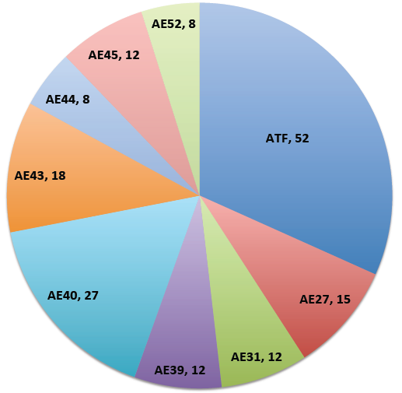
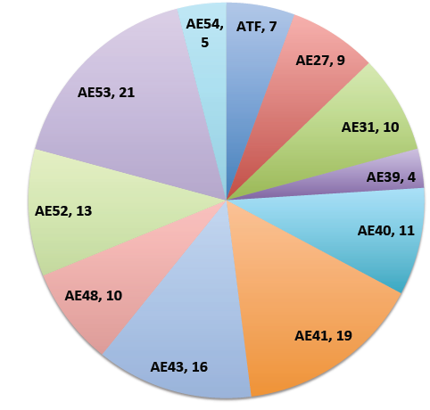
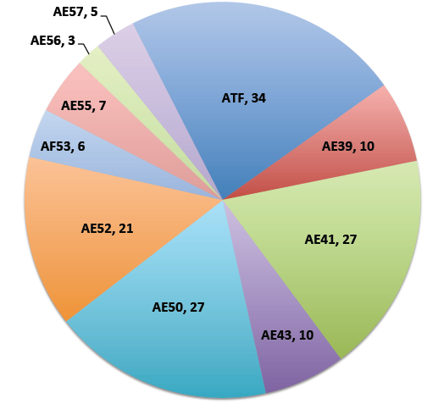
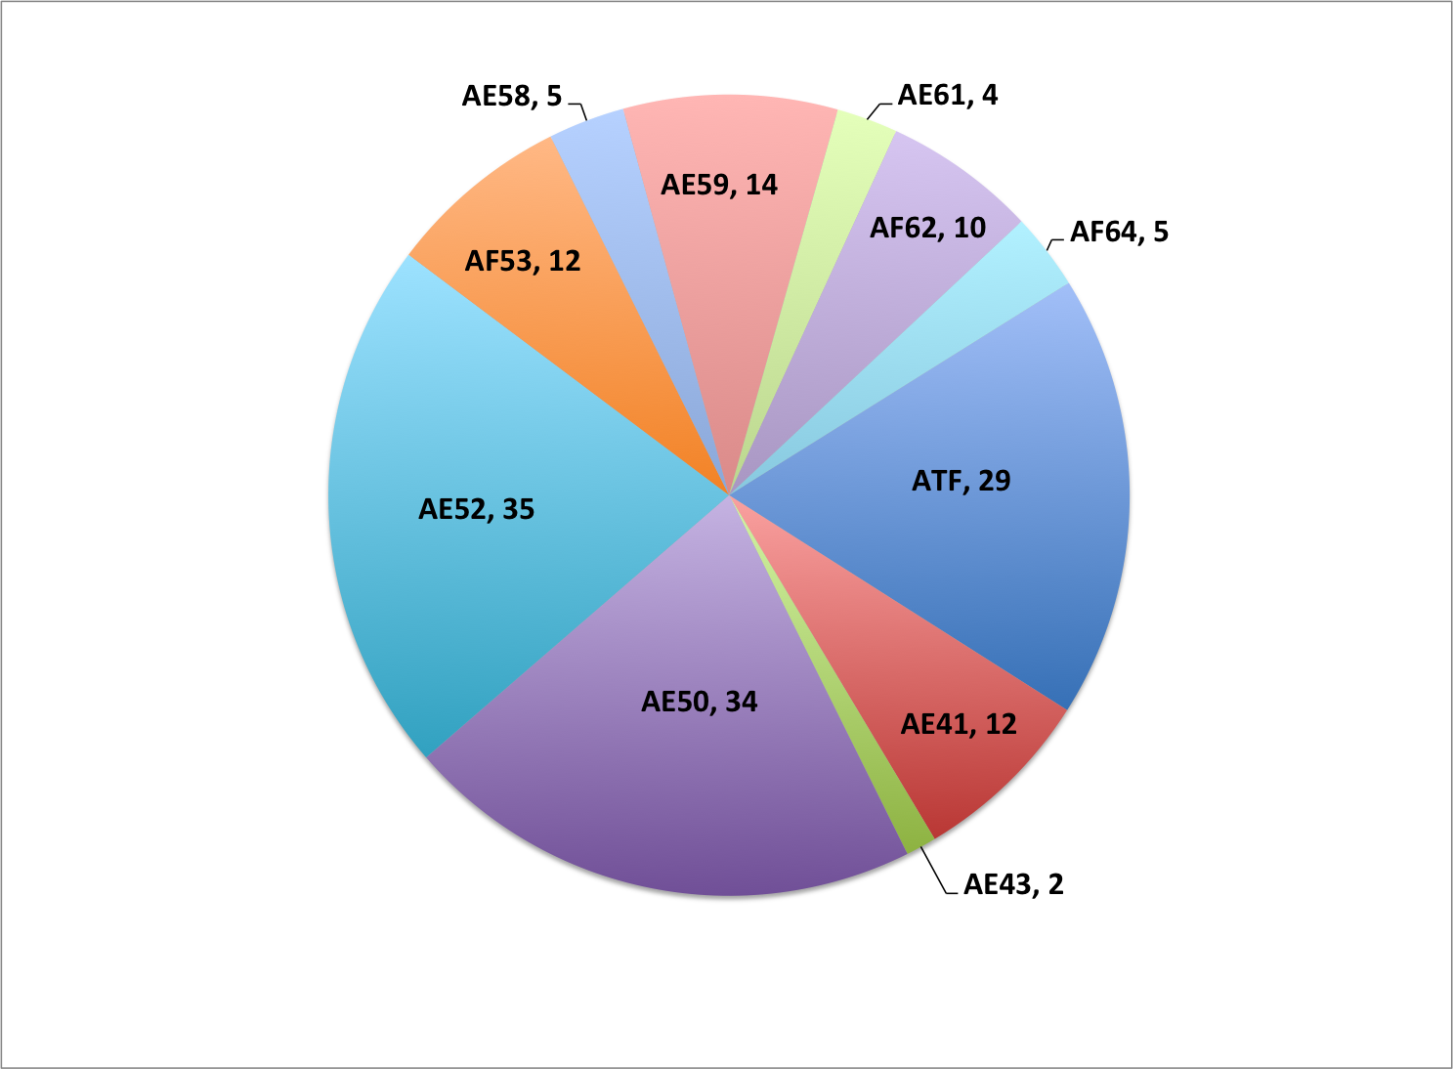
E-Beam Time
Allocation
for user
experiments
by code
2011
2012
In 2014:
13 user experiments received run time
20 experiments are in active portfolio
2013
2014

Slide 11

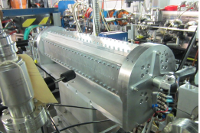

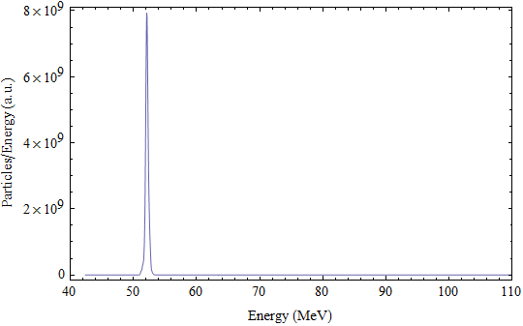
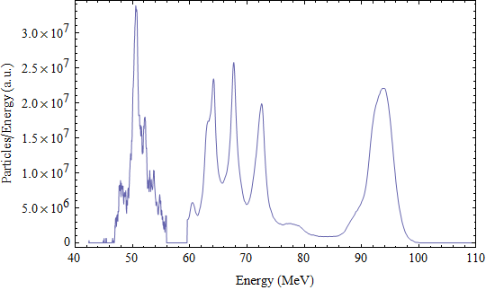



RUBICON - IFEL accelerator (CO₂ and e-beam co-propagation in helical tapered undulator)
Up to 50 MeV (100 MeV/m) to compare with previous IFEL record of 15 MeV
25 % capture @ >90 MeV
93.7 MeV mean, 2.0 % energy spread

Slide 12


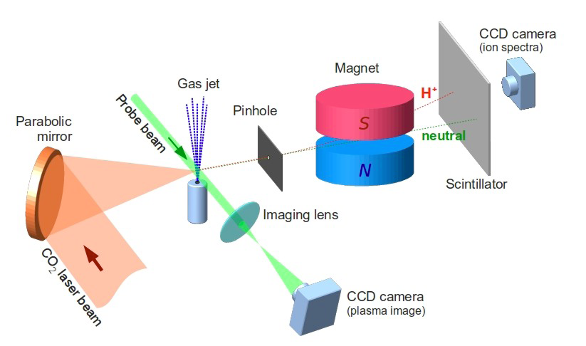
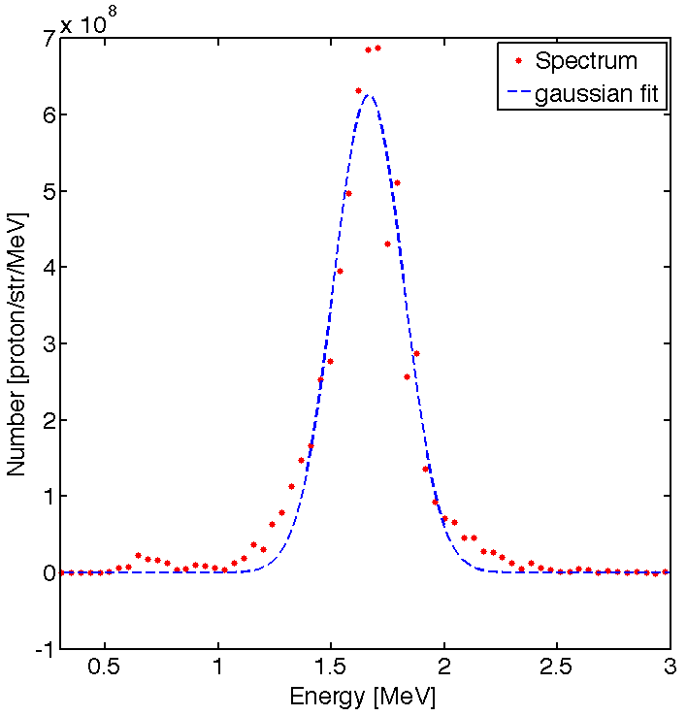
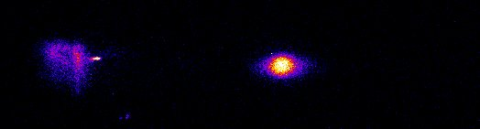
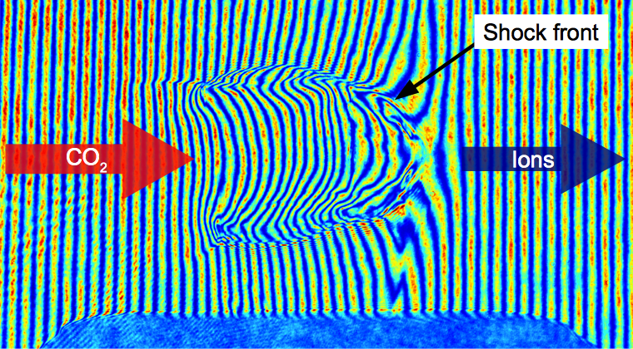
Shock Wave Proton Acceleration
(light or
neutrals)
1.7 MeV
protons
Hydrogen jet
12
Energy spread 10%
Spectral brightness up to 10⁹ proton/MeV/str
Proton energy up to to 3.2 MeV
First observations of ~1 MeV He⁺
N o z z l e
Laser-induced electrostatic shock reflects protons upon its propagation through the ionized H₂ jet.

Slide 13
Compton X-ray source
Multiple users from US, Japan, Italy
Compton harmonics
Phase-contrast imaging at a femtosecond exposure

Slide 14

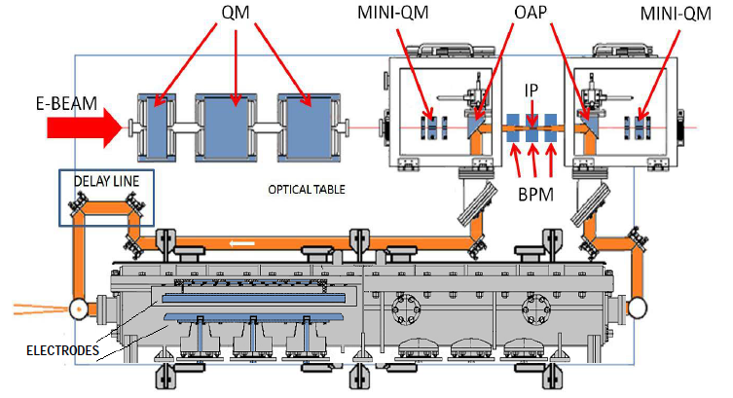
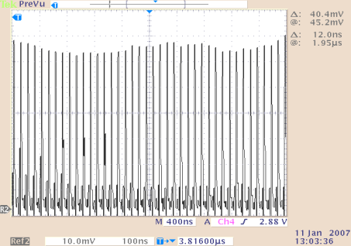
Intra-cavity Compton source
X-rays
Laser
It is anticipated that compact light sources affordable to any university will make a similar impact as PCs complementing main-frame computers.
100 interactions per a laser shot

Slide 15
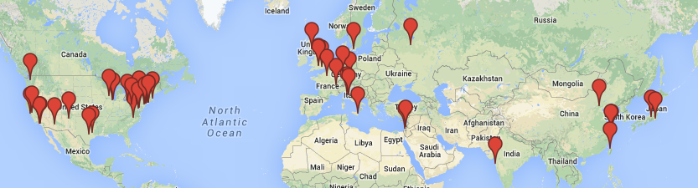
ATF user demography
Well established user facility, serves accelerator community for over 20 years
Presently:
40 active users
from 15 institutions
P5 Recommendations :
Host unique, world-class facilities that engage the global scientific community.
Strengthen national laboratory- university R&D partnerships, leveraging their diverse expertise and facilities.

Slide 16
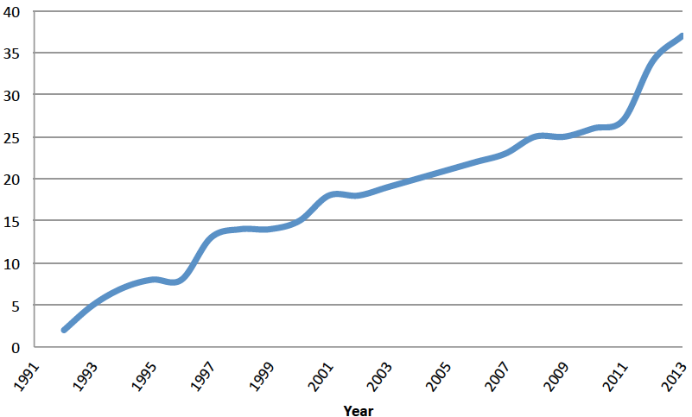
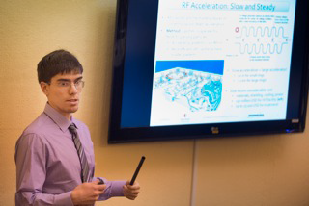
ATF impact on graduate training
Among ATF students:
Nathan Cook, graduate student at Stony Brook University, received the award for his talk at the 2013 BNL Young Researcher Symposium.
Ariel Nause, Tel-Aviv Univ., winner of the 2014 RHIC & AGS
Thesis Award.
New proposal
for Advanced Accelerator laboratory course from
Center for Accelerator Science and Education at SUNY SB
The goal of this course is to expose graduate students
to modern accelerator technology and to method of generating, accelerating and controlling high brightness electron beams.
Anticipated class attendance is 10 students.

Slide 17
Diversified scope of research
Notable achievements
The S-band photocathode electron gun 1995, and beam brightness records
3.5 MeV acceleration of electrons using the Inverse Cerenkov effect 1995
Forward Directed Smith-Purcell Radiation from Relativistic Electrons 1995
Demonstration of Emittance Compensation through the Measurement of the Slice Emittance 1996
1 MeV Inverse Free-Electron Laser acceleration experiment 1996
Experimental Observation of Femtosecond Electron Beam Micro-bunching by Inverse Free-Electron-Laser Acceleration 1998
Experimental observation of ballistic bunching of relativistic electrons 1996
Self Amplified Spontaneous Emission (SASE) in the visible 1998
Precision tomographic measurement of the beam density in phase-space 1998
Experimental Observation of Suppression of Coherent-Synchrotron-Radiation–Induced Beam-Energy Spread with Shielding Plates 2012
Study of wall roughness effects 2012
Demonstration of High-Gain Harmonic-Generation FEL 2000
Staged laser accelerator (IFEL) 2000
A number of records in inverse Compton generation of X-rays 1998-2006-2013
Demonstration of phasing between longitudinal and transverse components in plasma wakefields 2003
First staged monoenergetic laser electron acceleration (STELLA) 2004
Demonstration of particle acceleration by stimulated emission of radiation 2006
In-depth studies of PWA with multiple electron bunches 2008-present
Monoenergetic laser-driven proton source by shock wave acceleration 2010
Demonstration of beam statistical noise reduced below the shot-noise limit 2011
Phase contrast imaging of bio samples by single-shot picosecond Compton 2011
Study of shielding effects of coherent synchrotron radiation 2011
First experimental observation of the Current Filamentation Instability 2012
Color code: HEP BES NP Biomedical

Slide 18
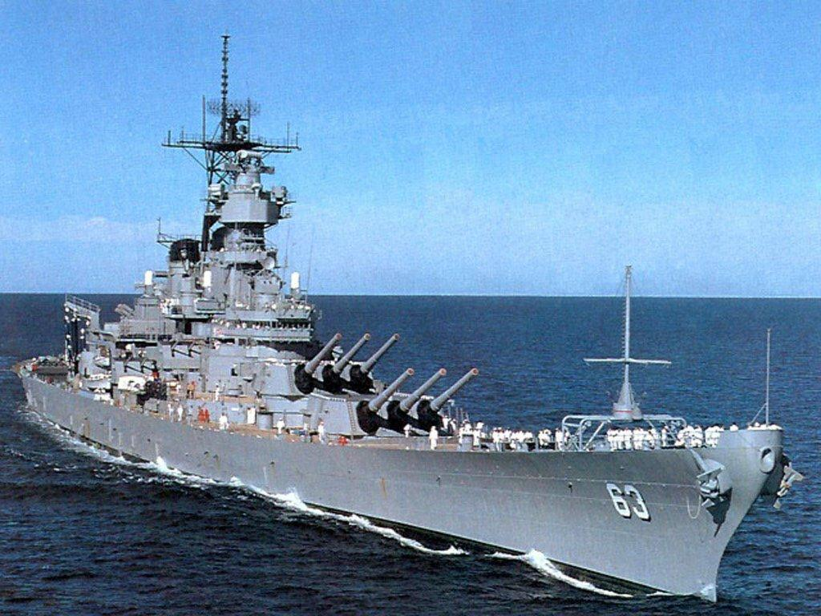
Accelerator Stewardship Concept
1994: Concept emerged in decisions of the J. Marx Panel
2006: The second round of the same panel provided concrete recommendations
2009: Symposium Accelerators for America’s Future
2011: US Senate report
2014: New Accelerator Stewardship program have been established
    ATF is recognized as a flagship user facility dedicated to Accelerator Stewardship
Stewardship
in
Accelerator R&D
ATF II

Slide 19
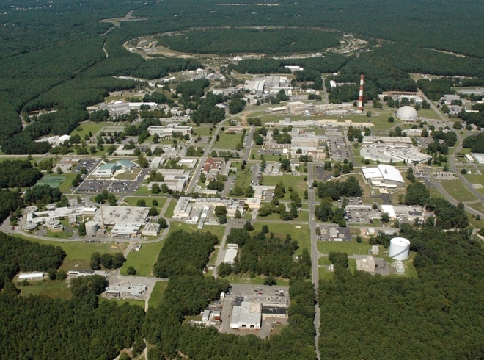
ATF II
912
ATF
820
ATF II upgrade funded by DOE HEP
under Accelerator Stewardship.

Slide 20
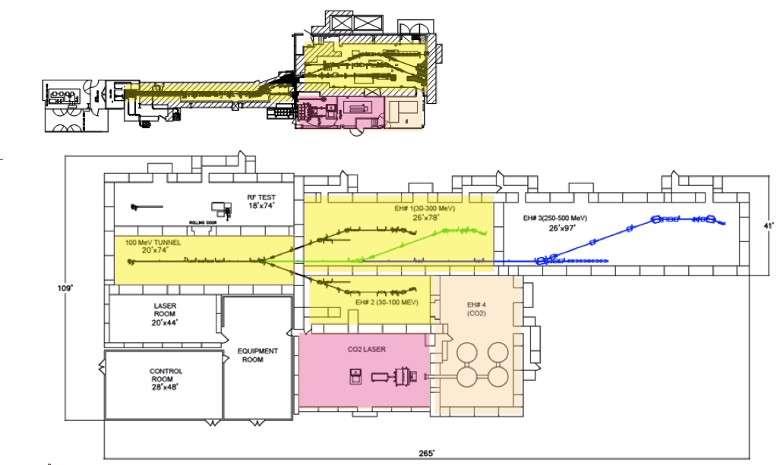
Major facility upgrade
Towards higher productivity:
ATF (BLDG.820)
Shielded area:
Total floor:
Exp. Halls:
x5
x7
x3
ATF II(BLDG.912)
Increased capabilities:
E-beam energy
80 MeV 500 MeV
Laser peak power
1 TW 100 TW

Slide 21

ATF facility upgrade start up
October 2013
Upgrade proposal is presented to DOE
February 2014
  DOE makes the decision to fund the Stage I upgrade ($5M)
June 2014
  BNL funds Program Development project on the CO₂ laser upgrade
  ($2M)
July 2014
DOE funds are available in the BNL financial plan.
Facility’s 3-year upgrade started.

Slide 22
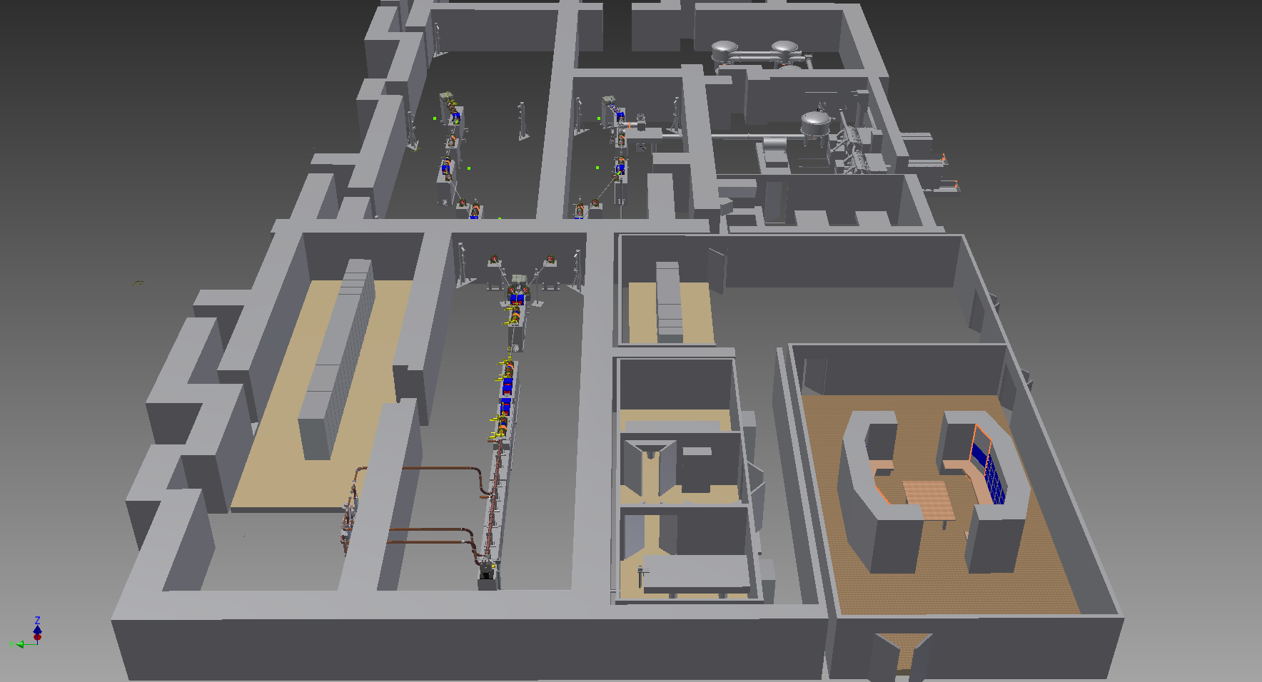
Layout of the 1st Stage of ATF II Upgrade
Experimental halls 1 & 2
CO2 Laser Rooms
Beam line power supply racks
Controls Racks and Equipment Room
Gun and Linac Hall
Main Control Room
Linac RF system
Gun Drive Laser Lab.

Slide 23
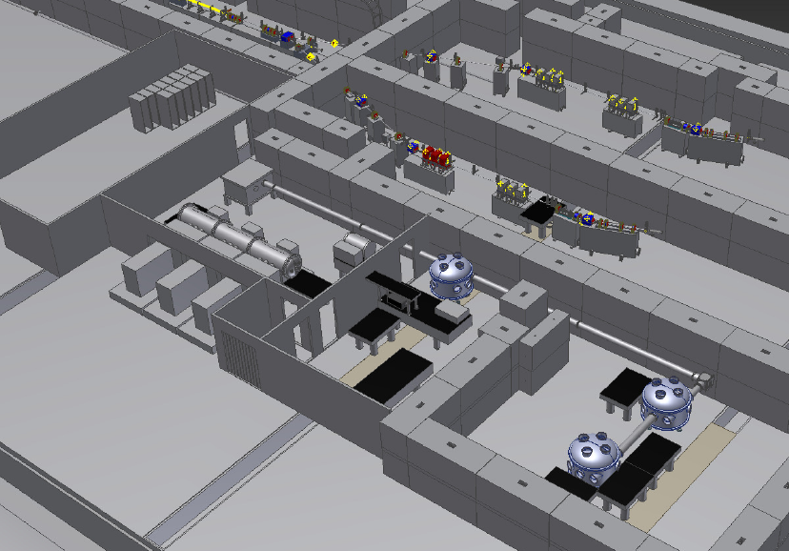
Layout of the 1st Stage of ATF II Upgrade

Slide 24


Principle diagram of 100 TW CO₂ laser
Collection
of innovations:
35 µJ
350 fs
Amplifier 1
OPA: fs seed
Stretcher + compressor = Chirped pulse amplification
High-pressure, isotopic amplifiers
Nonlinear compressor
10 µJ
100 ps
Ti:Al2O3
OPA
Stretcher
100 mJ
Amplifier 2c
Amplifier 2b
Amplifier 2a
70 J
50 J
2 ps
25 TW
Non-linear compressor
10 J
100 fs
100 TW
Compressor

Slide 25
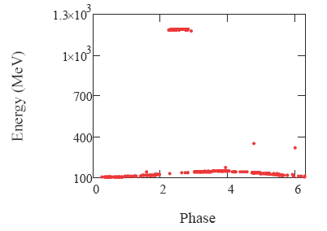

IFEL research
1 GeV/m @ 100 TW
Future –
Record-high gradient for vacuum accelerators
Present –
record for IFELs
energy gain and acceleration gradient
100 MeV/m
RUBICON
Past –
first staged monoenergetic laser accelerator
Notes:
Traditionally successful ATF IFEL research will have opportunity to demonstrate a new record in energy and high quality of accelerated beams that will make this vacuum accelerator competitive for compact installations.

Slide 26
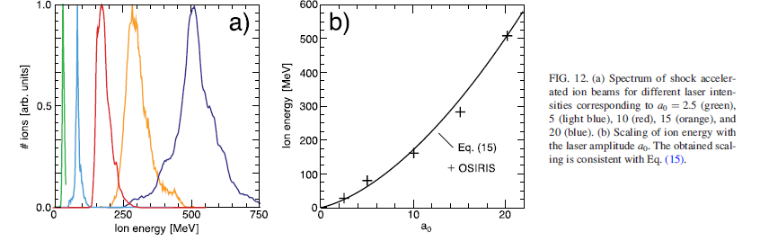
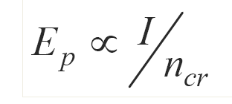
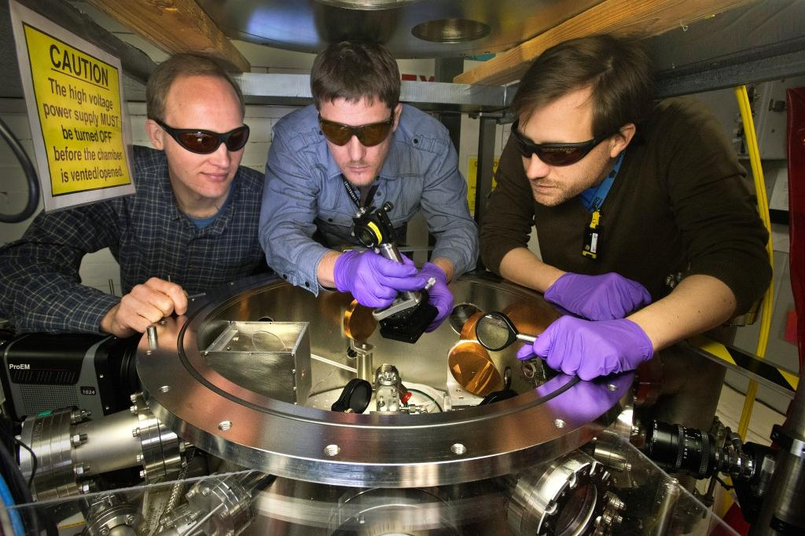
Shock Wave Proton Acceleration
Hydrogen jet
26
N o z z l e
Laser-induced electrostatic shock reflects protons upon its propagation through the ionized H₂ jet.
(light or
neutrals)
1.7 MeV
protons
Energy spread 10%
Spectral brightness 10¹² proton/MeV/str
Proton energy up to 3.2 MeV

Slide 27
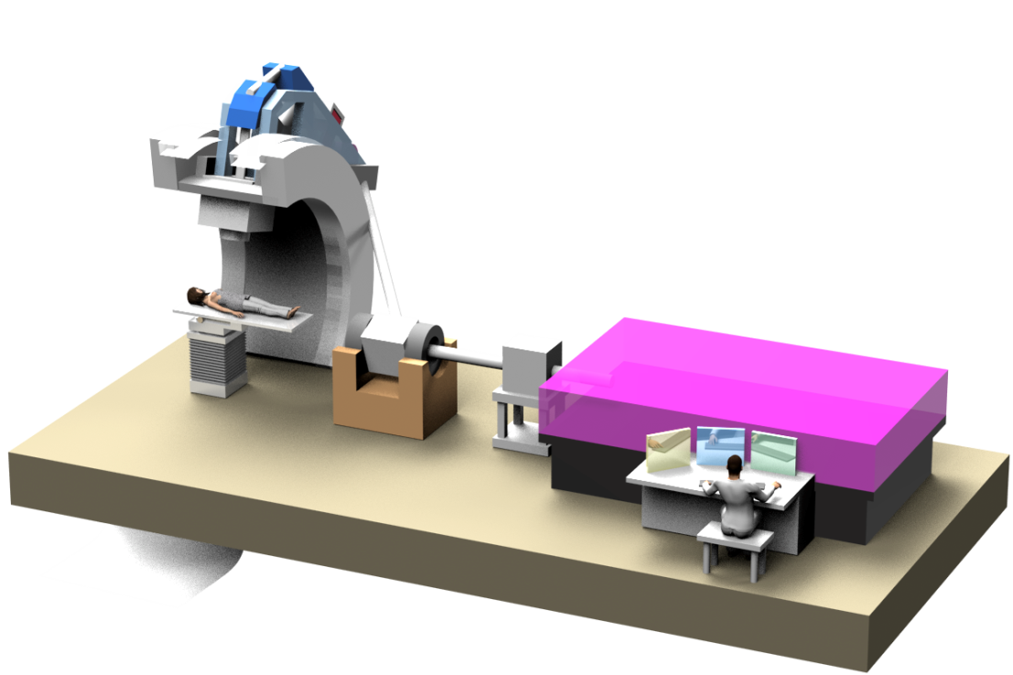
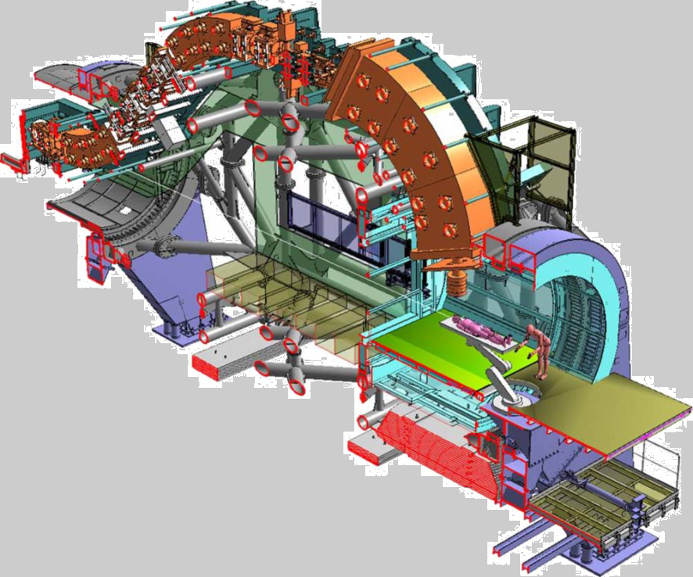
Conventional gantry (670 ton)
Artist’s view of laser-based therapy
Notes:
The idea is to replace most of bulky ion beam transport and shielding with optical laser beam delivery.
Place a compact plasma accelerator on the gantry and move it around patient as x-ray head in tomography.

Slide 28
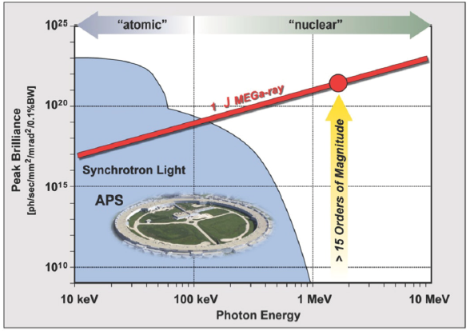
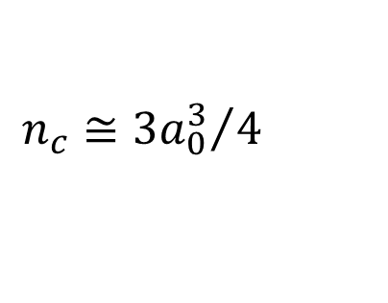
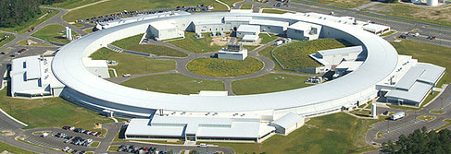
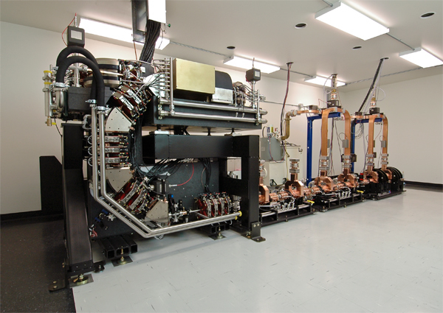
Peak Brightness of a Compton Source
1
100
10
1000
a₀
γ
Nonlinear
Compton source
1
1000
Linear Compton source
B ~ γ⁵
NSLS II
1keV 10keV 100keV 1MeV 10MeV
Photon Energy

Slide 29
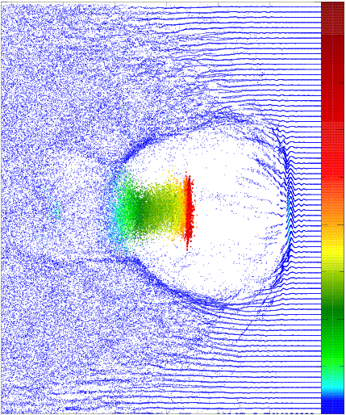
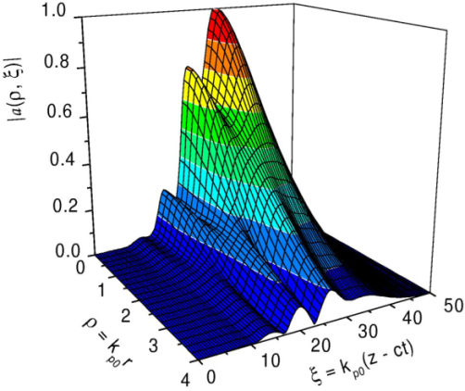
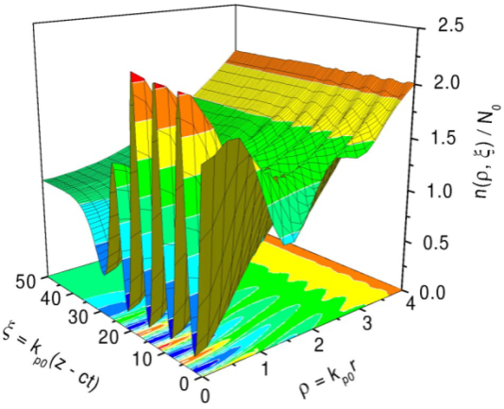
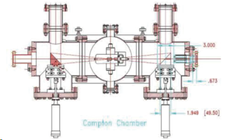
LWFA research
Future 100 TW –
Bubble LWFA
20 GeV/m
6 nC
Past –
Plasma source,
CO₂ laser channeling
Near future –
Self-modulated LWFA
with external injection,
> 1 GeV/m
@ 2.5 TW, 2 ps
Laser pulse
Wake field

Slide 30
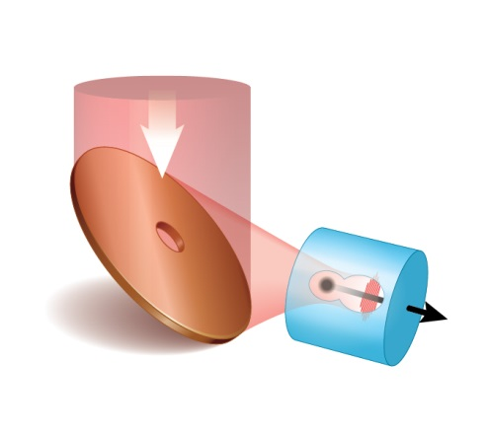



High-current bubble LWFA
CO₂
Benefits from using 100 TW CO₂ laser:
First-time opportunity for bubble LWFA @ λ=10 μm.
Proportional to λ increase of the bubble size allows higher accelerated charges
= 6 nC !
plasma
Electron density
Energy gain up to dephasing
Propagation in
a matched channel
e⁻-banch
CO₂
Courtesy of Wei Lu (Tsinghua Univ.)

Slide 31
LWFA combined with RF linac
CO₂
Unique opportunity for injecting a controlled femtosecond bunch into a plasma bubble for probing, seeding, staging
plasma
Electron density
Plan to serve 3 μm bunches into 30-100 μm bubbles
e—banch from linac
CO₂

Slide 32

Ultra-low emittance LWFA
CO₂
10 μm
a_{o}=1.4
Ti:Sapph
0.4 μm
a_{o}=0.01
like “Trojan Horse”
ε_{n}=50 nm
plasma
Electron density
Ti:Sapph
Strong collaboration on LWFA R&D based on a 100 TW CO₂ laser is being assembled that includes participants from:
UCLA, Austin Univ., Tsinghua Univ., LBNL, Stony Brook Univ.
with DESY and NRL likely to join.
e⁻-banch
CO₂

Slide 33



Slide 34
ATF vision
Providing users with research opportunities :
  not available elsewhere,
  at the cutting edge of strong-field physics and advanced accelerator science,
  with diverse coverage of Office of Science missions in Accelerator R&D and Stewardship.
Thank you
for your attention

Slide 35
Active ATF Experiments
AE31 - Multi-bunch Plasma Wakefield Acceleration, Univ. Southern California [BNL] (2004).
AE35 - High-brightness picosecond ion beam. SUNY SB (2005)
AE37- An X-band, traveling wave, deflection mode cavity. Radiabeam (2007)
AE39– DWA –high-gradient dielectric wakefield acceleration experiment. UCLA (2010)
AE41 – RUBICON - 220mEv/M -130 MeV energy gain helical IFEL experiment at BNL. UCLA(2009)
AE43 - PWFA Holography. Un. Austin (2009)
AE45 - Advanced imaging and ultra-fast material probing with inverse Compton scattering. INFN (2009)
AE48 - Experimental study of electron-beam microbunching dynamics. Tel-Aviv U. (2010)
AE49 - Measurement of coherent terahertz radiation using a real-time interferometer. UCLA (2010
AE50 - Plasma Wakefields in the Quasi-Nonlinear Regime. UCLA (2012)
AE52 - Beam Manipulation by Self-Wakefield at the ATF. Euclid Technilabs (2012)
AF53 – Nonlinear inverse Compton scattering. UCLA
AF54 – AXIS -5-um damage test. Radiabeam/UCLA (2012)
AE56 - A High-resolution Transverse Diagnostic Based on Fiber Optics. Radiabeam (2013)
AF57 - Corrugated Plate De-Chirper. Radiabeam (2013)
AF58 - ERL BPM Test. BNL (C-AD) (2014)
AE59 Inverse Compton Source for Extreme Ultraviolet Lithography. Radiabeam (2013)
AE60 - Ultrafast High-Brightness Electron Source., Advanced Energy Systems (2012)
AE61 - Transient Noise of MCT Detector Array Due to 70 MeV Electrons. Jet Propulsion Lab. (2014)
AF62 - Sub-femtosecond beam line diagnostics. UCLA (2014)
AE63 - Stony Brook Accelerator Laboratory Course, CASE@ATF. Stony Brook Un (2014)
AF64 - Surface Wave Accelerator and Radiation Source Based on Silicon Carbide. U. Tex. Austin (2012)

Slide 36
Accelerator Stewardship Defined
Serving as a catalyst to broaden and strengthen the community that relies on accelerators and accelerator technology.
Working with accelerator user communities and industrial accelerator providers to develop innovative solutions to critical problems, to the benefit of both the broader user communities and the DOE discovery science community.
Facilitating access to national laboratory accelerator facilities and infrastructure for both industrial and other U.S. government agency users/developers of accelerators and related technology.
E. Colby and M. S. Zisman, “The DOE-HEP Accelerator R&D Stewardship program”, Proc. PAC2013, Pasadena, CA USA

Slide 37

The ATF Program Advisory Committee
Former Members of the Committee:
• Ilan Ben-Zvi, Brookhaven National Laboratory
• Alexander Chao, Stanford Linear Accelerator Center
• Ernest Courant, Brookhaven National Laboratory
• Horst Foelsche, Brookhaven National Laboratory
• Wei Gai, Argonne National Laboratory
• Robert Gluckstern, University of Maryland
• Michael Harrison, Brookhaven National Laboratory
• Thomas Katsouleas, Duke
• Samuel Krinsky, Brookhaven National Laboratory
• Thomas Marshall, Columbia University
• Roger Miller, Stanford Linear Accelerator Center
• Steven Milton, Argonne National Laboratory
• Patrick O'Shea, University of Maryland
• Claudio Pellegrini, University of California at Los Angeles
• Veljko Radeka, Brookhaven National Laboratory
• Ronald Ruth, Stanford Linear Accelerator Center
• Richard Sheffield, Los Alamos National Laboratory
• Vladimir Shiltsev, FNAL
• Todd Smith, Stanford University
• Peter Thieberger, Brookhaven National Laboratory
• Jonathan Wurtele, University of California at Berkeley
Current Committee membership:
• Katherine Harkay, ANL
• Karl Krushelnick, Univ. of Michigan
• Wim Leemans (Chair), LBNL
• Sergei Nagaitsev, Fermilab
• James Rosenzweig, UCLA
• Vitaly Yakimenko, SLAC
Former Chairs of the Committee:
• Swapan Chattopadhyay, Thomas Jefferson NAF
• Chandrasekhar Joshi, UCLA
• James Rosenzweig, UCLA
• Andrew Sessler, Lawrence Berkeley National Lab.
• Robert Siemann, Stanford Linear Accelerator Center
• Maury Tigner, Cornell University
Truly a blue-ribbon committee for a quarter of a century

Slide 38

Provides users with unique combination of high brightness electron- and laser- beams
  Nd:YAG Laser
  λ1 = 1.06 µm
  λ2 = 0.266 µm
  14-ps pulse
  Stability 1 ps
81.6 MHz
×35
2.86 GHz
OSCILLATOR
  RF Gun
  1.6 cell S-band photocathode
MASTER CLOCK
AMPLIFIER
0.266 µm for
photocathode
4th HARMONICS
hν
Linac
Two traveling wave
SLAC sections
Beam energy
30-80 MeV
Bunch charge
up to 1nC
Normalized emittance
1.4 mm mrad
Bunch length
200 fs-10 ps
9.2 µm
e⁻
80 MeV
  Mid-IR (CO2) Laser
  λ = 9.2 – 10.6 µm
  Single 5-ps pulse
  2 TW peak power
  a₀=1.4
  1 pulse in 20 sec
81.6 MHz
1.06 µm for optical switch
Ti:SAPPHIRE
OPA
CO2 AMPLIFIERS

Slide 39

ATF upgrade opens up new science opportunities
Science of strong field λ-scaling
HHG
Laser-matter interaction studies at Iλ² >10²⁰ W/cm² in unexplored mid-IR spectral domain
Advanced accelerator studies
Ion acceleration – gas targets; H, D, He, Ne, etc.
High bunch-charge LWF electron acceleration.
Combining ATF laser with high brightness e-beam:
  Probing or seeding of laser-driven plasma wakes
  IFEL technology reaching the GeV level
  Advanced studies of Inverse Compton scattering, e.g. non-linear interactions, pulse recirculation, etc.
Source: Summaries of ATF Laser Upgrade Advisory Panel (C. Barty, P. Corkum, L. DiMauro, H. Kapteyn, S. Tochitsky, W. White ), October 10-11, 2013

Slide 40

All-optical Compton source
X10 gain in e-beam charge
and
X10 higher photon number per Joule
combine in
X100 higher Compton yield
Benefits from using CO₂ laser:
100 TW
100 fs
1 TW
25 ps
Tunable 50 keV - 50 MeV
Total photon yield 10¹¹
Total photon flux 10²⁴/s
Compton
source
LWFA

Slide 41
Accelerator Stewardship Concept
1994: Concept emerged in decisions of the J. Marx Panel
  “This (HEPAP) subpanel believes that the DOE and its predecessor agencies have de facto held a national trust for the stewardship of accelerator science and accelerator-based technology development primarily through their long-standing and sustained investments in this area.”
  The ATF serves as a good illustration to this statement as it actually provided an instrument for carrying out the accelerator stewardship missions since the facility’s inception.
2006: The second round of the same panel
  provided concrete recommendations that the stewardship role of OHEP for long- and mid-term accelerator R&D needs to be permanently maintained, enhanced, and properly funded.
2009: Symposium Accelerators for America’s Future
  showed importance of accelerators for the Nation and making the case for Federal support.
2011: US Senate report
  directed the DOE “to submit a 10-year strategic plan for accelerator technology research and development to advance accelerator applications in energy and the environment, medicine, industry, national security, and discovery science.”

Slide 42
Accelerator Stewardship Concept (continued)
2013: After series of workshops and panels the OHEP Stewardship mission has been defined*⁾ as follows:
  Serving as a catalyst to broaden and strengthen the community that relies on accelerators and accelerator technology.
  Working with accelerator user communities and industrial accelerator providers to develop innovative solutions to critical problems, to the benefit of both the broader user communities and the DOE discovery science community.
  Facilitating access to national laboratory accelerator facilities and infrastructure for both industrial and other U.S. government agency users/developers of accelerators and related technology.
2014: Presenting a DOE Funding Bill, the US Senate made the following ruling:
  The Committee recognizes the critical role accelerator technology can play in addressing many of the economic and societal issues confronting the country.
  The Committee supports the Office of Science’s efforts to make unique test facilities available to U.S. industry to accelerate applications of accelerator technology
  The Committee recommends $20,000,000 for Accelerator Stewardship within the funds for High Energy Physics.
2014: New programs in accelerator science have been established :
  DOE HEP Funding Opportunity Announcement (FOA) in Accelerator Stewardship.
  ATF operations and ATF II upgrade funded by DOE HEP under Accelerator Stewardship.
  ___________________________________
  *⁾ THE DOE-HEP ACCELERATOR R&D STEWARDSHIP PROGRAM, Eric Colby, Michael S. Zisman, Proceedings of PAC2013, Pasadena, CA USA

Slide 43


High-charge CO₂ bubble LWFA
can drive “Trojan Horse” PWFA
LWFA – ponderomotive action by a laser pulse results in electron heating to several MeV.
PWFA – electrons are expelled by the Coulomb force of the driver-bunch with negligible heating.
Path to low emittance:
Ti:sapph
“Trojan Horse” – concept of brightness transformer predicts ε_{n}=30 nm
PRL 108, 035001 (2012)

Slide 44

Concept of all-optical FEL
Impact of emittance reduction on Compton sources could be similar to the benefit gained from using low-emittance linacs instead of synchrotrons that resulted in inception of 4th generation coherent light-sources – FELs.
CO₂
Ti:sapph
CO₂
LWFA
We may be on a verge of a similar development that will add temporal coherency to their other attractive features of Compton sources.
Longer laser wavelength – higher gain
PWFA
(low ε)
Compton
FEL

Slide 45
Users (by sector and location)
Total users: 119
Data Period Oct 2010 – June 2013

Slide 46
Usage of resources
Completed
Completed
Laser/e-beam
13
Active
Active
e-beam
24
laser
4
Completed
Active projects: 19
Completed projects: 25
Active
46

Slide 47




CO₂ Laser Facilities for Strong-Field Physics
NY
CA
UCLA
Neptune lab.
ATF
Notes:
Two such facilities have been built in US in late 80's.
Neptune lab at UCLA, and Accelerator Test Facility at Brookhaven near NY.
Neptune lab acquired a huge e-beam sustained amplifier named MARS from Antares laser just decommissioned to that time at Los Alamos. It is limited in pressure to 3 atm and capable to deliver multi-kJ 160 ps TW pulses at the rate of a pulse per hour.
The ATF has been designed as a user's facility to explore effects from short few-picosecond pulses. Therefore, it is equipped with 10-atm lasers.

Slide 48


Shock Wave Ion Acceleration
Laser energy absorbed within critical plasma layer creates electrostatic shock wave at velocity
The shock field reflects upstream ions at double velocity.
n_{e}
n_{cr}
laser
V_{sh}
V
2V
2V_{sh}
Only CO₂ lasers, with their low n_{cr} , allow realizing this process in a gas jet.

Slide 49

Layout of Compton experiment in beam line 2A
Movable beam stop
Scattered X-Rays
Portable pedestal & spectrometer arm
UHV Mirror boxes
UHV interaction chamber
Beam line YAG BPMs
Laser beam path
Optical Table
E-beam
Moveable Quad triplet pedestal

Slide 50


Bunch compressor
First stage linac:
100 MeV
BNL-UCLA-SLAC Gun

Slide 51


Nonlinear pulse compressor
CONFIDENTIAL
(under evaluation for patentability)
n = n₀ + n₂I
25 TW
100 TW
10J, 100 fs
50 J, 2 ps

Slide 52
ATF Science Achievements in 2013
First demonstration of mass-shift effect and multiple harmonics in inverse Compton scattering.
Record-high acceleration gradient (100 MeV/m) and energy gain (50 MeV) from inverse FEL electron accelerator.
Demonstration of energy chirp compensation in the electron beam by Dielectric Wake Fields.
Demonstration and study of a Plasma Wake Field in the plasma blowout regime.
Detailed study of a novel Shock Wave ion acceleration regime using two laser pulses impinging on a supersonic gas jet.
Demonstration of 10% wall-plug efficiency in producing trains of picosecond pulses inside the CO₂ laser amplifier cavity aimed towards building a high-power Compton radiation source.
Developing and partial verification of a novel ultra-fast CO2 laser concept. This laser will dramatically enhance the ATF contribution to the cutting-edge advanced accelerator research.
Results presented at international scientific conferences and submitted for publication.

Slide 53

New science reach with laser upgrade
Enhancement of physical processes previously demonstrated with solid state lasers (THz, neutron sources).
Physical effects practically affordable only with long wavelength lasers (SWA, HHG).
New opportunities for LWFA research due to bigger and higher-charge bubbles and their probing and injection with femtosecond e-beams.
Enhancement of traditionally strong areas of ATF research based on combination of laser with e-beams (IFEL, ICS).

Slide 54


Compton FEL
Impact of emittance reduction on Compton sources could be similar to the benefit gained from using low-emittance linacs instead of synchrotrons that resulted in inception of 4th generation coherent light-sources – FELs.
We may be on a verge of a similar development that will add temporal coherency to their other attractive features of Compton sources.
Longer laser wavelength – higher gain
1st example - linac; L. Serafini et al, PRST-AB 9, 060704 (2006)
Electrons: 30 MeV, 3 nC, 3ps, ΔE/E=10⁻⁴, ε_{n}=0.6 μm
CO₂ laser: 100 GW, a₀=0.3, 100 ps
FEL: 7.6Å, L_{s}=3 cm, 10¹⁰ photons (X100 over incoherent), 2 MW, B_{pk}=10²⁶
2nd example – plasma
Electrons: 30 MeV, 0.3 nC, 50fs, ΔE/E=10⁻², ε_{n}=0.03 μm
CO₂ laser: 1TW, a₀=0.5, 10 ps
FEL: 7.6Å, L_{s}=3 mm, 10⁹ photons, 30 MW, B_{pk}=10²⁷
Notes:
Pierce parameter needed to estimate FEL power or energy per pulse. Show be proportional to N^2. Look how compares with linear Compton output, also spectrum and angle narrowing

Slide 55
In 2013, ATF ran 13 user experiments
Exp. | Name | Group | Run Time | Setup Time
AE35 | Ion Accel. | SUNY/Imperial Coll. | 172/22 | 80/10
AE39 | DWFG | UCLA | 75.4/8 (hrs/days) | 20/4 (hrs/days)
AE41 | RUBICON | UCLA | 129/20 | 91.6/17
AE43 | Holography | USC | 77/11 | 98/15
AE50 | PWFA in QNR | UCLA | 299/37 | 114/18
AE52 | DWFA | Euclid | 226.5/25 | 65.6/20
AE53 | Compton | UCLA | 39.5/5 | 9.7/2
AE54 | 5-um damage | Radiabeam/UCLA | 64/8 | 64/8
AE55 | Single e- | Princeton | 38.4/6 | 25.7/5
AE56 | Fiber-optic | Radiabeam | 16.2/3 | 15.9/3
AE57 | De-chirper | Radiabeam | 29.3/4 | 11.4/2
AE58 | PUE BPM | BNL | 29.9/5 | 11.1/2
AE59 | EUVL | Radiabeam | 72/9 | 40/5

Slide 56





E-beam instrumentation
“Brookhaven Gun”
Capillary discharge plasma source
e⁻
Mask technique

Slide 57



Beam/Plasma Interactions
PI – P. Muggli, USC
PWFA Self-Modulation Filamentation
First acceleration of a short electron bunch trailing a driver electron bunch in high-density plasma.
first demonstration
of the SMI seeding to
be used in experiments
in the planning phase at FACET and CERN.
first demonstration of filamentation instability when transverse beam size is bigger than plasma wavelength

Slide 58





Multi-bunch resonance PWFA
PI – P. Muggli, USC
simulations
experiment
58

Slide 59



DWFA research (acceleration, THz radiation, chirp correction)
PI – G. Adonian, UCLA
PI – S. Antipov, Euclid

Slide 60
Publications by Year
Citations by Year

Slide 61
ATF 2013 Operations
E-Beam
CO₂ Laser
Each pie includes available operation time in 2013 =1904 hours (8 hours/day, 5 days/week, excluding holidays, lab closure etc.)
Notes:
Proposed new ATF facility with multiple experimental halls will improve the ATF productivity by increasing the run time proportion.

Slide 62











Recent unpublished results in nonlinear Compton scattering
harmonics
mass shift
High laser power a₀>0.5
Low laser power a₀<0.1
K-edge
absorption
Fe foil

Slide 63
Stage 1 Detailed facility design & RSC review
QT8 QT9 QT10 QT11 QT12 QT13
Equipment Move from SDL , MIT & component purchases
ATF1 continues operations
Accelerator component tech support contracts/agreements
!00 TW CO2 laser component contracts, PFN and HP vessels
Construction of Shielding walls
Integration of PFN & HP Vessel at BNL to establish 1TW laser in 912
Install utilities and stage 1 Control systems
Install transport lines for solid state and CO2 lasers
CO2 and solid state Laser Labs in 912
ATFII Stage 2 Start
First experiments at Beam line 1
Transfer Equip. from 820 to 912
Assy Gun Linac & beam line systems
Assy CO2 compressor 2-40 TW System
Decommission building 820
Gun and Linac commissioning
ATF II Time Line in Quarters from Project start.
Beam line 1 commissioning
Beam Line 2 commissioning
Transfer ATF Ops. to 912
QT1 QT2 QT3 QT4 QT55 QT6 QT7

Slide 64


High-repetition CO₂ laser
CO₂ laser:
Pressure 10 atm
Repetition Rate 1 kHz
Average Power 1 kW
Prospective B_{ave}= 10¹³ @10keV
to 10¹⁹ @10MeV
(ph/s-mm²-mrad² -0.1%BW)
X-ray (γ-rays):
It is anticipated that compact light sources affordable to any university will make a similar impact as PCs complementing main-frame computers.
Notes:
Expected parameters

Slide 65

10 μm
a_{o}=1.4
0.4 μm
a_{o}=0.01
ε_{n}=50 nm
65

