Slide 1
US University Program:
Accelerator related research on superconductivity
Ralf Eichhorn
Cornell University
R.EICHHORN@CORNELL.EDU
Based on material provided by:
  Jean Delayen (Old Dominion)
  Michael Kelley, Ale Lukaszew (William and Marry)
  David Larbalestier (Florida State)
  Kenji Saito (Michigan State)
  Xiaoxing Xi (Temple)

Slide 2
Accelerator R&D
What will be the next HEP accelerator, a linac or a ring, or an ERL?
What do we need to build such a machine
Highly efficient accelerating cavities
  High gradients
  Low losses
High field magnets
No matter what the answer is, superconductivity is the key technology!

Slide 3

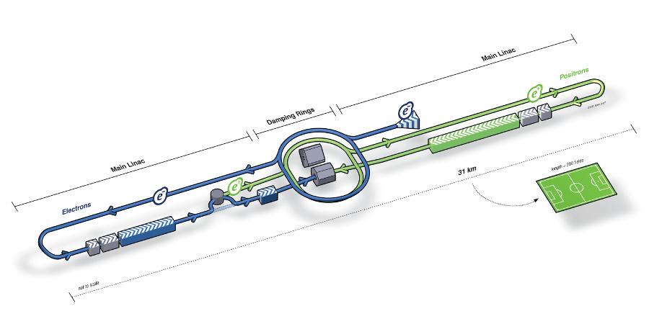
SRF Cavities for International
Linear Collider (ILC)
http://www.linearcollider.org/about/What-is-the-ILC
A proposed electron-positron collider, the ILC is a doorway to energy regimes beyond the reach of today's accelerators
Frequency: 1.3 GHz
Energy: Up to 500 GeV with an option to upgrade to 1 TeV
Uses16,000 SRF cavities made of pure Nb
About 31 km long with an accelerating gradient of 31.5 MeV/m

Slide 4
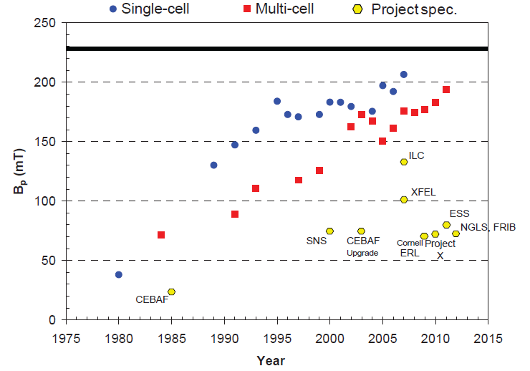
Looking Beyond Nb
Nb cavities have seen significant improvement in their performance, reaching the theoretical limit for Nb (H_{c} = 200 mT, H_{c1} = 170 mT)
For further improved cavity RF performance, new superconductor needed
Ciovati, Proc IPAC2013, Shanghai, China

Slide 5
MgB₂ Thin Films for SRF Applications
Teng Tan, Narendra Acharya, Matthaeus Wolak, Ke Chen, Alex Krick, Steve May, Evan Johnson, Michael Hambe, and Xiaoxing Xi
Department of Physics
Temple University, Philadelphia, PA
Collaborators
Mitra Taheri (Drexel), Enzo Palmieri (INFN), Tsuyoshi Tajima and Leonardo Civale (LANL), Ale Lukaszew (W&M), Charlie Reese (JLab), Ali Nassiri and Thomas Proslier (ANL)
Supported by DOE/HEP, ANL

Slide 6
MgB₂: Potential Low RF loss and High Gradient
 | Niobium | MgB₂
T_{c}/K | 9 | 40
ρ₀ /(μΩ cm) | 5 | 0.1
Energy gap/meV | 1.5 | 7 (σ), 2(π)
B_{c}(0)/T | 0.20 | possibly 0.80
B_{c1}(0)/T | 0.17 | <0.1
RF surface resistance depends on energy gap and residual resistivity. Larger gap and lower resistivity indicate potential low RF loss than in Nb.
Field gradient is ultimately limited by thermodynamic critical field. For MgB₂, B_{c}(0) could be as high as 800 mT, vs. 200 mT for Nb.
Lower critical field B_{c1}(0) may be important.

Slide 7
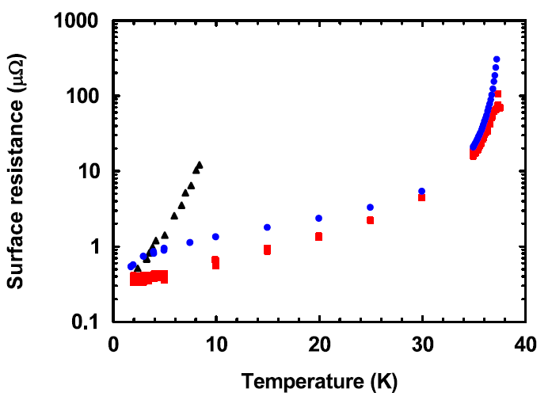
Surface Resistance: MgB₂ vs Nb
Stripline resonator
scaled to 1.5 GHz
Nb on sapphire
MgB₂ on LAO
MgB₂ on sapphire
Oates et al., SUST 23, 034011 (2010)
Lower surface resistance comparable to Nb film.

Slide 8
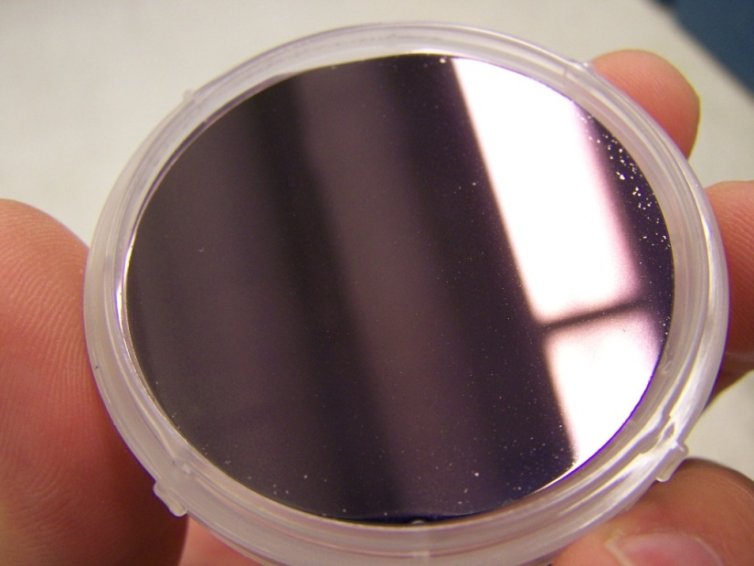
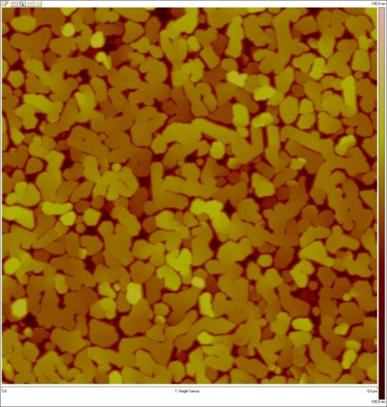
2” MgB₂ Films Grown by HPCVD
200 nm 2’’ MgB₂ film on sapphire
AFM image of film surface

Slide 9
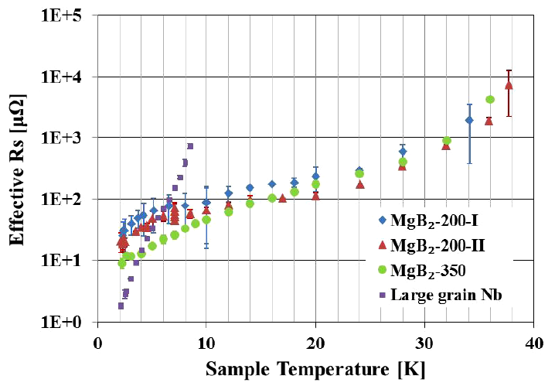
Surface Impedance Compared to the Best Nb
7.4 GHz, measured at JLab
Surface resistance of 2” dia. 350 nm MgB₂ film on sapphire comparable to the best large grain Nb at 4 K.
Xiao et al., SUST 25, 095006 (2012)

Slide 10
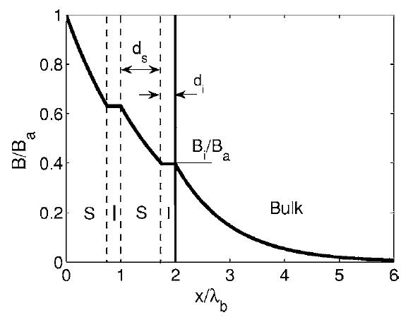
Enhancing B_{c1} by Multilayering
When vortices enter the superconductor, their motion driven by the RF field can contribution to RF loss.
When film thickness d < λ, B_{c1} is larger than the bulk B_{c1}
B_{c1} = (2φ₀/πd²)[ln(d/ξ)]
Vortex entrance field can be enhanced by coating a superconducting cavity with several thin film superconductors with d < λ.
Gurevich, APL 88, 012511 (2006)
Notes:
10

Slide 11
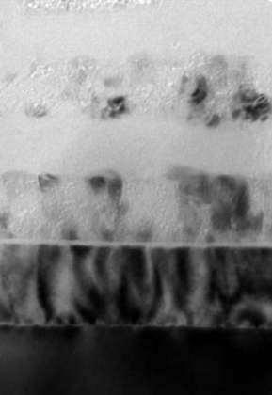
MgB₂-MgO Multilayer Films
MgB₂
MgO
MgB₂
MgO
MgB₂
Sapphire
5
5. a-MgB₂
4. poly-MgO
3. a-MgB₂
2. poly-MgO
1. Epitaxial MgB₂
4
3
2
Alternating MgB₂-insulator structures have been fabricated on sapphire substrate. Sputtering MgO are used as insulating layer.
Top MgB₂ layers amorphous.
1
SiC

Slide 12
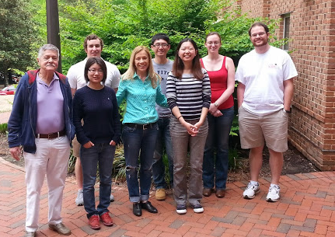


PROOF OF CONCEPT THIN FILMS AND MULTILAYERS TOWARD
ENHANCED FIELD GRADIENTS IN SRF CAVITIES
Rosa A. Lukaszew, Douglas B. Beringer, William M. Roach,
College of William and Mary, Williamsburg, Virginia, USA
Grigory V. Eremeev, Charles E. Reece, Anne-Marie Valente-Feliciano,
Thomas Jefferson National Accelerator Facility [TJNAF], Newport News, Virginia, USA

Slide 13
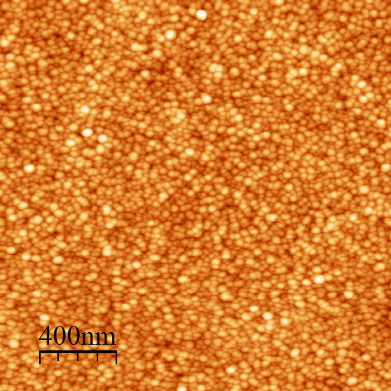
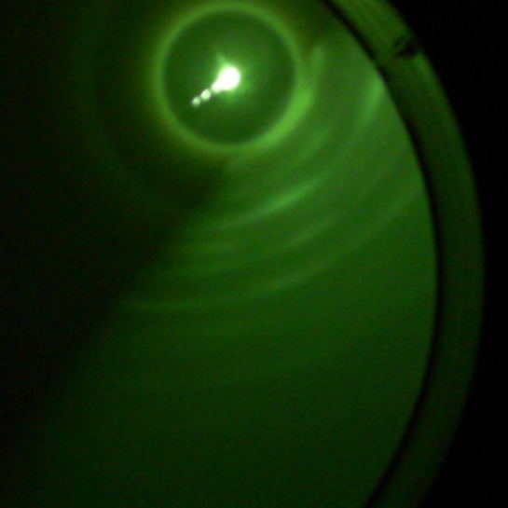
Nb-based trilayer
30 nm Nb
RHEED indicates
film with high
degree of (001)
texture
15 nm MgO
250 nm Nb
XRD confirmed RHEED results:
MgO (100)

Slide 14
Growth Procedure for NbN Films Partial Pressure Series
~400 nm NbN
600 °C growth
600 °C (40 V) for 30 min
3 nm MgO
RT growth
~1-2 ML Mg
600 °C growth
600 °C (40 V) for 1 hour
MgO (001)
All NbN films are ~200 nm thick based on XRR/Profilometry

Slide 15
Compare Surface Morphology of Nb and NbN similar films
NbN
Nb(100)
RMS Roughness for comparable film thickness:
NbN <1 nm
Nb(100) 1.21 nm
Nb(110) 2.45 nm
Nb(110)
D. B. Beringer, W. M. Roach, C. Clavero, C. E. Reece and R. A. Lukaszew, “Roughness analysis applied to niobium thin films grown on MgO(001) surfaces for superconducting radio frequency cavity applications” accepted for publication in Phys. Rev. ST Accel. Beams (2012).

Slide 16
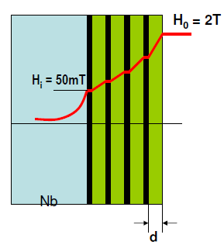
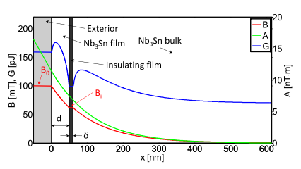
SIS Multilayer Films:
Theory Evaluation
SIS coatings: alternating thin layers of superconductor and insulator
Proposal showed films screening fields much higher than bulk B_{sh} (ultimate limit of bulk superconductors)
Our study of films using Ginzburg-Landau shows conclusively that only small gain in B_{sh} is possible relative to bulk
Gain is significant only for relatively small range in d
[1]
[1] A. Gurevich, App. Phys. Lett. 88, 012511 (2006), A. Gurevich, SRF Materials Workshop (2007).
Maximum gain for Nb₃Sn/I/Nb compared to Nb₃Sn bulk is ~12%
Nb₃Sn d<<λ
Multilayer with 5 S-I films (d = total thickness of S layers) over bulk Nb has smaller B_{sh} than single layer
Single-material SIS has smaller B_{sh} than bulk for any d
To left of peak, B_{max} limited by bulk B_{sh}
To right of peak, B_{max} limited by film B_{sh}

Slide 17
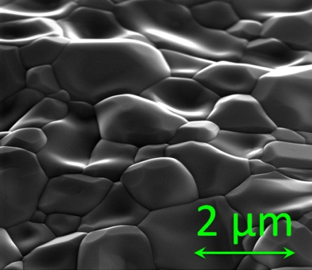
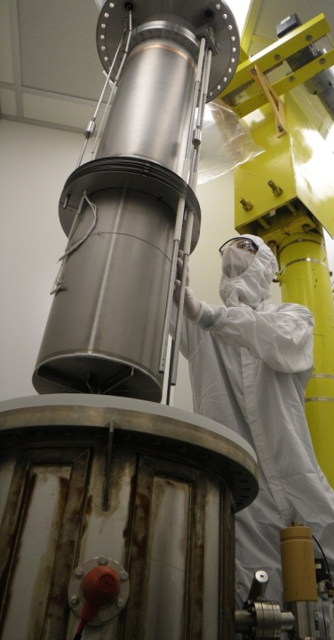
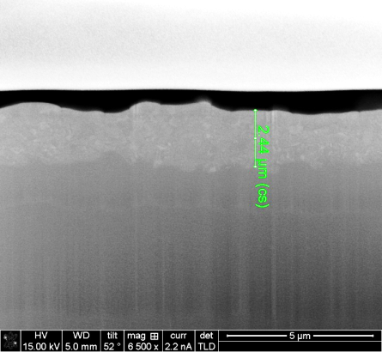
Nb₃Sn for SRF
Great potential
  T_{c} = double Nb → higher Q₀ at a given temperature
  Predicted B_{sh} = 400 mT → potentially double maximum gradient of Nb
Challenges
  Alloy rather than element, smaller coherence length: more challenging
  Relatively little R&D to date: need to find treatments that bring out full potential as has been done with Nb over 40 years
SEM image of surface
Nb₃Sn
Nb
Coating chamber at Cornell
x-section of 2-3 μm thick layer

Slide 18
SRF R&D in MSU
R&Ds are ongoing, directly for FRIB construction or as a backup plane
  Finial cavity design and its validation for FRIB
  Metal gasket sealed QWR bottom flange as a backup plan
  Cavity/fringe field interaction study on local magnetic shield in FRIB cryomodule
    Cavity/fringe field interaction investigation
    Magnetic shield study with local magnetic shielding
    Simulation of fringe field through the local shield on cavity outer surface, which is concerned to the flux trapping (Q-drop) after cavity quench

Slide 19
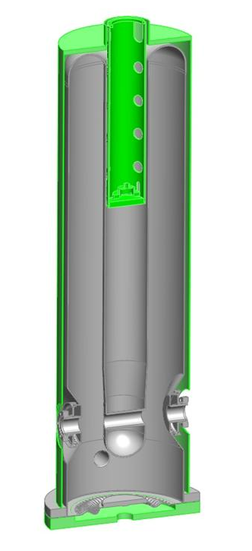
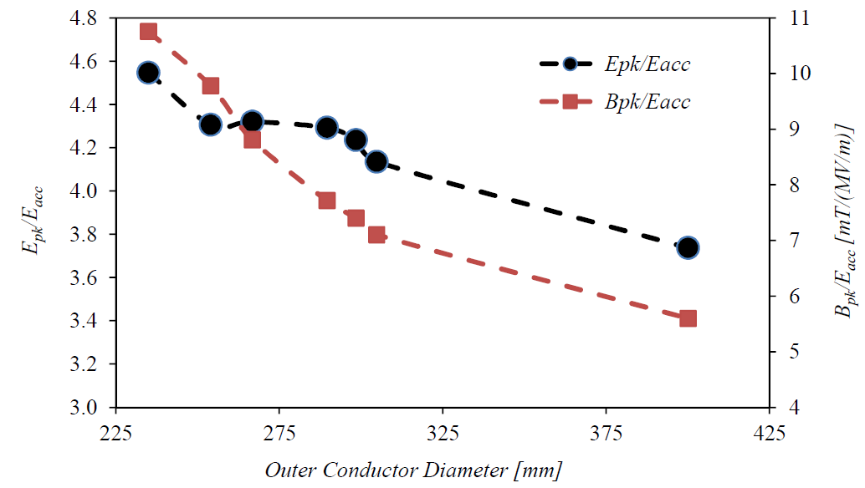
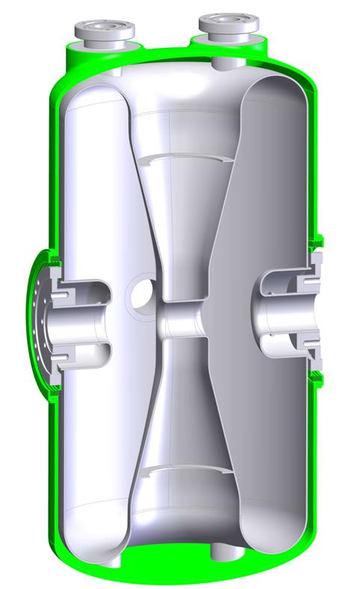
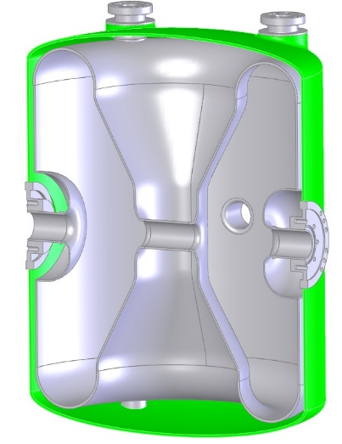
FRIB Final Cavity Design
Improved cavity design with lower Hp/Eacc and Ep/Eacc
The SRF Review Committee in 2011 recommended not to exceed E_{p}=35 MV/m and B_{p}=70 mT in operation based on experimental data of 40 QWRs in operation at TRIUMF
FRIB has adopted this specification to guarantee reliable operation of its linac with a good safety margin
  lower E_{p} & B_{p}, higher R_{sh} by increased outer conductor diameter
  Increased aperture of QWRs from 30 to 36 mm
  Increased operation E_{acc}: the FRIB driver linac could be shortened by 2 cryomodules
  FRIB operation gradient now more conservative, with B_{p}≤70 mT ,
HWR0.29
cavity | E_{p}/E_{acc} | B_{p}/E_{acc} | R_{sh} | E_{acc}
QWR085 | -9% | -11% | +38% | +10%
HWR29 | -3% | -28% | +47% | +10%
HWR53 | -17% | -19% | +13% | (+6)%
β=0.29
β=0.53
β=0.085

Slide 20
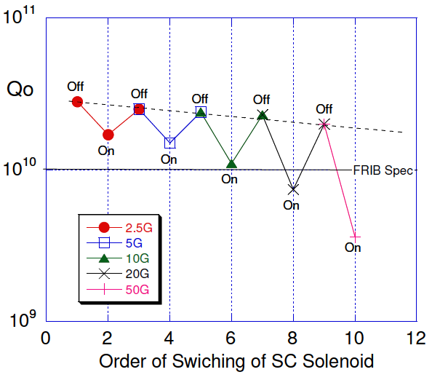
Cavity/Fringe Field Interaction Investigation
A fringe field of 4G causes a Q-drop under FRIB spec. with 0.53HWR when cavity happened quench
Meissner Shield
    Cavity performance no change up to 2500G fringe field, if no quench happens
Q_{O}-drop by the Quench
      Q_{O} drops under the FRIB specification (HWR) at > ~ 4G of fringe field
      Flux trapping by quench is proportional to the increased fringe field strength
“Annealing effect” (discovered in FNAL)
  Confirmed “annealing effect” against the Q_{O}-drop by a quench under
  “Annealing effect” can be use the Q_{O} recovery
Q_{O}-drop and Annealing effect @ Eacc=7.5MV/m
0.5G
1.0G
“Annealing effect”: when a Q_{O}-drop happened by cavity quench, switch off the solenoid and repeat RF processing, then Q_{O} recovers (FNAL).
2.0G
4.0G
10.0G

Slide 21
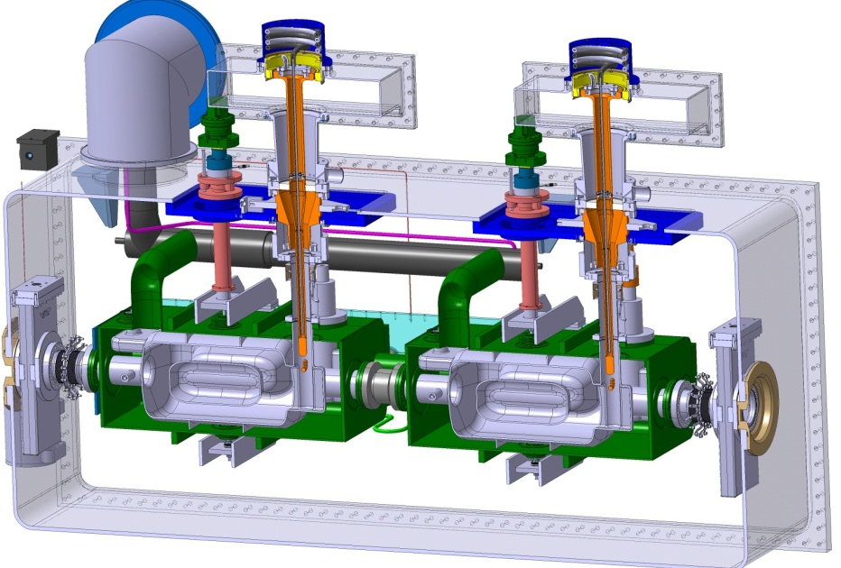
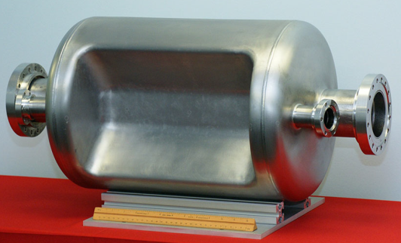
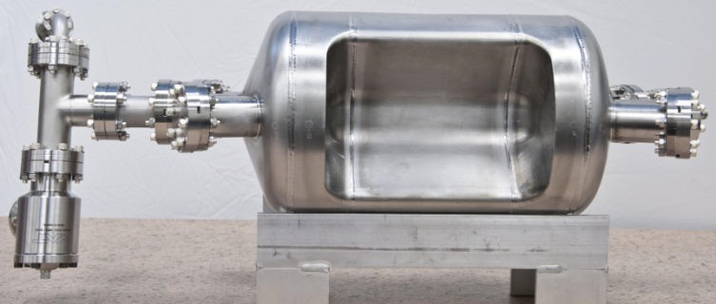
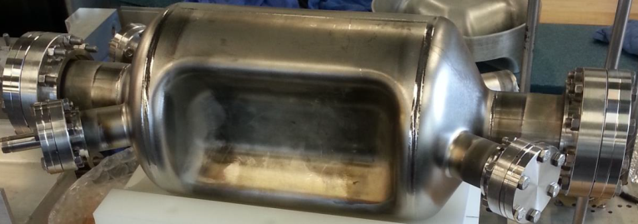
SRF Structures Development
Deflecting and crabbing cavities
  400 MHz crabbing cavity for LHC-HiLumi
    Supported by DOE HEP
  499 MHz deflecting cavity for Jlab upgrade
    Supported by DOE NP
  750 MHz crabbing cavity for MEIC
    Supported by DOE NP

Slide 22
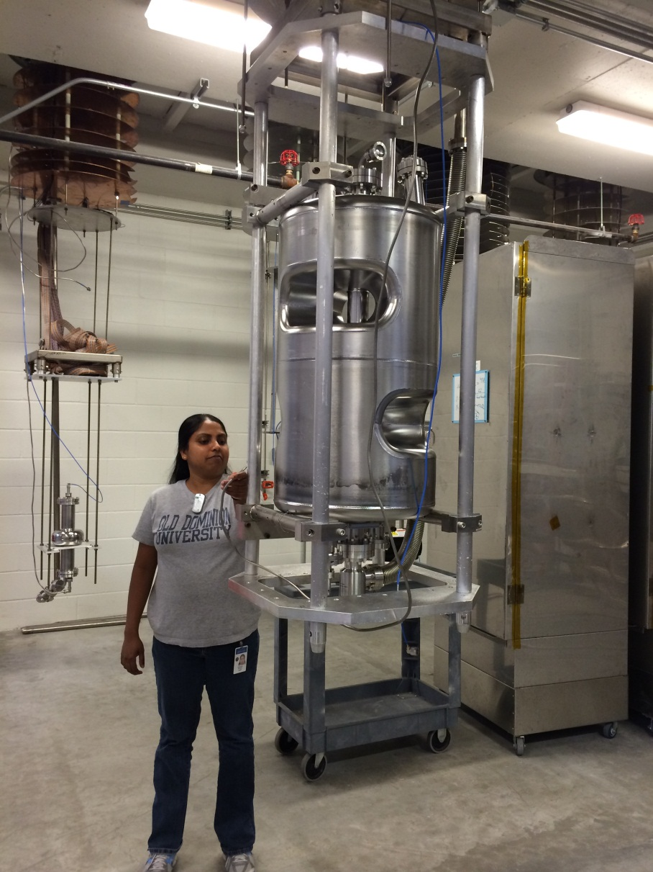
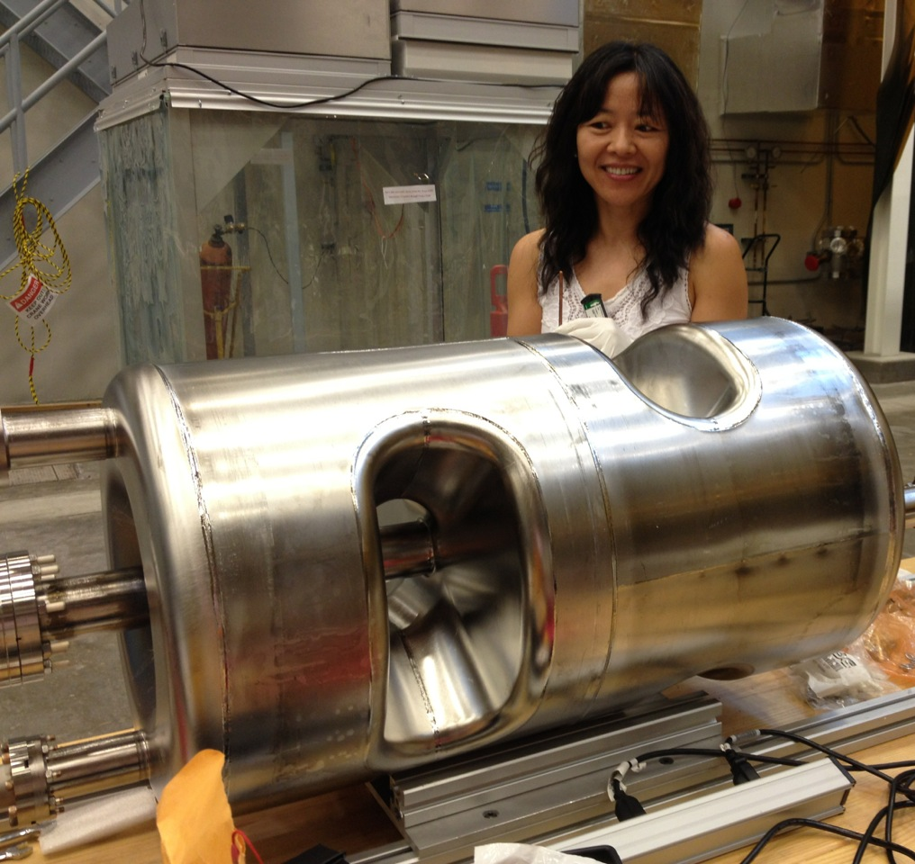
SRF Structures Development
Accelerating structures
  Spoke cavities for high-velocity applications
    Supported by DOE NP, DoD
Single and double spoke
325, 500, 700 MHz
β=0.75 - 1

Slide 23
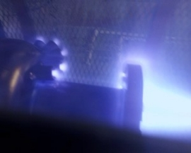
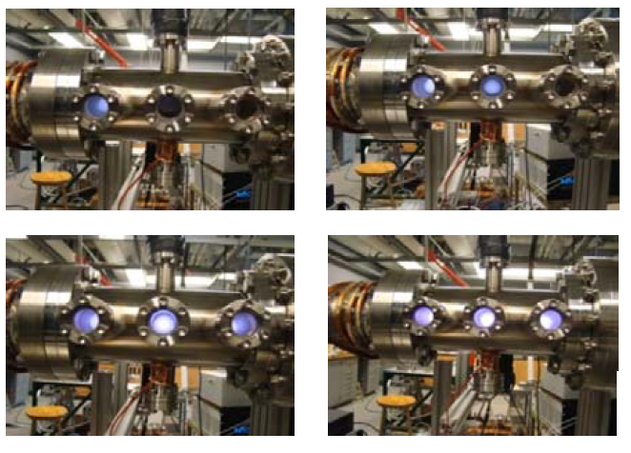
SRF Cavity Surface Processes
Plasma processing of srf niobium cavities (Cl₂/Ar plasma etching)
  Supported by DOE HEP

Slide 24
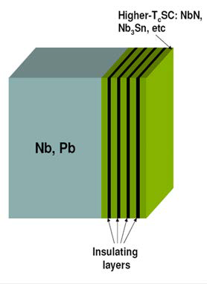
SRF Materials (theory and experiments)
“Investigation of new superconducting materials for the next-generation high-gradient rf cavities for particle accelerators”
  Supported by DOE HEP
“Experimental and Theoretical Studies of Fundamental Limits of Surface Resistance of Superconductors for Next Generation Particle Accelerators”
  Supported by NSF

Slide 25
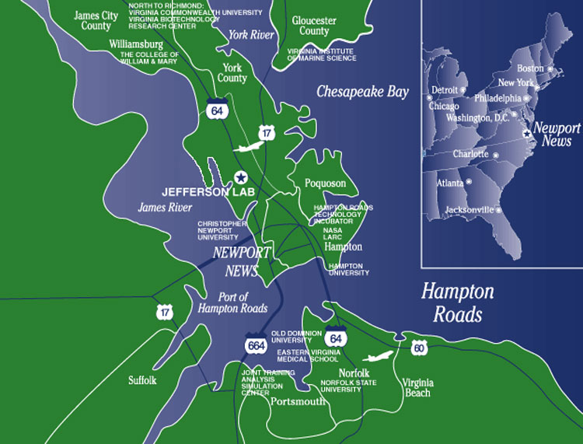
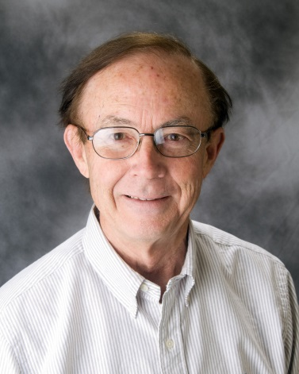
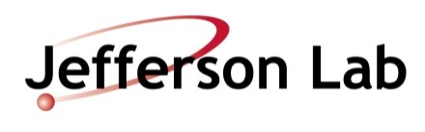

Slide 26
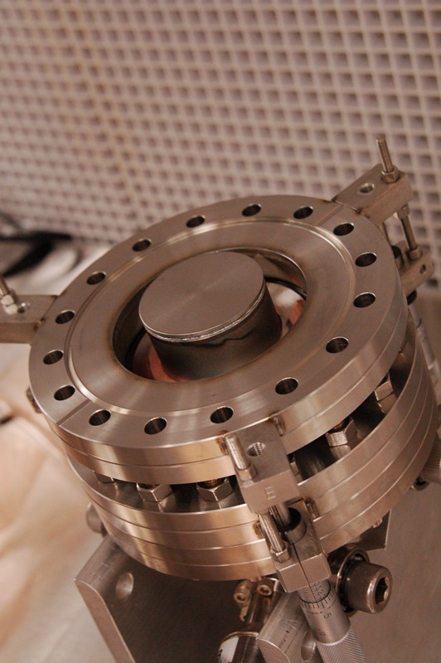
Collaboration of Michael Kelley (W&M) and Charles Reece (JLab)
Applying materials science to Nb SRF cavity interior surfaces
o New characterization approaches –
Topography - measurements, data analysis
Numerical model of impact on quality factor
Composition – SIMS, XPS
o Science-based process understanding –
EP, BCP, laser polishing
o Connection to SRF performance –
Measure surface impedance at 2 K (pictured)
New rf superconductivity theory
Sample: RF-sampled
area ~0.8 cm²

Slide 27
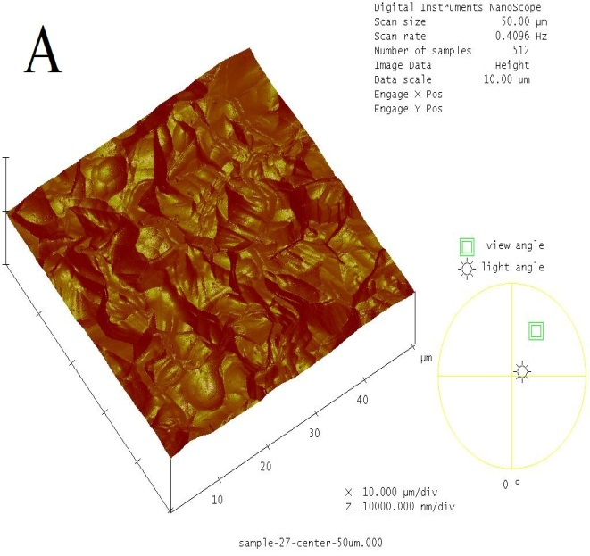
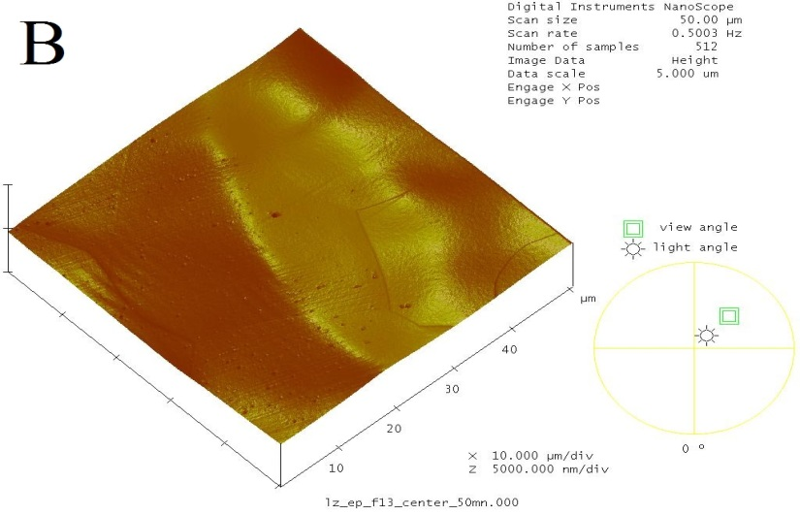
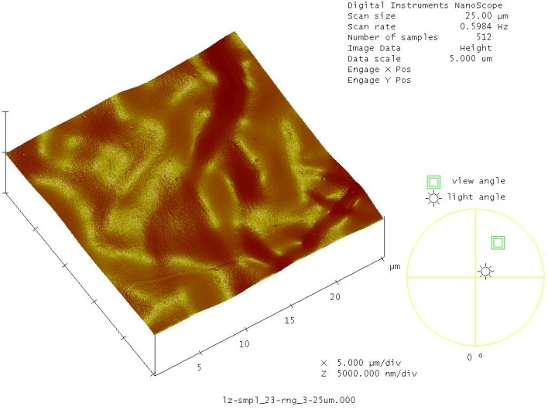
Collaboration of Michael Kelley (W&M) and Charles Reece (JLab)
AFM shows that BCP leaves sharp-edged roughness on Nb (left), removable by EP (center) or Laser Polishing (right), the latter without any chemistry

Slide 28
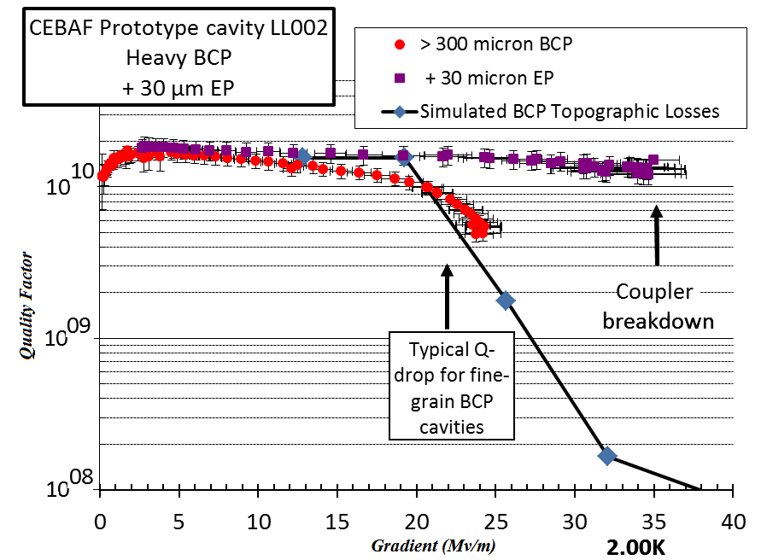
Collaboration of Michael Kelley (W&M) and Charles Reece (JLab)
Sharp edges enhance the local rf magnetic field, promoting local quenches. Our numerical model calculates the net effect to predict performance for an observed topography.

Slide 29
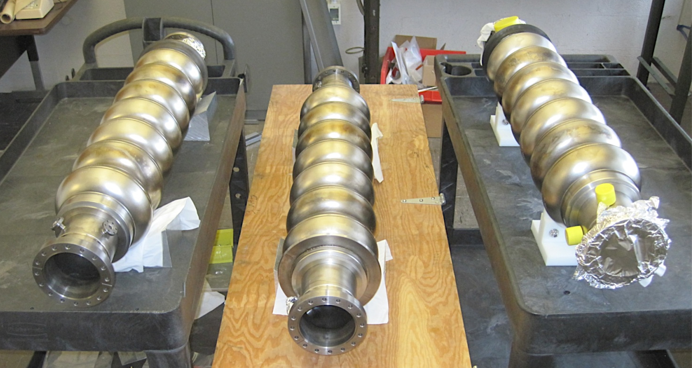
Cornell ERL Cavity test results
1.8 K

Slide 30
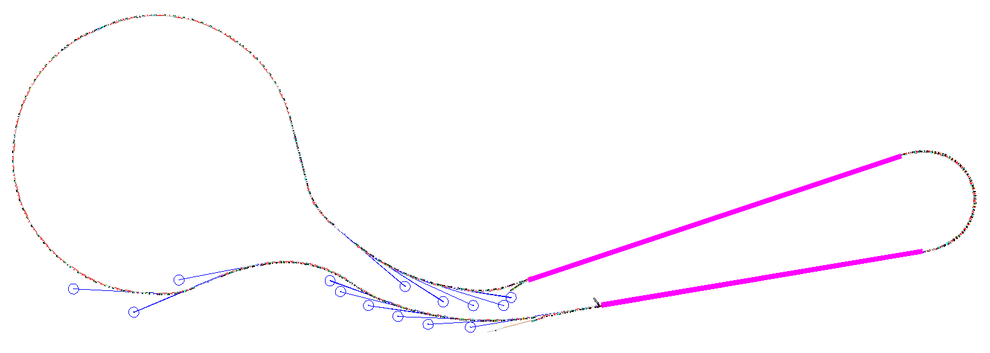
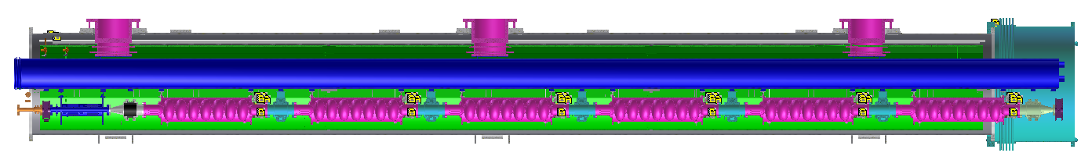
Linac cryomodule for the ERL (MLC)
Linac A
344 m with 35 cryomodules
Total 64 cryomodules, each:
six packages of 7-cell cavity/Coupler/tuner
a SC magnets/BPMs package
five regular HOMs/two taper HOMs
Linac B
285 m with 29 cryomodules
SC magnets & BPMs
7-cell cavity
Beamline HOM absorber
nominal length: 9.8 m
Intermodule unit

Slide 31
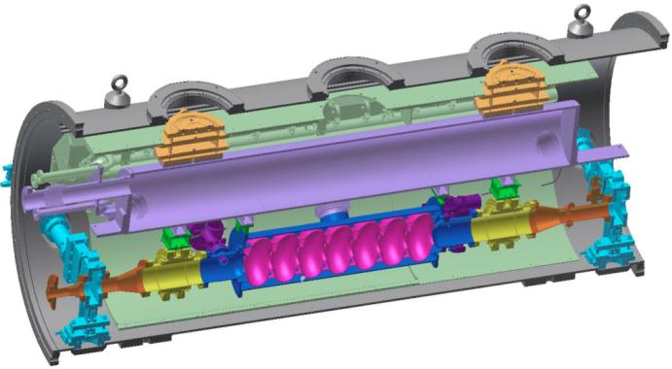
Horizontal Test Results
80K shield
HGRP
HOM load
cavity
HOM load
Gate valve
Horizontal Test Cryostat:
(@16MV/m, 1.8K):
Q0 = 3.5E10 without coupler
Q0 = 2.E10 with couplers
Q0 = 6E10 with coupler and HOM absorbers

Slide 32
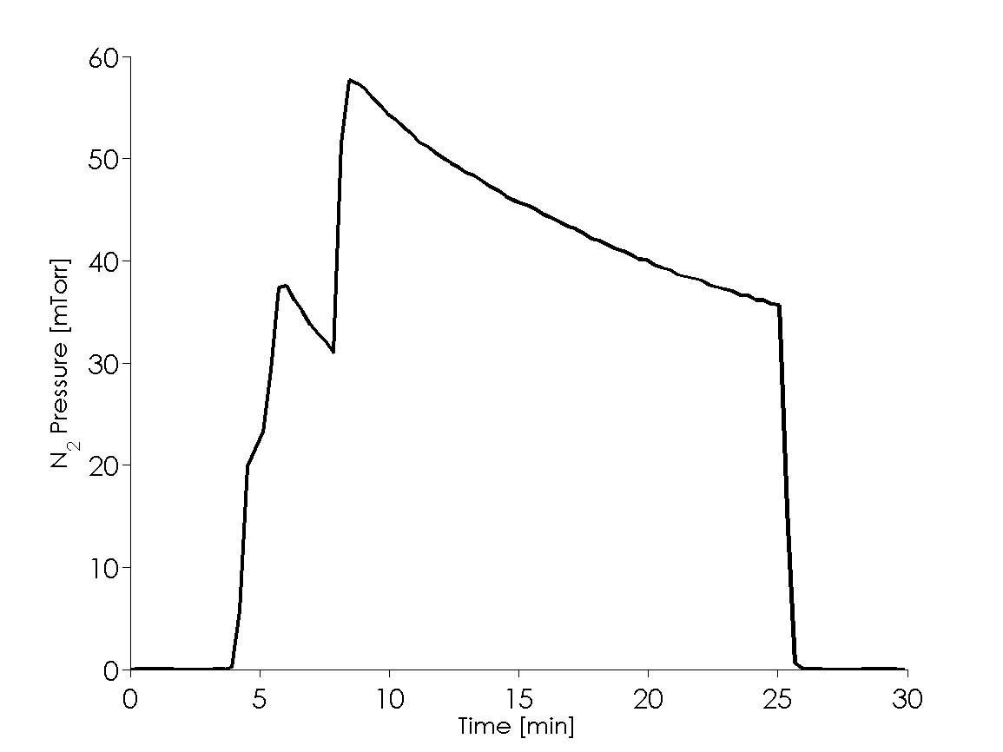
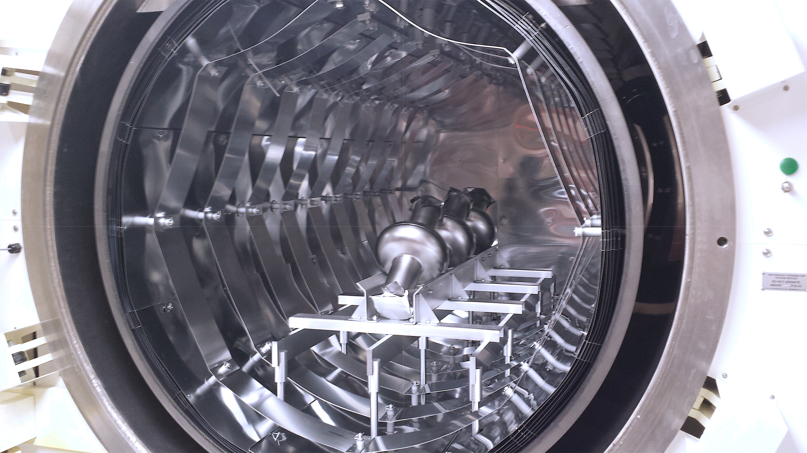
LCLS-II high Q collaboration
1st study: same N-treatment (800C; 20 min in N₂ followed by 30 min in vacuum), but different final VEP amounts
  N-treatment of all 5 single cell cavities done
  Test of three cavities completed

Slide 33
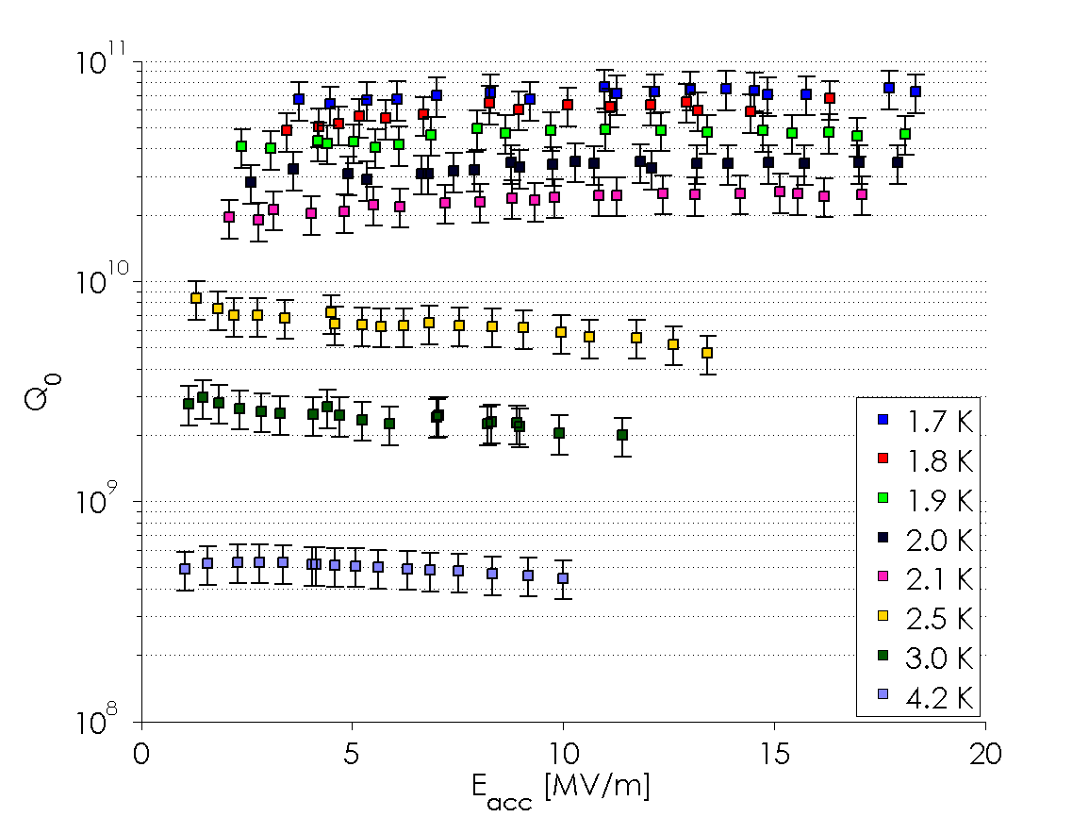
Nitrogen treated cavities

Slide 34
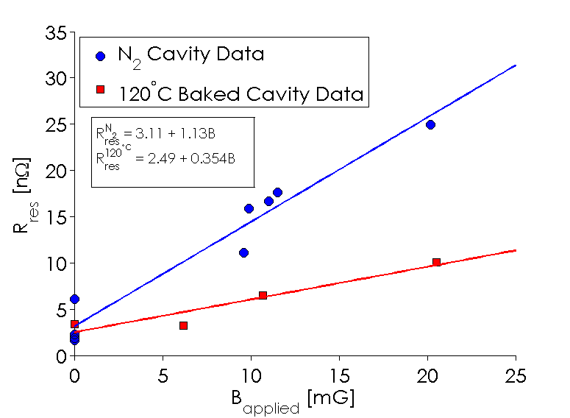
Trapping magnetic flux
Findings:
Nitrogen treated Cavities have ~1 nΩ/mG from external
field (fast cool down, >1K/min)
Figure is higher for slow cool-down
It’s 3 times higher than 120C baked cavities
For an HTC like magnetic shielding (~3mG) the residual from magnetic flux would be
3.5 nΩ for an N-doped cavity
Data might be used to set design specs on the cryo-module
Image Courtesy of Dan Gonnella
Cornell University

Slide 35
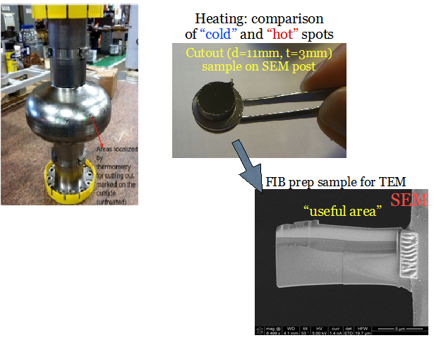
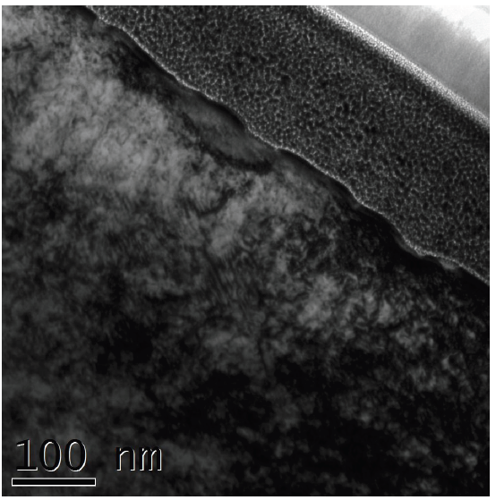

Nanostructural studies on cavity cutouts at Urbana-Champaigne (Ph.D. work of Y. Trenikhina – IIT/FNAL, collaboration with Prof. J.-M. Zuo at UIUC )
Use focused ion beam to make cross-sectional samples
Look at the penetration depth with subnanometer resolution in TEM at room AND T<100K temperatures
Determine chemical and defect structure by other state-of-the-art techniques (XPS, AES, SIMS, …)
TEM
Connect SRF performance to nanostructure
Urbana Champaign

Slide 36
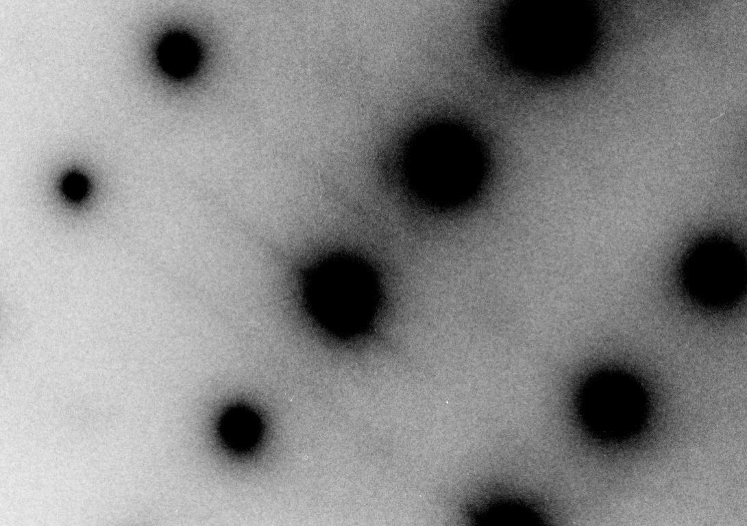
No nanohydrides at the surface of nitrogen doped cutouts
Nitrogen doping may fully trap hydrogen => only intrinsic Nb behavior is then manifested?
Room T and 94K: NO additional Nb hydride phases right underneath an oxide (within ~50 nm)
Urbana Champaign

Slide 37
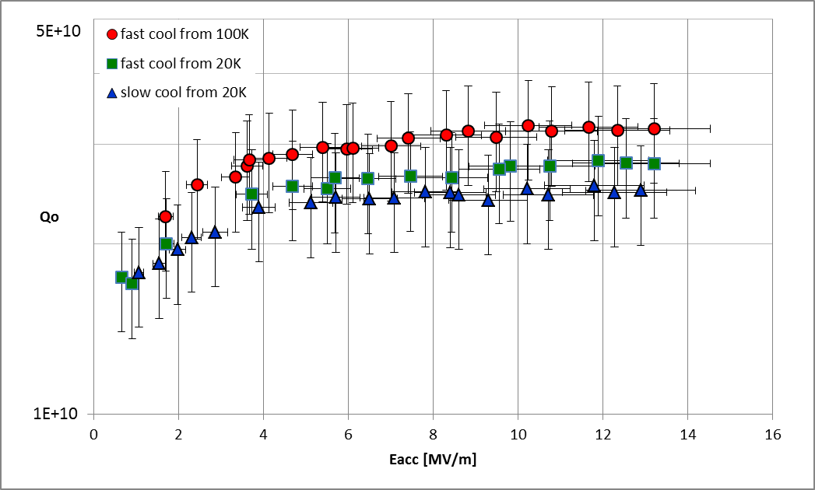
Comparison fast/slow cool
3.2E10 at 13.2 MV/m, fast cool
2.5E10 at 13 MV/m, slow cool
2K meas.

Slide 38

Better conductors for 16-20 T dipoles?
David Larbalestier
Applied Superconductivity Center, National High Magnetic Field Laboratory, Florida State University, Tallahassee FL USA
(special thanks to Lance Cooley (FNAL), Dan Dietderich (LBNL), Arno Godeke (LBNL) , Peter Lee (ASC), Mark Rikel (Nexans), Venkat Selvamanickam (TcSUH), Mike Sumption (OSU), Chiara Tarantini (ASC), and Aixia Xu (TcSUH) for input for this talk)
(And Bruce Strauss for yesterday’s talk)
Future Circular Collider Workshop
UniMail, University of Geneva, Geneva Switzerland
February 12-14, 2014
Supported by DOE-HEP, NSF, State of Florida and CERN

Slide 39




DOE-OHEP supported work at the Applied Superconductivity Center, National High Magnetic Field Laboratory, Florida State University on High Field Conductor Science and Technology
Central truth of all superconducting magnet technology:
no magnet is better than its conductor – energy stability margin of superconducting magnets are small and conductors must be quasi-perfect
DE-SC0012083 : Nb₃Sn Superconductors for the LHC and for Accelerators beyond the LHC
DE-SC0010421: The underlying science of high critical current density in round wire Bi-2212 (Bi₂Sr₂Ca₂CuO_{x})
All advances shown above came from over 30 years of strong interactions driven by DOE-HEP desire to support identification of key problems in an industry-magnet builder-science annual workshop – the 2013 participants are below
LHC – Nb-Ti, Hi-Lumi LHC Nb₃Sn, MAP, FCC, NMR – Bi-2212 – all round and twisted to reduce losses and field errors.

Slide 40


Both PIT and RRP Nb₃Sn conductors are less than optimal for accelerator use – the challenge for Hi-Lumi LHC use
Performance
Peak field
Cost
J_{C} (kA/mm²)
PIT 192
RRP 108/127
RRP 150/169
1
1.5
Dream wire
target performance:
J_{C} > 3 kA/mm²
D_{fil} < 20 μm
RRR > 150
Practical wire
J_{C} > 2.5 kA/mm²
D_{fil} < 30…40 μm
RRR > 150
2
2.5
PIT
3
3.5
target
4
RRP
10
200
20
150
D_{fil} (μm)
50
100
RRR (-)
Magnetization Field Quality
Stability
100
50
Stability Protection

Slide 41
Work Plan (DE-SC0012083): Nb₃Sn
1. Comprehensive Comparative Evaluation of Accelerator Quality RRP and PIT Conductors to improve Performance:
  Addresses use for LHC directly
2. Diffusion Barrier damage during cabling destroys Cu RRR and perhaps magnet stability (PhD student Michael Brown):
  Modelling and simulated cable damage by rolling (example in next slide)
3. Establish limits to performance of RRP working closely with the manufacturer Oxford Superconducting Technology (PhD student Charlie Sanabria working both at OST and FSU):
  A key issue is to use advanced digital imaging to quantitatively image both the input components to these complex RRP conductors – but to correlate to final properties
4. Establish the working limits of the CERN-supported PIT conductor made by Bruker in EU (PhD student Chris Segal) – partial support by CERN for collaboration with Bruker
  Key point has been to understand the quantity of Nb₃Sn that can be made by reaction of NbSn₂Snand Cu and note significant variations based on development of intermediate reaction state morphologies
Chris Segal won the first place Materials and Charlie Sanabria the second place (Large Scale) in the highly competitive Best Student Paper awards at the recent (August 2014) Applied Superconductivity Conference (1500 participants)

Slide 42





Quantification of strand deformation around narrow Nb₃Sn cable edge
This CERN PIT strand has been rolled to simulate cable degradation up to 20% OK, very bad after 30%.
90˚
θ
0˚
180°
6 5 4 3 2 1
Cabling produces the most diffusion barrier breaks (RRR loss) in interior filament rings.
30%
30%
0
45
90
135
PhD Student: Michael Brown

Slide 43


Work Plan for Bi-2212
Overall goals:
Develop process routes that produce high J_{c} in long length Bi-2212 round wire
Understand the complex microstructures produced in these wires
Understand the limits of performance of this conductor technology
Make 2212 into a viable conductor and magnet technology by collaborations with DOE-HEP magnet groups, CERN, the NHMFL and the industrial manufacturing base
Many coil types:
30 T NMR (MagSci goal – NSF support)
EUCARD2 dipole insert for CERN – US BSCCO effort
Underlying high quality science drives applications
100 bar furnace for coils, incl. LBNL CCT 2212 coil

Slide 44


Until very recently, all HTS conductors (Bi-2223, REBCO) were tapes delivered in reacted form
Bi-2212 upended this paradigm, delivering a high current density (the highest of all actually) in round-wire, multifilament, twisted form
The first HTS conductor to look like an LTS conductor
Conductor must be wound, then reacted
  Big advantage – very flexible architecture
Larbalestier et al. Nature Mat., April 2014
2012 with Overpressure
1990-2012
2212 (25% sc)
REBCO coated conductor (1% sc)

Slide 45
Broad Partnerships and Collaborations are in Place (non-HEP supported work in grey)
Bismuth Superconducting Strand and Cable Collaboration (BSCCo) – (leaders Larbalestier, Hellstrom, Cooley (FNAL), Godeke (LBNL), Ghosh (BNL) – direct DOE support to NHMFL (2013-2015, with FNAL and LBNL lab support through GARD funds)
  Industrial collaborations with Oxford Superconducting Technology (OST), Nexans and CERN
  Conductor Development Program (Dan Dietderich and Ken Marken leads)
BSCCo MOU with CERN for contributions to EUCARD2, (WP10) to develop 5-10 kA HTS cable for 5 T HTS insert dipole magnet –US side coordinator is David Larbalestier, leveraging BSCCO effort with support from the Conductor Development Program of DOE-HEP for industrial production, leader Dan Dietderich (LBNL).
NMR collaboration with RIKEN – Bi-2212 coil to be built for Professor Hideaki Maeda’s 500 MHz system
Coated Conductor Round Table – meeting of REBCO coated conductor project labs (NHMFL, MIT-NMR, MIT-PFC, BNL, CAPS-FSU, SuperPower, Advanced Conductor Technologies) coordinated by Trudy Lehner (SP), David Larbalestier (NHMFL) and Yuki Iwasa (MIT)
  The partnership with SuperPower on REBCO coated conductor starting in 2007 is what enabled us to propose 32 T so early
  R&D partnership with group of Selvamanickam at TcSUH through former PhD Aixia Xu
CORC with Danko van der Laan – several year collaboration, now with funds in from SBIR phase 2 on REBCO cables (HEP SBIR award)
32 T outsert coil design and manufacture – Oxford Instruments team led by Ziad Melhem
Broad outreach to the other applications described in MagSci – photons, MRI, regional centers

Slide 46
Key points – work required!
Three possible conductors (5 years)
  New and very much improved Nb₃Sn
  Further developed round wire Bi-2212
  Cable-friendly REBCO coated conductors
Three long shots (10 years)
  Round wire REBCO (2212 analog)
  Round wire Fe-base superconductor
  MgB₂ with in-grain scattering for high vortex pinning and H_{c2} enhancement

Slide 47
Summary
University programs to pursue accelerator R&D in the field of superconductivity exist at:
  Cornell
  Florida State
  Michigan State
  Old Dominion
  Temple
  Urbana-Champaign
  William and Marry
  ….
most of these groups have strong connections to accelerator labs

Slide 48
Thank You!

