Slide 1
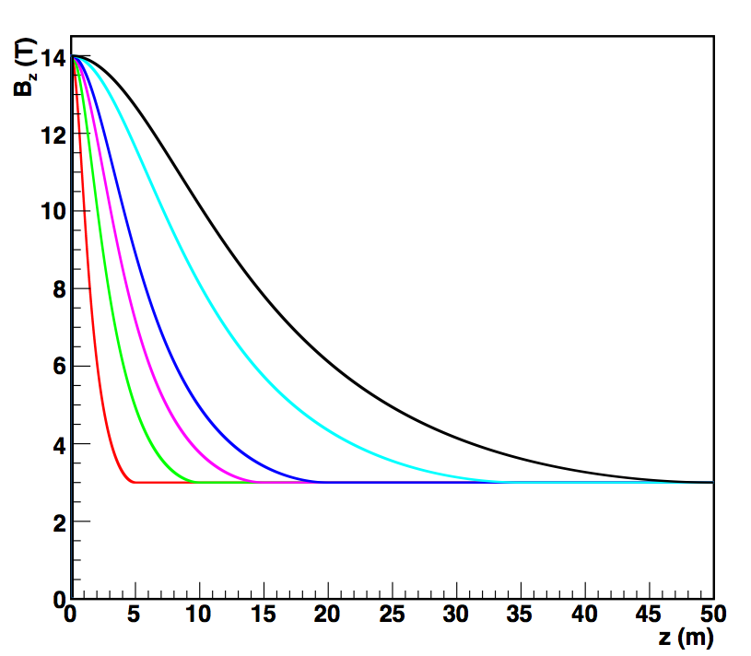
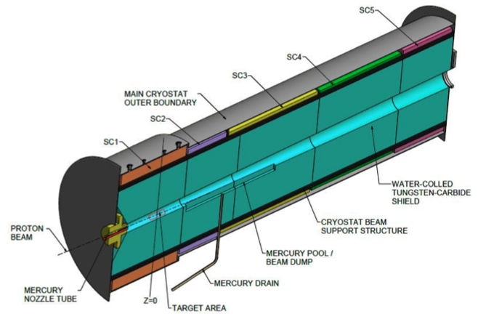
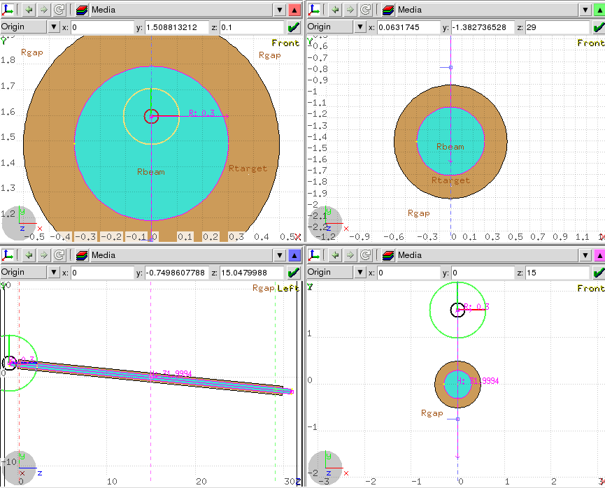
Studies on pion/muon capture at MOMENT
Nikos Vassilopoulos
IHEP, CAS

Slide 2
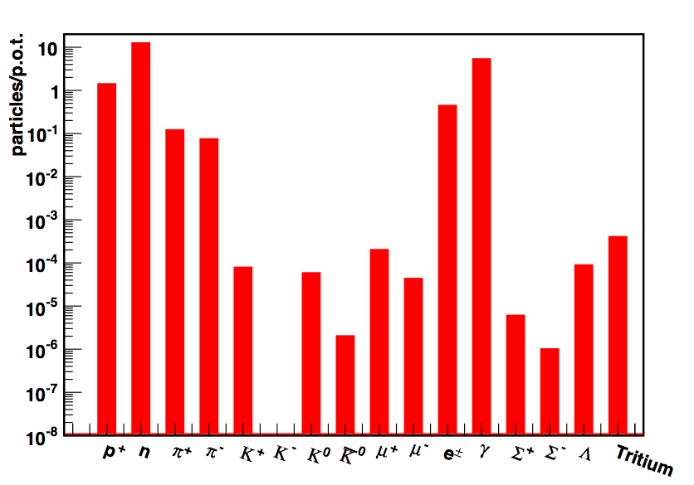
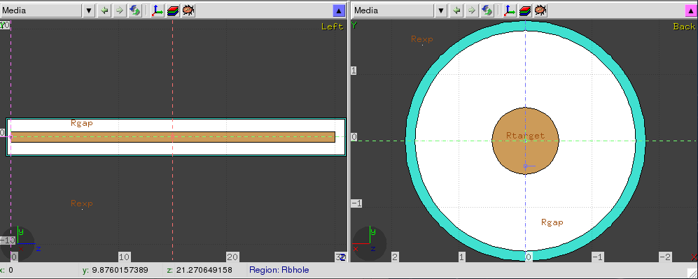
particle production for Hg
MOMENT – Hg, L =30 cm, R = 0.5 cm: current parameters
σ_{b} (mm) | π⁺ | π⁻ | μ⁺ | μ⁻ | n | p⁺
1 | 0.124 | 0.075 | 1.8x10⁻⁴ | 5.3x10⁻⁵ | 12.4 | 1.38
E_{k} = 1.5 GeV
no field, tilt
10⁶ p.o.t. -> stat. error <1% for π, n, p and 6, 15 % for μ⁺, μ⁻
FLUKA 2015

Slide 3
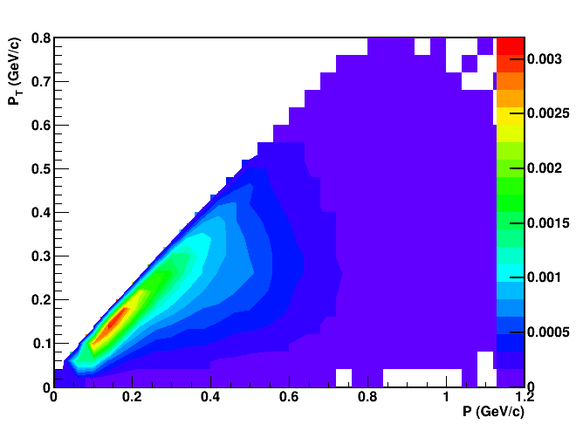
π⁺ production and P_{T} acceptance for adiabatic solenoids
for adiabatic taper solenoid
B₁=14 T, r₁ = 20 cm
P_{T1} = 420 MeV/c
B₂ = 3 T, r₂ = 43 cm
P_{T2} = 193 MeV/c
_
π⁺ for
<E_{μ}> ~ 300 ± 50% MeV
(<E_{μ}> ~ 57 % <E_{π}> )
P_{T} accepted
r₁ = 20 cm, r₂ = 43 cm
P_{T} accepted
r₁ = 14 cm, r₂ = 30 cm
P_{T} accepted
r₁ = 7 cm, r₂ = 15 cm
FLUKA 2015 (1e6 p.o.t.)
_

Slide 4
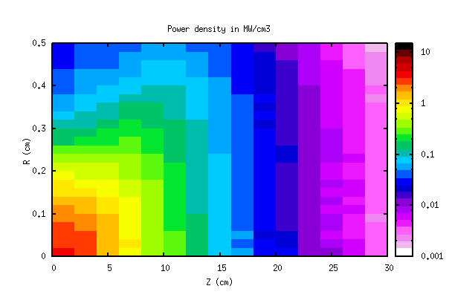
Power on target
P_{trg} = 2.5 MW

Slide 5
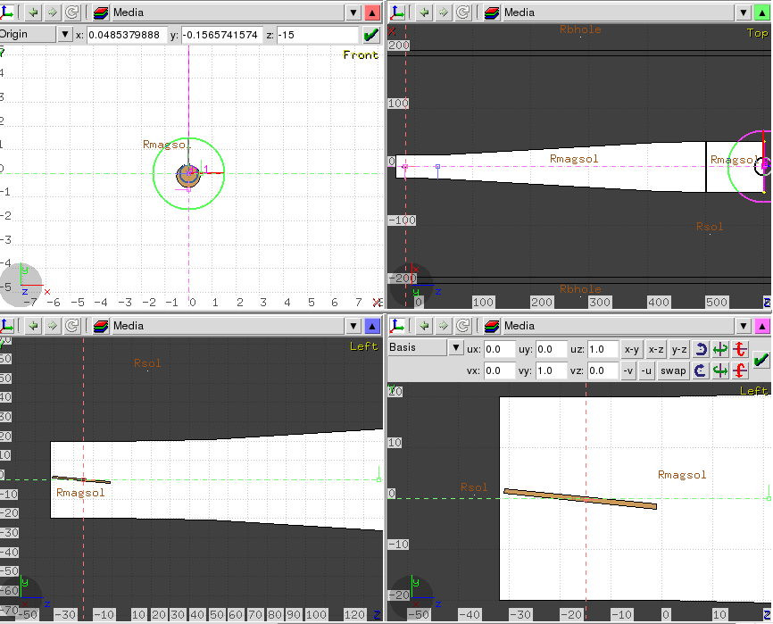
optimization studies
figure of merit:
π, μ, p yields, distributions downstream of:
the Main Capture Solenoid (MSC)
Adiabatic Transport Solenoid
Main Capture Solenoid
“idealized” field
B = 14 T, L_{MCS}= 32 cm, r_{MCS}= 20 cm
study tilts, lengths, radii, beam-sizes
Gaussian field approximation at MCS
B_{z}= 14 T -> 3 T
----->--->-->->
MSC
Adiabatic Transport Solenoid
L = 5, 10, 15, 20, 35, 50 m
r = 20 cm - > 43.2 cm
B = 14 T -> 3 T
B_{z}= 14 T
--->--->--->

Slide 6
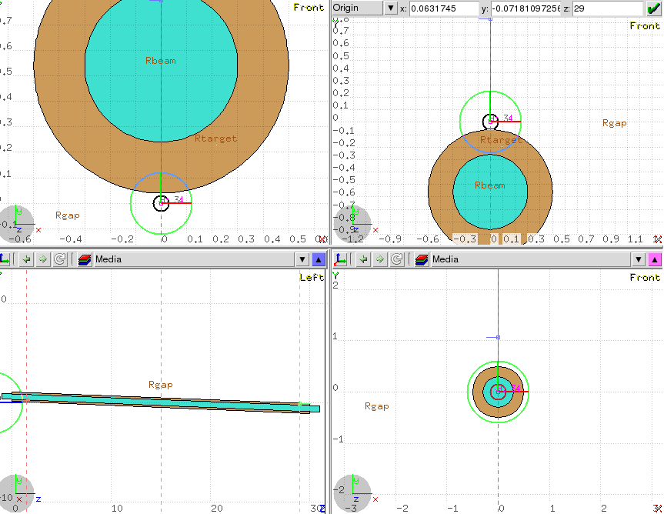
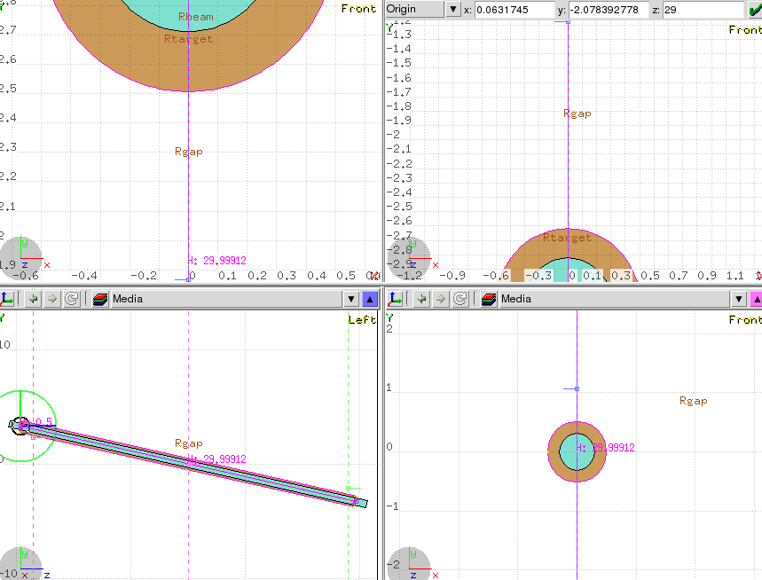
target tilt studies L_{trg}= 30 cm, r_{trg}= 5 mm, σ_{b}= 1 mm
π after one helix might hit the target, target tilt needed
,
downstream edge
downstream edge
upstream edge
upstream edge
40 mrad
220 mrad
B_{z}= 14 T
->->->->
B_{z}= 14 T
->->->->

Slide 7
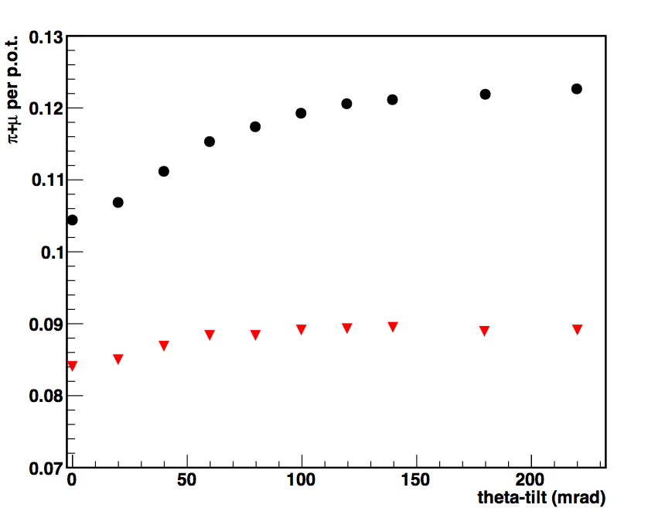
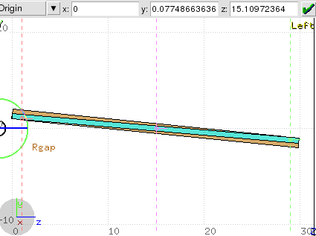
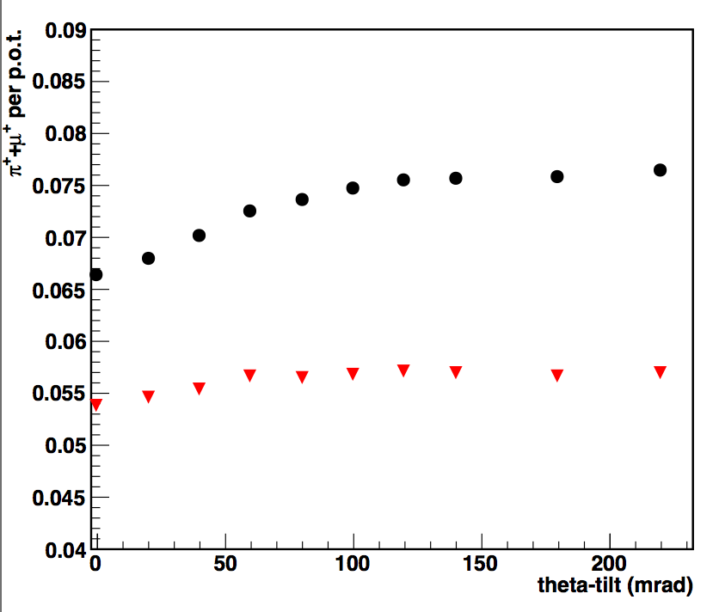
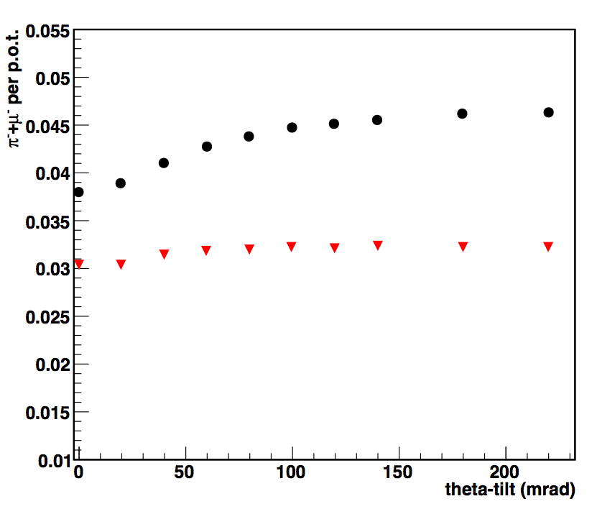
particle yields at the edge of MCS for different tilts
π+μ
all momenta in black
selection in red
pions 0.222 < P (GeV/c) < 0.776
muons 0.111 < P (GeV/c) < 0.438
statistical error < 1 %
write the % of pi & mu
π⁺+μ⁺
π⁻+μ⁻

Slide 8
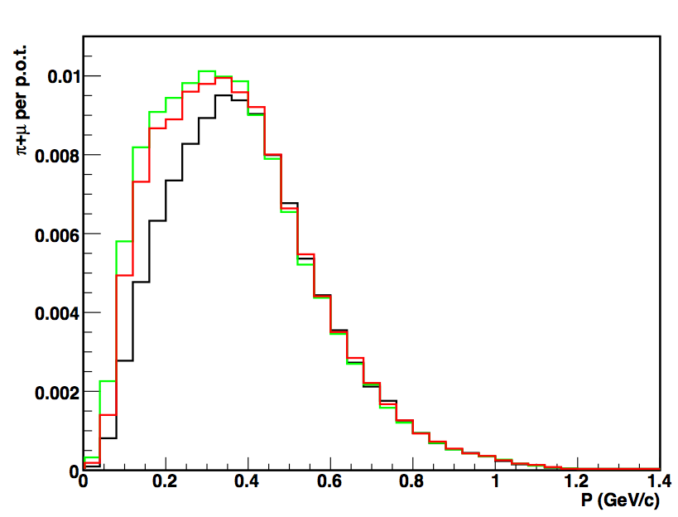
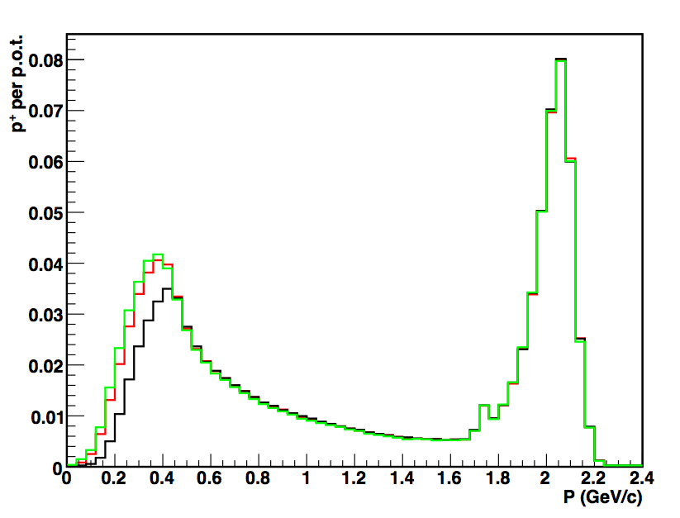
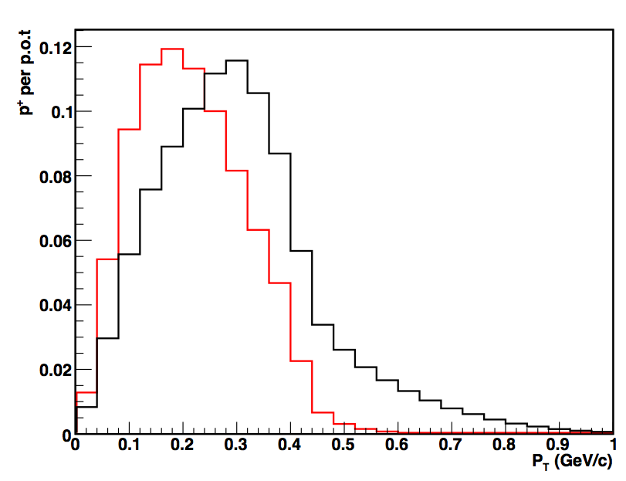
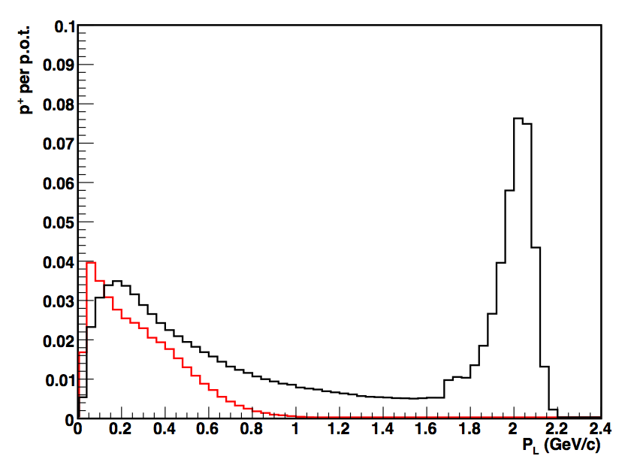
20, 100, 220 mrad
momenta
20, 100, 220 mrad
momenta
π+μ
p
100 mrad
transverse mom.
100 mrad
longitudinal mom.
π(x 7)
p
π(x 3)
p

Slide 9
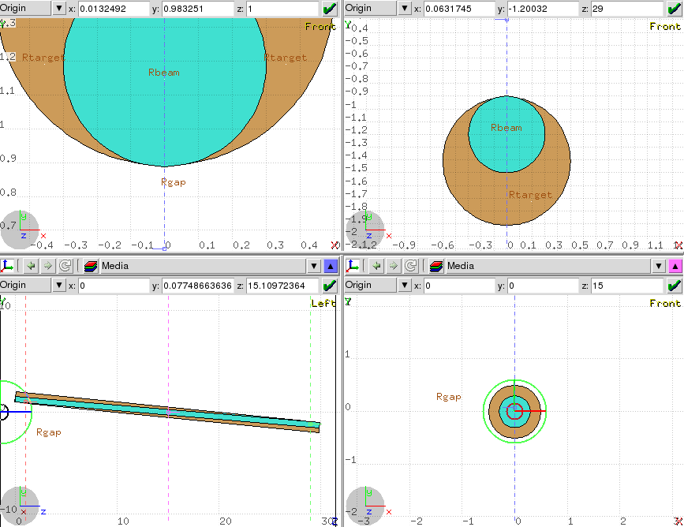
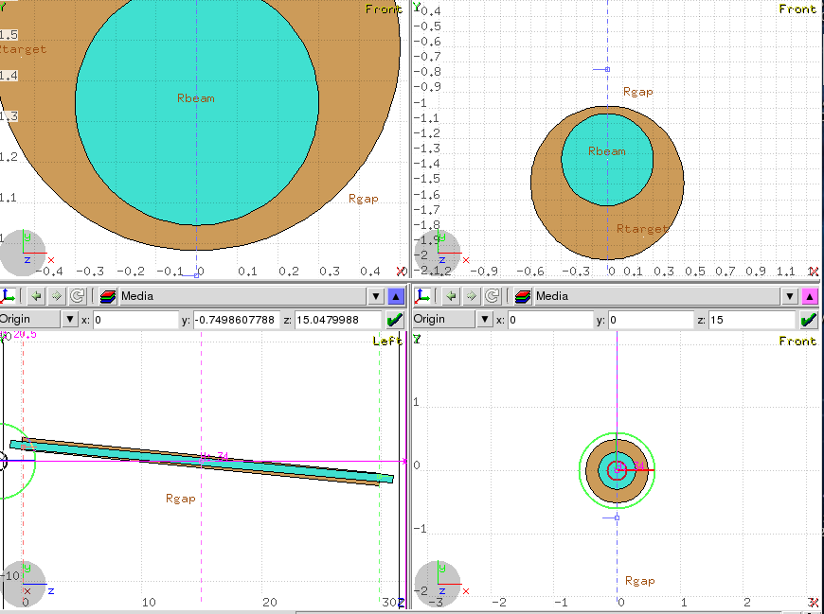
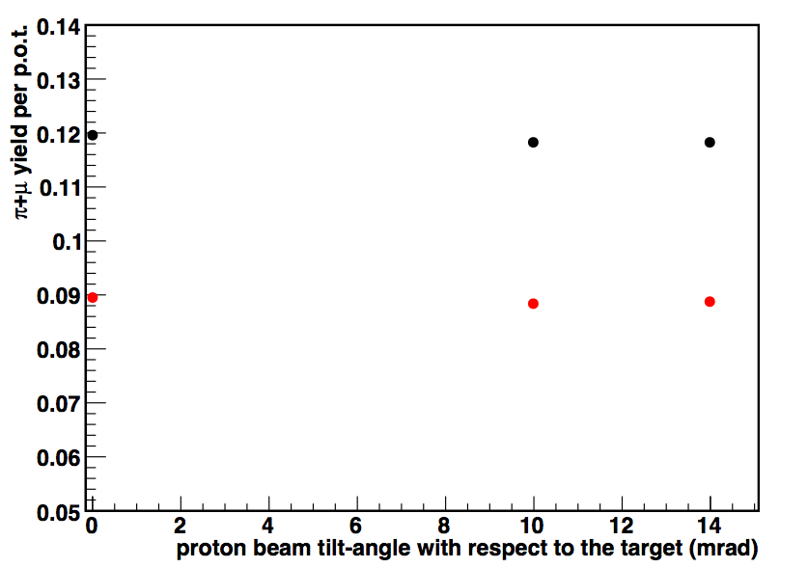
beam tilt with respect to the target
downstream edge
upstream edge
proton-tilt 14 mrad
proton-tilt 10 mrad
B_{z}= 14 T
->->->->
B_{z}= 14 T
->->->->
π+μ
similar yields
proton-tilt 0 mrad
statistical error < 1 %
B_{z}= 14 T
->->->->

Slide 10
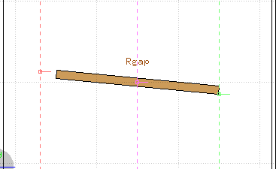
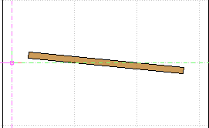
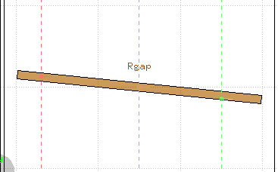
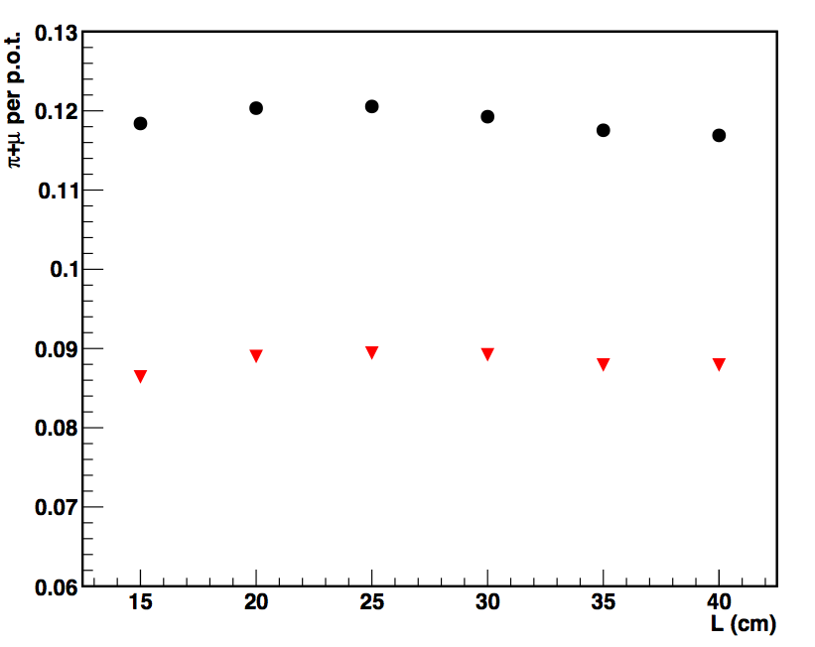
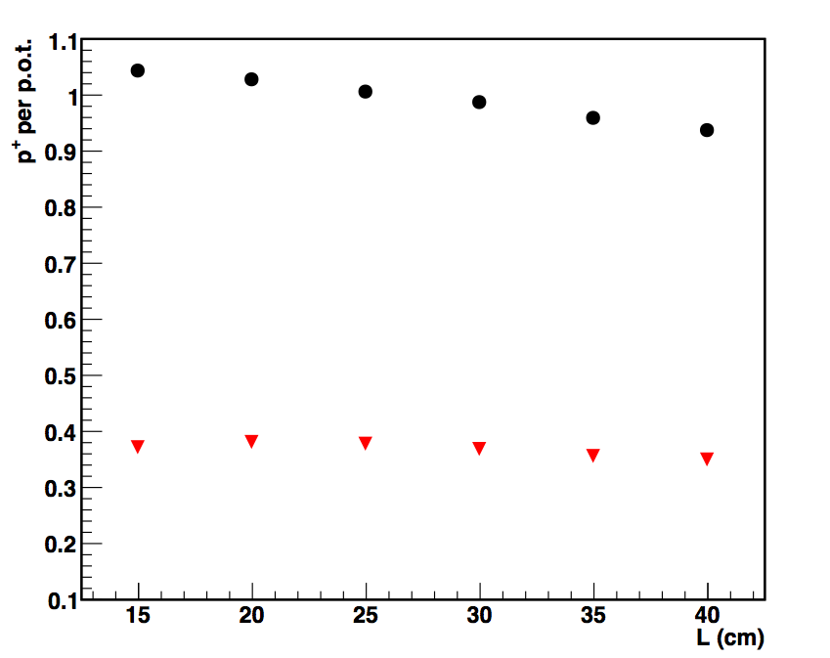
particle yields at the edge of MCS for different target lengths tilt=100 mrad, r_{trg}= 5 mm, σ_{b}= 1 mm
tilt 100 mrad
for L=15, 20, 25, 30, 35, 40 cm
B_{z}= 14 T
->->->->
B_{z}= 14 T
->->->->
B_{z}= 14 T
->->->->
π+μ
could do less or more if needed
p
statistical error < 1 %
λ_{I}
2λ_{I}

Slide 11
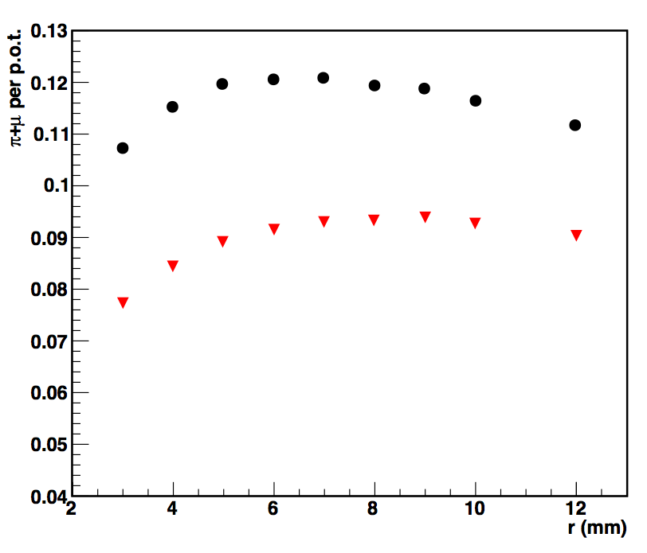
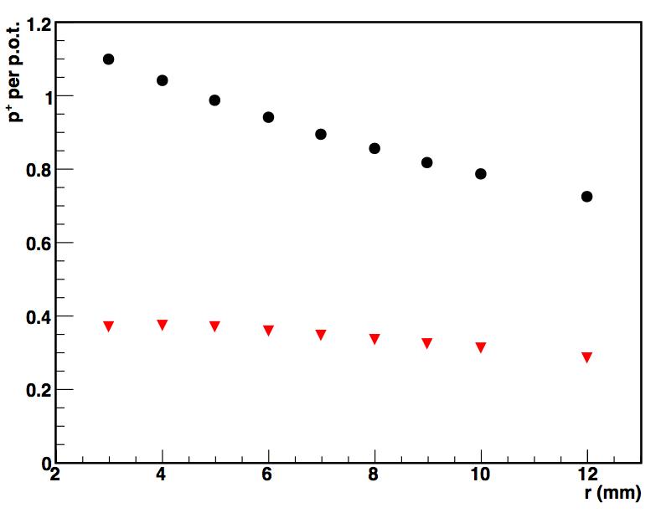
particle yields at the edge of MCS for different radii tilt=100 mrad, L_{trg}=30 cm, σ_{b}= 1 mm
π+μ
p
statistical error < 1 %
could do more in radius if needed

Slide 12
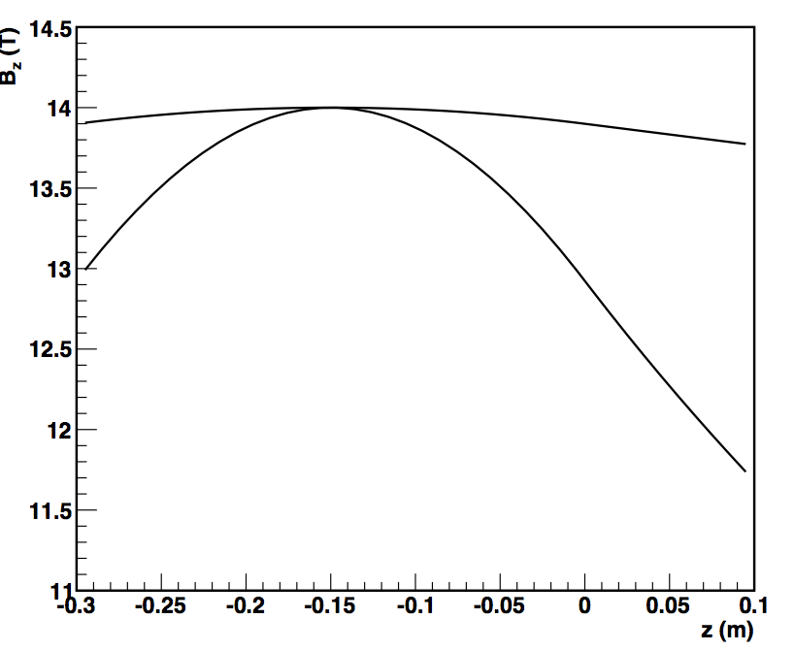
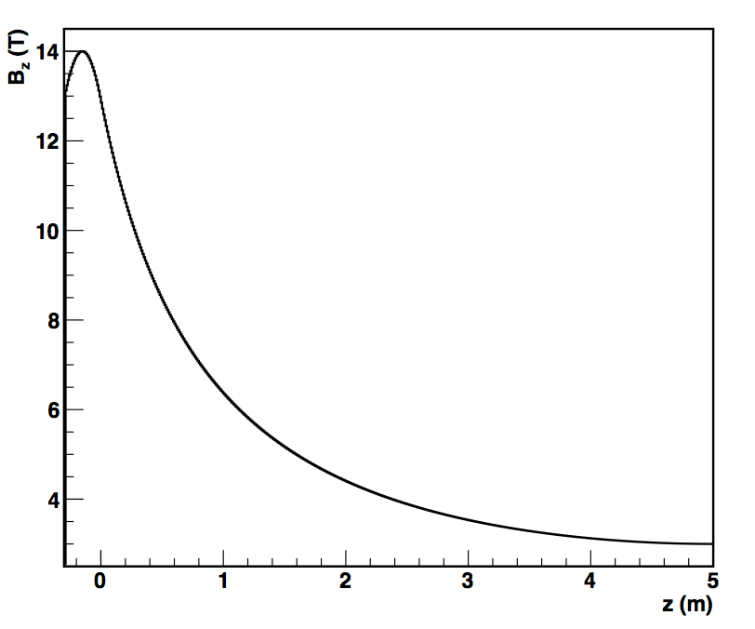
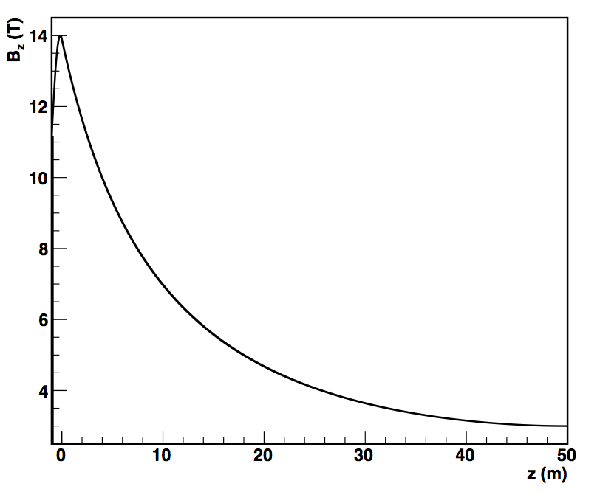
from ideal to Gaussian field for MCS
field as used in MOMENT studies, 0.8 % reduction within ±λ_{I}
L = 5 m
gaussian -0.3 m < z < 0.3 m
7% reduction reduction within ±λ_{I}
-λ_{I}
+λ_{I}
L = 50 m
particle yields at the edge of MCS for different target parameters fixed parameters : tilt=100 mrad or L_{trg}=30 cm or r_{trg}= 5 mm

Slide 13
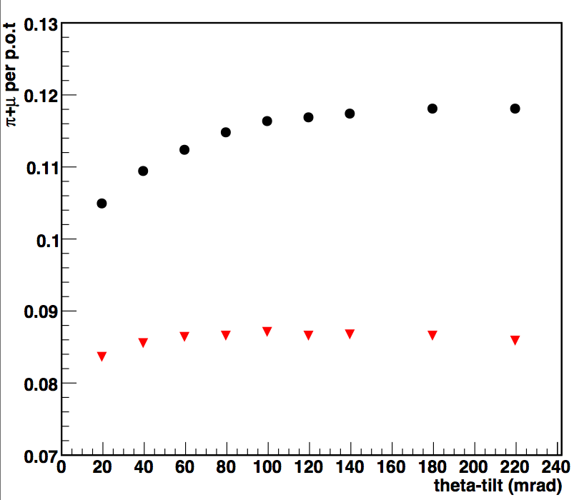
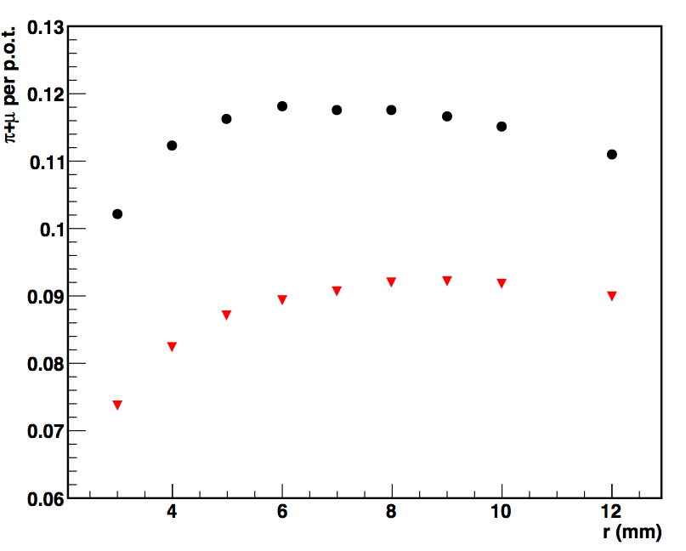
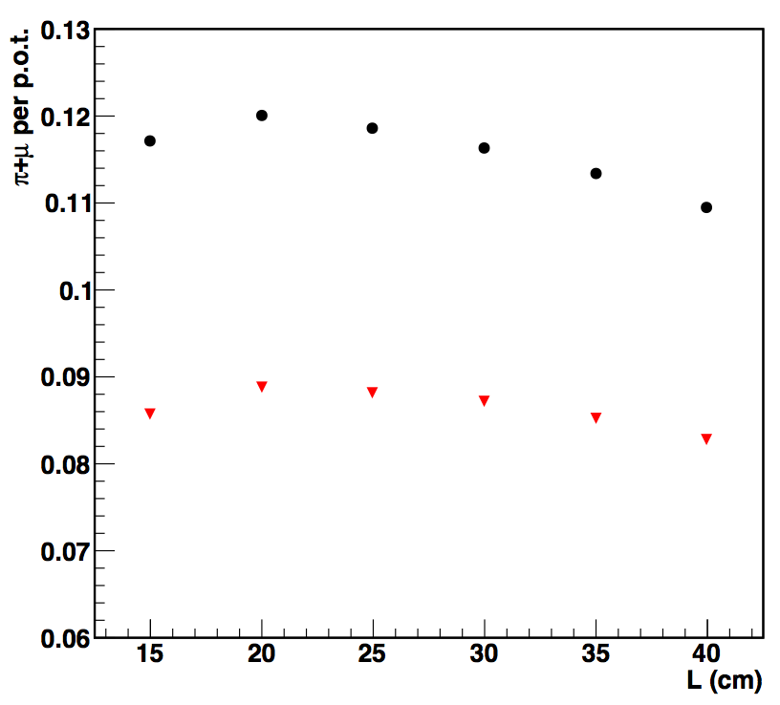
π+μ
π+μ
tilt
radii
π+μ
all momenta in black
selection in red
pions 0.222 < P (GeV/c) < 0.776
muons 0.111 < P (GeV/c) < 0.438
statistical error < 1 %
similar results to the ideal field B₀ = 14 T
length

Slide 14
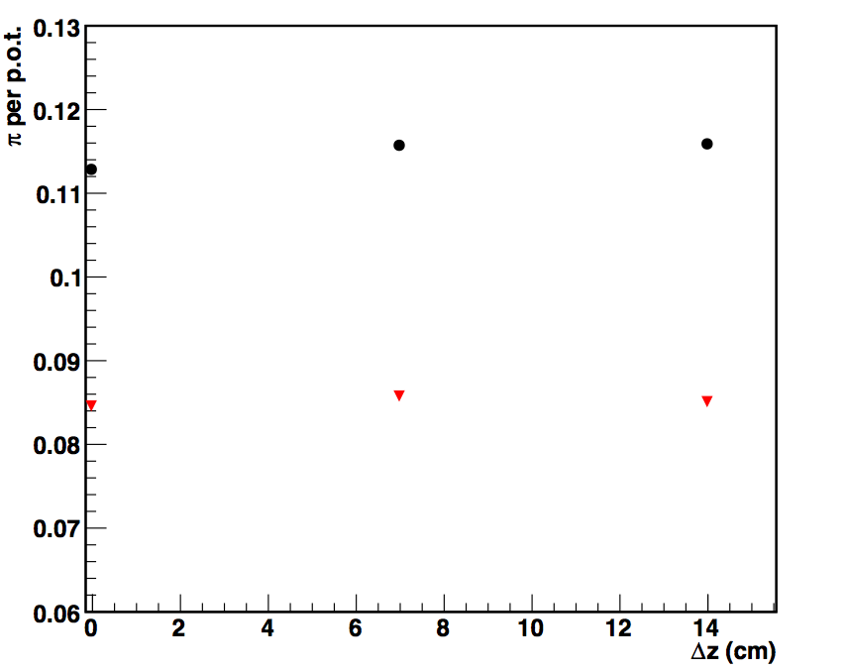
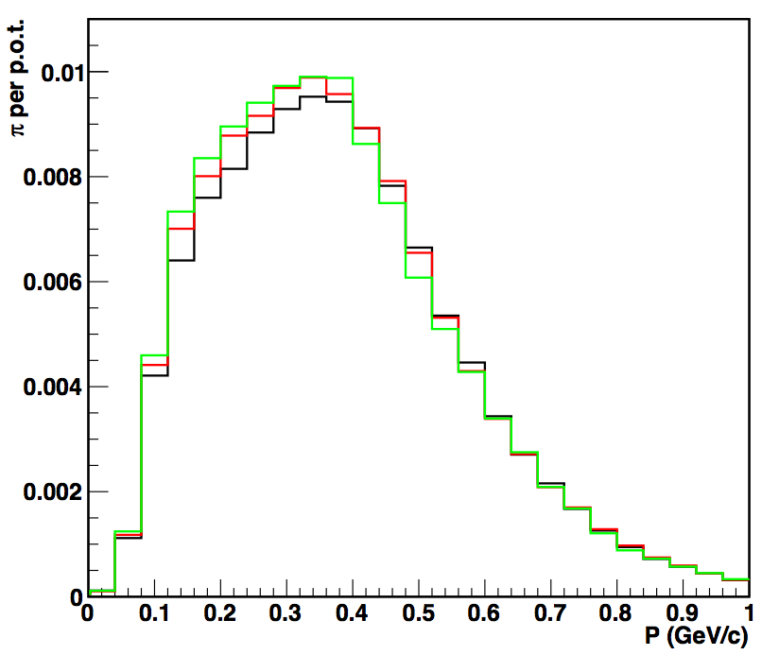
target displacement at MCS
target-center displaced by λ_{I} /2,λ_{I}
with respect to B₀
r_{MCS} : 20 cm
target center displaced by λ/2
target-center displaced by λ_{I}/4
target-center at B₀
similar yields

Slide 15
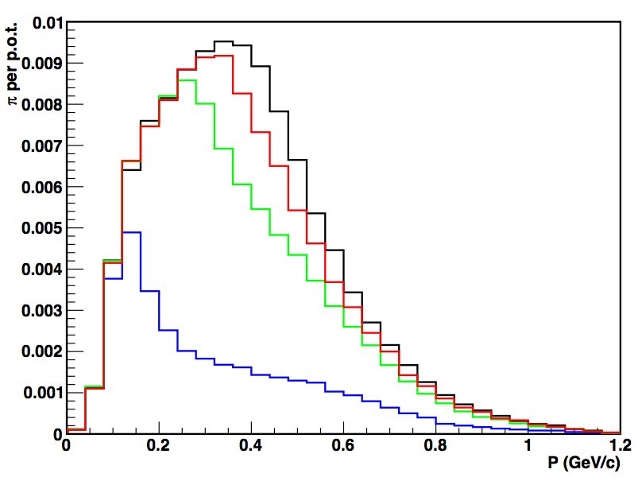
MCS radius
L_{hg}=30 cm, r_{hg}= 0.5 cm, tilt_{hg}= 100 mrad
L_{MCS}=32 cm, r_{MCS} = 7, 14, 30 cm, B₀=14 T, gaussian σ= 45 cm
r_{MCS}= 7, 14, 17, 20 cm
P_{T} acceptance shapes the momenta
low radii not useful for MOMENT
no downstream acceleration
best r_{MCS} = 17-20 cm

Slide 16
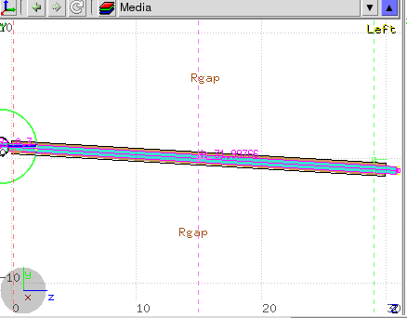
conclusions for the MCS
tilt 100 mrad
B₀= 14 T
at MCS edge:
target-tilt could be more than100 mrad
target-length, yield is maximal at 2 interaction lengths or slightly less
target-radius could be increased more than 5 mm for σ_{b}=0.1cm
yield remains similar when proton beam-axis tilted with respect to the target-axis -> to be studied with higher angles between the two
high energy protons could be separated (see Cai’s talk)
MCS radii should be ~ 17-20 cm

Slide 17
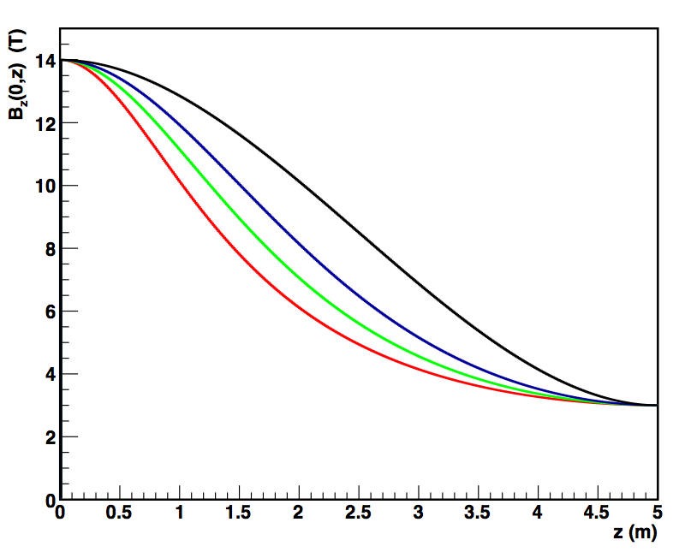
adiabatic transport solenoids
1) K. Paul and C. Johnstone, Optimizing the Pion Capture and Decay Channel, MUC0289 (9 Feb. 2004)
2) Analytic Forms for an Adiabatic Tapered Solenoid
Kirk T. McDonald
Joseph Henry Laboratories, Princeton University, Princeton (January 25, 2010)
slower decrease
steepest decrease of the Bz
L = 5 m

Slide 18
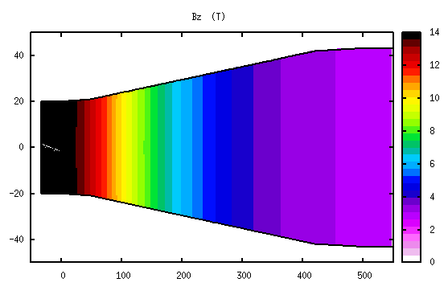
adiabatic inverse taper – 1st degree (ideal field, steeper field-decrease response)
field approximation implemented in FLUKA:
L = 5, 10, 15, 20, 50 m
5 m
Notes:
The question is what do we prefer muons or pions

Slide 19
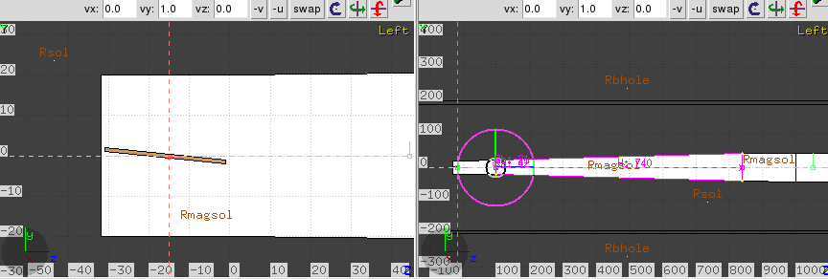
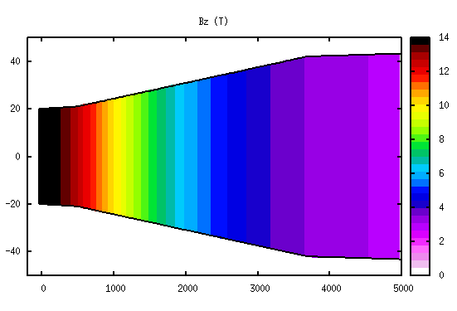
ideal MCS +
tilt 100 mrad
B_{z}= 14 T
->->->->
z₁ = 0 m
@ z₁= 0 m
r₁= 20 cm, B₁=14 T
@ z₂= 5 -> 50 m
r₂= 43.2 cm, B₂ = 3 T

Slide 20
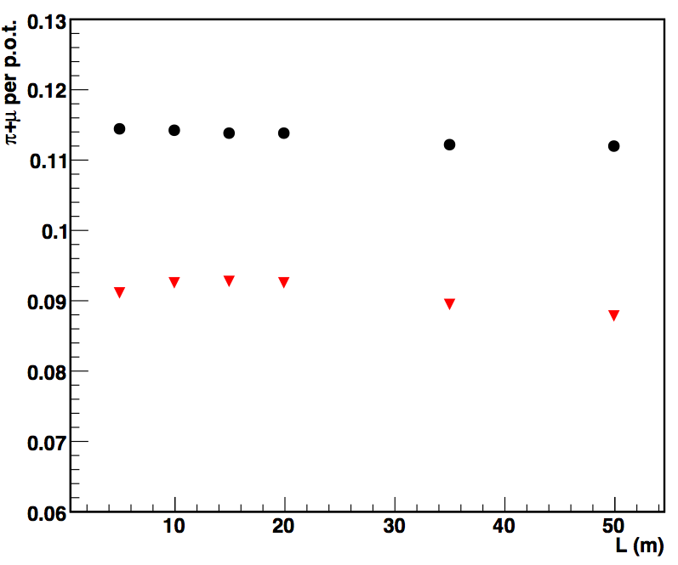
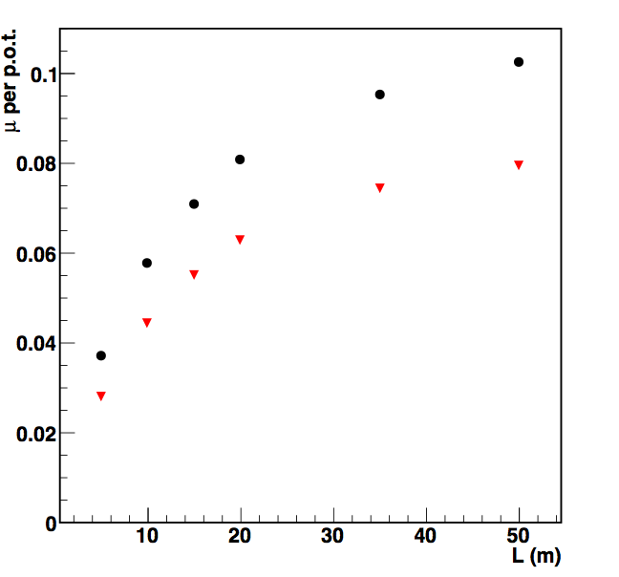
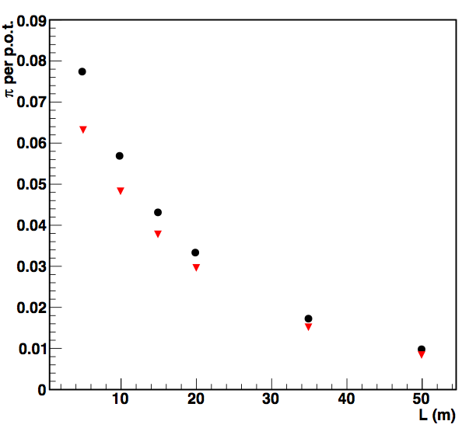
yields at the end of the adiabatic section vs length
all momenta in black
selection in red
pions 0.222 < P (GeV/c) < 0.776
muons 0.111 < P (GeV/c) < 0.438
statistical error < 1 %
geometry approximation systematic error
π+μ
μ
π

Slide 21
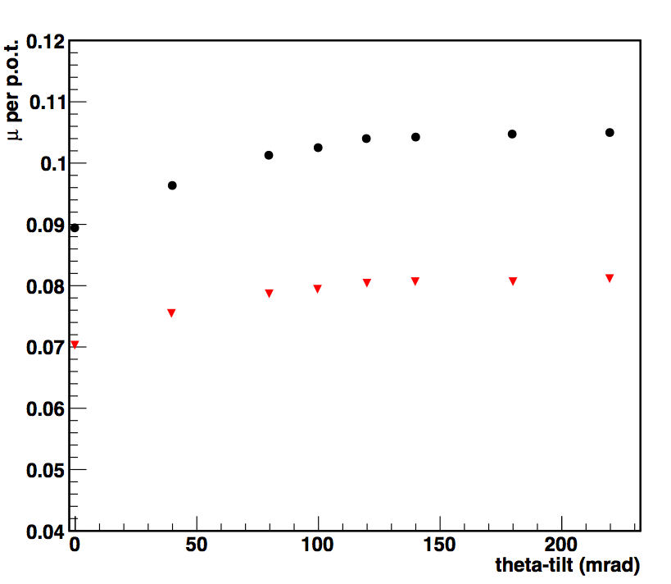
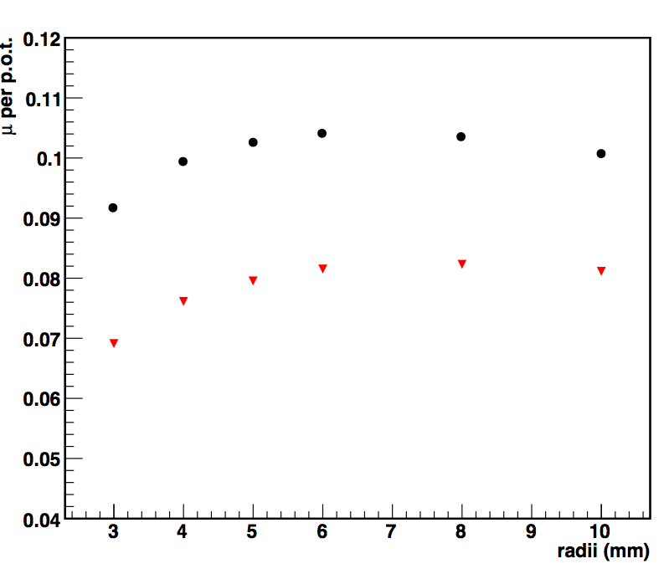
muon yields for inverse taper L = 50 m vs different target-tilts, radii
target-tilt
target-radii
μ
μ
tilt: plateau after 100 mrad
radii: could do more
statistical error < 1 %

Slide 22
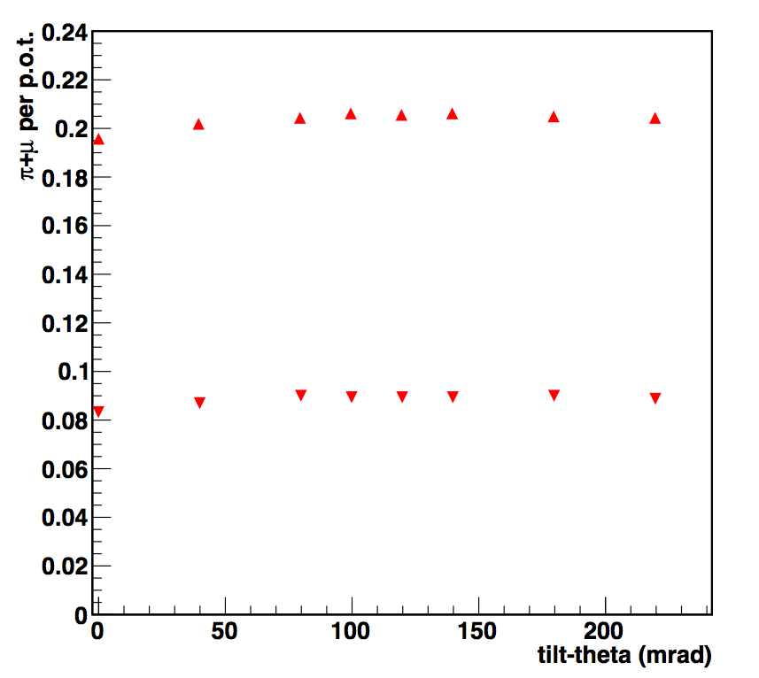
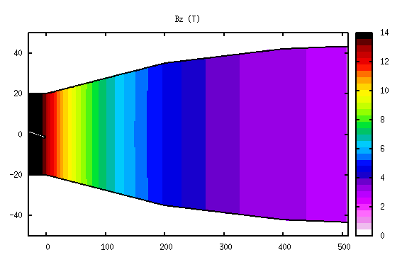
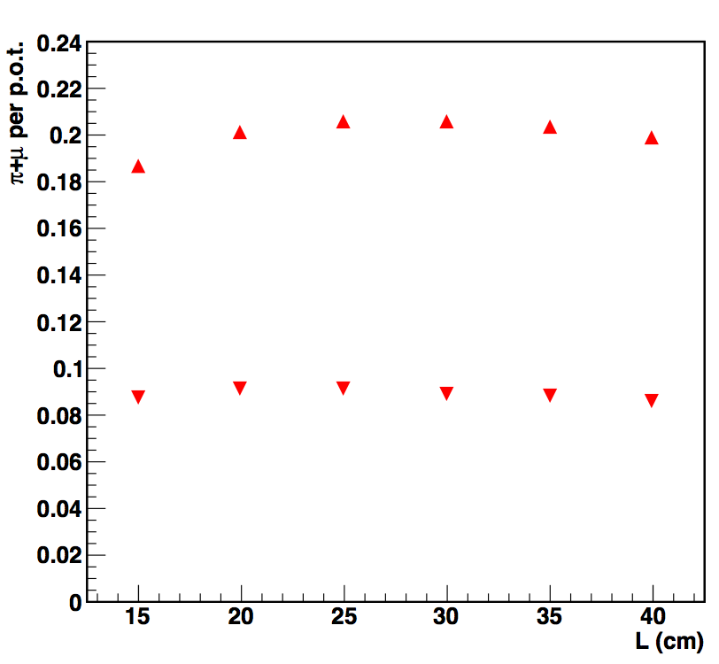
particle yields for L_{taper}=5 m, E_{k} = 1.5, 2.5 GeV
2.5 GeV
+
π+μ
1.5 GeV
tilt
2.5 GeV
2.5 GeV
π+μ
π+μ
1.5 GeV
1.5 GeV
length
radii

Slide 23
particle yields for L_{taper}= 50 m, E_{k} = 1.5, 2.5 GeV
2.5 GeV
+
μ
1.5 GeV
tilt
2.5 GeV
2.5 GeV
μ
μ
1.5 GeV
1.5 GeV
length
radii

Slide 24
proton yields for different target-tilts and tapers
L_{taper} = 5 m
p
L_{taper} = 50 m
p
all momenta in black
selection in red
proton 0.222 < P (GeV/c) < 0.776
statistical error < 1 %
there is a reduction of higher momentum protons with the tilt

Slide 25
conclusion/further studies
for 5, 50 m gaussian + 1st degree inverse adiabatic solenoid:
target-tilt 100 mrad or more
target-length 25 cm or more
target-radius 5 mm or more
higher momentum protons yields decreases with larger target-tilts
proton E_{k}= 2.5 GeV doubles the yields
next:
test the cubic field “slower decrease of the field” (similar results expected)
test with a different MC (geant4, MARS) to compare the yield patterns and their absolute values
Thanks

Slide 26
Power on target
100 mrad tilt
P_{trg} = 2.5 MW

Slide 27
particle yields at the edge of MCS for different beam sizes tilt=100 mrad, L_{trg}=30 cm, r_{trg}= 5 mm
π+μ
p
statistical error < 1 %
similar, could do less in beam size

Slide 28
momenta
momenta distributions
(to be updated)
L = 5, 10, 15, 20, 50 m
p
momenta
transverse momenta
μ⁺
μ

Slide 29
+
L = 5 m
L = 50 m

Slide 31
spatial distribution and transverse emittance
L = 5 m
L = 50 m

Slide 32
proton yields for inverse taper L = 50 m vs different target-tilts, radii
target-tilt
target-radii
p
p
statistical error < 1 %

