Slide 1


The Future of Charm Physics at LHCb
LHC Run II & the LHCb Upgrade
Chris Parkes
on behalf of the LHCb Collaboration

Slide 2
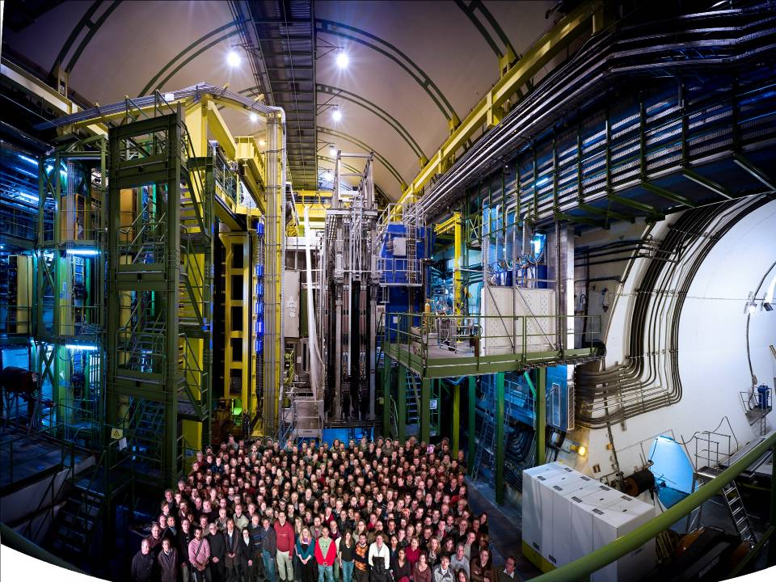

Muon System
RICH Detectors
Vertex Locator
Interaction
Point
Calorimeters
Tracking System

Slide 3
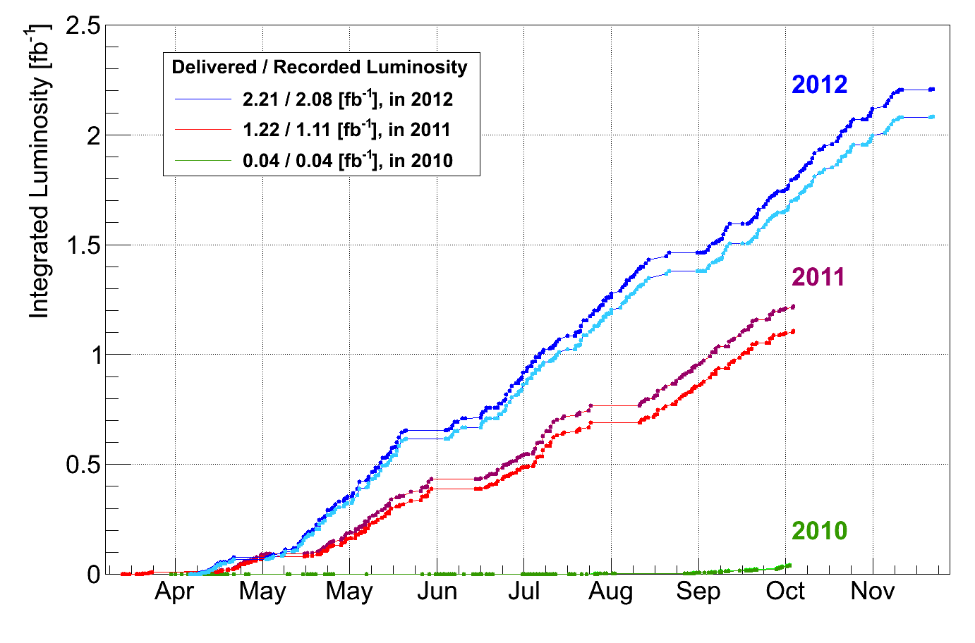
LHCb Timeline
LHC Run-I (2010-2012)
  Many results shown this week, more to come
LHC Run-II (2015-2018)
  Trigger computing increased, strategy evolved
LHC Run-III (2020-2023)
  LHCb Upgrade
LHC Run-IV (2025-)
  LHCb Upgrade (+ additions ?)
LHC
Run-1

Slide 4
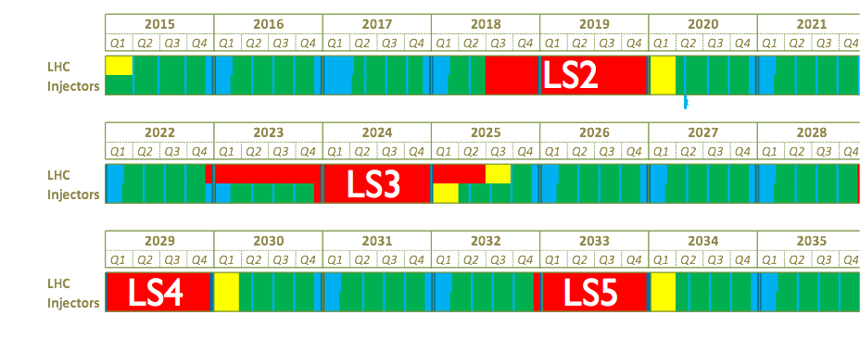
LHC Schedule & LHCb
LHC Run-II
LHCb Upgrade
LHCb Upgrade +
We don’t know yet !
Schedule till 2020 reasonably firm
HL-LHC upgrade in LS3
GPD main upgrades (phase II) scheduled for LS3

Slide 5
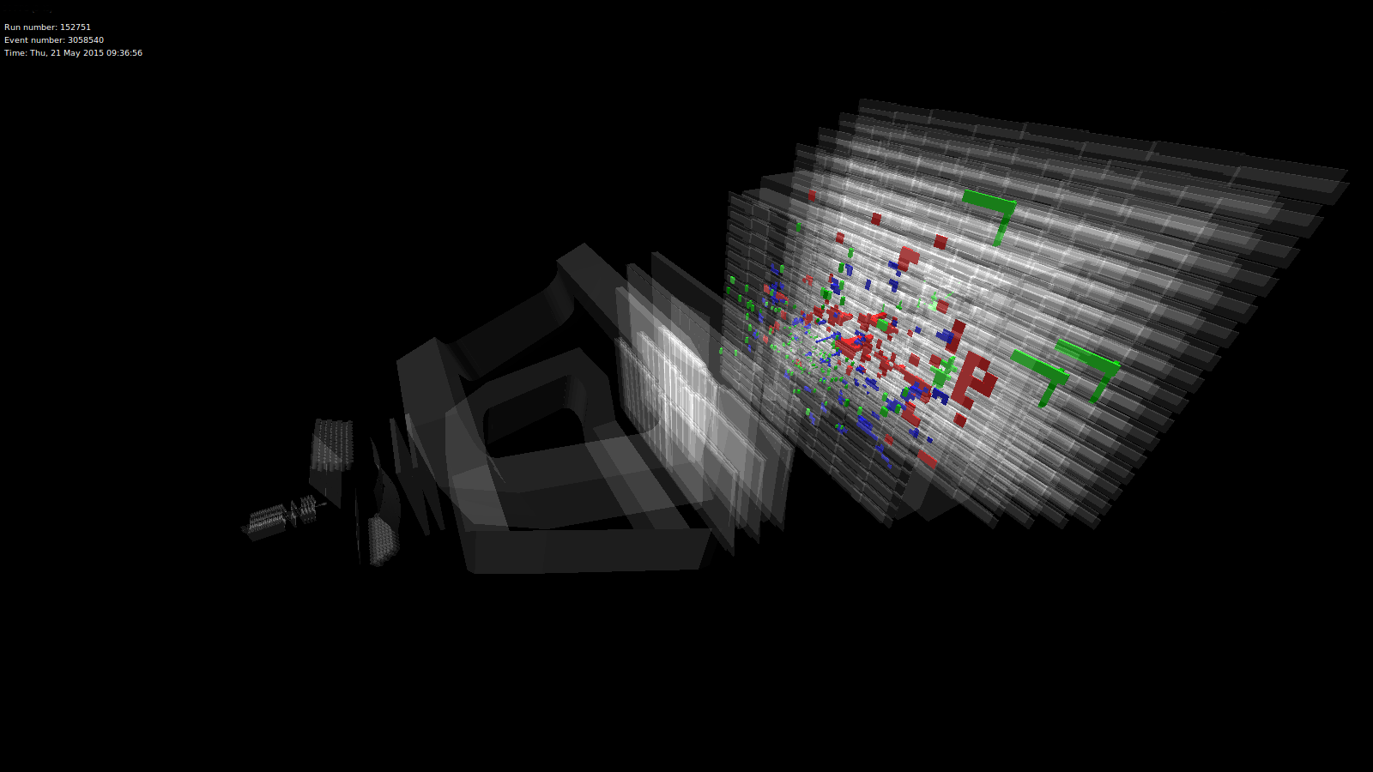
LHC Run II
LHC Run-II
Expectation ~ 5fb⁻¹
First 13TeV Collisions
20th May 2015

Slide 6
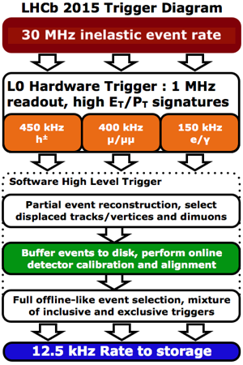
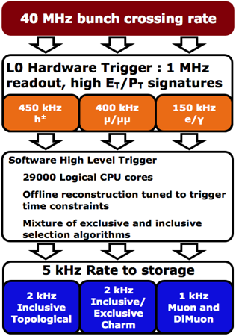
Trigger Evolution – Run II
Run I
Run II
15
(assuming currrent event size)

Slide 7
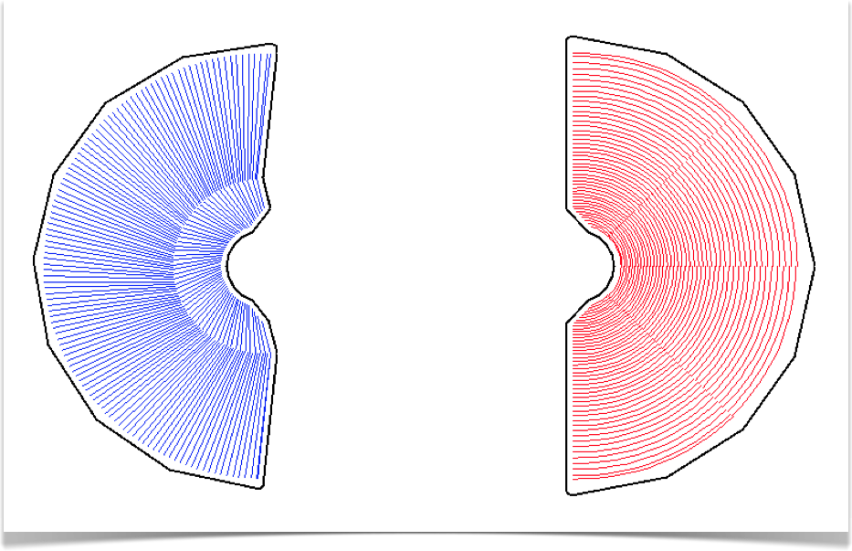
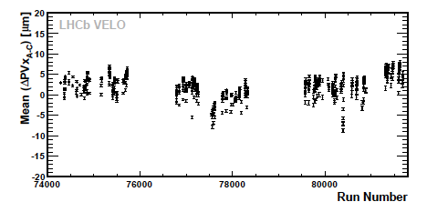
Online: Automatic Alignment & Calibration
Reference: G. Dujany, CHEP ‘15
Minimise Online / Offline differences
  Improve effective trigger performance
Automatic evaluation at regular intervals
  Vertex Locator (VELO) alignment as example
  O(1 min) CPU, update immediately
Half misalignment per fill in 2010
Max deviation ~ 10μm
Tracking: spatial & time alignment
RICH: mirror alignment, photon detector image corrections

Slide 8
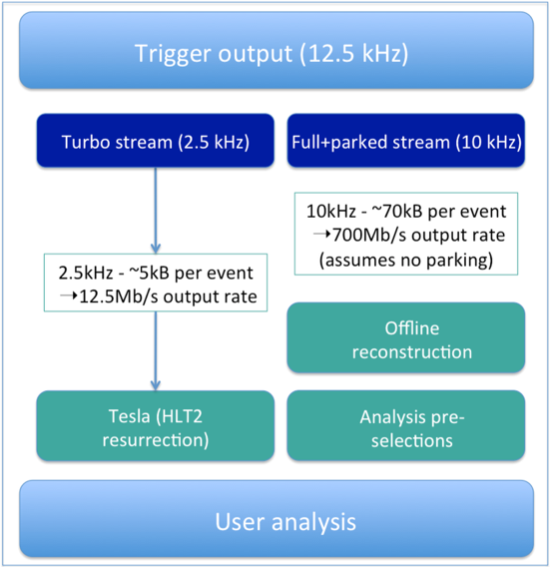
Turbo Stream
Reference: S. Benson, CHEP ‘15, LHCb-TALK-2015-066
  Raw data: electronic signals recorded from detector
  Analysis level: information of signal candidate tracks
Analyse directly on trigger output ?
  Online calibration
  a critical first step
Maximise number of events for user analysis
  Output rate is a limit
Testing mode
  Raw events will be kept

Slide 9

LHCb Physics Programme
Limited by Detector
But NOT Limited by LHC
Upgrade to extend Physics reach
  Exploit advances in detector technology
      Displaced Vertex Trigger, 40MHz readout
  Better utilise LHC capabilities
Collect >50 fb⁻¹ data
Modest cost compared with
existing accelerator infrastructure
Independent of
LHC upgrade
HL-LHC not needed
But compatible
With HL-LHC phase
Chris Parkes, Delta City, May 2015

Slide 10

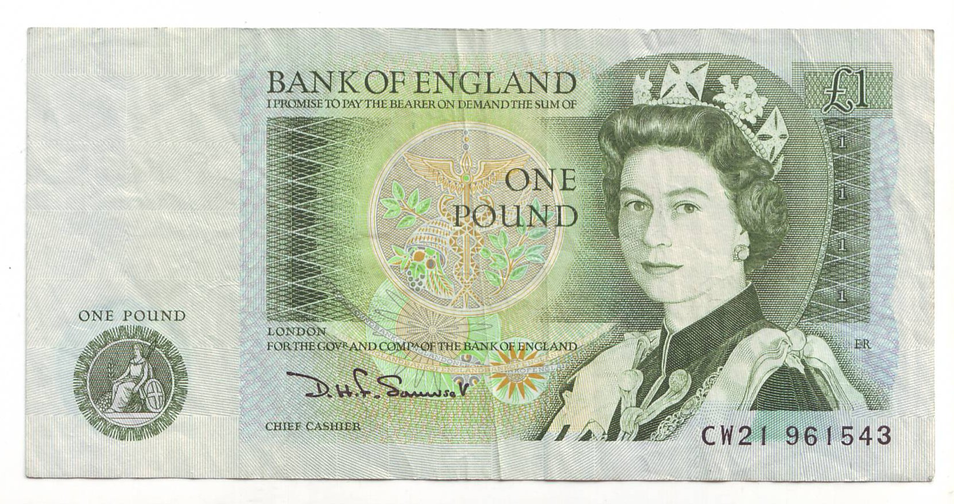
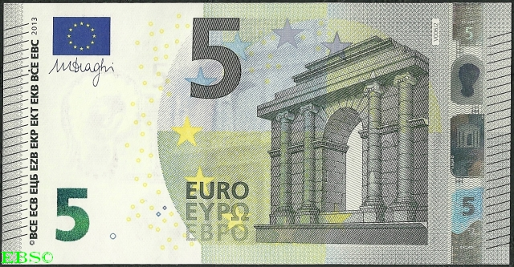
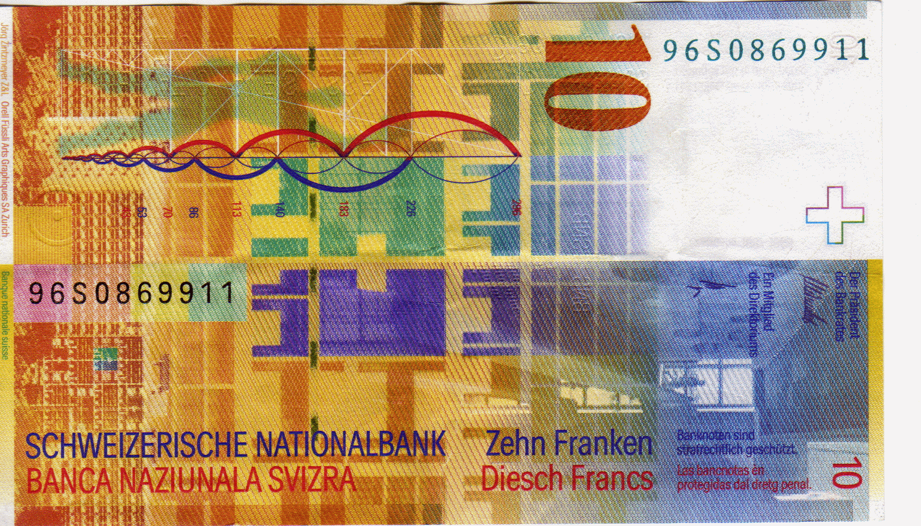

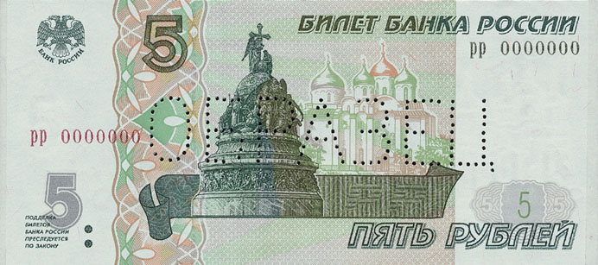
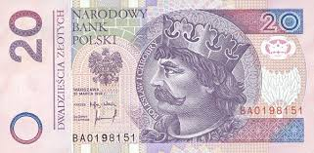
LHCb Upgrade Approved
Letter Of Intent 2011
Framework Technical Design Report 2012
Subsystem TDRs 2014
Funding largely in place from end 2014
CERN-RRB-2014-105
France
Germany
Italy
Netherlands
Spain

Slide 11
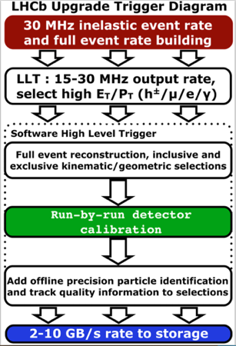
Trigger Evolution - Upgrade
Run II
Upgrade

Slide 12
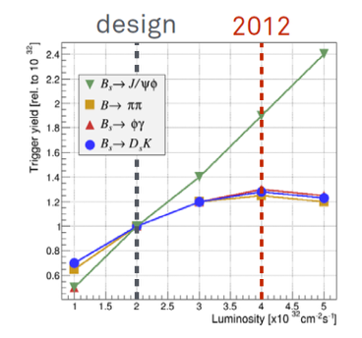
LHCb Trigger: the key to higher Lumi
Aim: Increase integrated luminosity from 2 fb⁻¹ to 5 fb⁻¹ per year
    Increase instantaneous luminosity to 2x10³³ cm⁻² s⁻¹
Current First Trigger Level:
Hardware Muon/ECAL/HCAL
1.1 MHz readout
Performance:
Muon channels scale
Hadronic channels saturate bandwidth
Hardware trigger particularly poorly suited to lower momentum of charm
No gain in hadronic channels with current trigger
Notes:
The current LHCb trigger allows to read out the full detector at 1.1 MHz. The purpose of L0 is reduce the event rate to that level .

Slide 13
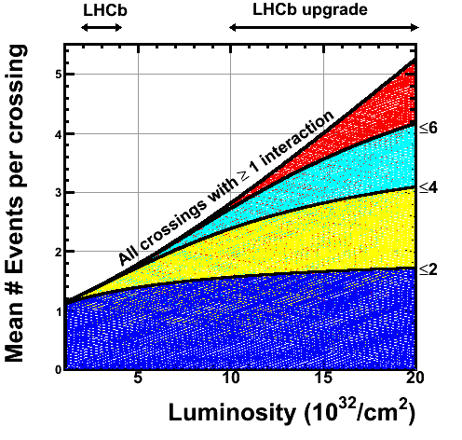
Solution: Upgrade to 40MHz readout
Read out full detector at 40MHz
  Major detector changes
  Front-end electronics
  must change
Use fully software trigger
  Increased flexibility
Maintain (improve) current
detector performance
  At increased multiple
  Interactions
  Occupancies
  Radiation Damage

Slide 14
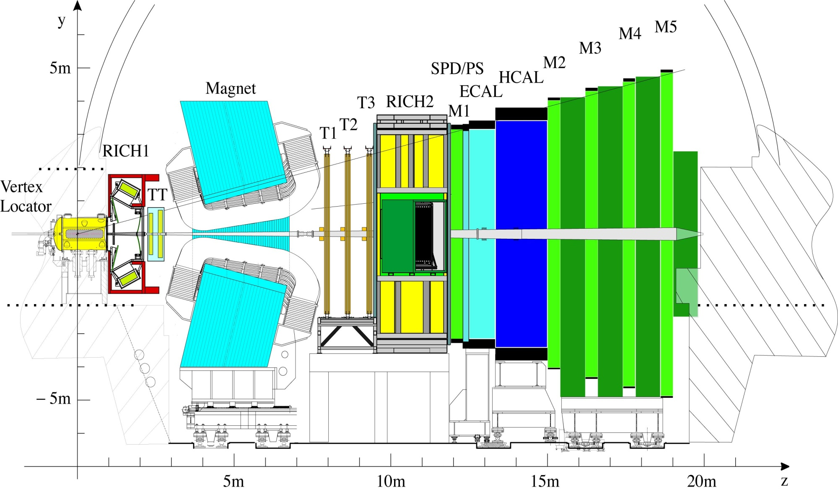
LHCb Upgrade to 40 MHz
VELO
Pixel
Detector
Upgrade Tracker
Silicon strips
Outer Tracker
Scintillating Fibres
Muon MWPC
(almost compatible)
RICH
Photon Detectors &
(partial) mechanics
Calo
PMTs (reduce PMT gain, replace R/O)
Chris Parkes
Notes:
Spd, ps and m1 removed completely
Readout detector at 40MHz to run full software trigger
Replacement of all sub-detector Front-End electronics to 40 MHZ readout
Replacement of all silicon detectors attached to the current 1MHz electronics
VELO, IT, TT, RICH photo-detectors
Remove some detectors due to increased occupancies at higher luminosity
RICH1-aerogel, M1, possibly PS&SPD
Eventually improve PID at low momenta by introducing TORCH

Slide 15
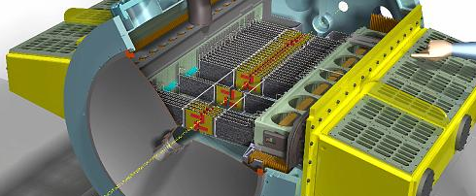

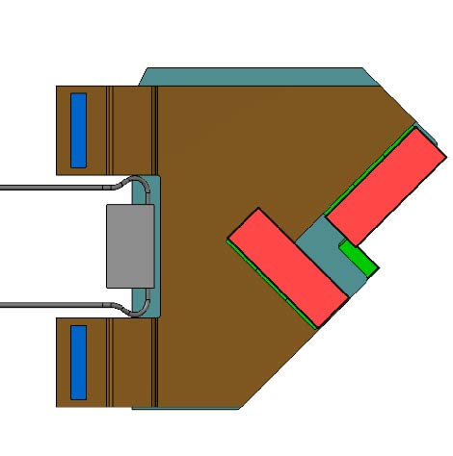
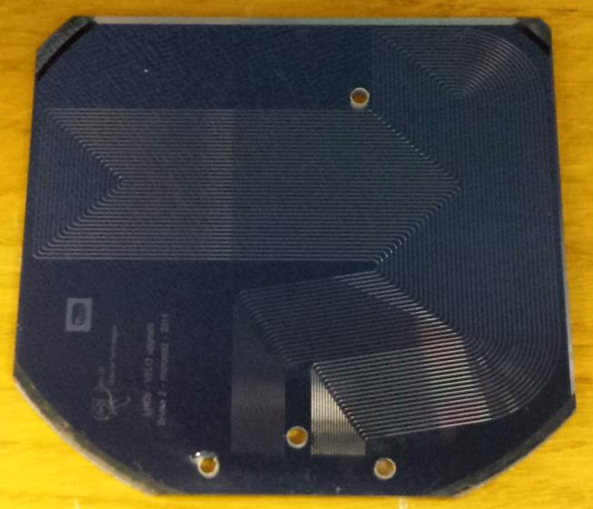
LHCb Vertex Locator Upgrade
Pixel Detector
  55x55μm
In vacuum
5mm from LHC beam
  10¹⁶ n_{eq}/cm²
  Retracted for filling
Silicon with Micro-channel
  Bi-phase CO₂ cooling

Slide 16
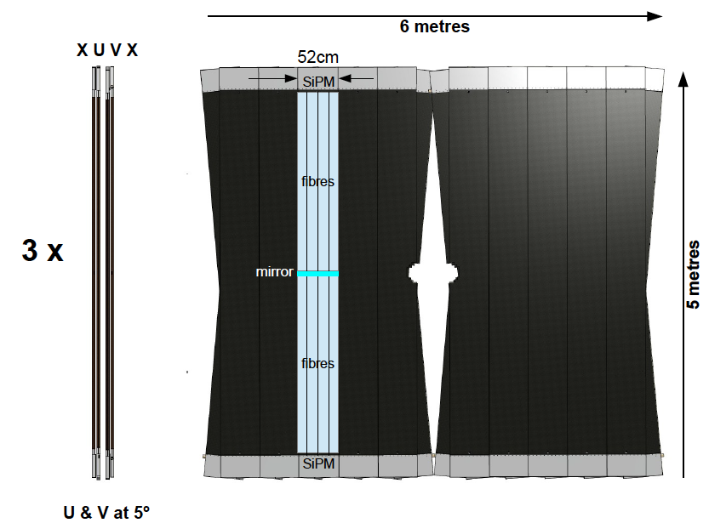
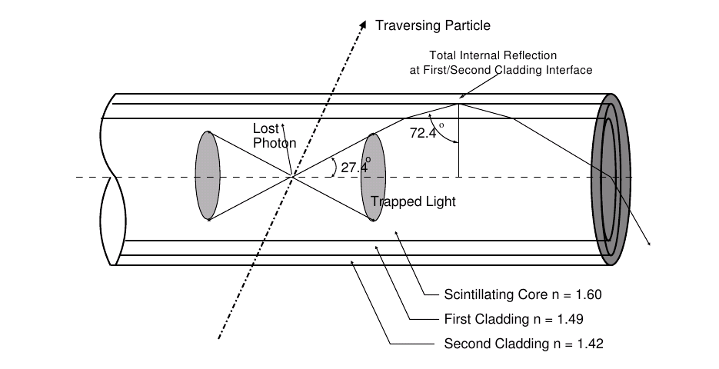
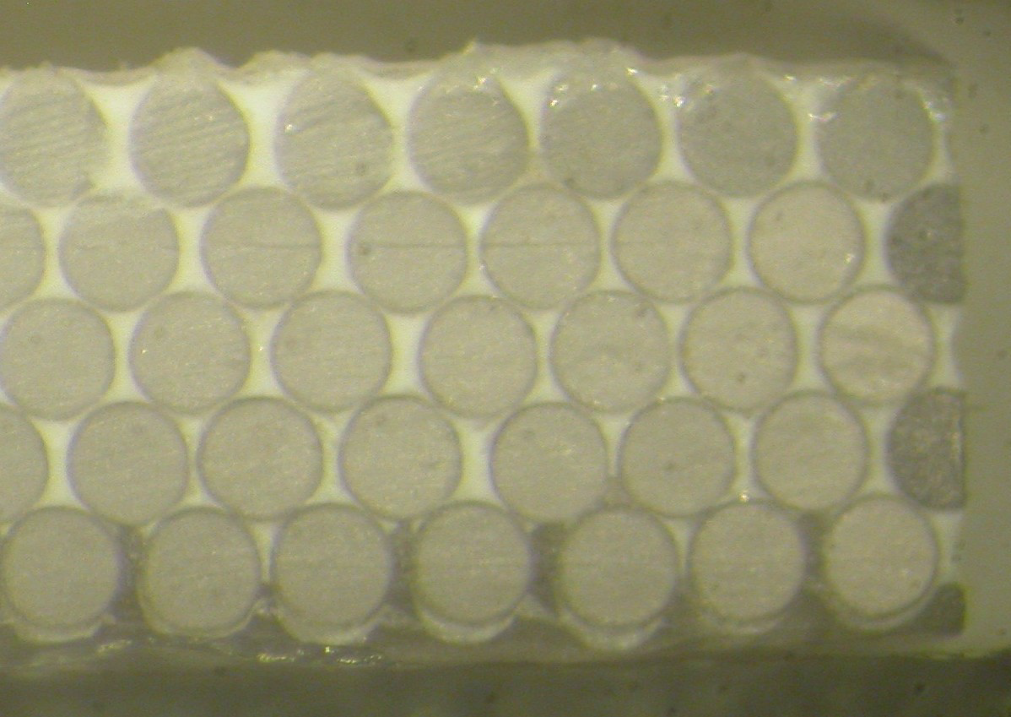
LHCb Scintillating Fibre Tracker
Mat made from
  250μm diameter fibres
  SiPM readout
Radiation hardness challenge
  Fibres & SiPMs
Defects (bumps) in fibres
  10,000 km fibre !

Slide 17
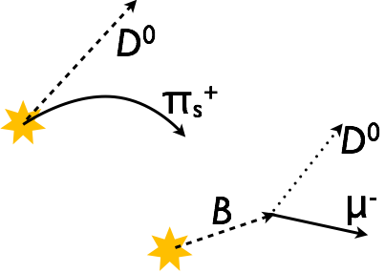
Sources of Charm
Prompt charm
Run I D➔Kπ: 100M
Offline selected D* tagged
(x5 untagged)
Semileptonic B-hadron decays
Run I D➔Kπ: 20M
Offline selected muon tagged
Hadronic B decays
Not only useful to measure CKM γ
Also revealed first spin-3 charm state
→ LHCb collaboration, Phys. Rev. Lett. 113 (2014) 162001

Slide 18
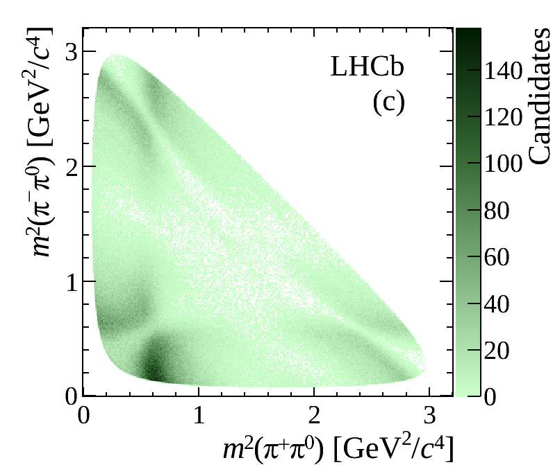
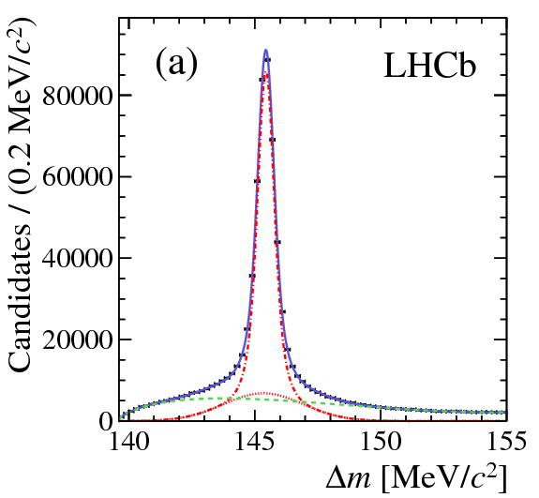

Physics Coverage / Limitations
Inclusive charm trigger selections are not feasible
  Upgrade will produce 800 kHz of analysable charm-hadron events
  80 GB/s with current data format
    can keep 2-10 GB/s for ALL LHCb physics
Have to decide in advance what to keep
  Cabibbo favoured modes prescaled ?
  Purely exclusive selection – trigger is offline selection
Limits of physics programme not yet reached
  Use of neutrals
  understanding production/detection asymmetries
arXiv:1410.4170; LHCB-PAPER-2014-054
D⁰➔π⁺π⁻π⁰: 1yr LHCb Run 1= 80 yrs B factory v1
Charm

Slide 19
Statistics
Upgrade
Run-I
Run-II
See backup slides for assumptions

Slide 20
Statistics – Cross-section Adjusted
Upgrade
Run-I
Run-II
13 TeV cross-section
See backup slides for assumptions

Slide 21
Statistics – Hadronic Trigger Adjusted
Upgrade
Run-I
Run-II
13 TeV cross-section
Trigger efficiency adjusted for hadronic modes
See backup slides for assumptions

Slide 22
Statistics: D⁰➔Kπ Events
100M
Billion

Slide 23
Future Charm Measurements – key channels
A_{Γ}, WS Kπ, ΔA_{CP}
  Inherently robust against systematics due to cancellations
  Not all at the same level, but no limiting uncertainty known
y_{CP} ≡ τ_{Kπ}/τ_{KK} - 1 ≈ y
  Comparison of two different final states
  Less robust, key is controlling lifetime bias
K_{S}ππ
  Leading systematics are either model uncertainties or measurements of CP content at threshold
  Benefits from BESIII
Rare Decays
  Systematics unlikely to limit, no bandwidth issues
Spectroscopy
  Bandwidth limitations for Cabibbo favoured modes ?

Slide 24
Future Sensitivities: D⁰➔μμ
D⁰➔μμ
1:Billion
Scaling sensitivities with √N from current LHCb results
  Assumes scaling of systematic uncertainties
  Ignores potential improvements in selections and analyses
Shows data set collection date

Slide 25
Future Sensitivities: Δ Α_{CP}
Δ Α_{CP}
~10⁻⁴ level
Scaling sensitivities with √N from current LHCb results (D* tagged only)
  Assumes scaling of systematic uncertainties
  Ignores potential improvements in selections and analyses
Shows data set collection date

Slide 26
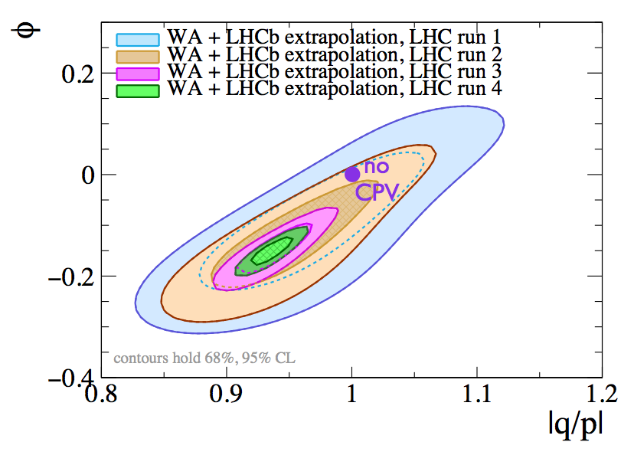
Future Sensitivities: CPV & Mixing
M. Gersabeck, 100TeV workshop, LHCb-TALK-2015-039
See backup slides for assumptions
Current World Average + LHCb projections (D* tagged only)
Central values of current world averages used

Slide 27
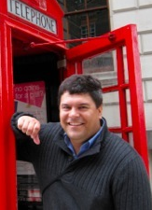
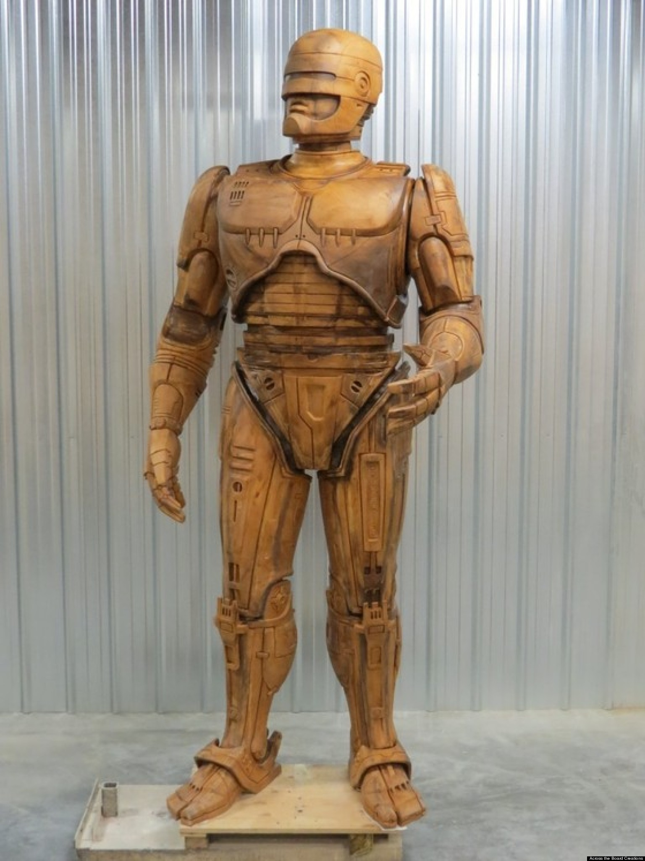
Conclusions
LHCb Charm programme has exceeded expectations for LHC Run 1
LHC Run II has begun
  Novel trigger strategies are required to keep pace
LHCb Upgrade
  Approved, ~ financed
  Significant technological
  challenges, fast timescale
  Bandwidth key to charm
  prospects
V1
Upgrade ?
Probe SM level CPV at LHCb Upgrade

Slide 28
Backup Slides

Slide 29
Physics Performance Assumptions
Based on LHCb-PUB-2014-040
Run-2
  Cross-section increases linearly with √s
  Non-muon trigger efficiency suffers from tighter thresholds and have a factor 2 lower efficiency
    Does not assume Turbo Stream
  2fb⁻¹ per year, 5fb⁻¹ in total for run II
Upgrade
  Removal of hardware trigger brings factor 2 efficiency boost for non-muon triggered events
    Charm factor may well be significantly higher
  ~5fb⁻¹ per year

Slide 30
Sensitivity Prediction Assumptions
Based on M. Gersabeck, LHCb-Talk-2015-039, for IHEP 100 TeV workshop
Mixing and CPV – A_{Γ}, y_{cp,}WS Kπ, K_{S}ππ
Uses current WA central values from fit
A_{Γ} : projection of LHCb 1fb⁻¹ D* tagged
WS Kπ: projection of LHCb 3fb⁻¹
y_{cp}: projection of LHCb 0.03fb⁻¹
K_{S}ππ:assume same sensitivity per event as Belle
Δ Α_{CP:} projection of LHCb 1fb⁻¹ prelim. result D* tagged only
D⁰➔μμ: projection of LHCb 1fb⁻¹ , leptonic trigger – different scaling
In all CPV,mixing D* tagged only is used in extrapolations
Use of semileptonic B decays, muon tagged, will improve results, and is
complementary in systematics

Slide 31
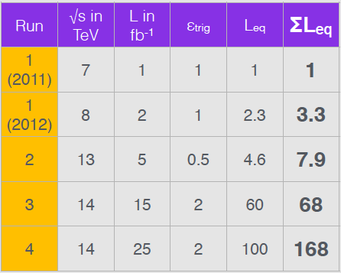
Extrapolations
M. Gersabeck, LHCb-Talk-2015-039, for IHEP workshop
L_{eq} - Calculate equivalent
luminosities to 7 TeV
Extrapolate signal
yields accordingly
Based on existing Run-I
measurements where available

Slide 32
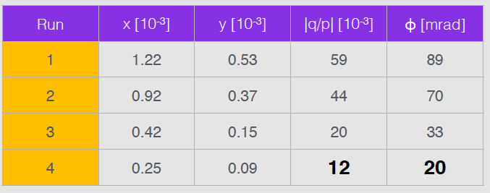
Future Sensitivities
M. Gersabeck, LHCb-Talk-2015-039, for IHEP workshop
Scaling sensitivities with √N
  Assumes scaling of systematic uncertainties
  Ignores potential improvements in selections and analyses

