Slide 1
Review of
Fermilab Detector
Research and Development
Relevant to CMS
18 December. 2014
Erik Ramberg
Fermilab

Slide 2
Fermilab Detector R&D Organization
The “Detector Advisory Group” consists of: (PPD unless otherwise noted)
  Technical Point of Contact Erik Ramberg
  Silicon tracking representative Ron Lipton
  DAQ and Triggering representative Alan Prosser (SCD)
  Calorimetry and photodetection representative Jim Freeman
  Liquid Argon R&D representative Stephen Pordes (ND)
  Astrophysics detectors representative Juan Estrada
  Intensity Frontier representative (CD) Bob Tschirhart
  Head, Particle Physics Division Patty McBride (ex-officio)
  Assoc. head for Engineering Eric James (ex-officio)
  Head, Particle Physics Initiatives Dmitri Denisov (ex-officio)
  Head, New Initiatives R&D Dave Christian (ex-officio)
  Scientific Computing (CD) Panagiotis Spentzouris (SCD)
  Ulrich Heintz (Brown University) (External Representative)
The group meets twice a month and monitors and reports on the activities in each of their portfolios.
Members give advice on the future of the program and participate in reviews of projects in each portfolio
TPOC informs the Division Heads and Offices of Research and Computing of plans arising out of group discussions and reviews.
After consultation with DOE, Division Heads and CRO then decide on approval of new directions
Erik Ramberg - Review of Fermilab Detector R&D, Oct. 29, 2014
2

Slide 3
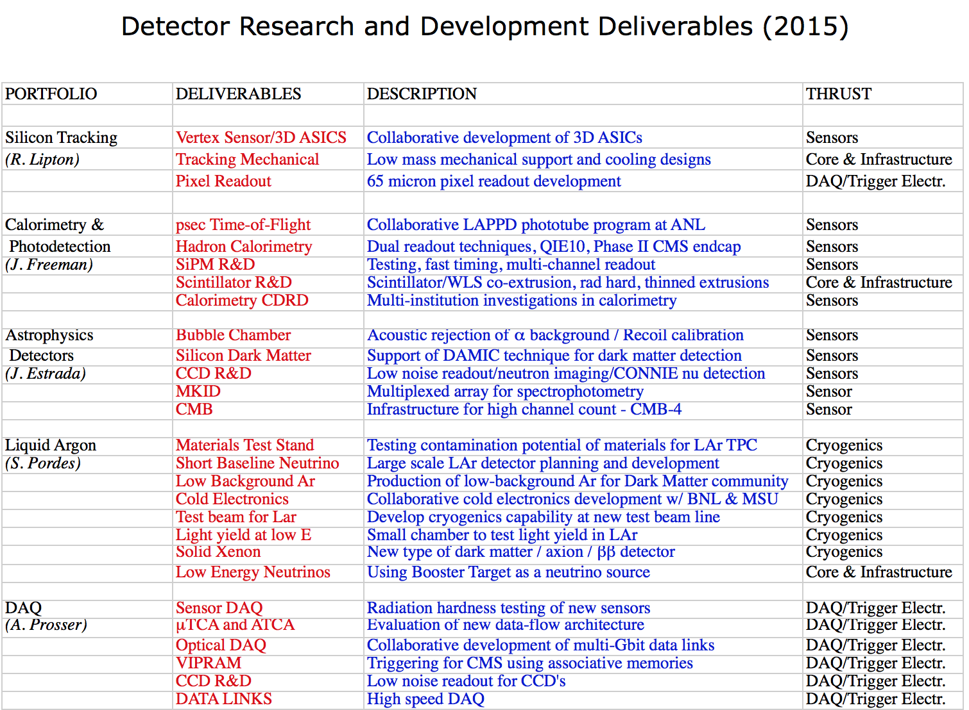
*
*
*
*
= especially relevant for CMS R&D

Slide 4
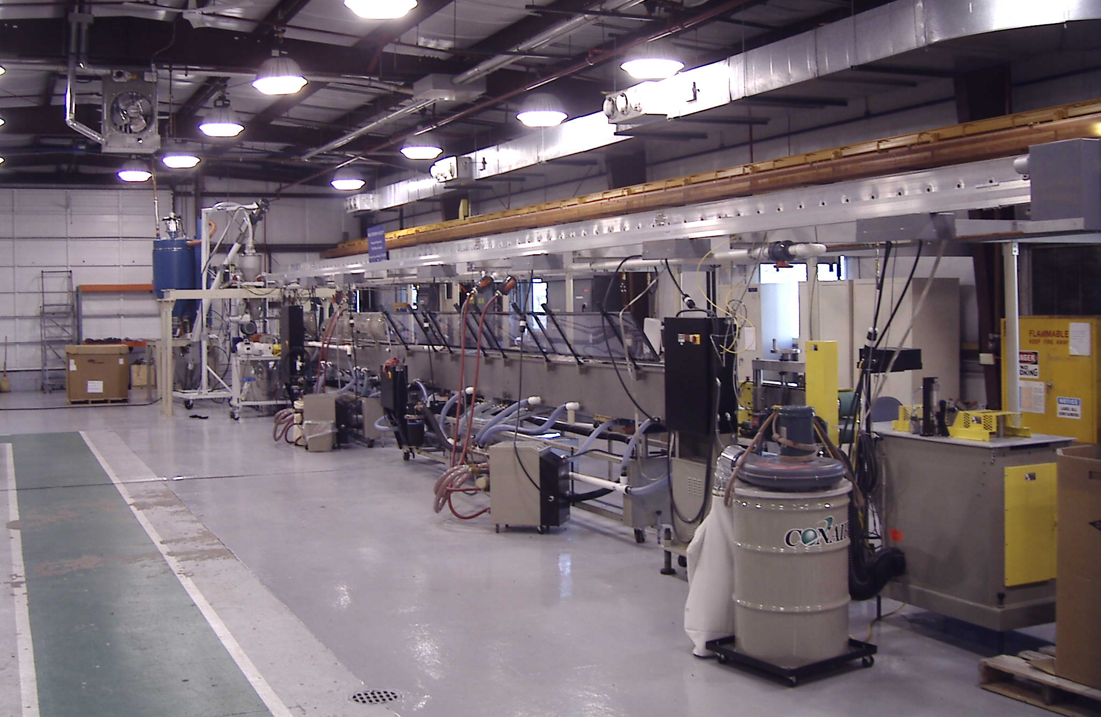
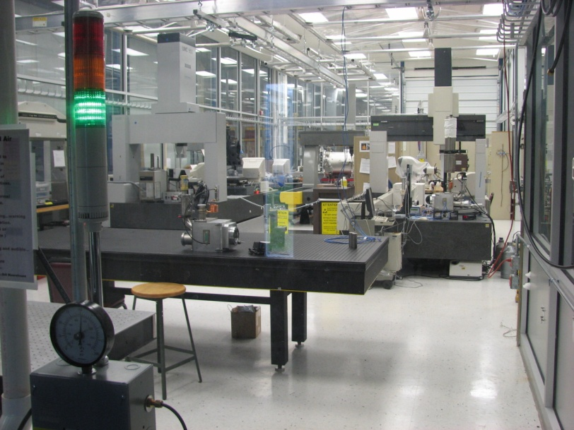
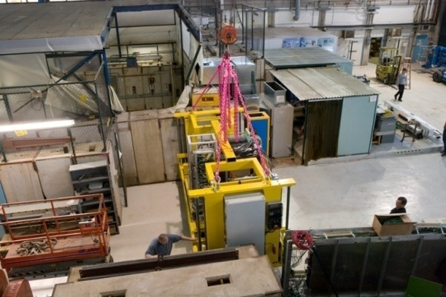
Fermilab Assets for Detector Research
Detector R&D program at Fermilab is enabled by our institutional strengths:
  Presence of research facilities such as:
    Test beam facility
    Silicon Detector facility
    Liquid argon test facility
    NICADD scintillator extrusion facility
    CCD characterization facility
    Thin-Film Facility
    High power laser laboratory
  Experienced, well established engineering groups, such as
    ASIC development
    Cryogenics
    Data Acquisition
We encourage a high degree of collaboration with the university community and other national labs, and we will continue to advertise the capabilities in detector support that Fermilab can deliver
Scintillator extrusion at Lab 5
Clean rooms and metrology at SiDet
CALICE at the
test beam
Page 4

Slide 5
‘KA25’ DOE budget category
The KA25 budget supports detector R&D at Fermilab that is programmatic to the OHEP mission, including both directed and general detector R&D.
This B&R funding category supports M&S and SWF of associated technical staff but does not support associated Fermilab scientific effort.
The KA25 review process includes regular internal reviews, and the OHEP complex-wide triennial reviews organized by OHEP. The next triennial complex-wide review will be held in the summer of 2015.

Slide 6
Collider Detector R&D Funding Opportunity (CDRD)
Fermilab was a part of several proposals prepared for the CDRD funding opportunity in 2012. We worked to increase our collaborative efforts with universities, other national labs and industrial partners.
Fermilab participated in several CMS projects selected for funding :
A Proposal to Develop a High Speed Data Link for Collider Experiments
  (ANL, U.Mn., OSU., FNAL, SMU, VegaWave)
  $360 K – ($64 K for FNAL)
Development of 3D Vertically Integrated Pattern Recognition Associative Memory
  (FNAL, U.Chicago, ANL, INFN (Padova), Tezzaron)
  $150 K – ($140K for FNAL)
Forward Calorimetry for a High Luminosity LHC
  (Virginia, Notre Dame, Iowa, Florida State, Minnesota, Cal.Tech, Feirald)
  $410 K ($0 for FNAL)
High speed data links and 3D VIPRAM will continue. How best can Fermilab help the calorimetry research?
Page 6

Slide 7
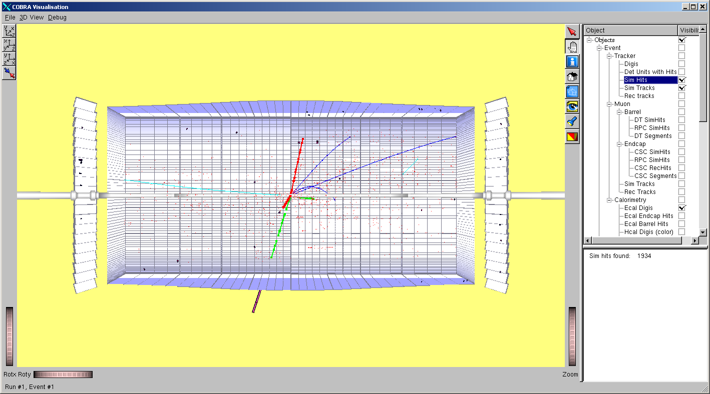
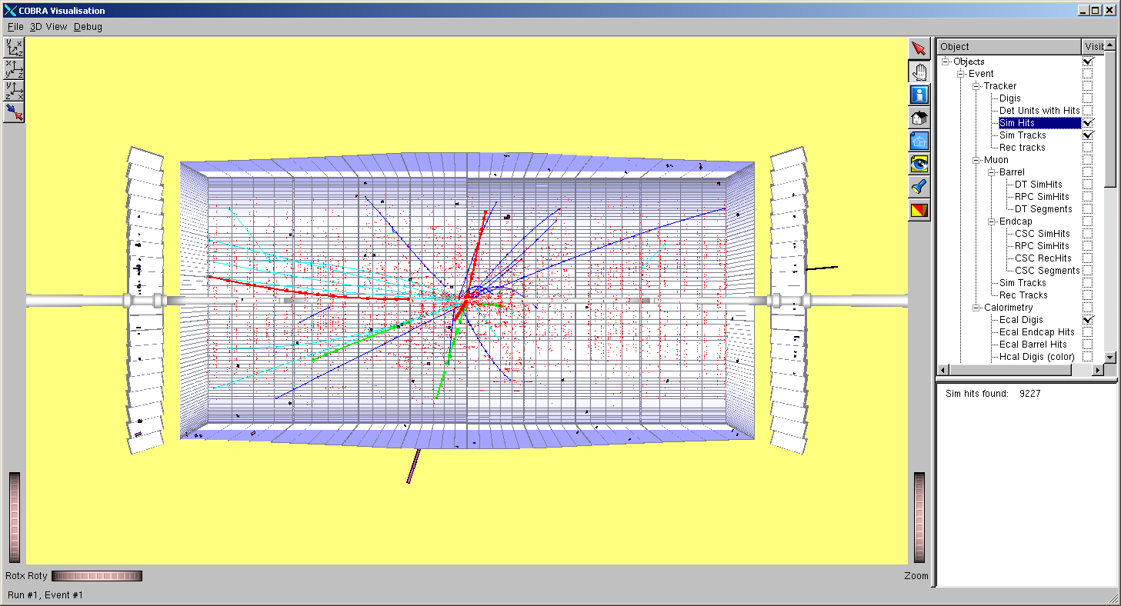
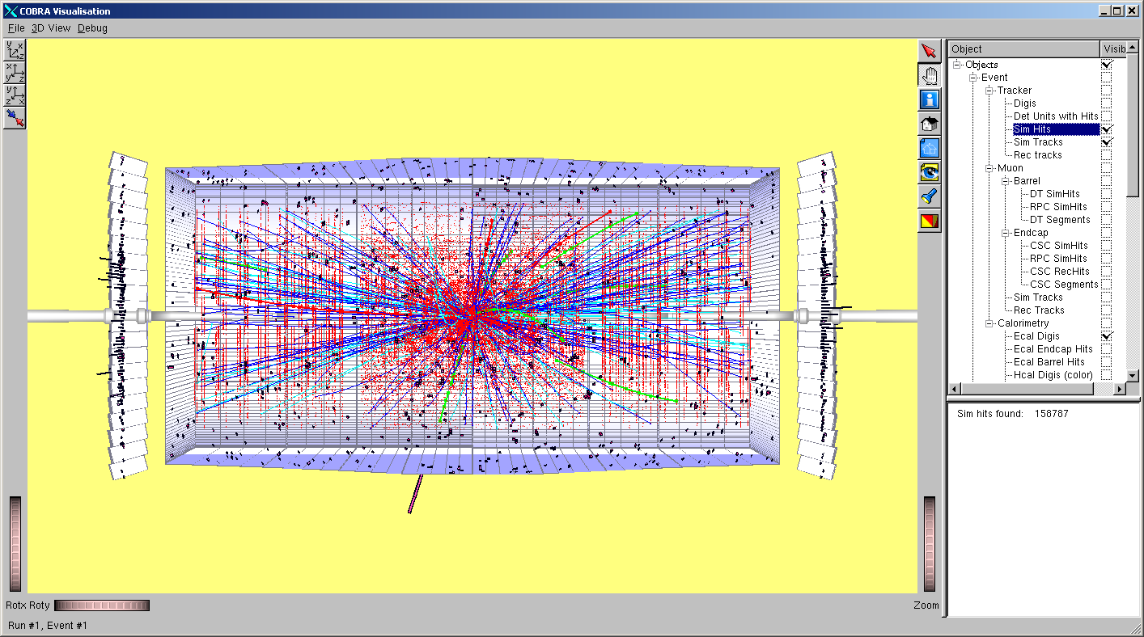
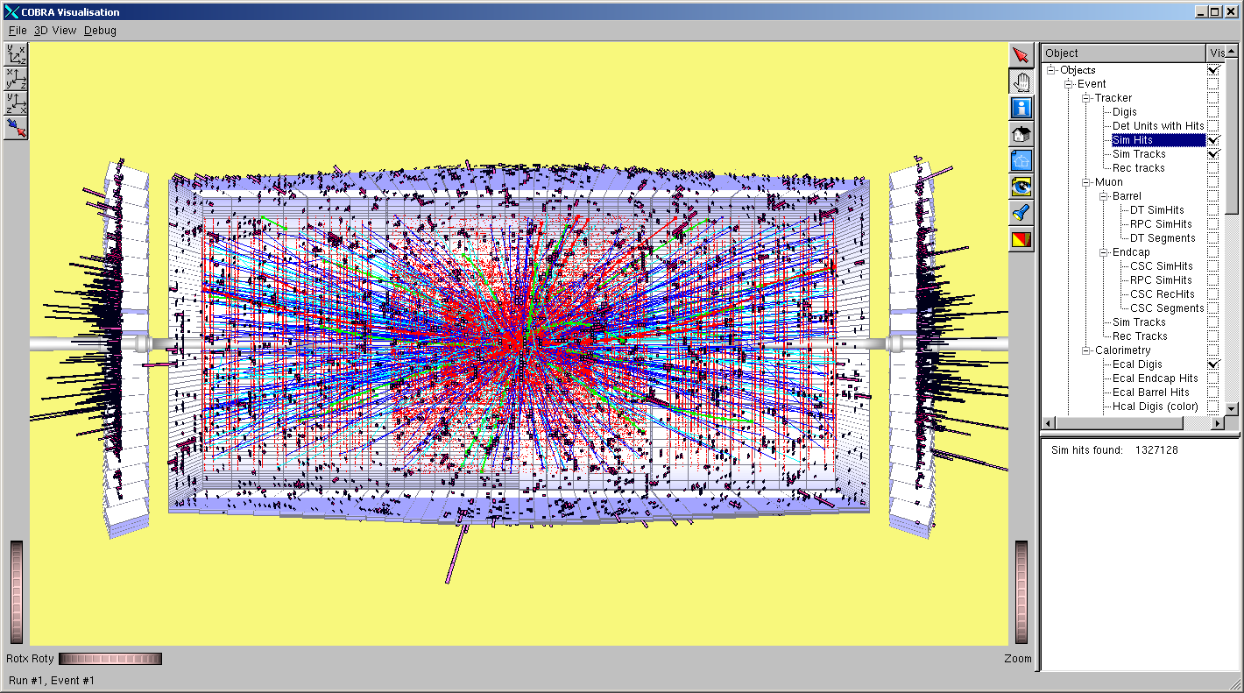
The challenge (from simulation) ….
10³² cm⁻² s⁻¹
10³³
10³⁴
10³⁵

Slide 8
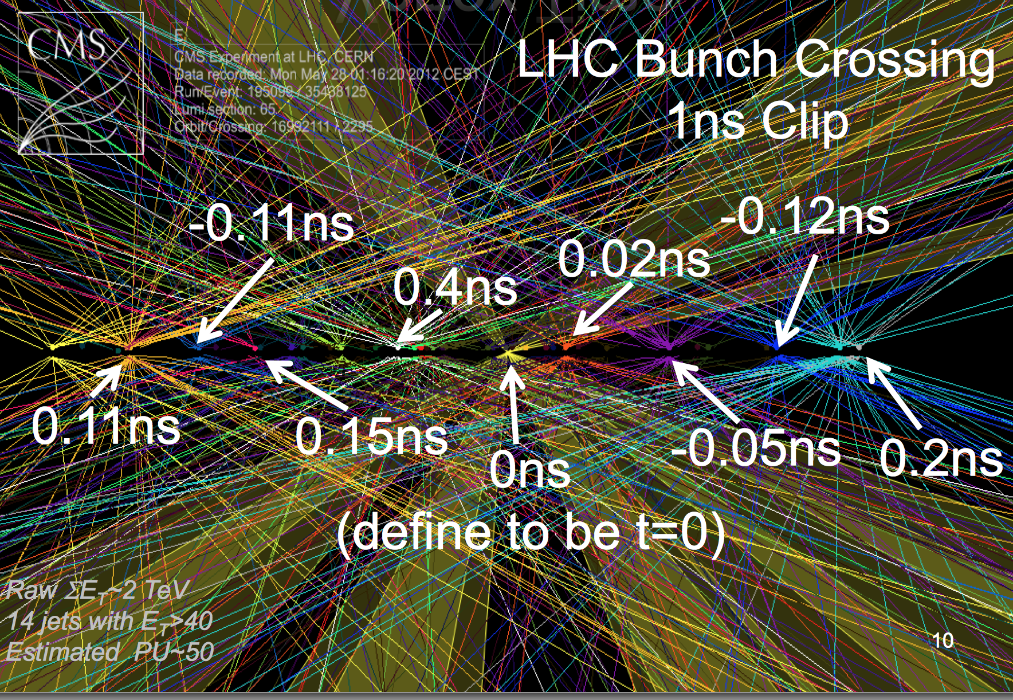
Everything must be fast in CMS Phase II
From Chris Tully SSI lecture, 2012:

Slide 9
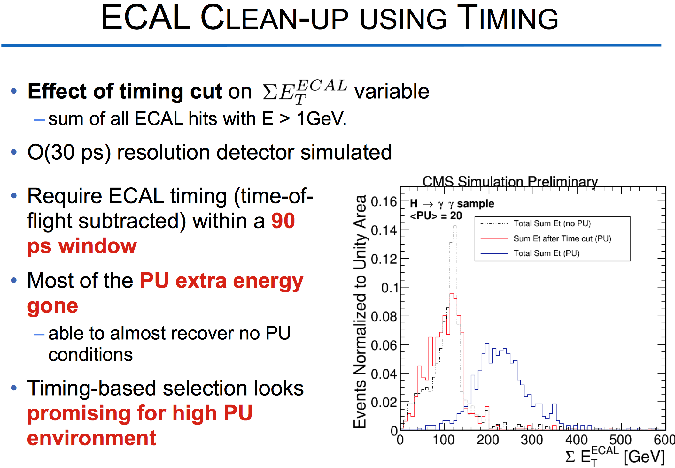
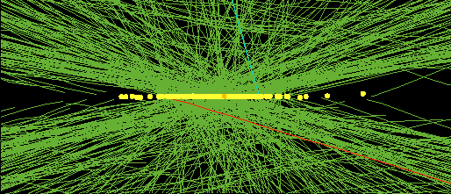
“TIMING PERFORMANCE OF THE CMS ECAL” Daniele del Re

Slide 10
CMS (& ATLAS) require new pixel detector technology (at least for the layers closest to the beam).
  Both sensor and electronics need greatly improved radiation tolerance:
    > 10¹⁶/cm² n equivalent
    ~ 1 Grad total ionizing dose
  And greater rate capability
    1 – 2 GHz/cm² hit density in inner layer
    CMS trigger rate will increase by a factor of ten (even as events get larger)
  Want smaller pixels
  And longer trigger latency (more memory in ROC)

Slide 11
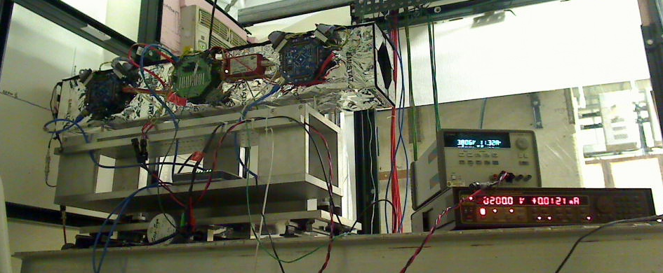
FNAL Has Had a Comprehensive Approach to Silicon Tracking, Triggering and DAQ R&D for Phase II upgrade of CMS
Creating a tracking and trigger system that can withstand the projected HL-LHC luminosities is arguably the most important detector challenge in the field of High Energy Physics.
There must be a comprehensive approach:
Sensor
Testing radiation hardness in new sensors (3D columnar + Diamond)
15 US universities
19 foreign institutions
5 laboratories
8 industrial partners
Front End
Providing new readout for pixel detectors
L1 Trigger
Track trigger using 3D techniques
Data Transmission
Multi-wavelength optical DAQ
Track Fitting
GPU’s and Associative Memory
Page 11
LLNL Visit - 24 January, 2012
11

Slide 12
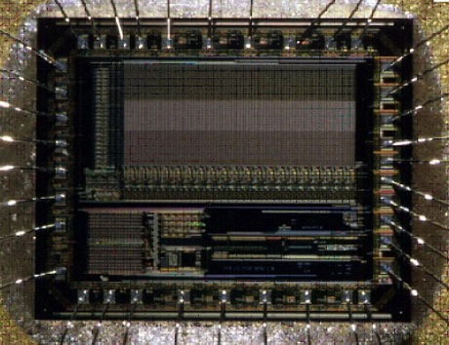
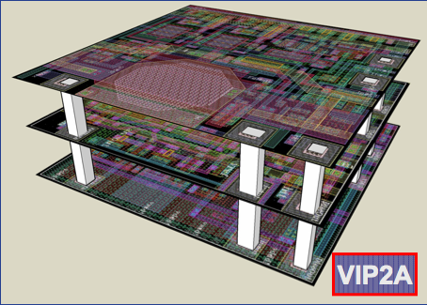
3-Dimensional ASIC program
Conventional Monolithic Active Pixel Sensor
3 tier 3D stack for FNAL ILC vertex chip, fabricated by MIT-LL
Fermilab has led the formation of a large international consortium (http://3dic.fnal.gov) addressing this technology. This group of 17 members from 6 countries shared a multi-project run in 2009 and we have successfully bonded chips from that run to X-ray sensors
We have established a close working relationship to Tezzaron (located near Fermilab) and the U.S. based firm Ziptronix. The tools and techniques learned from this R&D have been adopted by the major silicon fabrication brokers: MOSIS, CMP and CMC.
BES has agreed to fund ($2.5M) further 3D development of an x-ray imaging chip in collaboration with BNL and Argonne
This run will also contain the 3D associative memory chip (VIPRAM) for CMS

Slide 13
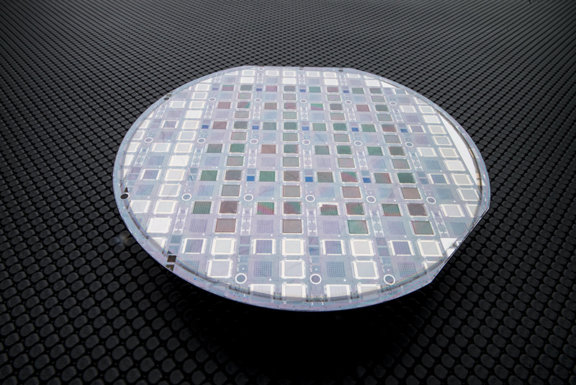
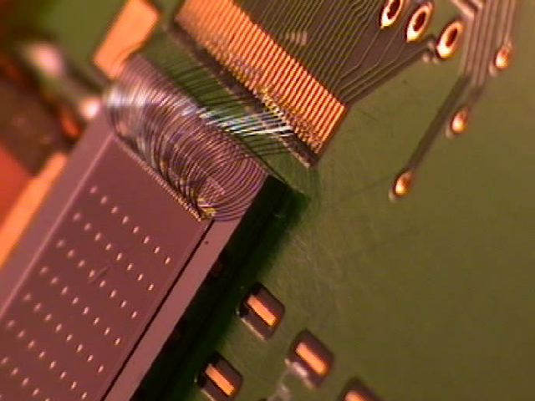
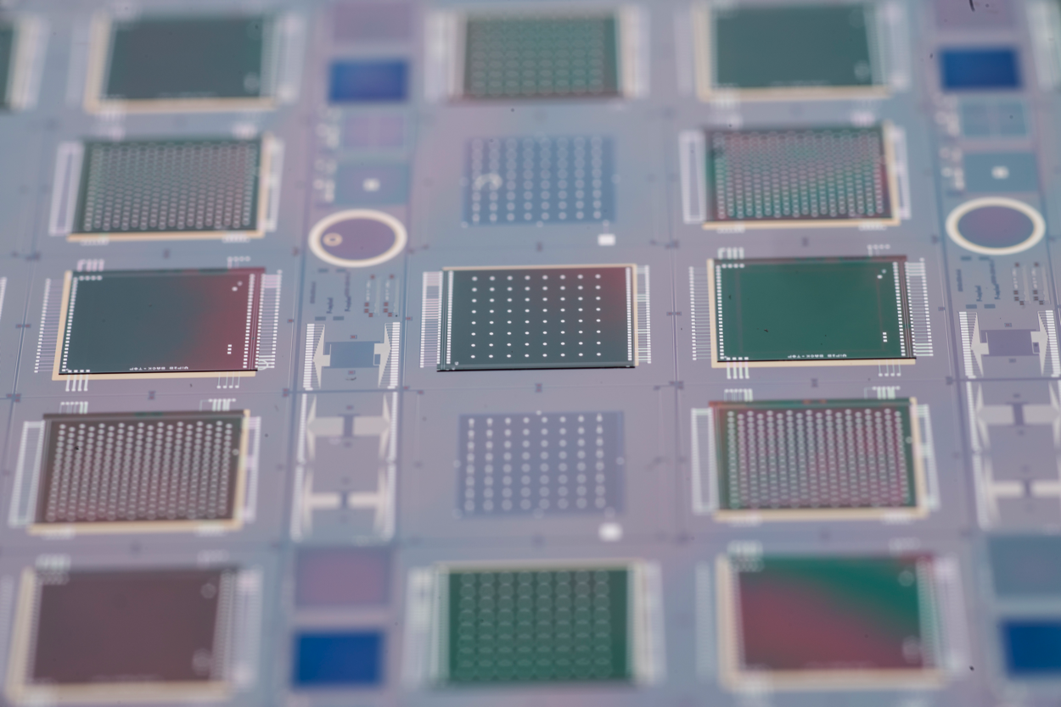
VICTR (CMS Track Trigger Chip)
Wafer with bonded Chips
.5 mm sensor
34 micron 2-tier VICTR chip
VIP
VICTR
VIP
Transmission radiogram of a small W mask (2.5x2.5 mm²) put on top of the sensor;
VIPIC
VIPIC
VIPIC (X-ray correlation detector)
VIP is very high density, very thin readout chip for ILC

Slide 14
Results: noise comparison fusion-bonded vs bump-bonded
Bump-bonded VIPIC1 larger pitch 100μm vs. 80μm for fusion-bonded
competitive
to MAPS!
32×38 pixels bonded, 2880 pixels floating
bump-bonded: ENC=69.6 e⁻ ± 5.1 μV/e⁻
larger input capacitance = larger noise, lower gain and more dispersions
LARGE FEEDBACK RESISTANCE
ENC=36.2 e⁻ ± 2.6 μV/e⁻
symmetrical noise distribution with
<3.4 % of pixels outside of ±3 σ range
ENC on fusion bonded device is close to that measured for floating inputs!
ENC=40e⁻ C_{in}<20fF, ENC=70e⁻ C_{in}>80fF

Slide 15
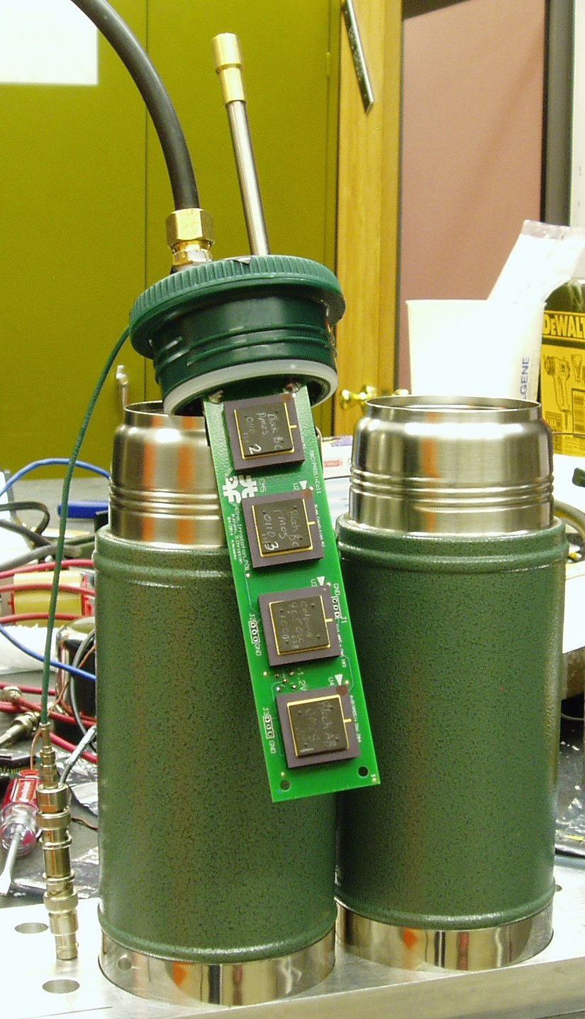
June Irradiation
Vortex cooler
Sandia Gamma Irradiation Facility “Cell 3”
  225 kCi of ⁶⁰Co
  Dose rate = 5.13 Mrad/hr
  Total dose = 1.1 Grad
  Devices kept “cold” except during measurements
Devices tested:
  Core NMOS & PMOS
  Double gate oxide thickness (2.5V I/O) NMOS
  NMOS bias: Gate = 1.2V, all others ground
  PMOS bias: ½ with all nodes = 1.2V (substrate gnd) & ½ with Gate (& substrate) = ground, all others 1.2V

Slide 16
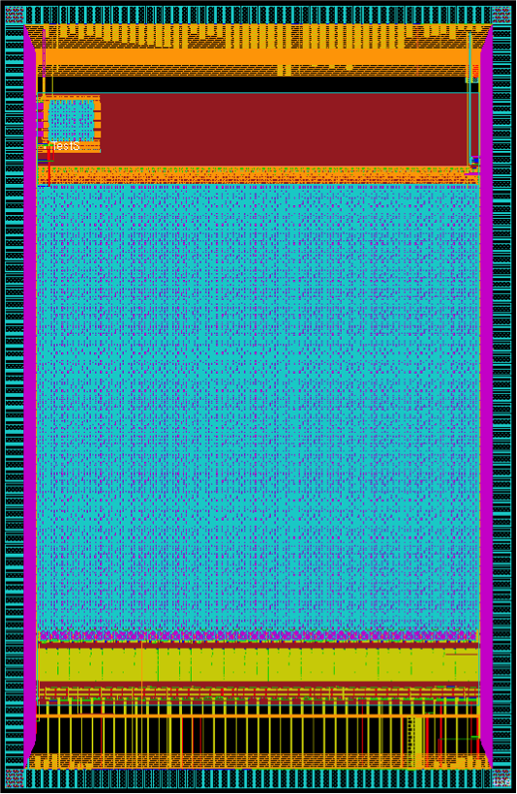
FCP130 Layout
A Small-Pixel Readout Chip
Pixel unit cell = 30μx100μ
Two types of ADC
  ½ of array each
Uses digital logic from other FNAL projects
Zero-suppressed readout using priority encoder
Normal readout at bottom; debug at top (including analog from selected cells); side pads accessible only when not bonded to a sensor.
Fabbed in 130 nm for now
8.5mm
5.5mm

Slide 17
Plans for 2015 & Beyond
Radiation testing (responding to RD53 priorities):
  “Warm” irradiation of 65nm transistors at Sandia GIF;
  If required, design, fabricate, & measure SEU test chip.
FCP130:
  Support sensor development.
Translate FCP130 cells to 65nm:
  Either prototype cells in small ASIC (only for bare chip testing), or
  Design & fabricate FCP65 (to be used with test sensors).
Longer term plans depend on RD53.

Slide 18
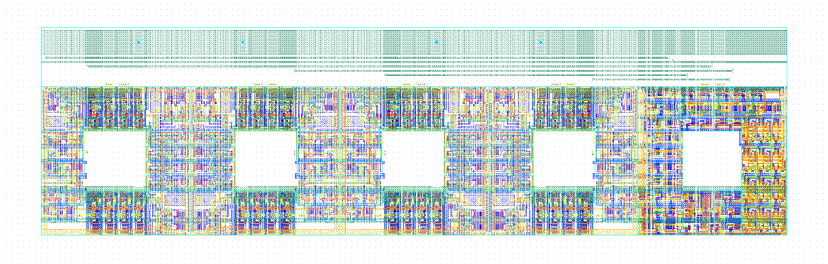
CMS Oriented fast pattern recognition using 3D ASIC
“VIPRAM” = Vertically Integrated Pattern Recognition Associative Memory
VIPRAM_L1CMS
Pipelined operation between PRAM and Data Output – focus = system
Significant layout optimizations
Control
CAM4
CAM3
CAM2
Ultimate goal is to stack up to 8 tiers reflecting tracker topology
CAM1
For details: Ted’s Liu talk (DAQ & Triggering)

Slide 19
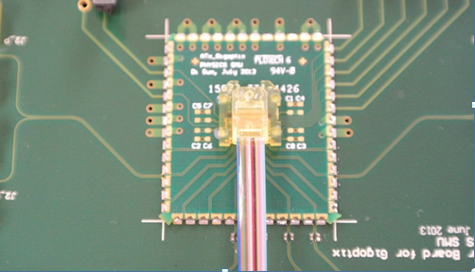
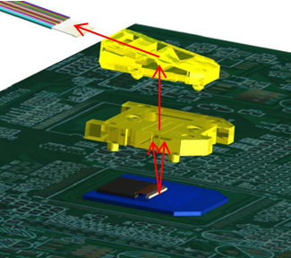
12-channel Array Optical Transmitter Module (ATx)
ATx is a compact (1.9 cm x 2.2 cm x 0.44 cm), radiation-tolerant, 12-channel array optical transmitter module towards 120 Gbps optical link, integrating array optical components, a VCSEL array with a driving ASIC in a custom transmitter module.
A custom low-cost and reliable “active-alignment” method was developed to solve the challenging alignment issue in the array optics area.
With a commercial VCSEL array driver, the ATx module successfully operated at 10 Gbps/ch and aggregate data rate of 120 Gbps. The optical transmitter eye diagram passed the eye mask, and the transmitted BER less than 10⁻¹² was achieved at 10 Gbps/ch.
Prizm Connector
MOI
ATx Module with
ribbon fiber attached
Optical Interface
Notes:
19

Slide 20
Calorimetry and Fast Timing research should evolve to more directly support issues relevant to Phase II CMS upgrades:
Radiation hard scintillators
Latest version of QIE
Investigate endcap calorimeter alternatives with test beam studies until downselect in Feb. 2015
  LYSO/Shashlik
  High granularity silicon
Then join succeeding effort?
Studies of fast timing in showers will continue, to understand how to mitigate pileup difficulties.
  Should we propose a fast timing pre-shower or shower max insert using MCP or SiPM?

Slide 21
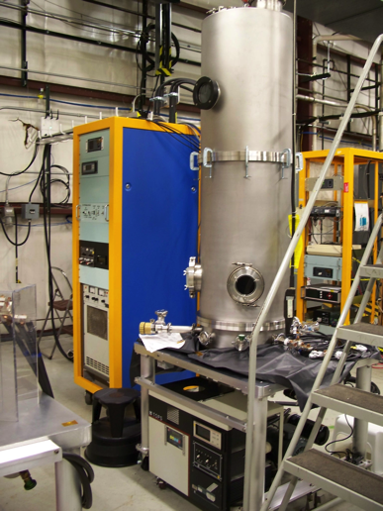
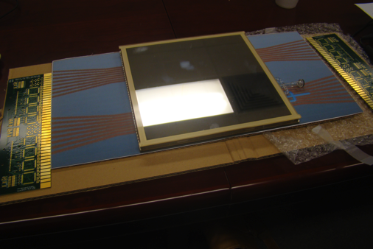
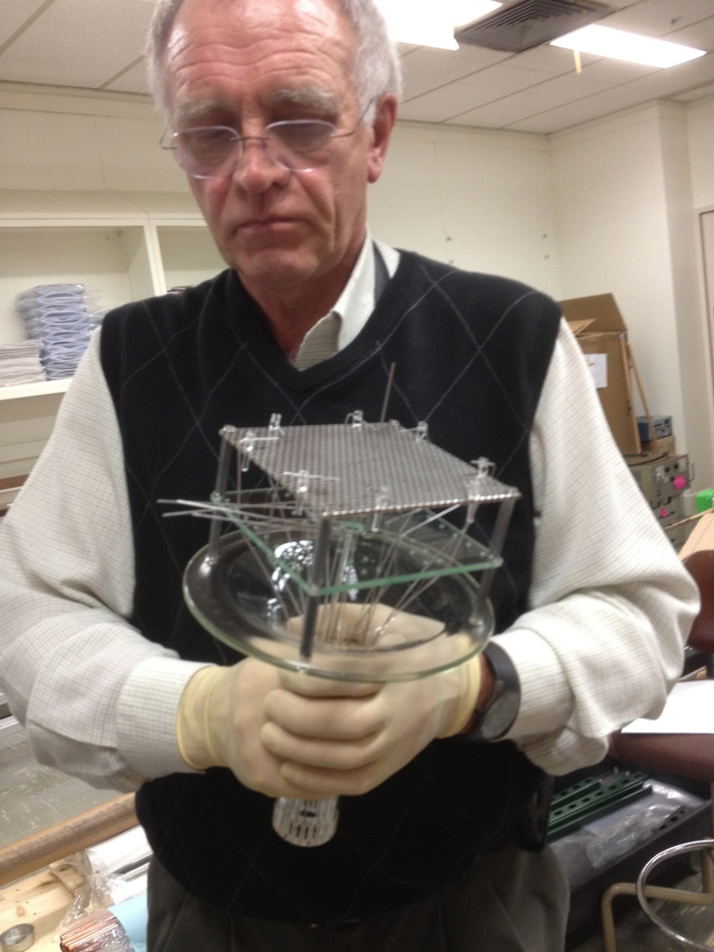
Support of LAPPD (‘Large Area Picosecond Photo Detector) Project at ANL and U.C.
A mockup of the 8” MCP/PMT:
Readout on both ends gives 1 mm positional resolution
Transmission line readout retains superb timing resolution
U.C./Hawaii is developing high speed digitizers (10-20 GHz)
Thin film coating plant for 8” plates
Anatoly Ronzhin holding the ‘chalice’ for systematic photocathode testing

Slide 22
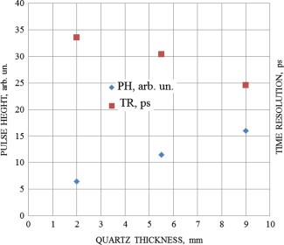
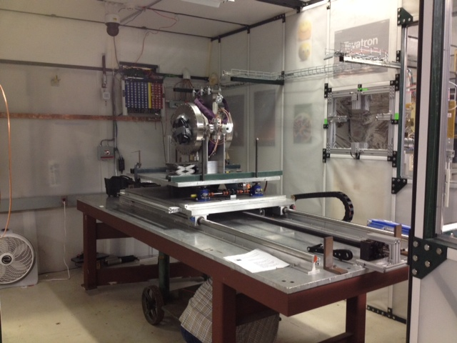
Fast timing using Secondary Emission in pores of a Microchannel plate
Goal is to measure timing in showers to 30 nsec, to disentangle pileup effects.
Propose to use bare MCP in vacuum (no scintillator, no photocathode).
Our first tests used 16 channels of a Photonis MCP/PMT with photocathode and varying thickness of radiator
Timing resolution for no quartz window extrapolates to ~37 psec
Pulse height for no quartz window extrapolates to non-zero value
Anatoly Ronzhin (FNAL), Artur Apresyan, Maria Spiropulu, Si Xie and Adi Bornheim (CalTech), Henry Frisch (UC)

Slide 23
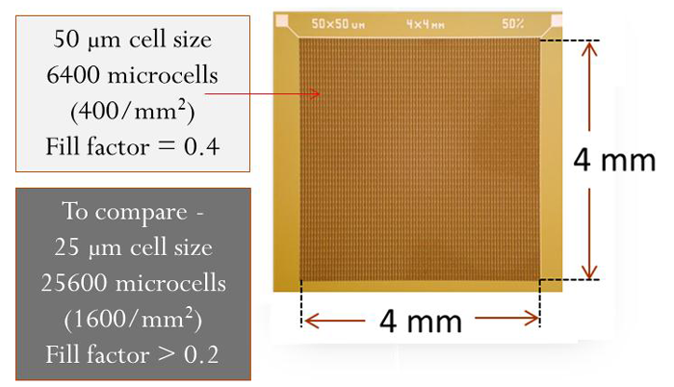
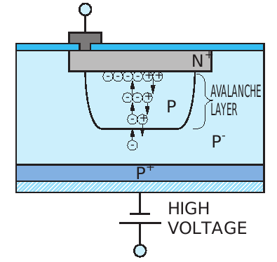
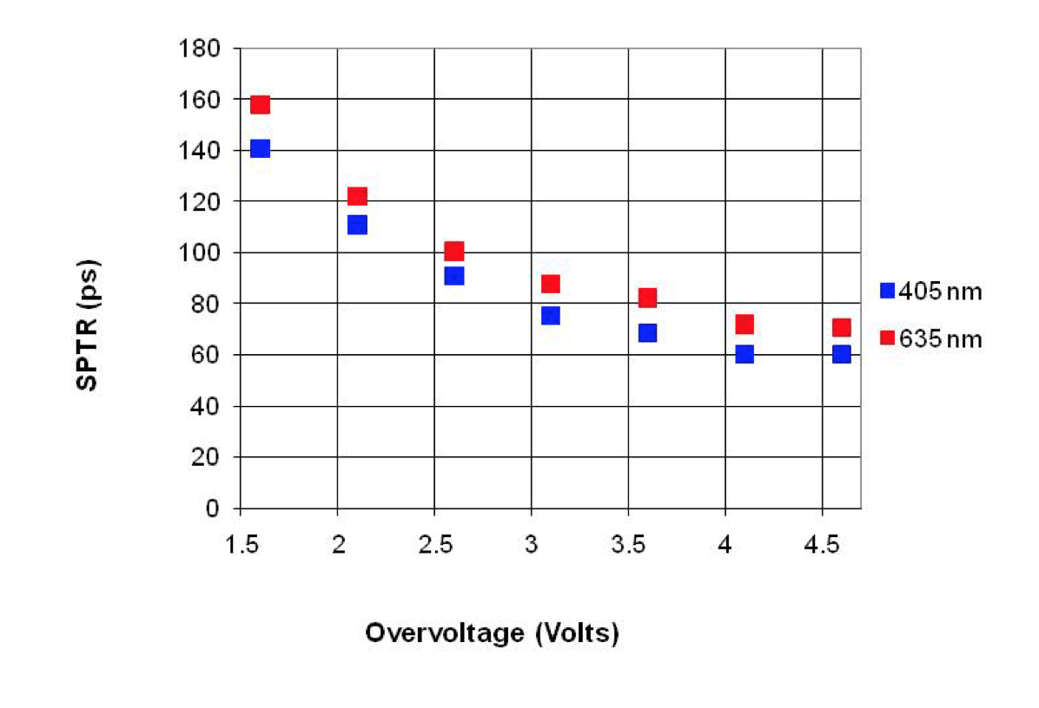
Fast Timing in Solid State
Silicon Photo-Multipliers (SiPM)
PN junction reverse biased beyond the Geiger mode breakdown voltage
Avalanche “quenched” with a series resistor
Array of thousands of these cells on a single chip that can be tailored for specific purposes
The avalanche region is very close to the surface (~1 micron), so timing can be excellent
Note single photon timing resolution of samples from IRST:
10 photons can give
25 psec resolution
(confirmed)
Radiation Soft !!

Slide 24
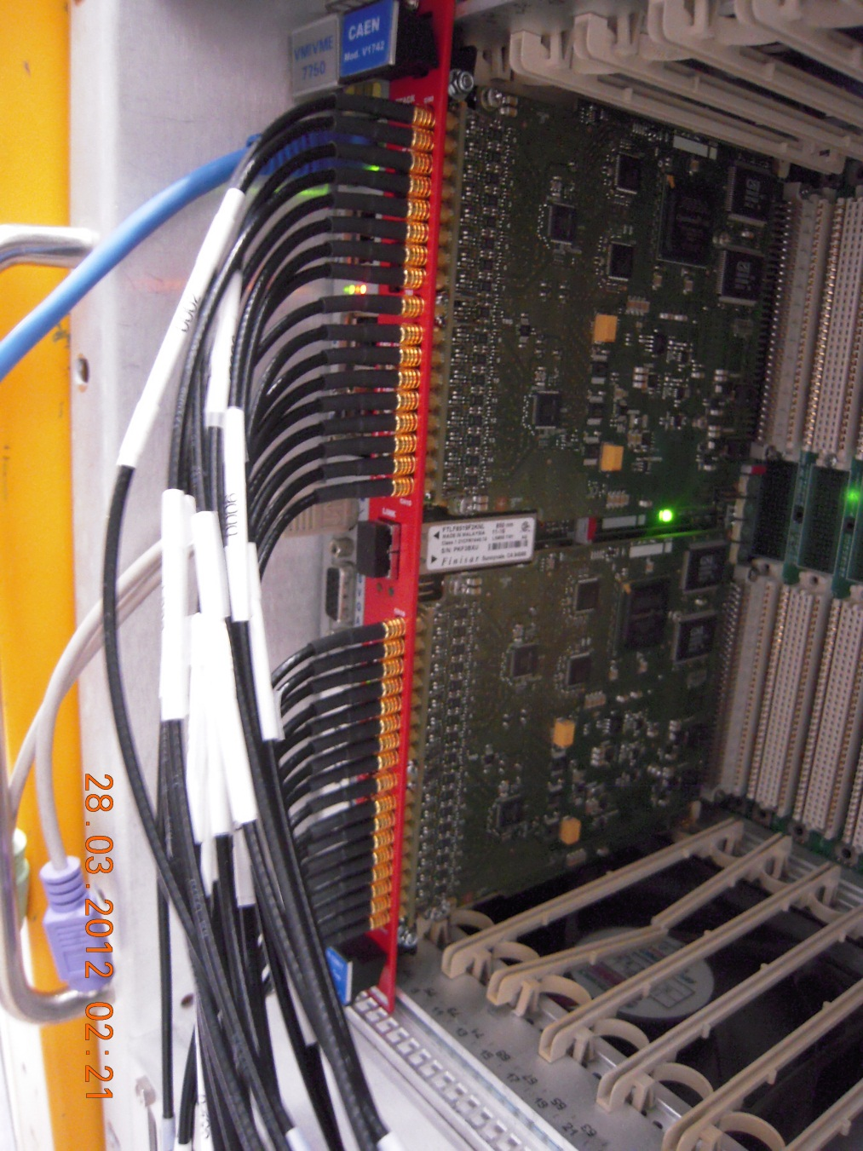
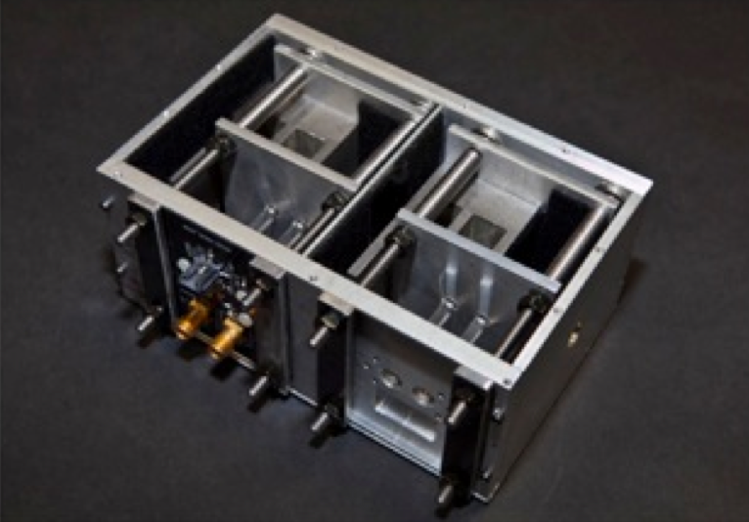
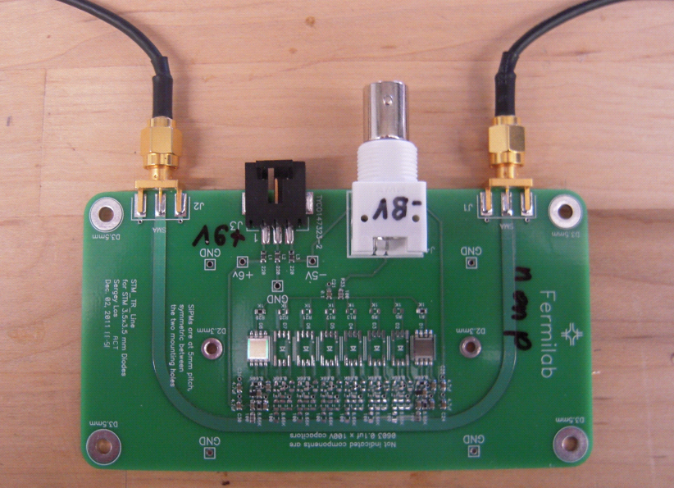
SiPM’s for Time-of-Flight and Calorimetry
Silicon PhotoMultipliers are multi-pixel avalanche photodiodes. Pixel sizes on the order of 50 microns and avalanche regions at the micron level.
Theoretically, they could be one of the fastest particle detectors for HEP (<16 psec seen at FNAL).
Fermilab has been studying their potential for TOF and calorimetry for many years. Designs developed at FNAL to be used in FP420 forward tracking at CMS.
DAQ techniques supported by KA25 are being used in Proton Computed Tomography with NIU
Recently we received a U.Chicago ‘seed’ grant to apply these techniques to PET-TOF.
Transmission line readout suitable for reading 8 separate SiPM’s
Example of one geometry of quartz bars and SiPMs for CMS forward region
CAEN 1742 module digitizes at 5 Gs/s. Good for timing and energy measurement

Slide 25
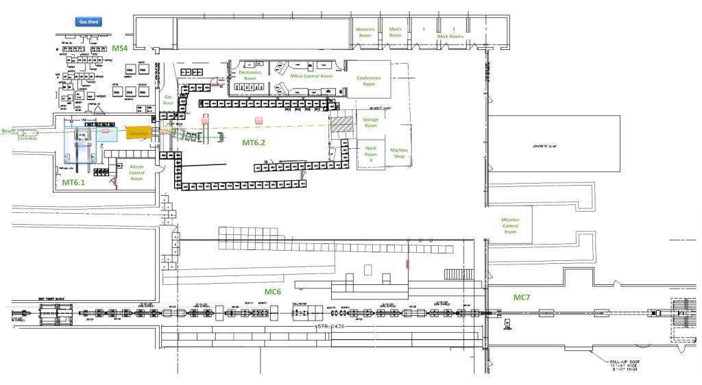
MCenter Beam as part of the Fermilab Test Beam Facility
Tertiary beam moved to MC7
The electronics and control room in the MWest stub
Installed cable
route for users
Walkway to access MC7
This section of pipe has been removed. Tertiary spectrometer for LariaT is here.
Can put another user area near JGG

Slide 26
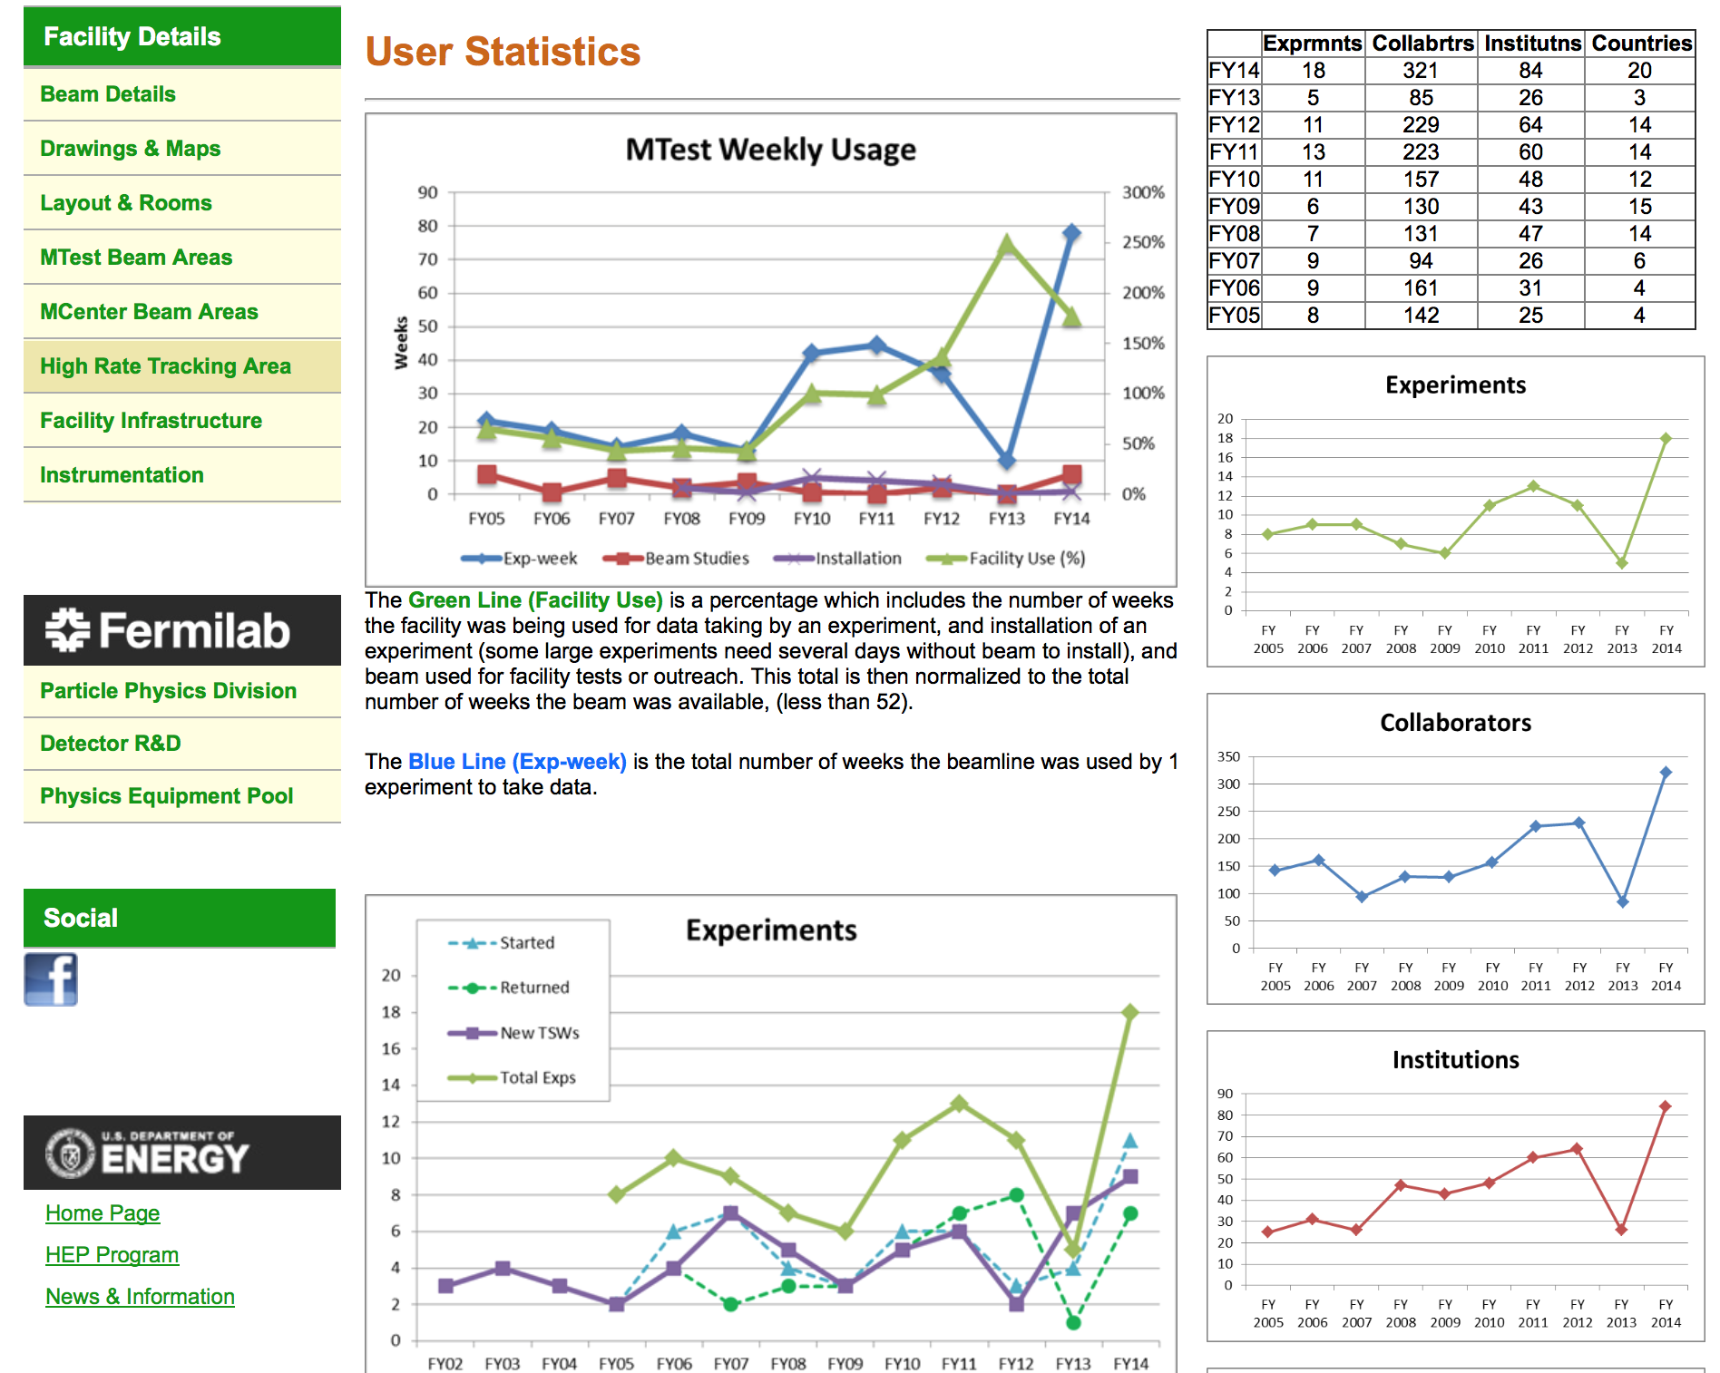

Slide 27
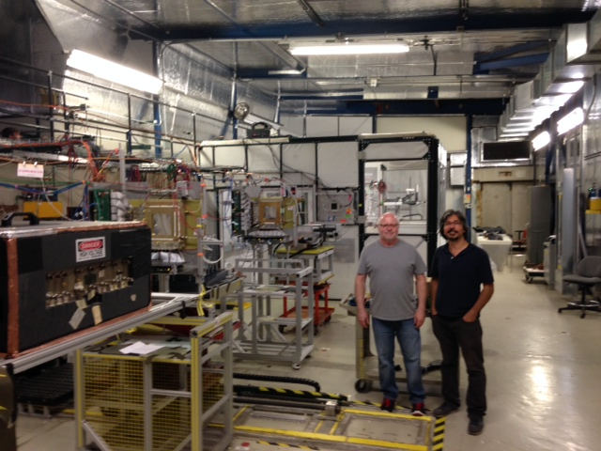
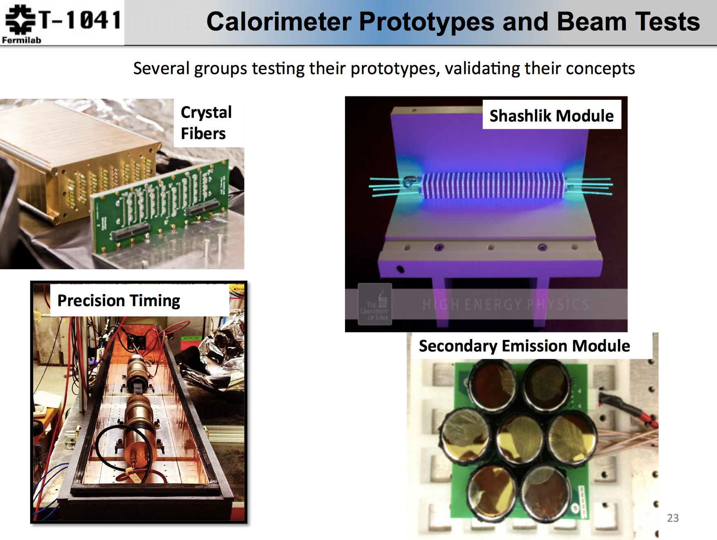
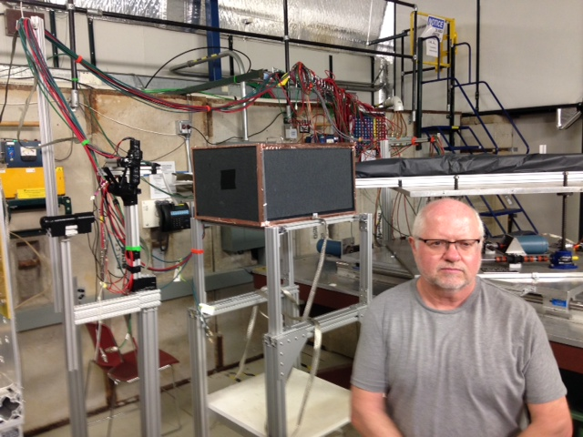
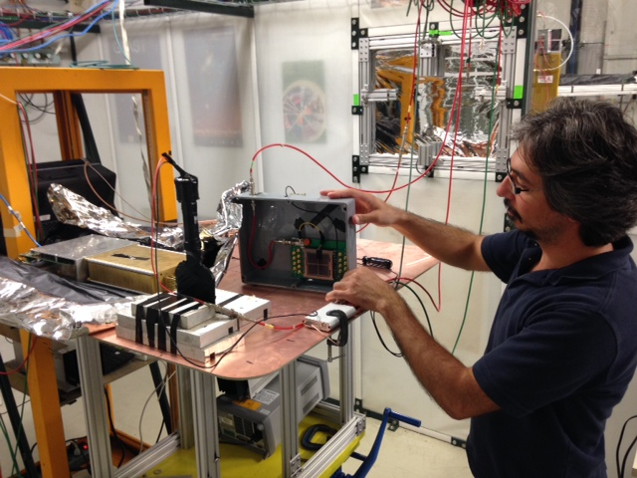
A Day at FNAL Test Beam
Section 2 of the Fermilab MTest beamline
8/11/2014
Jim Freeman new rad-hard scintillator studies. Behind him is TTU fiber based dual readout
Burak Bilki w/ new ANL MCP. Also studying new scintillators.

Slide 28
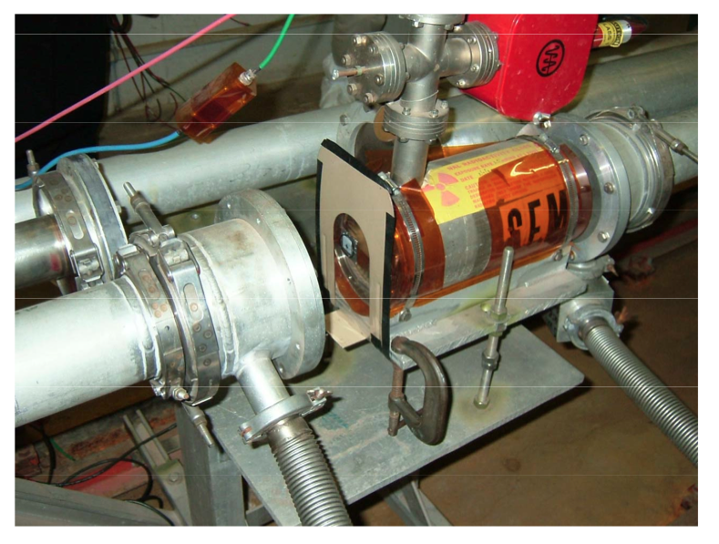
MTest irradiation areas
Have several areas in MTest beamline where high rate studies can take place:
  M01 has access to primary 120 GeV proton beam at 1E11 per minute.
  A high rate tracking area with flux of about 1E10 is set up in MT3
  Near primary target in MT4 you can have a mixed field of radiation that simulates conditions in the LHC halls, for instance.
    (Calculated dose for a Si sample irradiated @ 30 cm away from the aluminum target and pinhole collimator is ≈ 1.2E4 and ≈ 4.5E3 Gy/yr, respectively (very similar to LHC cavern)
Al Target
Beam Dump
These high radiation areas need further development to have regular use

Slide 29
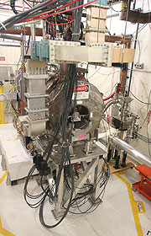
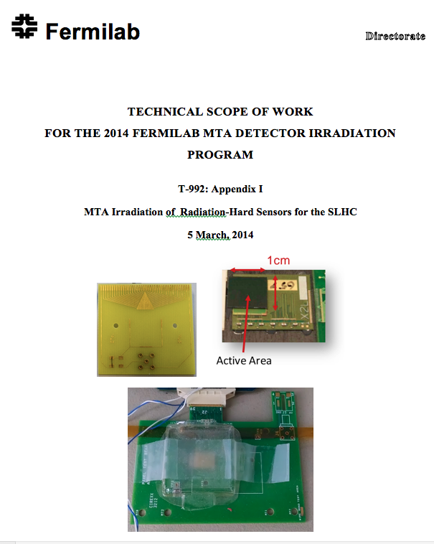
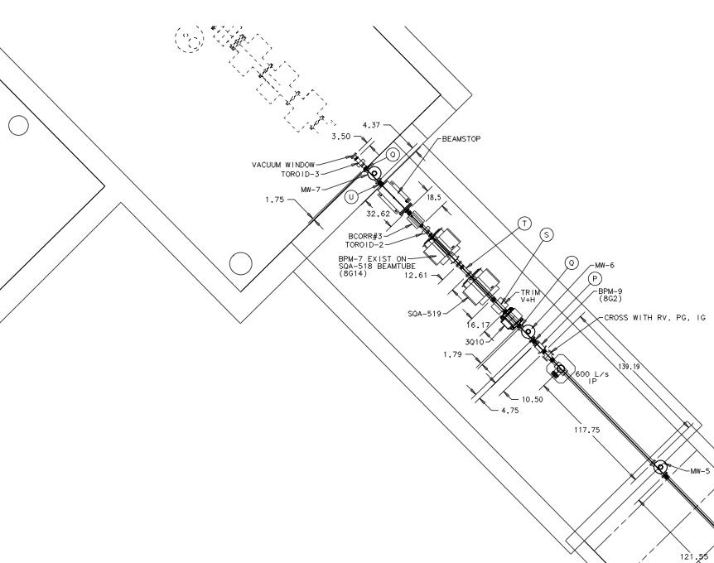
Investigating New Detector R&D Irradiation Capability at MTA in LINAC
The MTA experimental hall has accepted beam. (400 MeV protons)
It is possible that we will be able to perform detector irradiation studies there. Safety and scheduling issues being studied.
The MAP group has installed a table for supporting detector installations
Flux as high as 10¹⁴ / hour in the experimental hall
First Statement of Work submitted
Stand for beam stop, collimator and detectors already placed upstream of solenoid
Is this resource useful to the community?

Slide 30
Summary
Fermilab has based its detector R&D organization on a “Detector Advisory Group”, consisting of representatives of the major detector efforts.
R&D efforts have been centered on several major portfolios, linked to the highest priorities of HEP:
  Collider tracking and triggering
  Liquid argon detectors for neutrino and dark matter experiments
  High speed calorimetry and photodetection
  Astrophysics dark matter/dark energy
Fermilab’s resources, facilities and collaborations are crucial in detector research and testing
From the P5 report, detector R&D is shifting to a more project- directed approach
We should make sure that Fermilab detector program responds to the needs of CMS Phase II upgrades

Slide 31
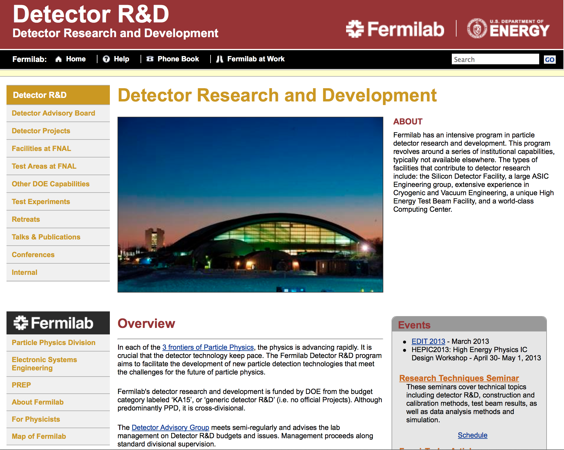
Our web site has links to our detector organization and facilities, as well as links to the EDIT school and our detector retreat and reviews:
http://detectors.fnal.gov
Useful Email:
FNAL detector point-of-contact:
ramberg@fnal.gov
Detector Advisory Committee:
detector-advisory@fnal.gov
Detector R&D mail list:
detectors@fnal.gov
Test beam users:
test_beam@fnal.gov

Slide 32
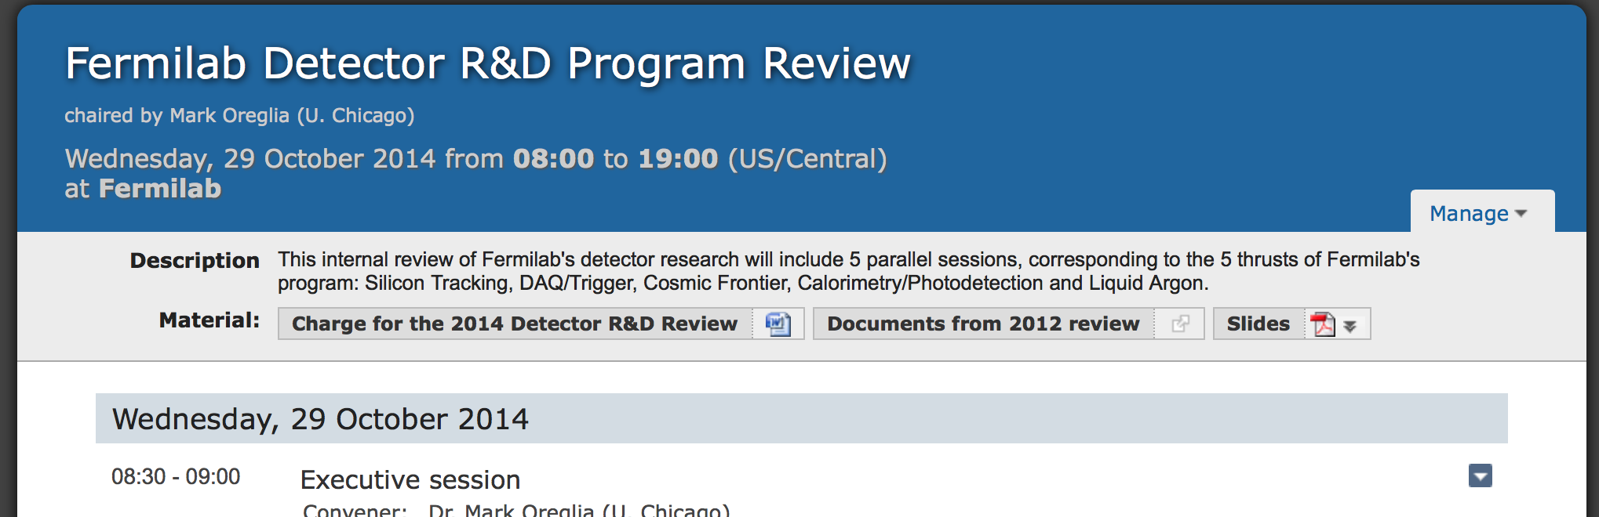
indico.fnal.gov/event/DetectorR&DReview

