Slide 1
Creating a reliable source of pure low-radioactivity argon
Henning O. Back – Princeton University
Fermilab Detector R&D Review

Slide 2
Atmospheric Argon Limit
Atmospheric Argon (AAr) | Underground Argon (UAr)
Contains beta emitter ³⁹Ar at a concentration of 8x10⁻¹⁶ Produced by cosmic ray neutrons Radioactivity of AAr = 1 Bq/kg | Hidden from cosmic rays Concentration of ³⁹Ar is at least 150 times less than AAr Radioactivity of UAr < 7mBq/kg ref. (arXiv:1204.6011)

Slide 3
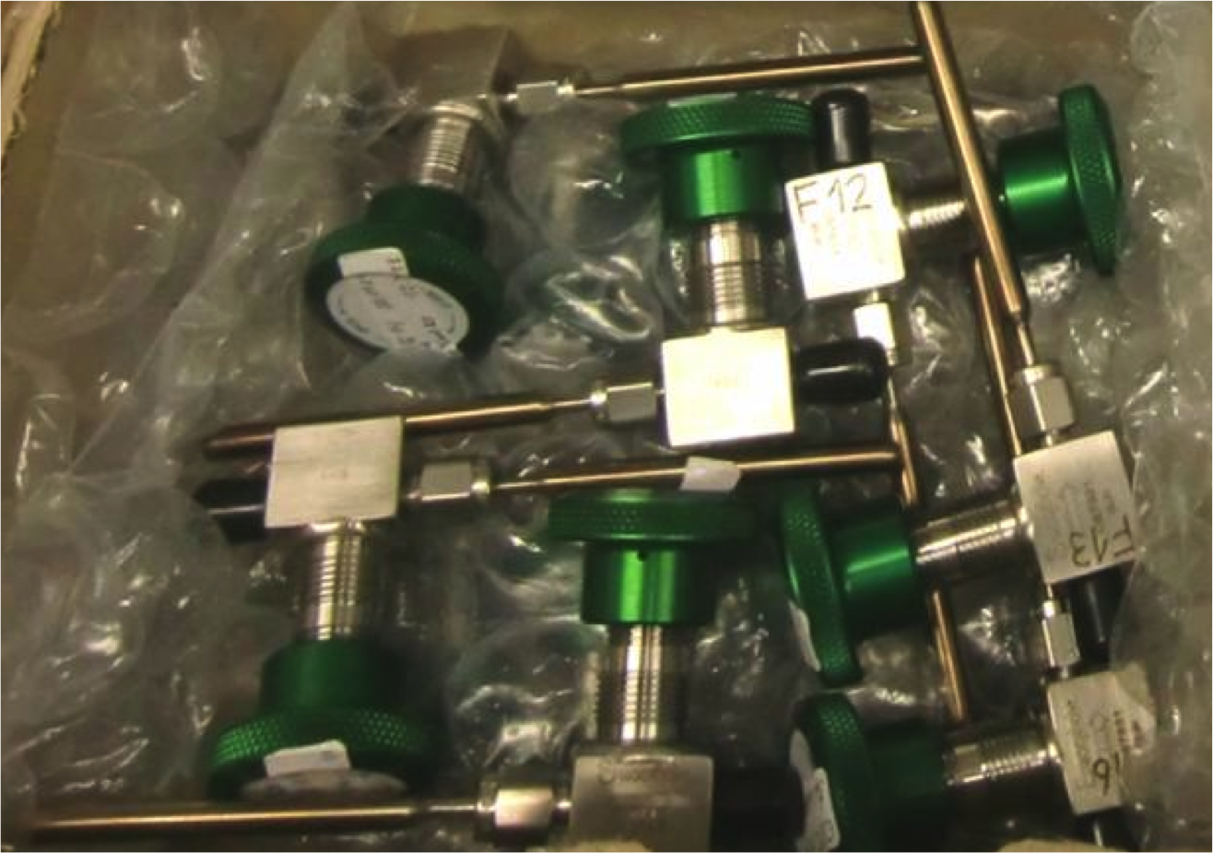
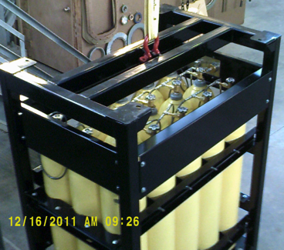
Low-radioactivity Argon is a National Resource
Radio-dating gas samples
Sole supplier of UAr to programs requiring low radioactivity argon
  Dark matter
    DarkSide – 152 kg target
    DEAP – No UAr
  Low-level radioactivity detection
    Argon radiometric dating (calibration gas)
      Argonne – ATTA
      Heidelberg, Germany – ATTA
      Bern, Switzerland – gas proportional counters(?)
    National Security
      PNNL – gas proportional counters
Inches
Our gas – 10 racks 4000 psi each
Feet

Slide 4
Terrestrial argon sources
As I understand them
Atmosphere (³⁹Ar/⁴⁰Ar = 8×10⁻¹⁶)
⁴⁰Ar comes from ⁴⁰K decay
Atmosphere
  ³⁹Ar produced by cosmic ray neutrons
  ⁴⁰Ar(n, 2n)→³⁹Ar
Crust
  No cosmic rays
  Neutrons from U and Th
Mantle
  Very low U and Th
  Lowest ³⁹Ar levels
Crust – 1ppm U and Th (low ³⁹Ar)
Mantle
Low U and Th
(lowest ³⁹Ar)

Slide 5
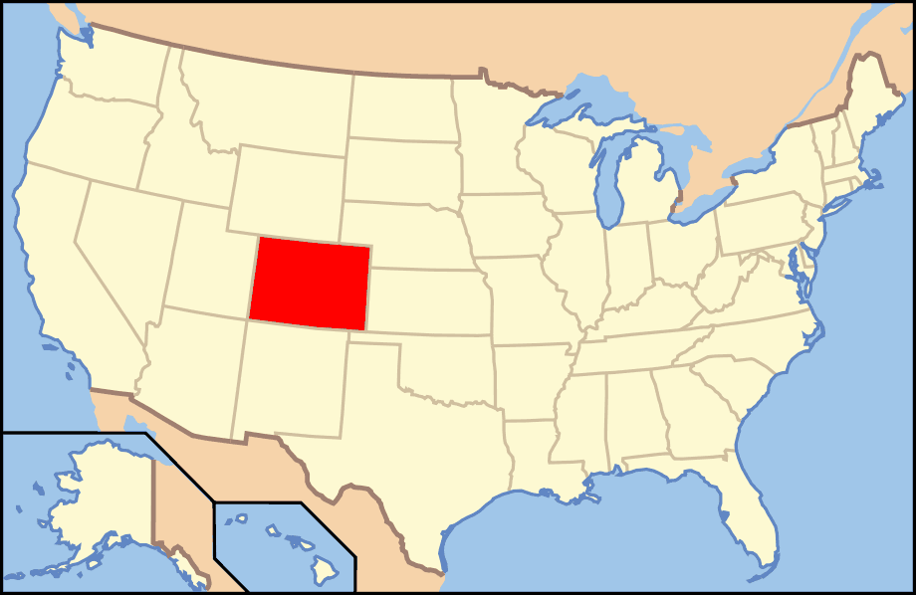
CO₂ well in SW Colorado
There are geological formations that trap gases underground
We found CO₂ well in SW Colorado (near Cortez)
Contains ~500 ppm Argon
³⁹Ar activity < 0.65% of atmospheric argon
(arXiv:1204.6011)

Slide 7
Getting to the underground argon

Slide 8
Getting to the argon
Extraction
  In Colorado we extract a crude argon gas mixture (Ar, N₂, and He)
Purification
  The gas from Cortez is then sent to Fermilab for further purification

Slide 9
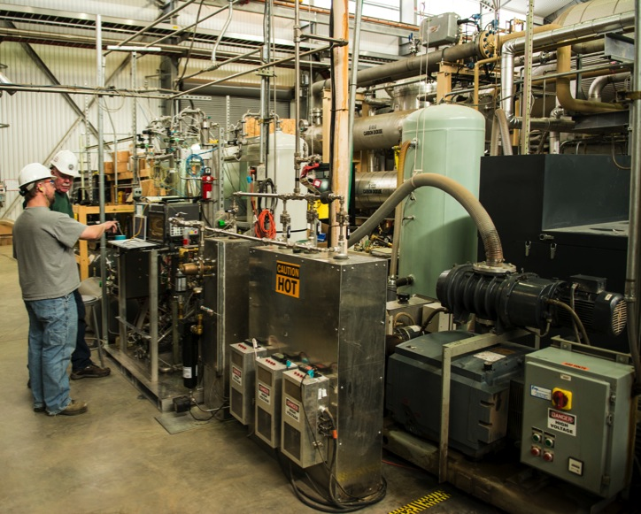
Underground Argon Source
Carbon Dioxide well in SW Colorado
  contains ~500 ppm argon
Princeton operates an extraction plant to produce crude argon mix from CO₂
Crude mix:
  Argon (3-6%)
  Helium (85-95%)
  Nitrogen (1-10%)
  Trace contaminants
    CO₂
    CH₄
    C₂H₆
    C₃H₈
    …
Gas is shipped to Fermilab for further processing and purification

Slide 10
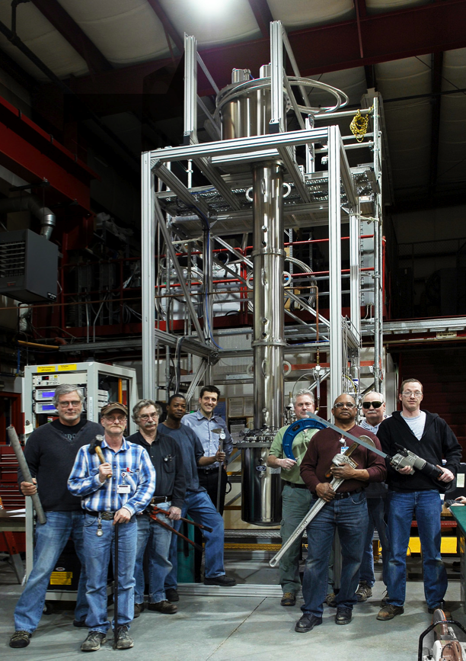
Purification at FNAL
The 2010 plan – commissioned Oct. 2011
Transportation cylinder racks
Cryogenic Distillation Column (CDC)
Booster
Input
Product
Waste
Great Initial Success
First commissioning with atmospheric argon (from Airgas)
  input mix: 6% Ar, 55% He, 44% N₂
  output: 100% Ar, <500ppm N₂

Slide 11
First Underground Argon (UAr) purification
Fall 2012
Processed 500k liters gas (at STP)
Reached 99.7% pure argon (12.3 kg)
Issues:
  Different gas mix stalled distillation – High He content
  Gas flow stopped abruptly – Clogging from impurities
  Very slow – Not enough cooling
  Never reproducible – Not without large UAr losses
  Column flooding – Column too small

Slide 12
The early 2014 issues
Methane contaminated gas ← kills scintillation light
  Actually an old problem (from early VPSA operations)
  BUT, need to recover this gas to make up for losses
Oxygen contaminated gas ← kills electron drift
  Increased production at VPSA plant to make up for losses
  Production increase came with Oxygen contamination

Slide 13
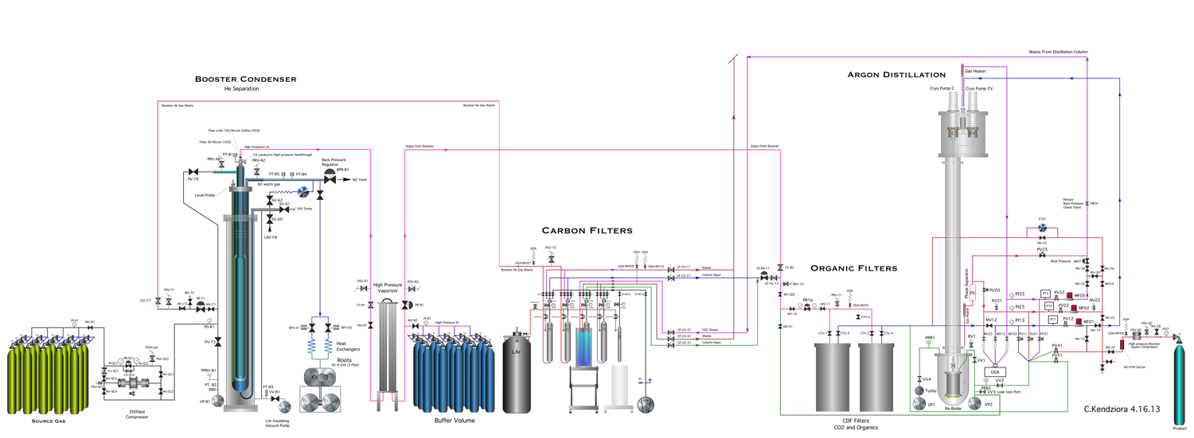
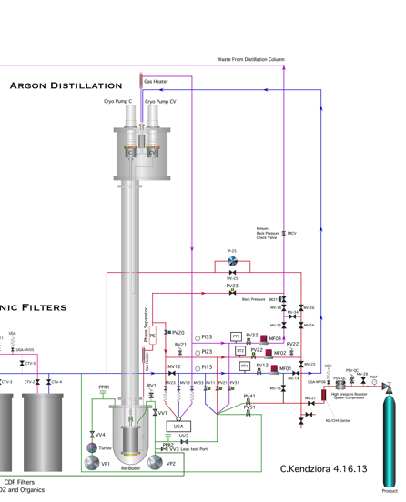
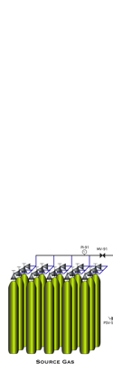
Plant Expansion

Slide 14
Plant systems
Oxygen
Gettering
Helium Separator
Waste Stream Argon Capture
Contaminant Freeze Out
Distillation

Slide 15
Plant systems simplified
Issues #6
Distillation to remove Methane
Vent
Recover UAr from He
Waste
Booster
CB
Charcoal Trap
(CBCT)
Storage
Product
Input
pumped out
Booster
Transportation cylinder racks
Waste
Waste
Condenser
Product
Condenser Booster Helium Separator
(CB)
Buffer Volume
CDF Organics Cold Traps
Oxygen Getter
Cryogenic Distillation Column (CDC)
Input
Product
Input
Product
Input
Product
Input
Issue #1
Removes helium
Issue #2
Removes freeze-out Impurities
Issue #7
Removes Oxygen
Reboiler
Vent
Issues #3,4, & 5
Distillation Column repairs and upgrades
Colorado gas
3-6% Ar, 1-10% N₂, 85-95% He
After He separation
order-of: 40% Ar, 60% N₂
Final Product
~100% UAr

Slide 16
Where we stand with UAr mass
UAr cylinders mass total – 106.4 kg
UAr mass waiting for purification
  in buffer waiting for Distillation Column – 18.3 kg
  extracted in Colorado waiting for shipping – 5.3 kg
Mass requiring reprocessing – 75.0 kg
  recovered from CH₄ and O₂ distillation
  emergency recoveries
  did not effectively remove N₂ or O₂
  TOTAL UAr MASS – 152.5 kg
  152 kg required for DarkSide-50

Slide 17
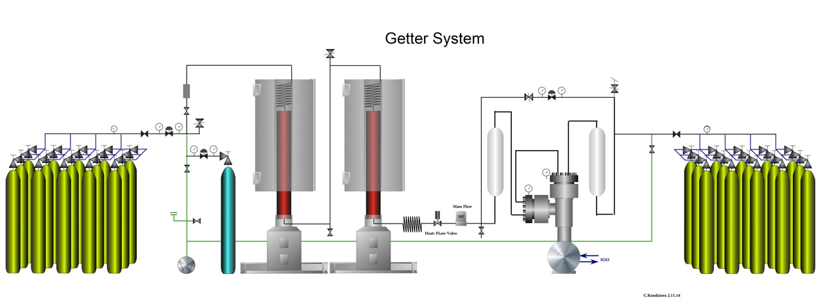
Final Polishing
UAr requires final polishing to become detector grade
Using heated Zirconium getters from SAES
1 getter column is enough for our estimated contamination levels (second is backup)
We will run all the UAr through the getters at one time
Under construction ← expected ready for operation 1 month
Typical contamination in all UAr cylinders
Contaminant | Concentration
CO₂ | 25 ppm
CH₄ | 114 ppm
N₂ | 80 ppm
O₂ | 250 ppm
All gas analysis performed by Pacific Northwest National Lab

Slide 18
Verifying UAr detector usability
Could there be a contaminant that makes it through all purification steps and is below our sensitivity?
Verify our UAr can scintillate and drift e⁻ - before putting into DarkSide50
Using Scene-LAr detector – small dual phase TPC
  Discussion to come – Hugh Lippincott

Slide 19
Schedule and conclusions
Schedule for Darkside-50 UAr target
  Production and validation of DarkSide target by end of year
Conclusions
  A reliable source of low-radioactivity argon has been established
  Extraction and purification of the UAr is possible on a large scale
  However, there have been issues along the way
  AND, we still have not shown that our UAr is detector grade
Future
  DarkSide would like to expand to a 1+ ton detector
  DEAP-3600 target (?)
  G3 argon detector
    single or dual phase
    50 ton (?)
  Need 100 kg/day source --- negotiations with Air Products
    In 2015 Air Products will extract He from the same CO₂
>150 kg UAr collected
The world’s supply

Slide 20
Future
UAr consumers:
  DarkSide would like to expand to a 1+ ton detector
  DEAP-3600 target (?)
  G3 Dark matter Argon detector
    single or dual phase?
    50 ton (?)
  Continuous consumer: low level radiation detection ← negligible amounts
Bottom Line: We need 100 kg/day purified UAr
  Negotiations with Air Products to extract UAr from new He plant
  (In 2015 Air Products will extract He from the same CO₂ as we are using)
  What can they provide us?
    Pure UAr?
      Almost certainly not
    UAr-N₂-O₂ mix? – Will there be CH₄?
      Current R&D to produce DarkSide-50 target has been invaluable
      Build on current experience to create new plant – further R&D required
  Are there other sources of low radioactivity argon? ← requires further investigations

