Slide 1
Overview of
Fermilab Detector
Research and Development
29 Oct. 2014
Erik Ramberg
Fermilab

Slide 2
Why are we doing this review?
Mid-course review to make sure we are addressing the correct mix of programs, according to Snowmass and P5, We will try to cover:
  R&D that has made transition to experiment funding
  Review of progress during last 2 years
  New R&D proposed
Prelude for summer 2015 DOE review
  How well are we collaborating?
  Are we using funding sources effectively?
  Are our facilities adequate and being used appropriately?
Improve communication/documentation

Slide 3
Charge to Committee
We request that you assess the quality and impact of Fermilab detector R&D efforts conducted in the last several years and to assess the merit, feasibility and alignment of proposed activities with the Snowmass vision and P5 recommendations for the U.S. detector R&D program. In particular we request that you:
1. Evaluate the impact and promise of the group’s research efforts in detector R&D:
a. The quality and impact of the Detector R&D by the group in the past two years.
b. The scientific significance, merit, and feasibility of the proposed future program and the competence and promise of the group for carrying it out.
c. The adequacy of resources for carrying out the proposed research, and cost- effectiveness of the research investment
d. How well do the group’s proposed activities align with the Snowmass vision and P5 recommendations?
2. Assess how effectively the detector R&D effort has exploited and leveraged existing facilities at Fermilab and the importance of these facilities to the future proposed program of work. Evaluate whether additional facilities are needed.
3. Evaluate Fermilab’s status and plans for collaborative efforts with universities, other national labs, and industry, in the general areas of detector R&D and technology transfer. Has Fermilab been effective in maintaining and seeking out additional partners for collaborative research?

Slide 4
Committee members
The committee members are as follows, with their parallel affiliation:
  Cosmic frontier detectors: Jeter Hall (PNNL); Dan Akerib (SLAC)
  Silicon tracking Paul Grannis (Stony Brook); Alex Grillo (UCSC)
  DAQ& Trigger: Mark Oreglia (U.Chicago); Henrik Van Der Lippe (LBNL)
  Calorimeter&Photodetector: Jose Repond (ANL); Chris Tully (Princeton)
  Liquid Argon: Hanguo Wang (UCLA): Bo Yu (BNL)
Representatives from 5 national labs and 5 universities
Encourage questions about any part of the program, not just the parallel thrust you’ve been asked to review.

Slide 5
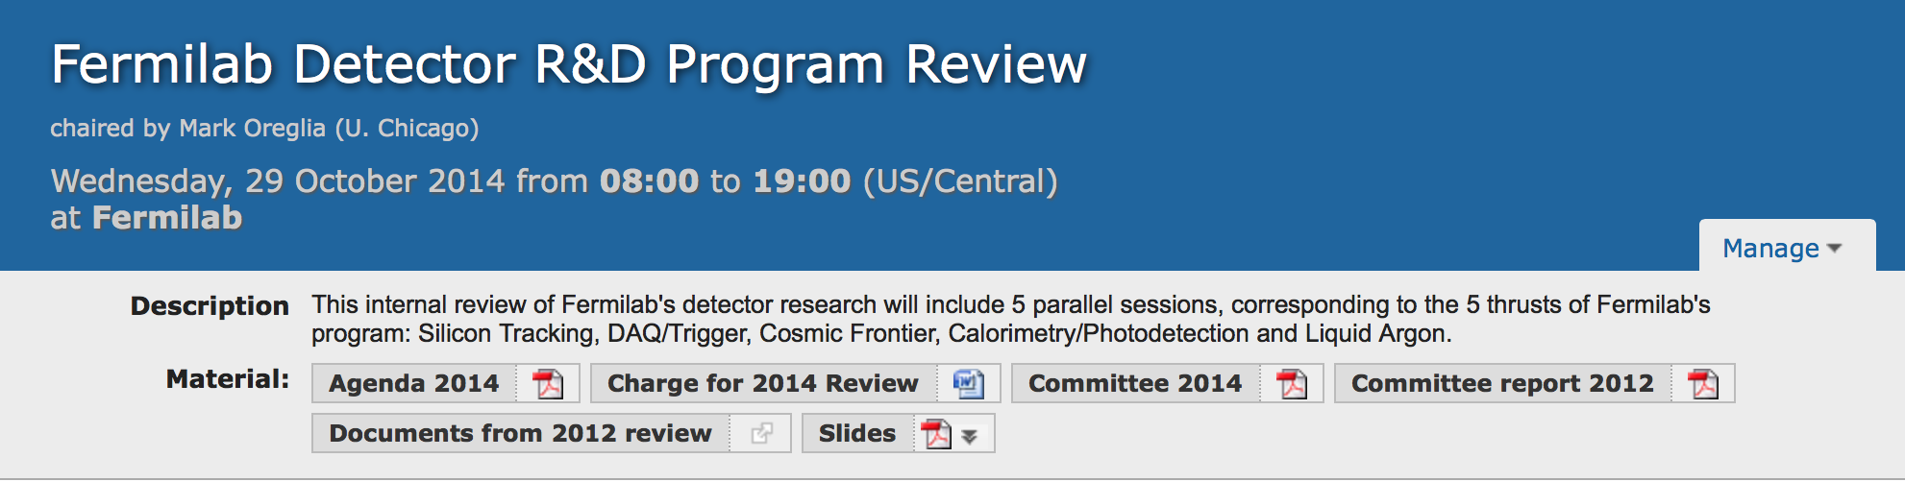
indico.fnal.gov/event/DetectorR&DReview
Documents from
2012 review
Account=‘reviews’
Password=‘detector_reviews’
Slides from
2012 review
Committee report from 2012

Slide 6
Agenda
8:30 Executive Session (Mark Oreglia)
9:00 Introductions (Greg Bock)
9:15 Overview (Erik Ramberg)
9:50 Coffee
10:00 Executive Session (Mark Oreglia)
10:30 Parallel Sessions:
  Cosmic Frontier (Juan Estrada)
  DAQ/Triggering (Alan Prosser)
  Collider Silicon (Ron Lipton)
  Calorimeter / Photodet. (Jim Freeman)
  Liquid Argon (Stephen Pordes)
12:50 Lunch
13:30 Executive Session (Mark Oreglia)
14:00 Directed R&D & Future (Peter Wilson)
14:30 Facilities (Eric James)
15:00 Transitions (Erik Ramberg)
15:30 Coffee
15:40 Executive Session (Mark Oreglia)
17:00 Closeout

Slide 7
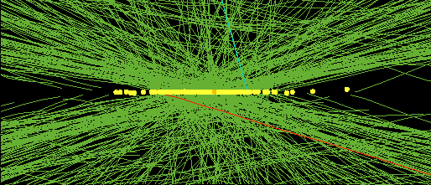
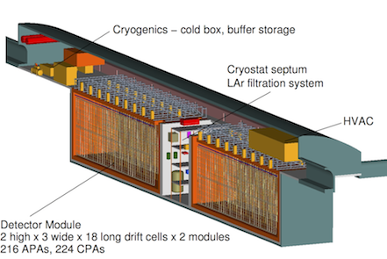
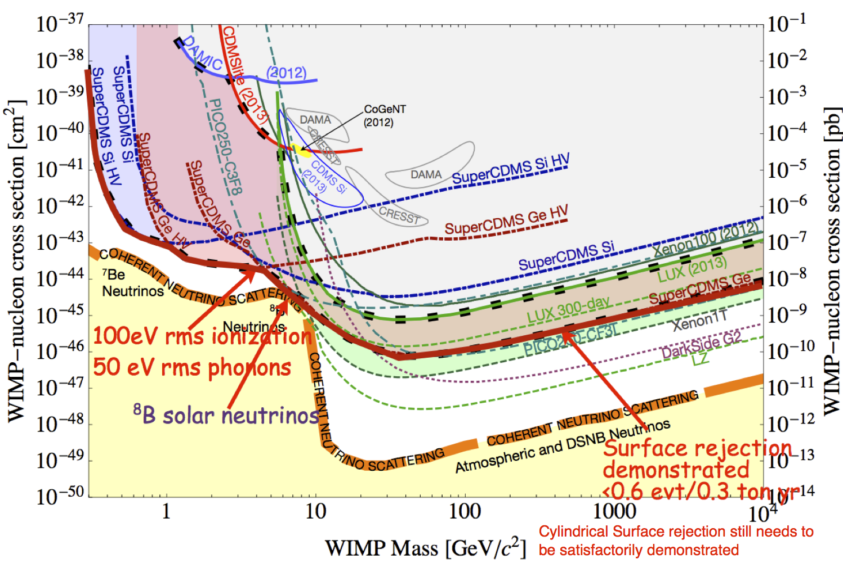
Priorities in the Frontiers of Detector R&D
Energy Frontier:
  Vertex sensors will have to withstand a total fluence of 10¹⁶ particles/cm²
  At full luminosity, several hundred overlaid events per 25 nsec crossing will make current triggers untenable
  For future lepton colliders, jet resolution of 3% required h
Intensity Frontier:
  LBNF will require high-performance, low cost multi-kton liquid Argon TPC’s
  Rare decays and interactions of Giga-Hz beams will require the lowest masses achievable
  Ultra-fast timing (~10 psec) photodetectors, trackers and calorimetry will become the norm
Cosmic Frontier:
  Dark matter detectors will need background levels of less than 1 nuclear recoil per ton per year
  Spectrophotometry of large sky surveys will need new methods to efficiently measure red-shifts in coincidence with position.
  Need low noise arrays of 10⁵ microwave sensors for CMB
Fermilab has a set of portfolios of detector research projects that are designed to meet these priorities
Erik Ramberg - Review of Fermilab Detector R&D, Oct. 29, 2014
Page 7
7

Slide 8
Comments from Snowmass and P5 on Detector Research and Development
From the Snowmass Instrumentation Working Group
  A stably and adequately funded generic instrumentation program with a balanced portfolio of risk, opportunities for young physicists, and a dedicated portion of the HEP budget is essential. It will ensure that the field invests in its future, and establishes a foundation for a competitive, healthy program for the long term
From the P5 report:
  Recommendation 27: Focus resources toward directed instrumentation R&D in the near-term for high-priority projects. As the technical challenges of current high-priority projects are met, restore to the extent possible a balanced mix of short-term and long-term R&D.
  Recommendation 28: Strengthen university-national laboratory partnerships in instrumentation R&D through investment in instrumentation at universities. Encourage graduate programs with a focus on instrumentation education at HEP supported universities and laboratories, and fully exploit the unique capabilities and facilities offered at each.

Slide 9
Fermilab Detector R&D Organization
The “Detector Advisory Group” consists of: (PPD unless otherwise noted)
  Technical Point of Contact Erik Ramberg (PPD)
  Silicon tracking representative Ron Lipton (PPD)
  DAQ and Triggering representative Alan Prosser (SCD)
  Calorimetry and photodetection rep. Jim Freeman (PPD)
  Liquid Argon R&D representative Stephen Pordes (ND)
  Astrophysics detectors rep. Juan Estrada (PPD)
  Intensity Frontier representative Bob Tschirhart (SCD)
  Head, Particle Physics Division Patty McBride (ex-officio) (PPD)
  Assoc. head for Engineering Eric James (ex-officio) (PPD)
  Head, New Initiatives R&D Dave Christian (ex-officio)
  Scientific Computing Panagiotis Spentzouris (ex-officio) (SCD)
  External Representative) Ulrich Heintz (Brown University)
The group meets twice a month and monitors and reports on the activities in each of their portfolios.
Members give advice on the future of the program and participate in reviews of projects in each portfolio
TPOC informs the Division Heads and Offices of Research and Computing of plans arising out of group discussions and reviews.
After consultation with DOE, Division Heads and CRO then decide on approval of new directions
Erik Ramberg - Review of Fermilab Detector R&D, Oct. 29, 2014
9

Slide 10
Portfolio’s of R&D projects are overseen by the Detector Advisory Group

Slide 11
Fermilab scientists involved in detector R&D
Ornella Palamara
Adam Para
Stephen Pordes
Erik Ramberg
Brian Rebel
Mitch Soderberg
Andrew Sonnenschein
Michelle Stancari
Chris Stoughton
Bob Tschirhart
Peter Wilson
Jonghee Yoo
Bradford Benson
Flavio Cavanna
Aaron Chou
David Christian
Carlos Escobar
Juan Estrada
Jim Freeman
Ashutosh Kotwal
Hugh Lippincott
Ronald Lipton
Ted Liu
Anna Mazzacane

Slide 12
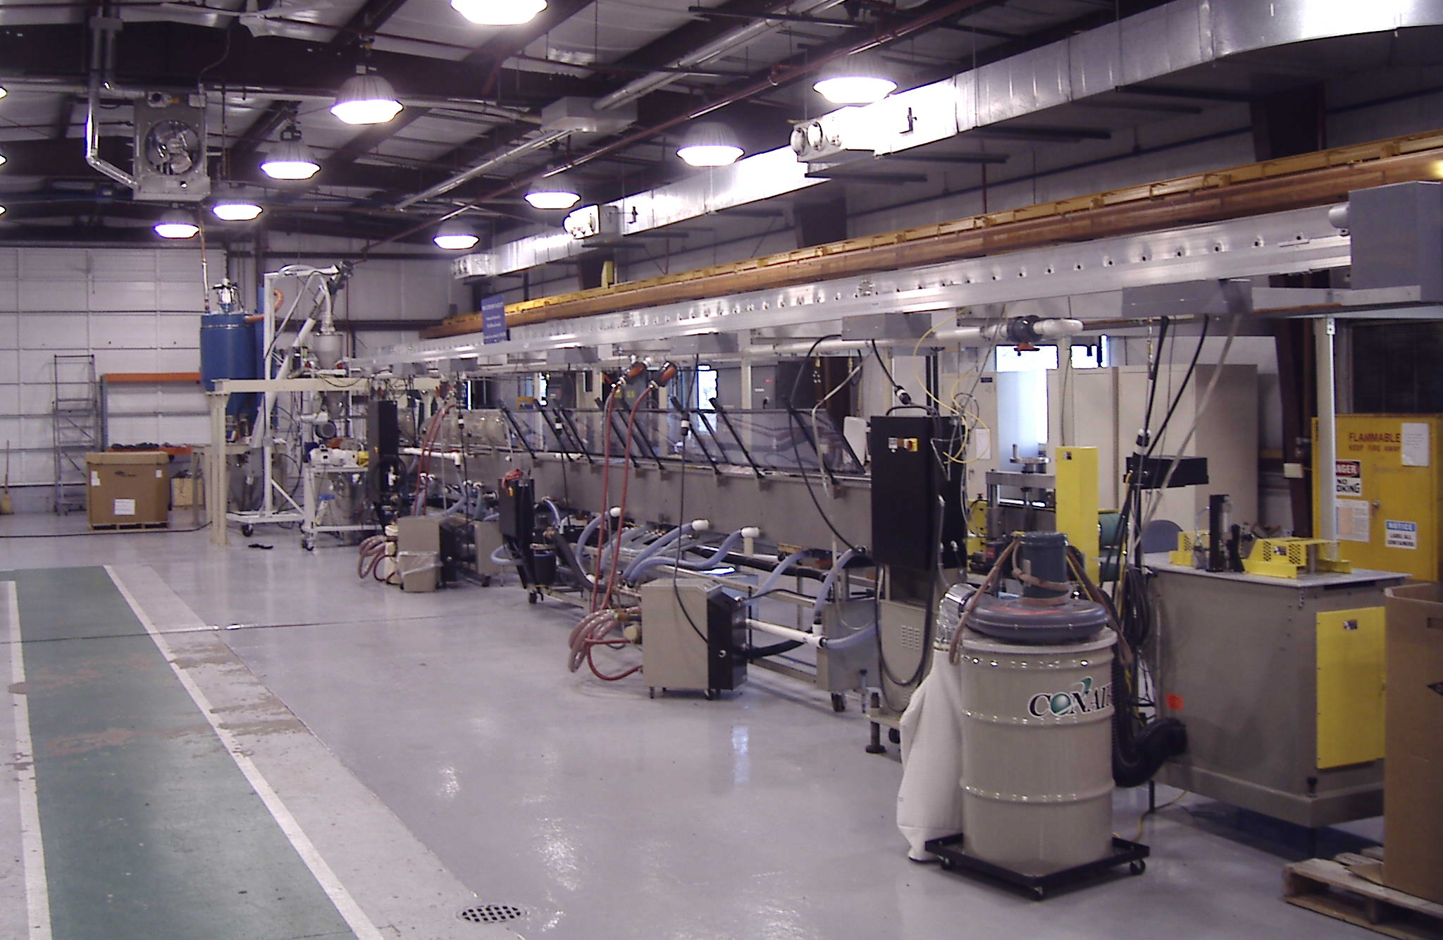
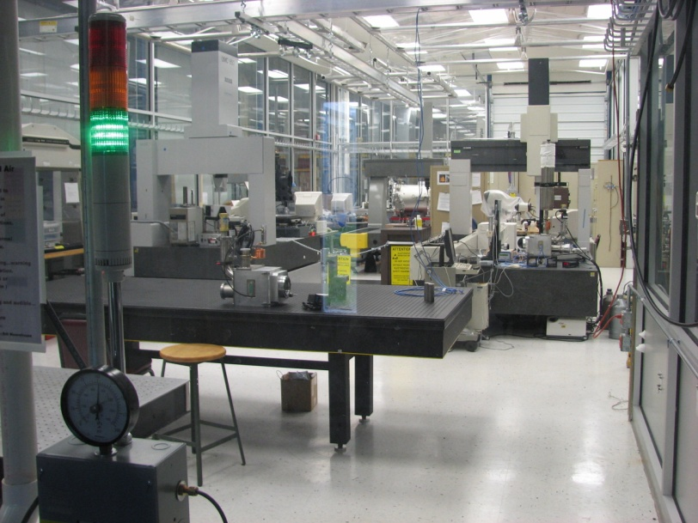
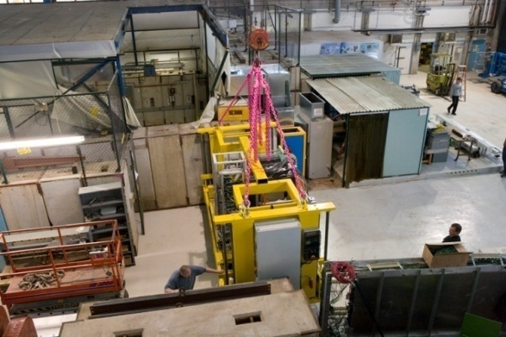
Fermilab Assets for Detector Research
Detector R&D program at Fermilab is enabled by our institutional strengths:
  Presence of research facilities such as:
    Test beam facility
    Silicon Detector facility
    Precision Metrology facility
    Rapid prototyping and Special Materials
    Scintillator Detector Development
    Thin-Film Facility
    Liquid Argon Test Facility
    ASIC Development Facility
  Experienced, well established engineering groups, such as
    ASIC development
    Cryogenics
    Data Acquisition
  We encourage a high degree of collaboration with the university community and other national labs.
(See Eric James talk)
Scintillator extrusion at Lab 5
Clean rooms and metrology at SiDet
CALICE at the
test beam
Page 12

Slide 13
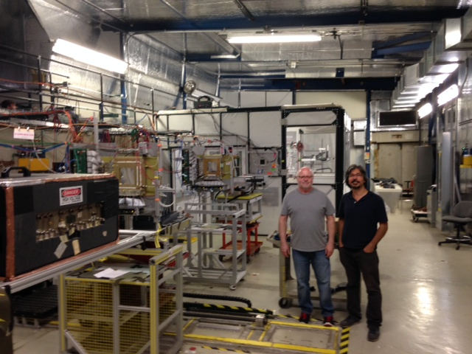
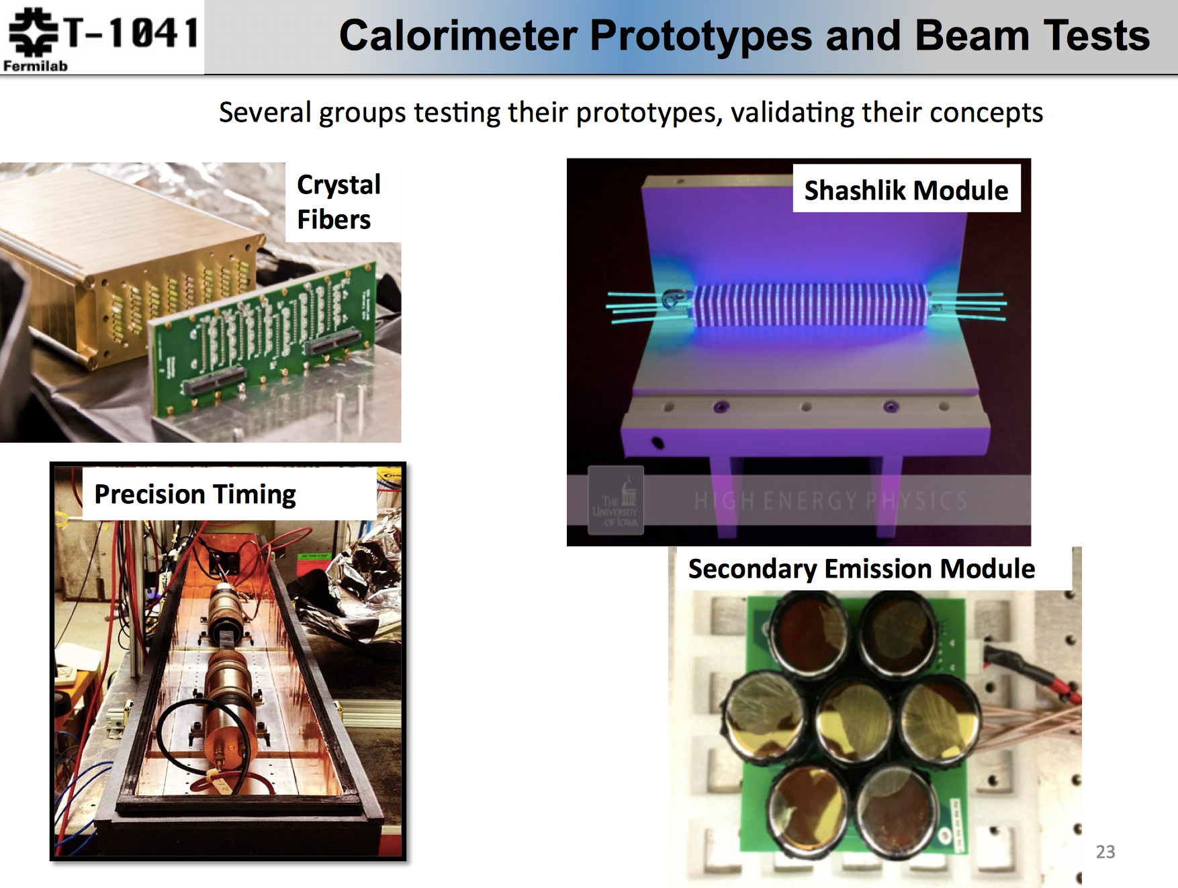
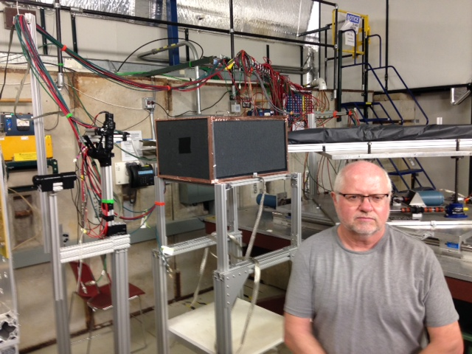
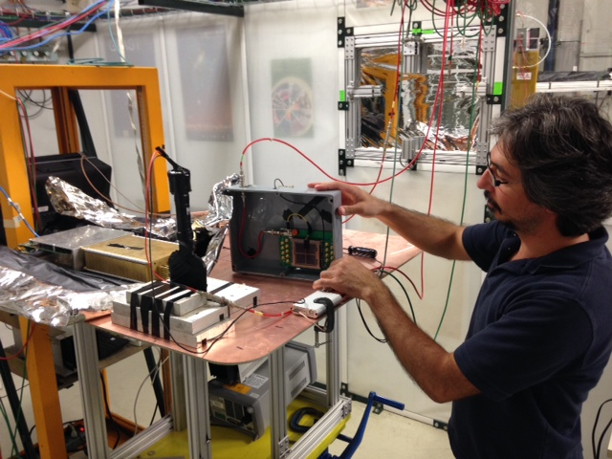
A Day at FNAL Test Beam
Section 2 of the Fermilab MTest beamline
8/11/2014
Jim Freeman new rad-hard scintillator studies. Behind him is TTU fiber based dual readout
Burak Bilki w/ new ANL MCP. Also studying new scintillators.

Slide 14
Silicon Tracking
(Managed by Ron Lipton)

Slide 15
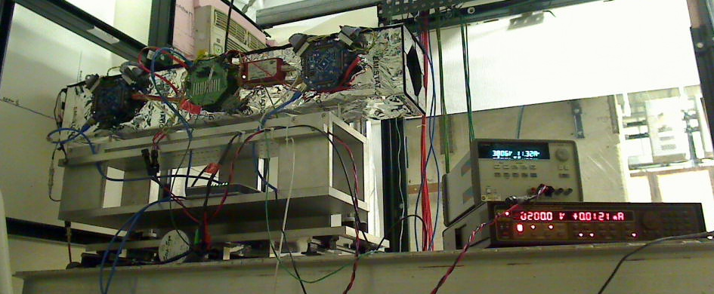
FNAL Provides Comprehensive Approach to Silicon Tracking, Triggering and DAQ R&D for Phase II upgrade of CMS
Creating a tracking and trigger system that can withstand the projected HL-LHC luminosities is arguably the most important detector challenge in the field of High Energy Physics.
There must be a comprehensive approach:
Sensor
Testing radiation hardness in new sensors (3D columnar + Diamond).
Sensor thinning and interconnects
15 US universities
19 foreign institutions
5 laboratories
8 industrial partners
Front End
Providing new readout for pixel detectors.
Low noise systems using 3D bonding
L1 Trigger
Track trigger using 3D techniques
Data Transmission
Multi-wavelength optical DAQ
Track Fitting
GPU’s and Associative Memory
Page 15
LLNL Visit - 24 January, 2012
15

Slide 16
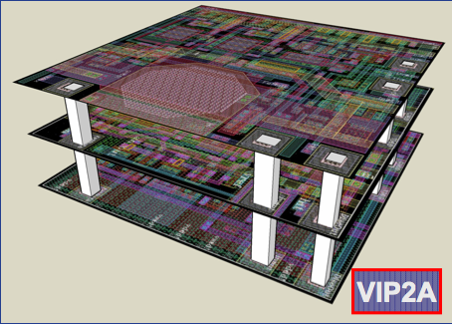
Transformative Capability of 3D Techniques in Integrated Circuits
Over the past several years we have
demonstrated the ability to:
Collaborate with commercial vendors to
build multilayer (3D) integrated circuits
with interconnection pitch of 4 microns
Bond the ICs to sensor and thin the two-layer circuits to 34 μm
Thin full sensor wafers to 50 microns and process the back contact
Reduce interconnect noise to ~0, reducing overall noise in fine pitch pixelated sensor by 2x
Build low mass support and cooling structures
We hope in the future to extend this to
8” thinned sensor wafers for CMS HGC and others
Low cost finely pixelated large area tiled arrays
3 tier 3D stack for FNAL ILC vertex chip, fabricated by MIT-LL

Slide 17
Some 3D Results
a
2 Tier VIP ILC vertex chip with CD¹⁰⁹ source
2x reduction in noise over bump bonding

Slide 18
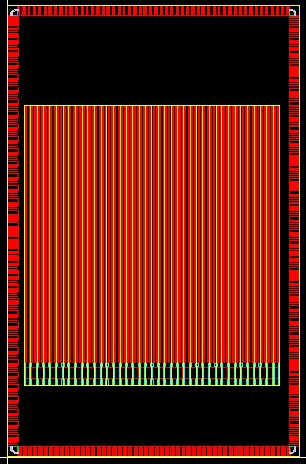
Silicon Pixel Detector Electronics R&D – RD53 (65nm CMOS)
120/60 PMOS
360/60 PMOS
unirradiated
1.1 Grad
1000/60 PMOS
240/60 NMOS
65nm test ASIC designed at FNAL
γ irradiation at -20C (w/Colorado at Sandia National Laboratory)
Small PMOS loses current gain.
Less damage than at room temp.
Test ROC designed (130nm CMOS) to demonstrate low threshold operation (<1000 e-) and facilitate sensor R&D.
30μ x 100μ pixels, staggered bump bonds, 4.8mm x 4.8 mm active area.
Chip tests will start in December
Notes:
Initial CERN (& later CPPM) rad damage testing of 65nm CMOS established it as the most likely technology for HL-LHC (most rad tolerant technology tested to date).
Biggest radiation effect is loss of drive current of small PMOS transistors; working on standard cells using PMOS 360/60 & bigger.
CMOS & ATLAS will run pixel detectors at ~ -20C (because SSDs will run at -20C to reduce leakage current).
Concern (last fall) w/in RD53 that damage at -20C would be worse than at room temp (because of what looks like room temp annealing in CERN & CPPM results).
That’s why we tested devices held at ~ -20C.
Rad testing has been done in collaboration w/Colorado group (Cumalat, Wagner); Colorado grad student (Michael Krohn) has played a large part.
Transistor characteristic curves show current in transistor (drain-souce current) as a function of gate voltage (gate-source voltage).
Almost no threshold shift observed (threshold is the gate voltage required to begin to turn on the transistor)
Significant loss of maximum current observed – similar to result with devices at room temperature, but much less severe (room temp 120/60 PMOS had lost >50% at 200 Mrad & was dead before 1 Grad).
NMOS curves stop at 877 Mrad because we destroyed that transistor before the next irradiation step.
Test ROC was designed in 130nm rather than 65nm for a number of reasons:
We’ve done other 130nm designs & we haven’t done 65nm designs yet (except for test chip which is just individual transistors)
Technology is similar enough so that design concepts can be tested & circuits translated to 65nm later
130nm is less expensive
We don’t yet have access to CERN-designed radiation tolerant 65nm design kit or agreement in place to design for CERN-sponsored MPW submissions.
Sensors have been built to match FCP130 & more are being built (“thin” (ish) silicon & 3D); will also test diamond sensors.

Slide 19
Triggering and Data Acquisition
(Managed by Alan Prosser)

Slide 20
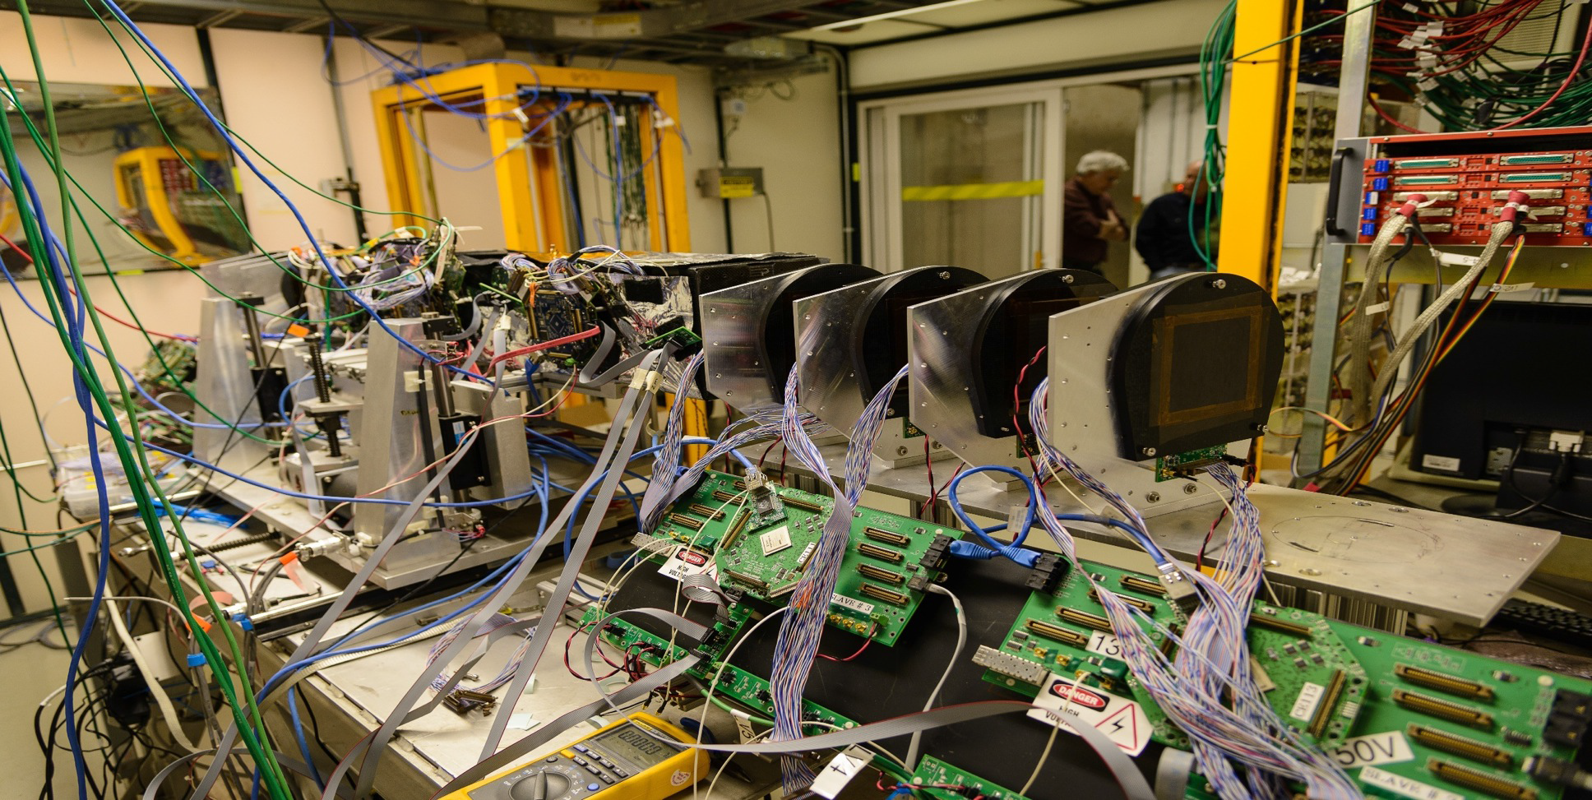
DAQ
Fermilab Test Beam Facility DAQ:
Old pixel telescope DAQ is based on CAPTAN
  Triggered, 1cm² coverage, and 8µm track resolution
New strip telescope completed in FY14 is based on CAPTAN too
  Dead-timeless, 16cm² coverage, and 5µm track resolution
Other DAQ:
For the last 10 years firmware and software from CAPTAN project supported
  collaborations within Fermilab, U.S. collaborators at Colorado and Purdue,
  and Italian collaborators in Milan, Lecce, and Torino.
New strip telescope encompassing old pixel telescope at FTBF

Slide 21
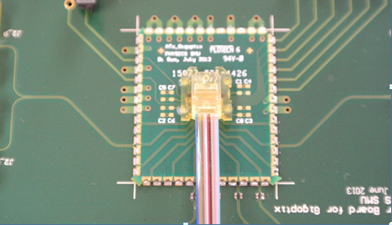
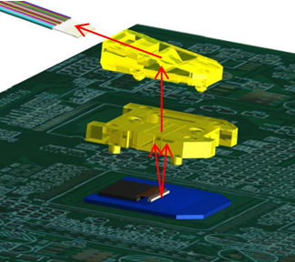
12-channel Array Optical Transmitter Module (ATx)
ATx is a compact (1.9 cm x 2.2 cm x 0.44 cm), radiation-tolerant, 12-channel array optical transmitter module towards 120 Gbps optical link, integrating array optical components, a VCSEL array with a driving ASIC in a custom transmitter module.
A custom low-cost and reliable “active-alignment” method was developed to solve the challenging alignment issue in the array optics area.
With a commercial VCSEL array driver, the ATx module successfully operated at 10 Gbps/ch and aggregate data rate of 120 Gbps. The optical transmitter eye diagram passed the eye mask, and the transmitted BER less than 10⁻¹² was achieved at 10 Gbps/ch.
Prizm Connector
MOI
ATx Module with
ribbon fiber attached
Optical Interface
Notes:
21

Slide 22
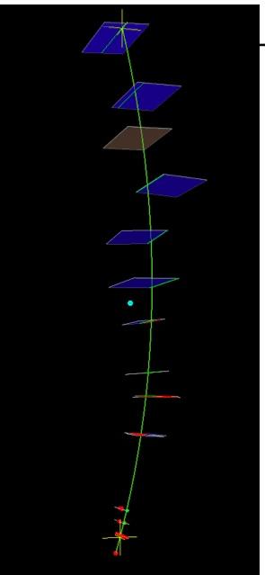
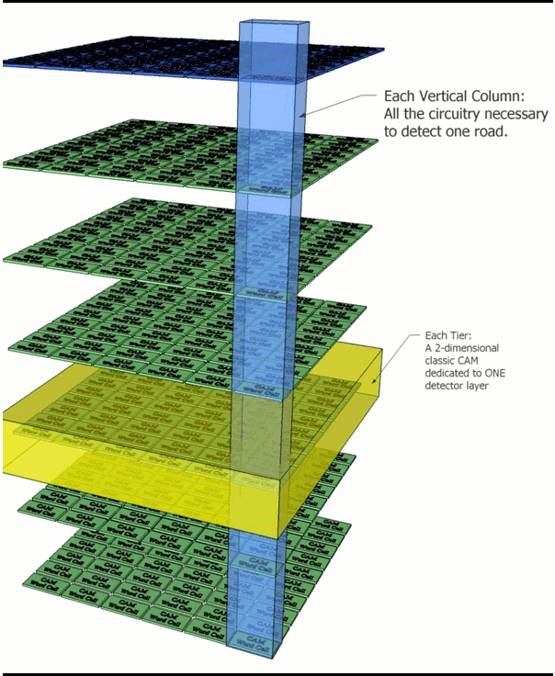
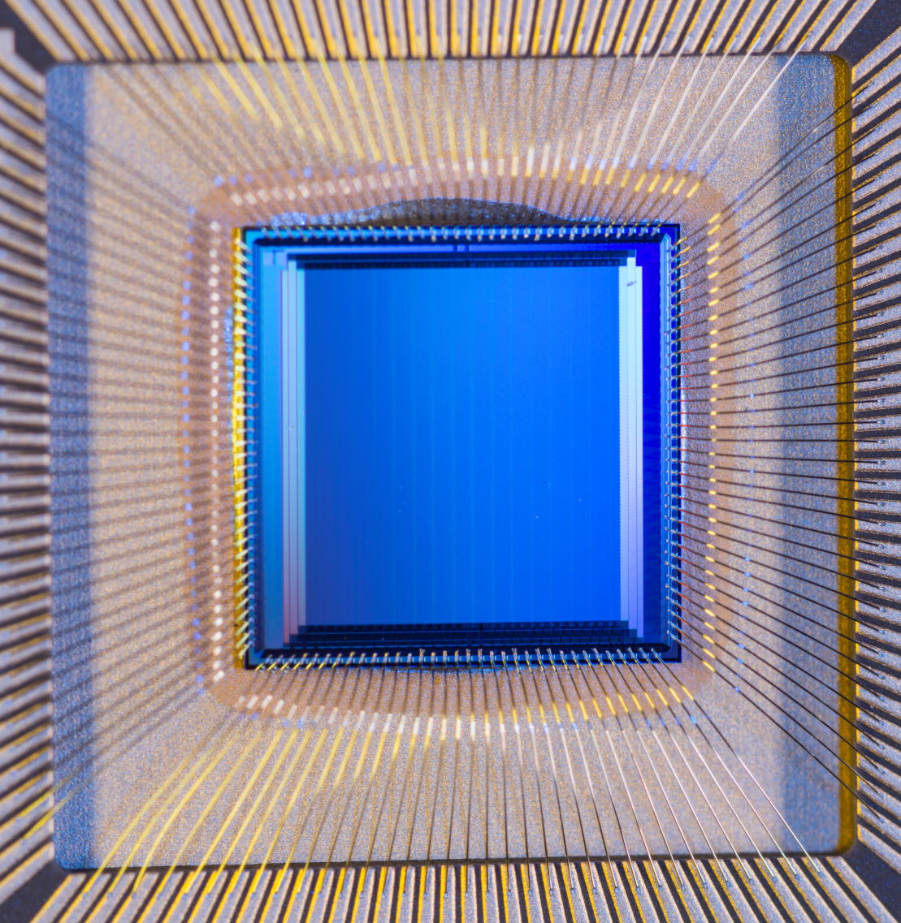
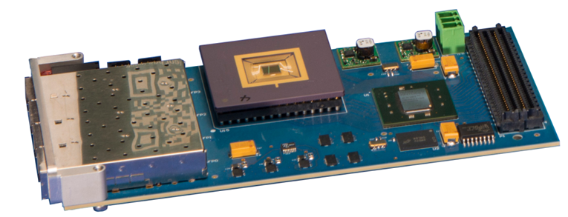
VIPRAM Project Status Summary
The past: with steady progress
Initial Idea: ~2010
VIPRAM concept paper: 2011
CDRD award: 2012
First 2D Design submission: 2013
First ProtoVIPRAM00 chip successfully tested: 2014
→ Design building blocks are ready for 3D stacking
CAM cell size: 25 um x 25 um, @ 130nm GF CMOS
The present and future:
The actual 3D design (protoVIPRAM01) ready: 2014
A 2-tier design for CMS tracking trigger (protoVIPRAM02): 2014-2015
Both Designs ready for submission: 2015
2-tier stacking testing for both designs: 2015-2016
Multi-tier stacking & testing for protoVIPRAM01: 2016-2017
→ Need continue generic R&D support for work related to 3D

Slide 23
Liquid Argon Detectors
(Managed by Stephen Pordes)

Slide 24
Integrated Approach to Liquid Argon R&D
The development of entire liquid argon systems means that new techniques in materials, electronics, or simulation can be addressed immediately:
Argon Purification techniques and cryogenics design
TPC Materials qualification and design
Readout Low-noise amplifiers in liquid
Full System in Neutrino Beam ArgoNeuT, LAriaT
Institutions we are collaborating with
in hardware R & D:
Yale - Syracuse (ArgoNeuT)
Michigan State University (TPC electronics)
M.I.T and Indiana University (Light readout)
BNL (TPC electronics and TPC design)
Princeton (depleted Argon recovery)
Indiana University (LAPD)
Automated Reconstruction LArSoft Simulation
ArgoNeut event
Synergies Dark Matter, Proton Decay
Page 24
LLNL Visit - 24 January, 2012
24

Slide 25
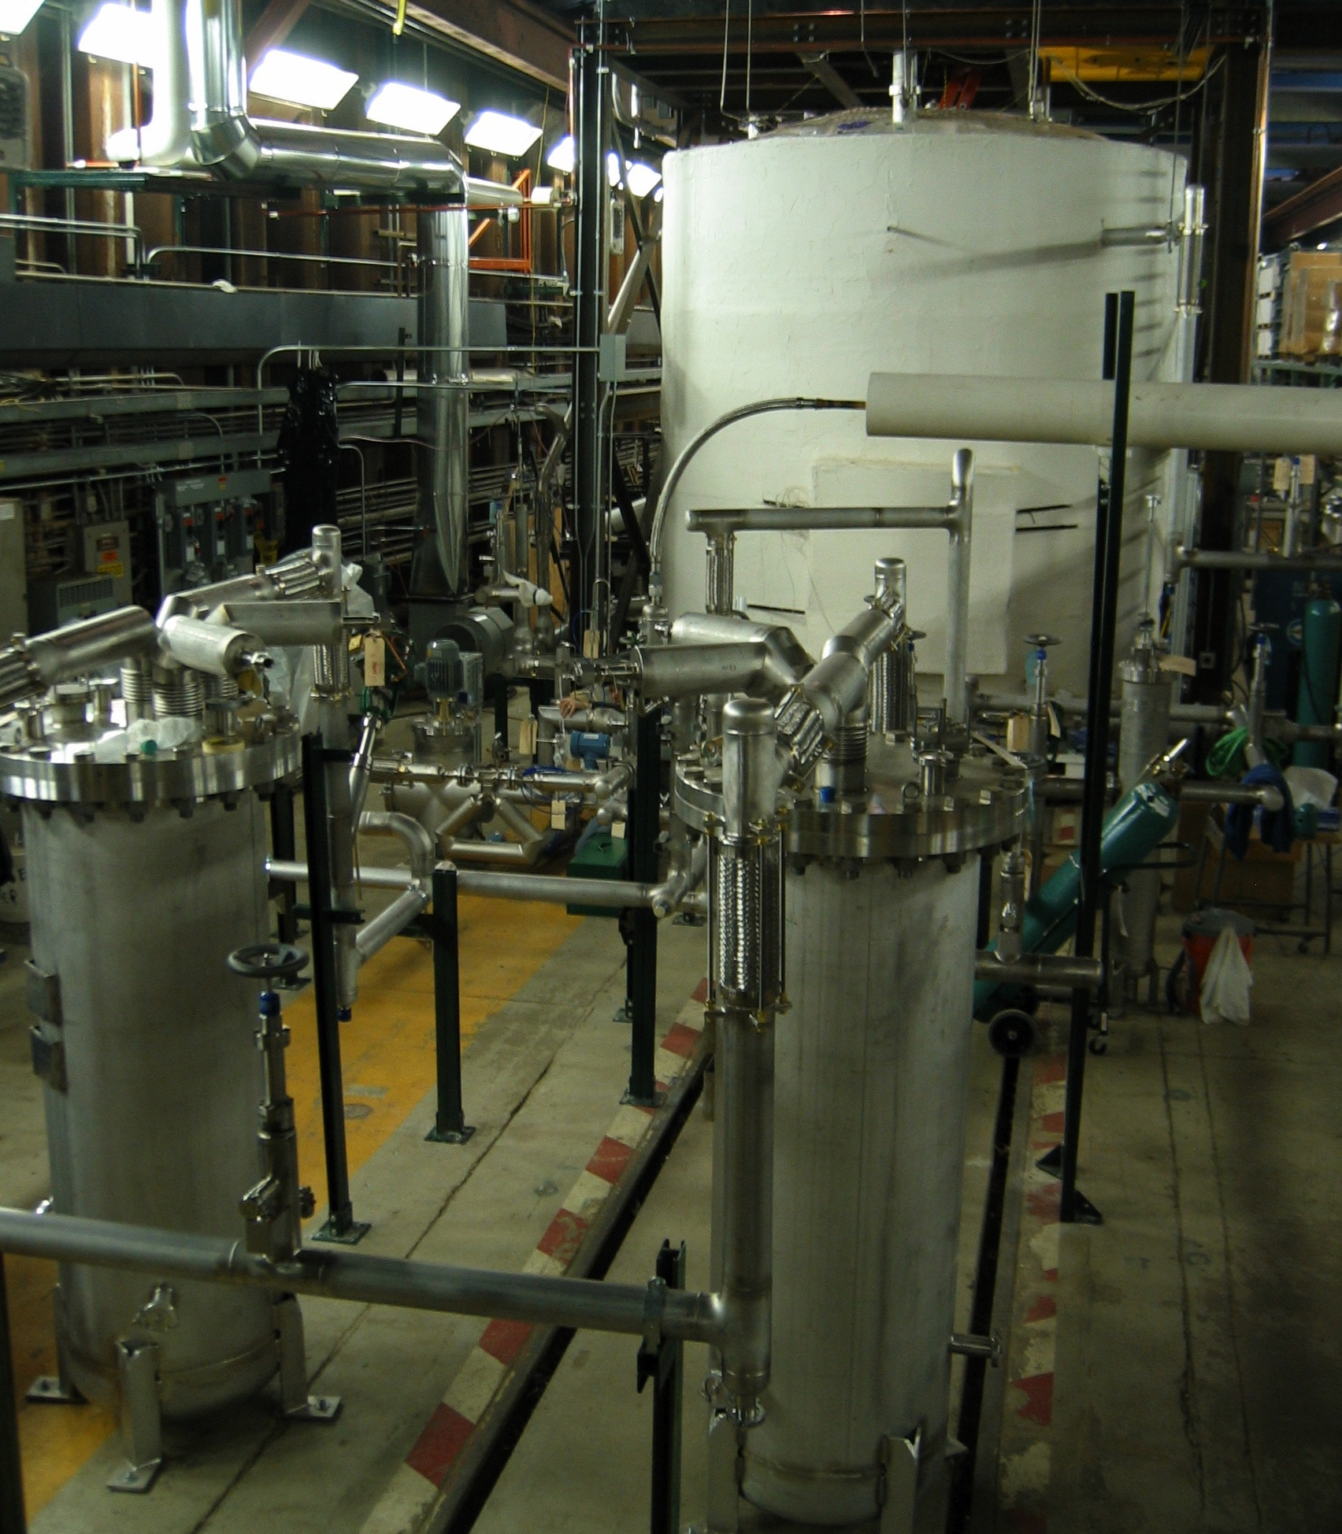
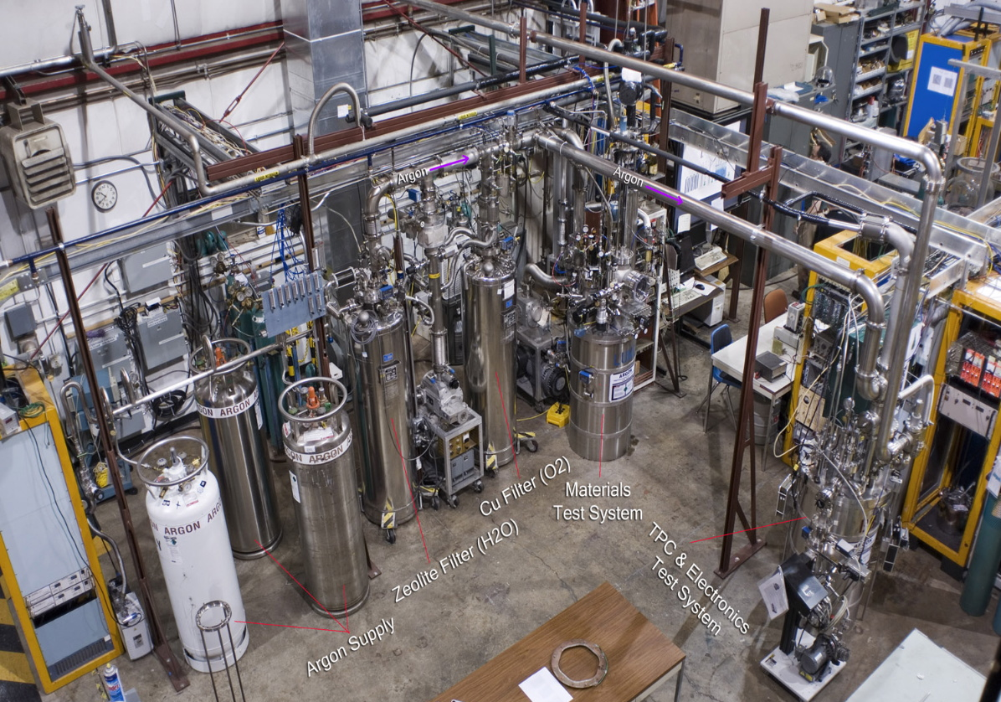
The Liquid Argon Program
The development of low-cost, low background and highly efficient liquid argon TPC’s are a national priority for both neutrino physics and dark matter physics.
Fermilab and collaborators have learned and developed techniques for handling large volumes of liquid Argon and retaining purity enough to drift electrons far distances. We have collaborated widely in the community on these efforts. The R&D is now paving the way for implementing truly large detectors (20-30 kton) with industrial techniques
LAPD 20 ton Liquid Argon Cryostat
Filled without evacuation. 5 meter electron drift distance.
Liquid Argon materials and electronics test stands

Slide 26
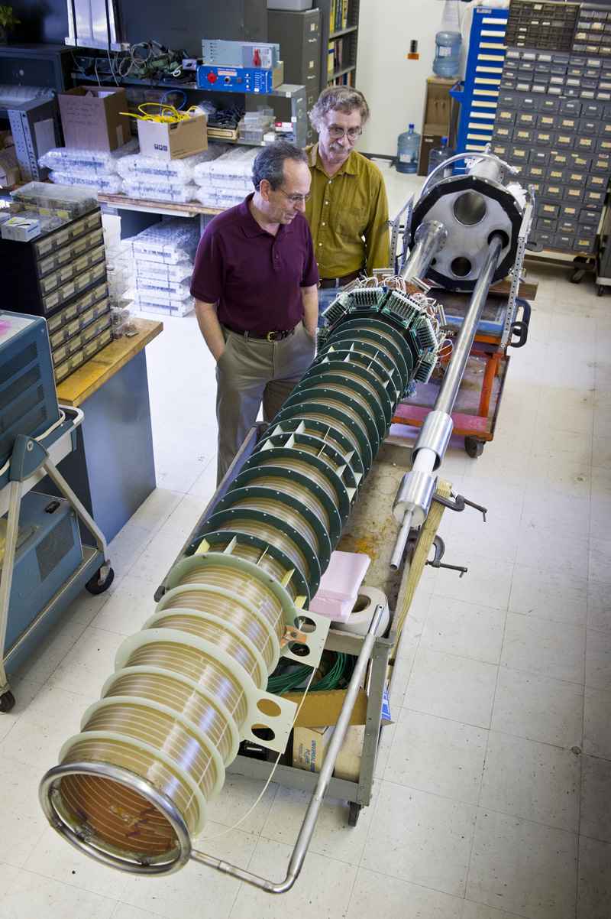
Recent Liquid Argon R & D at Fermilab
Neutrino Specific
TPC performance with electronics and HV -> BO TPC and Long BO TPC
Detailed behavior of particles in liquid Argon -> Test beam into LArTPC (LArIAT)
Dark Matter Specific
Light yield from nuclear recoils at low energy (<50 keV)
-> SCENE (Scint. Efficiency of Noble Elements)
Argon for low-background experiments
-> Purification of underground argon

Slide 27
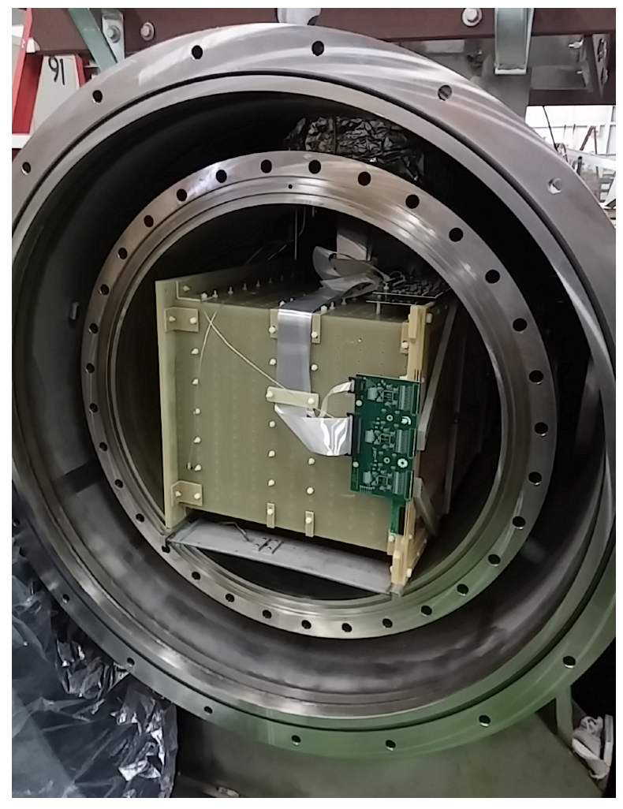
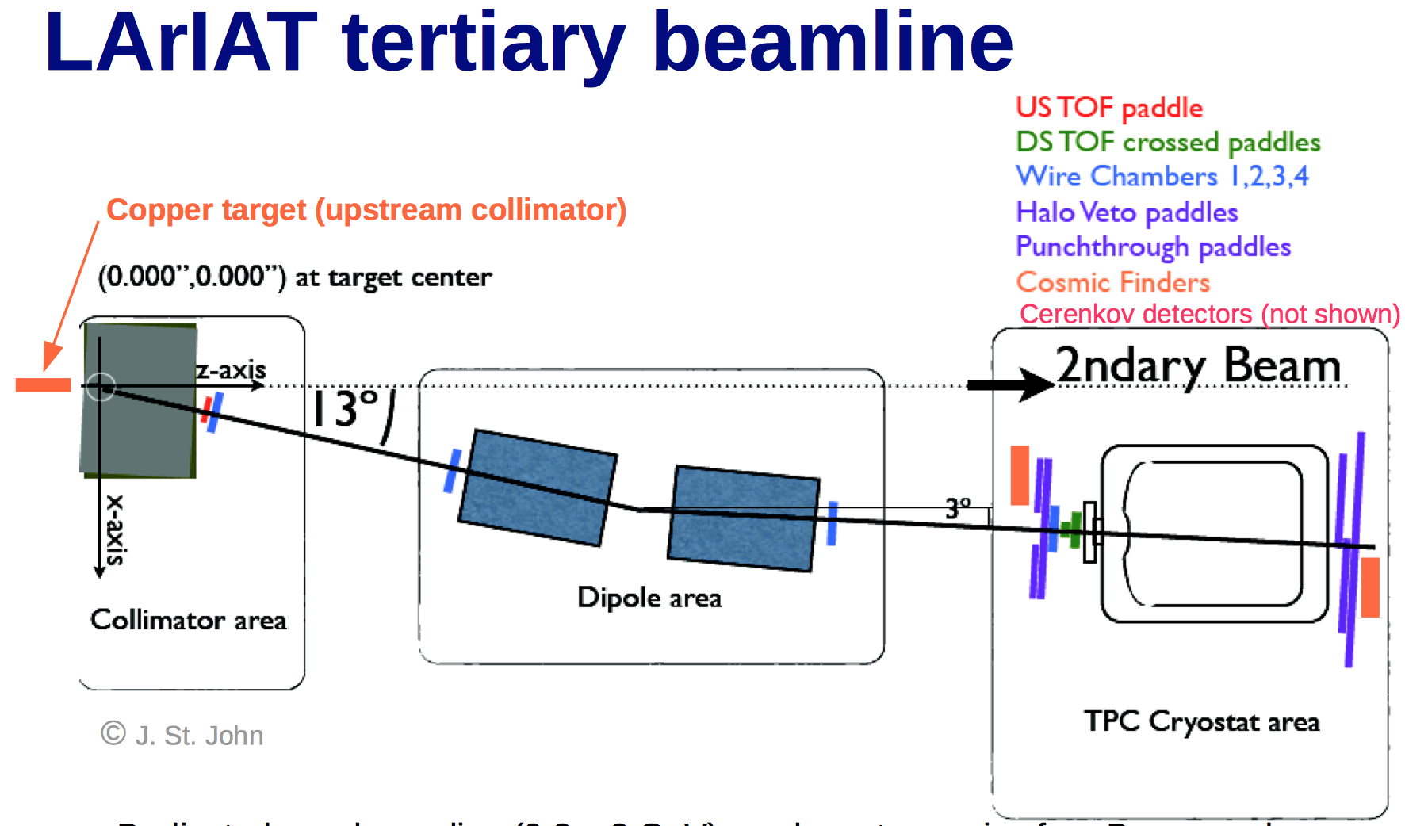
‘Liquid Argon in a Testbeam’=LArIAT
Tertiary beam used by MINERVA moved to new Mcenter Test Beam line
TOF Particle I.D. for 0.2-0.8 GeV beam

Slide 28
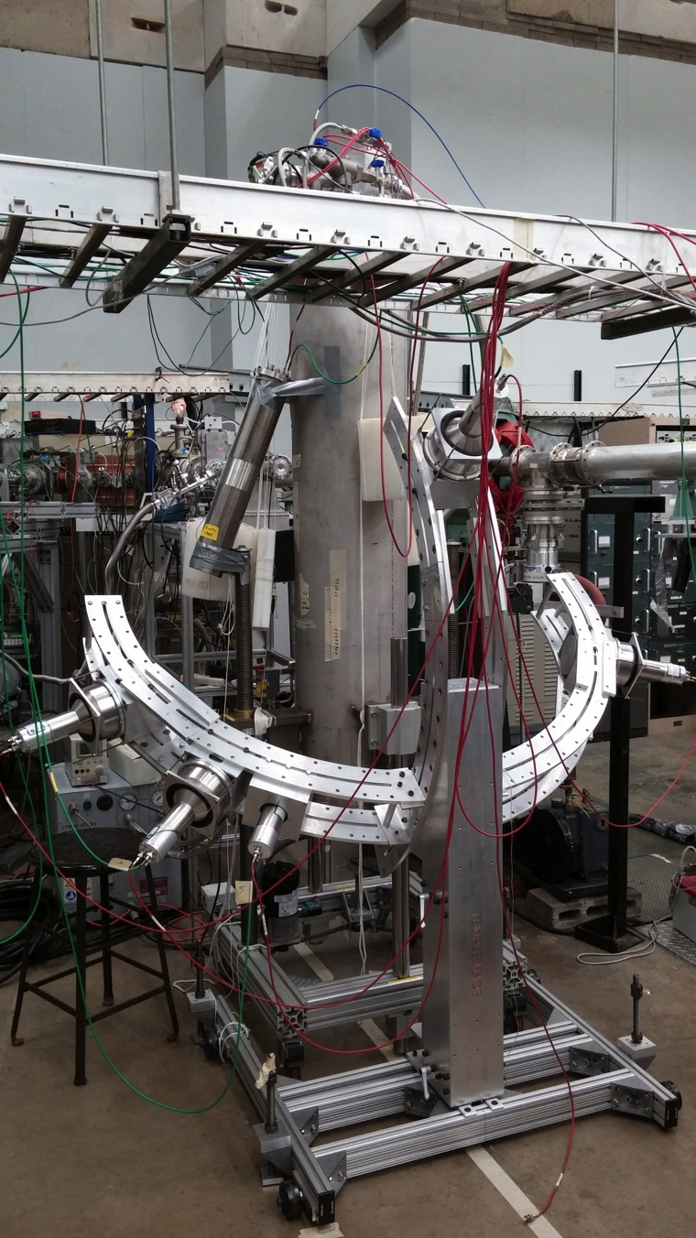
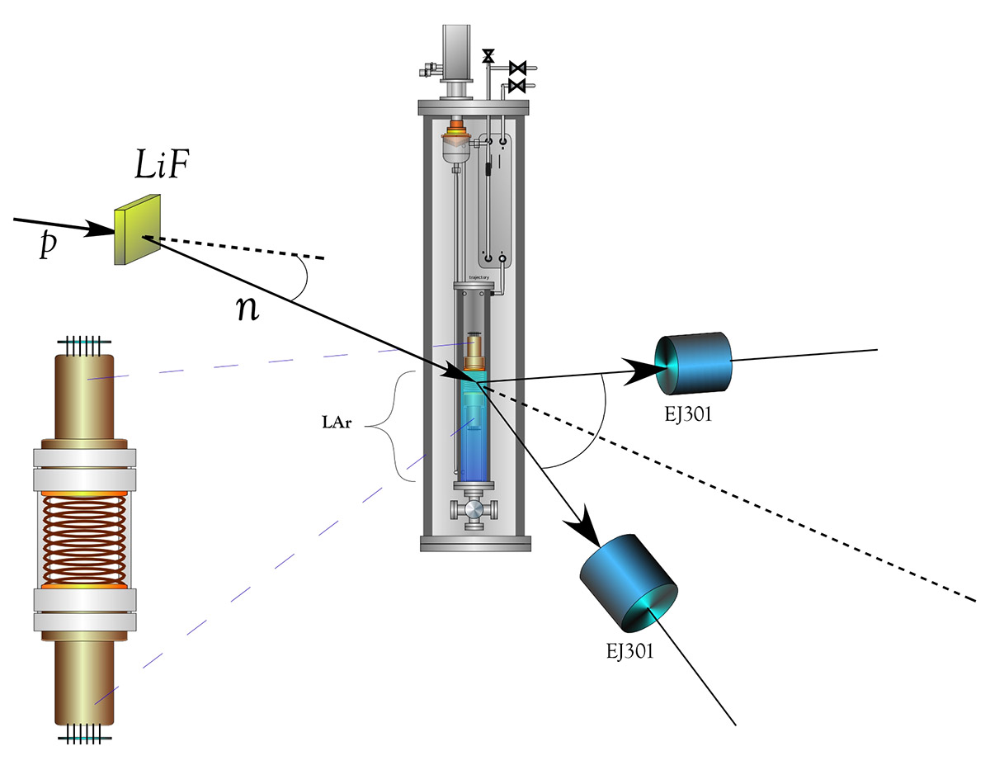
SCENE – Scintillation Efficiency of Noble Elements
Precision measurement of light output of Argon nuclear recoils in a dual-phase LArTPC using monoenergetic, low energy, pulsed Neutron Beam at Notre Dame
(Chicago, Fermilab, Princeton, Naples, Notre Dame, Temple, UCLA)
SCENE Schematic
2.5 MeV
0.5 MeV
β = 0.01
SCENE at Notre Dame
Scattering kinematics gives energy transfer

Slide 29
Calorimetry and Photodetection
(Managed by Jim Freeman)

Slide 30
Broad approach to calorimetry and photodetection:
Conceptual Studies – simulation of total absorption hadron calorimeter
Development of new materials – extruded scintillators, new crystals
Testing and characterization – optical properties, light yields
Development of new photosensors – LAPPD, SiPM
Readout Techniques – QIE10, LAPPD, SiPM (TB4 multichannel readout)
Test Beam Studies – T1004 (crystals), T1015 (heavy glass), GSI heavy ions
Large Integrated Systems – CALICE, digital HCAL
Collaborating institutions:
ANL (DHCAL, LAPPD)
Caltech/SICCAS (crystals development)
LAL Orsay (SiPM characterization)
University of Iowa (test beam studies)
University of Udine (scintillating glasses, test beam)
University of Lecce (test beam)
University of Cyprus (test beam, materials testing)
NIU (extruded scintillator)
U. Cyprus (SiPM charcterization)
STM; IRST-FBK; Voxtel (SiPM development)
CERN , Saclay, Milano, GSI (saturation studies)

Slide 31
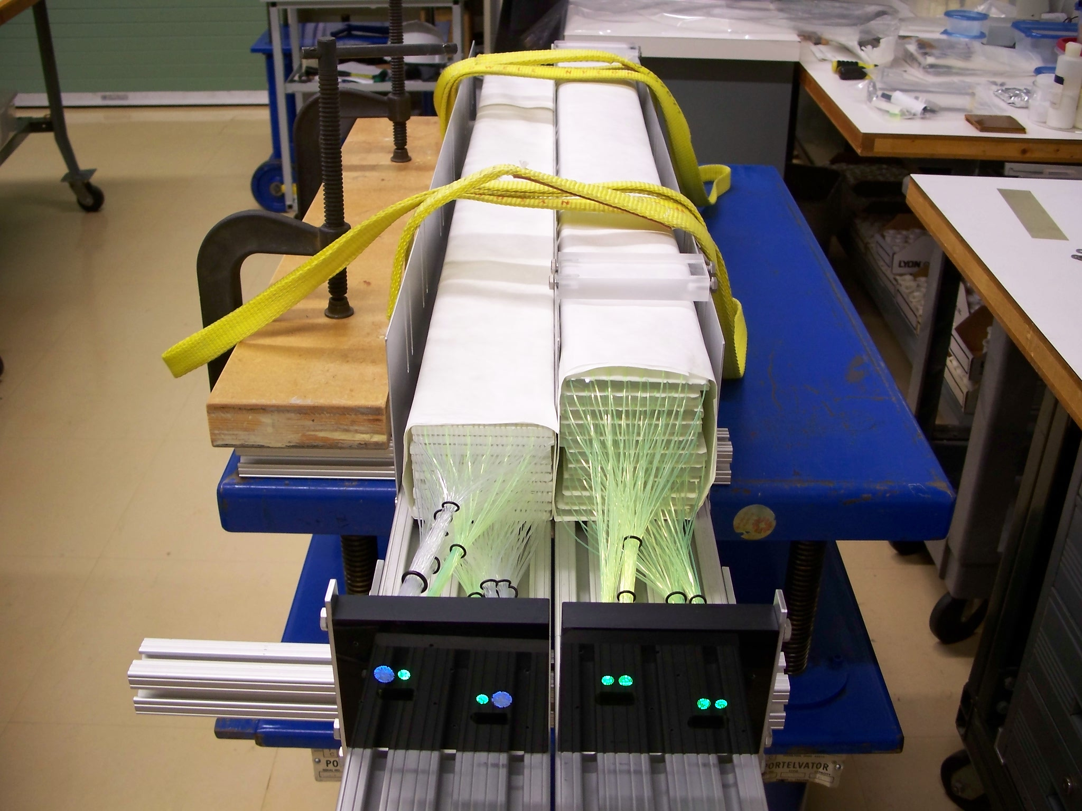
Dual Readout Calorimetry at FNAL
The two ADRIANO 2014 detectors designed for dual readout/total absorption for high energy experiments are at MTEST receiving beam.
Their dimensions (10 cm x 10 cm x 105 cm) corresponding to about 3.3 interaction lengths.
Being a dual-readout and totally active calorimeters (no passive absorber of any sort) they are expected to provide an hadronic energy resolution of the order of 30%/sqrt(E)

Slide 32
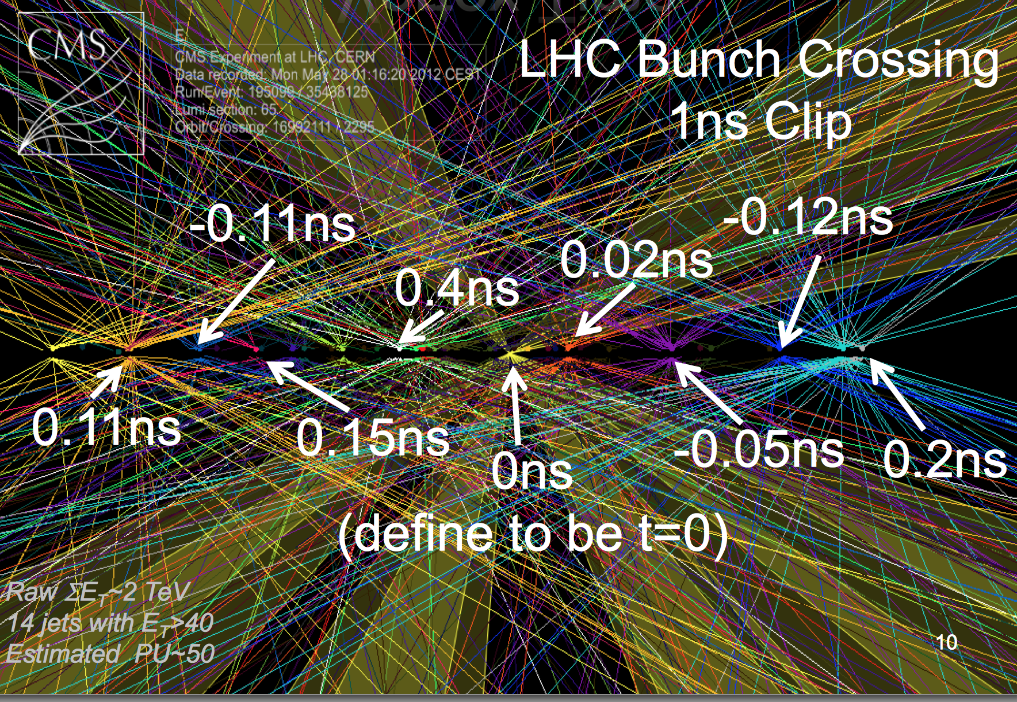
From Chris Tully SSI lecture, 2012

Slide 33
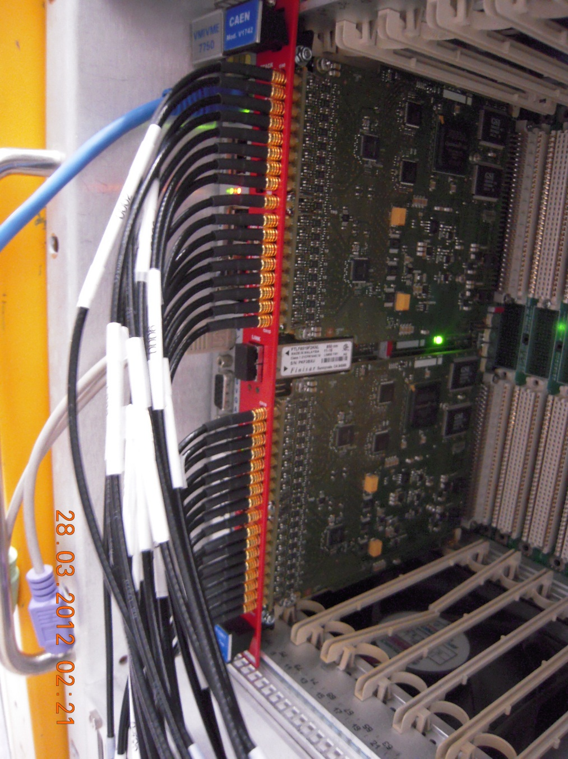
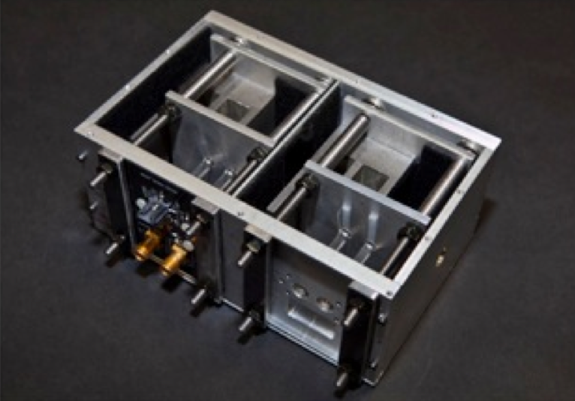
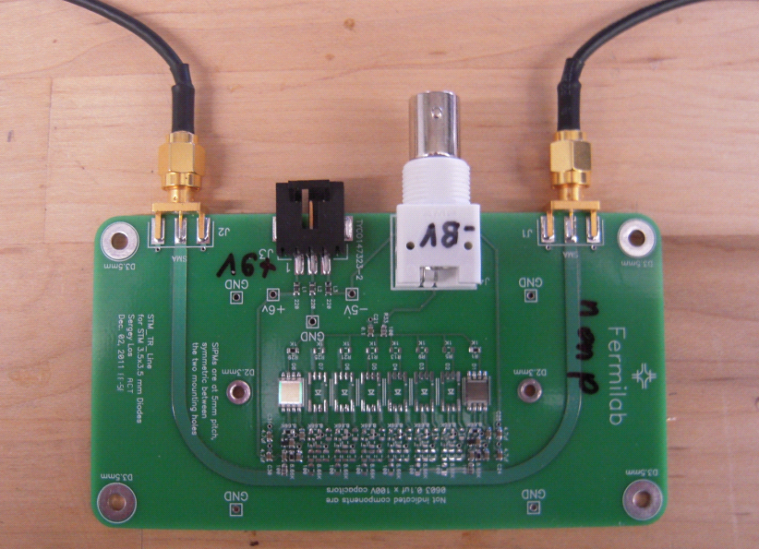
SiPM’s for Time-of-Flight and Calorimetry
Silicon PhotoMultipliers are multi-pixel avalanche photodiodes. Pixel sizes on the order of 50 microns and avalanche regions at the micron level.
Theoretically, they could be one of the fastest particle detectors for HEP (<16 psec shown at FNAL test beam).
Fermilab has been studying their potential for TOF and calorimetry for several years. Design and testing occurring now for potential use in FP420 forward tracking at CMS.
DAQ techniques supported by KA25 are being used in Proton Computed Tomography with NIU
Transmission line readout suitable for reading 8 separate SiPM’s
Example of one geometry of quartz bars and SiPMs for CMS forward region
CAEN 1742 module digitizes at 5 Gs/s. Good for timing and energy measurement

Slide 34
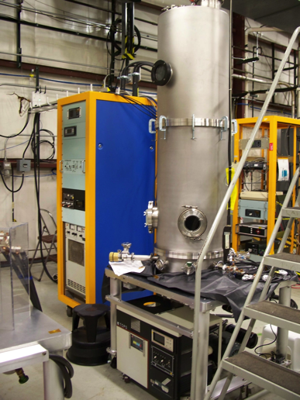
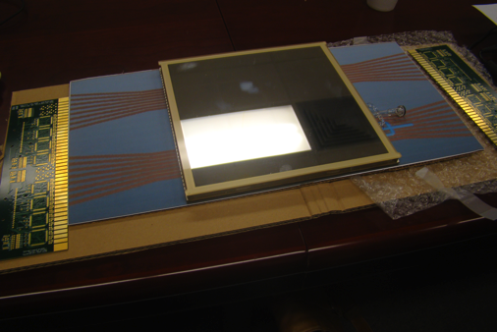
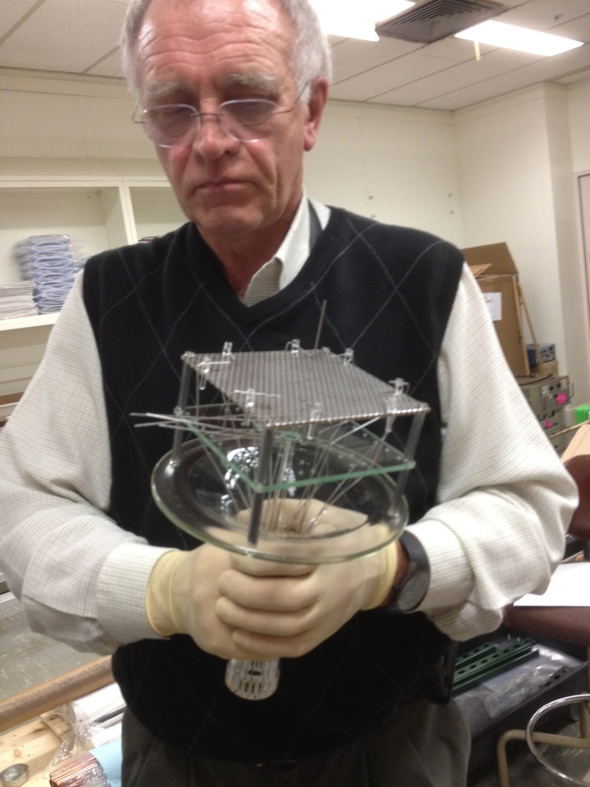
Support of LAPPD Project at ANL
(‘Large Area Picosecond Photo Detector’)
A mockup of the 8” MCP/PMT:
Readout on both ends gives 1 mm positional resolution
Transmission line readout retains superb timing resolution
U.C./Hawaii is developing high speed digitizers (10-20 GHz)
Thin film coating plant for 8” plates
Caltech, FNAL, U.Chicago have begun a collaboration to study EM shower timing using LAPPD microchannel plates.
Anatoly Ronzhin holding the ‘chalice’ for systematic photocathode testing

Slide 35
Astrophysics Detectors for
Dark Matter/Dark Energy
(Managed by Juan Estrada)

Slide 36
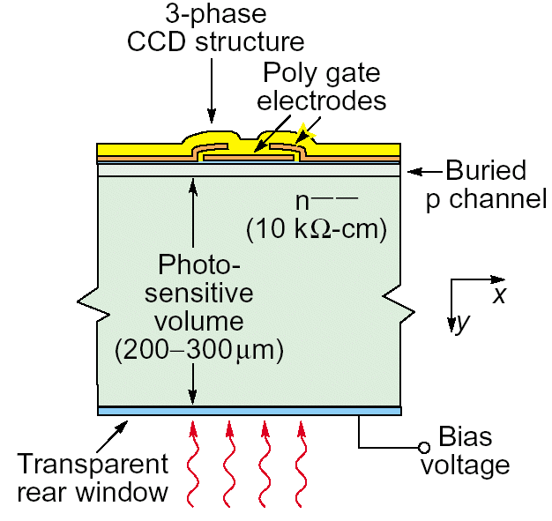
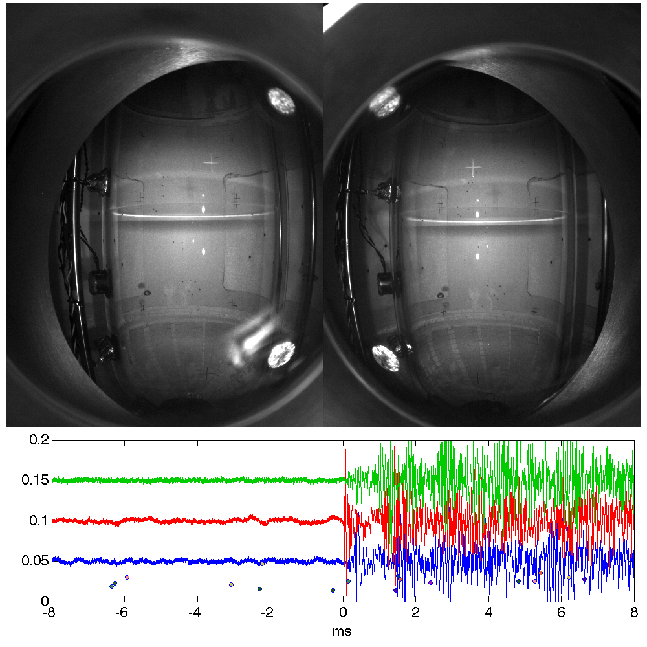
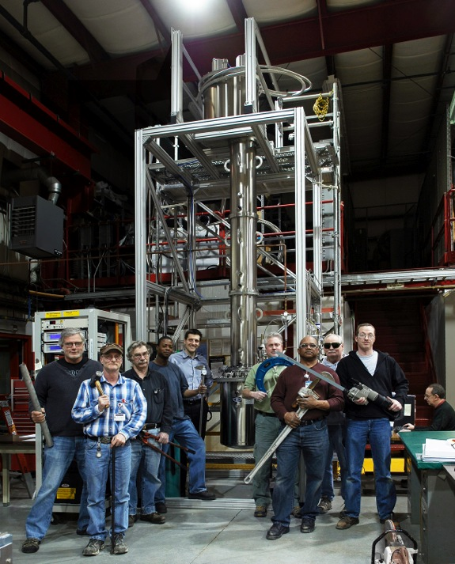

Alternative Techniques We Have Explored in
Dark Matter Detector R&D at Fermilab
Supported bubble chamber calibration R&D, such as threshold measurements and acoustic particle i.d. Has been adopted at ANL for stellar nuclear cross section measurements
Distillation column producing 39Ar depleted Argon for dark matter community.
Muons electrons diffusion limited hits.
Use DECAM thick CCD sensors for low-mass dark matter search (DAMIC)
Each avenue has had a strong collaborative
framework with significant Fermilab support, leading to operating experiments
Page 36

Slide 37
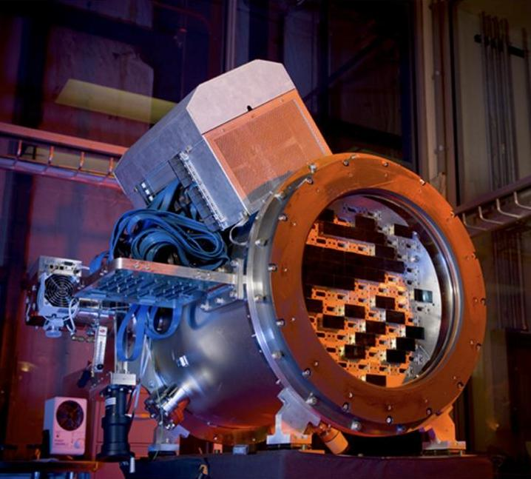
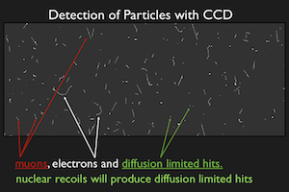
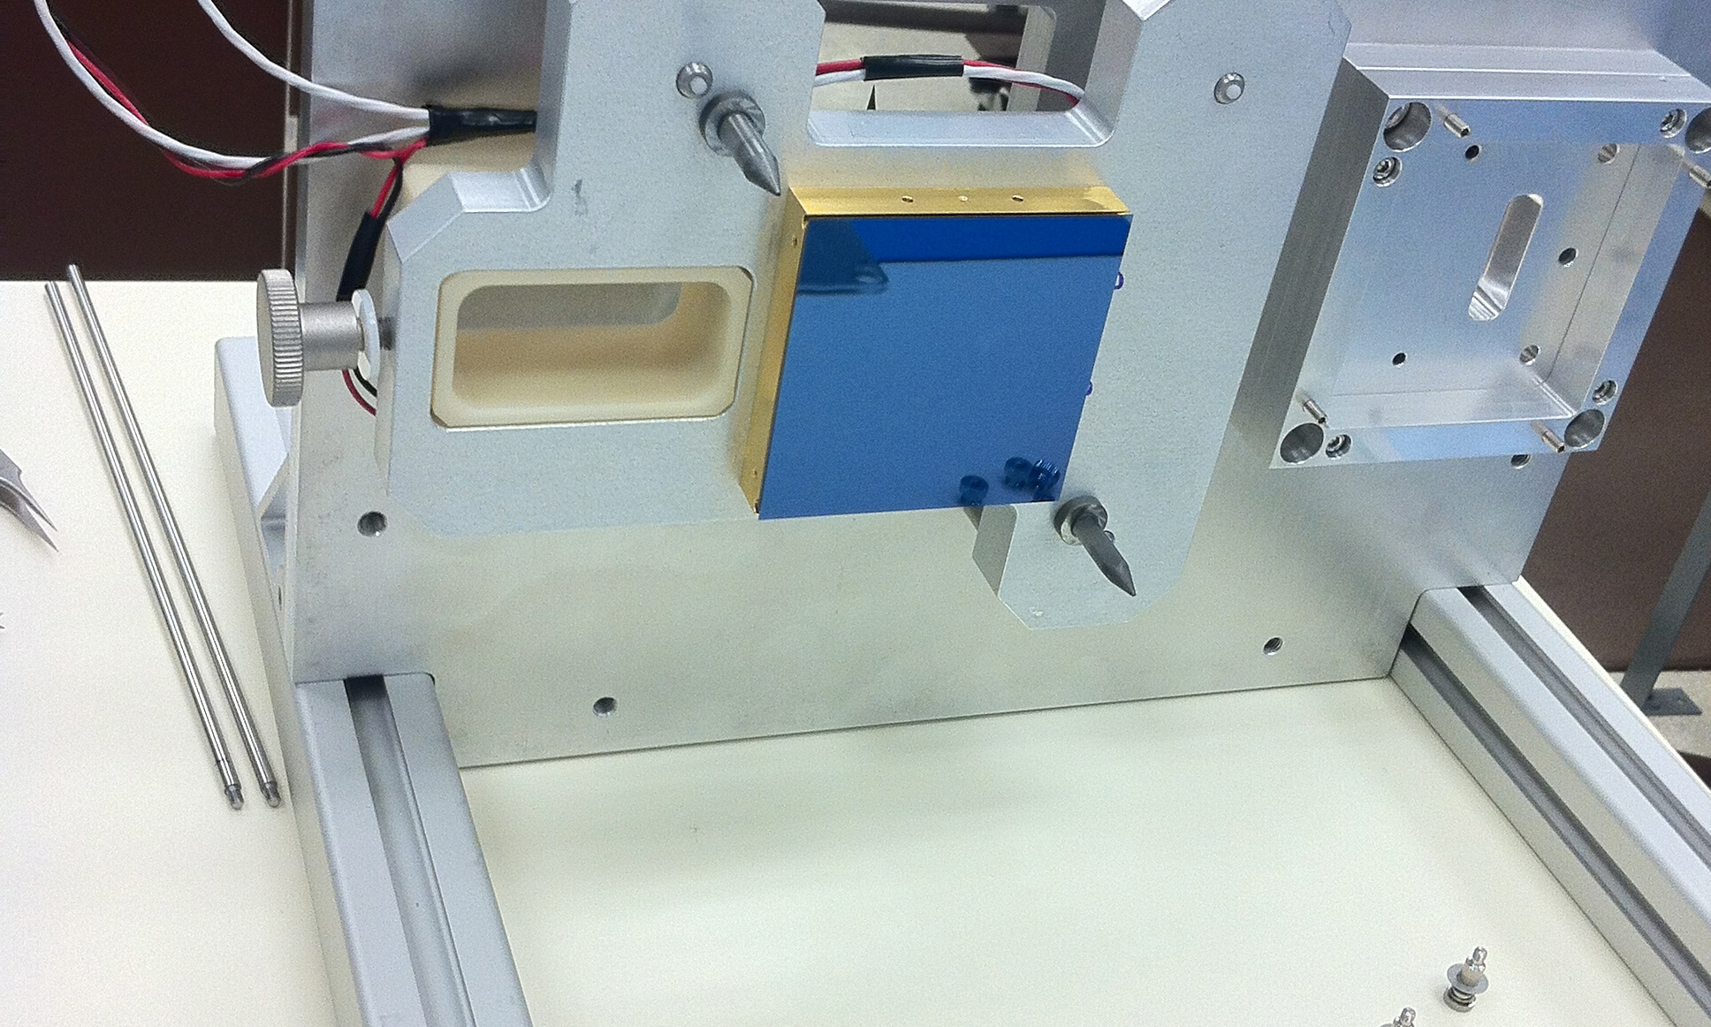
Expertise we gained from low noise readout and systems integration of DECAM sensors transitioned to detector R&D for DAMIC and is preparing us for DESI

Slide 38
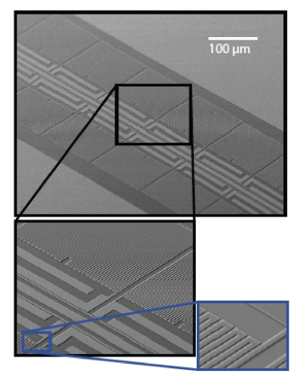
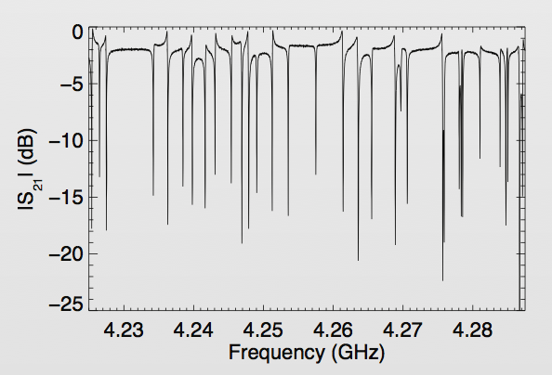
MKIDs : Have established a new cosmic frontier detector research effort at Fermilab
MKID = “Microwave Kinetic Induction Detectors”
Unlike CCD’s, MKID arrays can give a photon-by-photon energy and timing measurement, as well as position.
The capability of these detectors is well matched to our future astrophysics needs, namely spectrophotometry for large area sky surveys
Fermilab’s resources are an excellent match to what is needed for optical MKID research: experience in low level RF, high speed digitization and multiplexing.
Great deal of collaboration on this direction:
Resonances from each array element

Slide 39
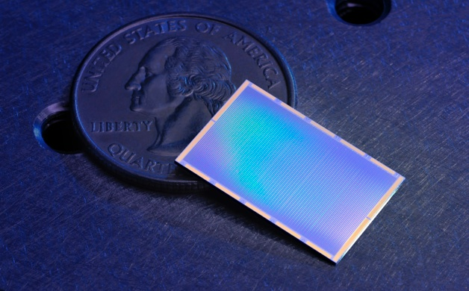
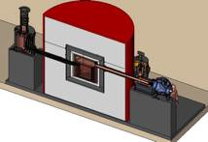
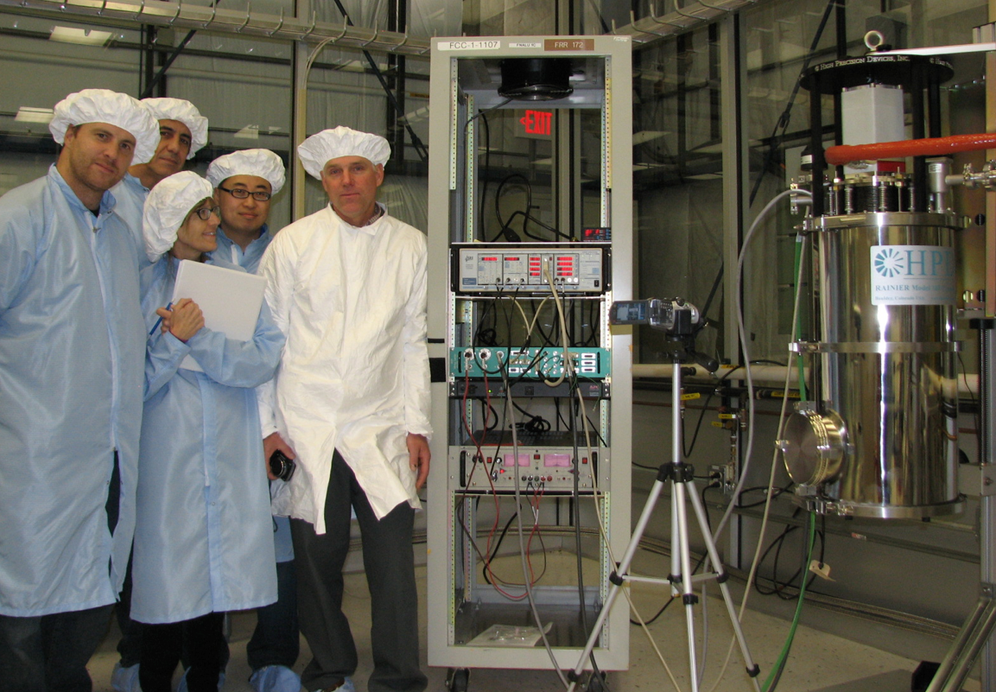
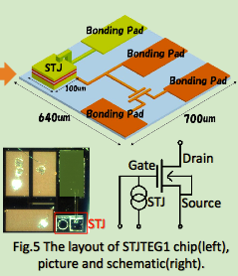
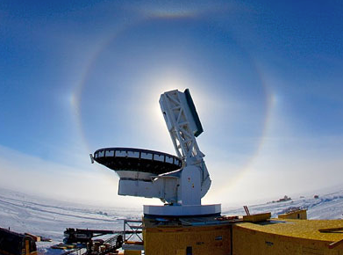
Using new ADR resource to establish low noise and multiplexing techniques in cryogenic detectors (<100 mK)
MKIDs (Dark Energy)
(main driver for the facility)
Super CDMS (Dark Matter)
Materials properties measurements
Adiabatic Demagnetization Refrigerator @ FNAL.
Operations start 2013.
30mK at FNAL for the first time!
STJ (neutrino decay)
Photon detector development with KEK group
SPT-3G (CMB)
Resonator tests
…build it and they will come. Used 100% of the time since day 1.

Slide 40
High Intensity Detector Challenges

Slide 41
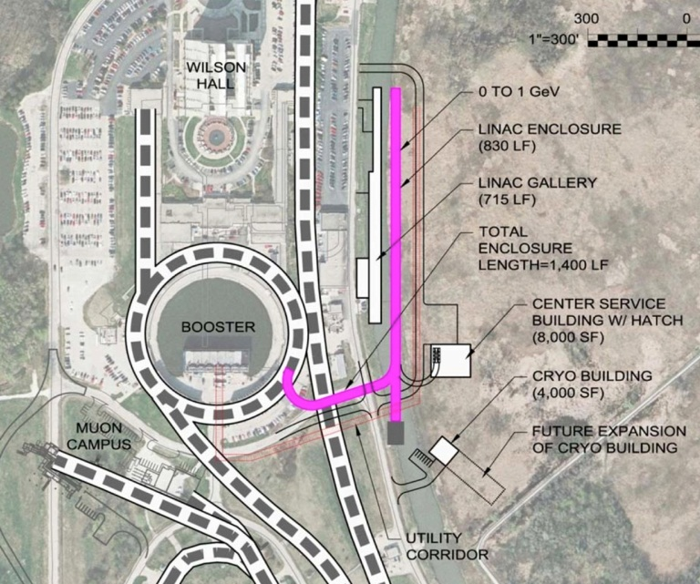
Detectors for High Intensity
Detector challenges relevant for next generation
Mu2e and next generation neutrino experiments,
All required by PIP-II intensity beams:
High rate Precision Photon Calorimetry
Very Low-Mass High-Rate Charged Particle Tracking
Time-of-Flight System Performance below 10 psec
High Precision Measurements of Neutrino Interactions
Large Area Cost Effective (LACE) Detector Technologies
(Snowmass study: arXiv:1309.6704)
These map well onto our current and planned program. R&D
projects will be supported along these fronts.

Slide 42


Neutron Rates in the Booster Target area. This would be background for next generation low energy neutrino experiments in that area: CAPTAIN, CENNS, etc.
50 m Absorber
6 m from Fe beam stop
310 n / 10¹⁶ POT
≈ 2.7×10¹⁶ / hr
Target 90° FOX
20 m from Be beam target
390 n / 10¹⁶ POT
2012 SciBath Loc
20 m from Be
beam target
211 n / 10¹⁶ POT
Collimator
8 m from Be
beam target
5608 n / 10¹⁶ POT
Stairwell
9 m from Be
beam target
1384 n / 10¹⁶ POT
SciBath
Fast neutron measurements (10-200 MeV) U. Indiana

Slide 43
Communication

Slide 44

Our web site has links to our detector organization and facilities, as well as links to the EDIT school and our detector retreat and reviews:
http://detectors.fnal.gov
Useful Email:
FNAL detector point-of-contact:
ramberg@fnal.gov
Detector Advisory Committee:
detector-advisory@fnal.gov
Detector R&D mail list (94 members):
detectors@fnal.gov
Test beam users (116 members):
test_beam@fnal.gov

Slide 45

Always open to interesting topics from international community
http://www-ppd.fnal.gov/eppoffice-w/Research_Techniques_Seminar/

Slide 46
Summary
Fermilab has based its detector R&D organization on a “Detector Advisory Group”, consisting of representatives of the major detector efforts and lab management
R&D efforts are centered on several major portfolios, linked to the highest priorities of HEP:
  Collider tracking and triggering that can support Phase 2 CMS upgrades
  Liquid argon detector studies for neutrino and dark matter experiments, while guiding production of new SBN near detector. Test beam studies with LAriAT in new MCenter beamline
  High speed calorimetry and photodetection for pileup mitigation at LHC.
  Astrophysics dark matter/dark energy/CMB detector development, including new concentration on cryogenic detectors
Fermilab’s resources, facilities and collaborations are crucial in detector research and testing
Considering the P5 report, detector R&D is beginning a shift into a more project-directed approach

Slide 47
Agenda
8:30 Executive Session (Mark Oreglia)
9:00 Introductions (Greg Bock)
9:15 Overview (Erik Ramberg)
9:50 Coffee
10:00 Executive Session (Mark Oreglia)
10:30 Parallel Sessions:
  Cosmic Frontier (Juan Estrada)
  DAQ/Triggering (Alan Prosser)
  Collider Silicon (Ron Lipton)
  Calorimeter / Photodet. (Jim Freeman)
  Liquid Argon (Stephen Pordes)
12:50 Lunch
13:30 Executive Session (Mark Oreglia)
14:00 Directed R&D & Future (Peter Wilson)
14:30 Facilities (Eric James)
15:00 Transitions (Erik Ramberg)
15:30 Coffee
15:40 Executive Session (Mark Oreglia)
17:00 Closeout

