Slide 1
Background context for this meeting

Slide 2
Contents:
Background
Summit; FNAL, 21—22 July 2014
Next steps defined at the Summit

Slide 3
Background
Background and context for this meeting

Slide 4
P5 recommendation:
Form a new international collaboration to design and execute a highly capable Long-Baseline Neutrino Facility (LBNF) hosted by the U.S. To proceed, a project plan and identified resources must exist to meet the minimum requirements in the text [of the report]. LBNF is the highest-priority large project in its timeframe.
P5’s Minimum Requirements for LBNF:
Exposure > 120 kt·MW·yr by 2035 timeframe
Underground far detector,
expandable to 40 kt LAr fiducial volume
1.2 MW beam power, upgradable
Capability to search for SNe bursts, proton decay

Slide 5
Int^{l} Mtg for Large Neutrino Infrastructures:
Organised, under the auspices of APpEC by S. Katsenevas
23—24 June 2014, Paris
Gathered PIs and funding-agency representatives to:
  Re-assess physics case
  Create a single “agency ear” as a support to the global neutrino community
Meeting informed by:
  CERN Council approval of Mid-term Plan which included resources for CERN Neutrino Platform
  P5 and HEPAP statements
  Japanese roadmap
Outcome presented in a press release:
“Neutrino Physics enters the global era”:
  They [the funding agencies] support the vision of the HEPAP/P5 report to host an international facility for short and long-baseline neutrino oscillations at Fermilab, where internationally driven collaborations are encouraged to propose a program optimised in baseline and detector technology. This approach, in parallel with the decision of Fermilab to upgrade its beam infrastructure (PIP-II) gives the opportunity for a rich international neutrino program at Fermilab.

Slide 6
ICFA Neutrino Panel:
In its initial report the Panel recognised that:
  To maximise the discovery potential … requires that the international neutrino community has timely access to a to a number of complementary and powerful facilities
  To ensure timely access to the necessary facilities it is necessary to exploit to the full the infrastructures at CERN, J-PARC and FNAL
    Such that each region makes a unique and critically-important contribution to the programme
The LBNF, as specified by P5, will be an exciting, unique and critically-important cornerstone of this programme

Slide 7
Summit; FNAL 21—22 July 2014
Background and context for this meeting

Slide 8
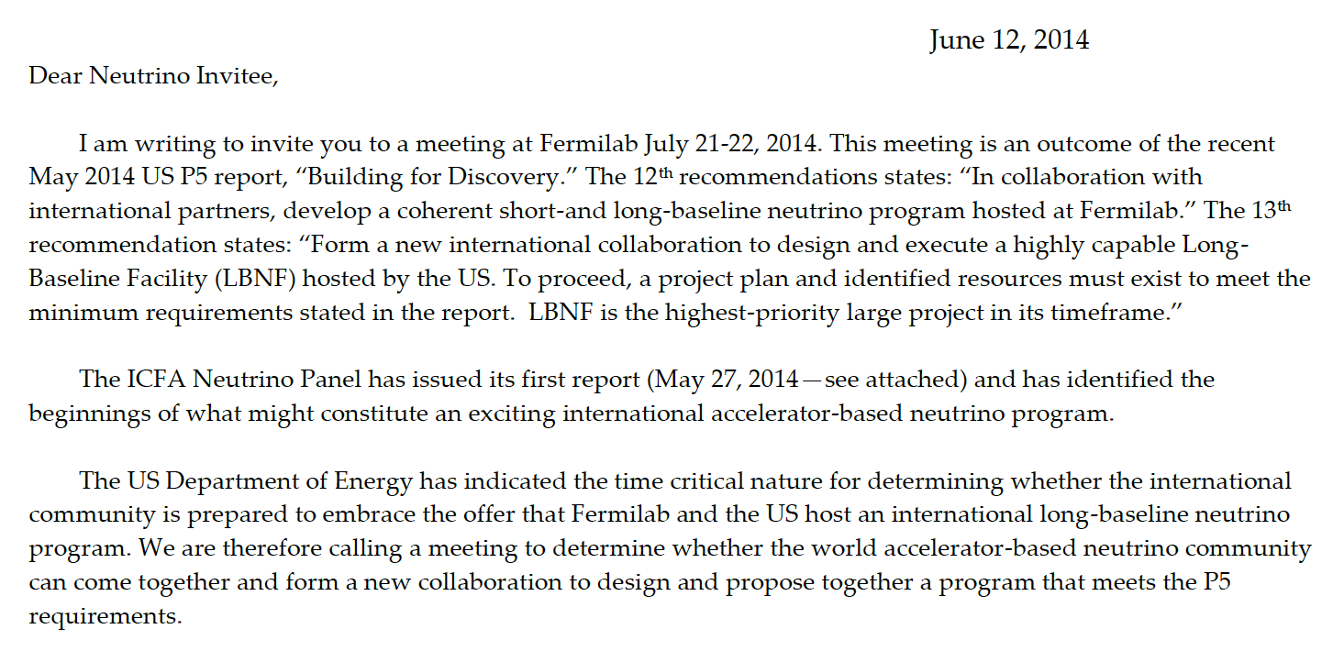
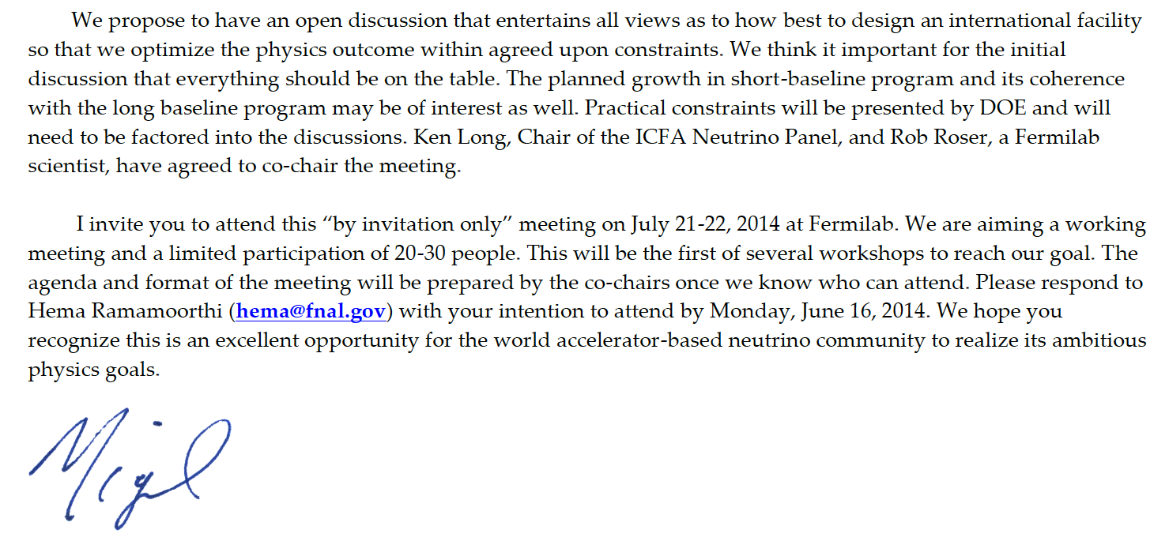
Mandate and invitation:
Invitation sent to key leaders in the field across the world.

Slide 9
Summit attendees:
48 participants spanning the three regions,
experiment, theory and phenomenology

Slide 10
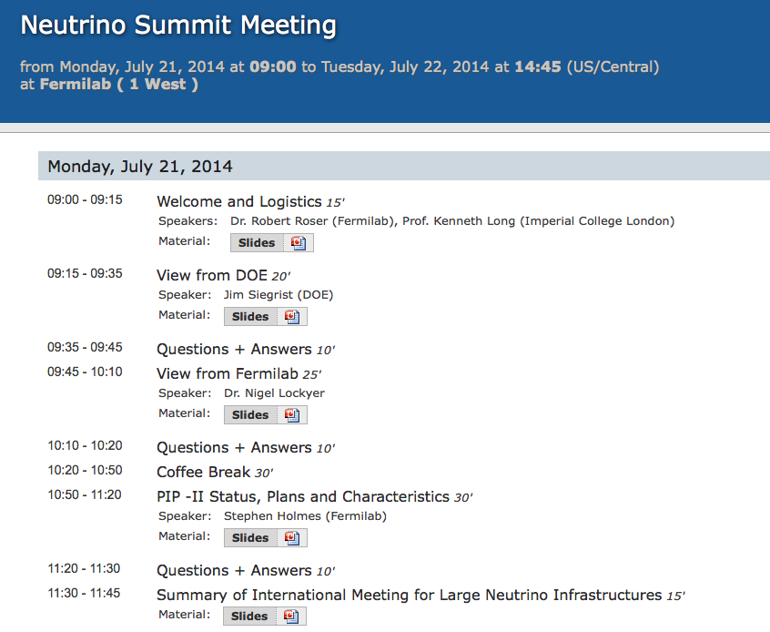
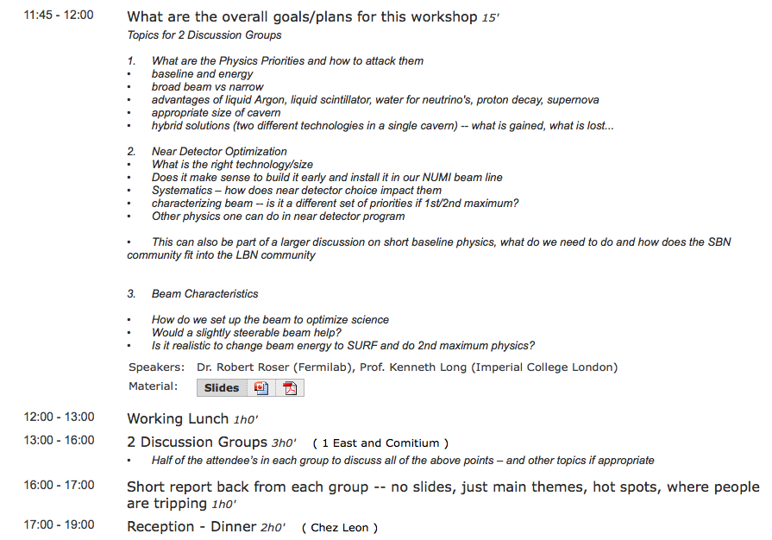
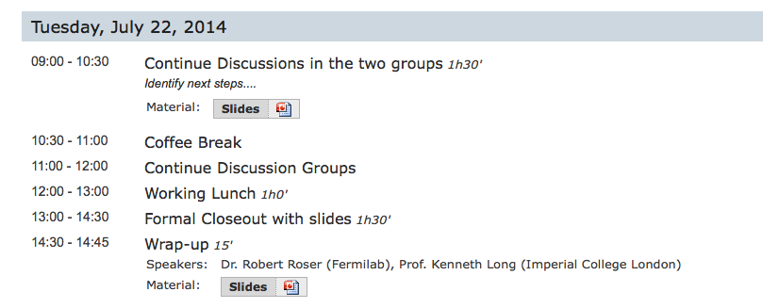
The summit agenda:

Slide 11
Assumptions:
Only two assumptions were made:
  Fermilab would provide the source of neutrinos;
  The baseline would be such that the matter effect could be exploited
i.e. baseline, beam energy and detector optimisation were all open for discussion.

Slide 12
Convergence and urgency:
The Summit noted the convergence of the field on the development of two concepts:
  Longer baseline, wide-band approach hosted in the US:
    Matched to LAr, possibly enhanced through H₂O/H₂O-scint
  Shorter baseline, narrow-band approach hosted in Japan:
    Matched to H₂0-Cherenkov
The summit acknowledged the:
  Urgency to establish a coherent and unified path forward on LBNF or the window of opportunity could close
and has agreed:
  A timetable for the preparation of the LOI and the full proposal (CDR)
  [LOI to PAC Nov/Dec 14 followed by CDR to PAC summer 2015]

Slide 13
Building the collaboration:
It was agreed to establish an
  Interim International Executive Board (IIEB)
to help form the collaboration and to:
  Deliver the LOI; and
  Guide the development of the CDR
The IIEB will:
  Report to the emerging collaboration;
  Be constituted and given its mandate by the ad-hoc funding-agency/lab-director group referred to above;
and importantly will …
  Be superseded by the collaboration governance as soon as the collaboration has been formed;

Slide 14
Next steps defined at the Summit
Background and context for this meeting

Slide 15
Next steps:
The formation of the IIEB will be expedited such that the IIEB can:
  Identify the international group that will draft the LOI, develop the CDR and execute the programme
  Call a meeitng of this international group in October or early November to:
    Debate the results from the working groups; and
    Craft the points which comprise the LOI

