Slide 1
Mu2e CD-2 Review Extinction Monitoring
Peter Kasper
L4 Manager for the Extinction Monitor
10/22/2014

Slide 2
Extinction Monitor Requirements
Monitor the extinction of beam hitting the target.
That is the final extinction of interest to the analysis
Out of time beam that misses the target does not easily produce background tracks
Requirements are discussed in Mu2e-DOC-894
Should be operating at all times during data acquisition.
Data should be available for online monitoring.
Data must be synchronized to the spill, so time evolution of out-of-time beam can be studied.
Should measure the proton pulse characteristics in addition to the extinction.

Slide 3
Extinction Monitor Requirements (cont’d)
From Mu2e-DOC-894:
Specification | Value
Sensitivity (90% C.L.) | 10⁻¹⁰
Extinction accuracy | 10%
Integration time | 6×10¹⁶ POT (~3 hours at design intensity)
Timing resolution (RMS) | <10 ns
Dead-time | <10 ns
Rate-dependent error over dynamic range | <10%
Initial readiness | When the production target is ready
Access time (assuming monthly access is needed) | 4 hrs
Radiation hardness (minimum protons delivered before replacement is required) | 4×10²⁰ POT

Slide 4
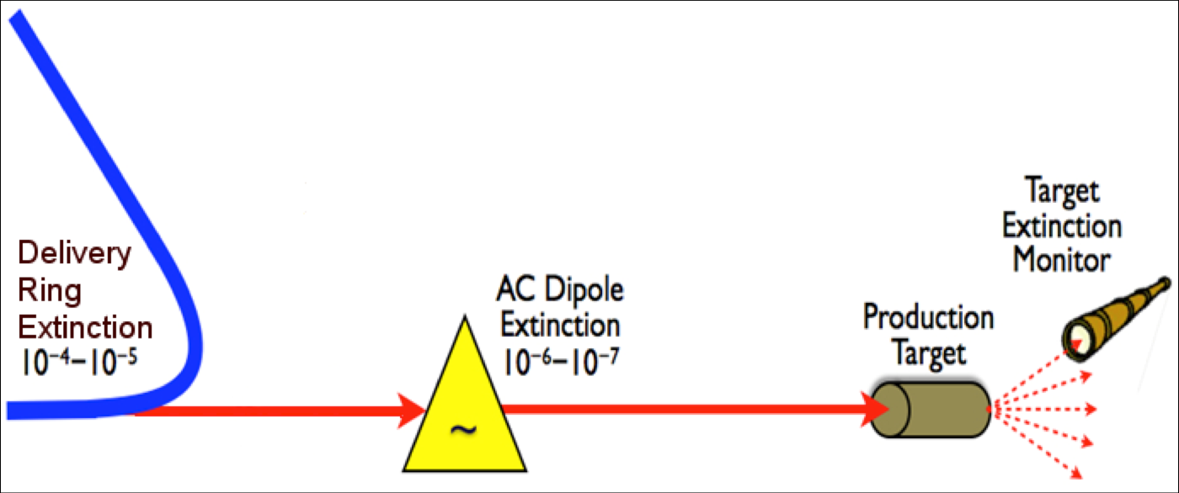
Principle of Operation
Since we are only interested in protons hitting the target we monitor the rate of secondary particles produced by interactions on the target
With ≈ 3 x 10⁷ protons/bunch it is not possible to measure a 10⁻¹⁰ extinction with a single bunch, nor is it feasible to count every proton.. Hence we must integrate over many bunches.

Slide 5
Principle of Operation … Filter + Detector
Filter
Selects a sample of suitable secondary particles and delivers them to the detector
Sets the per proton signal rate in the detector
Shields the detector from unwanted interaction products
Detector
Measure “in-time” and “out-of-time” signal rates with equal or known relative efficiency
Must have LOW “out-of-time” backgrounds compared to “out-of-time” signal rate

Slide 6
Location
Detector room is located above and behind the beam dumpz
3D model courtesy of Bartoszek Engineering
Detector Room
Production solenoid
Proton absorber and extinction monitor filter
Target
(too small to see)

Slide 7
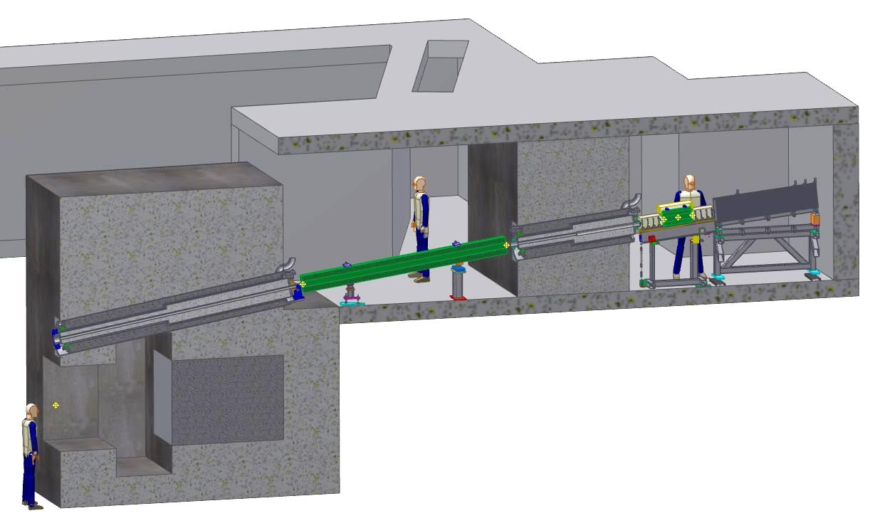
Filter Layout
Entry collimator
Filter magnet
Exit collimator
Primary beam absorber
Detector room

Slide 8
Filter Design
Locates detector outside target hall
Easy access for detector maintenance
Lots of room for shielding
Low radiation levels for detector + electronics
Entry collimator
Located in concrete above the primary beam dump
Admits forward produced high momentum secondaries
Filter magnet
Permanent dipole oriented to transmit ~4.5 GeV/c secondaries
Exit collimator
Admits signal particles through a 2m thick shield wall

Slide 9
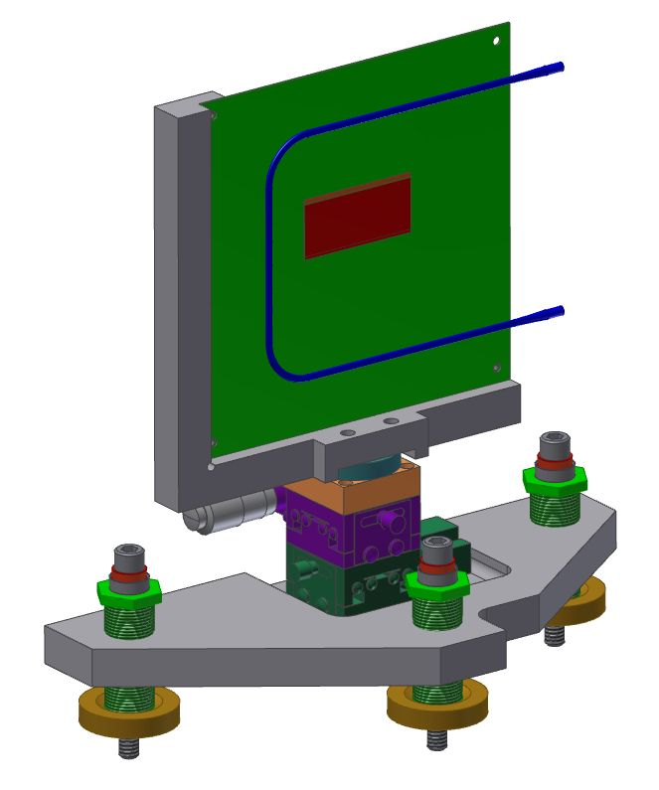
Pixels: the Basis of the Measurement
High granularity
Atlas style FE-14 sensor chips with 26,880 pixels per chip
Pixel size is 250 x 50 μm
4 upstream planes with 4 x 3.5 cm active area
4 downstream planes with 4 x 5.1 cm active area
Low Noise
Signal/noise = 15,000 / 121 electrons
Radiation hard to 300 Mrad (expect <1 Mrad/yr)
Huge cost saving by “piggy-backing” on LHC R&D and production

Slide 10
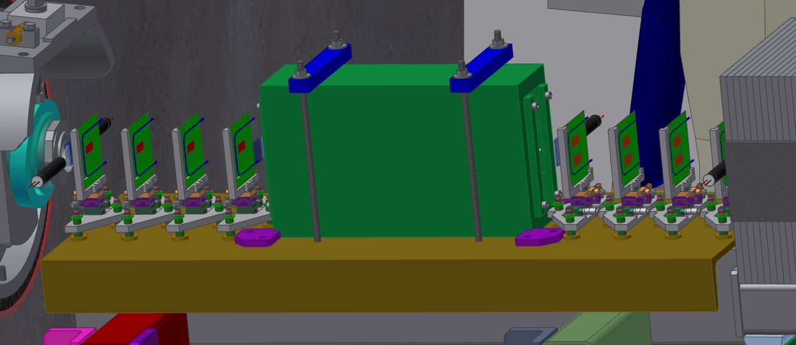
Detector Magnet
Magnet
Permanent dipole 0.14 T.m.
Main purpose is to prevent electrons produced in stopped muon decays from forming tracks

Slide 11
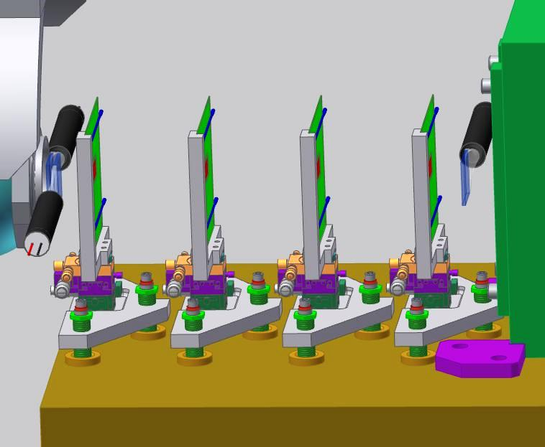
Trigger Counters
6 fast scintillator counters
Provide a trigger for the pixels
Also measure the time structure of the beam
Location of upstream trigger counters with respect to the pixel planes
The layout downstream of the magnet is a mirror image of the upstream

Slide 12
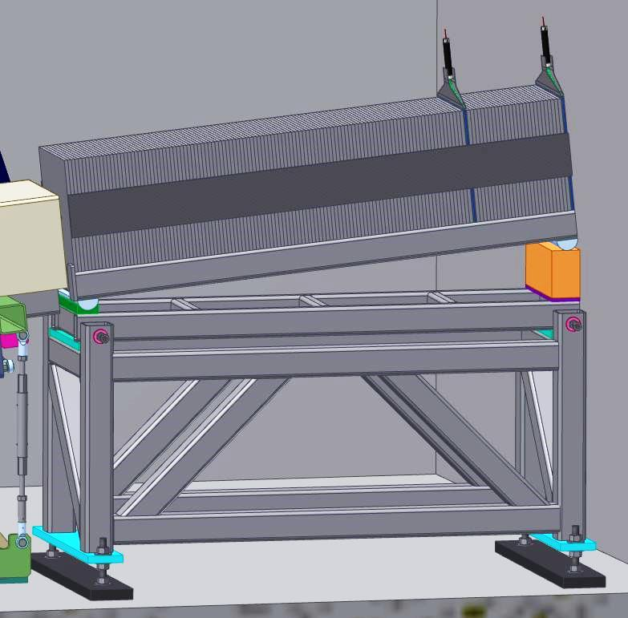
Muon ID Detector
Added in response to the down select review (discussed shortly)
Measures the muon content of the extinction signal
Muon content expected to be small for a real signal but backgrounds from cosmic rays or from interactions upstream of the production solenoid will be largely muons

Slide 13
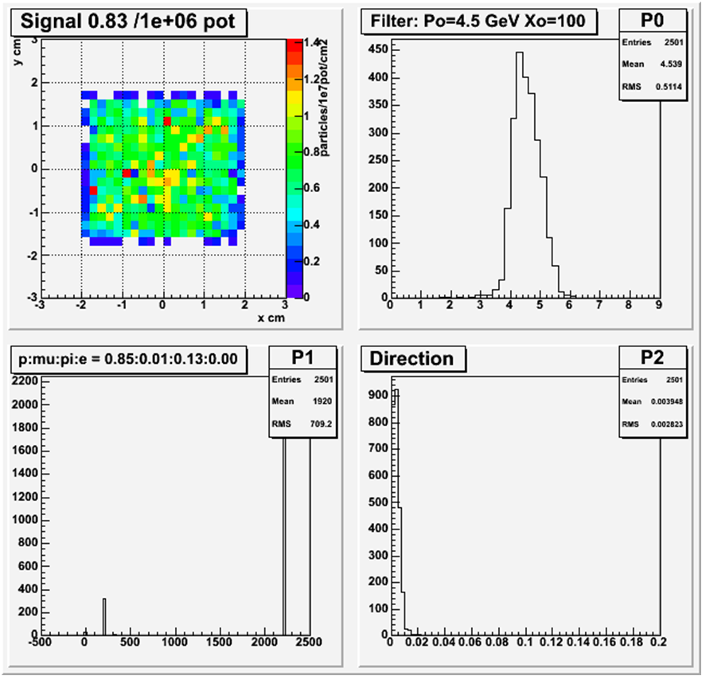
Performance … Sensitivity
To set a 90% CL upper limit of 1x10⁻¹⁰ extinction after 6x10¹⁶ POT requires a signal rate of 5x10⁻⁷ tracks/POT
The expected rate of 8.3x10⁻⁷ tracks/POT (≈ 25 tracks/bunch) meets this requirement
Background (cosmics, noise, etc) < .03 tracks/hour
~ .1 track/(6x10¹⁶ POT)
~ 2x10⁻¹² extinction
this can be measured and subtracted!
Track distributions surviving filter
p
π

Slide 14
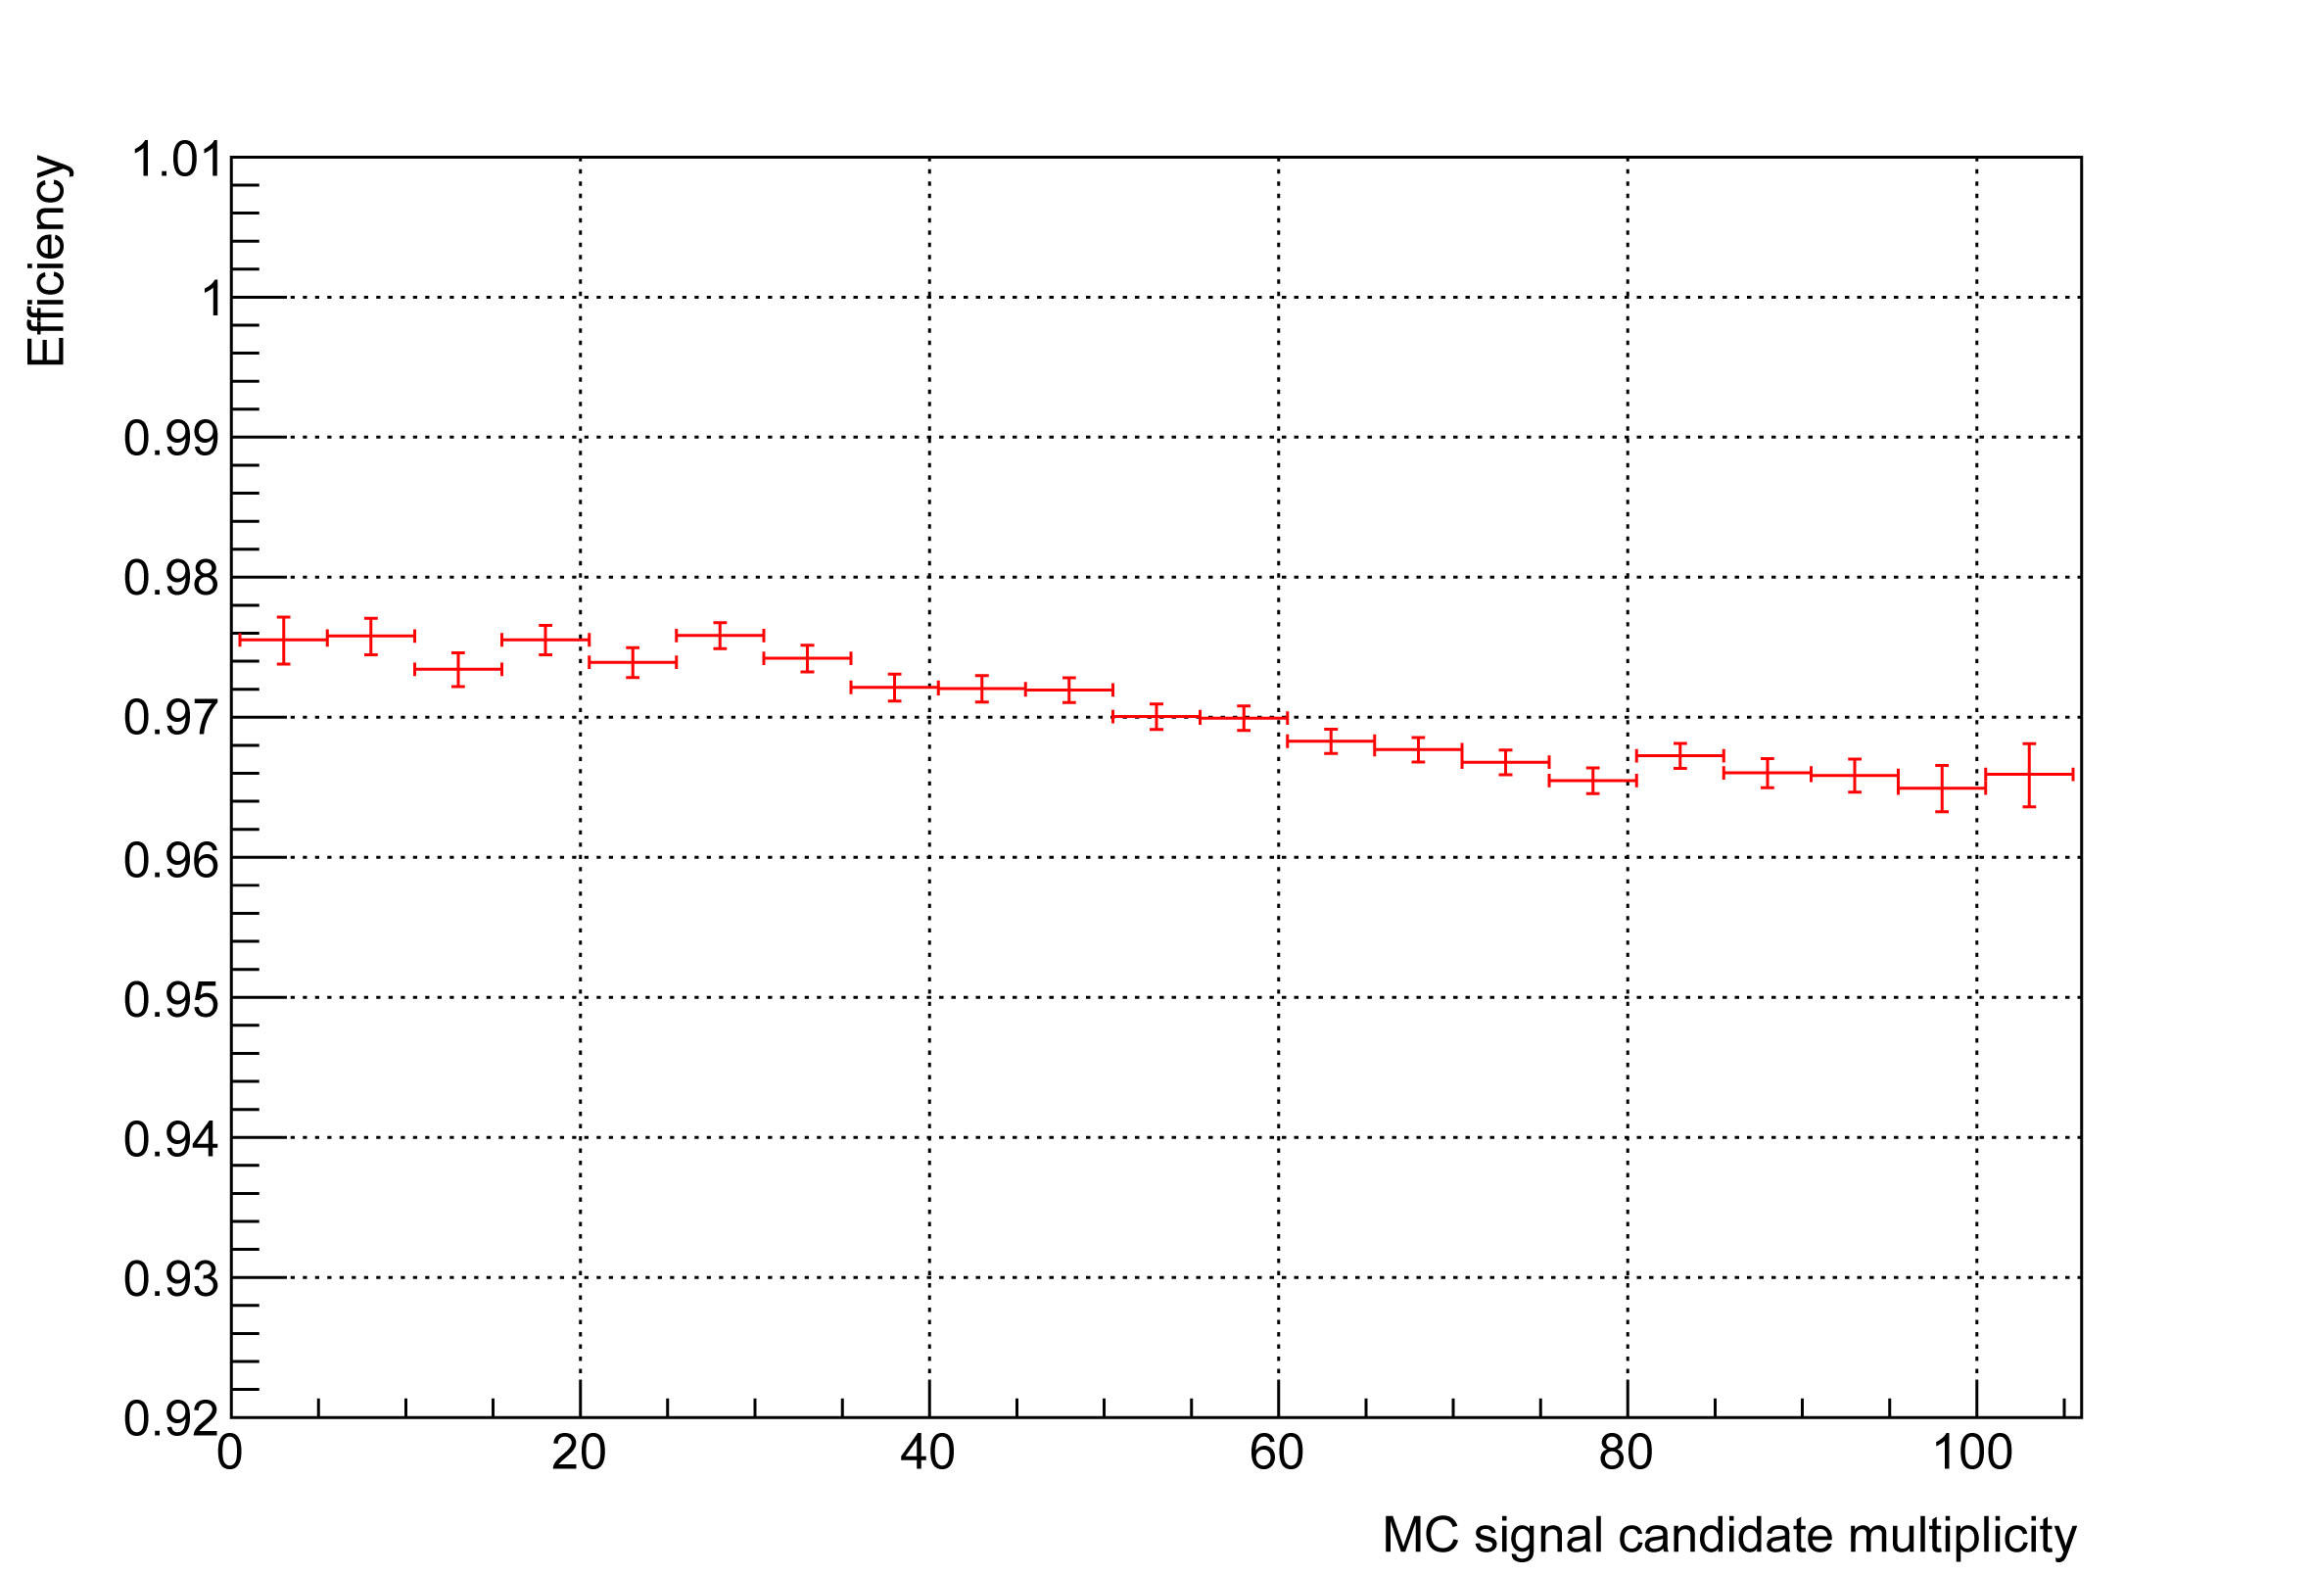
Performance … linearity
Track reconstruction efficiency:
The track reconstruction efficiency is expected vary by < 1% over a generous range of bunch intensities
The linearity requirement of 10% is comfortably met.

Slide 15
Changes since CD-1
At the time of CD-1, we were considering two possible designs for the monitor:
The pixel-tracking based design presented here.
A design proposed by UC Irvine, based on scintillators
An independent review committee was appointed by the spokespersons
The committee concluded that both designs could in principle satisfy the specification, but that the pixel-based design entailed lower risk.
The “Muon catcher” calorimeter was also added to this design to measure the muon content of the out of time signal as a test for false positives.

Slide 16
Quality Assurance
The most important issue in the construction is alignment, which will be monitored continuously throughout the civil construction and detector installation tasks.
Fabrication will be largely subcontracted, and will adhere to the subcontractor requirements in the “Fermilab Quality Assurance Plan”.
The pixels themselves will be qualified according to the standard ATLAS quality control procedure
(See JINST Vol 7. p. 11010 (2012)).

Slide 17
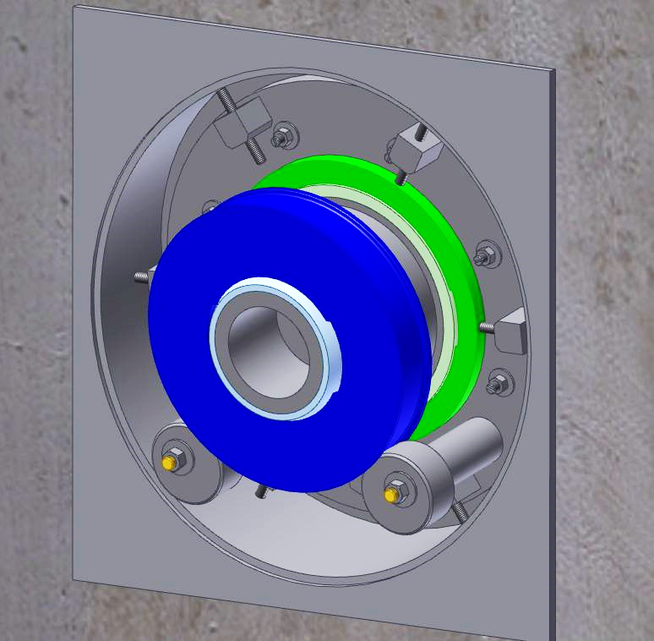
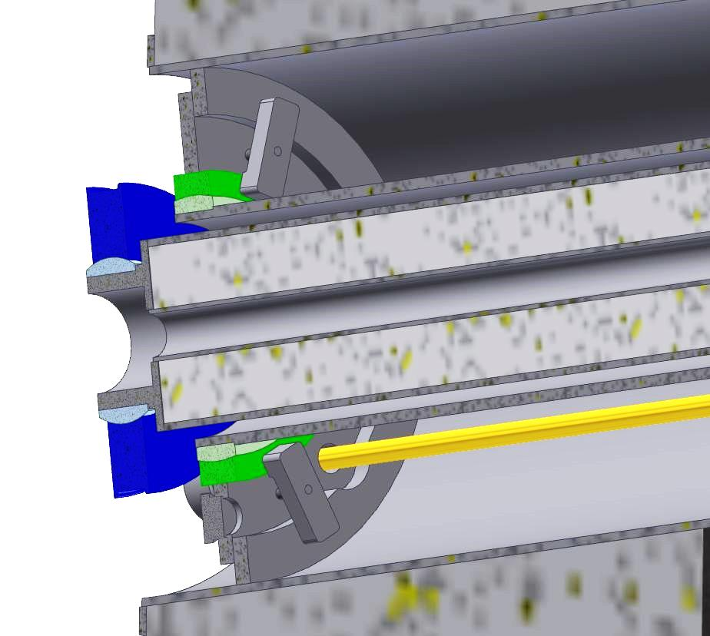
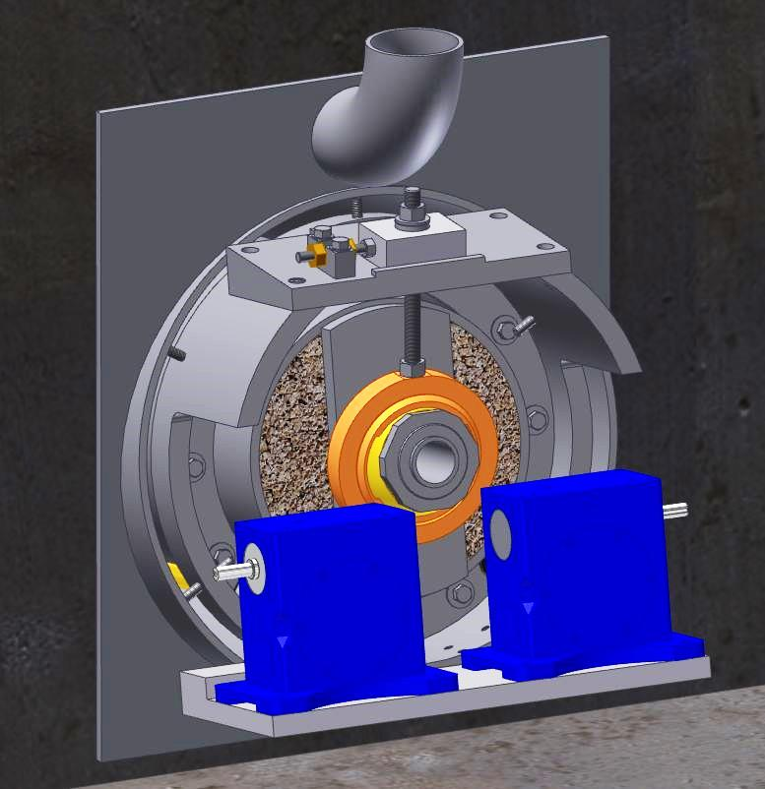
ES&H
The external monitor will not be accessible during operation, but simulations show there will not be any significant activation present when beam is off.
The target hall will however, not be easy to access and hence the entry collimator has been designed so that any necessary alignment adjustments can be done from the downstream end
Alignment cams
Cam shaft
Gear boxes

Slide 18
Summary
We have designed an extinction monitoring system that meets the requirements of the Mu2e experiment.
We are confident that we have met the requirements for CD-2 approval of this system.
Preliminary design complete
Project ready to baseline

