Slide 1



Mu2e CD-2 Calorimeter
Waveform Digitizer
U.S. DEPARTMENT OF
ENEGY
Office of
Science
Gianantonio Pezzullo
University and INFN of Pisa, Italy
October 23, 2014

Slide 2
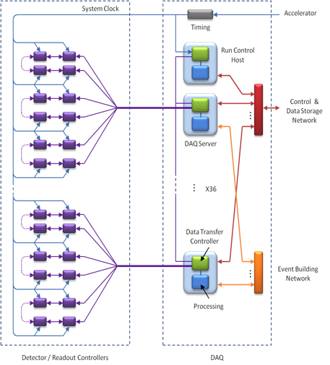
Mu2e DAQ system
DAQ architecture supports both streaming (Tracker, Calorimeter) and triggered (CRV) readout
DAQ Servers handle data readout, event building and processing
Bidirectional front-end interface for fast control and readout
Large front-end buffers for uniform data transfer

Slide 3
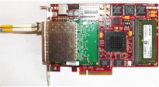

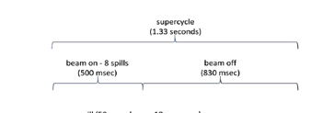
Mu2e DAQ system (Tracker example)
FEE
FEE
FEE
WD
WD
WD
WD
LVDS
FEE amplify and generates the signals
Waveform Digitizer (WD) performs: digitalization, pedestal suppression, sparsification and compression
ReadOut Controller (RoC) receives data from WD and write them in a huge buffer (~ 1 s od data)
Data are transferred to the DAQ during the supercyccle period (500 ms beam-on, 830 ms beam off)
ROC
WD
WD
WD
WD
LVDS
ROC

Slide 4
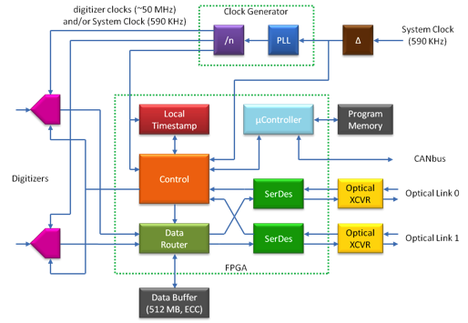
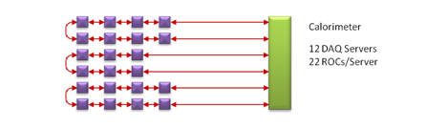
Roc
Readout Controller:
  WD interface
  Optical redundant connection throw DAQ servers (2.5 Gbit, 8b/10b)
    Slow control
    Timestamp
  Can be linked in daisy chains (rings)
  Project and specifics (hardware + firmware) under study @ FNAL for the tracker
Calorimeter will use 22 links ( 22 rings)

Slide 5
Calo WFD bandwidth and specifications
1860 crystals, 3720 channels (APD, SiPM, …)
BaF₂ : signal width ~ 50 ns , 200 mV → ADC sampling 200 MHz 12 bit.
  10 samples per signal, 20 con safety margin 2 after zero-suppression
  Mean occupancy after zero-suppression 20% → 40 kHz rate
3720 (chan.) x 12 (bits) x 20 (samples) x 40,000 (hits/s), corresponding to 35.7 Gbps + header + slow control (10 %) → 40 Gbps
22 links @ 2.5 Gbips (3.125 encoded) → 55 Gbps → bandwidth is OK
The FPGA will be the core component of the WD board. It will:
− Drive the ADCs control signals to synchronously get all the samples
− Write the data to a DDR memory. Data will be sent to the DAQ in the inter-spill period. Read data from the DDR and serialize them
  The WFD will be daisy-chained in rings. Each FPGA will thus receive data from the previous WD, add its own data and send them again to the next board
  Slow control commands will be received and served by the FPGA through the same fibers used for data

Slide 6
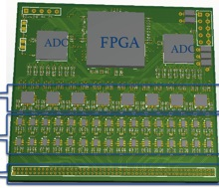
Calorimeter DAQ
  Tracker needs lots of logic on the digitizers, because it implements TDC on FPGA => backplane + ROC + 6 WD ( 7 FPGA “microsemi” / 96 channel)
  Two options under study for the calorimeter:
    ~ tracker
    ROC logic +analog + ADC on the same board/FPGA
ROC + analog + ADC
ROC
WD
WD
WD
WD
ROC
WD
WD
WD
WD
ROC + analog + ADC
ROC
WD
WD
WD
WD
ROC + analog + ADC

Slide 7
Calorimeter DAQ 2
“SuperRoC” option is preferable (one project, no links needed between boards…)
  Studies underway for taking the final choice:
    No options for Soc: Microsemi SmartFusion2 M2S150T
    Board dimensions constrained by the distance between the two
    calorimeter disks ( max allowed 15 x 15 cm² )
    Max number of boards imposed by the adopted mechanics
Single board option OK if:
  Board dimensions fit in the mechanics
  FPGA logic sufficient
Number of boards depend on the final # of channels choice:
  16 ch → 232 boards (our baseline goal)
  32 ch →116 boards (if achievable)

Slide 8
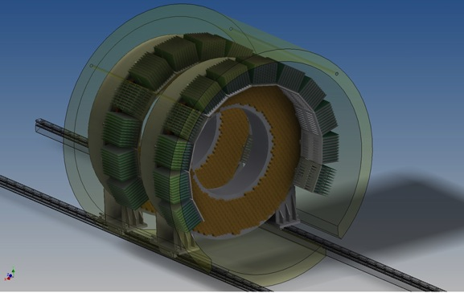
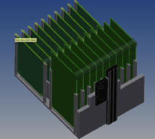
Mechanics
Electronics housed in crates (custom or standard) behind the disks

Slide 9
Mu2e environment
High magnetic field (1T) → problems for magnetic nuclei of DC-DC converters
Radiation (not too high but present) 100-1000 rad/y and high neutron flux (~1000 cm²/sec) → select rad-hard components
  FPGA (Soc) SmartFusion2 M2S150T is flash based, so no SEU
  ADC used in the prototype ADS58C48 must by qualified
All the electronics is in vacuum → degassing problems and need to use only conductive thermal dissipation.
Maintenance complicated → cryostat will not be opened more often than once per year
Project must be realized in “high reliability mode”,
like an experiment in the space

Slide 10
DC/DC
High efficiency needed, but high magnetic field present. It is not so easy to implement it.
FNAL technical devision is developing a DC/DC converter in B field (air inductor in air). Work is in progress. It will be used also by the tracker system.
INFN R&D (CSN-5) dedicated program has selected a commercial DC/DC converter which works on B-field and seems to satisfy the Mu2e requirements. Validation of this new DC-DC converter underway.

Slide 11
Prototype Digitizer PCB (1)
Prototype Digitizer PCB Block Diagram
5 boards of 8 channels/each with 200 msps and 12 bit ADC resolution constructed at University of Illinois. SOC: Xilink Spartan 6

Slide 12
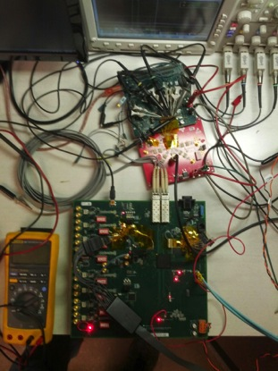
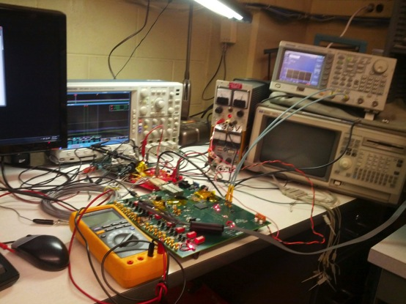
Prototype Digitizer PCB(2)
Pictures of the test setup for the digitizer at the University of Illinois

Slide 13
Prototype Digitizer PCB (3)
Testing and FPGA firmware development is ongoing.
  Hardware Subsystems Testing:
    Hardware subsystems on the board are being tested for functionality.
  Rate Testing:
    Firmware being written to perform a rate test to verify digitizer can handle data rates needed for project.
    Firmware will:
      Upon receipt of a “Start Trigger” signal, capture 10 samples of 11-bit, digitized data from 8 TI ADS58C48 ADCs.
      Convert the 11-bit data into 16 bit data.
      Combine & serialize data from all 8 channels
      Attach start of frame character and end of frame character to serialized data.
      Send frame data out Fiber Optic Transceiver, transmitters.
      Loopback optical frame data into Fiber Optic Transceivers, receiver.
      Compare frame data sent with frame data received, & assert error (light on-board led) if communication errors exist.
      Count errors occurring during transmission of frame data.

Slide 14
INFN short term Milestones
2014: in progress now .. usage of 2 demo boards smartFusion2 for doing preliminary transmission test via optical fiber
2015: realize a digitizer prototype and define the final factorization of the system, number and type of boards, number of channels, form factor.
2015: test all components @ high B field and high radiation environment

Slide 15
475.07.05 Digitizer cost breakdown & estimate
Sum of Value
Resource Type | Total
M Material | 12
N Non-Fermi Labor | 96
Grand Total | 108

Slide 16
475.07.05 Fee & Digi Labour and Material
Sum of Value
Resource Type | Total
M Material | 12
N Non-Fermi Labor | 96
Grand Total | 108

Slide 17
475.07.05 Fee & Digi FTE resources
Sum of Value
Resource Type | Total
M Material | 12
N Non-Fermi Labor | 96
Grand Total | 108

Slide 18
ADDITIONAL MATERIAL

Slide 19
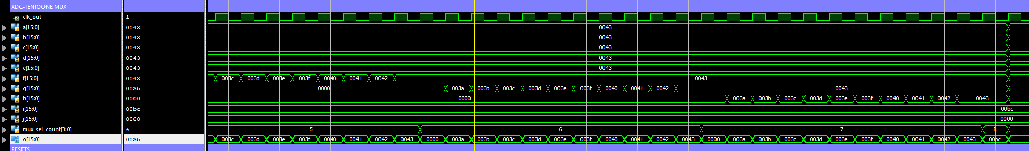
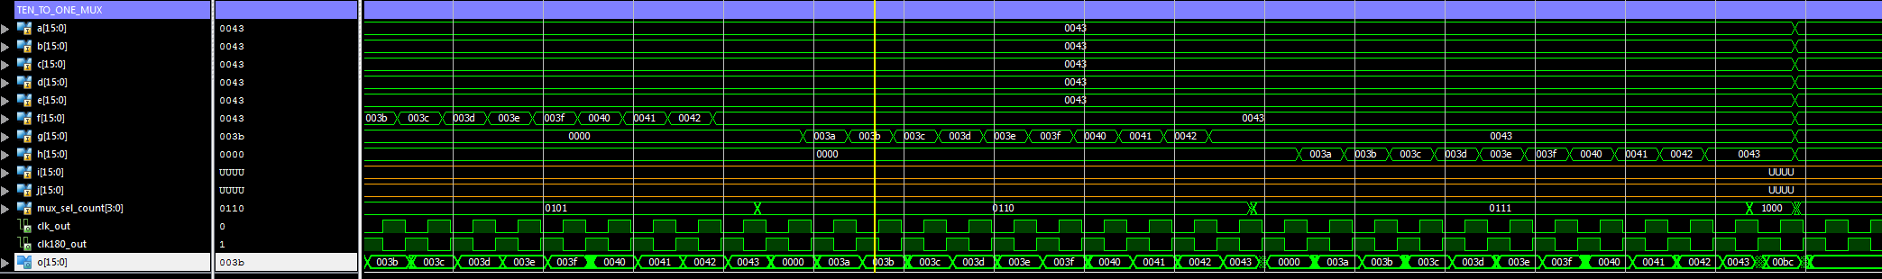
Extra Slides…
Behavioral Simulation screen captures of data going into & out of ten_to_one_mux module
Post-Route Simulation screen captures of data going into & out of ten_to_one_mux module

Slide 20
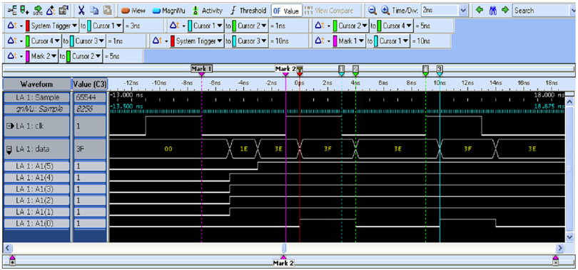
Extra Slides…
Logic Analyzer Screen Capture Showing All ‘Ones’ being outputted from ADC
(0b 111 1111 1111 => 0x3e, 0x3f)

Slide 21
Preliminary studies: Prototype Digitizer PCB
Block Diagram of Rate Test Firmware, Version 1
(Written in VHDL)

Slide 22
Prototype Digitizer PCB (4)
Rate Tests:
  First, write VHDL firmware to perform rate test @ 1.25 Gbips.
    Firmware is currently being written & tested.
      Firmware has passed functional simulation.
      Firmware has not yet passed post-route simulation and is under development.
        Post-route simulation has passed sending correct data through ten_to_one_mux module(see picture on previous slide).
        Post-route simulation for FIFO & Transceiver is currently under development.
      Firmware won’t be programmed into FPGA and tested, until it passes post-route simulation.
  Second, write VHDL firmware to perform rate test @ 2.5 Gbips.
    Test has not been started yet.
    Use the code from 1.25 Gbips test.
    Increase the clocks to capture data at a faster rate.
    Change transceiver clock & settings to increase output to 2.5 Gbips.

Slide 23
Preliminary studies: Prototype Digitizer PCB
Hardware Tests:
  First, write firmware (VHDL or ANSI C/C++) to test each subsystem.
    Optical Transceiver, ADCs, Clocks have been tested and are functional.
    Microcontroller, & CAN Interface are under development.
    Memory has some code written, but not complete or have been tested yet.
  Second, verify ADC data output format is well understood.
    Use Texas Instruments ADS58C48EVM, evaluation module & Prototype Digitizer PCB to understand ADC data output format.
    ADC data output format is understood and can be applied to rate test firmware.

Slide 24
Preliminary studies: Prototype Digitizer PCB
  Rate Testing (Cont.):
    Firmware Development Workflow:
      Write code.
        Fix syntax errors.
      Perform Behavioral Simulation.
        Fix logic errors.
        Iterate, until it passes Behavioral Simulation
      Perform Post-Route Simulation
        Fix Timing Errors.
        Re-write code.
        Iterate, until it passes Post-Route Simulation
      Program FPGA & confirm code works in hardware.
      Ie. Upon receipt of “Start Trigger” signal, will board capture data from 8 ADCs, digitize, serialize, and be outputted correctly @ 1.25 Gbips & 2.5 Gbips?

Slide 25
Preliminary studies: Prototype Digitizer PCB
Hardware Subsystem Testing:
  Tests are done to verify that each subsystem is working properly.
  Firmware either has been or has to be written to correctly perform the hardware tests.
  Subsystems being tested are:
    FPGA programmability
    ADCs
    Clocks
    Optical Transceivers
    Microcontroller
    CAN Interface
    Memory

