Slide 1
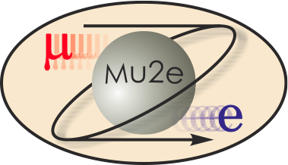
475.04.02 Production Solenoid
Vadim Kashikhin
L3 for Production Solenoid
October 21-24, 2014

Slide 2
Requirements - role of Production Solenoid
The Mu2e magnet system consists of three large superconducting solenoids. Production Solenoid (PS) is the first magnet in the chain, which collects and focuses pions and muons generated in interactions of an 8-GeV proton beam with a tilted high-Z target and directs them towards Transport Solenoid (TS).
PS performs the following functions in mu2e experiment:
Maximizes muon yield by efficiently focusing secondary pions and subsequent secondary muons towards the Transport Solenoid (TS) system, in the momentum range to be stopped in the stopping target;
Provides a clear bore for beam line elements such as the primary production target and secondary particle Heat and Radiation Shield (HRS);
Allows the primary proton beam to be steered into primary target; allows outgoing proton beam to exit without striking PS magnet shield.

Slide 3
Requirements - general
Magnetic:
  Nominal peak field on the axis 4.6 T;
  Maximum peak field on axis 5.0 T;
  Axial gradient -1 T/m;
  Gradient uniformity ±5 %.
Electrical:
  Operating margins: ≥ 30 % in I_{c}, ≥ 1.5 K in T_{c};
  Operating current 9÷10 kA;
  Peak quench temperature ≤ 130 K;
  Voltage across terminals ≤ 600 V.
Structural:
  Withstand forces at all conditions while part of the system or stand-alone;
  Cryostated magnet weight ≤ 60 tons;
  Compliance with applicable structural codes.
Cryogenic:
  Cooling agent: LHe at 4.7 K;
  Total heat flow to LHe ≤ 100 W;
  Cryostat ID 1.5 m;
  Conduction cooling.
Radiation:
  Absorbed dose ≤ 7 MGy total;
  Minimum RRR of Al stabilizer in the operating cycle ≥ 100.
Production Solenoid Requirements Document, Mu2e Document 945

Slide 4
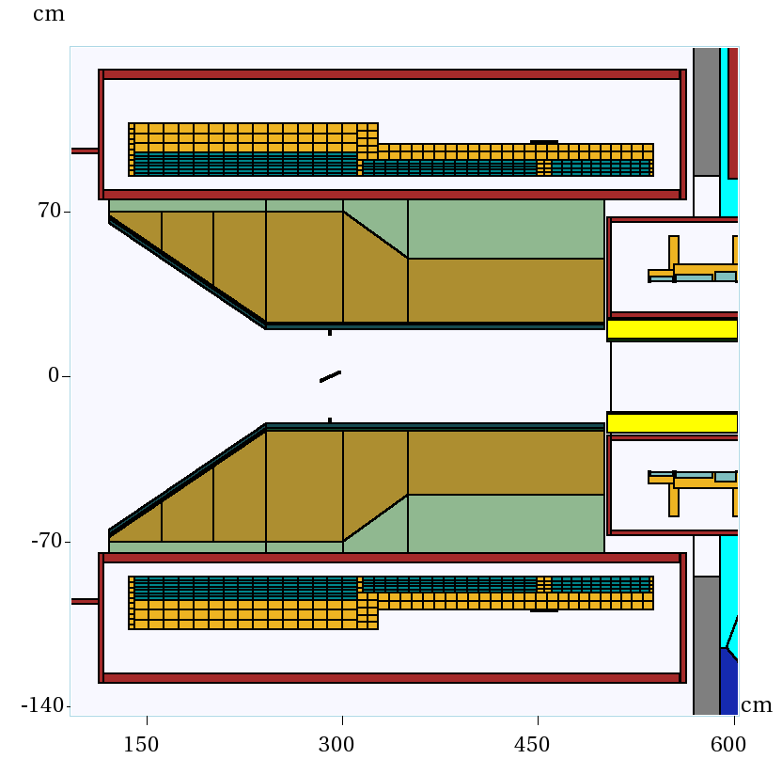
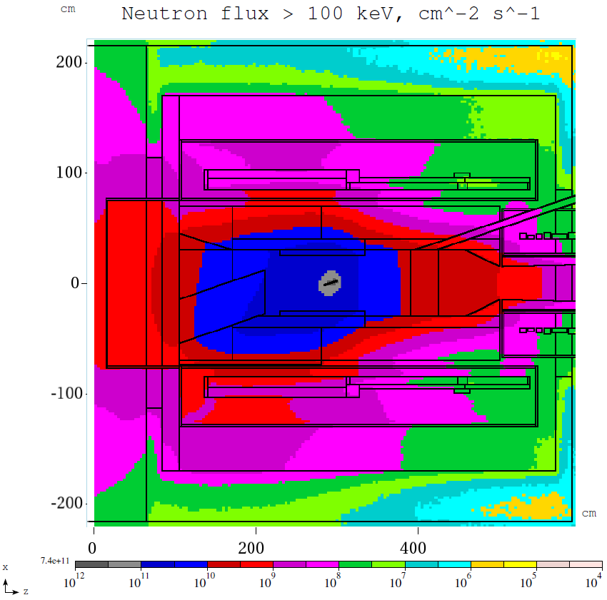
Requirements - radiation environment
It is expected that RRR will degrade after one year of operation as follows:
  Al RRR 500 → 100;
  Cu RRR 100 → 50;
Once the critical degradation is detected, the magnet will be thermo-cycled to recover the resistivity.
Requirements for the Mu2e Production Solenoid Heat and Radiation Shield, Mu2e Document 1092

Slide 5
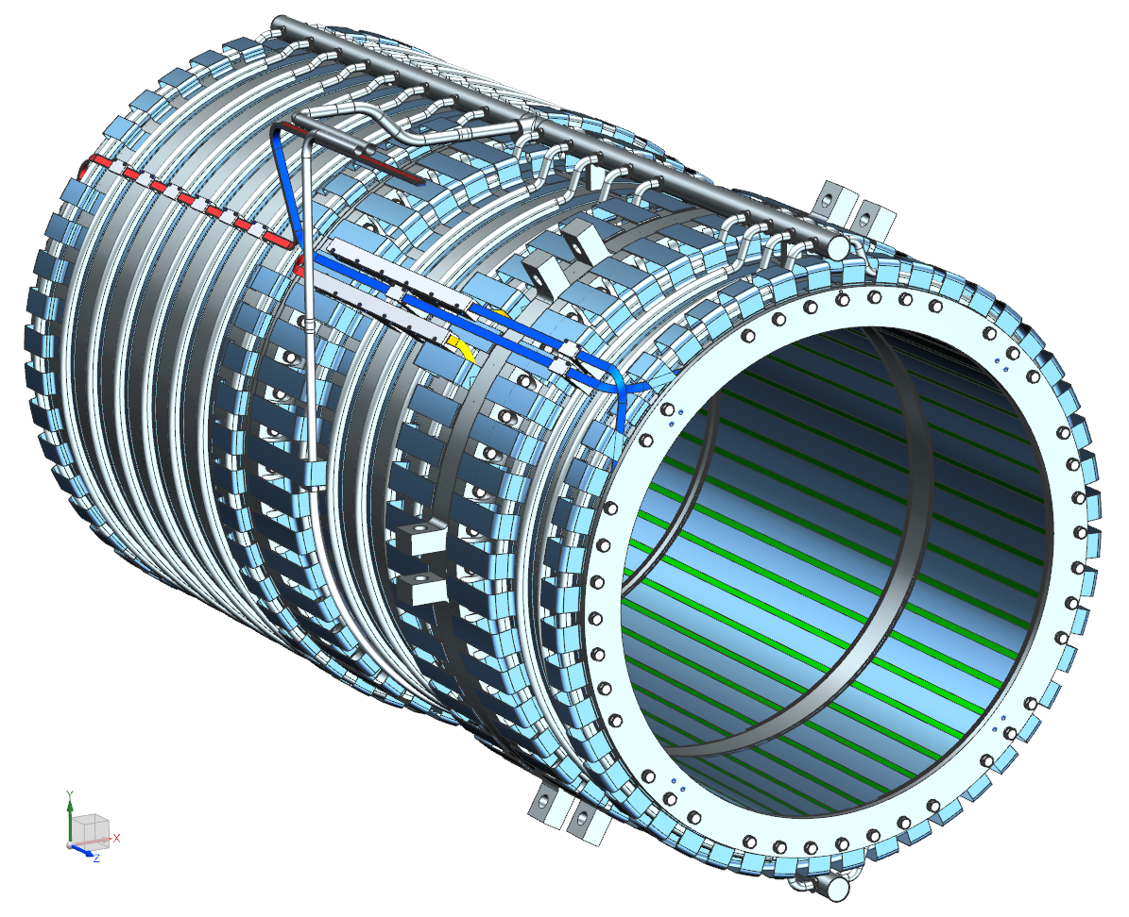
Design - main features
PS consists of three coil modules with 3-2-2 layers of the same Al-stabilized cable wound in the “hard way”;
Each module has an outer support structure made of Al 5083-O to manage the forces;
The shells are bolted together to form a single cold mass assembly.
The coil modules are installed inside of cryostat using axial and transverse supports.
Reference Design of the Mu2e Production Solenoid, Mu2e Document 3647

Slide 6
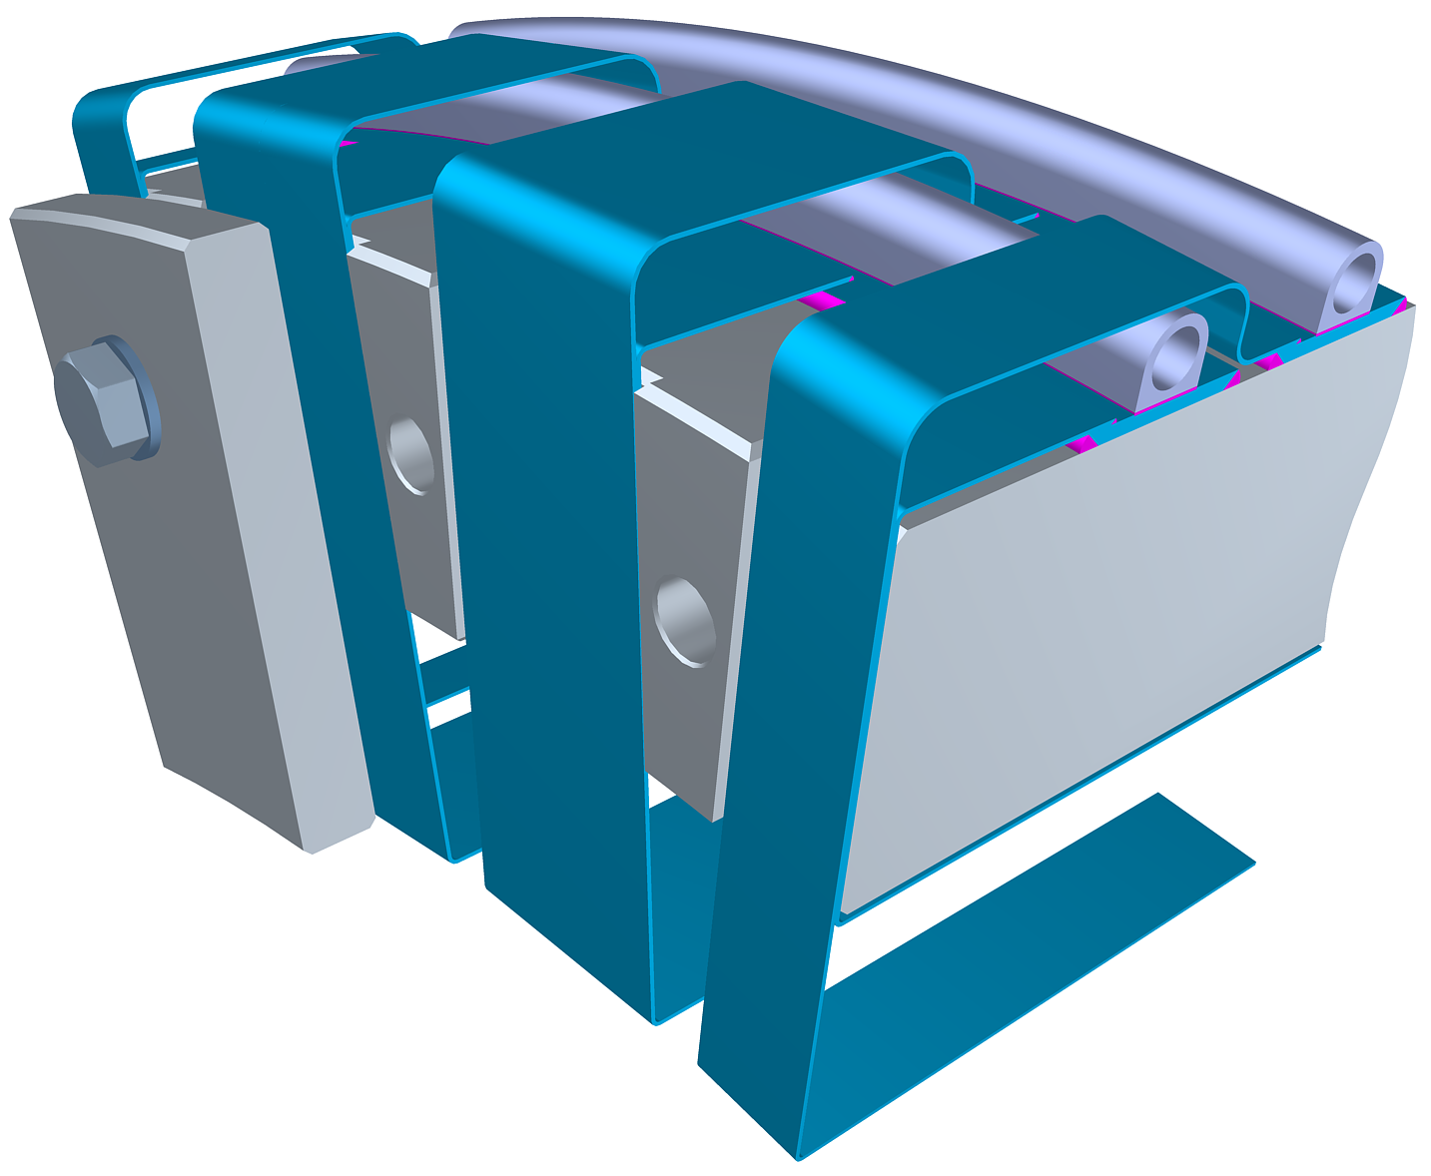
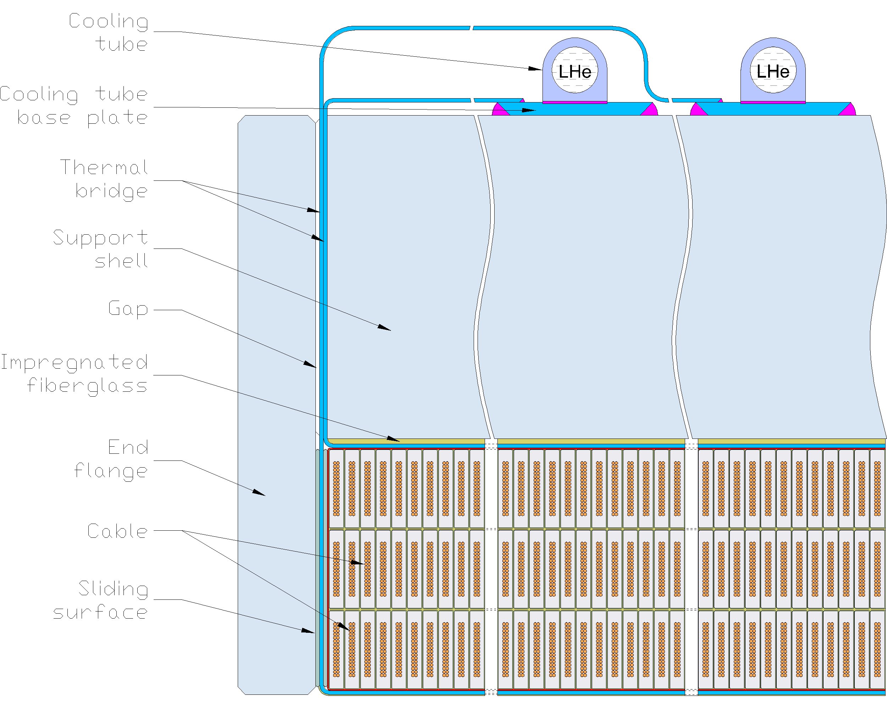
Design – cold mass components
Cables;
Cable insulation;
Ground insulation;
Thermal bridges;
Coil-shell buffer;
Washer plates;
Support shells;
End flanges;
Sliding layers;
Cooling tubes.

Slide 7
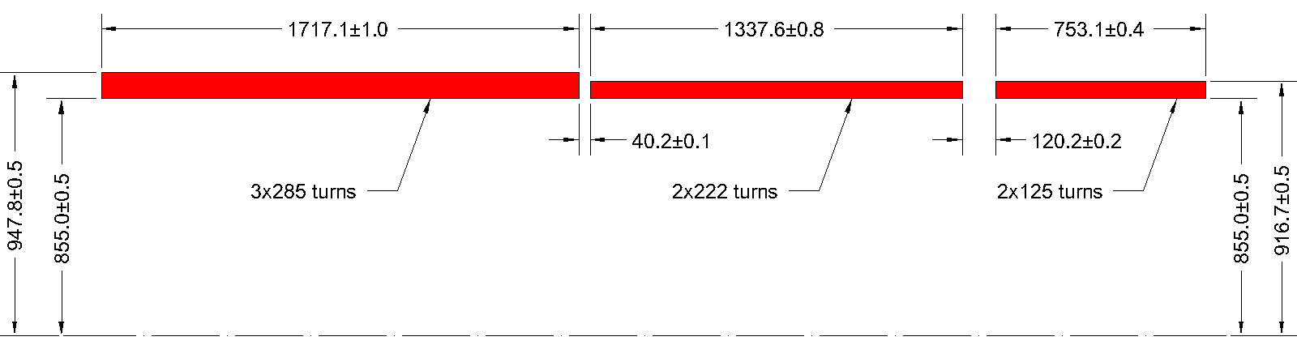
Design - coils and insulation
Coil envelope: exact number of turns and dimensions are important;
Insulation:
  Cable insulation - composite “UG” tape similar to that in ATLAS CS;
  Interlayer insulation: dry E-glass, creates channel for epoxy penetration;
  Ground insulation: dry E-glass and polyamide or “GUG” ATLAS CS type insulation.

Slide 8
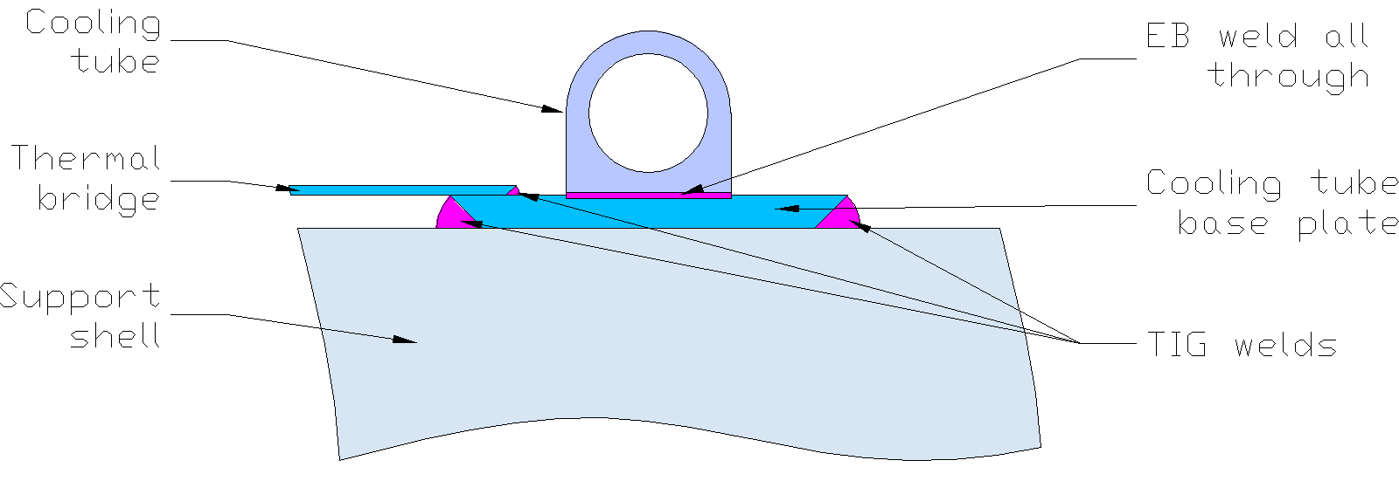
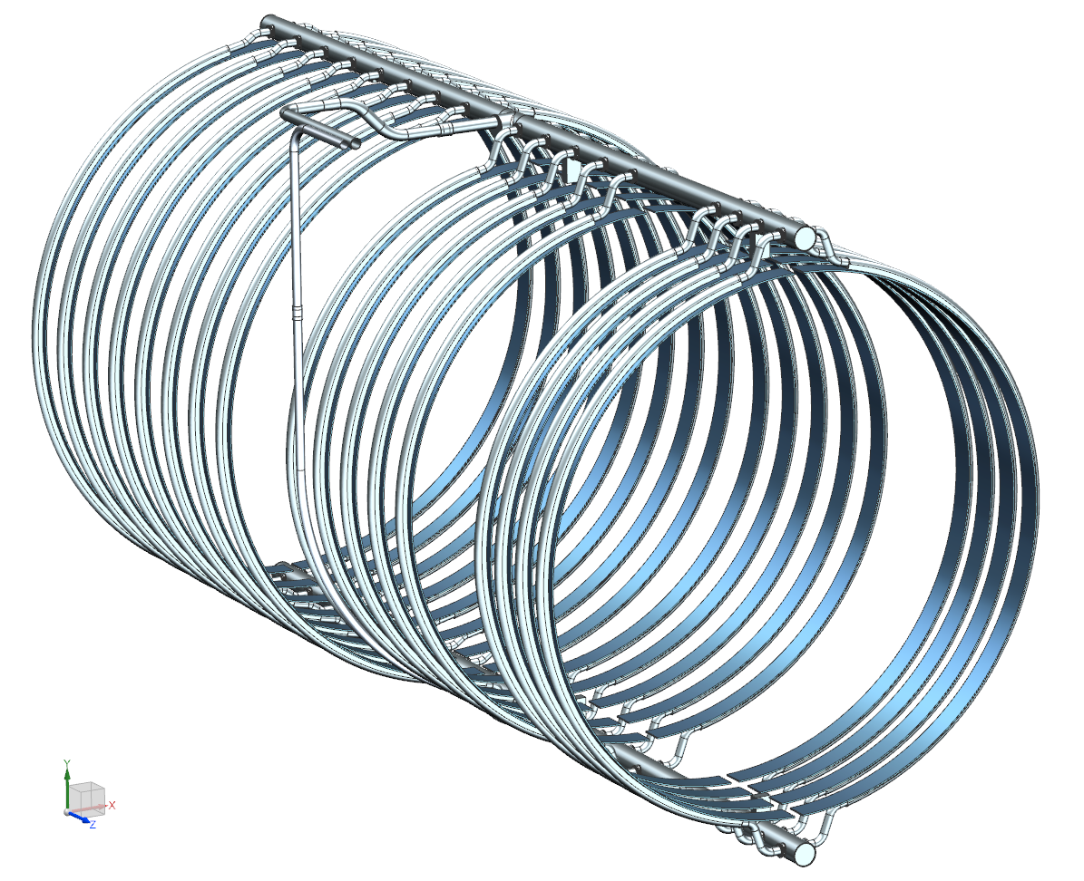
Design - thermosiphon system
2-phase He return
LHe supply
Return manifold
Thermal bridges (TB) are the main elements of the coil heat extraction:
  TB connection to the cooling system is an important design detail;
The D-shaped cooling tubes are EB-welded to the base plates of 5N Al;
TBs are TIG welded to the base plates;
This design minimizes ΔT between TB and LHe.
Transition tubes
PS Thermosiphon Design - Separated and Homogeneous Flow Models, Mu2e Document 4620
Supply manifold

Slide 9
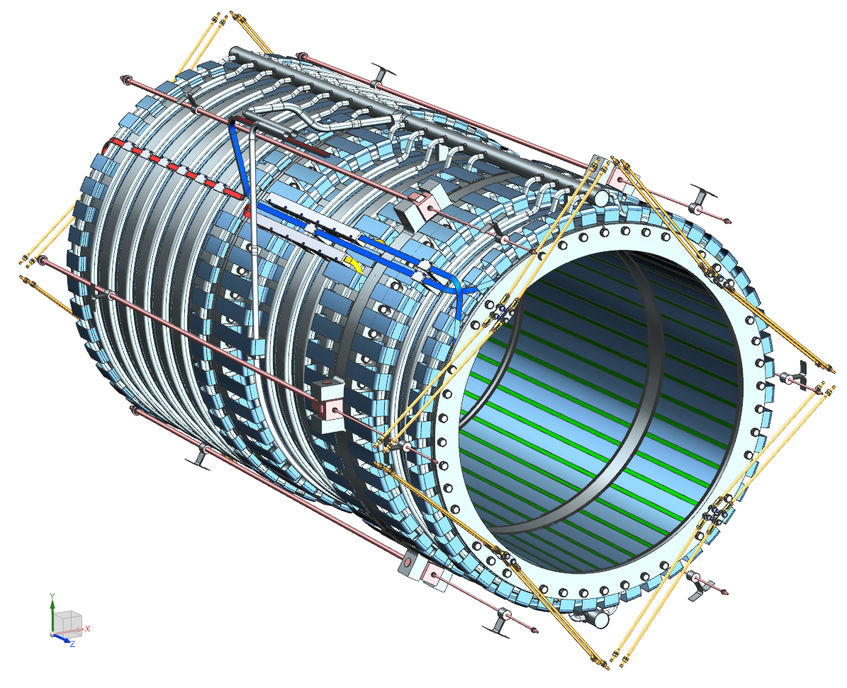
Design - cold mass suspension system
Axial suspension:
  6 asymmetric pairs of Inconel-718 rods;
  Belleville springs at each rod’s end to compensate the thermal contraction.
Radial suspension:
  4 pairs of Inconel-718 rods at each end;
  Half of the rods is loaded through the Belleville springs to compensate the thermal contraction.

Slide 10
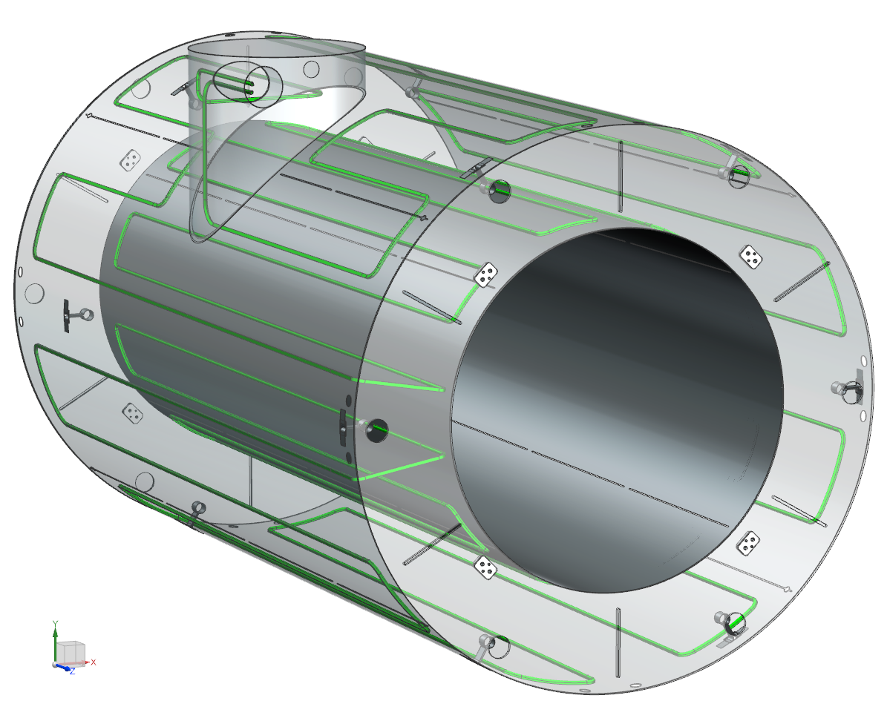
Design: 80 K thermal shield
Made of 6061-T6 aluminum;
LN2 tubing welded to the cold mass side of the shield;
Same radial suspension as for the cold mass;
Axial and radial slits in the shells and flanges to cut eddy currents in case of quench.

Slide 11
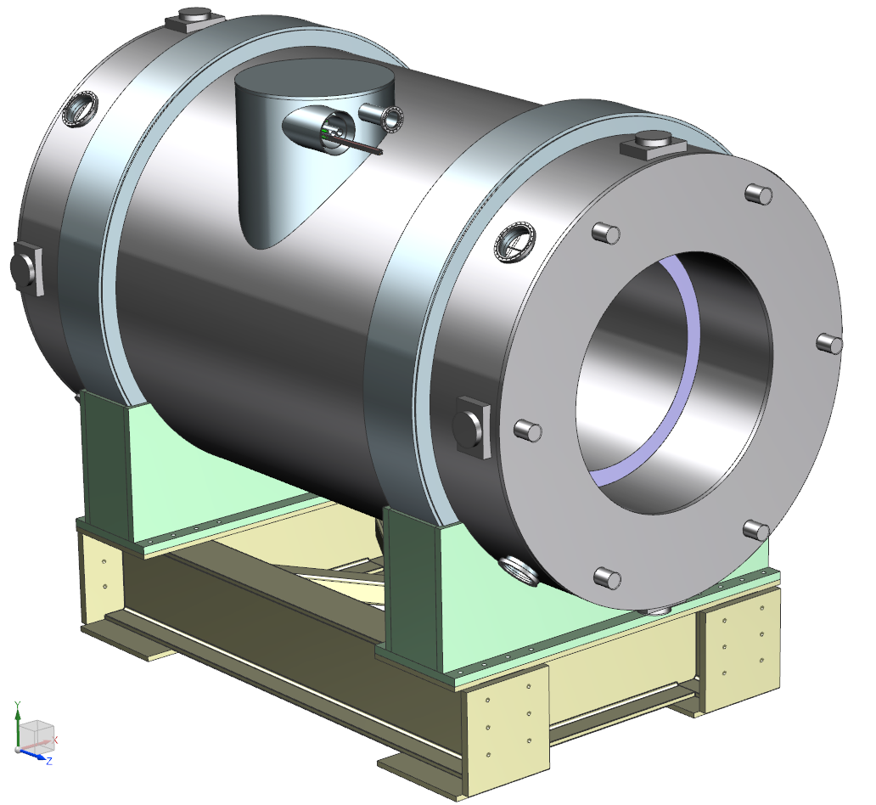
Design: vacuum vessel & support frame
Provides insulating vacuum and attachment points for all components (in and out);
Transfers all loads to ground:
  Cold mass and LN₂ shield weight through the radial supports;
  Lorentz forces through the axial supports;
  HRS weight through the inner shell (~55 tonnes);
Provides interfaces to:
  HRS upstream, downstream;
  Transport solenoid;
  Transfer line;
  Instrumentation line;
  Vacuum system.

Slide 12
Improvements since CD-1
  Initial RRR of Al stabilizer was reduced (600 → 500) to meet cable vendor capabilities;
  Plastic deformation of the Al stabilizer during cool-down and energizing has been extensively modeled. It was found that the shell thicknesses need to increase (83 mm → 125 mm, 50 mm → 70 mm) to comply with the structural code;
  High-strength Al alloy was selected instead of stainless steel for the bolts connecting the coil modules together;
  Trim power supply, extra bus-bar and HTS lead were eliminated. The field matching between PS and TS will be accomplished by trimming the current in TS1.

Slide 13
Value Engineering since CD-1
The design has been largely “fixed” for the purpose of developing a detailed reference design report and solid models to solicit vendor quotes for the final design and construction.
Trim power supply, extra bus-bar and HTS lead were eliminated.

Slide 14
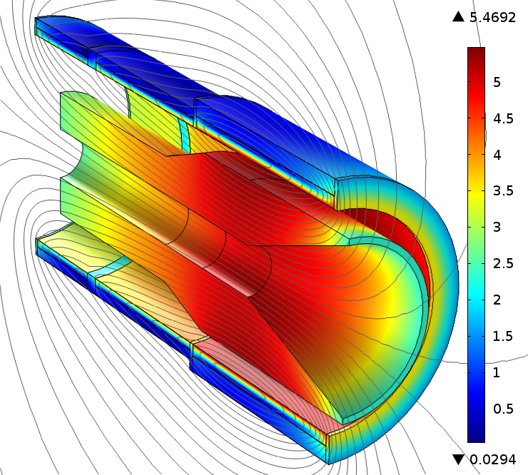
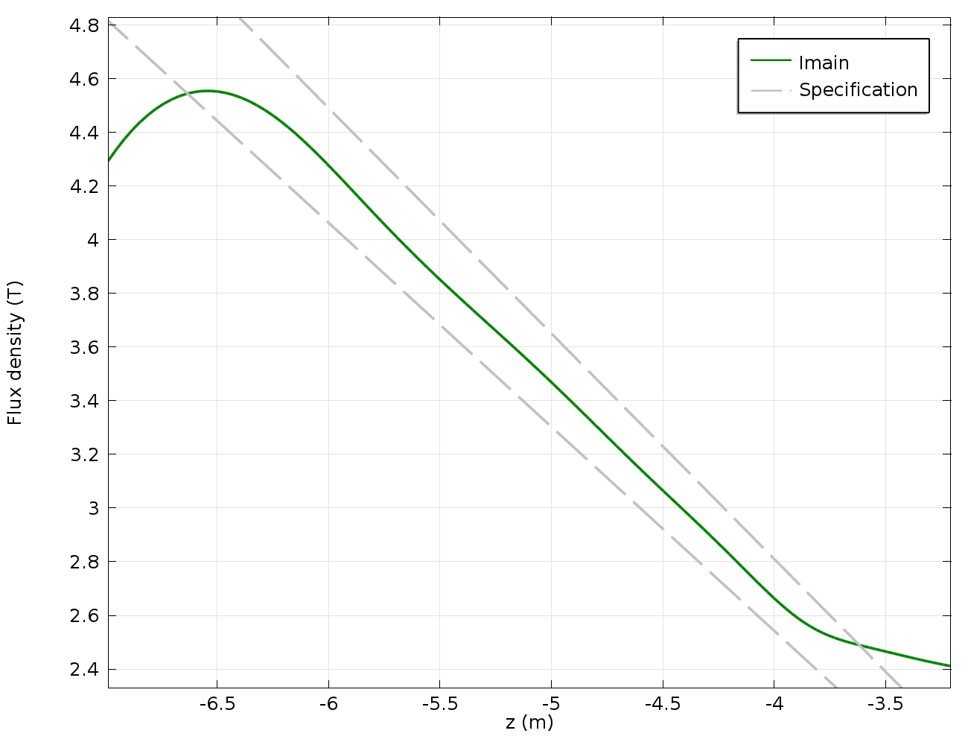
Performance - magnetic field
The magnetic field profile is within the specification;
Radiation shield (shown) made of high-resistivity bronze (magnetic permeability of ≤1.04) has minor impact on the field quality.

Slide 15
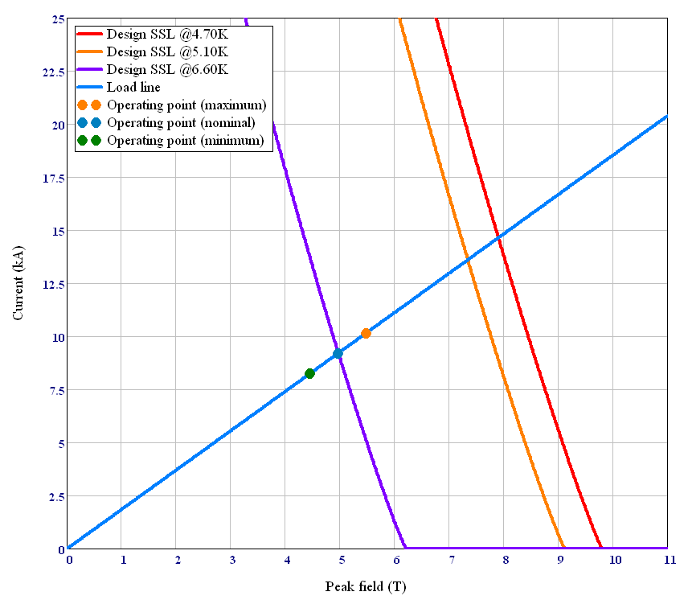
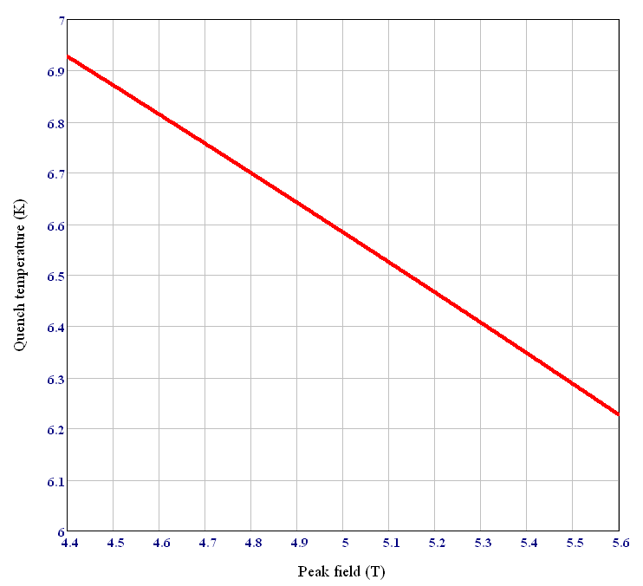
Performance – operating margins
Maximum current
Nominal current
The 1.50 K thermal margin must be maintained during the nominal operation per the magnet requirements;
It defines the maximum allowed coil temperature of 5.10 K (at the nominal current).

Slide 16
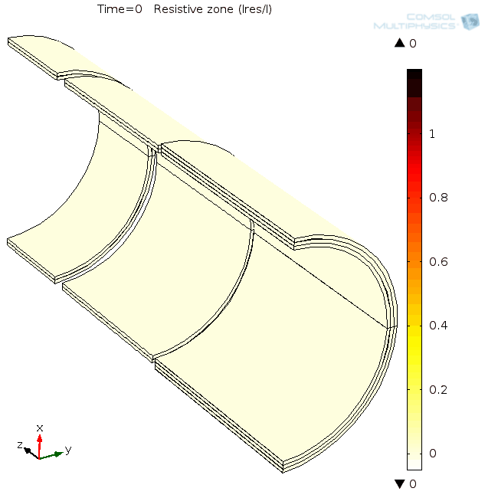
Performance - quench protection
RRR_{Al} = 100, with the HRS
The peak coil temperature is well below the limit of 130 K during normally-protected quenches.

Slide 17
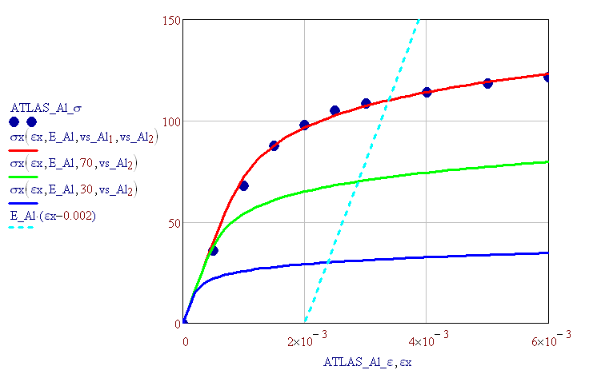
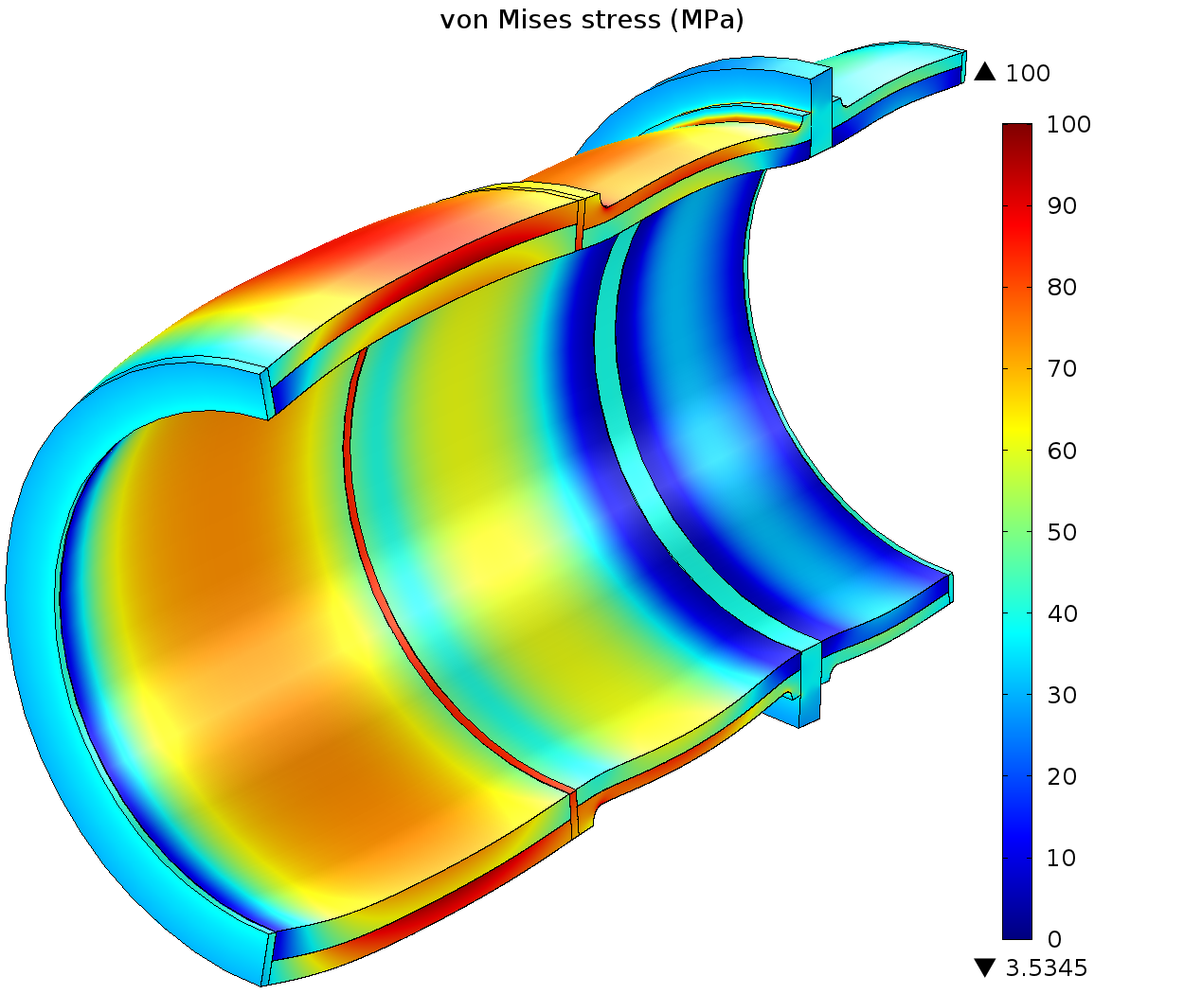
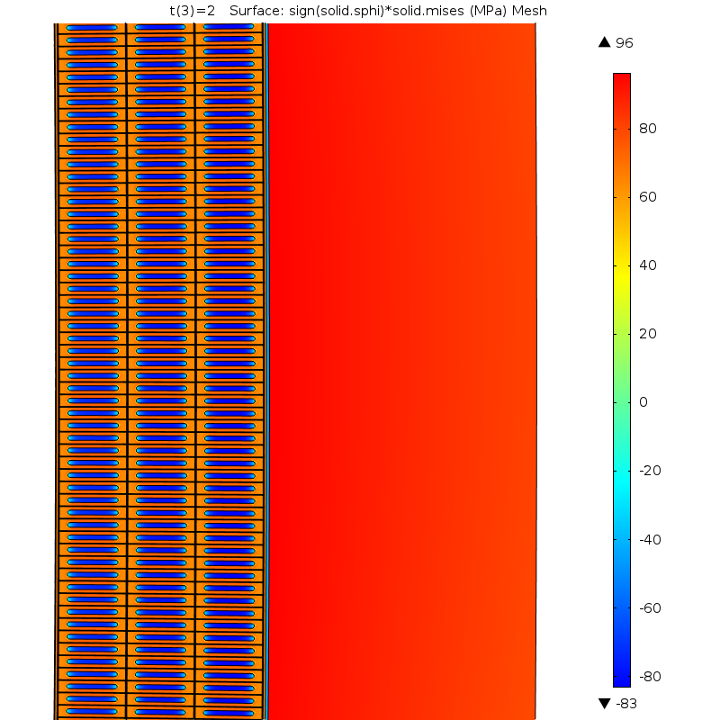
Performance - structural analysis
T = 5 K, I = I_{max}
elastoplastic coil properties
96 MPa
peak stress
The peak shell stress is below the maximum allowable value specified by ASME BPVC.

Slide 18
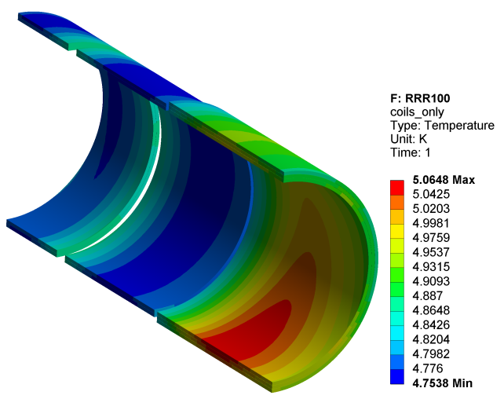
Performance – thermal analysis (T₀=4.7 K)
Operation conditions:
  RRR = 500, static heat load;
  RRR = 500→100, static+dynamic heat load;
The peak temperature is below the maximum allowable value at all conditions.

Slide 19
Remaining work before CD-3
Procure long-lead items:
  Order the production quantity of PS cable
    Hold points – delivery of the first 100 m of cable (prototype) and the longest piece length of 1.7 km (first article);
  Order final engineering design of PS by the magnet vendor;
Conduct technical review of the final PS design;
Prepare final design and drawing of the PS support stand;

Slide 20
Quality Assurance
The reference design has been reviewed by magnet experts, fulfills all the requirements, complies with the structural codes and has appropriate margins used in similar magnets:
  The magnet vendor has flexibility in changing the reference design to optimize the fabrication process. The vendor is responsible for demonstrating that the modified design still meets the requirements;
  Technical review of the final PS design is conducted before the magnet vendor is granted permission to fabricate the magnet.
The magnet vendor has to implement a quality assurance plan that meets the requirements for the design and construction of PS:
  Traveler system calling out all fabrication steps with internal sign-offs;
  Hold points prior to critical operations;
Vendor oversight by FNAL team;
Model coil to validate the magnet production tooling;
Extensive acceptance testing:
  On the production cable prior shipping it to the magnet vendor;
  On the magnet at the vendor site (warm/cold).
Procurement Specification for the Mu2e Production Solenoid, Mu2e Document 3669

Slide 21
ES&H
Radiation:
  The PS and its surroundings will become radioactive and access will be restricted in accordance with Fermilab procedures.
Cryogenic:
  Potential for oxygen deficient atmospheres (ODH). An (ODH) analyses will be conducted. Emergency response procedures will be developed for responding to alarm systems.
Stored Magnetic Energy:
  80 MJ of stored energy in PS the powering circuit. Quench protection systems have been designed to dissipate the stored energy in the solenoids in a controlled and safe fashion.
Coupled Magnetic forces:
  There are large forces within the PS itself as well as between the PS and TS. The PS is designed to resist these forces, but access to the magnet will be restricted during the times when it is powered.
Stray Magnetic Fields:
  >5 gauss fields are of particular concern because they can affect medical electronic devices (pacemakers); fields >600 gauss can impact ferromagnetic materials. The fringe field analysis document is in Docdb - Mu2e Document 1381.
  The PS has no return yoke. Access will be restricted when it is powered and warnings will be posted for persons with pacemakers.

Slide 22
Cost Distribution by Resource Type
Base Cost (AY k$)

Slide 23
Quality of Estimate
Base Cost by Estimate Type (AY k$)

Slide 24
Labor Resources
FTEs by Discipline

Slide 25
Cost Table
WBS 475.04.02 Production Solenoid
Costs are fully burdened in AY k$
 | M&S | Labor | BAC | Estimate uncertainty | % contingency on ETC | Total
475.04.02 Production Solenoid | 13,065 | 2,326 | 15,391 | 2,116 | 15% | 17,507

Slide 26
Major Milestones
Activity ID | Activity Name | Date
47504.2.021255 | T5 - PO issued for PS production conductor | 10/15/2014
47504.2.051655 | T5 - PO issued for PS final design | 10/27/2014
47504.2.031810 | T5 - PS support stand final design complete | 6/11/2015
47504.2.021312 | T5 - PO issued to perform PS production conductor acceptance tests | 8/12/2015
47504.2.051725 | T5 - PS magnet construction authorized | 2/24/2016
47504.2.021335 | T5 - PS production conductor delivered to magnet fabricator | 2/20/2017
47504.2.041040 | T5 - PS instrumentation delivered to magnet fabricator | 6/23/2017
47504.2.051736 | T5 - PS magnet arrives at FNAL | 8/23/2018
47504.2.051890 | T4 - Production solenoid ready for installation | 2/11/2019

Slide 27
Schedule
CD-3a
CD-4
CD-2/3b
CD-3c
Fabricate and QA Superconductor
KPPs Satisfied
Solenoid Design/Prototypes
Solenoid Fabrication and QA
Detector Hall Construction
Solenoid Infrastructure
Solenoid Installation and Commissioning
Fabricate and QA PS Conductor
PS Conductor Delivered to Magnet Vendor
PS Final Design & Rev.
PS Delivered to FNAL
PS Magnet Fabrication and
Acceptance Testing
PS Delivered to Experimental Hall
PS Support Stand Fabrication and QA
PS Support Stand Delivered to Experimental Hall
Q3 | Q4 | Q1 | Q2 | Q3 | Q4 | Q1 | Q2 | Q3 | Q4 | Q1 | Q2 | Q3 | Q4 | Q1 | Q2 | Q3 | Q4 | Q1 | Q2 | Q3 | Q4 | Q1 | Q2 | Q3 | Q4 | Q1 | Q2 | Q3 | Q4 | Q1 | Q2 | Q3 | Q4
FY14 FY15 FY16 FY17 FY18 FY19 FY20 FY21

Slide 28
Summary
The PS reference design meets all the requirements; the magnet vendor is to develop the final engineering design; technical design review will be performed prior to the magnet construction;
The magnet vendor has been selected. The vendor’s proposal for the final design and construction are included into the project cost and schedule;
ES&H issues have been analyzed and addressed;
Order for the production quantity of PS cable is in the process of being placed;
PS is ready to move into the final design phase.

