Slide 1
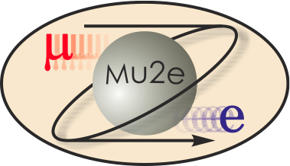
Solenoid Risk Analysis
Michael Lamm
L2 for Solenoids
10/21-24/2014

Slide 2
Outline
Solenoid Overview
Risk identification Procedure
How Risk is converted to $$$
Risk list as input to Mu2e Risk Management Analysis
Conclusions

Slide 3
Mu2e Solenoid System
Three solenoids, provide magnetic field for experiment
Production
Solenoid
Detector
Solenoid
protons
1 T
2.5 T
4.6 T
1 T
2 T
Transport
Solenoid

Slide 4
Scope Review
PS and DS: Final Design, Tooling and Fabrication by Vendor, from a detailed preliminary design and procurement spec. Final full-field testing at the vendor is an option.
TS: Components including coil modules built by Vendor, from final drawings from Mu2e project. Final testing is to be performed at Fermilab
Cryo distribution cold boxes and transfer lines built to print in industry
For all solenoid deliverables, we are responsible for the installation and commissioning and co-responsible for interfaces

Slide 5
Contingency: Estimate Uncertainty vs. Risk
Project holds contingency based on estimate uncertainty and risk
Estimation uncertainty is based on maturity of estimation
  Low uncertainty on vendor quotes, higher on engineering estimates.
Many of the solenoid project estimates are at the preliminary stage➔ 30-40% estimate contingency
  This is reflected in the RLS and shown in Mu2e project Cost Book
Exception is the PS and DS fabrication.
  Set at 15%
  We have a vendor quote on the PS and DS but still holding contingency, since the contract is not signed yet.
  Holding contingency based on expected change orders
    10% is reasonable based on “lessons learned”
Additional solenoid contingency based on risk
  This is the basis of our analysis here

Slide 6
Mu2e Risk Strategy
Solenoid Risk analysis is part of the a larger overall Project risk analysis
See Ron Ray’s talk (P2-Project Overview)
  Explains the overall Mu2e Risk Strategy
Also presentation by the Mu2e Risk Manager Mike Dinnon (B01-2 Risk Analysis)
  Explains how Primavera Risk Analysis Tool is implemented

Slide 7
Developing Solenoid Risk Register
Risk can be classified under 9 common risk areas
These risk areas are explained in detail in Table 1 of the Solenoid Risk Analysis Document
This was used not only to identify if the item is a true risk but also a guide to bottoms up risk identification

Slide 8
Generating Risk Register Bottoms Up
We formed a small working group to generate the Mu2e Solenoid Risk Register
Regular meeting participants: Michael Lamm (Solenoid L2), Tom Page (Project Engineer), Vadim Kashikhin (Production Solenoid L3), Mau Lopes (Transport Solenoid L3), Marc Buehler (Detector Solenoid L3), Jeff Brandt (Installation, Integration and Commissioning L3), Ruben Carcagno (External member, LARP Project Engineer)

Slide 9
Generating Risk Register Bottoms Up
First step in this process is to make list of possible problems that could occur during all phases of the Solenoid resource loaded schedule.
5 main areas from deliverables
  PS, DS, TS, Cryo distribution, Installation and Commissioning
Also consider problems associated with interfaces
  Both internal and external

Slide 10
Generating Risk Register Bottoms Up
Step II. Like-problems were combined into common risk register entries
  i.e. problems that result in the same consequence
For example, all PS coil fabrication errors combined into one risk
  hi pot failure, turn to turn short, voids or cracking in epoxy largely speaking have the same result: need to remake the coil.
  Then assigning a probability to the occurrence of this aggregate set of problems.
    We felt that this resulted in a more realistic estimation
Many risks in common risks amongst the PS/DS/TS, but we consider them separately because they will likely have different probabilities and impacts.

Slide 11
Generating Risk Register Bottoms Up
For each Risk, an estimate was made of M&S, Schedule impact and probability
Estimate probability from own experience + discussions from “lesson learned” and AOC
Estimate M&S and Schedule Impacts based on Resource Loaded Schedule and our own experience
  This in turn is based on vendor supplied costs and schedules particularly for the PS and DS.
Risks that had a low probability AND low cost/schedule were eliminated from consideration
  Guidance from the Mu2e Risk Management Plan

Slide 12
Noteworthy Risk items
We list some of the more noteworthy Solenoid risk register entries
PS/DS
Coil Failure during fabrication*
Final magnet does not pass final acceptance test
TS specific
TS cooling system does not perform as expected
Cryo Distribution
Cryogenic Feedbox has a cold leak
Installation, Integration and commissioning
PS shows up late, have to rent crane to install through PS Hatch
*Note: On recommendation of our AOC, we are ordering enough spare PS conductor to make a replacement PS 3-layer coil. Prior to this we only had enough spare conductor to replace one layer of this PS coil. This mitigates a larger cost and schedule risk.

Slide 13
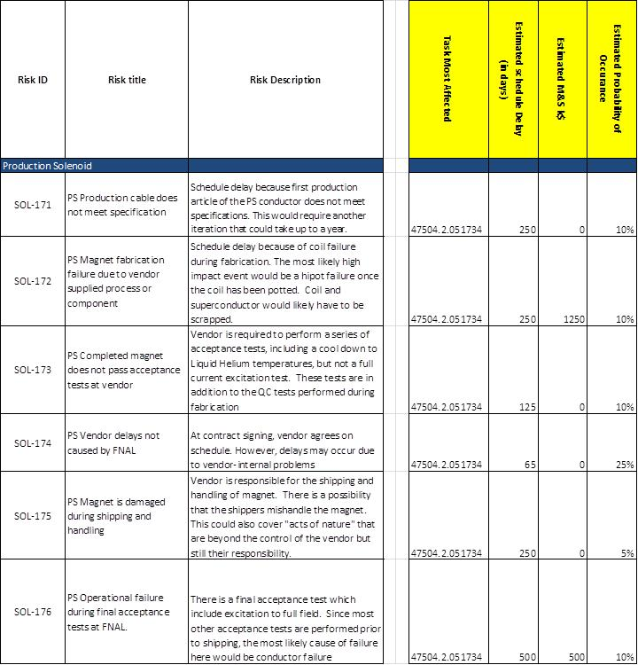
Sample Risks (PS)
Complete table located in the “Mu2e Solenoid Risk Analysis Document.
Table entries:
Risk identifier, title and description
Task most affected by risk
Estimate of schedule delay
Estimate of M&S
Estimated occurrence probability

Slide 14
Translating Risk into $’s
Multiple M&S-related risks are fairly easy to handle, given the amount and probability
Multiple schedule delays are more complicated
  Risk ➔ directly affect duration of one or more tasks.
  Because each task has a predecessor/successor, schedule related risks are very correlated.
  Tasks that are on the critical path will extend the project duration
    Standing army effects for all “level of effort tasks”
  Tasks that off critical path may or may not add any significant costs
    If delay is long it enough, it will go on the critical path for part but not all of the delay duration.
    Even off critical path, task can be on critical path for deliverable
For this reason the project is using the Primavera Risk Analysis Tool.

Slide 15
Mu2e Risk Strategy and Primavera Risk Analysis Tool
Primavera is the Project Scheduling Software Used by all Fermilab Projects
Primavera Risk Analysis tool works with directly with Primavera
  Properly accounts for schedule correlations
  Identifies key risks and orders them in significance
  Graphical interfaces

Slide 16
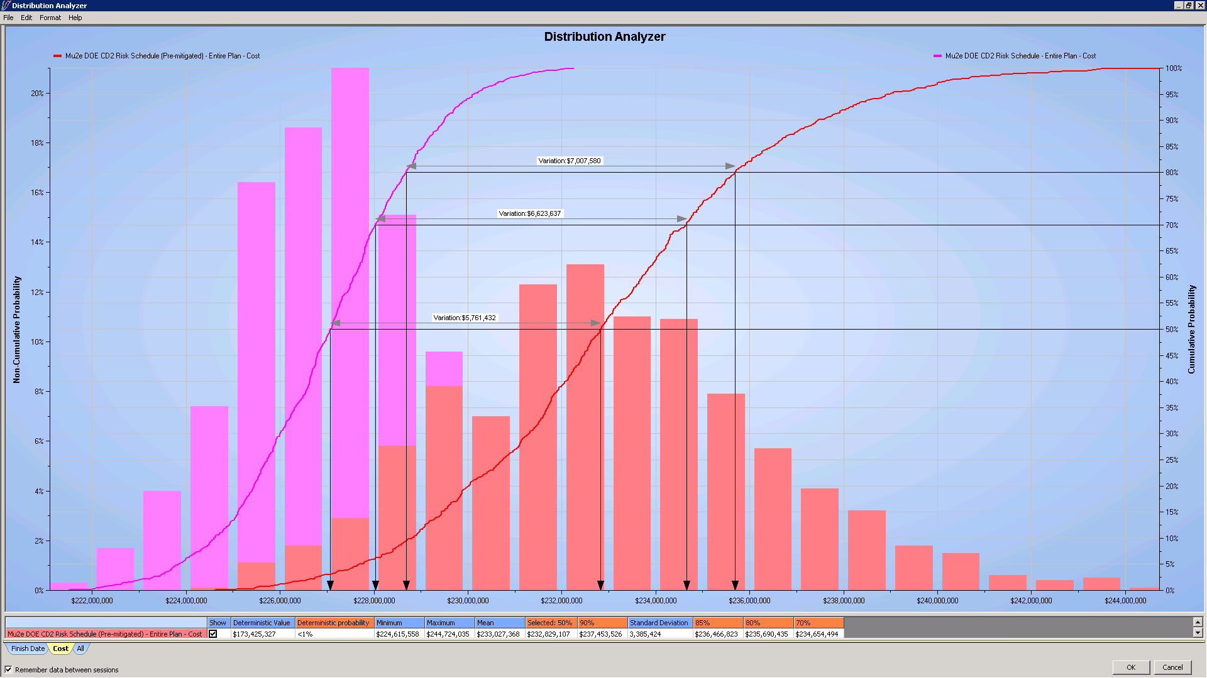
Primavera Risk Analysis Result
80% of “non risk” MC scenarios fall below this value
80% of “risk” MC scenarios fall below this value
Difference ($7M) represents Project RISK

Slide 17
Risk Contingency Associated with Solenoids?
Difficult to determine exactly because cost/schedule correlations with rest of Mu2e threats.
Project performed separate Monte Carlo analyses to check the primavera tool
Assumptions
  Cost of delaying project by one year : ~$2M
    Validated by running Primavera, delaying project by 1 year, running accounting software for “standing army” and escalation costs
  Assume risk entries have little or low correlations
    Valid since most events that occur at the same time have a low probability of occurrence

Slide 18
How much Risk Associated with Solenoids?
Using this methodology
Project risk is estimated to be $6.5 M with a 80% cumulative probability.
This is in very good agreement with $7M Primavera estimate
$3.5 M can be associated with solenoid-related risks
Thus a little over ½ the Risk contingency is associated with the Solenoids

Slide 19
Conclusion
A bottoms up risk analysis has been performed on the mu2e solenoids, as part of a larger risk analysis for the mu2e project
32 risks were identified with an associated probability, cost and schedule impact (there is also one opportunity identified)
Using the Primavera Risk Management tool, these risk when combined with other Mu2e risks predicts a ~$7M risk contingency with an 80% cumulative probability. This agrees well with a $6.5M risk “Excel based” Monte Carlo analysis.
$3.5 M can be associated with solenoid-related risks
Performing this analysis has helped us to identify the highest risk solenoid elements, and insure that the project is prepared in the unlikely event that these risks come to fruition.

