Slide 1
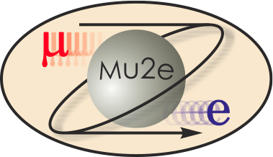
475.04.04 Mu2e Detector Solenoid
Marc Buehler
L3 for Mu2e Detector Solenoid
October 21-24, 2014

Slide 2
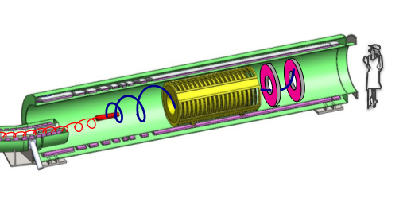
Requirements: Overview
Provide volume for the Mu2e experiment:
  1.8 m aperture, 10 m length
Provide precision magnetic field:
  Graded field region (2 T to 1 T) to focus muons on stopping target and deflection of conversion electrons towards spectrometer
  Uniform field region (1 T) for precision tracking and calorimetry

Slide 3
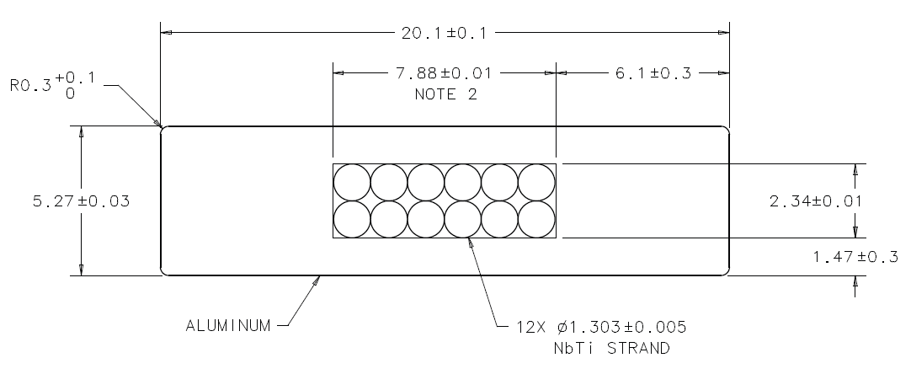
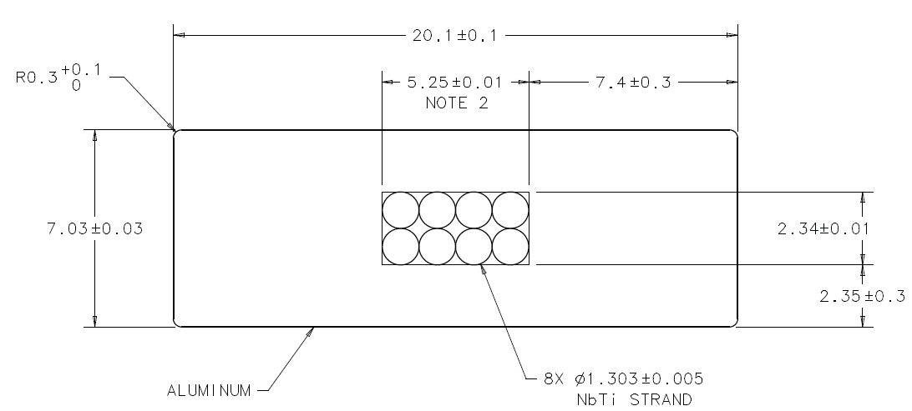

Design: Cable
DS uses Al-stabilized NbTi Rutherford cable
“Narrow” Conductor (“DS1”)
“Wide” Conductor (“DS2”,)
Furukawa
Hitachi
Order for production quantity of DS cable has been placed
Furukawa: SC wire is in production
Hitachi: SC wire completed. Start of Rutherford cable production.

Slide 4
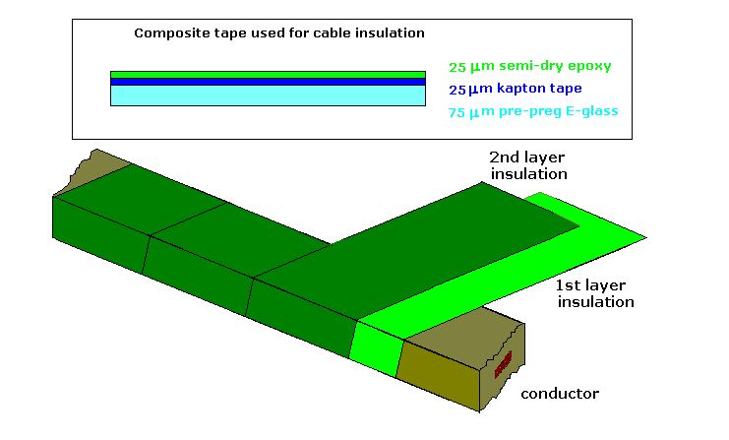
Design: Insulation Scheme
Require good electrical insulation, radiation resistance, and high thermal conductivity
Same type of cable insulation as used in the ATLAS Central Solenoid
2 layers of composite tape for conductor cable insulation
All gaps between turns and layers to be filled with epoxy
Additional ground insulation between coils and support structure

Slide 5
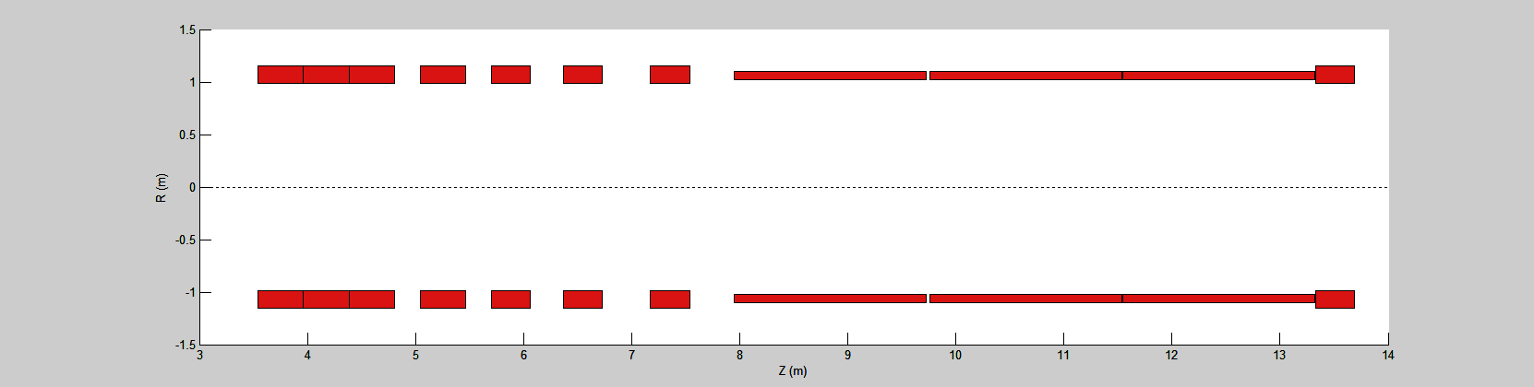
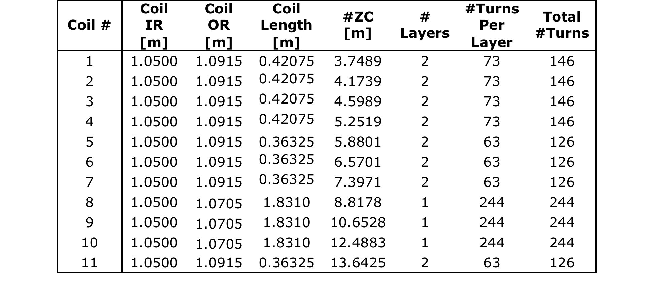
Design: Coils
1
2
3
4
5
6
7
8
9
10
11
DS coils
DS has 11 coils
Single-layer in tracker/calorimeter region
Double layer everywhere else

Slide 6
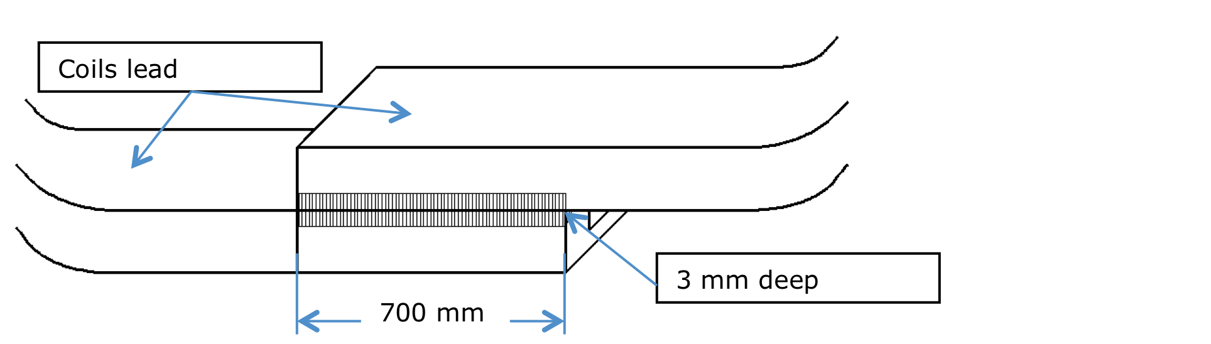
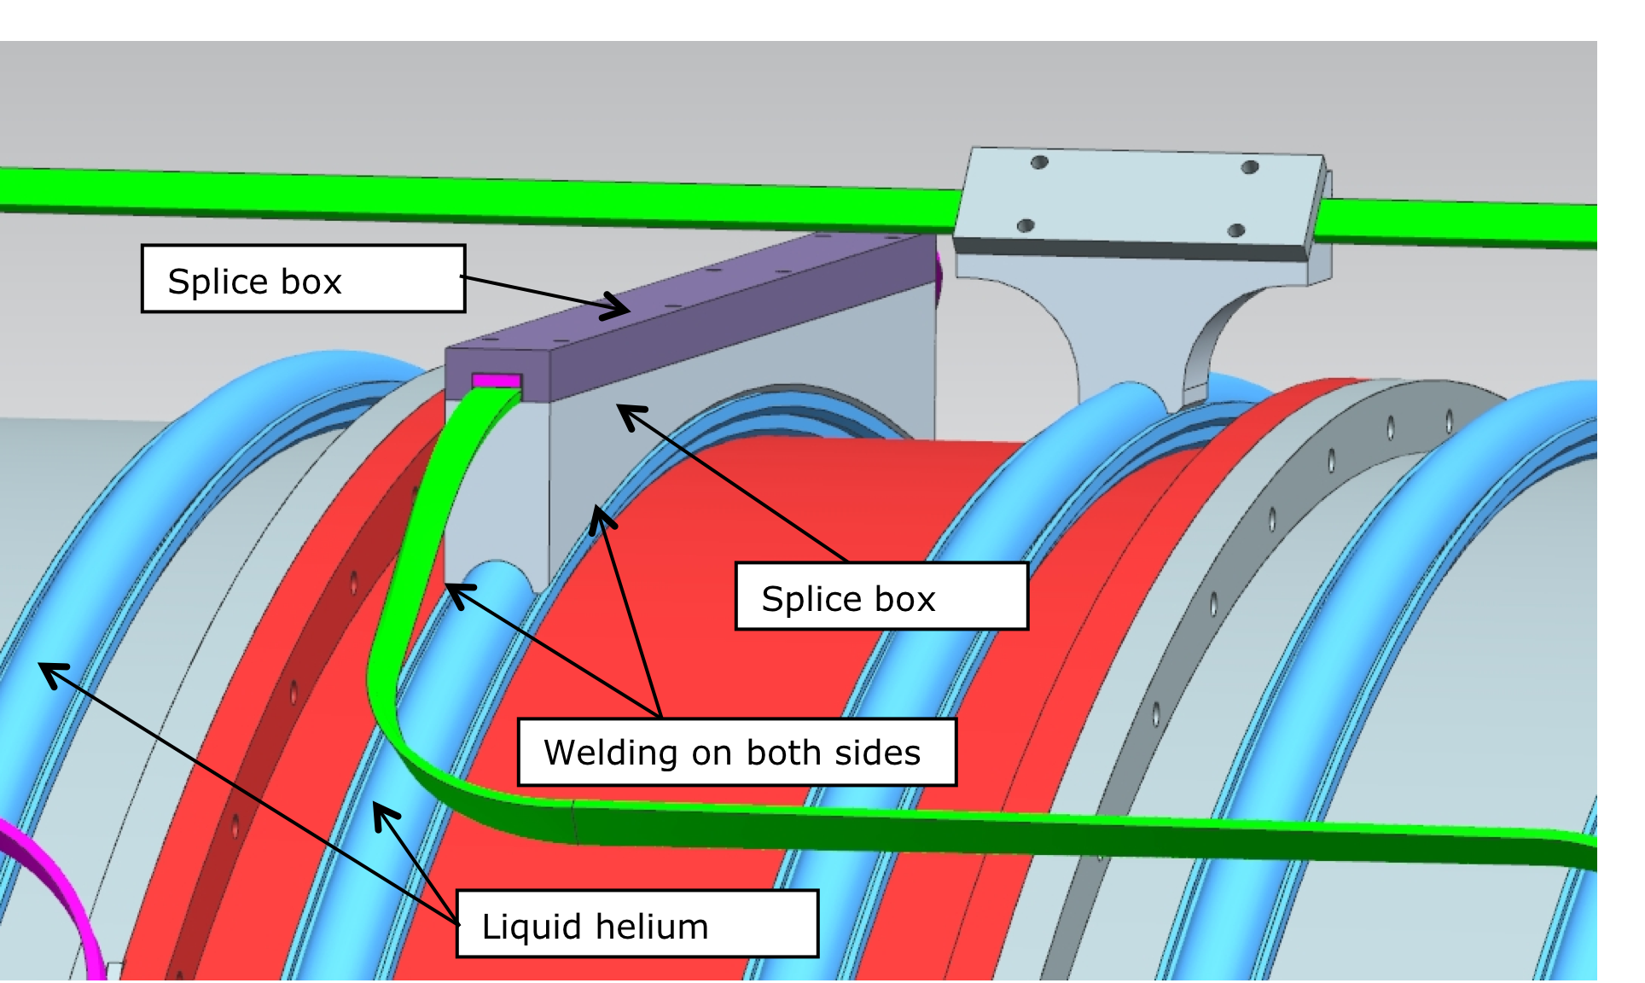
Design: Splices
Welded joint splices
700 mm splice length
Welding Aluminum on both narrow sides
No additional solder material
3mm weld penetration depth
NbTi temperature cannot exceed 350 C for >15 minutes
Splice box designed to provide mechanical support for splices
Made from 1100 Al
Splice box length is 700 mm
Splice box base welded to Helium cooling pipe
Voltage taps and temperature gauges on both splice ends

Slide 7
Design: Cold Mass
Coils are inserted into outer support Al shells to form a spool piece
Requires shrink fitting (interference fit) to maintain radial pressure between coils and shells
Cold mass consists of spool pieces and spacers
Spacers needed to obtain correct magnetic profile
Spacers can be machined to assure precise positioning of coils

Slide 8
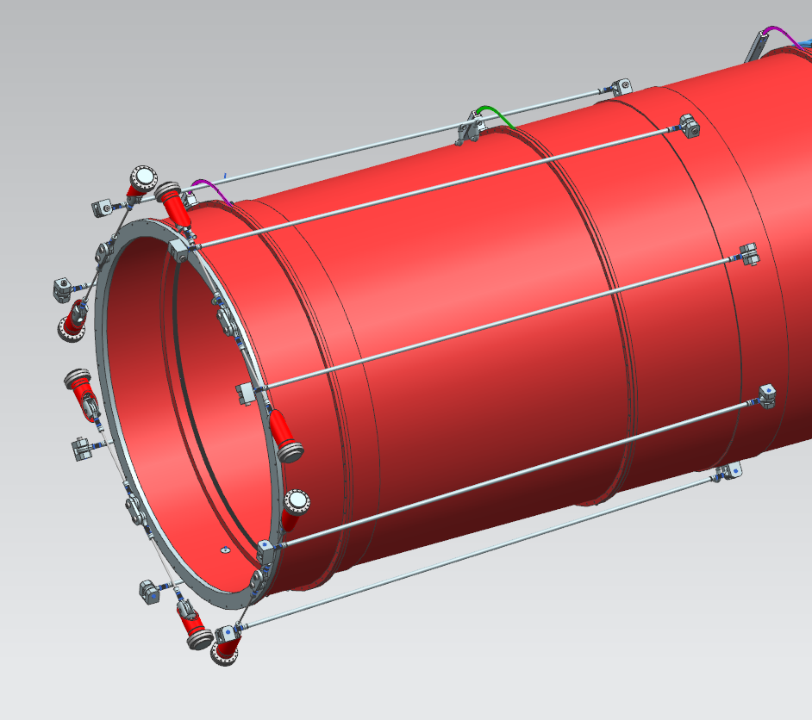
Design: Cold Mass Support
Inconel 718 used for both axial and radial cold mass supports
Forces:
  Dead weight: 110 kN
  Magnetic forces:
    DS-TS interaction: Pull towards each other
    DS coil interaction: radial forces trying to expand coils, axial forces trying to push coils together
    De-centering forces due to TS-DS interaction
Design loads
  Axial supports: 1000 kN
  Radial supports: 70 kN
More simulations:
  Heat loads through cold mass supports
  Contraction of coils under temperature and magnetic loads
  Deflection of cold mass under gravitational load
Radial Supports
Axial Supports

Slide 9
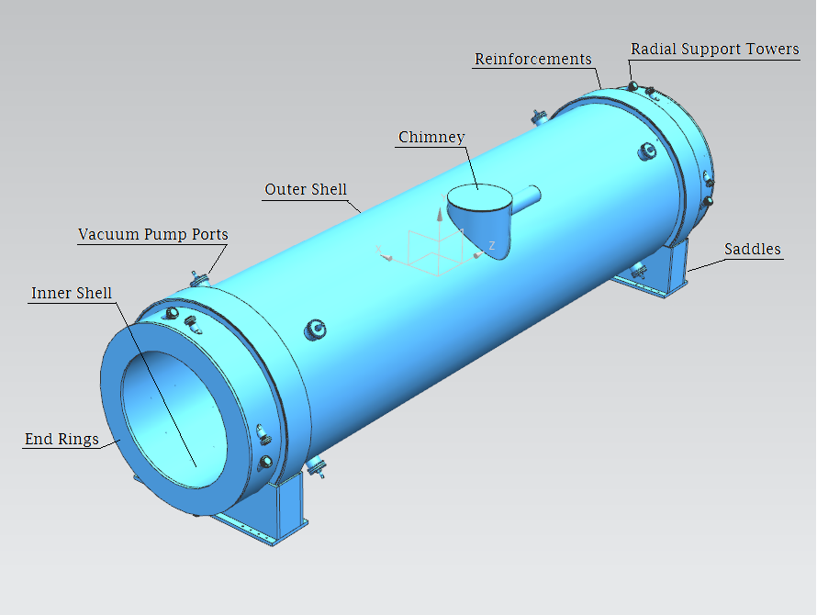
Design: Cryostat
~10 m long
~2.7 (1.9) m OD (ID)
Stainless steel
Openings in outer shell:
  Chimney for transfer line
  Vacuum ports
  Radial support towers
Bore must accommodate ~10 tons of equipment via rails attached to inner shell

Slide 10
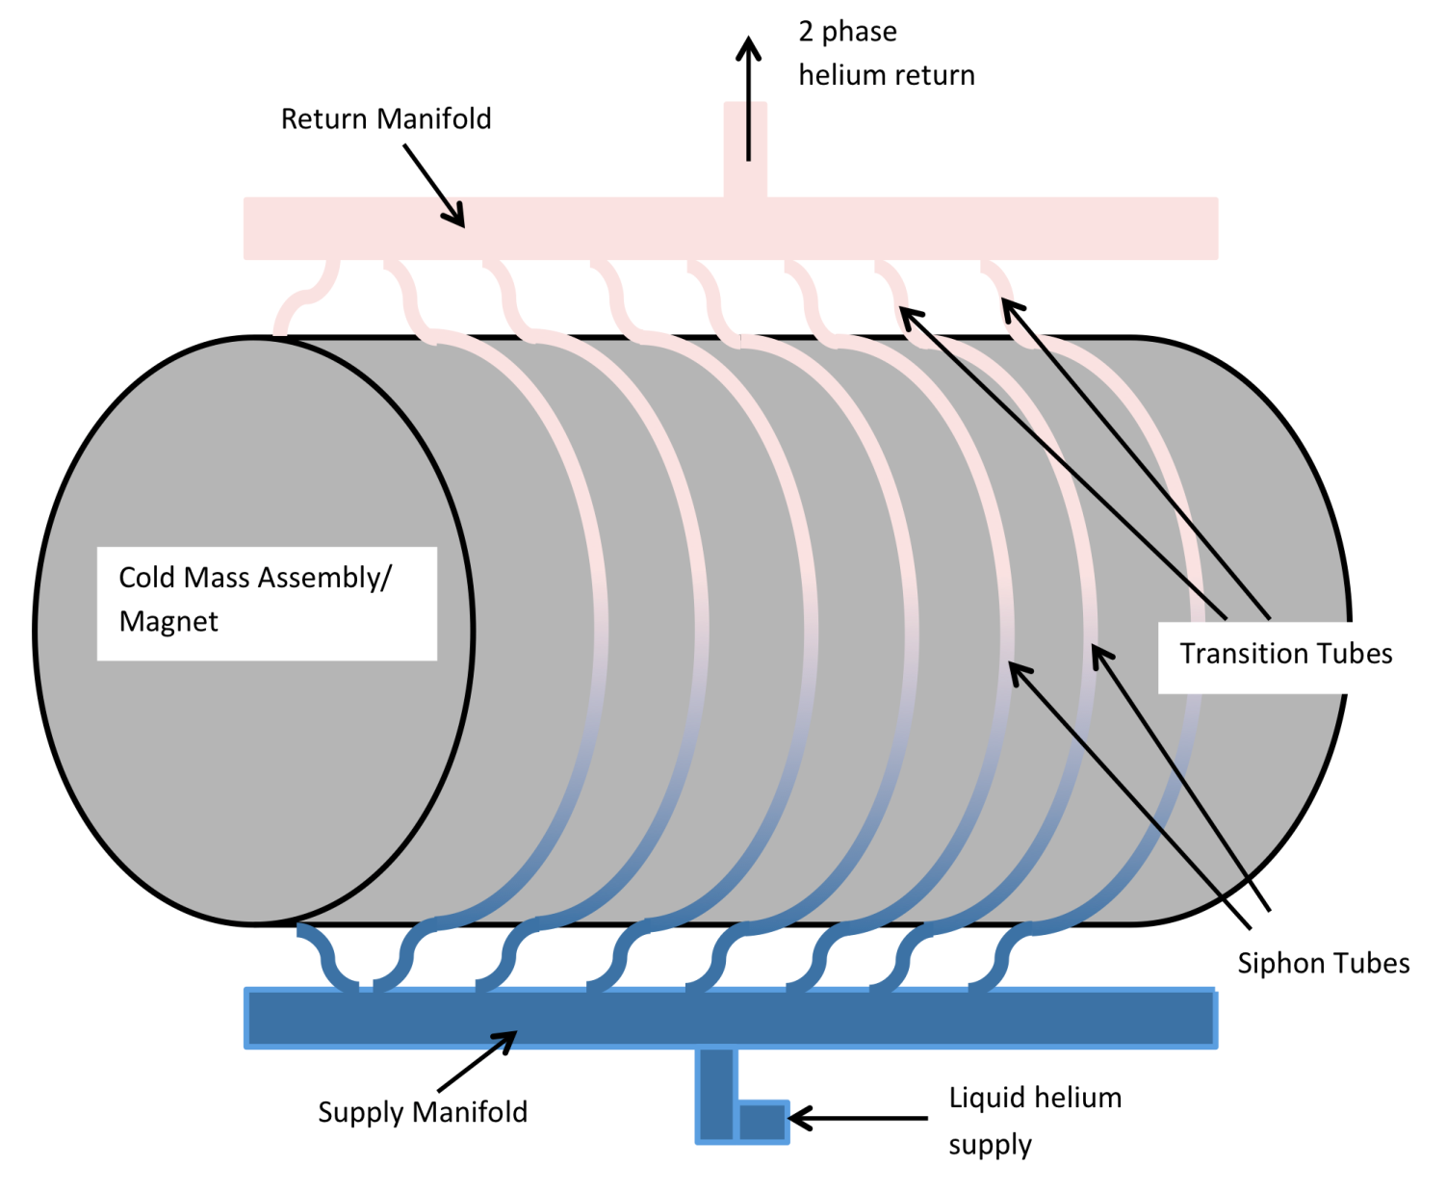
Changes since CD-1
Thermosiphon cooling scheme
Decision to use thermosiphon cooling scheme for cold mass assembly
Magnet length changed

Slide 11
Value Engineering since CD-1
Overall stable design:
  Develop RDR, technical drawings and solid model for potential vendors
Similar design approach for both DS and PS

Slide 12
Performance: Magnetic Field
Field maps with coil displacement errors were generated assuming manufacturing tolerances
Mu2e Tracking group used these field maps as inputs to their track reconstruction algorithms
Mu2e Tracking group verified that inputs satisfied physics requirements
DocDB 3942

Slide 13
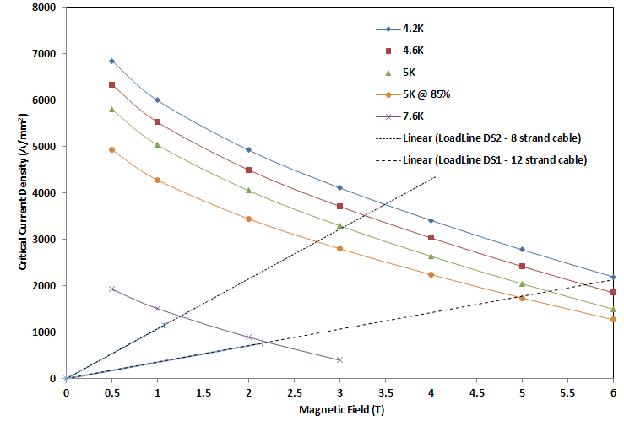
Performance: Operating Margins
Cable critical current density in the field range of interest at reference
Temp. (4.2 K), operating temp. (5 K), and 7.6 K to account for margin
Cable designed to operate at least at 45% of conductor quench current
2.5 K temperature margin w.r.t. conductor temperature of 5 K
Peak field in narrow conductor is 2.15 T
Peak field in wide conductor is 1.07 T
Larger margins in all other segments
J_{c} curves not from actual conductor
Peak Fields from simulation
13

Slide 14
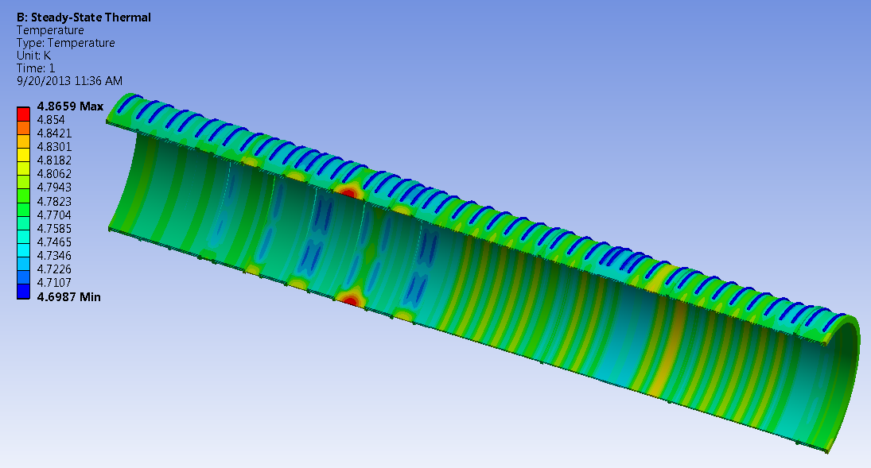
Performance: Thermal Analysis
Performed extensive modeling, to estimate cooling tube size and locations taking into account insulation material properties (FEA)
Temperatures do not exceed 5 K
Temperature profile of the DS assembly

Slide 15
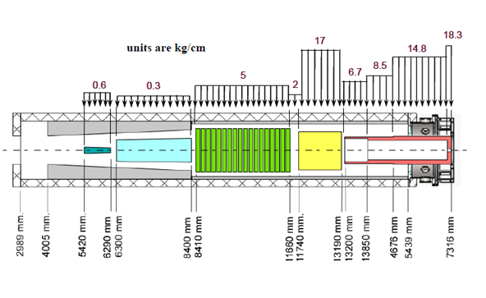
Performance: Loads on Inner Shell
Vertical deformation of inner vacuum shell under detector loadings: 1 mm max.
Stresses in inner vacuum shell under detector loadings: 26 MPa max.

Slide 16
Instrumentation
Sensor | Quantity
Coil Voltage Taps (Actual Primary & Redundant V-Taps) | 24
Lead Voltage Taps (Actual Primary & Redundant V-Taps) | 4
LTS Wires for SC Lead QP (Primary & Redundant) | 4
Quench
Protection
Splice Resistance (# of Splices) [2-wire Channels] | 10
Cold Mass Temperature (Cernox) | 29
Warm-up & Cool Down Temperature (Cernox) | 12
Supply & Return Manifolds Temperature (Cernox) | 8
80K Temperature (Platinum) (Shields & Cu. Leads) | 24
Strain (Axial & Radial Support Rods) | 24
Reflective Position Sensors (Coldmass) | 12
Temperature
Sensors
Strain Gauges
Position Sensors
(D. Orris)

Slide 17
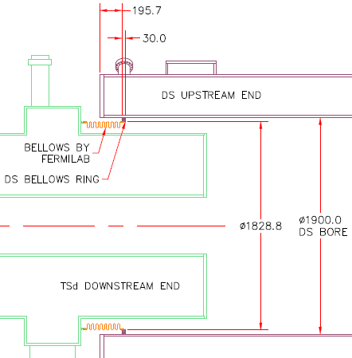
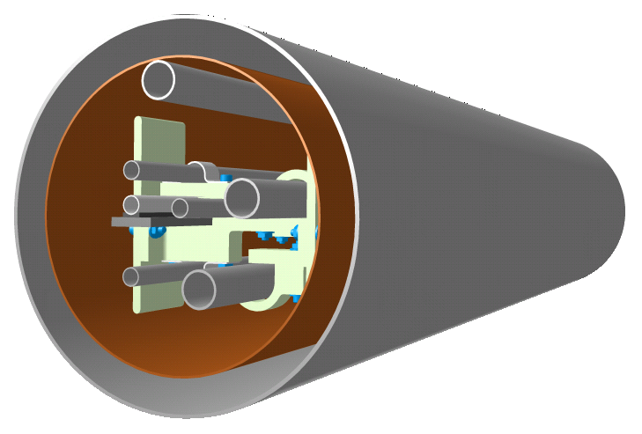
Interfaces
DS-TS interface:
  DS connects to TSd to provide a common Muon Beamline Vacuum System volume
  Connection via a flexible bellows
  Allows axial/lateral movement from cool-down and magnetic forces
Transfer Line:
  Attached to the side of the chimney
  10 inches OD
  DS superconductor, cryogenic piping
Instrumentation Port:
  To route instrumentation wiring
Connection Between DS and TSd
Transfer Line Cross Section

Slide 18
Remaining work before CD-3
Order final engineering design of DS by the magnet vendor
Conduct technical review of the final DS design
Prepare final design and drawing of DS support stand

Slide 19
Quality Assurance
The reference design has been reviewed by magnet experts, fulfills all the requirements, complies with the structural codes and has appropriate margins used in similar magnets:
  The magnet vendor has flexibility in changing the reference design to optimize the fabrication process. The vendor is responsible for demonstrating that the modified design still meets the requirements.
  Technical review of the final DS design is conducted before the magnet vendor is granted permission to fabricate the magnet.
The magnet vendor has to implement a quality assurance plan that meets the requirements for the design and construction of DS:
  Traveler system calling out all fabrication steps with internal sign-offs.
  Hold points prior to critical operations.
Vendor oversight by FNAL team
Model coil to validate the magnet production tooling
Extensive acceptance testing:
  On the production cable prior shipping it to the magnet vendor
  On the magnet at the vendor site (warm/cold).
Details are outlined in our Procurement Specification document (DocDB 3670)

Slide 20
ESH&Q
Cryogenic:
  Potential for oxygen deficient atmospheres (ODH). An (ODH) analyses will be conducted. Emergency response procedures will be developed for responding to alarm systems.
Stored Magnetic Energy:
  26 MJ of stored energy in DS the powering circuit. Quench protection systems have been designed to dissipate the stored energy in the solenoids in a controlled and safe fashion.
Coupled Magnetic forces:
  There are large forces within the DS itself as well as between the DS and TS. The DS is designed to resist these forces, but access to the magnet will be restricted during the times when it is powered.
Stray Magnetic Fields:
  >5 gauss fields are of particular concern because they can affect medical electronic devices (pacemakers); fields >600 gauss can impact ferromagnetic materials. The fringe field analysis document is in DocDB - Mu2e Document 1381.
  The DS has no return yoke. Access will be restricted when it is powered and warnings will be posted for persons with pacemakers.

Slide 21
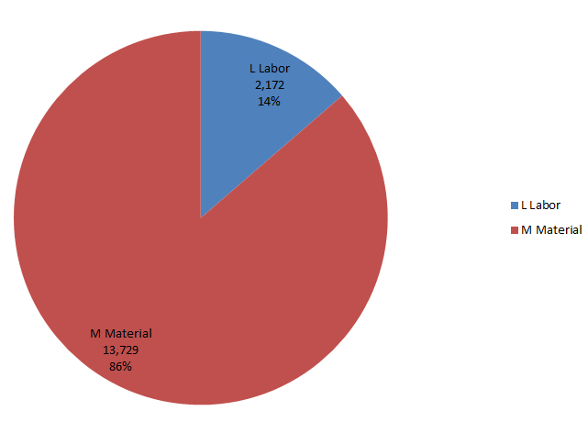
Cost Breakdown Labor vs Material
Base Cost AY k$

Slide 22
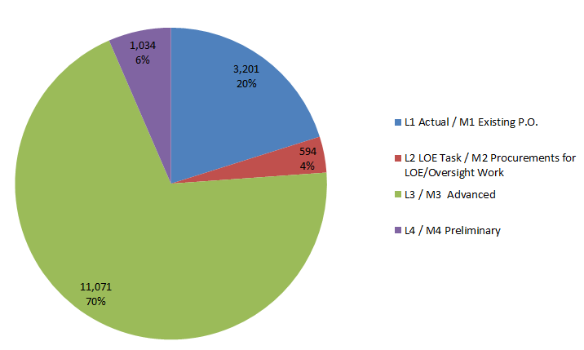
Quality of Estimate
Base Cost AY k$

Slide 23
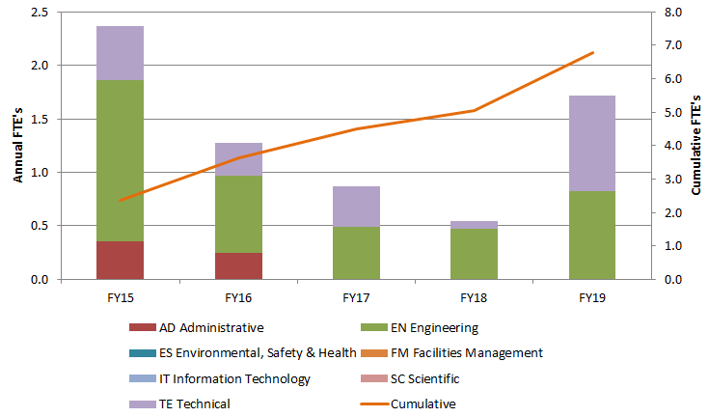
Labor Resources by FY

Slide 24
Cost Table
 | Base Cost (AY k$)
 | M&S | Labor | Total | Estimate Uncertainty (on remaining costs) | % Contingency on ETC | Total Cost
475.04.04 Detector Solenoid | 13,729 | 2,172 | 15,901 | 2,290 | 15% | 18,191
Grand Total | 13,729 | 2,172 | 15,901 | 2,290 | 15% | 18,191

Slide 25
Milestones
10/27/14: PO issued for DS final design
7/2/15: Final design complete for DS support stand
2/24/16: DS construction authorized
4/5/19: Magnet arrives at FNAL

Slide 26
Schedule
CD-3a
CD-3c
CD-2/3b
CD-4
Fabricate and QA Superconductor
KPPs Satisfied
Solenoid Design/Prototypes
Solenoid Fabrication and QA
Detector Hall Construction
Solenoid Infrastructure
Solenoid Installation and Commissioning
Detector Prototypes and Construction
Cosmic Ray System Test
Accelerator and Beamline Construction
Accelerator Commissioning (off Project)
Q3 | Q4 | Q1 | Q2 | Q3 | Q4 | Q1 | Q2 | Q3 | Q4 | Q1 | Q2 | Q3 | Q4 | Q1 | Q2 | Q3 | Q4 | Q1 | Q2 | Q3 | Q4 | Q1 | Q2 | Q3 | Q4 | Q1 | Q2 | Q3 | Q4 | Q1 | Q2 | Q3 | Q4
FY14 FY15 FY16 FY17 FY18 FY19 FY20 FY21

Slide 27
Summary
A detailed set of requirements and specifications for the DS, including RDR, TDR, drawings, and solid model have been developed
A vendor for the DS has been identified and the initial contract to develop the final design will be issued shortly
  Cost and schedule for DS incorporates information provided by vendor
Production quantity of DS cable is being fabricated
DS is ready to move into the final design phase

